Slide 1



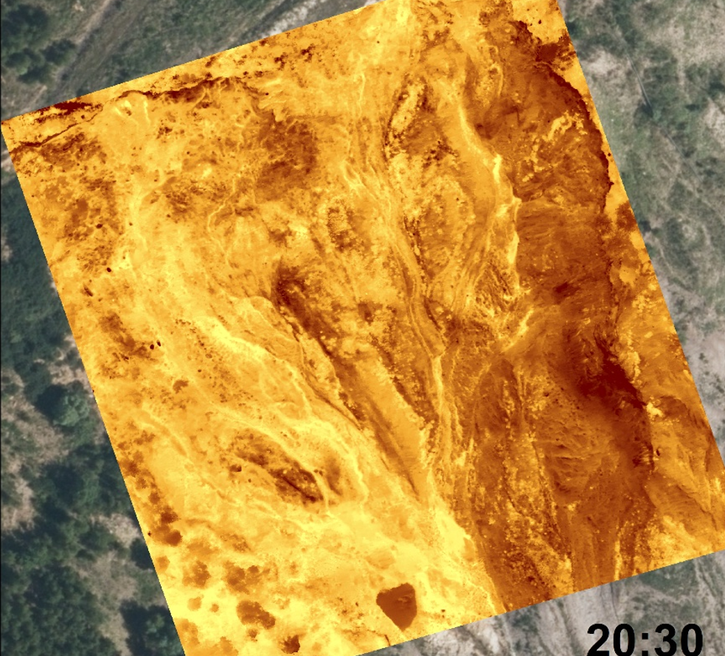



NH3.4 | PICO3.10 | EGU26-4213 | ECS |
UAV‑Based Infrared Thermography for
Characterising Unstable
Slopes in a Mining Area
Marco Loche, Bhargavi Chowdepalli, Ondřej Racek, Jan Klimeš, Jan Blahůt & Gianvito Scaringi |
marco.loche@natur.cuni.cz | Institute of Rock Structure and Mechanics,
Czech Academy of Sciences & Faculty of Science, Charles University | The Geohazards Group |
Vienna, 05.05.2026 |

Slide 2
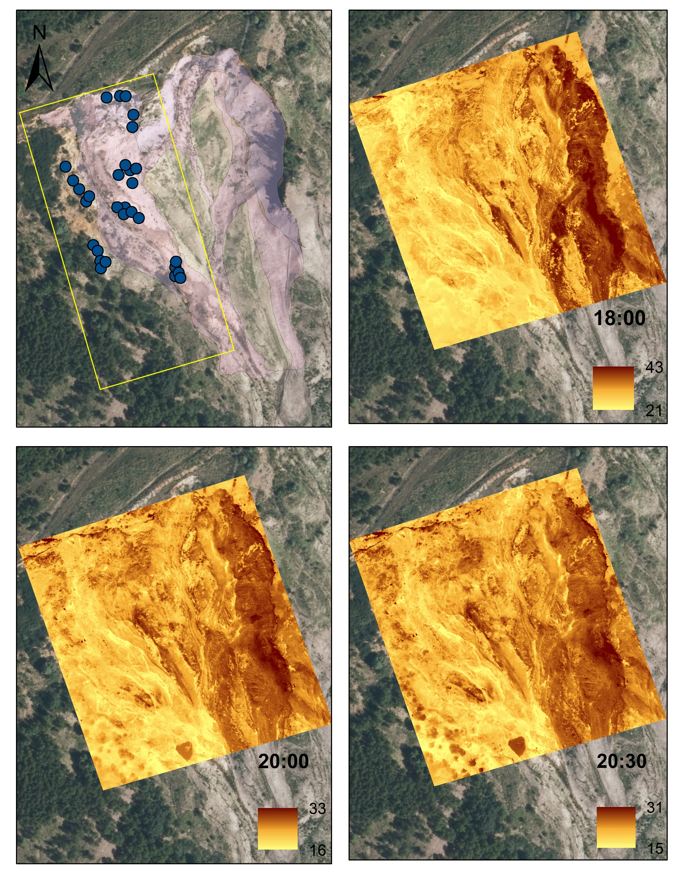
Introduction | PICO3.10 | EGU26-4213 | ECS |
2
The physical characterisation of soil samples remains fundamental for identifying potential instability in landslide areas.
InfraRed Thermography (IRT) has emerged for its potential to shed light onto the physical properties of geomaterials.
Indeed, Land Surface Temperature (LST) has been identified as a proxy for properties such as porosity and parameters such as the compressive strength.
(Loche et al, 2024. Infrared thermography reveals weathering hotspots at the Požáry field laboratory)

Slide 3
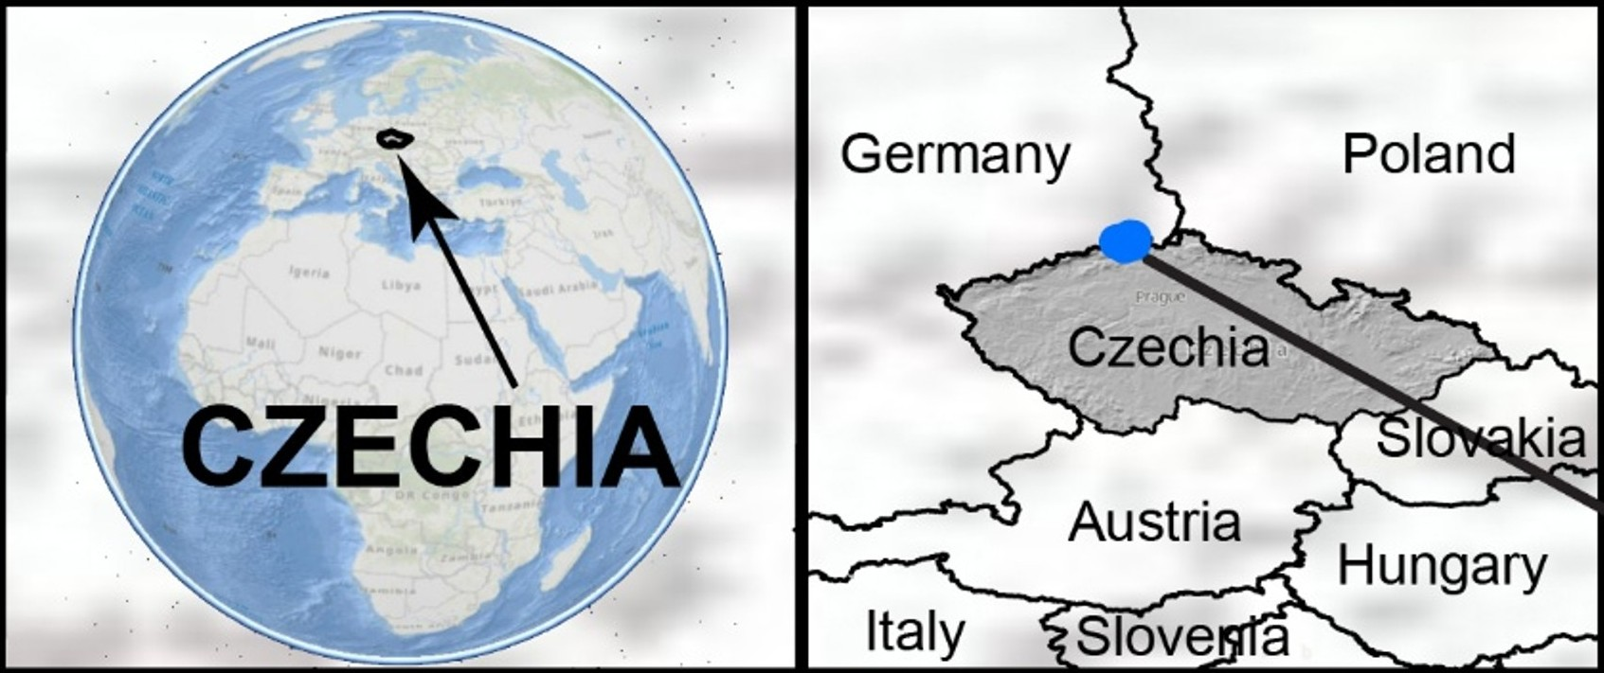

Study area | PICO3.10 | EGU26-4213 | ECS |
3
Jezeří Open-pit mining:
Location of the study area in Czech Republic.
Jezeří test site is an open-pit mining area. Identified by the rectangle is the sampled area.
Overview of the geomorphological landslide sectors.

Slide 4
Field experimental evidence | PICO3.10 | EGU26-4213 | ECS |
4
IRT suggests diverse soil behaviours:
Thermograms were recorded using an UAV where substantial thermal anomalies appeared.
ROIs were selected based on the geomorphological sectors of the landslide and sampled.

Slide 5
Field experimental evidence | PICO3.10 | EGU26-4213 | ECS |
5
Cooling patterns:
Cooling phase of the three ROIs (Scarp, Displaced Material, Accumulation) after the peak temperature (17:00) till the lowest temperature.
Details of the 210 minutes of the cooling phase and the time of the general inflection point for all the ROIs, reached at 18:00.

Slide 6
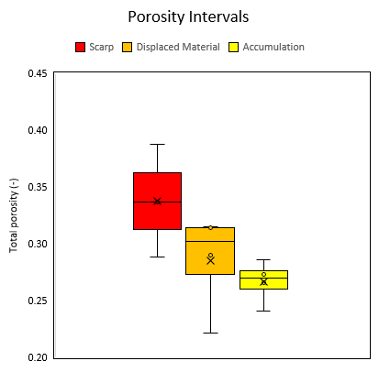
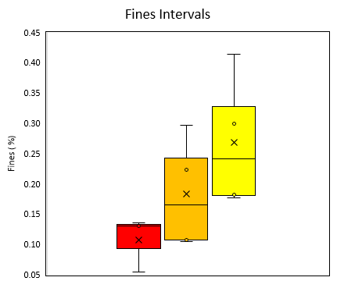
Laboratory experimental evidence | PICO3.10 | EGU26-4213 | ECS |
6
Physical properties of the samples confirm the diverse thermal behaviours:
In the figure, the mean values (µ) are presented together with corresponding relative standard deviations (σ) and total porosity (n).
The boxplots visualise the mean values and standard deviations.

Slide 7
Methodology | PICO3.10 | EGU26-4213 | ECS |
7
Mathematical background:
To quantitatively assess the thermal dynamics of the ROIs, we used the CRI, which quantifies the change in mean temperature (∆T, °C) per unit of time (∆t, min). Higher CRI values correspond to more rapid cooling of the soil for a given time interval, as summarised in Eq. (1): CRI = ∆T/∆t (1)
The laboratory experiments were interpreted through linear relationships.

Slide 8
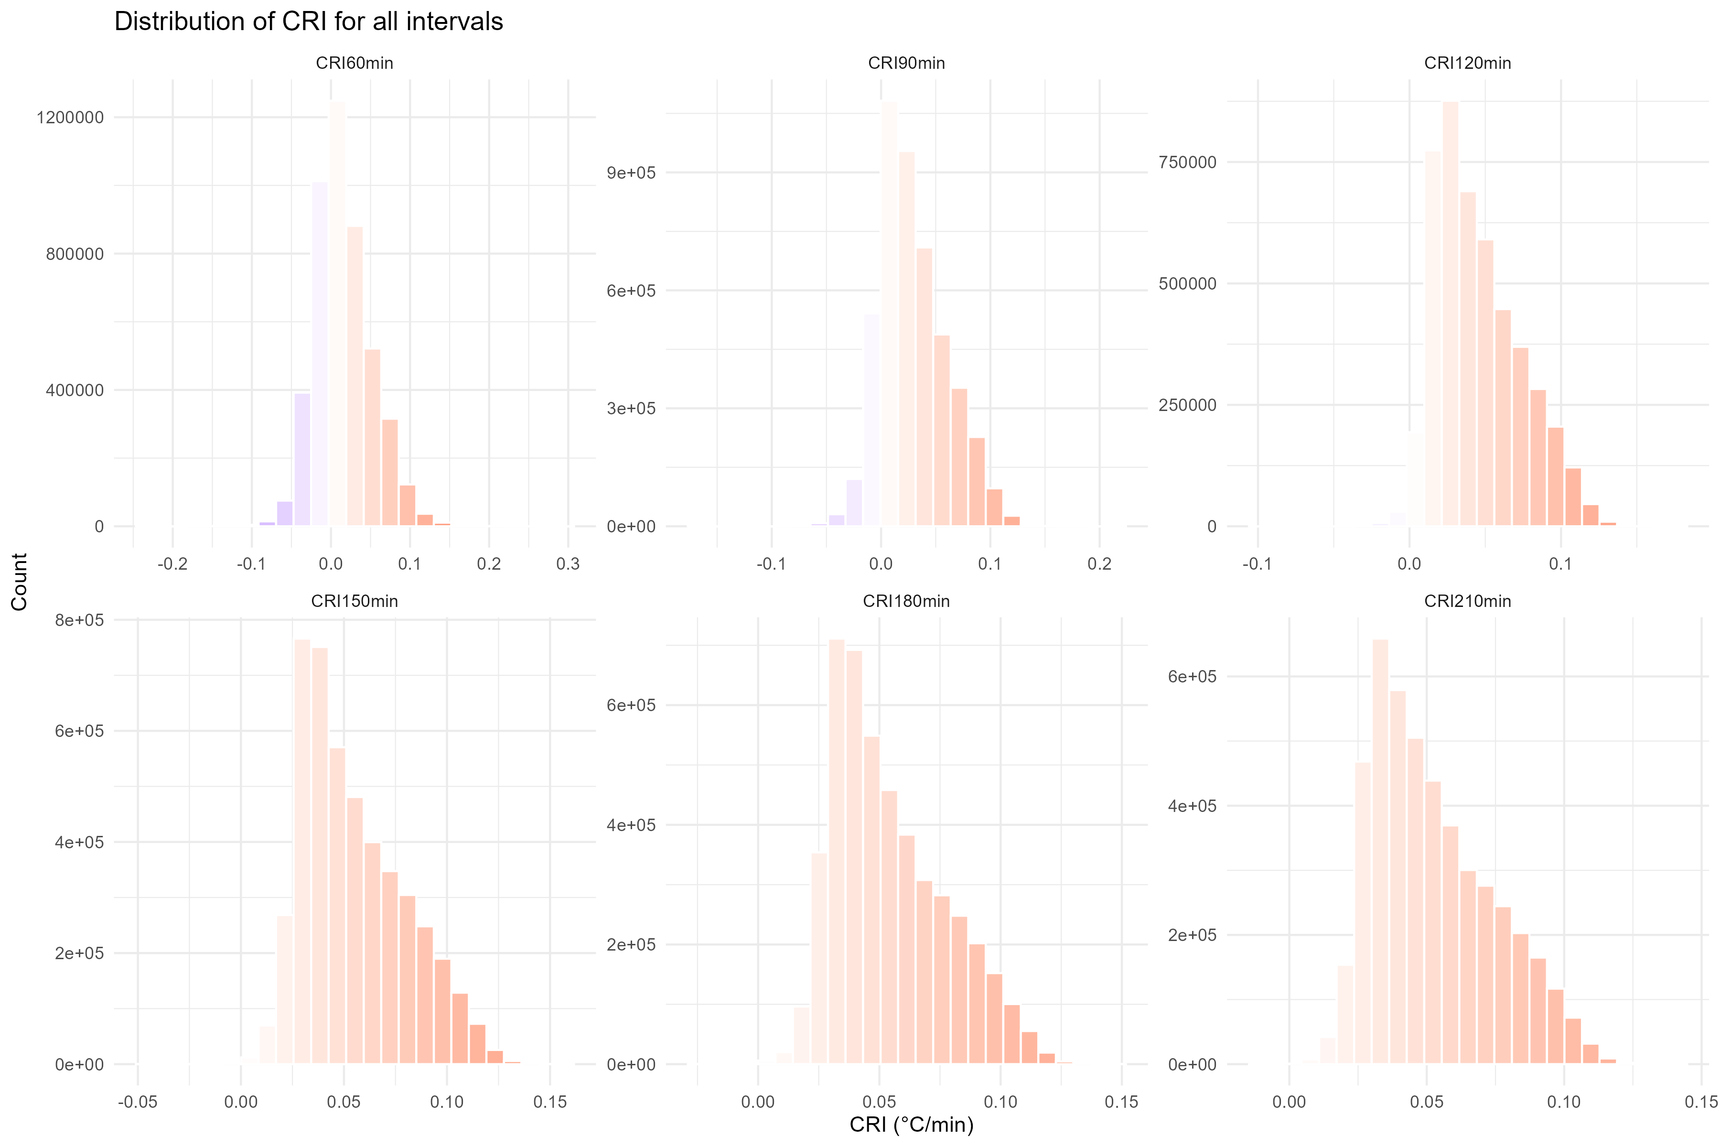
Are cooling rates changing in field? | PICO3.10 | EGU26-4213 | ECS |
8
Results of cooling rate indices for different time intervals:
Probability density functions for CRIs

Slide 9
Reasonable behaviour? | NH3.4 | PICO3.10 | EGU26-4213 |
9
Performance of measure porosity in the field:

Slide 10
Conclusions | PICO3.10 | EGU26-4213 | ECS |
10
What we understood:
This study proposes some highlights about the potential of Infrared Thermography (IRT) in identifying porous sectors within a landslide area.
The study’s findings align with other authors' suggestions.
The introduction of an equation may be valuable for estimating porosity within the studied ROIs.
(Loche et al, 2024. Infrared thermography reveals weathering hotspots at the Požáry field laboratory)

Slide 11
References | PICO3.10 | EGU26-4213 | ECS |
11
Loche M, Scaringi G (2005). Assessing the Influence of Temperature on Slope Stability in a Temperate Climate: A Nationwide Spatial Probability Analysis in Italy. Environmental Modelling & Software, 183, p.106217.
Loche M, Scaringi G (2023). Temperature and shear-rate effects in two pure clays: Possible implications for clay landslides. Results in Engineering, 20, p.101647.
Loche M (2024). Infrared thermography reveals weathering hotspots at the Požáry field laboratory. Scientific Reports, 14(1), p.14682.
Loche M, Scaringi G, Blahůt J, Hartvich F (2022). Investigating the potential of infrared thermography to inform on physical and mechanical properties of soils for geotechnical engineering. Remote Sensing, 14(16), p.4067.
Loche M, Scaringi G, Yunus AP, Catani F, Tanyaş H, Frodella W, Fan X, Lombardo L (2022). Surface temperature controls the pattern of post-earthquake landslide activity. Scientific Reports, 12(1), p.988.
Scaringi G, Loche M (2022). A thermo-hydro-mechanical approach to soil slope stability under climate change. Geomorphology, 401, p.108108.
Loche M, Scaringi G, Blahůt J, et al. (2021). An infrared thermography approach to evaluate the strength of a rock cliff. Remote Sensing, 13(7), p.1265.

