Slide 1


Recharge zone of influence–based evaluation of groundwater recharge efficiency in a semi-arid hard-rock region
Vishnuvardan Narayanamurthi
EGU26-4410 | Orals | HS8.2.13 |Virtual presentation

Slide 2
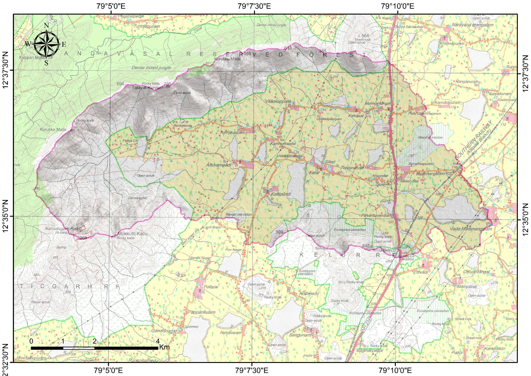
Overview
Highlights:
Groundwater recharge in semi-arid hard-rock areas is mainly controlled by tanks and small reservoirs.
Surface water bodies are critical recharge sources where natural recharge is low.
This study evaluates recharge efficiency using the Recharge Zone of Influence (RZOI) concept.
Numerical simulation was carried out using a 3D FEFLOW groundwater flow model.
Study area
EGU26-4410 | Orals | HS8.2.13 |Virtual presentation

Slide 3
Problem Statement and Objective
Problem Statement
Semi-arid hard-rock aquifers usually have limited primary porosity and low natural recharge.
Tanks and reservoirs store monsoon runoff and support groundwater recharge.
Conventional evaluation often depends on:
  Tank storage capacity
  Water spread area
  Surface availability
These indicators do not fully explain how recharge spreads through the aquifer.
Therefore, an aquifer-response-based assessment is needed.
Objective
To assess groundwater recharge efficiency of surface water bodies by delineating their Recharge Zone of Influence (RZOI) using a 3D groundwater flow model.
EGU26-4410 | Orals | HS8.2.13 |Virtual presentation

Slide 4
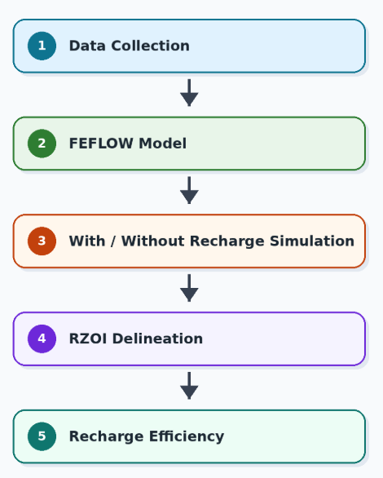
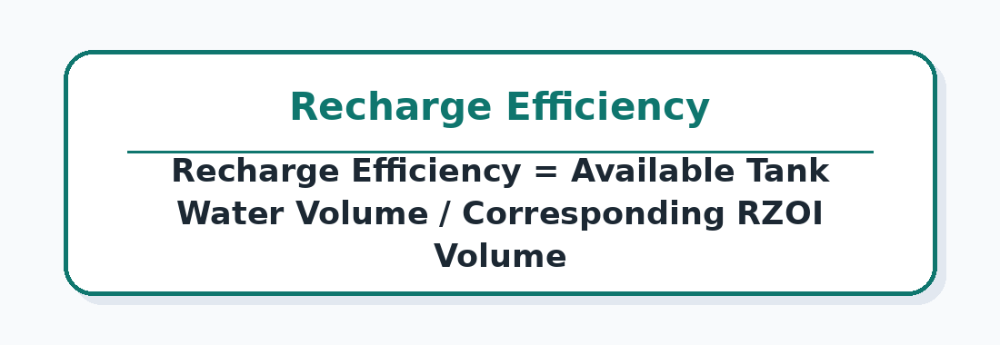
Methodology
Field and secondary data were collected:
  Water body area and storage
  Tank bed infiltration characteristics
  Groundwater levels
  Aquifer hydraulic parameters
  Rainfall and recharge inputs
A 3D groundwater flow model was developed in FEFLOW.
Two simulation scenarios were compared:
  Scenario 1: With water body recharge
  Scenario 2: Without water body recharge
Difference in simulated groundwater head was used to identify the RZOI.
EGU26-4410 | Orals | HS8.2.13 |Virtual presentation

Slide 5
RZOI and Recharge Efficiency Concept
Top view
RZOI definition:
RZOI represents the subsurface zone affected by recharge from a water body.
It includes both:
  Lateral spread of groundwater mounding
  Vertical rise in groundwater head
RZOI estimation:
Calculated from the difference between groundwater head contours simulated with and without tank recharge.
Recharge efficiency:
Estimated as the ratio of available water volume in the water body to the corresponding RZOI volume.
Equation format:
Recharge Efficiency = Water volume available in tank / RZOI volume
Head contour with tank recharge
Zone of influence
Head contour without tank recharge
Cross section view
EGU26-4410 | Orals | HS8.2.13 |Virtual presentation

Slide 6
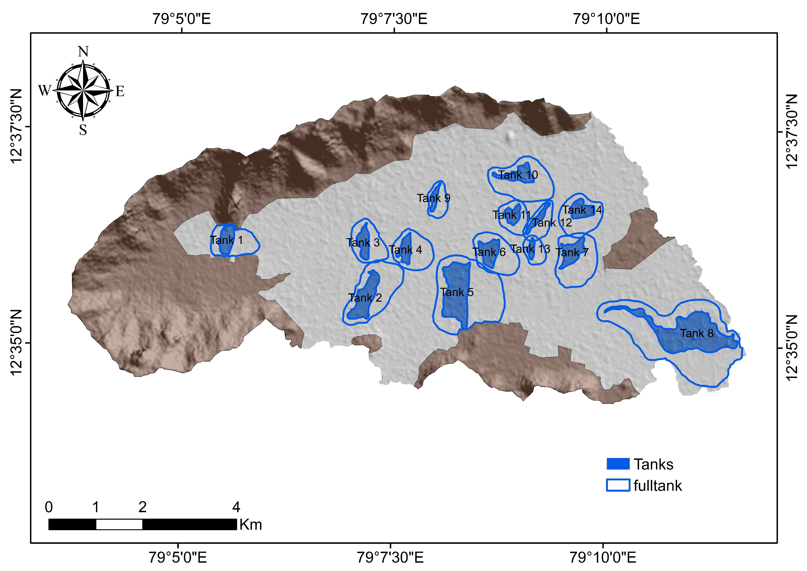
Results and Interpretation
Recharge Zone of Influence
Delineation of Recharge Zone of Influence (RZOI):
RZOI was delineated by comparing simulated groundwater head contours with and without tank recharge.
The influence zone represents the lateral spread and vertical rise of groundwater mounding around each water body.
RZOI extent varied significantly among the 14 tanks.
Larger tanks generally produced wider influence zones, but the extent was also controlled by aquifer hydraulic properties and infiltration capacity.
The largest water body showed an influence zone extending over more than 2.5 km².
EGU26-4410 | Orals | HS8.2.13 |Virtual presentation

Slide 7
Results and Interpretation
Groundwater Recharge Efficiency
Groundwater Recharge Efficiency
Recharge efficiency was calculated using the ratio of available tank water volume to corresponding RZOI volume.
The largest water body had a large RZOI but low recharge efficiency of about 17–18%.
A smaller water body showed the highest recharge efficiency of about 38–39%.
Higher efficiency was linked to better infiltration conditions, especially vadose zone infiltration capacity of about 5–6 mm h⁻¹.
Results indicate that recharge efficiency is mainly controlled by:
  Tank bed infiltration capacity
  Vadose zone hydraulic conductivity
  Subsurface aquifer condition
Surface water spread area had a relatively minor influence on efficiency.
 | Cumulative storage (m³) | Cumulative recharge zone volume (m³) | Recharge efficiency (%)
Tank 1 | 562740.33 | 139109.41 | 24.72
Tank 2 | 1404805.68 | 347408.44 | 24.73
Tank 3 | 326838.08 | 70270.19 | 21.50
Tank 4 | 351692.02 | 68404.10 | 19.45
Tank 5 | 4524873.78 | 758821.33 | 16.77
Tank 6 | 389373.63 | 68646.57 | 17.63
Tank 7 | 538921.13 | 111933.92 | 20.77
Tank 8 | 5614384.84 | 976902.96 | 17.40
Tank 9 | 111997.24 | 34495.15 | 30.80
Tank 10 | 634261.61 | 245332.39 | 38.68
Tank 11 | 235082.29 | 79739.91 | 33.92
Tank 12 | 140774.44 | 48595.34 | 34.52
Tank 13 | 58111.91 | 15481.01 | 26.64
Tank 14 | 401588.19 | 146178.10 | 36.40
EGU26-4410 | Orals | HS8.2.13 |Virtual presentation

Slide 8
Conclusion and Discussion
Conclusion:
The RZOI approach provides a better understanding of recharge effectiveness than surface indicators alone.
Larger water bodies do not necessarily produce higher recharge efficiency.
Smaller tanks with favorable infiltration and vadose zone conditions may perform better.
Recharge efficiency is primarily governed by infiltration capacity and vadose zone hydraulic conductivity.
Aquifer-based assessment is essential for prioritizing recharge structures in semi-arid hard-rock regions.
Closing statement:
RZOI-based assessment helps identify not just where water is stored, but where recharge is actually effective.
EGU26-4410 | Orals | HS8.2.13 |Virtual presentation

Slide 9
Thank you
and
Discussion
EGU26-4410 | Orals | HS8.2.13 |Virtual presentation

