Slide 1


The impact of forearc serpentinization on the composition of subduction-zone fluids revealed by Mg–Fe isotopes in jadeitites
Kun Chen*, Yi-Xiang Chen, Tatsuki Tsujimori, Hans-Peter Schertl Naoko Takahashi, Fang Huang, Walter V. Maresch
E-mail: Kun_Chen@mail.ustc.edu.cn
EGU 2026 General Assembly, Vienna, Austria, 8th May

Slide 2
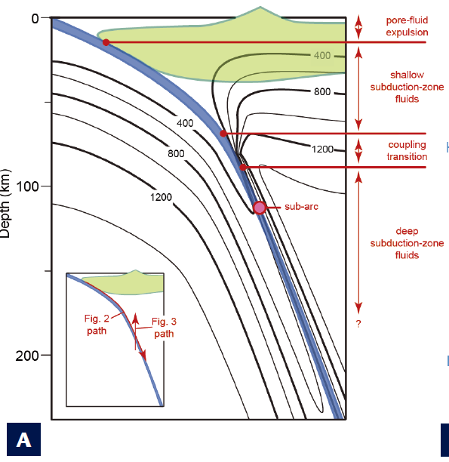
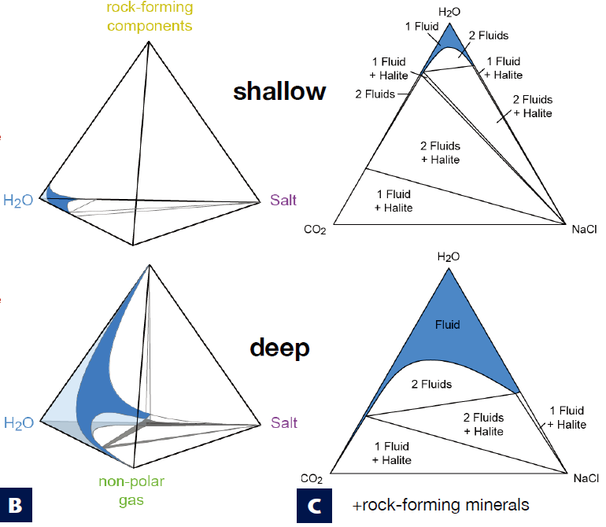
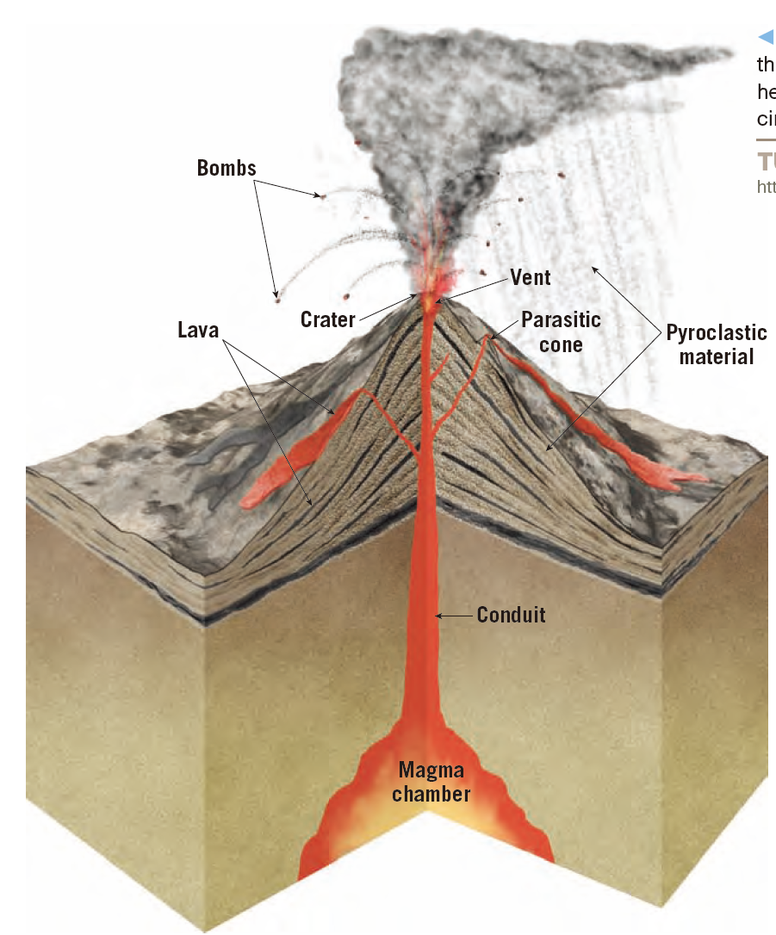
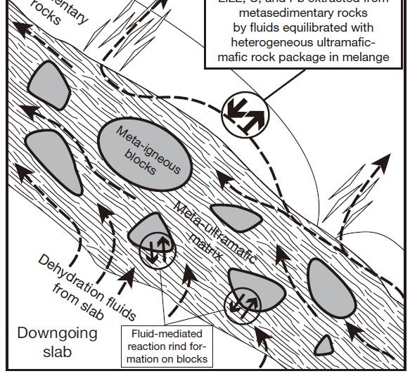
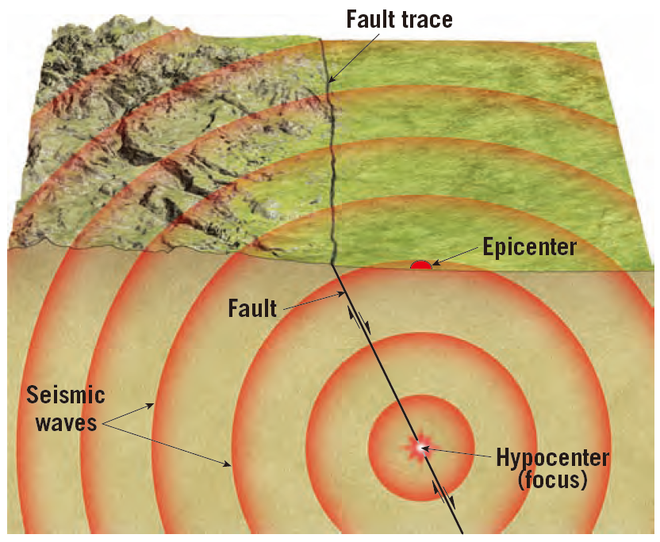

Introduction— subduction zone fluids(SZFs)
Volcano
Material cycle
A
C
v
B
E
Earthquake
Heterogeneity
melt
v
v
Diverse fluid sources with different compositions: sediment, altered oceanic crust, serpentinite.
residual
D
F
Bridge of material and energy exchange.
Critical for understanding geological processes: cycle and evolution of crust-mantle system, earthquake, volcanism…
A. Manning and Frezzotti, 2020; B. Schmidt and Poli, 2014; C-D. Pearson, 2017; E-F. Bebout, 2014

Slide 3
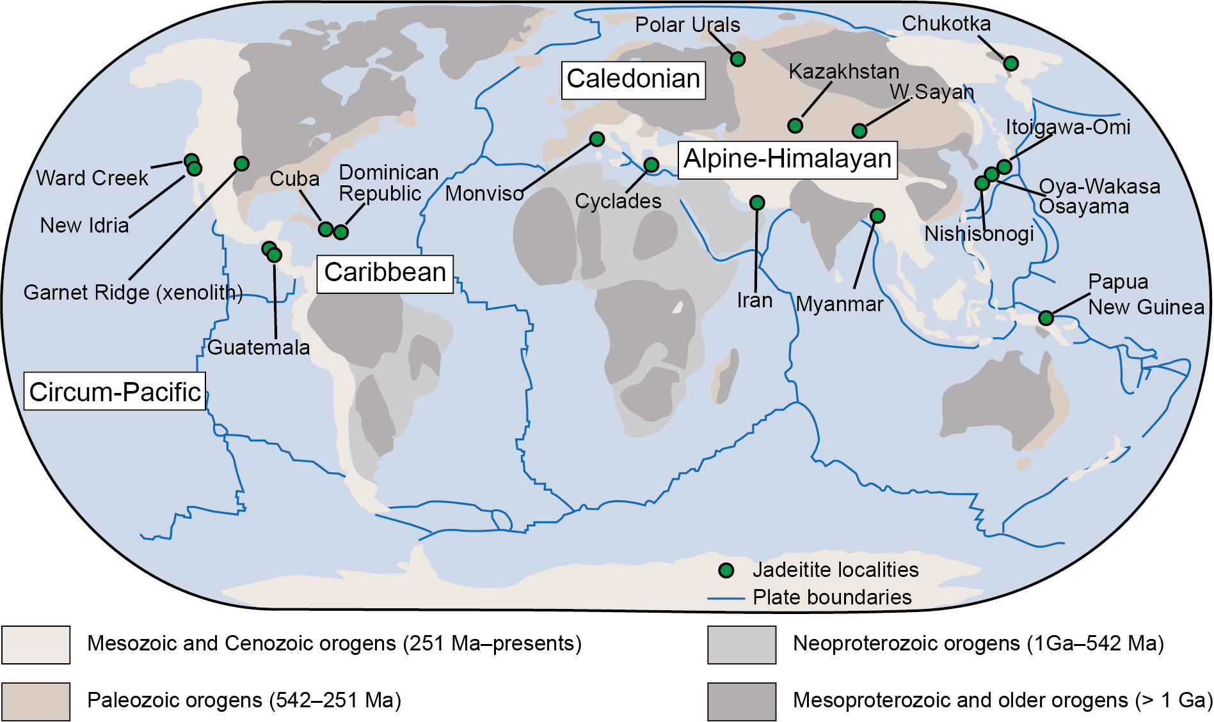
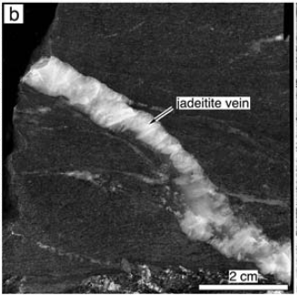
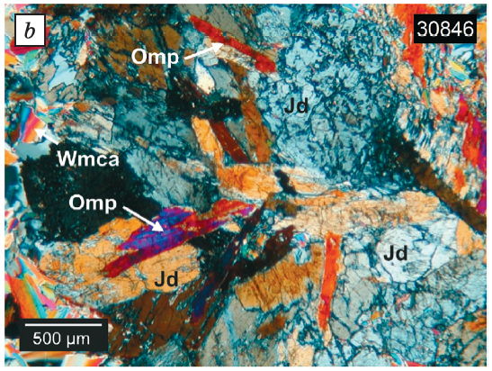
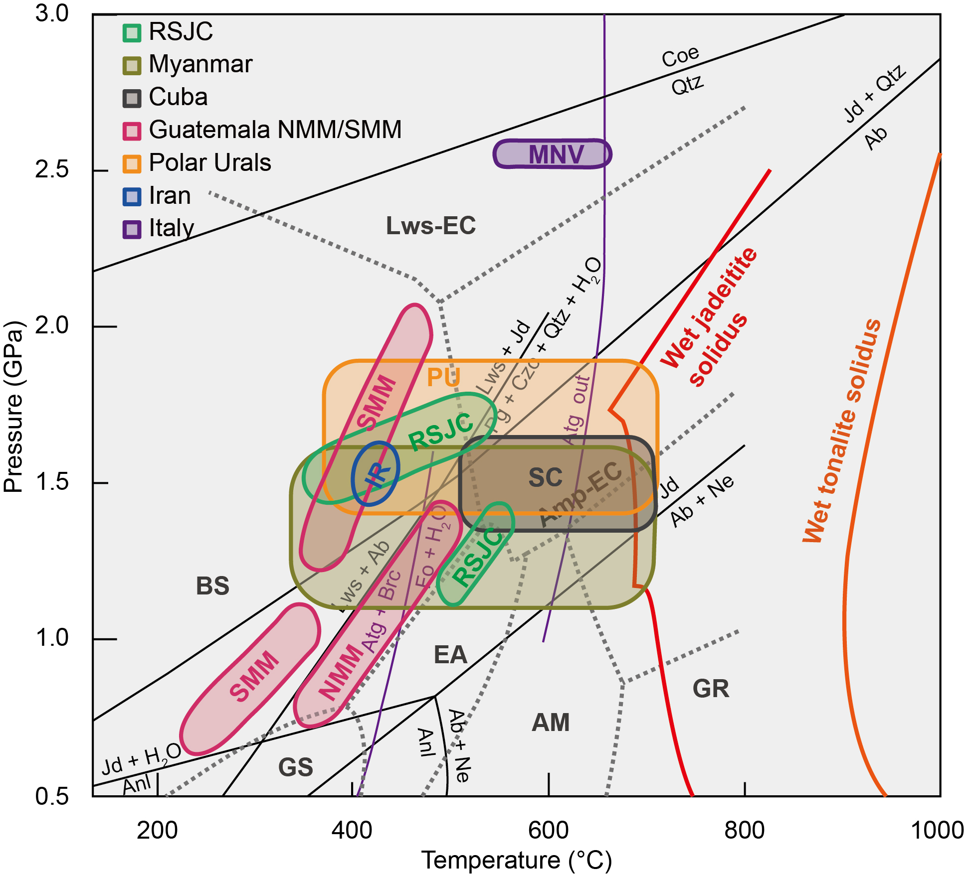
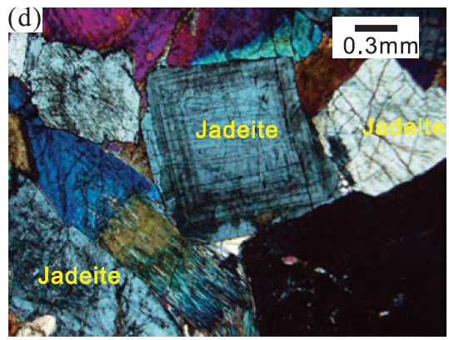
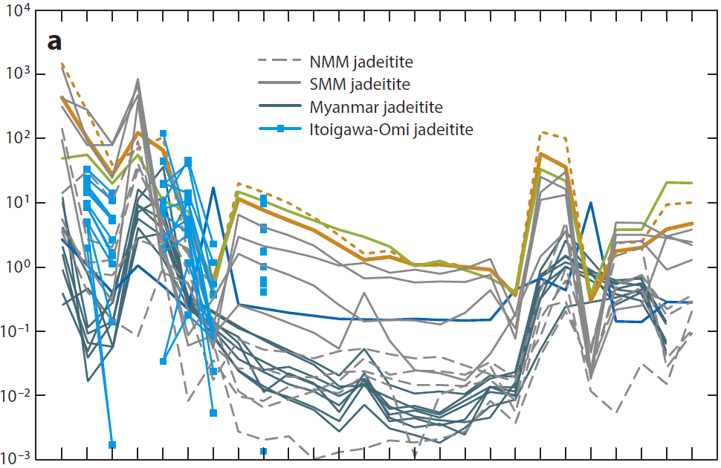
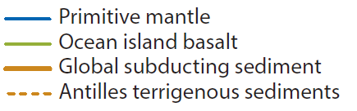

What is Jadeitite?— jadeitite (Jdt)
C
D
blueschist
G
New Idria
RSJC
A
E
F
Guatemala
B
G
Polar Urals
10~90+ vol.% jadeite,
Na-Al-Si rich, variable Mg-Fe-Ca
250–600 ℃
0.5–2.5 GPa
HP-LT blueschist-eclogite facies metamorphic rocks within serpentinite-matrix mélange.
Rich in Li, Ba, Sr, Pb, U, Th, Zr, Hf
A-B, G. modified after Harlow and Tsujimori, 2015; C. Tsujimori et al., 2012; D. Hertwig et al., 2021; E. Goto et al., 2017; F. Meng et al., 2016.

Slide 4
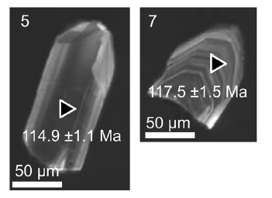
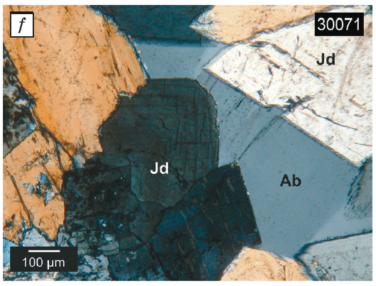
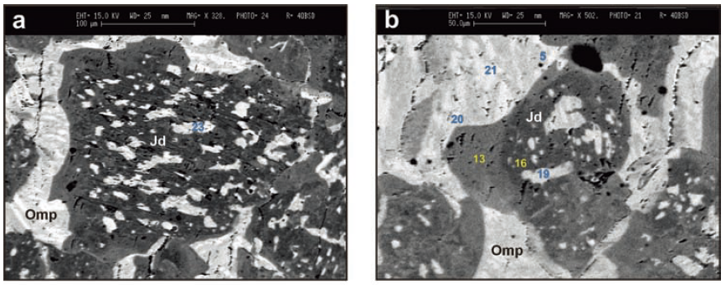
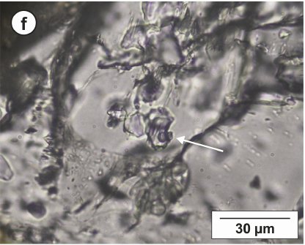
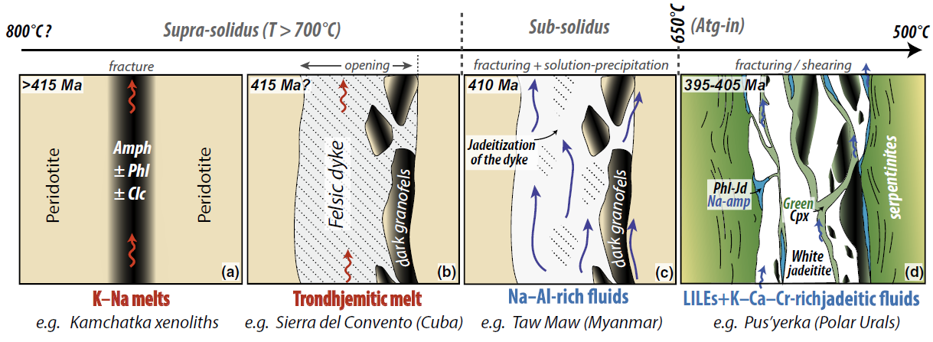
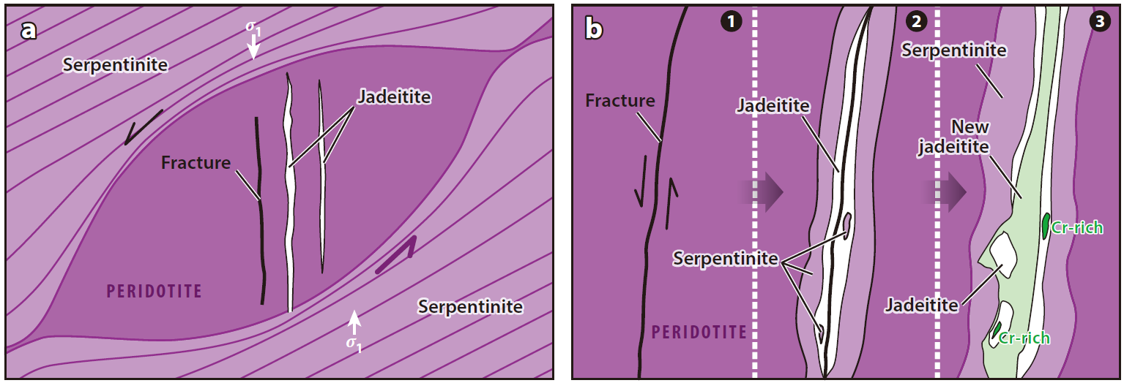
Controversy— 1. debates on petrogenesis
Precipitate from Na-Al-Si rich fluids (P-type)
Replace igneous precursors (R-type)
Oscillatory zoned jadeite
G
Inherited magmatic zircons
A
B
H
Serve as Unique archives of subduction-zone fluids
Qtz inclu in Qtz
Fluid inclusions
I
J
Relict Omp in Jd
C
D
E
F
K
L
A, H. Hertwig et al., 2021, 2016; B, D. Schertl et al., 2012, 2019; C. Kawamoto et al., 2018; E-F. Harlow and Tsujimori, 2015.
G. Shigeno et al., 2012; I-J. Compagnoni et al., 2012; K-L. Anhiboust et al., 2020.

Slide 5
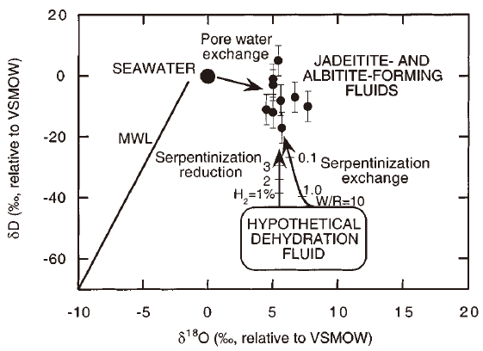
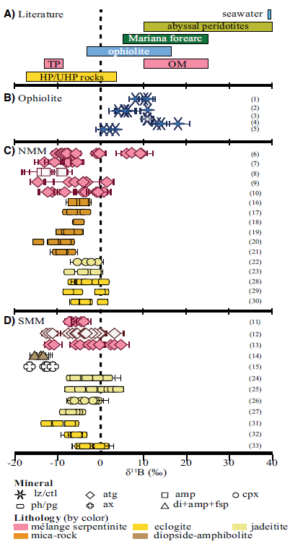
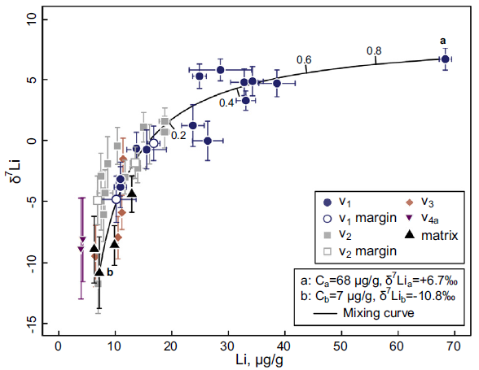
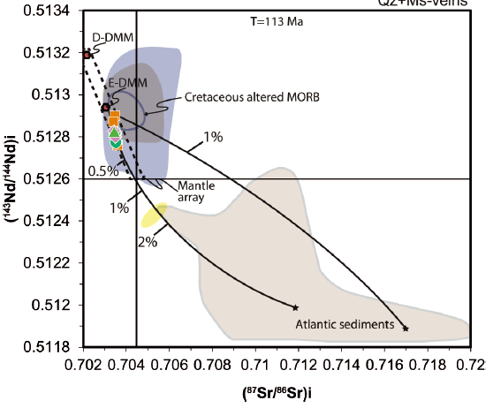

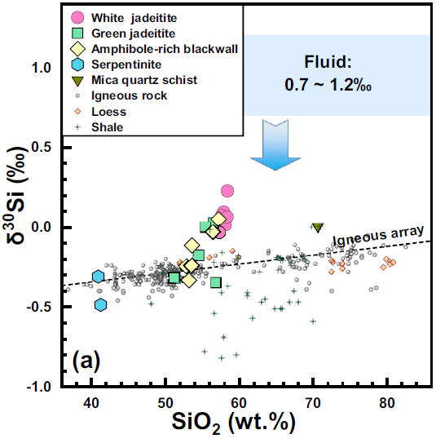
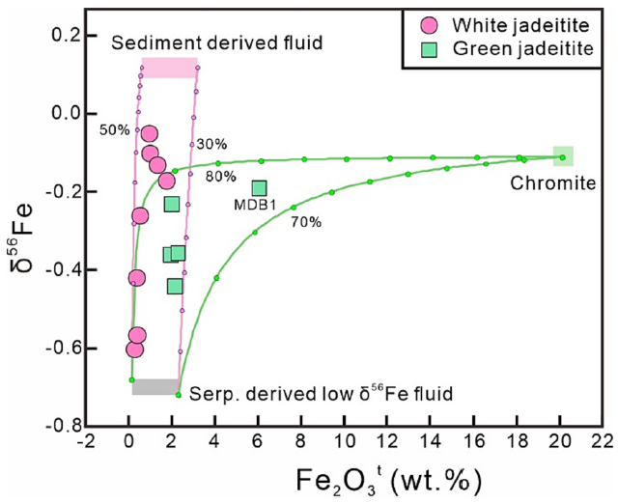
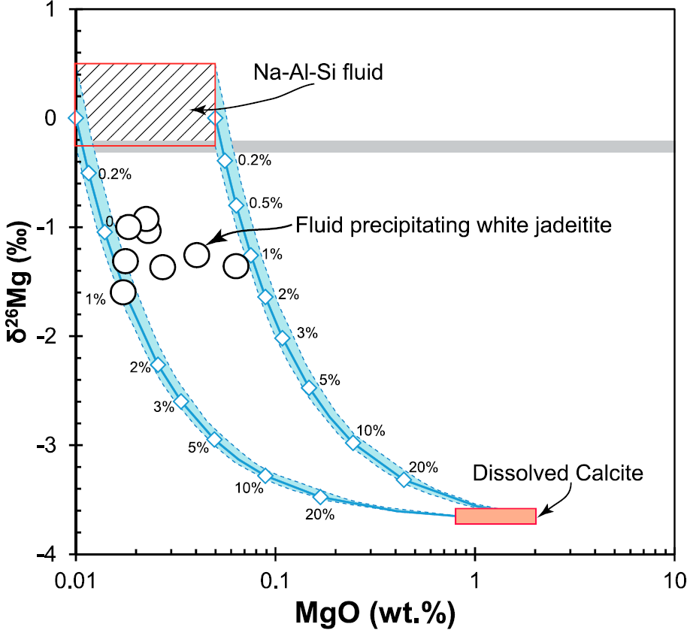
Controversy— 2. debates on multiple fluid sources
A
C
D
B
Guatemala: Serpentinization + Slab-derived
New Idria & Cuba: AOC-derived
G
Paradox:
sources & exposures
Misinterpretation:
single isotope
fluid-rock interactions
F
E
Myanmar: Sediment + Ser-derived fluid + Carbonate
Johnson and Harlow, 1999; B. Martin et al., 2016; C. Takahashi et al., 2018; D. Cárdenas-Párraga et al., 2021; E-G. Chen et al., 2018, 2019, 2023.

Slide 6
Methods and goals
Methods
Integrated stable isotopic investigations (Sr-Nd-O-Si-Mg-Fe…).
Comparative analyses.
Goals
Stable isotopic compositions of Jdt-forming fluids.
Constraints on potential fluid sources.
Implications on petrogenesis of Jdts and chemical heterogeneity of the mantle.

Slide 7
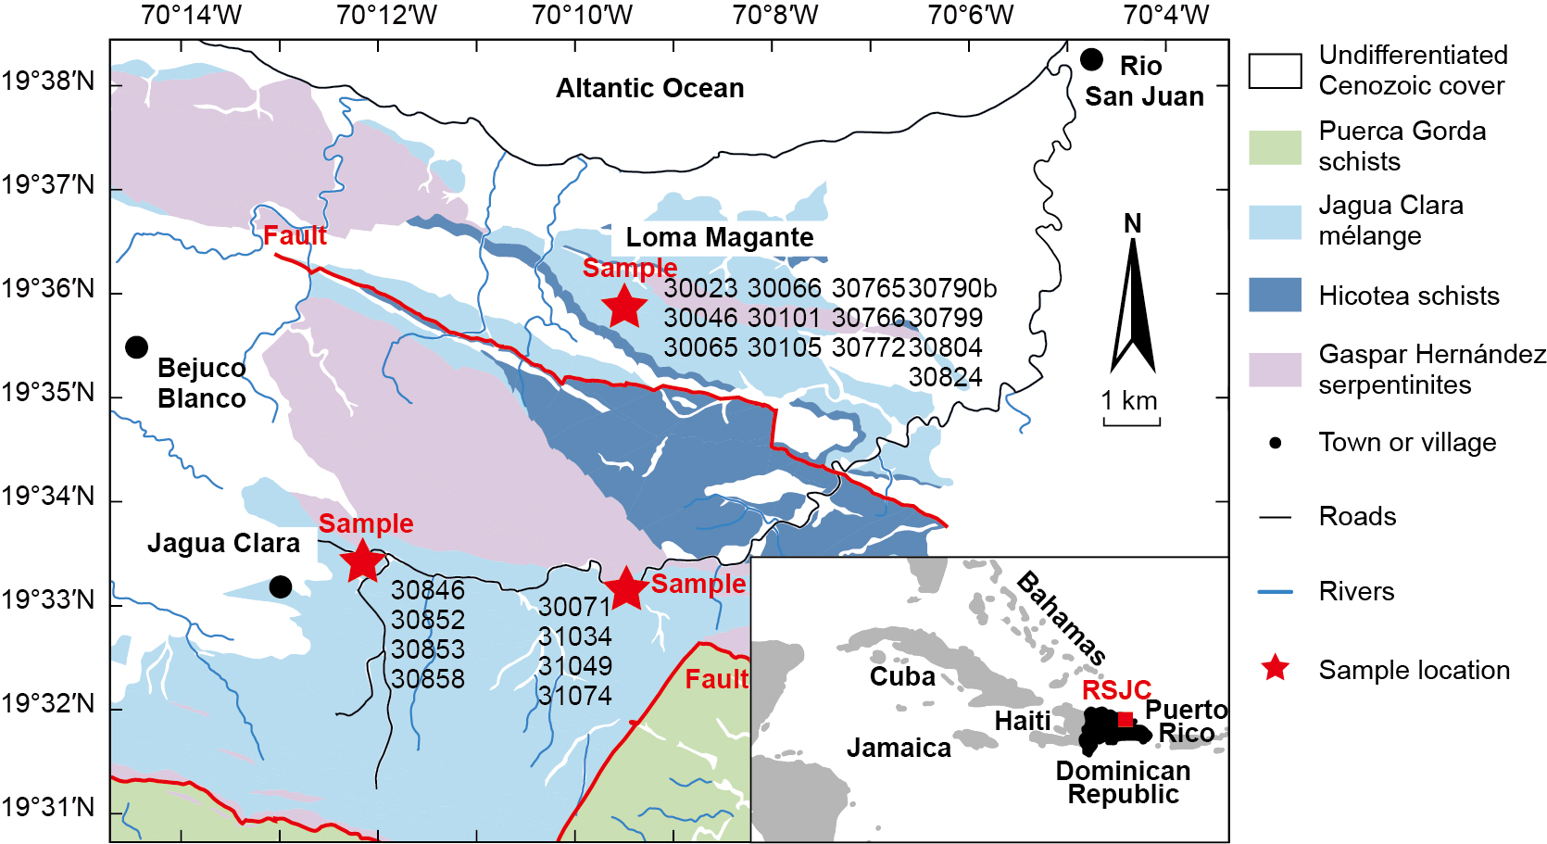
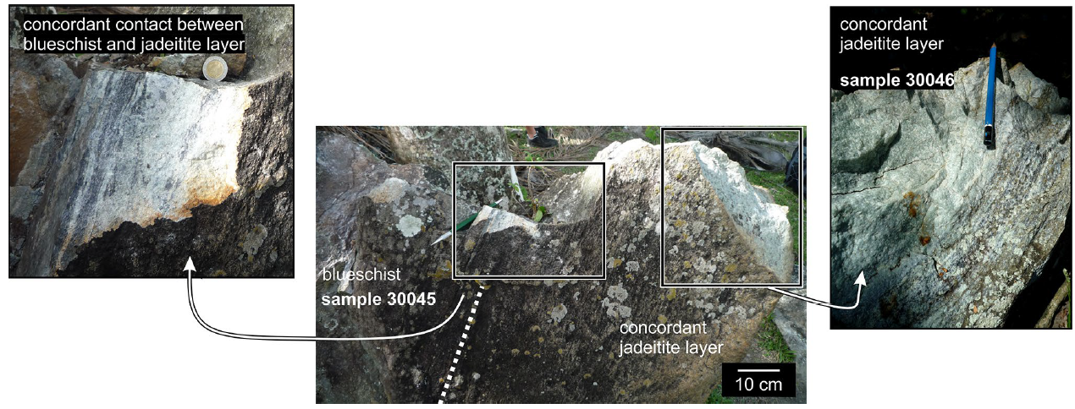
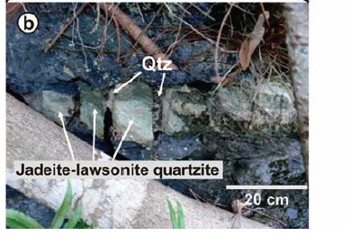
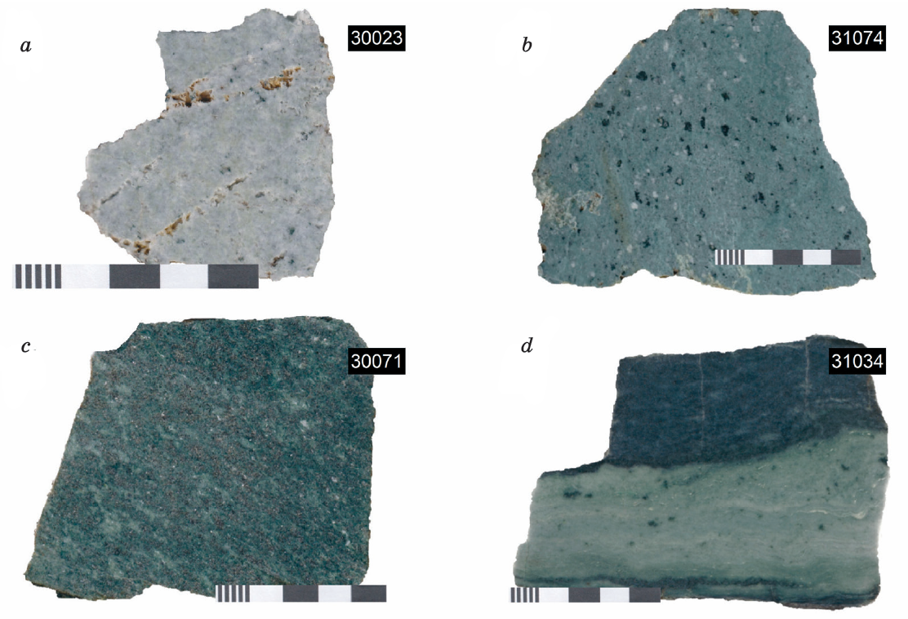
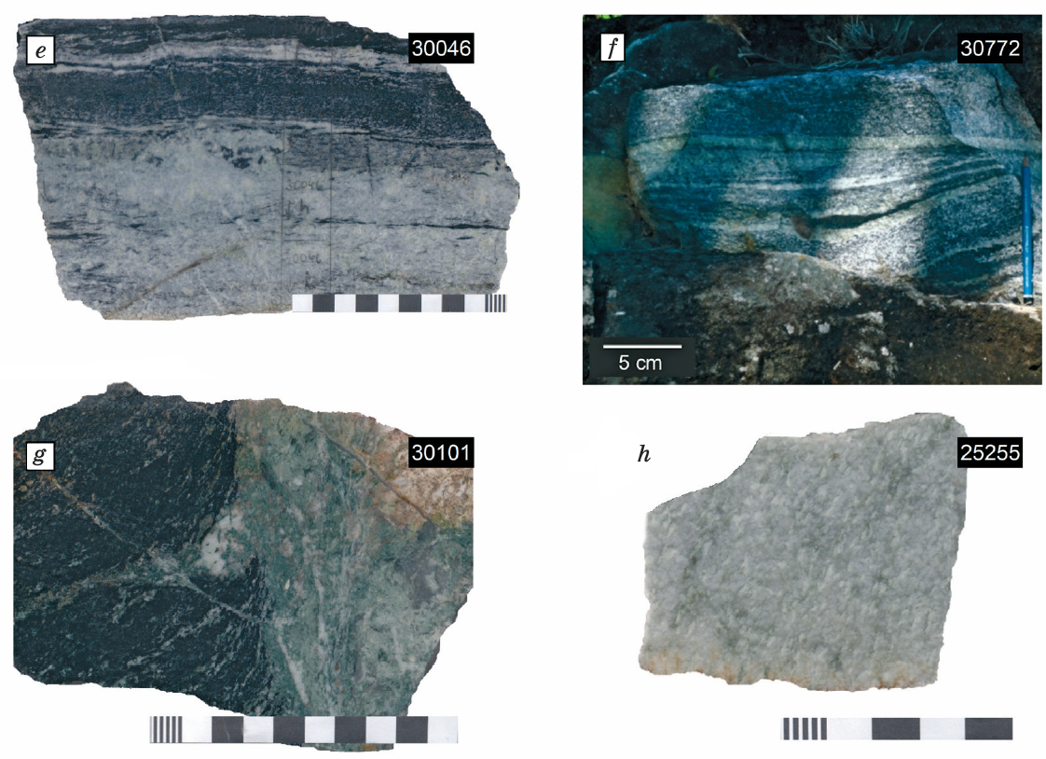
Samples — jadeitites from the Dominica Republic
B
①direct contact with blueschist (country rock is serpentinite)-HP metamorphism
A
C
D
Jadeitite
Blueschist
Blueschist
E
G
Chl/Ep
I
Blueschist
K
Gln-Jd layer
③RSJC hosts jadeitite and jadeite-rich quartzite of both P- and R-type origins
Matrix-quartz-free
suite
②Matrix-quartz-bearing
suite
Jdt s.str
F
H
Blueschist
J
L
Quartzite
Jadeitite

Slide 8
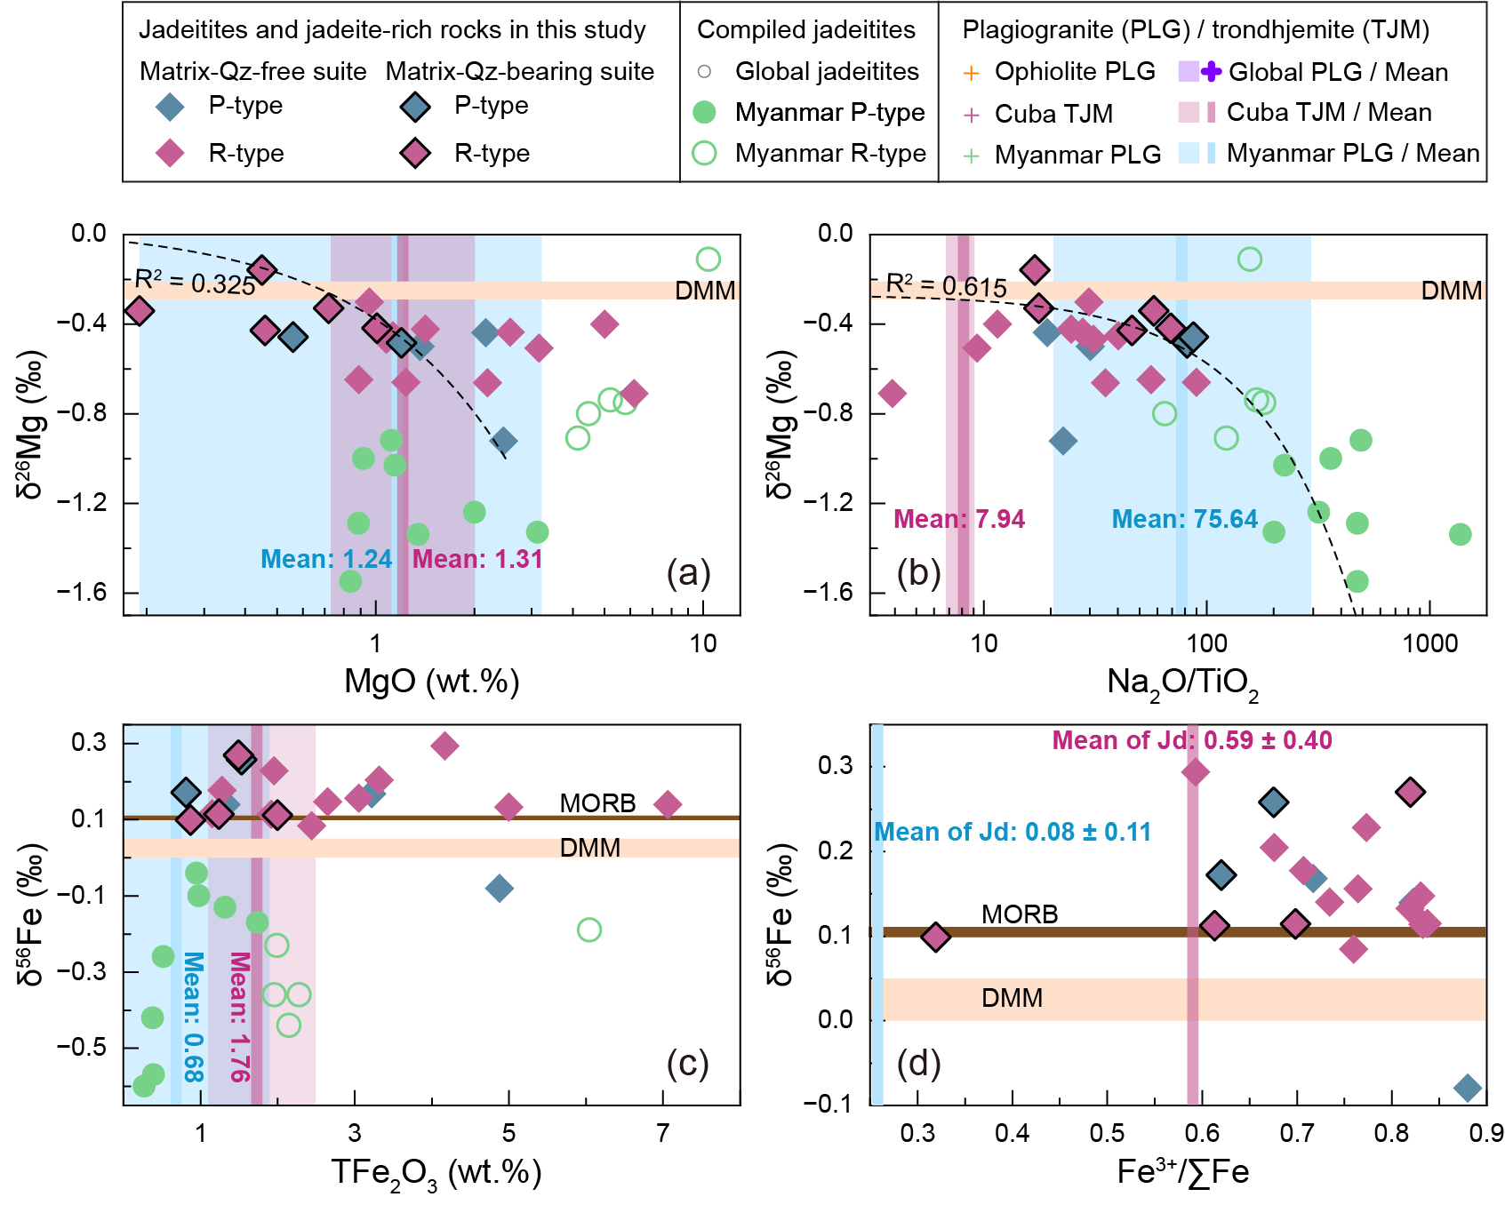
Results— light Mg and heterogeneous Fe isotopic compositions
Consistent light Mg isotopes with different deviation from the mantle are related to Jdt formation process.
Heterogeneous Fe isotope.
High Fe content and contrasting Fe³⁺/∑Fe ratios.
A
B
C
D

Slide 9
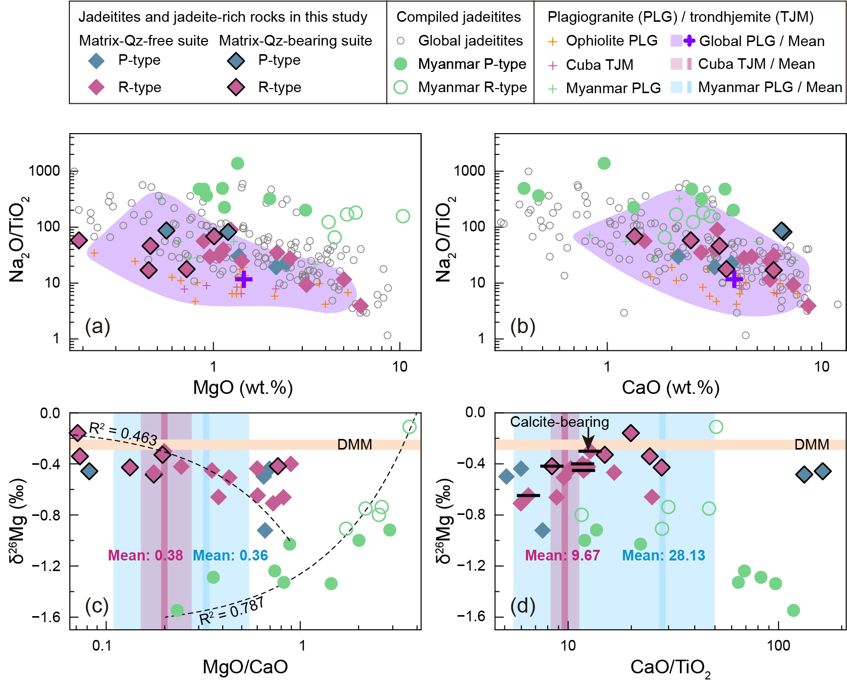
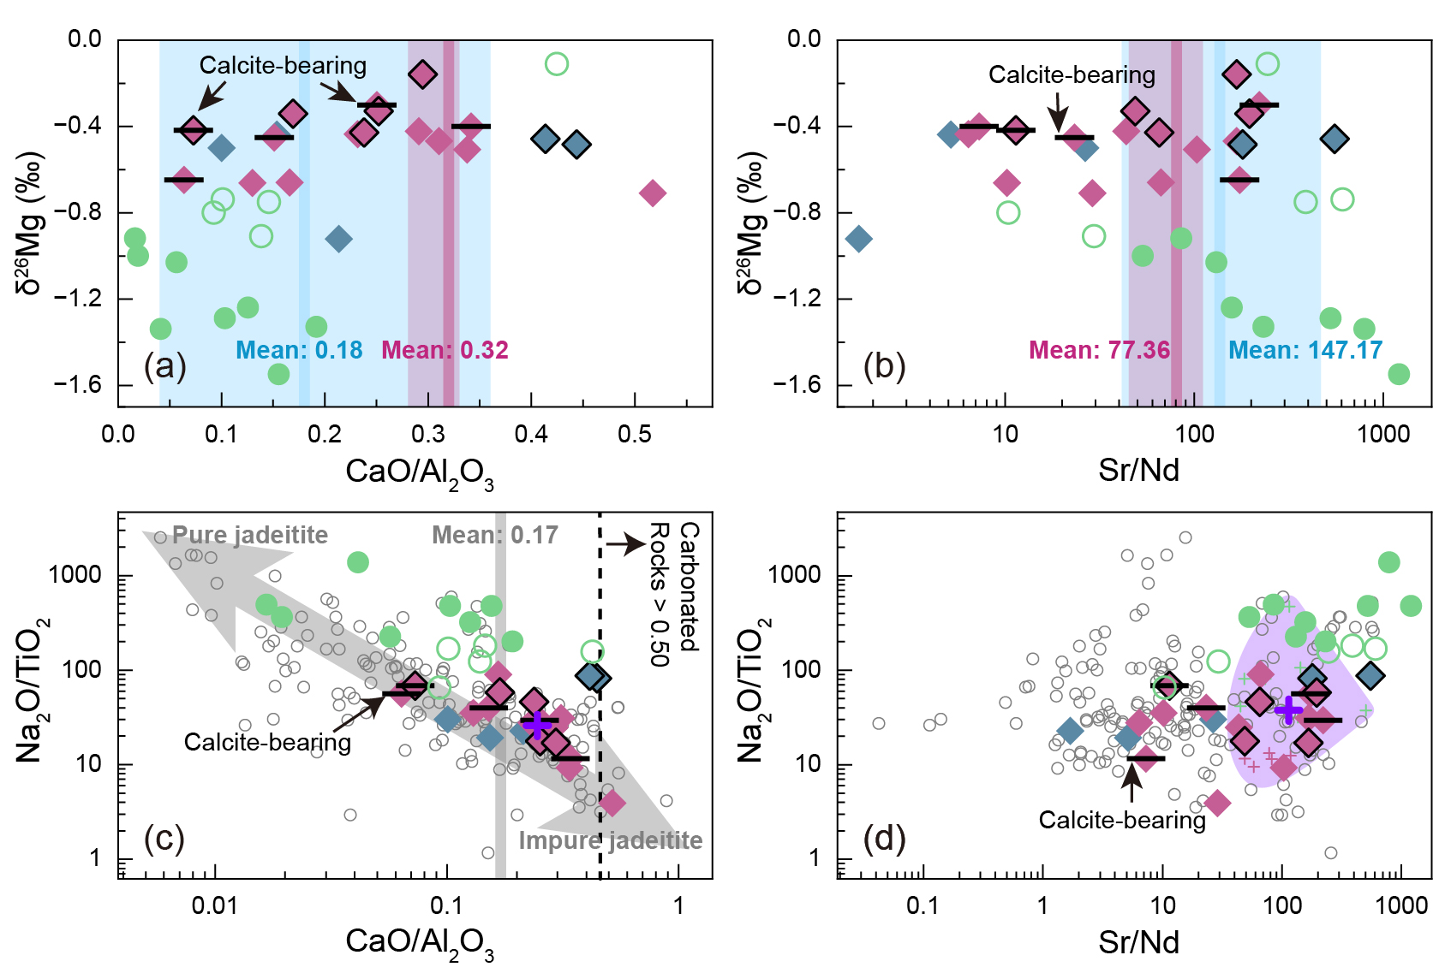
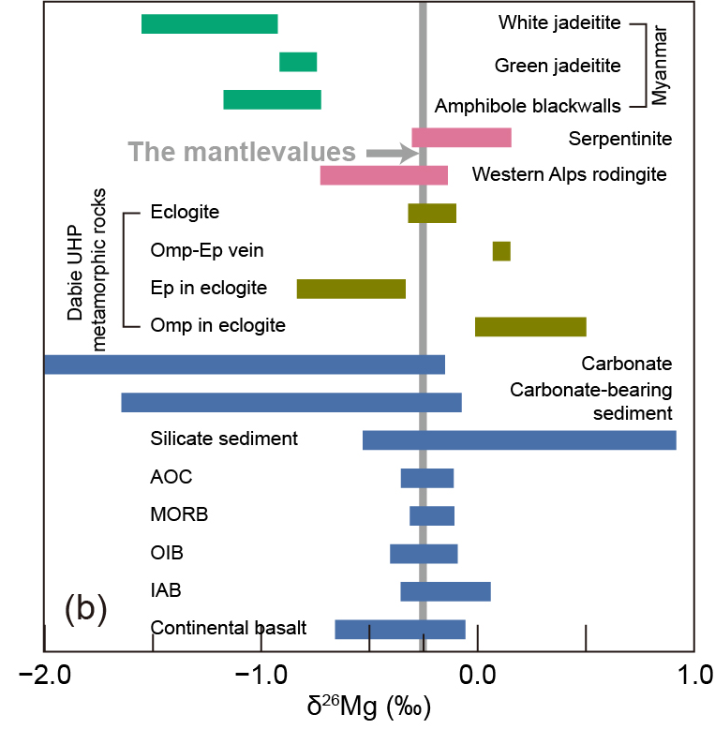
Discussion 1.1 — light Mg isotope & carbonate
preclude contribution from carbonate
B
B
D
E
A
C
F
G
Low δ²⁶Mg are usually ascribed to carbonates.
Covariations in Mg, Ca and Na controlled by Jd.
No correlations between low δ²⁶Mg values and carbonate signals.
A. Modified after Teng et al., 2017; D-G. Chen et al., 2026.

Slide 10
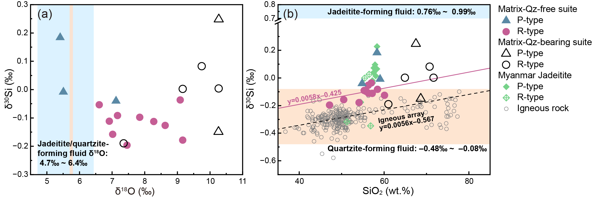
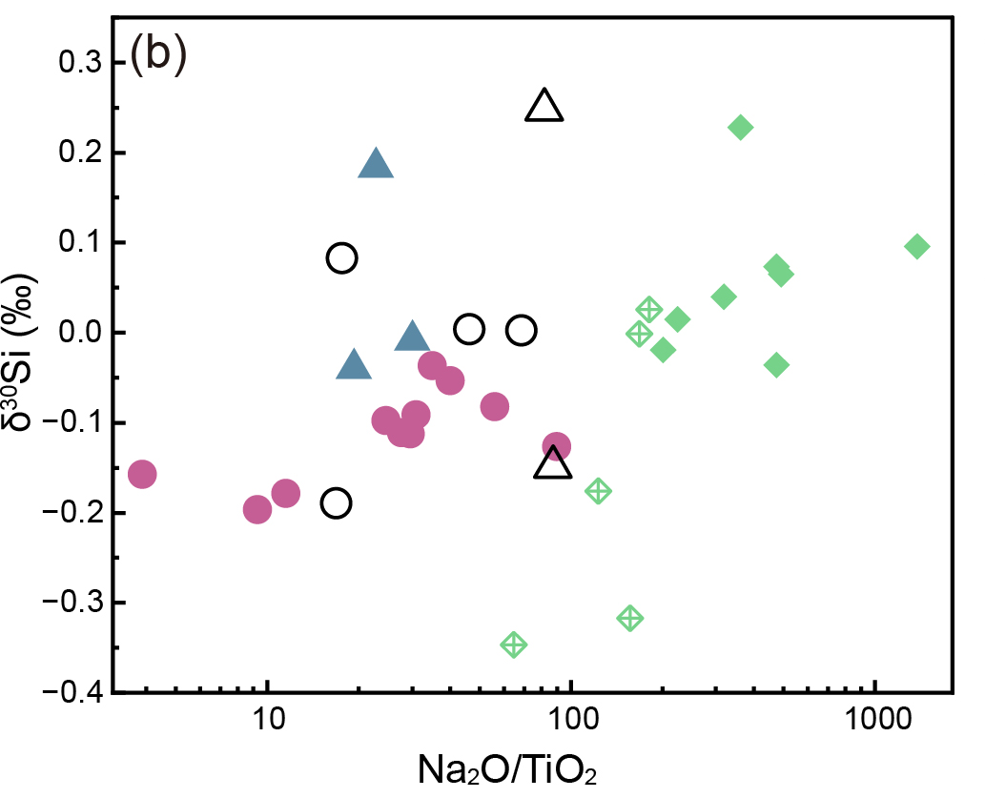
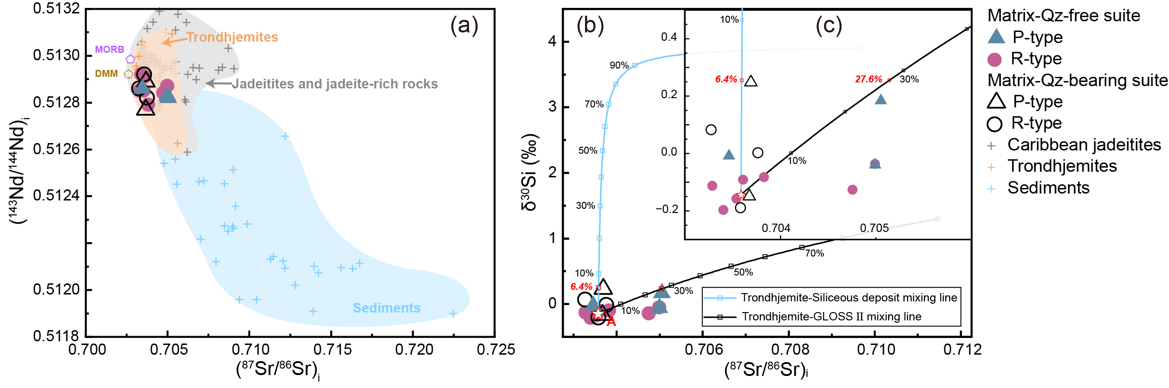
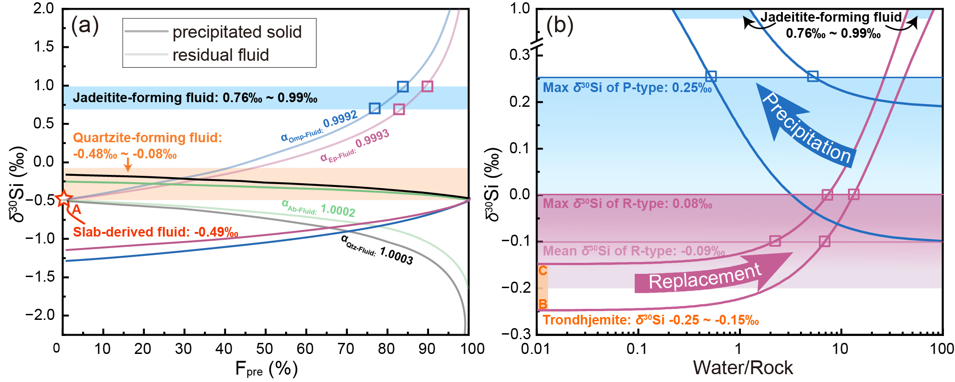
Discussion 1.1— light Mg isotope & carbonate
A
B
C
D
Heavy Si derived from Jdt-forming fluids
Not derived from sediment
E
F
G
AOC-derived fluids are potential source rather than sediments.
Evolved altered oceanic crust fluids contribute to heavy Si isotope
A-G. Chen et al., 2025.

Slide 11
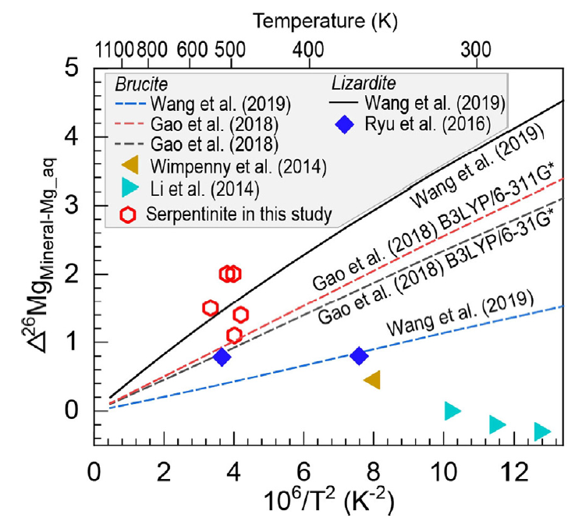
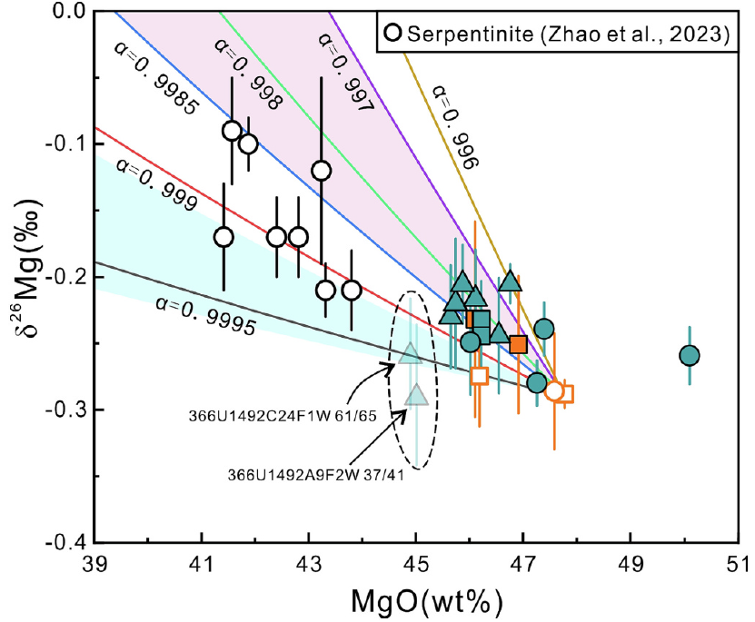
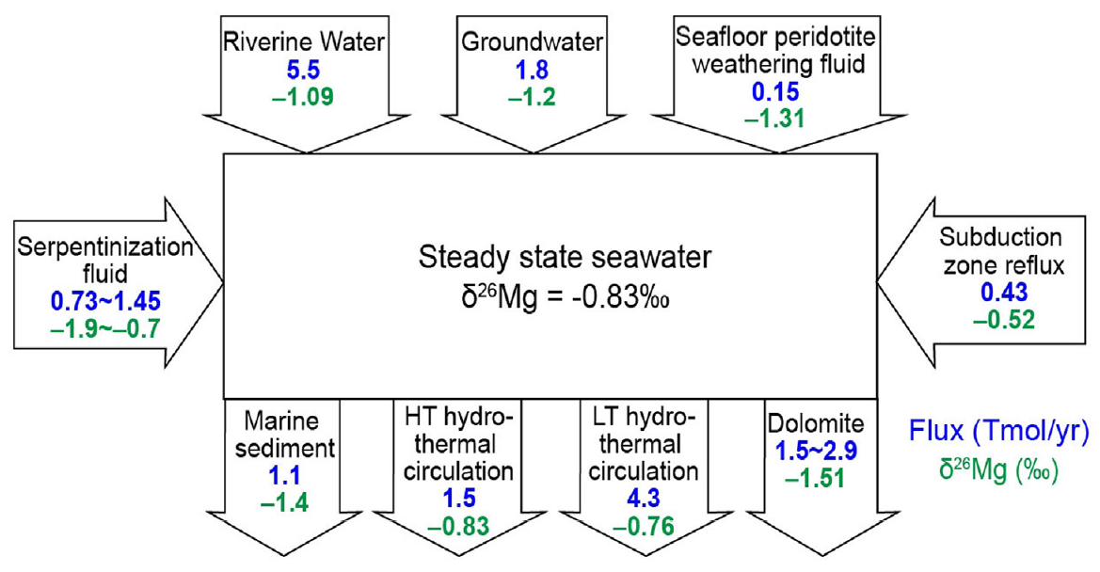
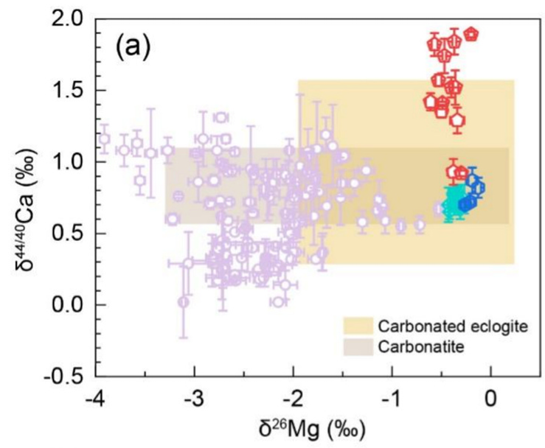
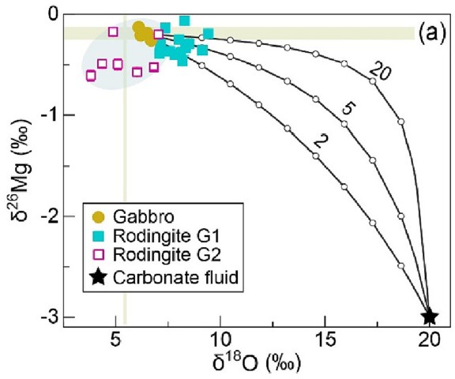
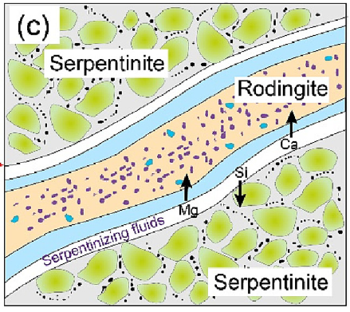
Discussion 1.2— light Mg isotope & serpentinizing fluids
serpentinizing fluids have light Mg isotopic compositions
C
A
B
D
E
F
Metasomatic rocks (rodingites) associated with serpentinization show low δ²⁶Mg values
Serpentinizing fluids (equilibrated with the serpentinized peridotite) represent a potential light Mg isotope source for associated rocks.
A. Wang et al., 2019; B. Wang et al., 2023; C-F. Zhao et al., 2023, 2025.

Slide 12
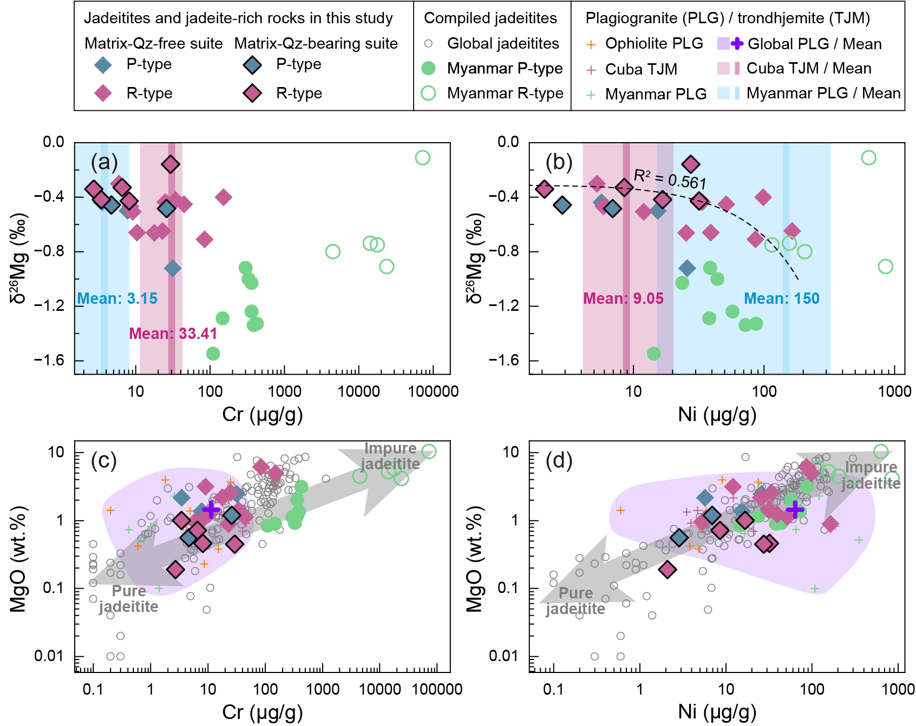
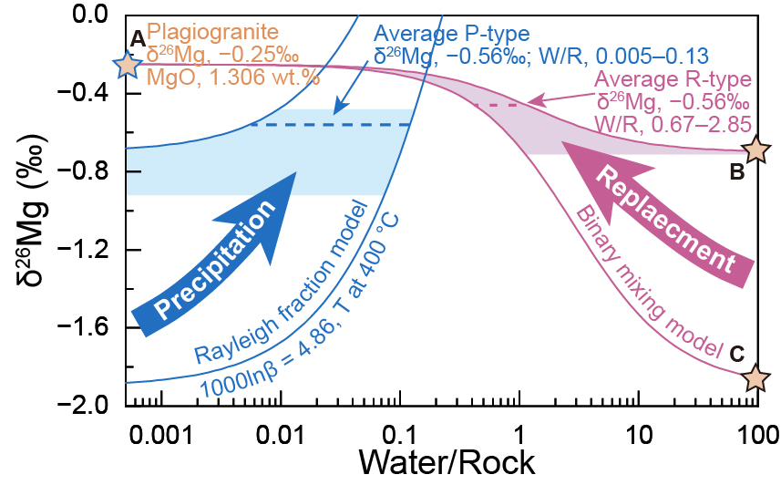
Discussion 1.2— low δ²⁶Mg derived from serpentinizing fluids
A
B
C
Covariations between low δ²⁶Mg and mobile elements during serpentinization (Cr, Ni and MgO)
D
E
Positive correlations
among MgO, Cr and Ni
F
Covariations Cr, Ni and MgO in global jadeitites + simulation results.

Slide 13
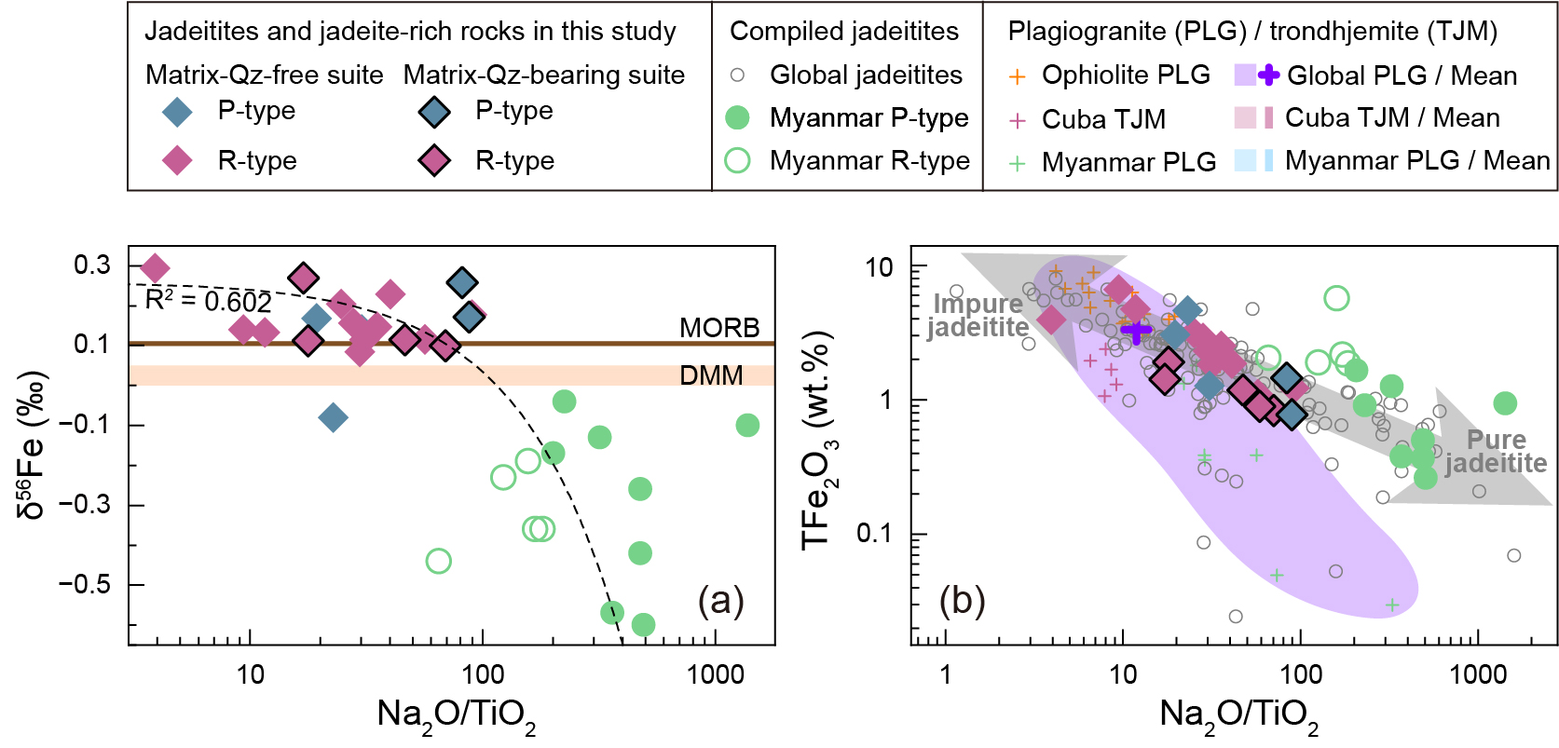
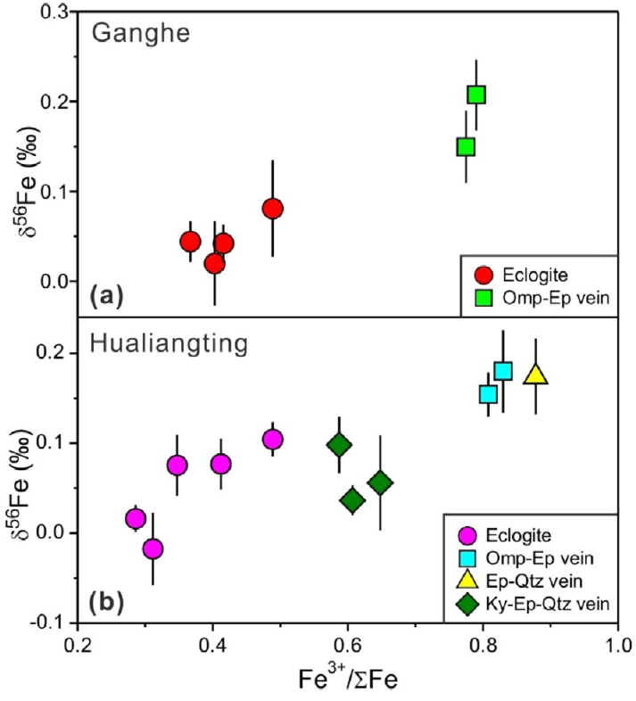
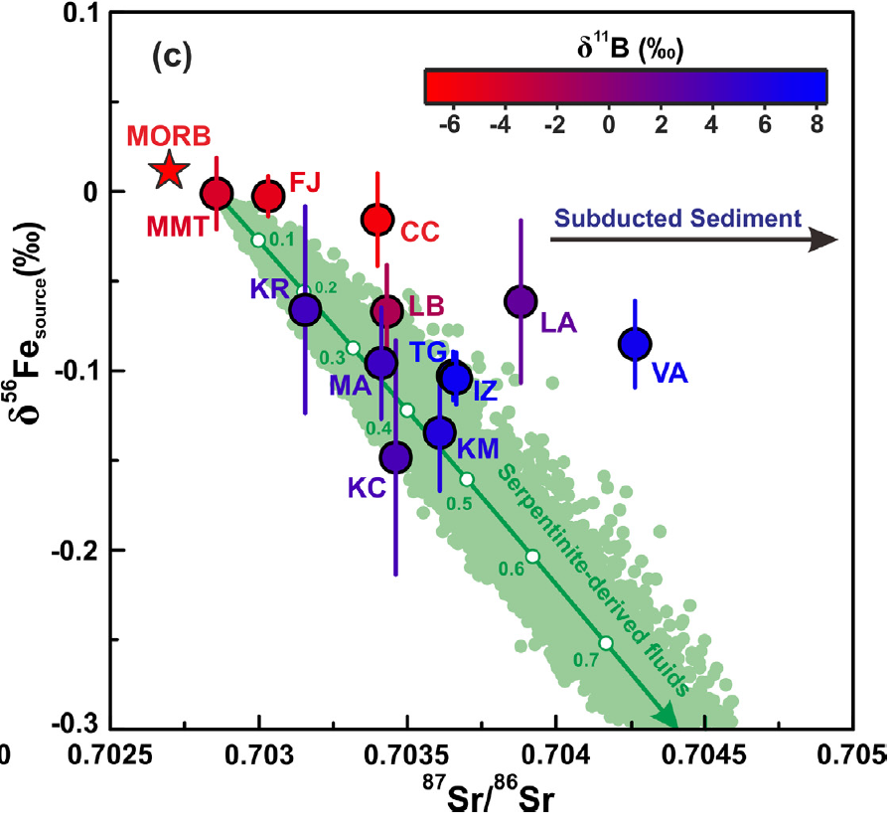
Discussion 2.1— contrasting δ⁵⁶Fe values & fluid sources
D
A
C
C
D
AOC-derived fluids:
high δ⁵⁶Fe values
Serpentinite-derived fluids:
low δ⁵⁶Fe values
B
contrasting δ⁵⁶Fe values are related to Jdts formation.
Fluid sources cannot explain this Fe isotope heterogeneity.
C. Huang et al., 2020; D. Chen et al., 2023.

Slide 14
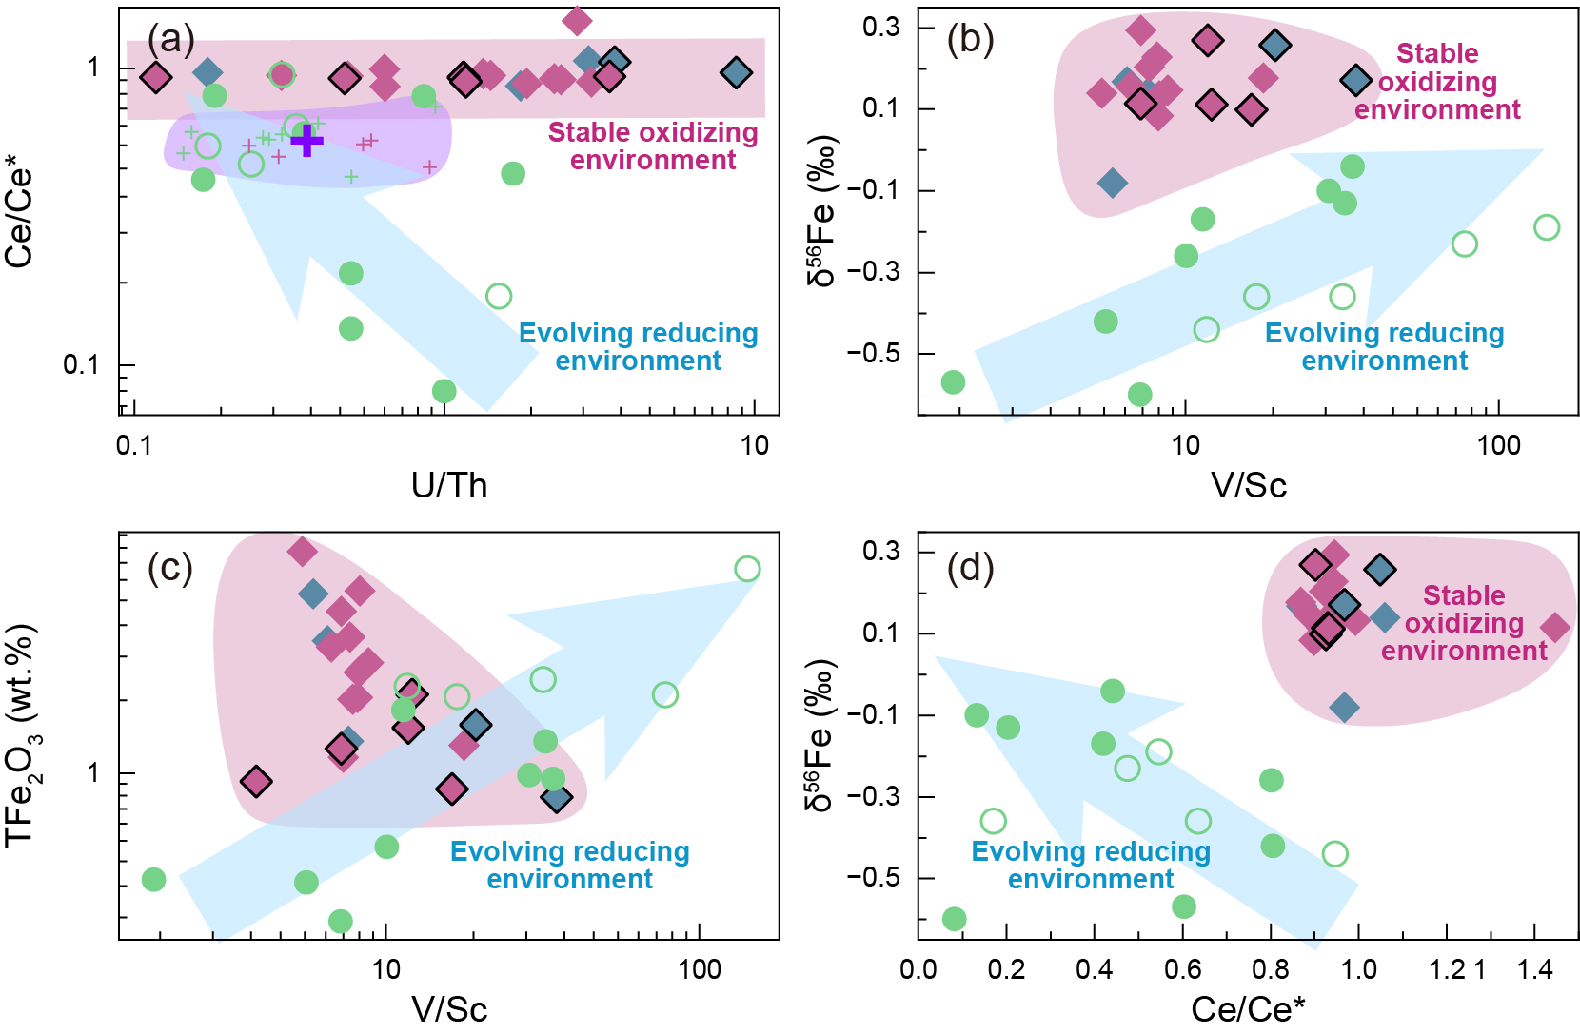
Discussion 2.2— heterogeneous δ⁵⁶Fe values & redox variation
A
B
E
C
D
Fe isotopic differences is related to the redox-sensitive proxies.
Dominican jadeitites: stable oxidized condition.
Myanmar jadeitites: relatively reduced condition.
Observed heterogeneous δ⁵⁶Fe is related to redox variations.

Slide 15










Discussion 2.3— serpentinization mediate redox and δ⁵⁶Fe
A
B
C
D
Ol/Opx proportions control the content of Mg, Ca, Sb, As, Ce and REEs partition.
F
G
E
H
δ⁵⁶Fe values, redox state and redox-sensitive proxies vary during serpentinization.
Ol-dominant: higher Mg/Ca, constant REEs, relatively reduced condition.
Opx-involved: lower Mg/Ca and REEs, relatively oxidized conditions.
A. Klein et al., 2020; B-D. Deschamps et al., 2010; E-G. Debret et al., 2024; H. Deng et al., 2022.

Slide 16


Discussion 2.3— serpentinization mediate redox and δ⁵⁶Fe
A
B
E
D
F
C
Heterogeneous Fe isotopic compositions in jadeitites is related to redox variations driven by diverse serpentinization environment.

Slide 17

Conclusions
Fluid sources: dominantly derived from AOC-fluids commonly mixing with serpentinizing fluids.
Serpentinizing fluids contribute to the light Mg isotopic compositions.
Diverse serpentinization environment mediate the redox state and produces the heterogeneity of Fe isotopes observed in jadeitites.
The mixtures of above fluids either directly precipitate as P-type jadeitites or metasomatize igneous precursors to form R-type jadeitites.
A
B
C

Slide 18


THANK YOU
VERY MUCH !

