Slide 1
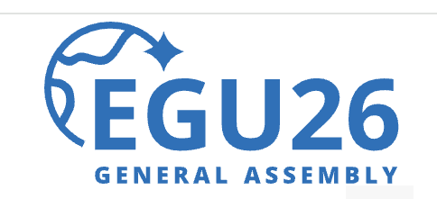
MINERAL-ASSOCIATED CARBON PERSISTENCE ARISES FROM STEADY-STATE DYNAMICS, NOT SATURATION
Vienna, Austria & Online | 3–8 May 2026
Francisco J. Matus
francisco.matus@ufrontera.cl
Laboratory of Conservation and Dynamics of Volcanic Soils
Universidad de La Frontera
Temuco-Chile
Notes:
Thank you for the opportunity:
For decades, mineral-associated organic carbon has been interpreted as evidence of carbon saturation. Here, I show that the same relationship may instead emerge from steady-state dynamics.

Slide 2
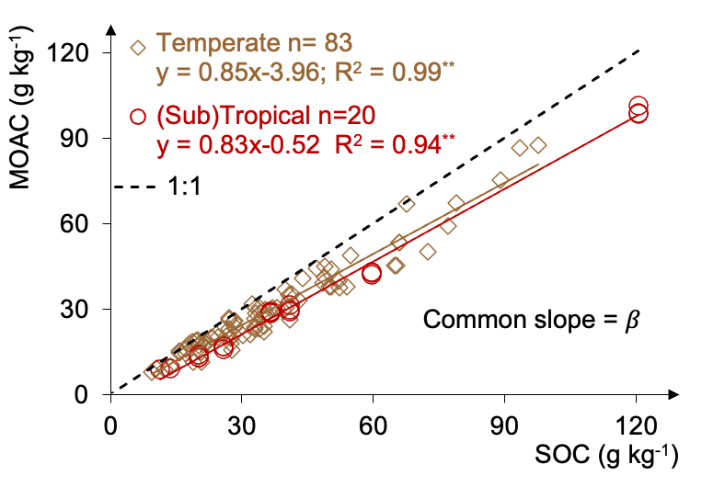
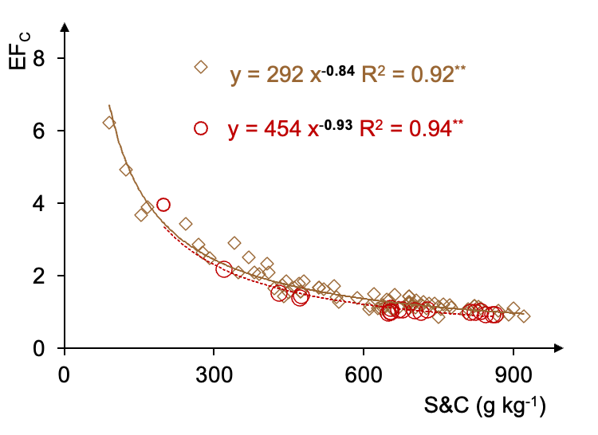
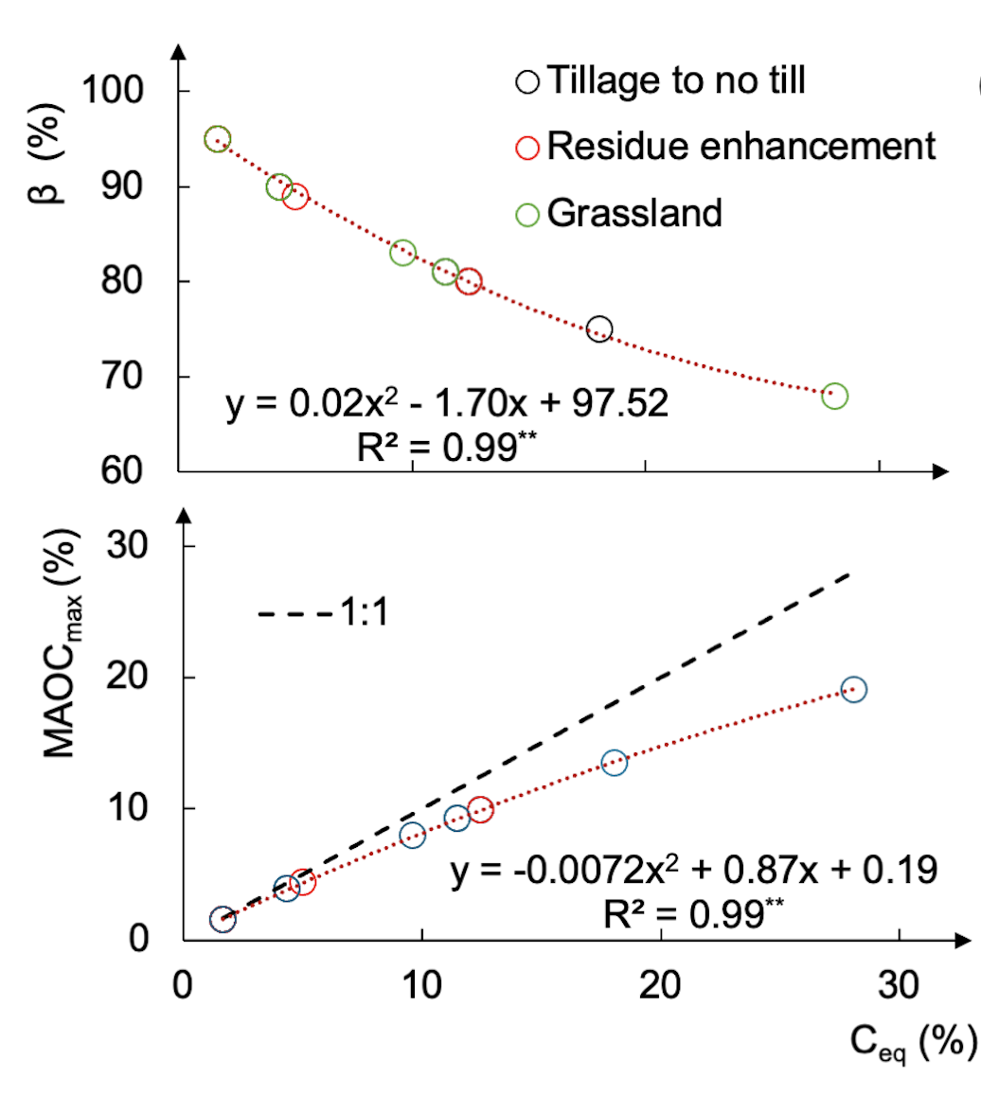
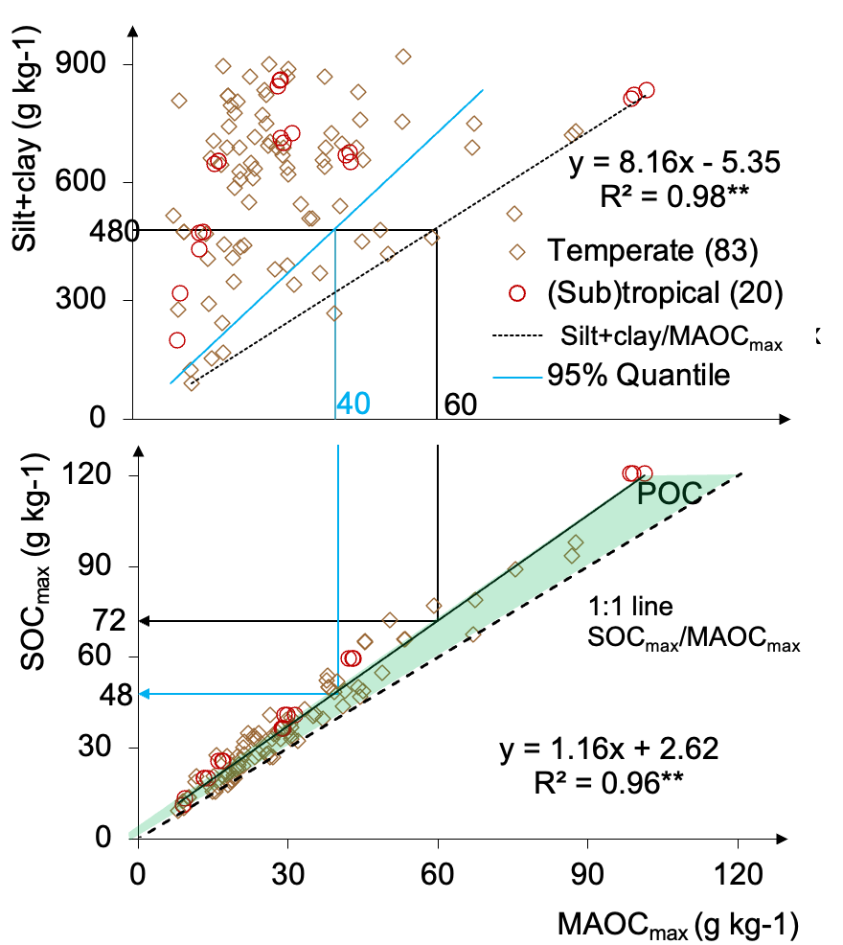
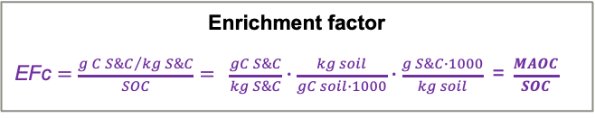
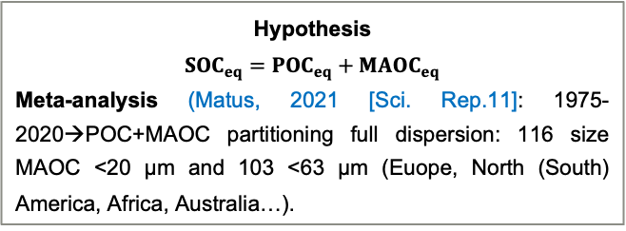
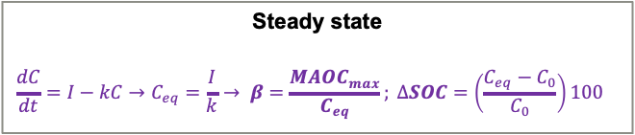
MINERAL-ASSOCIATED CARBON PERSISTENCE ARISES FROM STEADY-STATE DYNAMICS, NOT SATURATION
Introduction
Soil organic carbon (SOC) debated mineral-associated organic carbon (MAOC) saturation or steady state:
Hypothesis
$${SOC}_{eq}={POC}_{eq}+{MAOC}_{eq}$$
Meta-analysis (Matus, 2021 [Sci. Rep.11]: 1975-2020→POC+MAOC partitioning full dispersion: 116 size MAOC <20 μm and 103 <63 μm (Euope, North (South) America, Africa, Australia…).
Enrichment factor
EFc $=$ $\frac{{g C S\&C}/{kg S\&C}}{SOC}$ $= \frac{gC S\&C}{kg S\&C}∙\frac{kg soil}{gC soil∙1000}∙\frac{g S\&C∙1000}{kg soil}\text{ = }\frac{MAOC}{SOC}$
Steady state
$$\frac{dC}{dt}=I−kC→C_{eq}=\frac{I}{k}→ β=\frac{{MAOC}_{max}}{C_{eq}}; ∆SOC=\left(\frac{C_{eq}−C_{0}}{C_{0}}\right)100$$
Model Validation
Review (Matus, 2025 [Soil Sci & Plant Nutr. 1-11]: SOC and teq experiments (cropland to grassland) → climate (warm, cold, tropical) → new steady state (West & Six, 2007).
Green: measured
Notes:
The persistence of soil organic carbon remains debated. One hypothesis proposes that soils approach a steady state, where carbon inputs balance carbon losses rather than carbon saturation.
If MAOC truly becomes saturated, an inflexion point should appear when SOC is used as a proxy for carbon input.
Here, we tested whether the saturation concept is supported by the data using a global meta-analysis. As shown for tropical and temperate soils, no inflexion point appears; instead, we observe a highly significant relationship with a common slope across a wide range of soils.
Since Christensen in 1985, the enrichment factor, the carbon concentration in MAOC divided by total SOC, has been interpreted as evidence of carbon saturation and later incorporated into the Hassink saturation framework. However, solving the equation considering the fitting coefficient close to one, the same common slope is obtained.
We further tested this by modelling the dataset of West and Six in several biomes where time and percentage of SOC change for a new equilibrium were measured. Here, in the upper panel, the common slope decreases as the C equilibrium increases because MAOC decomposes more slowly than the particulate organic carbon. In the lower panel, MAOC still does not show evidence of saturation.
In the right panel, an algorithm for soil C sequestration is presented using the common slope.
Overall, these results are more consistent with steady-state dynamics than with direct evidence for carbon saturation.

