Slide 1

Impacts of Stratospheric Ozone on Antarctic Spring Sea Ice: Based on WACCM6
Shujie Chang¹, Zhenfeng Chen¹, Wuhu Feng², Ren Ci³, Ting Xu⁴, Haotian He¹ ¹College of Ocean and Meteorology, Guangdong Ocean University, China; ²National Centre for Atmospheric Science (NCAS), University of Leeds, UK; ³School of Ecology and Environment, Tibet University, China; ⁴Shenzhen Meteorological Bureau, China
Sea-ice response
Surface warming / cooling
Wind + Ekman changes
2-minute PICO introduction High-ozone years minus low-ozone years · Antarctic spring (SON)
Main message: ABS loses sea ice, while the Weddell Sea gains sea ice.

Slide 2
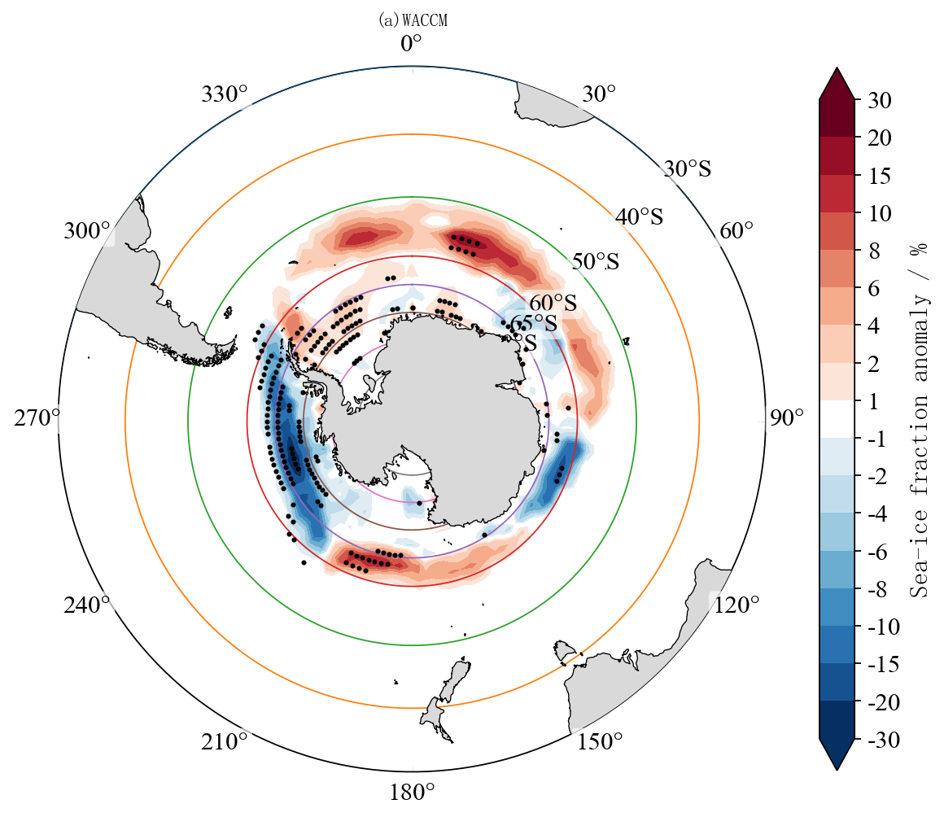
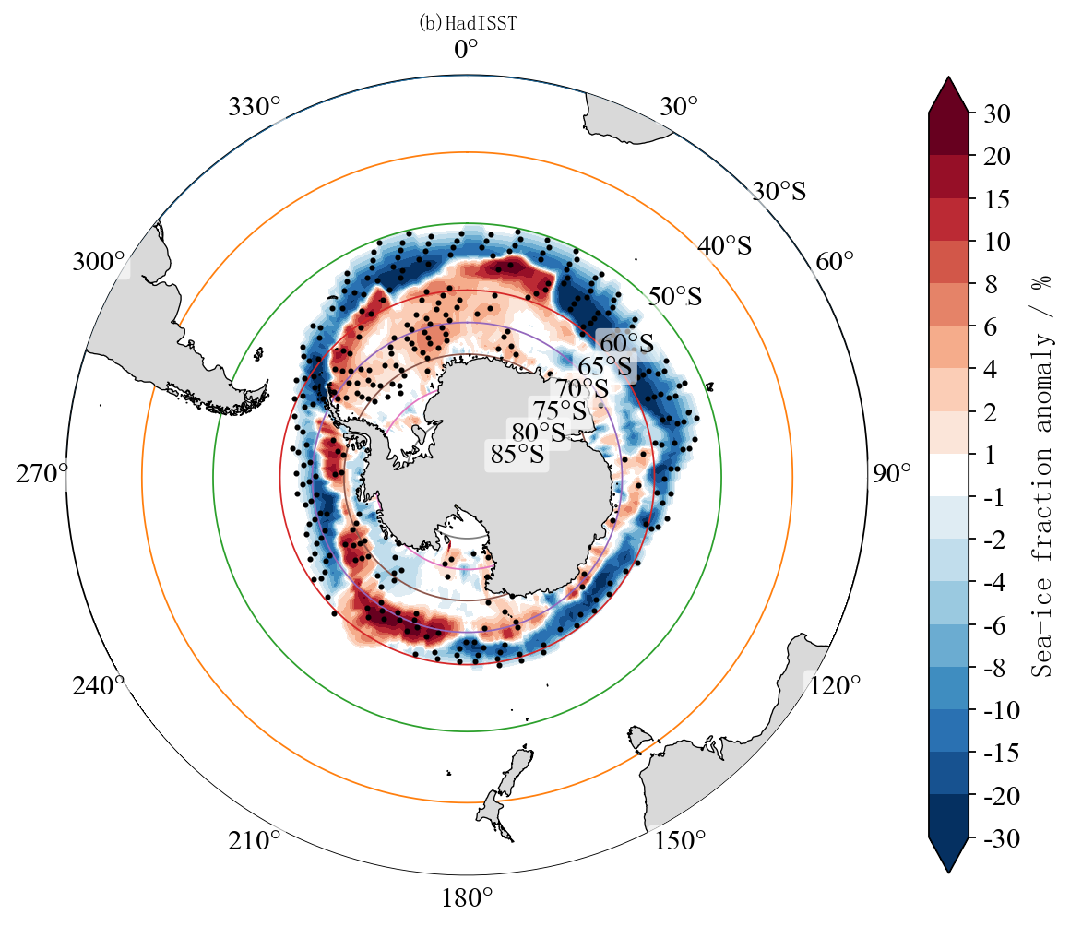
Sea ice response in Antarctic spring
Question: where is the sea-ice response strongest?
High-ozone years minus low-ozone years
WACCM6
HadISST
Seasonal ice zone 60–70°S
ABS less ice
Weddell Sea more ice
Magnitude 5–20%
The model result and observation show a similar regional contrast.

Slide 3
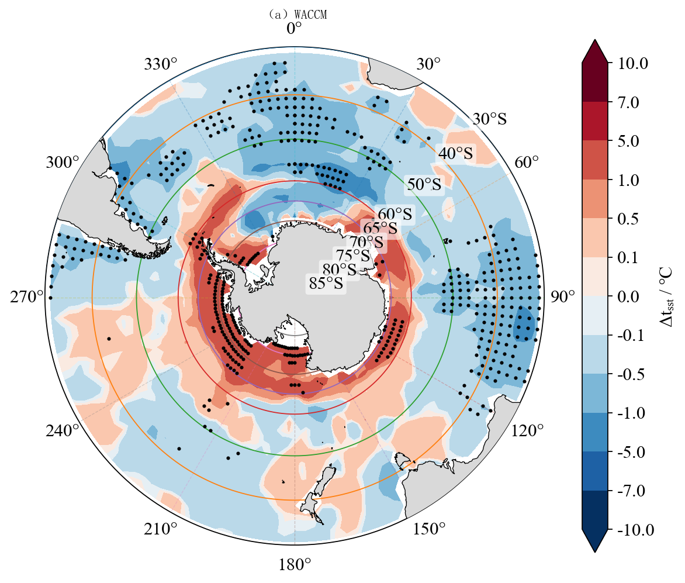
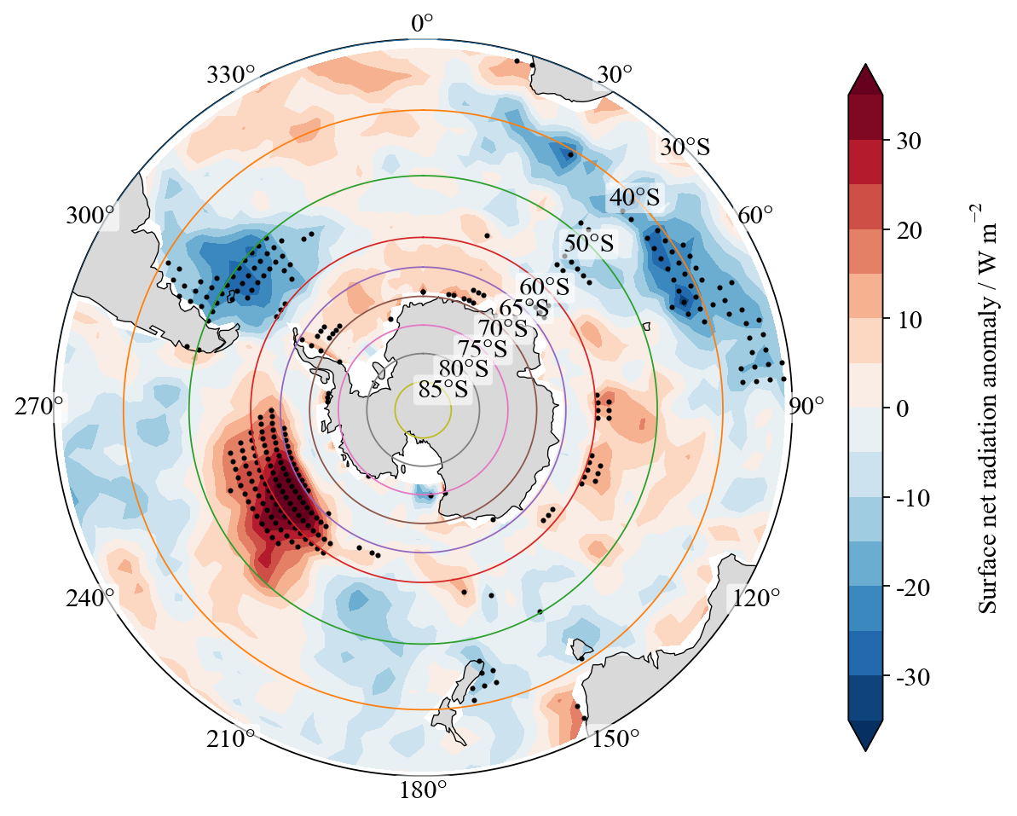
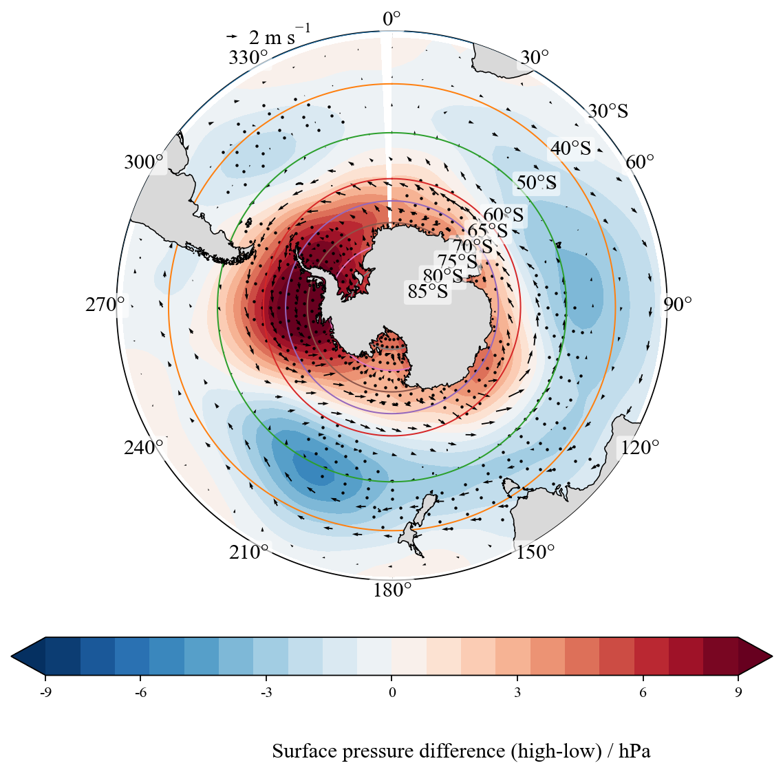
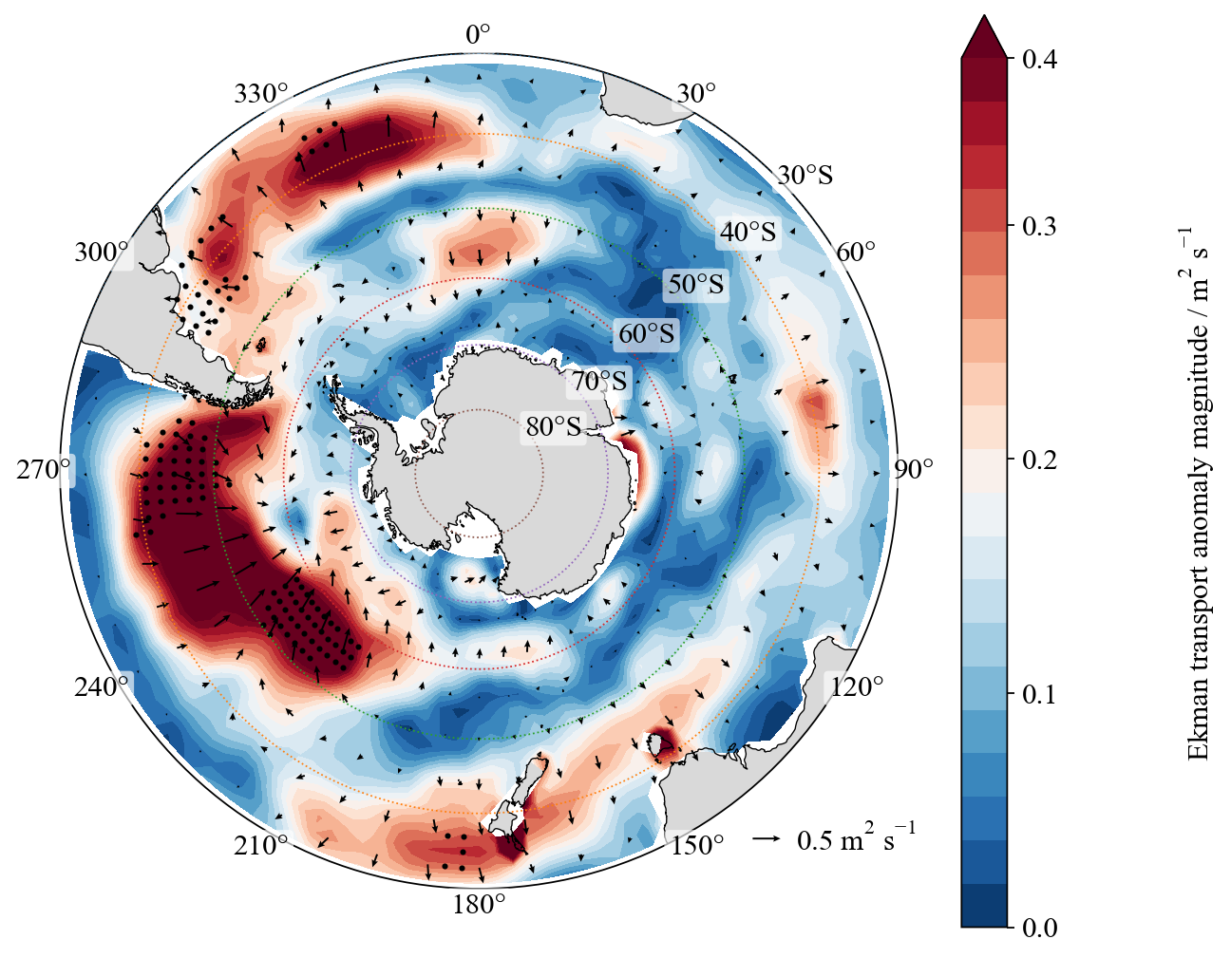
Surface and wind changes support the regional contrast
Question: do surface and wind fields point to the same regional pattern?
SST anomaly
Surface energy
Pressure + wind
Ekman transport
ABS: warmer SST + more energy
Weddell Sea: cooling + less heating
Wind / Ekman: supports the contrast
Together, these fields explain why ABS loses ice while the Weddell Sea gains ice.

