Slide 1




Instantaneous PPP convergence with a Decoupled Clock Model
Marcus Franz Wareyka-Glaner¹, Gregor Möller¹
¹ Department of Geodesy and Geoinformation, Technische Universität Wien, Austria
06 Mai 2026
marcus.glaner@geo.tuwien.ac.at

Slide 2
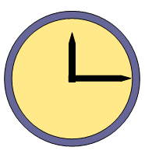
Decoupled Clock Model (DCM)
idea: code and phase measurements are not synchronized with the same level of precision
separate receiver code and phase clock error
uncommon parameterization
receiver clock error
receiver code clock error
receiver phase clock error
Wareyka-Glaner, 06/05/2026

Slide 3
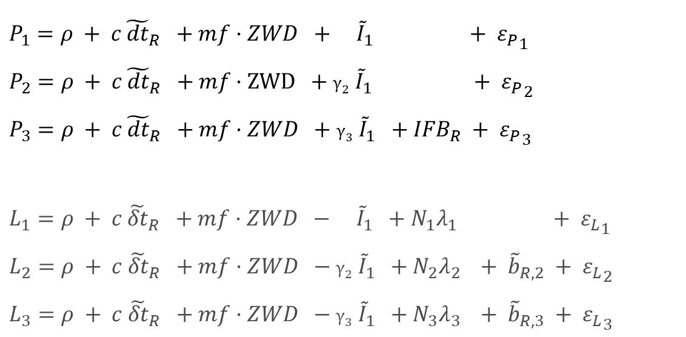
Uncombined Decoupled Clock Model
$P_{1}=ρ + c{ \tilde{dt}}_{R} +mf·ZWD + {\tilde{I}}_{1} + {ε_{P}}_{1}$
$P_{2}=ρ + c{ \tilde{dt}}_{R} +mf·ZWD +γ_{2} {\tilde{I}}_{1} + {ε_{P}}_{2}$
$P_{3}=ρ + c{ \tilde{dt}}_{R} +mf·ZWD +γ_{3} {\tilde{I}}_{1} +{IFB}_{R} + {ε_{P}}_{3}$
$L_{1}=ρ + c {\tilde{δt}}_{R} +mf·ZWD − {\tilde{I}}_{1} +{N_{1}λ}_{1} + {ε_{L}}_{1}$
$L_{2}=ρ + c {\tilde{δt}}_{R} +mf·ZWD −γ_{2} {\tilde{I}}_{1} +{N_{2}λ}_{2} + {\tilde{b}}_{R,2} + {ε_{L}}_{2}$
$L_{3}=ρ + c {\tilde{δt}}_{R} +mf·ZWD −γ_{3} {\tilde{I}}_{1} +{N_{3}λ}_{3} + {\tilde{b}}_{R,3} + {ε_{L}}_{3}$
Code
Phase
Wareyka-Glaner, 06/05/2026

Slide 4
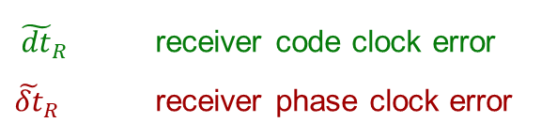
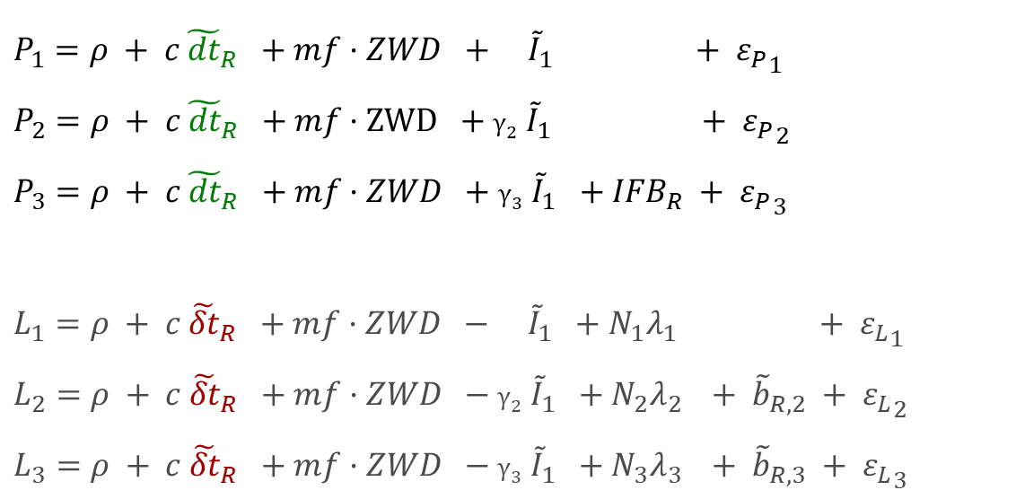
Uncombined Decoupled Clock Model
$P_{1}=ρ + c{ \tilde{dt}}_{R} +mf·ZWD + {\tilde{I}}_{1} + {ε_{P}}_{1}$
$P_{2}=ρ + c{ \tilde{dt}}_{R} +mf·ZWD +γ_{2} {\tilde{I}}_{1} + {ε_{P}}_{2}$
$P_{3}=ρ + c{ \tilde{dt}}_{R} +mf·ZWD +γ_{3} {\tilde{I}}_{1} +{IFB}_{R} + {ε_{P}}_{3}$
$L_{1}=ρ + c {\tilde{δt}}_{R} +mf·ZWD − {\tilde{I}}_{1} +{N_{1}λ}_{1} + {ε_{L}}_{1}$
$L_{2}=ρ + c {\tilde{δt}}_{R} +mf·ZWD −γ_{2} {\tilde{I}}_{1} +{N_{2}λ}_{2} + {\tilde{b}}_{R,2} + {ε_{L}}_{2}$
$L_{3}=ρ + c {\tilde{δt}}_{R} +mf·ZWD −γ_{3} {\tilde{I}}_{1} +{N_{3}λ}_{3} + {\tilde{b}}_{R,3} + {ε_{L}}_{3}$
Code
Phase
${ \tilde{dt}}_{R}$ receiver code clock error
${\tilde{δt}}_{R}$ receiver phase clock error

Slide 5
Uncombined Decoupled Clock Model
$P_{1}=ρ + c{ \tilde{dt}}_{R} +mf·ZWD + {\tilde{I}}_{1} + {ε_{P}}_{1}$
$P_{2}=ρ + c{ \tilde{dt}}_{R} +mf·ZWD +γ_{2} {\tilde{I}}_{1} + {ε_{P}}_{2}$
$P_{3}=ρ + c{ \tilde{dt}}_{R} +mf·ZWD +γ_{3} {\tilde{I}}_{1} +{IFB}_{R} + {ε_{P}}_{3}$
$L_{1}=ρ + c {\tilde{δt}}_{R} +mf·ZWD − {\tilde{I}}_{1} +{N_{1}λ}_{1} + {ε_{L}}_{1}$
$L_{2}=ρ + c {\tilde{δt}}_{R} +mf·ZWD −γ_{2} {\tilde{I}}_{1} +{N_{2}λ}_{2} + {\tilde{b}}_{R,2} + {ε_{L}}_{2}$
$L_{3}=ρ + c {\tilde{δt}}_{R} +mf·ZWD −γ_{3} {\tilde{I}}_{1} +{N_{3}λ}_{3} + {\tilde{b}}_{R,3} + {ε_{L}}_{3}$
Code
Phase
reparametrized, details:
Naciri & Bisnath (2021)
Wareyka-Glaner, 06/05/2026

Slide 6
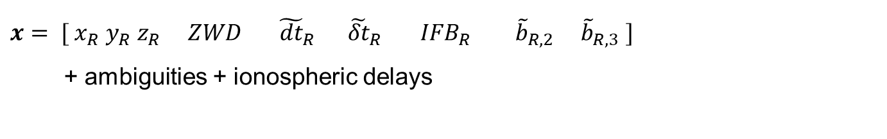
Parameters
$x= [{ x}_{R} y_{R} z_{R} ZWD{ \tilde{dt}}_{R}$ ${\tilde{δt}}_{R}$ ${IFB}_{R}$ ${\tilde{b}}_{R,2}$ ${\tilde{b}}_{R,3} ]$
+ ambiguities + ionospheric delays
datum of the phase observations was lost (decoupling receiver clock)
define datum of ambiguities with a datum satellite (DS):
ambiguities of DS are not estimated
set ambiguities of DS to zero
→ float ambiguities are free of any delays or biases
→ LAMBDA 4.0 (Massarweh et al., 2024)

Slide 7
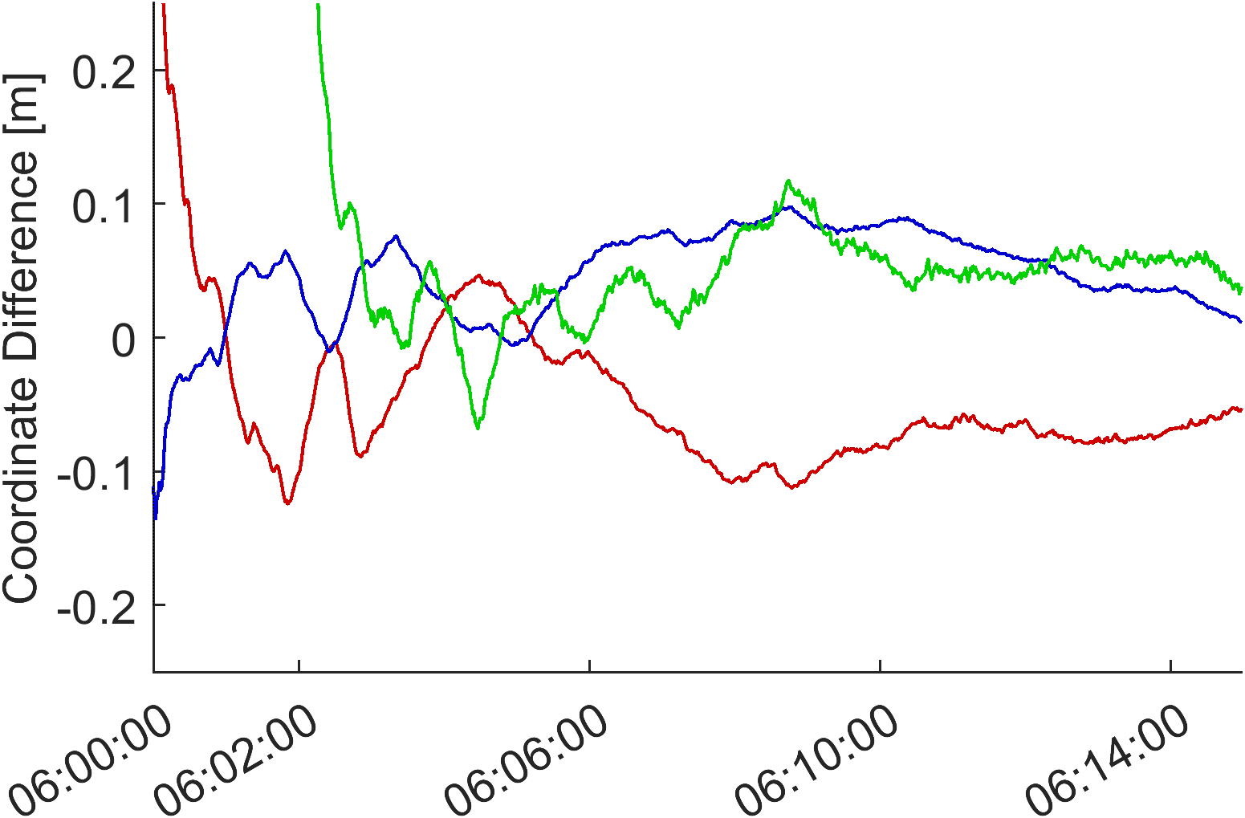
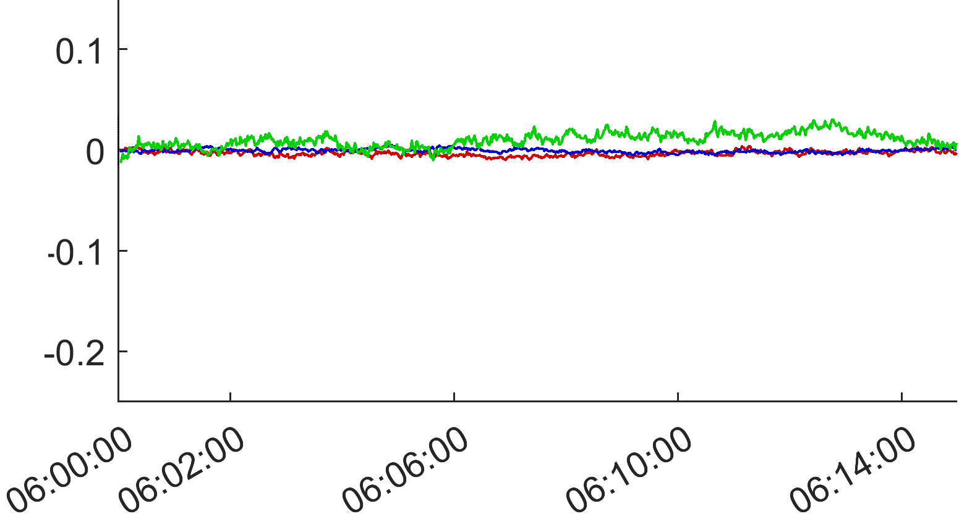
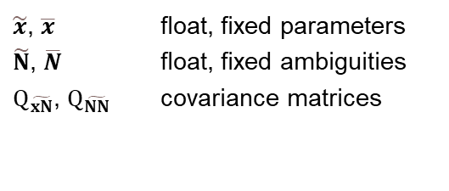
Float
Fixed
$$\overline{x}=\tilde{x}−Q_{\tilde{xN}} {Q_{\tilde{NN}}}^{−1} \left(\tilde{N}−\overline{N}\right)$$
$\tilde{x}$, $\overline{x}$ float, fixed parameters
$\tilde{N}$, $\overline{N}$ float, fixed ambiguities
$Q_{\tilde{xN}}$, $Q_{\tilde{NN}}$ covariance matrices

Slide 8


Test case
Software | (https://github.com/TUW-VieVS/raPPPid)
Data | 26 IGS MGEX stations, June 29, 2025
Observations | GPS: L1 + L2 + L5, GLONASS: G1 + G2 Galileo: E1 + E5a + E6, BeiDou-3: B1 + B2a + B3 1 sec interval, reset of solution: every 15 min
Satellite products | WUM MGEX rapid (Geng et al., 2022) orbits, clocks, biases, attitude
Processing mode | static-kinematic, post-processing
Wareyka-Glaner, 06/05/2026

Slide 9
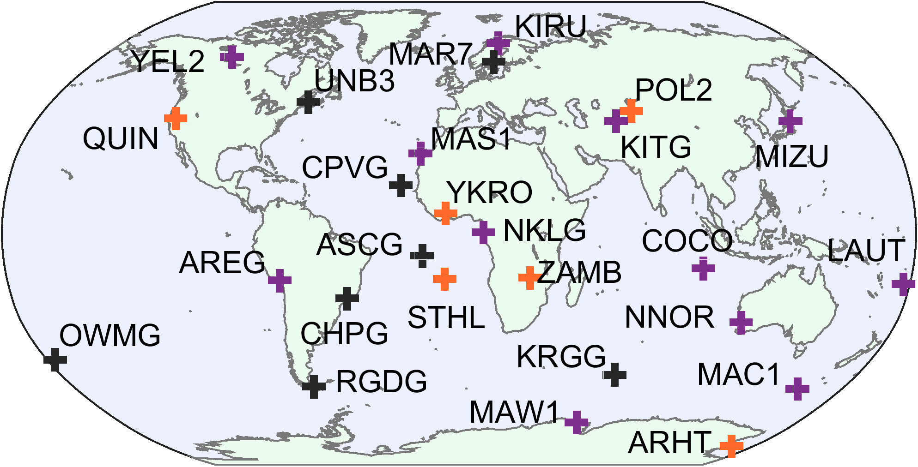
Stations
receiver type:
Septentrio PolaRx5
Javad TRE-3 Delta
Trimble Alloy
… missing antenna calibrations for some GNSS frequencies
Wareyka-Glaner, 06/05/2026

Slide 10
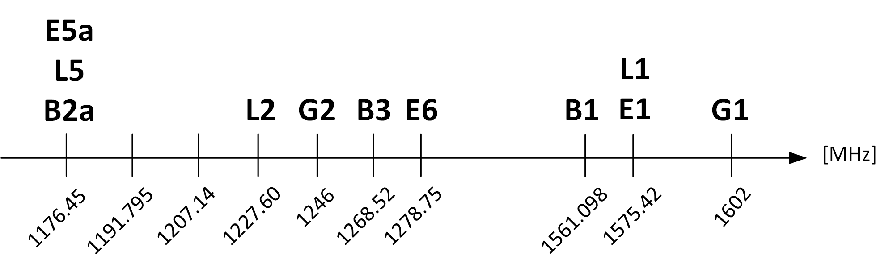
ANTEX Corrections
missing E6 antenna calibration: → PCV: take nearest available
→ PCO: linear interpolation
… processed frequencies

Slide 11
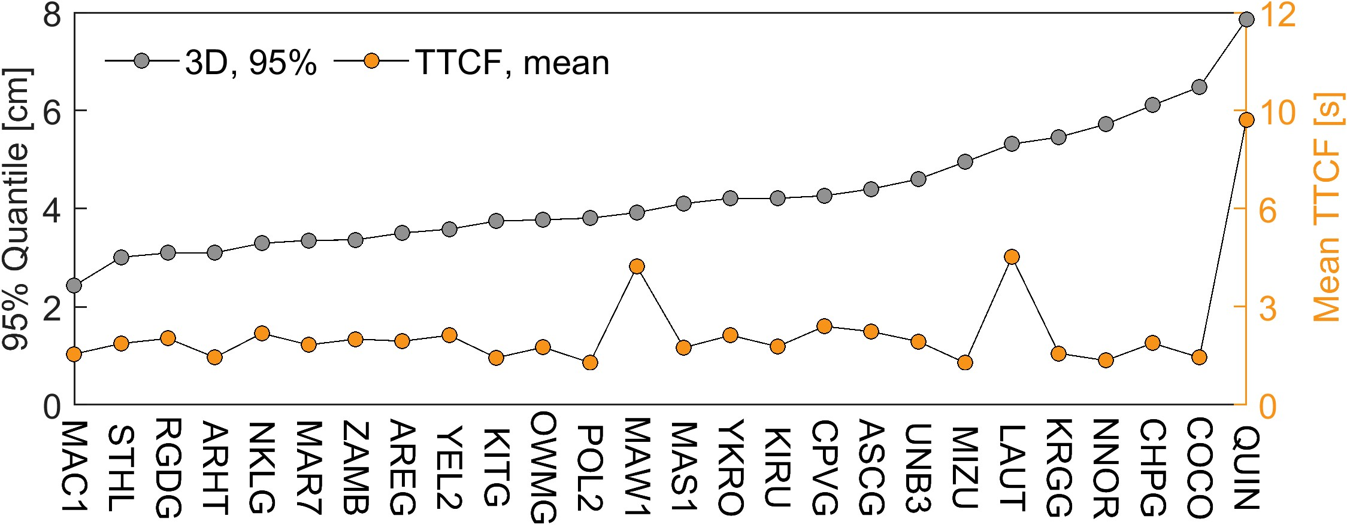
Fixed Results
TTCF … time to correct fix, achieved when 2D < 5 cm for the complete remaining period

Slide 12
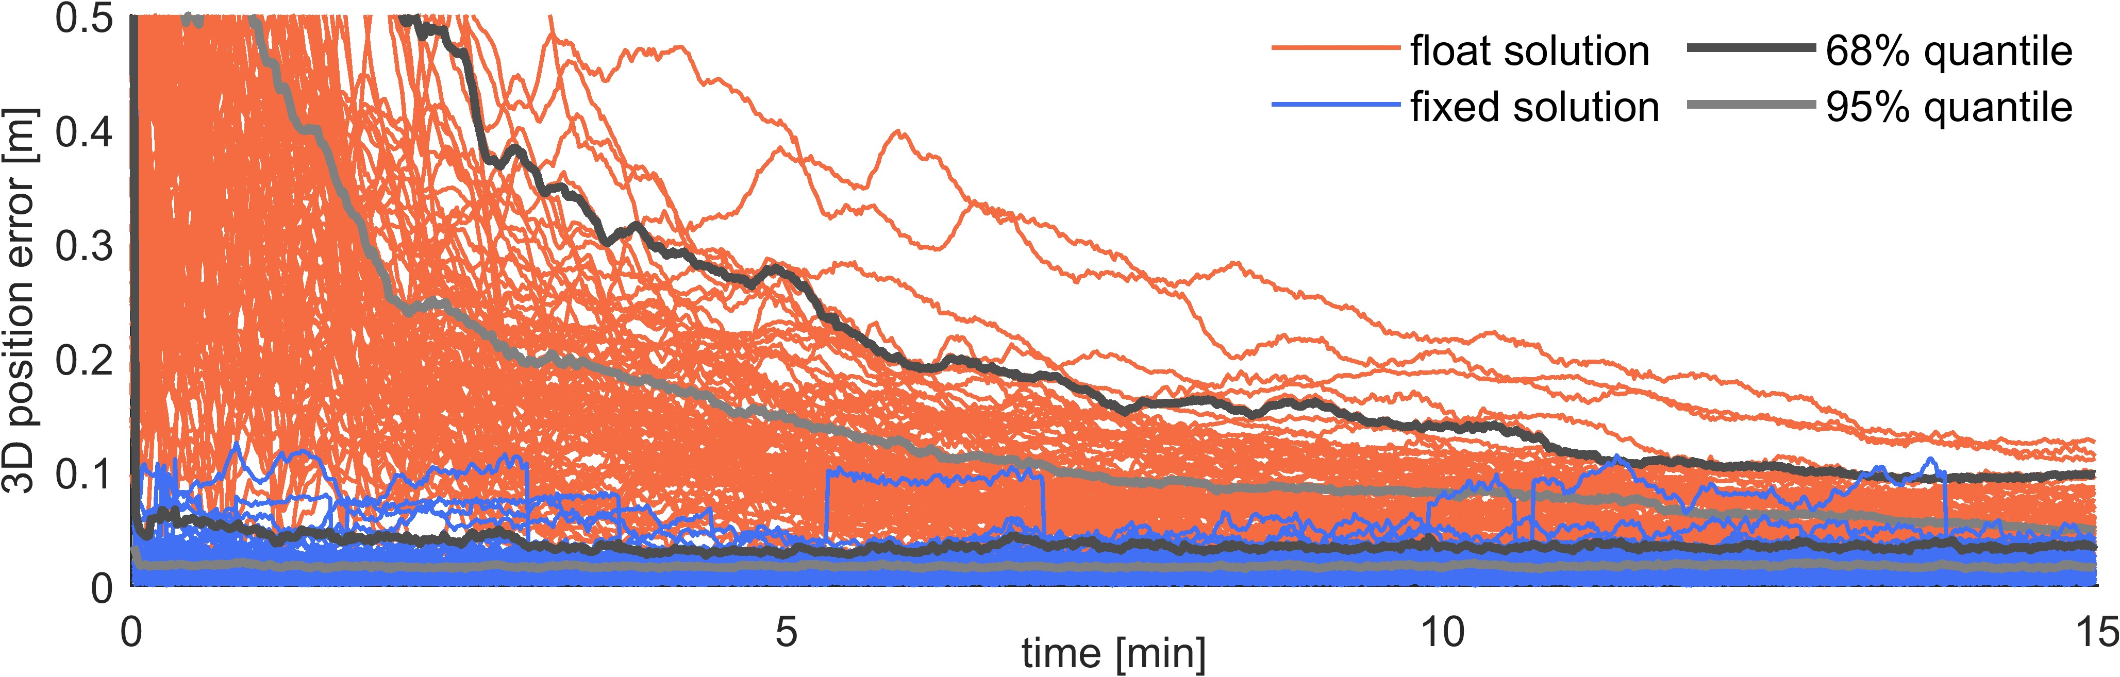
Single station
AREG (Arequipa, Peru)
fixed solution
3D < 10 cm: 99.65%
3D < 5 cm: 98.04%
more results and details: Wareyka-Glaner, M. F. (under review). Instantaneous PPP convergence with a decoupled clock model, triple-frequency multi-GNSS observations, and integer ambiguity fixing. GPS Solutions

Slide 13
Summary
DCM is an elegant and innovative approach for PPP-AR
instantaneous convergence with rapid satellite products
future work:
3+ frequencies
real-time processing

Slide 14
References
Geng, J., Wen, Q., Zhang, Q., Li, G., & Zhang, K. (2022). GNSS observable-specific phase biases for all-frequency PPP ambiguity resolution. Journal of Geodesy, 96(2), 11. https://doi.org/10.1007/s00190-022-01602-3
Glaner, M. F., & Weber, R. (2023). An open-source software package for Precise Point Positioning: raPPPid. GPS Solutions, 27(4), 174. https://doi.org/10.1007/s10291-023-01488-4
Naciri, N., & Bisnath, S. (2021). An uncombined triple-frequency user implementation of the decoupled clock model for PPP-AR. Journal of Geodesy, 95(5), 60. https://doi.org/10.1007/s00190-021-01510-y
Massarweh, L., Verhagen, S., & Teunissen, P. J. G. (2024). New LAMBDA toolbox for mixed-integer models: Estimation and evaluation. GPS Solutions, 29(1), 14. https://doi.org/10.1007/s10291-024-01738-z

Slide 15
Supplementary

Slide 16

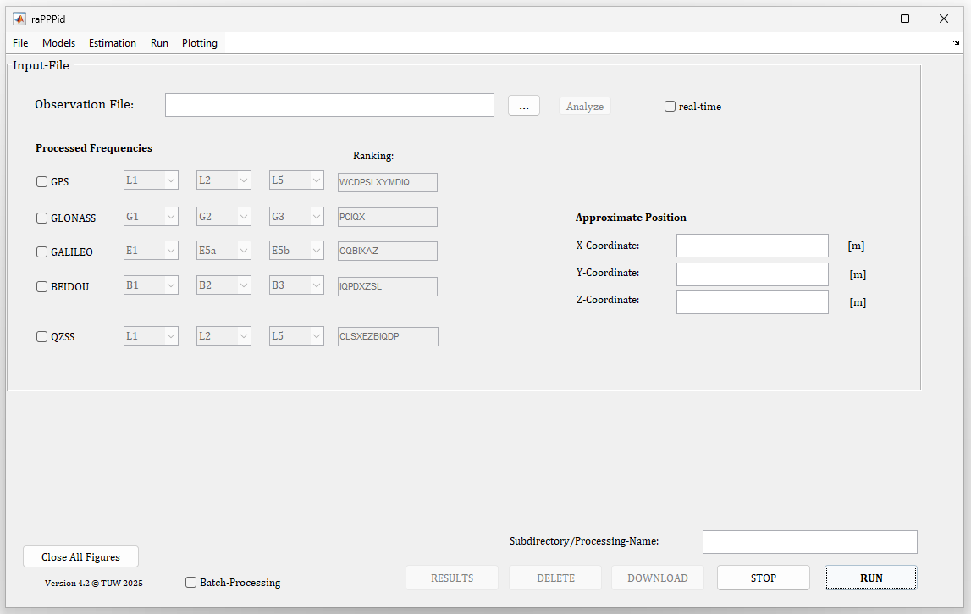
raPPPid
open-source PPP software
GitHub: https://github.com/TUW-VieVS/raPPPid
documentation: https://vievswiki.geo.tuwien.ac.at/en/raPPPid
Wareyka-Glaner, 06/05/2026

Slide 17
Software raPPPid (VieVS PPP) (Glaner & Weber, 2023)
Data 26 globally distributed IGS MGEX stations (June 29, 2025)
Observations GPS: L1+L2+L5, GLONASS: G1+G2, Galileo: E1+E5a+E6, BeiDou-3: B1+B2a+B3
Observation ranking GPS: WC, GLONASS: PC, Galileo: CQX, BeiDou: IPDX
Observation interval 1 sec, reset of solution: every 15 min
Processing mode post-processing, uncombined DCM, static-kinematic
Raw observation noise code 30cm, phase 2mm
Observation weighting elevation weighted, sin²(elev), cutoff angle 5°
Correction models Phase Wind-Up, solid Earth tides, relativistic effects, PCO + PCV, ocean loading
Troposphere model VMF3 + GRAD, residual zenith wet delay is estimated, process noise 5mm /√h
Float ambiguities constant, zero-difference, cycle-slip detection: dLi-dLj + HMW
PPP-AR fixing cutoff 10°, reference satellite = highest satellite
Fixing LAMBDA 4.0 (Massarweh et al., 2024)
Orbits, Clocks, Biases, Attitude WUM MGEX rapid (Geng et al., 2022)
Wareyka-Glaner, 06/05/2026

Slide 18
missing antenna calibration: → PCV: take nearest available
→ PCO: linear interpolation (or nearest)
E5
B2a+b

Slide 19
Missing Calibrations
Station | Antenna | Missing calibrations
MAW1 | AOAD/M_T AUST | GPS, GLONASS, Galileo, BeiDou
MIZU | SEPCHOKE_B3E6 NONE | Galileo E6, BeiDou B1, B3
NNOR | SEPCHOKE_B3E6 NONE | Galileo E6, BeiDou B1, B3
OWMG | TRM159900.00 NONE | GPS L5, Galileo, BeiDou
QUIN | ASH701945E_M SNOW | GPS L5, GLONASS, Galileo, BeiDou
YKRO | ASH701945C_M NONE | BeiDou B2a
ZAMB | AOAD/M_T NONE | GPS L5, Galileo, BeiDou
stations of the test case lacking antenna calibrations

Slide 20
Statistics
FIXED
Ø TTCF¹ (2D < 5 cm) | 2.44 | s
no correct fix | 0.00 | %
Ø 2D error | 0.60 | cm
Ø 3D error | 1.83 | cm
stdev 3D error after 15 min | 1.30 | cm
2D < 5 cm | 99.78 | %
3D < 5 cm | 96.59 | %
Ø ZTD error | 0.69 | cm
FLOAT
Ø convergence² (2D < 10 cm) | 6.55 | min
no convergence | 5.81 | %
Ø 2D error | 10.71 | cm
Ø 3D error | 17.55 | cm
stdev 3D error after 15 min | 3.80 | cm
Ø ZTD error | 1.67 | cm
¹ … time to correct fix, achieved when 2D < 5 cm for the complete remaining period
² … achieved when 2D < 10 cm for the complete remaining period

Slide 21
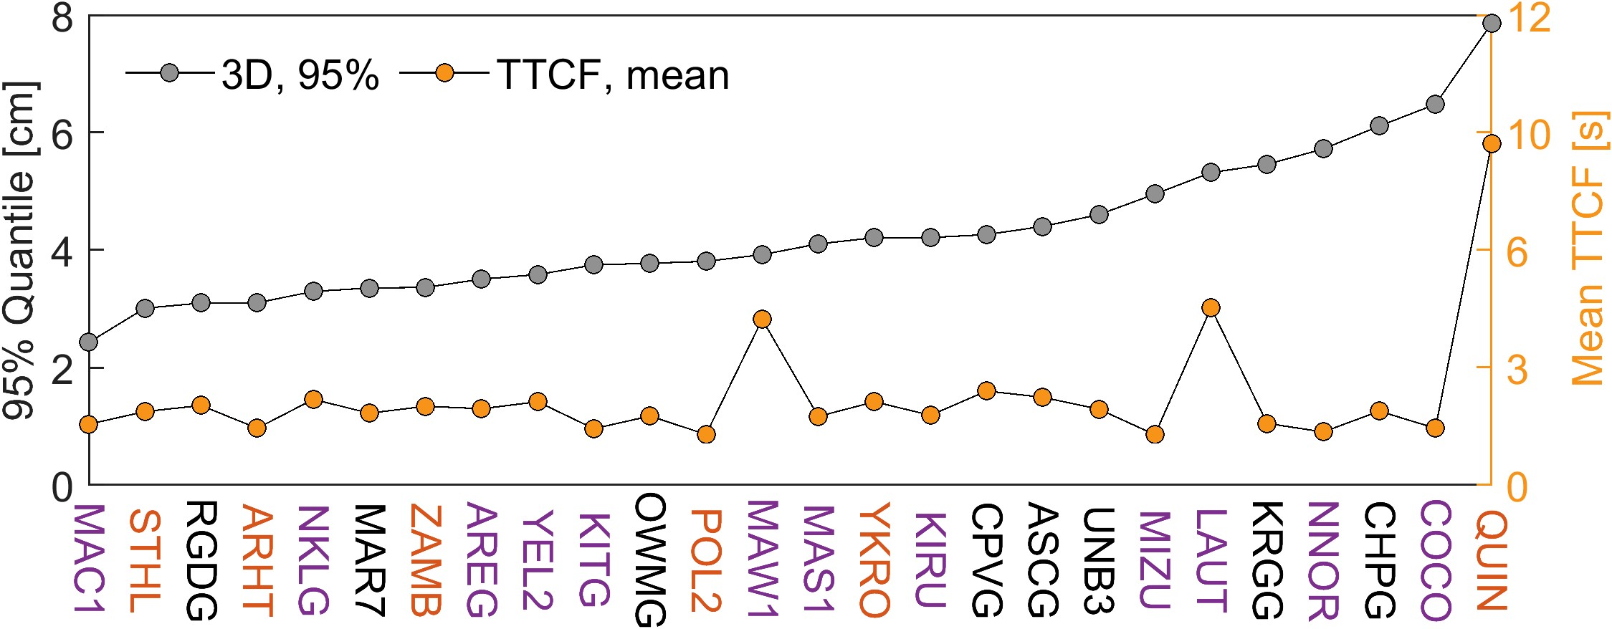
Fixed Results
TTCF … time to correct fix, achieved when 2D < 5 cm for the complete remaining period

Slide 22
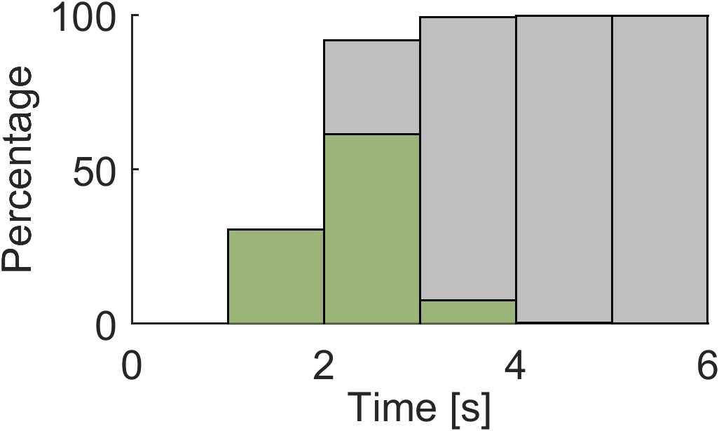
Histogram of TTCF
grey: cumulative distribution function
green: probability distribution function
TTCF within 3 seconds: 91.82 %
TTCF within 4 seconds: 99.32 %

Slide 23
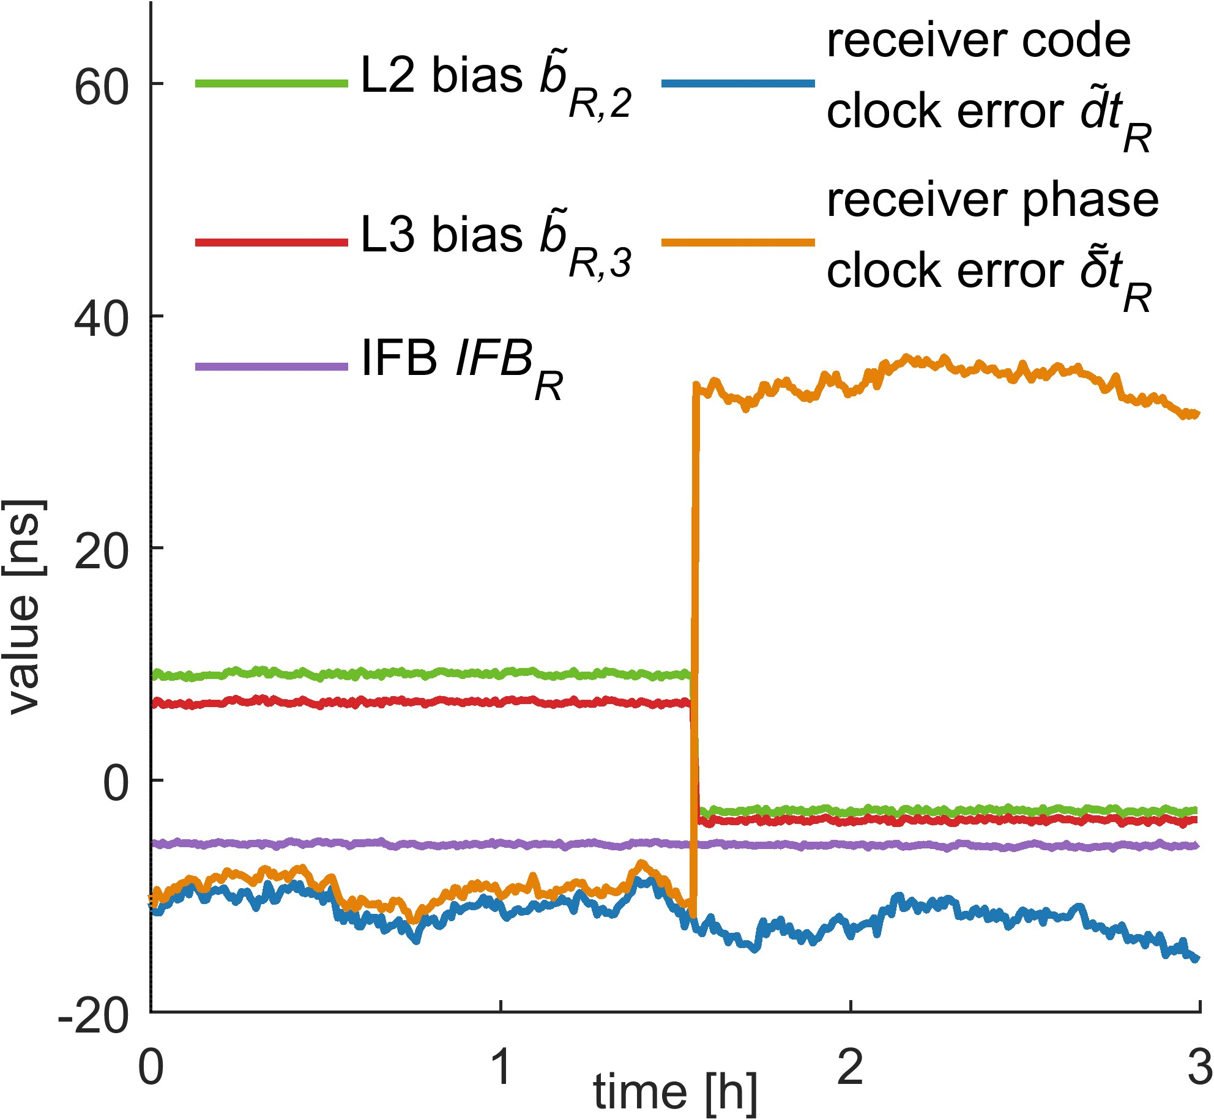
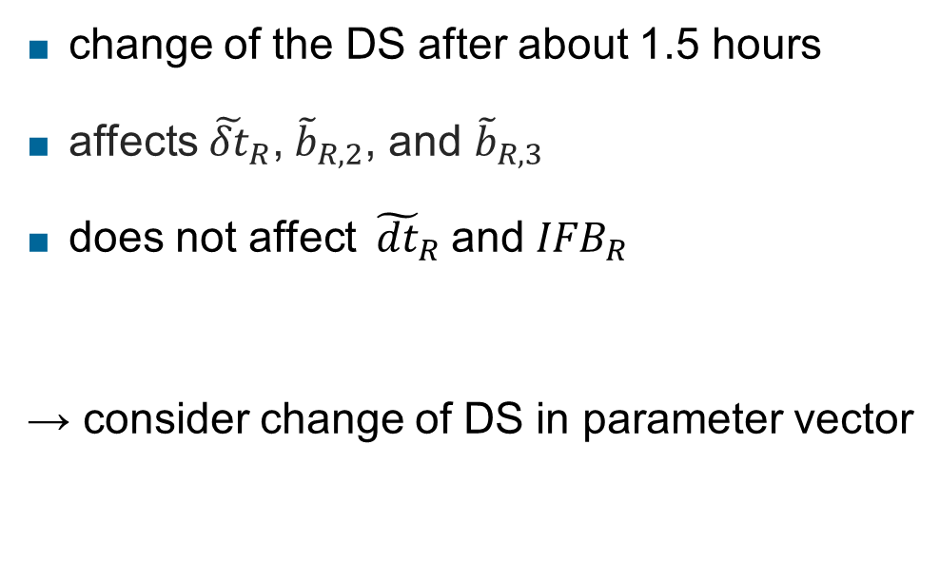
Datum Satellite
change of the DS after about 1.5 hours
affects${ \tilde{δt}}_{R}$, ${\tilde{b}}_{R,2}$, and ${\tilde{b}}_{R,3}$
does not affect ${ \tilde{dt}}_{R}$and ${IFB}_{R}$
→ consider change of DS in parameter vector

Slide 24

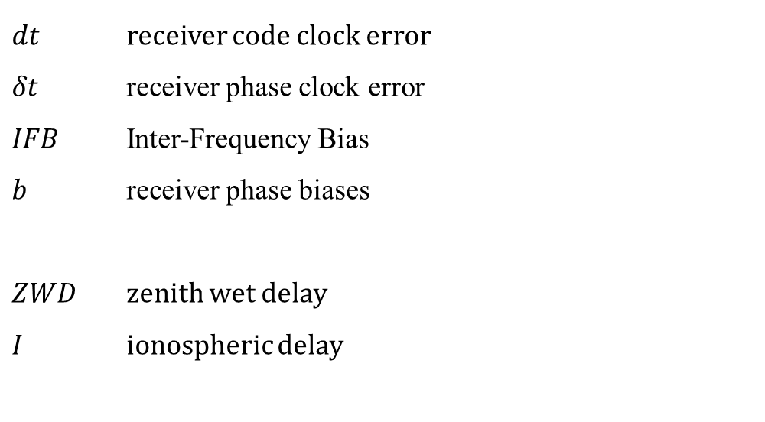
Variables
reparametrized
${}_{i}$ frequency
$ρ$ geometric distance
$c$ speed of light
$mf$ wet mapping function
$ε_{}$ noise and negligible errors
$γ_{i}=f_{1}^{2}/f_{j}^{2}$
$dt$ receiver code clock error
$δt$ receiver phase clock error
$IFB$ Inter-Frequency Bias
$b$ receiver phase biases
$ZWD$ zenith wet delay
$I$ ionospheric delay

