Slide 1
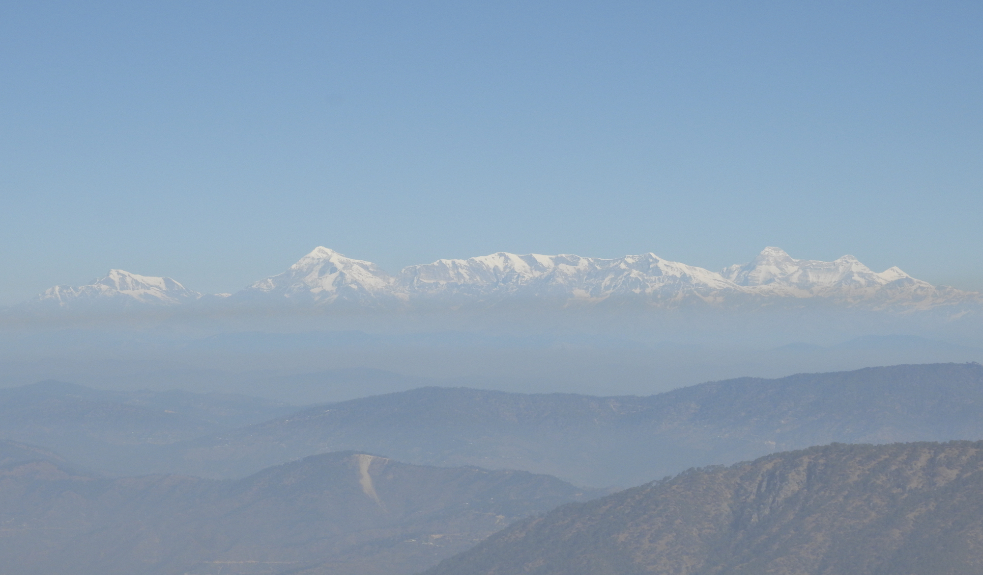


Plio-Pleistocene and modern erosion rates in the Himalaya from paired cosmogenic radionuclides Supplementary slides
EGU26-5053
session GM5.2
08.05.2026
Sohini Bhattacharjee¹, Bodo Bookhagen¹, Rajiv Sinha²
¹University of Potsdam, Germany, ²Indian Institute of Technology Kanpur, India
Scan for the abstract

Slide 2
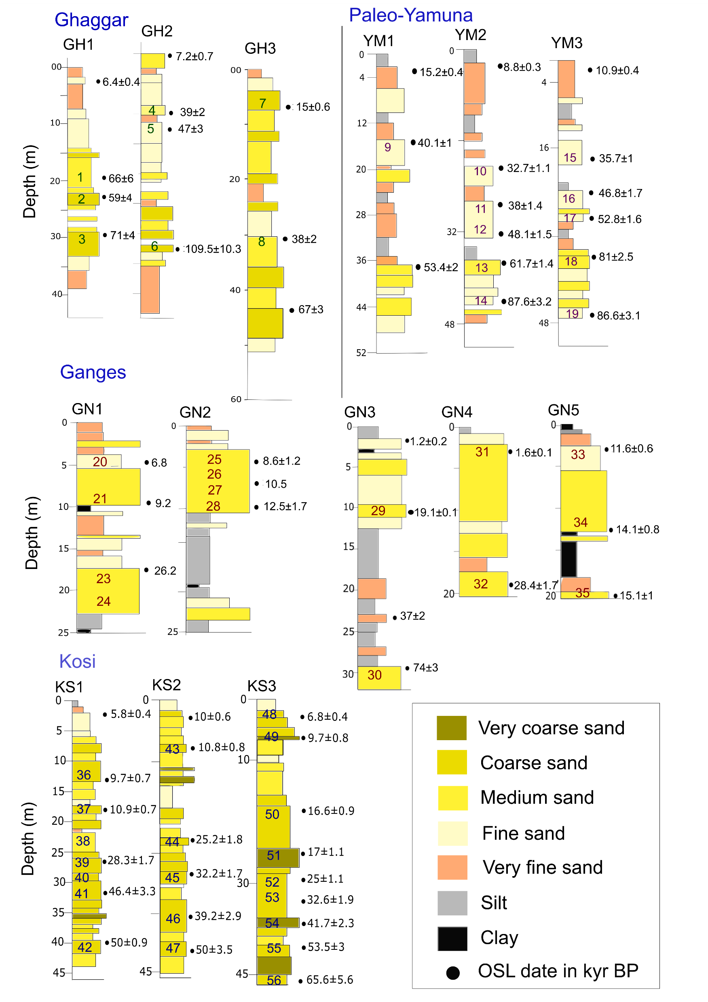
Lithologs of the drill cores
Sutlej
A total 56 samples from 14 cores are dated with OSL and IRSL dating techniques.
The dates are considered as the samples’ depositional age (in kyr) in the coring location

Slide 3
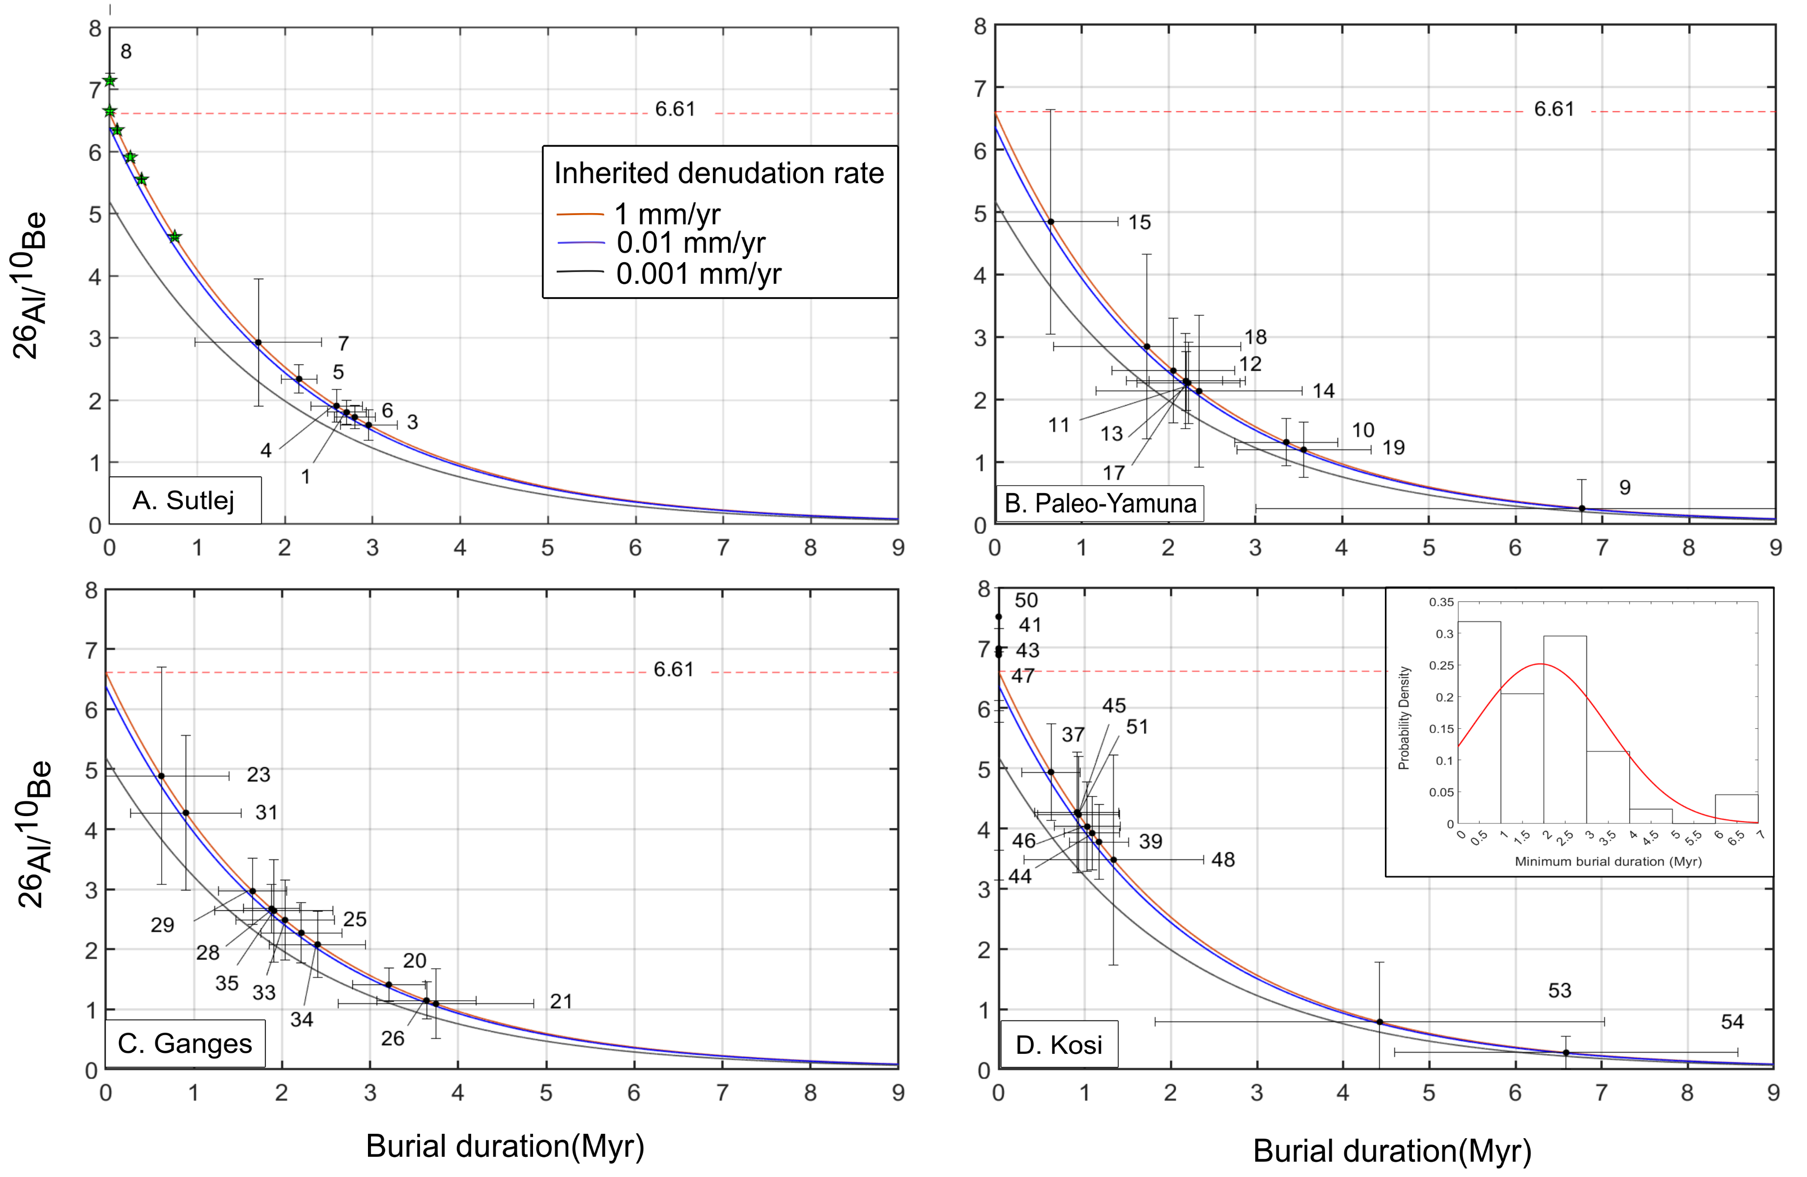
Ratio of the samples and their minimum burial durations
Riverbed samples
)
)
)
Modified after Bhattacharjee et al., 2023

Slide 4
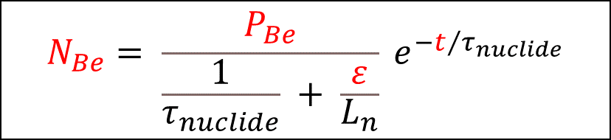
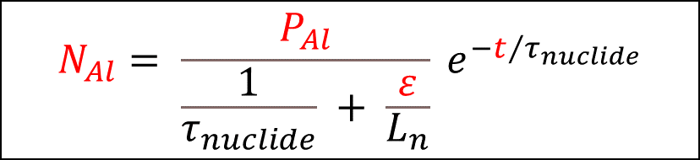
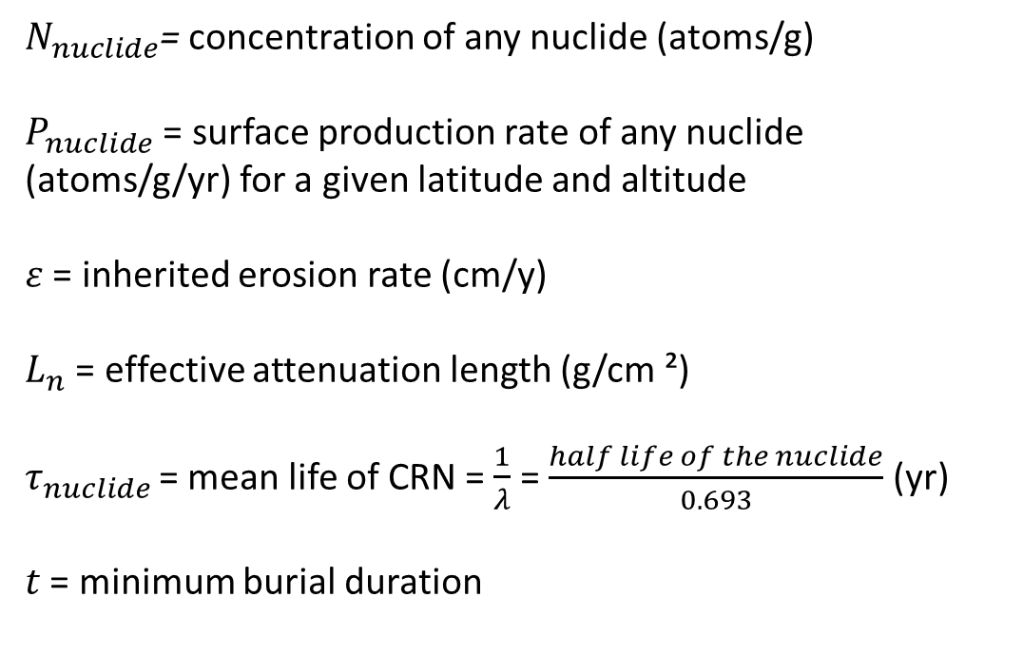
Principle equations
$N_{nuclide}$= concentration of any nuclide (atoms/g)
$P_{nuclide}$ = surface production rate of any nuclide (atoms/g/yr) for a given latitude and altitude
$ε$ = inherited erosion rate (cm/y)
$L_{n}$ = effective attenuation length (g/cm ²)
$τ_{nuclide }$= mean life of CRN = $\frac{1}{λ}$ = $\frac{half life of the nuclide}{0.693}$ (yr)
$t$ = minimum burial duration
$$N_{Al}= \frac{P_{Al}}{\frac{1}{τ_{nuclide}} + \frac{ε}{L_{n}}} e^{{−t}/{τ_{nuclide}}}$$
$$N_{Be}= \frac{P_{Be}}{\frac{1}{τ_{nuclide}} + \frac{ε}{L_{n}}} e^{{−t}/{τ_{nuclide}}}$$
Granger and Muzikar, 2001

