Slide 1
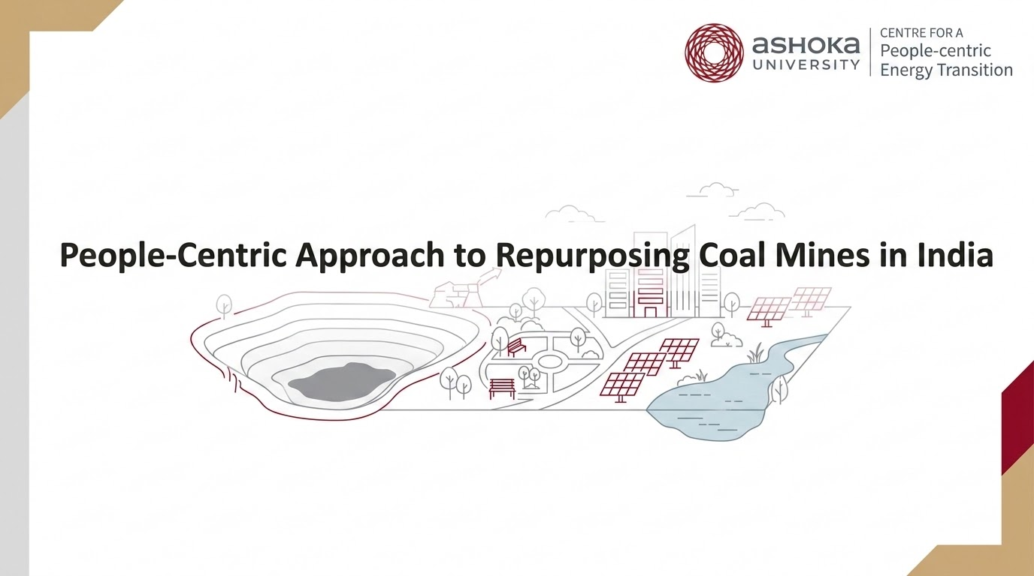

Slide 2

Building a Post-Mining Decision Support System
Goals
  Create an India-specific framework to assess the suitability of post mining land uses (PMLUs) on closed and abandoned mine lands
  Develop a flexible methodology to operationalize the framework
  Create outputs (e.g., analyses, tools) to demonstrate the framework and methodology
Guiding Principles
  Systems thinking to re-conceptualize coal mines from isolated parcels of land to areas embedded in a surrounding social-ecological system (SES)
  Mixed-Methods approach to balance biophysical constraints of the landscape with regional socioeconomic needs
  Stakeholder-oriented framework based in multi-stage consultations with communities, district, state, and central decision makers and experts
Notes:
Transitioning to the “top down” aspect of our repurposing work at ACPET, our goal was to create a framework and methodology to evaluate suitable post-mining land uses in India using a systems-thinking, mixed-methods, and stakeholder-driven approach drawing on biophysical and socioeconomic data.

Slide 3
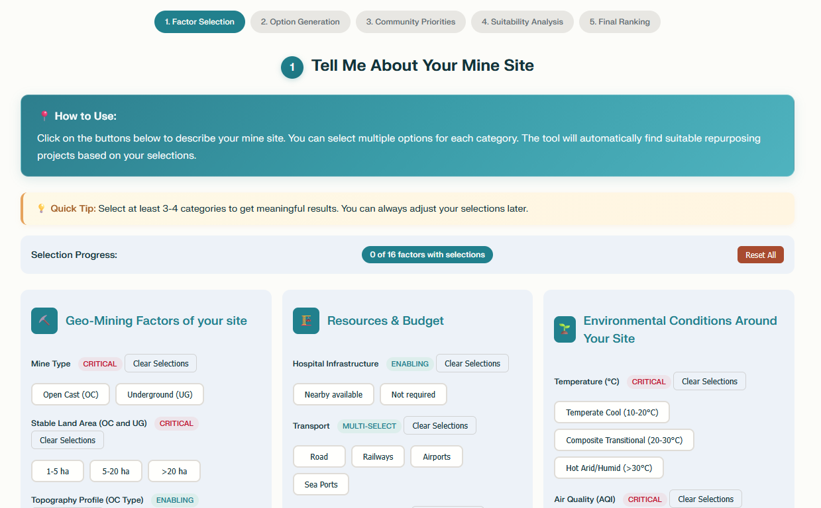
Contributions to CCO’s SUVIKALP Tool
Decision support tool based on user input of:
  Site characteristics
  Environmental conditions
  Resources & budget
  Community priorities (RECLAIM framework)
ACPET’s contributions
  Increased the number of Post Mining Land Uses (PMLUs) listed in the tool
  Added relevant biophysical and socioeconomic criteria and thresholds for each PMLU based on available literature
  Created a resource library for each PMLU (~500 case studies, RfPs/Tenders)

Slide 4
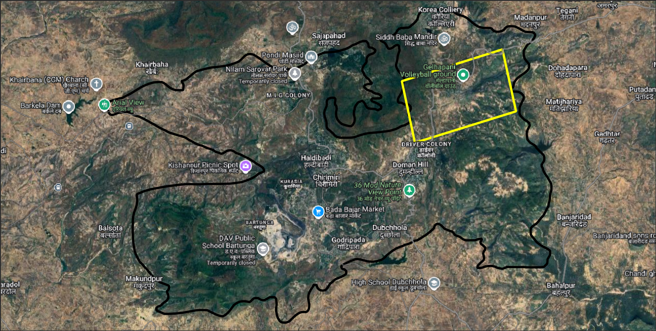
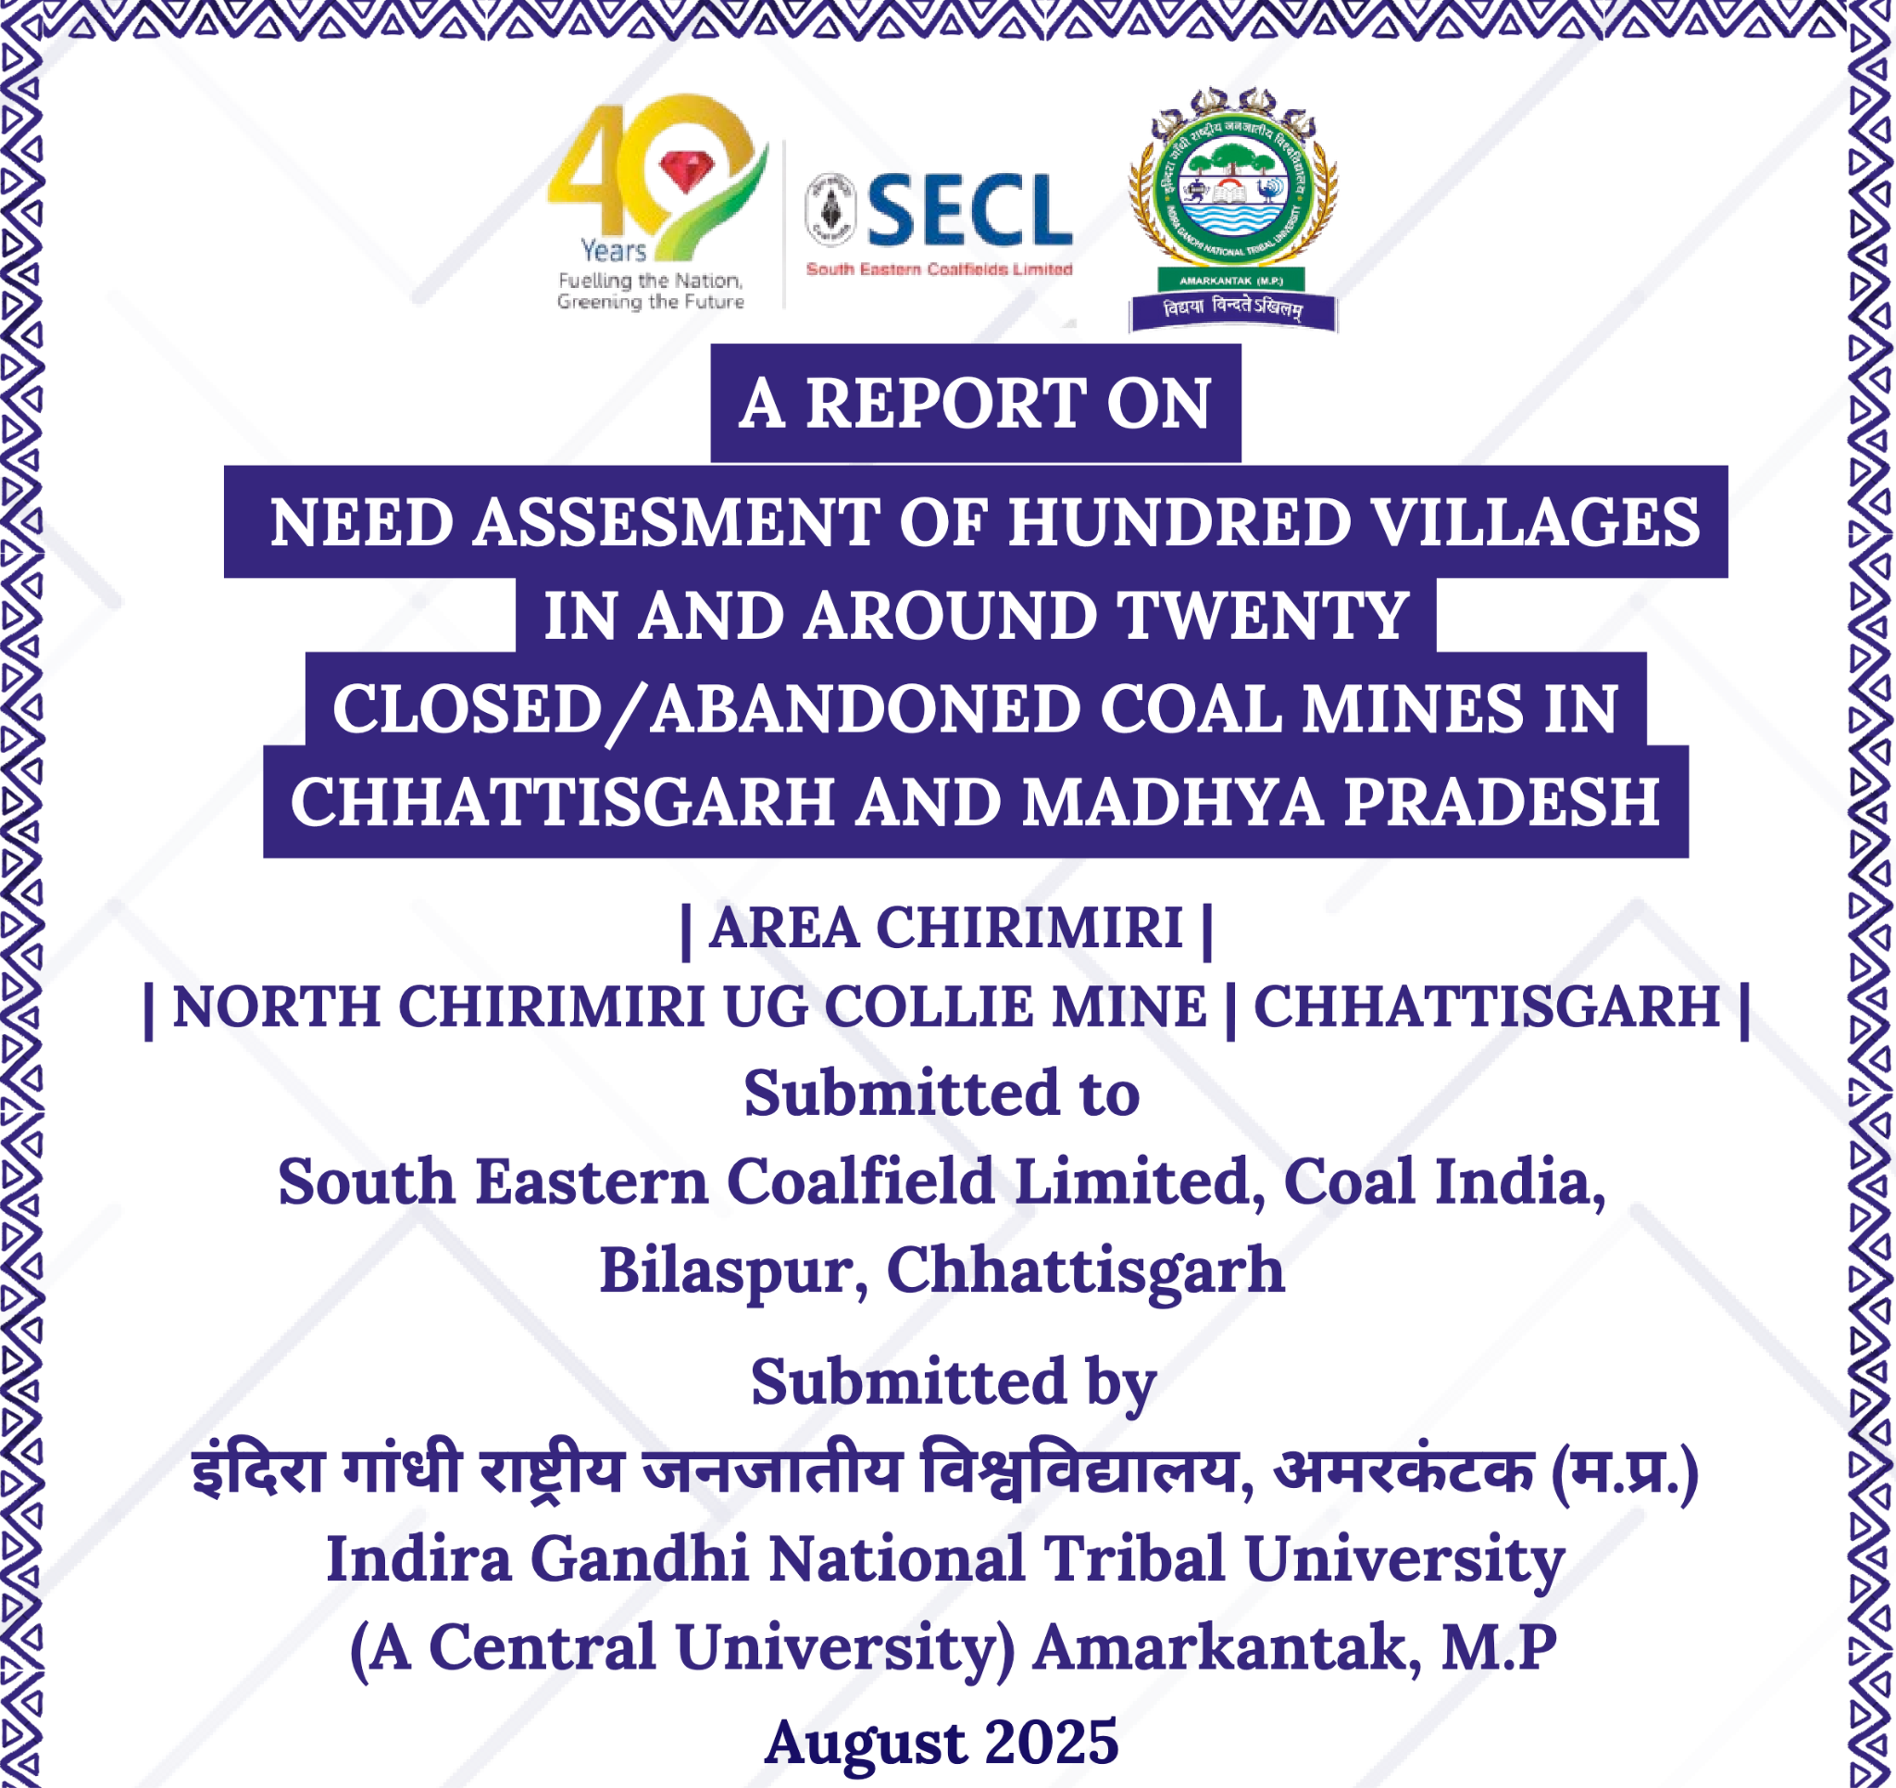
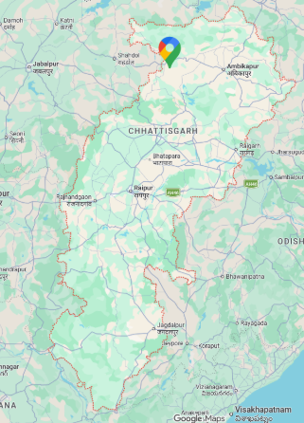
SECL Pilot Analysis: North Chirimiri
  Identify pilot site
Main Figure: Chirimiri Coalfield and North Chirimiri UG delineated in yellow; Insert: Map of Chhattisgarh
Shortlisting PMLUs: Bringing the GIS/remote sensing data about the mine site together with community inputs

Slide 5
Methodology
Identify post-mining land uses (PMLUs) from stakeholder consultations + needs assessment
Match GIS/remote sensing datasets to selected PMLUs
Assign weights to PMLUs based on community priorities
Map suitability of each PMLU within North Chirmiri UG mine site

Slide 6

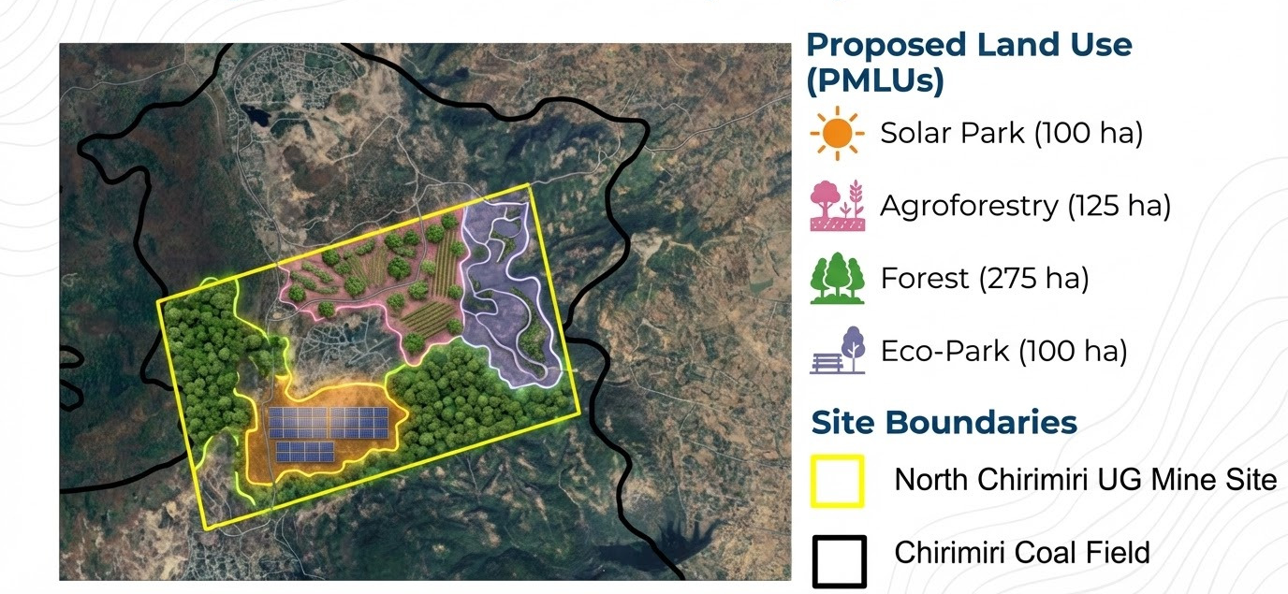
Multi-Objective Land Allocation (MOLA)
Notes:
Following the addition of GIS/remote sensing data and community/stakeholder weights to the model, we use multi objective land allocation or MOLA to create a visualization of where the potential PMLUs may be located.

