Slide 1


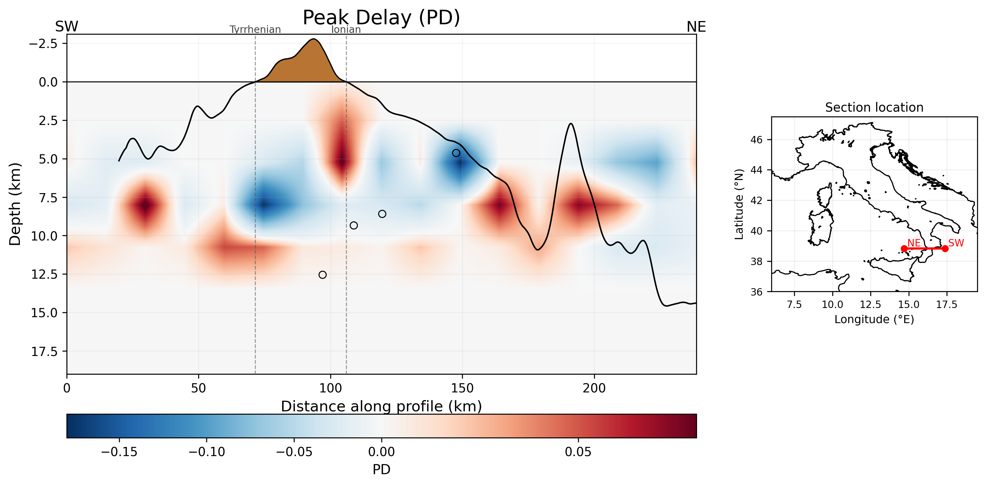
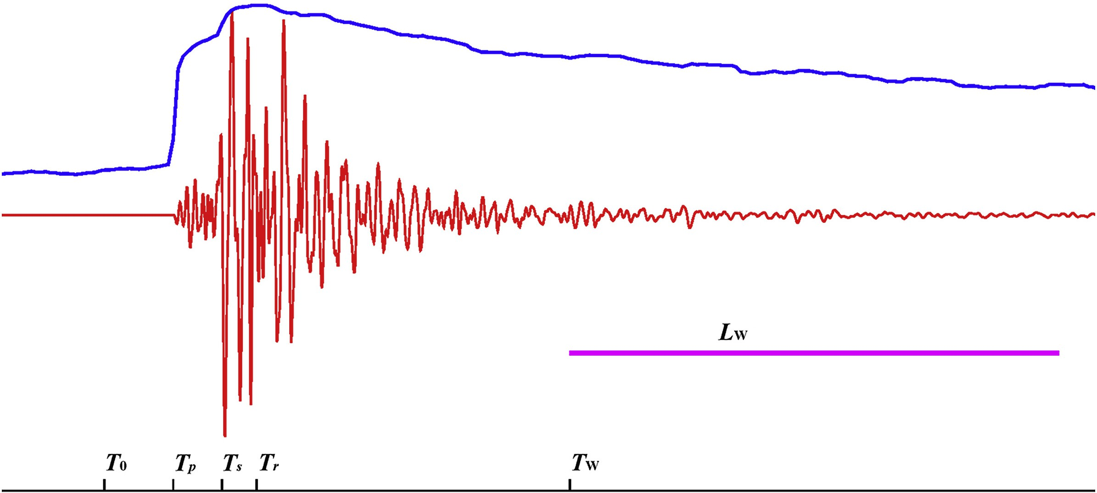
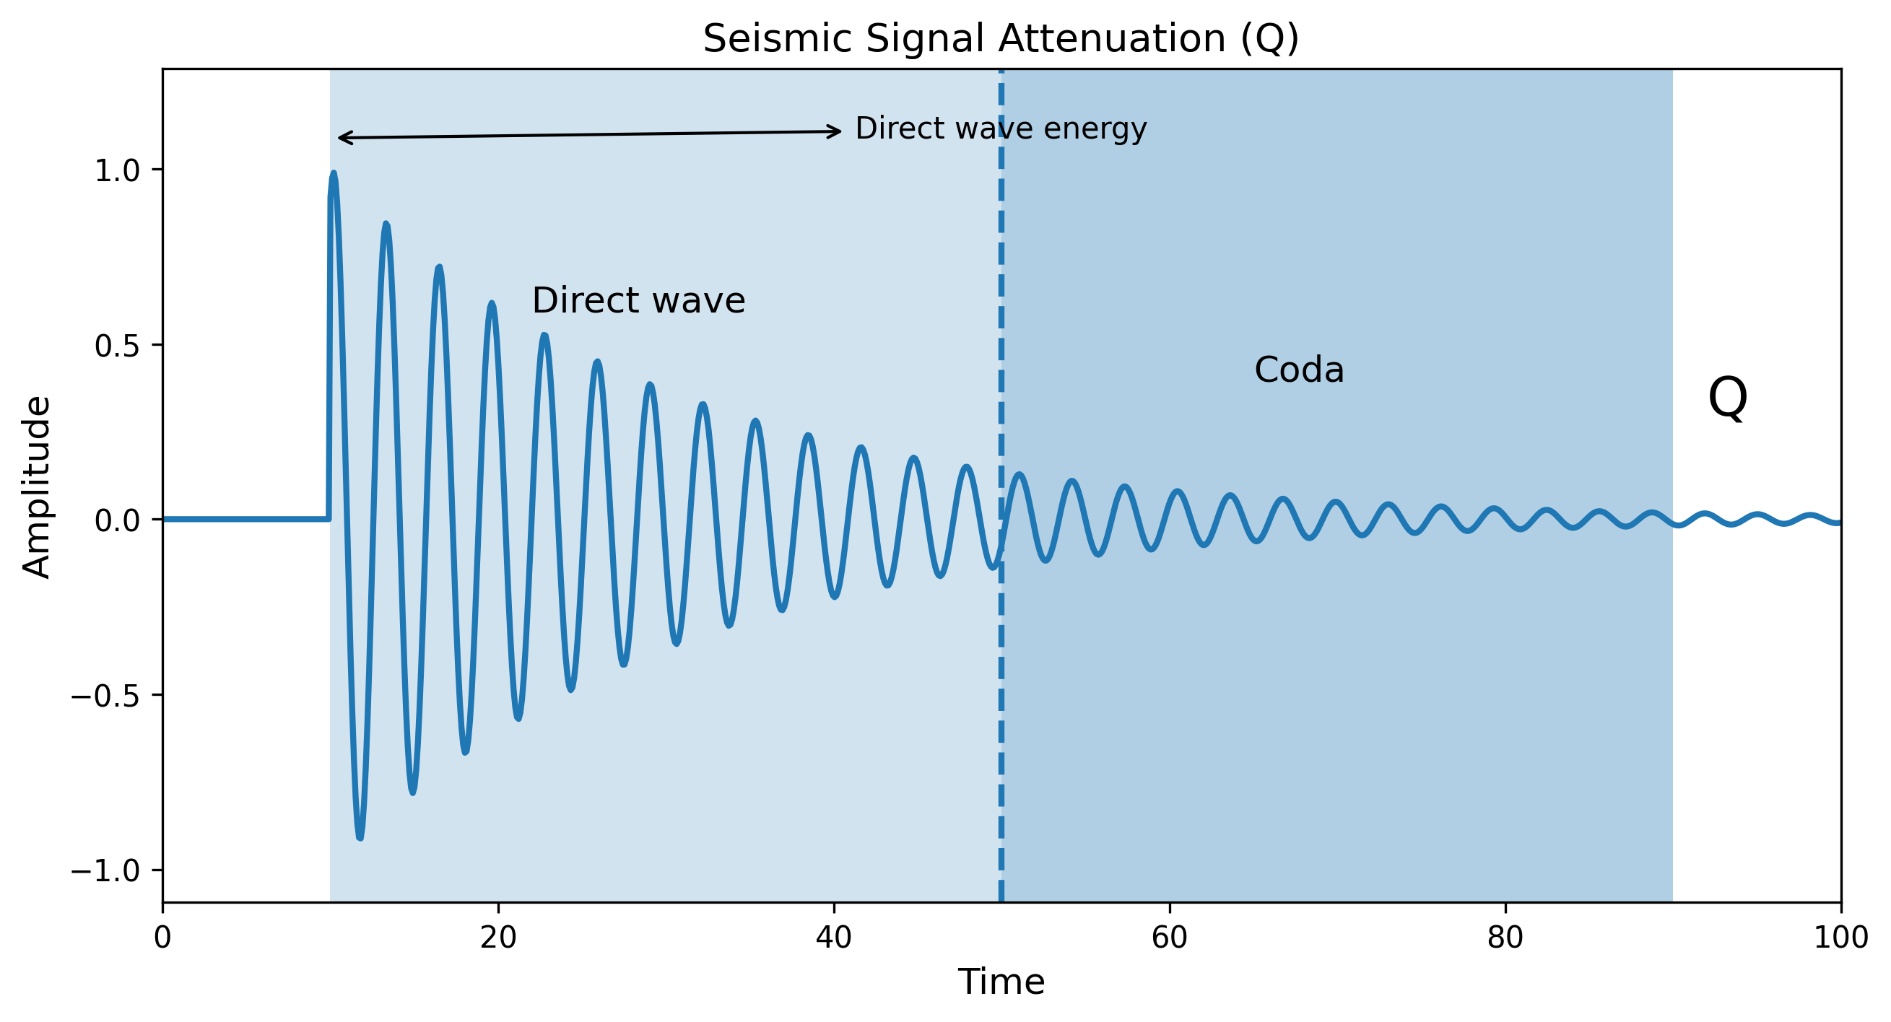
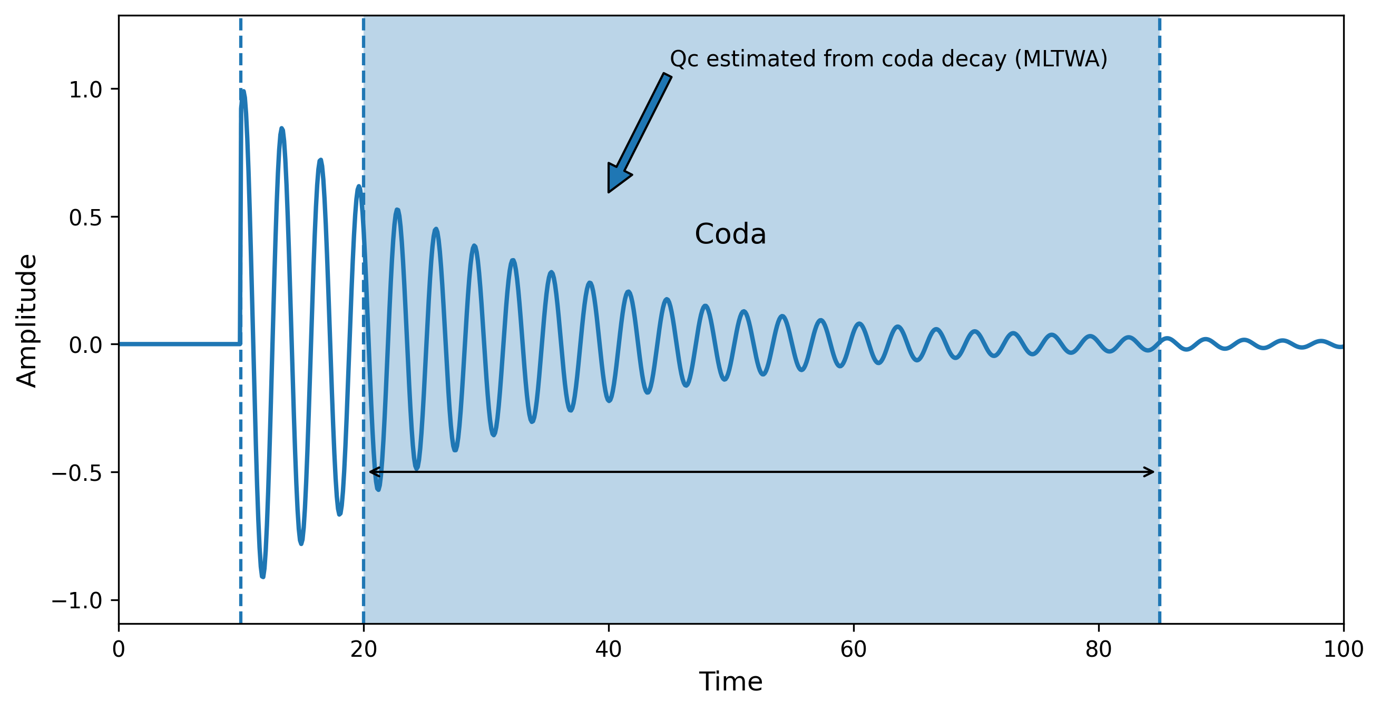
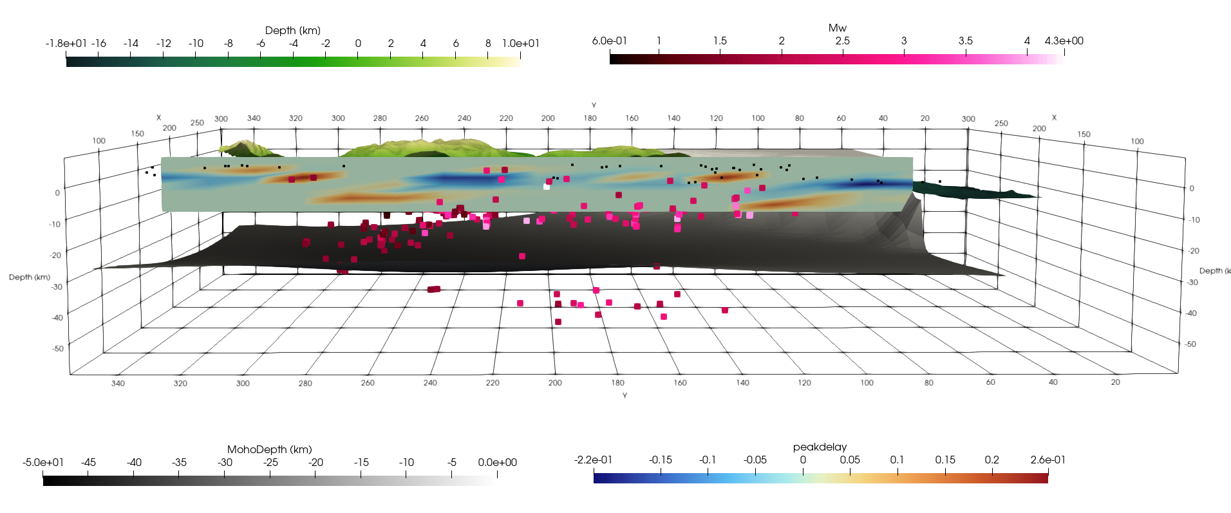
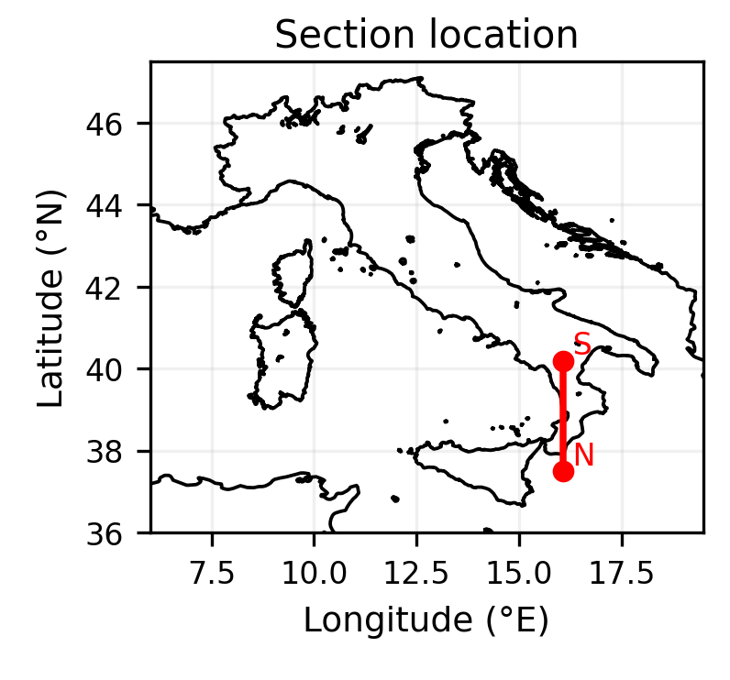
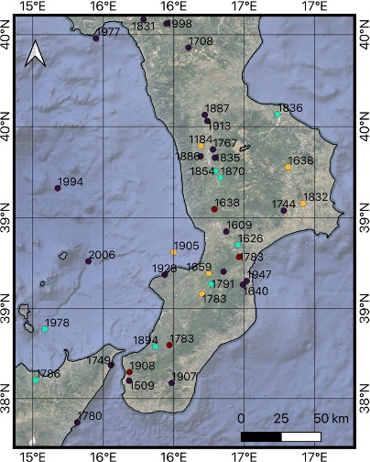
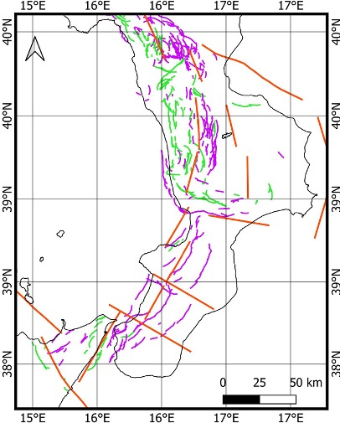


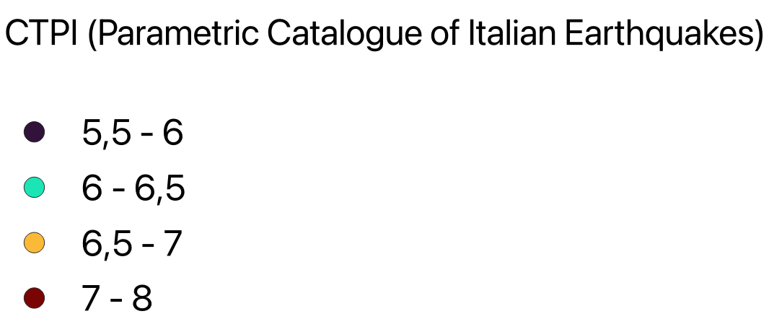
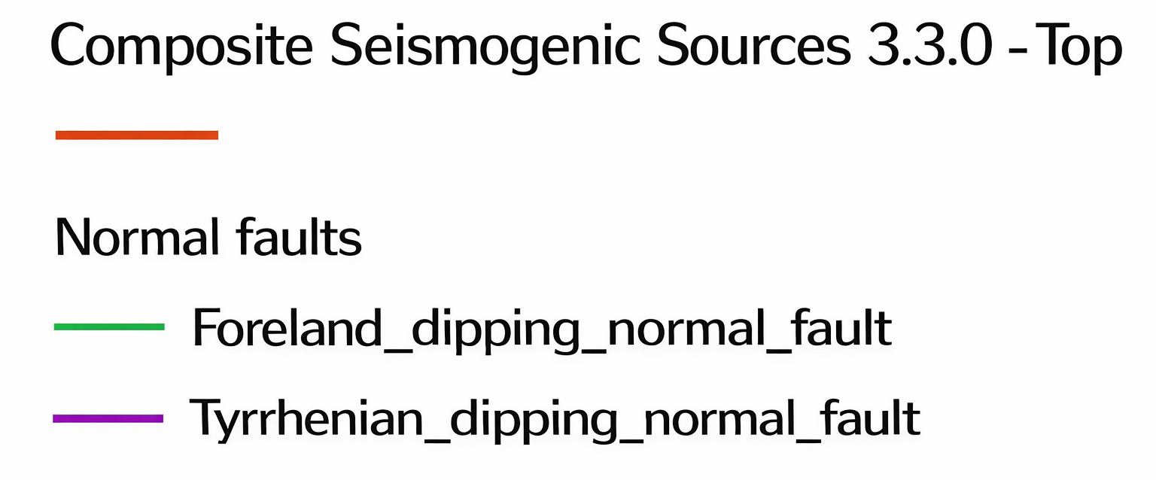
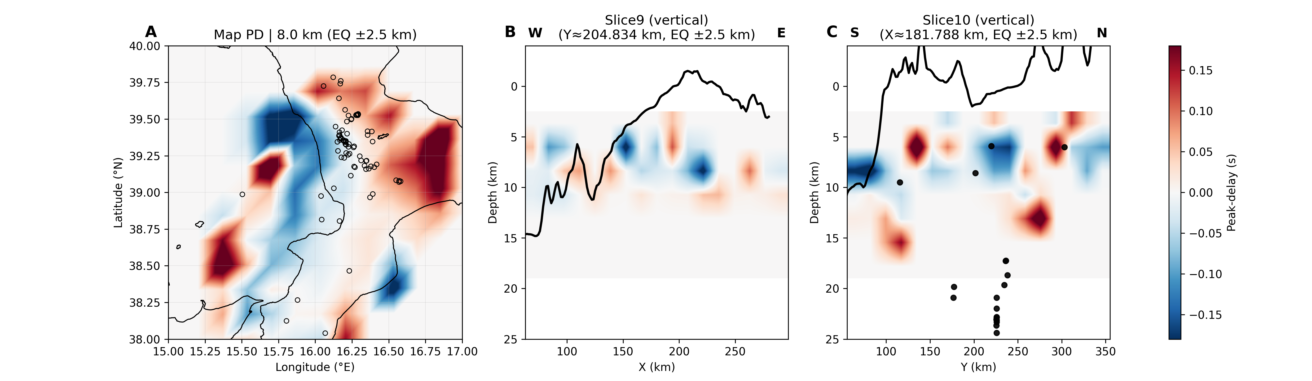
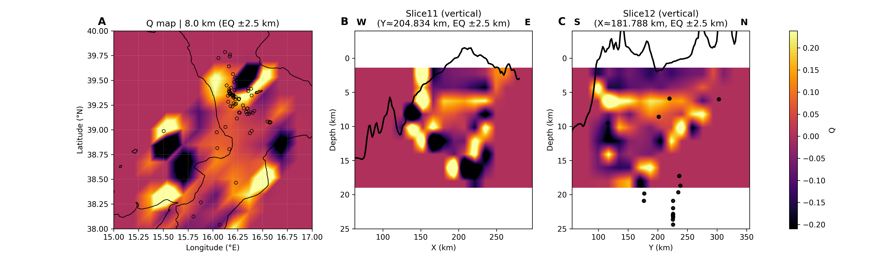
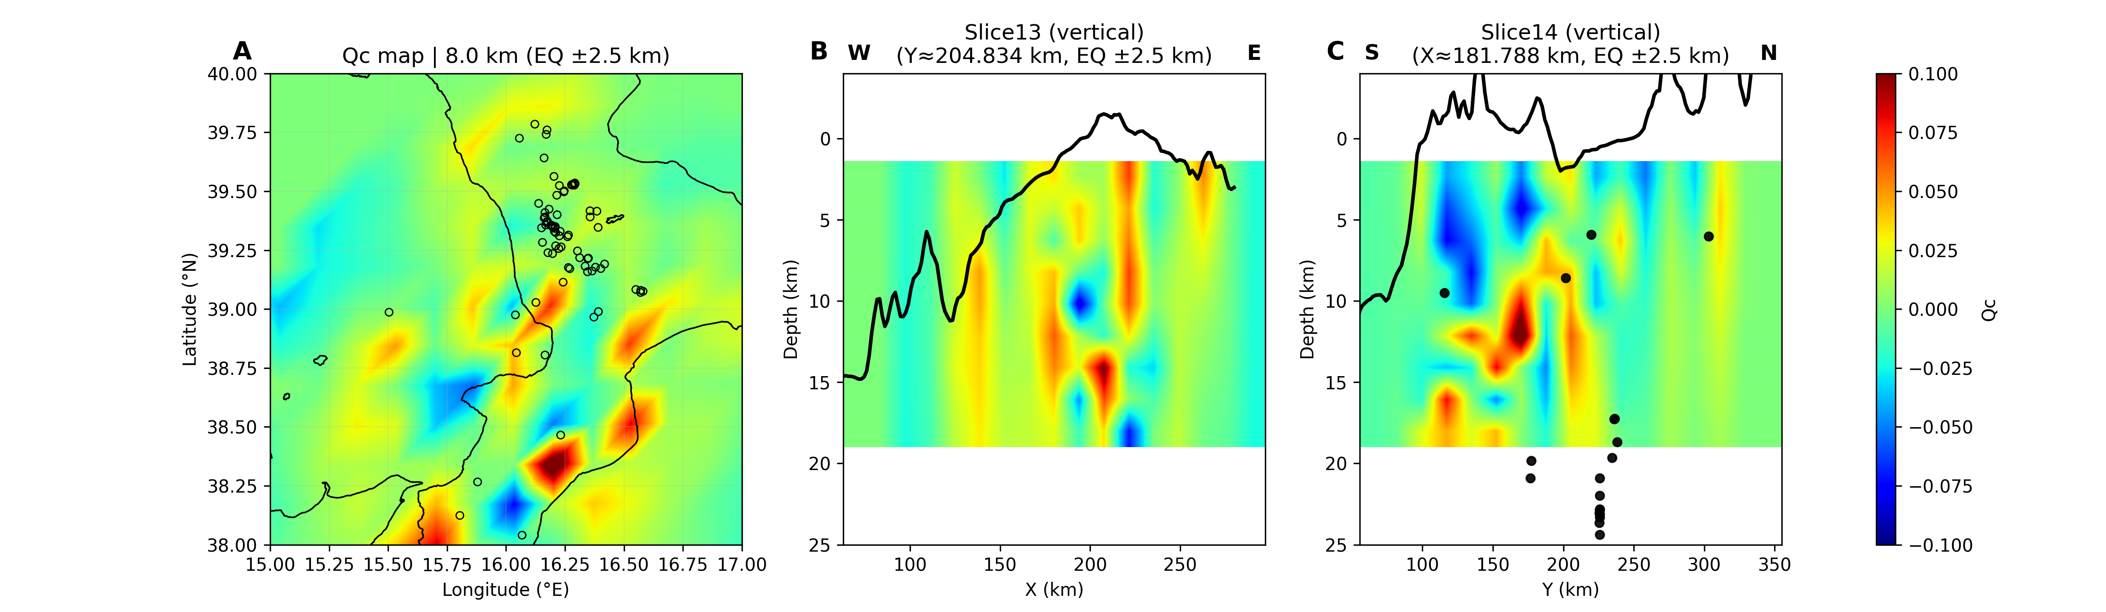
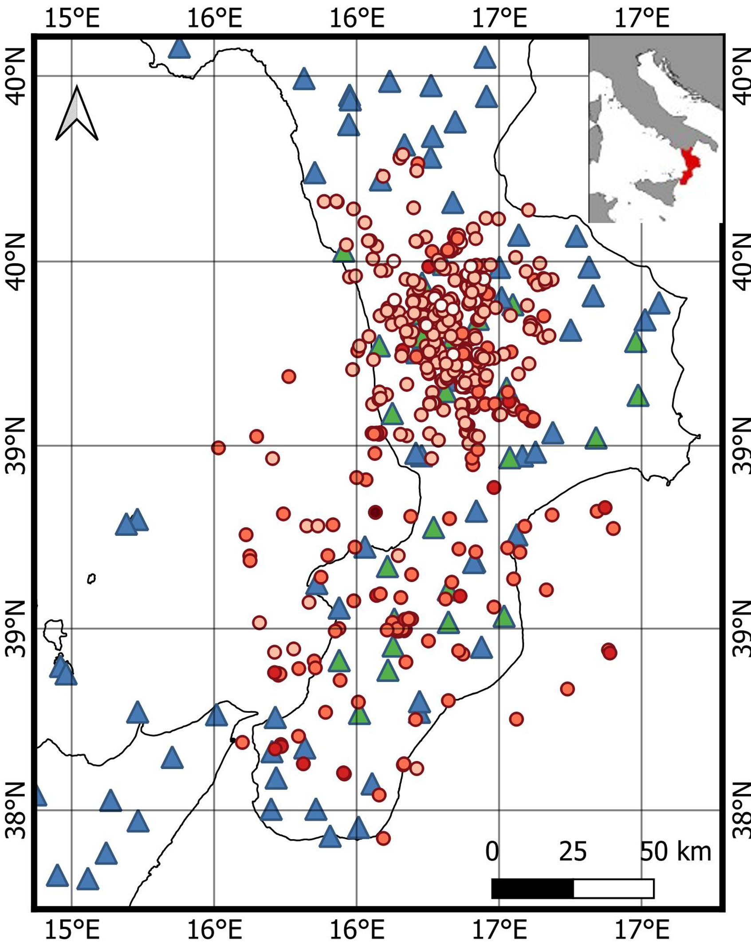
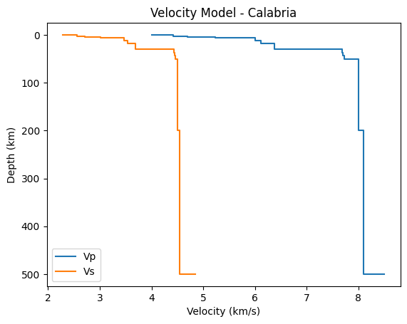
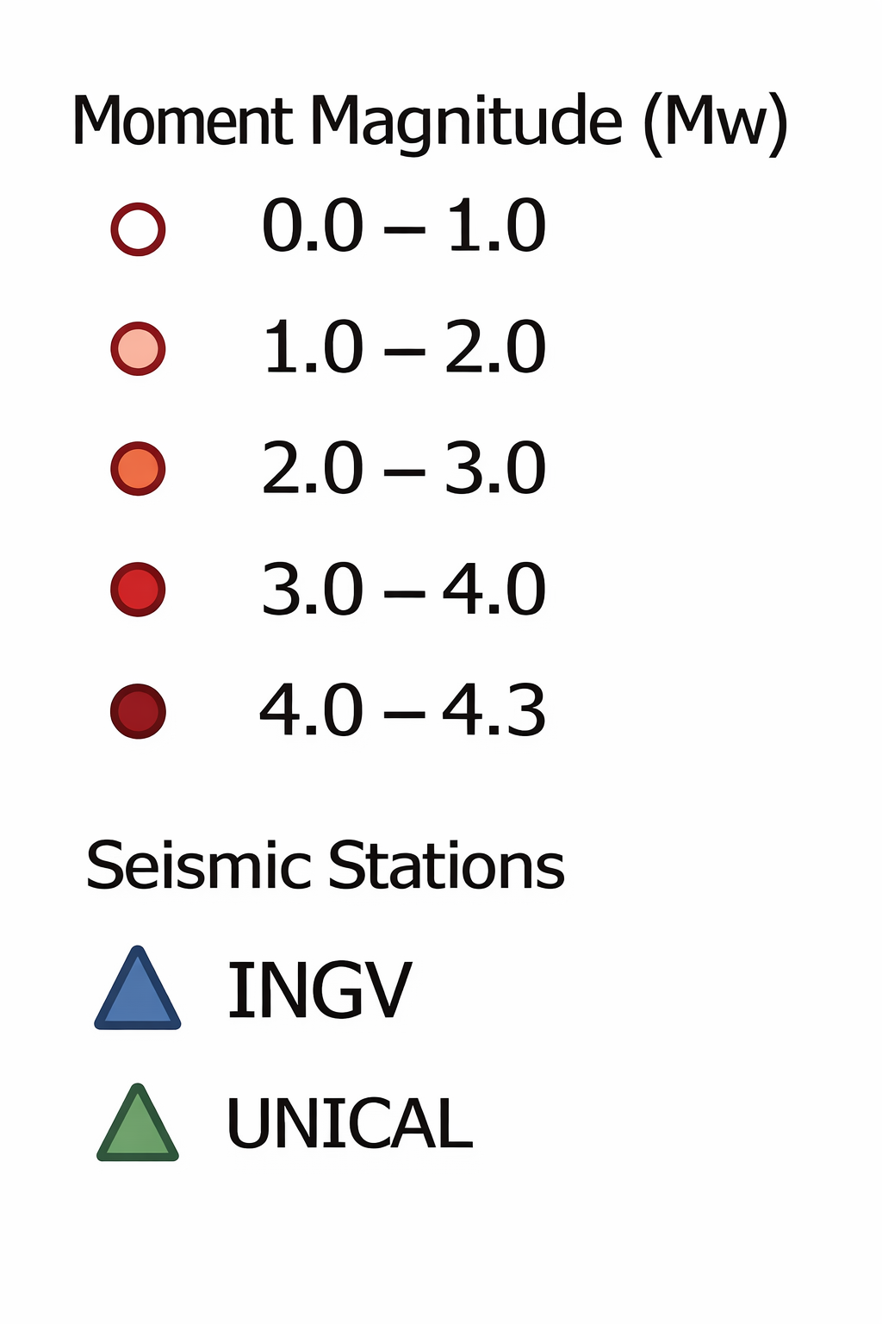
Multi-parameter seismic attenuation tomography of the Calabrian crust (Italy) using MuRAT3D
Gaia Caporale¹, Mario La Rocca ³ ,Rita de Nardis ¹, Luca De Siena ²
Contact: gaia.caporale@phd.unich.it
“G. d’Annunzio” University of Chieti–Pescara, Italy; 2.Department of Physics and Astronomy, University of Bologna, Italy; 3.Department of Physics, University of Calabria, Italy
1. Aim
4. What we measure
Seismic attenuation is a key parameter for investigating crustal heterogeneity, fracturing, and fluid distribution. In this study, we use a relocated local-earthquake dataset and the MuRAT3D framework to image scattering and attenuation patterns in the Calabrian crust.
The selected vertical PD cross-section shows how projected seismicity is distributed along the profile together with surface and bathymetric variations.
MuRAT provides a multi-parameter description of seismic energy loss.
Peak Delay (PD) is mainly related to scattering, Q describes total attenuation, and Qc mainly reflects intrinsic attenuation.
These parameters provide complementary information on crustal heterogeneity and wave propagation.
2. Study Area
Peak Delay (PD)
Total attenuation (Q)
Coda quality factor (Qc)
P
Maximum envelope
Historically, Calabria has been struck by several large and destructive earthquakes, some of which also generated tsunamis. This makes the region a natural laboratory for investigating the links between active faulting, earthquake generation, and seismic hazard.
The accompanying 3D view provides additional structural context by combining the attenuation pattern with projected earthquakes and the main crustal surfaces used for interpretation, including the Moho as a first-order structural constraint.
MuRAT – Multi-Resolution seismic Attenuation Tomography
5. Preliminary results
Together, these observations support the presence of significant structural complexity within the Calabrian crust.
Preliminary attenuation images reveal marked lateral variability across the Calabrian Arc, with strong contrasts between offshore and onshore domains and localized anomalies related to significant crustal heterogeneity. Horizontal maps at 6 Hz highlight consistent spatial variations in Peak Delay (PD), total attenuation (Q), and coda attenuation (Qc).
6. Ongoing work / Next steps
Current work is focused on refining the multi-frequency attenuation patterns, improving the geological interpretation of the anomalies, and testing methodological updates introduced in MuRAT4.
3. Dataset
B
C
7. Take-home message
The dataset includes about:
490 local earthquakes recorded between 2016 and 2024;
Integrating:
local (UNICAL) , national (INGV) , and temporary seismic networks.
The first MuRAT results indicate that the Calabrian crust is characterized by significant attenuation contrasts. Even at this preliminary stage, the images highlight spatially variable seismic energy loss, providing a useful framework for future geological interpretation.
8. References
Event relocation:
  De Siena, L., Margerin, L., & Calvet, M., 2014. Seismic energy envelopes in volcanic media: Towards quantitative scattering and absorption imaging. Physics of the Earth and Planetary Interiors, 222, 1–15;
  Lavecchia, G., De Nardis, R., Visini, F., Ferrarini, F., & De Matteis, R., 2020. Active faulting and seismotectonics in Southern Italy. Journal of Geodynamics, 136, 101710.
  Locati, M., Rovida, A., Camassi, R., Ercolani, E., Bernardini, F., Castelli, V., Caracciolo, C. H., & Tertulliani, A., 2021. The Italian earthquake catalogue CPTI15, from the 1st millennium to the present. Seismological Research Letters, 92(1), 379–390.
  Schweitzer, J. (2001). HYPOSAT – An enhanced routine to locate seismic events. Pure and Applied Geophysics, 158(1), 277–289.
• 1D velocity model validated for Calabria
The maps include Peak Delay, Q, and Qc at 6 Hz.

