Slide 1
Predicting Air Pollution from sparse and movable observation points using machine learning techniques
Abhishek Ajit Sabnis, Mihai Mitrea, Lya Lugon, Karine Sartelet, Marc Bocquet, Xiaoyuan Cheng, Shupeng Zhu, Sibo Cheng
(Supplement material to Poster)

Slide 2
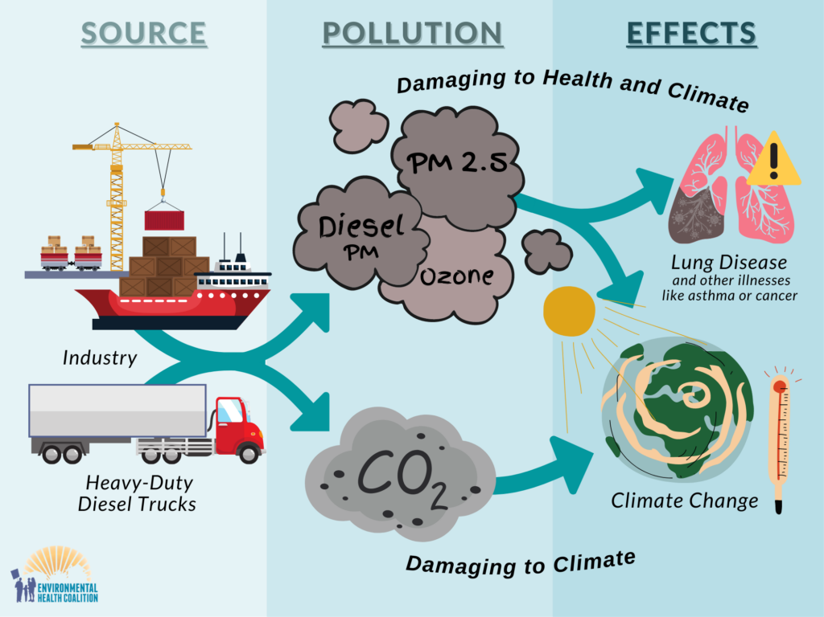
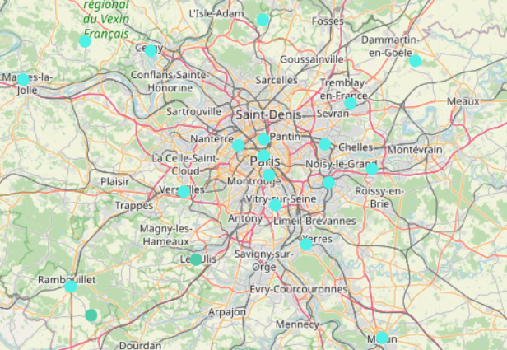
Introduction
Motivation
We need
Accurate and fine scale monitoring
Climate change
mitigation policies
Urban planning
https://www.geodair.fr/donnees/consultation
Current infrastructure of sensor stations is not sufficient to monitor full-grid pollutants
https://animalia-life.club/qa/pictures/effects-of-air-pollution-on-environment

Slide 3
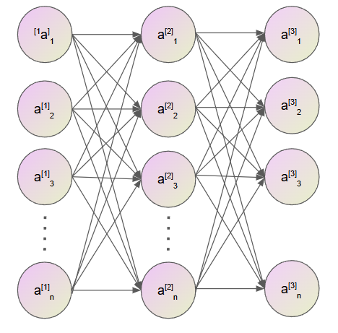
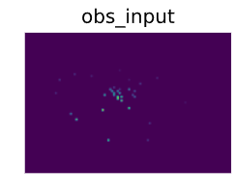
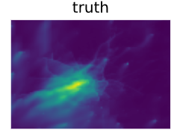
Introduction
Problem Statement
Can we use machine learning to reconstruct the pollution field?
Task: Reconstruct multi variable field for NO2, O3, PM10, PM2.5
Challenge: Sparse number of available sensors that can vary temporally

Slide 4
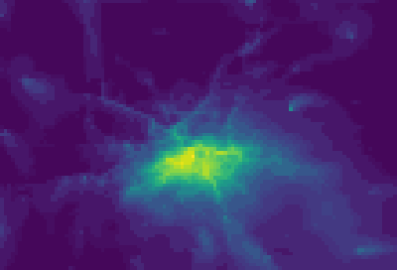

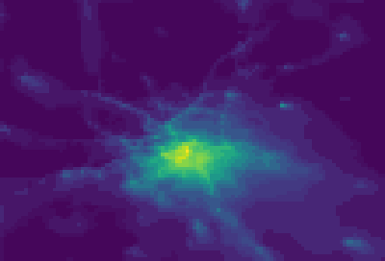
What are the existing limitations?
Most methods model pollutants individually (ignoring intrinsic interactions among pollutants)
Methods trained on synthetic data do not evaluate on real-world observations
Real world sensors switch on-and-off over time (temporal missing data)
NO2
O3
Create jointly processed ML based model trained on simulation data and evaluate on real world data
Ground truth simulations
Model input
(Voronoi Tessellations)
ML model prediction
Example: 32 timesteps of NO2

Slide 5
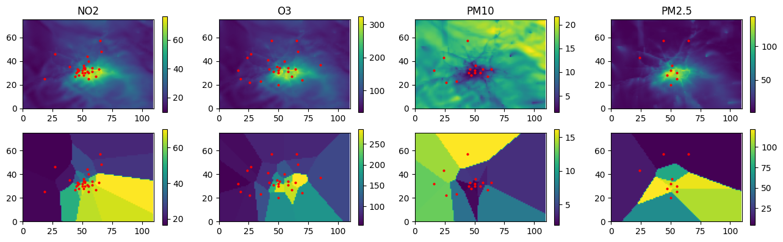
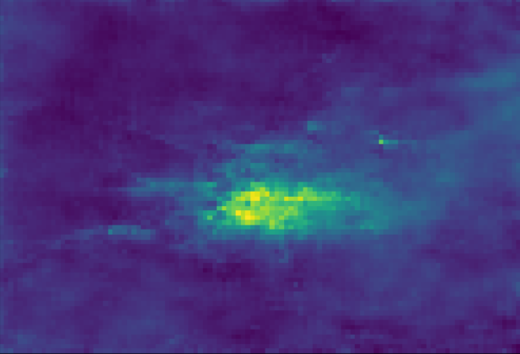
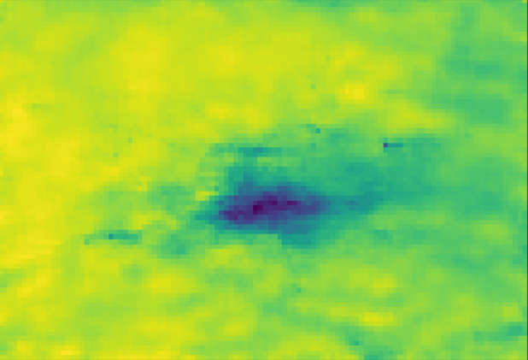
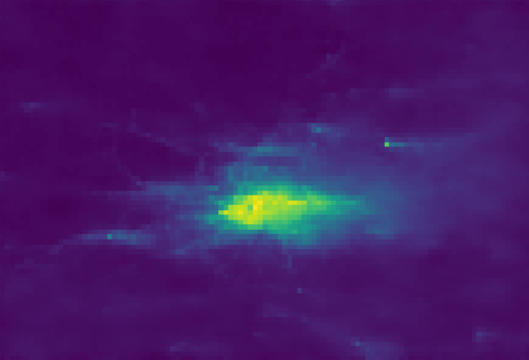
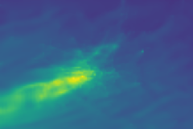
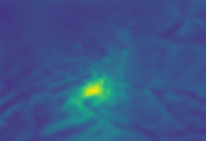
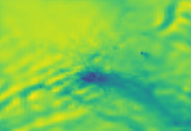
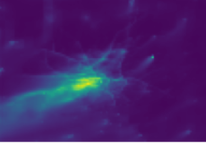
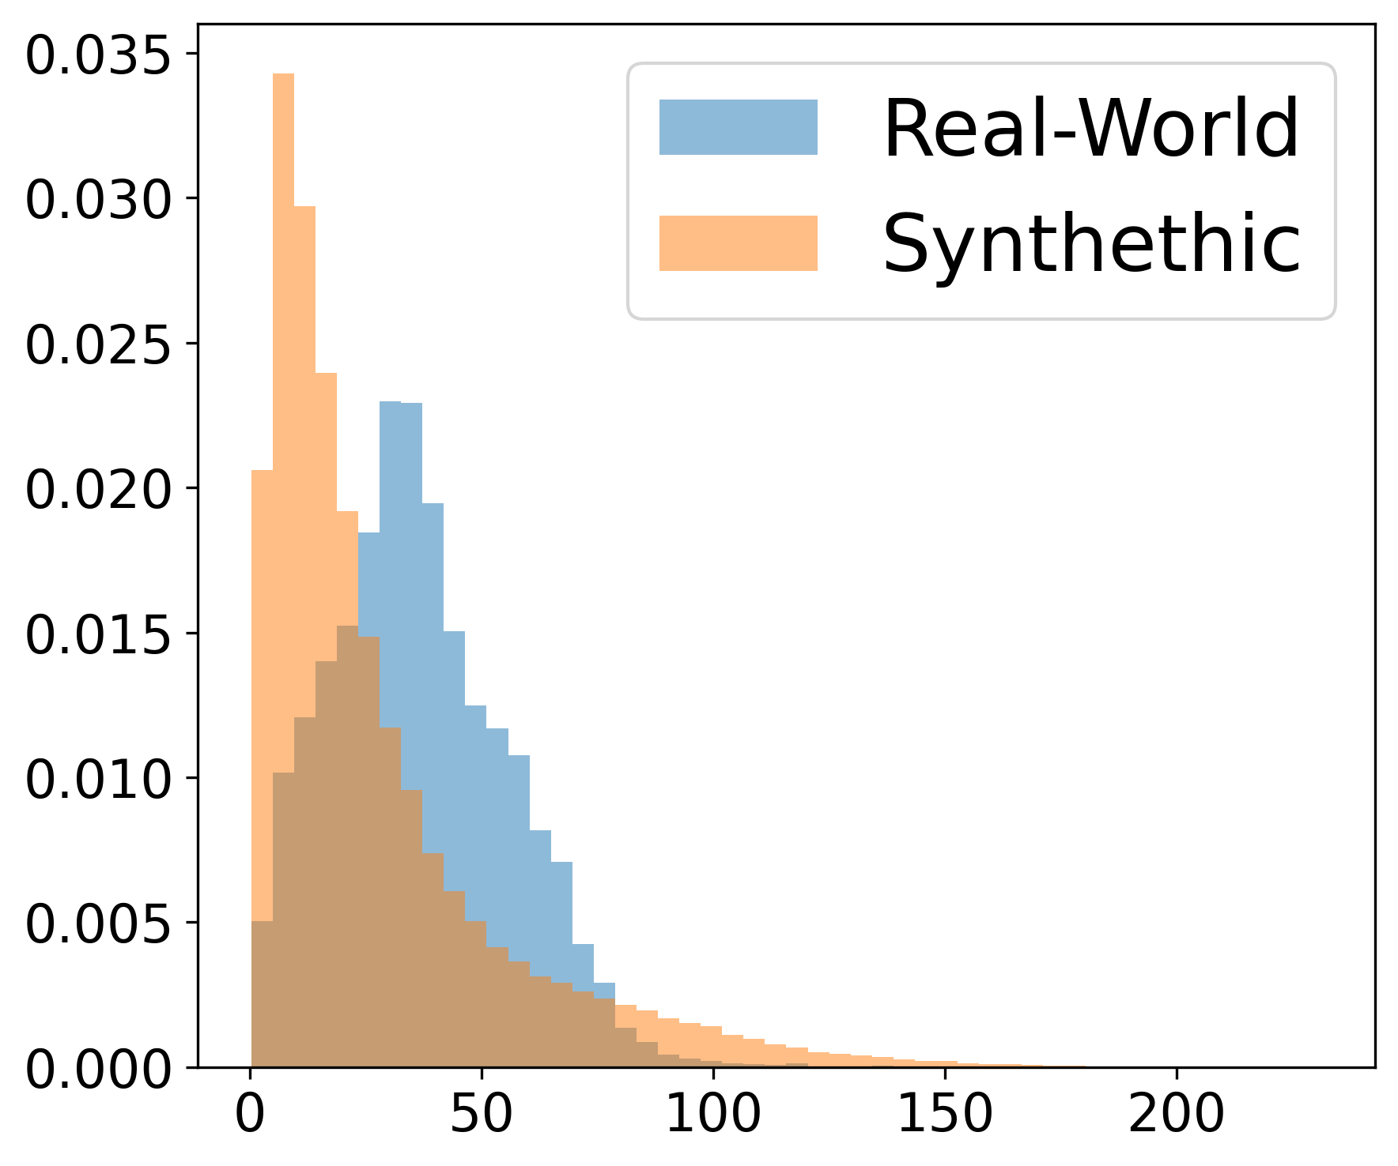
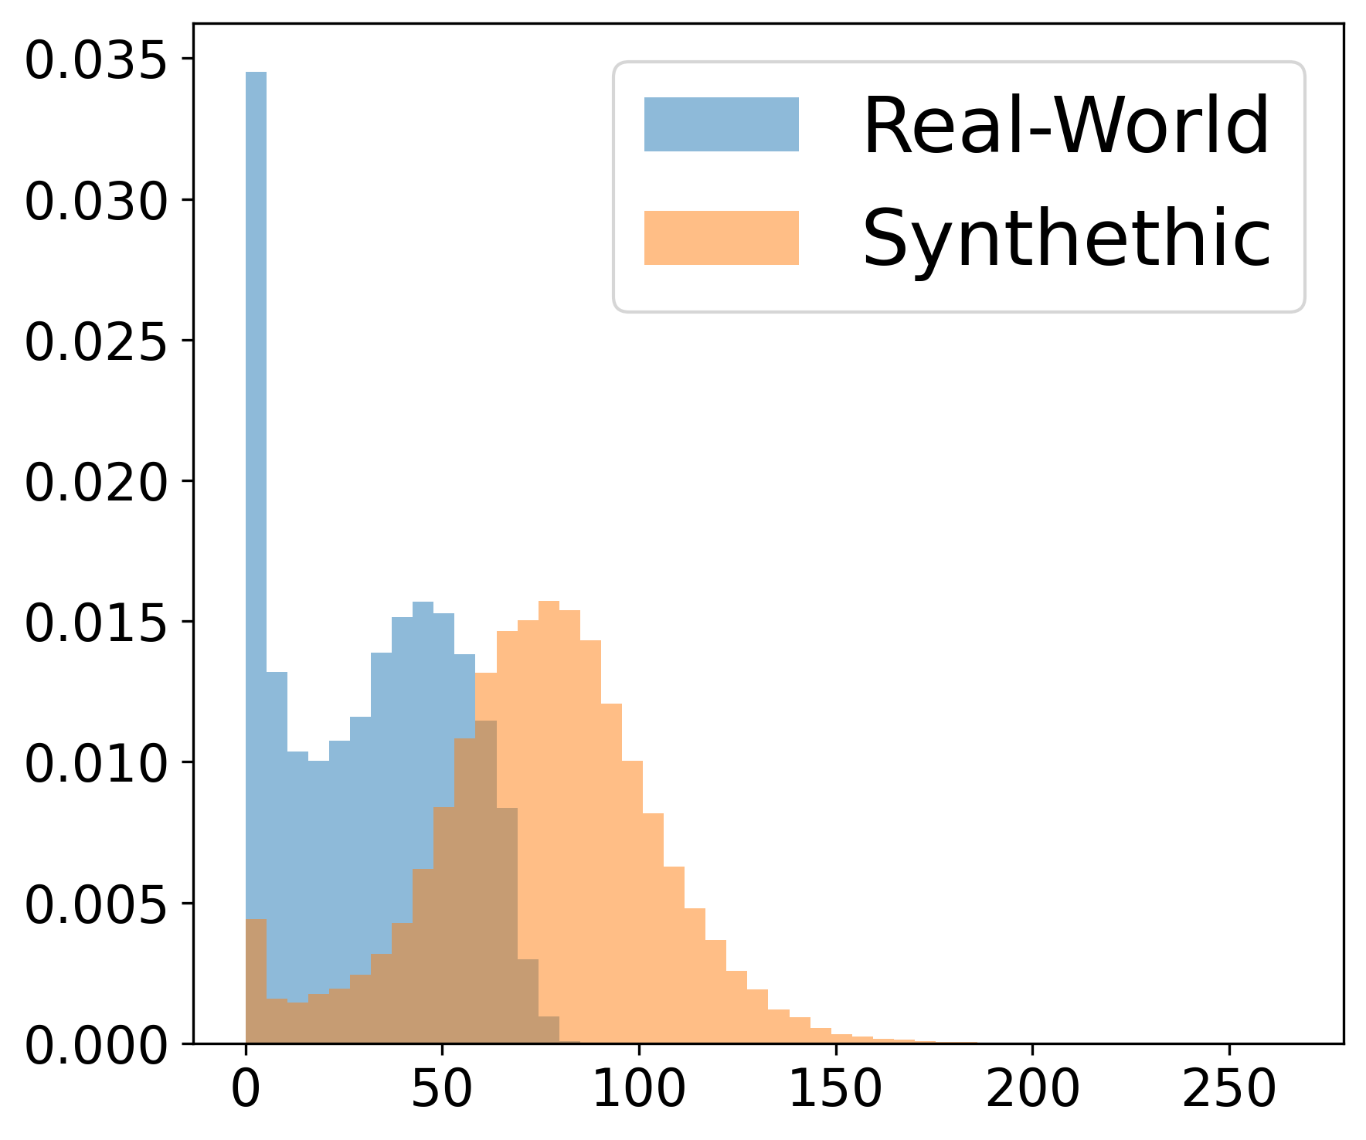
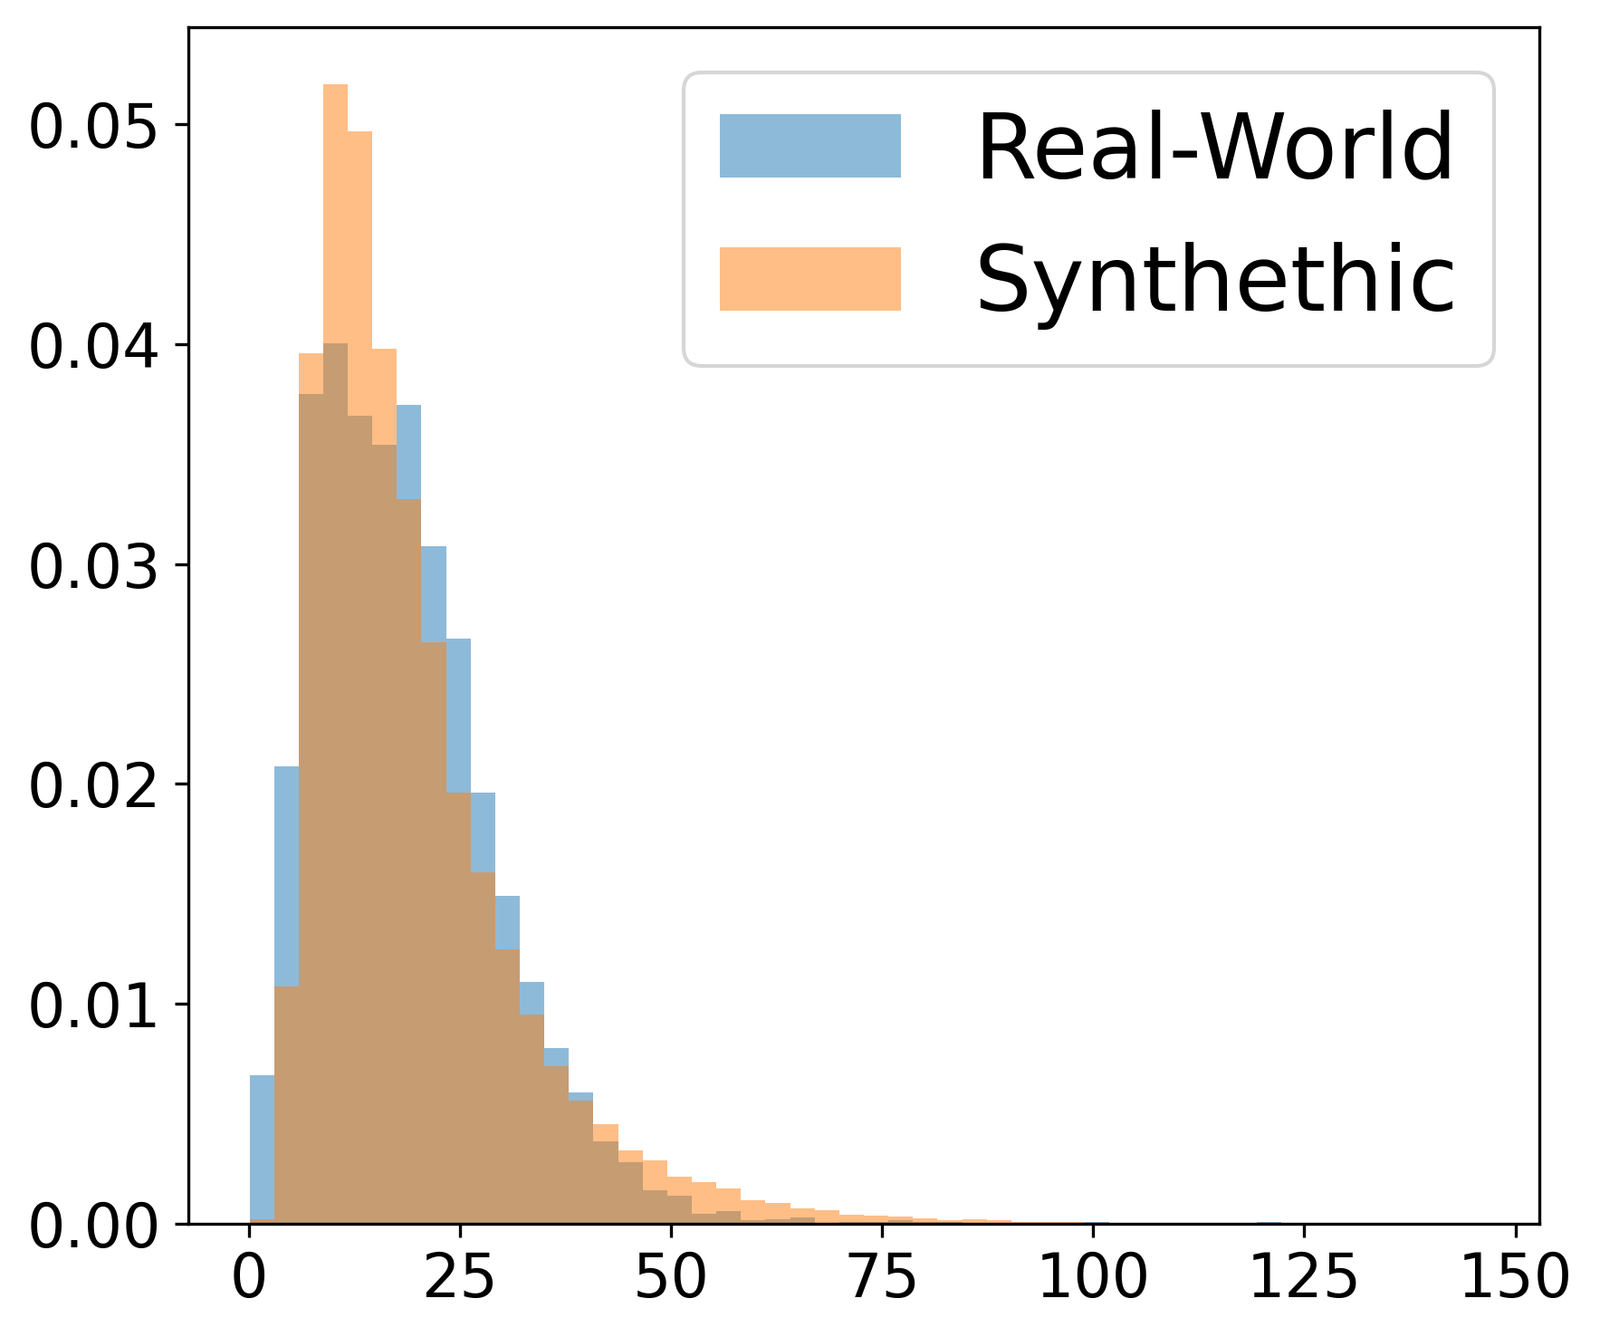
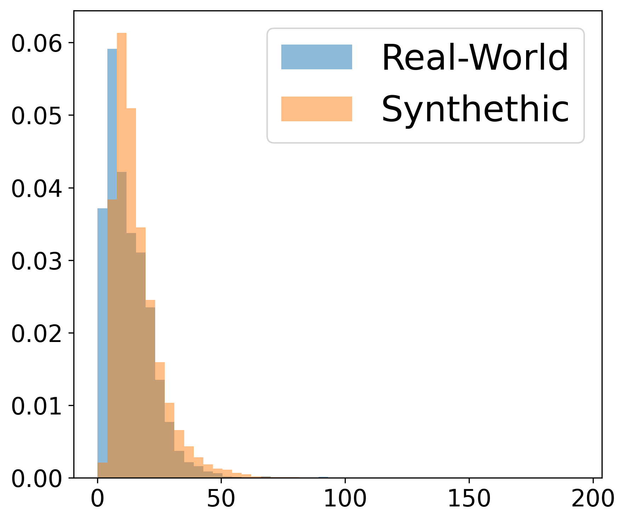
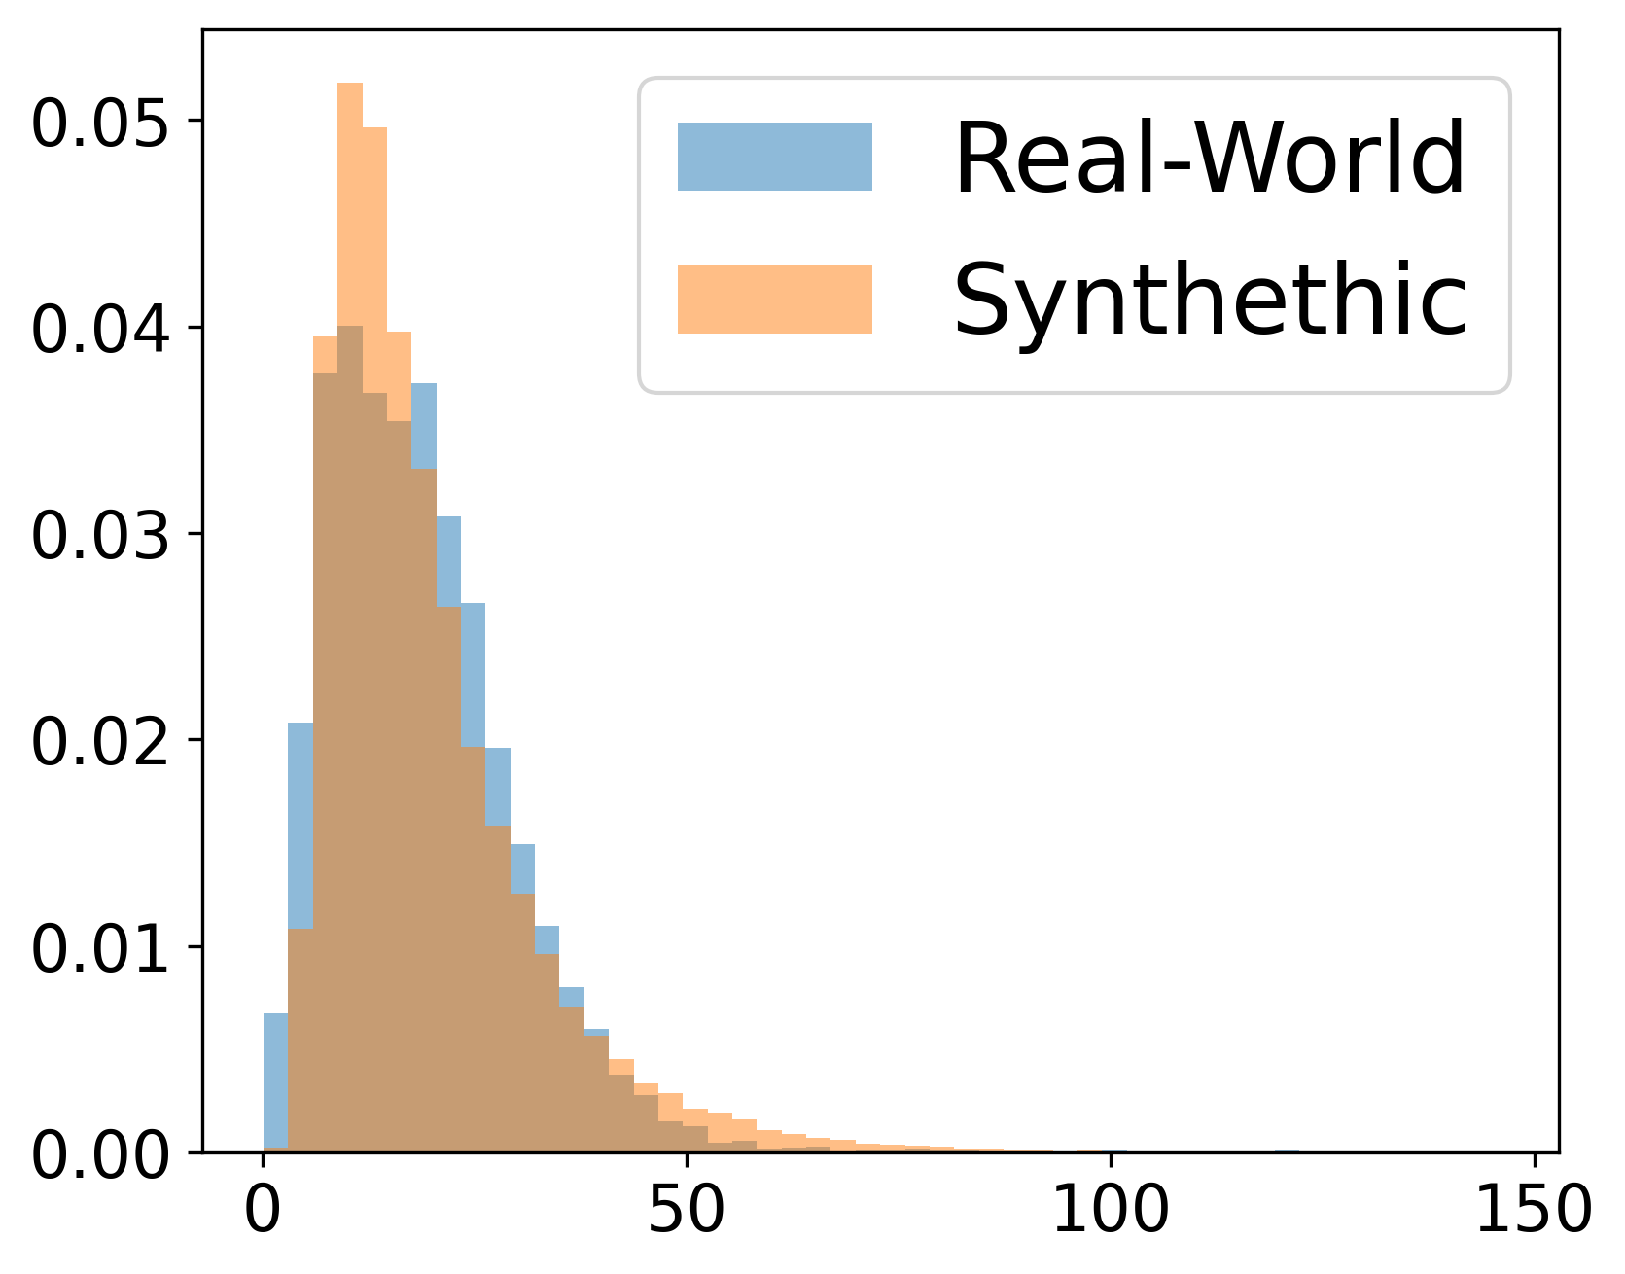
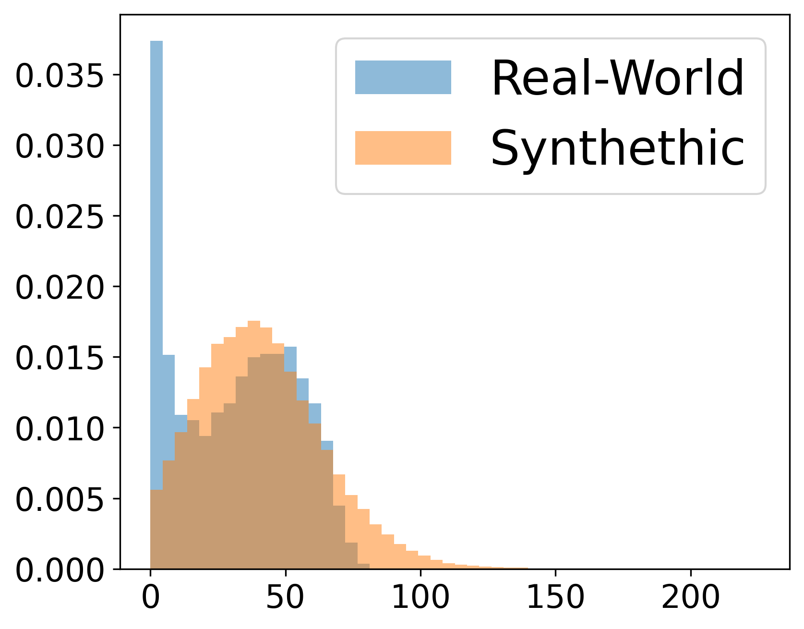
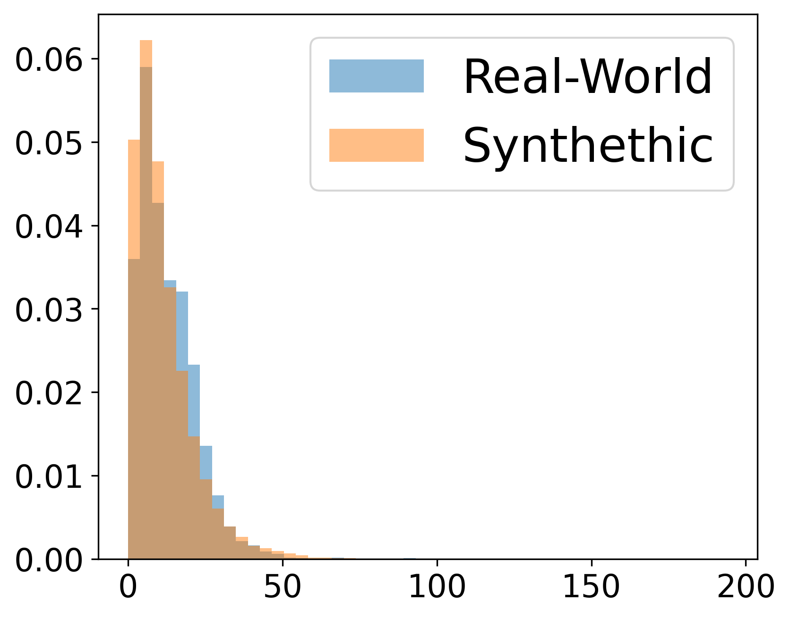
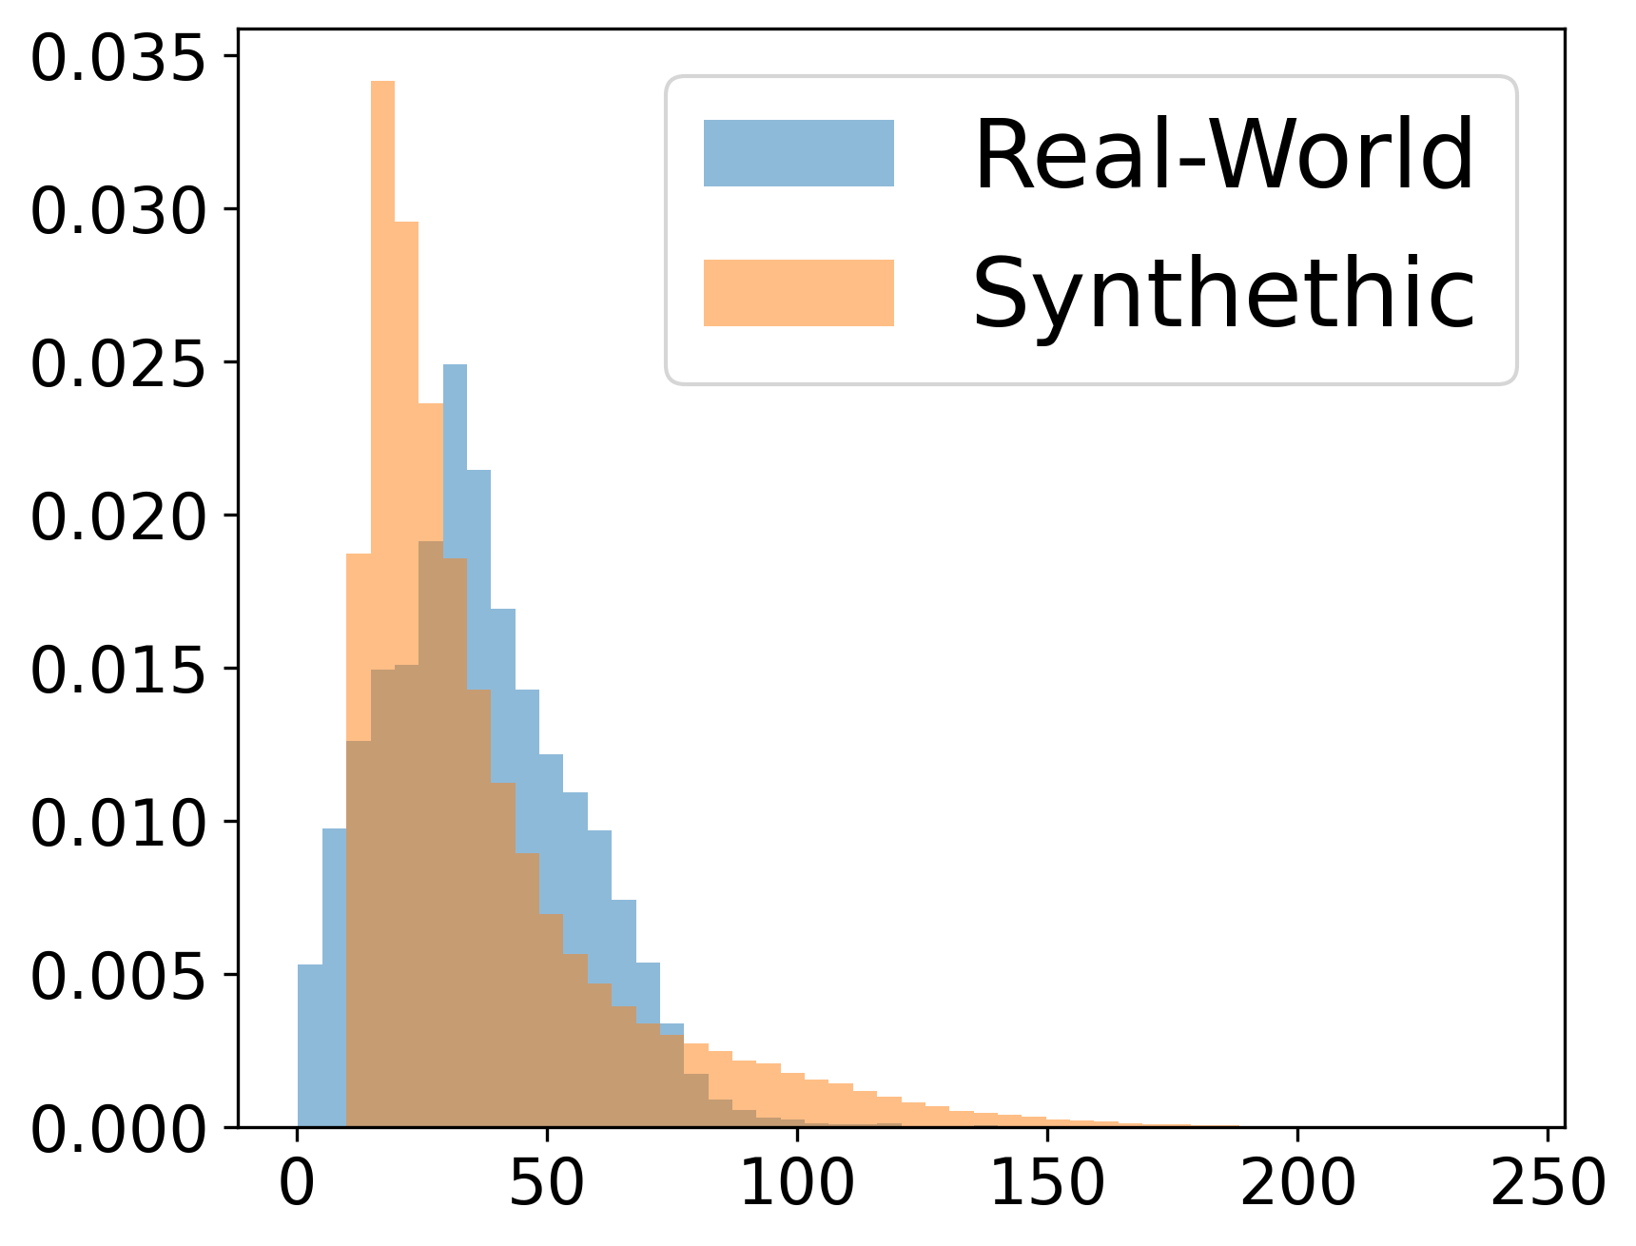







Data Preparation
Simulation data (for training model)
t = n
Simulation dataset
Jan 01 2014 to Dec 20 2014
(Hourly recording)
Step 1: Mask with sensor location
Step 2: Create Voronoi Tessellations
$$NO_{2}$$
$$O_{3}$$
. . .
t = T
$$PM2.5$$
$$PM10$$
$$O_{3}$$
$$NO_{2}$$
t = 0
$$PM10$$
$$PM2.5$$
NO2
O3
PM10
PM2.5
Before
Apply augmentations on simulation dataset to mimic the real-world data distribution
After

Slide 6


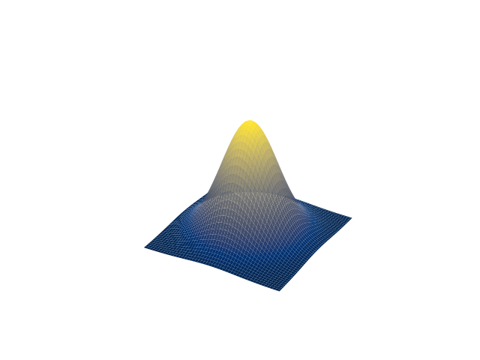
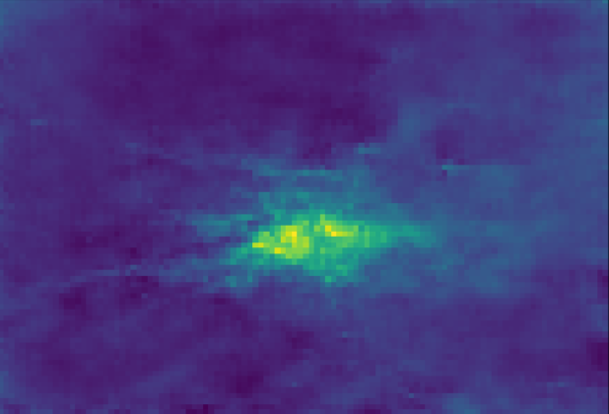
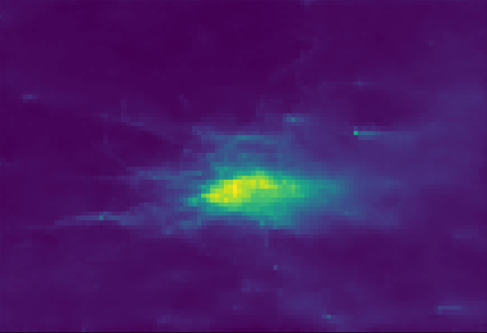
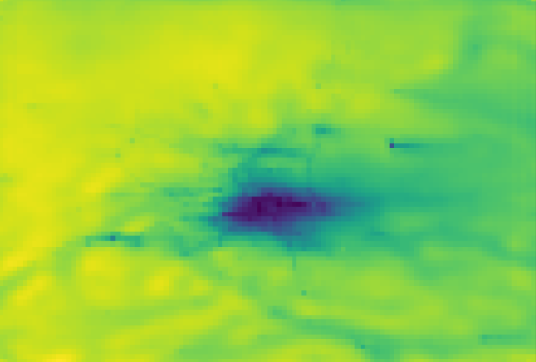
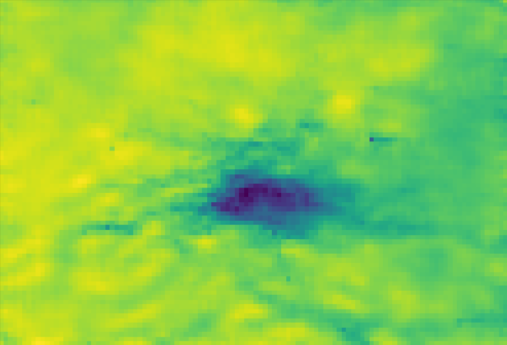
Model Training
Deterministic
Neural Network
(VUnet/ ViTAE/ CLSTM)
Multi pollutant Voronoi tessellation
Prediction
Generative
Voronoi
Embedding
. . . .
Neural Network (Unet)
Mean Ensemble
prediction
Sample n-dim Gaussian Noise
Diffusion sampling
Predictions

Slide 7
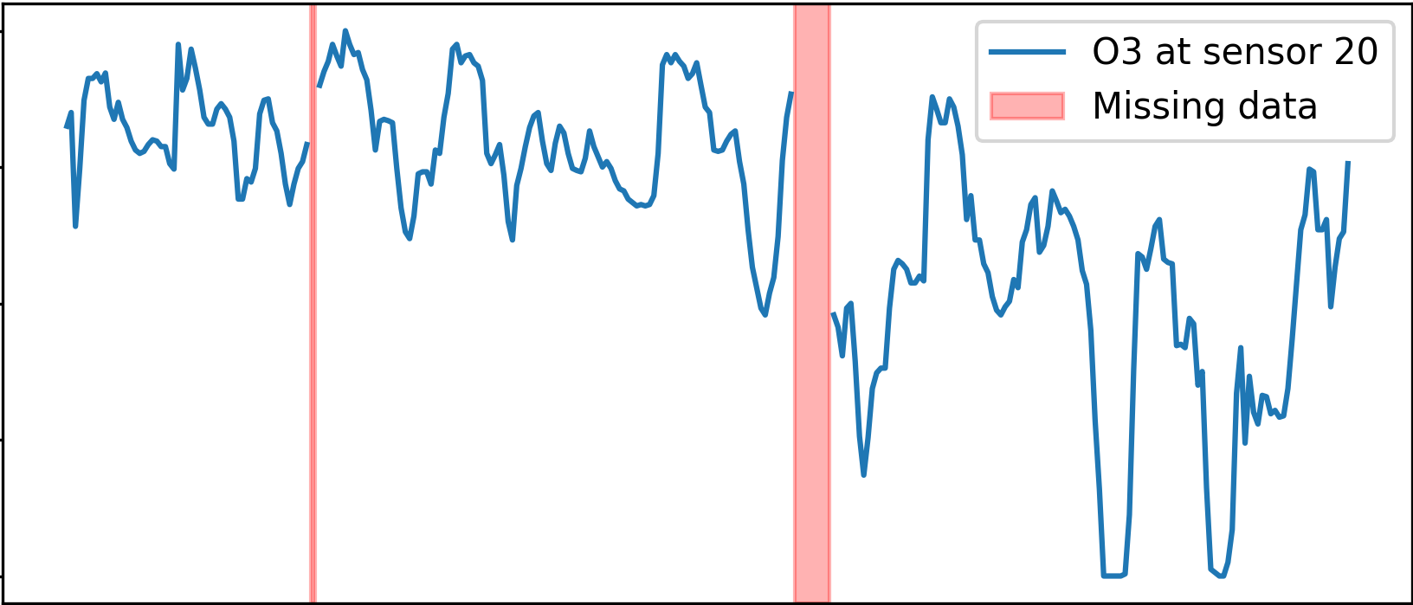
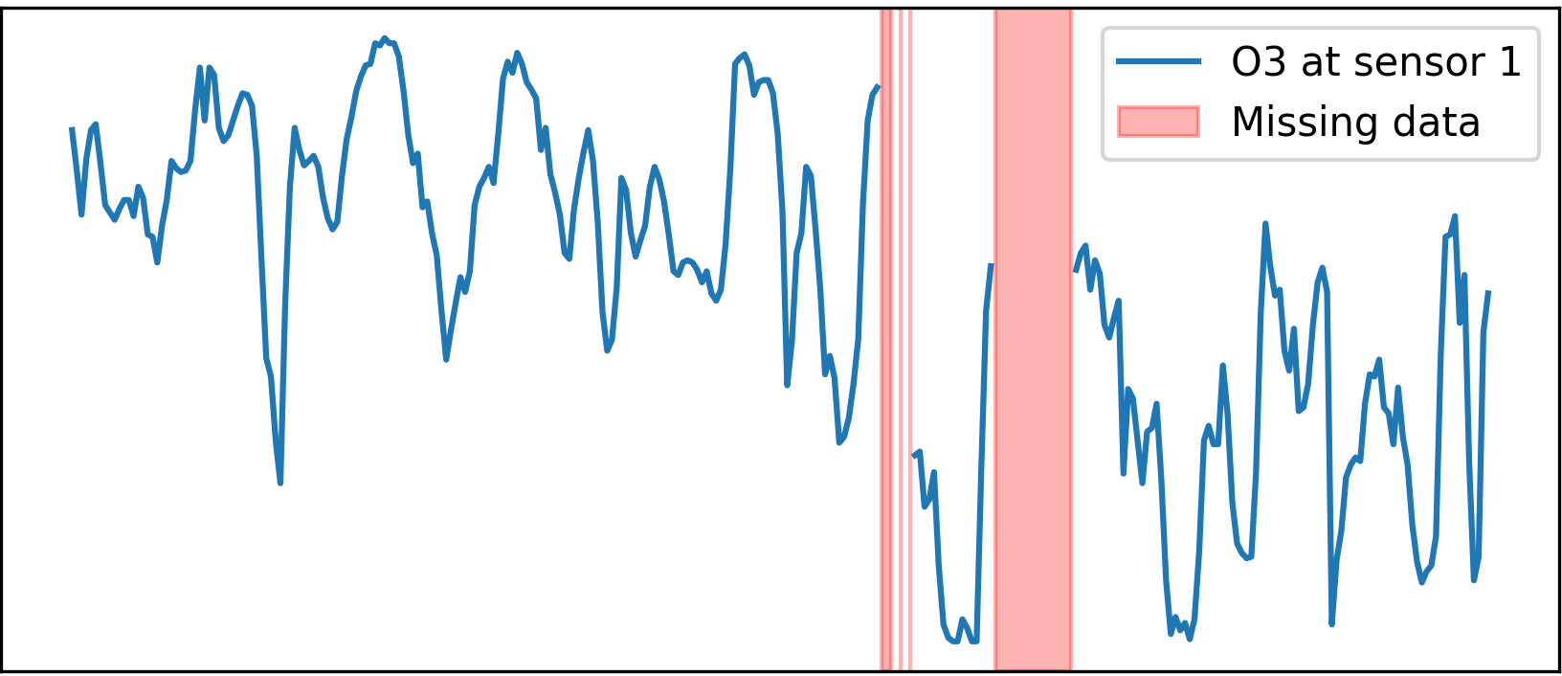

Model Testing
Real world observation data
Inner city boundary
Construct Voronoi Tessellations
s20
. . .
Jan 01
s1
ML model prediction
Jan 07
Jan 15
Randomly discard 2 sensors( )
Missing data
Evaluate against heldout test points

Slide 8


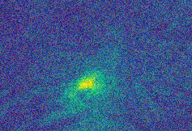
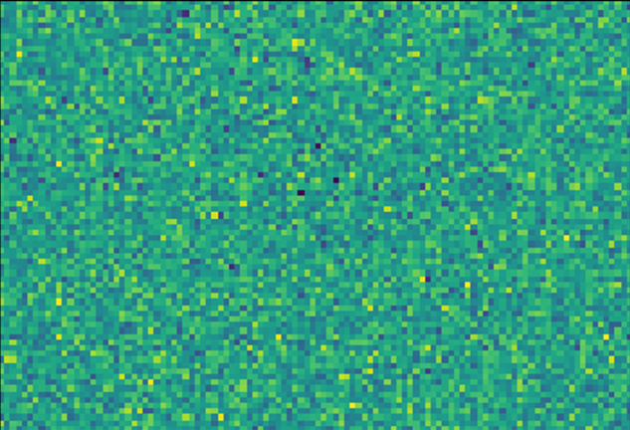
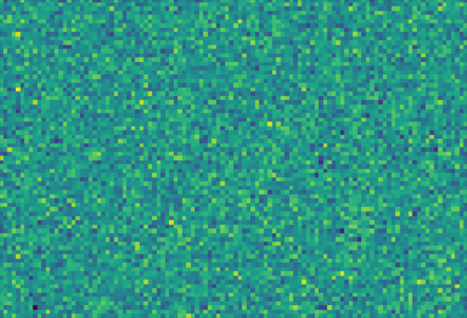
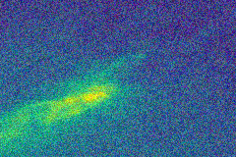
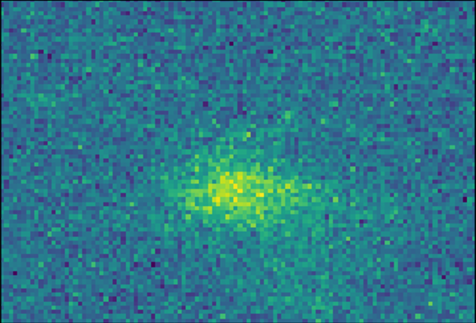
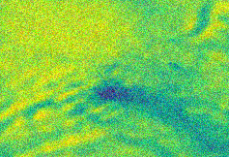
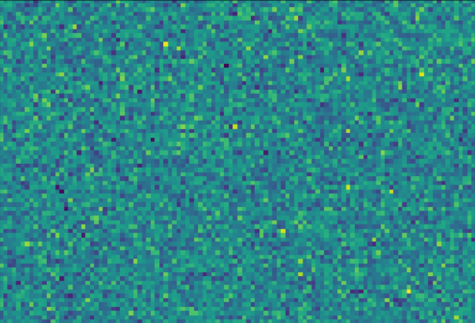
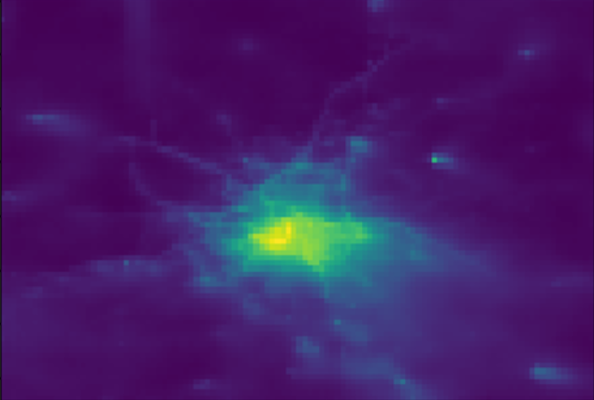
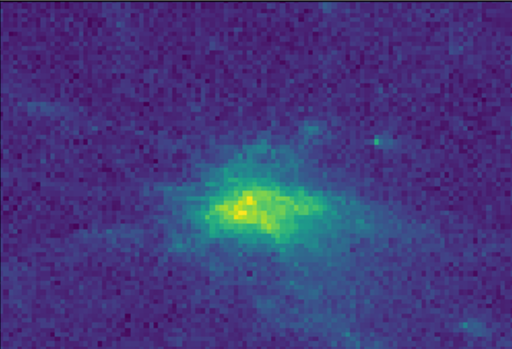









Methodology
Generative – Diffusion model
Add noise
$$x_{0}$$
$$x_{r−1}$$
$$x_{r}$$
$$x_{R}$$
Back Sampling
$$x_{r−1}$$
(Noisy Image)
SDE Solver++
Denoiser $D_{θ}$ (UNet model)
$$x_{r}$$
Forward Diffusion
Denoised Image
$dx=f\left(x,t\right)dt+g\left(t\right)dw$
Voronoi embedding
Neural Network
Reverse Diffusion
$dx=\left[f\left(x,t\right)−g^{2}\left(t\right)∇_{x}log p_{t}(x|c,σ)\right]dt+g\left(t\right)dw$

Slide 9
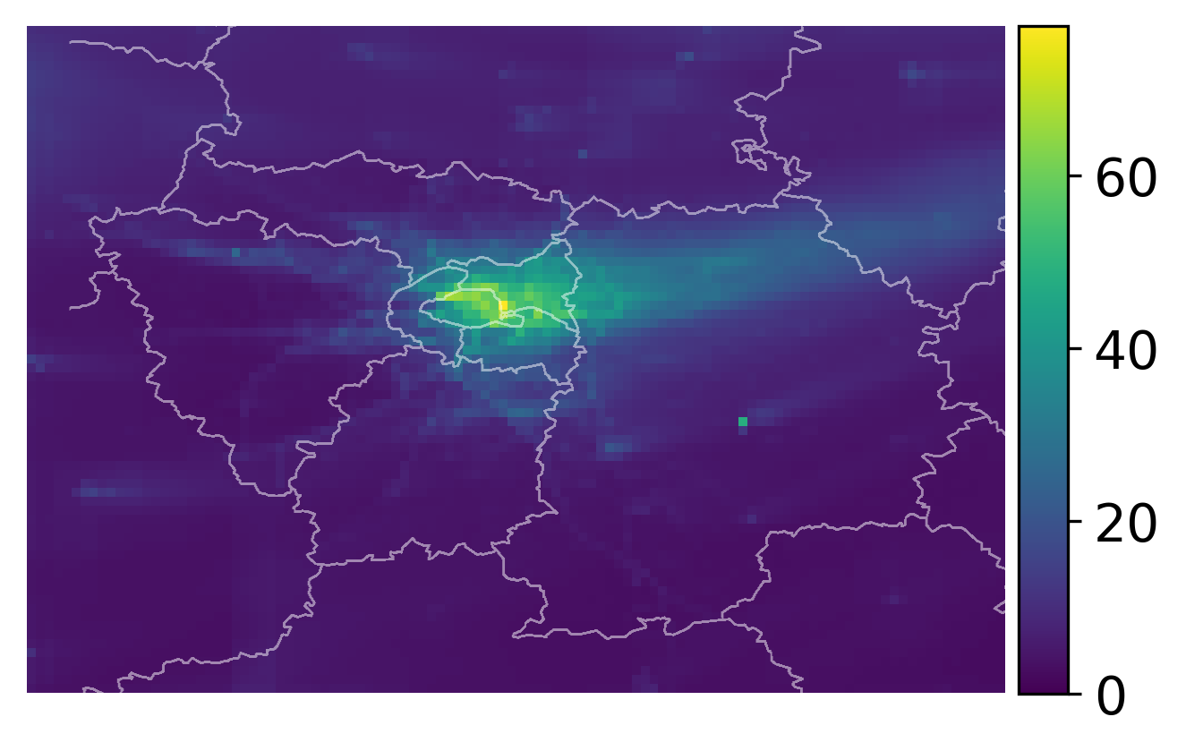
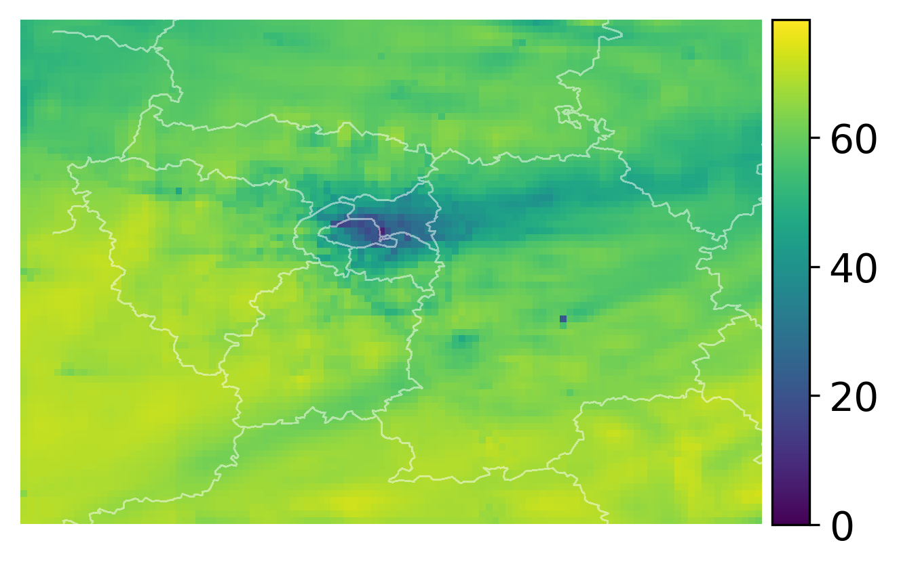
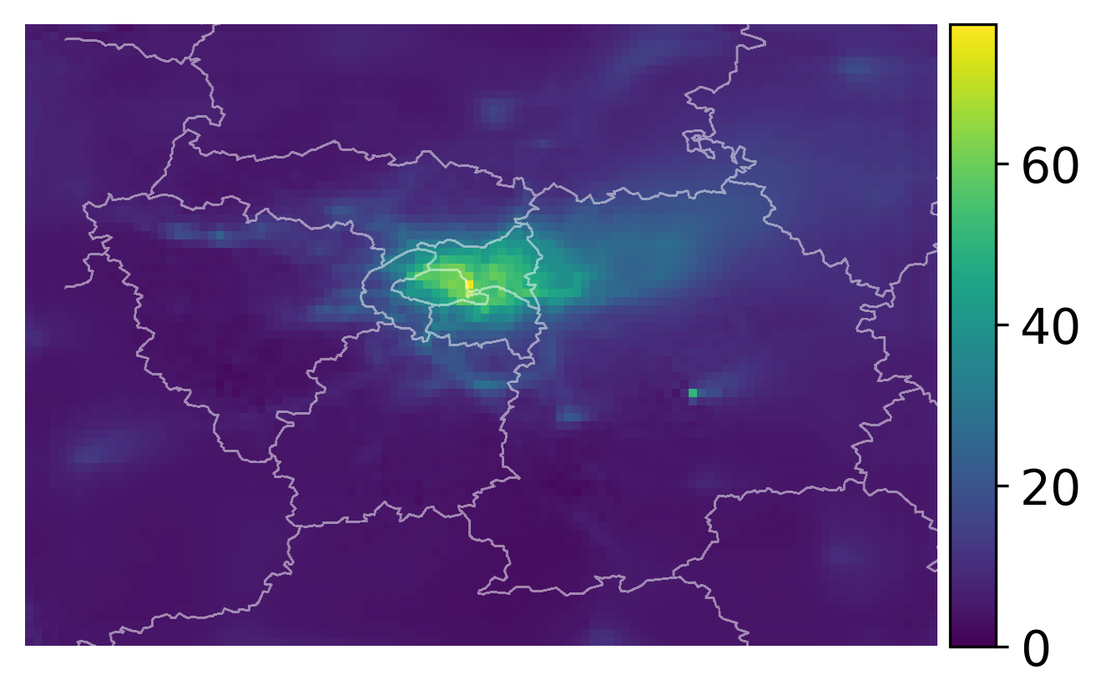
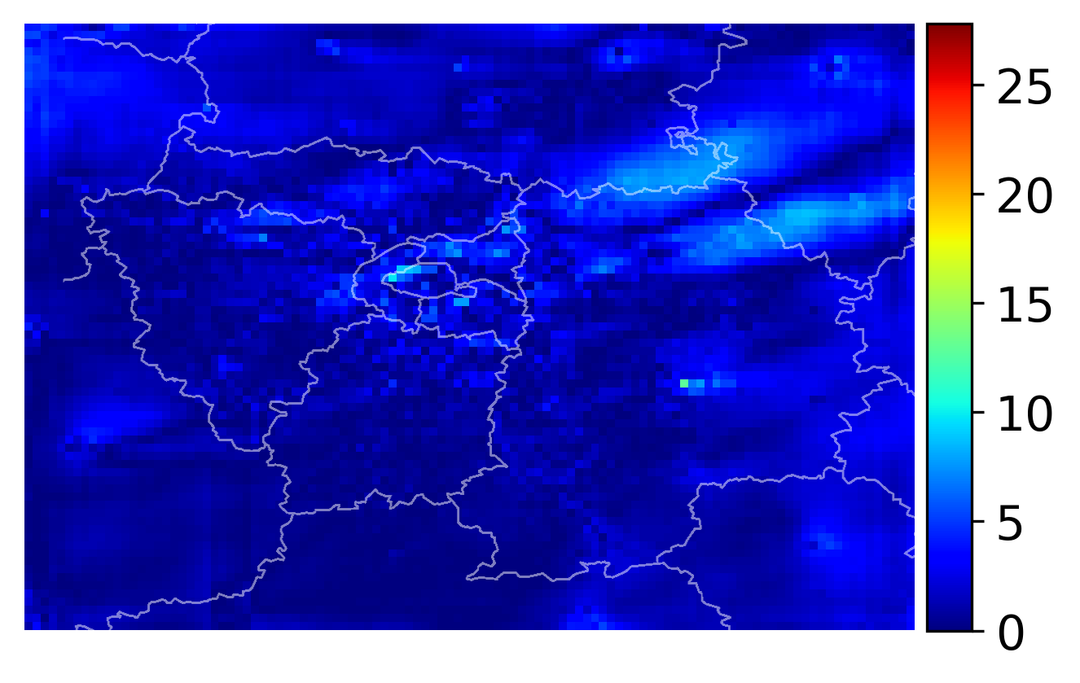
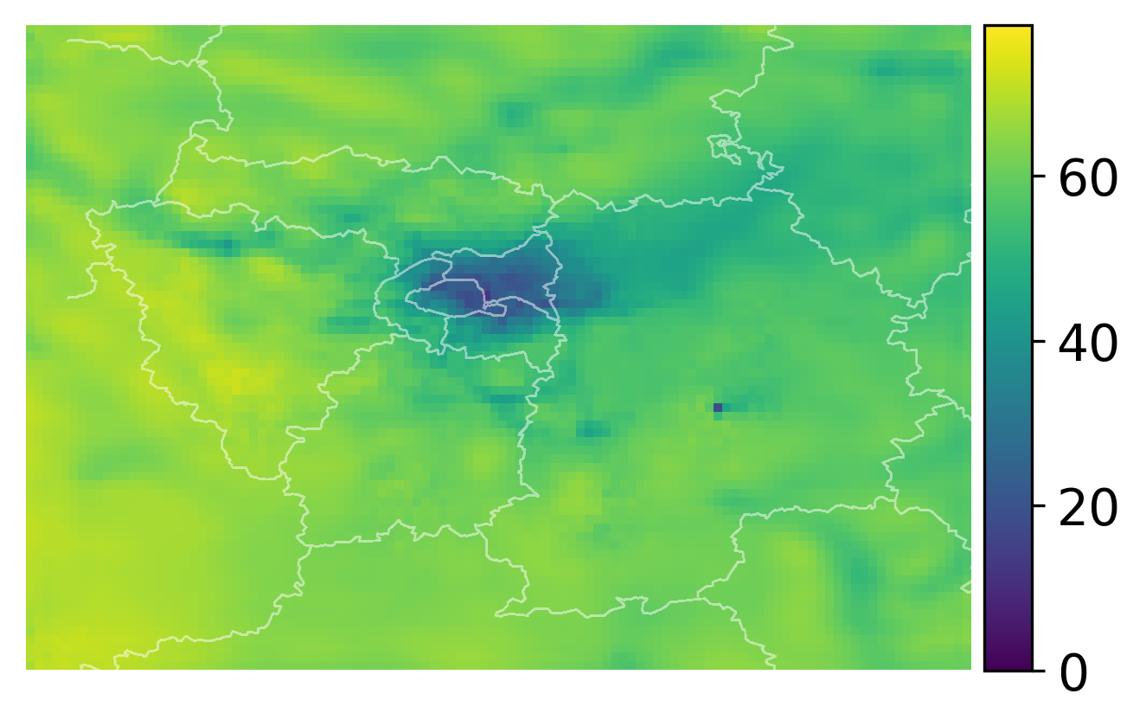
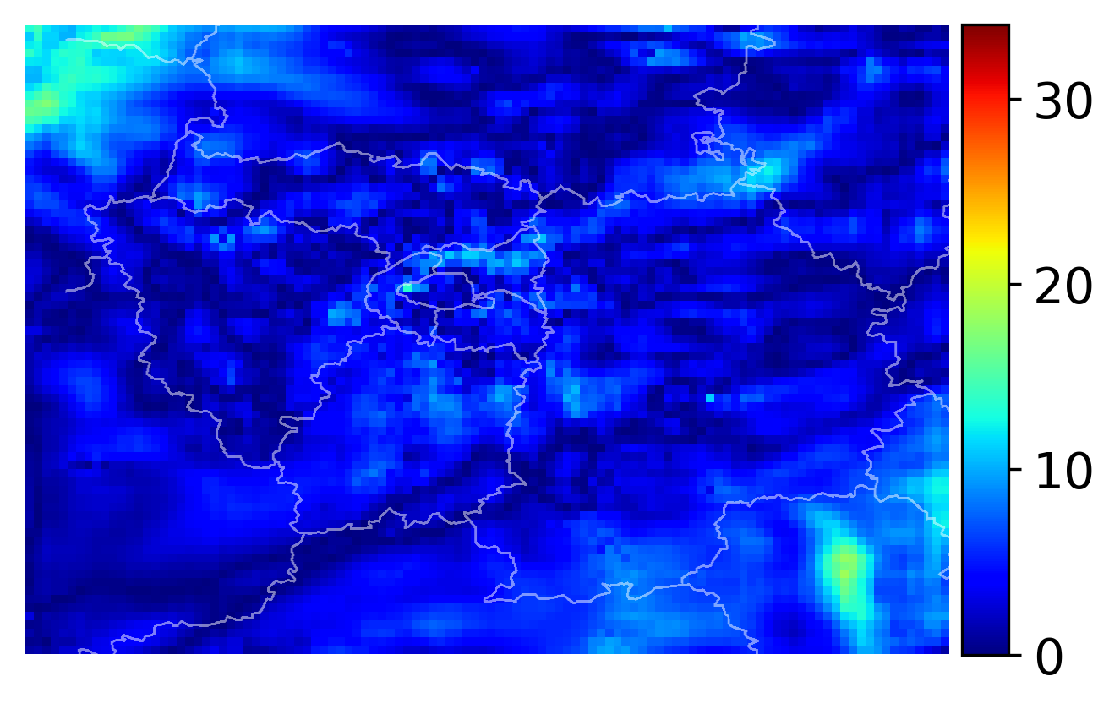
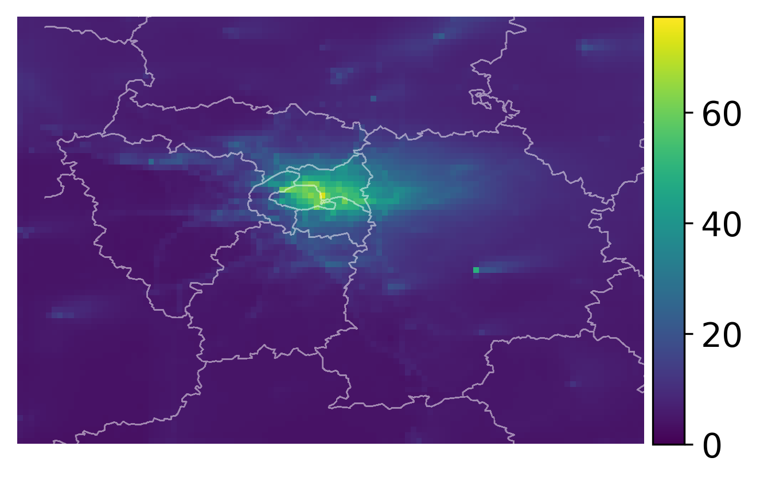
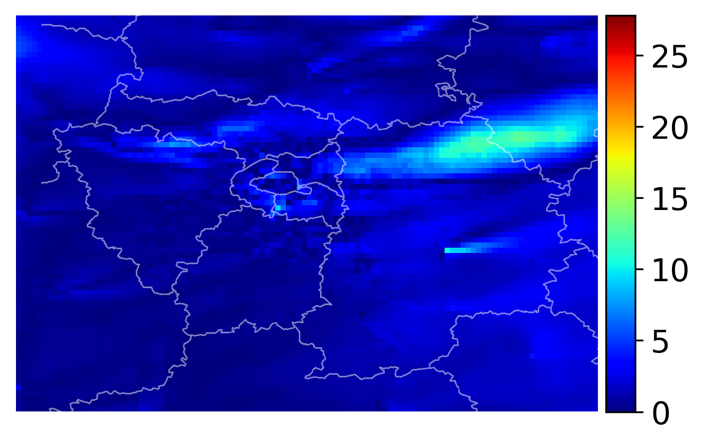
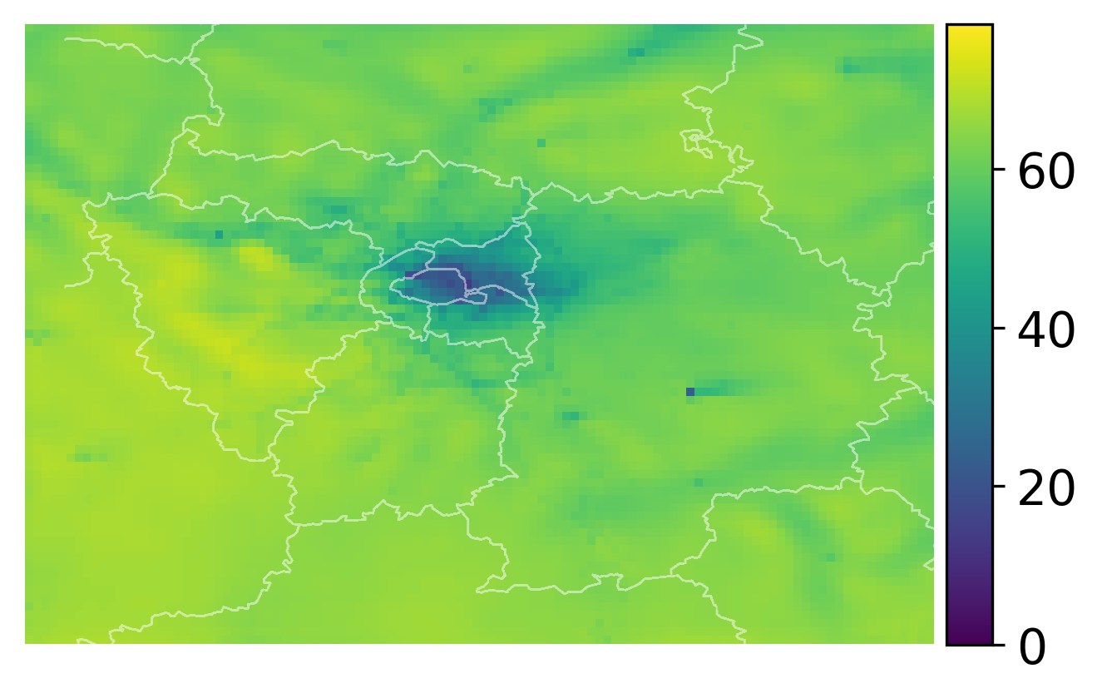
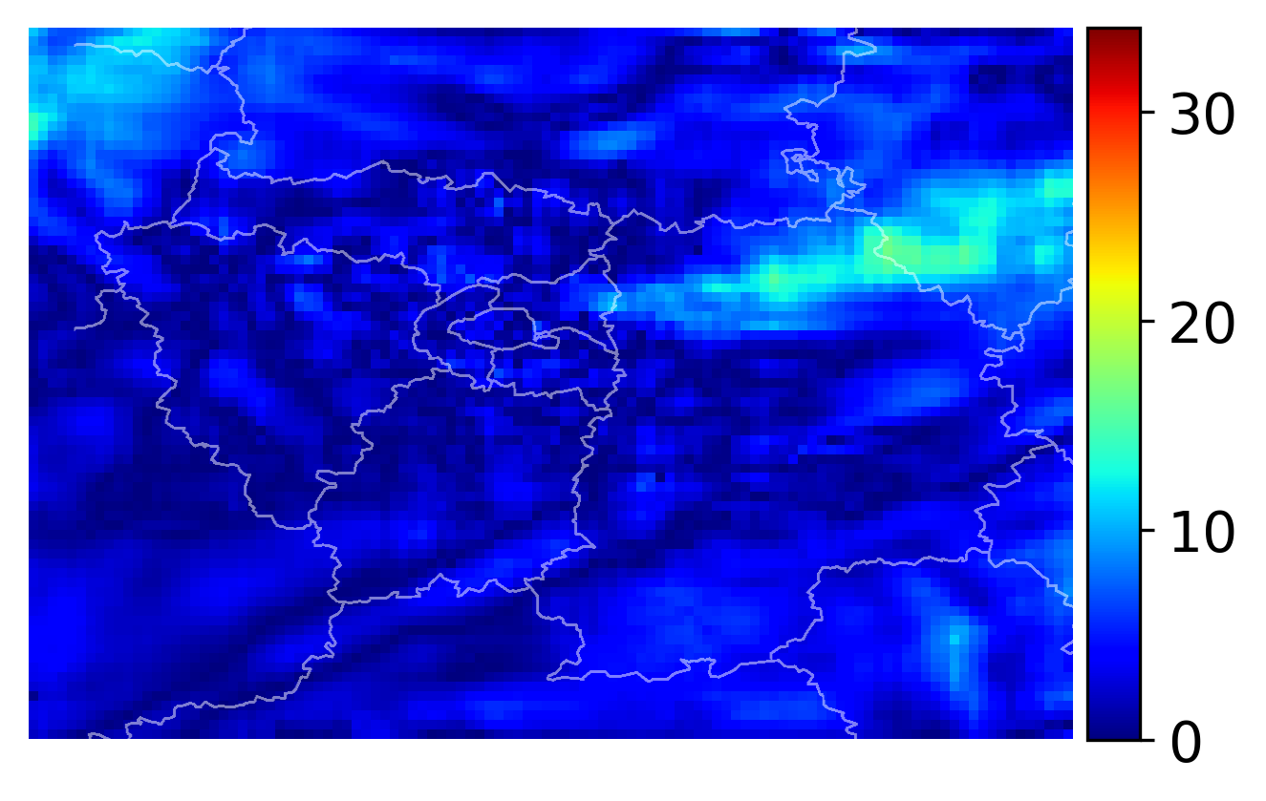




Results
Simulation data
NO2 Ground
Truth
O3 Ground
Truth
Discriminative (VUnet)
Generative (Diffusion)
Kriging (Traditional)

Slide 10














Results
Simulation data
PM10 Ground
Truth
PM2.5 Ground
Truth
Deterministic (VUnet)
Generative (Diffusion)
Kriging (Traditional)

Slide 11





Results
Simulation data – Ensemble effect of Generative model
Stochasticity enables ensembling in diffusion models and it outperforms the best discriminative model.
95% confidence bounding ellipse for ground truth vs predicted points of diffusion model
NO2
O3
PM10
PM2.5

Slide 12




Results
Simulation Data
NO2
O3
Demonstration of reverse sampling in diffusion model along with the power spectral graph of intermediate outputs.
Diffusion implicitly performs alignment in frequency domain!
The reconstruction happens in a coarse-to-fine manner with low frequency components (coarse structure) getting aligned followed by high frequency (fine details)

Slide 13

Results
Real world data
Deterministic
Generative

Slide 14





Results
Real world data
NO2
O3
PM10
PM2.5
Diffusion model has best alignment of power value with polyphemus (ground truth)
Distribution of ground truth vs predicted for real world data for Diffusion model. The error distribution for outer and inner city point is similar which shows our model performs irrespective of location being around a denser sensor network

