Slide 1
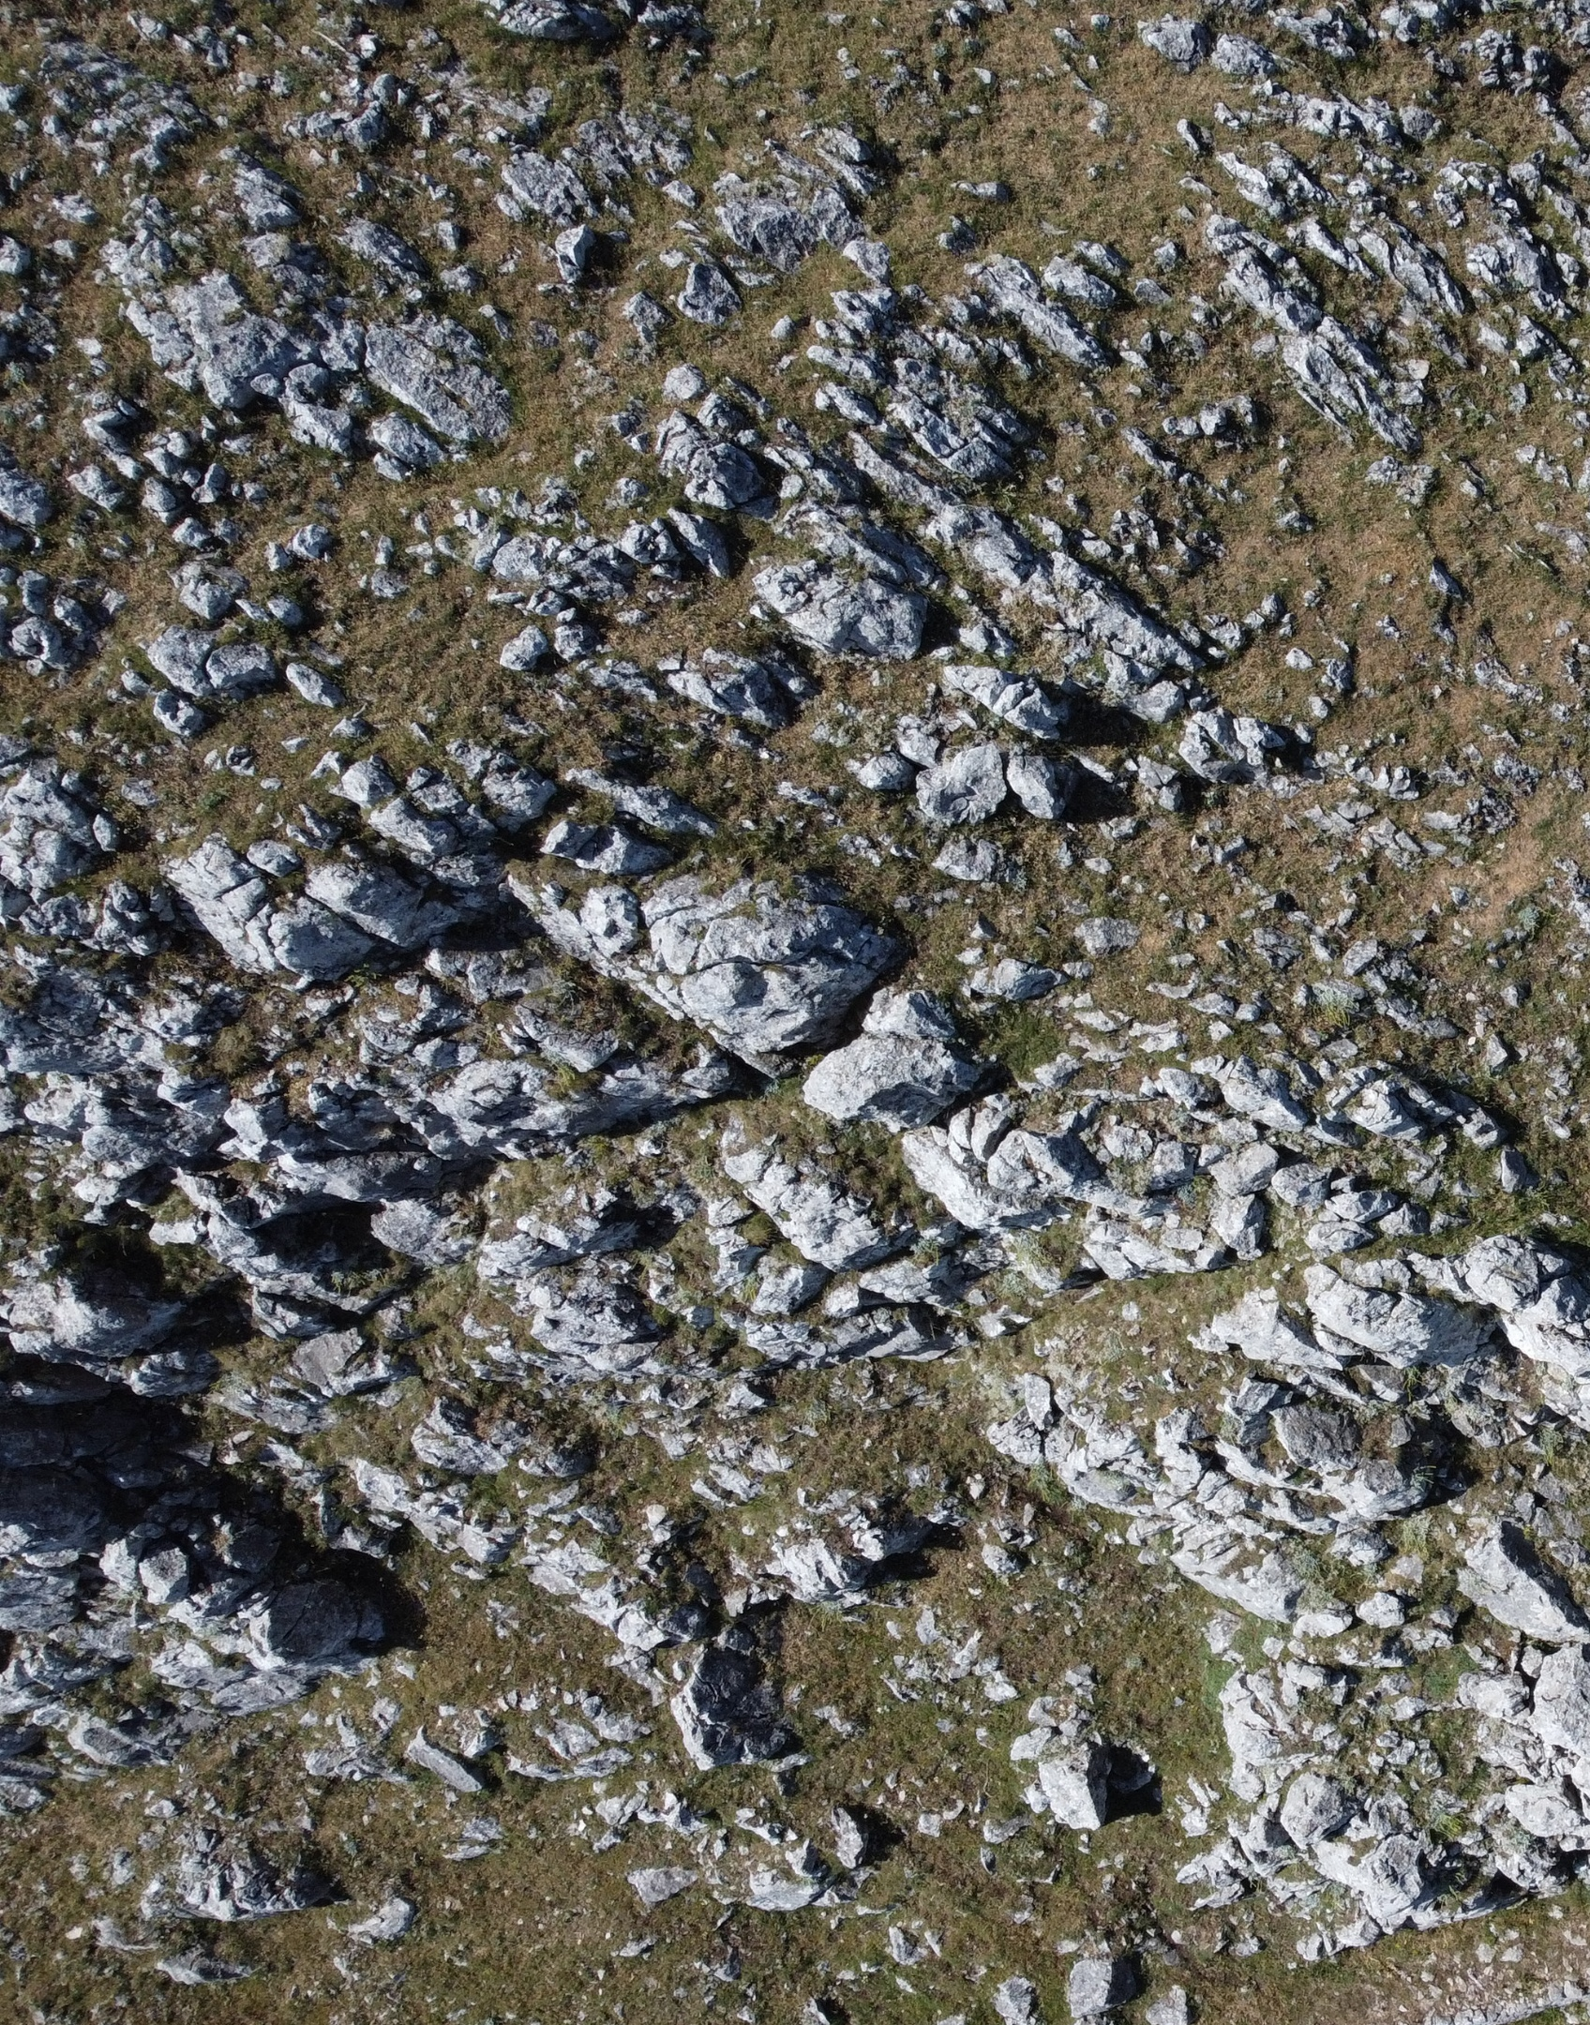

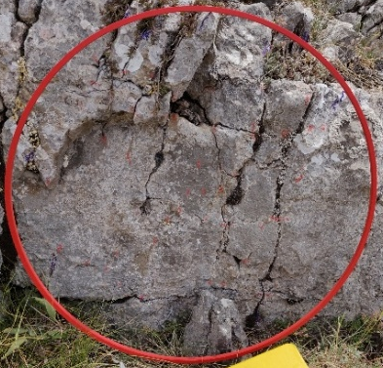
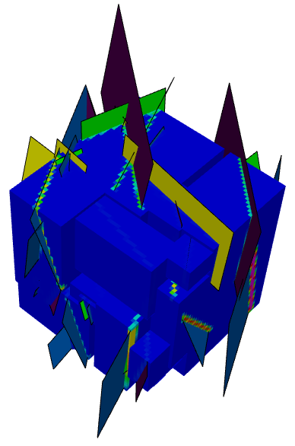
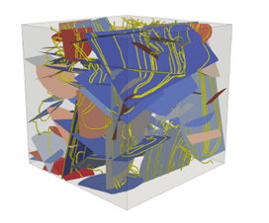
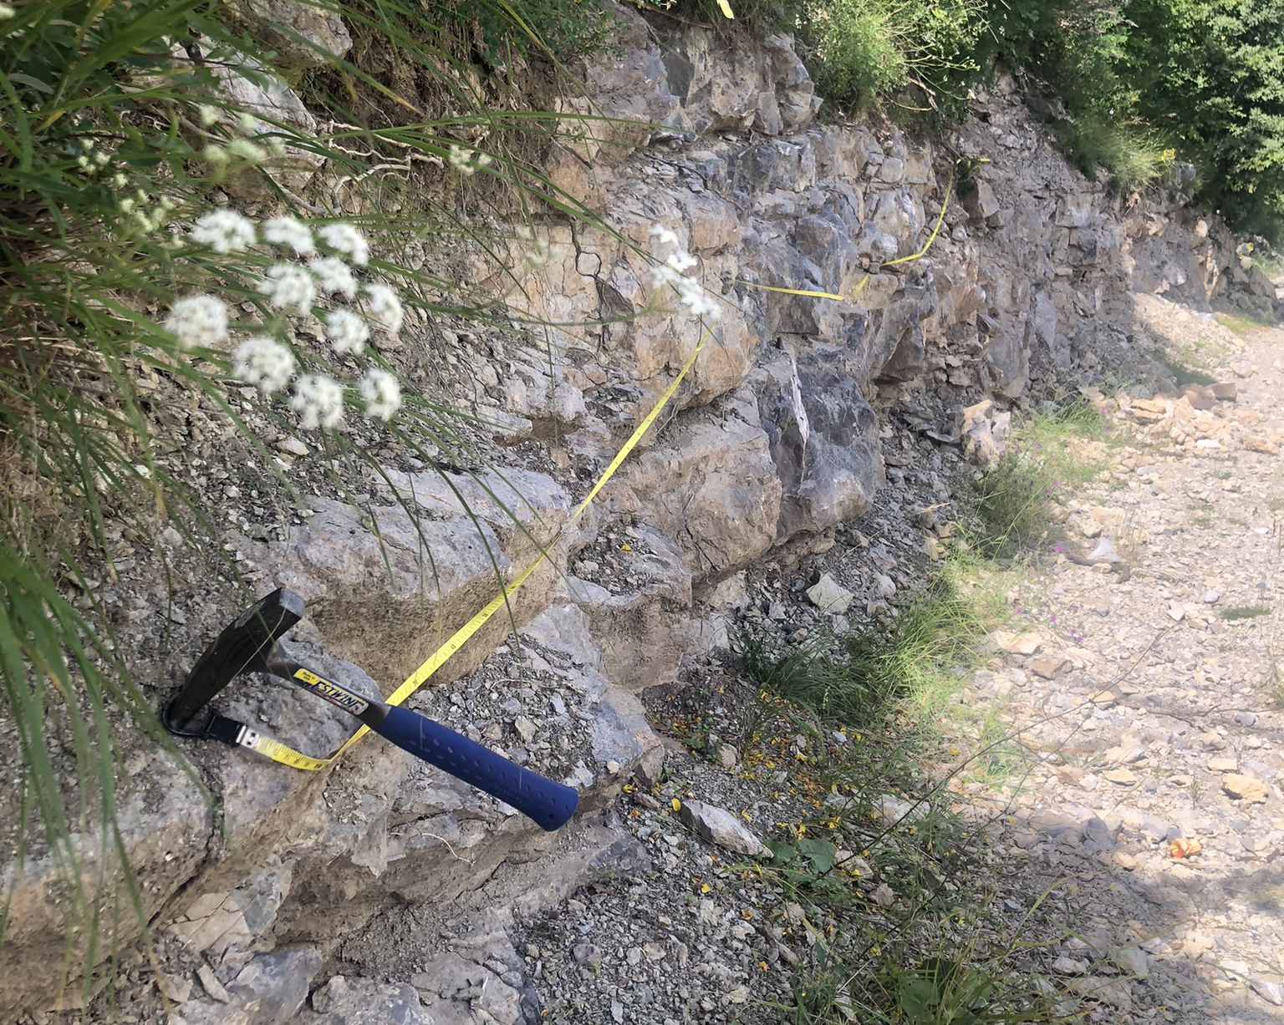

Permeability Anisotropy in Fractured Mesozoic Platform Carbonates under Variable Triaxial Stress Conditions
Ian Abdallah¹, David Healy², Jeffrey Hyman³, Giacomo Prosser¹,
and Fabrizio Agosta¹
¹University of Basilicata, Italy
²University of Leeds, UK
³Los Alamos National Laboratory, USA
𝜎_{zz}
𝜎_{yy}
CSL
Field data
𝜎_{xx}
LSL
LSL
DFN modelling
Flow simulations
Viggiano Mt. Southern Italy
May 4th, 2026

Slide 2
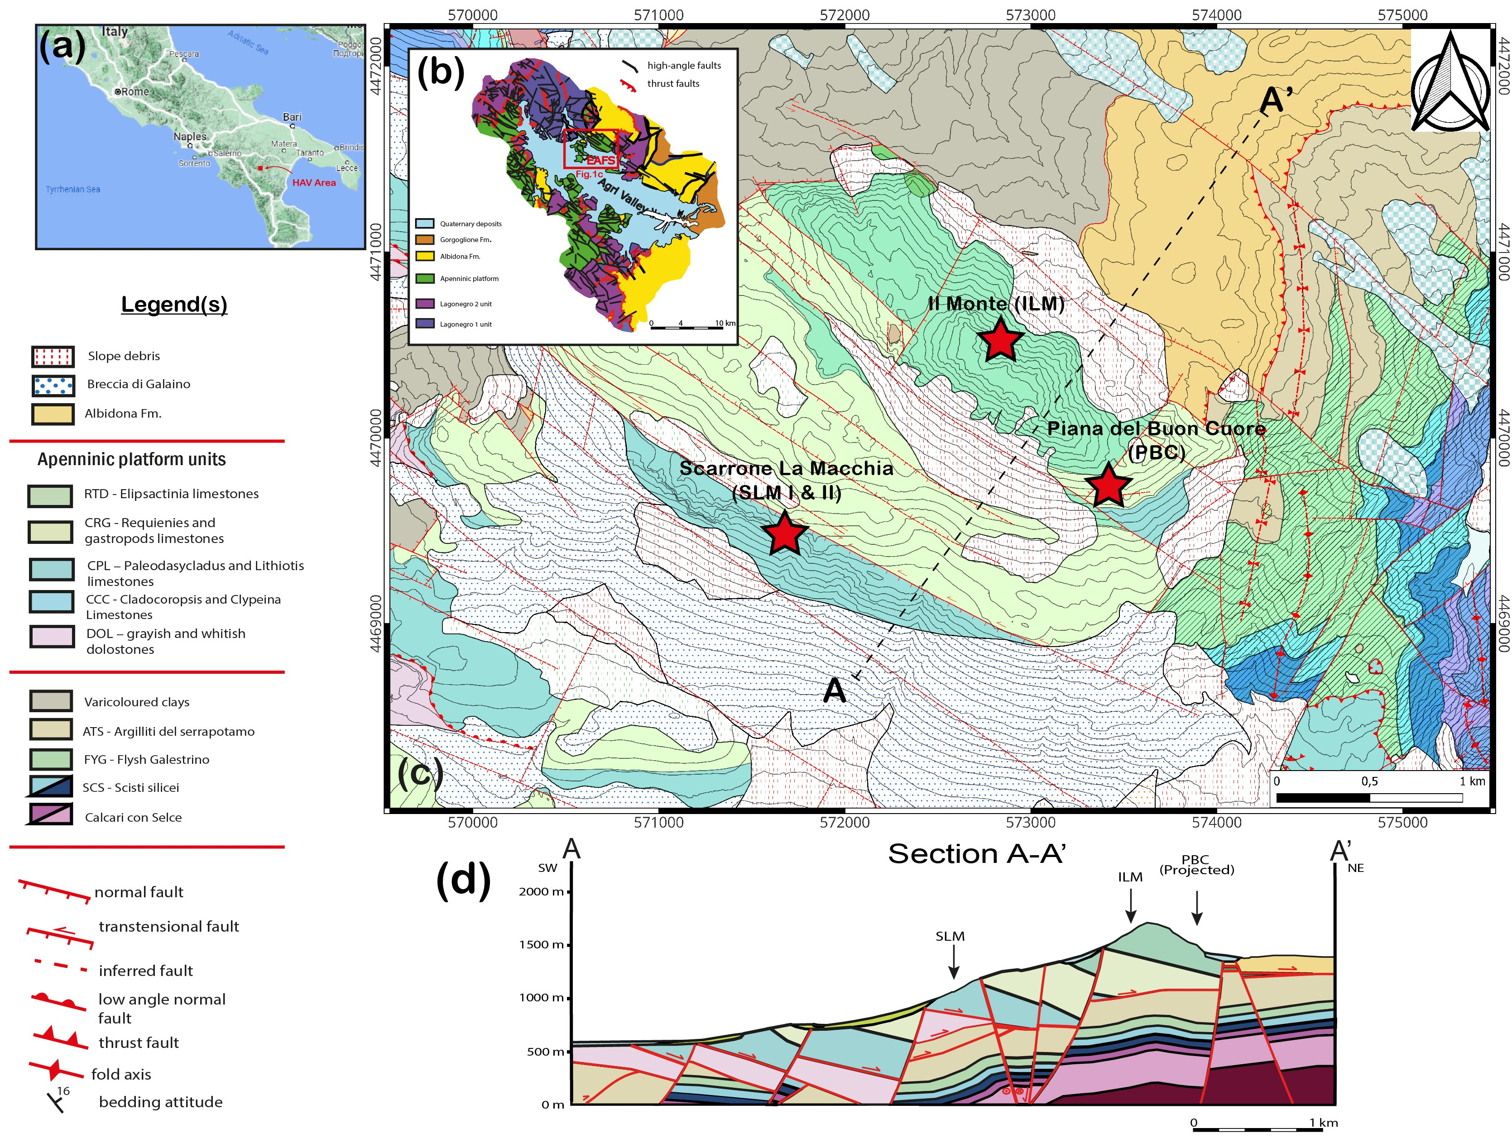
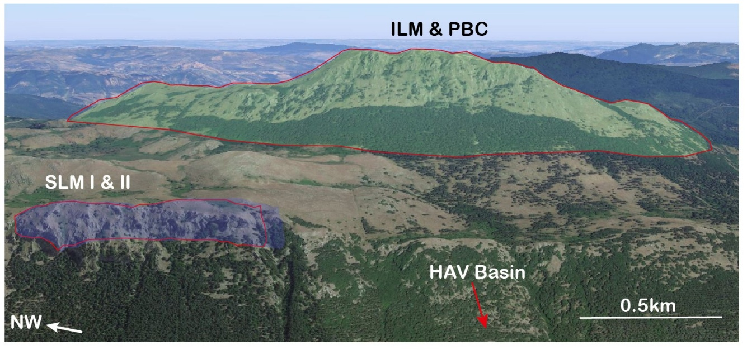
Study area of the Viggiano Mt., Southern Italy
Viggiano Mt. ~15km²
East Agri Fault System:
N90-120
N20-30
N130-150
Il Monte (ILM) – U. Cretaceous
Piana Buon Cuore (PBC) – L. Cret/U. Jura.)
Scarrone la Macchia (SLM I & SLM II) – Toarcian & Sinemurian/Pliensbachian
(High Agri Valley, HAV)
(High Agri Valley, HAV)
Platform carbonates
Basinal carbonates
2/10
(modified after Palladino et al., 2023)

Slide 3
Stratigraphic setting and outcrop-scale structural elements
Il Monte (ILM)
Massive carbonates high energy, deposited along the paleo-slope of the carbonate platform Cretaceous (Albian – Cenomanian)
Scarrone la macchia (SLM I & II)
SLM I & SLM II
PBC
Massive carbonates high energy, oolites, oncolites and intraclasts, deposited on a platform margin environment (L. Cretaceous to Upper Jurassic)
SLM I & SLM II
• Oolithic carbonates high energy depositional settings, carbonate ramp rimmed by sand shoals (Toarcian)
• Well-layered carbonates low-medium energy, open lagoonal setting (Sinemurian-Pleinsbachian)
3/10

Slide 4
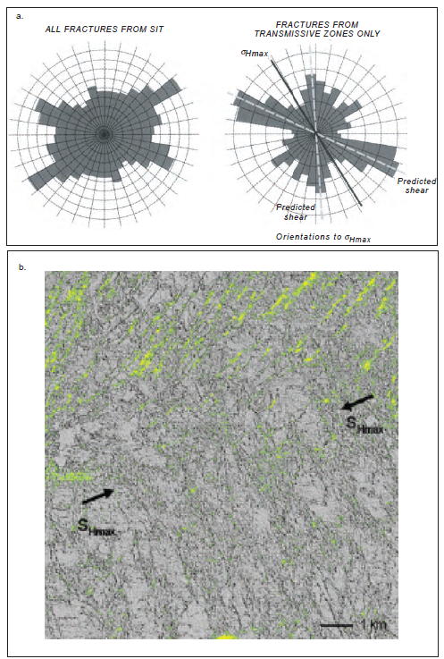
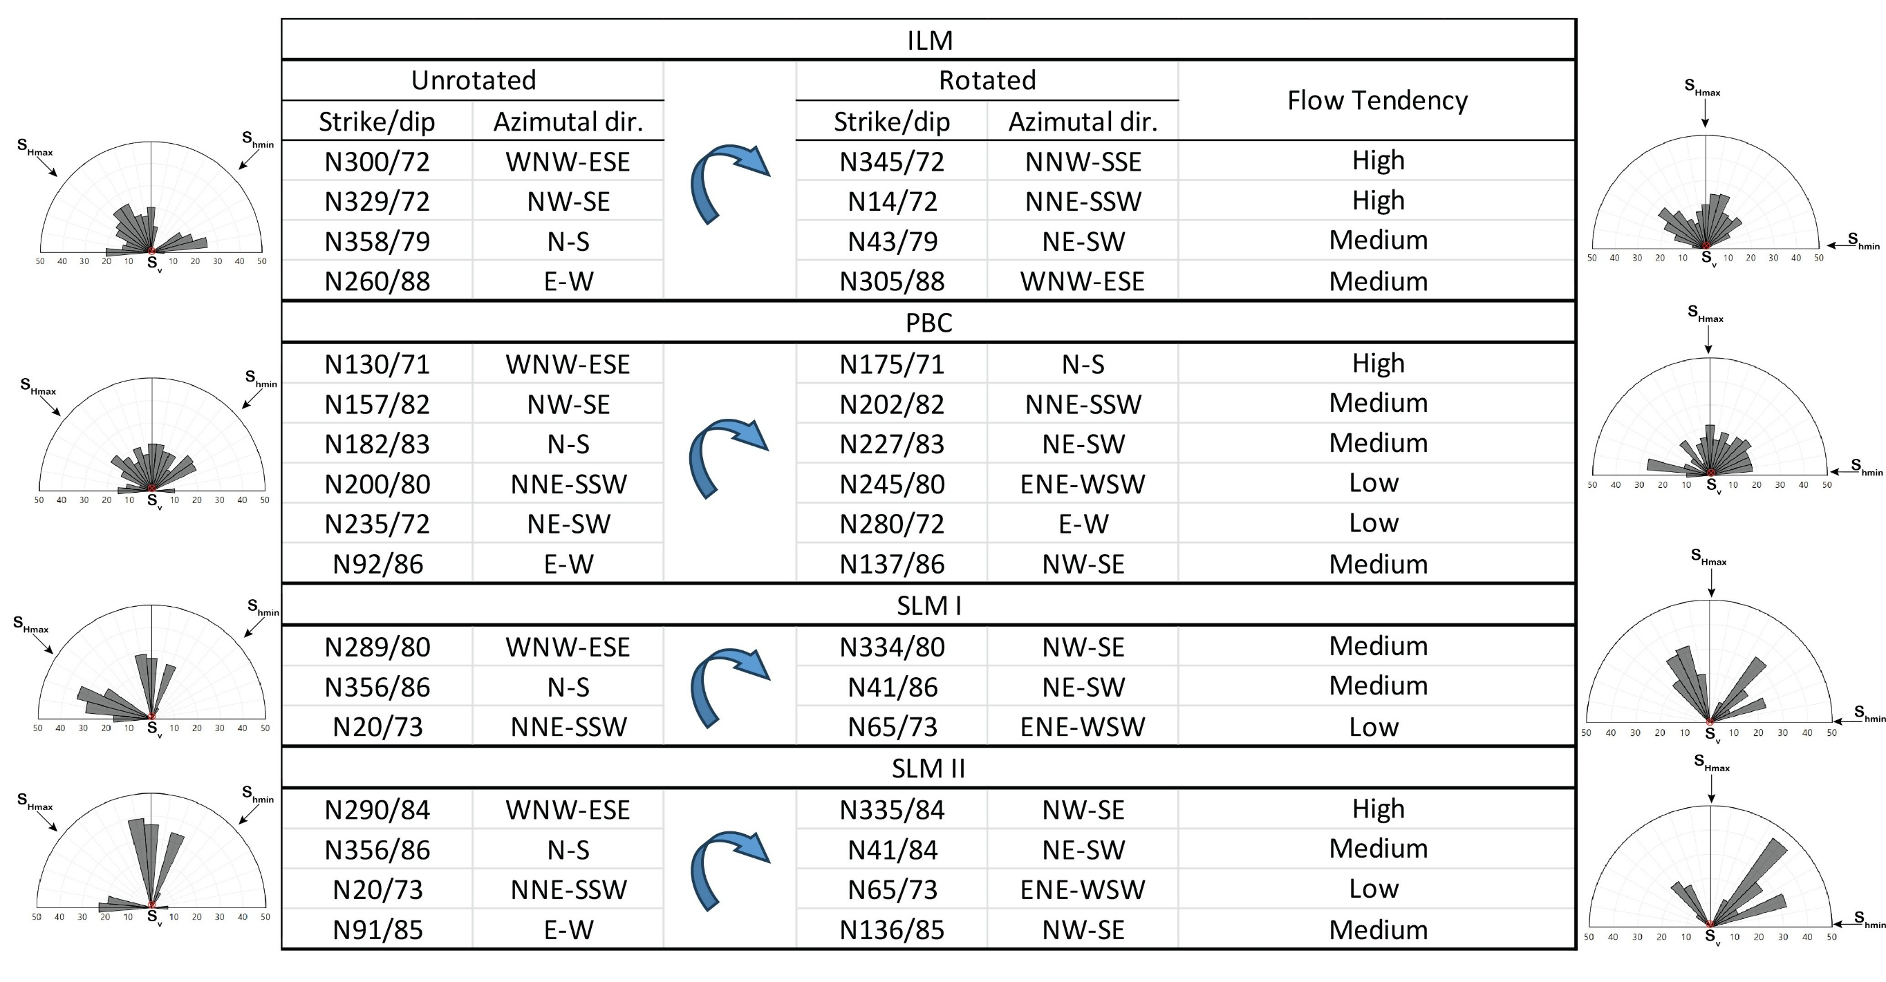
Critically stressed fracture hypothesis – High tendency to flow
Critically stressed fractures are fractures that are just at the verge of slipping or dilating under the current in-situ stress field
The shear stress acting on their surfaces is nearly equal to the frictional resistance that holds them closed
When a fracture is critically stressed, it tends to be hydraulically active
Crictically stressed fractures, oriented ~ 30 degrees to the maximum horizonal principal stresses are most likely to flow
Our data
σ_{v} ≈ 13 MPa, σ_{hmax} ≈ 10 MPa (NW–SE), and σ_{hmin} ≈ 7.6 MPa (NE–SW)
Geologically connected may not be hydrologically connected
6/10
(Ligtenberg et al., 2005; Barton et al., 1995; Heffer, et al., 1993, 1995; Gutmanis et al., 1998; Roger, 2003; Zoback, 2010).

Slide 5
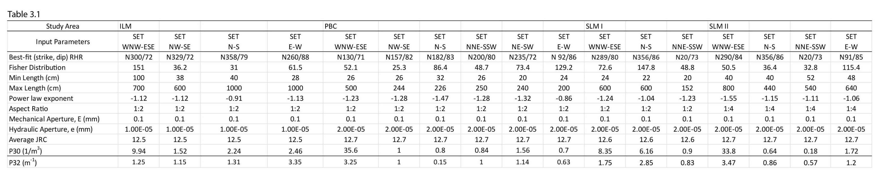
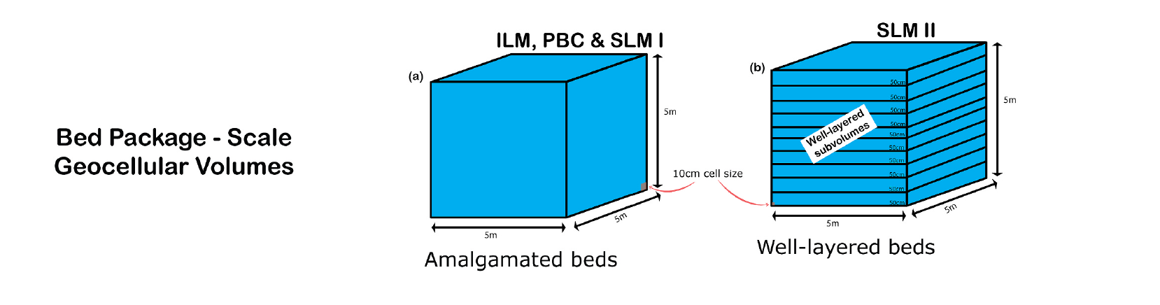
Methods – Data Input & DFN model configurations
Unstressed model → aperture = min 0.1 mm (prop. to length)
Stressed model → aperture= stress vs. aperture correlation
DFN models for fractures at 500m aquifer equivalent depth
4/10

Slide 6
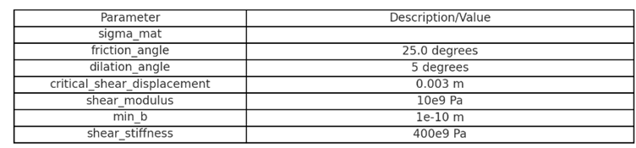


Methods – In-situ stress conditions
At 500m depth: σ_{v} ≈ 13 MPa, σ_{Hmax} ≈ 10 MPa (NW–SE), and σ_{hmin} ≈ 7.6 MPa (NE–SW).
$$S_{v}> S_{Hmax}> S_{hmin}$$
Stress-modulated aperture values
$$b= b_{o} − U_{n}+ U_{d}$$
After Barton – Bandis model
$FVM, Keff=\frac{q∗ μ}{∇P}$
b – computed aperture value
b_{o} -​ minimal aperture value
U_{n} - displacement due to normal stresses
U_{d} - displacement due to shear stresses
Barton, 1982
Bandis et al.,1983
Lisle et al., 2006
Baghbanan and Jing, 2008
Jaeger and Cook, 2007
Stabile et al., 2021
Additional geomechanical parameters:
$$direchlet boundary conditions$$
LANL, NM, USA
5/10

Slide 7
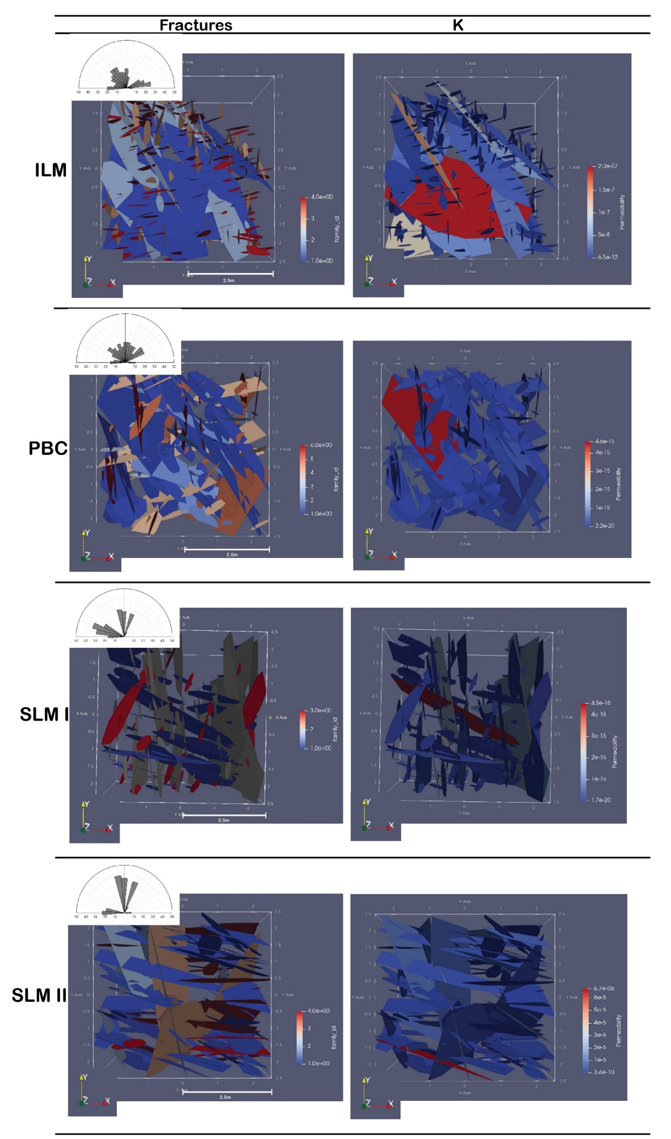
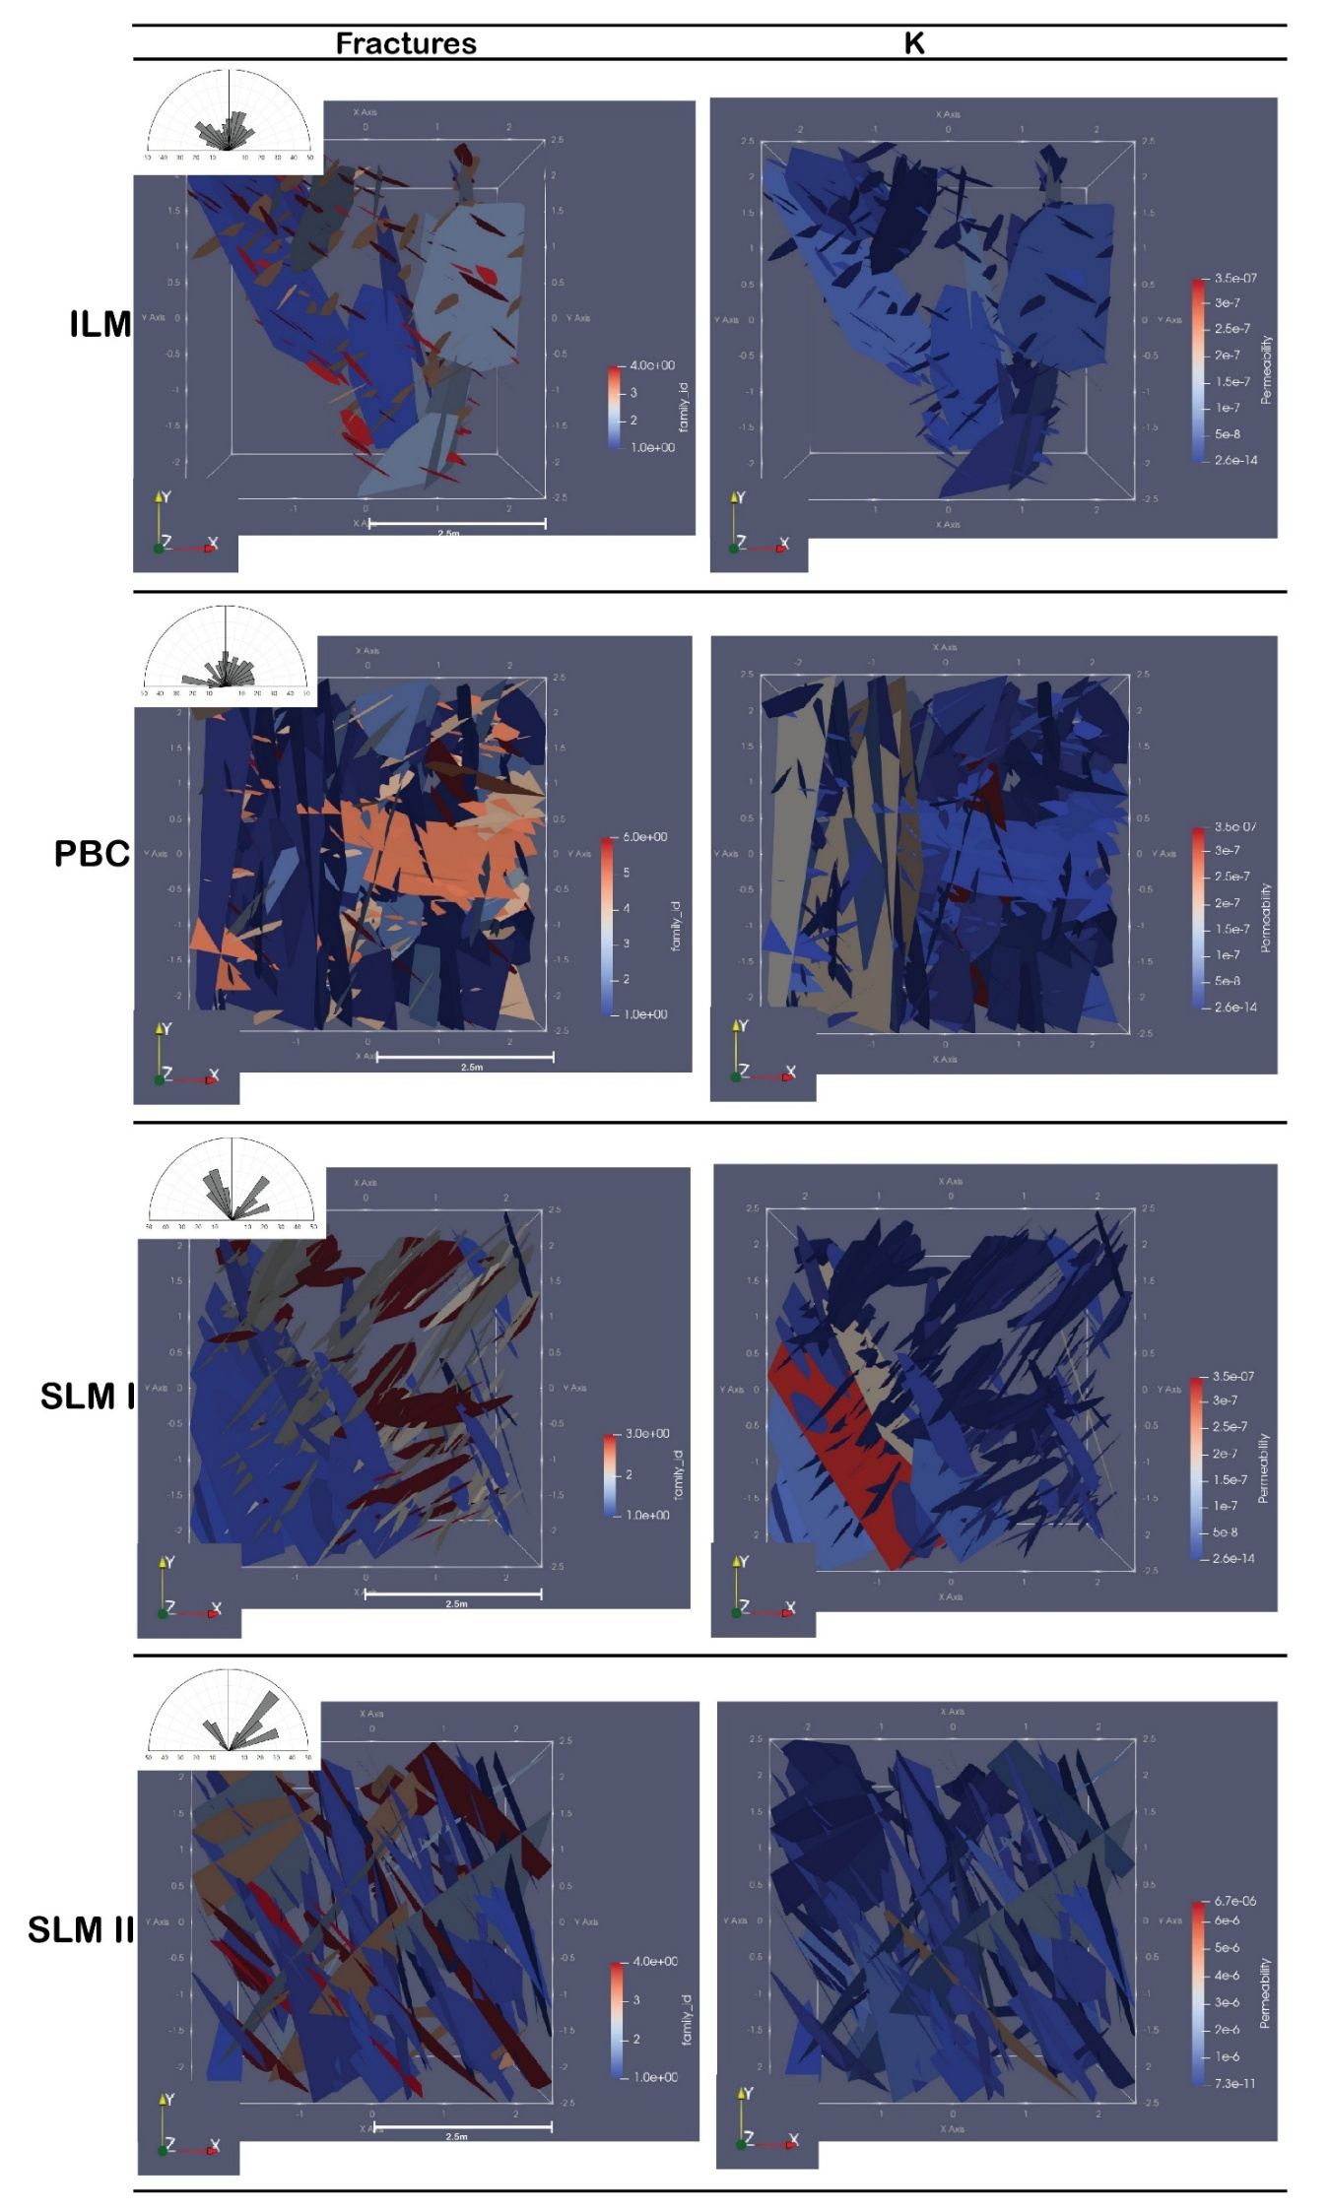
Results - Graphical results for unstressed & stressed DFN models
unstressed & stressed
7/10

Slide 8
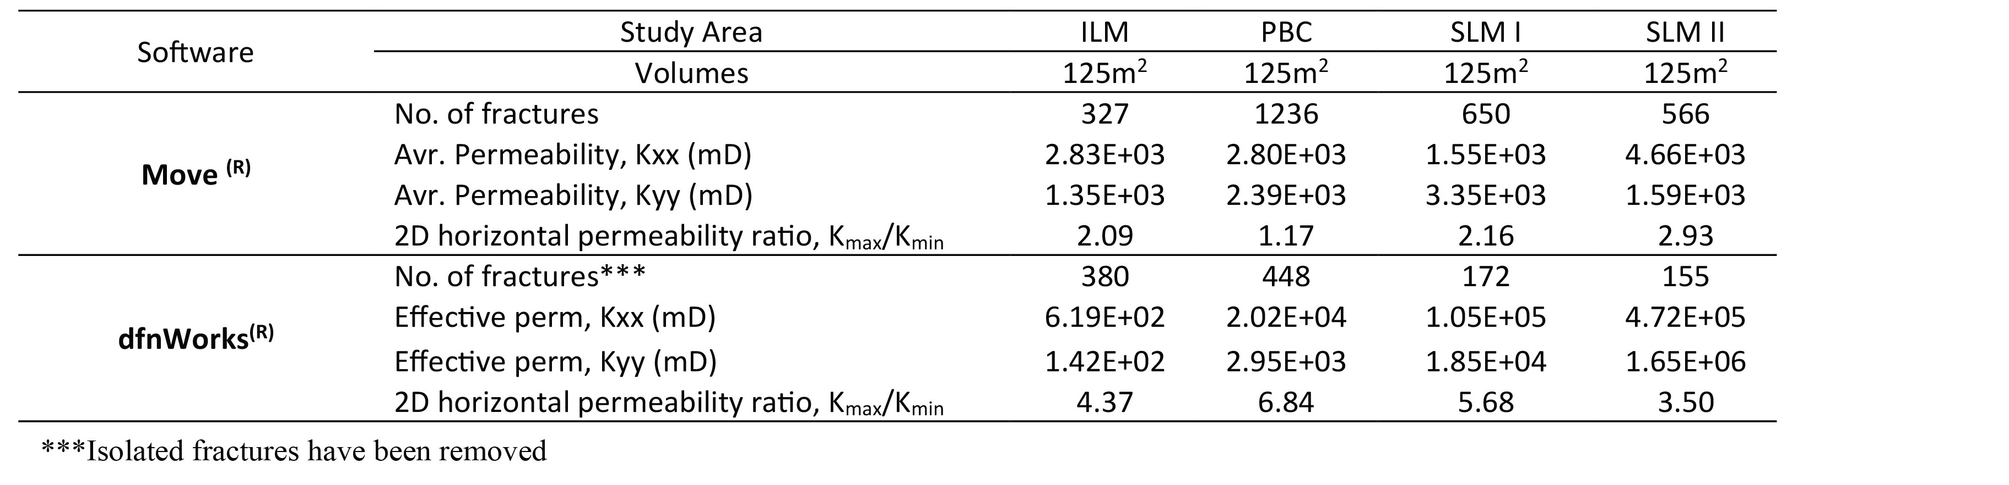

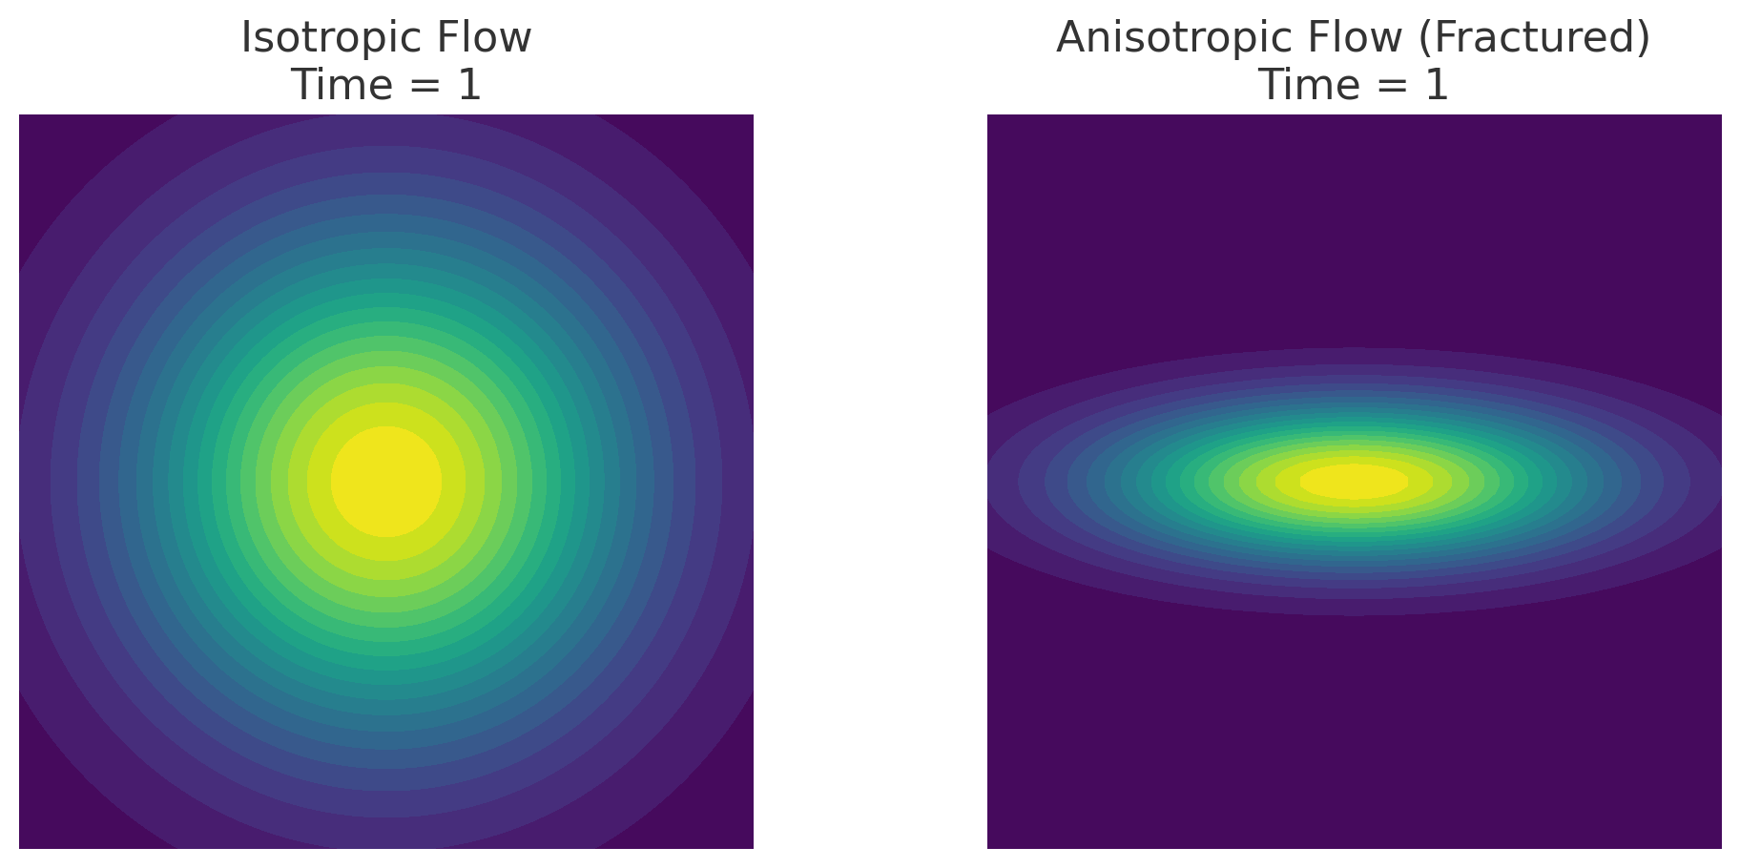
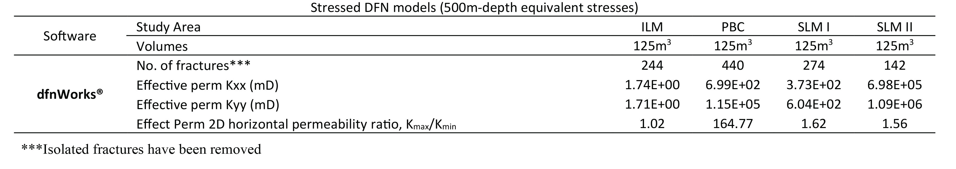
Results – Stress Dependent Permeability Anisotropy (kₘₐₓ/kₘᵢₙ)
(from Abdallah et al., 2024; JSG)
Unstressed DFN models -> minimum Aperture: 0.1mm Proportional to Length
Stressed DFN models -> Aperture: stress – modulated for 500m depth
σ_{v} ≈ 13 MPa, σ_{hmax} ≈ 10 MPa (NW–SE), and σ_{hmin} ≈ 7.6 MPa (NE–SW)
dfnWorks®- ILM, SLM I, showed reduction in effective permeability, K_{eff} value due to stress
dfnWorks®- PBC, and SLM II, we see combined gain and loss of effective permeability, K_{eff},
dfnWorks®- when subjected to stresses, ILM, SLM I, and SLM I result more isotropic flow, PBC behaves differently
Fractures at the subsurface may behave differently from what is observed on outcrops – permeability ellipses may differ
8/10

Slide 9
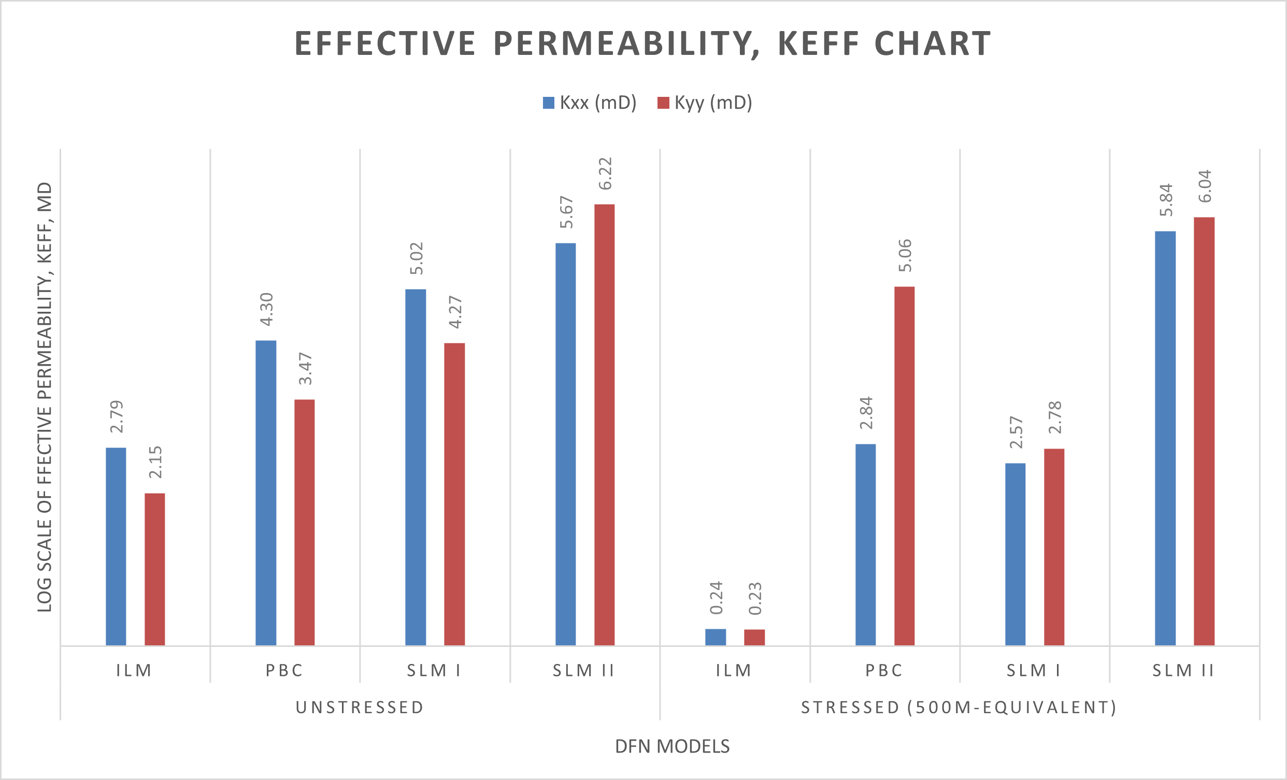
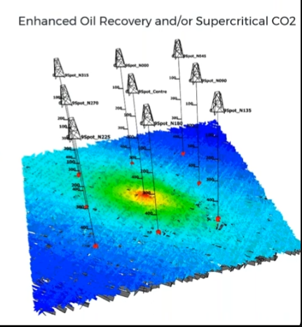
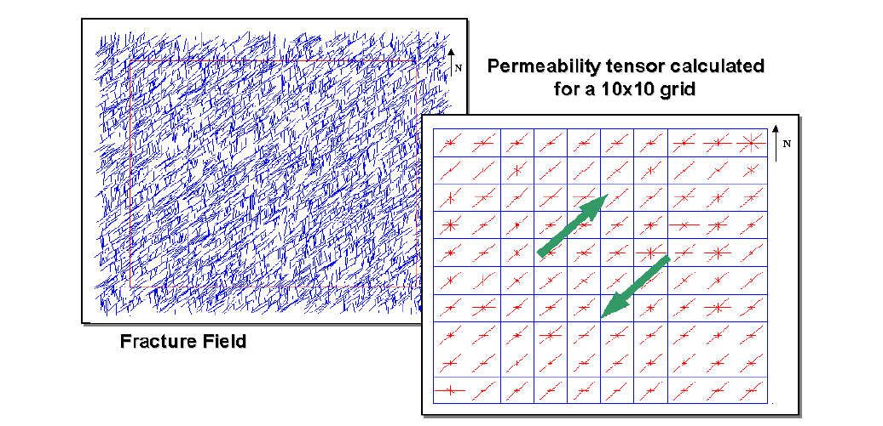
Summary and Applications
Geologically connected may not be hydrologically connected
Depositional settings plays a major role in fracture behavior, connectivity and permeability anisotropy – SLM II : Bed interfaces confining fractures may result in laterally or horizontal longer fractures, - interplay with NSBs could lead to more connectivity and fluid-flow
NSB tend to form longer, more persistent fracture enhancing vertical permeability
Stressed DFN models → PBC shows increase in permeability anisotropy ratio when compared with unstressed models of the same sizes
ILM, SLM I, SLM II undergoes the opposite effect → opening of new channels → more isotropic flow at 500m depth
Summary
(Abdallah et al., under revision; GSL)
Applications
DFNs and geomechanical models translate field data into permeability tensors and flow anisotropy maps
Directional permeability guides well placement, injection design, and reservoir performance prediction
Applications extend to geothermal systems, CO₂ storage, groundwater flow, and environmental risk assessment
9/10

Slide 10
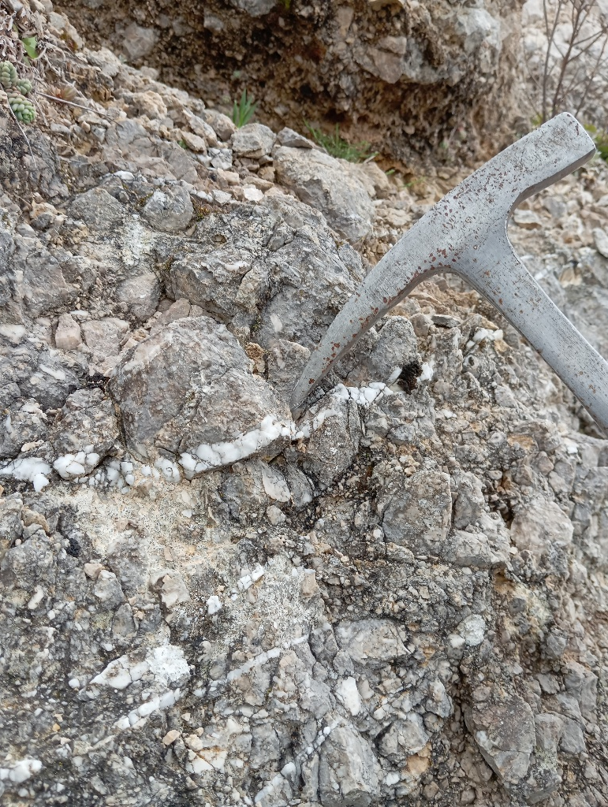
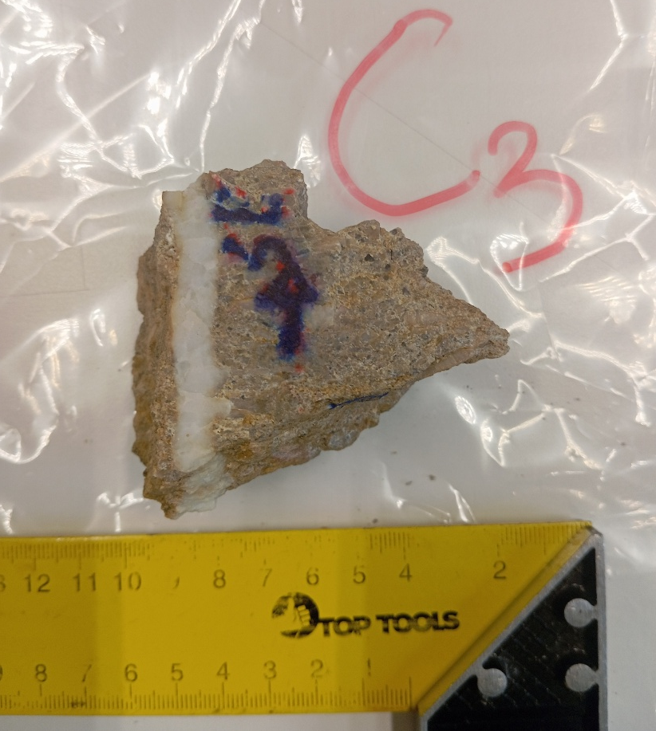
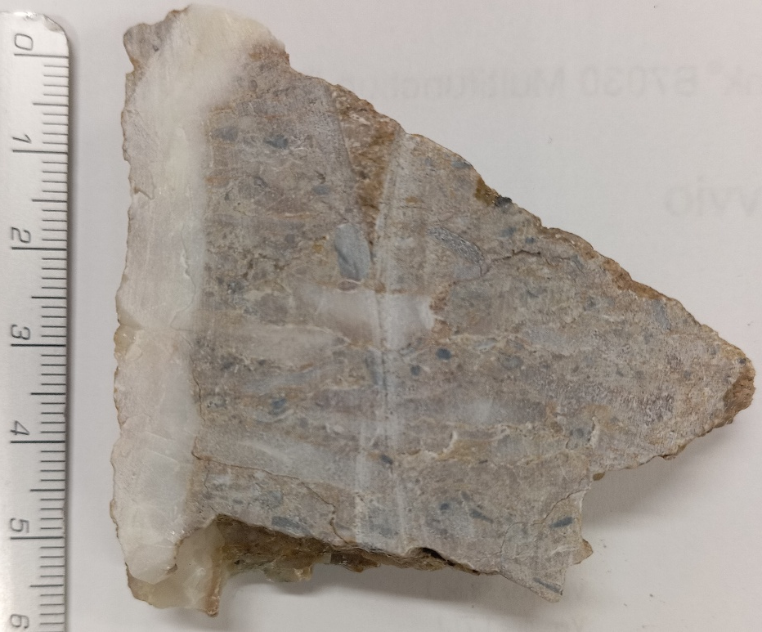
Ongoing work:
DFN Modeling Enhanced by True Aperture Data
The problem of fracture aperture data:
data points after field inspection of both well-layered and oolithic limestone rocks
Paleo‑Aperture Data
Within and away from fault-zones
1. Field & Lab Workflow:
• Collect vein samples systematically (outcrop & core)
• Thin section & cathodoluminescence analysis → syn‑fracturing vs. sealing veins
• Blocky, Crack-seal bands and fibrous textures as paleo‑aperture proxies
2. Integration into DFN Models:
• Use measured paleo‑aperture distributions for realistic aperture scaling
• Distinguish open vs. sealed fractures for hydraulic connectivity
• Improve stress-aperture coupling and permeability anisotropy predictions
Thank you all
for
listening
10/10

