Slide 1

Impact of extreme heat on building cooling energy demand: a hybrid model based on the coupling of indoor and outdoor climatevariations
Ziyi Cao
Shanghai Jiao Tong University, China-UK Low Carbon College
2026-05-05
Notes:
Good afternoon, everyone. I'm Ziyi Cao from Shanghai Jiao Tong University, China-UK Low Carbon College.On behalf of my co-author, Wang Kai,it’s my pleasure to be here and give all of you my brief introduction about my research. In this study, we focus on predicting air conditioning operation status and estimating power consumption during high-temperature periods by using indoor-outdoor temperature-humidity data.

Slide 2
Contents
1. Background and Significance of the Study
2. Research Approach and Methods
3. Current Research Results
4. Future Research Plans
Notes:
My presentation is mainly divided into the following four parts:

Slide 3
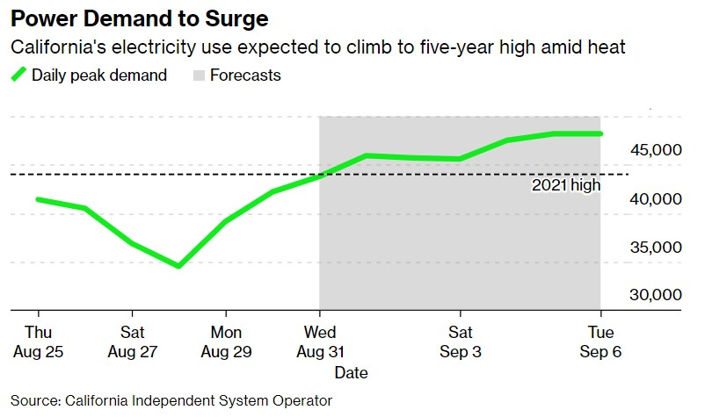
Research Significance and Background
Rising temperatures lead to increased use of air conditioning, causing urban energy consumption to spike, particularly during heatwaves. This poses challenges for energy management and sustainability, as seen in California's potential power shortages in 2022 due to prolonged heat and drought.
Accurate predictions of cooling demand during these periods are essential for sustainable energy use and urban planning.
Fig.1 California's electricity usage is expected to reach its highest level in five years due to the hot weather
Notes:
Buildings consume 40% of global energy, with AC as a key driver. During heatwaves, AC usage increases rapidly, just as the picture shows...。 Our work aims to predict AC states and power use by combining behavioral patterns and environmental data.

Slide 4
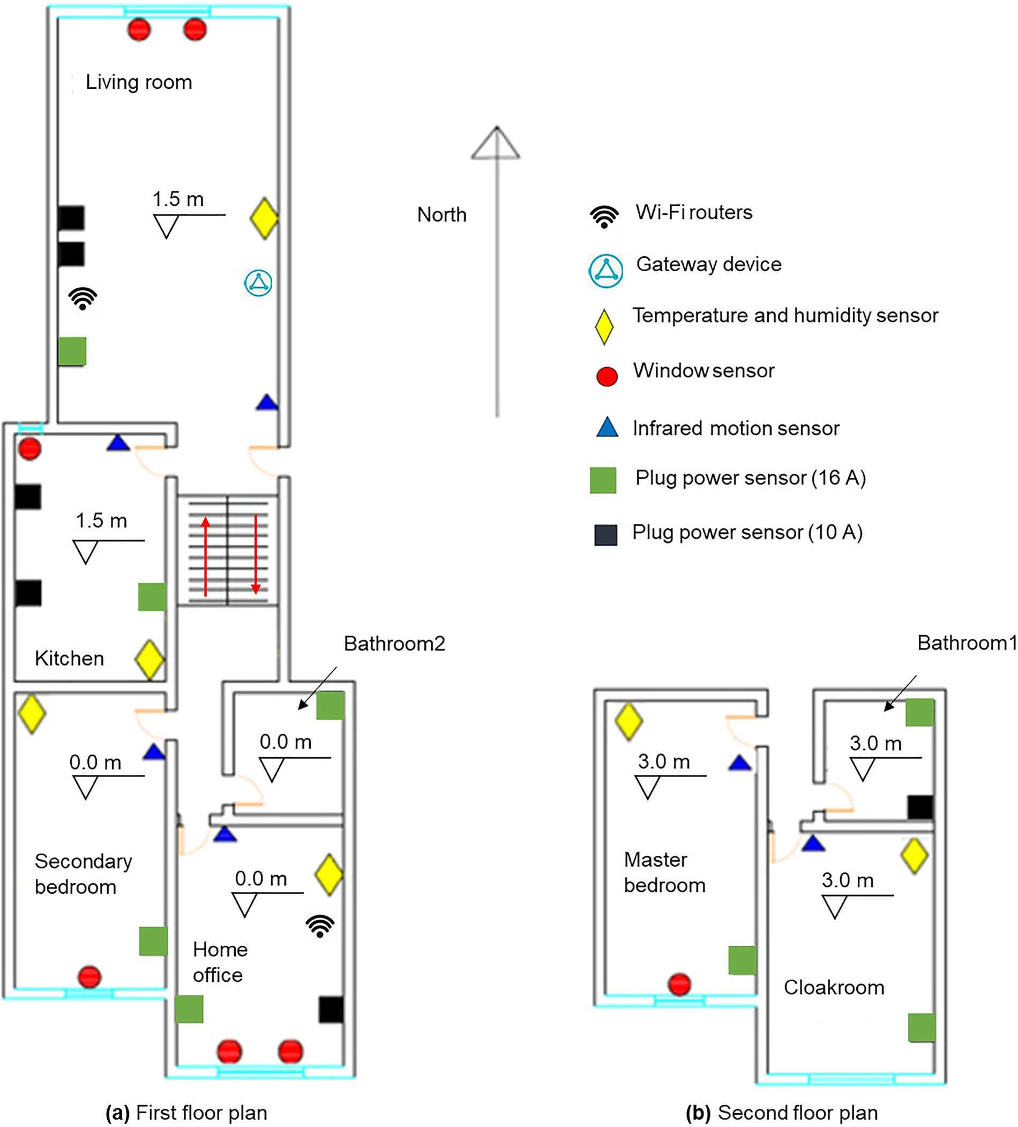
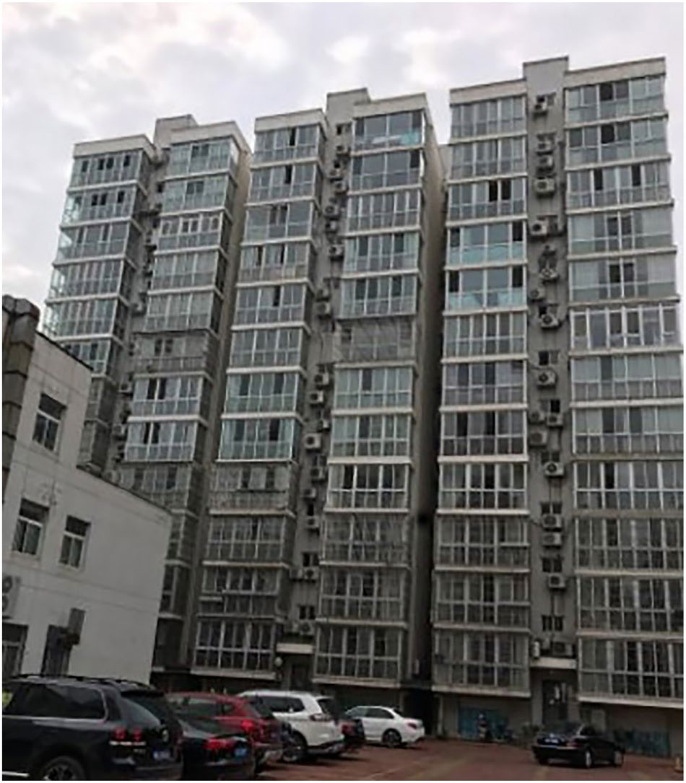
Dataset Interpretation
The dataset of this study is sourced from the public dataset of the paper, CN-OBEE[1]. It includes the indoor and outdoor temperature, humidity and air conditioning power data of an home office room in Beijing from June to September 2021.
Fig.2 Building appearance (south elevation).
Fig.3 Floor plans of apartment and sensor locations.
[1]. Wang, C., Li, X., Sun, W., An, J., & Gao, S. (2024). Occupant behavior, thermal environment, and appliance electricity use of a single-family apartment in China. Scientific Data, 11(1), 65

Slide 5
Methodology Overview
Feature engineering (time windows, weighted features)
XGBoost for state prediction
Distinguish the AC status based on indoor and outdoor temperature and humidity data over different time periods
Urban user-level scale regional expansion calculation
Pelt algorithm for change-point detection
Calculate Pac through equations
Notes:
Here is the brief research method. Our approach distinguishes AC status based on indoor and outdoor temperature and humidity data over different time periods. We use feature engineering to capture temporal patterns, predict AC states with eXtreme Gradient Boosting, refine the results with Pelt’s change-point detection, and estimate power consumption using a heat balance model.This method can be used to process the collected data on the residents' rooms in the area, thereby enabling the calculation of urban area expansion.

Slide 6
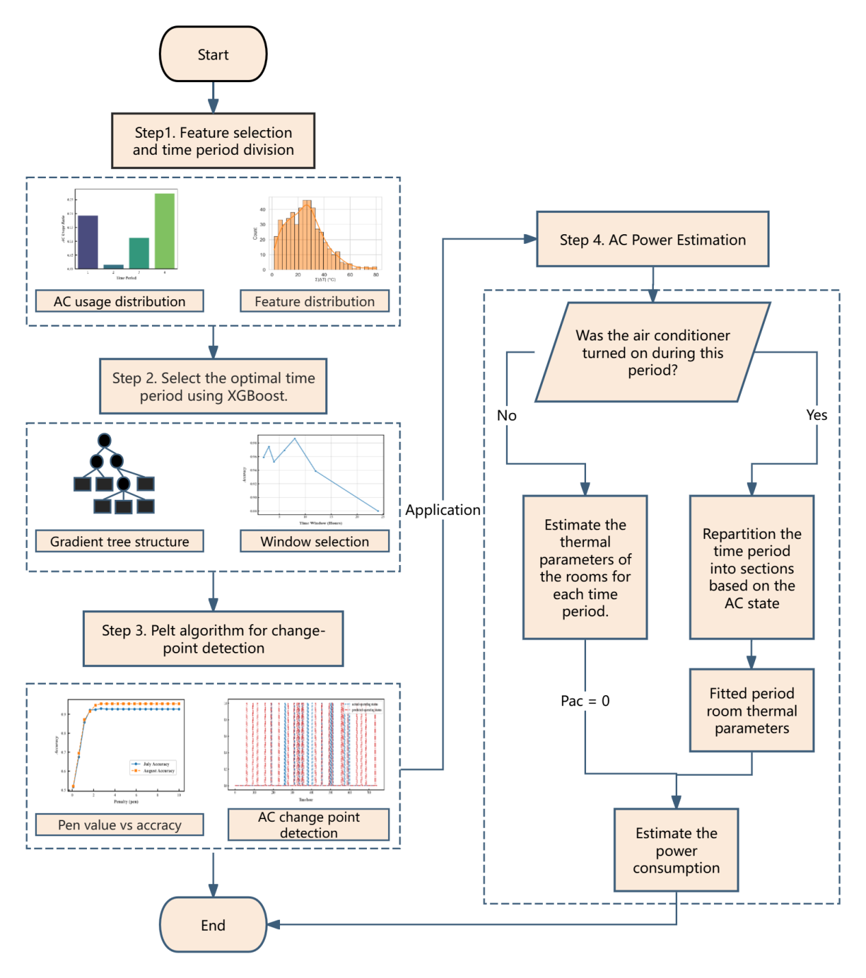
Workflow
Fig.4. The workflow of AC operation status prediction and power estimation model
Notes:
Here is the detailed workflow. As previously mentioned, feature engineering is applied to process the indoor and outdoor temperature and humidity data for distinguishing the operating status of air conditioners. The thermal parameters are fitted through the thermal balance equation when the air conditioner is turned off, and the air conditioner power is recalculated using the well-fitted thermal parameters.

Slide 7
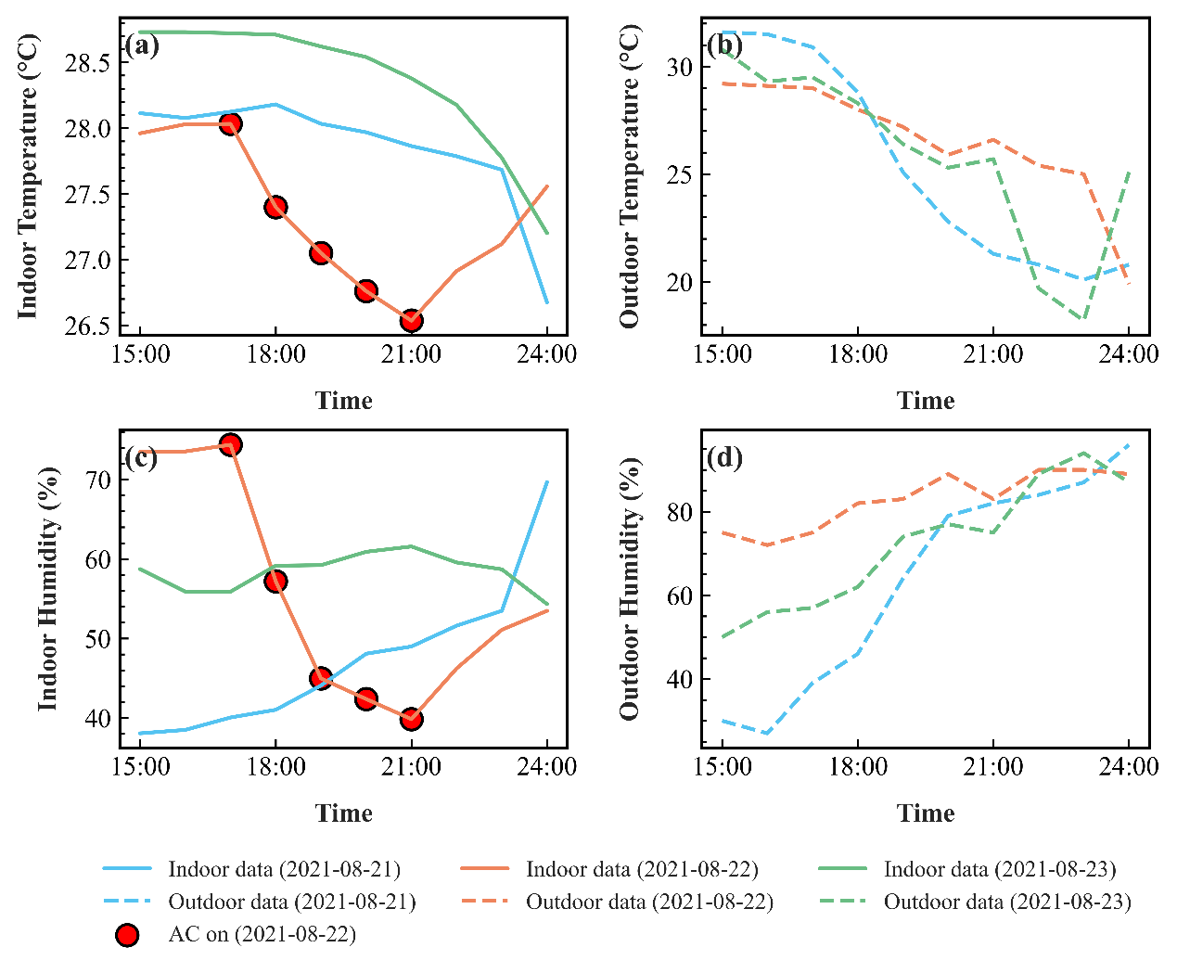
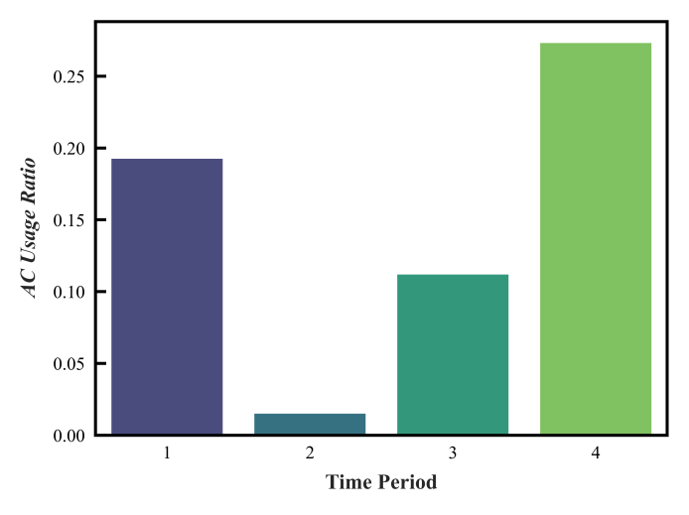
Feature Engineering
Fig.5 Distribution of AC usage by time periods (0–6, 6–12, 12–18, 18–24 Hours)
Fig.6 Temperature and Humidity Trends with AC Usage (August 21-23, 2021): (a) Indoor and Outdoor Temperature Trends, (b) Indoor and Outdoor Humidity Trends
Notes:
For the data processing part, as shown in fig 4, AC usage peaks at night (0–6 and 18–24), associating with human behavior patterns.We identified critical features like indoor-outdoor humidity differences.

Slide 8
Feature Engineering
Predict the maximum AC state (ac_on_max) within each window
Table 1: Feature Input of the AC State Prediction Algorithm
Notes:
AS for feature engineering, these features were caculated for each time window and used as input to the classifier. The model was trained to predict the ma AC state ,which indicates whether the AC was turned on at any point during that period.

Slide 9
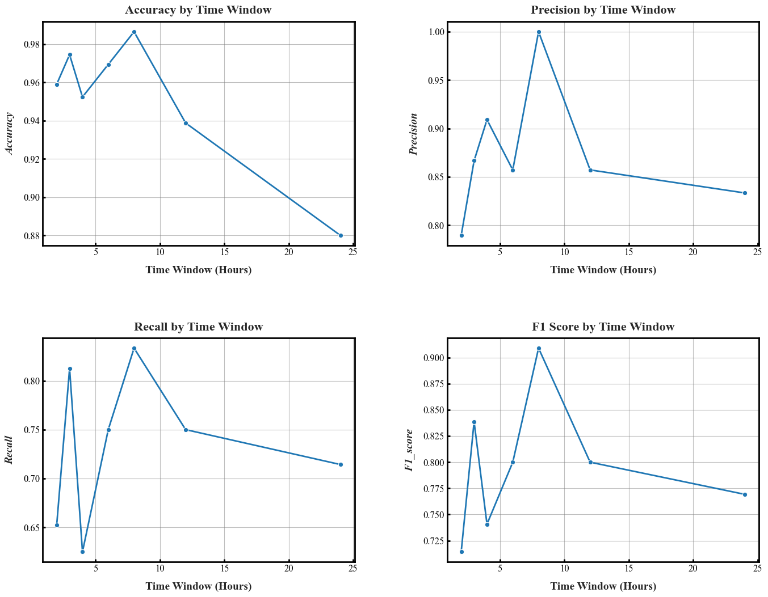
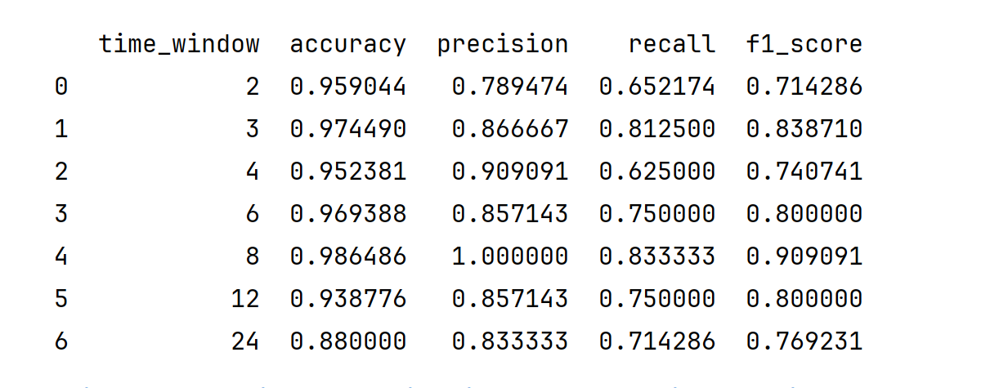
XGBoost for time window AC state prediction
Fig.7 The result of feature time window division by xgboost
Notes:
Here is the result for the most suitable time window to analyze air conditioning (AC) state transitions,we can see the 8-hour window strikes a balance—long enough to smooth noise but short enough to detect transitions.

Slide 10
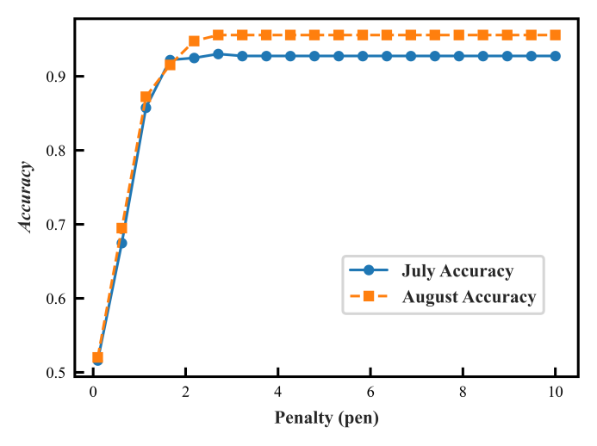
Weighted Feature input of AC state Change-Point Detection
Fig.8 Accuracy comparison across pen values for July and August
Table 2. Weighted Feature Input of AC State Change-Point Detection
Notes:
Each feature at the current moment, as listed in Table 2. And the training process diagram of the PELT parameters
(The key parameter for the Pelt algorithm is the penalty value (pen), which controls the sensitivity of change-point detection.To determine the optimal penalty value (pen), we evaluated the algorithm's performance on July and August data .And the training process diagram of the PELT parameters)

Slide 11
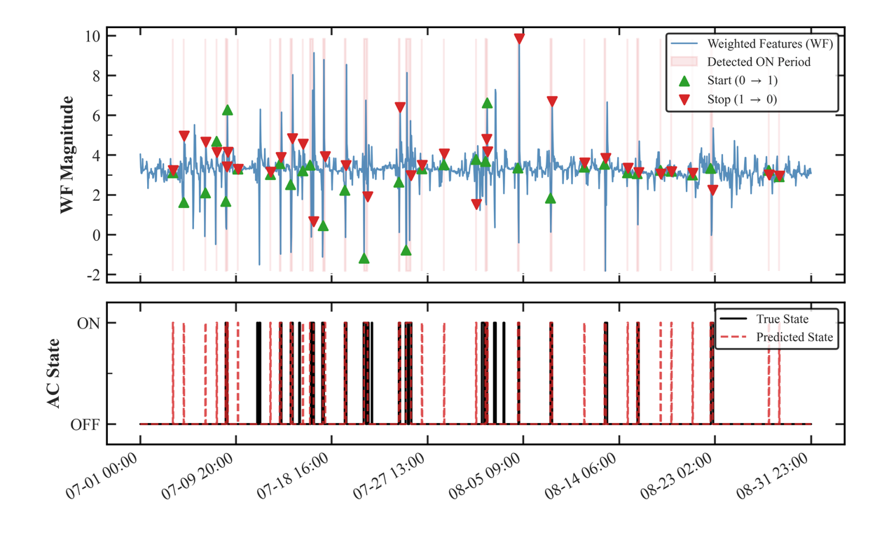

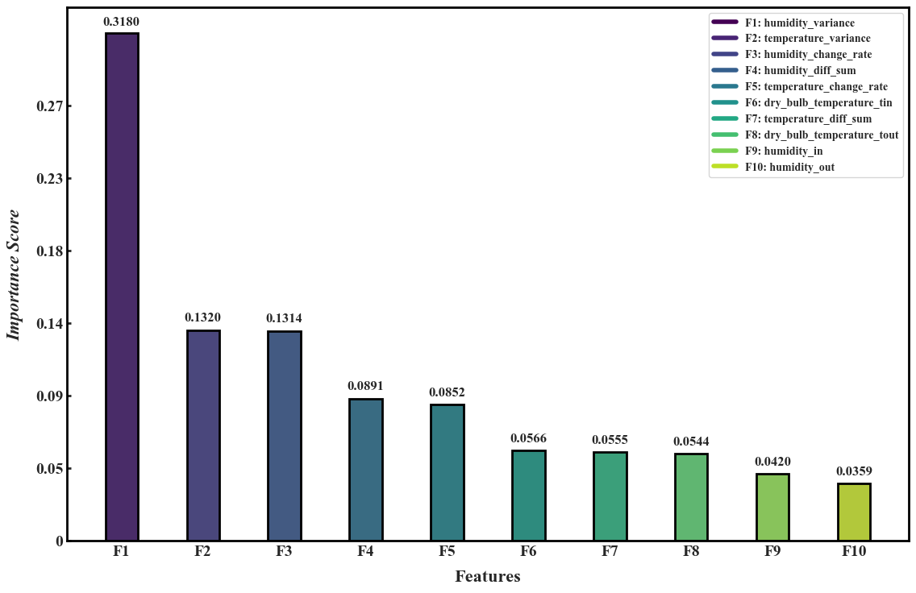
Pelt results for change-point detection
Fig 9. Results for change-point detection
Fig 10. Importance of input features
Notes:
For change-point detection in the AC state, the algorithm emphasizes real-time features and the weighted influence of historical data. The features, sourced from raw data and weighted according to their importance using feature importance analysis with a Random Forest model, are computed within an 8-hour time window. Pelt predicts that the accuracy of the momentary change point of air conditioning can reach over 90%.

Slide 12
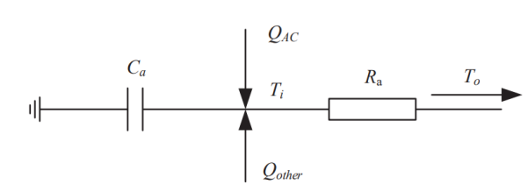
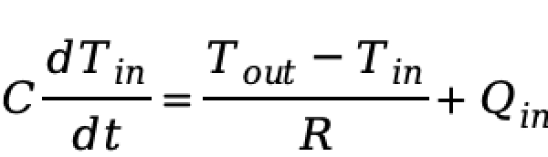
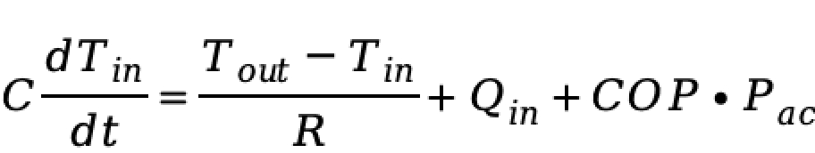
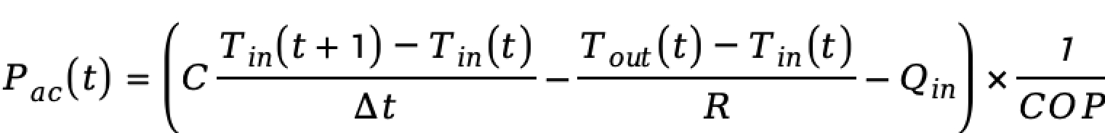
Estimating Pac
Fig 11. AC Equivalent Thermal Parameter Model[2]
Select feature tags to differentiate between the on and off states of the air conditioner:
[2]. Song, Z., Shi, J., Li, S., Chen, Z., Jiao, F., Yang, W., & Zhang, Z. (2022). Data-driven and physical model-based evaluation method for the achievable demand response potential of residential consumers' air conditioning loads. Applied Energy, 307, 118017.
Notes:
Through the room thermal equation, We can obtain the rate of change of indoor temperature and the relationship between the heat from the air conditioner.By dividing the time period into segments based on the status of the air conditioner switch, we can estimate the air conditioner power using a simple linear thermal parameter model.

Slide 13
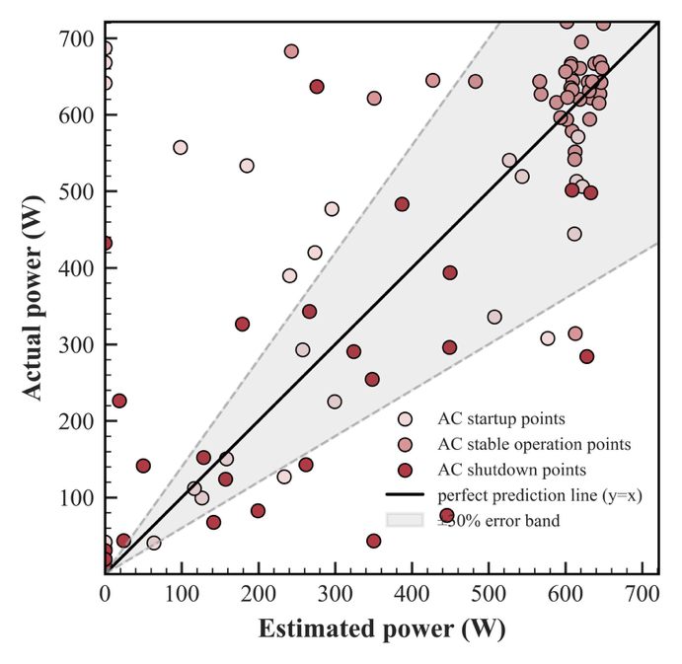
Pac prediction result
Table : Fitting Results of the Thermal Parameters of the RC Model
Using the Actual Indoor-Outdoor Temperature Data During AC Of Period
Time period | Number | C (J/℃) | R(℃/W) | Q_in (W)
[0,8) | 959 | 6.03e+06 | 0.033 | 498.75
[8,16) | 965 | 6.97e+06 | 0.056 | 161.38
[16,24) | 917 | 6.86e+06 | 0.065 | 259.37
Fig 12. Estimation results of room thermal parameters
Notes:
The air conditioning power calculated based on the thermal parameters fitting is shown in Figure 12. The Fitting Results of the Thermal Parameters of the RC Model
Using the Actual Indoor-Outdoor Temperature Data During AC Of Period

Slide 14
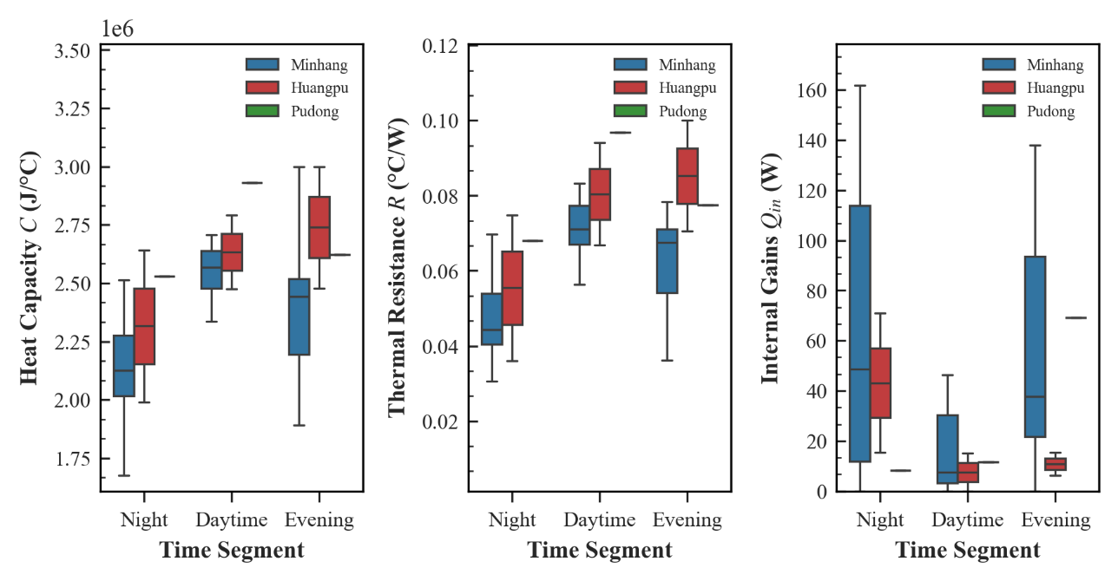
Regional multi-user thermal parameter fitting
Region | Number of buildings | Volume
pudong | 3 | 2398
minhang | 15 | 23805
huangpu | 9 | 19230
Fig 13. Box plot of thermal parameter fitting
[1] BEN Y, MA F, WANG H, et al. A spatio-temporally weighted hybrid model to improve estimates of personal PM2.5 exposure: Incorporating big data from multiple data sources[J]. Environmental Pollution, 2019, 253: 403-411.
Notes:
We applied the above-mentioned method to the data of some residents' rooms and fitted the thermal parameters collected in Shanghai during the summer of 2017, the dataset is derived from a research project on the assessment of indoor air quality for residents.

Slide 15
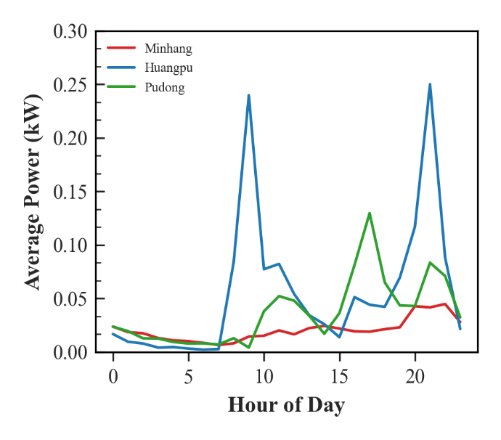
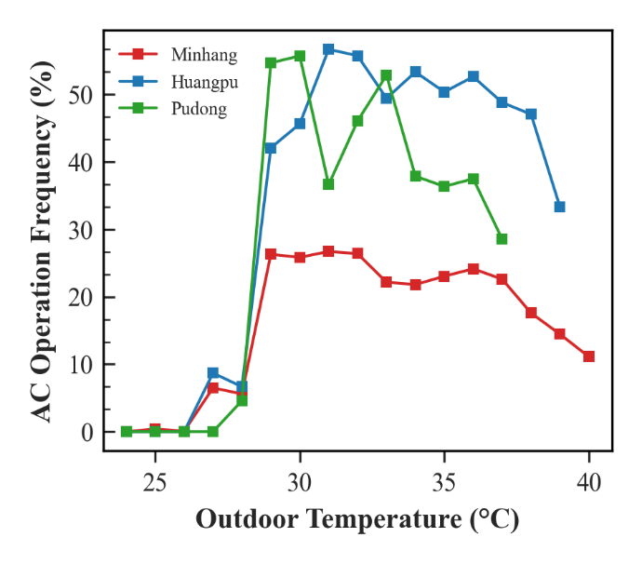
Regional calculation results
Fig 14. Residential Air Conditioning Average Load Profile
Across Selected Administrative Districts
in Shanghai During Summer 2017
Fig 15. Response Curves of Residential Air Conditioning Operating Rate
to Outdoor Temperature Variation
in Selected Districts of Shanghai During Summer 2017
Notes:
This is the preliminary result and analysis we have obtained so far, as the amount of data is relatively small.If sufficient data can be collected, it will be possible to conduct an analysis at the city scale.

Slide 16

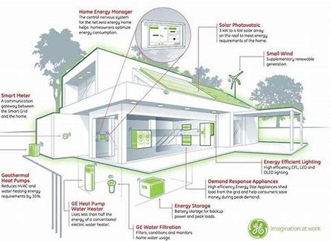
Future Research Plans
More integration of environmental factors
Model generalization across regions and seasons
Notes:
For future works, we could consider incorporating other environmental factors (such as indoor air quality, etc.) into the model. These factors may have significant impacts on the usage and energy consumption of air conditioners.Secondly, the usage behavior of air conditioners may vary in different geographical regions and seasons. Therefore, future research can be extended to other areas (such as Shanghai, etc.) and explore the changes in the usage patterns and energy consumption of air conditioners under different seasons.

Slide 17
Thank you

