Slide 1

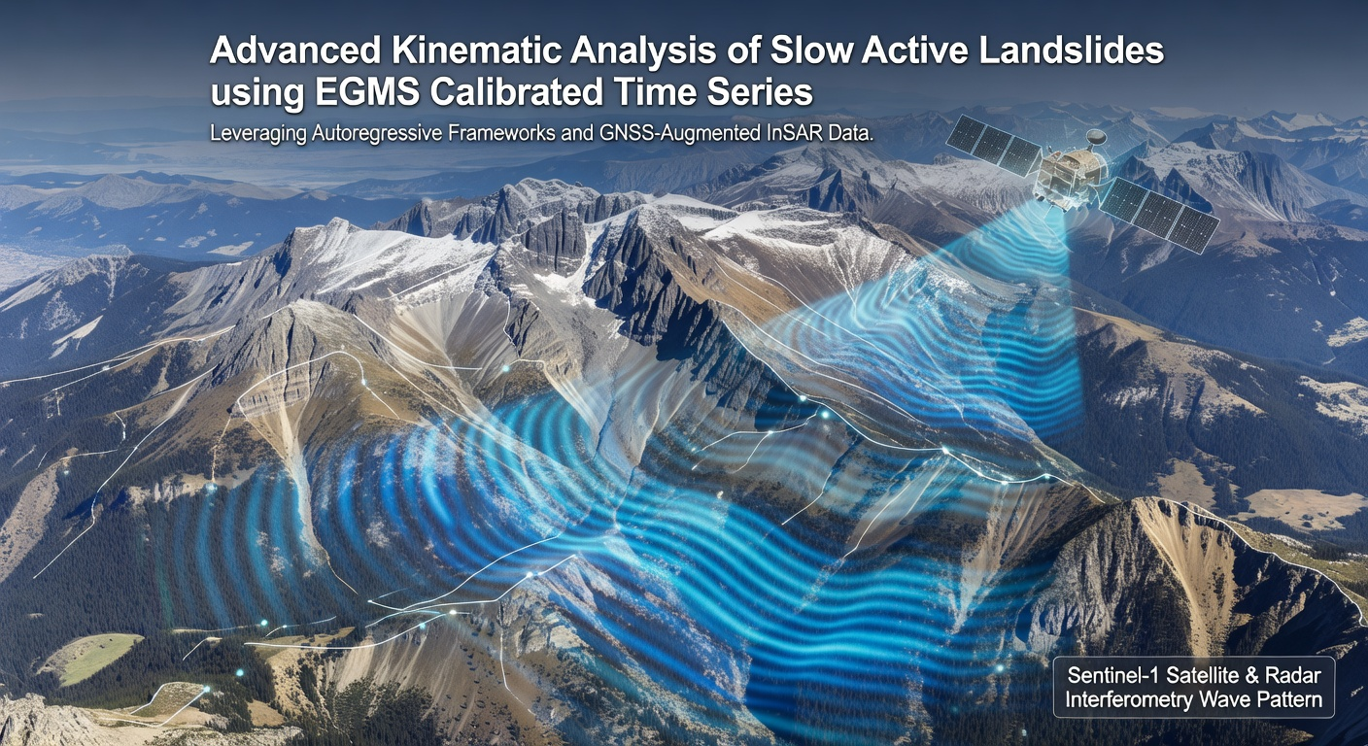
Enhancing the performance of data-driven models through preprocessing and feature engineering for the forecasting of landslide displacement
PhD student: Milad Sabaghi
Supervisor: Prof. Piernicola Lollino
Co-supervisor: Prof. Mario Parise
Department of Earth and Environmental Sciences, University of Bari Aldo Moro

Slide 2
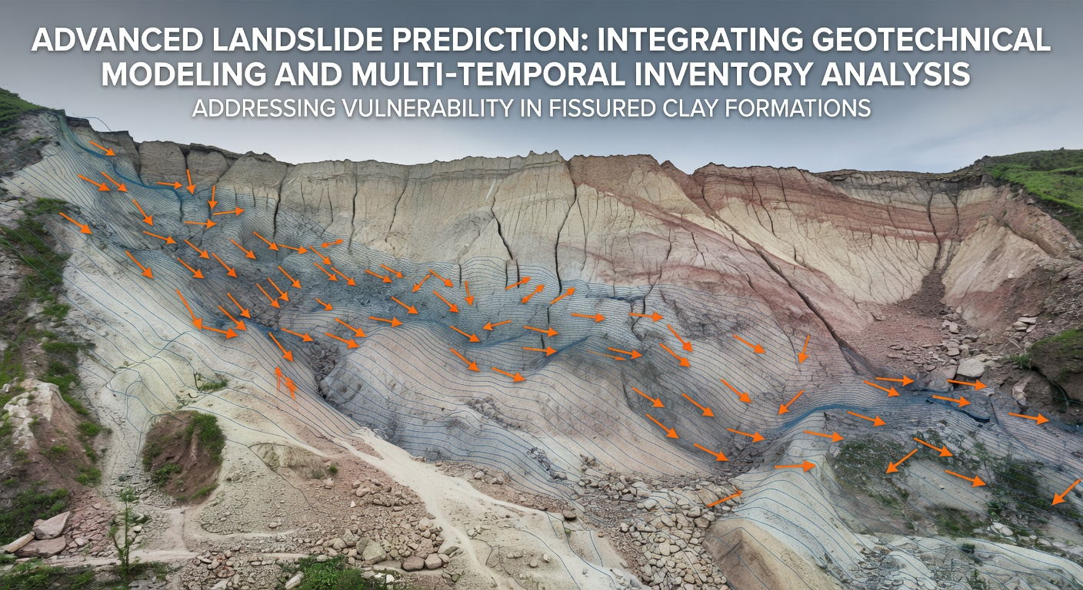
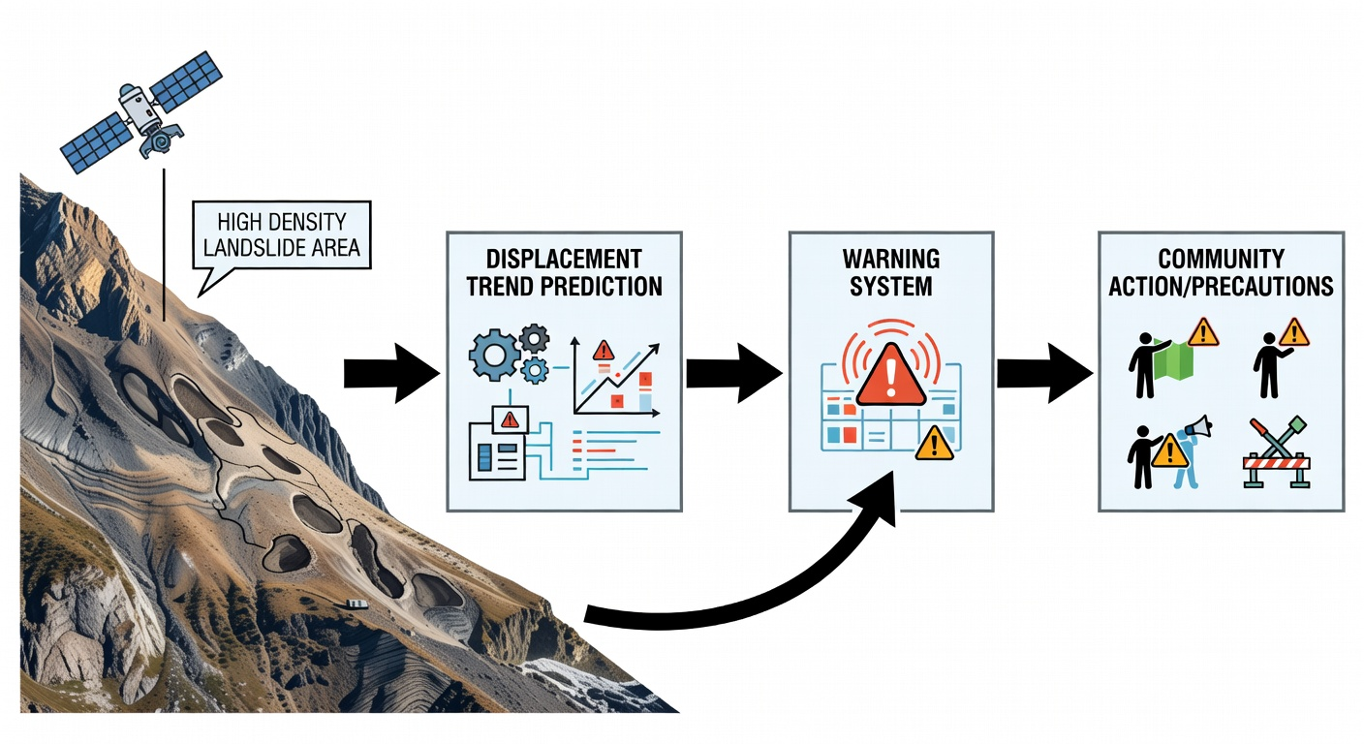
Introduction & Motivation
The Challenge:
Slow landslides pose long-term risks to infrastructure and communities.
Accurate kinematic prediction is essential for early warning systems (EWS).
Complex deep learning models often lack interpretability and require massive datasets.
Research Objective:
To demonstrate that "smart data" (feature enrichment) is more critical than “complex models”
To evaluate the impact of feature engineering on simple regression models for landslide displacement.

Slide 3
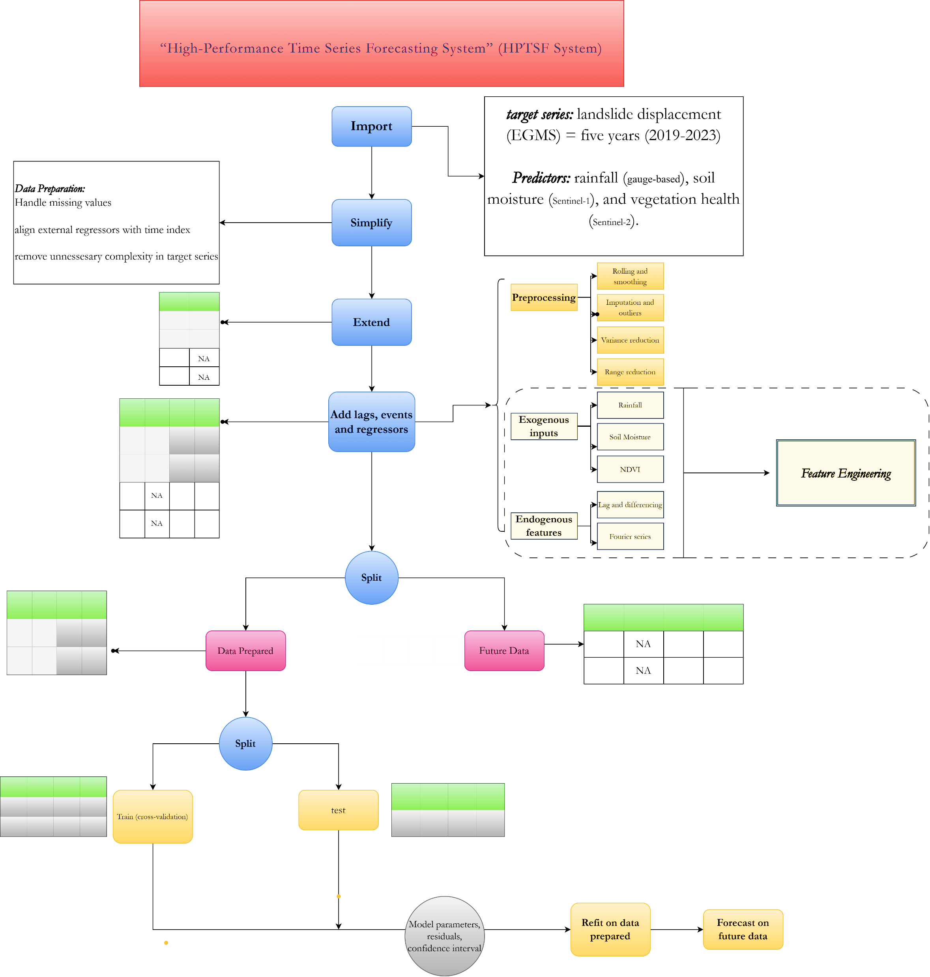
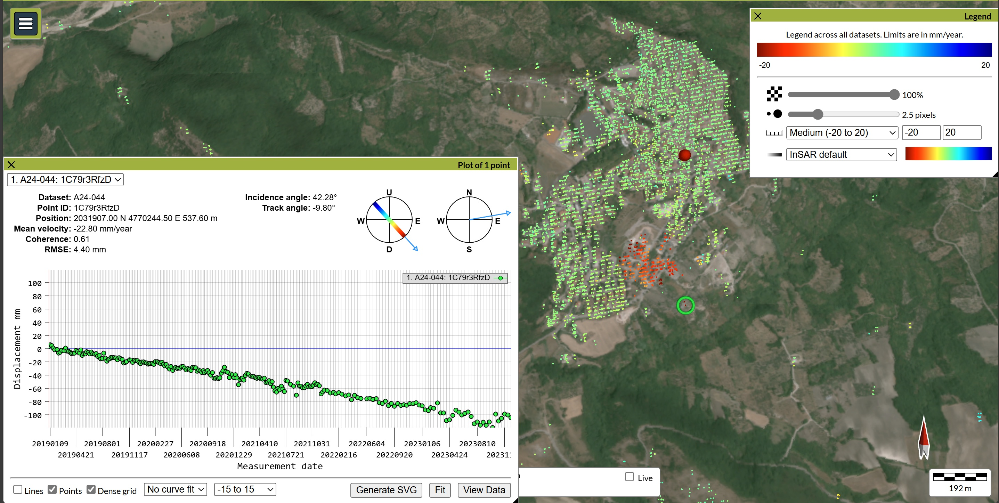
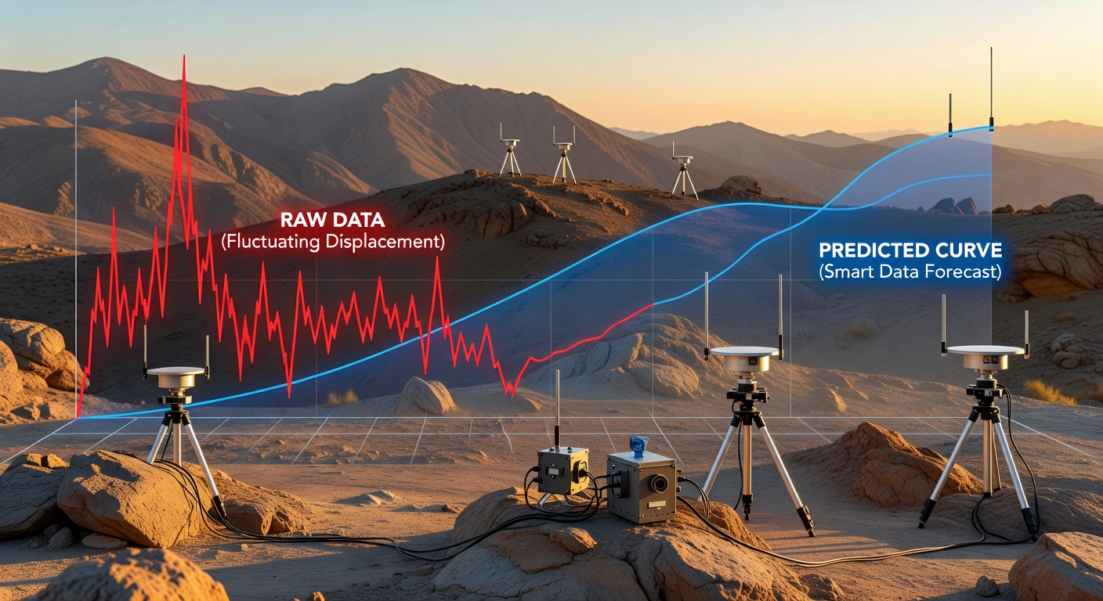

Slide 4
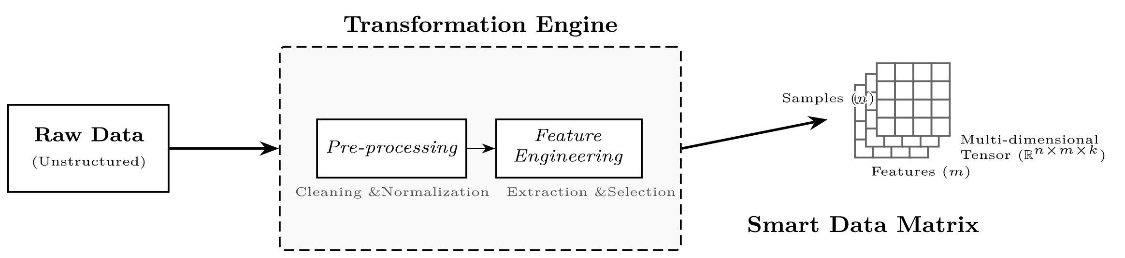
Feature Engineering — extracting, creating,& transforming raw data into features. This is critically done with domain knowledge.
This is where the "art" of feature engineering lies. It involves using Domain Knowledge to synthesize new information that the model might not easily "see" in the raw data.
Interaction Features
Temporal Features
Aggregation Features

Slide 5
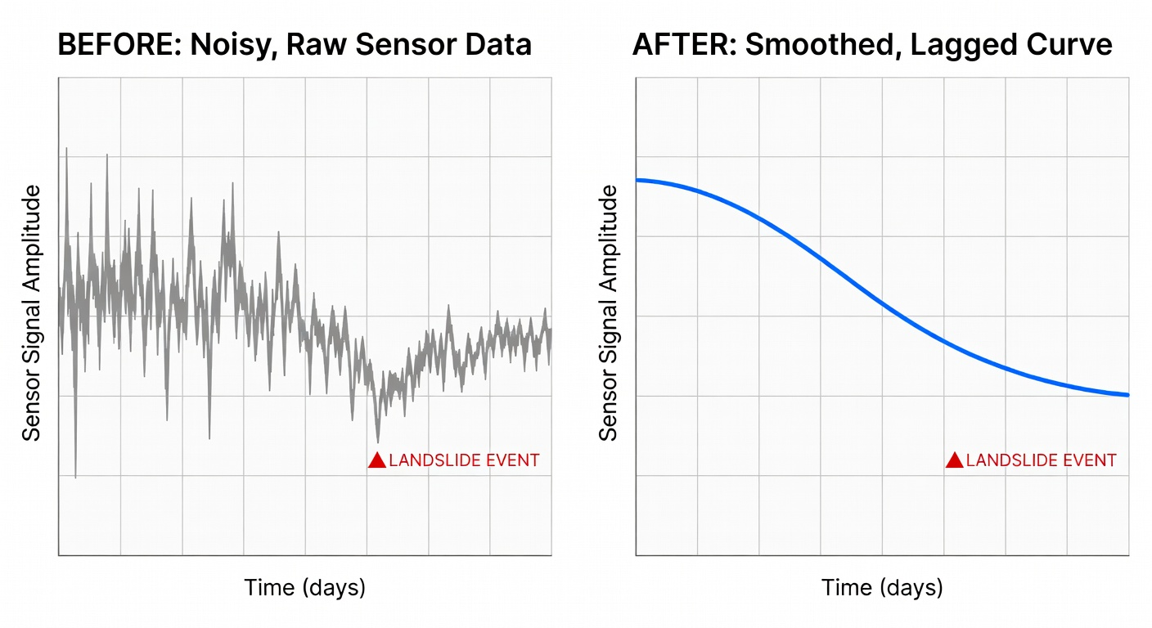

Slide 7
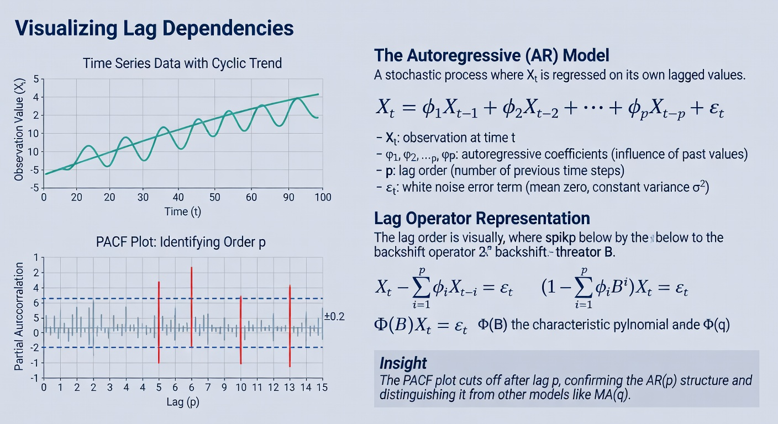
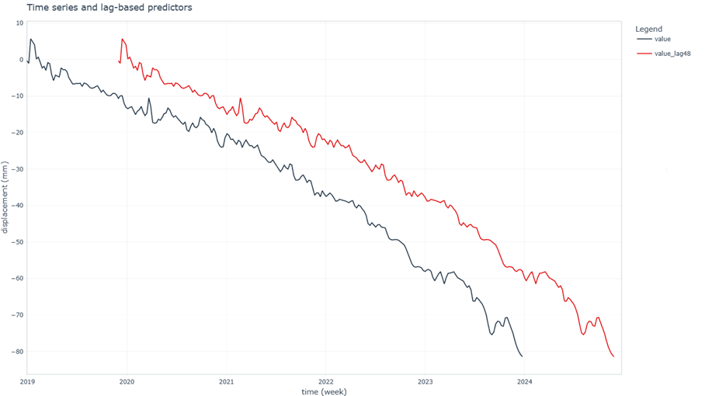

Slide 8
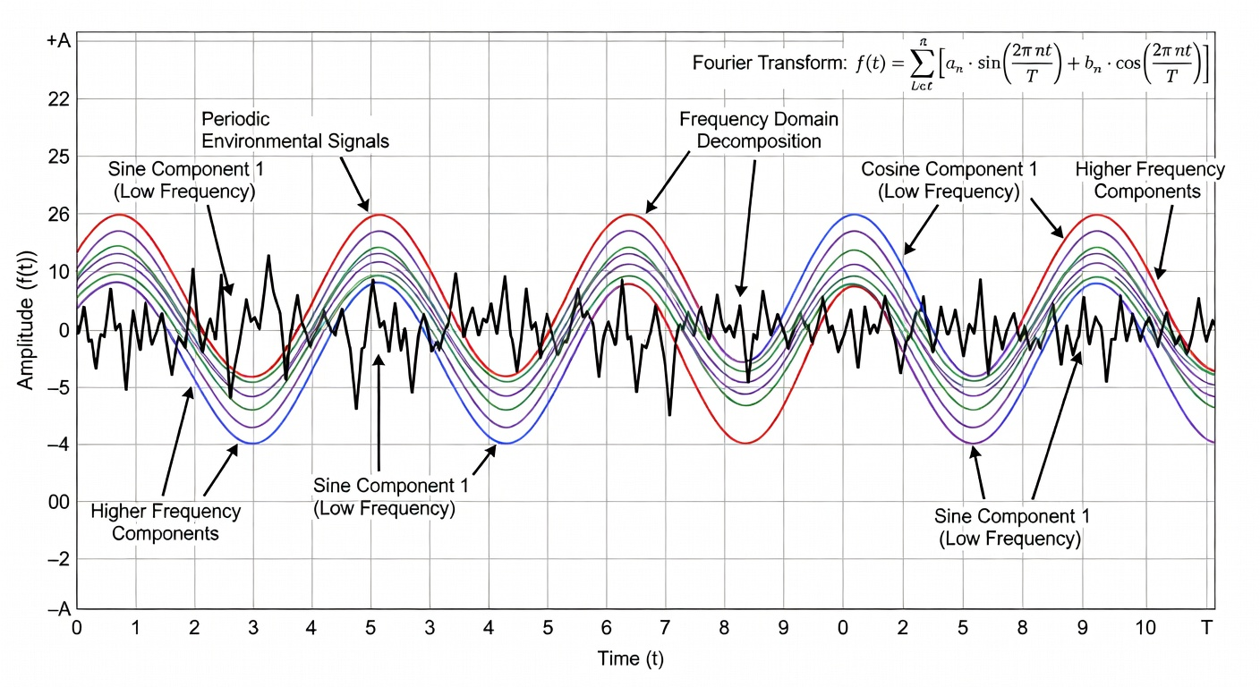

Slide 9

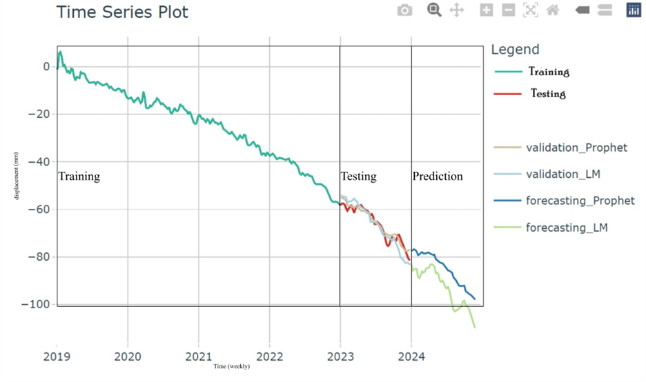
Choosing models: Prophet and LM, and results

Slide 10
.model_id | .type | mae | mape | mase | smape | rmse | rsq
LM (After Feature engineering) | Test | 2.47 | 3.70 | 2.46 | 3.69 | 3.17 | 0.912
LM (before Feature engineering) | Test | 9.02 | 13.20 | 9.00 | 14.2 | 9.80 | 0.88
PROPHET (After Feature engineering) | Test | 1.64 | 2.44 | 1.64 | 2.47 | 2.02 | 0.929
PROPHET (Before Feature engineering) | Test | 14.7 | 18.6 | 4.27 | 16.8 | 15.4 | 0.38
Notes:
Notebooklm site
10

Slide 11
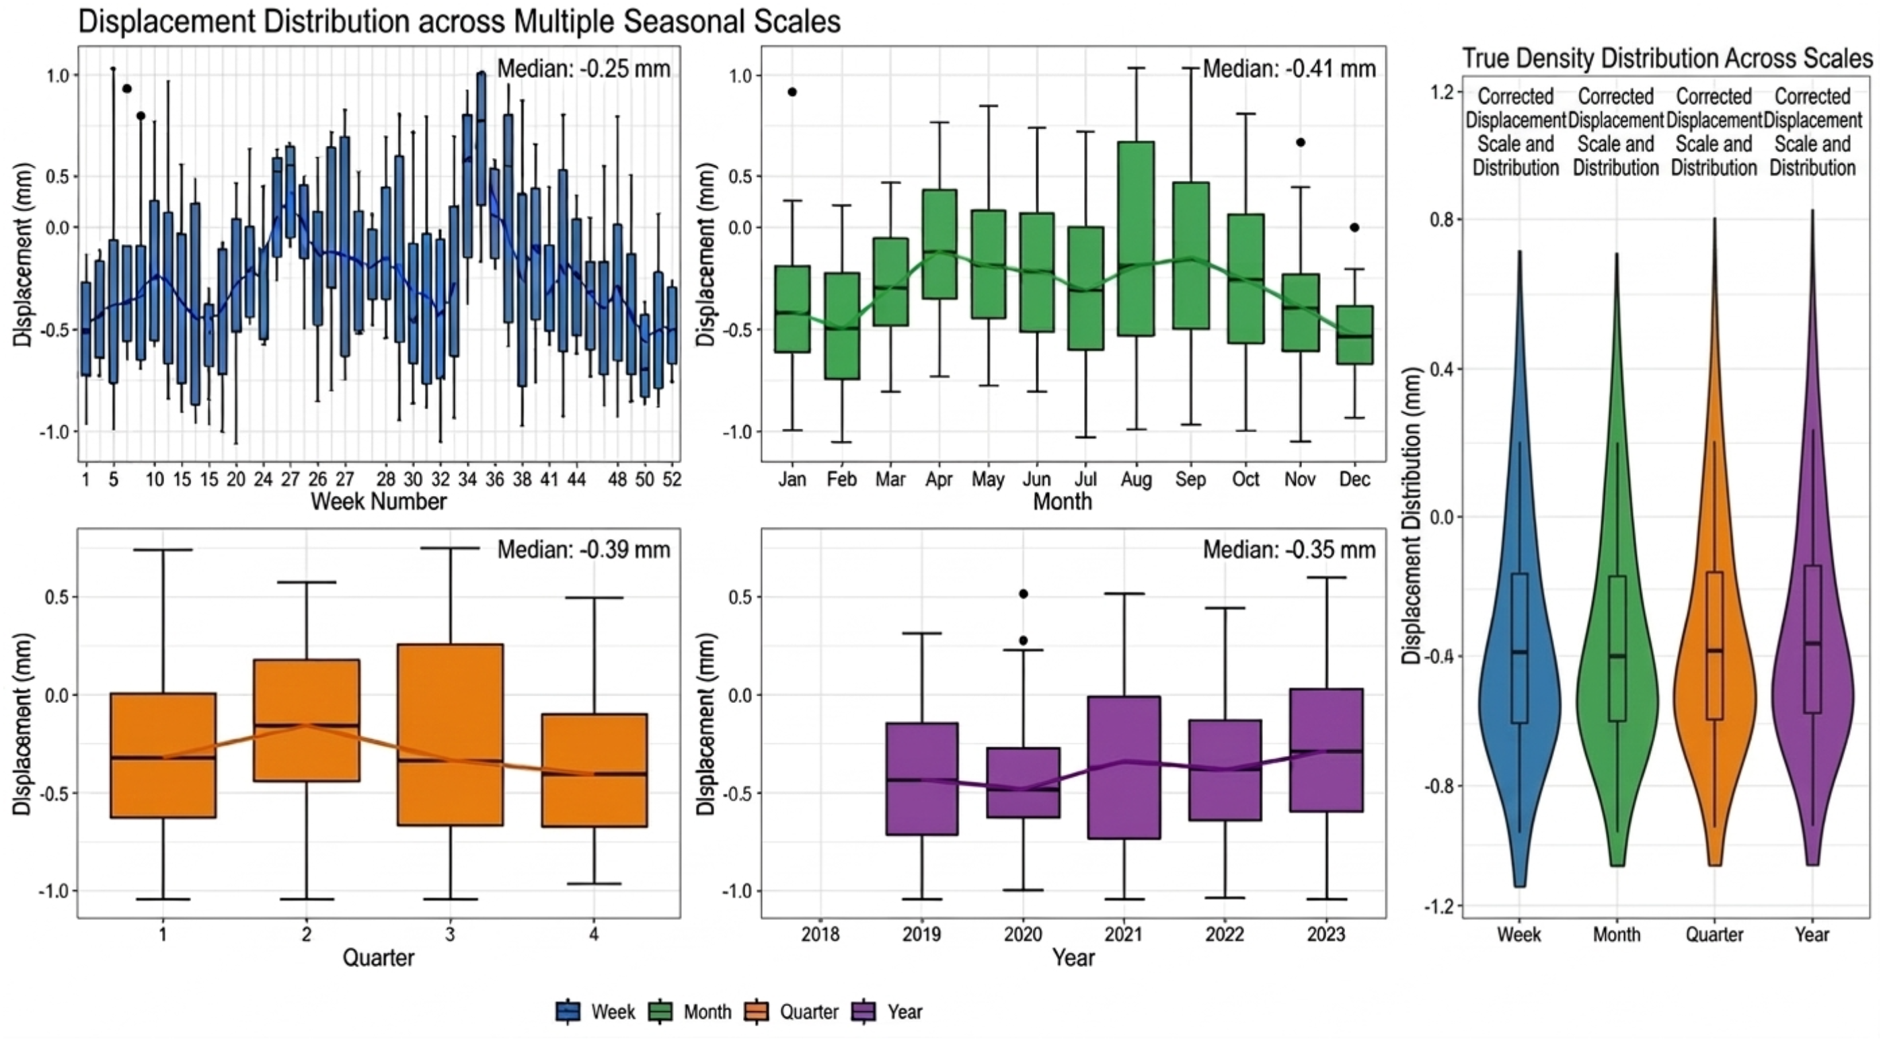
Conclusion:

Slide 12
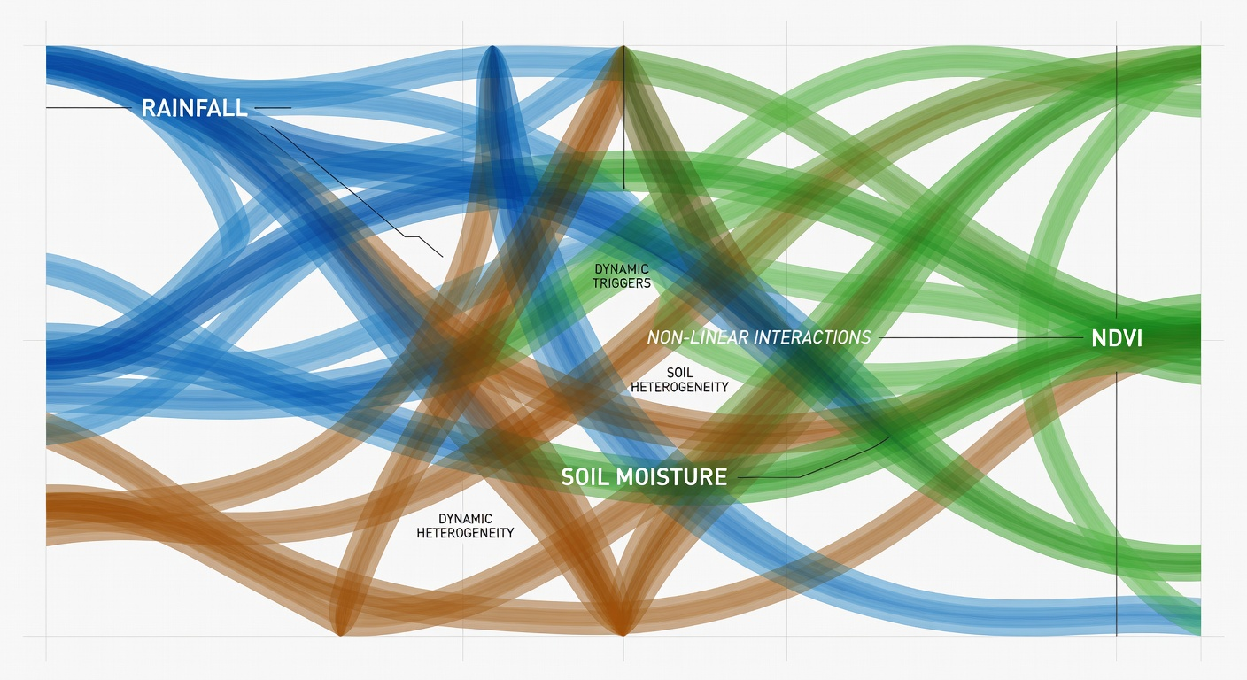
Thank you
Question?

