Slide 1
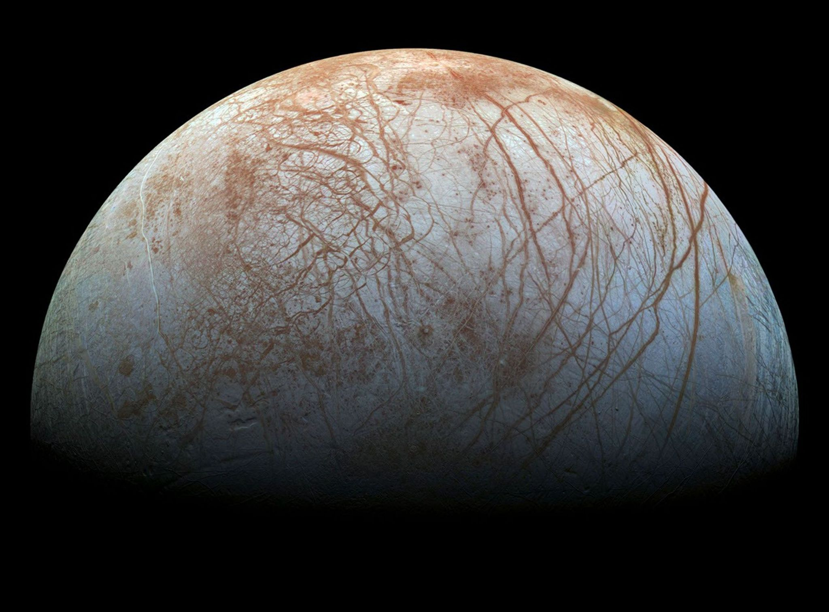

The Effects of Impacts on Europa’s Ice Shell Dynamics:
A GAIA Parameter Study
Davide Izzo^{1,2}, Ana-Catalina Plesa¹, Kaiyi Dai³, Kai Wünnemann^{3,4}, Hauke Hussmann¹,
¹DLR Institute of Space Research, ²TU Delft, ³Museum für Naturkunde Berlin, ⁴Freie Universität Berlin

Slide 2
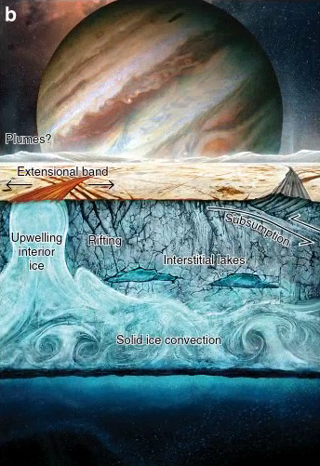
Key Processes in Europa’s Ice Shell and Surface Tectonics
Solid ice convection – Key for transporting of heat and driving tectonics [Howell & Pappalardo, 2020]. With tidal effects, these processes have implications for the formation of lenticulae and chaos regions.
Rifting of the brittle lid – Tidal flexing by Jupiter stretches and fractures the cold surface ice, forming cracks and ridge systems across Europa’s surface [Pappalardo et al., 1998].
Upwelling & extension at the surface – Rising warm ice thins the brittle lid, opens rifts and extensional bands where new ice from interior could fill the gaps at the surface [Prockter et al., 2002; Howell & Pappalardo, 2018].
Interstitial Lakes: Local pockets of melt or salty liquid form within the shell, acting as temporary reservoirs between ocean and surface [Schmidt et al., 2011].
Subsumption: In some places, surface plates may be transported downward into the shell, bringing oxidized material from the surface to the ocean [Kattenhorn & Prockter, 2014; Howell & Pappalardo, 2019, 2020].
Schematic from adapted Howell & Pappalardo (2020, Nat. Commun. 11, 1311), FIG. 1
1

Slide 3
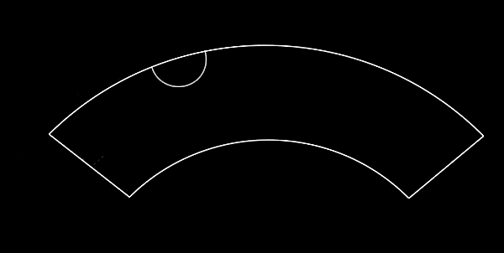
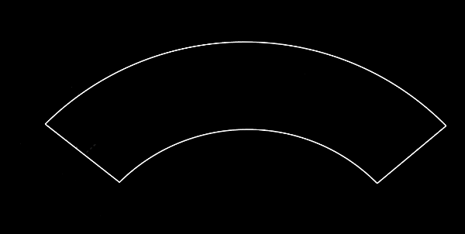
Europa‘s surface and subsurface
Convection?
The exchange of material between the surface and the subsurface ocean of Europa is a key aspect in assessing the ocean habitability [Hand et al. 2007]
Surface mobilization?
2
Notes:
Impact events can play an important role in this active environment, especially for exchange of material within the ice shell and between ice and ocean. Exchange of material is key to ocean habitability since the transport of oxidants from the surface to the ocean can support a chemically active and energy-rich ocean.
Impacts might trigger either direct or indirect exchange via convection.
We have direct exchange when impacts excavate through the ice, possibly creating surface-to-ocean conduits via which two way mass transfer might be achieved. In this project we focus more on the second pathway: do impacts events trigger/enhance convection to move material within the shell? With this in mind these are our main research questions:

Slide 4
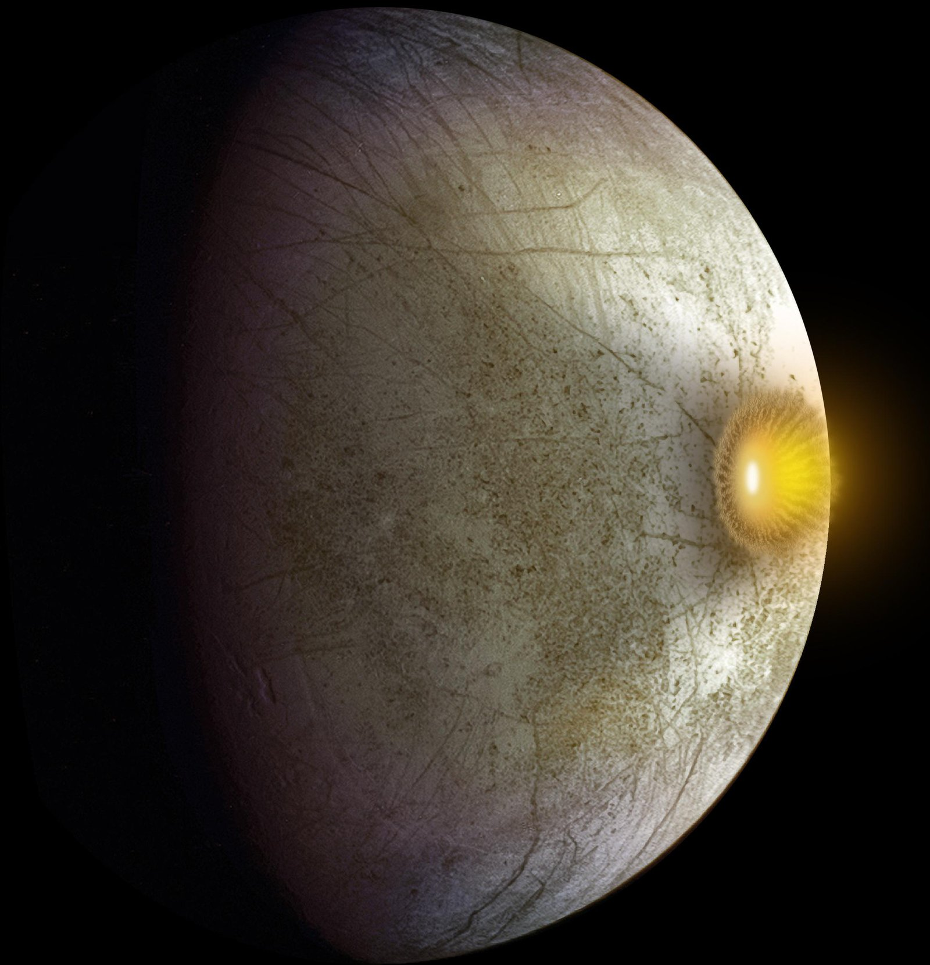
How do impacts influence the dynamic state of the ice shell?
RESEARCH QUESTIONS
Can an impact locally trigger or enhance convection?
Can impactor material be mixed in the shell and/or transported to the ice-ocean interface?
Credits:NASA/JPL-Caltech
3
Notes:
Can an impact locally trigger or enhance convection?
Can impacts mobilize Europa surface or break the stagnant lid?
For my 3 months internship and the thesis work did so far we started to dive into the first of these questions: so explore how impacts-related thermal and compositional anomalies can generate or influence a convective pattern Now we explain the model set-up:

Slide 5
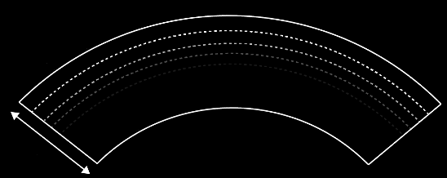
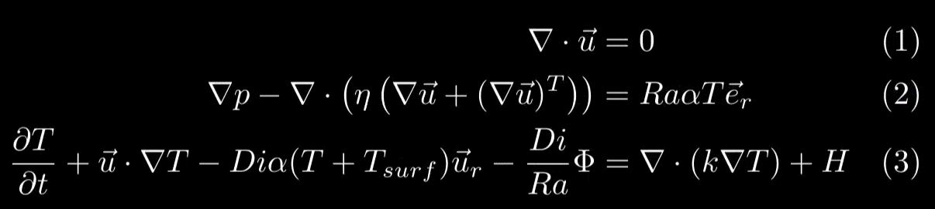
Model set-up
T surface = 110K
Geodynamic models with GAIA [Hüttig et al., 2013]
Particle-in-cell tracking method [Plesa et al., 2013]
Temperature boundary conditions
2D cylindrical geometry
30 km
T bottom = 268K
Different impactor radii (0.5 km, 1 km, 1.8 km).
Cons. of Mass
Icy impactor (910 kg/m3).
Cons. of Momentum
Cons. of Energy
4
Notes:
We use GAIA geodynamic code solving the eq. in a 2D cylindrical geometry.
-We set as boundary conditions the temperature at surface and ocean-ice interface, both with free slip.
-We use a particle-in-cell methodm to track the compositional variations. This will be especially relevant in a later phase of the project when we want to look at chemical variations.
-The ice shell thickness is fixed at 30km.
The solved equations are for conservation of mass, conservation of momentum and conservation of energy:
First equation ensures ice behaves as incompressible flow.
Second controls how the ice flows and deforms in response to viscosity, pressure and buoyancy
Third tracks how temperature evolves due to several processes: time evolution of temperature, advection of heat, adiabatic heating/cooling, viscous dissipation, thermal diffusion and tidal heat source.

Slide 6
T surface = 110K
2D cylindrical geometry
T bottom = 268K

Slide 7
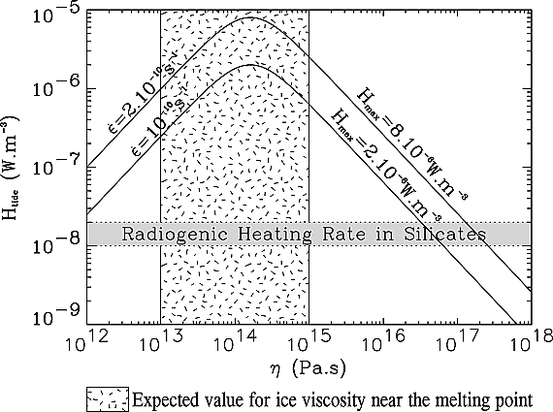
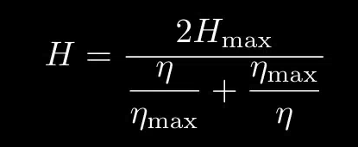
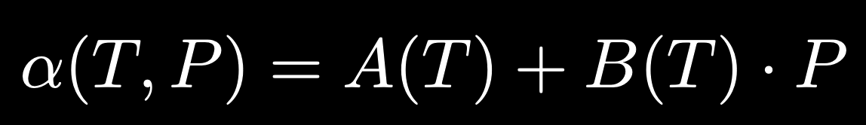
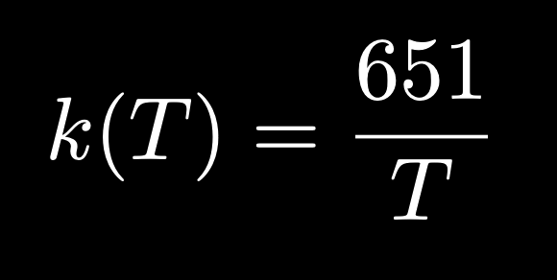
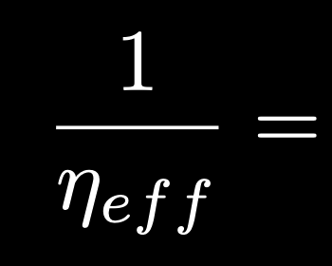
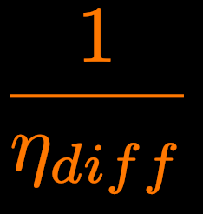
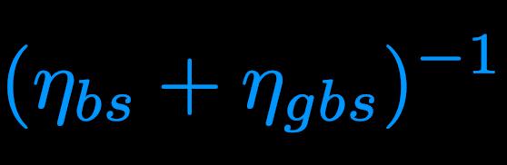
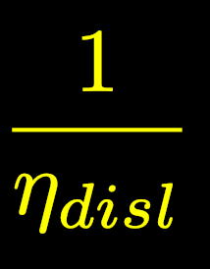

Model set-up
Effects of tidal heating [Tobie et al., 2003].
Temp- and press-dependent ice thermal expansivity and conductivity [Feistel & Wagner 2006, Petrenko & Whitworth, 1999]
Volumetric tidal heating rate within Europa's ice shell calculated with the equation shown as a function of ice viscosity for two extreme tidal strain rate values (at poles and equator) [Tobie et al.,2003].
composite rheology [Goldsby & Kohlstedt, 2001]
We choose H_{max⁡}(2e-6 W/m3) and η_{max⁡​}(1.5e14 Pa.s) so that the peak matches the expected tidal strain rate at equator.
Effective viscosity
Diffusion creep
(grain size)
Basal slip (strain rate) + Grain boundary sliding
(strain rate, grain size)
Dislocation creep
(strain rate)
5
Notes:
One very important additional element for our model is tidal heating. We include it following Tobie et al. Here volumetric tidal heating rate H depends only on the local viscosity by eta.
Hmax is the max heating and occurs at etamax. From the plot we see that for both higher and lower viscosities the dissipation drops. We choose Hmax and etamax from Tobie et al., so that the peak matches the expected tidal strain rate at equator. In GAIA these are converted to non-dimensional, passed to module TidalHeating which computes H(eta) at every grid cell.

Slide 8
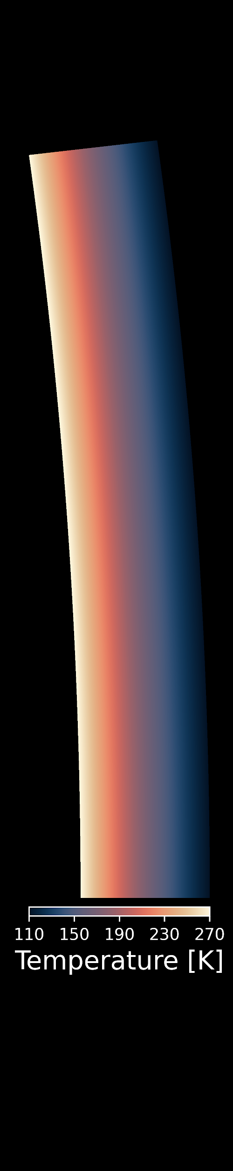
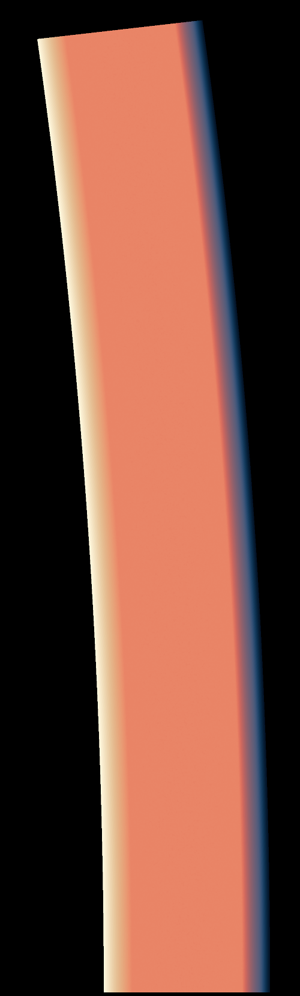
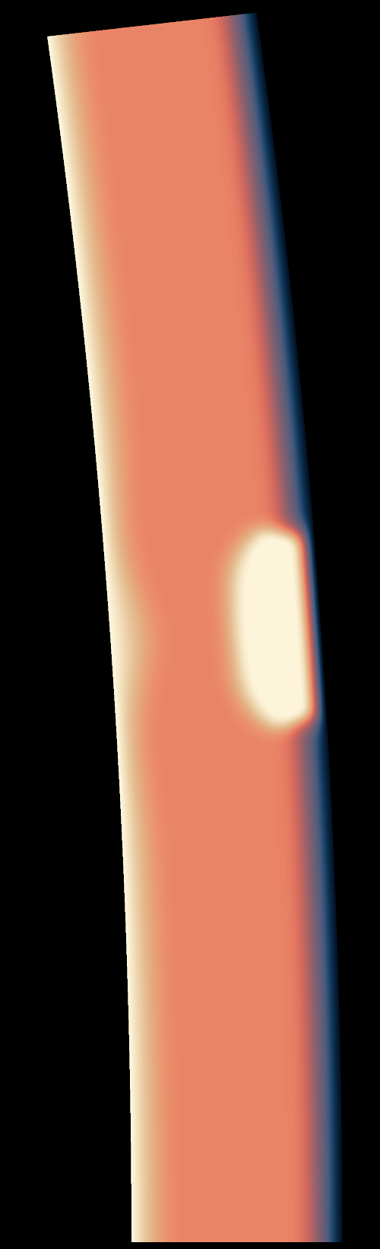
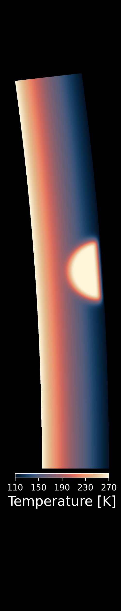
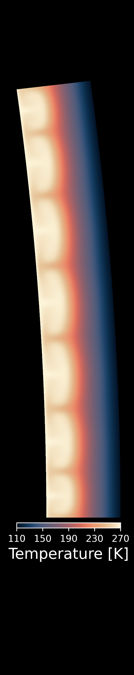
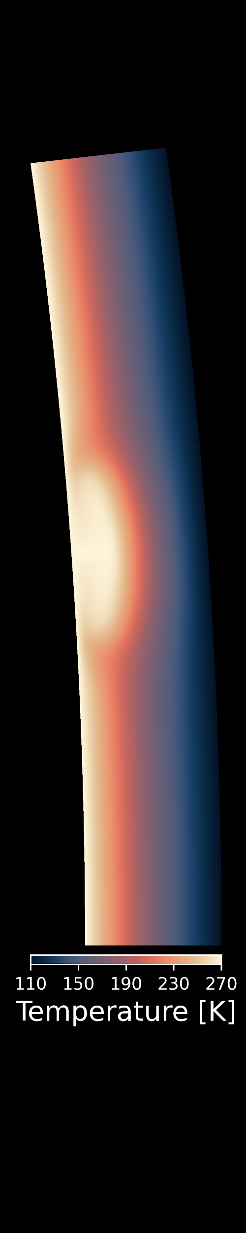
Convective and Conductive: Initial State
Convective (hot) T-profile
Conductive (cold) T-profile
Time:
0 Myr
25 kyr
60 Myr
IMPACT-GENERATED LOCALISED CONVECTION !!
6
Notes:
We start here comparing two different thermal states at which the impact is set. The impact time is 25ky from the beginning of the evolution, end time is at 30Myr and the grain size for both cases is 1mm.
On the right we see the case in which the shell has already gone through 10Myr evolution after a first random perturbation, and reached a conductive steady state. On the left, the impact is plugged since the very beginning of the evolution, when the shell has yet to evolve to a conductive steady state, thus being in a convective initial state.
On the far left we see the average temperature profiles of both cases, and we might as well easily distinguish the conductive profile from the convective. At the time of the impact, we can see the impact anomaly having an effect on the average temperature until approximately 15km depth, with the conductive case having a bigger shift in the curve, as expected from the lower global temperature over the shell at those depths. At the end time we observe the real change. For the conductive case a single plume is generated from the impact anomaly, while in the convective case a series of plumes is generated: this makes the average temperature of the convective case to strongly increase in those last 15km, far surpassing the average temperature of the conductive case in the last 6-5km of the shell, where previously the conductive temperature was comparatively higher.

Slide 9
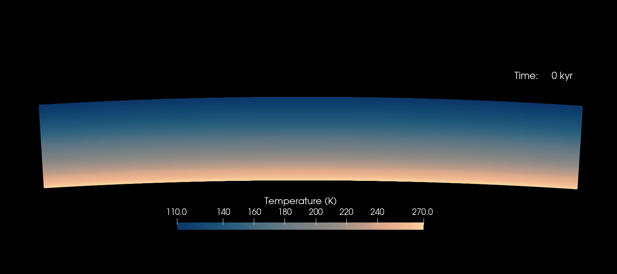
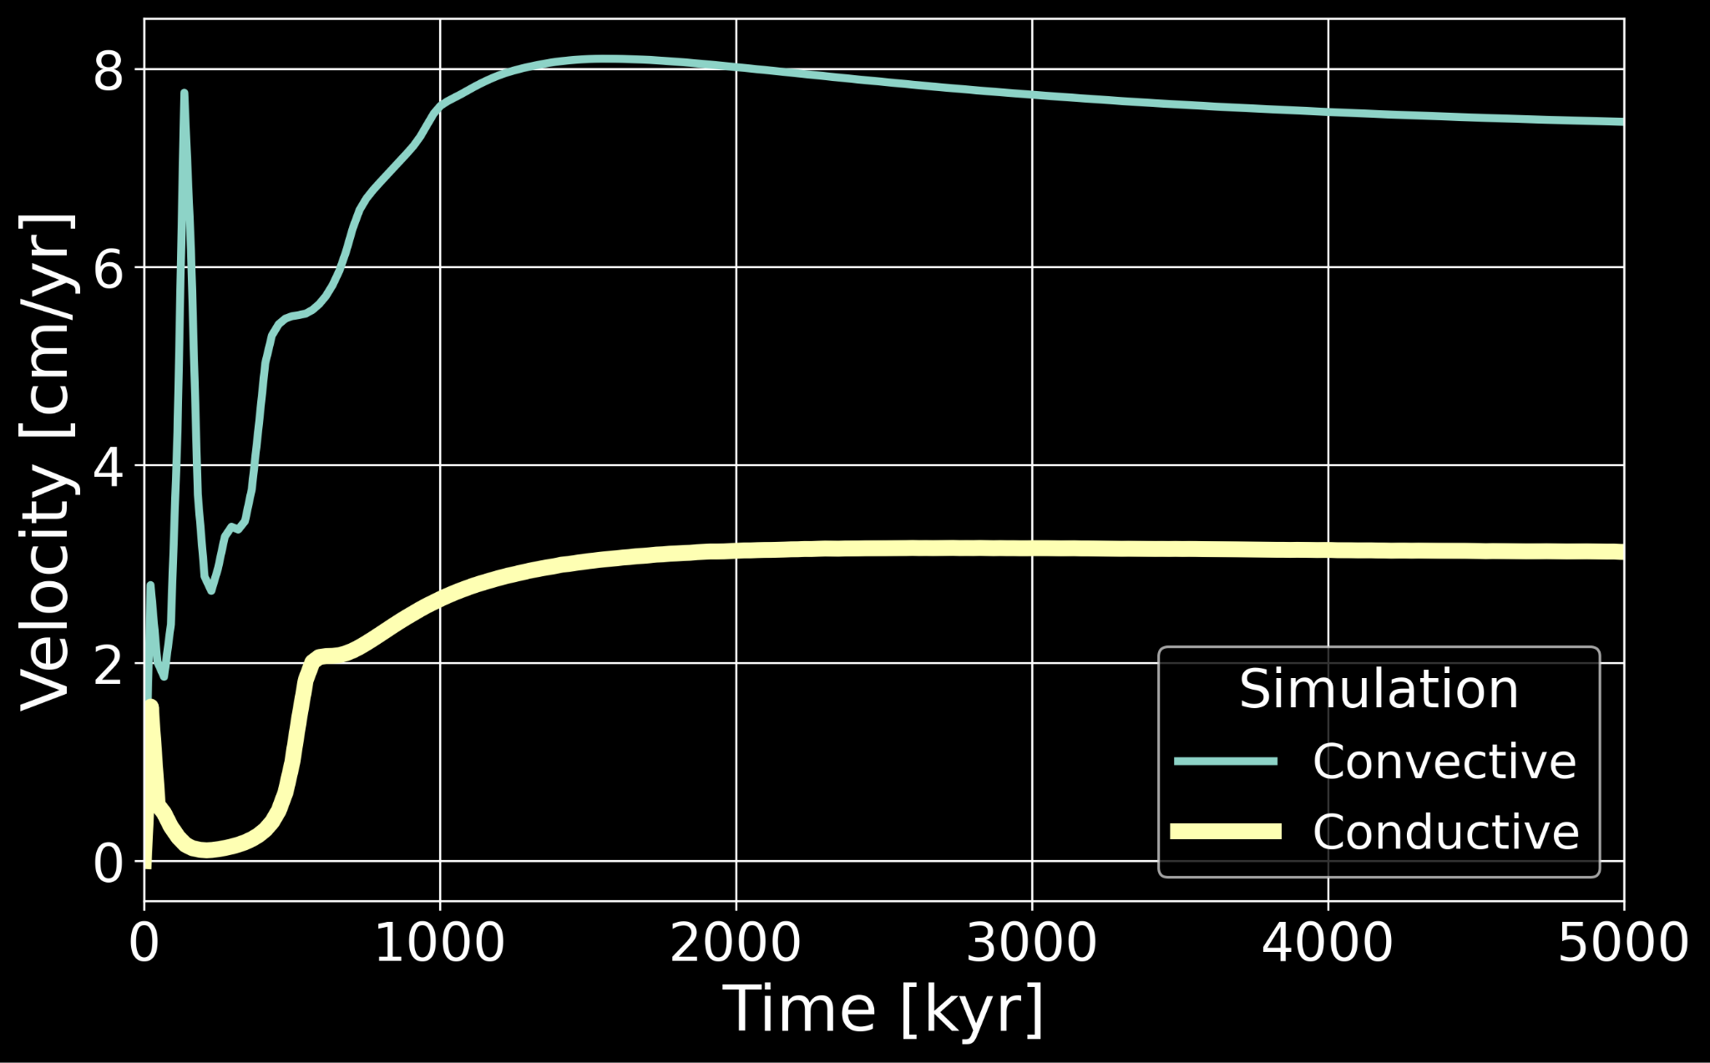
Ice shell dynamics after an impact: Initial conductive (cold) T-profile
11
Notes:
After the initial velocity increase given by the impact onset, the conductive case slows down until it starts increasing again after about 400-500 kyr. At approximately 800 kyr, the velocity slows down a bit for few kyr and then starts increasing again slowly approaching the final velocity. This can be nicely related to this video of the thermal evolution, explaining how the velocity is directly linked to the plume evolution. After the impact, the initial thermal peak dissipates, until the plume is generated and the temperature increases again right at the same time when we see the velocity increase. That little decrease in velocity for few kyr is due to the plume that slows and eventually stops its upward motion, after which the plume starts expanding laterally, therefore causing the successive increase in velocity until reaching its final steady state.

Slide 10
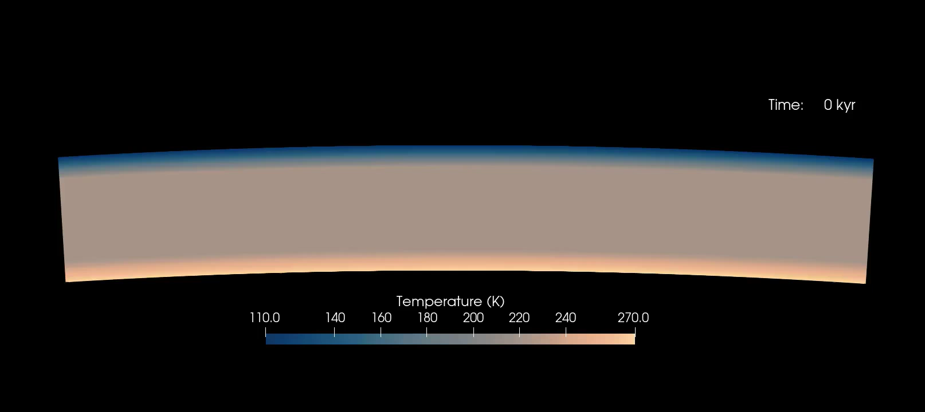
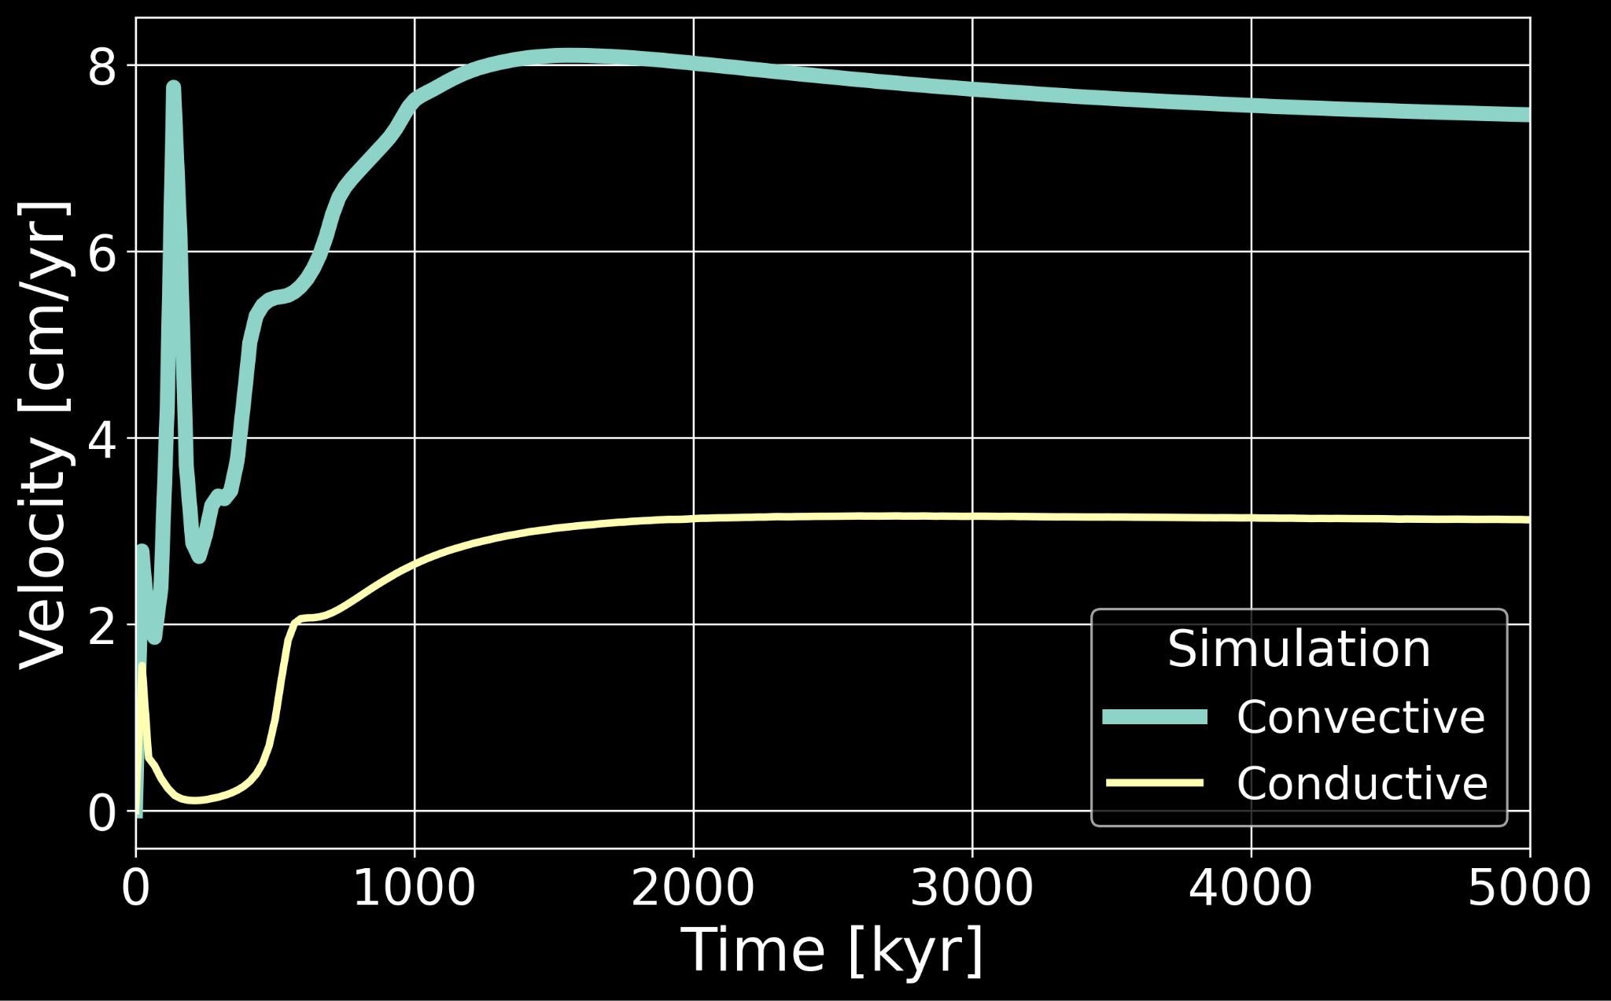
Ice shell dynamics after an impact: Initial convective (hot) T-profile
12
Notes:
For the convective state, we see many more bumps and changings in the velocity curve, which now we know is directly related to the plumes evolution. In facts, since here we have a bunch of plumes setting-off, each pair of plume that generates correspond to one of those velocity bumps. Also, here the plumes generates much faster.

Slide 11

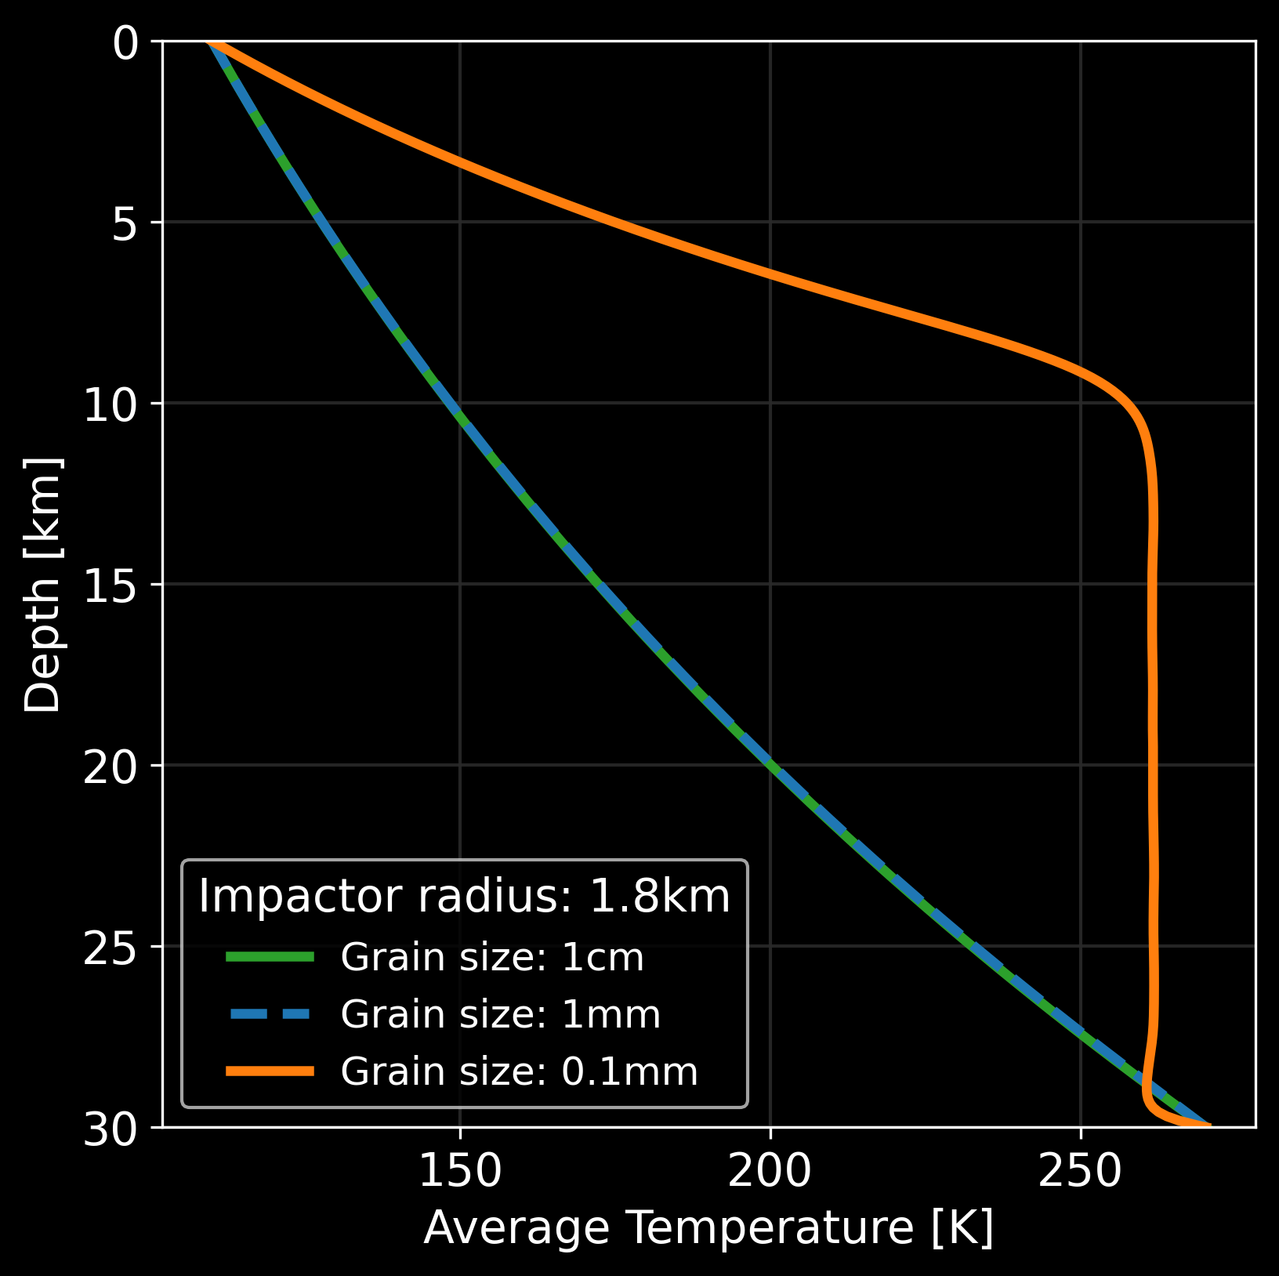
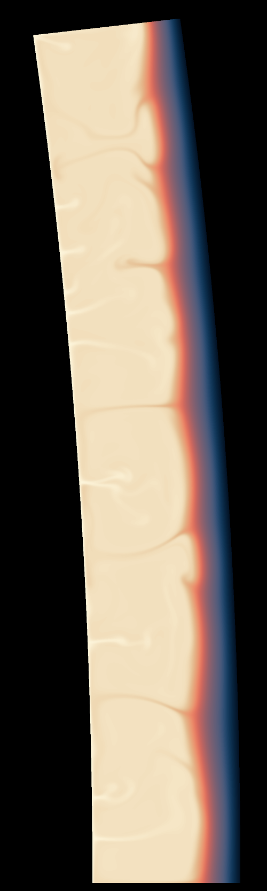
Grain size effect: Impactor Radius 1.8km
0 Myr
Grain Size:
1 cm
1 mm
0.1 mm
7
Notes:
Grain size controls viscosity: smaller grains → weaker ice → easier convection.
Here besides the generation of the plume in the median case (G= 1mm) its average temperature profile is the same as the purely conductive case with the biggest grain-size. The case with smaller grain size, on the other hand, correspond to the highly convective case, with a much higher average temperature across the shell. Now, if we take a look at the average temperature plot, we see how it changes at the time of impact.

Slide 12
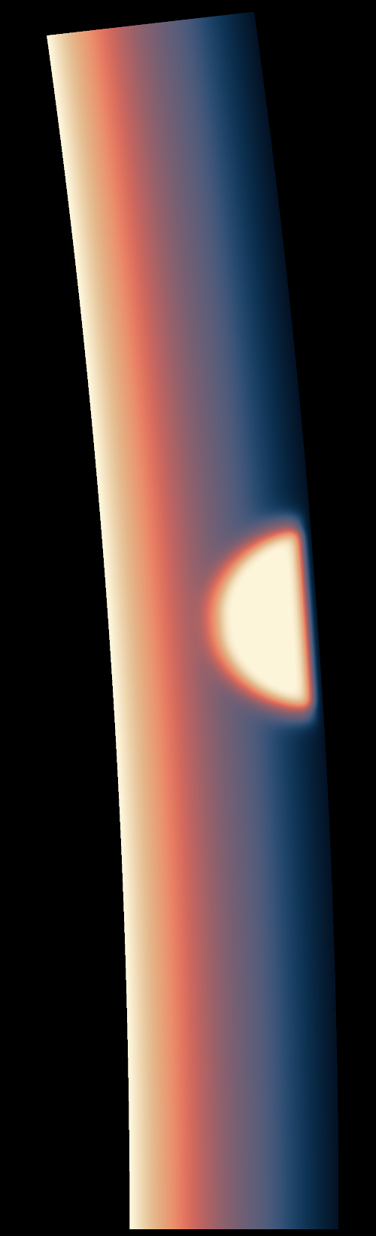
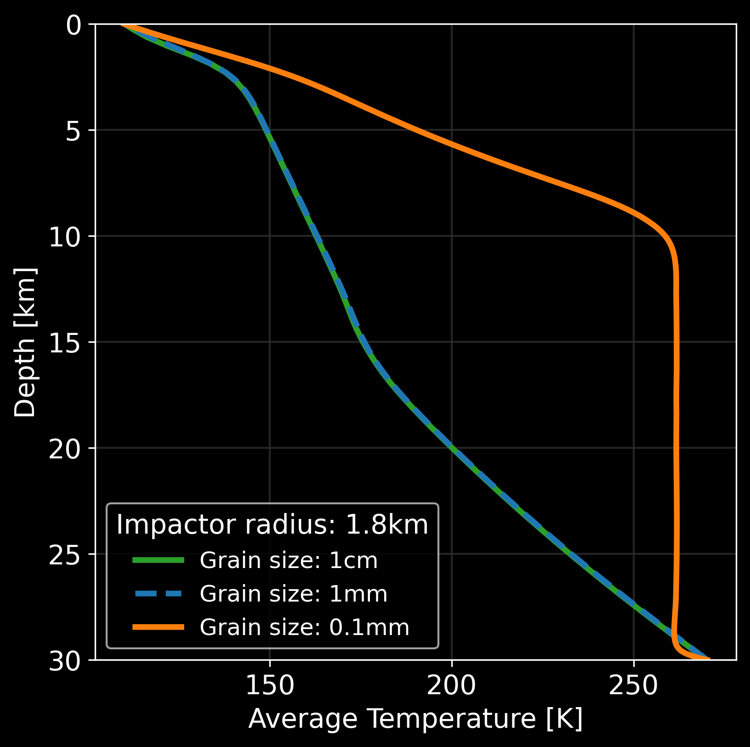
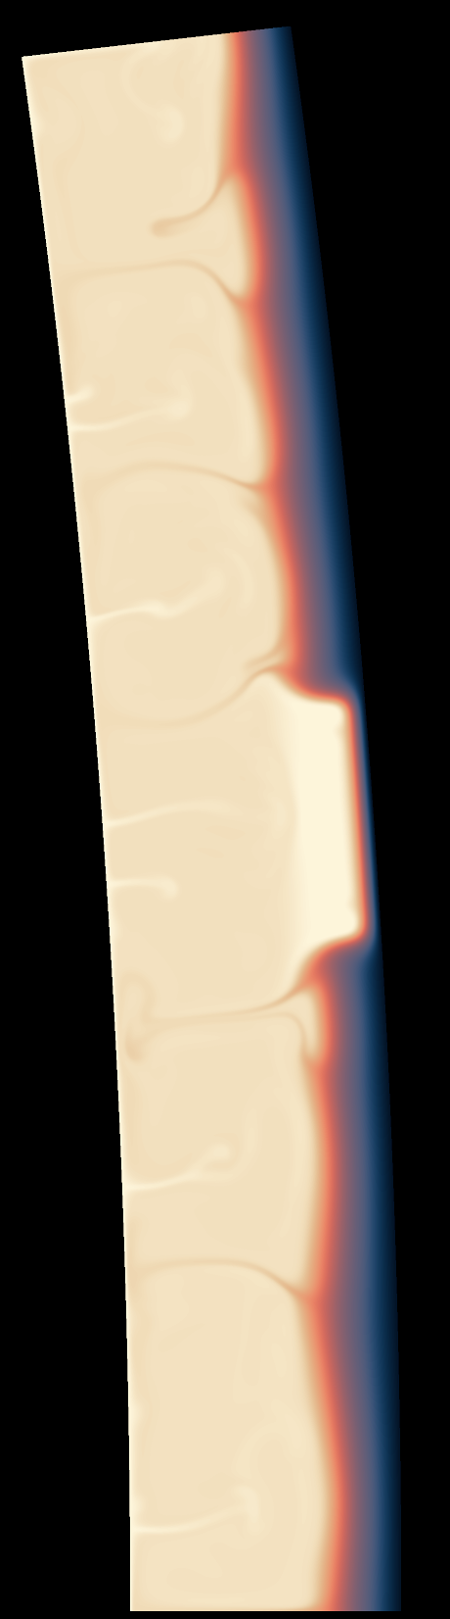
Grain size effect: Impactor Radius 1.8km
25 kyr
Grain Size:
1 cm
1 mm
0.1 mm
8
Notes:
Grain size controls viscosity: smaller grains → weaker ice → easier convection.
Here besides the generation of the plume in the median case (G= 1mm) its average temperature profile is the same as the purely conductive case with the biggest grain-size. The case with smaller grain size, on the other hand, correspond to the highly convective case, with a much higher average temperature across the shell. Now, if we take a look at the average temperature plot, we see how it changes at the time of impact.

Slide 13
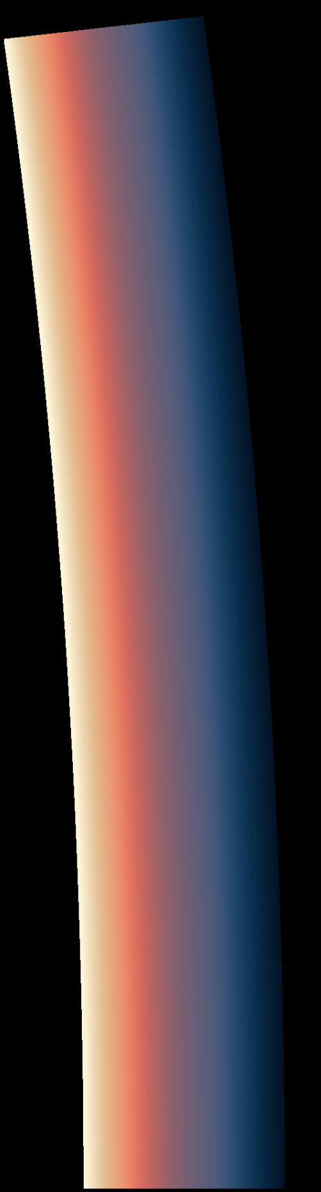
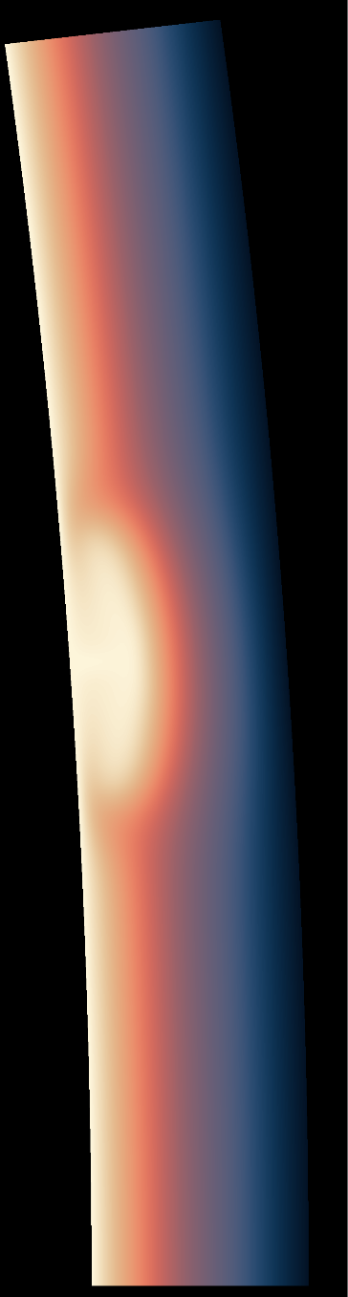
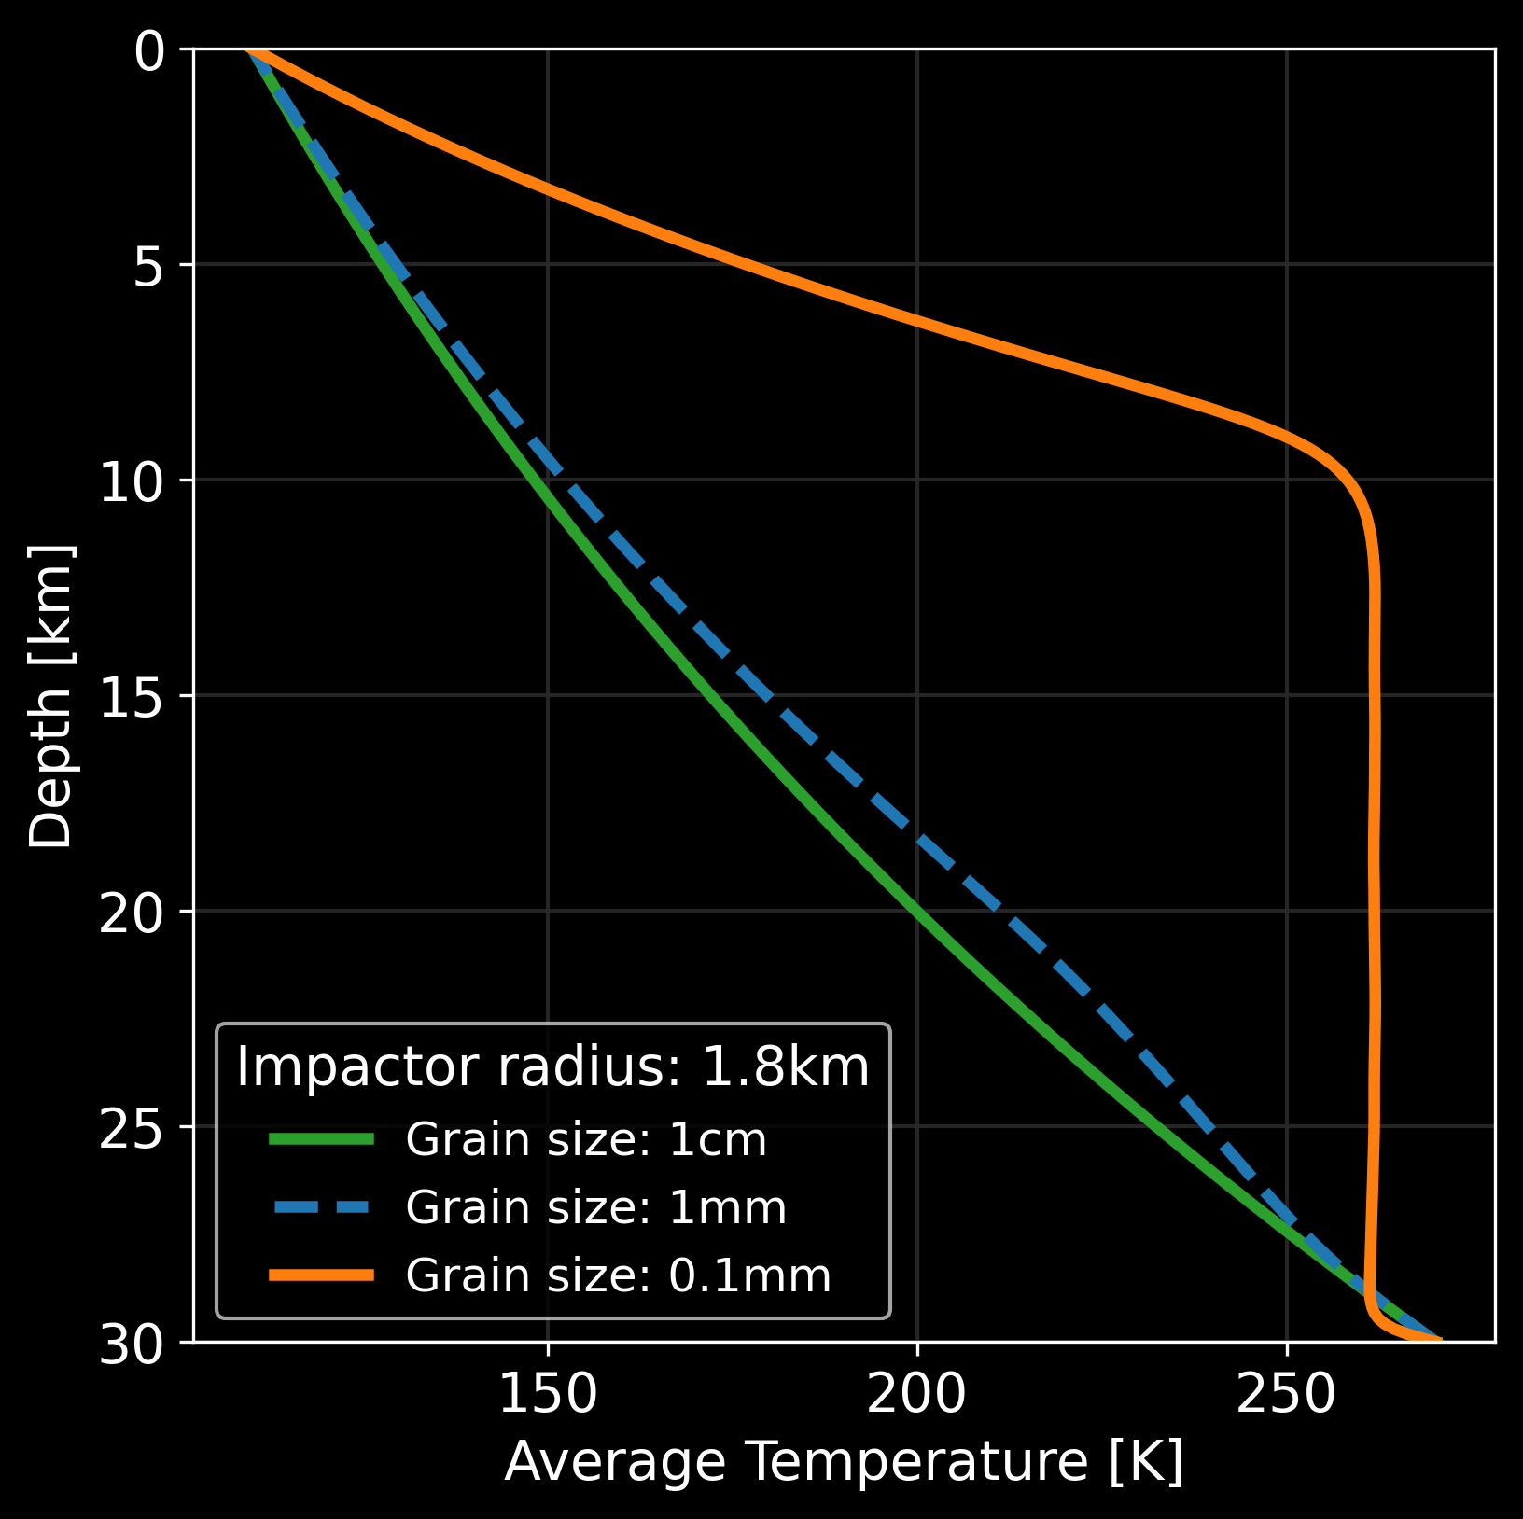
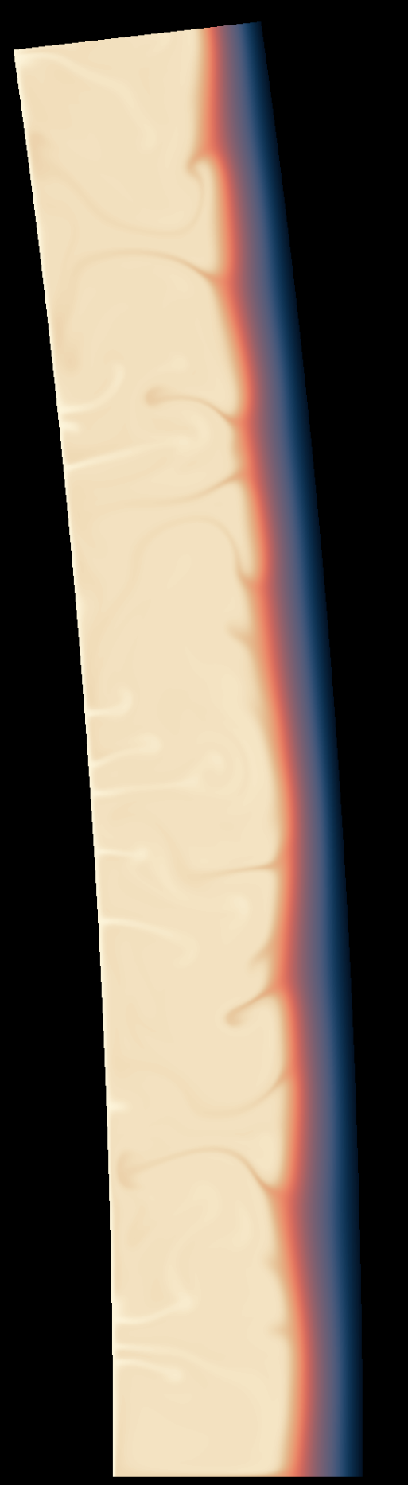
Grain size effect: Impactor Radius 1.8km
30 Myr
Grain Size:
1 cm
1 mm
0.1 mm
IMPACT-GENERATED LOCALISED CONVECTION
9
Notes:
Grain size controls viscosity: smaller grains → weaker ice → easier convection.
Here besides the generation of the plume in the median case (G= 1mm) its average temperature profile is the same as the purely conductive case with the biggest grain-size. The case with smaller grain size, on the other hand, correspond to the highly convective case, with a much higher average temperature across the shell. Now, if we take a look at the average temperature plot, we see how it changes at the time of impact.

Slide 14
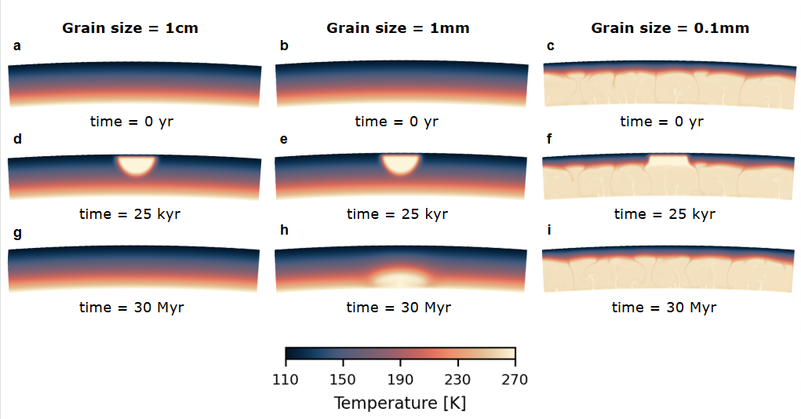

Slide 15
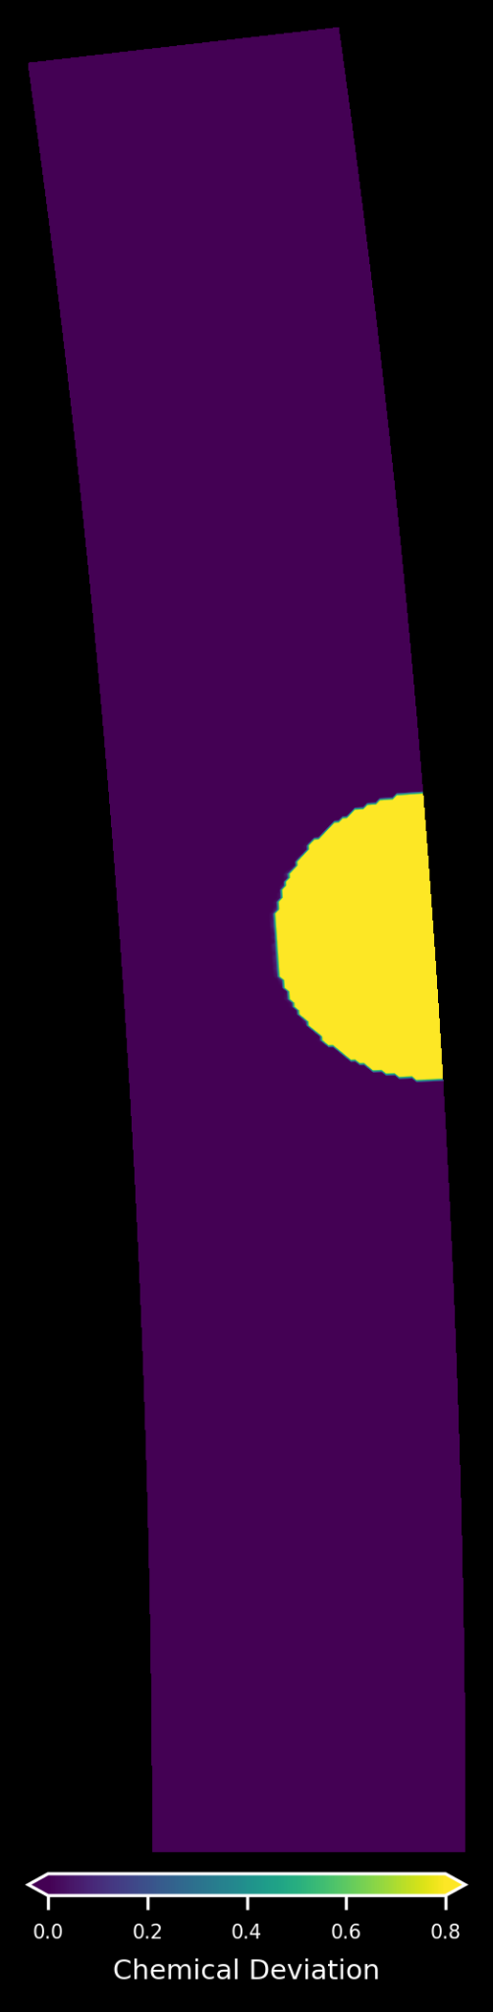
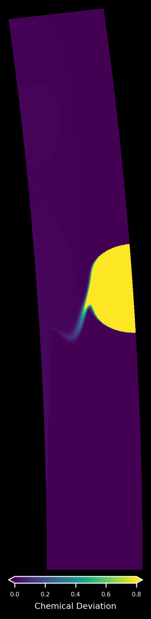
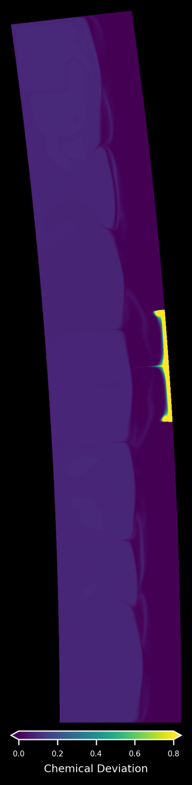
1 x Earth’s ocean salinity: Grain size effect
Impactor radius: 1.8km, time: 60Myr
Decreasing grain size increases material mixing
Medium case: plume still generated, pushed away by sinking of the impactor material
Convective case: mixing is quick and efficient
Grain Size:
1 cm
1 mm
TRANSPORT TO ICE-OCEAN INTERFACE POSSIBLE !!
0.1 mm
time = 9e5 yr
10
Notes:
At the moment of the impact, G = 1cm and G = 1mm still have same average temperature profile and the bumps given by the impact anomaly can be seen.

Slide 16

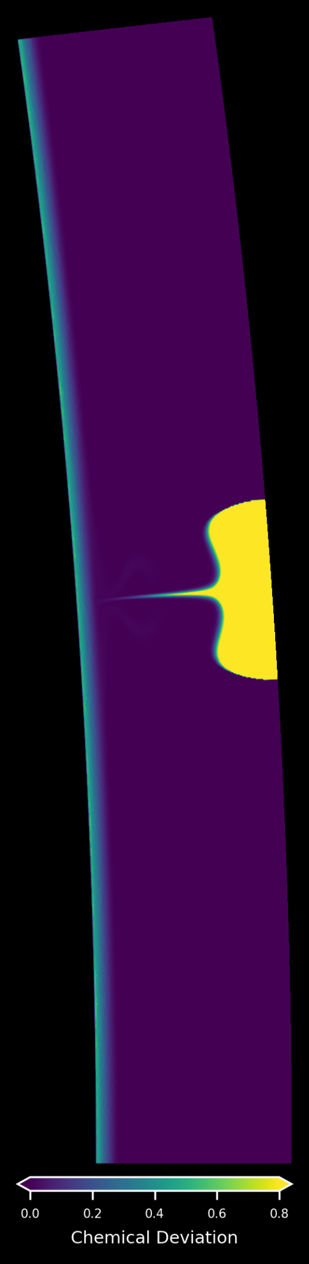
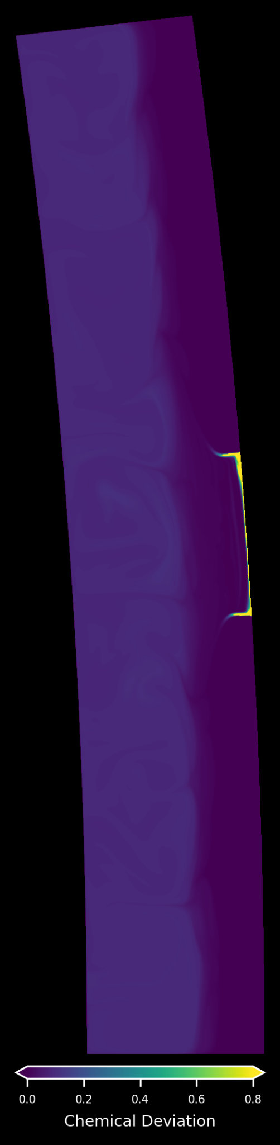
2 x Earth’s ocean salinity: Grain size effect
Impactor radius: 1.8km, time: 60Myr
Grain Size:
1 cm
Decreasing grain size increases material mixing
Medium case: denser sinked material inhibits plume formation
Convective case: mixing takes more time than previous case
1 mm
0.1 mm
time = 2 Myr
TRANSPORT TO ICE-OCEAN POSSIBLE !!
13
Notes:
At the moment of the impact, G = 1cm and G = 1mm still have same average temperature profile and the bumps given by the impact anomaly can be seen.

Slide 17
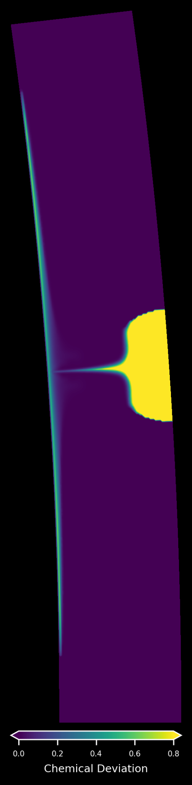
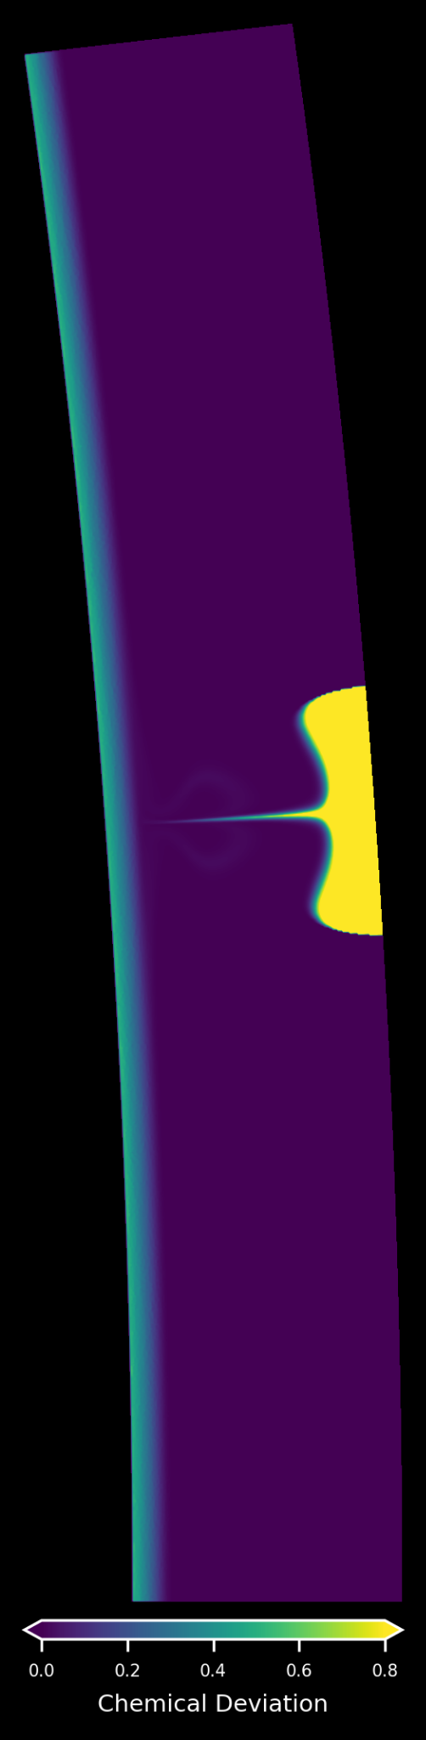
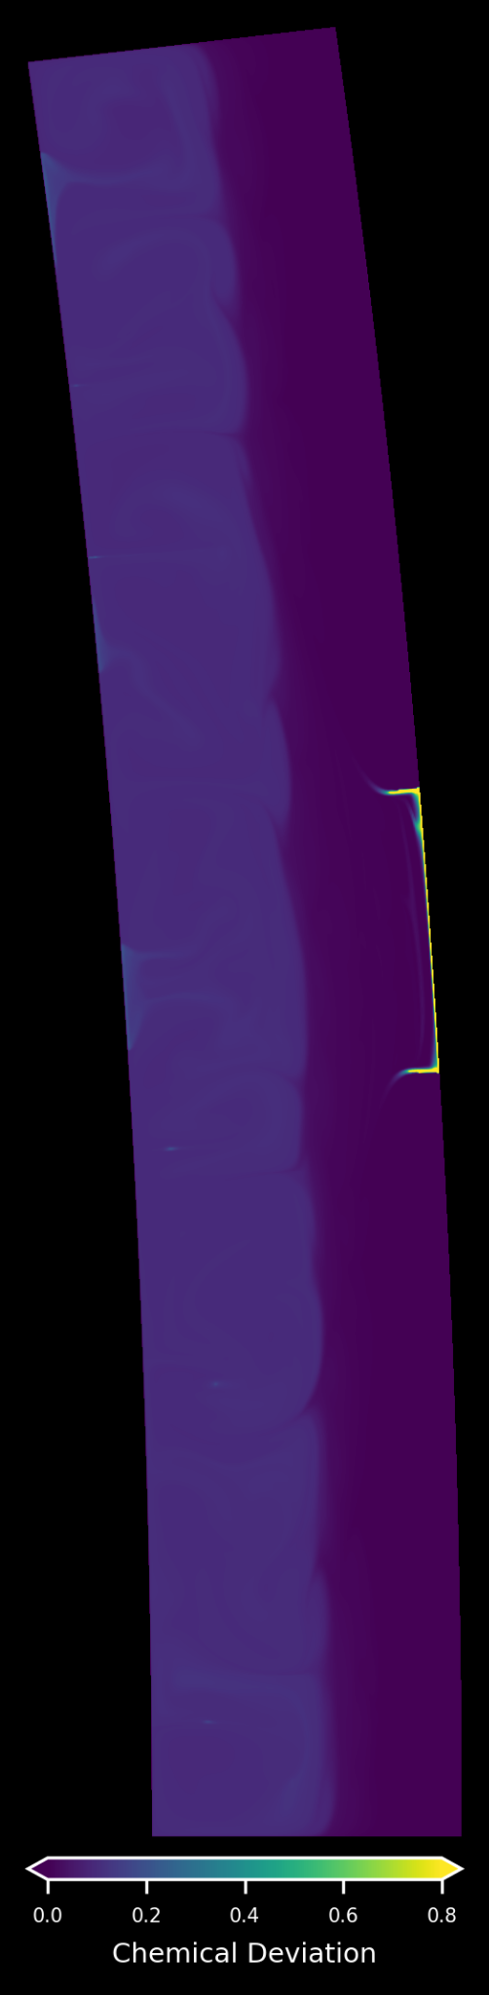
4 x Earth’s ocean salinity: Grain size effect
Impactor radius: 1.8km, time: 60Myr
Grain Size:
More salinity leads to more transport to ice-ocean interface
Medium case: denser sinked material inhibits plume formation
Convective case: mixing takes more
For all cases there is transport of material to ice-ocean interface.
1 cm
1 mm
0.1 mm
time = 5 Myr
14
Notes:
At the moment of the impact, G = 1cm and G = 1mm still have same average temperature profile and the bumps given by the impact anomaly can be seen.

Slide 18



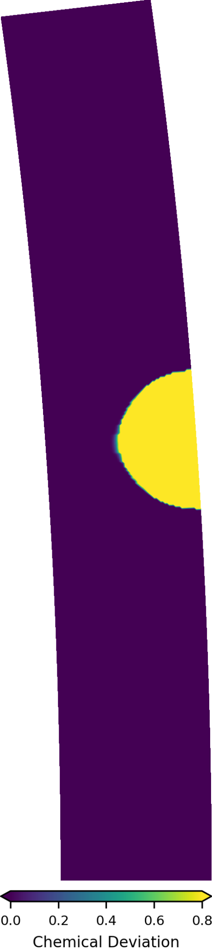
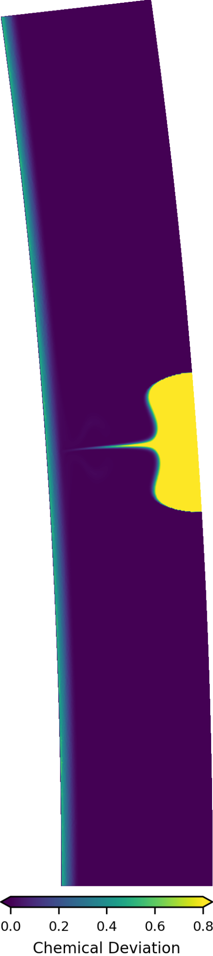
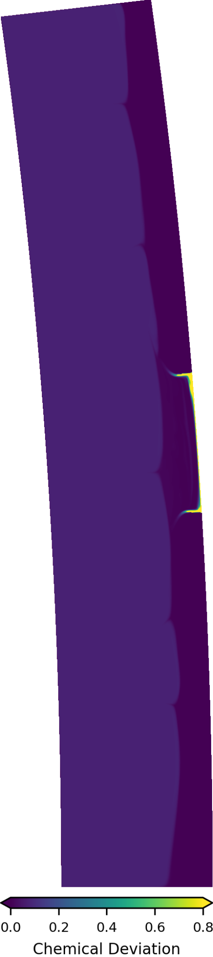
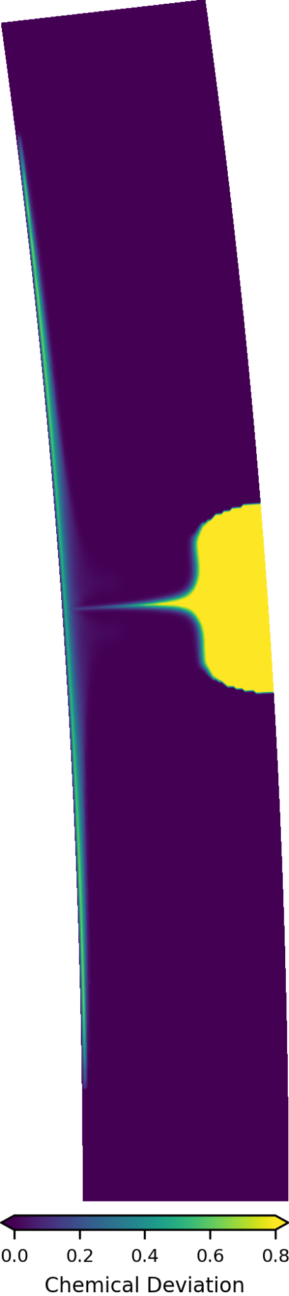
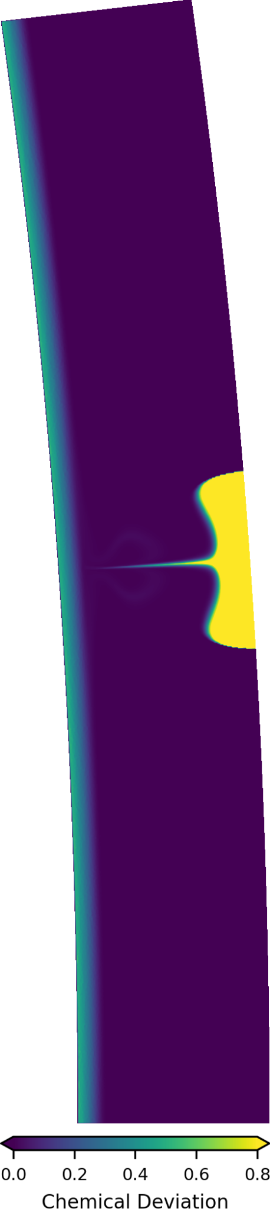
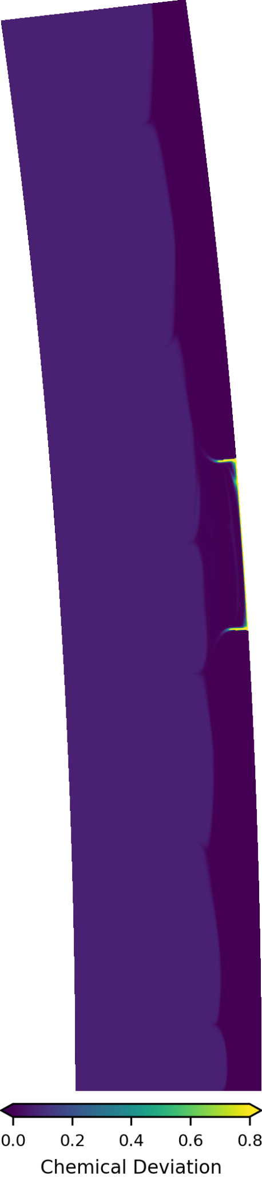
Grain size = 1cm
Grain size = 1mm
Grain size = 0.1mm
1xEarth’s ocean salinity
2xEarth’s ocean salinity
4xEarth’s ocean salinity

Slide 19
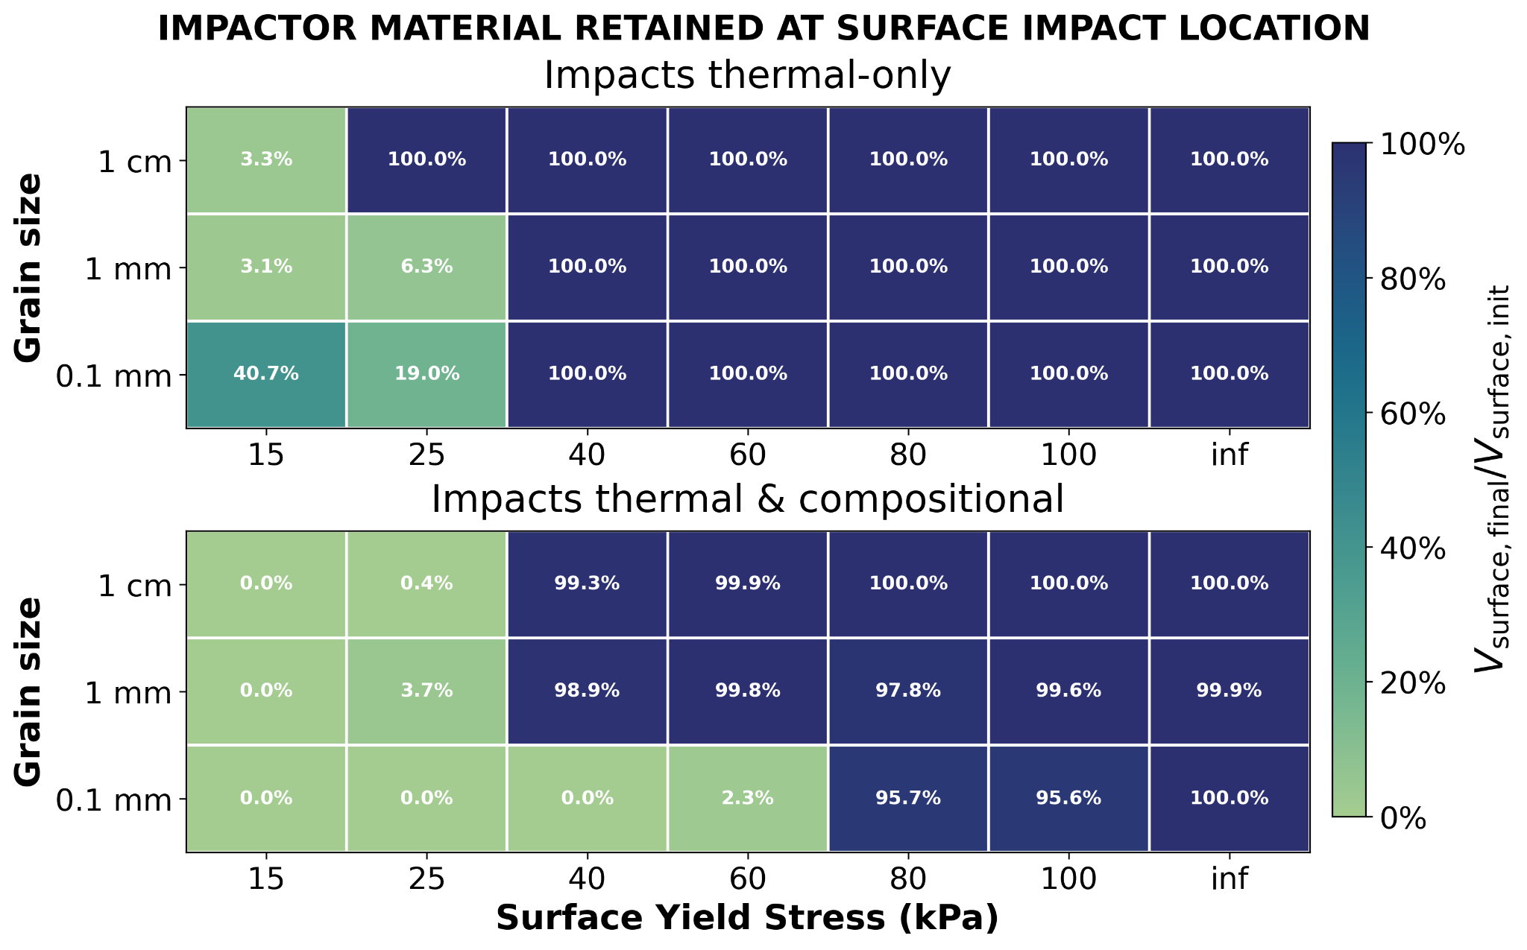


Surface Mobilisation

Slide 20


Slide 21

Grain size = 0.1mm
Surface Yield Stress = 15kPa

Slide 22

Grain size = 0.1mm
Surface Yield Stress = 15kPa

Slide 23




Brittle YS = 15kPa, Grain size = 1 cm

Slide 24




Brittle YS = 15kPa, Grain size = 1 mm

Slide 25




Brittle YS = 15kPa, Grain size = 0.1 mm

Slide 26




Brittle YS = 25kPa, Grain size = 1 cm
Brittle YS = 25kPa, Grain size = 1 mm

Slide 27


Brittle YS = 25kPa, Grain size = 1 cm
After around 15 Myr the chemical anomaly eventually helps winning the surface yield stress. The impactor material sinks entirely allowing surface mobilization.

Slide 28



Brittle YS = 25kPa, Grain size = 1 mm
After around 41 Myr the chemical anomaly eventually helps winning the surface yield stress. The impactor material sinks entirely allowing surface mobilization.

Slide 29

The 1e-2m grain size, without SM, had no material transported below the anomaly
The 1e-3 had about 0.6% of volume sunk, now its up to 12.50%
The 1e-4m will probably act similarly, as already without SM almost all of the anomaly was mixed

Slide 30




1xEarth’s ocean salinity, Grain size 1 mm, no SM
1xEarth’s ocean salinity, Grain size 1 mm, with SM
Brittle YS = 40kPa, Grain size = 1 mm

Slide 31
Conclusions
Impact-induced thermal anomalies can trigger buoyant plumes that persist over Myr timescales → localized convection ✔
For a grain size of 1mm and an impactor radius of 1.8km
Density difference between impactor and ice shell can allow for material sinking and mixing ✔
Smaller grain sizes and bigger impactor’s salts concentrations → more mixing and sinking → density anomalies in the shell
Transport of salty material to the ice-ocean interface is observed for multiple parameters spaces -> ice-ocean material exchange possible
For biggest grain size (1cm) and salinity of 1x-2x Earth’s ocean concentration, the chemical anomaly is trapped at the impact location → gravity anomalies at craters → constraint on grain size
Credits:NASA/JPL-Caltech

Slide 32

Future work
Investigate whether the impact itself can create local weakening or breaking of the conductive lid, allowing surface material exchange
For which impact / rheology cases do we obtain surface mobilization?
Over what timescales does this mobilization persist after the impact?
Model the possible gravitational anomalies and surface expressions of impact-generated plumes and density variations
Explore the cumulative effect of repeated impacts on lid stability, and long-term shell evolution
This illustration provided by NASA depicts the Europa Clipper spacecraft over the moon, Europa, with Jupiter at background left. NASA/JPL-Caltech/AP

Slide 33

Thank you
Temperature residuals
Grain size = 1 mm
Convective initial state
1.8 km impactor size

Slide 34

Thank you
100 impacts over 45 Myr plus 15Myr of post-impacts evolution
Angular ratio 1/15 = 24° wedge
Impactor radii 0.25km-1.8km
Grain size = 1 mm

Slide 35

APPENDIX
Scaling laws [Melosh, 1989]
Particle velocity field u_{p}(r)
Isobaric core radius r₀
Core particle velocity u_{p0}
Shock-induced temperature anomaly ΔT
Radius of the thermal anomaly R
ξ, C and S are material parameters

Slide 36


Convective and Conductive Initial State: How long do the impacts effects last?
10
Notes:
In terms of velocity and equilibrium this test gave interesting results. For both the conductive and convective cases, the plumes generated seem to reach a steady state at a certain constant velocity, indicating a self-sustained localized convection. This state stays stable at least during the given simulation time of 30Myr and it is thought to remain like this in time until the onset of other anomalies. As expected, the convective case reaches higher velocity than the conductive case with the single plume. Notably, the first seems to take longer time to plateau, around 5 Myr, while the second seems to get around 3 Myr.
It is interesting to understand how those velocity bumps actually relates to the impact anomaly and post-impact evolution.

Slide 37




Grain size effect: Impactor Radius 1.0km
t = impact
G = 1 cm
G = 1 mm
G = 0.1 mm
15
Notes:
For the smaller impactor we see of course how the anomaly acts upon a smaller depth, so the profile remains conductive for longer.

Slide 38


Grain size effect: Velocity Comparison
Impactor Radius = 1.8km
Impactor Radius = 1.0km
16
Notes:
Here we see the velocity comparison for the case with impactor radius 1.8km and 1.0km for different grain sizes. In dots the average steady state velocity of the convective case (smaller grain size) is plotted: this is because the simulation without impacts that was run for 10Myr was already very convective and did not exactly converge to a value but showed an oscillation around this average velocity. Oscillation that as we can see actually continues, with probably a higher magnitude, after the impact. However, since the shell is already very convective and velocity is already quite high, the effect of the impact on the velocity is not really visible or much distinguishable from the already existing velocity. Differently, for the median case we see what we already saw at the beginning of the presentation: the impacts generates a plume and that plume increases the average velocity of the ice shell to a steady state around 3 cm/yr. For the last case, the purely conductive, the impacts generates a boost in velocity that is only temporary until it smoothes out and reaches a purely conductive steady state with 0 velocity. If look at the 1.0km impactor case, velocity oscillations are a bit smaller than the bigger impactor case, but the velocity behaviour remains similar: many oscillations, a lot of dynamics, effect of the impact alone not clearly distinguishable; the 1mm grain size median case for this smaller impactor does not generate a plume and indeed the velocity approaches zero and a purely conductive state around 6 Myr. For the smallest grain size the velocity is again orders of magnitude smaller, purely conductive apart for the very brief spike given by the impact.

Slide 39



Grain size effect: Temperature comparison at depth over time
GS = 1cm
GS = 1mm
Time of impact = 25ky
Impactor radius = 1.8km
GS = 0.1mm
17
Notes:
For the convective case, the thermal signature of the impact disappears much faster, hardly distinguishable from the background. In the convective case the background temperature is much warmer already, thus the impact anomaly dissipates faster. We can also see it by comparing the max temperature at 50kyr with the background for both convective and conductive: we observe a difference of 140K for the conductive sims and 80K for the convective sim.

Slide 40



Grain size effect: Temperature comparison at depth over time
GS = 1cm
GS = 1mm
Time of impact = 25ky
Impactor radius = 1.0km
GS = 0.1mm
18

Slide 41


Impactor size effect: Velocity Comparison
20
Notes:
From the velocity plot we can observe again how the impactor size strongly controls the velocity, as a consequence of the bigger temperature anomaly. Particularly, from this test we could conclude that: only the largest impact (1.8 km radius) generates long-lasting convective enhancement, with the single plume we already observed previously, thus the evolution to a constant particles velocity around 3 cm/yr; smaller impacts fade quickly and barely affect global shell dynamics, but we can still observe how the 1.0km impactor case has one order of magnitude higher velocity at impact.

Slide 42


Impactor size effect: What happens for the convective initial state cases?
Convective cases (impacts at the very beginning).
Same grain size (1 mm).
r = 0.5 km
Plumes and convection are triggered even for lower impactor radii when they are set on the convective initial state.
r = 1.0 km
For the smaller impactor, the plumes are less.
1km and 1.8km form same number of plumes
r = 1.8 km
21

Slide 43


Impactor size effect: What happens for the Convective initial state cases?
22

Slide 44

Angular ratio effect: Grain Size 1mm
Wider shells have wider areas at lower temperature and velocity, while the impact anomaly and plume remain the same.
Higher angular span, with same ice shell thickness, gives smaller average velocities.
25
Notes:
Since the thermal anomaly generated by the impact is in terms of size is the same across the three cases, and the same is also the single plume that is produced, the angular wedge of the shell has an influence in both the average velocities and temperatures. Wider shell will have wider areas at lower temperature and velocity while the impact anomaly and plume stay the same: this explains the yellow line of AR1/15 being the smaller velocity in the comparison. Same reasoning for the other two cases.

Slide 45






Convective and Conductive: Tidal Heating
Impact time = 25.000 years
End time = 30e6 years
Grain size = 1 mm
Impactor radius = 1.8km
Convective
Conductive
t = 0
t = imp
t = end
10
Notes:
We start here comparing two different thermal states at which the impact is set. The impact time is 25ky from the beginning of the evolution, end time is at 30Myr and the grain size for both cases is 1mm.
On the right we see the case in which the shell has already gone through 10Myr evolution after a first random perturbation, and reached a conductive steady state. On the left, the impact is plugged since the very beginning of the evolution, when the shell has yet to evolve to a conductive steady state, thus being in a convective initial state.
On the far left we see the average temperature profiles of both cases, and we might as well easily distinguish the conductive profile from the convective. At the time of the impact, we can see the impact anomaly having an effect on the average temperature until approximately 15km depth, with the conductive case having a bigger shift in the curve, as expected from the lower global temperature over the shell at those depths. At the end time we observe the real change. For the conductive case a single plume is generated from the impact anomaly, while in the convective case a series of plumes is generated: this makes the average temperature of the convective case to strongly increase in those last 15km, far surpassing the average temperature of the conductive case in the last 6-5km of the shell, where previously the conductive temperature was comparatively higher.

Slide 46



Thermodynamic parameters
Temperature-dependent thermal conductivity of ice [Petrenko & Whitworth, 1999]:
Temperature- and pressure-dependent thermal expansivity of ice [Feistel & Wagner 2006]:
4
Notes:
Starting with thermodynamic parameters we use:
-A temperature dependent thermal conductivity of ice, so conductivity decreases with temperature.
-Expansivity that depends on temperature and pressure.

Slide 47

Ice rheology
composite rheology (Goldsby & Kohlstedt, 2001)
Effective viscosity
Diffusion creep
(grain size)
Basal slip (strain rate) + Grain boundary sliding
(strain rate, grain size)
Dislocation creep
(strain rate)
7
Notes:
We use composite rheology with 3 mechanisms:
-Diffusion creep, which is grain-size dependant
-BS+GBS, which depends both on strain rate and grain size
-Dislocation creep, which is strain-rate dependant
This rheology will determine how our ice shell will respond to impact-induced stresses.

Slide 48



Angular ratio effect: Grain Size 1mm, Impactor Radius 1.8km
t = impact
AR = 1/45 = 8°
AR = 1/30 = 12°
AR = 1/15 = 24°
18
Notes:
The next parameter is purely numerical but physically meaningful: the angular ratio. The nominal AR was 1/45, corresponding to an angular wedge of 8 degrees, the median case is AR 1/30 corresponding to an angular wedge of 12 degrees and the last case is AR 1/15 with an angular wedge of 24 degrees. Fixing the grain size and impactor radius, and varying the angular ratio, we obtain a difference in the magnitude anomaly depending on the fact that wider shells imply wider areas of low temperature, thus the average goes down; however, as expected, the impact anomaly depth does not vary with the 3 cases since the ice shell thickness is the same and the impactor radius is fixed.

Slide 49



Angular ratio effect: Grain Size 1mm, Impactor Radius 1.8km
t = end
AR = 1/45 = 8°
AR = 1/30 = 12°
AR = 1/15 = 24°
19
Notes:
Here we see the temperature bump moving towards deeper depths because of the plume formation, and how the small difference because of the wider shells is still present. What we conclude here is that the single plume outcome that was originally generated for the grain size of 1mm and impactor radius of 1.8km, is equally generated for the different tested angular ratios.

Slide 50


Grain size effect on Tidal Heating: Impactor Radius 1.8km
t = 0
t = 0
G = 1 cm
G = 1 mm
G = 0.1 mm
14
Notes:
Here again, tidal heating occurs in the lower part of the ice shell where the viscosity is close to the viscosity associated with maximum dissipation
For a vigorously convective ice shell where the viscosity in the convective layer is lower than the viscosity associated with maximum dissipation, the maximal tidal dissipation now occurs at the top of the convective sublayer and in cold plumes, where the viscosity value is close to the viscosity associated with maximum dissipation (eta_max)

Slide 51


Grain size effect on Tidal Heating: Impactor Radius 1.8km
t = impact
t = impact
G = 1 cm
G = 1 cm
G = 1 mm
G = 1 mm
G = 0.1 mm
G = 0.1 mm
16
Notes:
Tidal heating is amplified at the location of the impact, since the impact locally decreases the viscosity in the upper part of the ice shell, bringing its value close to the viscosity associated with maximum dissipation

Slide 52


Impactor size effect: Grain Size 1mm
t = impact
R = 500m
R = 1000 m
R = 1800 m
17
Notes:
Here we keep grain size fixed (1 mm) and vary impactor radius. As expected, impactor size strongly controls temperature anomaly depth. and therefore, as we’ll see in a bit, the velocity. From the average temperature profiles plot we can clearly observe this difference: the biggest impactor gives a temperature anomaly (in orange) that reaches about 15-16km depth, the median impactor size gives an anomaly (in blue) that reaches about 9-10km and finally the smallest impactor gives an anomaly (in green) that only affects the first few to 5 km depth. From the temperature snapshots we can in fact see that the anomaly magnitude itself does not really change by varying the impactor radius, rather is its the radius of the anomaly, which gets larger and therefore influence average temperature and the depth at which the bump is obseved.

Slide 53

Impacts set-up
Impact thermal-induced and compositional anomalies are parameterized using scaling laws [Melosh, 1989].
Vertical incidence θ = 0 and ⍴_{imp} = ⍴_{target}.
Different impactor radii (0.5 km, 1 km, 1.8 km).
[Wakita et al., 2024] for study on best fit of impactor radii with craters and multi-ring basins formation.
[Nesvorny et al., 2023] for impact probabilities on Jovian moons.
Impactor velocity is set to 15 km/s [Wakita et al., 2024; Cox and Bauer, 2015]. Approximately 8% of JFCs collide with Europa at speeds 9–15 km/s [Zahnle et al., 1998, Figure 4].
Different thermal states at the time of the impact (i.e. cold conductive or warm convective ice shell).
Simulated impactors were ice spheres (910 kg/m3) . Actual cometary impactors would be compositionally heterogeneous and porous, with bulk density about 600 kg/m3 [Weissman et al., 2004; A’Hearn et al., 2005].
The picture compares four large impact structures on Jupiter's icy moon, Europa. Clockwise, from top left, are Pwyll, Cilix, Tyre, and Mannann'an [NASA/JPL/DLR].
8
Notes:
Impacts are implemented using scaling laws from Melosh, assuming a vertical incidence and densities of impactor and target the same -> icy impactor. Later in the project mixtures of salts and dust in the impactor will be also considered.
-We explore different impactor radii, following size constraints given by best-fit studies with multiring surface features and falling within higher impact probabilities on Jovian moons as observed in Nesvorny et al.
-The impact velocity is fixed at 15 km/s, consistent with other numerical modelli studies like Wakita et al., and Cox and Bauer. This velocity is actually les that the estimated velocity of 26.5km/s but is common practice to use this value for computational reasons. Moreover, the chosen velocity remains Europa-relevant as it is assumed that 8% of JFC impact Europa at speeds of 9-15 km/s.
-We test impacts on both conductive and convective pre-impact shells
Finally, the simulated impactors were taken as icy spheres. Actual cometary Impactors would be compositionally heterogeneous and porous.

Slide 54



Convective and Conductive: Tidal Heating
Impact time = 25.000 years
End time = 30e6 years
Grain size = 1 mm
Impactor radius = 1.8km
Convective (hot) T-profile
Conductive (cold) T-profile
t = 0
t = 0
t = imp
t = imp
t = end
t = end
10
Notes:
Tidal heating occurs in the lower part of the ice shell where the viscosity is close to the viscosity associated with maximum dissipation
Since an impact locally decreases the viscosity in the upper part of the ice shell, tidal heating will be amplified at the location of the impact As plumes emerge and have a warmer temperature that leads to a viscosity close to the viscosity associated with maximum dissipation, maximum tidal heating occurs in such plumes

Slide 55
The Effects of Impacts on Europa’s Ice Shell Dynamics:
A GAIA Parameter Study
Davide Izzo^{1,2}, Ana-Catalina (Ina) Plesa¹, Hauke Hussmann¹
¹DLR Institute of Planetary Research, ²TU Delft

Slide 56


2 x Earth’s ocean salinity: Porosity effect on mixed volume
G = 1mm
Porous material sinks as around ½ of the amount of non-porous material.
2-4.5% of volume of sinked material compared to the 0.05-0.6% for half the salinity.
Material sinks to the ice-ocean interface and after 60Myr is slowly increasing.
15
Notes:
At the moment of the impact, G = 1cm and G = 1mm still have same average temperature profile and the bumps given by the impact anomaly can be seen.

Slide 57


2 x Earth’s ocean salinity: Porosity effect on mixed volume
G = 0.1mm
Mixed material sums up to 12-13% of total shell volume. Little difference from lower salinity case.
As for the previous convective case, mixed volume decreases towards a steady value as the material is uniformly mixed.
We can conclude the convective regime is the main driver for the mixing patterns, rather than impactor salinity.
15
Notes:
At the moment of the impact, G = 1cm and G = 1mm still have same average temperature profile and the bumps given by the impact anomaly can be seen.

Slide 58
2 x Earth’s ocean salinity: Grain size effect
Impactor radius: 1.8km, time = 60Myr
Decreasing grain size increases material mixing.
In the median case the plume is not generated anymore because of the opposing effect of chemical buoyancy.
For the convective case (smallest G) we only have 2Myr simulation run time, but we can already see how the mixing is quick and efficient.
G = 1 cm
G = 1 mm
?
G = 0.1 mm
time = 2 Myr
15
Notes:
At the moment of the impact, G = 1cm and G = 1mm still have same average temperature profile and the bumps given by the impact anomaly can be seen.

