Slide 1
Vojtech Enev^{1,3}, Kristyna Mullerova³, Leona Kubikova^{1,3}, Jakub Ciz², Katerina Liskova (Stastan)³, Martina Klucakova^{1,3}, and Miloslav Pekar^{1,3}
Quantification of Humic Substances in Caustobiolites and Commercial Products Using a New Standardization Method
¹Materials Research Centre, Faculty of Chemistry, Brno University of Technology, Purkynova 118, Brno, 612 00, Czech Republic;
²Institute of food science and biotechnology, Faculty of Chemistry, Brno University of Technology, Purkynova 118, Brno, 612 00, Czech Republic;
³Physical and Applied Chemistry, Faculty of Chemistry, Brno University of Technology, Purkynova 118, Brno, 612 00, Czech Republic.
Author: Vojtech Enev
7. 5. 2026

Slide 2
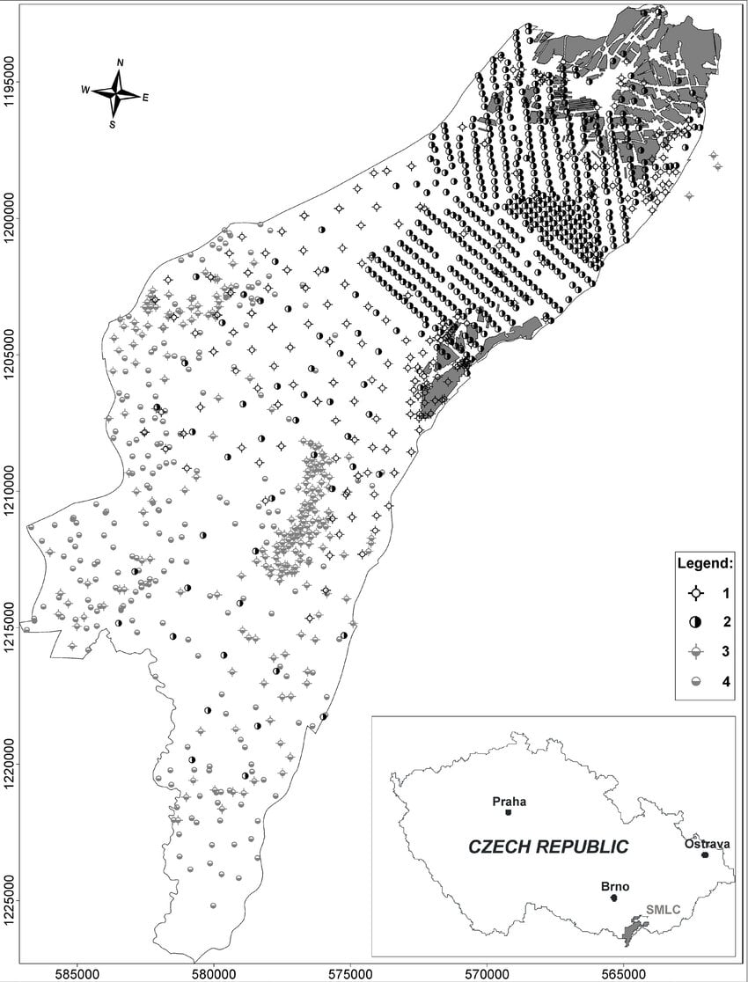
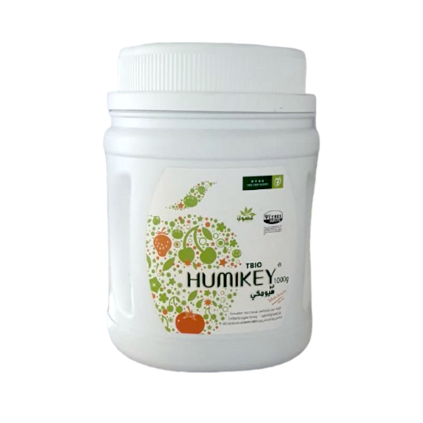
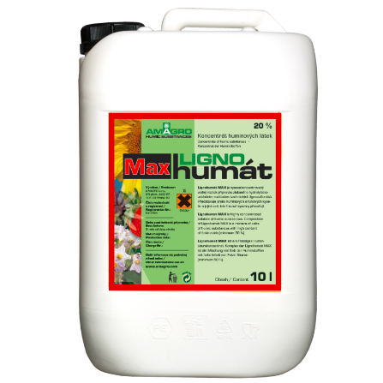
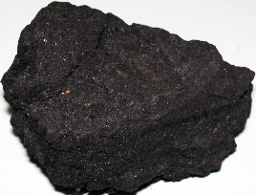
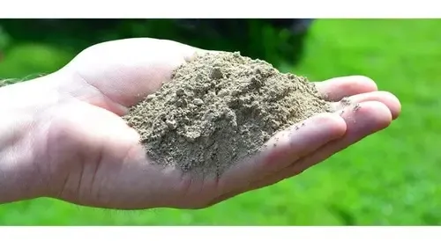
methods and materials
caustobiolites (lignite, leonardite, and alginite);
commercial humate products.
northern part of the Vienna basin, Mír mine near Mikulčice, Czech Republic
OM – organic matter
HL – huminové látky
Leonardite (Afşin,
Kahramanmaraş,
Turkey)
commercial humate
alginite (Pinciná, Slovakia Republic)

Slide 3
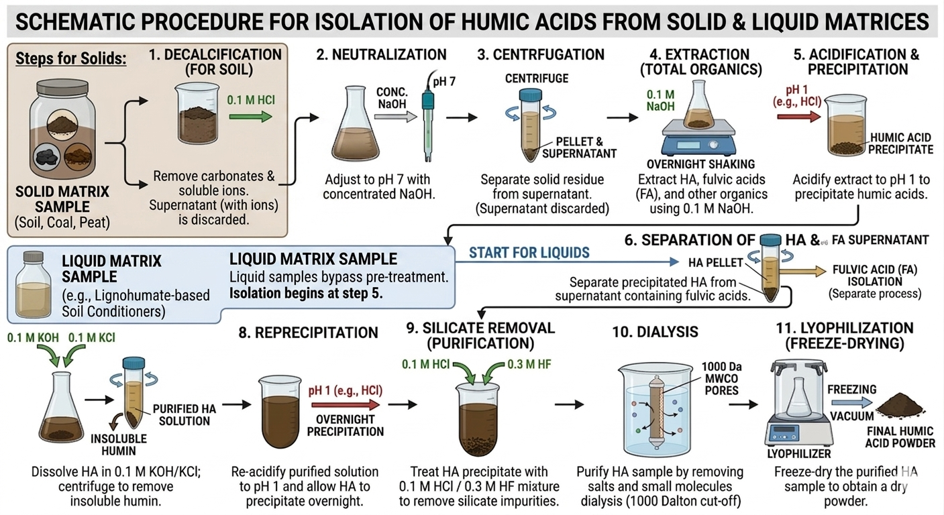
methods and materials

Slide 4
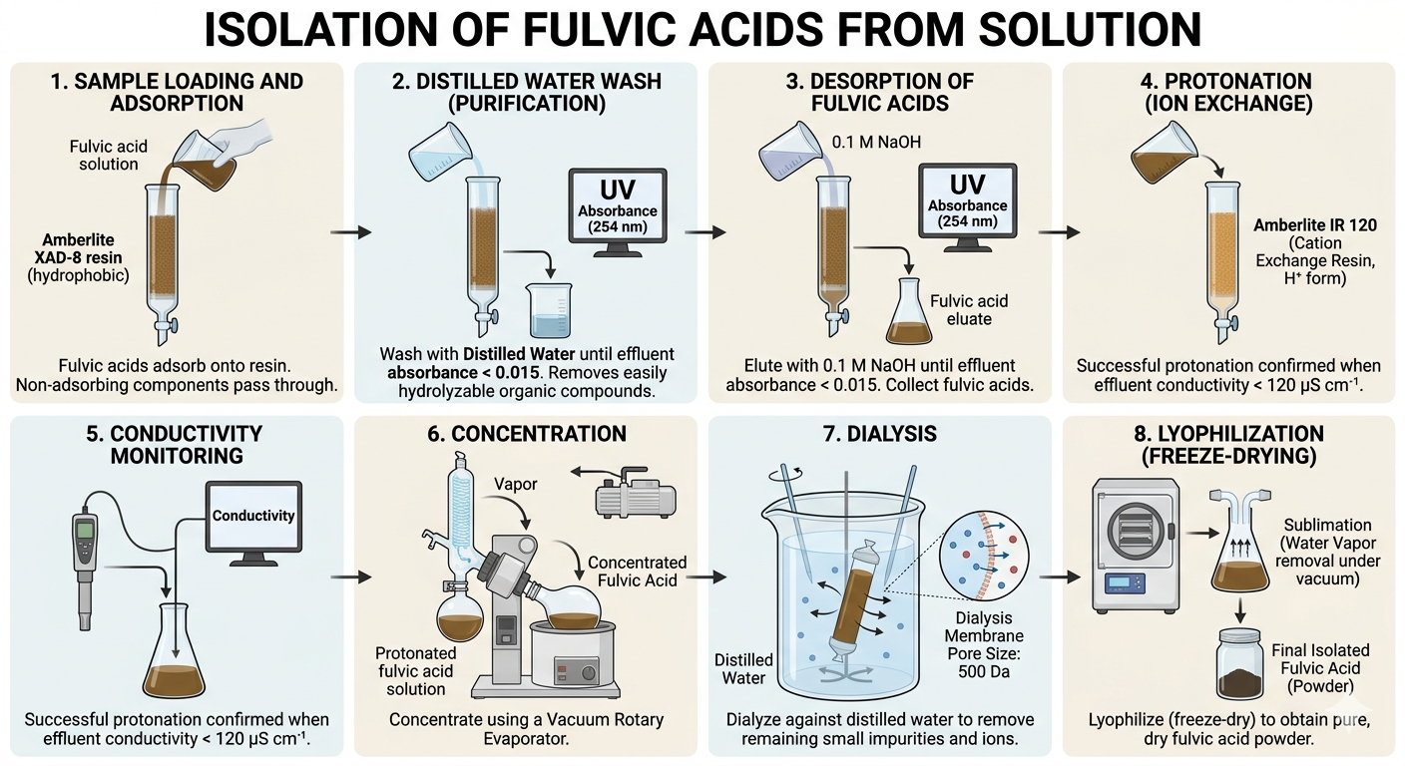
methods and materials

Slide 5
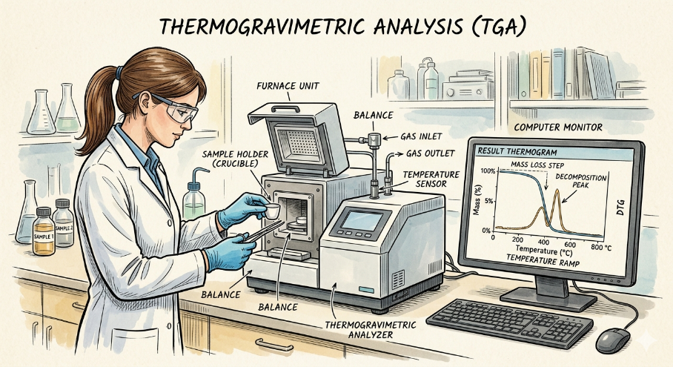
results and discussion
content of individual organic fractions (humic and fulvic acids) in caustobioliths and soil conditioners (soil amendment products)
sample | HA | FA
 | wt. %♣ (ash free)
alginite | 20,00 | 10,00
oxyhumolite | 51,00 | 4,10
leonardite | 54,22 | 3,70
lignohumate MAX | 31,20 | 30,60
HUMKEY | 63,32 | 18,20
content of humic substances was obtained by gravimetric analysis
soil conditioner
♣ wt. % by weight calculated on an original organic matter basis for the isolation of humic substances

Slide 6

results
and discussion
elemental analysis
sample | C | H | N | S | O | moisture | ash
 | at. % |  |  |  |  | wt. %
alginite HA | 34.84 | 52.55 | 2.40 | 0.78 | 9.42 | 6.64 | 1.25
alginite FA | 34.84 | 48.38 | 2.29 | 1.58 | 12.92 | 5.58 | 25.60
oxyhumolite HA | 35.77 | 53.32 | 1.74 | 0.00 | 9.17 | 4.91 | 1.52
oxyhumolite FA | 33.19 | 51.21 | 1.68 | 1.06 | 12.85 | 7.07 | 7.69
leonardite HA | 45.98 | 35.99 | 0.56 | 0.00 | 17.47 | 4.81 | 0.83
leonardite FA | 33.60 | 49.56 | 0.56 | 0.00 | 17.47 | 4.01 | 0.45
lignohumate MAX HA | 38.94 | 40.93 | 0.99 | 0.12 | 19.02 | 4.58 | 0.55
lignohumate MAX FA | 40.43 | 46.20 | 0.90 | 0.51 | 11.96 | 10.55 | 1.22
HUMKEY HA | 49.04 | 33.07 | 1.83 | 1.32 | 14.73 | 5.33 | 0.12
HUMKEYFA | 35.90 | 34.39 | 1.78 | 1.54 | 26.39 | 6.01 | 2.08

Slide 7
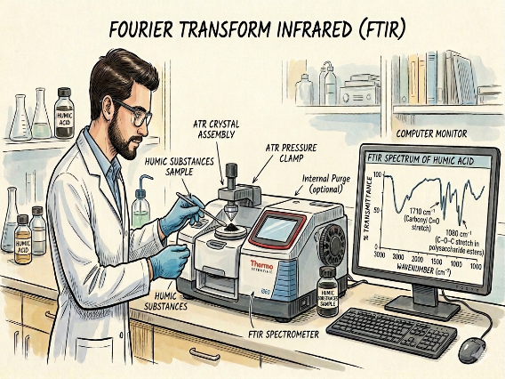
results
and discussion
FTIR spectroscopy
3700–3000 cm^{–1} O–H and N–H stretching of alcoholic, phenolic, carboxylic, secondary amide, amine functional groups;
2950–2800 cm^{–1} C–H stretching of aliphatic species (–CH₂–, –CH₃, –O–CH₃⟶lignin residues);
2700–2400 cm^{–1} hydrogen bond between two carboxylic functional groups;
1720–1700 cm^{–1} C=O stretching of carboxylic functional groups;
1620–1590 cm^{–1} C=C stretching of aromatic species;
1500 cm^{–1} C=C stretching of aromatic species such as lignin fragments;
1400 cm^{–1} stretching of carboxylate functional groups (slats form);
1250–1200 cm^{–1} stretching of alkyl/aryl-esters; phenolic –OH; carboxylic functional groups;
1180–1100 cm^{–1} C–O–C/O–C–C stretching of alkyl/aryl-ether/ester functional groups;
1040–1000 cm^{–1} C–O stretching of alcoholic functional groups and polysaccharide fragments (cellulose, hemic-cellulose…);
♣ 1550 cm^{–1} N–H and C–N deformation/stretching vibrations of secondary amide groups;
♣ 1450 cm^{–1} C–H deformation vibration of aliphatic functional groups;
♣ 1370 cm^{–1} vibration of carboxylate functional groups;
♣ 1450 cm^{–1} C–H deformation vibration of aliphatic functional groups.

Slide 8
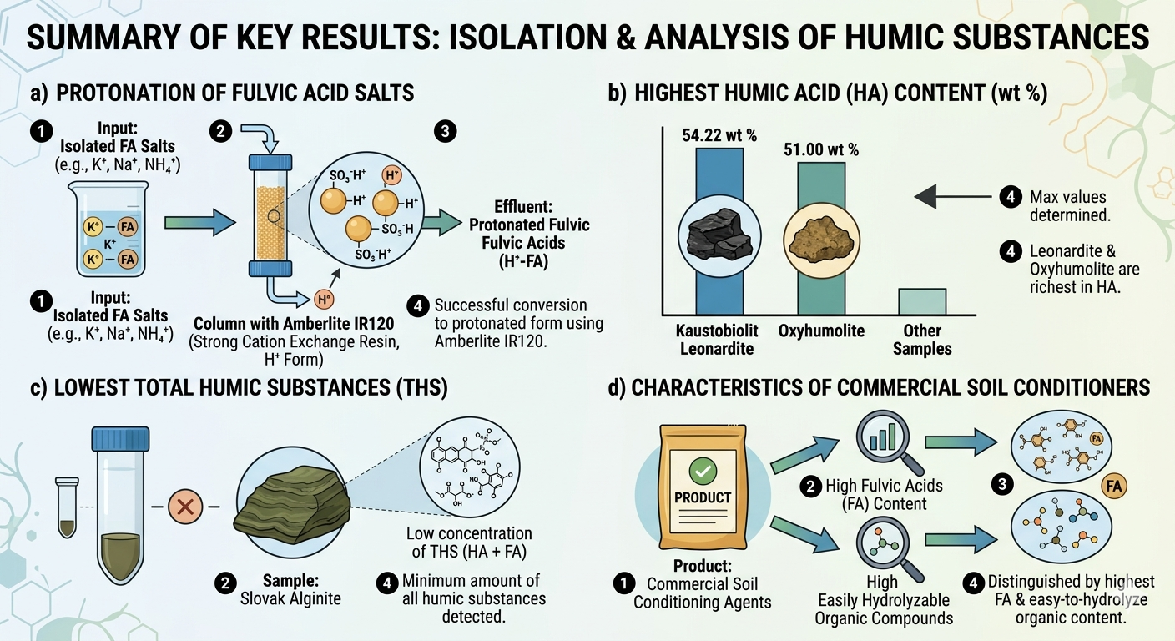
conclusion

Slide 9
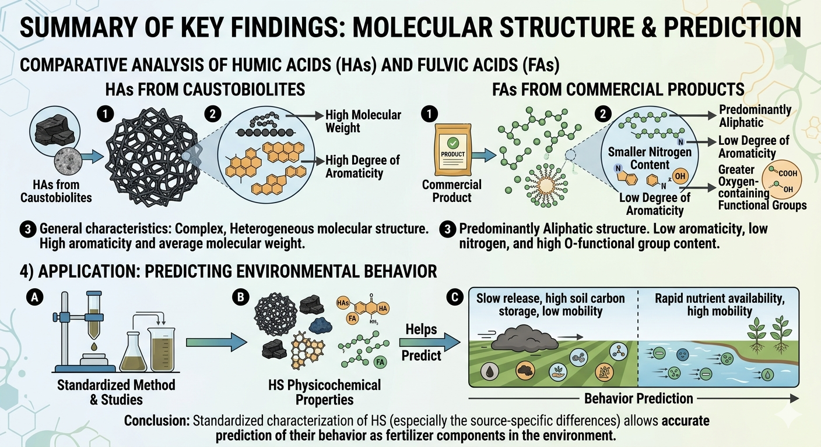
conclusion

Slide 10

The authors gratefully acknowledge the financial and scientific support provided by the NATO Science for Peace and Security Programme (SPS) under the project G6296. We deeply appreciate NATO's commitment to fostering international scientific cooperation and addressing critical security and environmental challenges.

