Slide 1



EGU26 General Assembly - 08/05/2026
- NP6.4 Stratified Turbulence and Gravity-Driven Density Currents: From Geophysical to Planetary to Astrophysical Flows -
Numerical investigation of the turbulent gravity wave break-up near a critical level
Thomas Vandamme¹, Juan Pedro Mellado¹, Victor Avsarkisov¹
Project-collaboration: Marc Avila², Marika Federer², Jens Rademacher¹, Roland Welter¹
¹University of Hamburg, ²University of Bremen

Slide 2
Introduction
Dissipation rates during GW break-ups have uncertainty of order 1 (e.g. Strelnikov et al. 2017).
How does this dissipation rate depend on wave properties and background shear near a critical level?
Critical level break-ups were studied in Winters & D’Asaro (1989, 1994) – we are interested in the turbulent state after the break-up.

Slide 3
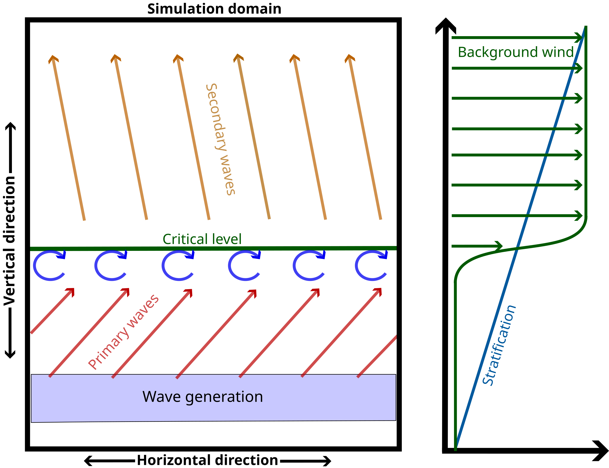

Simulating turbulent breaking gravity waves: Concept
Non-dimensional scenario:
Initial background flow:
Primary wave signal:

Slide 4
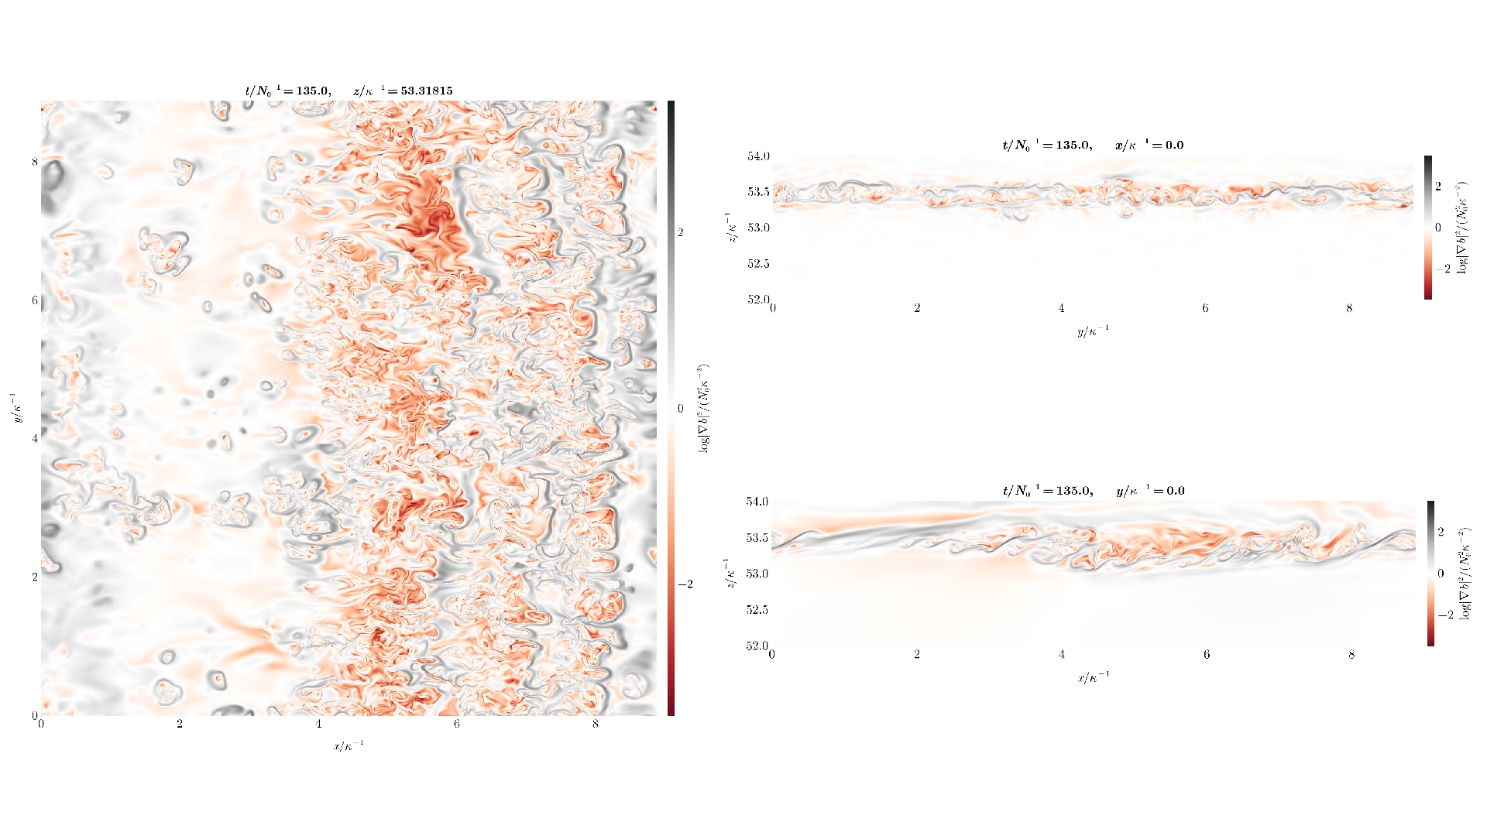
Three-dimensional DNS of a turbulent breaking GW

Slide 5
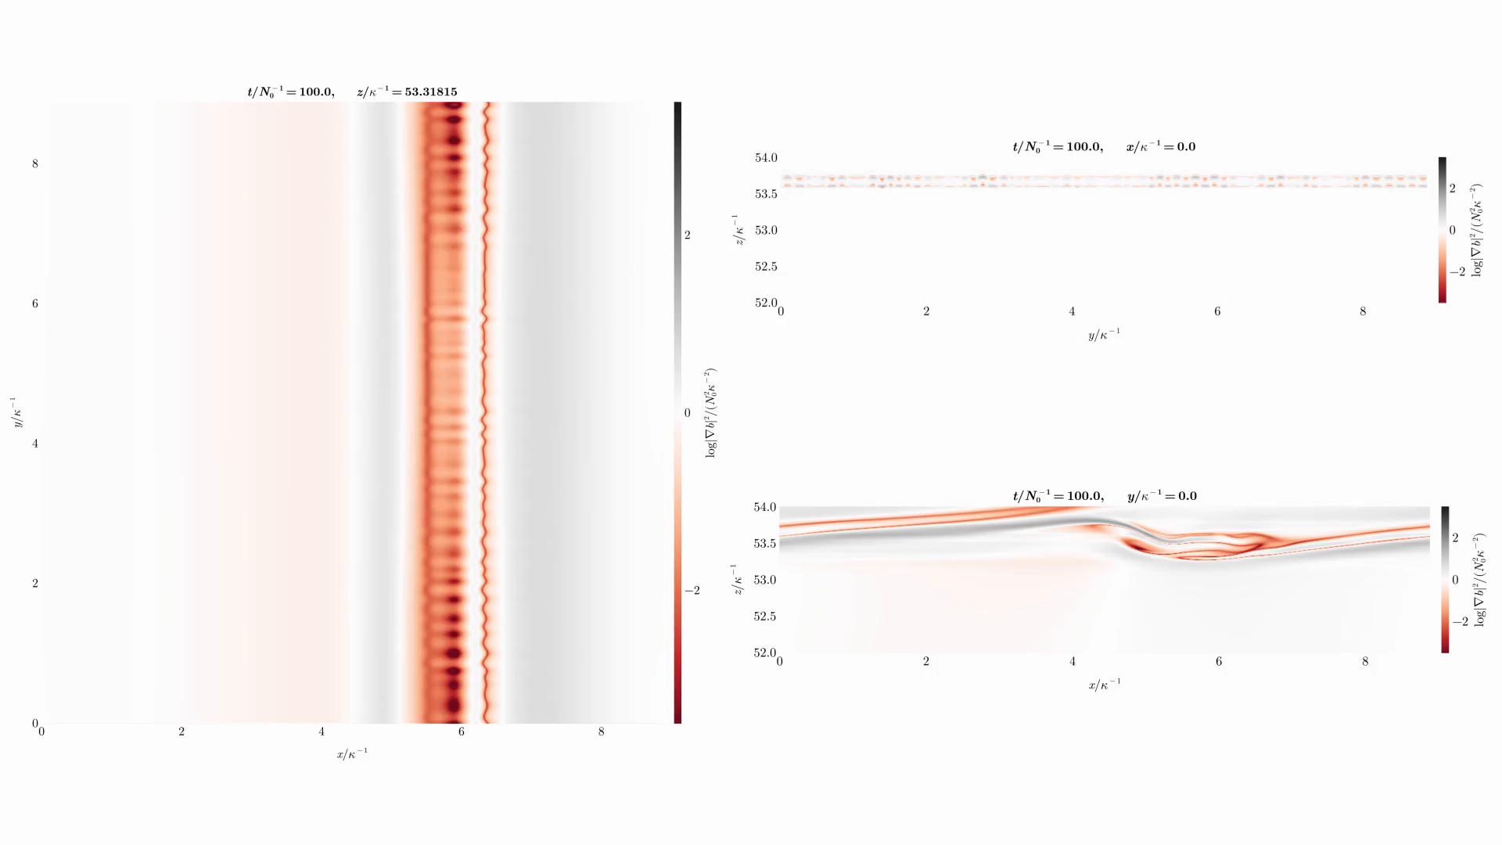
Three-dimensional DNS of a turbulent breaking GW

Slide 6
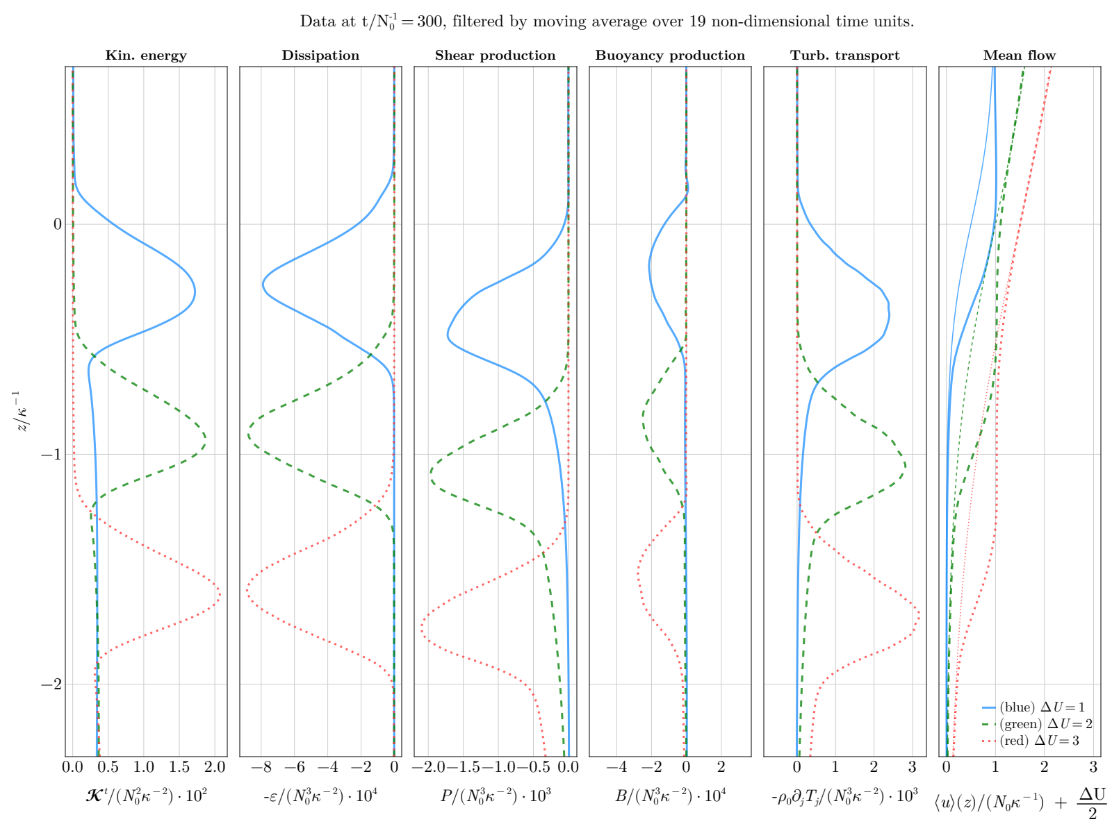
Horizontal statistics for the kinetic energy budget
Statistical properties show approximately the same values; Results seem to be rather independent of ∆ U
The mixing length seems to be independent of ΔU as well;
The main effect of ∆ U is to move the critical level down
The turbulent transport is the main source, likely representing the wave bringing energy from below

Slide 7
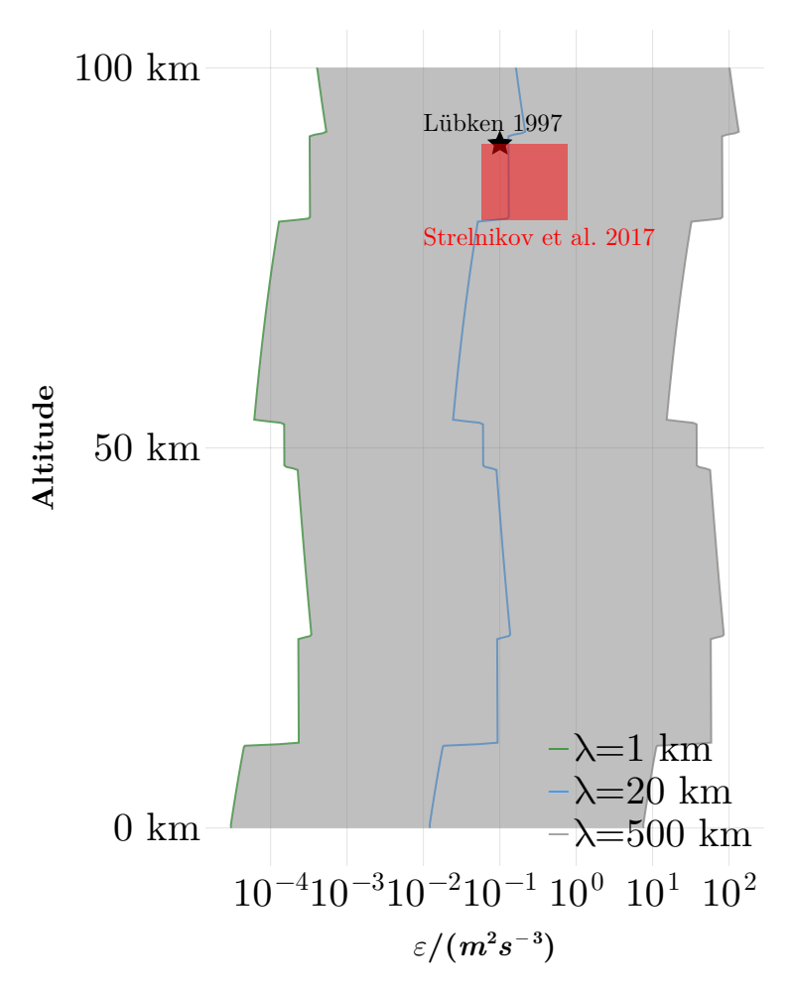
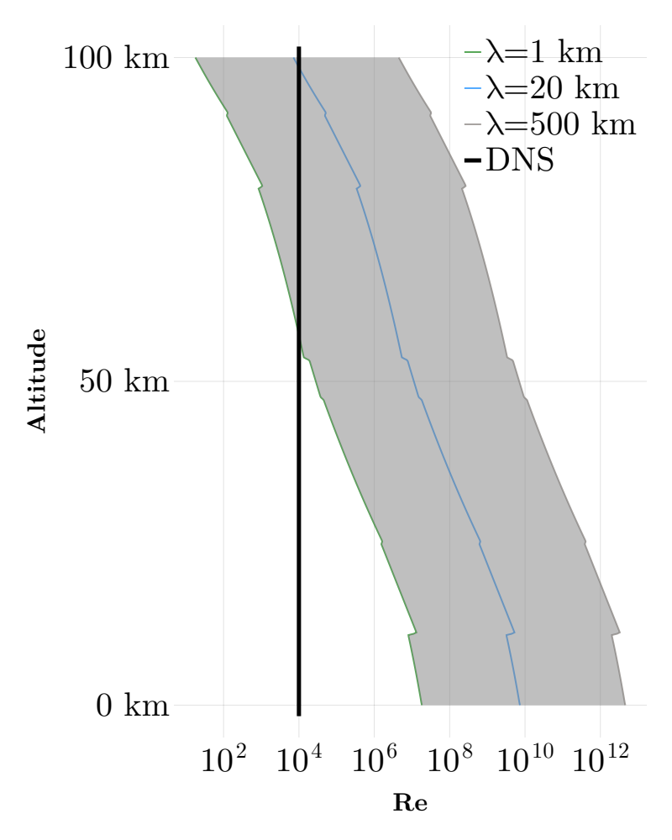
Comparison to atmospheric measurements
We obtain a dissipation rate ε ≃ 10⁻³ N0 ³ κ⁻²
The Reynolds number is defined as Re = N0 / (νκ²)=10⁴
We consider typical wavelengths of λ ∈ [1 km, 500 km]
Values for N0 are taken from the U.S. Standard Atmosphere Model

Slide 8
Conclusion
Turbulent dissipation rather independent from the background shear and scales with N0 and κ
DNS for turbulent breaking GWs near a critical level
Results are comparable to atmospheric measurements
Vandamme & Mellado 2026 (in prep.)

