Slide 1
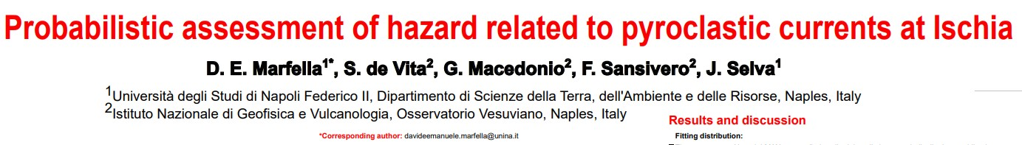


SUPPLEMENTARY MATERIALS OF ABSTRACT EGU26-5712:

Slide 2
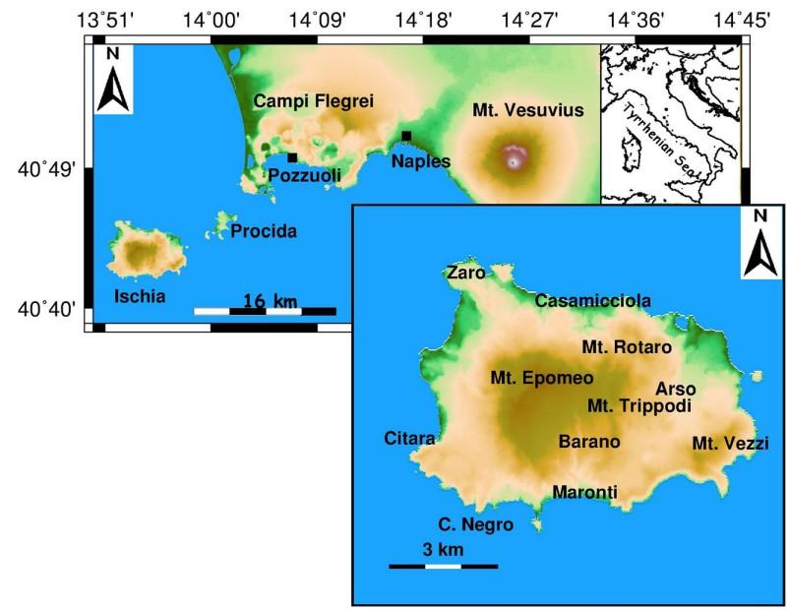
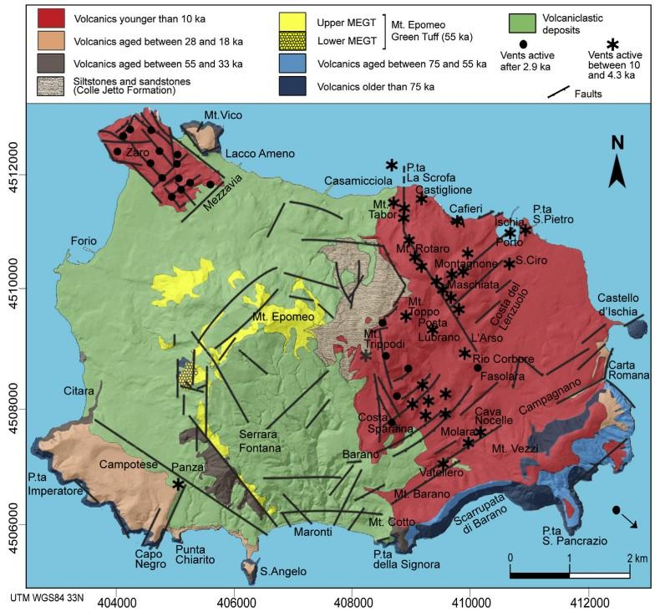
Geological map of Ischia (de Vita et al., 2013, modified by Della Seta et al., 2012)
Map of Neapolitan Volcanic District and Ischia Island (Capuano et al., 2015)

Slide 3
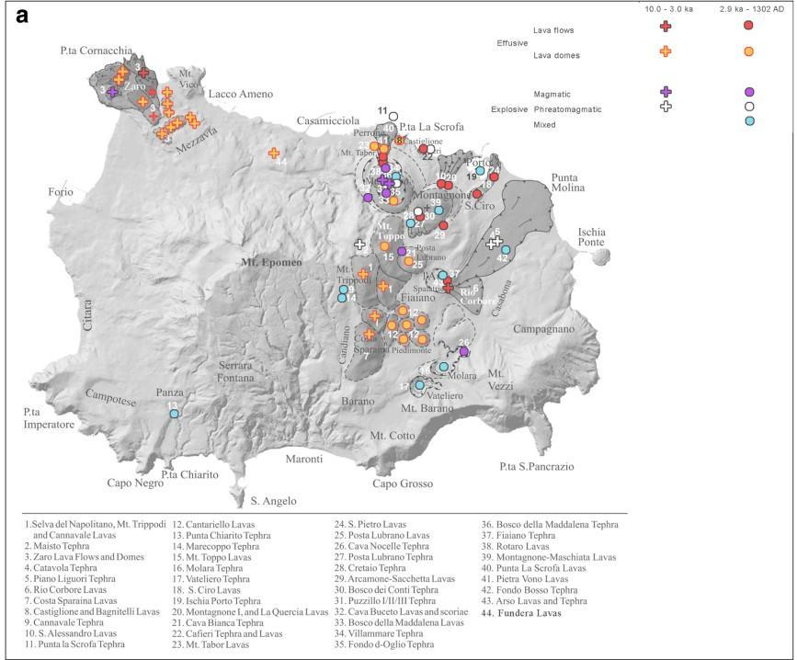
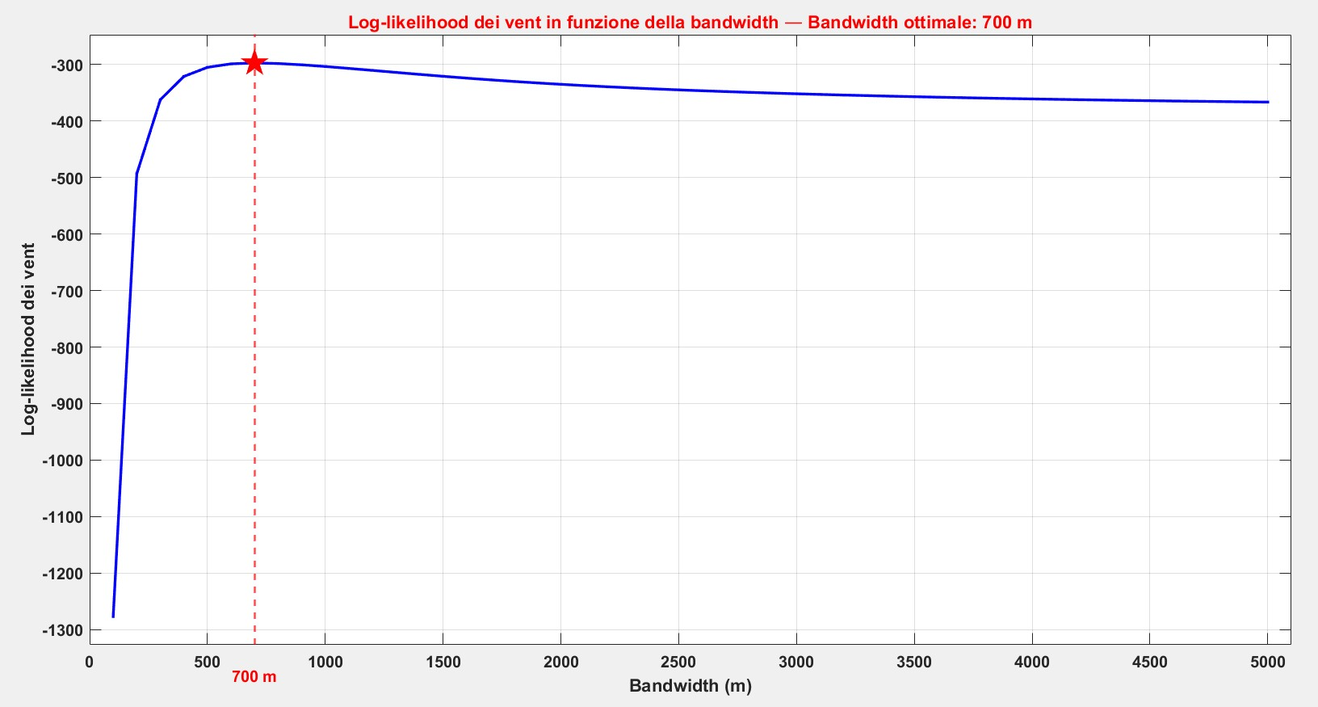
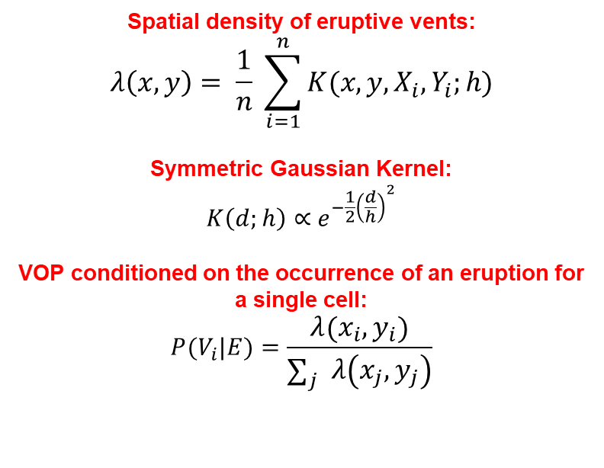
Spatial density of eruptive vents:
$$λ\left(x,y\right)= \frac{1}{n} \sum_{i=1}^{n}{K(x,y, X_{i},Y_{i};h)}$$
Symmetric Gaussian Kernel:
$$K\left(d;h\right)∝{ e}^{−\frac{1}{2}{\left(\frac{d}{h}\right)}^{2}}$$
VOP conditioned on the occurrence of an eruption for a single cell:
$$P(V_{i}|E)=\frac{λ\left(x_{i},y_{i}\right)}{\sum_{j}{λ\left(x_{j},y_{j}\right)}}$$
Bebbington (2013)
Connor et al. (2019)
Log-likelihood of vents VS bandwidth (best bandwidth: 700 m)
Jones et al. (1996) & Connor et al. (2019)
Log-likelihood of vents
Ischian vents of the last 10 ky (Selva et al., 2019, modified from de Vita et al., 2010)

Slide 4
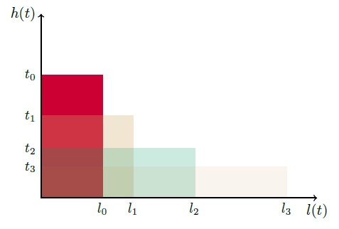
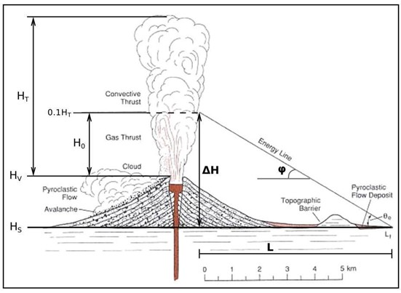
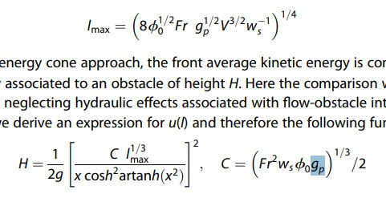


PROPAGATION MODELS
Box Model (Biagioli et al., 2019)
Energy Cone (Tierz et al., 2016, modified by Wohletz e Heiken, 1992)
Heim’s Relation (1882):
$$\frac{H}{L}=\tan{φ}$$
Box Model Propagation
Equation
Energy Cone Propagation Equation:
$$H_{cone}= H_{v}+ H_{0}−d∙tan\left(φ\right)$$
Neri et al. (2015)

Slide 5
ONE-SAMPLE KOLMOGOROV-SMIRNOV TESTS
(FITTING STATISTICAL TESTS FOR H, φ, L_{MAX}, & C)

Slide 6
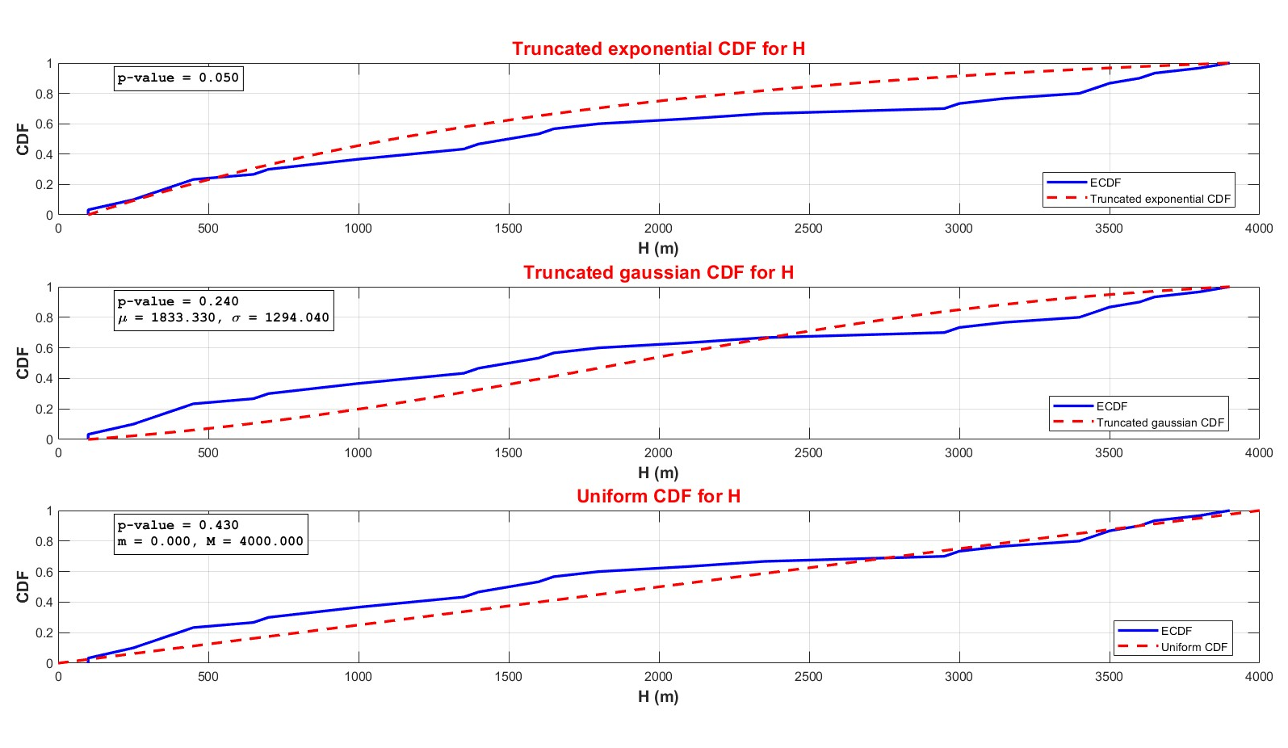

Slide 7
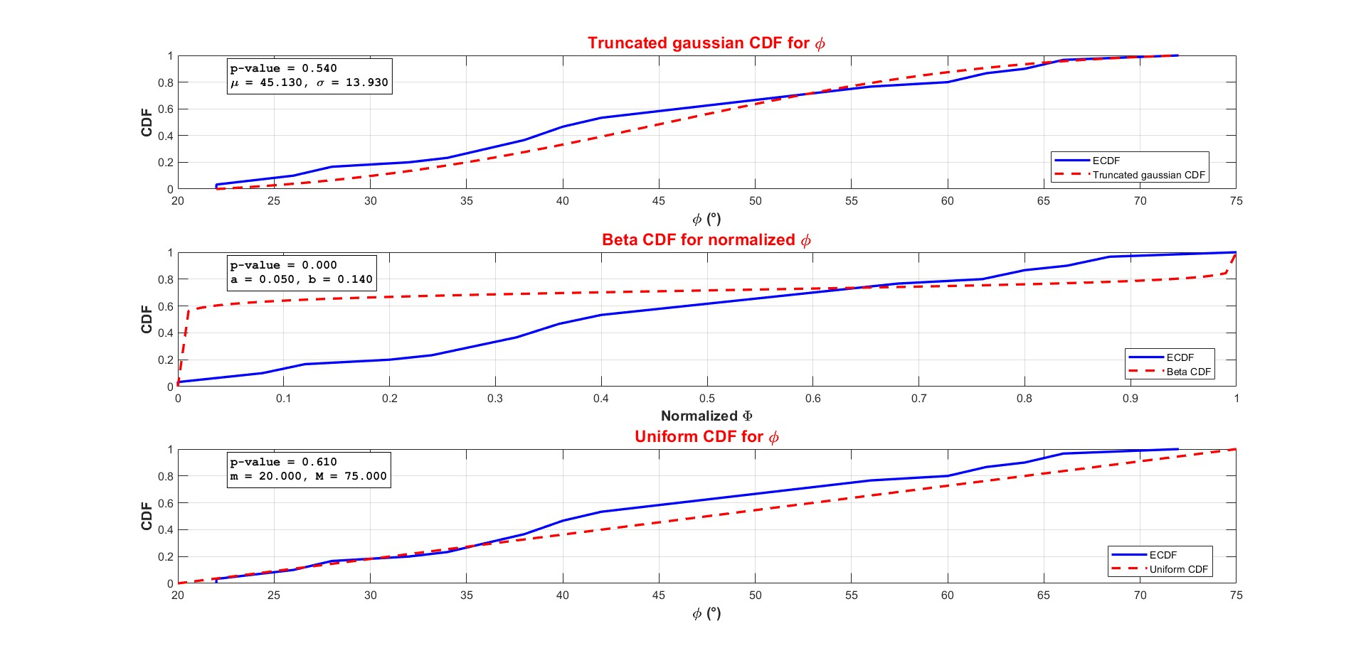

Slide 8
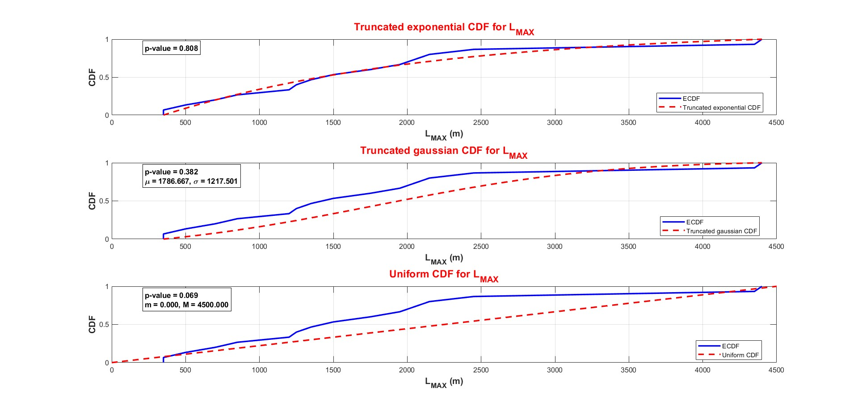

Slide 9
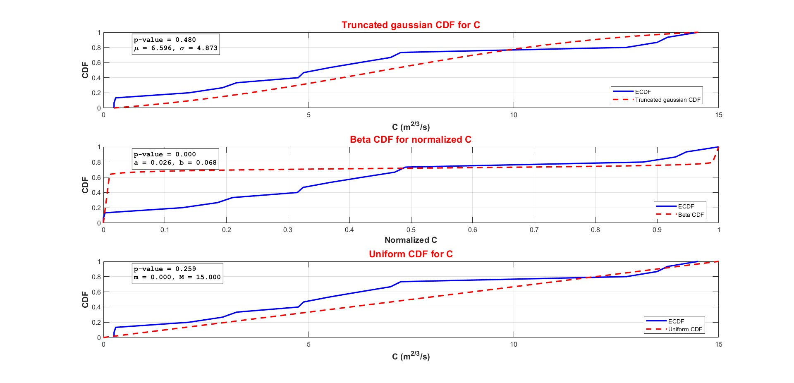

Slide 10
PEARSON & KENDALL’S TESTS
(CORRELATION CHECK BETWEEN H-φ AND L_{MAX}-C)

Slide 11
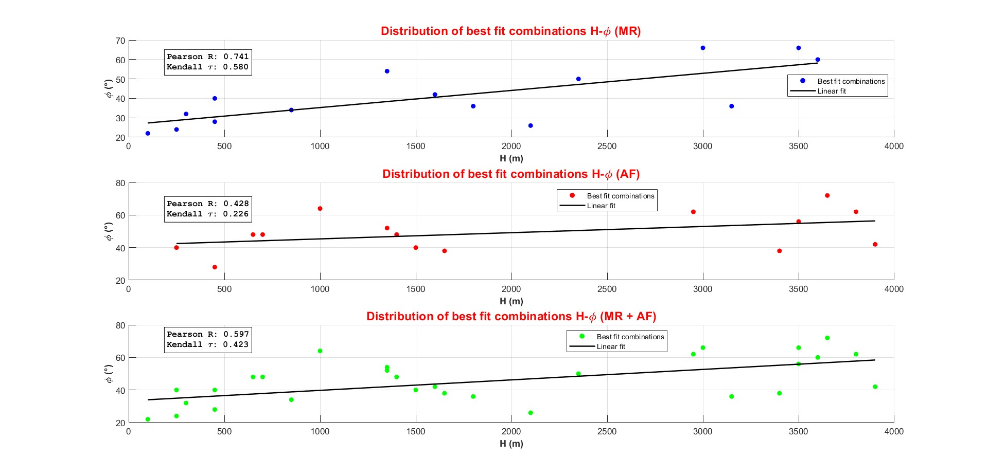

Slide 12
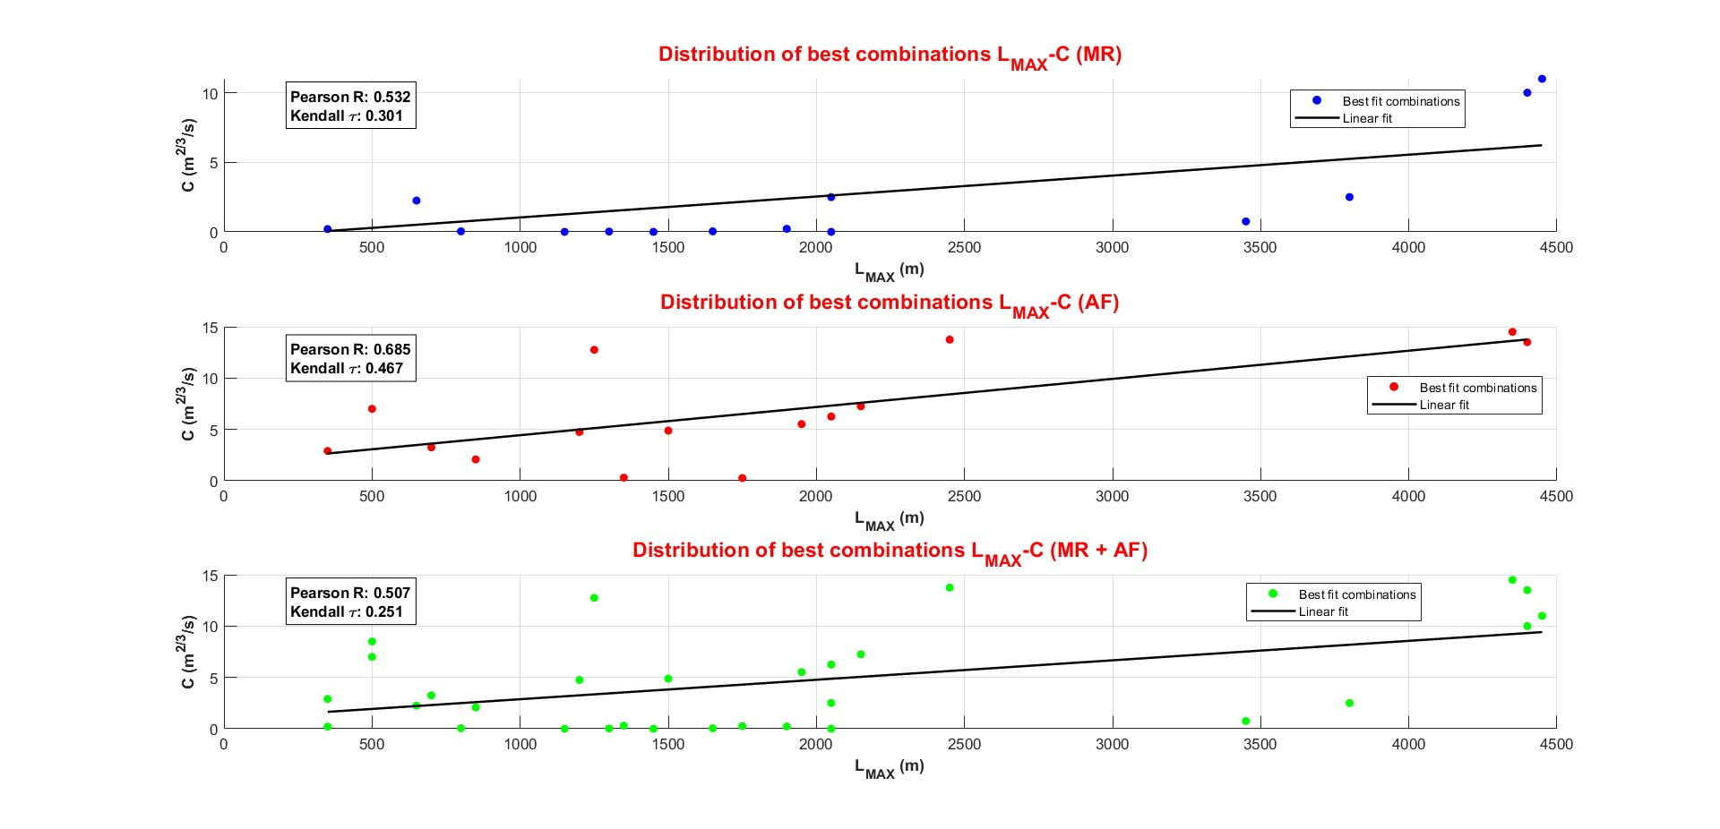

Slide 13

Hazard of a PDC invasion conditioned by the occurrence of an explosive eruption:
$$P\left(I|E;\vec{x};ΔT\right)=\sum_{i=1}^{N}{\sum_{j=1}^{M}{P\left(V_{i}|E\right) P(S_{j}|E) P\left(invasion in \vec{x}|V_{i},S_{j}\right)}}$$
Marzocchi et al. (2010)
Sampling of parameters’ distributions
Propagation models (Energy Cone & Box Model)
VOP
Probability of PDC invasion per single cell through Monte Carlo simulation:
$$P\left(x,y\right)= \frac{N_{I}\left(x,y\right)}{N_{S}}$$

Slide 14
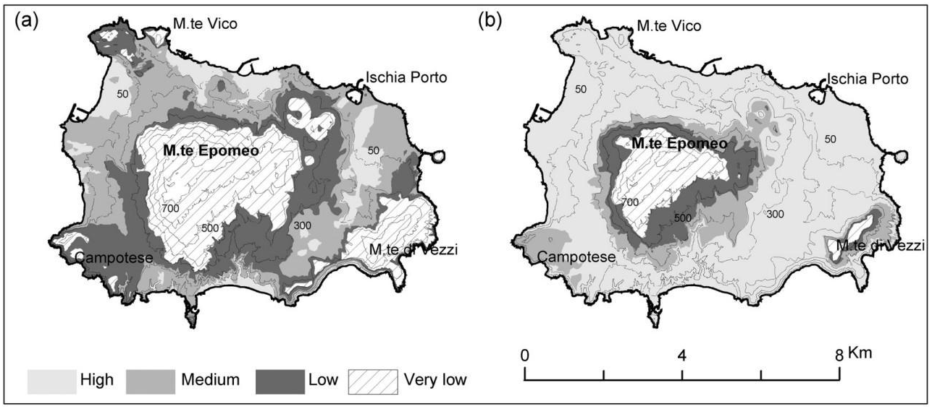
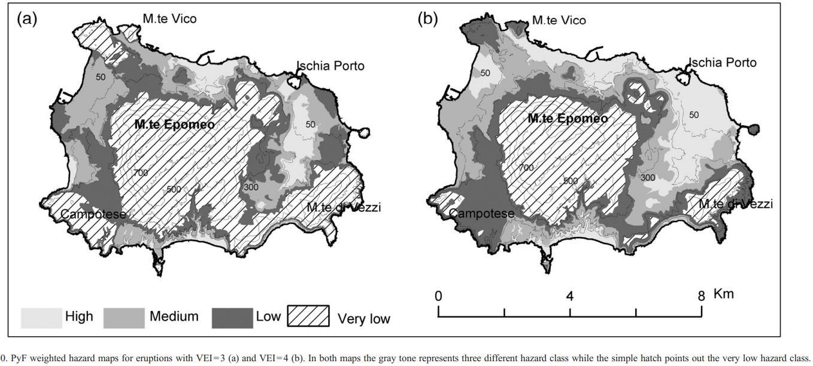
PDCs’ HAZARD MAPS BY ALBERICO ET AL. (2008)
Equiprobable hazard maps for VEI = 3 (a) and VEI = 4 (b) proposed by Alberico et al. (2008). In both maps, the grey tones represent three different hazard classes while the hatched lines indicate the very low hazard class.
Weighted hazard maps for VEI = 3 (a) and VEI = 4 (b) created by Alberico et al. (2008). In both maps, the grey tones represent three different hazard classes while the hatched lines indicate the very low hazard class.

Slide 15
References:
Alberico, I., et al. (2008), JVGR, 171(1-2), 118-136, DOI: 10.1016/j.jvolgeores.2007.11.014
Bebbington, M. S. (2013), JVGR, 252, 14-28, DOI: 10.1016/j.jvolgeores.2012.11.010
Biagioli, G., et al. (2019), DOI: 10.5281/zenodo.2616551
Capuano, P., et al. (2015), Bull Volcanol 77, 79 (2015). DOI: 10.1007/s00445-015-0965-4
Connor, C. B., et al. (2019), Statistics in Volcanology 4. 3: 1− 25. DOI: 10.5038/2163-338X,4.
Della Seta, M., et al. (2012), B Volcanol. 2012; 74:79–106, DOI: 10.1007/s00445-011-0501-0
de Vita, S., et al. (2013), Quat Int. 2013; 303:142–52, DOI: 10.1016/j.quaint.2013.01.002
de Vita, S., et al. (2010), Stratigraphy and Geology of Volcanic Areas, 464, p.193–239. Geological Society of America Special Papers, DOI: 10.1130/2010.2464 (10)
Jones, M. C., et al. (1996), Journal of the American Statistical Association, 91(433):401–407, DOI: 10.1080/01621459.1996.10476701.2,11
Marzocchi, W., et al. (2010), Bull. Volcanol. 72, 705–716, DOI: 10.1007/s00445-010-0357-8
Neri, A., et al. (2015). J. Geophys. Res. 120, 1605–1622, DOI: 10.1002/2014JB011776
Selva, J., et al. (2019), J Appl. Volcanol. 8, 5 (2019), DOI: 10.1186/s13617-019-0086- 4
Tierz, P., et al. (2016). Bull. Volcanol. 78:79, DOI: 10.1007/s00445-016-1073-9
Wohletz, K., Heiken, G. (1992), Volcanology and Geothermal Energy. University of California Press, Berkeley

