Slide 1







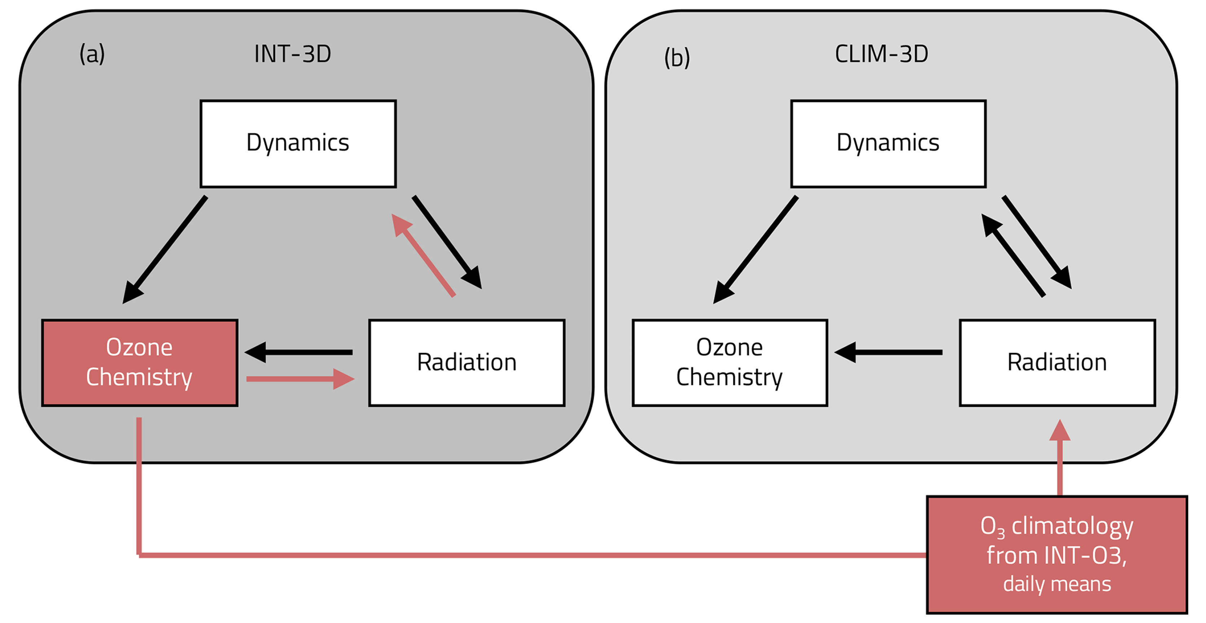

Predictability of Arctic Stratospheric Ozone Extremes: Insights from
Targeted WACCM Hindcasts
Weiji Hu¹, Andreas Chrysanthou¹, Marina Friedel², and Gabriel Chiodo¹
weijihu@ucm.es
Instituto de Geociencias (IGEO), Consejo Superior de Investigaciones Científicas - Universidad Complutense de Madrid (CSIC-UCM)
Institute for Meteorology, Leipzig University, Leipzig, Germany
1. Motivation
Background:
The ozone-circulation link, established in the Antarctic through decades of research[Thompson et al., 2011], is also increasingly evident in the Arctic [Calvo et al., 2015; Ivy et al., 2017], where statistical associations are prominent. Recent studies have further demonstrated the causal role of ozone depletion in driving surface responses [Friedel et al., 2022a].
The Gap & Objective:
However, the dynamics behind individual events remains unclear. Here, we move beyond the mean response to focus on extreme Arctic ozone-loss events: exploring their precursors, dynamical evolution, and predictability.
2. Model Set up
3. The extreme event
WACCM configuration
200-Years time slice experiments
Fig. 2
Extreme Event:
WACCM spontaneously generates extreme Arctic O₃ depletion events with magnitudes comparable to reanalysis
Model Bias:
While O₃ peaks and declines earlier than in MERRA2 (possibly associated with well-documented model biases), the model's overall representation remains reasonable.
CESM1-WACCM4 [Marsh et al., 2013]
1.9° × 2.5°, 66 levels
Fully coupled ocean and sea ice
Fixed year-2000 boundary conditions
Interactive O₃ can be switched on/off
Fig. 1
Hindcast experiments
Initialized from selected extreme ozone-loss years in INT-3D.
Start dates:
1 Jan, 1 Feb, 1 Mar
Paired configurations:
H-INT-3D and H-Clim-3D
Schematic of experimental setups. (a) INT-O3: fully interactive ozone-radiative-dynamic feedbacks. (b) Clim-3D: ozone is prescribed to a 3D daily climatology.
Source: Friedel et al. (2022b)
6. Interactive Ozone’s Role
Fig. 7
Paired hindcasts with interactive(H-IND-3D) vs. prescribed(H-Clim-3D) ozone (February initialization)
4. Dynamical relationships and potential event precursors
5. Predictability and drivers of extreme events
Fig. 6
Fig. 3
Fig. 4
Note: FWD is based on 60°N zonal wind at 50 hPa: first drop below 7 m/s sustained for ≥10 days
Spread among Jan-initialized hindcasts:
Some capture the extreme event while others fail.
Ensemble spread increases starts by mid-February.
What does interactive O₃ do in this extreme event?
Interactive O₃ group remains lower and closer to the reference, with radiative feedback sustaining the magnitude and persistence of the event.
How does ozone feedback sustain the event?
Interpretation: Lower O₃ reduces radiative heating, helping maintain a colder, stronger vortex.
Dynamical evidence: Interactive O₃ shows later mean final warming (at least 7 days) and larger spread, suggesting delayed vortex breakdown.
Two-way coupling: Circulation drive O₃ evolution, which in turn feeds back onto the dynamics.
Fig. 5
Precursor signal & skill correlation in Jan initial group
We test whether ensemble spread is linked to earlier wave activity.
We relate mid-winter wave forcing to member-wise O₃ RMSE.
Members with stronger mid-winter wave activity show larger total O₃ RMSE.
Reanalysis:
ERA5 (AO&NAM)
MERRA-2 (O₃).
Weak DJF wave forcing → positive NAM
Weak DJF wave forcing is associated with stronger JFM vortex.
Weak wave forcing → more spring O₃ depletion
The same precursor also links to stronger Arctic ozone loss.
The NAM–AO linkage
Moderate overall, but stronger in WACCM low-O₃ years, which may suggest enhanced S–T coupling. While not seen in reanalysis—could be due to small sample size.
Both 2020 and model extremes exhibit strong positive NAM/AO, implying robust coupling during these peak events.
Ideal Event: The clear precursor signals in the extreme year provide a robust framework for predictability studies.
Key Question: How predictable are these extreme events, and what role do ozone-radiative feedbacks play?
The most extreme events provide a robust framework for hindcast experiments.
7. Conclusions
Acknowledgment
Winter wave forcing is identified as a precursor of spring O₃ minimum in both model and observations
Arctic 2020-like depletion events cannot be skillfully predicted more than 2 months in advance; prediction uncertainty is largely explained by mid-winter wave forcing variability, which effectively limits forecast skill
Interactive O₃ chemistry delays the Final Warming, leading to more prolonged ozone depletion
We acknowledge funding from the European Research Council within the ERC StG project SOCLIM, ref. no. 101078127.
References
Calvo, N., et al. (2015). Environ. Res. Lett., 10(9), 094003.
Friedel, M., et al. (2022a). Nat. Geosci., 15(7), 541-547.
Friedel, M., et al. (2022b). Atmos. Chem. Phys., 22(21), 13997-14017.
Ivy, D. J., et al. (2017). Environ. Res. Lett., 12(2), 024004.
Marsh, D. R., et al. (2013). J. Climate, 26(19), 7372–7391.
Thompson, D. W. J., et al. (2011). Nat. Geosci., 4(11), 741-749.
Note: O₃ RMSE is integrated over Jan 1–May 30.
Notes:
Motivation
Anthropogenic emissions of chlorofluorocarbons (CFCs) caused severe springtime polar ozone depletion through photochemical loss in both hemispheres. Although emissions of the major ozone-depleting substances have been phased out under the Montreal Protocol, effective equivalent stratospheric chlorine (EESC) remains elevated, and greenhouse-gas-driven stratospheric cooling continues to favor ozone loss. According to the 2022 Scientific Assessment of Ozone Depletion, Arctic ozone is not expected to return to 1980 levels until around the mid-21st century, and large year-to-year dynamical variability means that severe Arctic ozone-loss events can still occur even during overall recovery.
Previous studies have shown that ozone anomalies are linked to large-scale circulation. In the Southern Hemisphere, Antarctic ozone depletion is statistically associated with a positive SAM-like summertime circulation response in both observations and models. Similar statistical links have also been identified in the Arctic: low spring ozone is associated with a stronger polar vortex and a positive NAM/NAO-like response at the surface. However, because Arctic low-ozone years also tend to coincide with unusually strong polar-vortex conditions, statistical relationships alone cannot show whether the Northern Hemisphere signal is driven by ozone depletion itself or by the underlying dynamics.
Friedel et al. (2022) addressed this problem with fully coupled WACCM4 experiments that compared interactive ozone with prescribed-ozone configurations, thereby isolating the role of ozone feedback and moving the problem from statistical association toward physical attribution. Yet these studies mainly describe what happens on average, and may mask the event-to-event dynamical diversity of extreme Arctic ozone-loss winters. Here, we therefore focus on the events themselves: identifying precursors, understanding the dynamics of extreme Arctic ozone loss, and assessing the hindcast predictability of both the ozone event and its associated circulation response.

