Slide 1
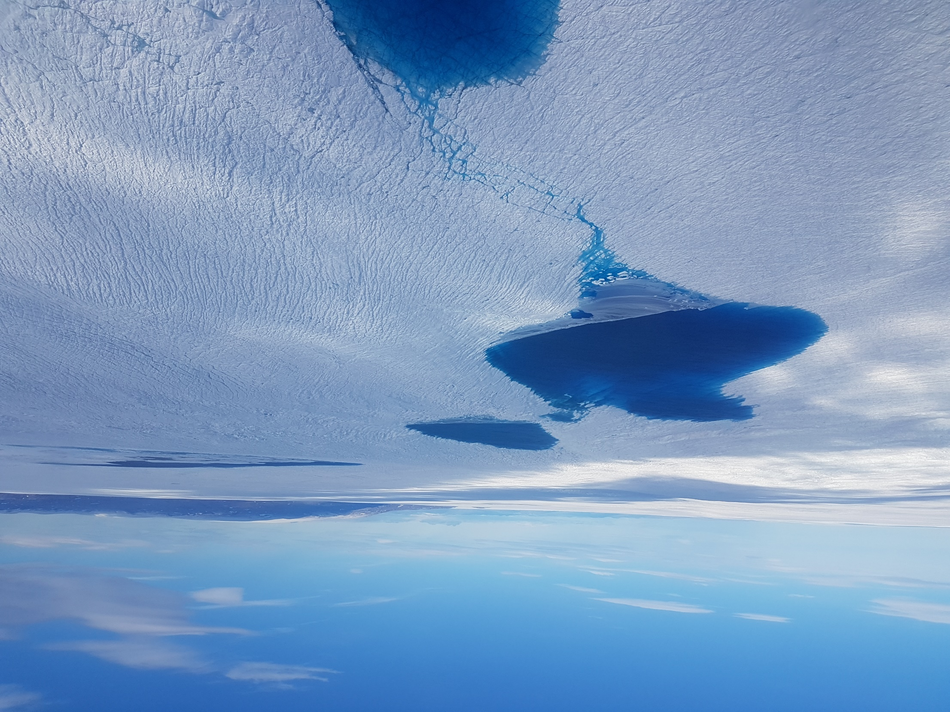
GNSS measurement of seasonal ice flow velocity of the northeast Greenland ice stream and Jakobshavn Isbræ, Greenland.
Shfaqat Abbas Khan, Javed Hassan, William Colgan, Kuba Oniszk, Gong Cheng, Alicia Bråtner, Mathieu Morlighem, Sina Marie Felten, Helene Seroussi, Christian Solgaard, Danjal Berg, Valentina Barletta, Anja Løkkegaard, Dominik Fahrner, Anuar Togaibekov, and Tobias Soche

Slide 2
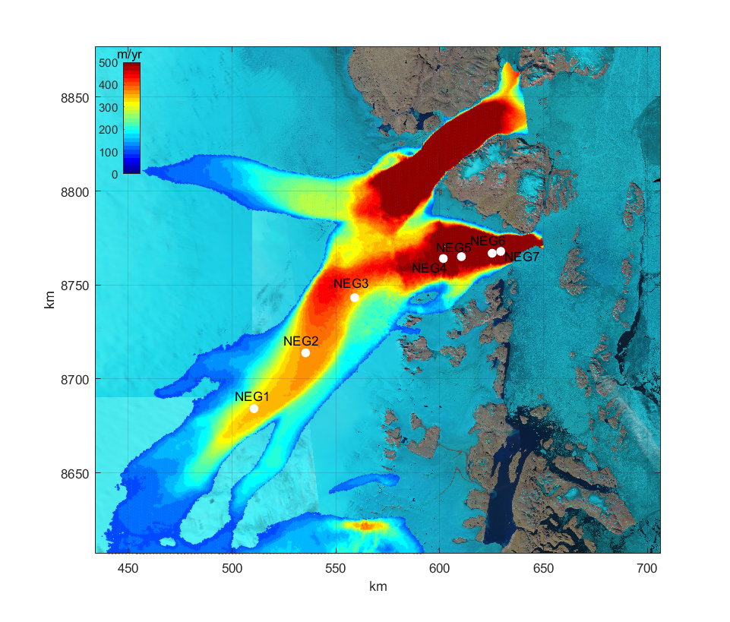
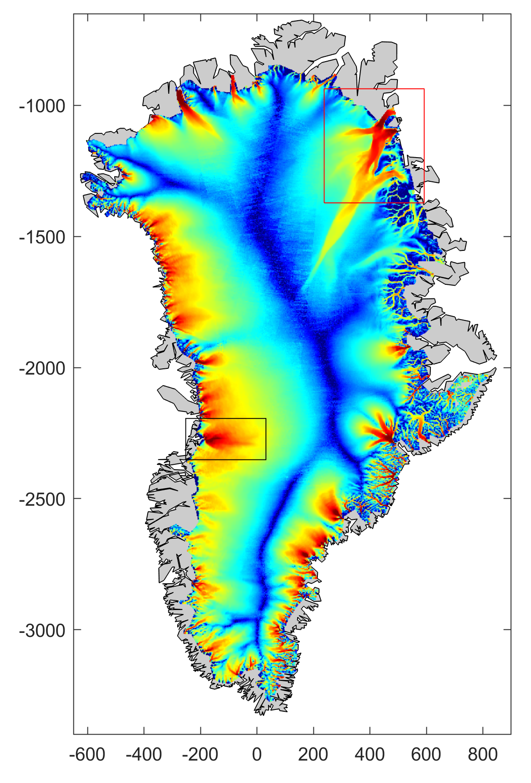
GPS network on NEGIS

Slide 3
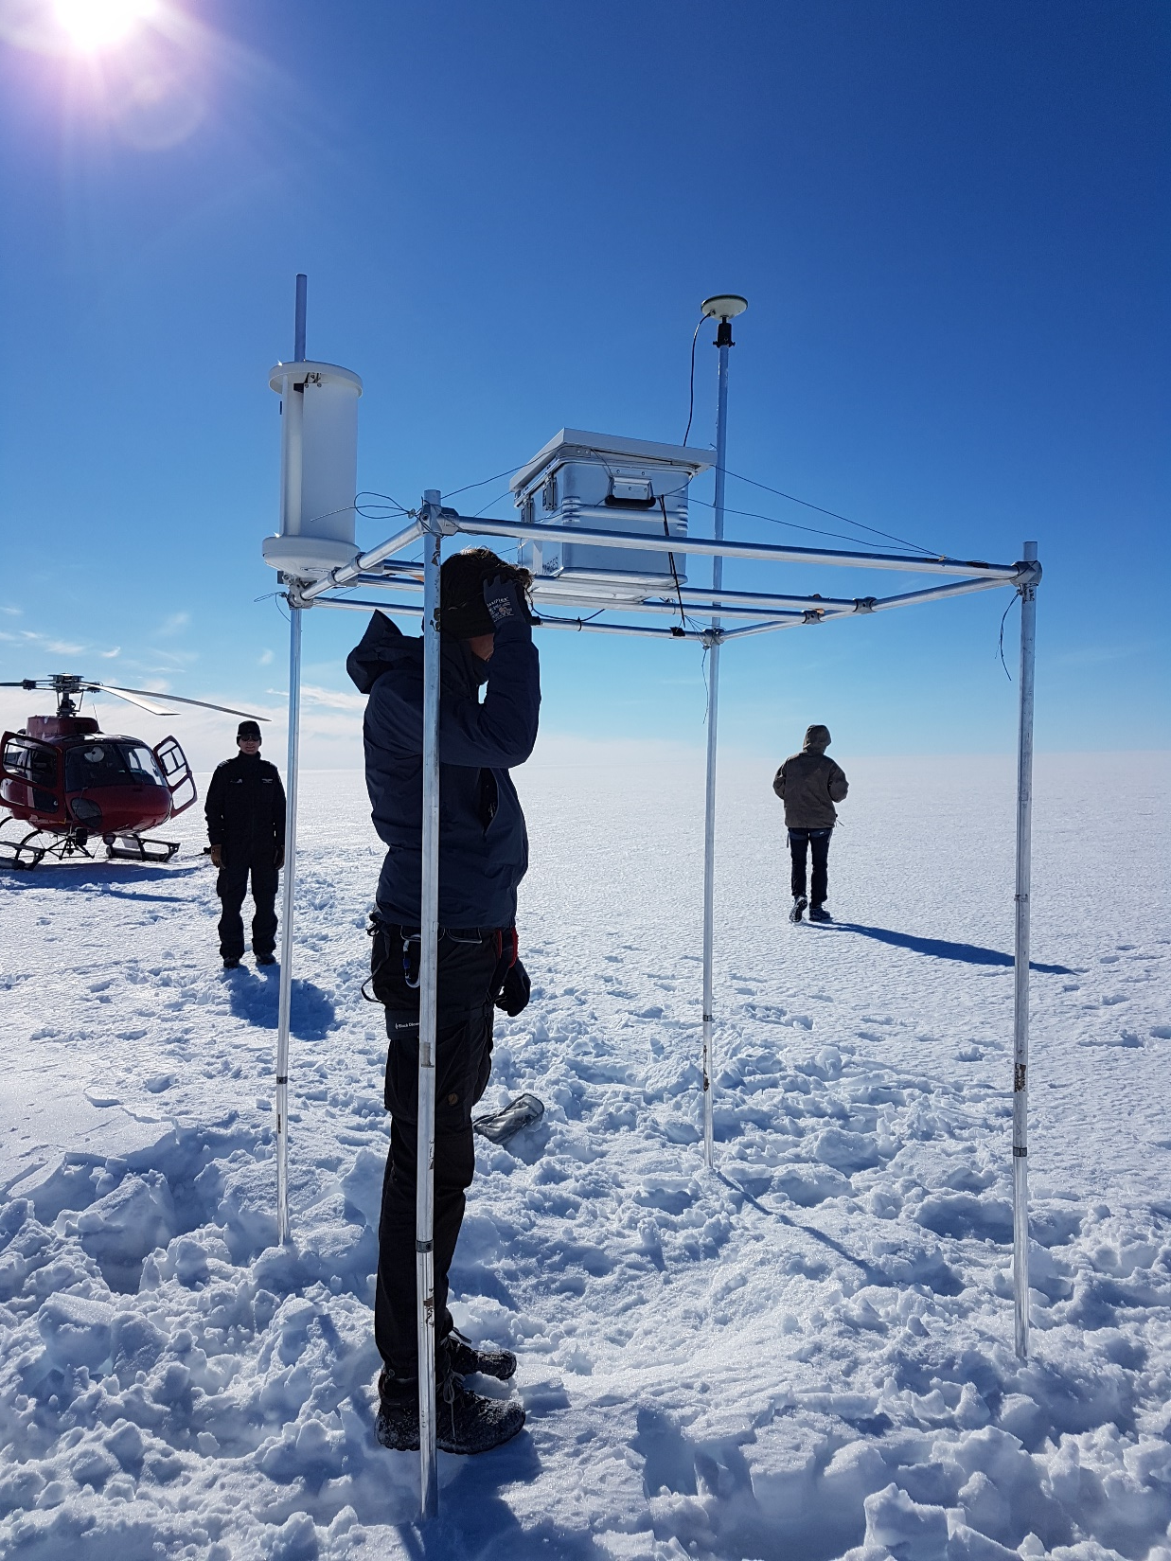

Slide 4
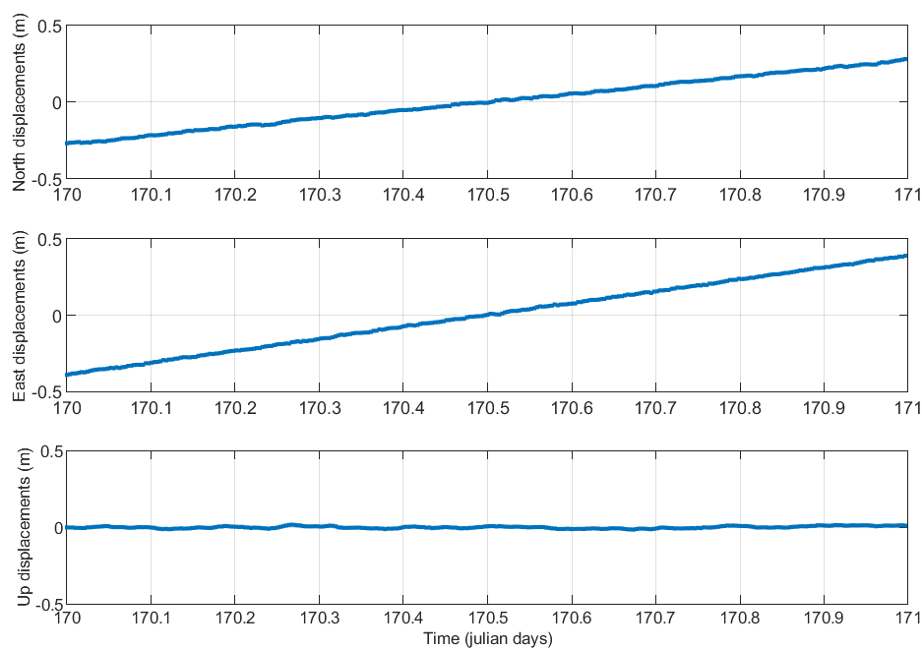
GPS time series over 1 day, sampling rate 10 sec.

Slide 5
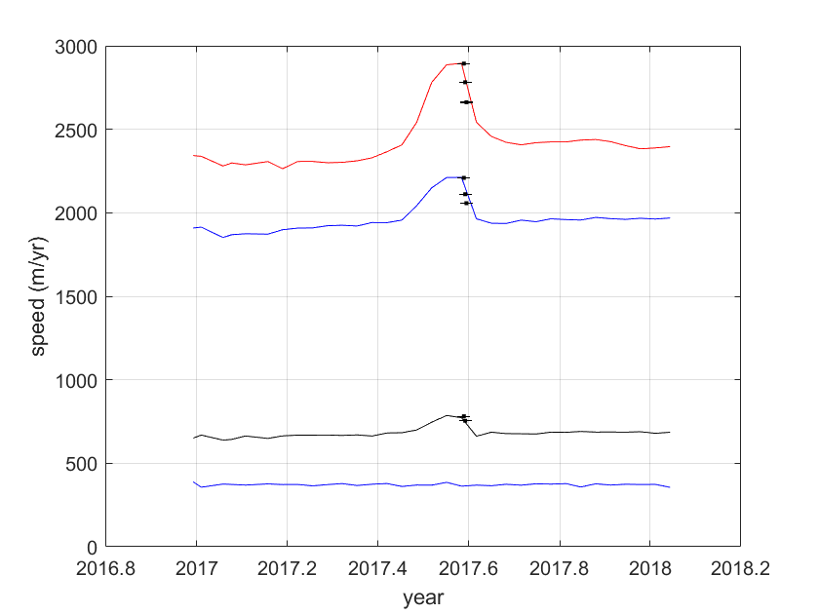
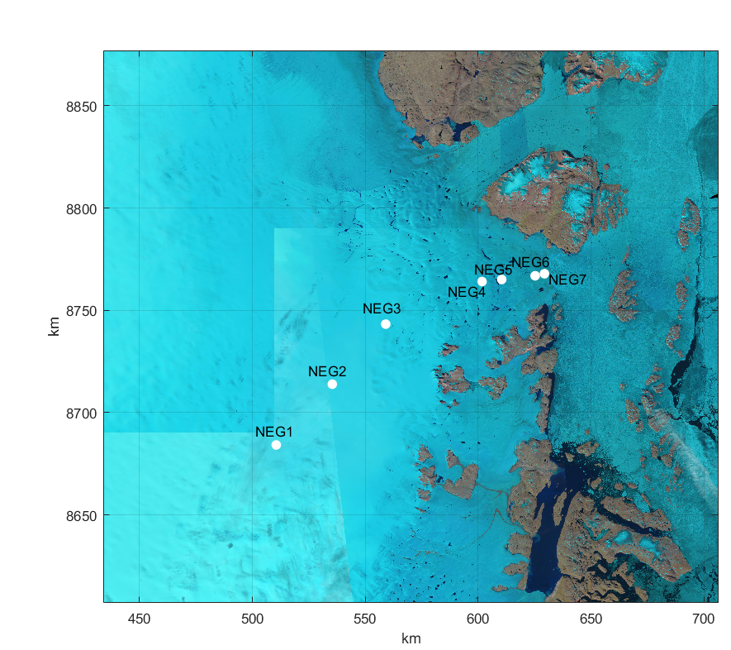
Ice speed from mosaics based on ESA Sentinel-1 SAR offset tracking.
NEG7
NEG6
NEG5
NEG3

Slide 6
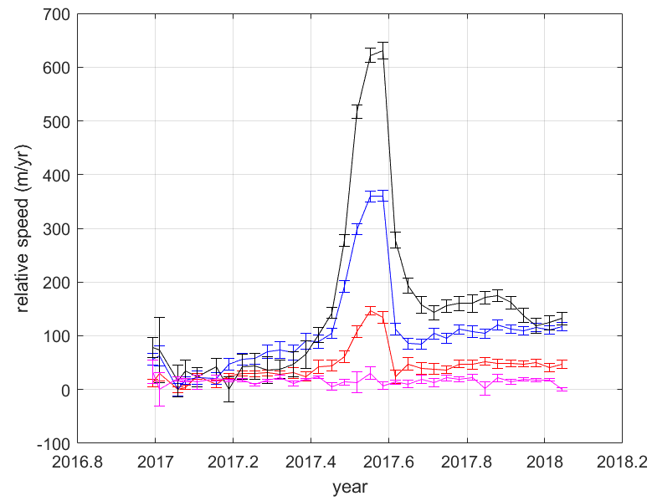
Ice speed from mosaics based on ESA Sentinel-1 SAR offset tracking.
NEG7
NEG6
NEG5
NEG3

Slide 7
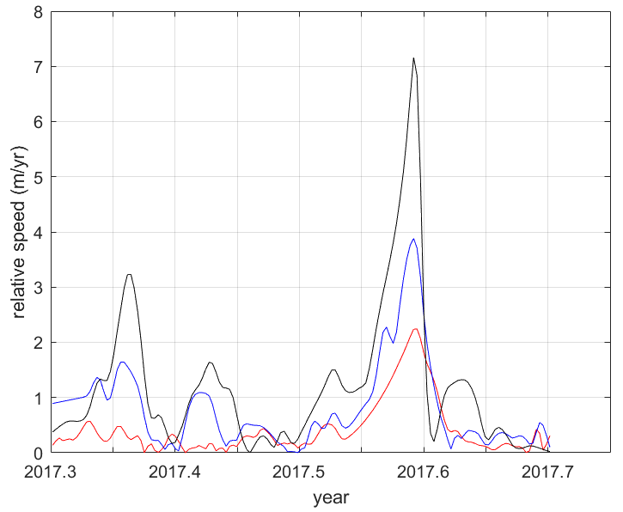
Ice speed from GPS
NEG3
NEG2
NEG1

Slide 8
Model
We use the Ice-sheet and Sea-level System Model (ISSM)
Basal melt parameterization for the floating shelf from Choi et al. 2021
Daily SMB forcing from MAR
subglacial hydrology model from Ehrenfeucht et al 2023

Slide 9
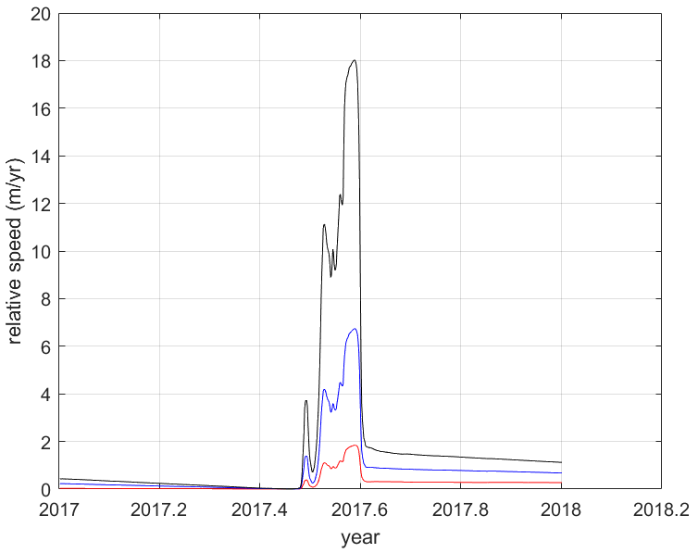
NEG3
NEG2
NEG1

Slide 10
Conclusions:
Long-term changes:
ZI keeps retreating and thinning (2003-2023)
Acceleration in flow speed 200 km upstream
Short-term changes
Large variability in ice speed from Sentinel-1 SAR offset tracking
(not fully captured by flow model)
summer speed propagate deep into the interior (~200 km inland)
Our model results suggest hydrology is the main driver of the summer speed up at inland GPS stations.

Slide 11
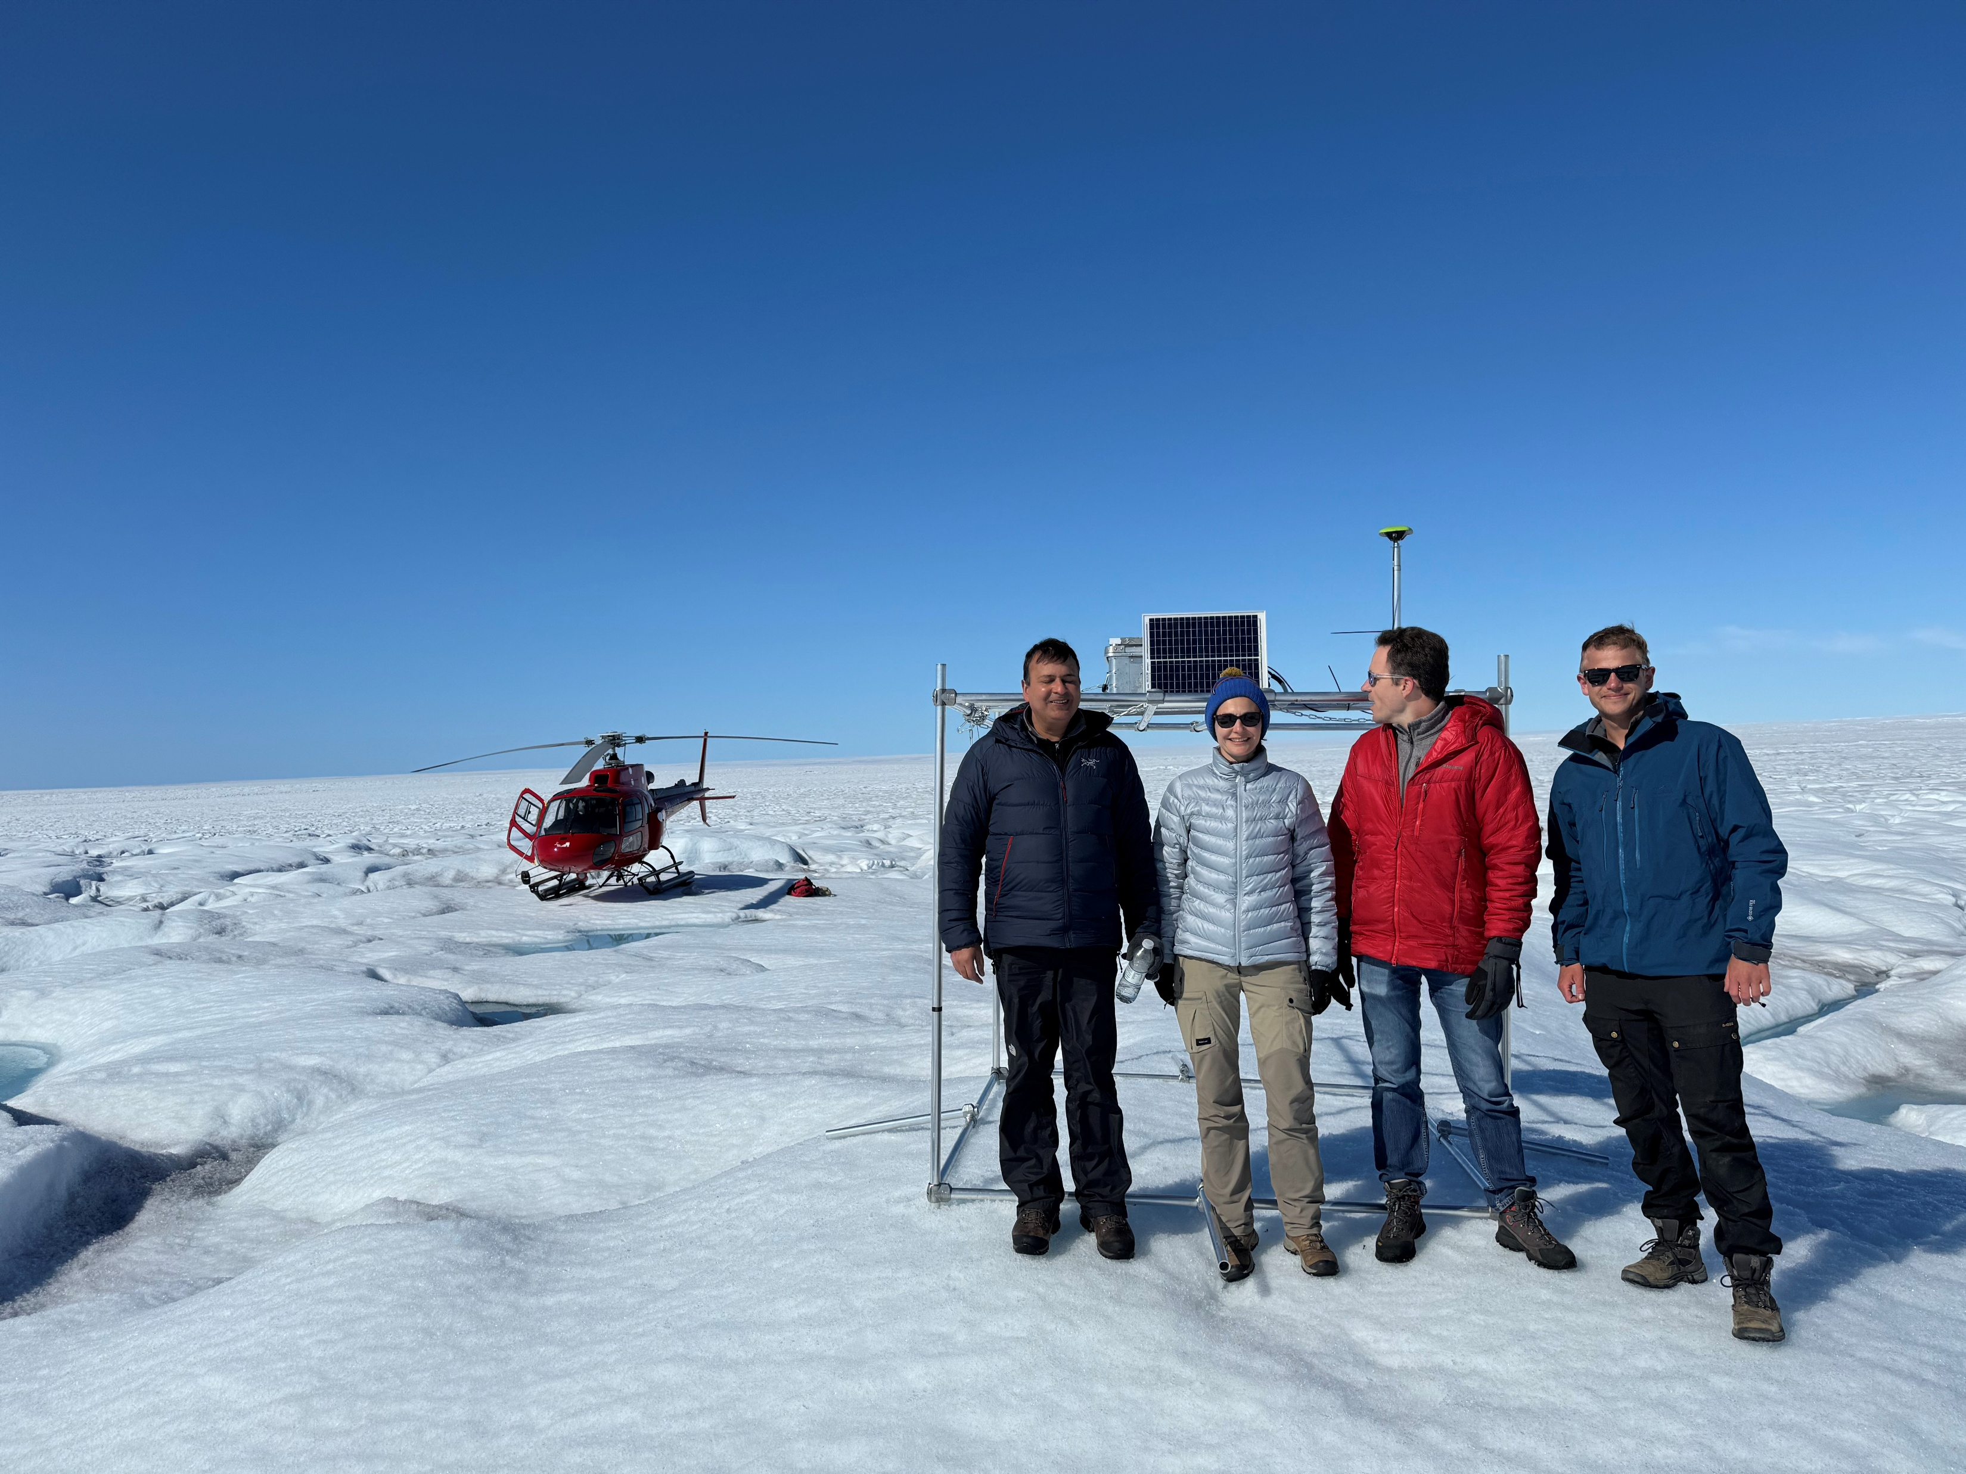
New GPS sites at Jakobshavn Isbræ
inland propagation of surface velocity changes
August 2024

Slide 12
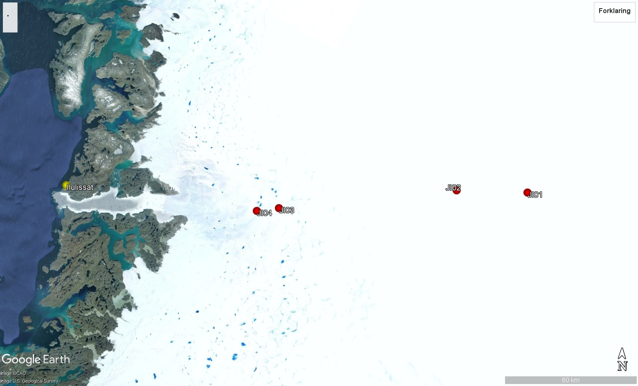
153 km

Slide 13
