Slide 1
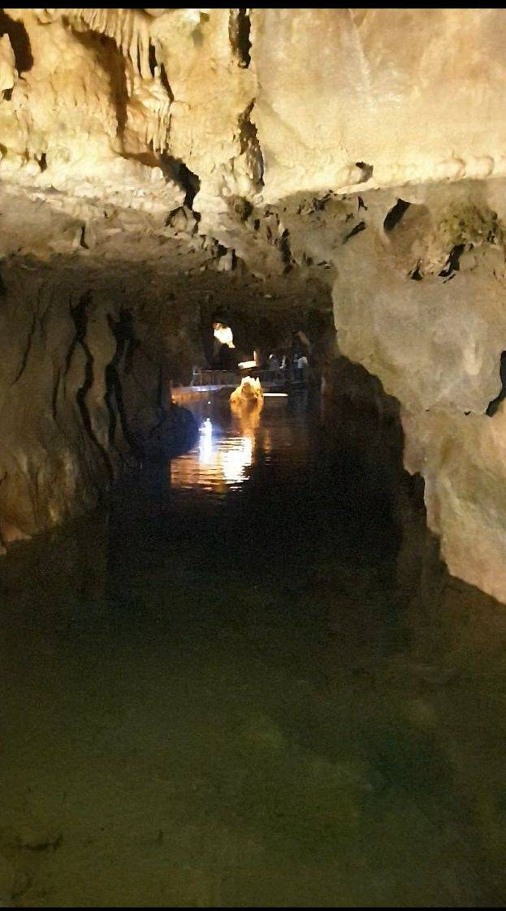
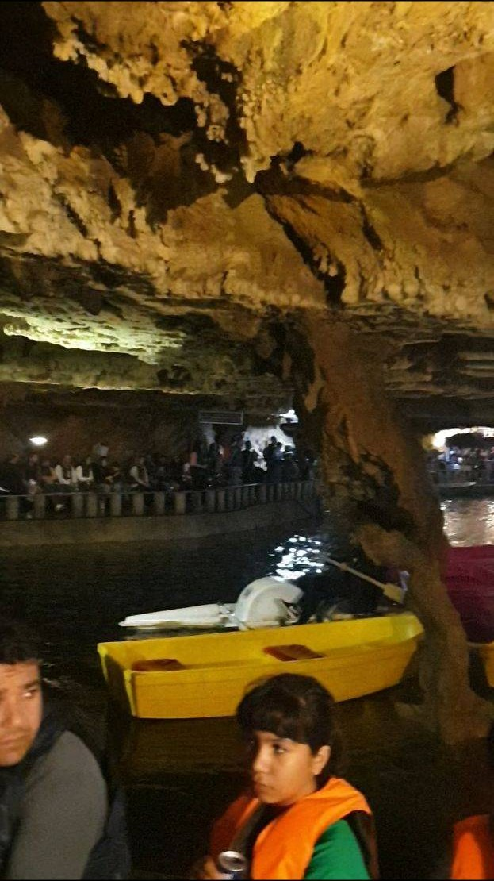
Alisadr cave
Supplement S2 – Figure X
Linear water corridor in Alisadr Cave showing a long, straight passage with nearly parallel walls and a notably flat ceiling surface. The geometry of the passage is inconsistent with typical dissolution morphologies and instead suggests anthropogenic modification.

Slide 2
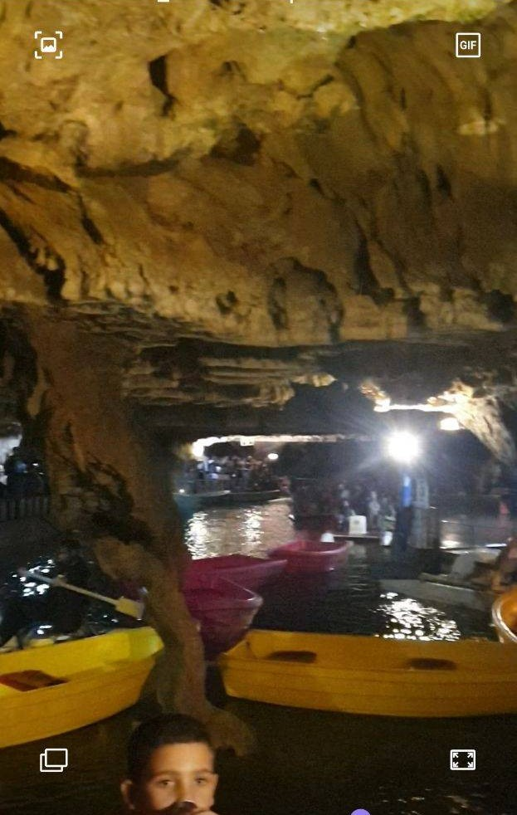
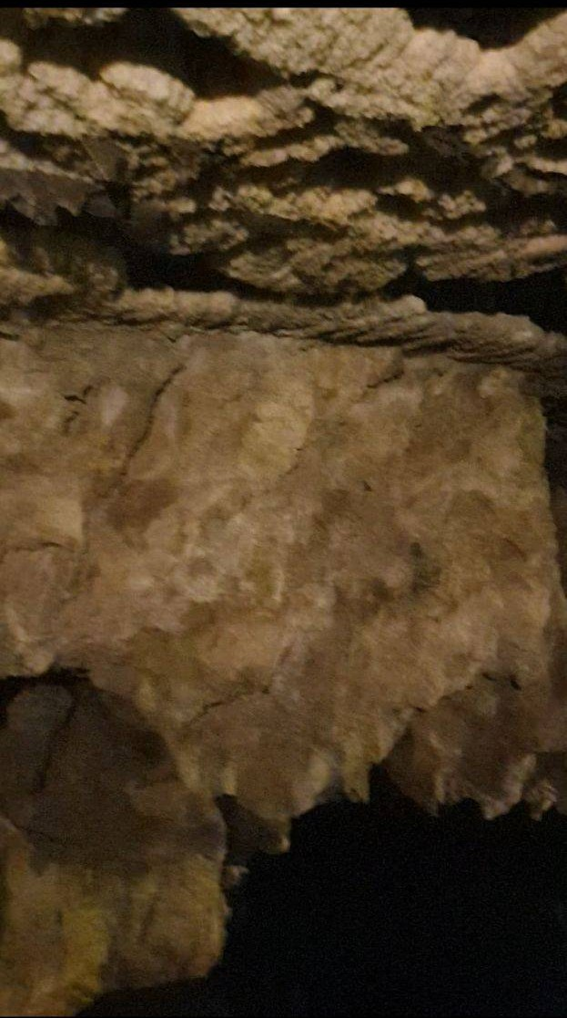
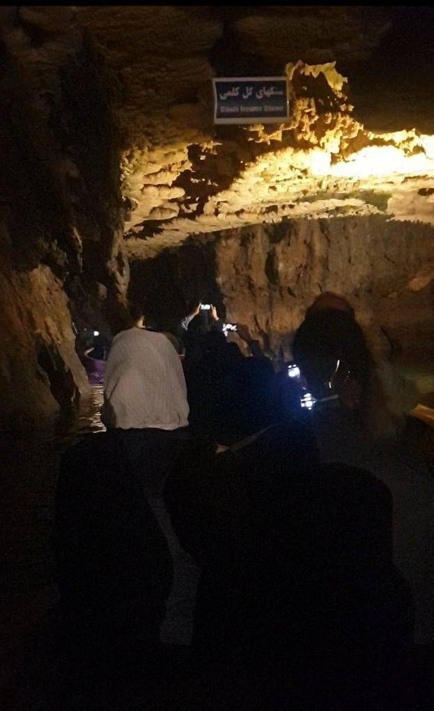
Supplement S2 – Figure Y
Another view of the same passage, highlighting the uniform roofline and sustained linearity of the corridor. The absence of dome-shaped dissolution ceilings and the presence of planar fracture-like wall surfaces support the hypothesis of engineered enlargement.

Slide 3
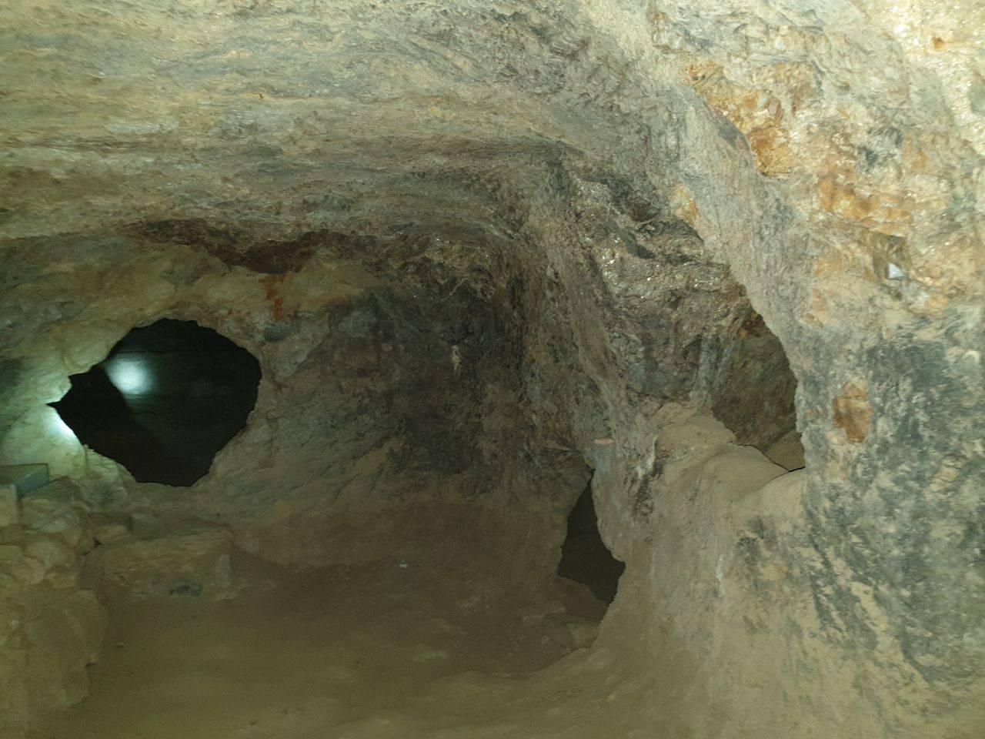
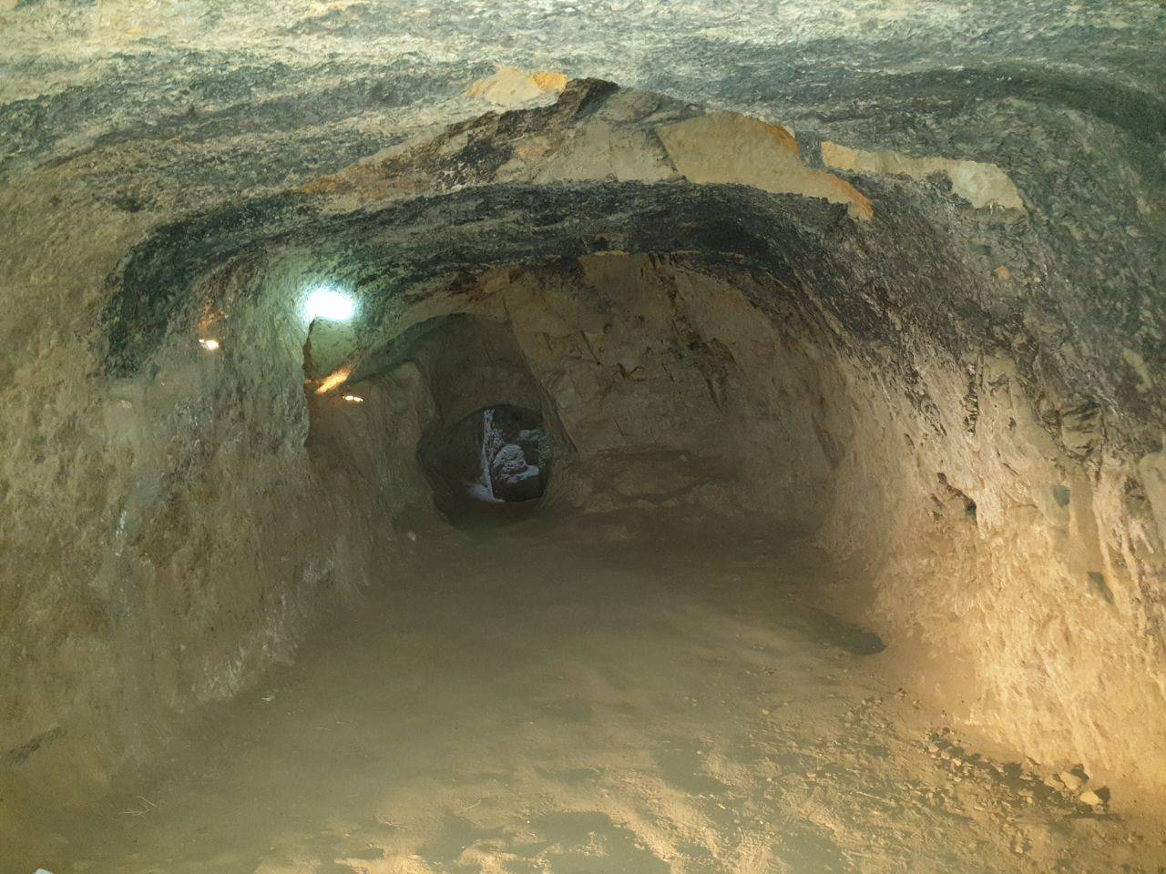
Supplement S2 – Figure (Samen–1)
A chamber in the Samen underground complex featuring a uniformly curved ceiling and smoothed lateral walls. The absence of dissolution features and the presence of large-scale surface leveling indicate intentional excavation.

Slide 4
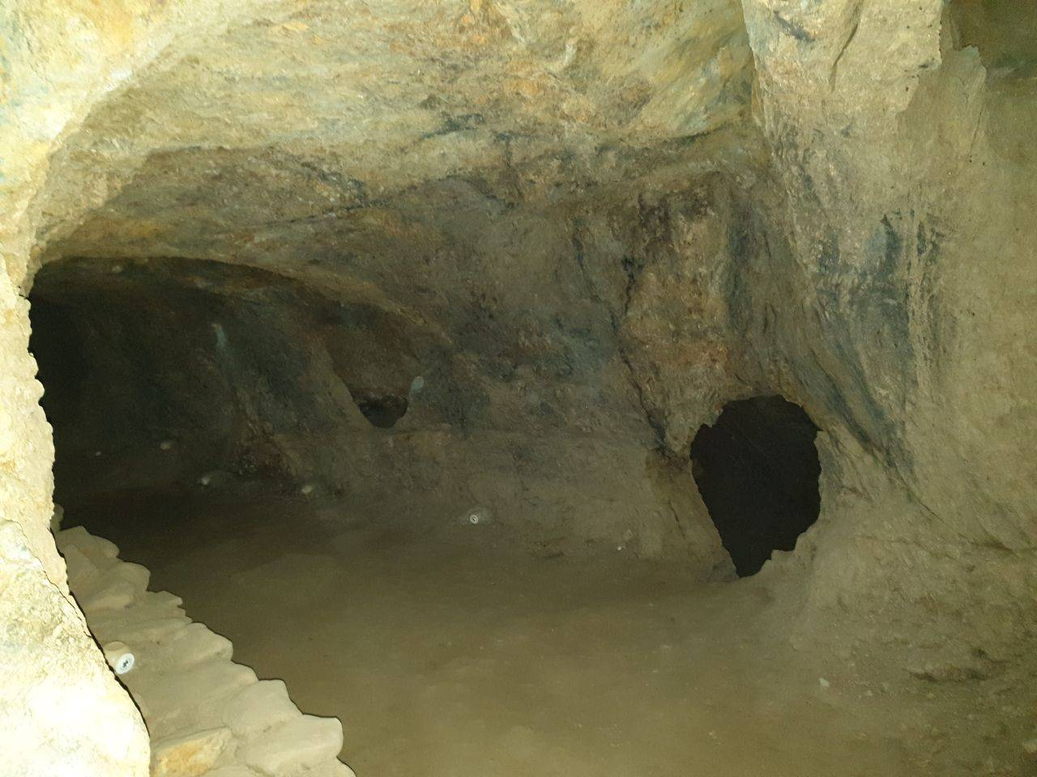
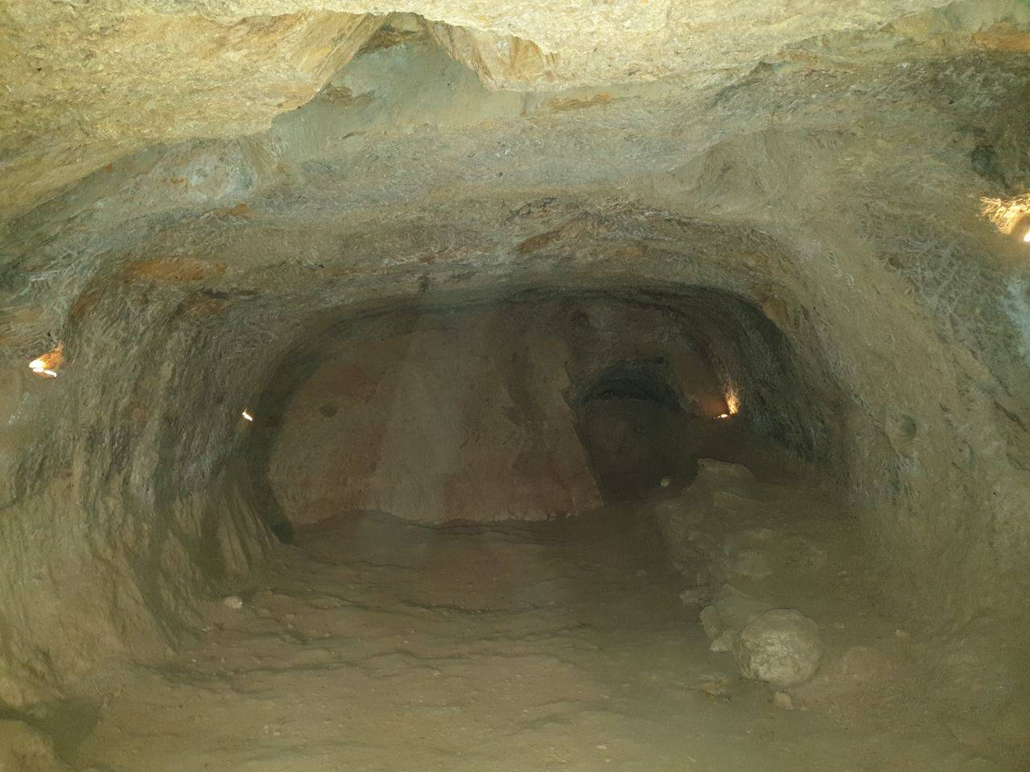
Supplement S2 – Figure (Samen–2)
Another room in the Samen complex showing a continuous arched roof and a flat, human‑scaled floor. The geometry of the entrance passage and the planar wall surfaces support an anthropogenic origin.

Slide 5
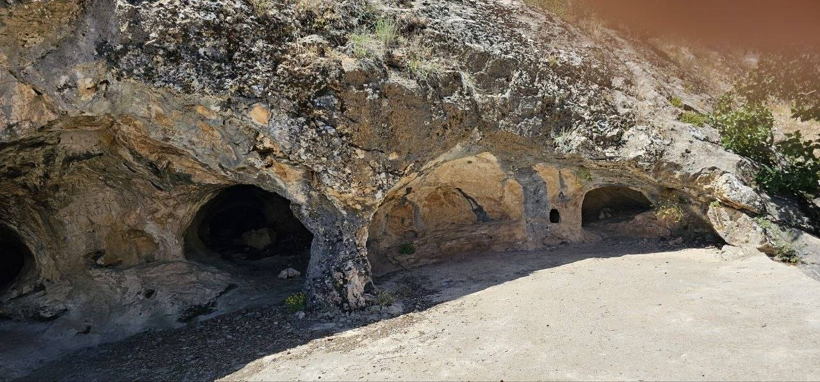
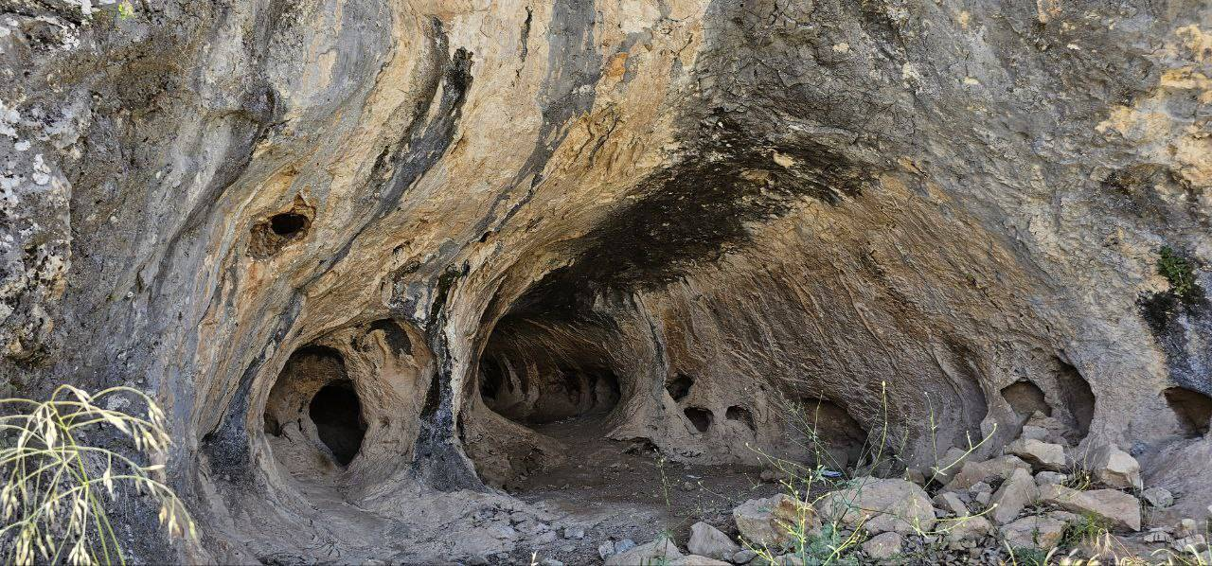
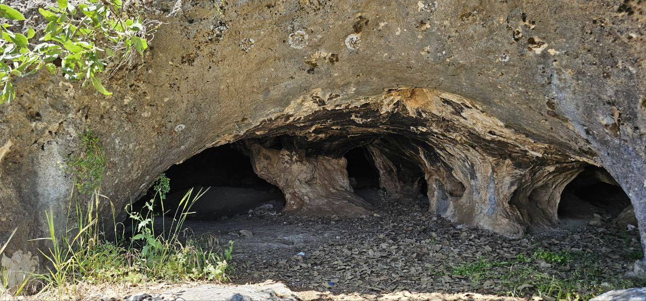
Supplement S2 – Figure (Deh-Sheykh–1)
Supplement S2 – Figure (Deh-Sheykh–2)
Supplement S2 – Figure (Deh-Sheykh–3)
Three entrance chambers of the Deh‑Sheykh rock complex in the Zagros. Each entrance exhibits a fully arched, intentionally shaped opening with consistent curvature and no dissolution morphology.
The entrances are aligned at a uniform elevation and spaced at regular 20‑meter intervals along the cliff face, forming a geometric rhythm incompatible with natural cave development.
Circular and oval‑shaped portals demonstrate controlled excavation. Planar wall surfaces and directional floor leveling around the openings further support anthropogenic origin.

Slide 6
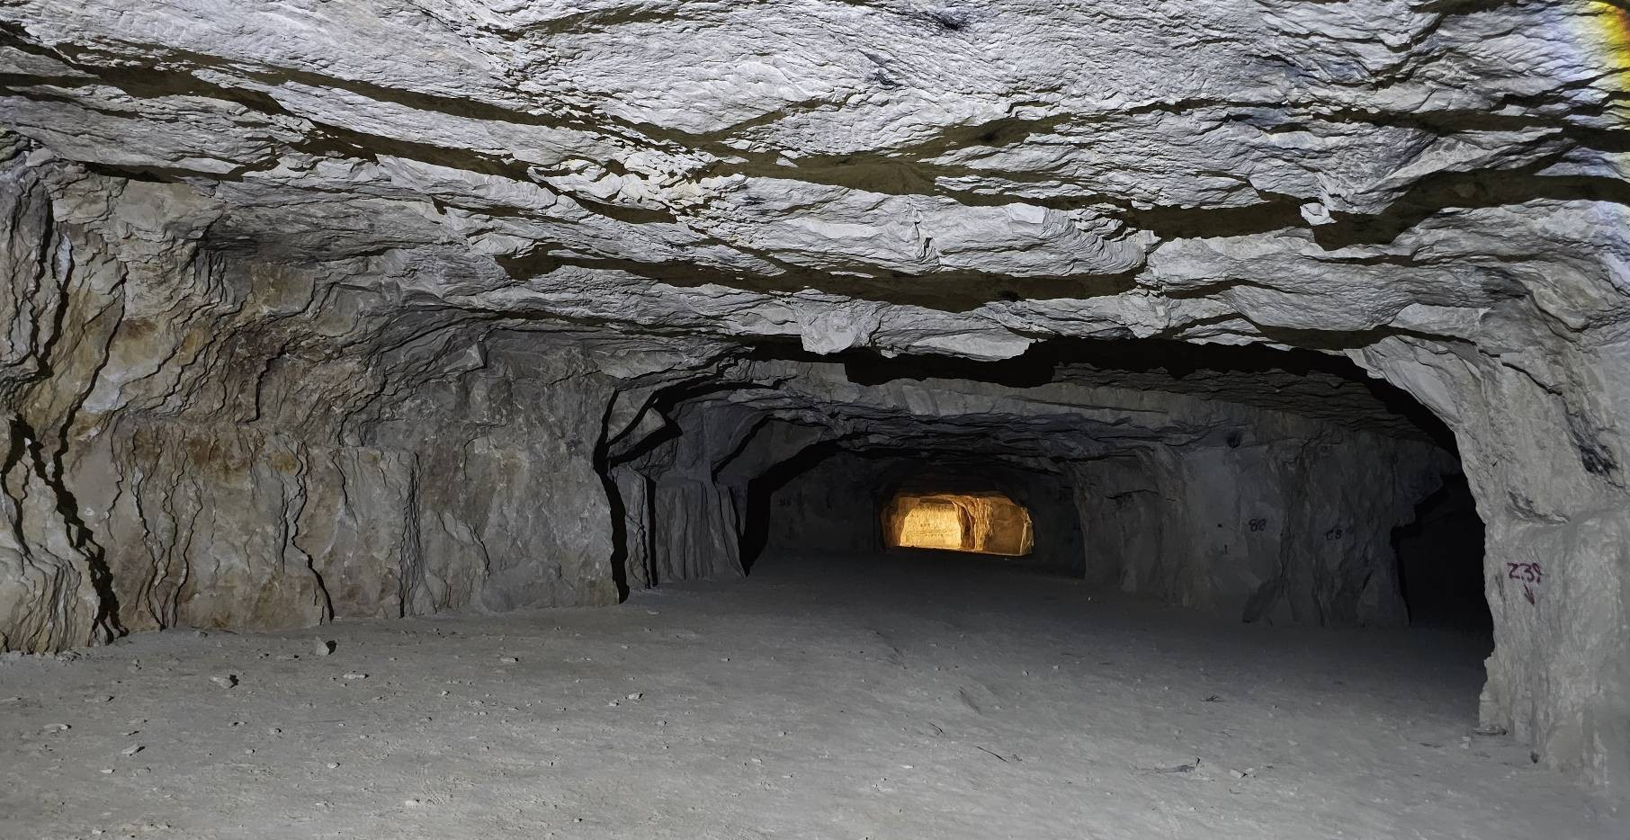
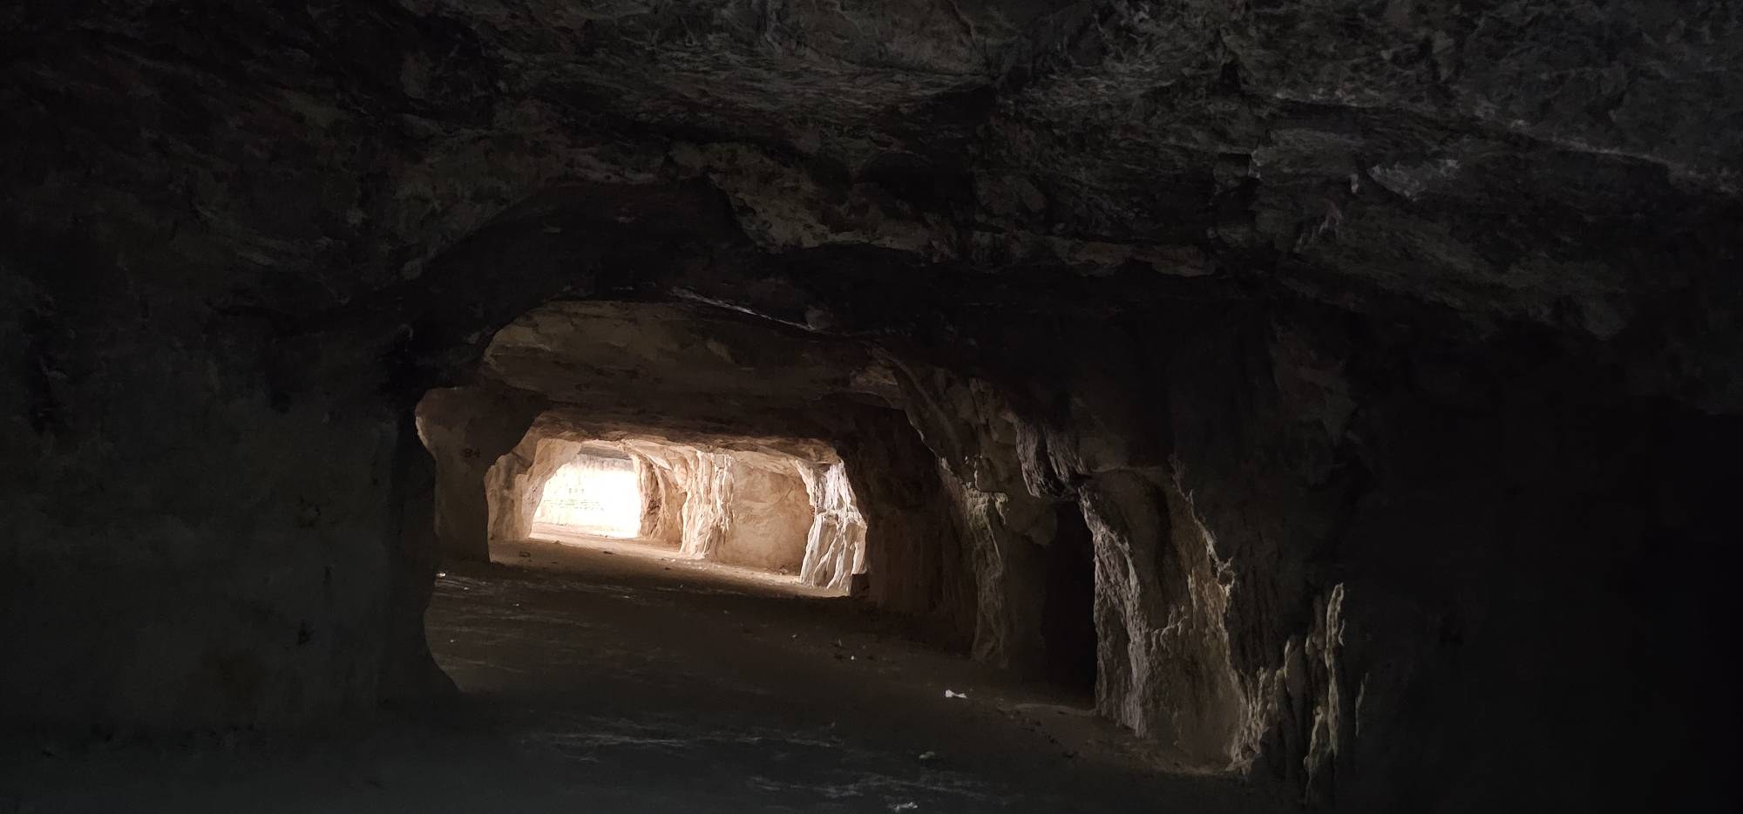
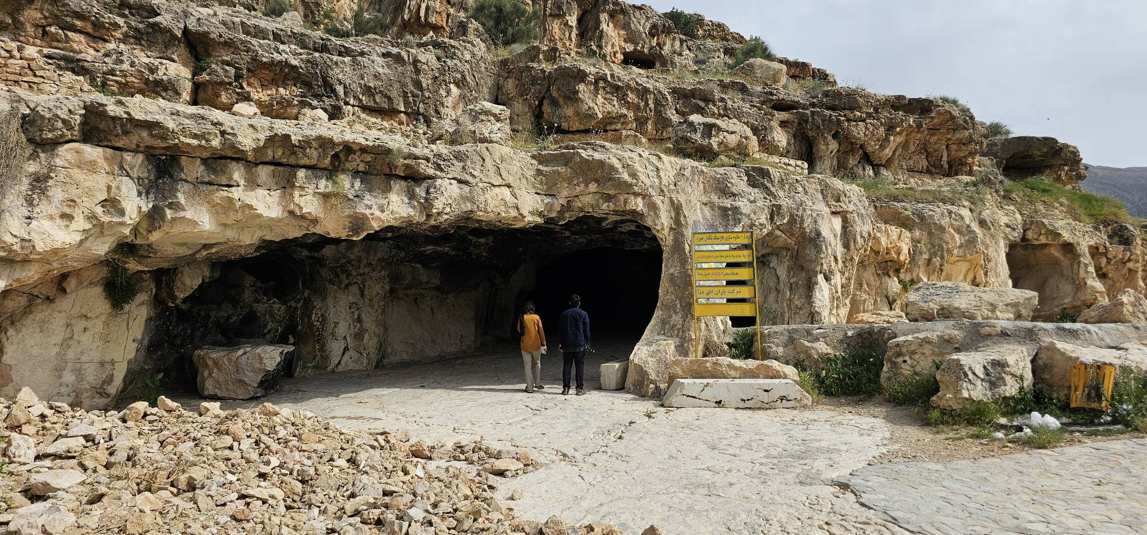
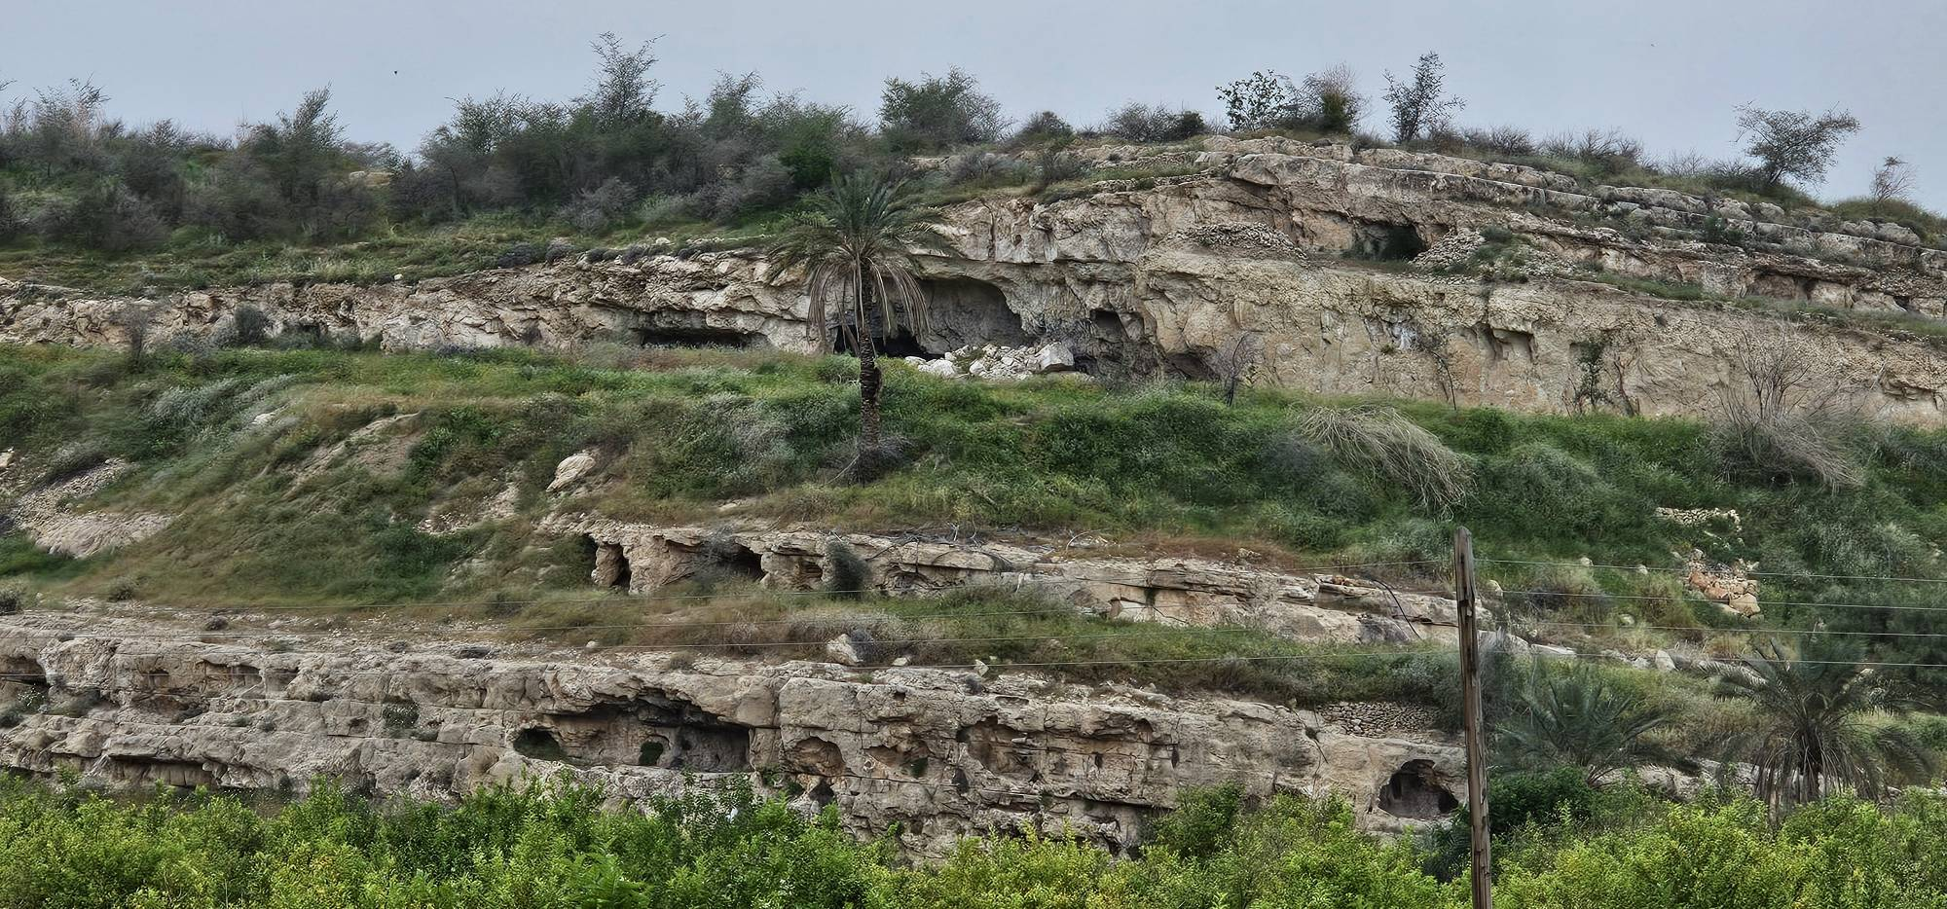
Supplement S2 – Figure (Sangtarāshān–1)A large-scale rock‑cut complex known as the Sangtarāshān hand‑hewn cave. The interior shows engineered support pillars, planar ceilings with linear fracture patterns, and leveled floors, all indicative of controlled excavation rather than natural karstic formation.

Slide 7
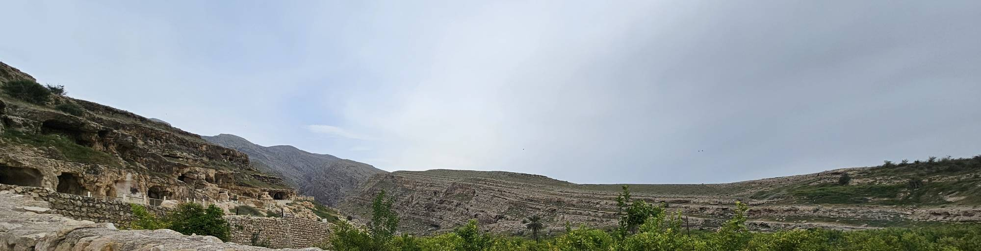
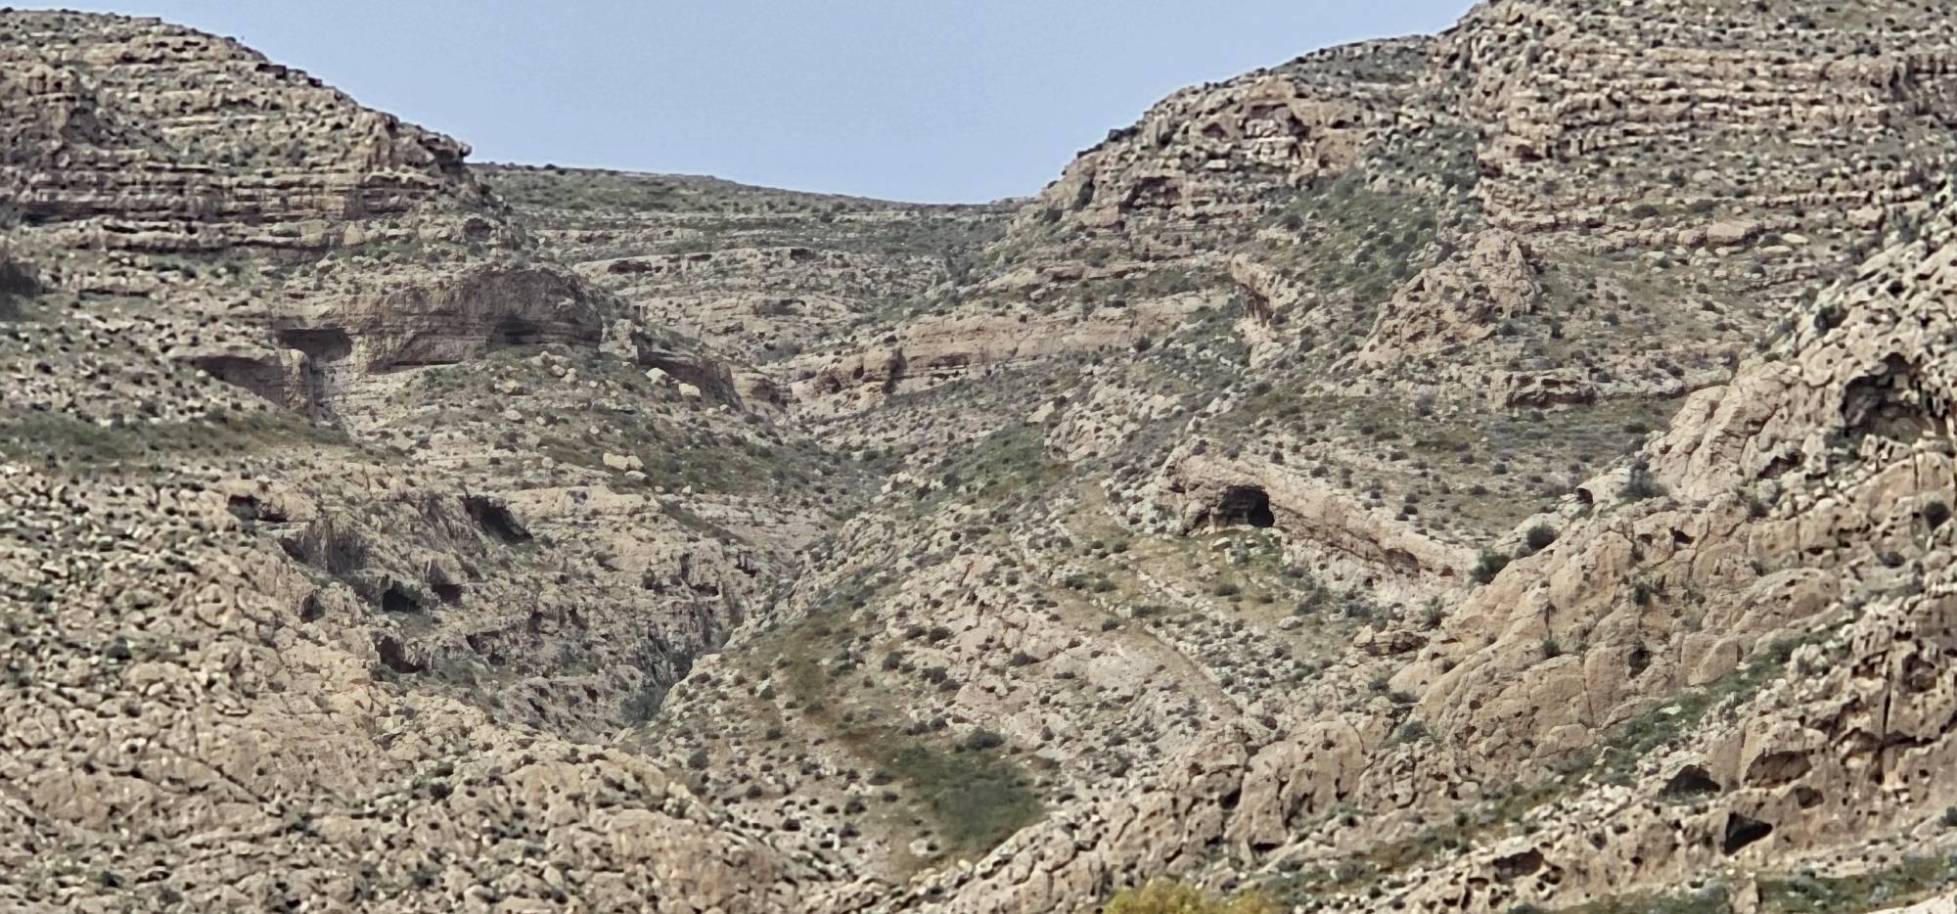
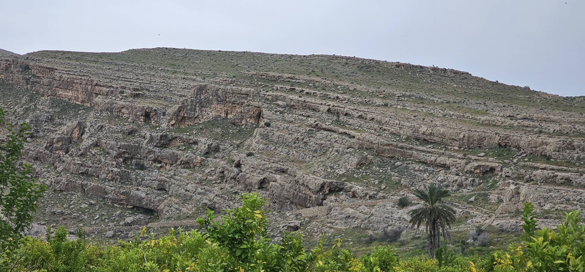
Sangtarashan is part of a large engineered landscape: thousands of ancient water‑control structures and dozens of artificial cave openings surround the main complex, revealing systematic human modification of both surface and subsurface environments.

Slide 8
“Across the Iranian Plateau—especially throughout the Zagros Mountains—clear evidence suggests the existence of an ancient, highly intelligent society deeply attuned to the natural environment. Understanding that intense seasonal rainfall on the steep slopes of the Zagros caused rapid soil erosion, this society recognized that the landscape, left on its own, could not sustain forests or stable rangelands. In response, they designed and built an immense system of dry‑stone terraces and watershed‑management structures, numbering in the millions, spread across vast mountain fronts. Through these terraces they controlled water, stabilized soil, and created the foundation for stepwise orcharding,
reforestation, and long‑term ecological regeneration.
The traces of this ancient environmental engineering and large‑scale desert‑reversal strategy can still be seen today, scattered across many parts of the plateau and most prominently in the Zagros highlands.
This, however, raises a fundamental question: Where did the large populations required for such monumental landscape engineering live?
One compelling possibility is that they
resided within the mountains themselves—inside extensive cave systems and underground settlements. These subterranean environments would have provided stable temperatures, protection, and long‑term habitation spaces for the communities who undertook this massive environmental transformation.”

Slide 9
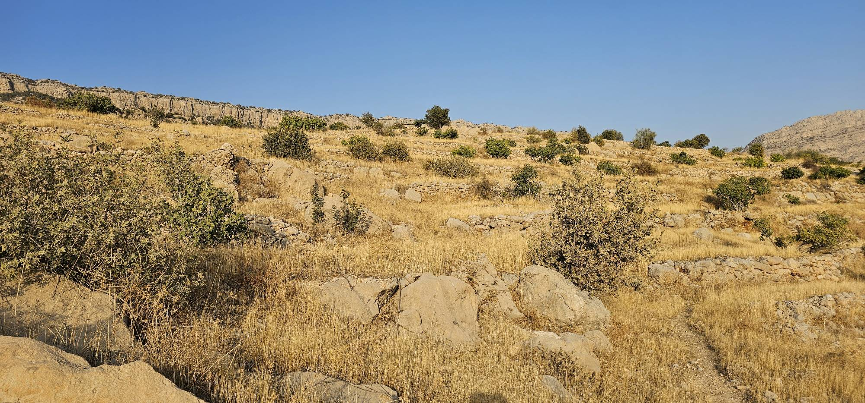
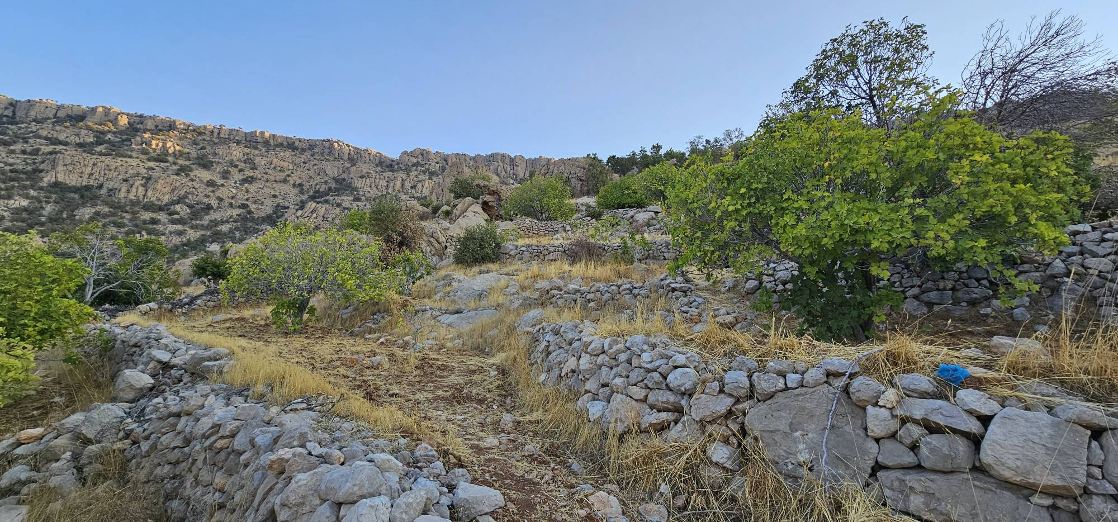
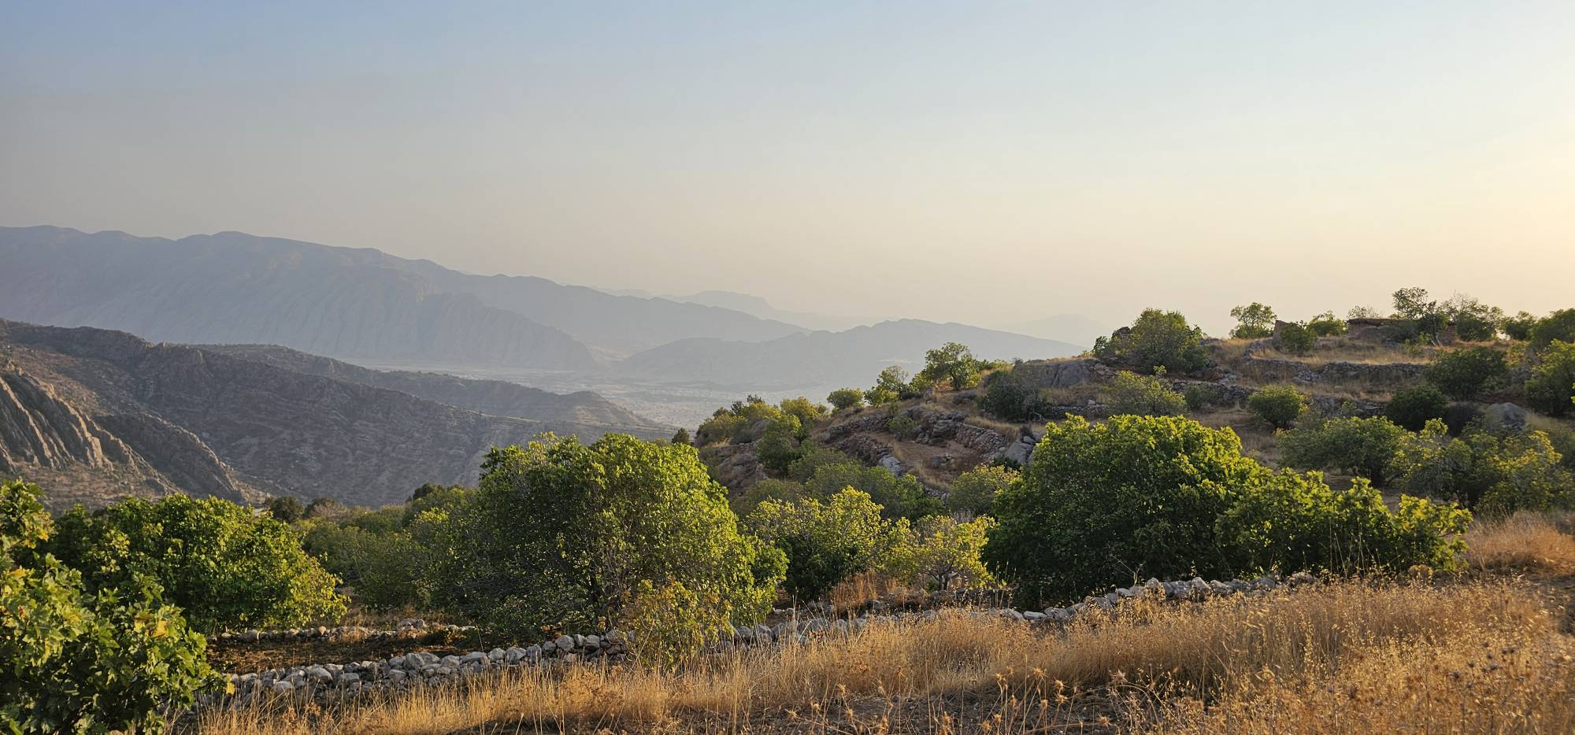
“In many parts of the Zagros Mountains, traces of these dry‑stone structures can still be observed. In some areas they are clearly visible in the landscape, while in others they can be identified through recognizable patterns in satellite imagery, particularly in Google Earth.”

Slide 10
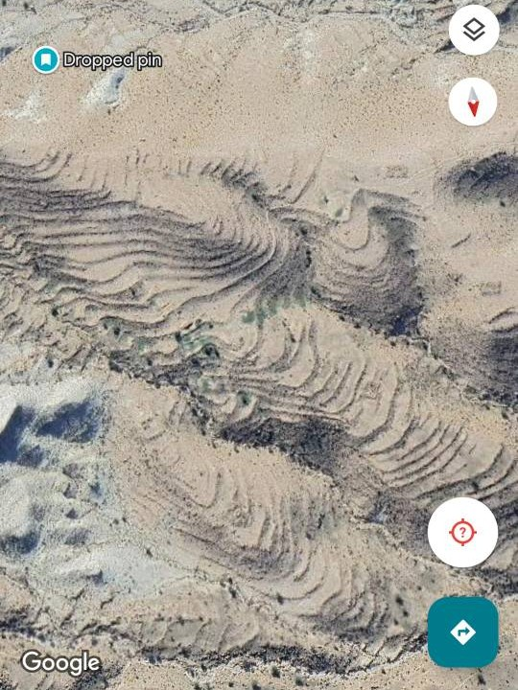
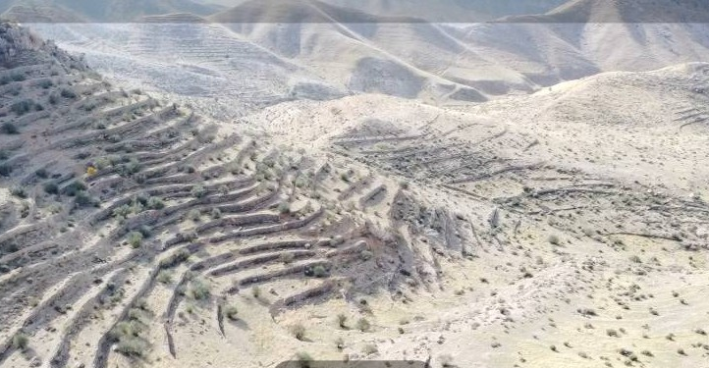
Helishot
Supplement S2 – Figure (Drone–1)
Aerial view of a multi-layer terracing system on a large Zagros slope. The terraces follow curvilinear contour lines with consistent spacing, demonstrating intentional landscape engineering rather than natural erosion.
Supplement S2 – Figure (Drone–2)
High-density terracing on a steep limestone ridge. The repeating structural pattern and contour-aligned walls indicate a coordinated, large-scale system of slope modification and water management.
Googel Earth

Slide 11
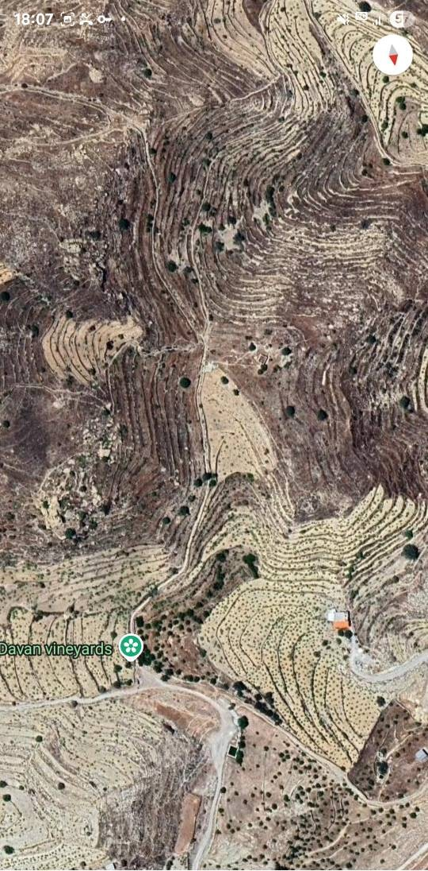
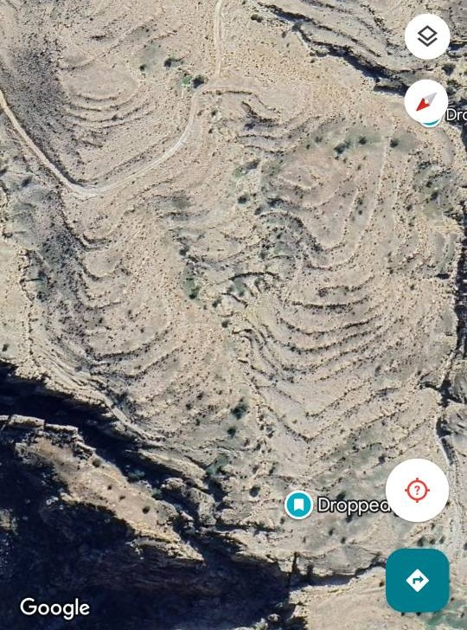
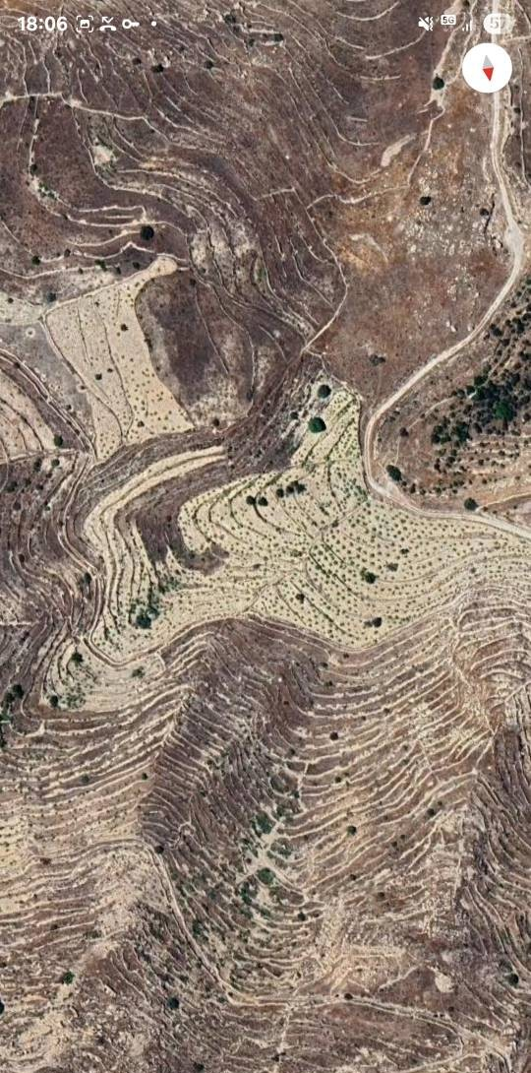
Supplement S2 – Figure (GE-1)
(The Ancient terraces farming)
Google Earth imagery showing large-scale contour-following terracing. The repeating curvilinear lines with consistent spacing indicate intentional landscape engineering rather than natural slope processes.

Slide 12
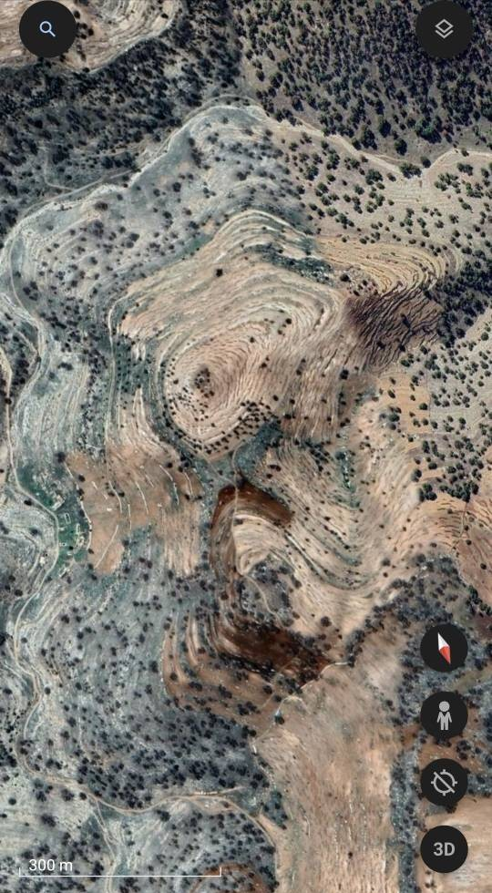
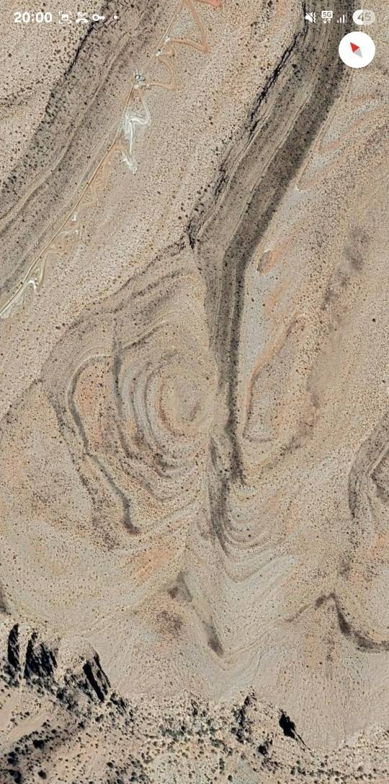
Supplement S2 – Figure (GE-2)
A pair of opposing hillslopes with mirrored terracing patterns. Such bilateral symmetry is characteristic of coordinated human modification of terrain.

Slide 13
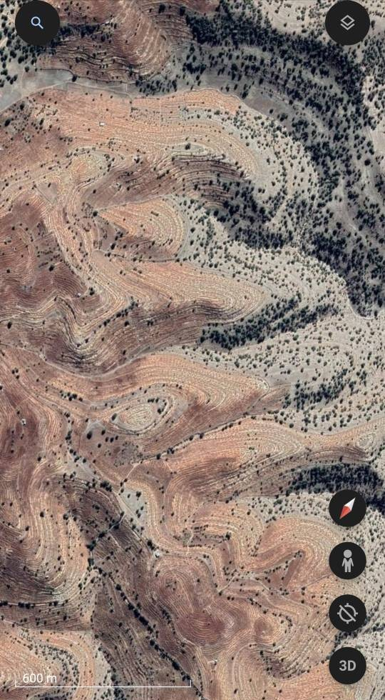
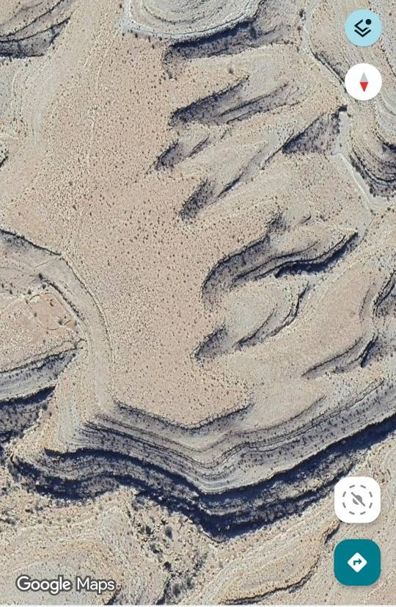
Supplement S2 – Figure (GE-3)
Soft, wave-like terracing visible across the entire slope. The continuity of these lines even in areas with minimal relief demonstrates an engineered contour system.

Slide 14


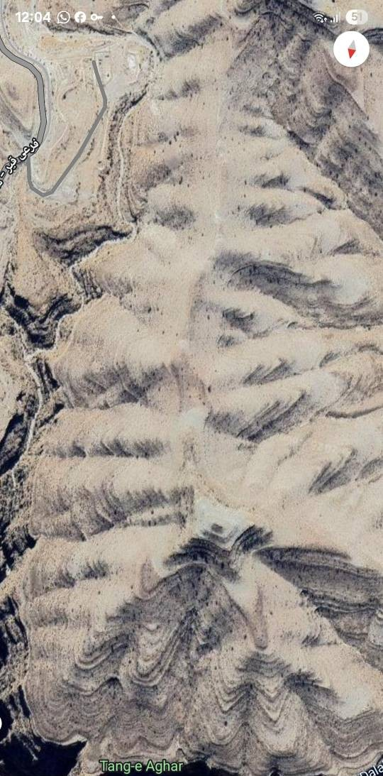
Supplement S2 – Figure (GE-4)
High-density terraces forming a complex network of contour-aligned walls. The uniformity of spacing and curvature indicates deliberate construction at landscape scale.

