Slide 1


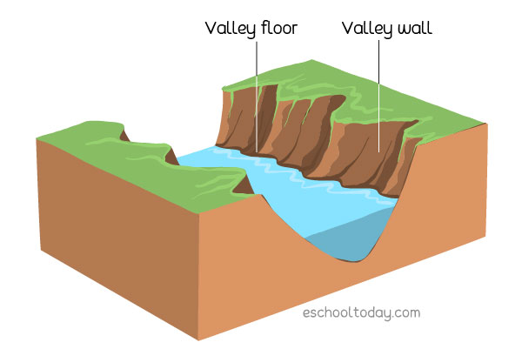
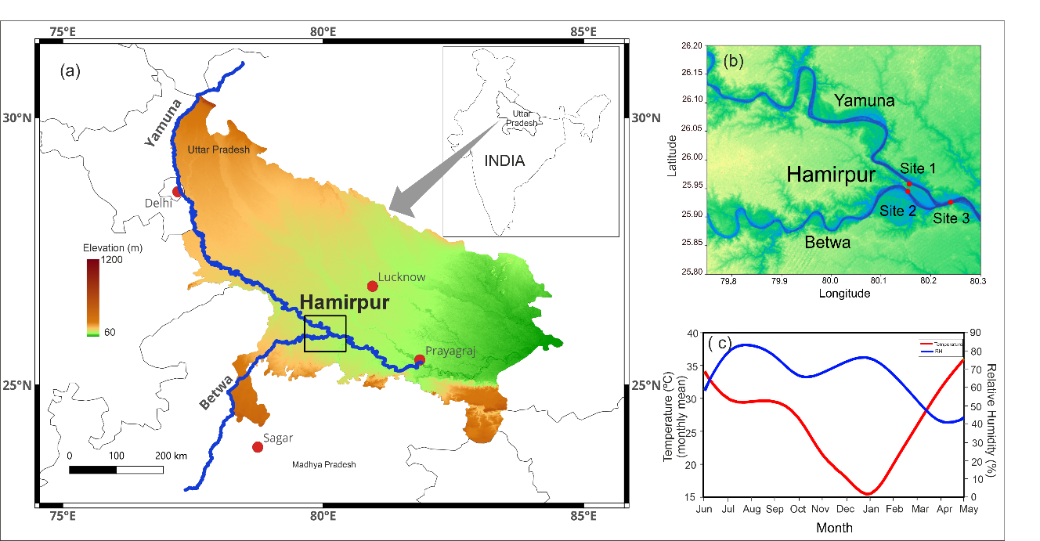

Seasonal variation in the quantitative contribution of water sources: A case study from the Yamuna River, India
Glacial meltwater
Bayesian approach of discerning proportional contribution
Precipitation input
Groundwater incursion
Volume fraction of water controlled by Beta
Isotopic
variability
Sanchita Banerjee¹, Amal M.S^{1, 2}, Prasanna K^{1*}
¹Birbal Sahni Institute of Palaeosciences (BSIP), Lucknow (U.P.), India- 226007
²Academy of Scientific and Innovative Research (AcSIR), Ghaziabad, Uttar Pradesh, India- 201002

Slide 2
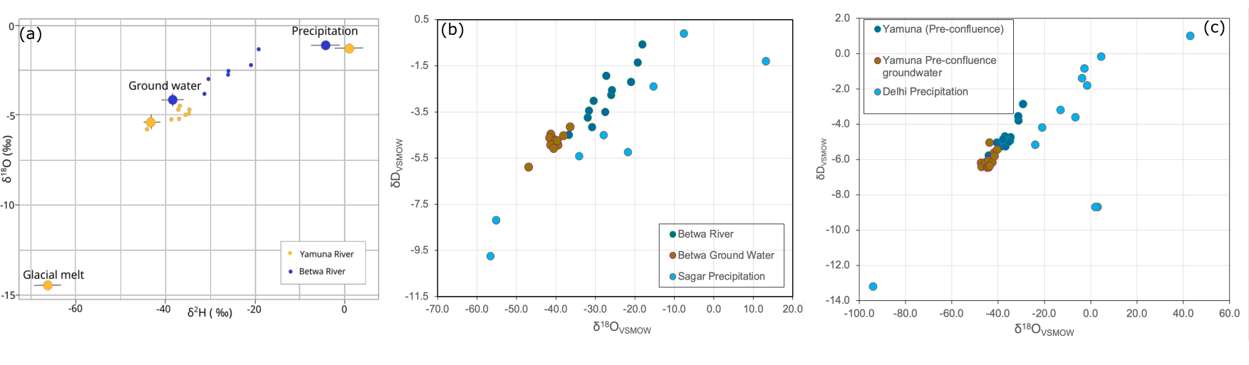
Contextualization of monitored seasonal δ¹⁸O and δD of River and Groundwater
Objective
Application of stable isotopes : as conservative or non conservative tracer being impacted by the hydro- climatological processes
Semi-arid region of Central India:
Physiographically and climatologically distinct from the eastern part of Ganga Plain
Targated site: Proximity of Hamirpur, Uttar Pradesh (confluence of Yamuna and its tributary river Betwa)

Slide 3
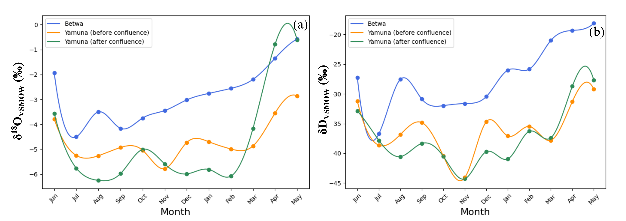
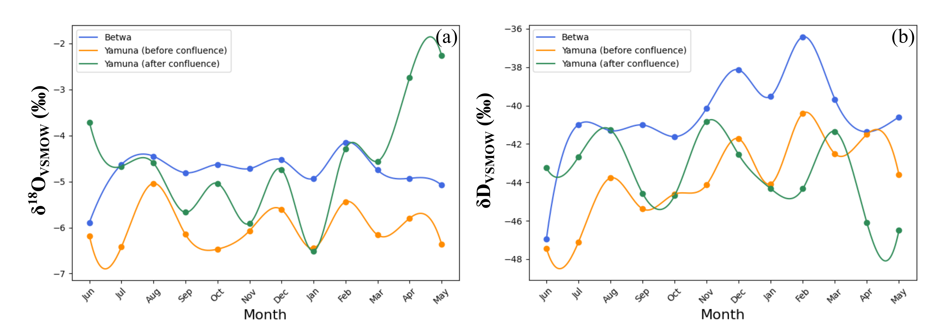
Seasonal variation in measured δ¹⁸O and δ²H composition of River and Groundwater
July,2023 to May, 2024 δ¹⁸O and δ²H compositional variability in River water sampling sites
Betwa River water isotopic imprints exhibits a consistent trend of enrichment being rainfed
Yamuna retains comparatively less relative variation and lighter composition observed due to the input through southwestern monsoon and western disturbances
July,2023 to May, 2024 δ¹⁸O and δ²H compositional variability in adjacent Groundwater sampling sites
Absence of seasonal trends in depletion or enrichment in groundwater implies that the recharge of groundwater is occurring through permeation from the upstream region.

Slide 4
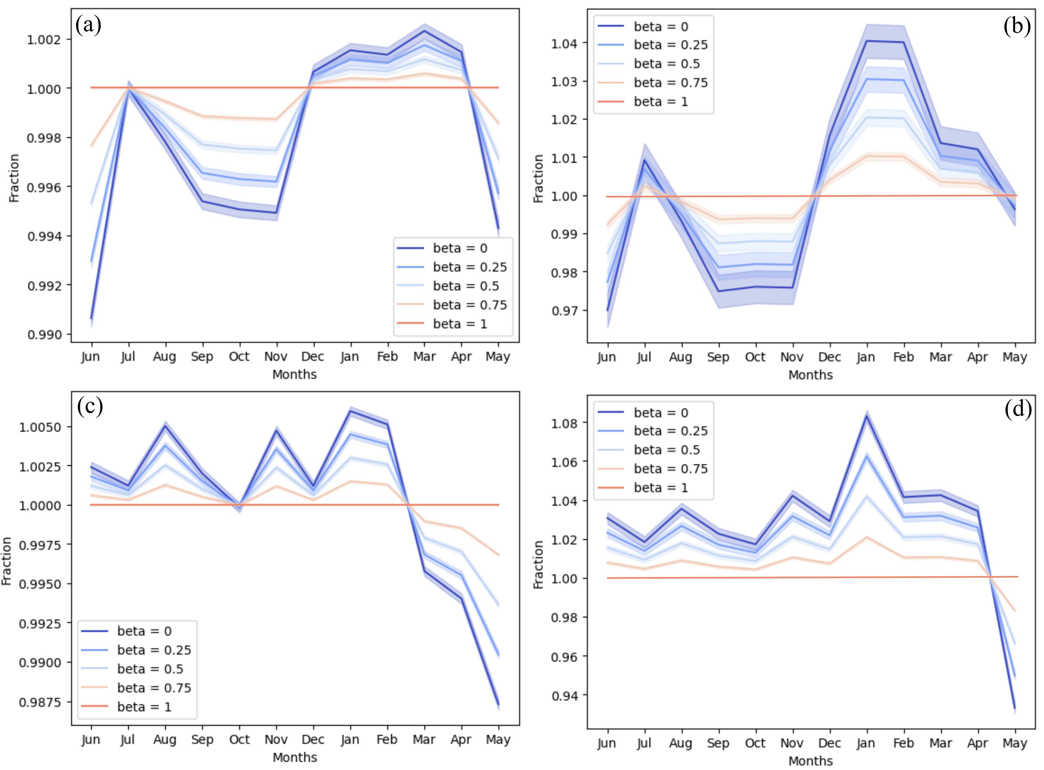
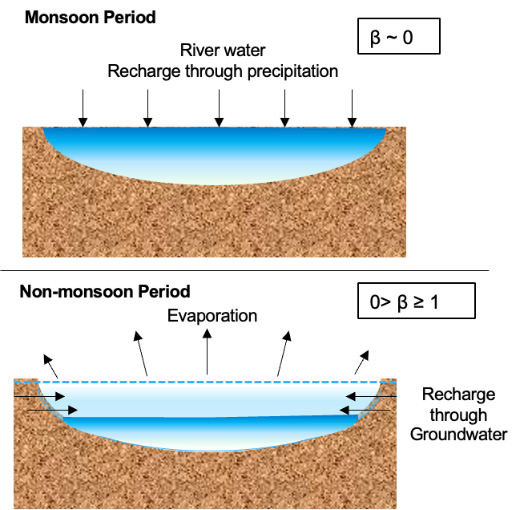
Implementation of the Rayleigh fractionation model to decipher the seasonal isotopic variability
Fraction of remaining water is a compound function of input through groundwater or aquifer water and output through evaporation.
Beta (β) = rate of input/ rate of output (dN_{in}/dN_{out})
Betwa River
δ¹⁸O derived
δD derived
Yamuna River
δ¹⁸O derived
δD derived

Slide 5
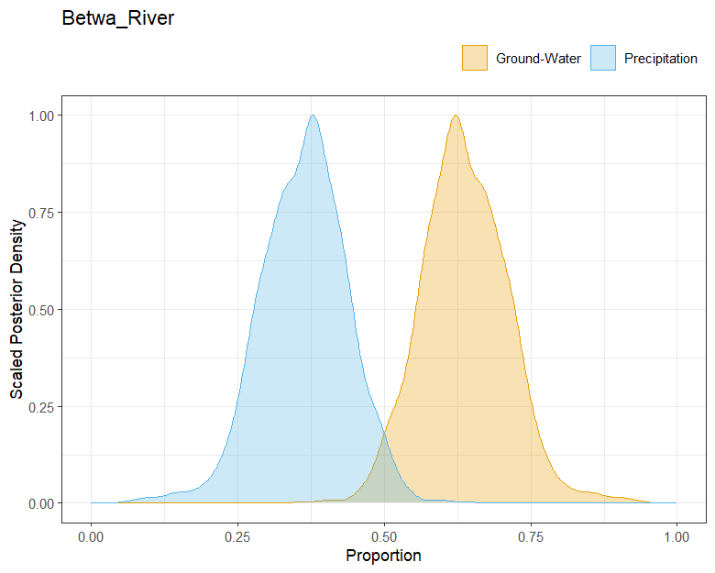
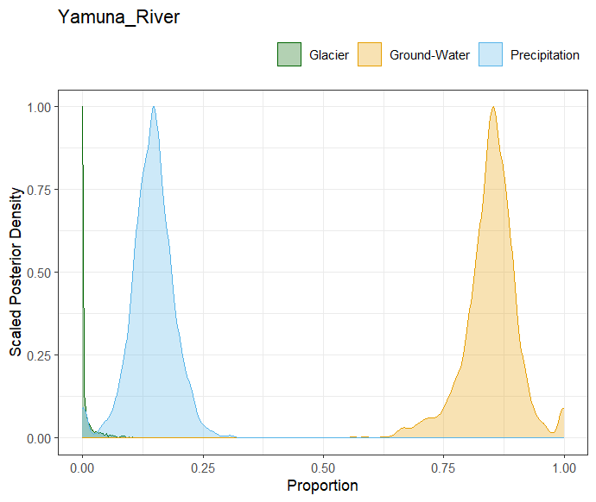
MixSIAR model : Bayesian Mixing model for estimating source water mixing proportion
Posterior probability distribution of source water contribution evaluated using riverwater δ¹⁸O and δD composition with uninformative prior distribution or assumption
Proportional source water component mixing in Betwa River
Proportional source water component mixing in Yamuna River
Condition: f > 1
Months: December, January, February, March, April
Condition: f > 1
Months: January, February, June, July, August, September, October, November, December
Groundwater :81.2 ± 7 %
Precipitation : 16.2 ± 4.6 %
Glacial melt : 2.7 ± 3 %
Groundwater : 63.7± 7.4 %
Precipitation : 36.3 ± 7.4 %
Condition: f <1 Months: May, June, August, September, October, November (Monsoon including extreme evaporative phase of May)
Condition: f <1 Months: March, April, May (specifically Pre-monsoon evaporation)
Groundwater contribution reduces to 2-7.5 % in extreme case of recharge through precipitation with least impact of evaporation.
Groundwater contribution reduces to 1.5 to 6 % in extreme case of recharge through precipitation with least impact of evaporation.

Slide 6
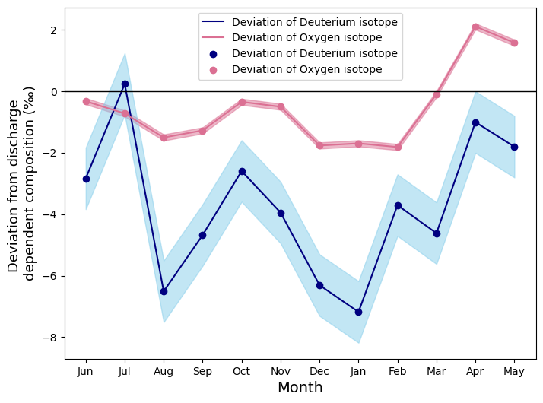
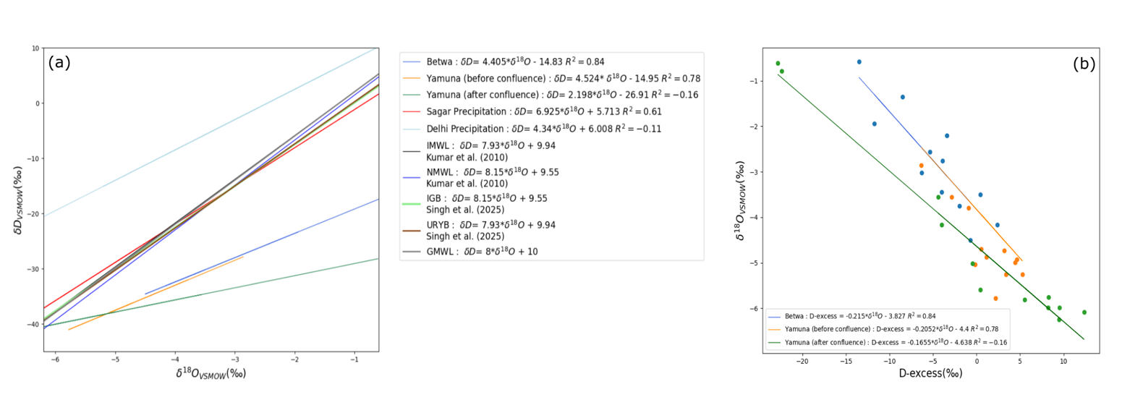
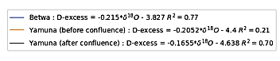
Dynamics in post-confluence isotopic signatures due to groundwater seepage
The post-confluence Yamuna experiences extreme evaporation as evident from negative correlation of δ¹⁸O and D-excess and river water level is maintained through groundwater influx.
Pre and post confluence Yamuna follows a similar pattern in the recharge through groundwater source as monitored using the deviation from the discharge dependent mass-balance isotopic composition
March, April, May month experiences the enrichment with reduced recharge through ground water unlike rest of the part of year
Physiography and the gradient controls the saturation of the vadose zone, while turning groundwater to be the major contributing source of the riverine flow.
overexploitation of groundwater resources could significantly compromise river flow sustainability and regional livelihoods.

