Slide 1
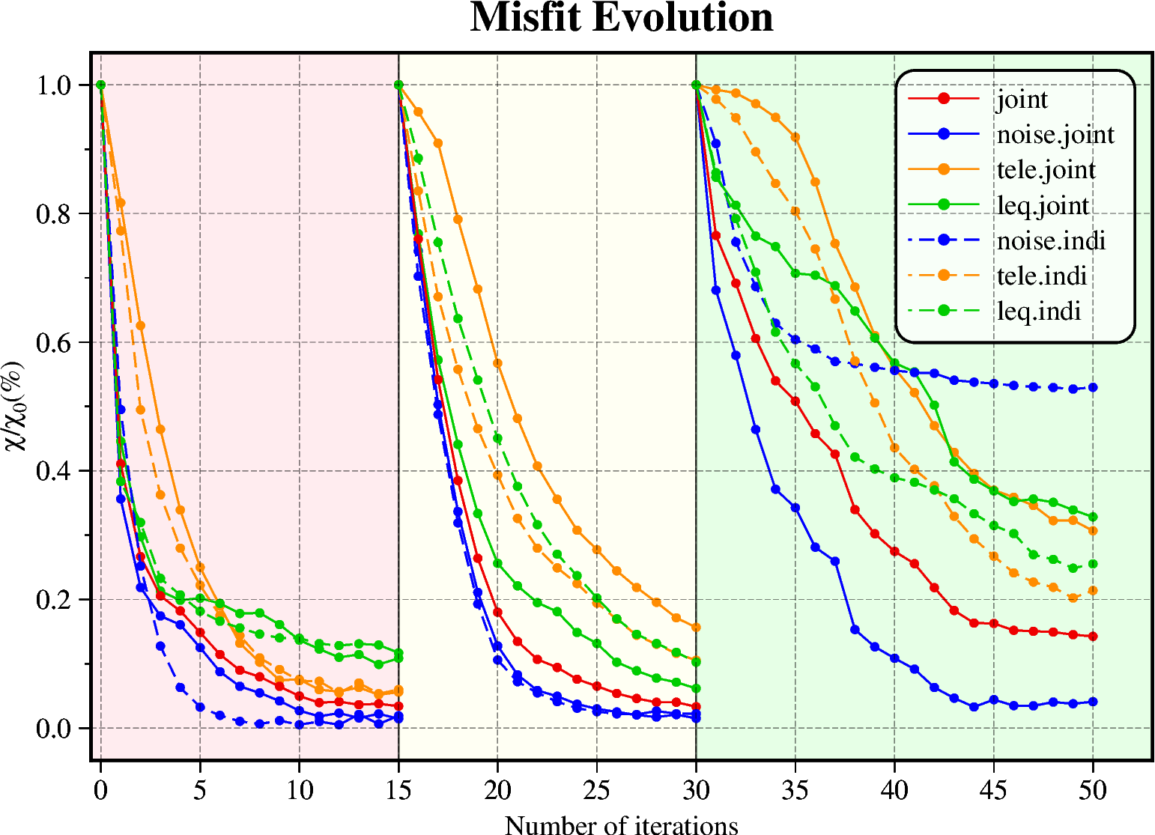
Misfit Evolution
Muti-Scale
0-15 iters：
Noise：15-10s
Tele: 25-10s
Leq: 15-10s
16-30 iters:
Noise：15-5s
Tele: 25-5s
Leq: 15-5s
31-50 iters:
Noise：15-3s
Tele: 25-3s
Leq: 15-3s

Slide 2
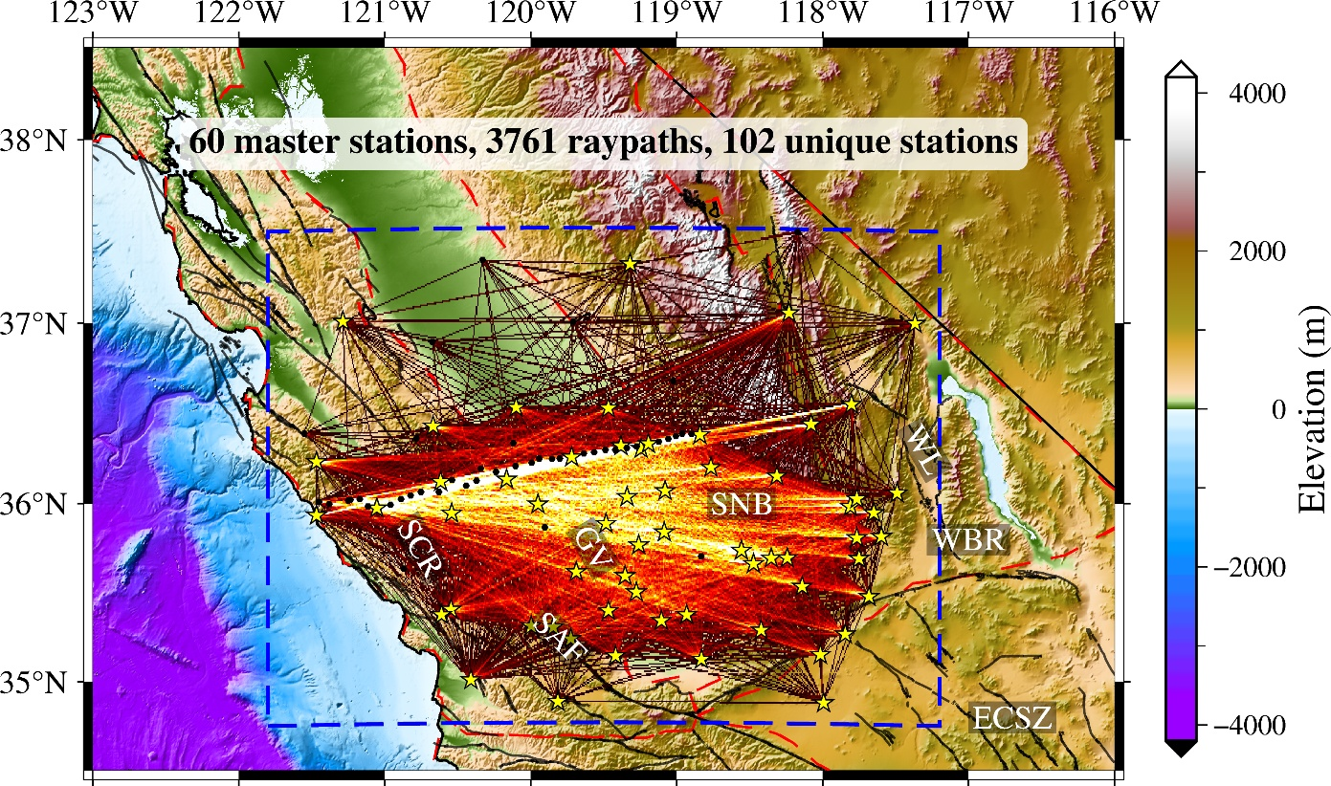
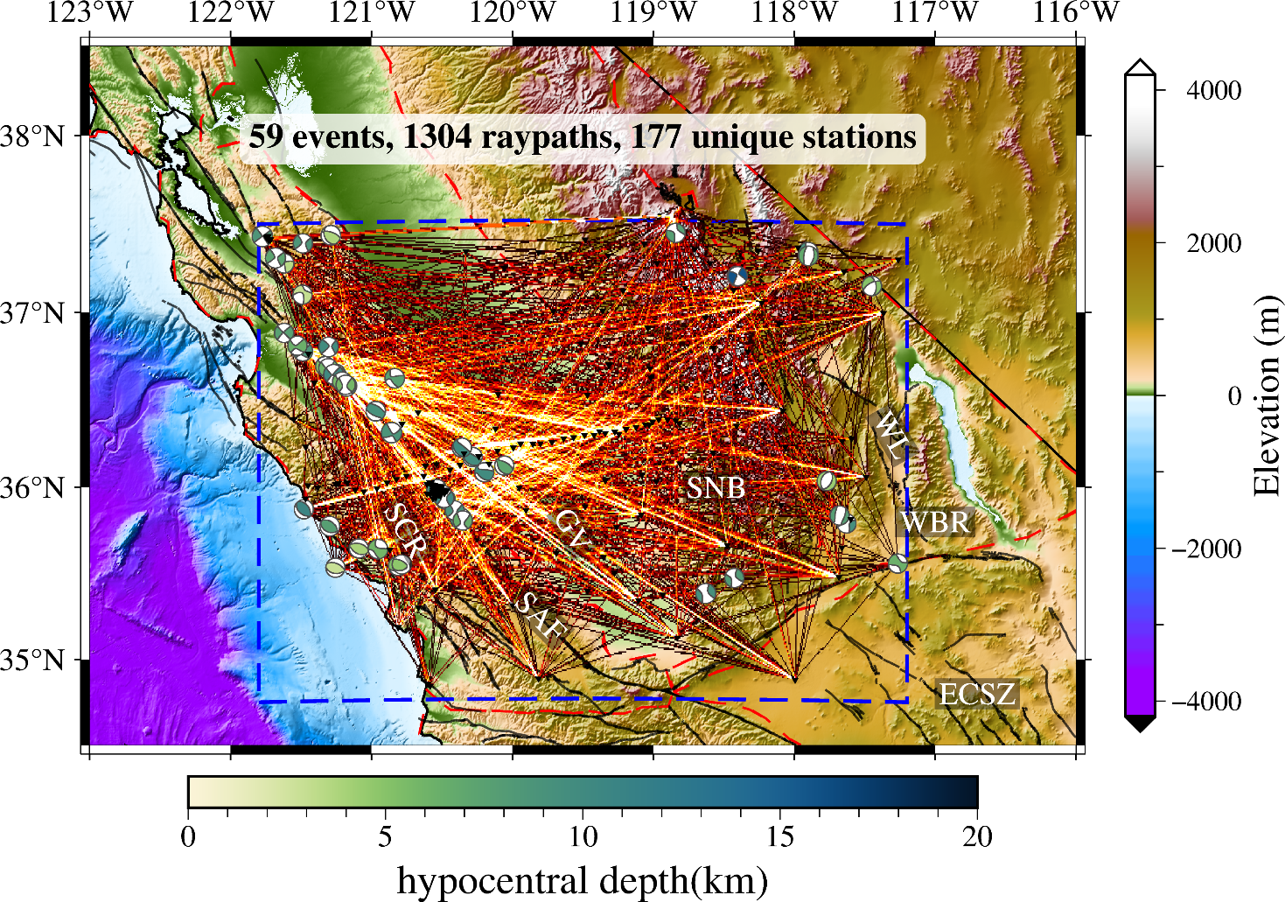
Ray Density
Noise
Leq

Slide 3
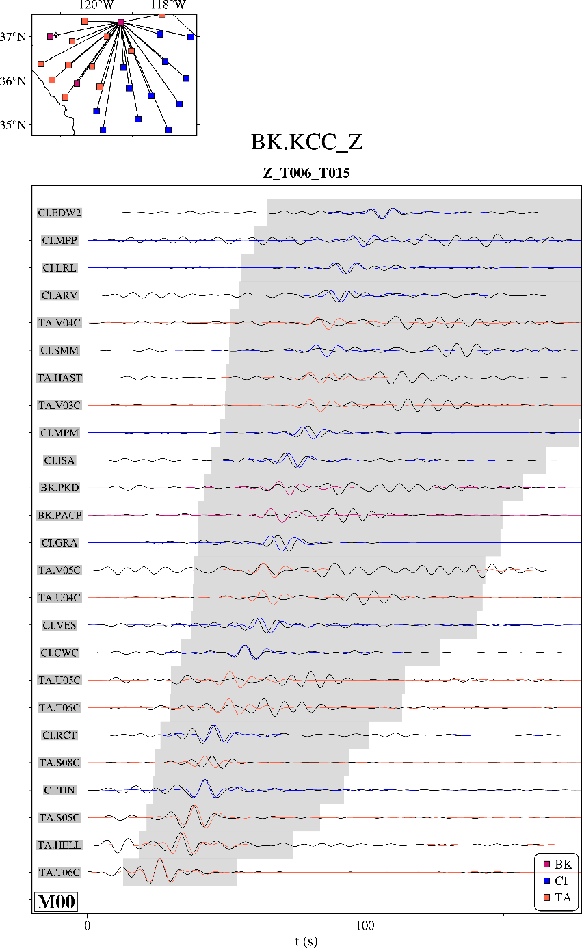
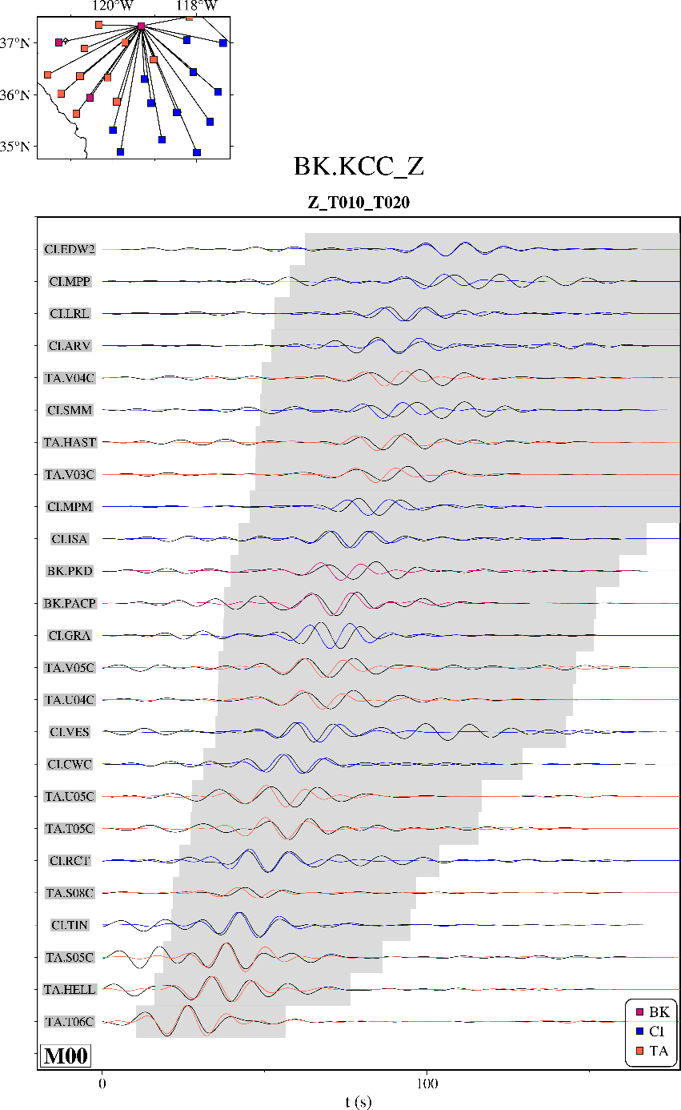
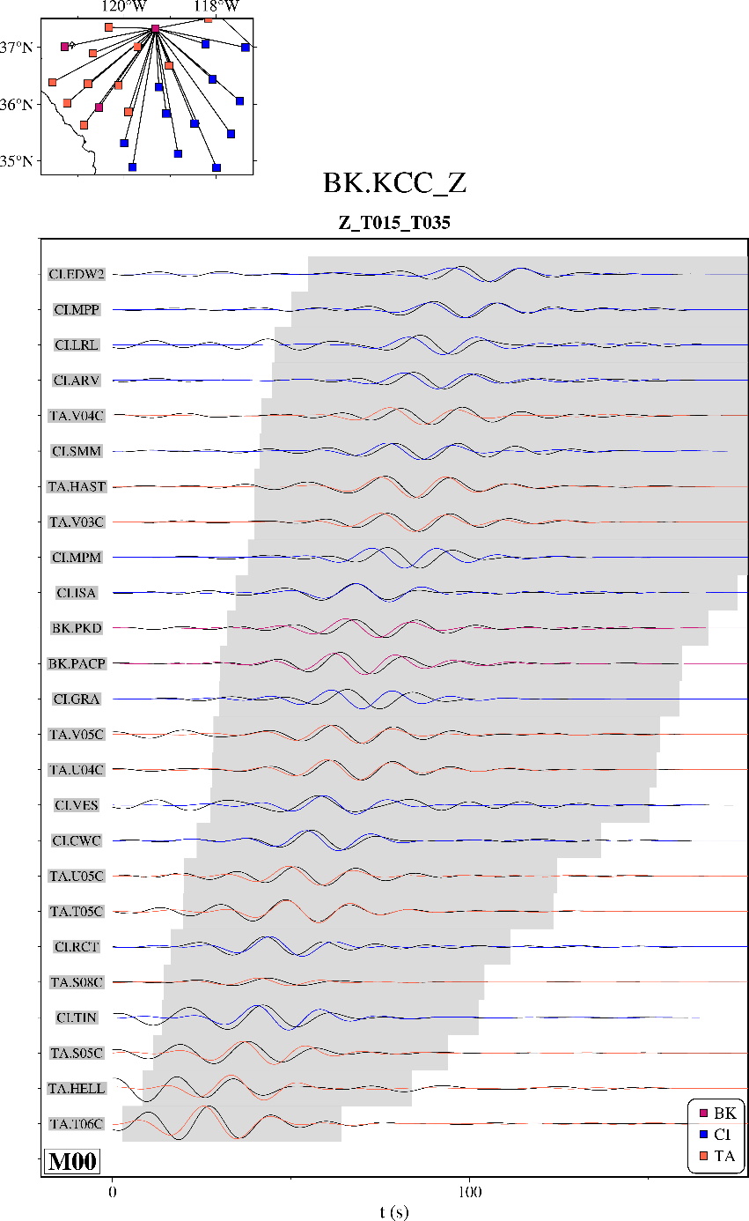
Noise waveforms

Slide 4
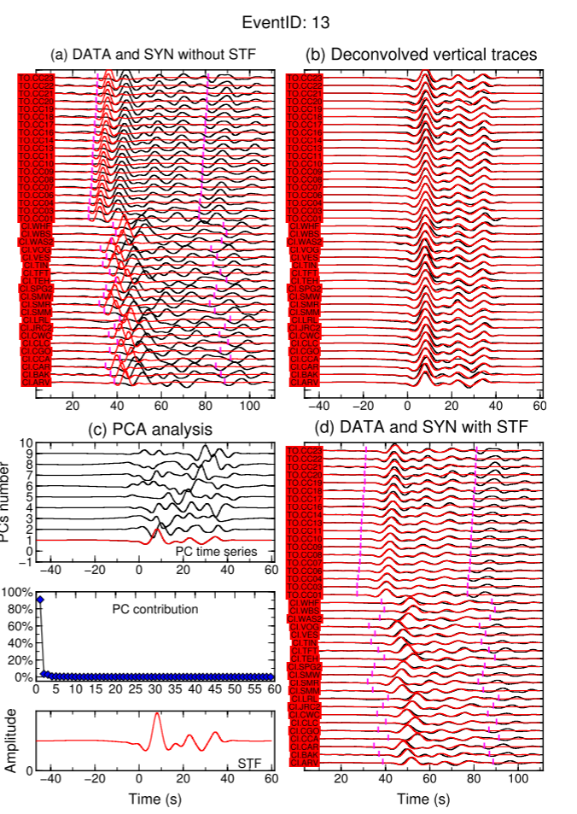
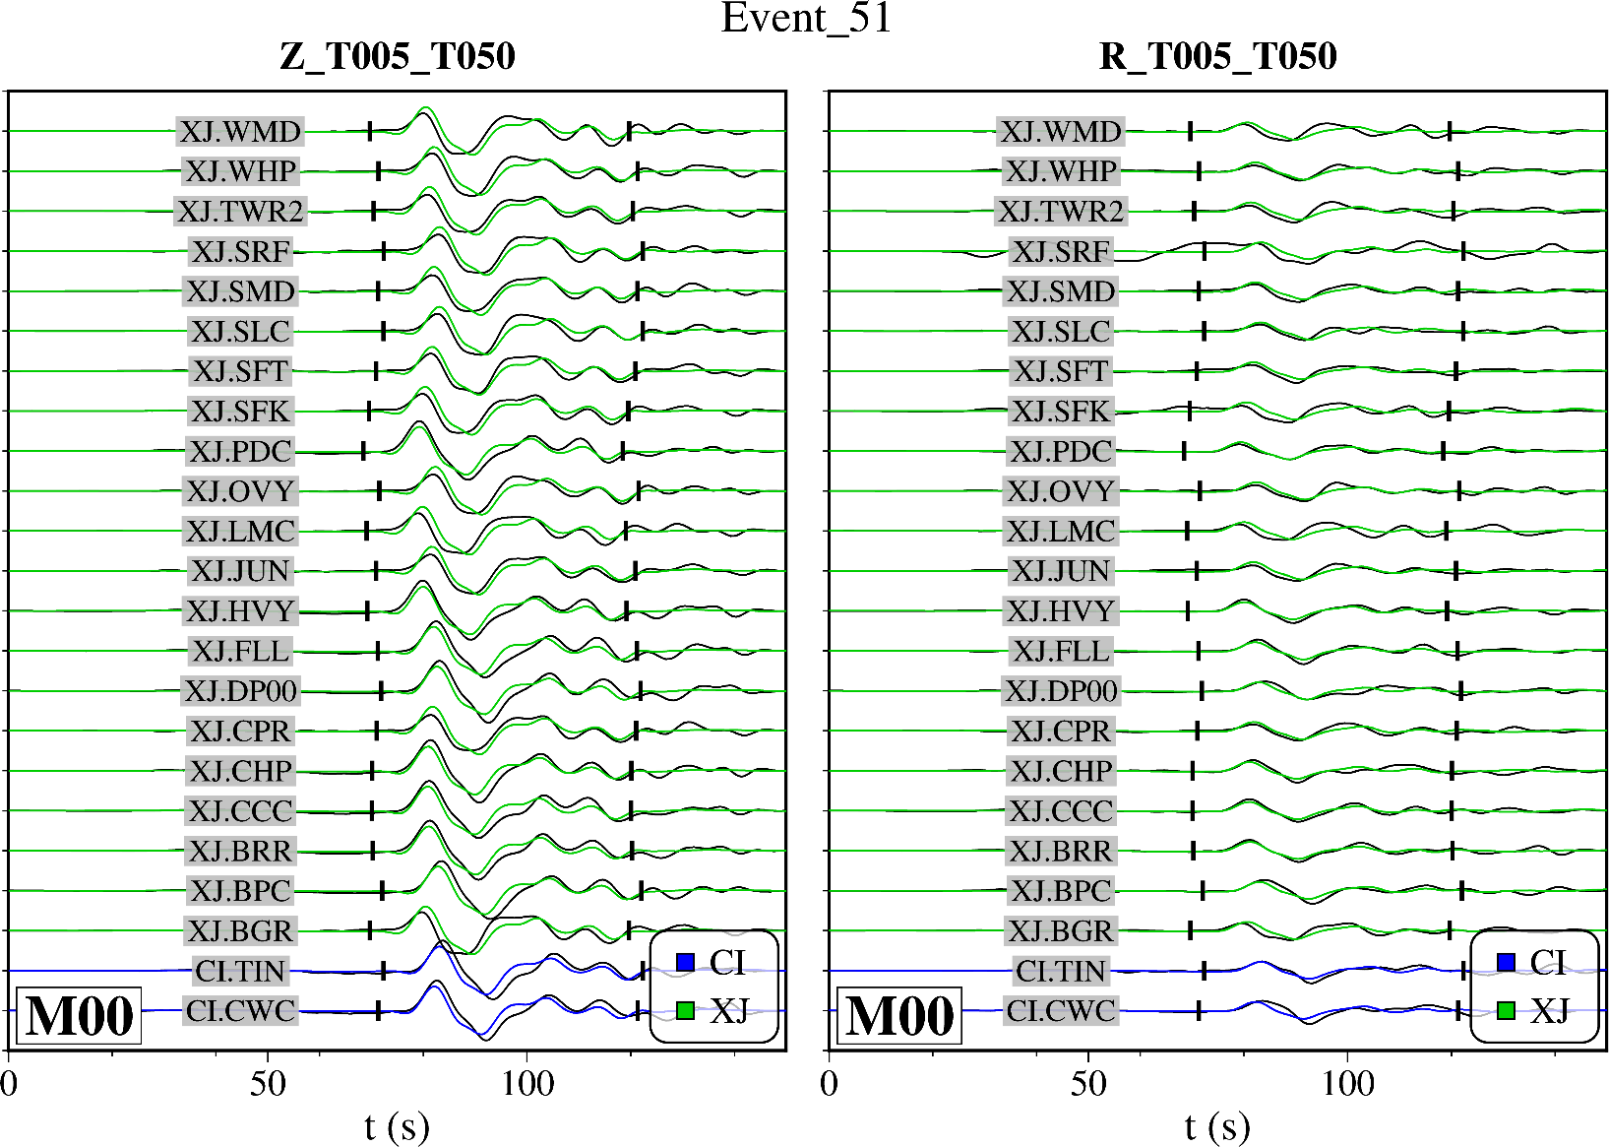
Tele waveforms

Slide 5
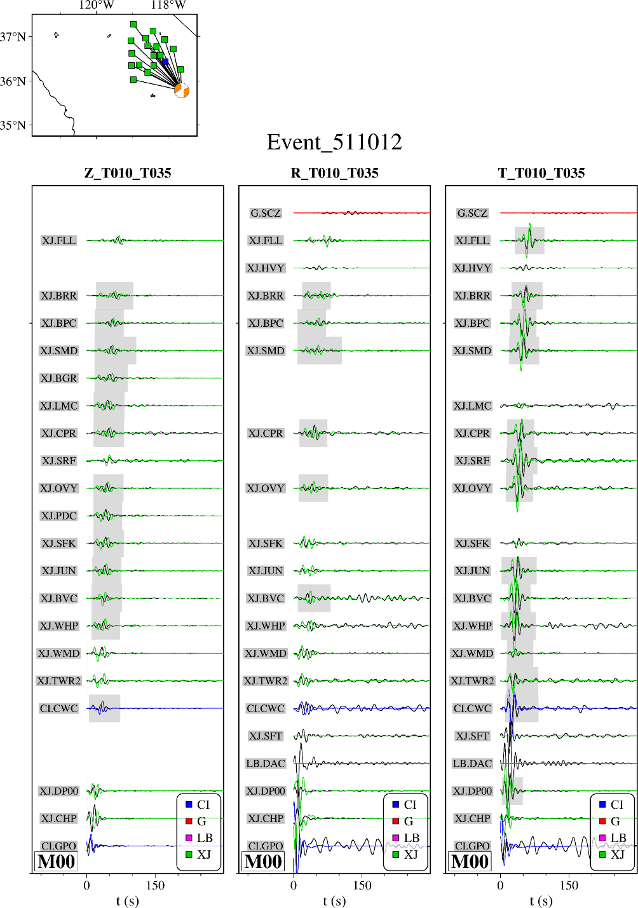
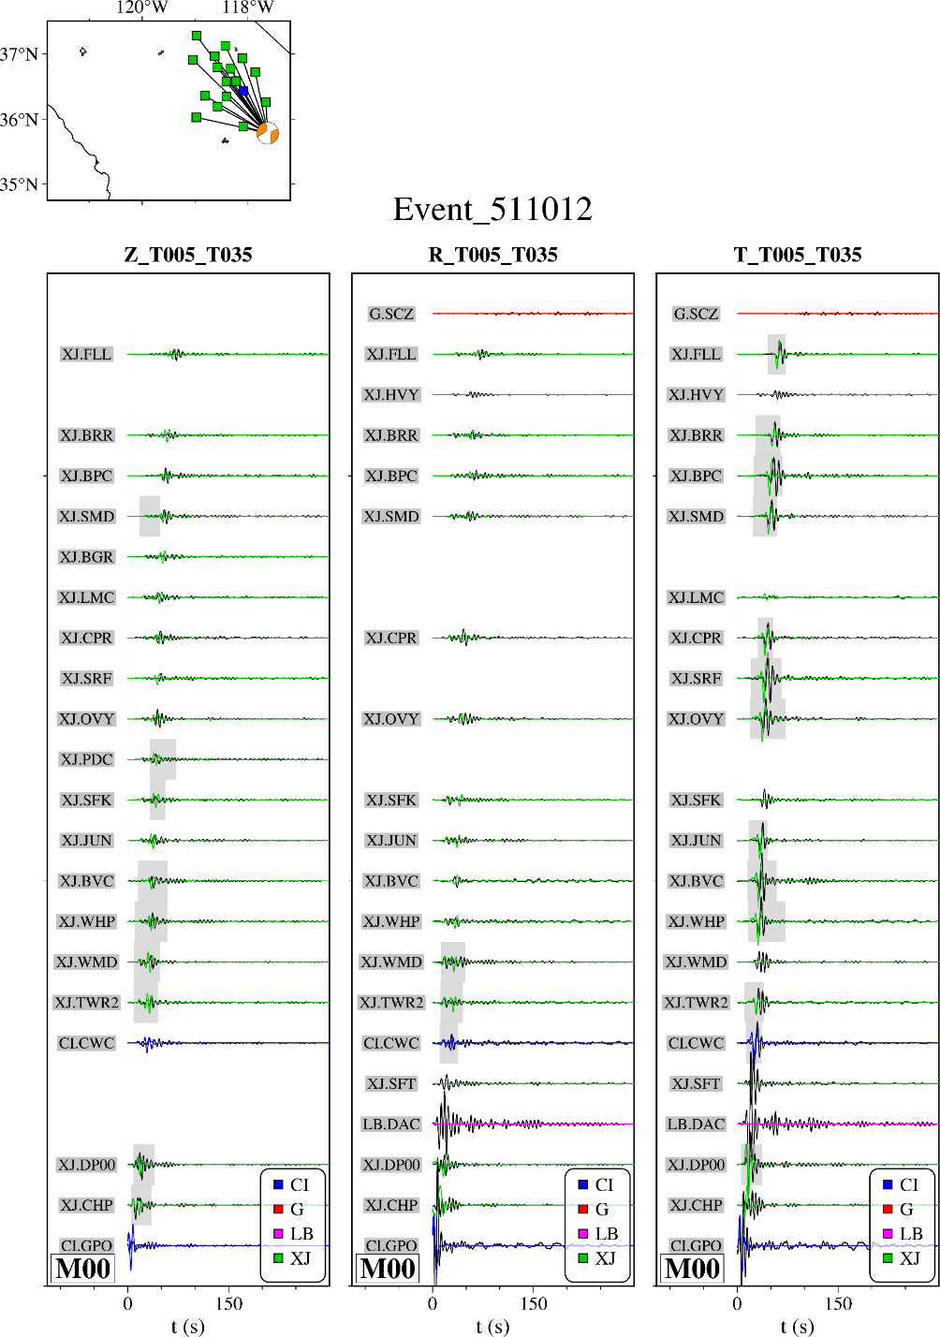
Leq waveforms

