Slide 1


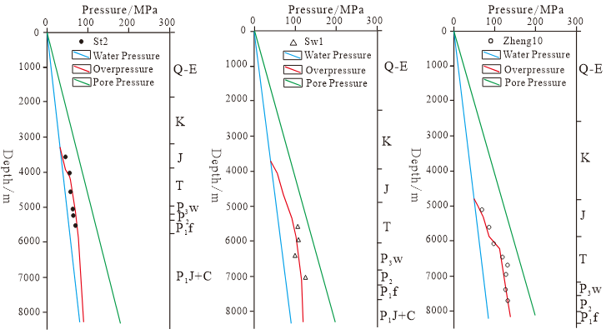
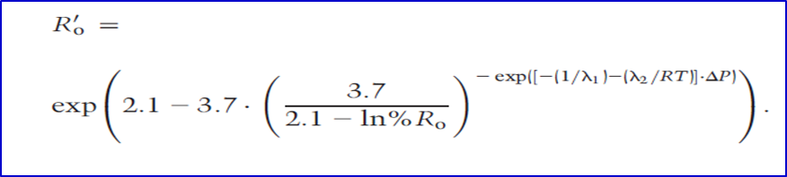
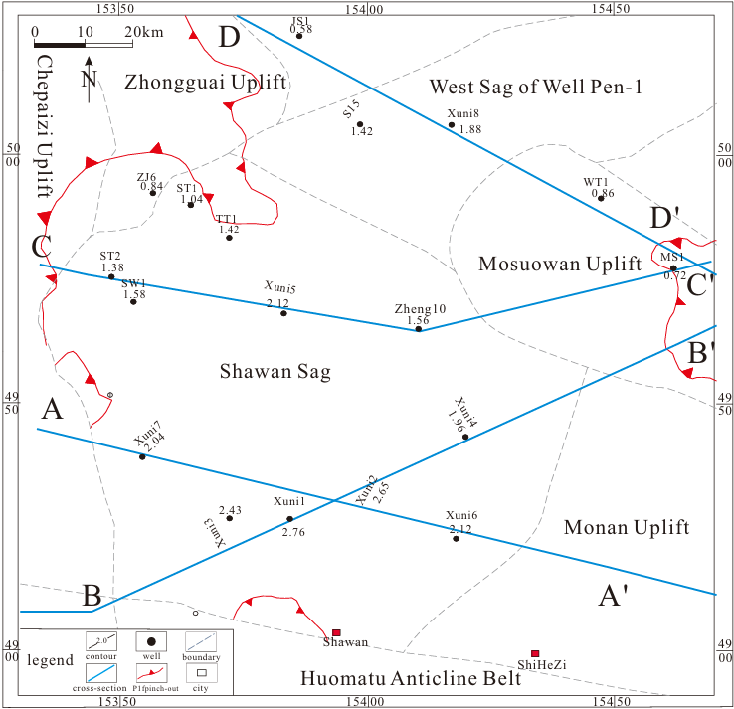
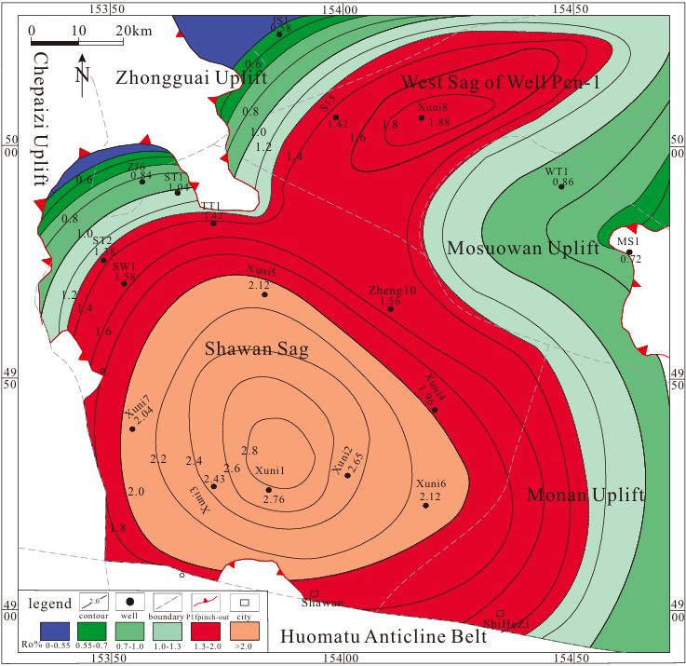
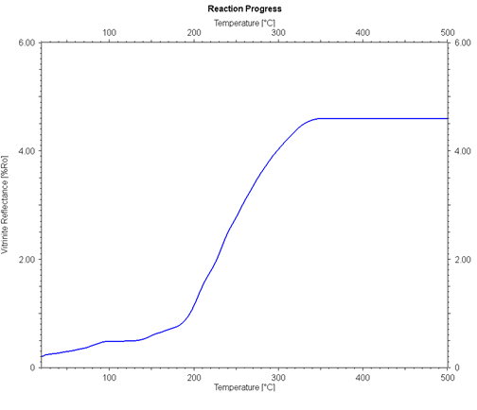
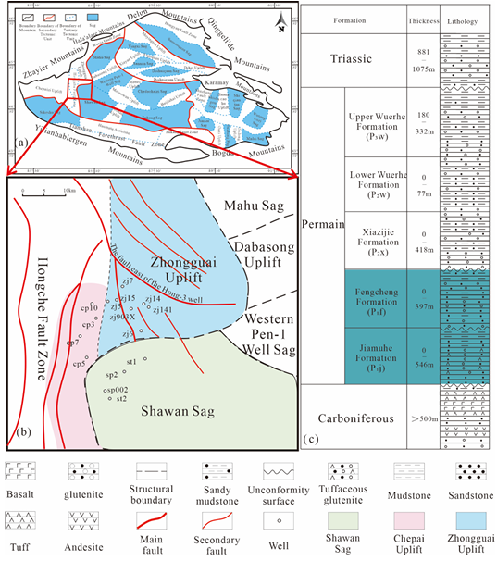
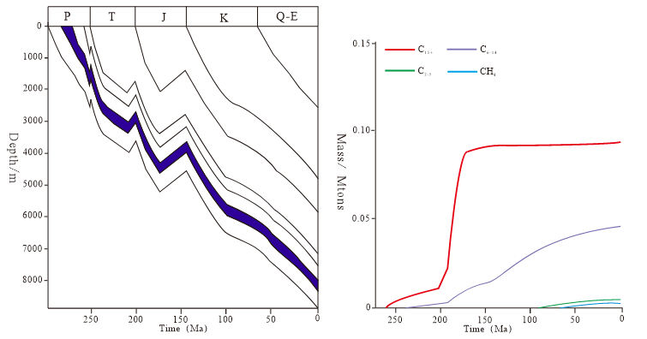
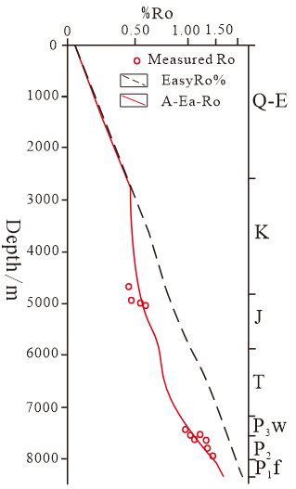
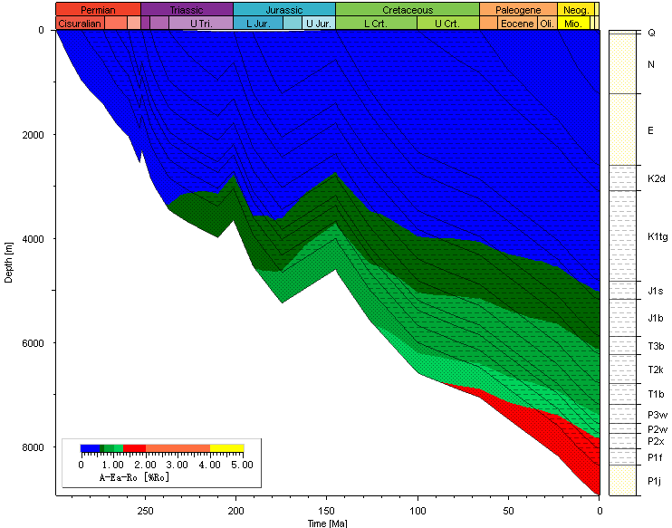
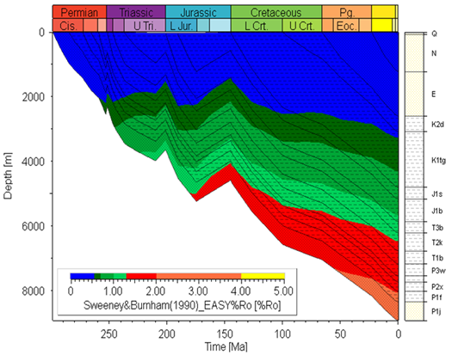
Maturity Evolution History and Hydrocarbon Generation Evolution History of Hydrocarbon Source Rocks in the Fengcheng Formation, Shawan Sag, Under the Influence of Overpressure
Bing He¹, JianLiang Liu²
^{1,2}China University of Petroleum, East China (Qingdao), School of Geosciences
Introduction
In recent years, With the continuous advancement of oil and gas exploration technologies and associated theoretical frameworks, deep to ultra-deep oil and gas exploration has emerged as a pivotal component of contemporary petroleum geology research and currently seems as a focal area of interest. But, overpressure is prevalent in deep to ultra-deep formations, and there are substantial discrepancies in studies regarding the impact of overpressure on the maturity of hydrocarbon source rocks and hydrocarbon generation.(Hao et al., 1995).These discrepancies have hindered a mass understanding of hydrocarbon formation and phase states in ultra-deep settings, thereby constraining deep oil and gas exploration endeavors(Dalla Torre et al., 1997) .
b
a
b
a
c
Fig. 4 (a) Four cross-sections along with simulated well location results; (b) Planar contour map.
Fig. 2 (a) Evolution of overpressure in a single well(b) Formula and parameters of the A-Ea-Ro model(c) Improved Ro evolution
Previous studies conducted multi-component hydrocarbon generation kinetic research on the Permian Lucaogou Formation source rocks based on low-maturity source rock samples(Zhao et al., 2022). This study adopts the same model. Light oil (C6-14) started to generate around 225 million years ago, with its production gradually increasing but remaining consistently lower than that of heavy oil throughout the entire hydrocarbon generation period. Currently, liquid hydrocarbon generation still dominates, while gaseous hydrocarbons (below C5) have been generated in small quantities since the Neogene.(Fig. 5).
Geological Setting
In this study, Ro single-well simulations were conducted by inputting various geological parameters into the Petromod software. By comparing the simulation results of the A-Ea-Ro model, which accounts for the influence of overpressure, with those of the EasyRo% model, which does not consider overpressure (Fig. 3b,c), as well as simulating the Ro variation curve with depth (Fig. 3a), it can be observed that: (1) The simulated results closely match the measured data, indicating that Ro is suppressed due to the influence of overpressure; (2) Ro exhibits a continuous increase with the burial history, and the present Fengcheng Formation is currently in the stage of wet gas generation.
The Shawan is located in the central depression belt of the northwestern margin of the Junggar Basin, primarily encompassing the Shawan Sag and its adjacent Zhongguai and Chepai uplifts (Fig.1 a,b). The main hydrocarbon source rocks within the depression are the Lower Permian Fengcheng Formation (P1f) and the Lower Wuerhe Formation (P2w)(Lv H et al,. 2025), which are characterized by great burial depth and high hydrocarbon generation potential (Fig.1c).
a
b
c
Fig. 5 Simulation results of hydrocarbon generation process in Well Zheng-10
a
b
c
Conclusion
Fig. 3 (a) Depth simulation curve of Ro, (b, c) Simulation of EasyRo% and comparison between A-Ea-Ro simulations for Well Zheng-10
(1) A negative correlation exists between vitrinite reflectance and pressure vertically, with Ro evolution lower than normal in overpressure zones.(2) Thermal simulations show that higher pressure under the same temperature results in a lower equivalent Ro and more medium-to-heavy hydrocarbons, indicating pressure‘s inhibitory effect on hydrocarbon source rock maturity and products(3)Overpressure inhibits heavy hydrocarbon cracking to gas. This study enhances theoretical understanding and has practical implications for hydrocarbon exploration in ultra-deep formations of the Shawan Sag.
Fig. 1 Geological setting map. (a,b) Map showing the sub-tectonic units of the Junggar Basin and location of the study area
Methods and Results
Under the clear understanding of the impact of overpressure on Ro, four structural cross-sections passing through the center and adjacent areas of the Shawan Depression, along with data from approximately 13 individual wells, were selected for 2D simulation (Fig. 4a). Based on the simulation results, contour maps of P1f Ro were plotted for the Shawan Depression and its surrounding regions (Fig. 4b). It is evident that, at present, the central part of the depression has reached the overmature stage, leading to substantial generation of condensate oil and gas. Other areas have attained high maturity, with the Shawan Depression fully entering the condensate gas generation phase. In contrast, liquid hydrocarbons are still being generated at the margins of the depression, such as along the boundary with the Chepaizi Uplift.
The Shawan Sag in the Junggar Basin is characterized by widespread and high-intensity overpressure development, coupled with huge hydrocarbon resources in the lower stratigraphic assemblage.It is not difficult to discern from the actual
measured well pressure simulations that the Shawan Depression extensively features overpressure(Fig.2 a). Therefore, by adjusting the parameters of the A-Ea-Ro model (the Ro "fireworks" model proposed by the author for the Fukang Depression, which is also located in the Junggar Basin and exhibits overpressure)(Hou M et al,. 2020), we modify the Ro evolution process to achieve simulation and calibration of Ro evolution in this region.
The genesis
References
[1] Fang H, Yongchuan S, Sitian L, et al. Overpressure retardation of organic-matter maturation and petroleum generation: a case study from the Yinggehai and Qiongdongnan Basins, South China Sea[J]. 1995, 79(4): 551-562.
[2] Dalla Torre M, Mählmann R F, Ernst W J G E C A. Experimental study on the pressure dependence of vitrinite maturation[J]. 1997, 61(14): 2921-2928.
[3] Lv H, Kuang H, Zhang L, et al. Controls of Zeolite Development on Reservoir Porosity from Lower Permian Formations in Shawan and Its Adjacent Areas, Western Junggar Basin[J]. 2025, 15(12): 1247.
[4] Hou M, Zha M, Ding X, et al. A prediction model of vitrinite reflectance for suppression of organic-matter maturation by overpressure[J]. 2020, 128(2): 189-200.
[5] Zhao Z, Feng Q, Liu X, et al. Petroleum Maturation Processes Simulated by High-Pressure Pyrolysis and Kinetic Modeling of Low-Maturity Type I Kerogen[J]. Energy & Fuels, 2022, 36(4): 1882-1893.

