Slide 1



Hybrid Data-Driven and Enhanced AHP Framework for Flood Susceptibility Mapping
EGU General Assembly 2026
Sharif University of Technology
Department of Civil Engineering
Supplementary Information
EGU26-611 | HS 7.5 | Hydro-Meteorological Extremes and Hazards: Vulnerability, Risk, Impacts and Mitigation
Author(s): Amirhossein Haddadi, Ammar Safaie
Presenter: Amirhossein Haddadi

Slide 2
Supplementary Information
1

Slide 3
Methodology
2
Hybrid Data-Driven and Enhanced AHP Framework for Flood Susceptibility Mapping, EGU26 | Amirhossein Haddadi (amir.haddadi81@sharif.edu), Ammar Safaie (asafaie@sharif.edu)

Slide 4
Results – AHP Susceptibility Map & layers’ Weight
3
Hybrid Data-Driven and Enhanced AHP Framework for Flood Susceptibility Mapping, EGU26 | Amirhossein Haddadi (amir.haddadi81@sharif.edu), Ammar Safaie (asafaie@sharif.edu)

Slide 5
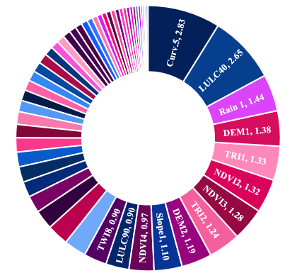
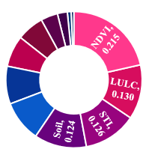
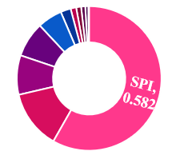
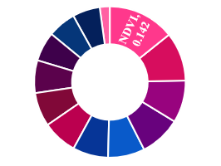
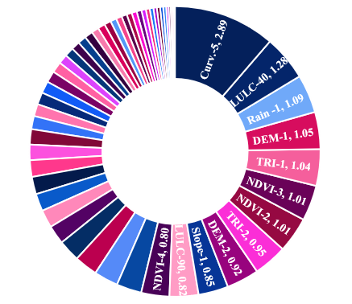
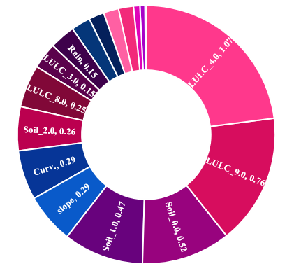
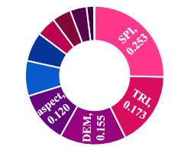
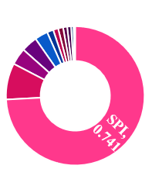
Weights
LR & GAM
FR
WoE
  CV
  SE
  RF
  CE
  AdaBoost
4
Hybrid Data-Driven and Enhanced AHP Framework for Flood Susceptibility Mapping, EGU26 | Amirhossein Haddadi (amir.haddadi81@sharif.edu), Ammar Safaie (asafaie@sharif.edu)

Slide 6
Input Layers
The input spatial layers were prepared at different spatial resolutions, including 10 m, 30 m, and 5.5 km.
All layers were subsequently resampled to a uniform spatial resolution of 10 m using the resampling technique to ensure spatial consistency in the analysis.
It is recommended that future studies apply downscaling approaches and utilize high‑precision, high‑resolution datasets to further improve the accuracy and reliability of the results.
5
Hybrid Data-Driven and Enhanced AHP Framework for Flood Susceptibility Mapping, EGU26 | Amirhossein Haddadi (amir.haddadi81@sharif.edu), Ammar Safaie (asafaie@sharif.edu)

Slide 7
Data-Driven AHP performance
7
Hybrid Data-Driven and Enhanced AHP Framework for Flood Susceptibility Mapping, EGU26 | Amirhossein Haddadi (amir.haddadi81@sharif.edu), Ammar Safaie (asafaie@sharif.edu)

Slide 8
Full Comparison Results
Model / Method | Type | Main Strengths | Main Limitations | Spatial Pattern in Susceptibility Map | Overall Performance
CV (Coefficient of Variation) | Unsupervised statistical weighting | Simple, objective weighting based on variability of factors; useful when flood inventory data are limited | May overemphasize highly variable factors and does not directly use flood occurrence data | Produces strong contrast between susceptibility classes; highlights broad high‑risk zones | Moderate reliability for preliminary susceptibility mapping
Shannon Entropy | Unsupervised information‑based weighting | Measures information contribution of each conditioning factor; balanced weight distribution | Limited ability to represent complex relationships between factors | Generates smoother and more balanced susceptibility classes across the basin | Moderate performance with stable spatial patterns
Entropy‑CRITIC | Hybrid objective weighting (Entropy + criteria conflict) | Considers both information content and correlation between factors; reduces redundancy among variables | Still independent of actual flood occurrence data | Produces more balanced and consistent spatial patterns compared to other unsupervised methods | Relatively more reliable among unsupervised approaches
Logistic Regression (LR) | Supervised statistical model | Easy interpretation, computationally efficient, clear relationship between predictors and flood probability | Assumes linear relationship between variables and flood occurrence | Produces relatively generalized susceptibility zones with smoother transitions | Good baseline predictive performance
Generalized Additive Model (GAM) | Supervised semi‑parametric statistical model | Captures nonlinear relationships using smooth functions; better representation of environmental processes | More complex interpretation and higher computational demand | Shows more detailed spatial variability and localized susceptibility patterns | Higher predictive capability than LR
AdaBoost | Supervised ensemble machine learning (boosting) | Improves weak learners by focusing on misclassified samples; capable of detecting subtle patterns | Sensitive to noise and outliers in the dataset | Produces fragmented and locally variable susceptibility zones | Good predictive ability but less stable than RF
Random Forest (RF) | Supervised ensemble machine learning (bagging) | High accuracy, robust to noise, captures complex interactions between variables | Less interpretable than statistical models | Identifies high‑risk river corridors, historically flooded areas, and high‑rainfall mountainous regions clearly | Highest overall performance and spatial reliability
Frequency Ratio (FR) | Supervised bivariate statistical model | Simple implementation; directly relates conditioning factors to historical flood occurrence | Assumes independence between variables; cannot model interactions between factors | Clearly highlights areas where floods historically occurred | Good predictive ability but limited in handling complex relationships
Weight of Evidence (WoE) | Supervised bivariate probabilistic model | Based on Bayesian probability; evaluates positive and negative influence of each factor class | Requires conditional independence between predictors; sensitive to correlated variables | Produces clear probabilistic separation between low and high susceptibility zones | Reliable statistical performance when assumptions are satisfied
8
Hybrid Data-Driven and Enhanced AHP Framework for Flood Susceptibility Mapping, EGU26 | Amirhossein Haddadi (amir.haddadi81@sharif.edu), Ammar Safaie (asafaie@sharif.edu)

Slide 9
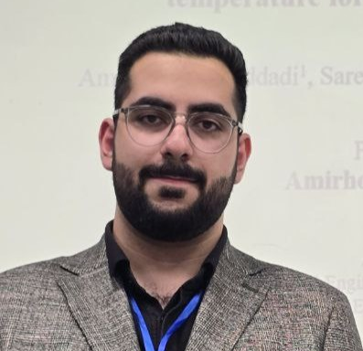



Thank You for Your Attention!
Hybrid Data-Driven and Enhanced AHP Framework for Flood Susceptibility Mapping, EGU26
By Amirhossein Haddadi (amir.haddadi81@sharif.edu) and Ammar Safaie (asafaie@sharif.edu)
Amirhossein Haddadi
M.Sc. Student, Department of Civil Engineering
Sharif University of Technology
LinkedIn: https://www.linkedin.com/in/amirhossein-haddadi-aa8b54282/
Google Scholar: https://scholar.google.com/citations?hl=en&user=wqig0OcAAAAJ
E-mail: amir.haddadi81@sharif.edu | amir0haddadi@gmail.com

