Slide 1

Early Forecasting of Crop Irrigation for Sustainable Water Use with Satellite Data and Machine Learning
Presenting Author: Sarfraz Munir - Senior Regional Researcher, IWMI
Email: s.munir@cgiar.org

Slide 2


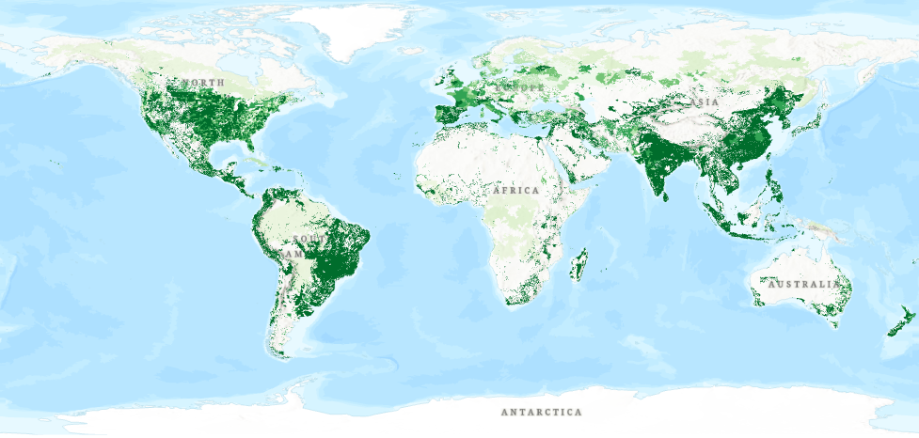







Irrigated Agriculture – Global Perspective
Irrigated agriculture uses 72% of global freshwater withdrawals (FAO, 2023)
30–100% higher yields in irrigated areas compared to rainfed (UNESCO, 2024)
40% global agriculture production comes from 20% of agriculture land (FAO/OECD, 2021)
Global Irrigated Area - FAO (V 5.0)
By 2050, 50% more food (than 2012) is needed to meet global demands of growing population (FAO, 2018, 2021)
Innovative irrigation management is key contributor to global food security and rural livelihoods under climate change

Slide 3
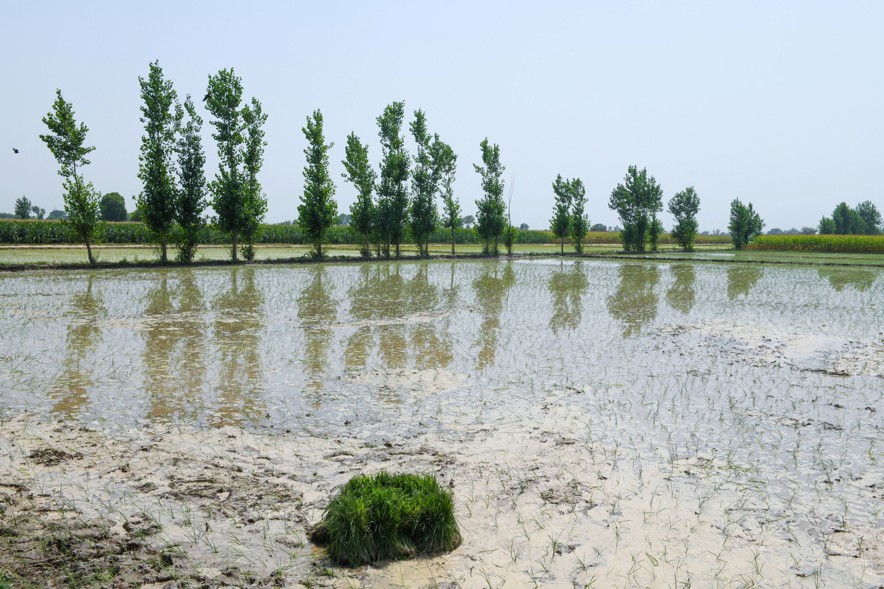
Application of Irrigation Demand Management (IDM) to Improve Water Productivity
Why does it matter?
Warabandi (Rotational time-sharing system)
Climate variability & irrigation cycles
Groundwater resources depletion
Low water productivity
Seasonal crop water requirements are not aligned with fixed water delivery schedules
What’s Driving the Urgency
The Warabandi Challenge
Research Gaps
Pakistan's IBIS operates under a supply-driven rotational schedule (warabandi), allocating water in fixed proportions regardless of crop type, growth stage, or actual evaporative demand. Result: Chronic over-irrigation causes waterlogging and soil salinization across 6.19 million ha; acute under-irrigation damages crops at peak growth stages.
Existing ML studies target yield estimation, not irrigation scheduling
Limited Biophysical models assume fixed schedules; focus on broad trends, not crop-stage-specific demand
Limited studies integrate EO + climate forecasting framework at field scale
Lack of user-oriented tools translating model outputs for farmers

Slide 4
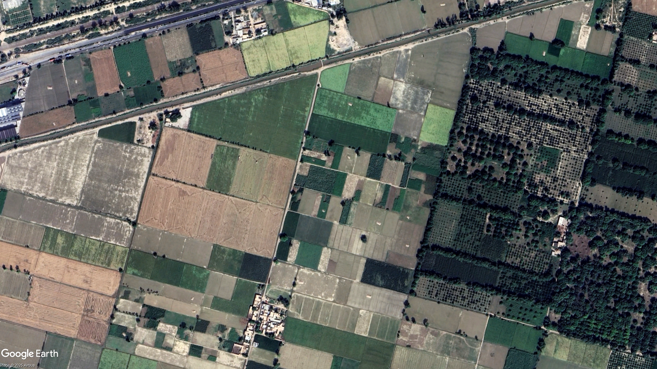
Material and Methods
Remote Sensing and Data Mining based Approach

Slide 5
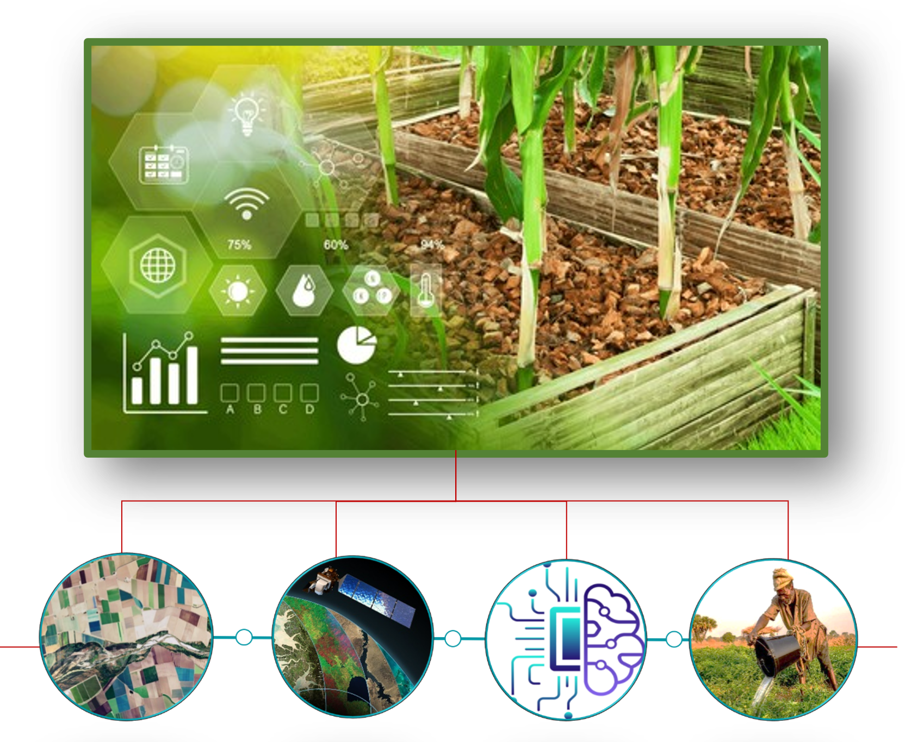
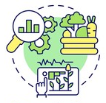
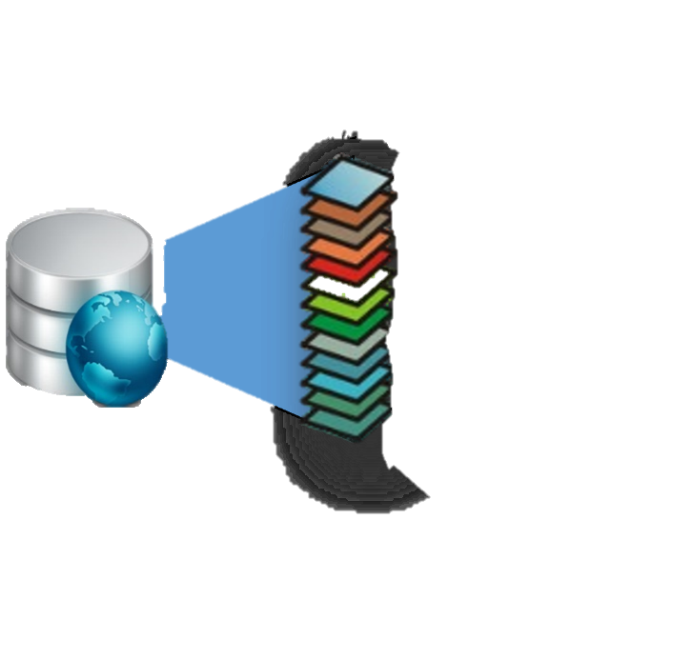





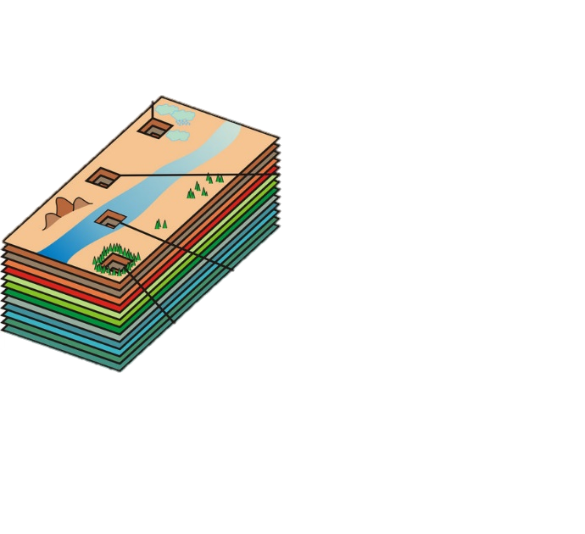
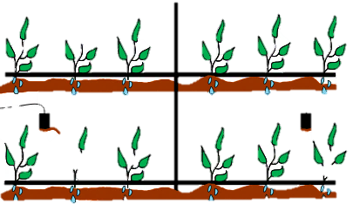
Methods: Application of Irrigation Demand Forecasting (IDF) to Improve Water Productivity
Use EO and climate data to develop a short-term irrigation forecasting model using data mining approaches.
Combine meteorological forecasts with EO indicators for inform irrigation management scheduling practices.
Translate model outputs into user-oriented tools or dashboards that provide clear, advance irrigation guidance for farmers and water managers.
oil Moisture Sensor
Satellite Parameters
(Landsat + PlanetScope)
LST, NDVI, SAVI,
LULC, Net Radiations
(Spatial temporal scales)
Database development and Processing
Google Earth Engine integrated with Colab for model development.
Forecasting Approach
Crop water requirement (ET) with CNNs networks and Machine Learning models.
GEE based EO data to forecast satellite inputs to generate irrigation crop water demand.
Target users: Smallholder farmers and irrigation planners' timely irrigation decisions.

Slide 6
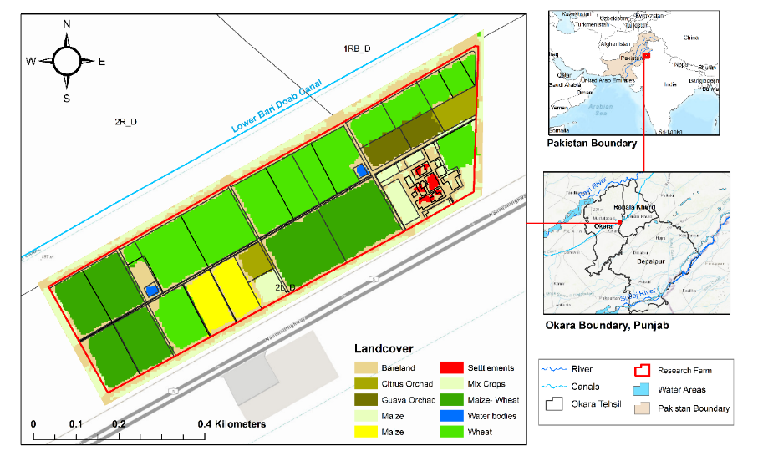
Study Area
The study was conducted at the Water Management Research Farm (WMRF), located at 30°52'N, 73°36'E in Renala Khurd, district Okara, Punjab, Pakistan.
The farm covers with diverse crops wheat, rice, maize, potato, guava, and mixed orchards representative of central Punjab irrigated plains , and is equipped with a continuously operating EC flux tower providing independent ETa ground-truth

Slide 7
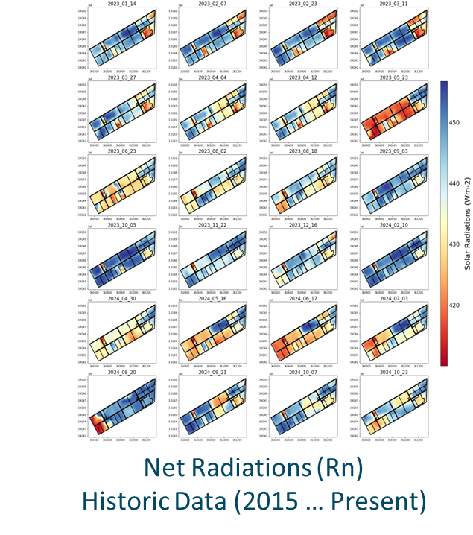
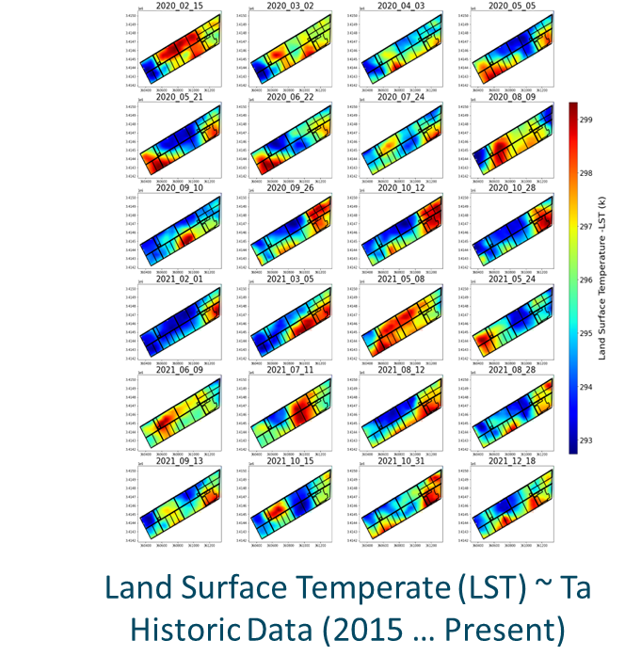
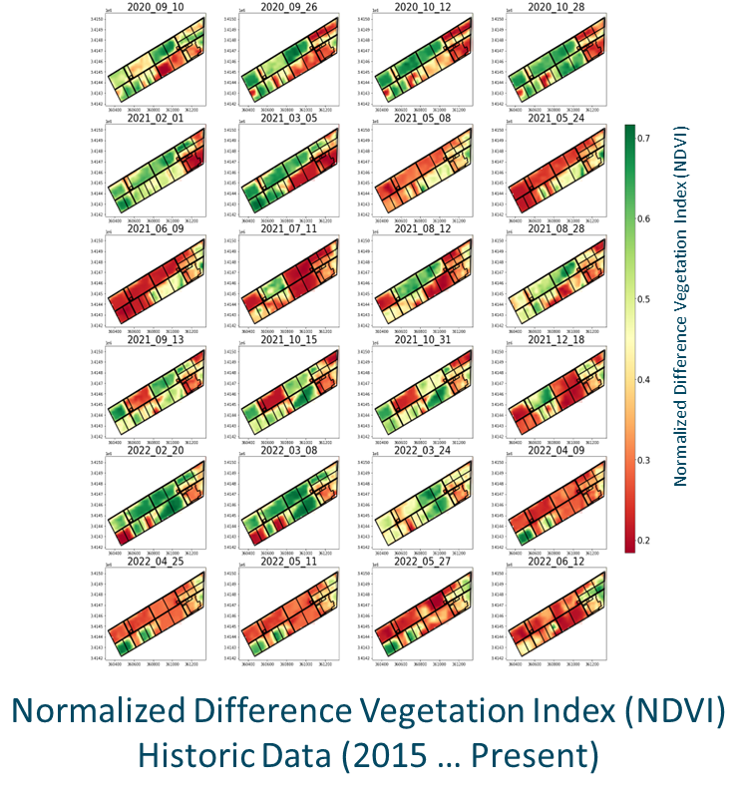
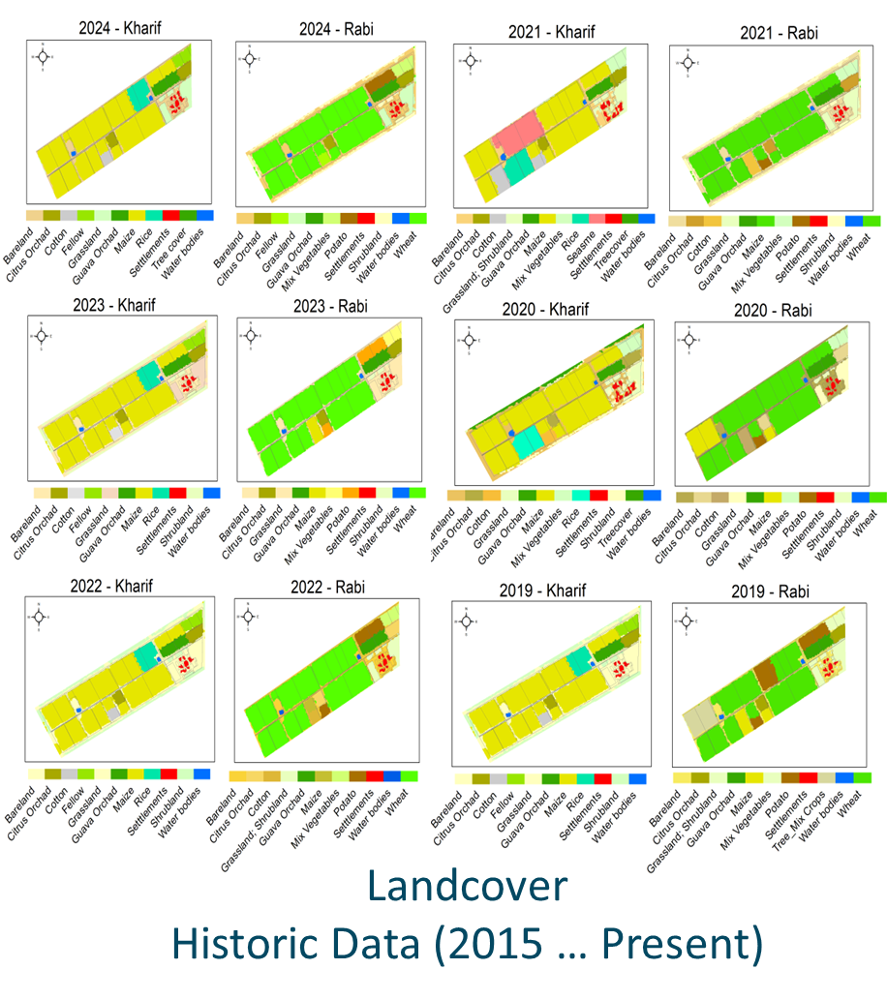


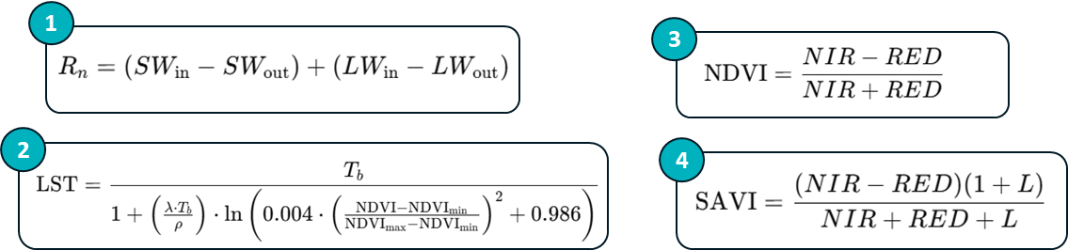
Methods: Application of Irrigation Demand Forecasting (IDF)
EO Parameters (Landsat & PlanetScope)
Normalized Difference Vegetation Index (NDVI)
Soil adjusted vegetation index (SAVI)
Net Radiations (Rn)
Land Surface Temperature (LST)
Landcover – crops spectral signatures (PlanetScope)
Crop Calendar (Sowing and Harvesting Periods)
~ Crop water requirement (Evapotranspiration) based on Landcover

Slide 8
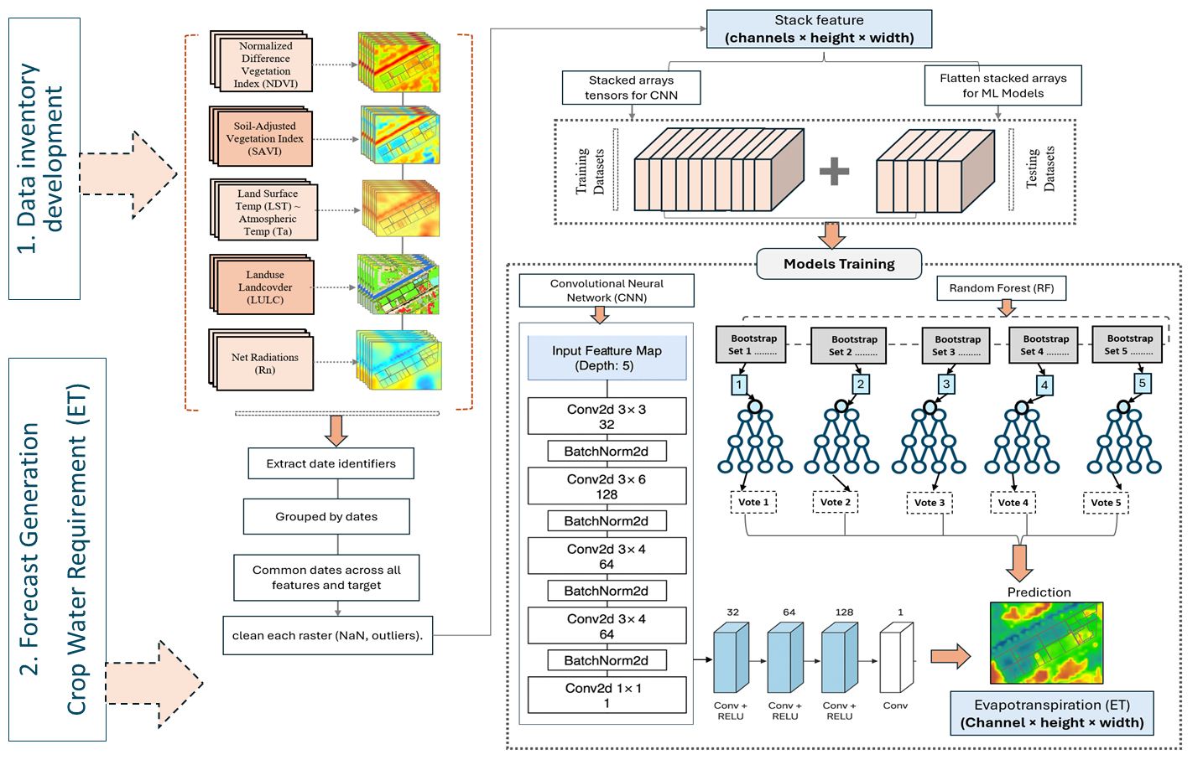
Methodology: Flow Diagram

Slide 9
Results and Outcomes
Remote Sensing and Data Mining based Approach

Slide 10
Results: Spatio-temporal Dynamics of Biophysical Variables (2015–2025)
r = 0.95
LST ↔ Rn
R² = 0.75
ETa ↔ NDVI
Strong positive correlation — radiation drives surface temp in semi-arid irrigated system
Canopy density governs crop water use during growing seasons
r = 0.97
NDVI ↔ SAVI
r = 0.83
ETa ↔ Rn
High multicollinearity — addressed with VIF analysis during feature selection
Radiation dominates crop water use, confirming SEBAL energy balance physics

Slide 11
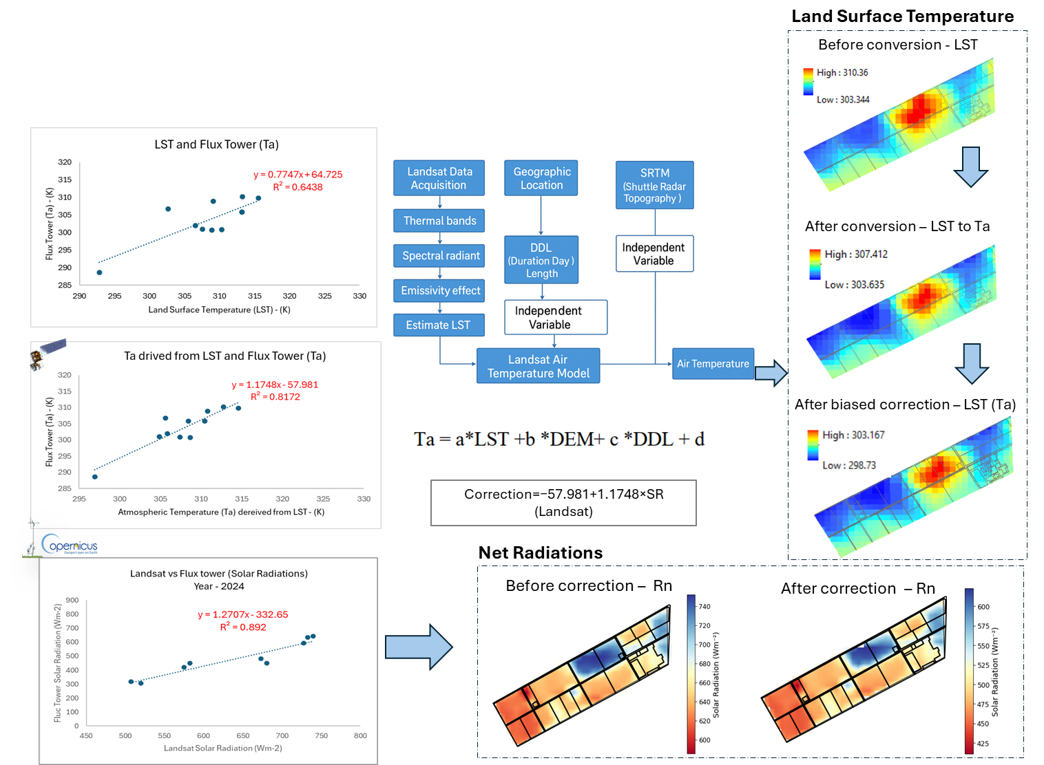
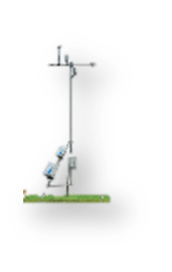
Validation: Input Parameters
Results: Application of Irrigation Demand Forecasting (IDF) to Improve Water Productivity
Land Surface Temperature (LST)
Net Radiations (Rn)
Landcover
Eddy Covariance Flux Tower

Slide 12
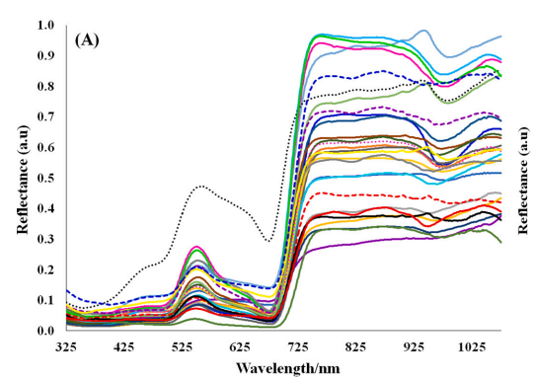
Results: Seasonal ETa Patterns & Inter-variable Relationships
Kharif Peak: 7.5 mm/day
June–August: rice transplanting + peak solar radiation
Rabi Minimum: 1.2 mm/day
December–February: winter wheat, low solar input
ETa ↔ Rn: r = 0.83
Radiation is the dominant driver of crop water use
ETa ↔ NDVI: r = 0.81
Canopy density (vegetation cover) governs transpiration
LULC & Cropping Pattern Dynamics
Dominant system: Wheat–rice and wheat–maize bimodal rotations Classification accuracy: ~91% (stratified ground-truth sampling) Temporal stability: Dominant cropping systems stable over 2015–2025 decade, confirming reliability of bimodal Kharif–Rabi cycle as ETa modelling structure

Slide 13
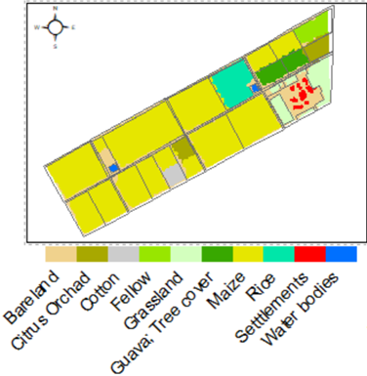
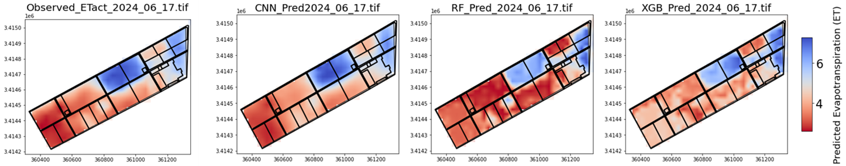
Kharif Season: Date: 2024-June-17
Results: Application of Irrigation Demand Forecasting (IDF) to Improve Water Productivity
Landcover Information - Kharif
Crop (acre/mm/day) | PySEBAL (ET) | XGB Boost (ET) | CNN (ET) | RF (ET) | Flux Tower (ET)
Rice | 6.370 | 5.95 | 6.798 | 5.022 | 6.99
Maize | 2.88 | 3.69 | 4.15 | 3.04 | 4.54
Guava Orchard | 5.73 | 5.61 | 6.50 | 6.075 | 5.60
Calculated ET
Predicted ET (Data Mining Models)

Slide 14
Results: Model Performance Evaluation
Model | R² | RMSE (mm/day) | MAE (mm/day) | Advantage
CNN | 0.90 | 0.21 | 0.34 | Hierarchical spatial feature extraction
Random Forest | 0.87 | 0.29 | 0.42 | Robust under heterogeneous patches
XGBoost | 0.84 | 0.35 | 0.48 | Efficient tabular feature handling

Slide 15
Field-Scale Validation vs. Eddy Covariance Flux Tower
Date / Crop | CNN | Flux Tower | ΔET
Jan 2022 — Wheat | 2.01 | 1.99 | +0.02
Feb 2023 — Wheat | 3.46 | 3.54 | −0.08
May 2024 — Rice | 4.46 | 4.54 | −0.08
Aug 2024 — Rice | 6.50 | 5.60 | +0.90
Oct 2024 — Rice | 1.30 | 1.27 | +0.03
Key Findings
CNN accuracy: ETa estimates within 0.02–0.09 mm/day of flux tower for winter wheat and Kharif rice under normal conditions Tree-based models: RF and XGBoost severely underestimated peak Kharif rice demand (3.0–3.1 vs. 4.54 mm/day observed) CNN: Superior spatial feature extraction captures field-level ET dynamics that pixel-wise models miss

Slide 16
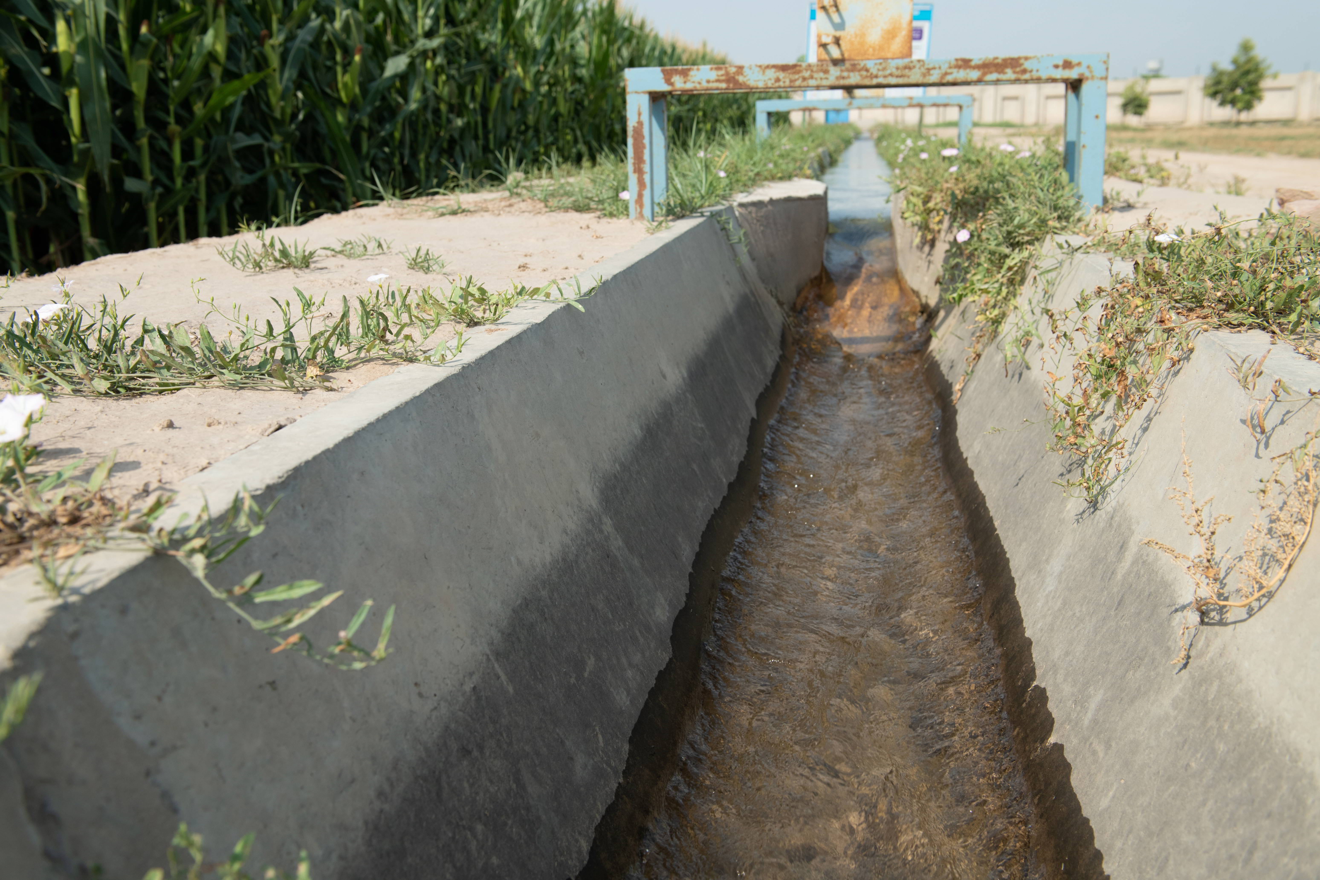
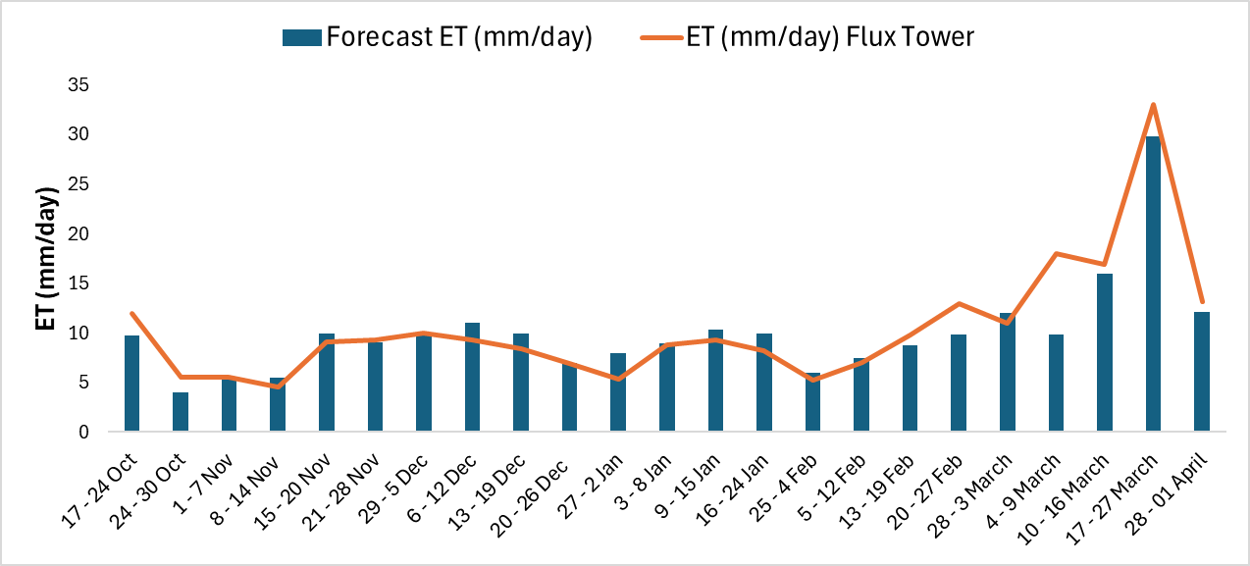
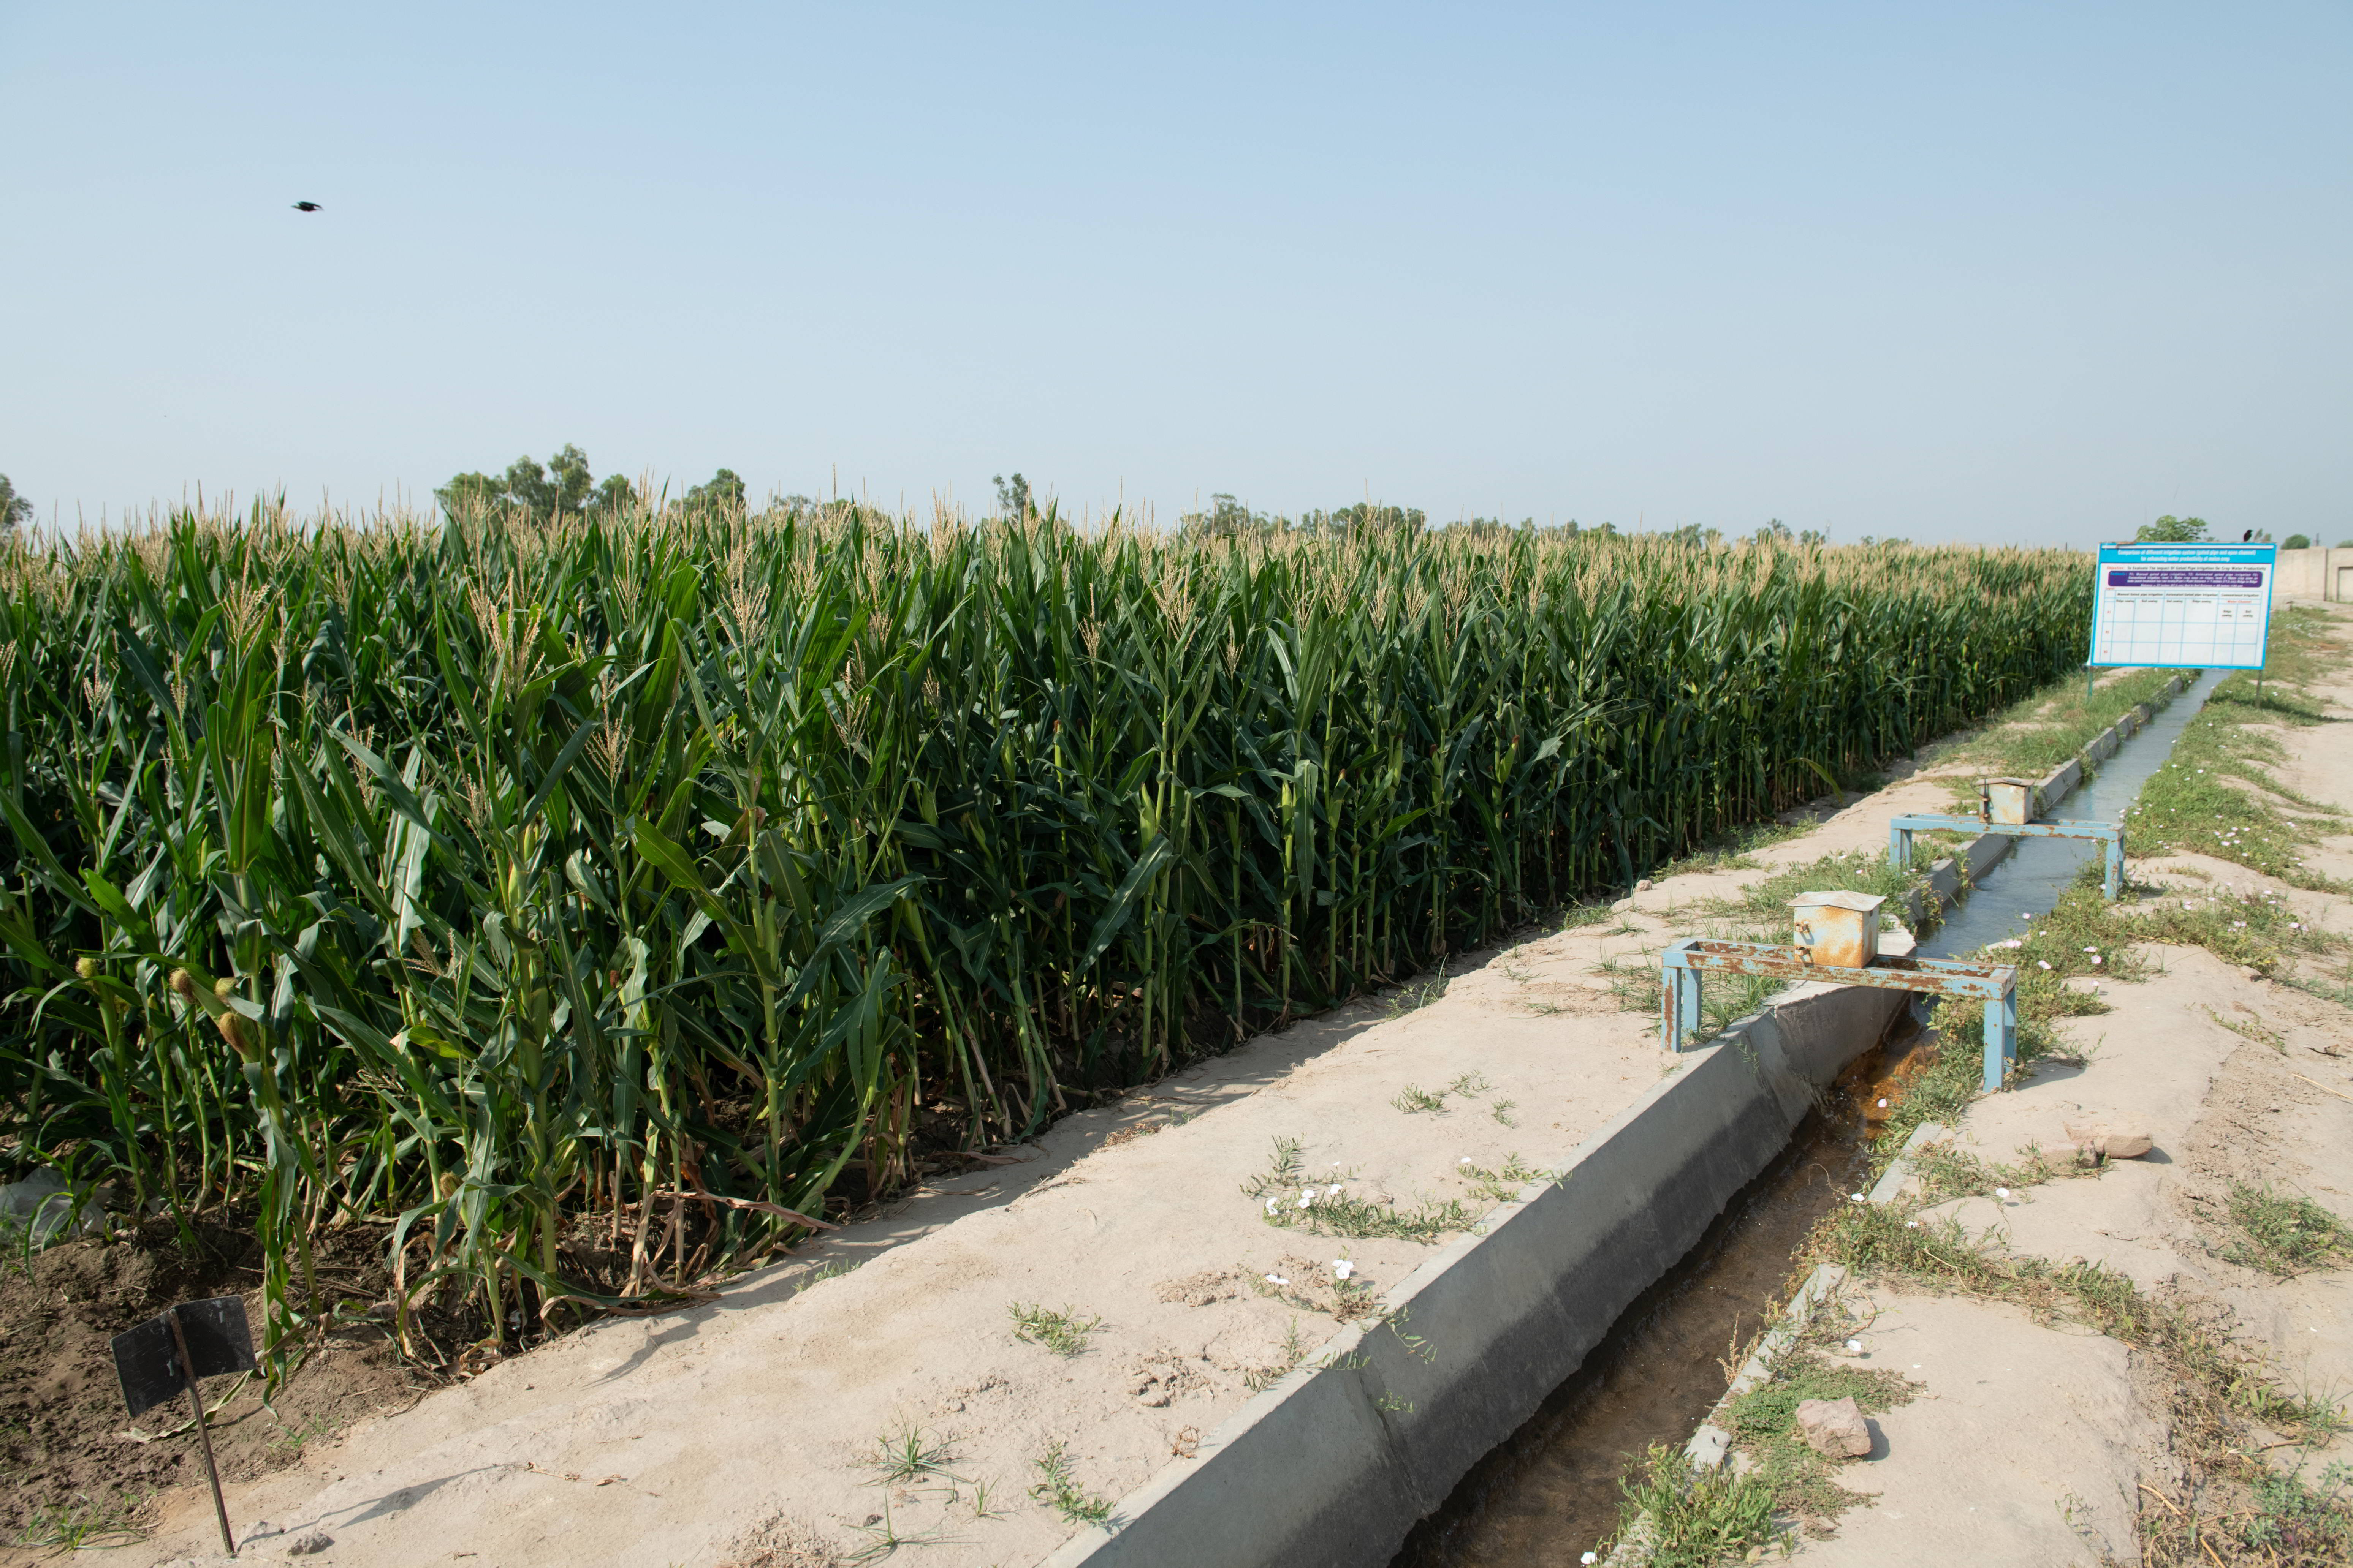
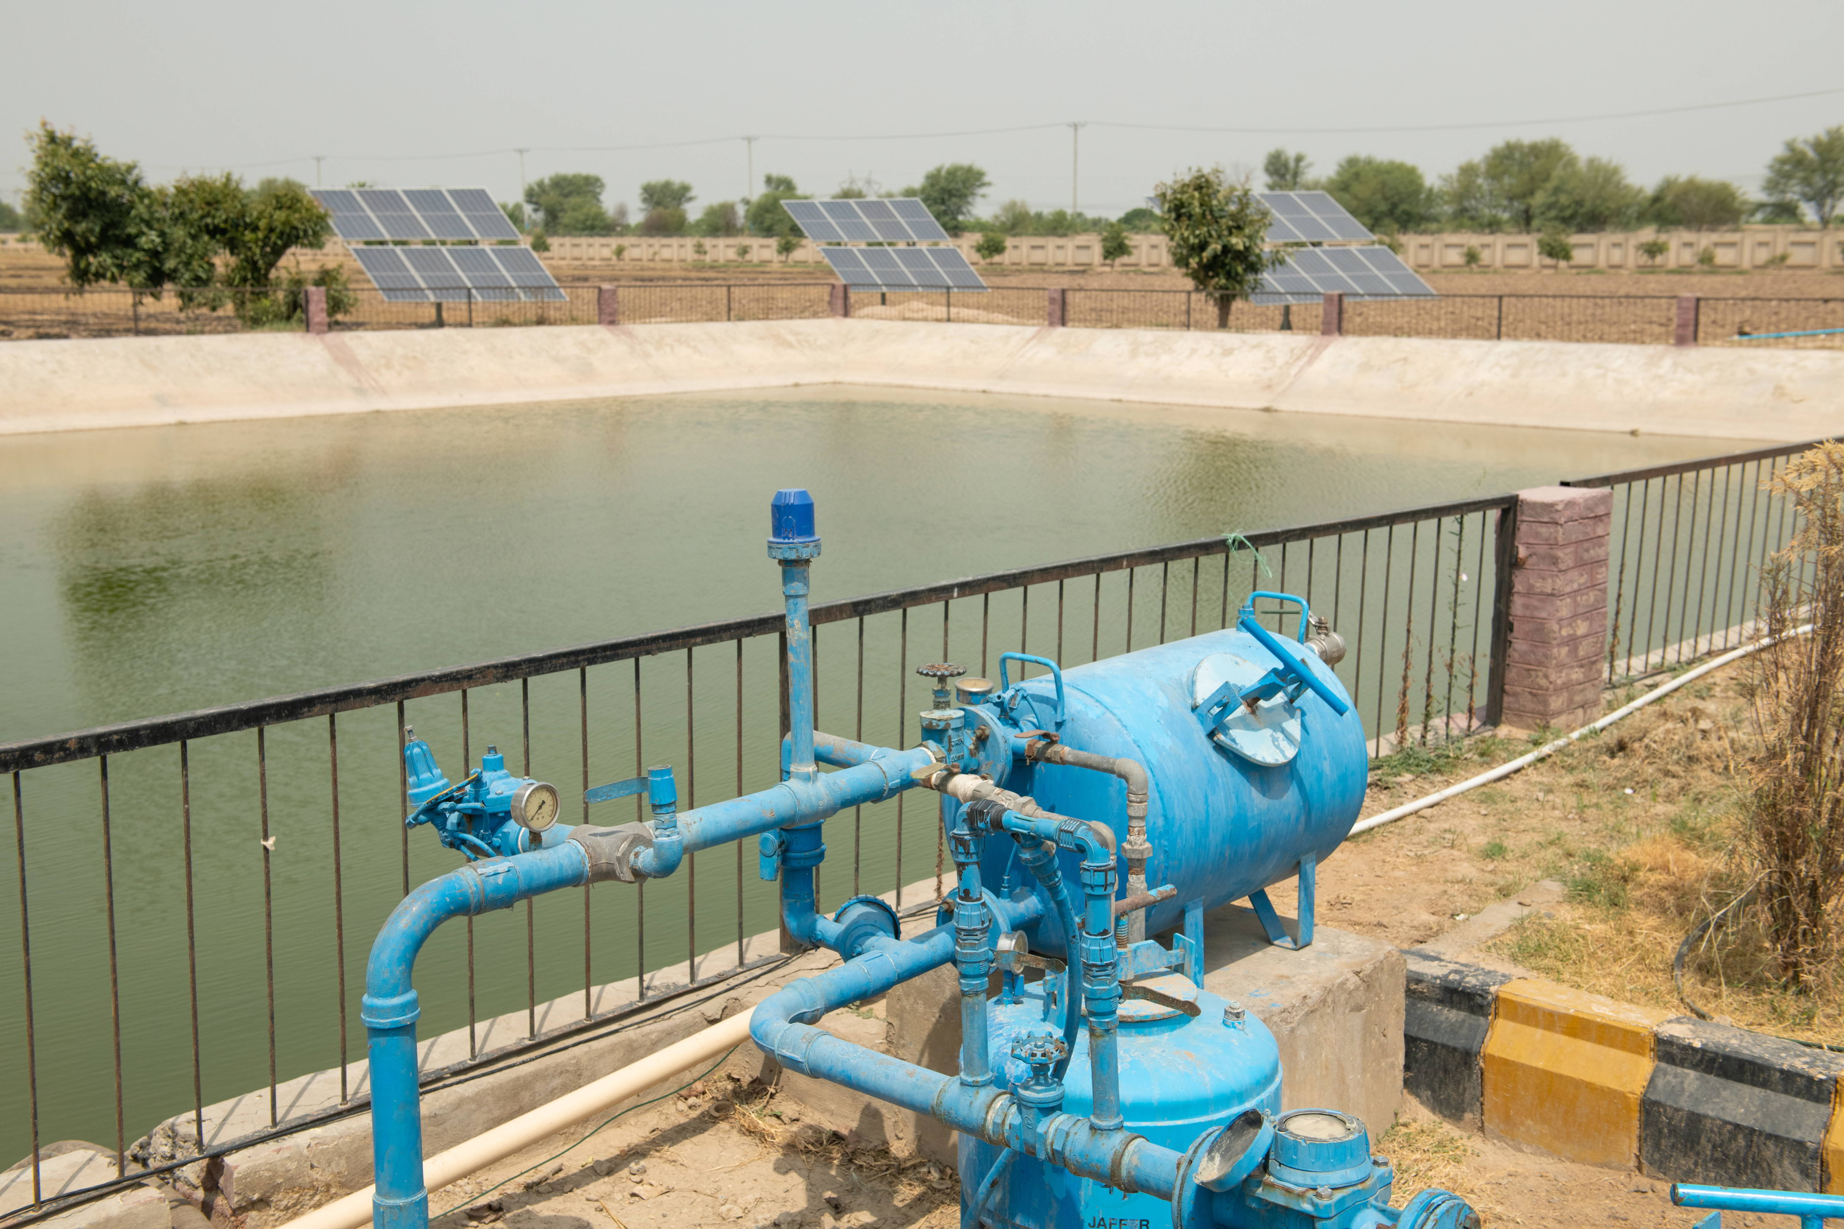
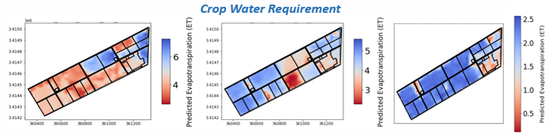
Weekly Forecast vs. Actual ET (mm/day)
Application of Irrigation Demand Forecasting (IDF) to Improve Water Productivity
Ground Truthing and Validation
Time (Week) | Weekly Forecast ET (mm/day) | ET (mm/day) Flux Tower
17 - 24 Oct | 9.7 | 12
24 - 30 Oct | 3.99 | 5.5
1 - 7 Nov | 5.34 | 5.53
8 - 14 Nov | 5.53 | 4.53
15 - 20 Nov | 9.97 | 9.1
21 - 28 Nov | 9.03 | 9.29
29 - 5 Dec | 10.01 | 9.97
6 - 12 Dec | 11 | 9.32
13 - 19 Dec | 9.98 | 8.39
20 - 26 Dec | 6.99 | 6.89
27 - 2 Jan | 7.99 | 5.3
3 - 8 Jan | 8.98 | 8.8
9 - 15 Jan | 10.32 | 9.26
16 - 24 Jan | 9.98 | 8.24
25 - 4 Feb | 5.99 | 5.24
5 - 12 Feb | 7.44 | 6.99
13 - 19 Feb | 8.8 | 9.8
20 - 27 Feb | 9.87 | 13
28 - 3 March | 12 | 11
4 - 9 March | 9.86 | 18
10 - 16 March | 16 | 16.89
17 - 27 March | 29.87 | 33
28 - 01 April | 12.12 | 13.15

Slide 17
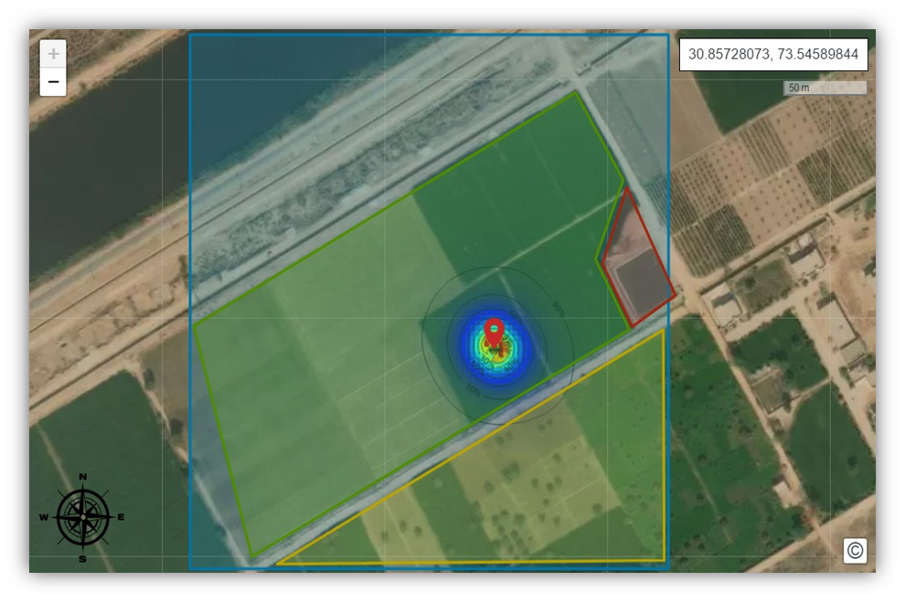
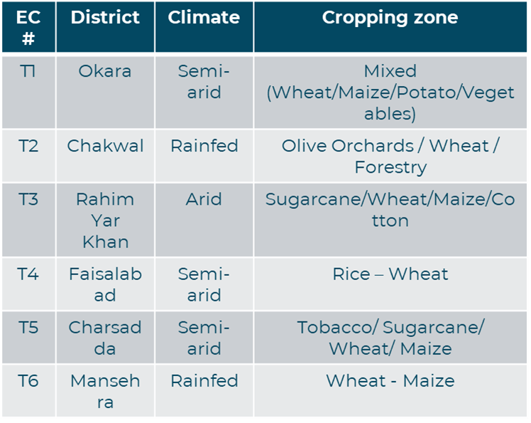
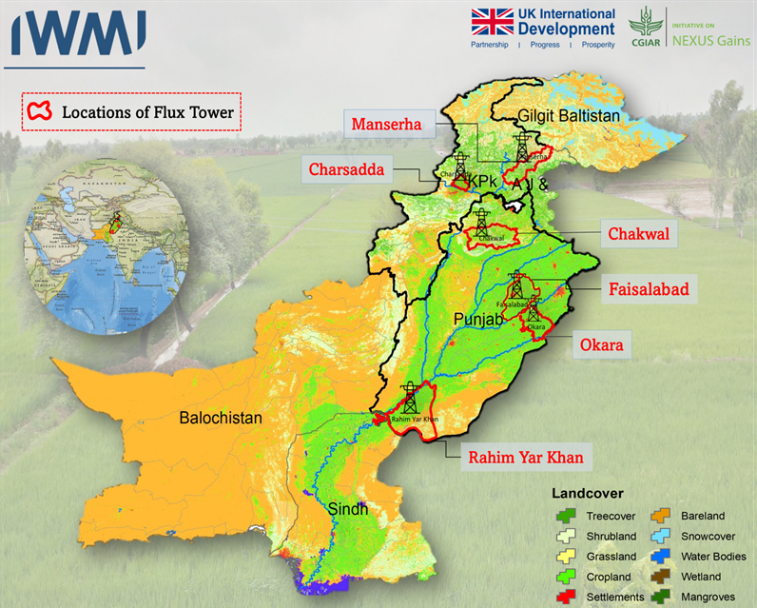
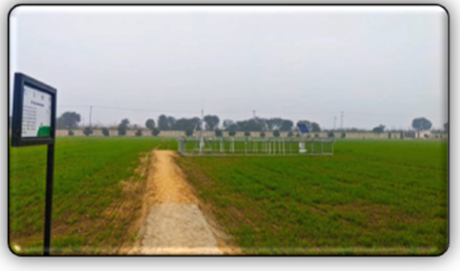
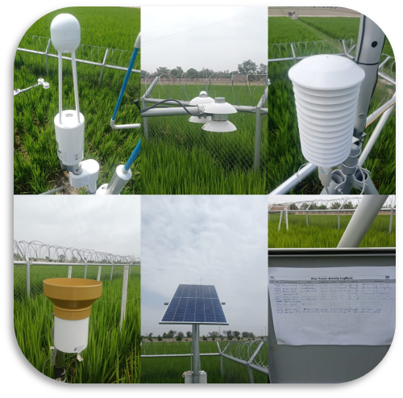
Application of Irrigation Demand Forecasting (IDF) to Improve Water Productivity
Fluxes Footprint Analysis and Allocation
EC Flux System
Four EC Flux system have been installed in Punjab Pakistan and operational since 2023.
Two more EC Flux system will be installed in the heterogenous regions of KPK.
Two EC systems have been equipped with Methane Gas Analysers in Rice-Wheat & Mixed regions.

Slide 18
Conclusion
01
CNN outperforms RF and XGBoost: R² = 0.90, RMSE = 0.21 mm/day, MAE = 0.34 mm/day — a 3–10% improvement in R² over tree-based models.
02
Field-scale validation: CNN ETa estimates within 0.02–0.09 mm/day of eddy covariance flux tower for wheat and rice under normal conditions.
03
Operational forecast skill: Weekly cumulative ETa (R² = 0.934, NSE = 0.865, KGE = 0.909, PBIAS = −2.59%), with only 15.7 mm seasonal difference.
04
Strategic framework: Translates weekly ETa into crop-specific advisories, adaptive warabandi scheduling, and conjunctive groundwater management.
05
Scalable template: WMRF methodology replicable across South Asia's water-stressed canal irrigation systems.

Slide 19

Thank You

