Slide 1
Plucked Apart: Grain-Scale Mechanics of Mafic Enclave Disintegration
Jakob Scheel¹, Michael Gardner², Philipp Ruprecht¹
¹Department of Geological Sciences and Engineering, University of Nevada, Reno
²Department of Civil and Environmental Engineering, University of California, Davis
This research is being supported by the National Science Foundation (NSF) grant 2122789
Notes:
Enclaves record:
Mafic enclaves are the 'black boxes' of magmatic systems.
record the moment mafic recharge meets a silicic reservoir
an event that often triggers volcanic eruptions that we see at the surface.
Their fate and survival:
Question: what determines the enclave's fate?
discrete blobs, or vanish into the host magma?

Slide 2
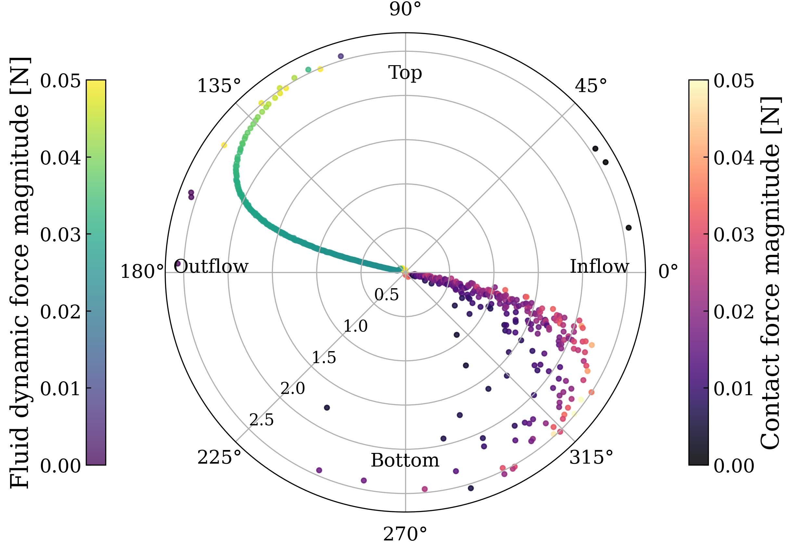
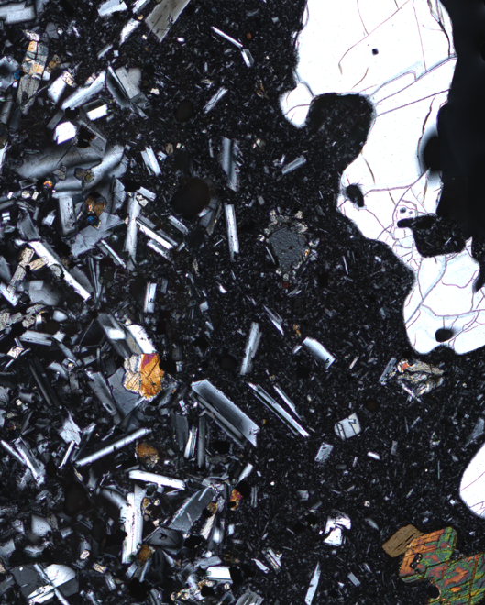
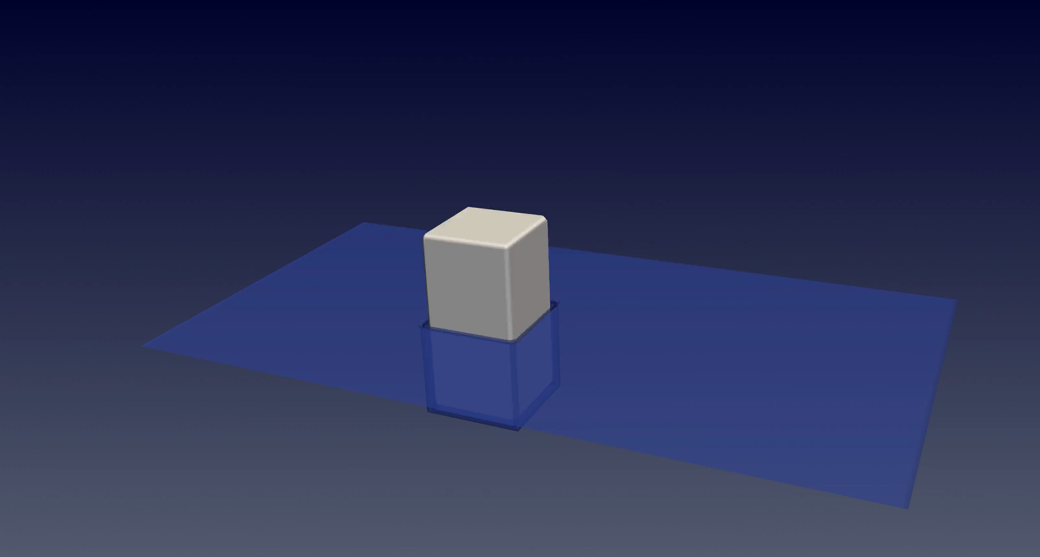
Overview
Grain-scale plucking model
Enclave
Host
Notes:
Complex boundary on micro-photograph:
micro-photograph, we see complex boundaries between an enclave and the host where crystals are literally on the verge of being lost
We hypothize that a magmatic shear flow in the host leads to crystal plucking and enclave disintegration over time
numerical approach & plucking simulation
understand this, we’ve developed a new numerical approach using a coupled Lattice Boltzmann and Discrete Element Method model

Slide 3
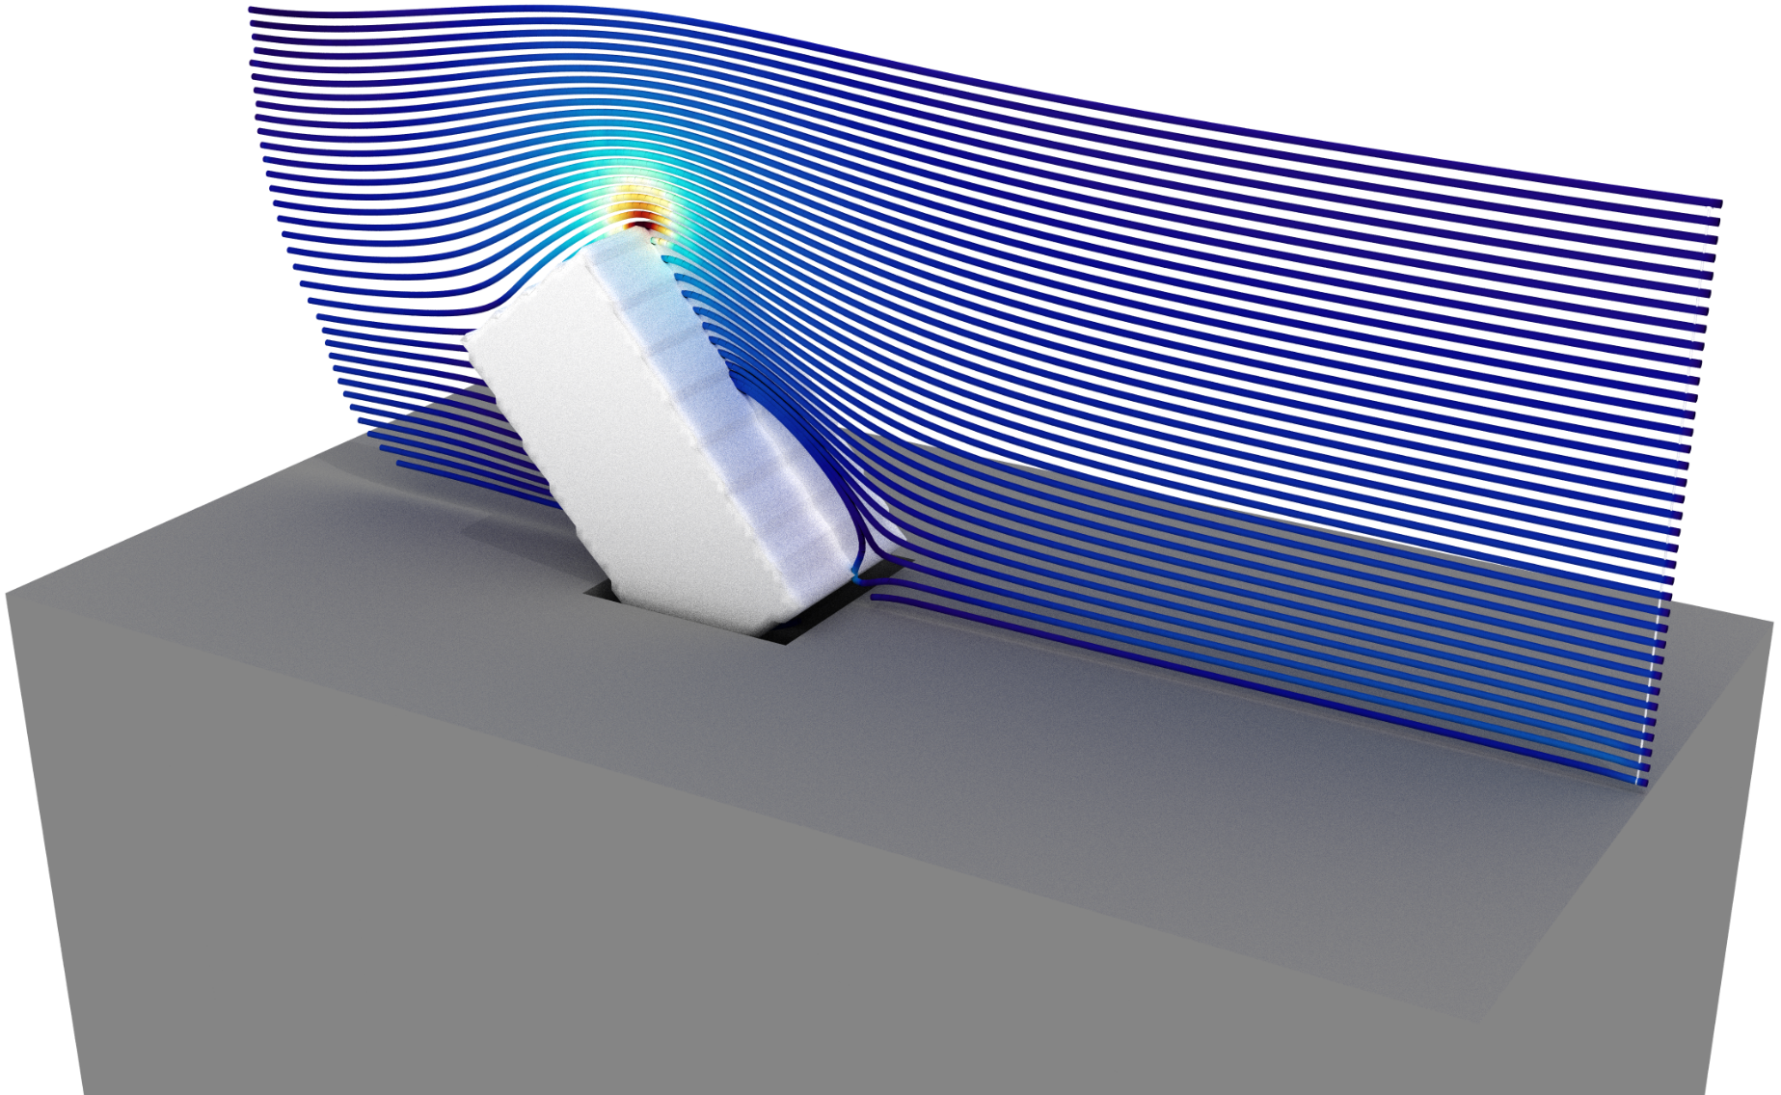
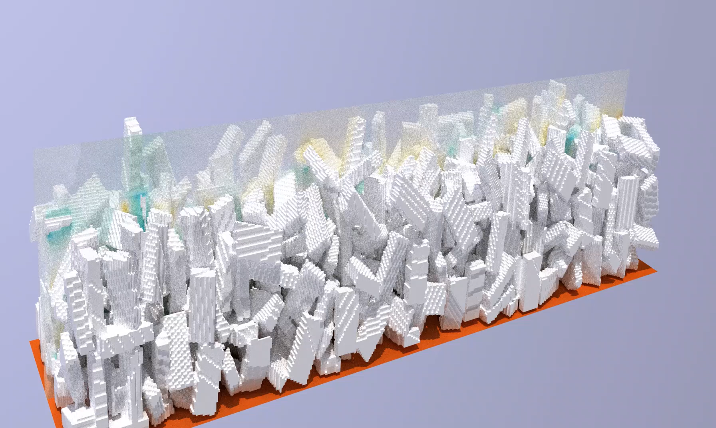
Overview
Multi-particle upscaling
Single crystal plucking
Crystal cumulate erosion
Notes:
erosion
Using our numerical approach we can then scale up to a multi-particle system, where we see the erosion of crystal cumulate layers.
viscosity
one result: our simulations reveal a surprising regime: at high viscosities, the rate of disintegration becomes viscosity-independent.
Driving factors
survival of the enclave is dictated by two things: the magma velocity and the geometric arrangement of the crystals at the boundary.
Final:
Quantifying these grain-scale mechanics allows us to predict hybridization rates and better constrain magma residence times in the crust.

Slide 4
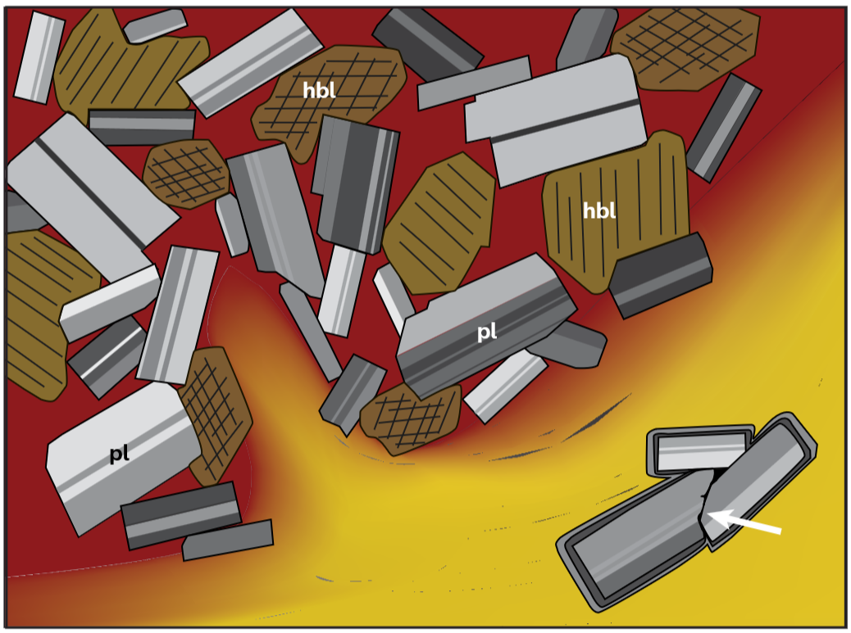
Erosion in Magmatic Systems
Grain-scale erosion
Enclave
Host
Humphreys et al., (2025)

Slide 5

How to model crystal erosion?
IC & BC: Solid enclave interface, simple crystal intergrowth
Numerical Solver: HLBM
Equations:
Navier-Stokes & Newton-Euler
Material properties: Magma & Crystal
“Cooking Pot”, dreamstime.com

Slide 6
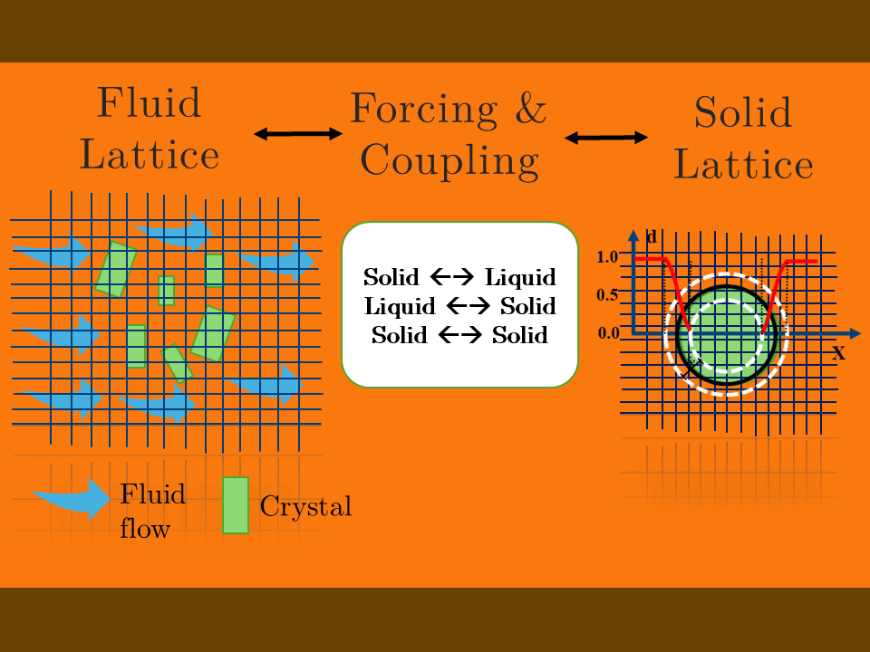
CFD-DEM: Homogenized Lattice Boltzmann
Magma flow: fluid grid
Crystal trajectory: solid grid
Modified from Akter, (2026)

Slide 7
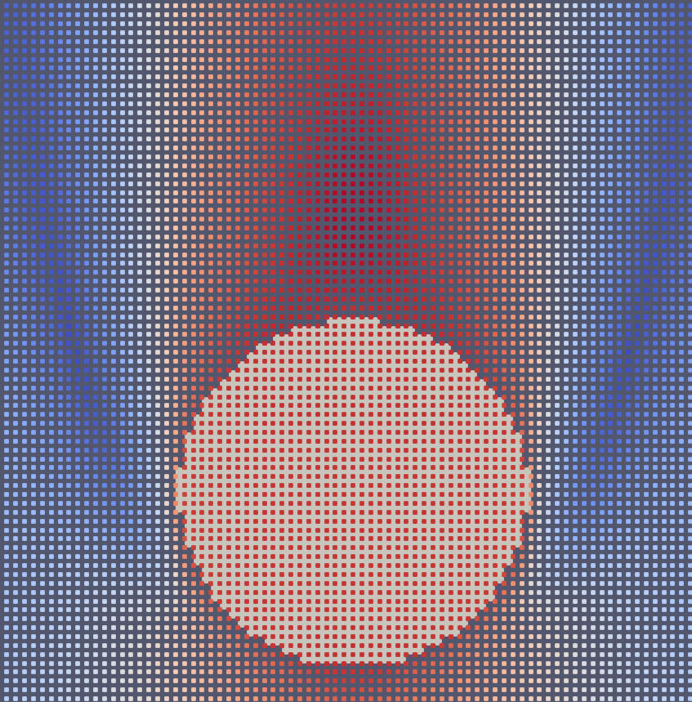
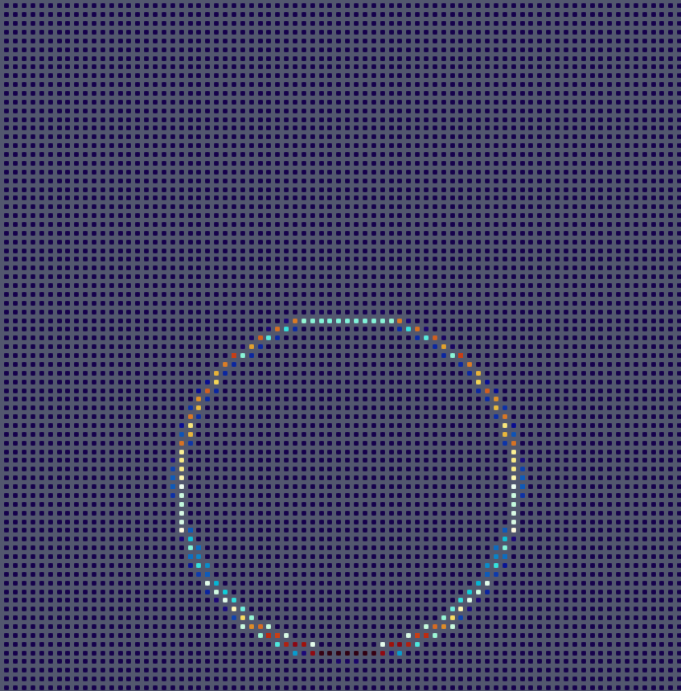
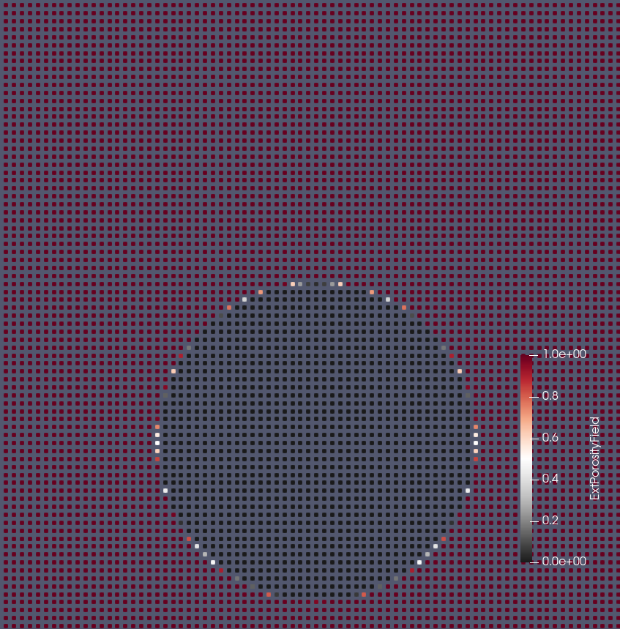
CFD-DEM: Homogenized Lattice Boltzmann
Fluid Grid
Grid Coupling: Momentum Transfer
Particle Grid

Slide 8
Enclave Erosion: Plucking
Enclave
Host

Slide 9

Forces acting on crystal
Host: liquid
Enclave: solid

Slide 10
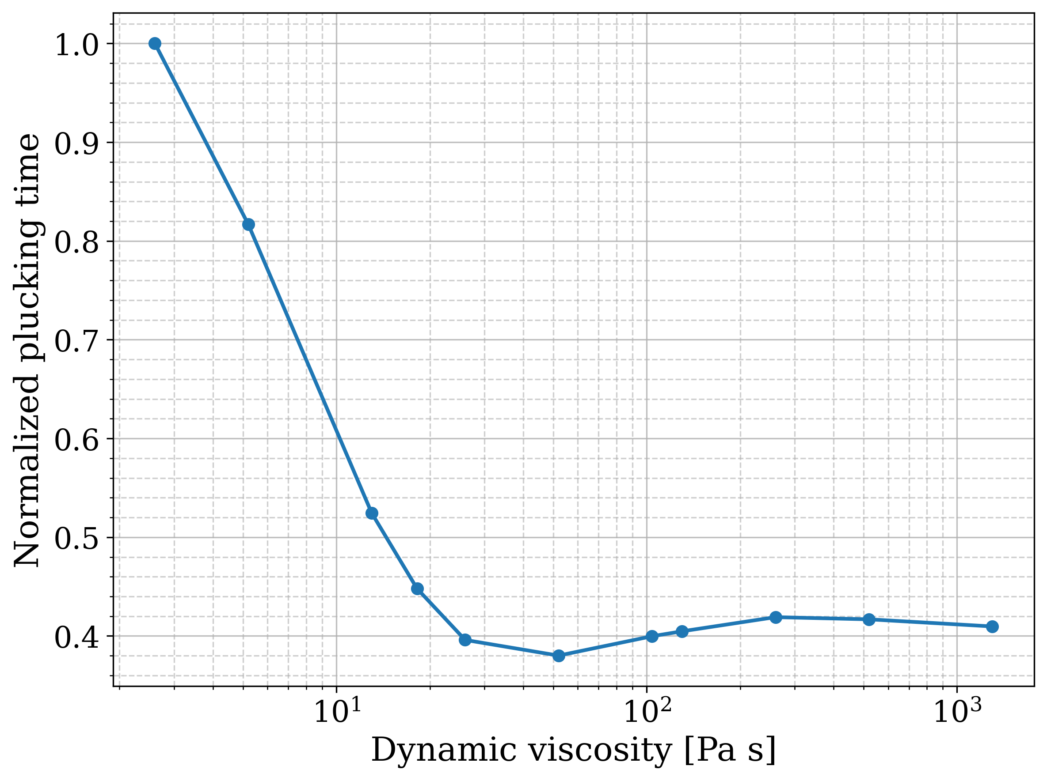
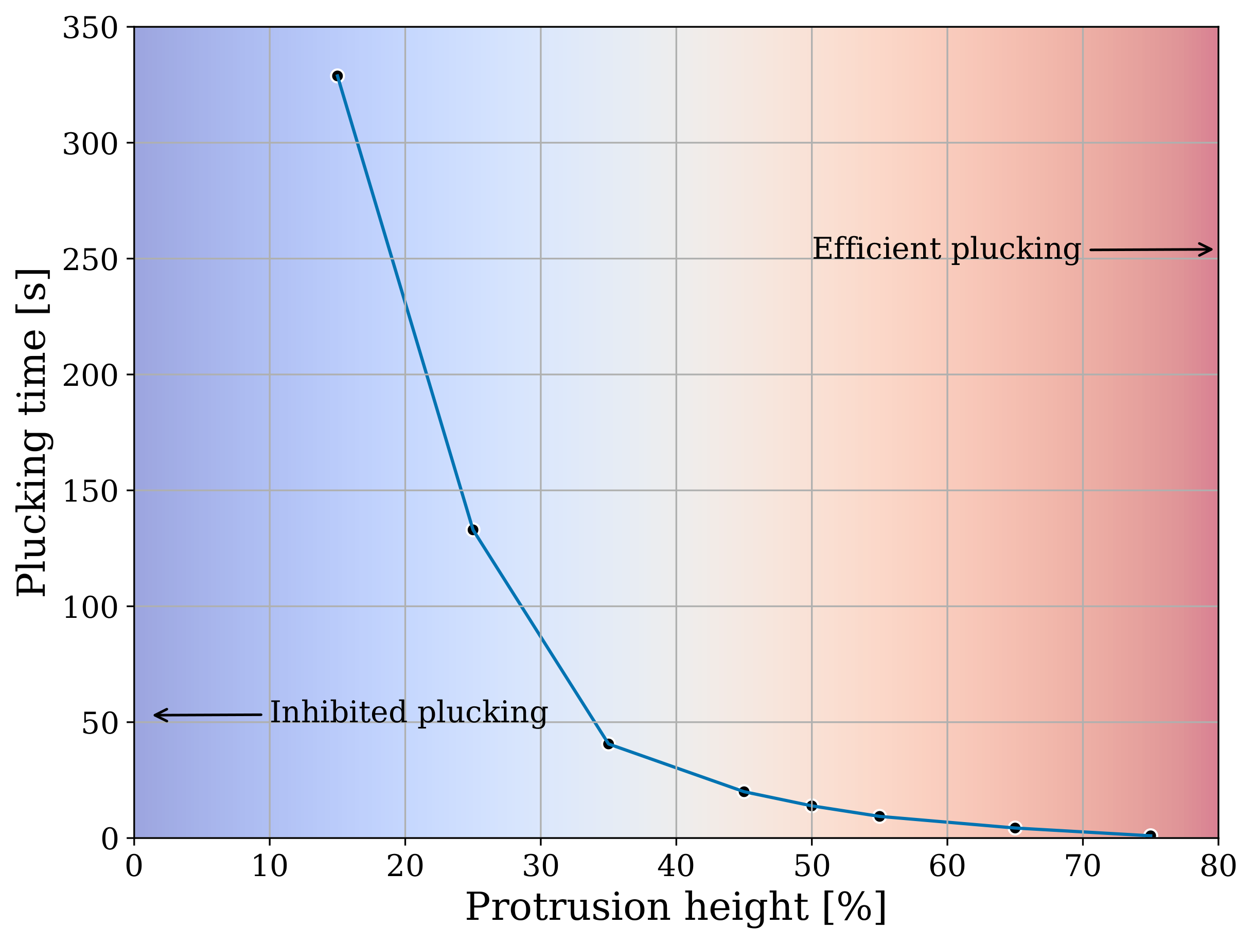
Enclave Erosion: Parameter space
Magmatic viscosity
Notes:
Model viscosity independent in magmatic settings
Geometry and velocity driving factors on micro-scale

Slide 11
Multi-Crystal erosion
Work in progress ☺
Notes:
Add multiple particles to investigate mass erosion rate
this is still work in progress

Slide 12
References
Akter, S. (2026); UC Davis Round Table, Poster Presentation
Humphreys, M. C., Namur, O., Bohrson, W. A., Cooper, G. F., Cooper, K. M. & Spera, F. J. (2025), ‘Crystal mush processes and crustal magmatism’, Nature Reviews Earth & Environment 6

