Slide 1
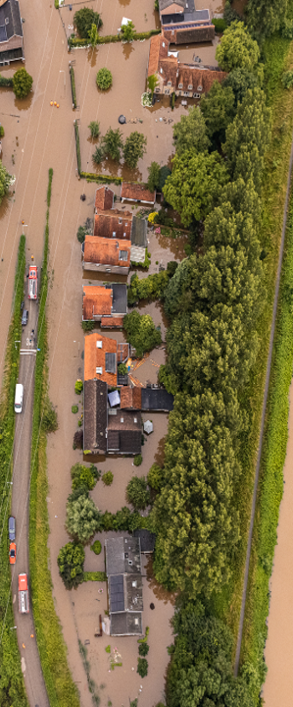




A first exploration of compound events including rainfall and potential adaptation measures in deltas
Dagmar Mennes, Frances Dunn, Hans Middelkoop, David Gold, and Marjolijn Haasnoot
Utrecht University, The Netherlands
Background
Pico navigation
main menu
Compounds event including rainfall
Modeling framework
Arrows can be used to navigate through slides in a subsection
First results
Conclusion
→ online presentation page
Next
EGU 2026
Notes:
Hey who am I what am I doing

Slide 2
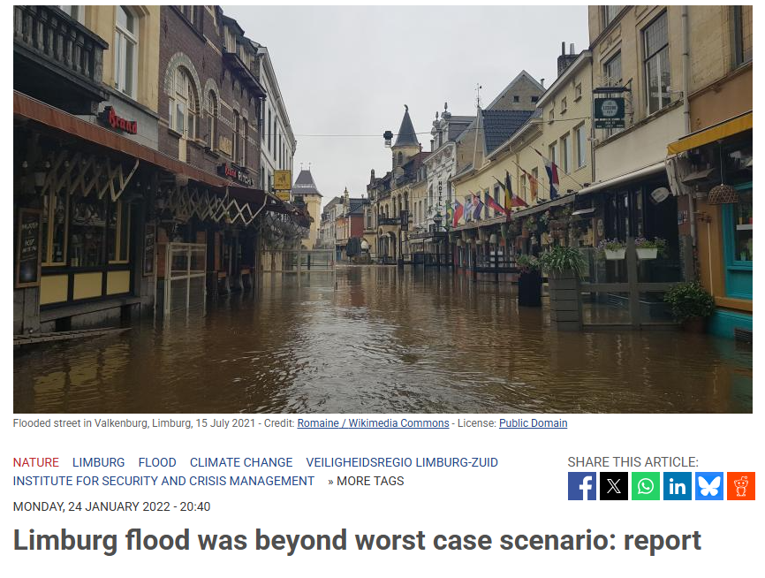
A first exploration of compound events including rainfall and potential adaptation measures in deltas
Improve the understanding of illustrative past and potential future compound events including rainfall by analysing their drivers, impact and responses.
2 minute-madness
ANP. (2022)
→ To the online presentation page
Notes:
Hint on influence on CC but assume much knowledge
Hint on adaptation stuf
- models often single hazards
- maladaptation offten occurs.

Slide 3
Background of compound flooding in the Netherlands
Adaptation is often focused on individual events, potentially overlooking compound event risks (Haasnoot et al., 2020; Van Alphen, 2016; Schlumberger et al., 2024; Simpson 2021).
Developing adaptation strategies for compound events is difficult due to the uncertainty in their occurrence, complexity and the extremes of the events (IPCC, 2022)
We aim to create a method to understand the risks posed by uncertain rainfall including compound events, by analyzing past and potential future compound event scenarios with various adaptation strategies.
Background

Slide 4
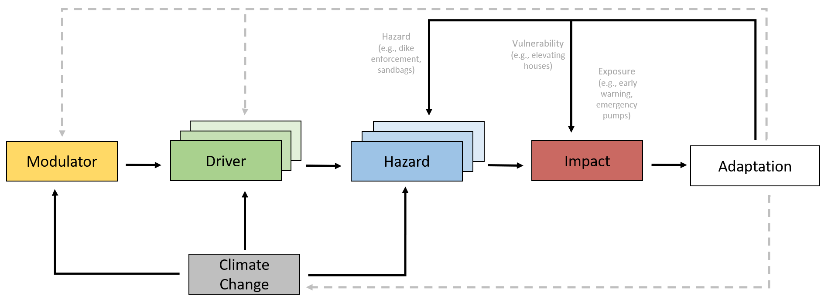
Definition of compound events and adaptation
“A compound event is an event that is created by multiple (not necessarily extremes) events (e.g., rainfall and a storm flood) or variables (e.g., a precondition) that together contribute to a societal or environmental risk or impact”.
→ Extreme rainfall is the main driver in this research
Compounds event including rainfall
Adaptation of figure 1 by Zscheischler et al., (2020)
Notes:
First what is a CER
Definitie
Afkorting
figuur
Waaruit bestaat het
Modulator→ groot stysteem e.g. lage druk systeem
Driver→ regen/SS
Hazard→ overstroming
Impact→schade
Adaptatie→ miste→ een hazard stopt niet bij schade maar adaptatie vind plaats om risico te verminderen

Slide 5
Potential compound events including rainfall in the Netherlands over the last 25 years
Compounding rainfall events
Type of events:
Multivariant: two simultaneous drivers
Pre-condition: prior event influences the main event
Many Dutch storms often don’t include extreme rain. Climate change is expected to increase the possibility for extreme rainfall during storms which makes the occurrence of compound events with extreme rainfall more likely
Compound events with extreme rain | Year
Noorderzijlvest region (rain and storm surge) | 2012
Summer rain Limburg July 2021 (saturated soil and intense rainfall) | 2021
Storm Ciaran (rain and storm surge) | 2023
High water Zwolle (High river discharge and storm surge) | 2023
5 December ‘Sinterklaas’ storm | 2013
Dudley, Eunice and Franklin: triple storm | 2022
Storm Poly | 2023
Storm Boris | 2024
Storm Conall | 2024
Storm Darragh (twin storm) and Storm Eowyn | 2024
Storm Bert | 2024
Compounds event including rainfall
Notes:
Side note for the identified events
Some of the events are also caused due to mechanical failure.
Some events with extreme rainfall not ‘perfect’ due to parameters like the rainfall intensity but are still included.
Archetypes CER events
Mention location of
Type of events most common
Main drivers
What type of areas
lake ijssel
----------------------------------
Many potential hazard with, unfortunately missing rain sometimes for storms
Climate change --> more rainfall in storms expected so potenitally more cer
Database shows devision in archetype regions
Brought back to two main regions: east/west NED
East: high relatively fast draining

Slide 6
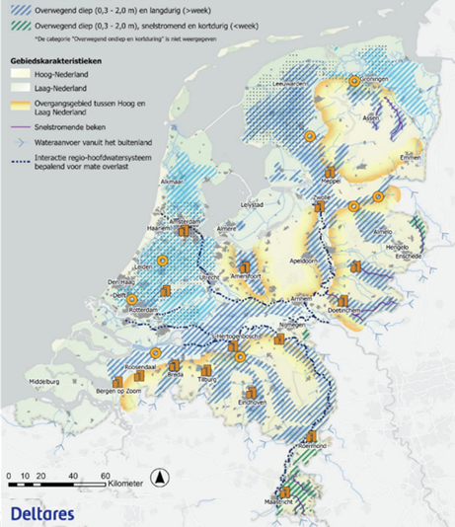
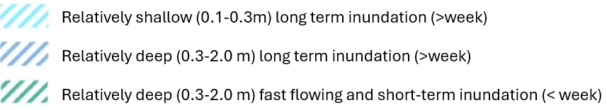
Archetype areas based on historical events and the hydrogeomorphology
Two main areas
East: relatively high elevation, gravity drainage
West: relatively low elevation, manual drainage (pumps)
Compounds event including rainfall
Adaption of figure by Maas, B., Juch, S. & Bruijn (2025)

Slide 7
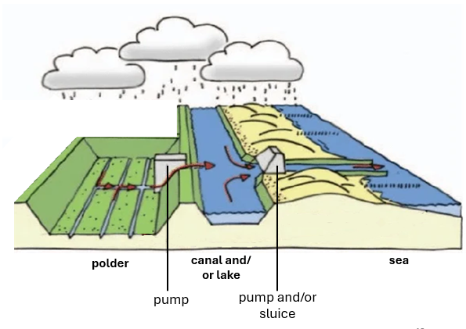
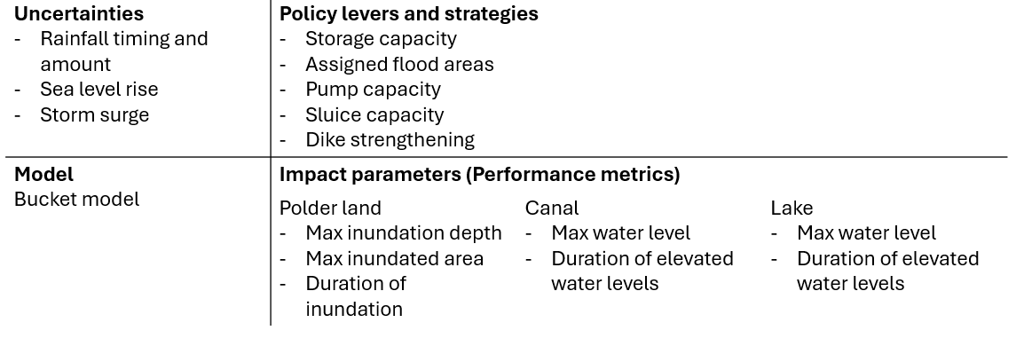
Model set up and stress test for various event scenarios and archetype
zoom in
Adaption of figure 8 by Napier, John. (2021)
Model layout: polder archetype
Agricultural fields, canals, lake and sea
Stress testing of various rainfall compound scenarios with different adaptation strategies
Asses the effectiveness of different adaptation measures on impact parameters for different hazard scenarios
Find robust adaptation strategies for various future scenarios
Method/toolkit for stress testing: Exploratory Modelling and Analysis (EMA) Workbench
Modeling framework
zoom in

Slide 8
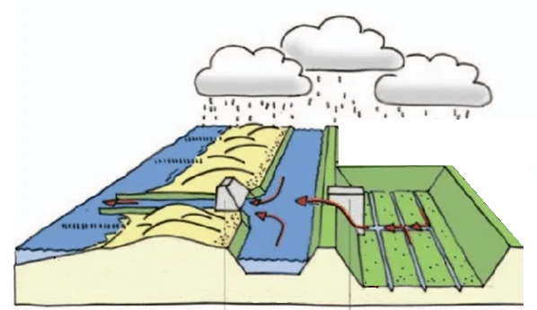
Model set up for polders
zoom out
Activity of the pumps and sluices depends on the water level, and predefined thresholds in the next part of the system.
Modeling framework
polder
canal and/ or lake
sea
Adaption of figure 8 by Napier, John. (2021).
pump
pump and/or sluice

Slide 9
XLRM framework for model set up
Robust Decision Making | RAND
zoom out
Uncertainties Rainfall timing and amount Sea level rise Storm surge | Policy levers and strategies Storage capacity Assigned flood areas Pump capacity Sluice capacity Dike strengthening
Model Bucket model | Impact parameters (Performance metrics)
 | Polder land Max inundation depth Max inundated area Duration of inundation | Canal Max water level Duration of elevated water levels | Lake Max water level Duration of elevated water levels
Modeling framework

Slide 10
Run set up for a multivariant compound rainfall event
Rainfall scenarios: range 25→300 mm in 1 hr
Sea level rise (SLR) scenarios: range 0→2 m
Storm Surge: 2 m on the day of the rainfall
Adaptation strategy: include a pump at the lake
First Results
Drivers rainfall & storm surge
Hazard flooding
Impact Inundation depth and duration, duration of elevated water levels and maximum water levels
Adaptation
Include pump to drain the lake alongside a sluice

Slide 11
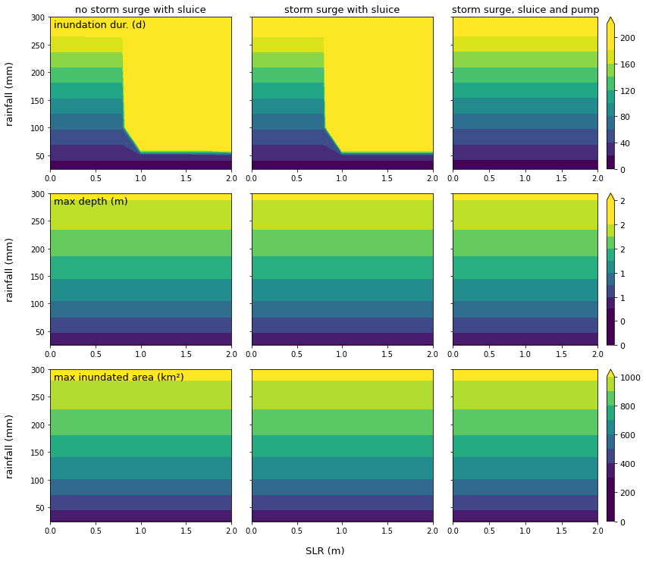
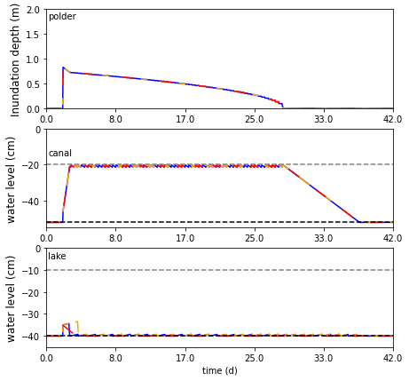
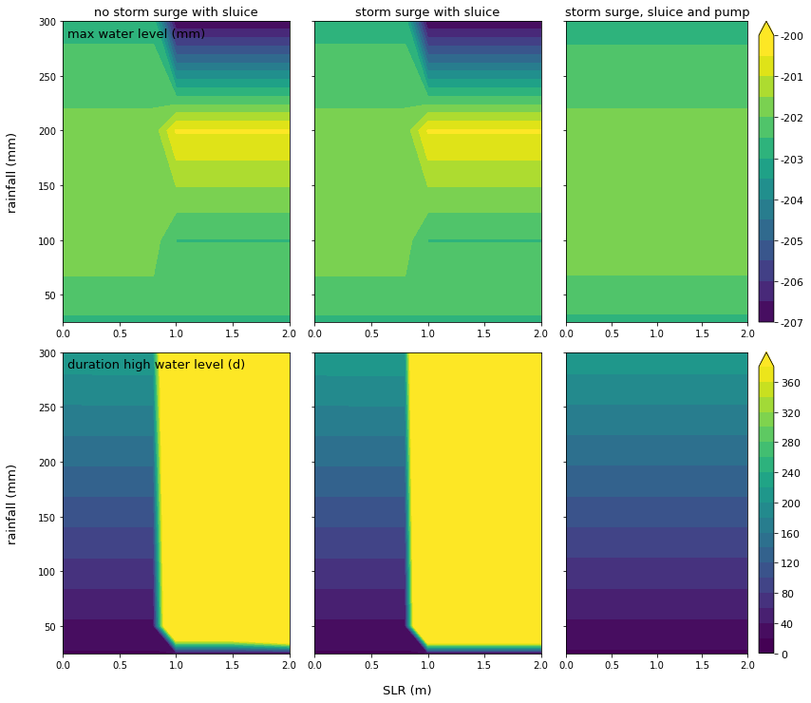
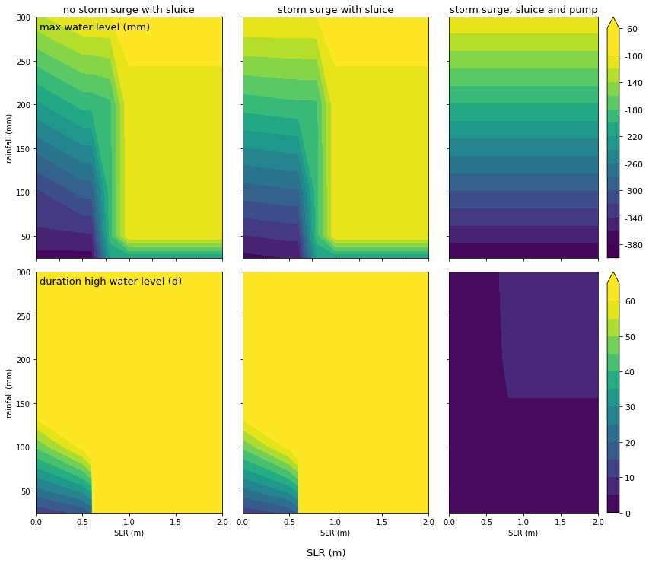
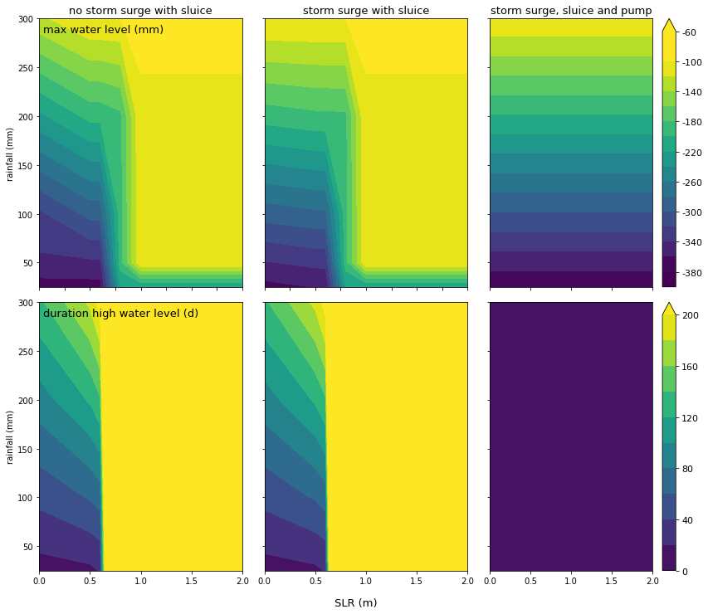
First results of a multivariant rainfall including compound event Event: rainfall and a storm surge
Polder impact
zoom in
Inundation and water levels over time
Zoom in
Canal impact
zoom in
First Results
Lake impact
zoom in

Slide 12
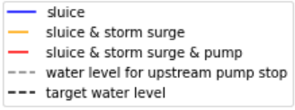
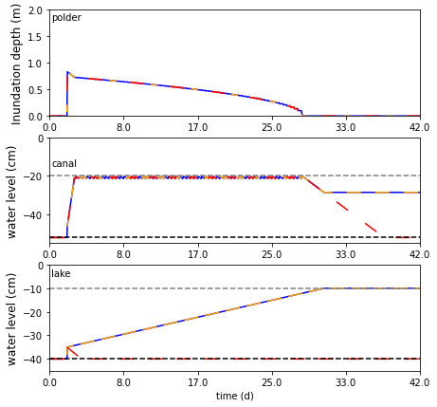
Inundation depth and water levels over time
zoom out
50 mm rain & 0 m sea level rise
50 mm rain & 1 m sea level rise
First Results
For a limit sea level rise the system is still able to drain fully. For a larger sea level rise the lake and the canal drainage is no longer possible unless the pump at the lake side (adaptation measure) is installed.
zoom to lake

Slide 13
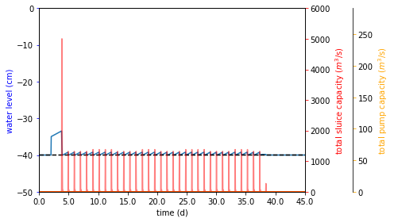
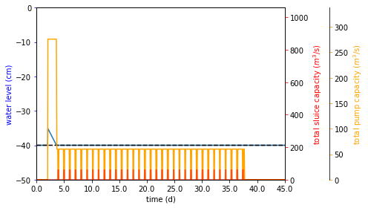
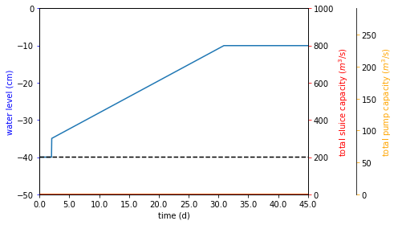
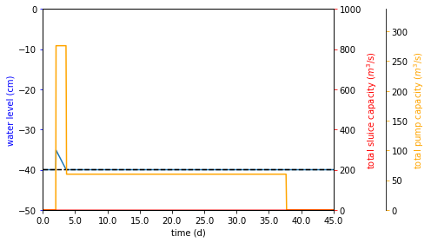
Lake water levels over time for different sea level rises 50 mm rain and 2 m storm surge on day of rain
zoom out
No pump
With pump
0,5 m sea level rise
The sluice switches on and off depending on the tides, and the pumps only work when needed
First Results
1 m sea level rise
1 m sea level rise stops the sluice and if installed the pump stays on until the whole system is drained

Slide 14
Polder impact Colour reflects the inundation duration (days)
zoom out
First Results
First Results
A sea level rise of 0.6 m hinders downstream discharge. As a result drainage of the polder is hindered, leading to longer inundation durations.
A storm surge, which hinders the sluice downstream, slightly increases the duration of inundation.
The pump at the lake side allows constant drainage of the system and thus sea level is no longer a controlling factor and the duration only depends on rain.

Slide 15
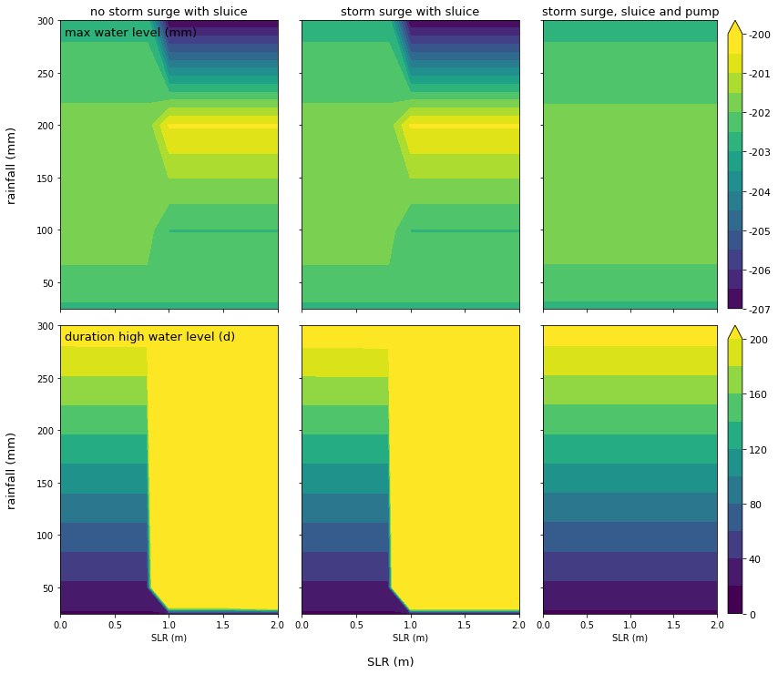
Canal water level impact Colour reflects the duration of elevated water levels (days)
zoom out
First Results
First Results
First Results
When the sea rises above 0.6 m the sluices downstream are hindered, which limits the canal discharge increasing the duration of the impact
2 meter storm surge increases the duration of the higher water levels with a few hours
The instalment of the pump at the lake allows for continues drainage of the canal lowering the duration of the impact

Slide 16
Lake water level impact Colour reflects the duration of elevated water levels (days)
zoom out
First Results
First Results
SLR crosses a threshold and the sluices at the lake side become hindered. This hinders the discharge form the canal leading to long durations of high water levels
The adaptation measure at the lake (installment of the pump) allows for continues drainage in the canal lowering the duration of the impact
Sea level rise starts hindering and eventually stops the discharge from the lake leading to long durations of the impacts
2 meter storm increases the duration of the elevated water levels with a few hours
The pump ensures a constant discharge from the lake to the sea leading to a maximum impact of 9 days

Slide 17
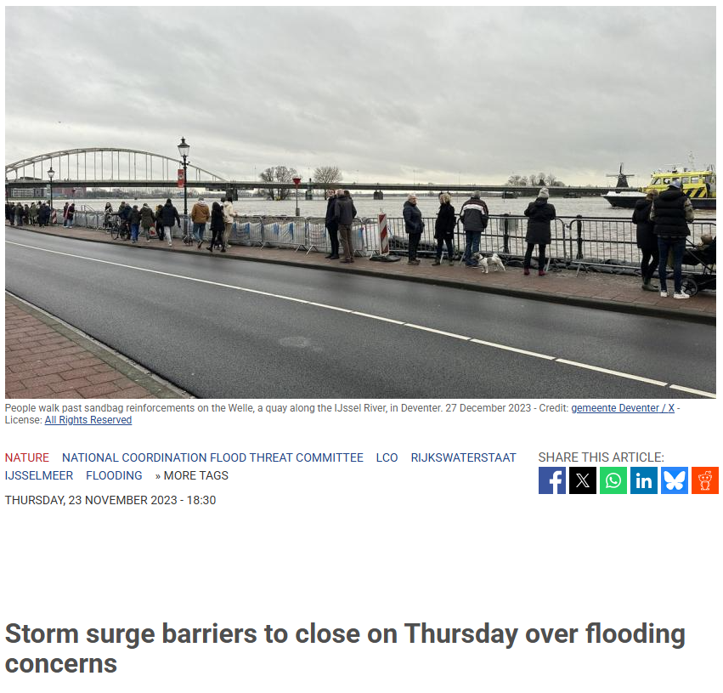
Conclusion
The Netherlands is susceptible to rainfall including compound events based on past events and it is expected that climate change will increase the risk
The susceptible areas in the Netherlands can be subdivided into manual draining and gravity draining regions
These first scenarios show that downstream event drivers influence the upstream impact by limiting the drainage of the system and adaptation is needed to limit the consequences
Conclusion
ANP. (2023)

Slide 18
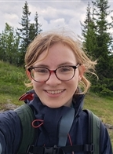

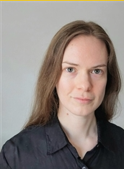

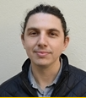
Team
Dagmar Mennes MSc
Prof. dr. Marjolijn Haasnoot
Dr. Frances Dunn
Prof. dr. Hans Middelkoop
Dr. ir. David Gold

Slide 19
References
ANP. (2022, January 24). Limburg flood was beyond worst-case scenario: Report. NL Times. https://nltimes.nl/2022/01/24/limburg-flood-beyond-worst-case-scenario-report
ANP. (2023, November 23). Storm surge barriers to close on Thursday over flooding concerns. NL Times. Storm surge barriers to close on Thursday over flooding concerns | NL Times
Haasnoot, M., Kwadijk, J., Van Alphen, J., Le Bars, D., Van Den Hurk, B., Diermanse, F., Van Der Spek, A., Oude Essink, G., Delsman, J., & Mens, M. (2020). Adaptation to uncertain sea-level rise; how uncertainty in Antarctic mass-loss impacts the coastal adaptation strategy of the Netherlands. Environmental Research Letters, 15(3), 034007. https://doi.org/10.1088/1748-9326/AB666C
IPCC. (2022). Summary for Policymakers. In Climate Change 2022 – Impacts, Adaptation and Vulnerability (pp. 3–34). Cambridge University Press. https://doi.org/10.1017/9781009325844.001
Maas, B., Juch, S.& Bruijn (2025). Landelijk waterbeeld grootschalige extreme regen. Deltares. 21-10-2025
Napier, J. (2021). Living with Water: Infrastructure and Urbanism in Jakarta. Ecocycles, 7(1), 52–72. https://doi.org/10.19040/ecocycles.v7i1.191
Schlumberger, J., Haasnoot, M., Aerts, J. C. J. H., Bril, V., van der Weide, L., & de Ruiter, M. (2024). Evaluating Adaptation Pathways in a Complex Multi-Risk System. Earth’s Future, 12(5). https://doi.org/10.1029/2023EF004288
Simpson, N. P., Mach, K. J., Constable, A., Hess, J., Hogarth, R., Howden, M., Lawrence, J., Lempert, R. J., Muccione, V., Mackey, B., New, M. G., O’Neill, B., Otto, F., Pörtner, H. O., Reisinger, A., Roberts, D., Schmidt, D. N., Seneviratne, S., Strongin, S., … Trisos, C. H. (2021). A framework for complex climate change risk assessment. In One Earth (Vol. 4, Issue 4, pp. 489–501). Cell Press. https://doi.org/10.1016/j.oneear.2021.03.005
Van Alphen, J. (2016). The Delta Programme and updated flood risk management policies in the Netherlands. Journal of Flood Risk Management, 9(4), 310–319. https://doi.org/10.1111/jfr3.12183n
​Zscheischler, J., Martius, O., Westra, S., Bevacqua, E., Raymond, C., Horton, R. M., van den Hurk, B., AghaKouchak, A., Jézéquel, A., Mahecha, M. D., Maraun, D., Ramos, A. M., Ridder, N. N., Thiery, W., & Vignotto, E. (2020). A typology of compound weather and climate events. In Nature Reviews Earth and Environment (Vol. 1, Issue 7, pp. 333–347). Springer Nature. https://doi.org/10.1038/s43017-020-0060-z

