Slide 1


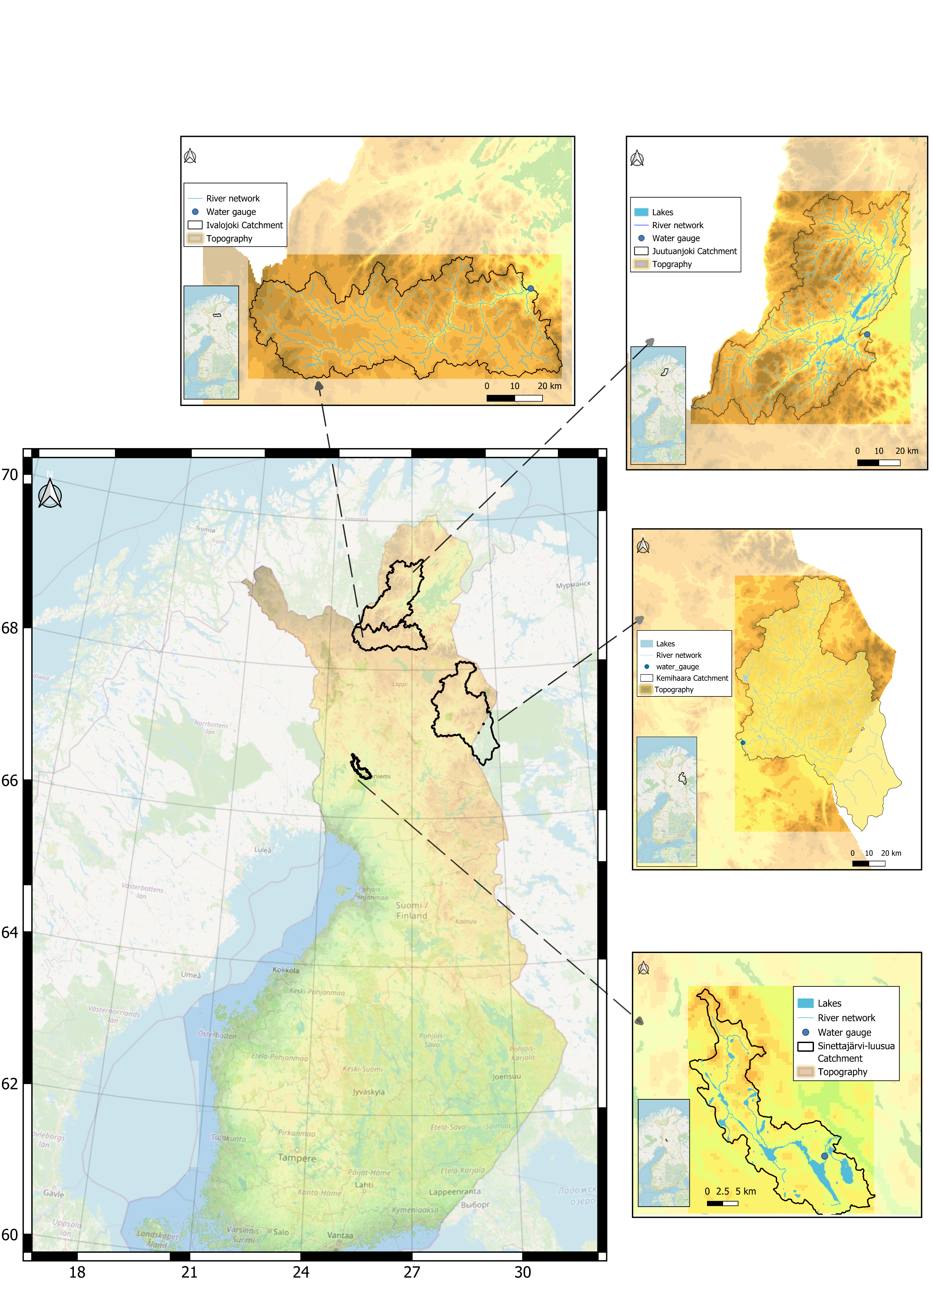



Changes in Snowmelt Timing and Peak Flow Generation in Non-Regulated Finnish Catchments
Maedeh Edraki and Ali Torabi Haghighi
Trend analysis (1980–2024) using Mann–Kendall and Sen’s slope tests
Using climate variables and timing characteristics of peak flow and Snow Water Equivalent (SWE)
A degree-day model to overcome discontinuous SWE measurements

Slide 2
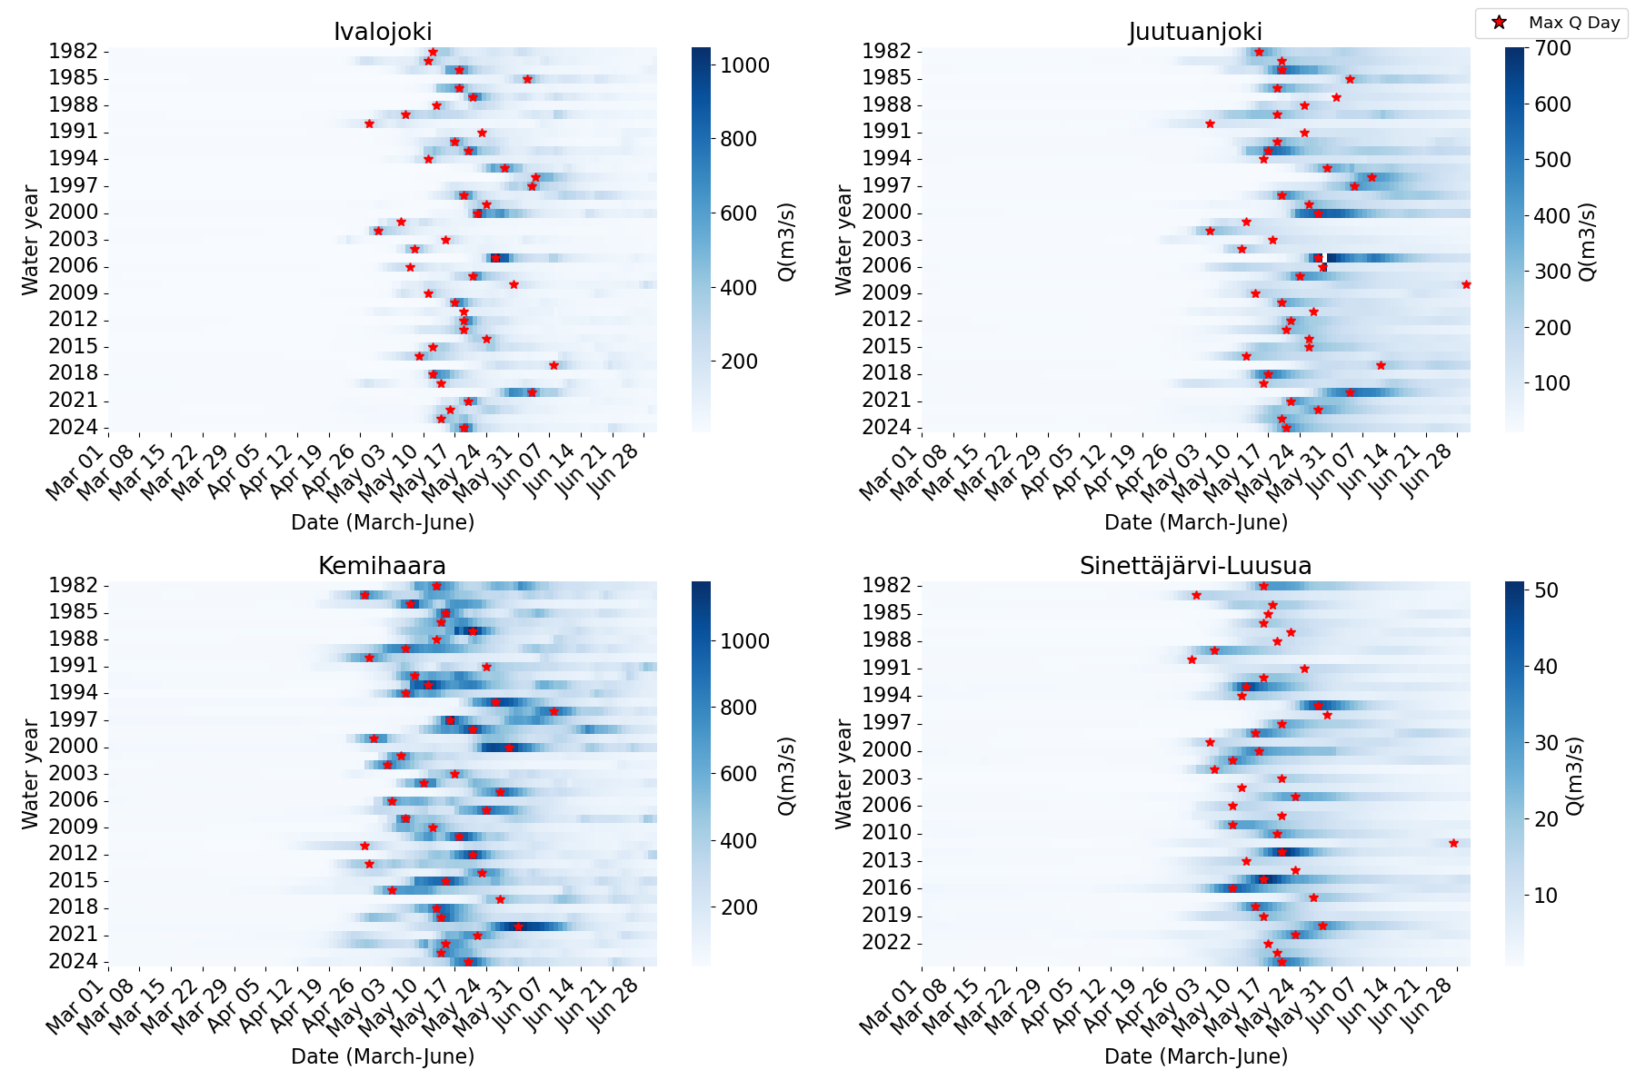
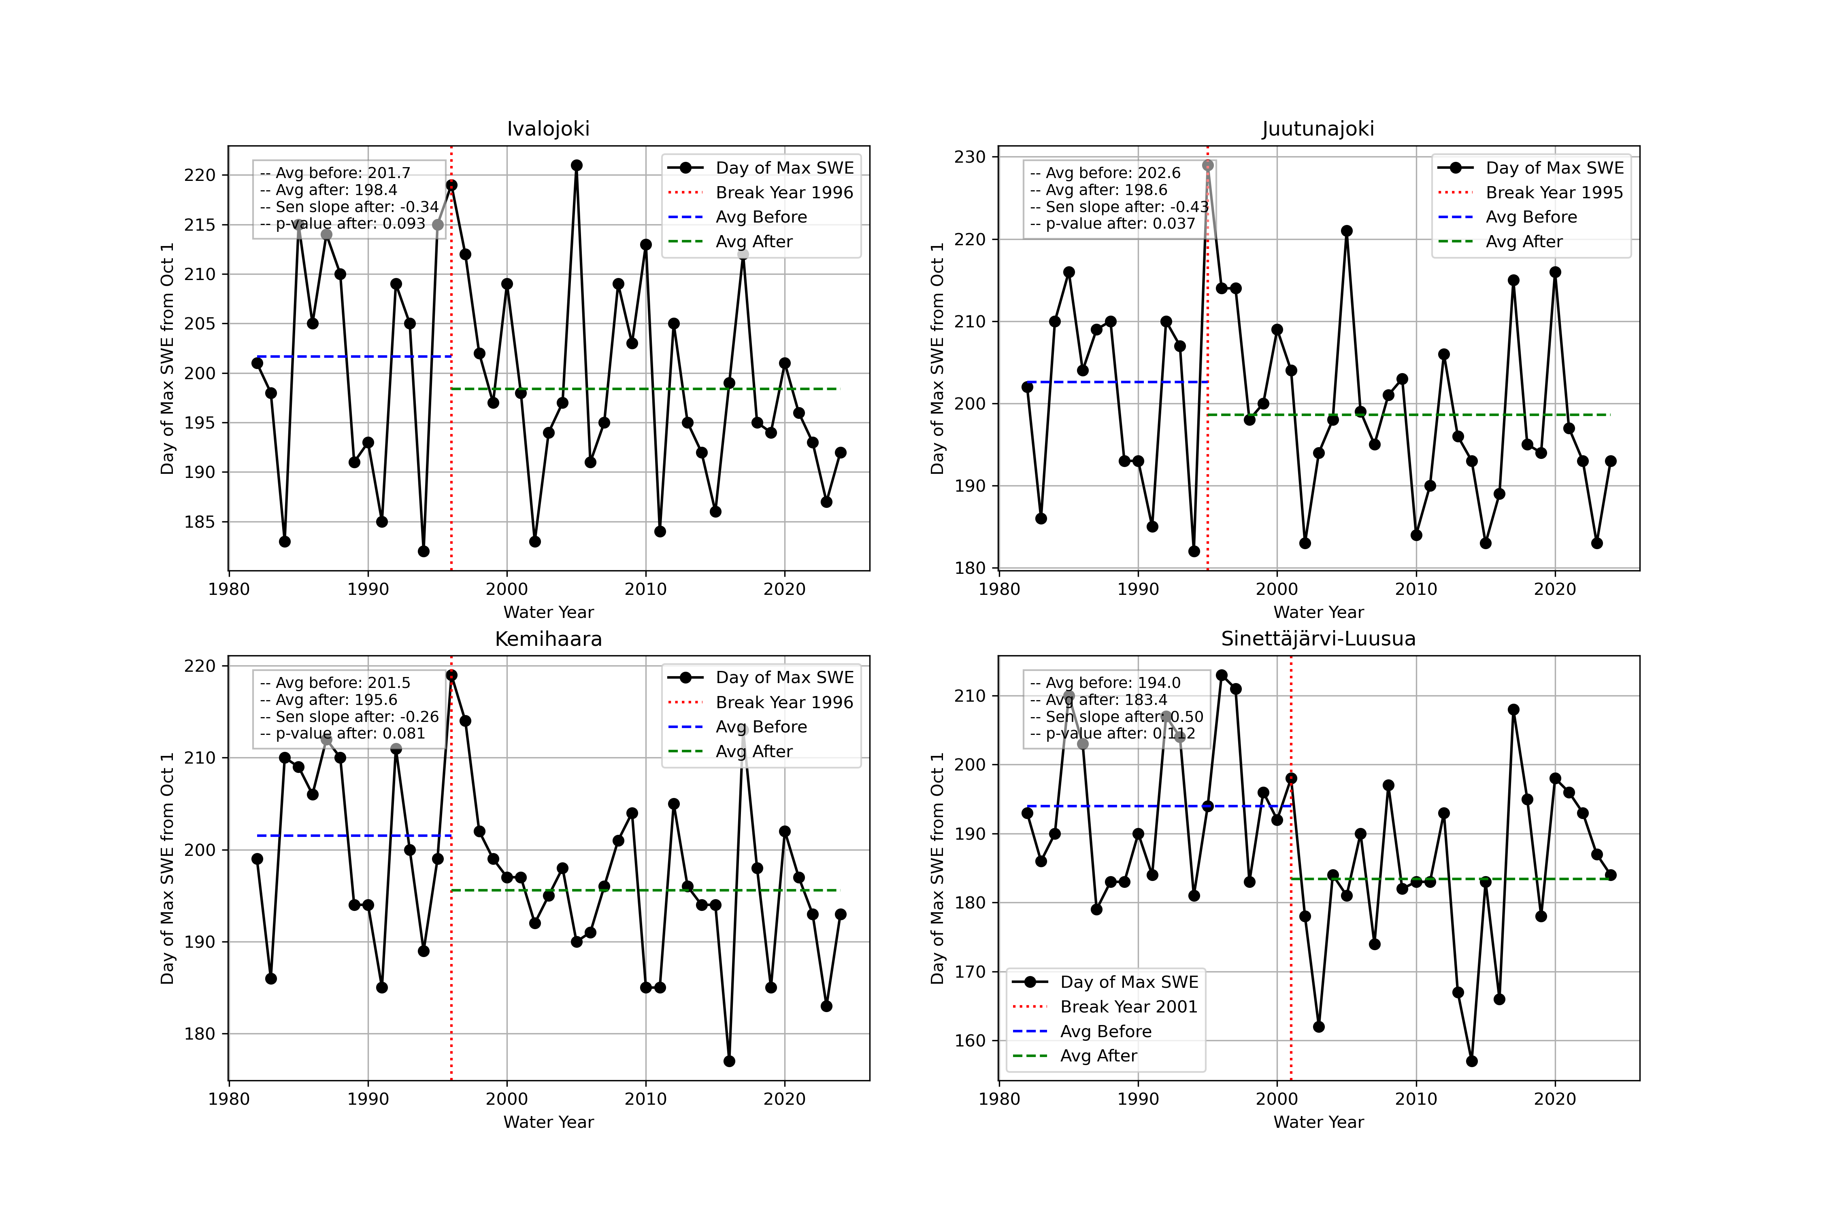
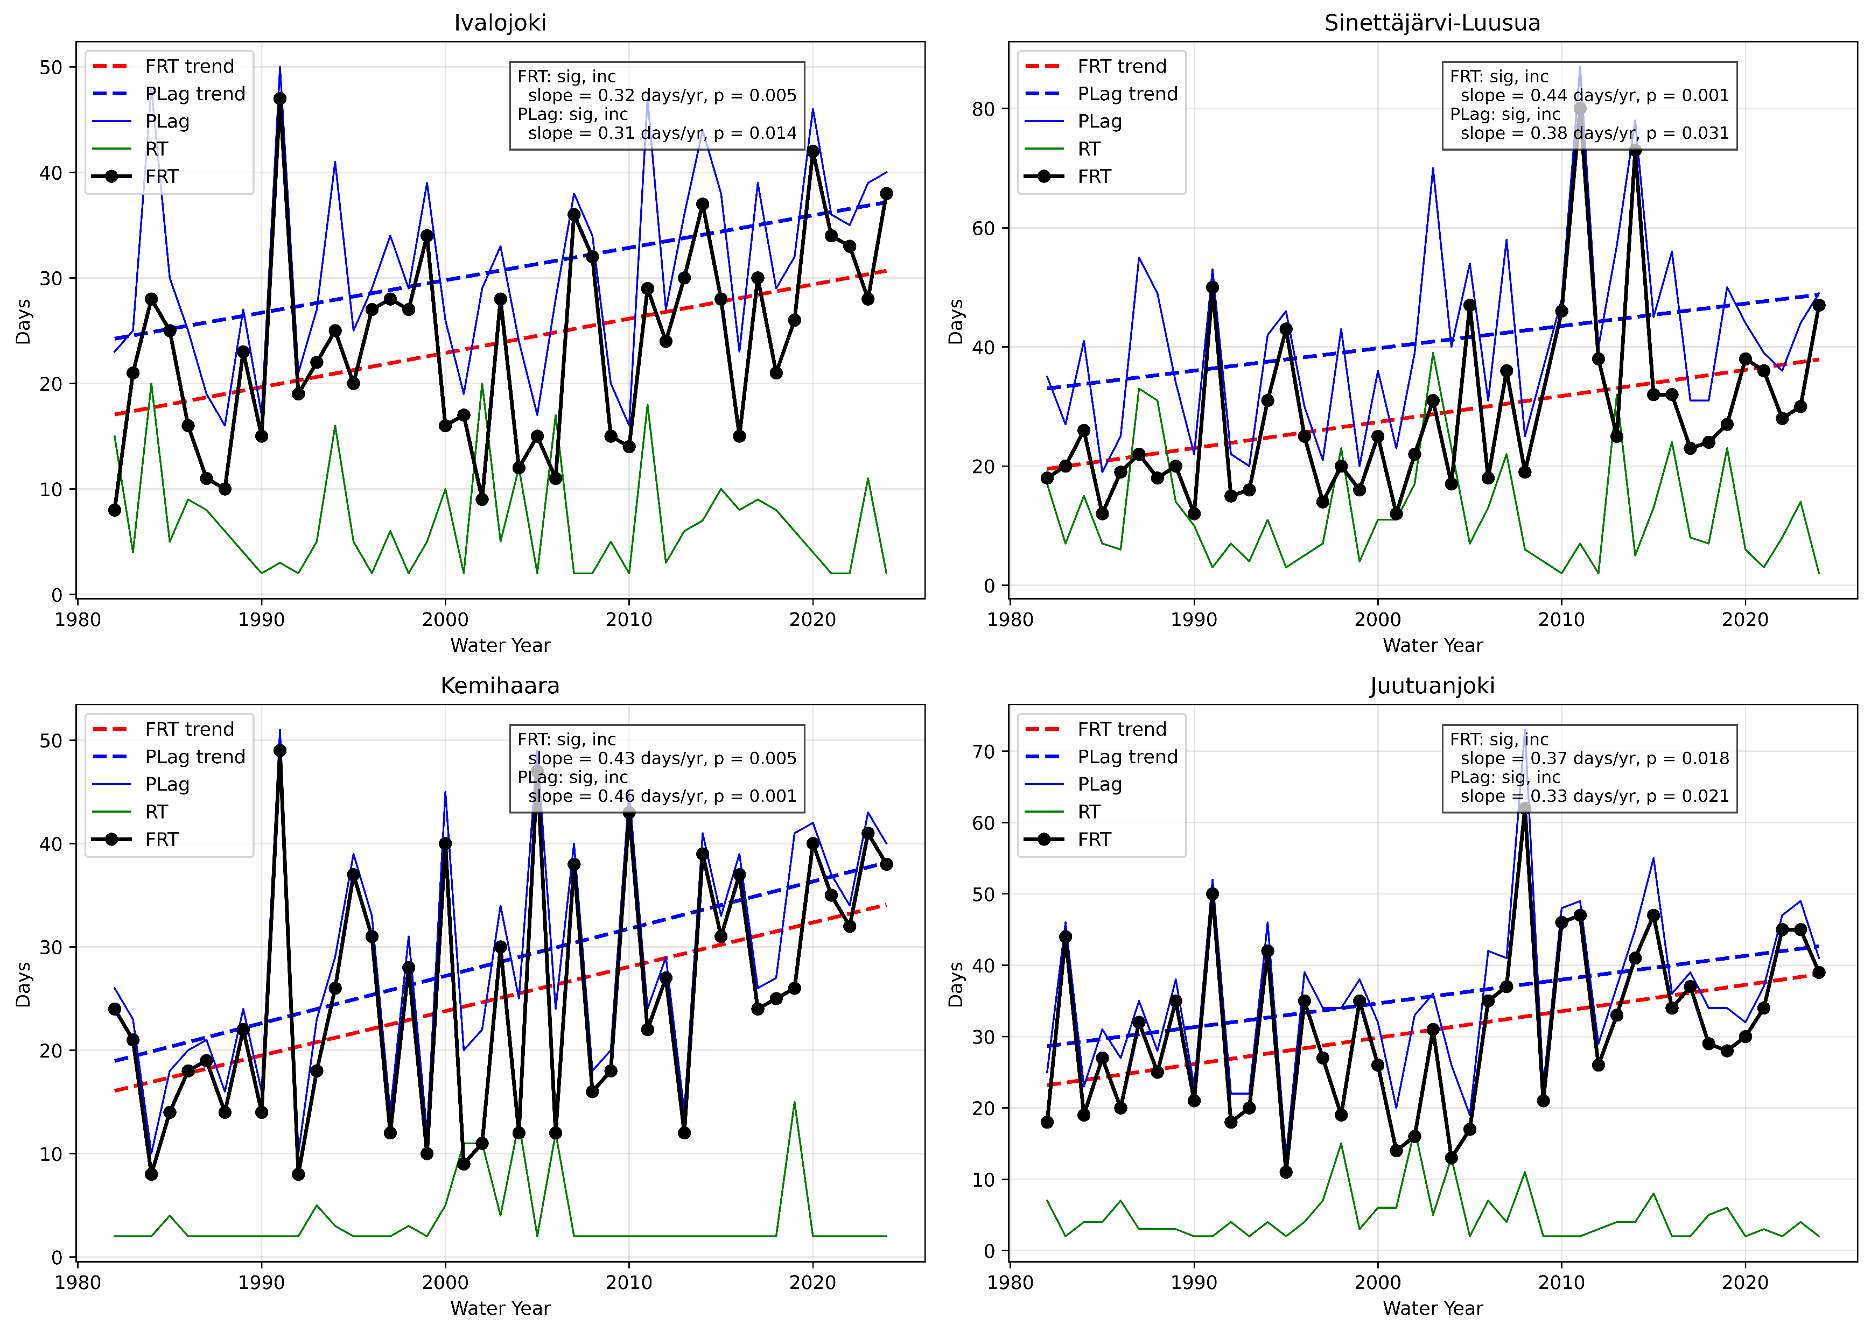
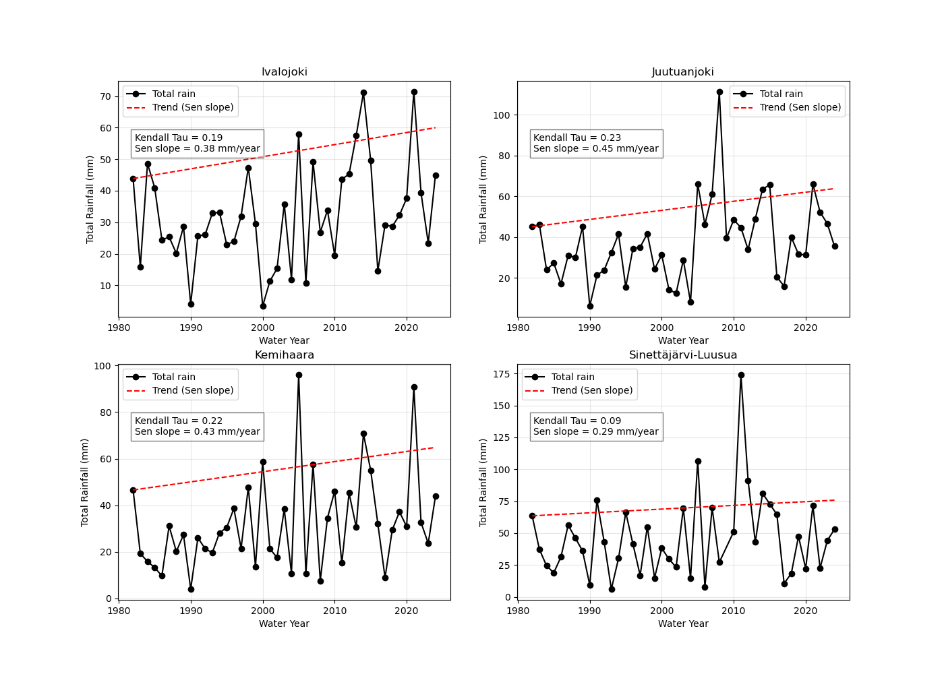
Changes in Snowmelt Timing and Peak Flow Generation in Non-Regulated Finnish Catchments
Daily flow
No clear changes in calendar-based peak flow timing
Earlier melt onset timing
Shifting earlier at rates up to 0.5 days/year after the mid-1990s
SWE timing
Rising limb becoming longer
Peak flow occurs later relative to melt (lag ↑)
Melt response timing remains consistent
Flow timing
Increasing ROS events (0.29–0.45 mm yr⁻¹)
Likely contributes to altered spring peak flow timing
Rain-On-Snow (ROS)

Slide 3
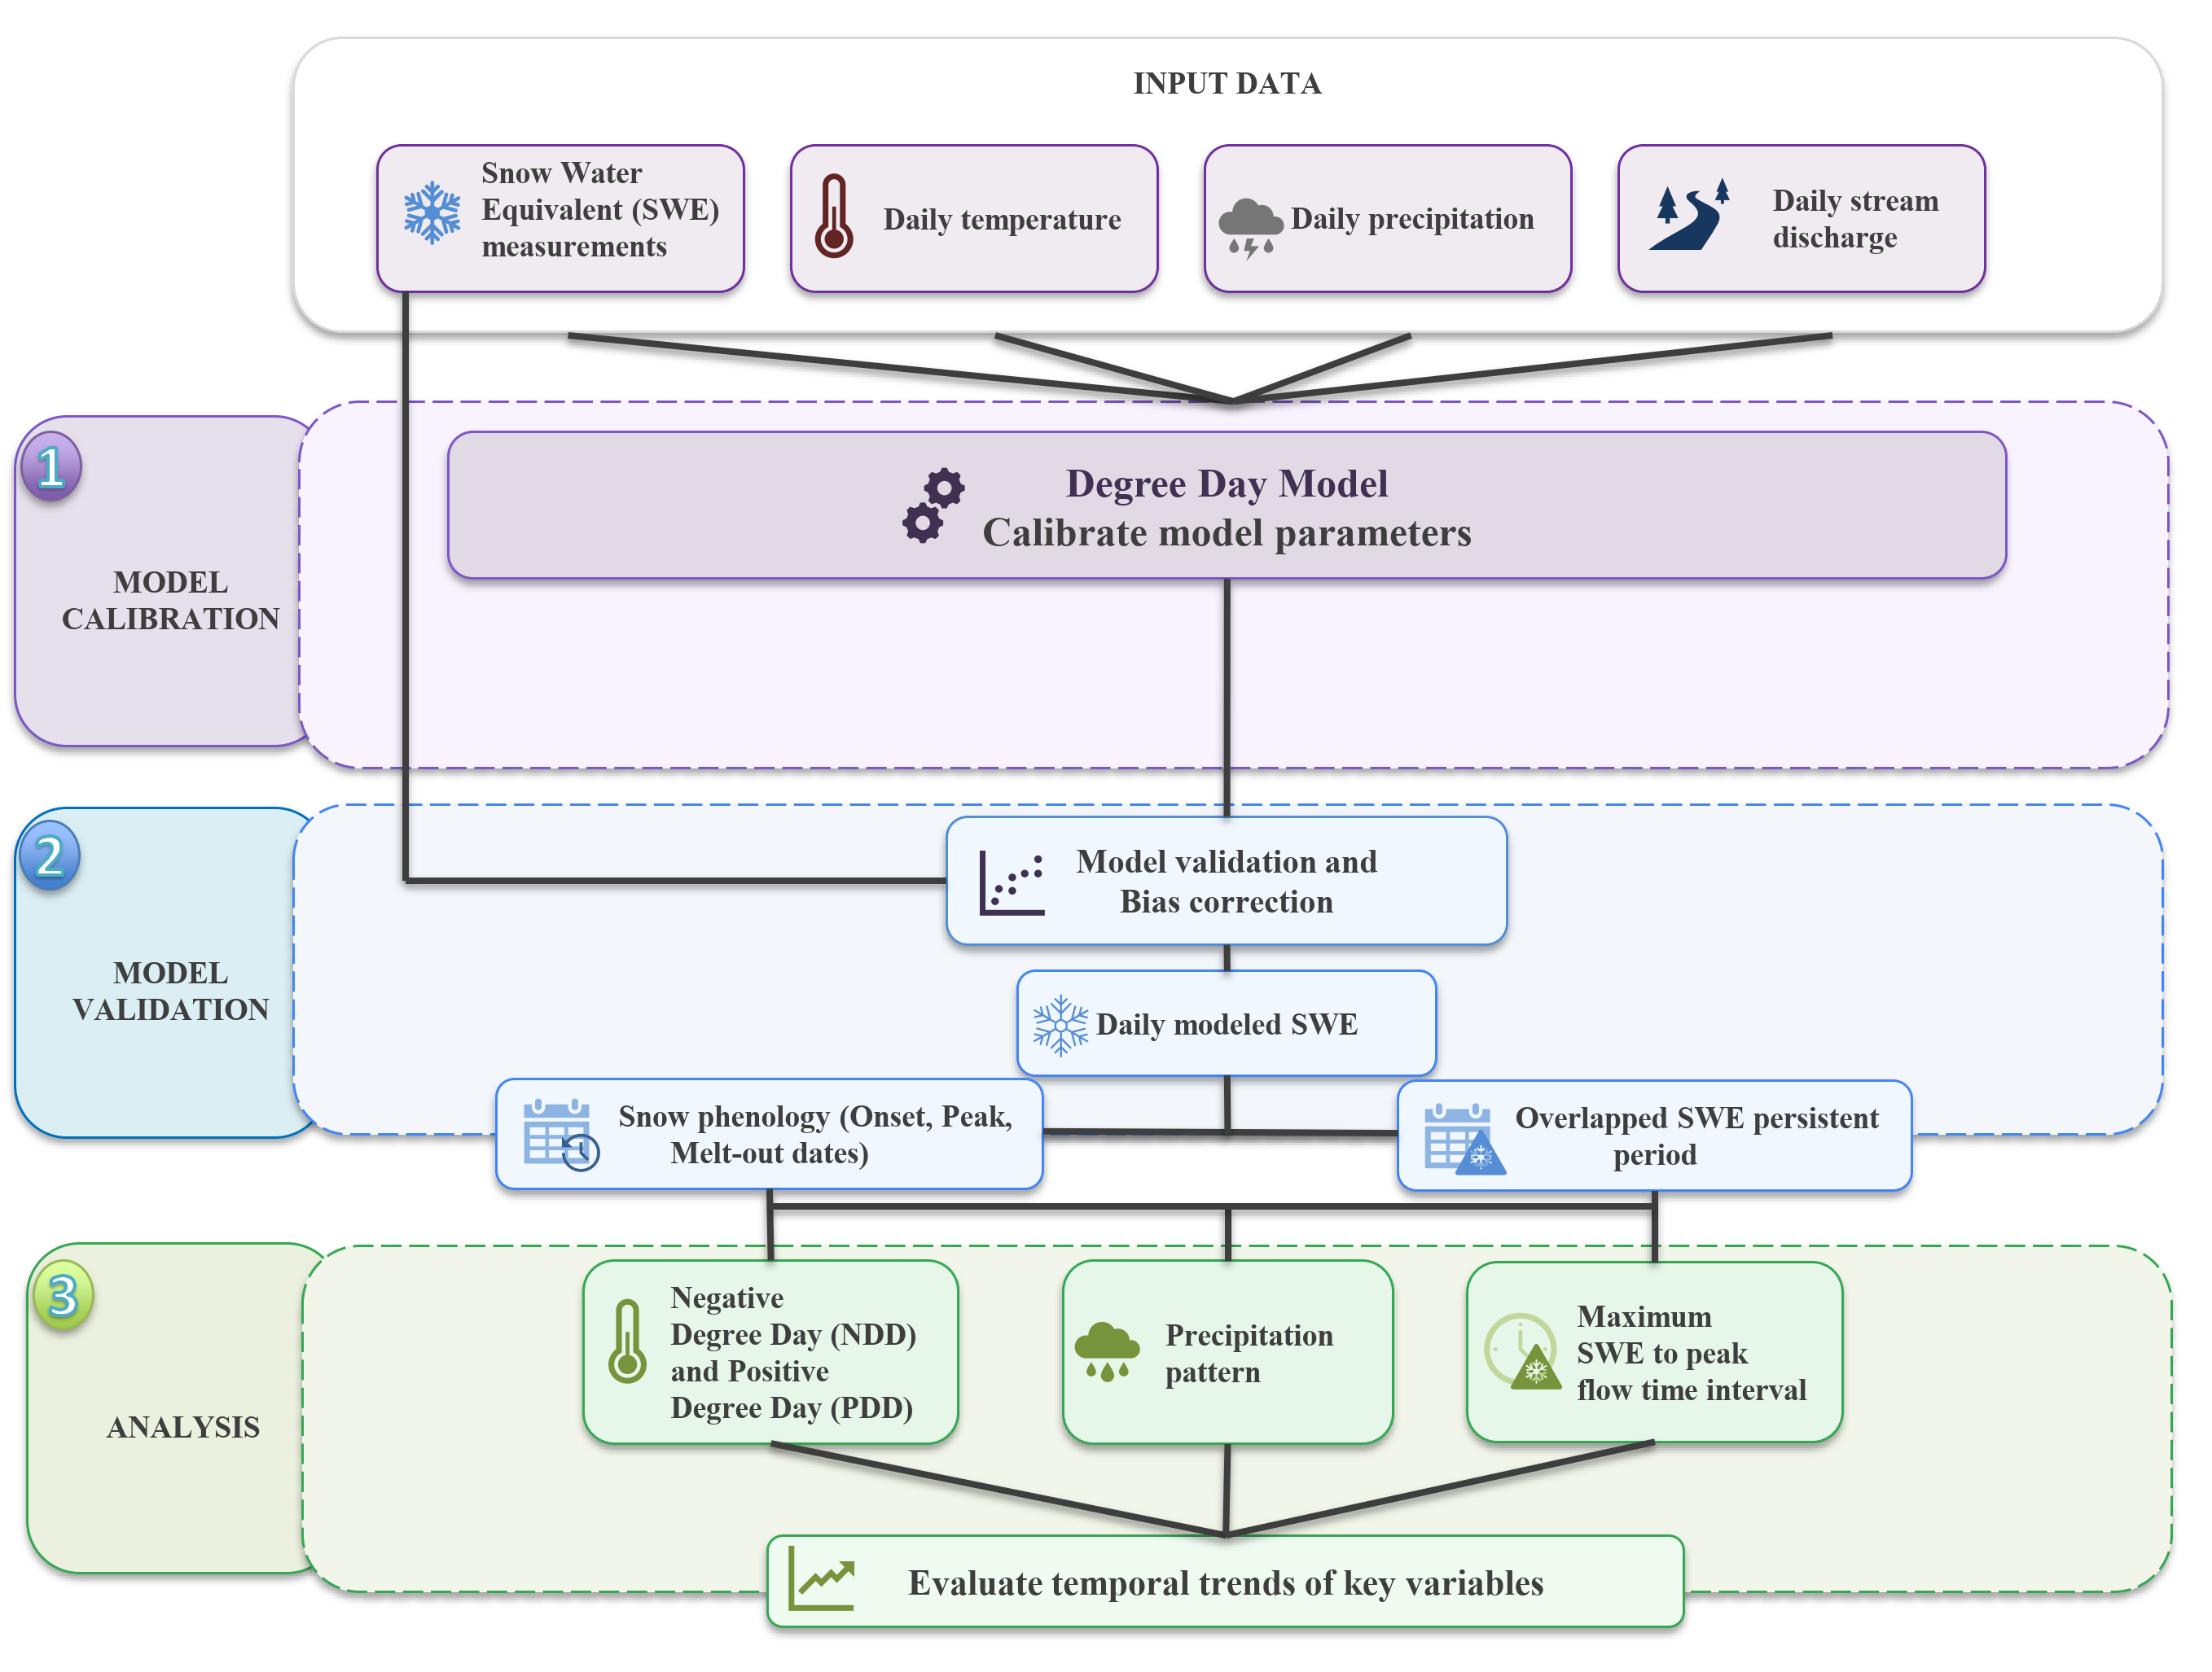
Changes in Snowmelt Timing and Peak Flow Generation in Non-Regulated Finnish Catchments

Slide 4
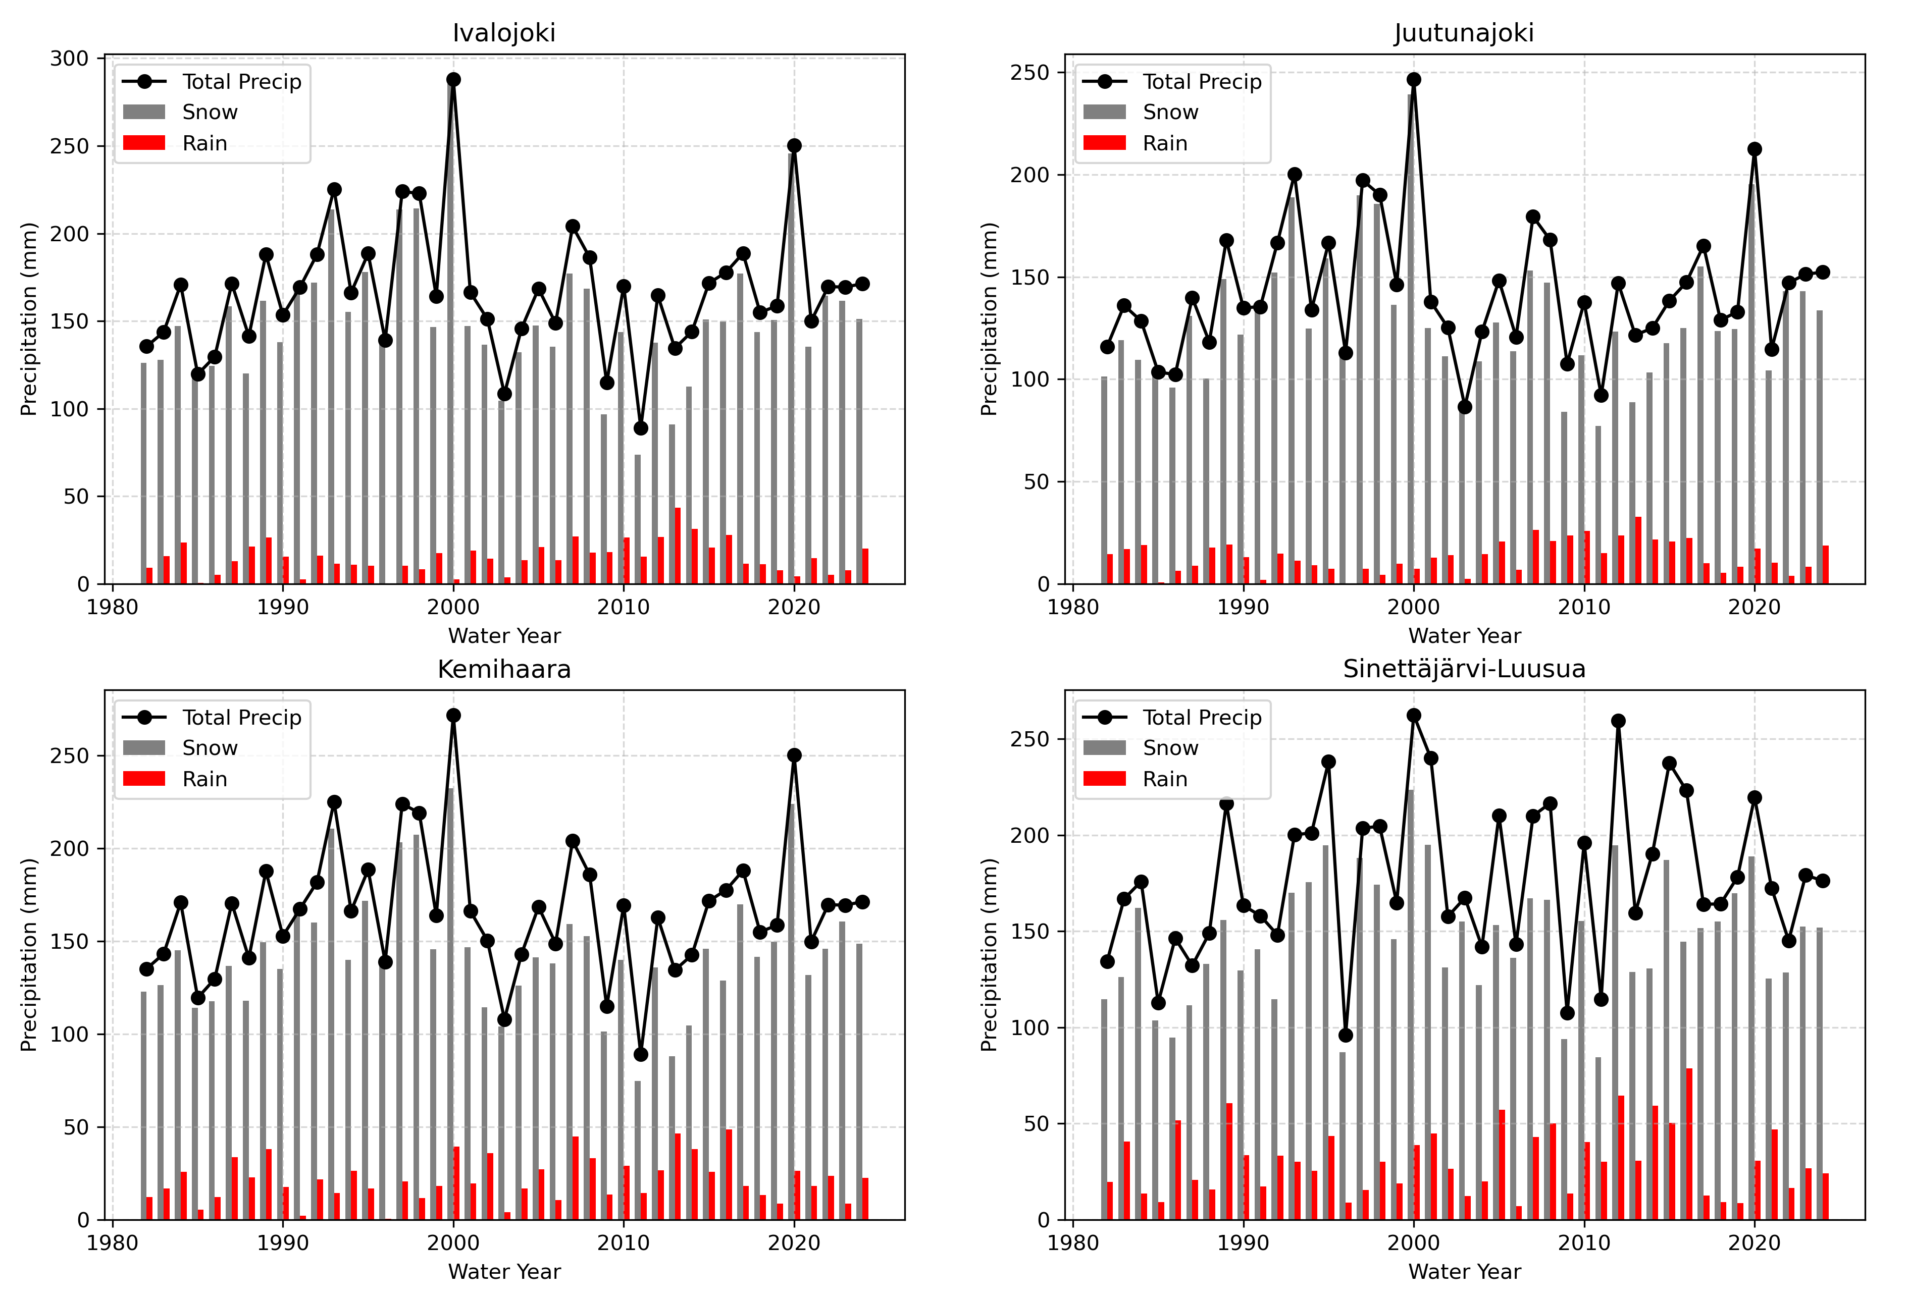
Changes in Snowmelt Timing and Peak Flow Generation in Non-Regulated Finnish Catchments
Total precipitation during snow-covered period remained unchanged
Precipitation pattern

Slide 5
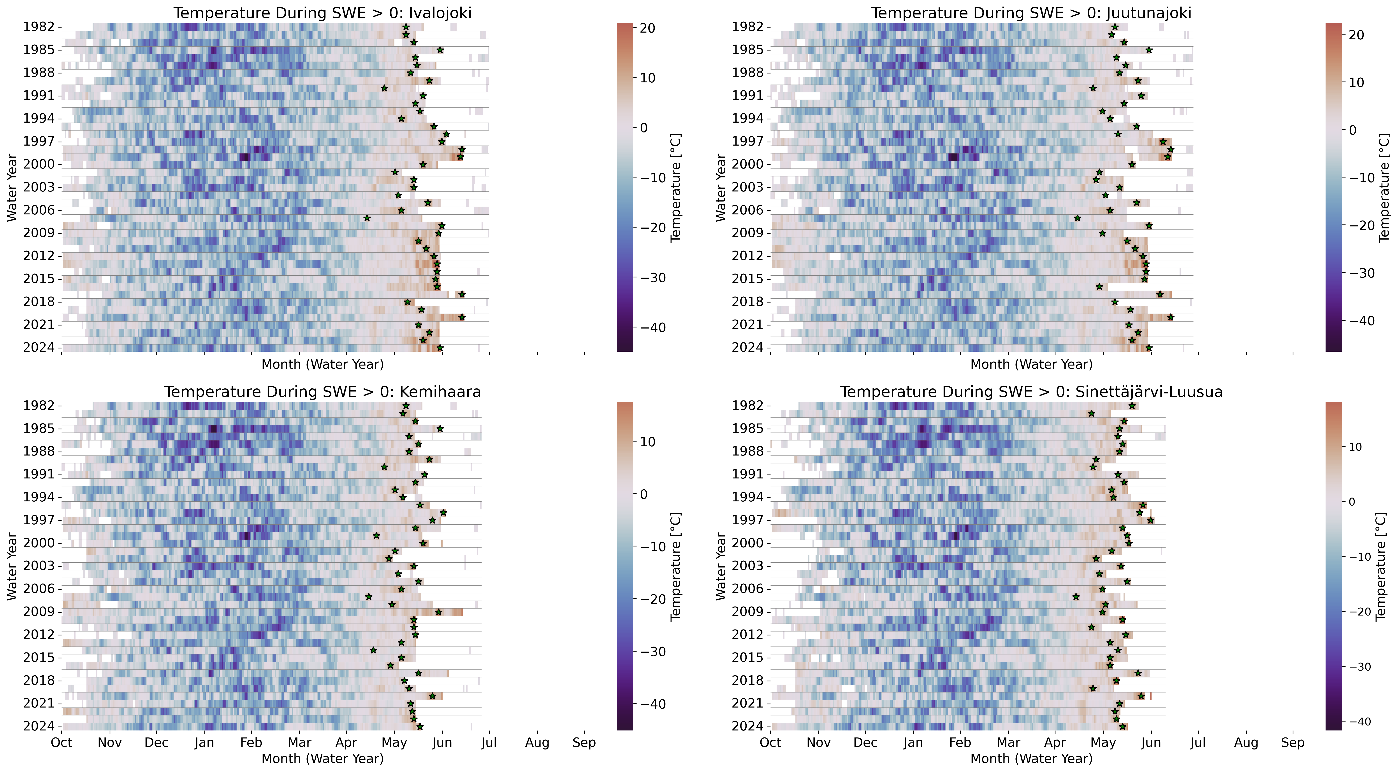
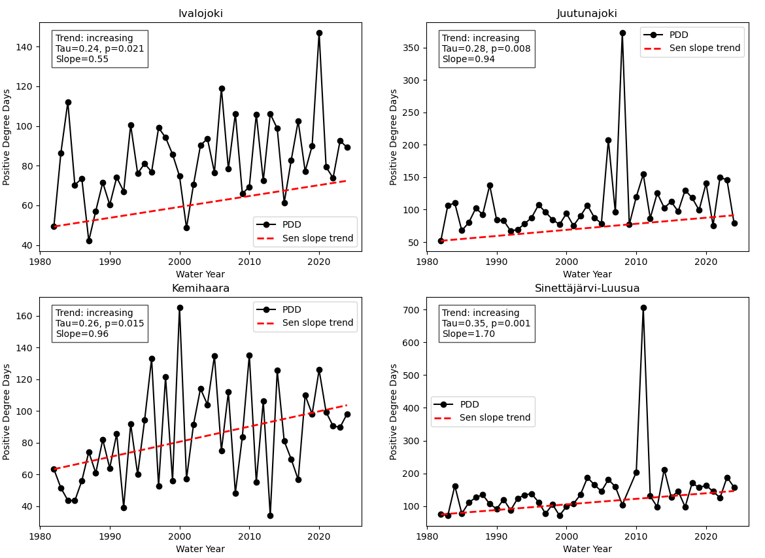
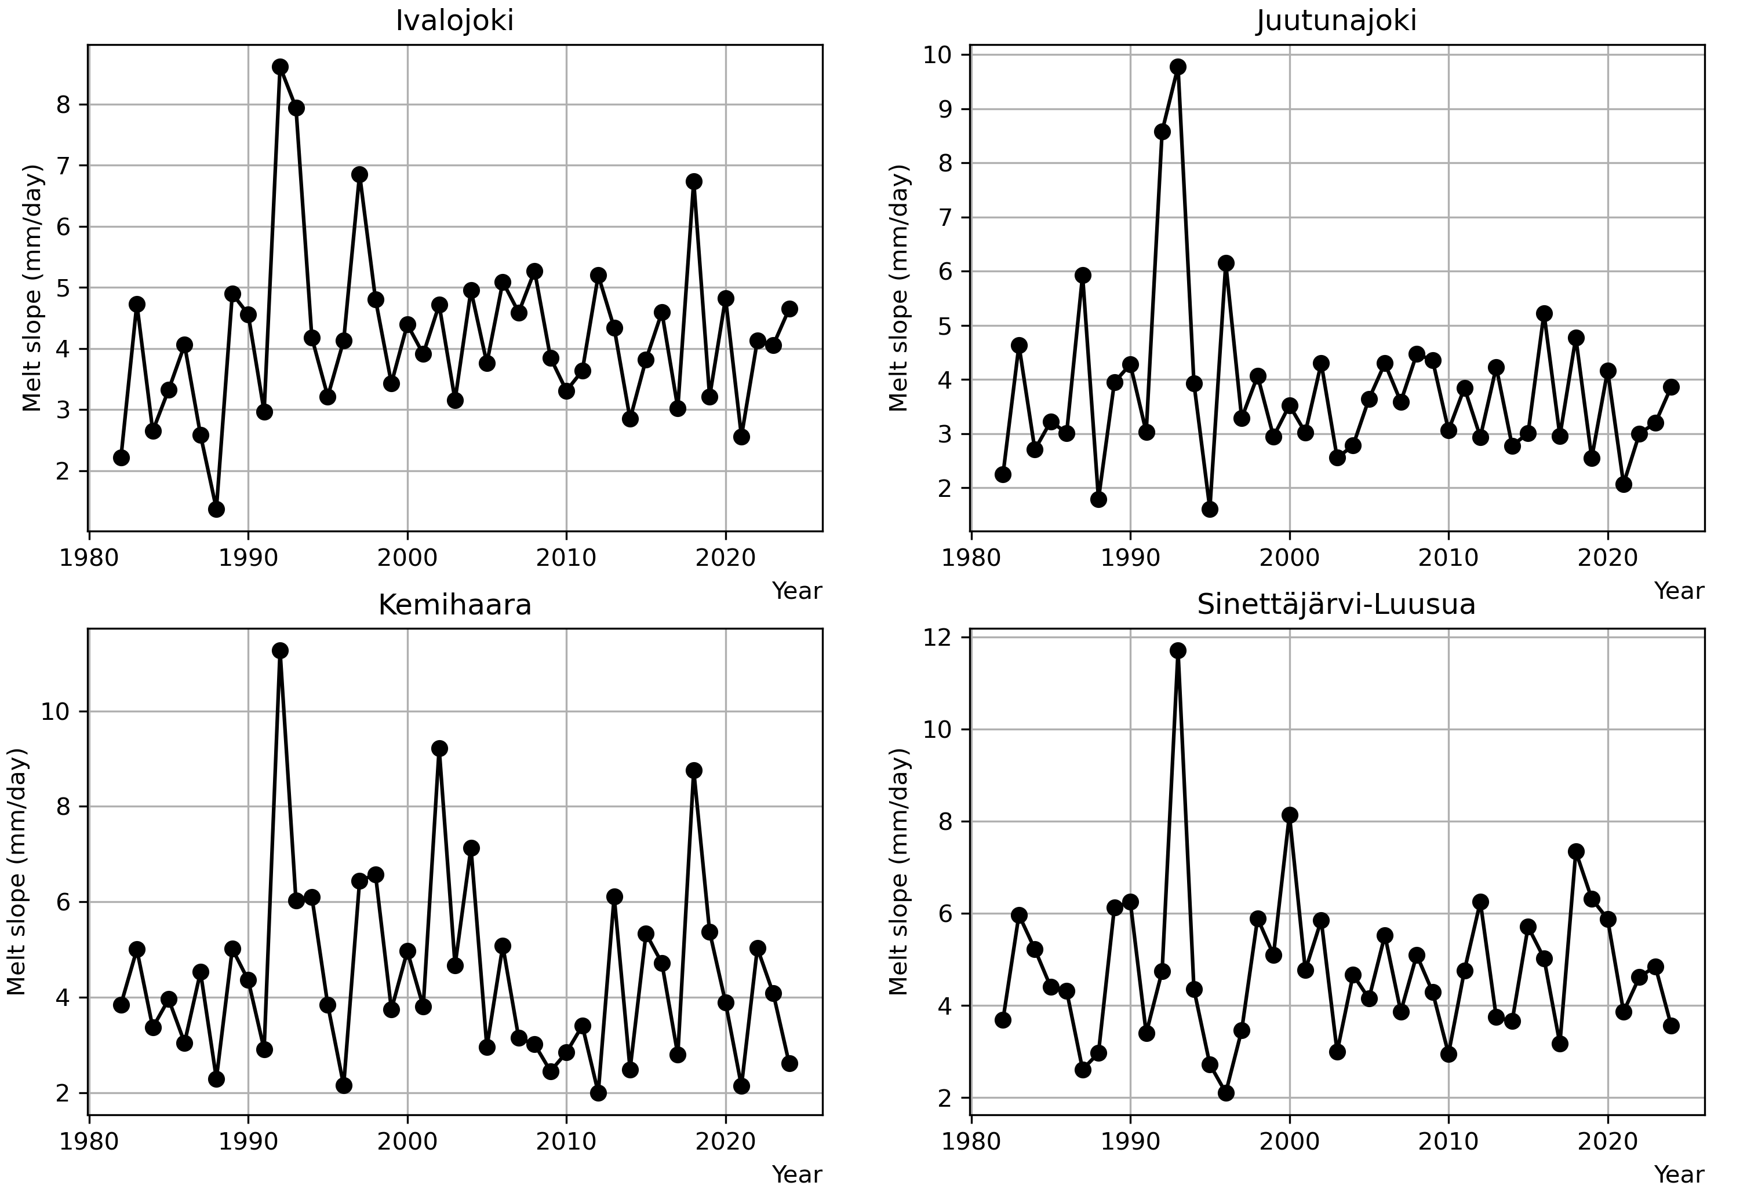
Changes in Snowmelt Timing and Peak Flow Generation in Non-Regulated Finnish Catchments
Positive degree days have increased
Expected earlier peak flow generated by melt
Temperature during melting period
The rate melt process accelerate daily
Recent warming has not led to faster within-season melt
Near-zero degrees have become more frequent in the latest years
More systematic changes are observed for temperature than precipitation
Daily snowmelt rates
Temperature during snow-covered period

Slide 6
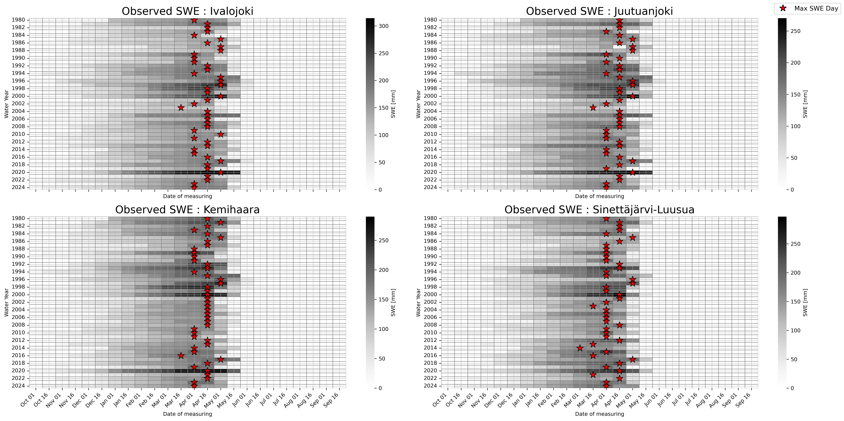
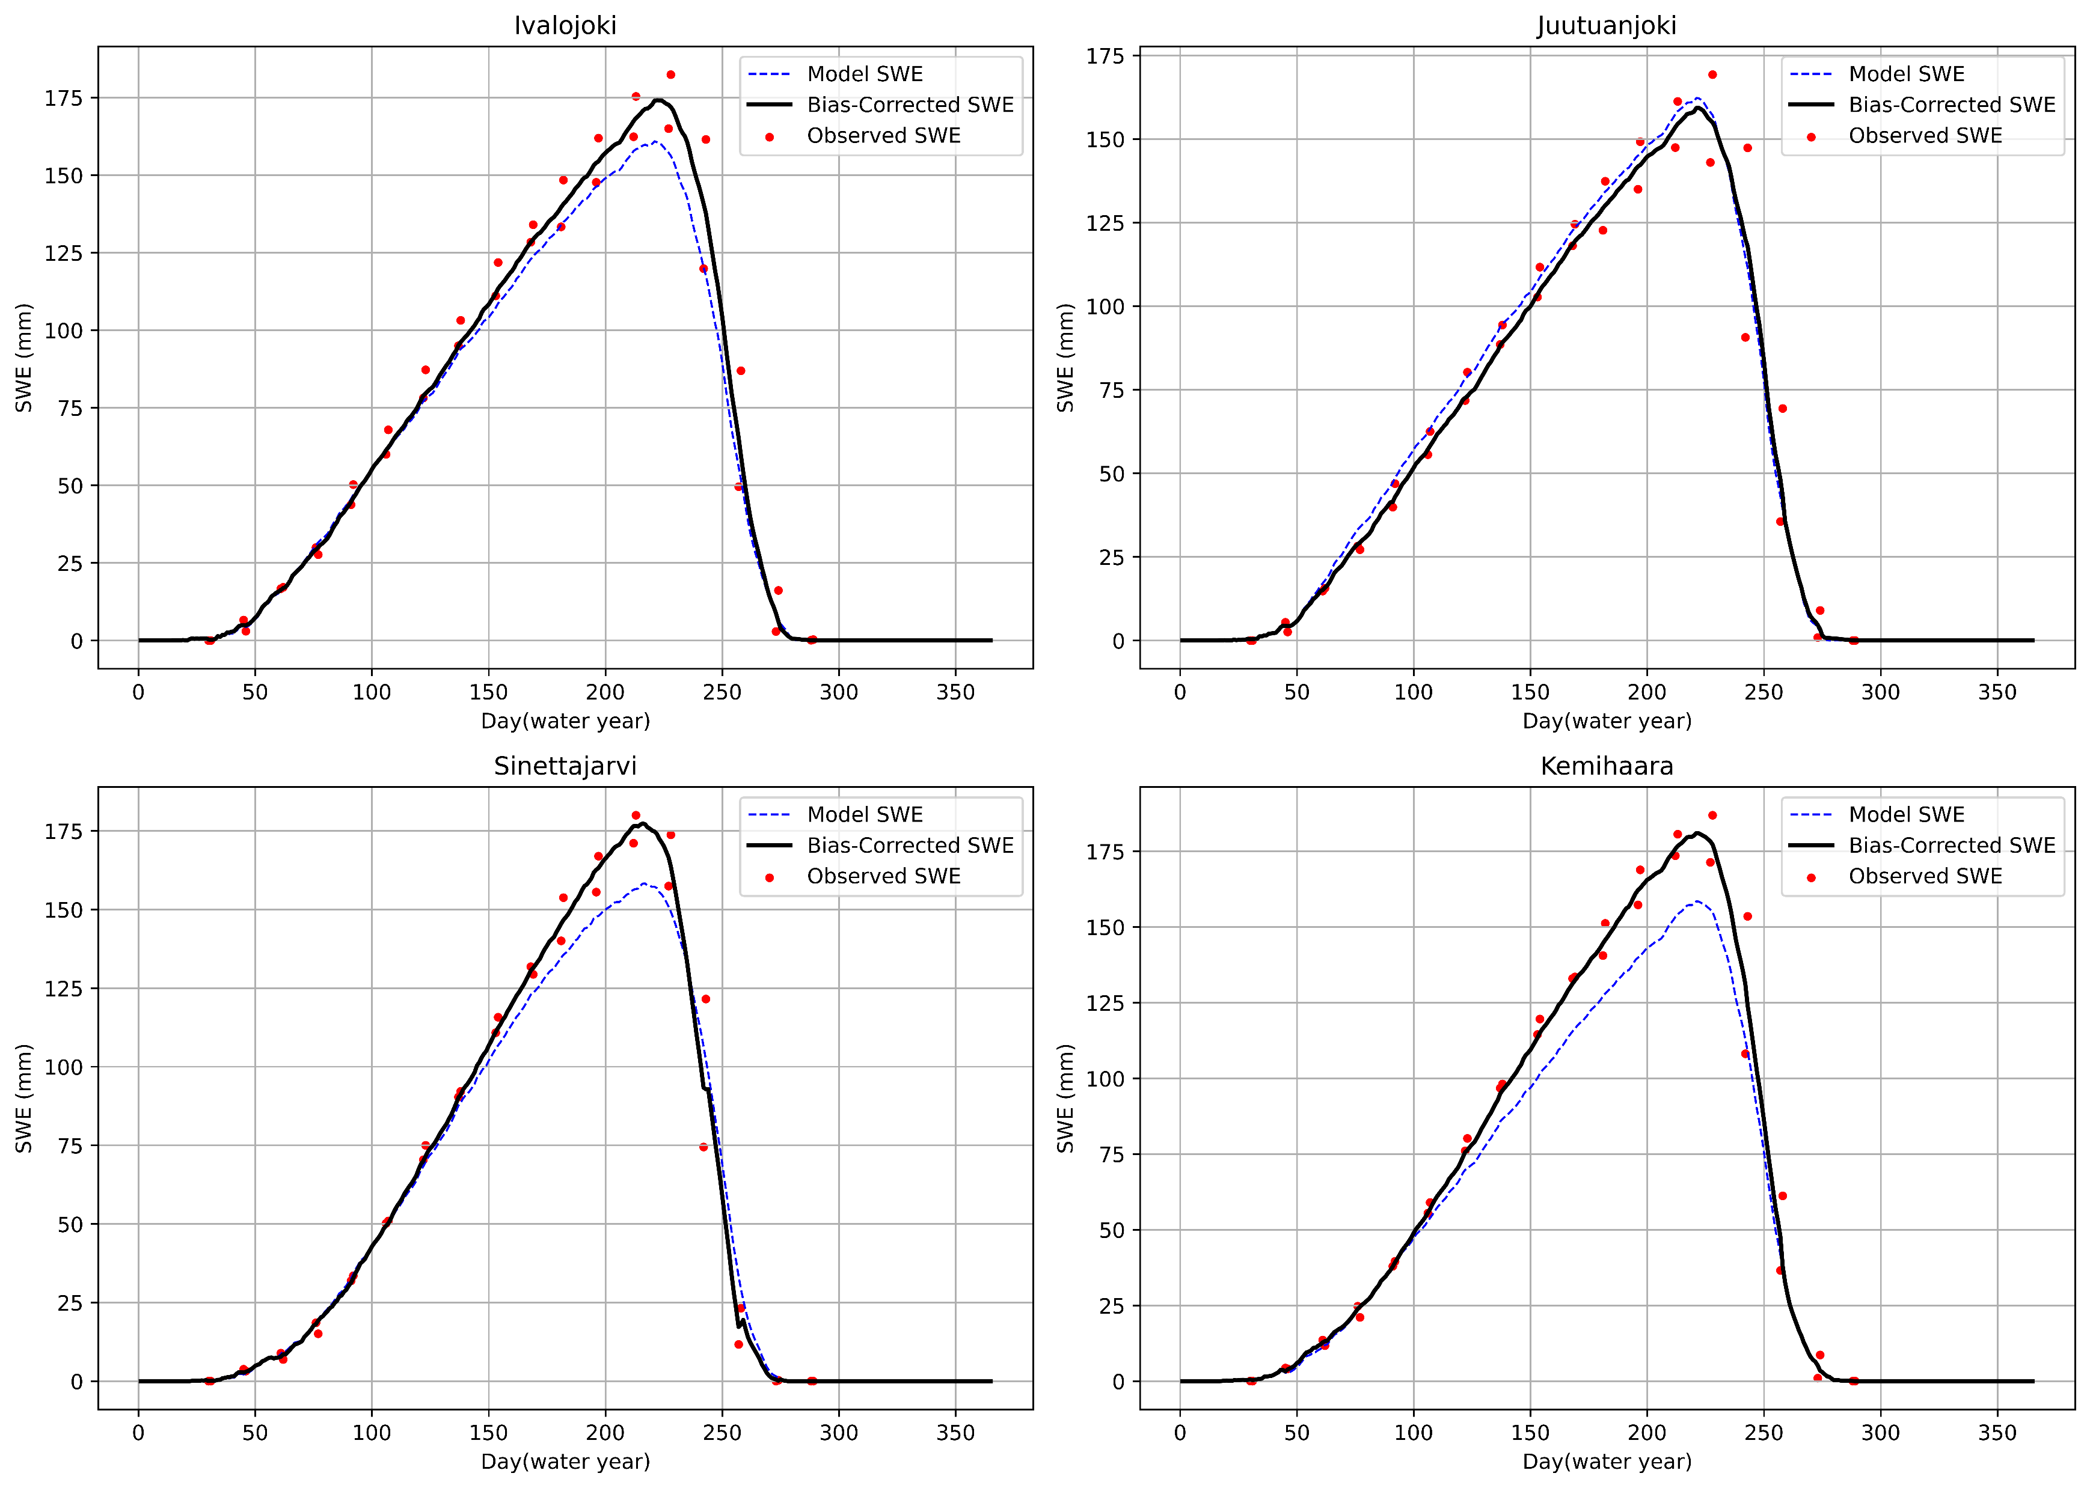
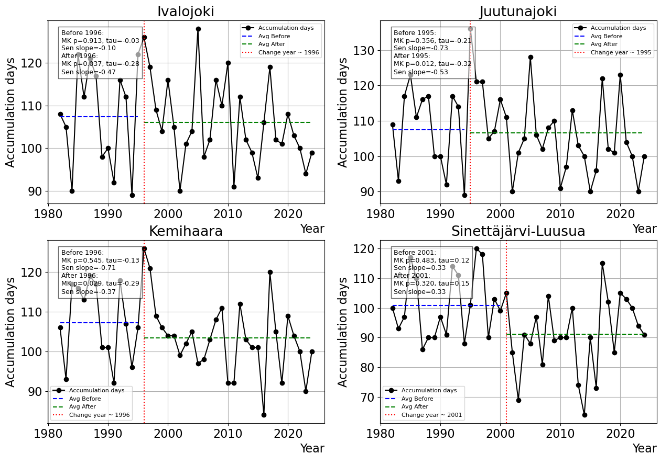
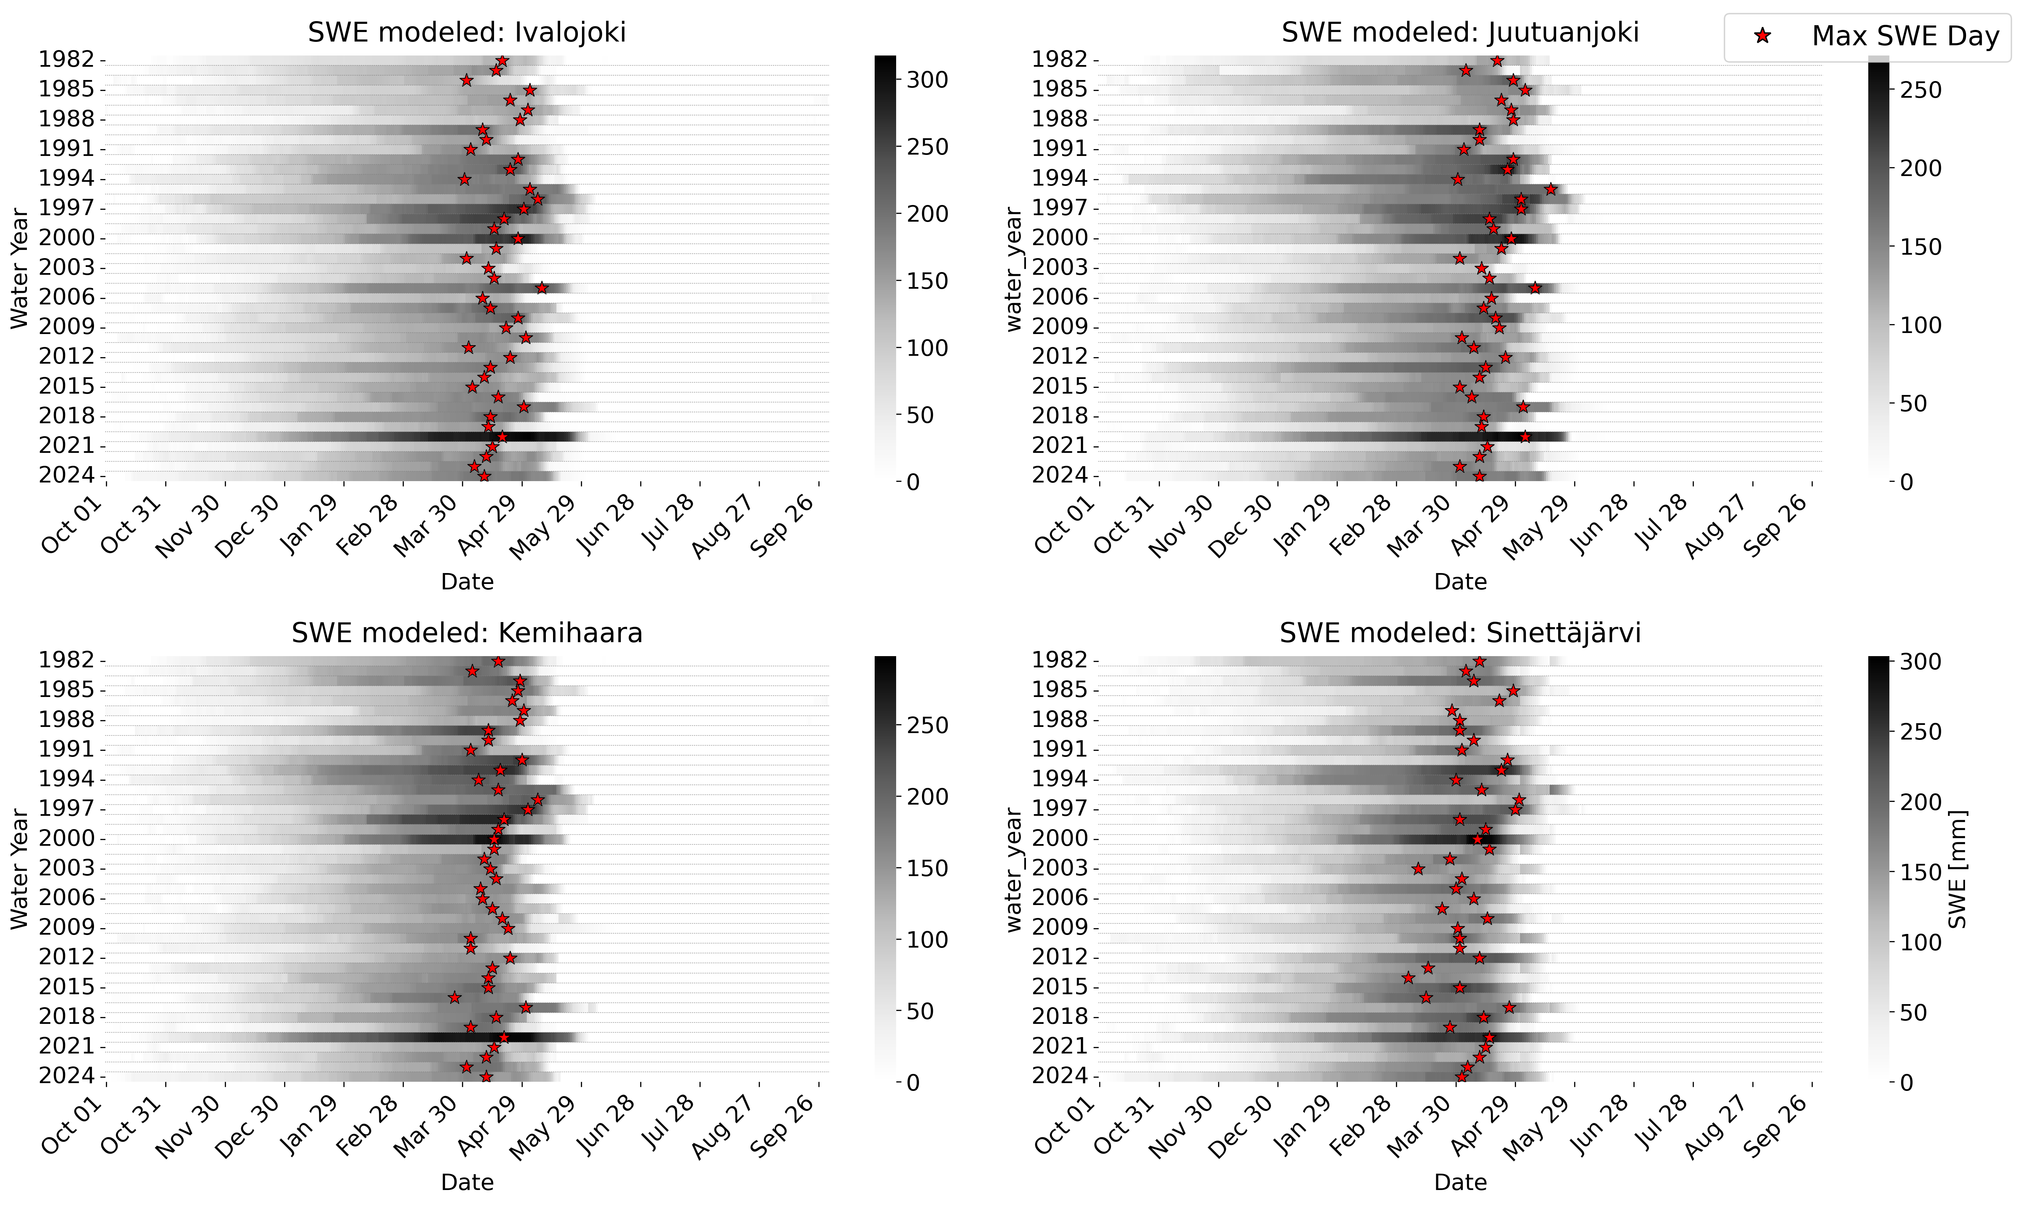
Changes in Snowmelt Timing and Peak Flow Generation in Non-Regulated Finnish Catchments
Temporal mismatch with flow
Missing the actual maximum water content from snow
Snow accumulation period
Discontinuous measurements
Significantly shorter period from the year SWE alterations were detected.

Slide 7
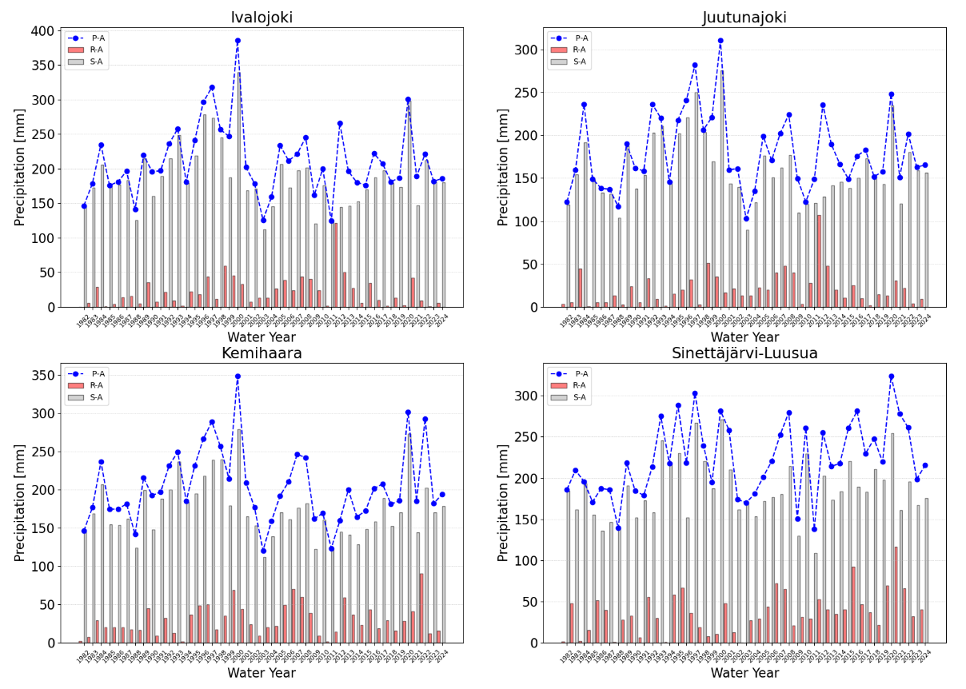
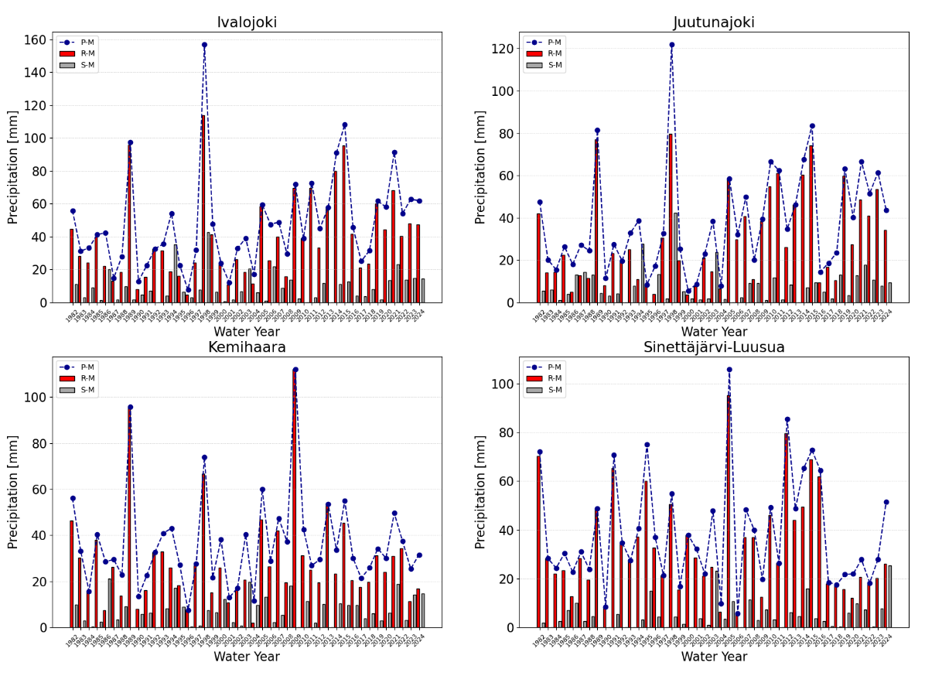
Changes in Snowmelt Timing and Peak Flow Generation in Non-Regulated Finnish Catchments
Precipitation pattern during snow accumulation period
Precipitation pattern during snow melt period
Catchment | Precipitation | LTM ⃰ | Period | WLTM-RP ⃰ ⃰
Ivalojoki | Rain | 14.99 | <= 1996 | 2.5
 | Rain | 14.99 | > 1996 | 2
 | Rain | 14.99 | WholePeriod | 2.15
 | Snow | 152.16 | <= 1996 | 2.14
 | Snow | 152.16 | > 1996 | 3.11
 | Snow | 152.16 | WholePeriod | 2.69
 | Total | 167.15 | <= 1996 | 2.14
 | Total | 167.15 | > 1996 | 2
 | Total | 167.15 | WholePeriod | 2.05
Juutunajoki | Rain | 13.43 | <= 1995 | 2.33
 | Rain | 13.43 | > 1995 | 1.93
 | Rain | 13.43 | WholePeriod | 2.05
 | Snow | 129.66 | <= 1995 | 2.33
 | Snow | 129.66 | > 1995 | 2.64
 | Snow | 129.66 | WholePeriod | 2.53
 | Total | 143.09 | <= 1995 | 3.5
 | Total | 143.09 | > 1995 | 2.07
 | Total | 143.09 | WholePeriod | 2.39
Kemihaara | Rain | 21.66 | <= 1996 | 2.5
 | Rain | 21.66 | > 1996 | 2
 | Rain | 21.66 | WholePeriod | 2.15
 | Snow | 144.5 | <= 1996 | 2.5
 | Snow | 144.5 | > 1996 | 2
 | Snow | 144.5 | WholePeriod | 2.15
 | Total | 166.16 | <= 1996 | 1.88
 | Total | 166.16 | > 1996 | 1.87
 | Total | 166.16 | WholePeriod | 1.87
Sinettäjärvi-Luusua | Rain | 30.99 | <= 2001 | 2.5
 | Rain | 30.99 | > 2001 | 2.56
 | Rain | 30.99 | WholePeriod | 2.53
 | Snow | 146.87 | <= 2001 | 2.22
 | Snow | 146.87 | > 2001 | 1.77
 | Snow | 146.87 | WholePeriod | 1.95
 | Total | 177.86 | <= 2001 | 2.5
 | Total | 177.86 | > 2001 | 2.09
 | Total | 177.86 | Whole Period | 2.26
No significant long-term precipitation trend
Shorter return periods after snow-cover change
Indicates intensified rainfall during snowmelt
Long Term Mean (LTM) Precipitaion and corresponding return period

