Slide 1
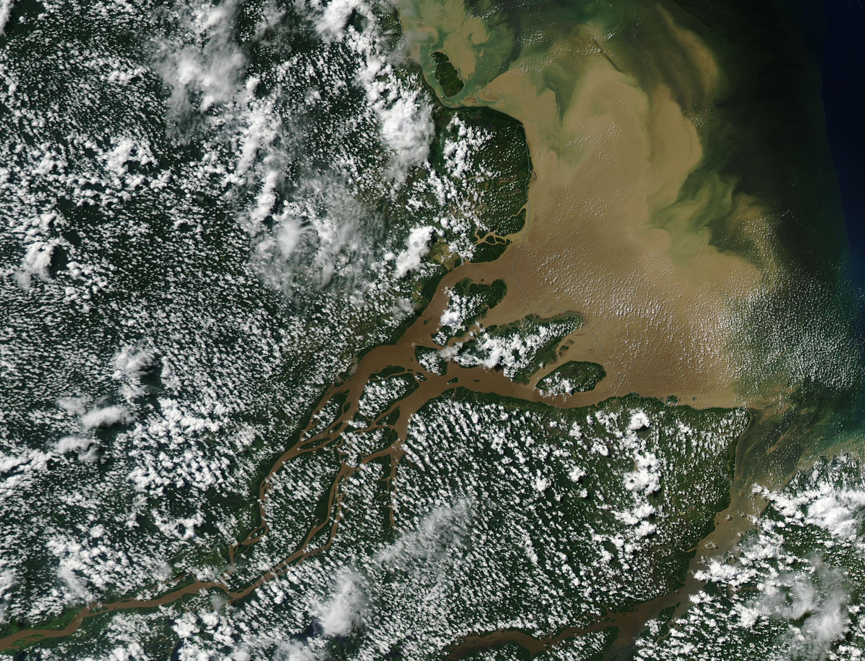


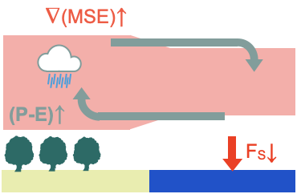
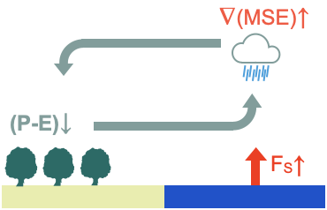


The response of Tropical land-ocean precipitation partitioning to CO2 and SST increase in global storm-resolving simulations
Marius Schulz and Cathy Hohenegger
Max-planck-institute for meteorology, Hamburg
“Fast” (4xCO2): $χ↑$
”Slow” (+4K): $χ↓$
Precipitation partitioning $χ=\frac{P_{l}}{P_{tot}}$
Opposite land-sea precipitation shifts in the “fast” and “slow” response to CO2 increase
GSRMs simulate convection explicitly – no convective parameterization needed
How does the precipitation partitioning respond to CO2 and SST increase in ICON ?

Slide 2



Key findings
ICON at 10km shows a better baseline representation of precipitation partitioning than CMIP6 models
We develop a quantitative framework for precipitation partitioning based on the land’s energy and mositure budget
Land-sea heating asymmetries drive the shifts in the tropical precipitation partitioning
ICON exhibits a stronger landward shift of precipitation in response to CO2 direct radiative forcing than the AMIP6 ensemble
marius.schulz@mpimet.mpg.de

Slide 3
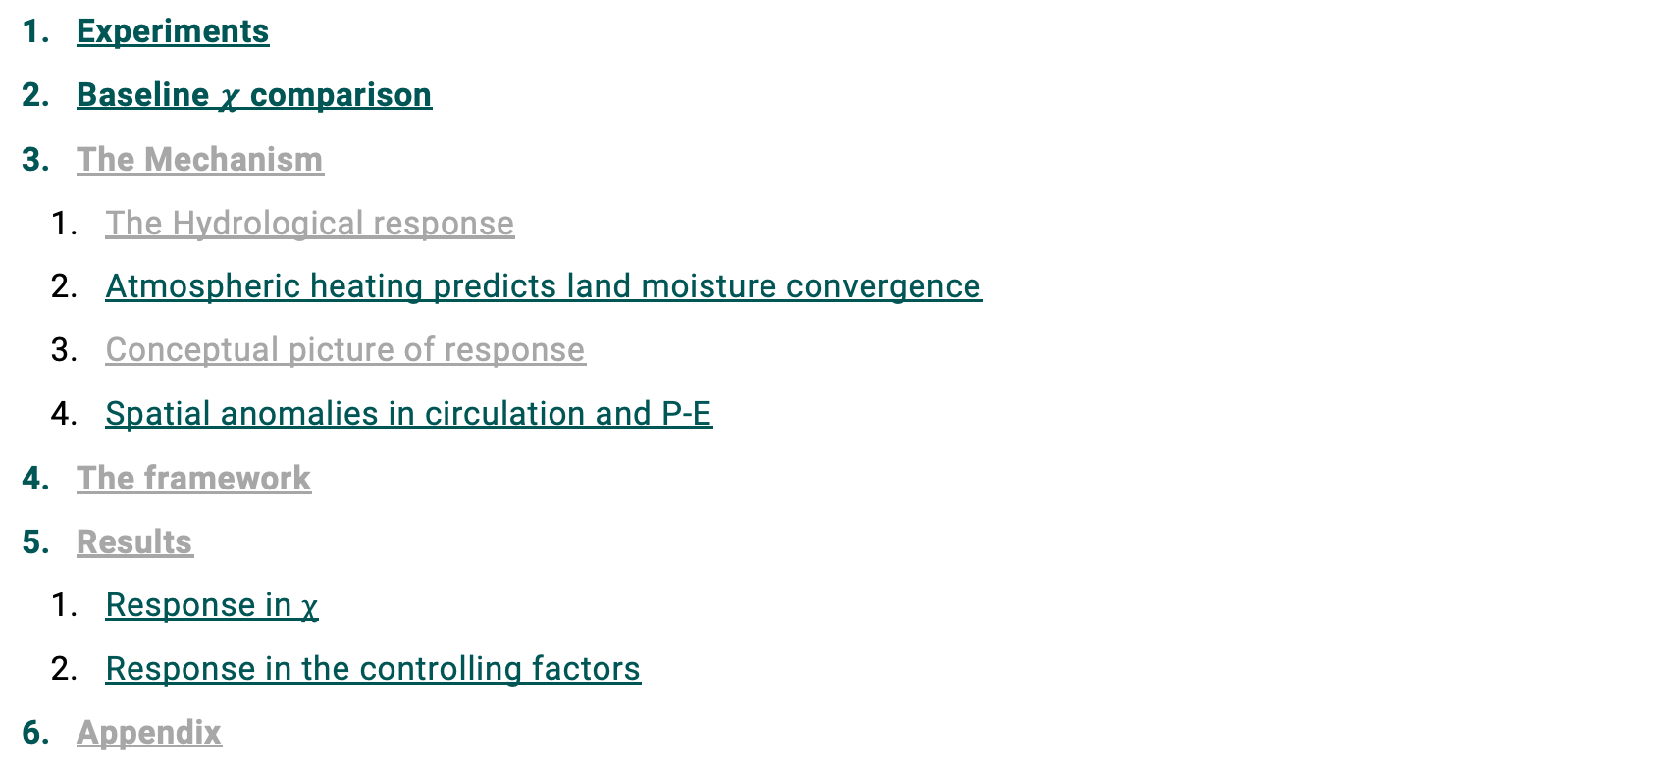
Table of contents
Experiments
Baseline $χ$ comparison
The Mechanism
    The Hydrological response
    Atmospheric heating predicts land moisture convergence
    Conceptual picture of response
    Spatial anomalies in circulation and P-E
The framework
Results
    Response in $χ$
    Response in the controlling factors
Appendix

Slide 4

Methods: The ICON experiments
amip
amip-p4k
amip-4xco2
Model | ICON-Sapphire Atmosphere-Land (Hohenegger et. al., 2023)
Resolution | 10km horizontal resolution (R2B8)
Period | 15 years (1979-1994)
Ocean BC | Historical SSTs | +4K uniformly | Historical SSTs
GHG | Historical CO₂ | Historical CO₂ | 4xCO₂

Slide 5
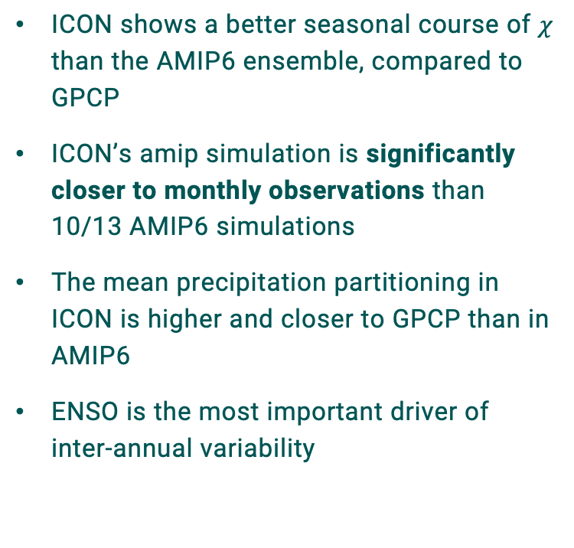
The baseline of precipitation Paprtitioning
ICON shows a better seasonal course of $χ$ than the AMIP6 ensemble, compared to GPCP
ICON’s amip simulation is significantly closer to monthly observations than 10/13 AMIP6 simulations
The mean precipitation partitioning in ICON is higher and closer to GPCP than in AMIP6
ENSO is the most important driver of inter-annual variability

Slide 6
The Hydrological response to 4xCO2 and +4K
Mechanism (I)
The precipitation response over ocean follows changes in RCE
Precipitation changes over land are opposite to ocean, and dominated by land moisture convergence

Slide 7
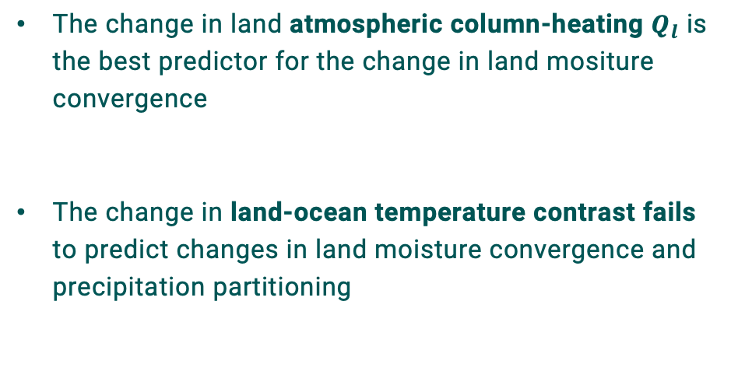
Land atmospheric heating best predictor for land moisture convergence adjustments
Mechanism (II)
The change in land atmospheric column-heating $Q_{l}$ is the best predictor for the change in land mositure convergence
The change in land-ocean temperature contrast fails to predict changes in land moisture convergence and precipitation partitioning
$$Q_{l}=LH+SH −R_{net}$$

Slide 8
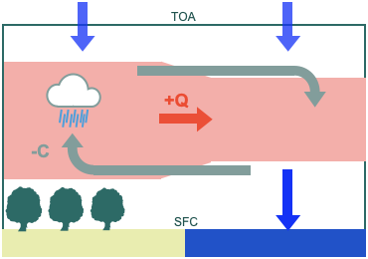
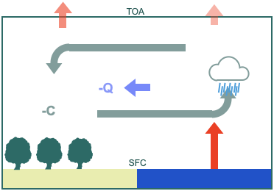
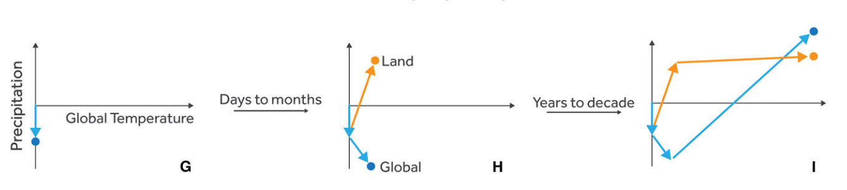
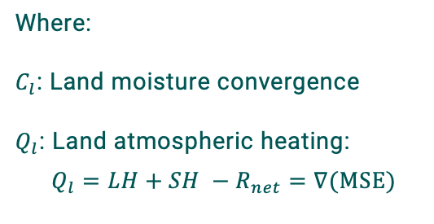
Opposite heating asymmetries and circulation adjustments in 4xco2 and +4K
Mechanism (III)
Zonal anomalies:
4xCO2
+4K
Where:
$C_{l}$: Land moisture convergence
$Q_{l}$: Land atmospheric heating:
$$Q_{l}=LH+SH −R_{net}=∇(MSE)$$
Response time after abrupt forcing:
Allan et. al., 2020

Slide 9
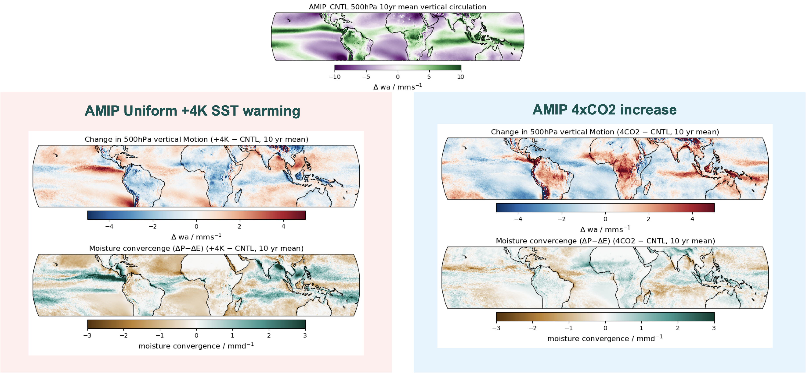
Spatial anomalies in vertical wind and mositure convergence
Mechanism (IV)

Slide 10
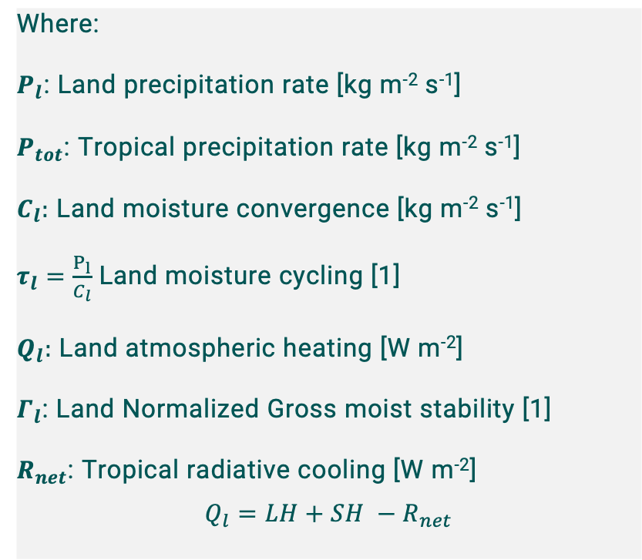

harnessing the land moistrue and energy budget
The Framework
Thermodynamical vs. dynamical:
$$χ=\frac{P_{l}}{P_{tot}}=\frac{C_{l}τ_{l}}{P_{tot}}$$
2) Moisture-energy coupling (NGMS):
$$Γ_{l}=\frac{Q_{l}}{{L_{v}C}_{l}}$$
4) Combination:
$$χ=\frac{Q_{l}τ_{l}}{{L_{v}P}_{tot}Γ_{l}}$$
In RCE:
$$χ=\frac{Q_{l}τ_{l}}{R_{net}Γ_{l}}$$
Where:
$P_{l}$: Land precipitation rate [kg m⁻² s⁻¹]
$P_{tot}$: Tropical precipitation rate [kg m⁻² s⁻¹]
$C_{l}:$ Land moisture convergence [kg m⁻² s⁻¹]
$τ_{l}=\frac{P_{l}}{C_{l}}$ Land moisture cycling [1]
$Q_{l}:$ Land atmospheric heating [W m⁻²]
$Γ_{l}$: Land Normalized Gross moist stability [1]
$R_{net}$: Tropical radiative cooling [W m⁻²]
$$Q_{l}=LH+SH −R_{net}$$

Slide 11
The response of precipitation partitioning in ICON and AMIP6
Compared to the 13-model AMIP6 ensemble, ICON shows a similar response, but:
  A stronger response to 4xCO2
  A relatively weak response to +4K
Combined, the differences suggest a more stable precipitation partitioning in ICON under global warming

Slide 12
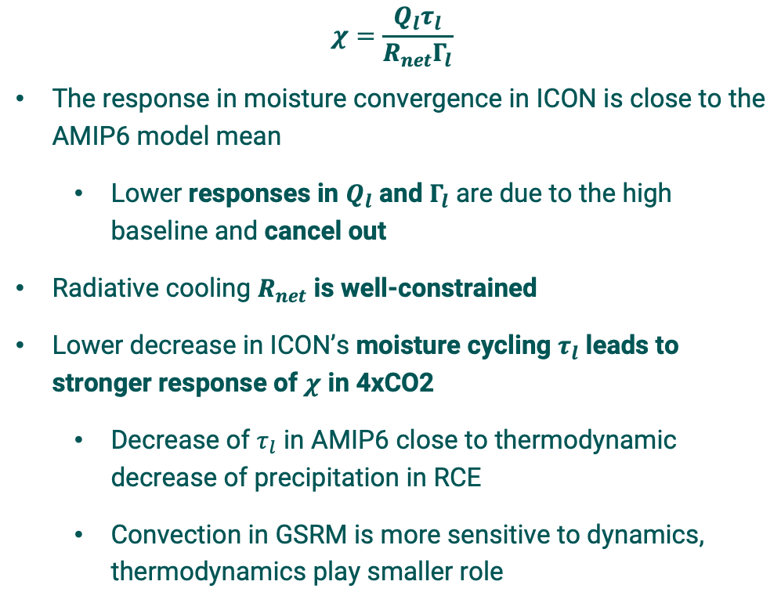
The response of Controlling factors in ICON and AMIP6
$$χ=\frac{Q_{l}τ_{l}}{R_{net}Γ_{l}}$$
The response in moisture convergence in ICON is close to the AMIP6 model mean
  Lower responses in $Q_{l}$ and $Γ_{l}$ are due to the high baseline and cancel out
Radiative cooling $R_{net}$ is well-constrained
Lower decrease in ICON’s moisture cycling $τ_{l}$ leads to stronger response of $χ$ in 4xCO2
  Decrease of $τ_{l}$ in AMIP6 close to thermodynamic decrease of precipitation in RCE
  Convection in GSRM is more sensitive to dynamics, thermodynamics play smaller role

Slide 13
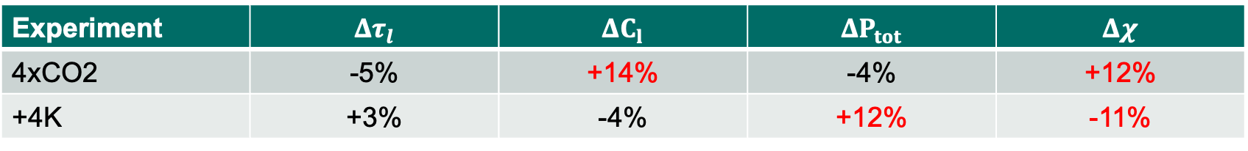
Thermodynamical vs. dynamical changes
Appendix I
Relative change compared to control
Experiment | $$Δτ_{l}$$ | $$ΔC_{l}$$ | $$ΔP_{tot}$$ | $$Δχ$$
4xCO2 | -5% | +14% | -4% | +12%
+4K | +3% | -4% | +12% | -11%

Slide 14
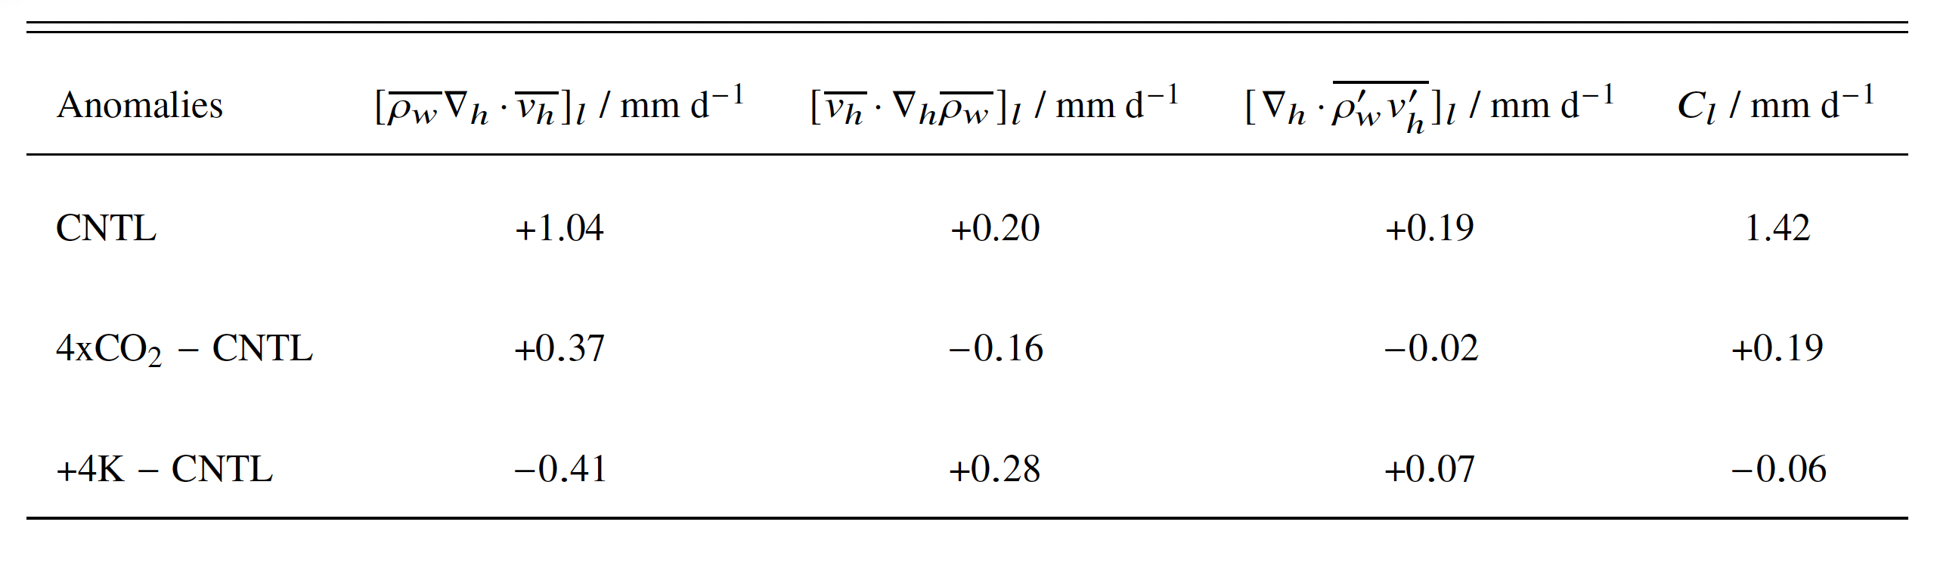


Proving the circulation component is responsible for the response in land moisture convergence
Appendix II
Mean circulation
Mean humidity gradient
Eddy terms ($Δt<1d$)
Changes in circulation cause direction of change in $C_{l}$
Humidity gradient even act as negative feedback

Slide 15
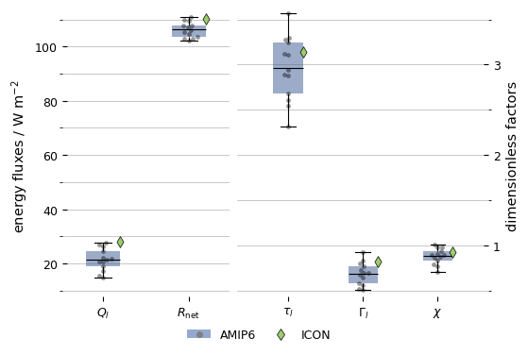
The baseline from the moisture&energy perspective
Appendix III

