Slide 1
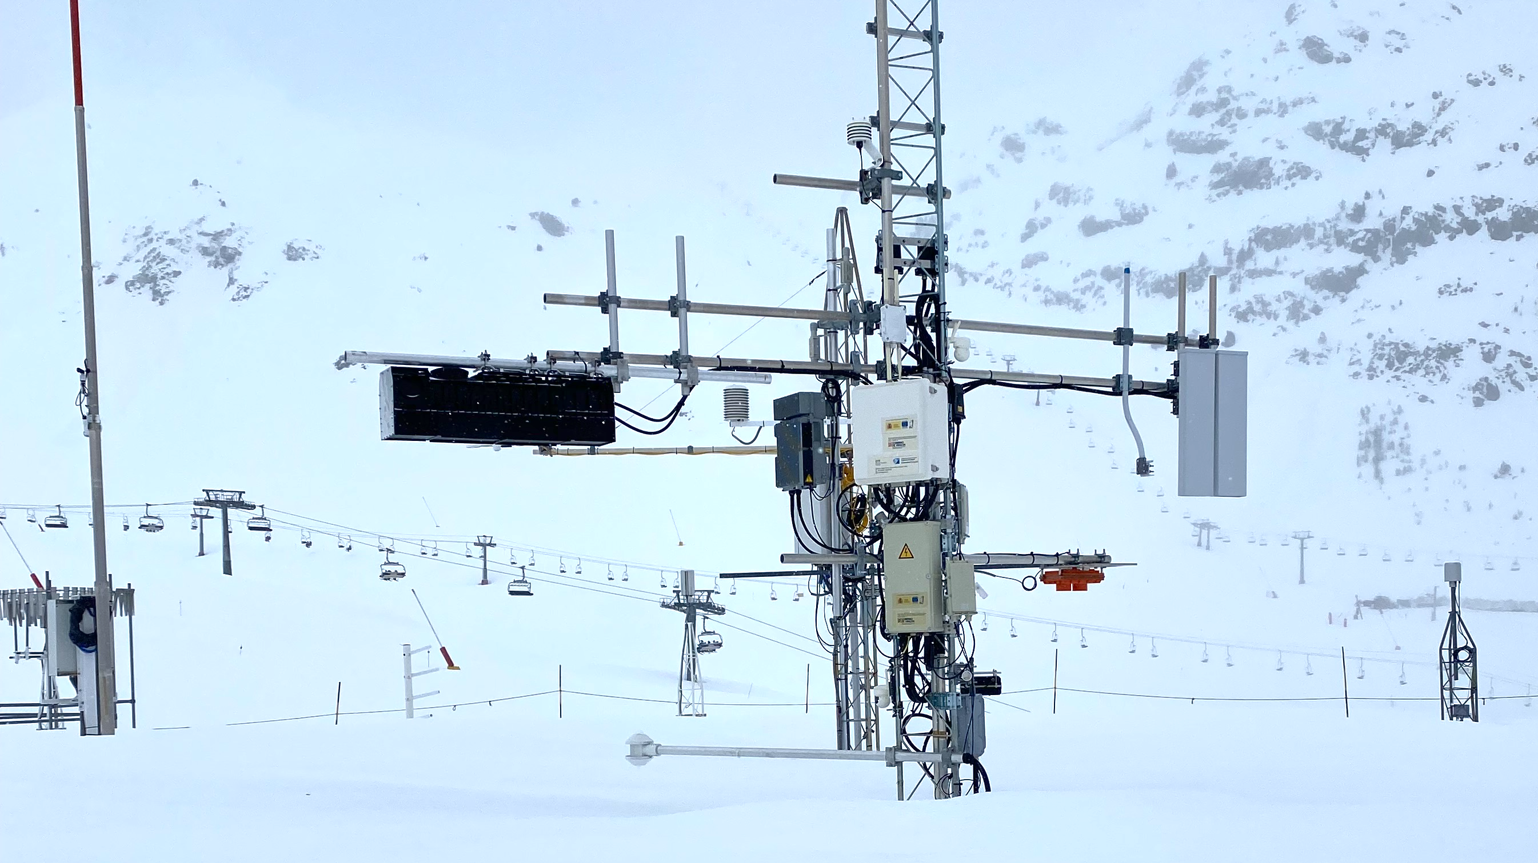



Estimation of Liquid Water Content and Density in the Surface Layer of the Snowpack from the Phase and Amplitude of SFCW of Radar Signals
Pico presentation
Adrián Subías (asubias@unizar.es)
Víctor Herráiz / Iñigo Salinas
Rafael Alonso
CR6.2 : Geophysical and in situ methods in the Cryosphere
EGU General Assembly 2025, Vienna, Austria & Online | 3– 8 May 2026

Slide 2


SFCW radar snowpack reflectance: a complex inversion problem
Full electromagnetic inversion of the snowpack is highly complex and remains an ongoing challenge.
As a first step, we focus on the surface reflection to retrieve density and LWC of first layer.
Air–snow and snow–ground interfaces clearly identified. We focus on the complex surface reflection.
$$Γ= Γ^{′}+jΓ^{′′}=\left|Γ\right|e^{jϕ}$$
$n_{2}=n_{2}′$+j$n_{2}′′$= $\frac{1−Г}{1+Г}$
LWC of first layer
density of first layer

Slide 3
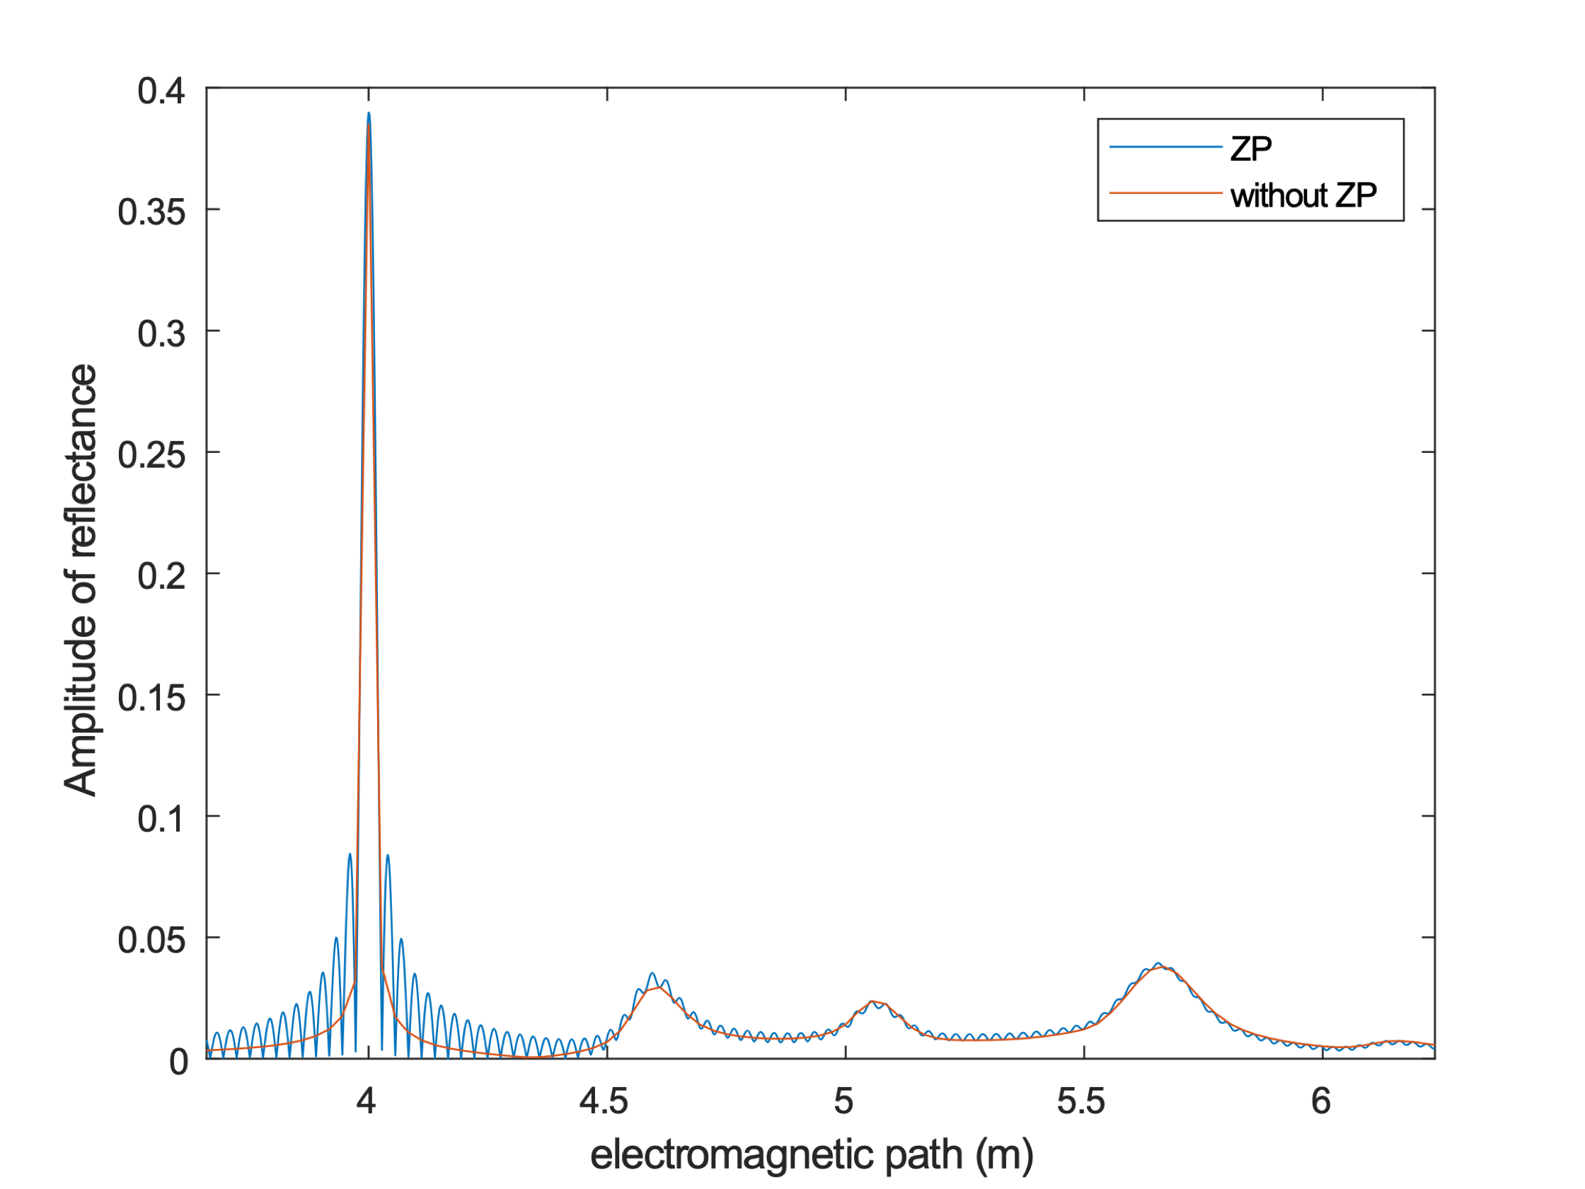


Physical basis: why phase and amplitude work?
Volumetric fractions: $Air:φ_{air}; Ice:φ_{ice}; Water:φ_{water}$
Density: $ρ_{wet−snow}=φ_{air}ρ_{air}+φ_{ice}ρ_{ice}+φ_{water}ρ_{water}$
Complex refractive index: $n_{wet−snow}=φ_{air}n_{air}+φ_{ice}n_{ice}+φ_{water}n_{water}$
$$Γ$$
$$Γ=0.39e^{−0.0168j}$$
density = 307 kg/m³
LWC = 10 %
Stimated density = 324 kg/m³
Stimated LWC = 11 %
Initial density and LWC retrieval
Synthetic snowpack structure
Theoretical reflection of structure

Slide 4
Preliminary stimation of LWC and density
 | Snowpit measurement |  | Estimations based on radar measurement
Date | LWC (%) | Density (Kg/m³) | LWC (%) | Density (Kg/m³)
06/12/2025 | 2.75 | 235 | 2.9 | 204
30/12/2025 | 0 | 155 | 0 | 100
06/01/2025 | 1.1 | 416 | 2.5 | 426
15/01/2025 | 0 | 305 | 2.6 | 317
19/03/2026 | 4.3 | 398 | 6.5 | 377

Slide 5
Estimation of Liquid Water Content and Density in the Surface Layer of the Snowpack from the Phase and Amplitude of SFCW Radar Signals
Additional information
Adrián Subías (asubias@unizar.es)
Víctor Herráiz / Iñigo Salinas
Rafael Alonso
CR6.2 : Geophysical and in situ methods in the Cryosphere
EGU General Assembly 2025, Vienna, Austria & Online | 3– 8 May 2026

Slide 6
Index
Overview of the System
Step-Frequency Continuous Wave Radar (SFCW)
Hardware/Software Implementation of the SFCW Radar
Electromagnetic properties
Electromagnetic Modelling of the Snowpack
Examples of Comparative Analysis
Preliminary experimental results

Slide 7
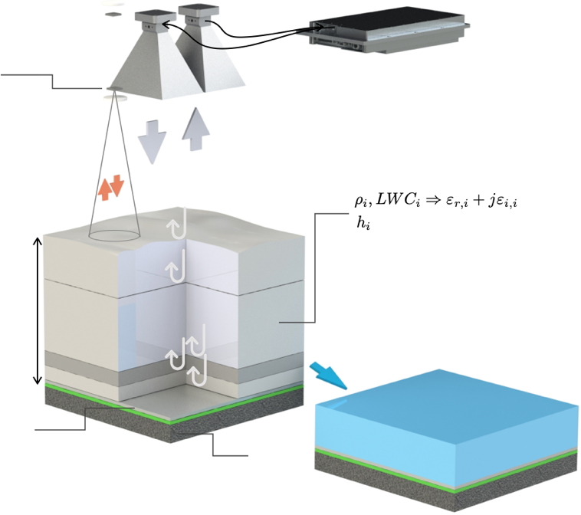

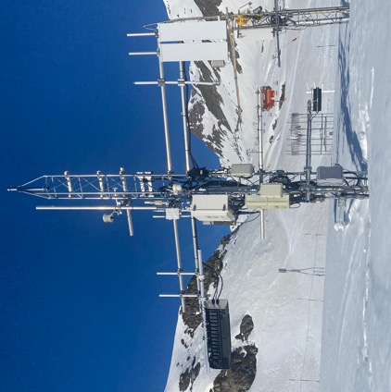

1. Overview of the System
Complex spectral Reflectance of snowpack (0.6-6 GHz, ∆f=2.5 MHz, 2160 points) with coherent SDR
UWB TX RX antennas
Coherent Software Defined Radio (SDR) 0.6 – 6 GHz
FMCW 60GHz height measurement
Temporal / spatial reflectance
snowpack
H
SWE
Soil or metal sheet

Slide 8
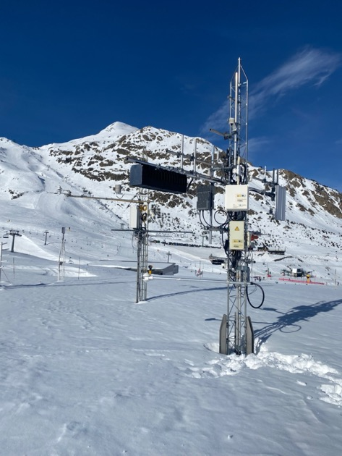
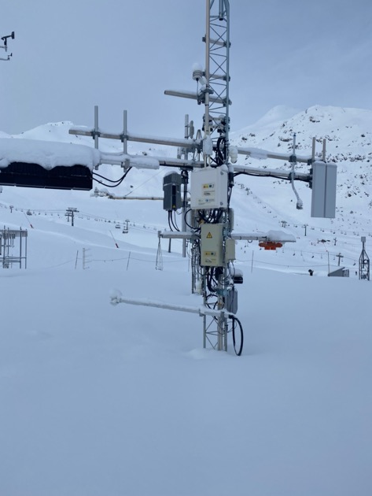
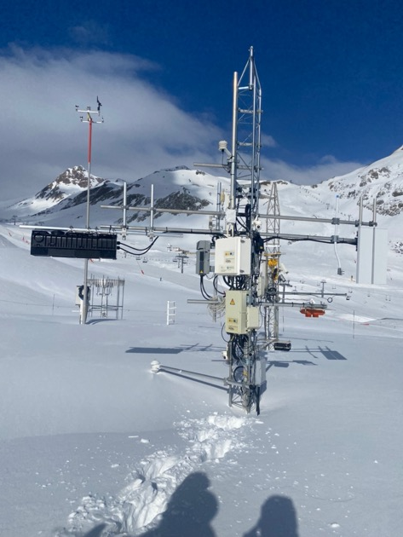
1. Overview of the System

Slide 9
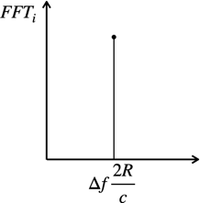
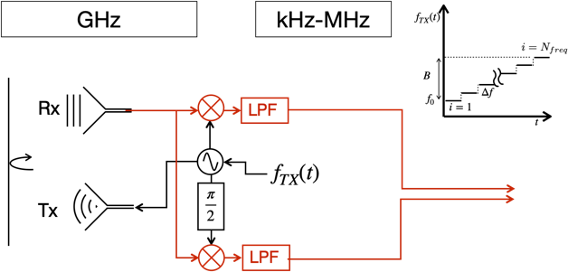
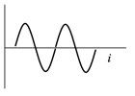



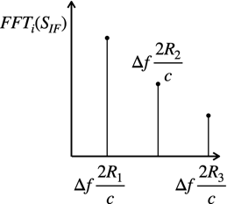

2. Step-Frequency Continuous Wave Radar (SFCW)
Fundamentals
Single-target detection
Intermediate frequency (IF)
An SFCW radar transmits consecutive trains of continuous wave signals with progressively increasing frequencies toward the target. After signal processing, typically involving a Fast Fourier Transform (FFT), the final result is a peak that indicates the distance, R, to the target. In the case of multiple targets, the transformation results in distinct peaks in the frequency domain, each corresponding to the distance of a different target.
Advantages
High range resolution:
By effectively synthesizing a large bandwidth through small frequency steps, SFCW radar achieves very precise distance measurements.
Simple transmitter design:
The transmitter is simpler compared to high-power pulsed radar systems.
Disadvantages
Longer measurement time:
Because many frequencies need to be transmitted sequentially, acquiring a full measurement
takes more time compared to pulsed radar. Snow is a static target !!!.
Multi-target detection

Slide 10
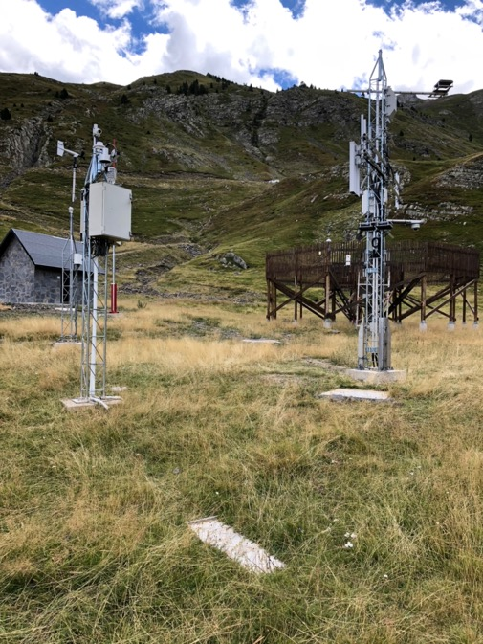

3. Hardware/Software Implementation of the SFCW Radar
Radar performance
Parameter | Value | Parameter | Value
Start frequency | 600 MHz | Stop frequency | 6 GHz
Number of steps (Nfreq) | 2161 10000 | Stepped-frequency, | 2.5 MHz 0.54 MHz
Chirp period | 7 min 25 sec | Unambiguous range, Ru | 60 m 280 m
Resolution (in vacuum) | 2.8 cm | Intermediate frequency (IF) | 77 kHz
Sampling rate | 1.562502 MS/s | Antennas wide band | 675 MHz–12 GHz
Directivity of antennas | 9.69 dBi @ 2.4 GHz | FOV of Tx and Rx antennas | < 15°
$$Δf$$
Reflecting plate
SAIH-CHE N014 CRN gauge in soil

Slide 11
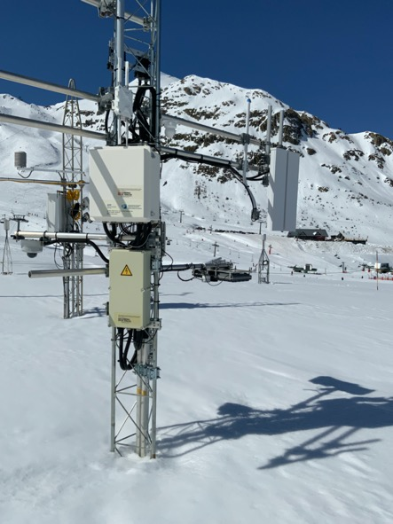
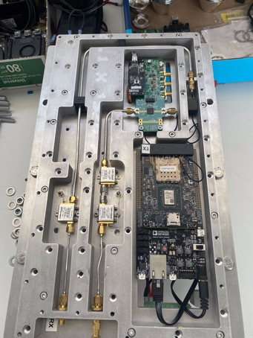
3. Hardware/Software Implementation of the SFCW Radar
The ADRV9361-Z7035 SDR board from Analog Devices has been selected, integrating two coherent transmit and receive channels. It is a highly compact System on Module (SOM).
The module is based on the AD9361 Integrated RF Agile Transceiver™ and the Xilinx Z7035 Zynq®-7000 FPGA, enabling a reliable and robust measurement system within the 70 MHz to 6 GHz frequency range.
Inside the radar block, a MATLAB® program runs on the computer, where the SDR transmits and receives 2160 frequencies between 600 MHz and 6 GHz, corresponding to frequency steps of 2.5 MHz. The duration of this sweep is approximately 7 minutes.
Broadband DRH (Double-Ridged Horn) antenna (1 GHz – 6 GHz) for transmission and reception
Broadband Vivaldi antennas
LPF
TX circuit
SDR
RX circuit

Slide 12
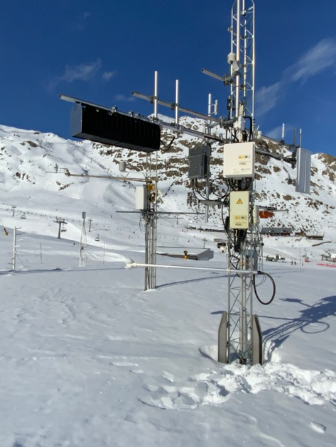
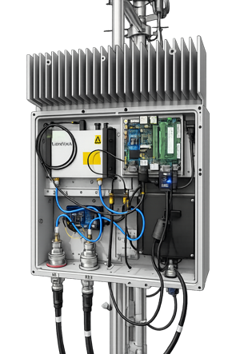
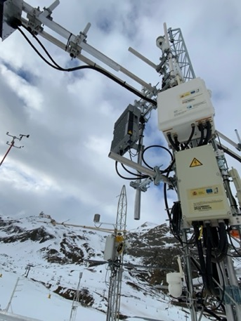
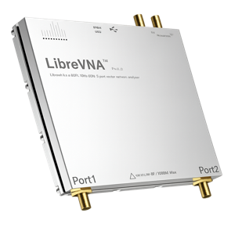
3. Hardware/Software Implementation of the SFCW Radar
The LibreVNA has been selected as the core measurement instrument, integrating coherent transmit and receive capabilities within a compact and versatile platform. It is a highly flexible open-source vector network analyzer (VNA) designed for accurate and repeatable RF measurements. The system is based on a dual-channel RF architecture combined with high-speed digital processing, enabling a reliable and robust measurement system over a frequency range typically spanning from 100 kHz to 6 GHz.
Inside the radar block, a MATLAB® program runs on the computer, where the VNA transmits and receives 10000 frequencies between 600 MHz and 6 GHz, corresponding to frequency steps of 0.54 MHz. The duration of this sweep is approximately 25 seconds.

Slide 13
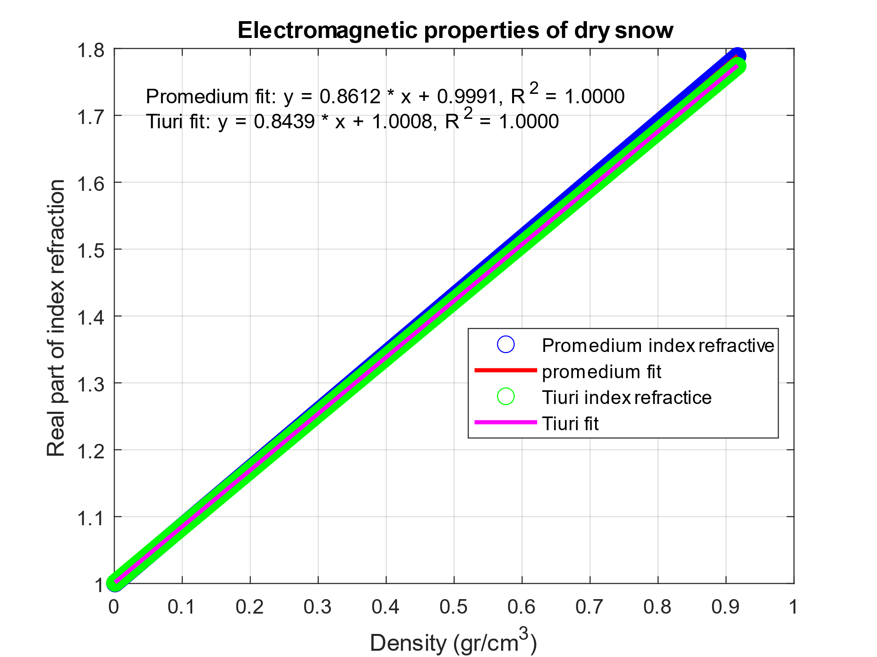
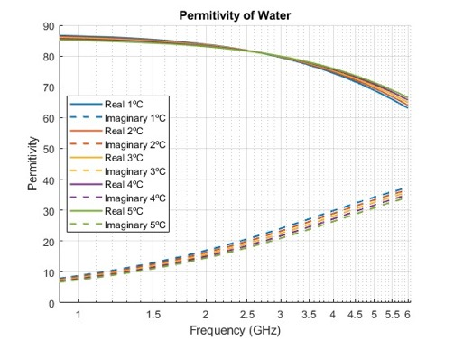

4. Electromagnetic Properties of snowpack
Dry snow:
Air: $ρ_{air}$ = 1.2 kg/m³; $ε_{air}$ = 1
Ice: $ρ_{ice}$ = 917 kg/m³; $ε_{ice}$ = 3.2
The imaginary part in dry snow is negligible
Water: $ρ_{water}$ = 1000 kg/m³; $ε_{water}$ = $ε$’_{w} + j$ε$’’ _{w}

Slide 14
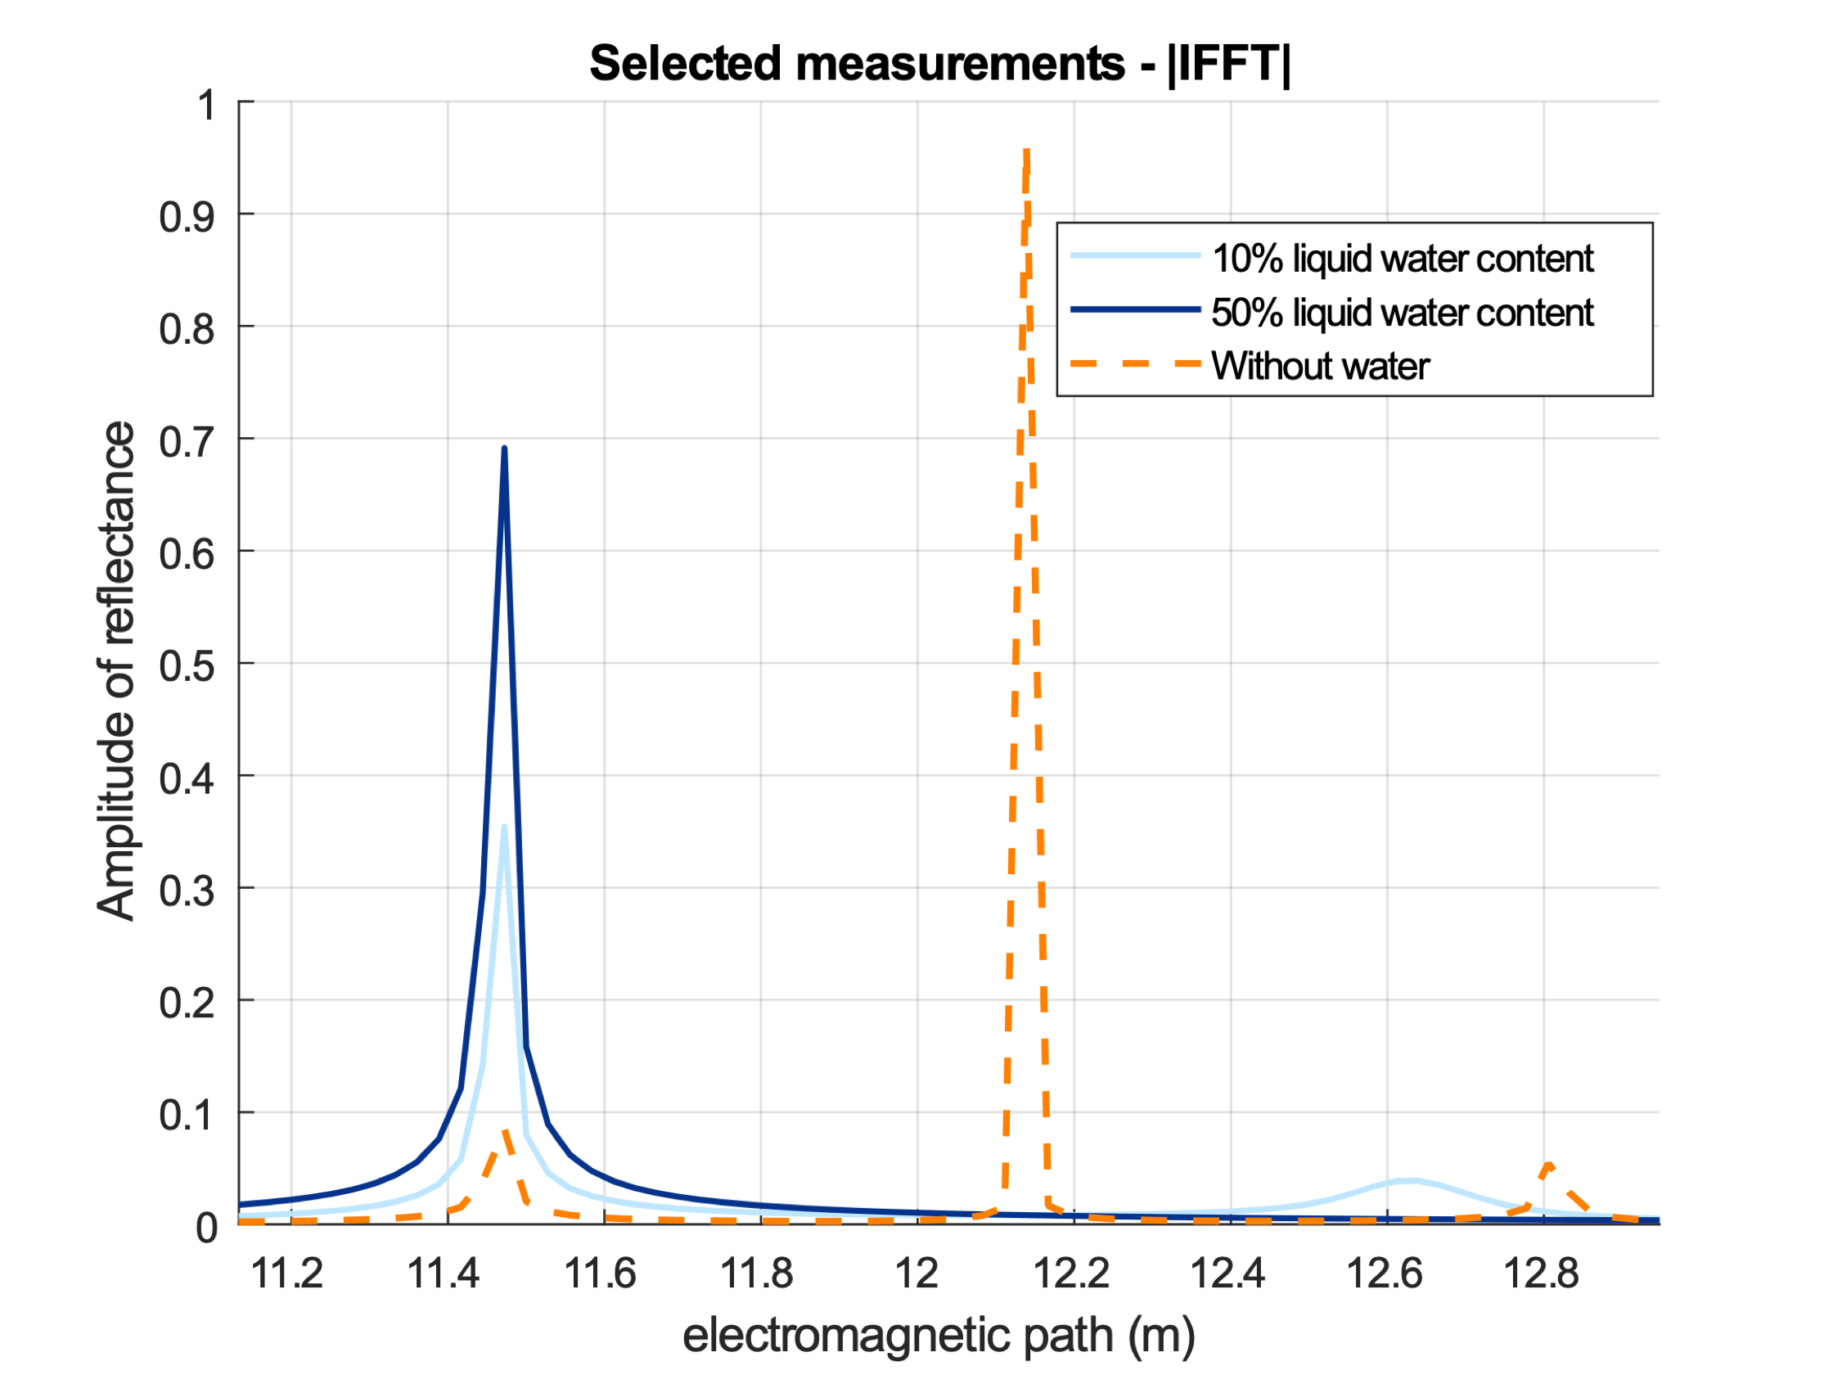
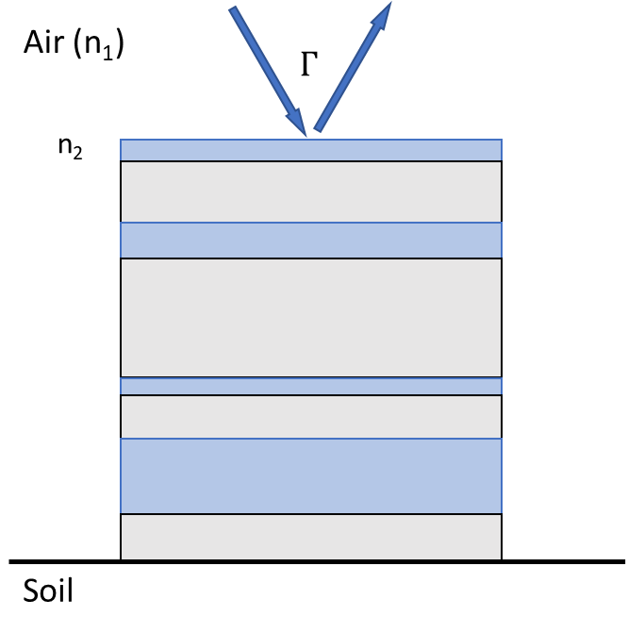
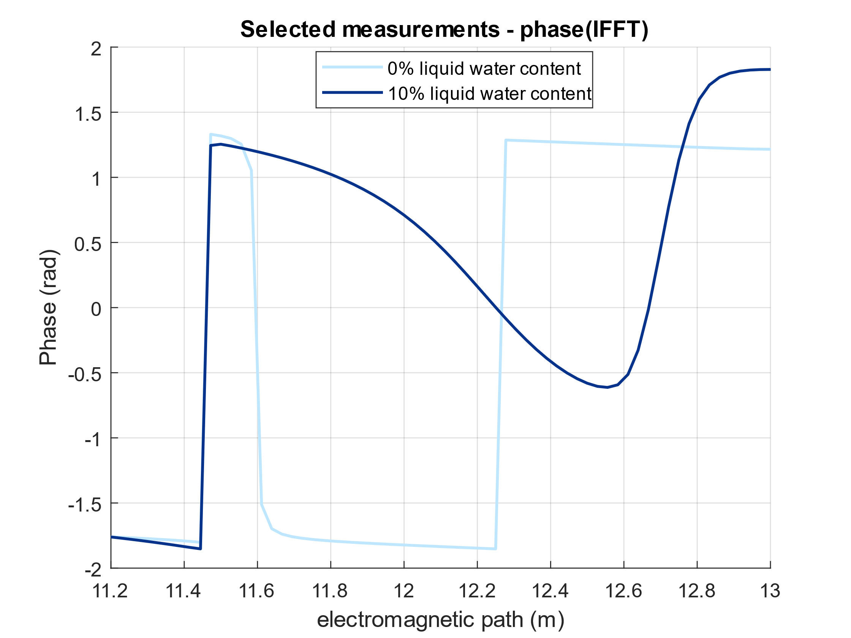

4. Electromagnetic properties
Reflection coefficient under Stepped Frequency Continuous Wave radar
$$Γ= Γ^{′}+jΓ^{′′}=\left|Γ\right|e^{jϕ}$$

Slide 15
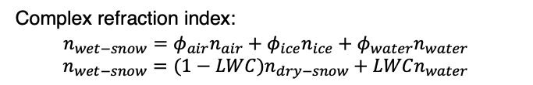

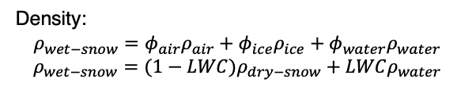
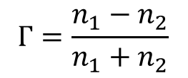

4. Electromagnetic Properties
Gamma coefficient
Volumetric fractions:
$$Air:φ_{air}; Ice:φ_{ice}; Water:ρ_{water}$$
Reflection coefficient at the interface air-snow:
Density:
$$ρ_{wet−snow}=φ_{air}ρ_{air}+φ_{ice}ρ_{ice}+φ_{water}ρ_{water}$$
$$ρ_{wet−snow}=(1−LWC)ρ_{dry−snow}+LWCρ_{water}$$
$$Г=\frac{n_{1}−n_{2}}{n_{1}+n_{2}}$$
Complex refraction index:
$$n_{wet−snow}=φ_{air}n_{air}+φ_{ice}n_{ice}+φ_{water}n_{water}$$
$$n_{wet−snow}=(1−LWC)n_{dry−snow}+LWCn_{water}$$
n₁ = air refractive index
n₂ = first layer snowpack refraction index
$$n=n^{′}+jn^{′′}=\sqrt{ε}=\sqrt{ε^{′}+jε^{′′}}$$

Slide 16
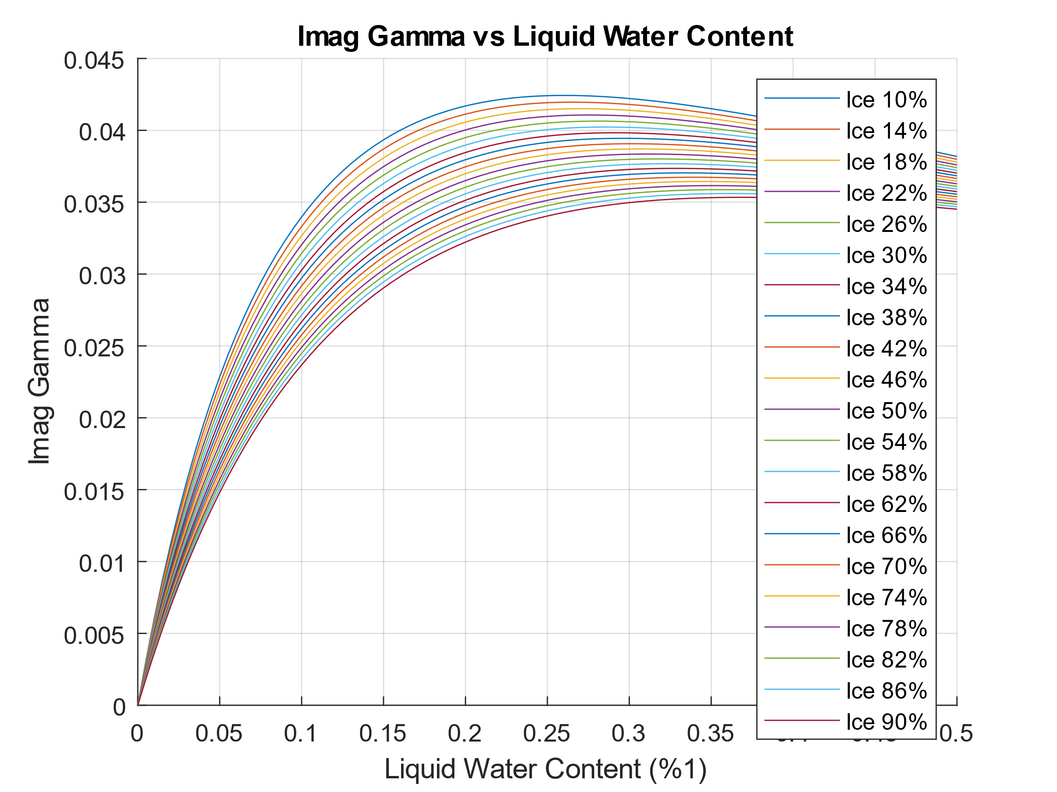
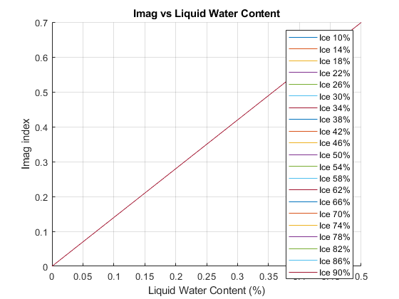
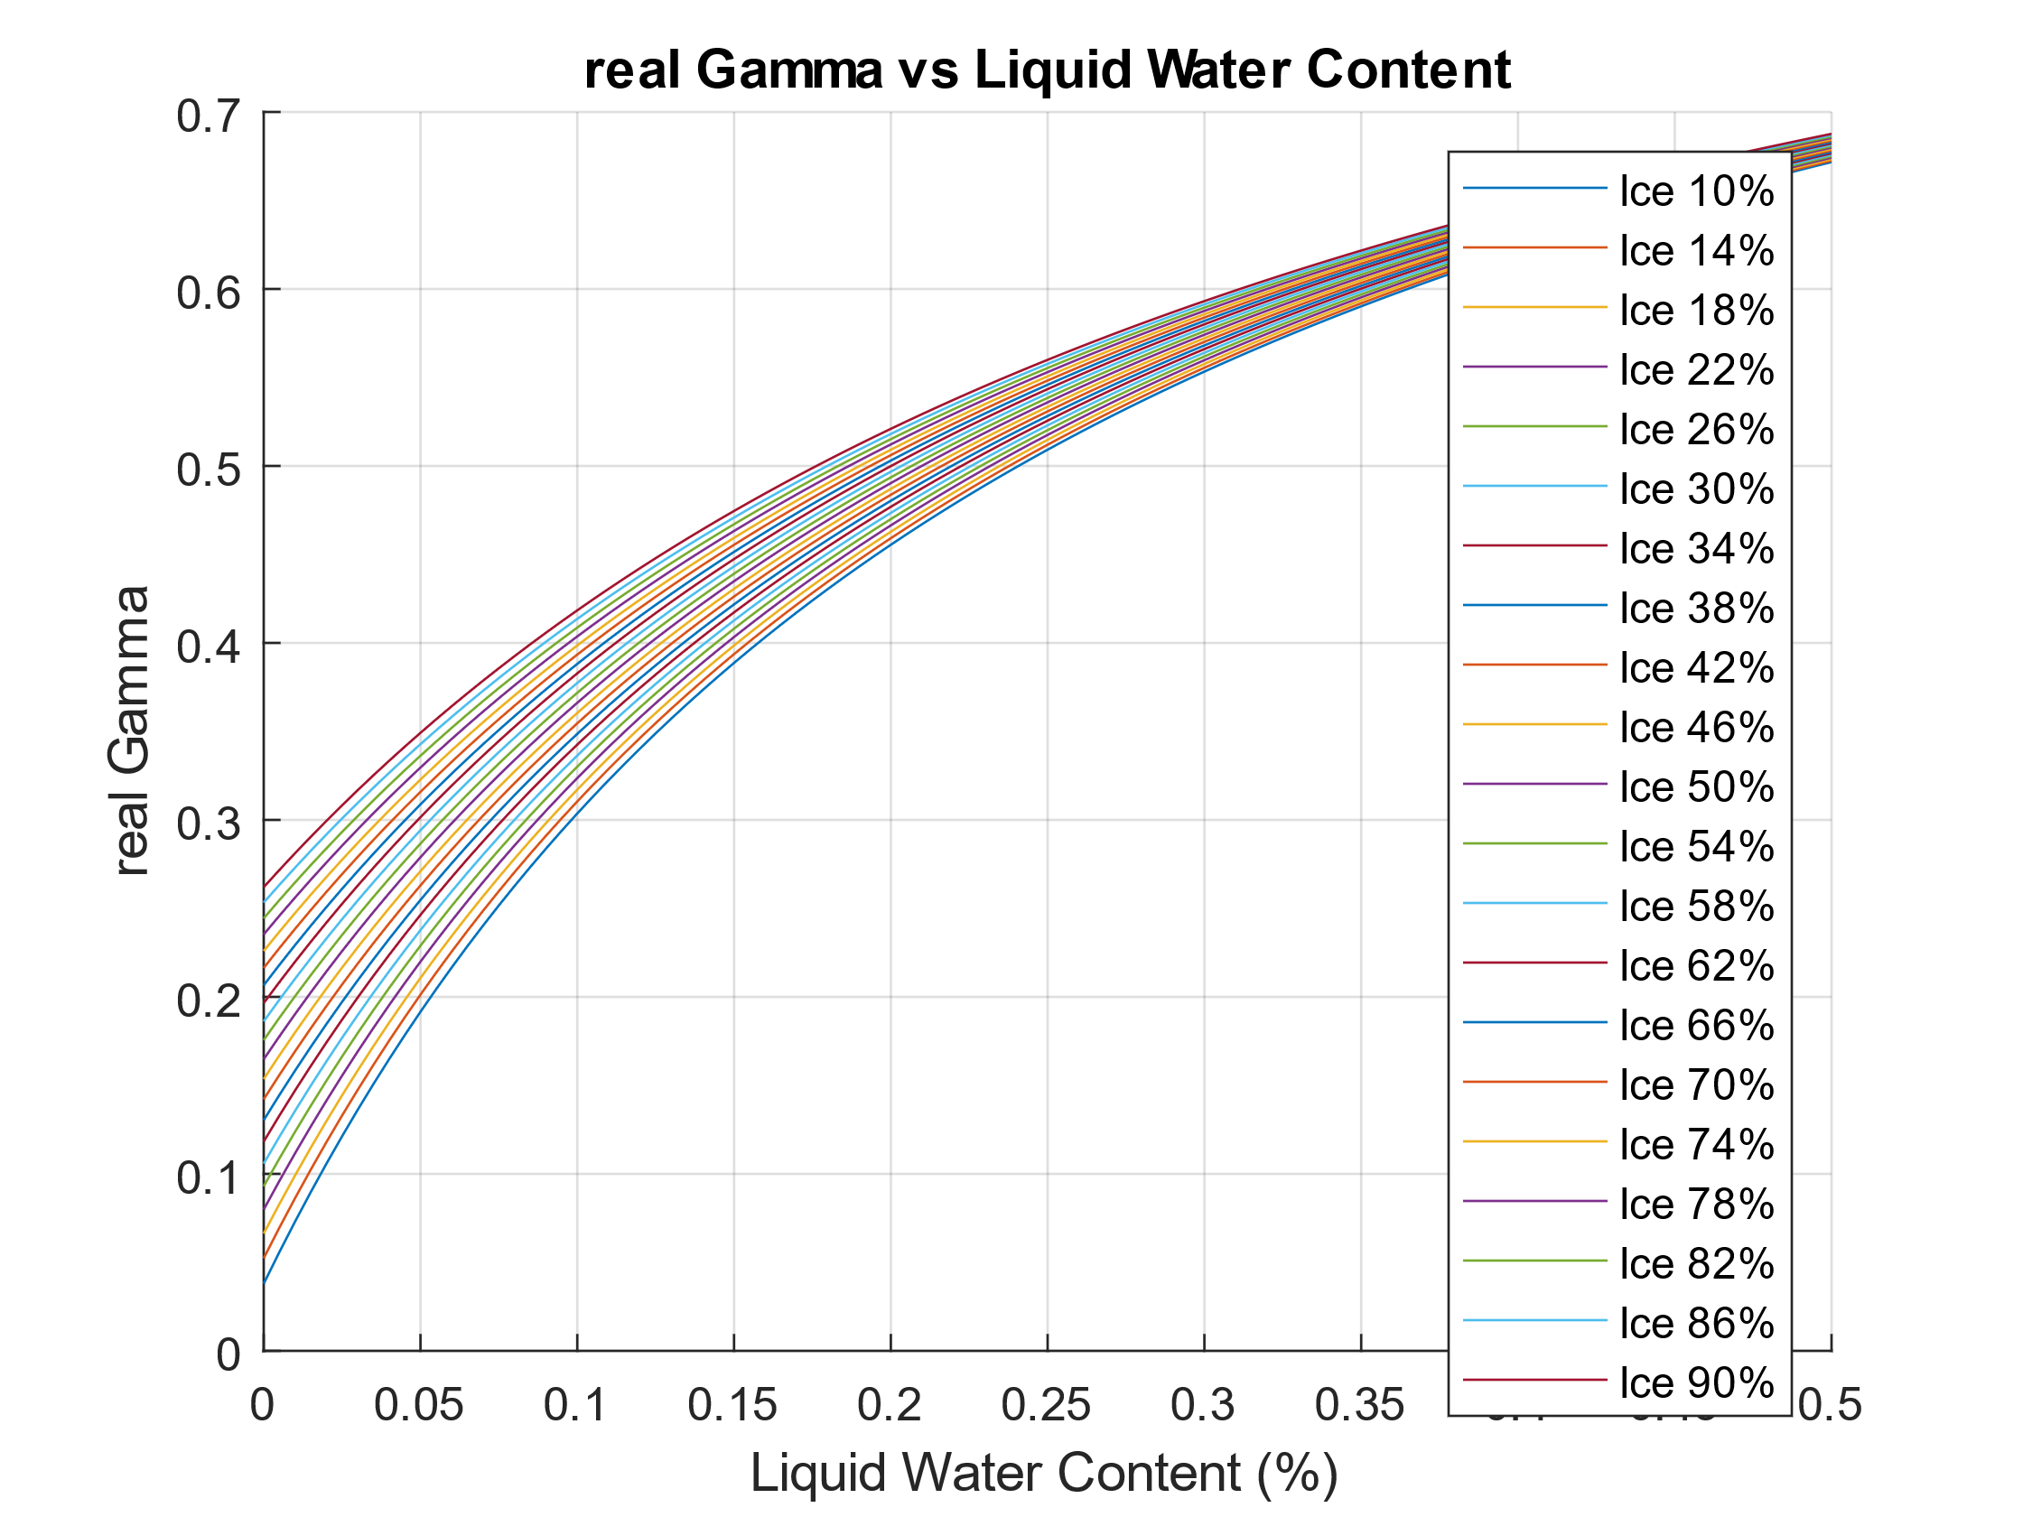
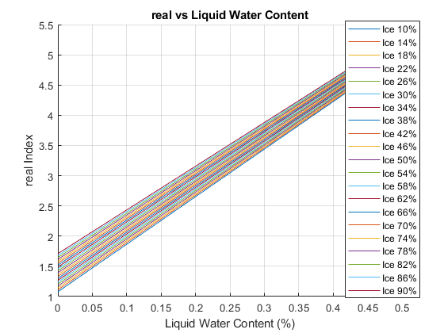



4. Electromagnetic Properties
Air–Snow Interface Refractive Index from Γ
$$\sqrt{ε_{2}}= n_{2}=\frac{1−Г}{1+Г}$$
$Г=$ $Г′$+j$Г′′$
$n_{2}=n_{2}′$+j$n_{2}′′$= $\frac{1−Г}{1+Г}$

Slide 17




4. Electromagnetic Properties
Inverse processes
Reflection coefficient at the interface air-snow:
$Г=\frac{n_{1}−n_{2}}{n_{1}+n_{2}}=\frac{1−n_{2}}{1+n_{2}}=$ $Г′$+j$Г′′$
1.33 is the slope of the linear relationship
1.33 is the mean value of the imaginary refractive index over our bandwidth (0.6-6 GHz)
Refraction index of surface layer:
$\sqrt{ε_{2}}= n_{2}=\frac{1−Г}{1+Г}$ $=\frac{1−(Г^{′}+jГ^{′′})}{1+(Г^{′}+jГ^{′′})}$
1.33 is a value very close to the imaginary refractive index at the central frequency (3.3 GHz)
$n_{2}=n_{2}′$+j$n_{2}′′$
$LWC= ϕ_{water}=$ $n_{2}′′$/1.33

Slide 18


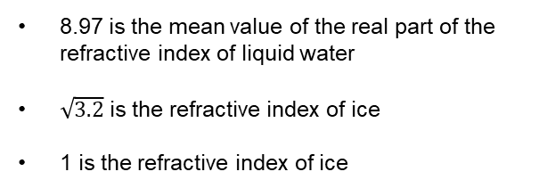


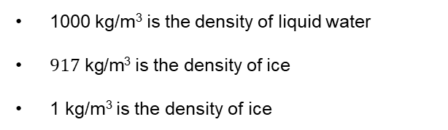
4. Electromagnetic Properties
Inverse processes
$n_{2}=n_{2}′$+j$n_{2}′′$
$$n_{2}^{′}=8.97･LWC+n_{dry−snow}(1−LWC)$$
8.97 is the mean value of the real part of the refractive index of liquid water
$\sqrt{3.2}$ is the refractive index of ice
1 is the refractive index of ice
$$n_{dry−snow}=ϕ_{Ice}･\sqrt{3.2}+\left(1−ϕ_{Ice}\right)1$$
$$ρ_{dry−snow}=ϕ_{Ice}･917+\left(1−ϕ_{Ice}\right)1$$
1000 kg/m³ is the density of liquid water
$917 \text{kg}\text{/}\text{m}\text{3}$ is the density of ice
1 kg/m³ is the density of ice
$$ρ=1000･LWC+\left(1−LWC\right)ρ_{dry−snow}$$

Slide 19
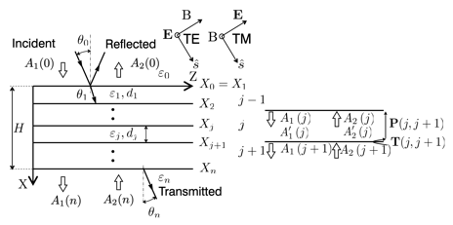
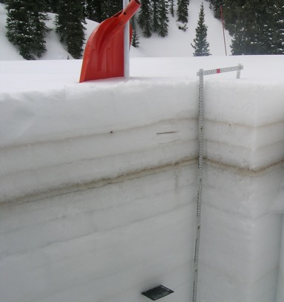



5. Electromagnetic Modelling of the Snowpack
Analytical plane wave reflection model of snowpack
Our radar operates with wavelengths ranging from 2 meters to 5 centimetres, which are significantly longer than the characteristic grain size of snow. This condition minimizes scattering effects and justifies the assumption that snow layers can be modeled as homogeneous and isotropic media. To compute the snowpack reflectance, we employed the matrix method for planar multilayer electromagnetic structures (SnowCal software).
Assuming that there is no upward propagating wave in the medium n, the reflectance of multilayer is:
reflectance spectrum
The relation between spectral and temporal reflectance can be derived by means of the fourier transform

Slide 20
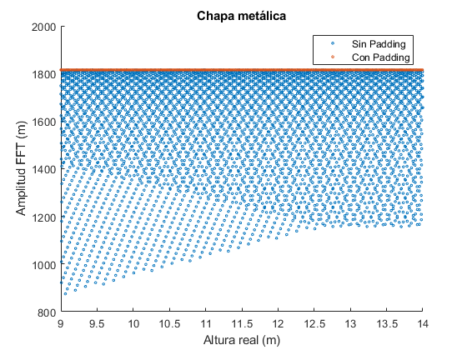
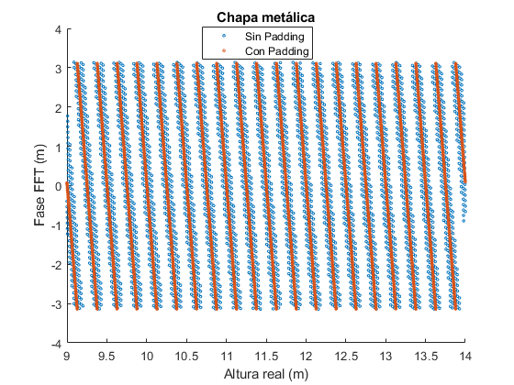
6. Examples of Comparative Analysis
Amplitude and phase correction: propagation wave
A simulation is performed to analyze the reflection from a metallic plate by progressively shifting its position in 1 mm steps over a range from 9 to 14 meters. The objective is to evaluate the behavior of the FFT response, specifically observing how the amplitude remains constant while the phase evolves with distance. The amplitude is expected to remain unchanged because the analysis is carried out under the plane-wave assumption, where no geometrical spreading or additional losses are introduced. In contrast, the phase exhibits a significant variation with displacement, which is a key aspect of the study. This is particularly relevant because the propagation is not limited to a single frequency but spans a wide bandwidth from 0.6 to 6 GHz, where the wavelength varies considerably. As a result, the phase response represents an integrated effect over the entire frequency range, making its interpretation essential for accurately understanding the electromagnetic path and the positioning of reflectors.
Phase FFT (rad)
Amplitude FFT (a.u.)
Position of metal plate (m)
Position of metal plate (m)

Slide 21
6. Examples of Comparative Analysis
Amplitude and phase correction: propagation wave
Once the theoretical behavior has been analyzed, we aim to observe the same behavior in real measurements. A metallic plate is progressively displaced in front of the setup over a range of distances within the system’s operating domain. This verification is not trivial, as it requires assessing the phase and amplitude stability of our signal generator, and because the phase analysis involves the entire bandwidth, applying the inverse Fourier transform.

Slide 22
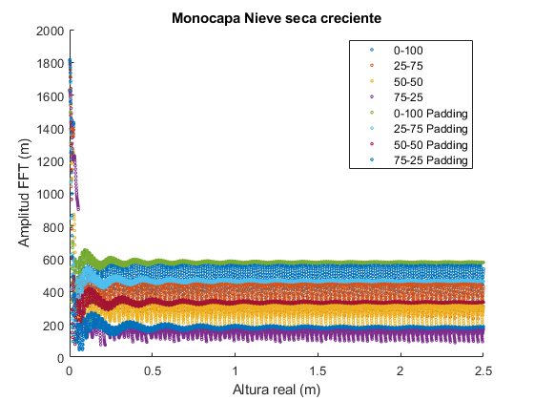
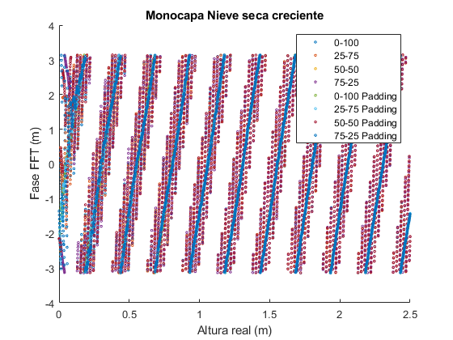
6. Examples of Comparative Analysis
Amplitude and phase correction: propagation wave
We simulate a single layer of dry snow with four different densities to examine whether increasing its thickness leads to the same behavior patterns in amplitude and phase. For small thicknesses, we observe interference effects that impact the measurement, resulting in reduced stability in the peak amplitude. However, as the thickness increases to typical values, the amplitude stabilizes, and the phase exhibits the same variation trend as observed for the metal plate.
Amplitude of FFT (a.u)
Phase of FFT (rad)
Snowdepth (m)
Snowdepth (m)

Slide 23
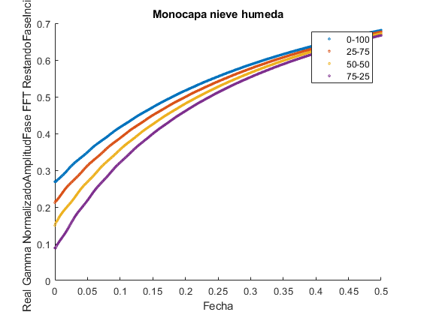
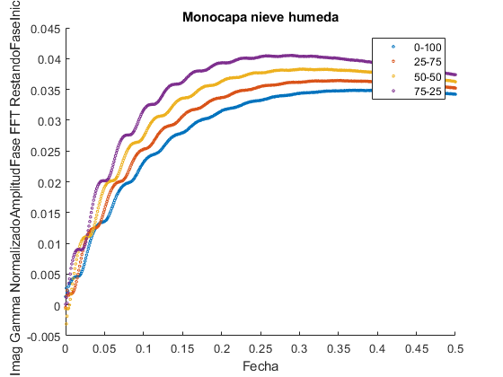

6. Examples of Comparative Analysis
Simulation wet snow monolayer
We simulate a 1-meter-thick single layer with different initial dry snow densities and progressively increase the liquid water content to analyze the response in both amplitude and phase of the reflection coefficient.
$Г=Г′$+j $Г′′$
Monolayer
Monolayer
Real part of reflection coefficient
Imaginary part of reflection coefficient
LWC (%1)
LWC (%1)

Slide 24
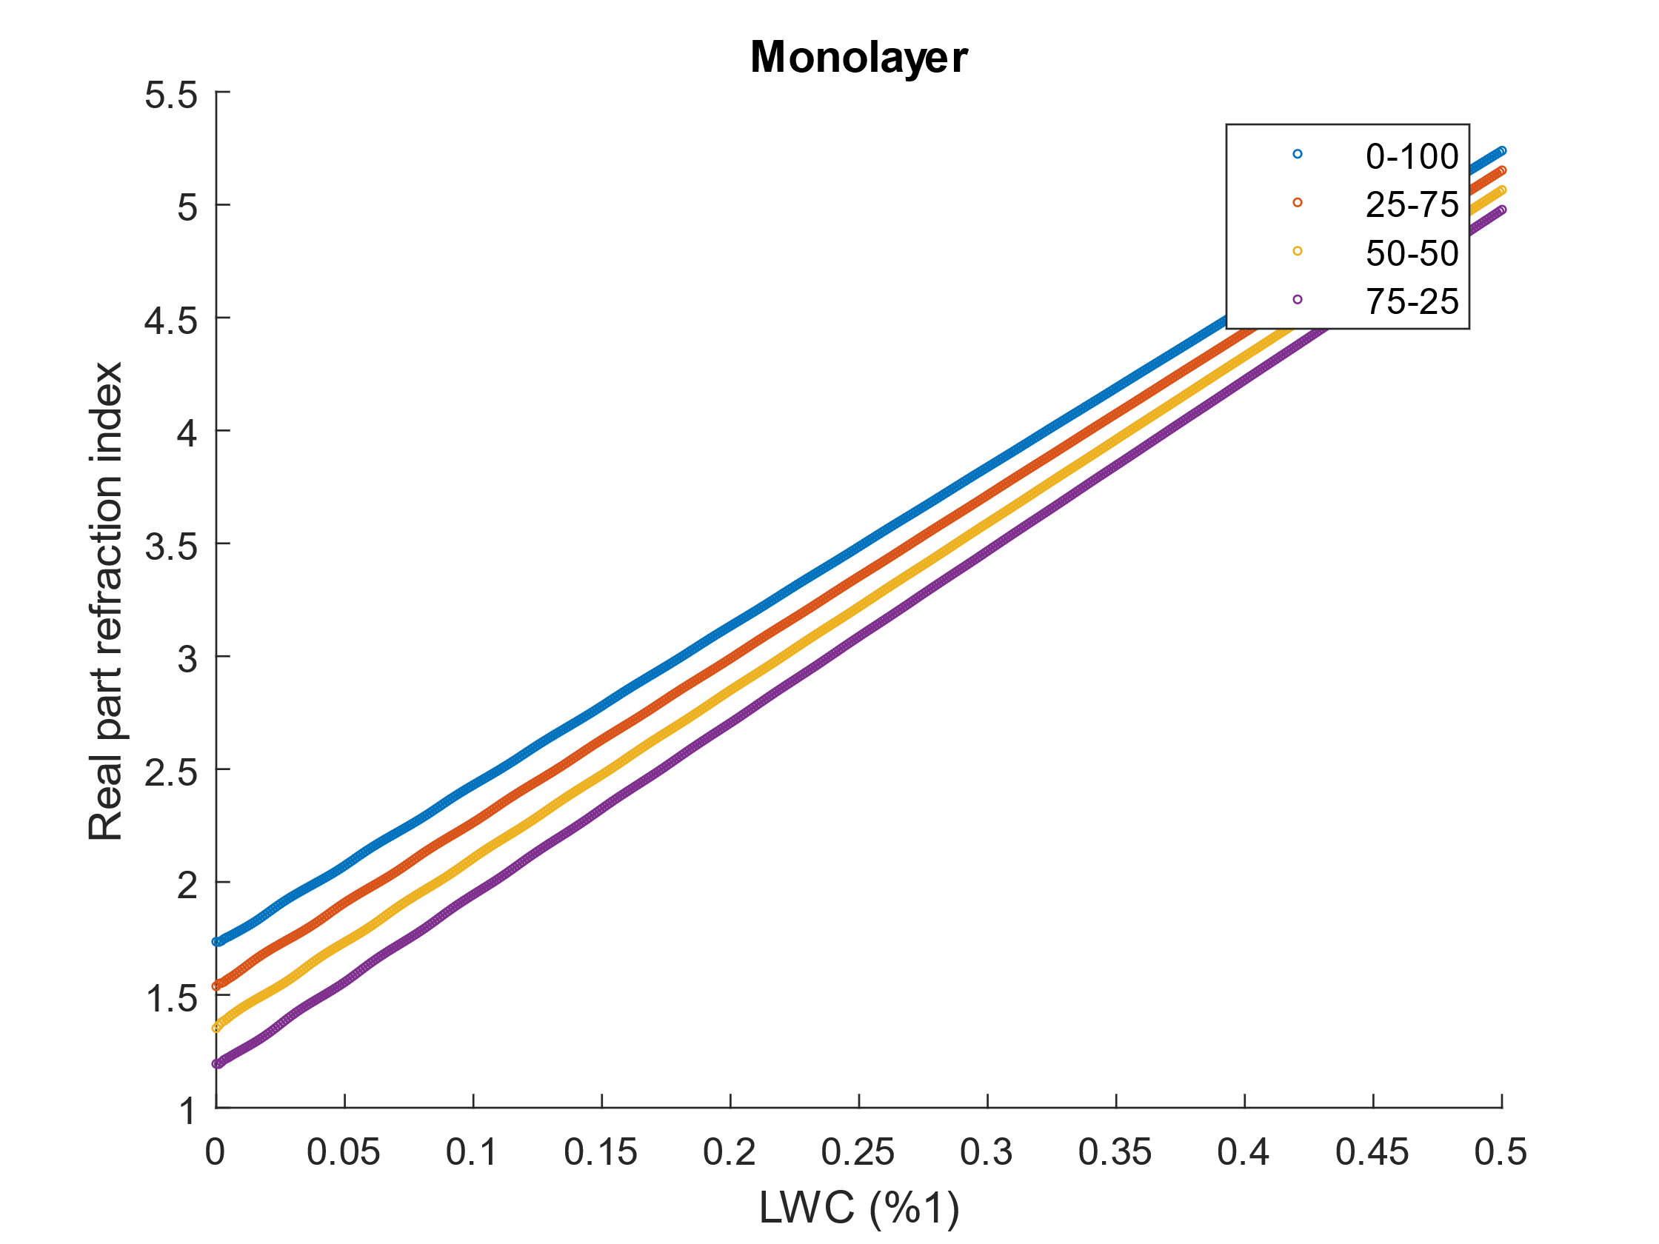
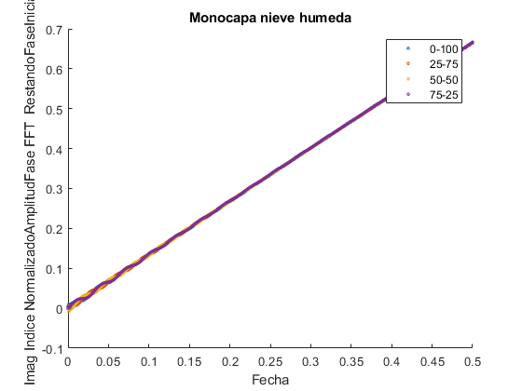
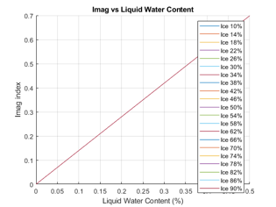


6. Examples of Comparative Analysis
Simulation wet snow monolayer
Once the evolution of the reflection coefficient has been obtained, it is converted into refractive index, and the results are compared again with the curves derived from the estimation of the volumetric fractions.
$n_{2}=n_{2}′$+j$n_{2}′′$
Monolayer
Imaginary part of refractive index
LWC (%1)

Slide 25
6. Examples of Comparative Analysis
Simulation of multilayer snowpack: 3-layer
A three-layer snowpack structure is simulated, consisting of two wet snow layers and one dry snow layer. The first and the last layers are wet snow, representing the effect of solar radiation and the heat released by the ground. Three different conditions are considered for the surface layer, where the ice and air fractions are kept constant, and only the liquid water content is varied.
First case:
‘Real’ density = 459 kg/m³
‘Real’ LWC = 0%
Estimated density = 462 kg/m³
Estimated LWC = 1%
Second case:
‘Real’ density = 513 kg/m³
‘Real’ LWC = 10%
Estimated density = 529 kg/m³
Estimated LWC = 11%
Third case:
‘Real’ density = 730 kg/m³
‘Real’ LWC = 50%
Estimated density = 732 kg/m³
Estimated LWC = 50%

Slide 26
7. Preliminary experimental results
 | Snowpit measurement |  | Radar measurement
Date | LWC (%) | Density (Kg/m³) | LWC (%) | Density (Kg/m³)
06/12/2025 | 2.75 | 235 | 2.9 | 204
23/12/2025 | 0 | 170 | 1.2 | 216
30/12/2025 | 0 | 155 | 0 | 100
06/01/2025 | 1.1 | 416 | 2.5 | 426
15/01/2025 | 0 | 305 | 2.6 | 317
21/01/2025 | 0 | 119 | 3.9 | 133
07/03/2025 | 3 | 377 | 0 | 329
19/03/2026 | 4.3 | 398 | 6.5 | 377

Slide 27
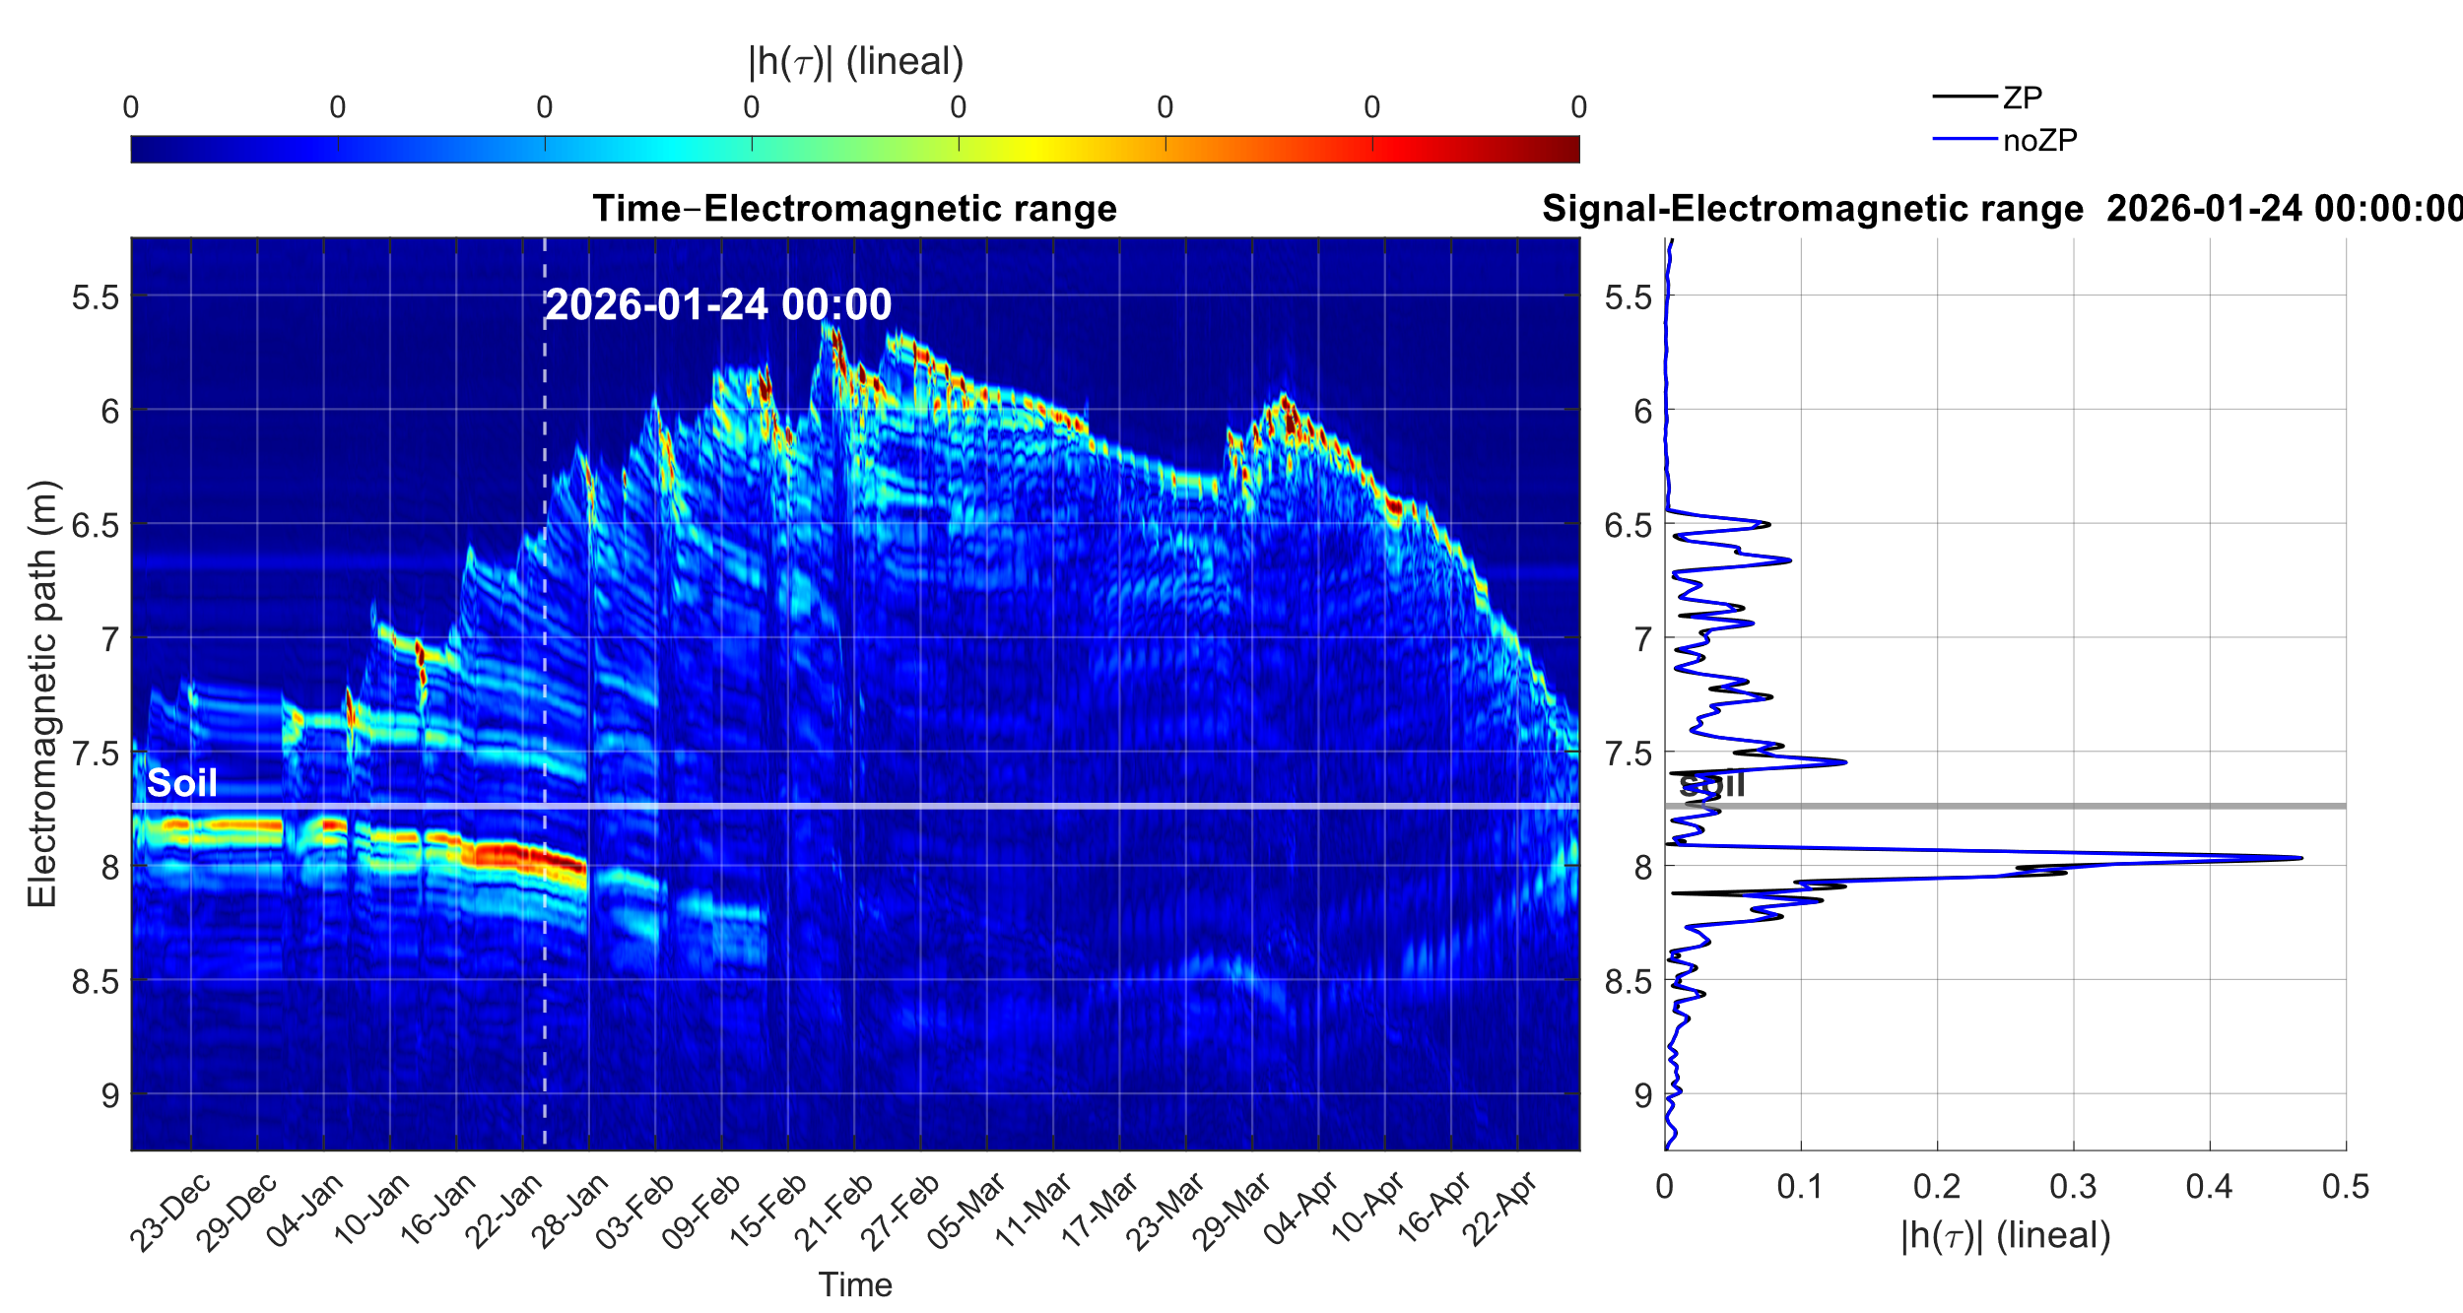
7. Preliminary experimental results
Time evolution: Horn system (VNA)

Slide 28
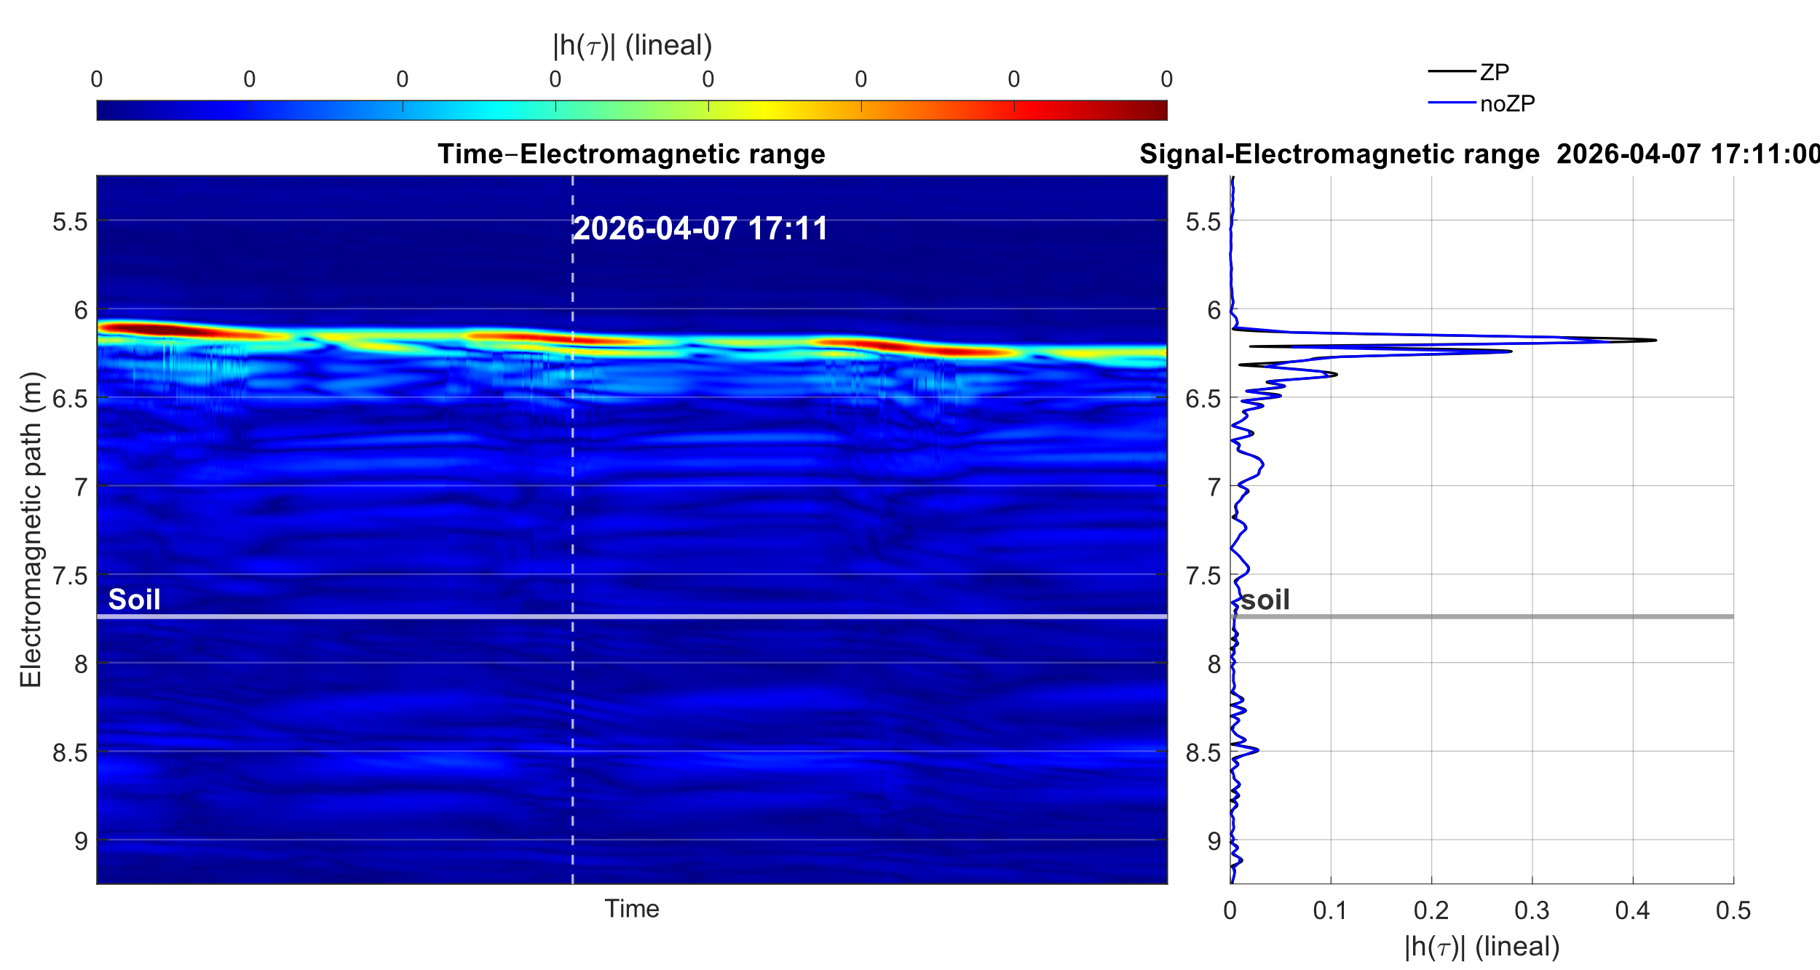
7. Preliminary experimental results
Time evolution: Horn system (VNA)

Slide 29
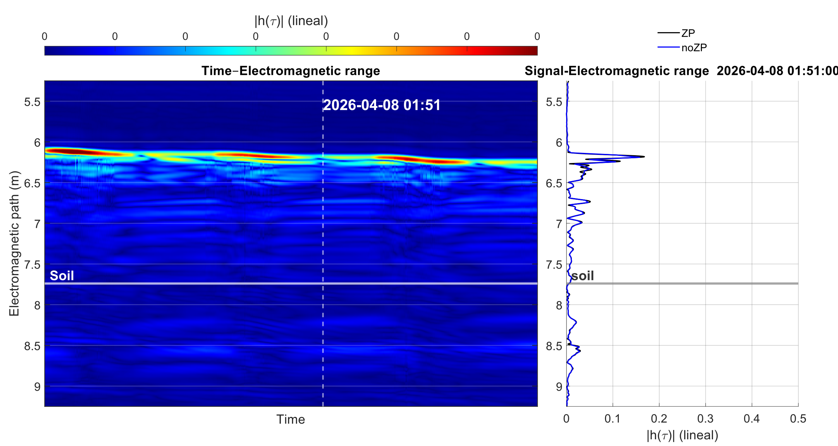
7. Preliminary experimental results
Time evolution: Horn system (VNA)

Slide 30
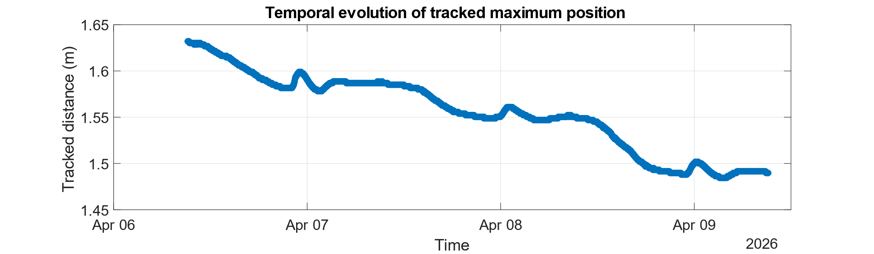
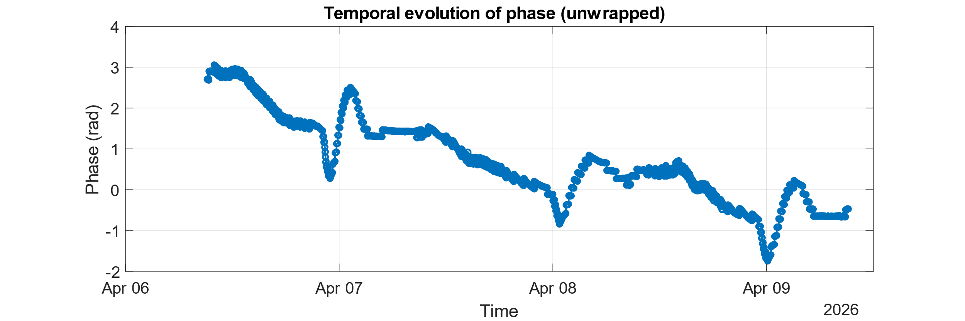
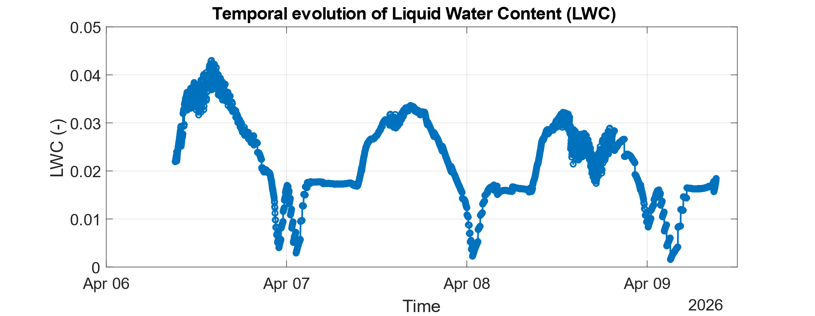

7. Preliminary experimental results
Time evolution: Horn system (VNA)

Slide 31

7. Preliminary experimental results
Time evolution: Vivaldi system (SDR)

Slide 32

7. Preliminary experimental results
Time evolution: Vivaldi system (SDR)

Slide 33



7. Preliminary experimental results
Time evolution: Vivaldi system (SDR)
This situation highlights one of the main challenges when working with phase measurements: the ambiguity introduced by phase wrapping between π and −π. Even for smooth and continuous physical variations, the phase representation exhibits discontinuities due to its bounded interval.
Therefore, a proper phase unwrapping is required to reconstruct the true continuous phase evolution and avoid introducing non-physical phase jumps.

Slide 34



Contact: asubias@unizar.es
Departamento de Física Aplicada
Escuela de Ingeniería y Arquitectura de Zaragoza
Universidad de Zaragoza
C/María de Luna, 1, Edificio Betancourt, 50018, Zaragoza
Supported by project PID2021-124451OB-I00
Acknowledgments to

