Slide 1
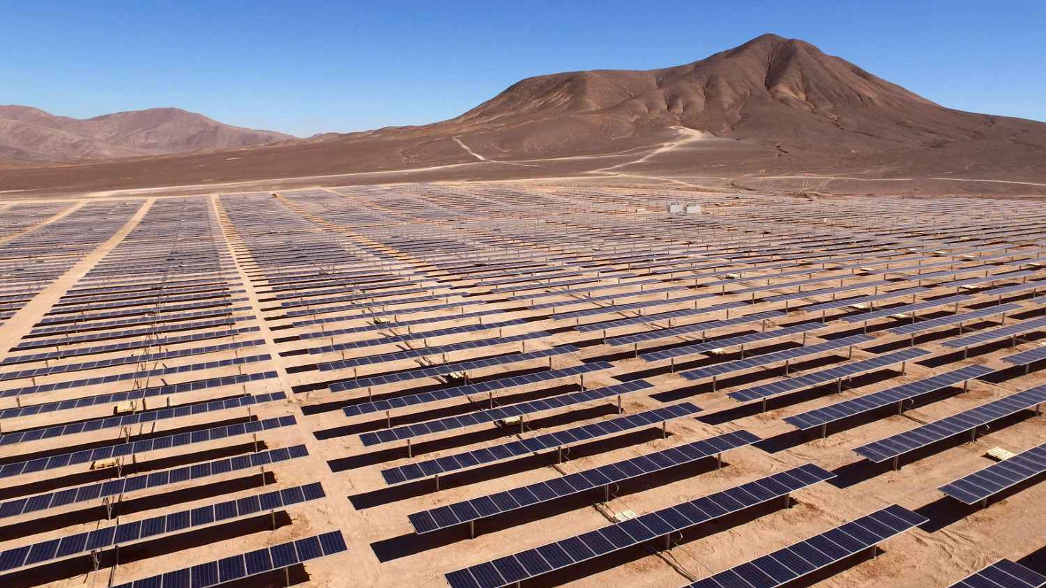

EGU GENERAL ASSEMBLY 2026
ENERGY & CLIMATE RESEARCH
Long-term Energy Demand and
Carbon-Neutrality Pathways for Egypt
A LEAP-Based Scenario Analysis (2017–2070)
Integrated Energy System Modeling for Sustainable Transition
서울시립대학교 , 도시공학과, 박사과정
Ph.D. Candidate, Dept. of Urban Planning and Design
University of Seoul
Ashraf El Haddad 아슈라프 엘하닫
G20243614
ashraf@uos.ac.kr
| University of Seoul | 2026
G20243614
ashraf@uos.ac.kr
May 2026
Vienna, Austria

Slide 2

01
Introduction
CONTENTS
02
Methods
03
Results
04
Conclusion

Slide 3
01 | INTRODUCTION & CONTEXT
Egypt's Energy-Climate Challenge
116M+
6-7%
92%
Population
Annual GDP Growth
Fossil Fuel Share
A rapidly growing population is driving unprecedented increases in energy demand across all sectors.
Strong economic expansion fueling industrialization and urban development energy needs.
Dominant fossil fuel dependency creating exposure to price volatility and high carbon lock-in.
Problem statement: Why This Research Is Needed
Three Compounding Pressures
01
Surging Energy Demand
02
Fossil Fuel Dependency
03
Climate and sustainability Commitments
Population growth, rapid urbanization, and increasing cooling needs are driving electricity and fuel needs to
record levels. Demand projected to triple by 2050
with no sign of long-term saturation.
Oil and natural gas dominate Egypt's energy mix,
creating exposure to price shocks and locking in
high carbon emissions for decades without transition.
Egypt's NDC, Vision 2030, ISES 2035, and NCCS 2050 set ambitious renewable and emissions targets, yet integrated pathway implementation remains underexplored.

Slide 4
02 | RESEARCH FRAMEWORK
Research Questions & Research Gap
Core Research Questions
What Existing Studies Have Done
Partial-sector analyses of Egypt's electricity system (renewable
integration in the power sector only)
Q1
How much can renewable electricity alone reduce Egypt's long-term CO₂
emissions under growing energy demand?
Short-term projections to 2030 or 2035 aligned with Vision 2030 targets
→ Power transition focus
Single-scenario studies without a comparative scenario framework
Q2
How much can end-use efficiency improvements reduce future energy demand and emissions without major power-sector changes?
Sectoral efficiency or renewable studies without system-wide integration
→ Efficiency transition focus
The Gap This Study Fills
Q3
What combined supply- and demand-side pathway enables Egypt to achieve long-term carbon neutrality?
No existing study provides a full national, bottom-up, long-horizon (2017–2070)
An integrated energy system model for Egypt that jointly evaluates:
→ Integrated Carbon Neutral Pathway
Demand-side transformation
Renewable expansion
Electrification
Research Focus: Future Energy Demand projections to achieve Carbon Neutrality and
Improve Energy Efficiency across all sectors.
System optimization
Using LEAP soft-linked with NEMO: developing and comparing six long-term LEAP scenarios to identify realistic carbon-neutrality pathways for Egypt.

Slide 5
03 | RESEARCH GOAL & OBJECTIVES
Research Goal & Specific Objectives
Overarching Goal
Develop the first comprehensive, long-range (2017–2070) integrated energy system model for Egypt to assess carbon-neutrality pathways under six structured transition scenarios.
Specific Objectives
O1
Model Development
O2
Optimization Integration
O3
Scenario Design
Build and calibrate a national bottom-up LEAP energy
model for Egypt using the 2017 base year with sector-
level techno - economic parameters.
Soft-link LEAP with the NEMO optimization module
to derive a least-cost net-zero benchmark (NZ-OPT) for comparison with policy scenarios.
Design and run six transition scenarios covering the full
spectrum from BAU to carbon-neutral pathways through
2070.
O4
Impact Quantification
O5
Policy Insights & Transferability
Quantify the roles of renewable energy expansion, demand-side efficiency, and electrification in achieving deep decarbonization.
Provide evidence-based policy insights for Egypt and transferable modeling frameworks for other
rapidly growing emerging economies in the MENA region and globally.
Study Timeline: Base Year 2017 | Time Horizon 2017–2070 | 6 Scenarios | LEAP + NEMO Integration

Slide 6
04 | RESEARCH METHODOLOGY
Research Flow & Methodology
Seven-Step Research Flow
Data Sources & Base Year
1
Literature Review
IEA
CAPMAS
LEAP-based studies in MENA & global developing economies
Egypt energy policy: Vision 2030, ISES 2035, NCCS 2050, NDC
National energy balances, fuel
Consumption by sector, CO₂ emissions
Population data, household surveys,
economic activity indices
2
Data Collection
Base Year 2017: IEA, CAPMAS, EEHC, IRENA, World Bank
LEAP Model Setup
EEHC
IRENA
3
Egyptian Electricity Holding Co.
Installed generation capacity, electricity production & consumption
Renewable energy technology costs,
capacity factors, deployment potential
Bottom-up demand tree: residential, commercial, industrial, transport, and agriculture sectors
Scenario modelling methodologies & decarbonization pathways
4
Scenario Design
Six transition scenarios from BAU to net-zero pathways
World Bank
NREA
GDP growth rates, urbanization rates,
transport fleet data
Solar & wind resource maps, existing
RE projects, pipeline capacity
5
NEMO Optimization
Power sector optimization for least-cost net-zero benchmark
6
Analysis & Results
Model Design & Validation
Comparative scenario assessment and impact quantification
→ LEAP bottom-up demand tree across 5 sectors
→ Supply module: fossil, hydro, solar PV, wind, nuclear
7
Policy Implications
→ Calibration to 2017 energy balance data
Evidence-based recommendations for Egypt and the MENA region
→ Sensitivity testing for robustness

Slide 7
05-1 | Research Flow & Methodology
Literature Review: Comparison between LEAP Model and other models (bottom-up models)
Park et al. (2016) | Used a bottom-up model to evaluate the electrical energy production in South Korea. Their study involved calculating the optimal portfolio, considering renewable energy technologies explicitly, up until 2050, with the cost effectiveness of measures being assessed.
Prina et al. (2020) | Performed a comprehensive assessment of the categorization algorithms used in modelling bottom-up energy systems. Their findings showed that the Market Allocation and The Integrated Markal-EFOM System (TIMES)(MARKAL/TIMES) and the Open -Source Energy Modelling Systems(OSeMOSYS) were observed to possess somewhat lower temporal and techno-economic data resolutions while exhibiting moderate spatial resolutions.
Prina et al. (2021) | Conducted a thorough analysis of the available bottom-up models, where they evaluated and compared forty-three different studies that utilized these models for analysis at the national level.
Sanchez et al. (2021) | Conducted a study to assess the role of bottom-up energy models in informing policy formulation for enhancing residential building and sector-specific electricity end-use efficiency.
The findings showed that models constructed using a bottom-up approach do not afford a wide range of tools for analysis, which plummets their ability to effectively assist in policy formulation.

Slide 8
05-1 | Research Flow & Methodology
Literature Review : Previous modelling studies globally and for Egypt
Many case studies have been developed on GHG mitigation and reduction policies. Accordingly, there are many researchers who have adopted the LEAP model in their work, and there are several studies that have reviewed Egypt’s energy policies:
Felver, T. B. (2020). | Utilized LEAP to forecast Azerbaijan’s potentialCO2 emissions through three distinct scenarios.
Emodi et al. 2017 | Explored Nigeria’s future energy demand, supply, and associated GHG emissions from 2010 to 2040 using the (LEAP) model
Cai et al.2023 | Applied LEAP model to investigate different pathways for achieving a carbon emission peak and carbon neutrality by implementing five scenarios before 2030 in China considering economy, transportation, population, power sectors and available renewable sources
Mondal & Ringler .(2020) | Evaluated national and regional benefits of alternative energy development plans, via introducing four different scenarios for the period 2014–2050.these scenarios that involve trading in electricity reduce system costs by 4.5 -7.2% compared to a reference scenario that assumes no energy trading.
Shahid et al.(2021) | Created an LEAP model for Pakistan’s electricity system from 2016 to 2040.
Yang et al.(2021a, b) | LEAP model was developed to examine the ecological and socioeconomic impact of the introduction of renewables in the Chinese province of Zhang.
Energy modelling previous studies for Egypt
Mondal et al. ( 2018) | Used the TIMES energy system model to examine Egypt’s energy policy goals, as in Egypt’s Vision 2030. concluded that the current supply of energy needs to diversify from natural gas to a mix of technologies and highlighted opportunities to fulfill rising electricity demand while addressing energy security and low-carbon development concerns from 2016 to 2050
Rady et al.2018 | Used OSeMOSYS to model Egypt’s power-generation sector, to provide policymakers with better plan for future investments in the power sector. It concluded that the lowest-cost electricity-generation mix always includes hydropower, natural gas-fired steam cycles, wind power, and solar PV rooftop technologies, focused on the analysis of two different energy demand scenarios and did not investigate increasing RETs for power generation in Egypt.
Elsayed et al.(2023) | Analyzed various scenarios of electrical energy generation and consumption in Egypt for 2020 and 2050 using LEAP model . The results show that the natural gas contribution will decline till reaching its peak of 61.5% by 2050 for (NON) scenario. However, this share will be less than 16.5% by 2045 for (REN.70) scenario. Whilst nuclear share will be 4.6% by 2050 for (REF.A) scenario. Found that the renewable scenarios have the lowest long-term production cost compared to other scenarios. However, this study does not consider deep detailed analysis for energy demand.
Gibson et al.(2024) | Included a renewable energy development scenario based on ISES 2035 targets and IRENA’s proposed modifications.
Mondal et al. (2019) | Examined Egypt’s power sector energy supply strategies using the TIMES model, with a particular emphasis on CO2 mitigation, renewables integration and restrictions on natural gas usage.
Findings : indicated that energy mix diversification is necessary to improve supply reliability, reduce reliance on fossil fuels and reducing GHG emissions.

Slide 9
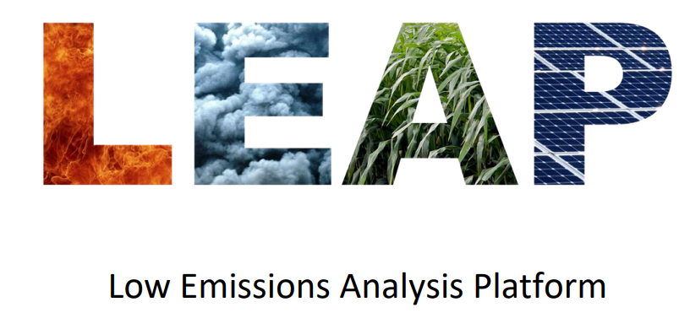
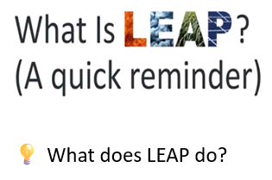
05 | LEAP MODEL FRAMEWORK
LEAP Model — Framework Overview
What is LEAP?
Egypt LEAP Model Structure
LEAP (Long-range Energy Alternatives Planning) is a widely-used bottom-up integrated energy planning tool developed by the Stockholm
Environment Institute (SEI).
DEMAND SECTORS
Models' energy demand, supply, transformation, and GHG
emissions
Residential
Commercial
Industrial
Transport
Agriculture
Bottom-up approach models each sector & end-use technology
Scenario flexibility: any number of user-defined pathways
TRANSFORMATION
Full GHG accounting across all fuels and sectors
Power Plants
Oil Refineries
Gas Processing
Transmission
NEMO Soft-Link
NEMO (Next Energy Modelling System for Optimisation) is an open-source, least-cost power sector optimization model.
RESOURCES / SUPPLY
Soft-linked with LEAP, NEMO determines the optimal technology mix, capacity expansion, and dispatch schedule for Egypt's electricity system under each scenario's constraints.
Natural Gas
Oil
Solar PV
Wind
Hydro
Nuclear
Base Year: 2017 | Time Horizon: 2017–2070 | Soft-linked with: NEMO | 6 Scenarios

Slide 10



06 | LEAP Model — Equations
As a result of these features, the LEAP model is best suited for creating scenarios for complex energy systems. (Malka et al.2021)
The energy consumption for each activity level broken down by subsectors and fuel types is calculated in the model using Eq. 1
ED k : stands for energy consumption,
AL : stands for activity level,
EI : energy intensity.
EI: Energy used by fuel type K, technology j, in sector i per unit of activity for sector / technology​
$EI k,j,i=\frac{\text{Final} \text{energy} \text{consumption} \text{of}\text{ (}\text{fuel} \text{k}\text{, }\text{tech} \text{j}\text{, }\text{sector} \text{i}\text{) }\text{in} \text{base} \text{year}}{Activity level ofsector or technology in base yea}$ $= \frac{ED k,j,i}{AL k,j,i}$
The carbon emission for every activity was estimated using Eq. (2):
- ED e, i emission is the pollutant emission,
- AL refers to the activity level,
- EI refers to the energy intensity, and
- EF k, j , i, p is the pollutant P emission (kg) factor from fuel type k for equipment j , from sector i .
The emission factor per each fuel type is calculated by using Eq. (3)
EF stands for the localized carbon emission factors,
NCV stands for net calorific value, CEC u stands for the carbon oxidation rate of energy u,
and 44/12 stands for the molecular weight ratio of CO2 and C.

Slide 11
05 | LEAP MODEL FRAMEWORK
LEAP Model — Mathematical Framework
As a result of these features, the LEAP model is best suited for creating scenarios for complex energy systems. (Malka et al. 2021)
1
Energy Consumption
2
Carbon Emissions
3
Emission Factor
ED = AL × EI
Emission = AL × EI × EF
EF = NCV × CEC × (44/12)
Energy Demand = Activity Level × Energy Intensity
Emissions = Activity × Intensity × Emission Factor
Localized carbon emission factor calculation
EF: Localized carbon emission factors
EDk: Energy consumption by fuel type k
EDe,i: Pollutant emission from sector i
NCV: Net calorific value of fuel
AL: Activity level (demand driver)
AL: Activity level
CECu: Carbon oxidation rate of energy u
EI: Energy intensity (energy per unit activity)
EI: Energy intensity
44/12: Molecular weight ratio of CO₂ to C
EFk,j,i,p: Emission factor for pollutant p from fuel k, equipment j, sector i
Calculates energy consumption for each activity level broken down by subsectors and fuel types
Estimates carbon emissions for every activity across
all sectors and fuel types
Calculates emission factor per fuel type, incorporating
local energy characteristics

Slide 12
06 | SCENARIO DESIGN
Six Transition Scenarios
From Business-as-Usual to Least-Cost Net-Zero Pathway
S1
BAU / REF
S2
PET
S3
RPT
Business-as-Usual Reference
Policy-Aligned Transition
Renewable Power Transition
Baseline projection with no additional policies.
Historical trends in energy demand, fuel mix, and
emissions continue to 2070.
Reflects Egypt Vision 2030, ISES 2035, NCCS 2050,
and updated NDC commitments. Models officially
planned RE targets.
Aggressive large-scale integration of solar PV, wind, and hydro in the power sector. Deep decarbonization of electricity supply.
Serves as reference for all scenario comparisons
Policy-consistent transition pathway
Supply-side decarbonization focus
S4
EDT
S5
CNS
S6
NZ-OPT
Efficiency-Driven Transition
Carbon-Neutrality Strategy
Least-Cost Net-Zero (NEMO)
Emphasis on demand-side energy efficiency
improvements and demand moderation across
residential, commercial, industrial, and transport
sectors.
Integrates high renewable penetration with demand-side measures under a long-term carbon emissions
constraint. Coordinated deep decarbonization.
LEAP is soft-linked with NEMO to derive the least-cost pathway to net-zero. Optimal technology mix, investment sequencing, and system flexibility.
Demand-side mitigation focus
Integrated net-zero pathway
Cost-optimization benchmark
Scenario Logic: Progressive isolation of policy effects, supply-side decarbonization, demand-side efficiency, and their combined role in achieving carbon neutrality

Slide 13
09 | Egypt: National LEAP Scenario Framework (2017–2070)
Scenario | Aim | Description | What Changes vs. BAU
Reference / Current Policies (BAU / REF) | baseline benchmark under continuation of existing and already-announced energy and climate policies. Provide a baseline benchmark under continuation of existing and already-announced energy and climate policies. | Gradual renewables growth but continued dominance of fossil fuels, especially natural gas, in power and final energy use. Rising energy demand, only incremental efficiency gains, and steadily increasing energy-related CO₂ emissions to 2070. | Demand grows with population & GDP; fossil fuels (esp. gas) remain dominant; no additional decarbonization effort Fossil fuel lock‑in, high and rising CO₂ emissions, exposure to fuel price volatility and import risks, and misalignment with long‑term climate and sustainability goals.
Planned Energy Transition PET | Full implementation of Egypt Vision 2030-35, NDCs, and official energy strategies : Assess the impact of fully implementing current national energy and climate strategies and NDCs (e.g. Vision 2030). | Policy‑consistent transition with faster renewables deployment, | Faster renewables, moderate electrification, stronger efficiency than BAU; Fossil fuels, especially gas, remain important. emissions growth slows but does not reverse Implementation and financing gaps, institutional and regulatory barriers, risk that announced targets and plans are delayed or only partially delivered.
Renewable - Led Power Transition RPT | Supply-side decarbonization case: Explore an accelerated decarbonization pathway focused on the power sector. | Accelerated solar & wind deployment in the power sector :High solar and wind penetration dominate the future electricity mix (optionally under a power‑sector CO₂ cap). Supported by grid reinforcement, storage and flexibility options. Limited new fossil capacity and earlier fossil retirements. Power‑sector CO₂ falls sharply; electricity becomes a key low‑carbon carrier for end‑use sectors. | High penetration for Wind & solar Rapid fossil phase-down in electricity; grid expansion, storage, electrification of end-uses: High upfront capital needs, grid integration and system flexibility challenges, resistance from fossil incumbents, and need for strong planning, regulation, and system operation capabilities.
Efficiency-Driven Demand Transition EDT | Demand-side decarbonization case : Assess the potential of ambitious cross‑sectoral energy efficiency to curb demand and emissions. | Aggressive & strong efficiency improvements across buildings, industry, and transport (reduction in energy demand growth : Strong end‑use efficiency in buildings, industry and transport: higher appliance and building standards, industrial process upgrades, efficient vehicles and public transport, plus some electrification. Final energy demand growth is substantially reduced relative to BAU, with only moderate supply‑side transformation. | Lower energy intensity; slower final energy demand growth; limited supply-side change : High initial investment needs, behavioral and institutional barriers, split incentives (e.g. landlord–tenant), difficulties enforcing standards and achieving widespread behavioral change.
Carbon-Neutrality Strategy (Narrative) CNS | Main net-zero pathway: Define a policy‑driven, narrative pathway consistent with achieving economy‑wide net‑zero CO₂ by 2070. | Combined supply- and demand-side transformation: deep efficiency, extensive electrification, near‑zero‑carbon power, fuel switching, and phase down of unabated fossil fuels after mid‑century. Limited role for CCS and low‑carbon fuels in hard‑to‑abate sectors. Energy demand is much lower than BAU and CO₂ declines steeply toward near‑zero by 2070. | Deep efficiency, high electrification, near-zero-carbon power, fossil phase-out after mid-century: Very high investment and coordination requirements, technology and policy uncertainty, social and labour transition challenges, dependence on long‑term political commitment and international support.
Net-Zero Optimized Pathway (NEMO) NZ-OPT | Provide a cost‑minimizing benchmark Net‑Zero pathway under an economy‑wide CO₂ constraint to 2070. | NEMO optimizes the energy system under a long‑term CO₂ cap that drives energy‑related emissions to net‑zero by 2070. Chooses the least‑cost mix of generation, conversion, and end‑use technologies subject to technical and policy constraints. Serves as an optimization benchmark to compare with the narrative CNS pathway. | Optimization-driven technology mix; serves as comparison to CNS (not a policy narrative) Strongly dependent on assumptions (technology costs, resource potentials, constraints). May yield pathways that are cost‑optimal in the model but politically or socially difficult to implement or misaligned with just transition priorities.

Slide 14
06 | SCENARIO FRAMEWORK
Scenario Framework & Key Assumptions
Scenario | Main Purpose | Electricity Mix Assumptions | Demand & Energy Assumptions | Emissions Logic
S1 BAU / REF Reference | Baseline benchmark under continuation of existing policies | Gas-dominated system; RE 30–35% by 2050 | Final energy demand growth: 2.0–2.5%/yr; Efficiency improvement: 0.5%/yr | CO₂ emissions rise until ~2040, then stabilize
S2 PET Policy-Aligned | Vision 2030, Energy Strategy 2035, NDC implementation | RE share 42% by 2035; 45–50% by 2040 | Demand reduction vs BAU: 5 – 8% by 2030; Efficiency improvement: 1%/yr | CO₂ emissions peak 2030 –2035, gradual decline after
S3 RPT Power Transition | Clean electricity focus; isolate power sector decarbonization | RE share 60% by 2040; 75 –80% by 2050; 85 – 90% by 2070 Gas plants remain as backup/reserve capacity with low utilization for system adequacy and flexibility. | Final energy demand follows BAU (no extra efficiency) | Power-sector CO₂ ↓ 70 – 85% by 2050; residual emissions remain
S4 EDT Efficiency-First | Demand-side mitigation; isolate efficiency impact | Power sector follows PET scenario; limited supply-side change: so decarbonization is driven primarily by demand-side measures rather than supply-side change. | Buildings' energy intensity ↓ 30 – 40% by 2050; Transport energy/km ↓ 25–35%; Appliances: Best Available Technology by 2040. Final energy demand vs BAU ↓ 15 - 20 % by 2040 to ↓ 20 – 25 % by 2050 | CO₂ emissions reduced, but fossil power remains
S5 CNS Carbon - Neutrality | Integrated net-zero pathway; combined effect under CO₂ constraint | RE share 80 – 90% by 2050; 90 – 95% by 2070 | Final energy demand ↓ 25 – 30% vs BAU by 2050; Strong electrification in buildings & transport | Net emissions → near zero by 2070
S6 NZ- OPT NEMO Optimized | Least-cost net-zero benchmark; cost-optimal reference : NZ-OPT is a cost-optimal benchmark that shows the cheapest way to reach net-zero, used to test whether our policy-driven pathway is realistic and efficient. | Model chooses optimal mix under constraint | Model selects cost-optimal efficiency & supply | Hard net-zero constraint by 2070; emissions must be zero
Key Insight: "CNS represents a realistic policy pathway, while NZ-OPT provides an objective benchmark to assess its economic efficiency."

Slide 15
Scenario Comparison → Egypt Framework
Country | Scenario Focus | Key Strength | Main Limitation | Lesson Used for Egypt
Japan | Economy-wide net-zero under CO₂ constraints | Clear net-zero ambition; constraint-based logic | Heavy reliance on imports, CCS/CDR, high costs | Net-zero framing & least-cost benchmark (CNS, NZ-OPT)
Jordan | Power-sector transition (LEAP) | Clear renewable-led electricity pathways | Demand side largely implicit | Control power-sector scenario/ NOT rely on demand reductions (RPT) :
Korea | System-wide supply –demand transition | Strong efficiency & electrification treatment | Highly industrialized, low growth context | Depending on demand-side pathway (efficiency of end uses) / power sector close to BAU → (EDT)
Spain | Policy-driven decarbonization (LEAP) | Clear baseline → policy → decarbonization structure | Assume EU regulations, stable energy demand, which differs from Egypt’s growing demand | Policy-aligned transition (PET) (Full implementation of Egypt’s existing energy and climate policies)
Notes:
I use Japan to guide net-zero ambition and constraint logic, Jordan to isolate power-sector transitions, Korea to explicitly model demand-side efficiency, and Spain to anchor policy-driven pathways. These elements are adapted to Egypt’s rapid demand growth, renewable potential, and Vision 2030, resulting in a transparent and policy-relevant framework.

Slide 16

Comparative International Practices to Egypt’s Scenario Framework
Jordan Scenarios: LEAP-Based Electricity Scenario Framework
It provides a clear, LEAP-based framework focused on the electricity sector.
Jordan scenarios follow a logical progression from a business-as-usual baseline to renewable expansion and finally to a CO₂ - constrained case.
This structure is for understanding power-sector decarbonization pathways and the role of renewables in reducing emissions.
The main strength of the Jordan framework is its clarity in analyzing clean power-sector transitions.
Key limitation: demand-side dynamics and energy efficiency across end-use sectors are not explicitly addressed.
Gresat, A., Sukchai, S., & Thanarak, P. (2018). Journal of Renewable Energy and Smart Grid Technology, 13(2).
scenario | Focus | Description
Scenario 1 | BAU (base line) | Continuation of current electricity expansion plans Business-as-usual (base plan to 2025; conventional replacement thereafter)
Scenario 2 | BAU + RE ( Policy transition) | Renewables added to meet future demand growth: BAU to 2025 + renewables added after 2025 to meet demand (no new conventional replacements)
Scenario 3 | High – RE (BAU + Nuclear) Supply-side decarbonization | Renewables dominate electricity generation BAU to 2025 + two nuclear plants + new gas plants to meet demand
Scenario 4/5 | (coal / oil shale variants) | Adds coal and/or oil shale technologies
Scenario 6 | CO₂-constrained CO₂ limit | Climate constraint : Electricity expansion limited by emission caps Same as prior scenario but with CO₂ emissions restrictions/constraints

Slide 17
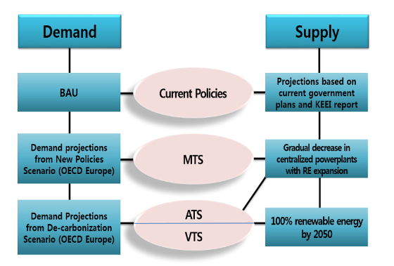
South Korea: LEAP-Based Whole Energy System Scenarios
Code | Scenario | Focus | Description
BAU | BAU/Baseline | Existing policies and strategies | Energy demand and supply follow existing policies, limited renewable expansion
MTS | Moderate Transition Scenario | Policy-driven transition with increased RE shares and moderate demand management | Moderate renewable growth and efficiency improvements
ATS | Advanced Transition Scenario | Supply-side decarbonization + electrification | Accelerated renewable expansion with deeper structural change in the power sector and electrification
VTS | Visionary Transition Scenario | High-ambition transition combining clean supply and reduced energy demand | Clean supply combined with reduced energy demand no reliance on crude oil, coal, natural gas, or nuclear energy in 2050.
Summary of the Korea scenarios
Korean LEAP 4 scenarios provide a structured example of energy transitions based on energy consumption and RE share differences up to 2050.
Scenarios allows to interaction between supply-side decarbonization and demand-side transformation to be assessed within a single modelling framework.
It emphasizes changes in both renewable energy share and total energy demand, which aligns well with Egypt’s proposed scenario structure.
Adapt to Egypt by distinguishing policy-driven, renewable-led, and efficiency-driven pathways within a consistent modelling framework.
reflects a highly industrialized economy, which means that some assumptions are not directly transferable to Egypt.

Slide 18
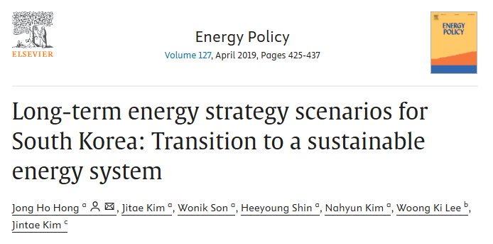
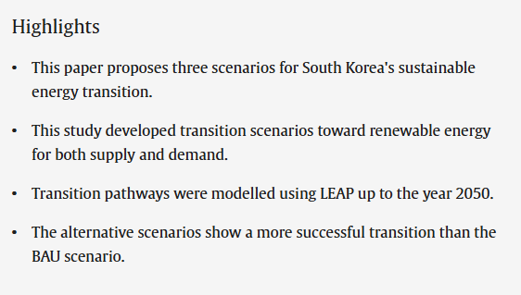
South Korea scenarios using LEAP model
Hong et al. (2019), Energy Policy : this article develops multiple energy system scenarios using the LEAP model for South Korea.
Hong J. H., Kim J., Son W., Shin H., Kim N., Lee W. K., & Kim J. (2019). Long-term energy strategy scenarios for South Korea: Transition to a sustainable energy system. Energy Policy, 127, 425–437

Slide 19
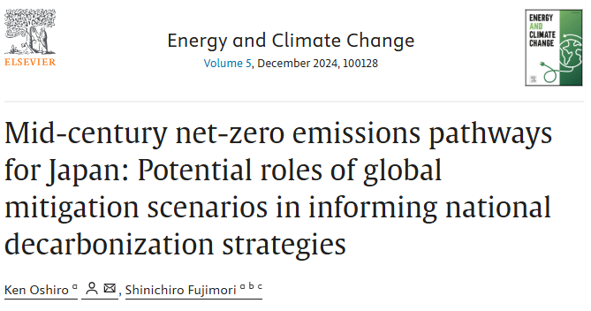
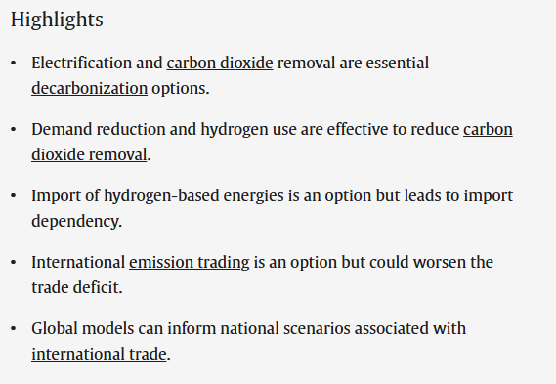
Japan’s Net-zero emissions pathways /scenarios
Oshiro, K., & Fujimori, S. (2024). Mid-century net-zero emissions pathways for Japan: Potential roles of global mitigation scenarios in informing national decarbonization strategies. Energy and Climate Change.
Ken Oshiro & Shinichiro Fujimori (2024), Energy and Climate Change ; develop long-term net-zero decarbonization pathways for Japan and evaluate how global climate scenarios can inform national strategies.
Japan’s approach combines global climate ambition with national policy /strategy instruments
Notes:
High-Level Scenario Structure (Japan) — From the Article
The authors develop pathways that:
explore mid-century net-zero emissions,
assess how global mitigation scenarios (like 1.5–2°C trajectories) can shape Japan’s strategy,
integrate national contexts into scenario design. ScienceDirect
This provides a policy-driven national scenario set, which you can adapt conceptually as another benchmark for Egypt.

Slide 20
Explores diverse pathways for Japan to achieve its net-zero emissions target by 2050, considering both domestic and international mitigation options, a national bottom-up energy system model (AIM/Technology-Japan) with global IAM outputs.
Five NZE pathways:
CDR-heavy (BECCS + DACCS)
Alternative fuels (hydrogen, synfuels)
Low-demand society
Import-dependent (hydrogen & synfuels)
Emission trading (international credits)
Key findings include:
Electrification + power sector decarbonization are unavoidable across all scenarios.
Carbon Dioxide Removal (CDR), and hydrogen/synthetic fuels are essential decarbonization options across all net-zero scenarios.
Upscaling CDR, reducing energy demand, and importing low-carbon energy carriers or emission allowances are alternative pathways, each with their own technological, economic and societal challenges.
Global energy system models can inform national scenario assessments by providing information on international trade of low-carbon energy and emission allowances, which are important options for Japan given its limited domestic energy resources( domestic renewables are insufficient ).

Slide 21
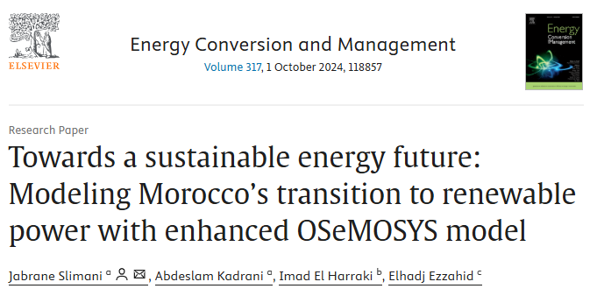
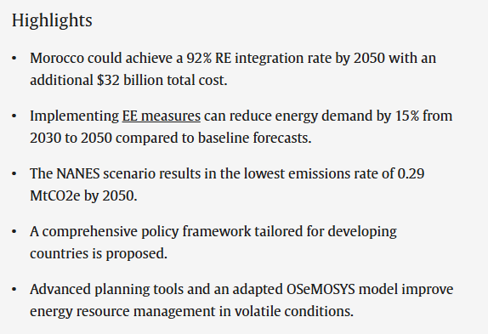
Morocco’s OSeMOSYS-based scenario modelling transition to renewable power
Goal : Develops an enhanced OSeMOSYS energy system model to examine long-term energy supply strategies (reach a renewable - dominant electricity system by 2050
A baseline and three alternative scenarios were developed,
How far can decarbonize electricity if the renewables increase and slightly control demand?
Scenario | Objective | Key Assumptions
BAU | Continuation of current policies | Electricity demand keeps rising No new CO₂ constraint; Delayed gas investments (still needed) Moderate RE growth
RNES (Ratified National Energy Strategy) | Policy-aligned transition(official policy) | Renewables reach 52% of capacity by 2030 Small demand reduction (5%) vs baseline
NMNES (New Moderate National Energy Strategy) (Moderate Decarbonization) | Accelerated RE + emissions control | Renewables > 60% by 2050 ( 57% 2040,67% 2050) Demand grows slower ( reduction 10% lower than BAU) CO₂ reduction from 2025;
NANES (New Ambitious National Energy Strategy) (Ambitious Decarbonization) | Near-zero electricity emissions | 72 % RE by 2040, 92 % by 2050; Strong demand reduction ~15 % Strong CO₂ constraint Storage & flexibility required

Slide 22
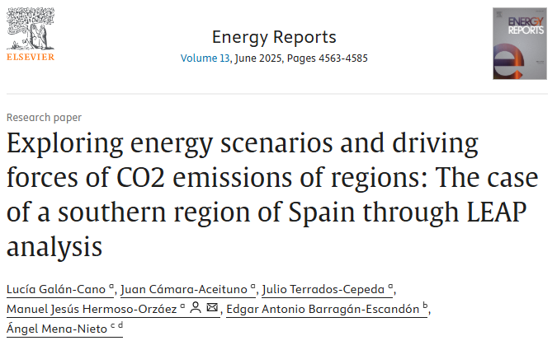
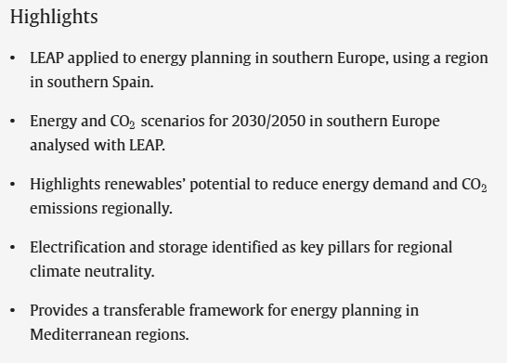
Spain’s energy scenarios and driving forces of CO₂ emissions
Key points :
Compares 3 scenarios : Baseline (current policy); Efficiency scenario (ambitious energy saving actions) ; Long-term decarbonization (targeting climate neutrality) pathways for energy demand and CO₂ emissions
Finds that even ambitious efficiency improvements and renewable integration may not fully achieve long-term climate targets without deeper transformation (e.g., electrification, storage).

Slide 23
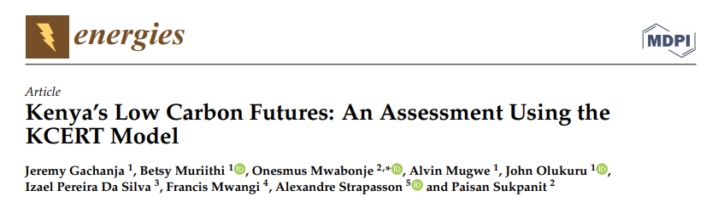

Kenya’s Low Carbon Futures by 2050
It aims to explore long-term low-carbon development pathways for Kenya up to 2050 by Estimating future energy demand and emissions
Testing policy and mitigation options
Supporting national climate strategy and NDC planning
KCERT (Kenya Carbon Emissions Reduction Tool) → Built on LEAP framework
Scenario-based simulation model covering the whole energy system
Scenarios
BAU (Business-as-Usual) → Continuation of current trends
Low-Carbon Development Scenario → Strong renewables, efficiency, electrification
High Ambition Mitigation → Aggressive mitigation across all sectors
Sector-Focused Mitigation → Targeted actions in power, transport, buildings
Sensitivity / Policy Variants → Variations in technology costs, growth, and uptake rates
Findings :
Kenya can achieve large emissions reductions by : Expanding geothermal and renewables , Electrifying transport and Improving efficiency
2. Many mitigation options are: Cost-effective or low-cost
3. Power sector becomes: reach to low-carbon early due to
geothermal and hydro
Limitations
No explicit net-zero constraint so No “hard carbon-neutrality by year X” scenario
No structural separation of pathways : Power-only vs demand-only vs combined strategies
Not an optimization benchmark , cannot provide a least-cost net-zero reference like your NZ-OPT (NEMO)

Slide 24
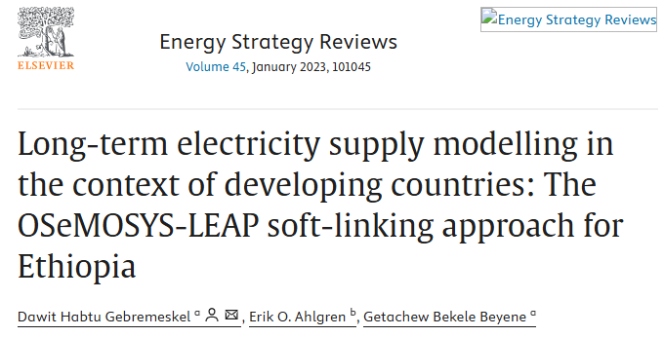
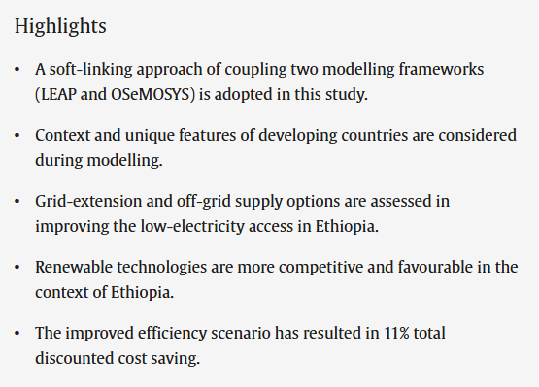
Ethiopia’s Scenarios using OSeMOSYS- LEAP model
To analyze long-term electricity supply pathways for Ethiopia Least-cost capacity expansion under different development strategies, using OSeMOSYS with LEAP which used mainly for demand projection ,focus on:
Power system expansion
Hydropower and renewable utilization
Investment needs and system costs
Regional electricity exports
Scenarios
Reference / BAU → Current plans and trends continue
High Demand / High Growth → Rapid domestic electricity demand growth
Export-Oriented → Large-scale generation built to export power to neighboring countries
Hydropower-Dominated → Maximum exploitation of hydro potential
Diversified Renewables → Mix of hydro, wind, solar, geothermal to reduce climate and hydrology risk
Findings : Ethiopia can supply very low-carbon electricity mainly using:
  Hydropower
  Geothermal Wind
  Export-oriented strategies require : Massive grid and generation investment
  Diversification is important to: Reduce drought risk & Improve system reliability
Limitations
Only electricity sector : No buildings, transport, industry, or demand-side efficiency
No economy-wide emissions : No carbon-neutrality or net-zero constraint
No demand-side mitigation: Demand is exogenous; no efficiency scenarios

Slide 25
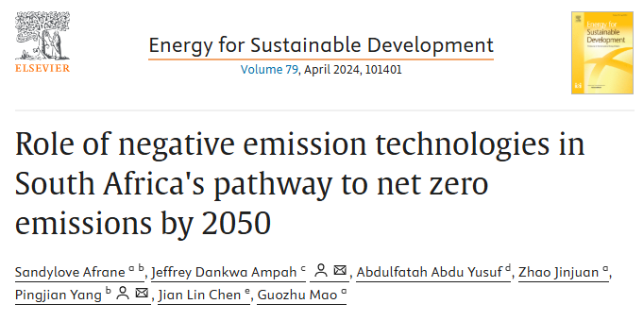
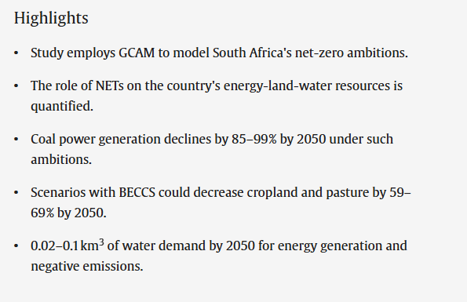
South Africa's pathway to net zero emissions by 2050
Uses the the Global Change Assessment Model (GCAM-South Africa ) integrated assessment model to explore long-term decarbonisation pathways up to 2050.
Considers both emissions reduction measures and NET deployment (e.g., BECCS and DACCS) in its scenario set.
Formulates five distinct scenarios:
  A reference scenario that does not incorporate climate policy
  Four net-zero scenarios with varying assumptions about NETs and mitigation strategies.
If the country MUST reach net-zero, how hard does the system need to change?
Not focused on renewables targets
focused on a carbon constraint
Net-zero WITH carbon removal (NETs)
Assumption:
Some CO₂ can be removed later (BECCS, DAC, CCS)
Power transition can be slightly slower
System has more flexibility
But land/water impacts increase
Net-zero WITHOUT removals
Assumption:
No carbon removal allowed
Renewables + efficiency must grow very fast
Fossil fuels disappear almost completely

Slide 26
Country | Model & Focus | Scenario Type | Strengths | Limitations | What Egypt Builds On
Kenya | KCERT / LEAP (economy-wide, policy tool) | BAU vs Low-Carbon policy narratives | Good sector coverage; strong policy storytelling | No separation of supply vs demand effects; no hard net-zero constraint; horizon to 2050 | Scenario communication, policy linkage, sectoral presentation
Ethiopia | OSeMOSYS + LEAP (electricity planning) | Power-sector development & export strategies | Strong capacity-expansion and cost optimization | Only electricity sector; no demand-side mitigation; no economy-wide decarbonisation | Power-system modelling, resource constraints, investment logic
Morocco | OSeMOSYS (power system, decarbonization) | BAU → policy → moderate → ambitious RE | Clear RE targets, demand wedges, CO₂ pressure, flexibility needs | Electricity-focused; not economy-wide; no full demand-side transition | Scenario architecture: RE targets + demand wedges + CO₂ pressure
Egypt | LEAP + NEMO (full energy system) | BAU / PET / RPT / EDT / CNS / NZ-OPT | Separates policy, supply, and demand effects; economy-wide; long-term (2070); net-zero + cost-optimal benchmark | ????? | Integrates and extends African best practice into a diagnostic, policy-relevant framework

Slide 27
Explicit Mapping: Africa → Egypt Scenario Framework
Egypt Scenario | Other scenarios | Key assumptions for Egypt
BAU / REF What if Egypt continues as today | Morocco – BAU | Continuation of current policies (baseline under growing demand) Renewables grow slowly no additional CO₂ constraint Gas remains dominant
PET (Policy-aligned transition) What if Egypt actually does Vision 2030 & NDC? | Morocco – RNES | Full implementation of official national targets and plans (Egypt Vision 2030 and NDC commitments Official renewable targets Official efficiency improvements No extreme assumptions
RPT (Power transition) What if Egypt clean electricity as fast as possible? | Morocco – NMNES / NANES | Accelerated renewable deployment with milestone targets (Egypt’s strong solar and wind potential High solar & wind growth Gas declines gradually Demand stays as BAU no change
EDT (Efficiency-first) What is happen If buildings and transport, other appliances use less energy | Morocco – Demand reduction wedges | Explicit demand reduction relative to baseline (5 – 15%) (efficiency gains in buildings, appliances, and transport Efficient appliances Better buildings Efficient transport Power mix not radically changed
CNS (Carbon -neutrality strategy) What if Egypt combines everything needed? | Morocco – NANES + South Africa net-zero logic | Combined RE expansion, demand moderation, and CO₂ constraint (a realistic, narrative pathway to carbon neutrality Clean electricity Strong efficiency Long-term CO₂ constraint
NZ-OPT (NEMO) What is the cheapest way to reach net-zero? | South Africa – Net-zero with/without NETs | Hard net-zero constraint shaping system optimisation (Provides a least-cost benchmark under strict emissions limits Emissions must reach zero (or near-zero) Model chooses technologies No narrative bias

Slide 28
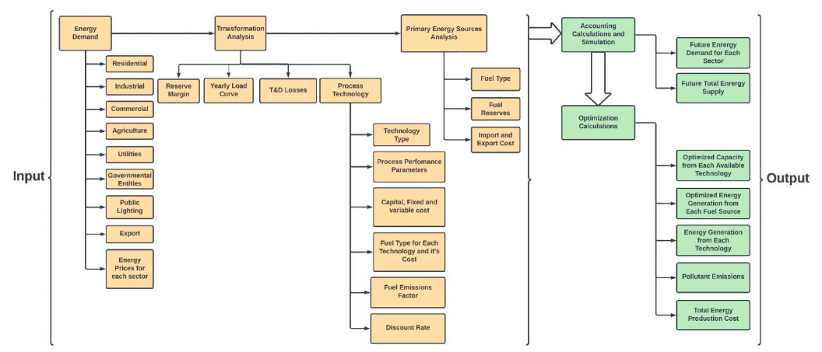
LEAP framework for Egypt
Scenario development
Examining energy demand, which informs resource energy and transformation analyses.
Assessing available energy supply resources and technologies for converting energy sources, including fossil fuels and renewables
Calculating projected energy consumption based on demand, followed by optimization that employs cost-benefit analysis.
Scenario design and analysis
The year 2017 is the baseline year, and 2070 is the end year of analysis.
Three scenarios will be developed in the LEAP Model
- Current account, its base year 2017
- Business-as-usual scenario (BAS) as the baseline
- Mitigation Scenario (2018- 2070)
LEAP model for Egypt

Slide 29
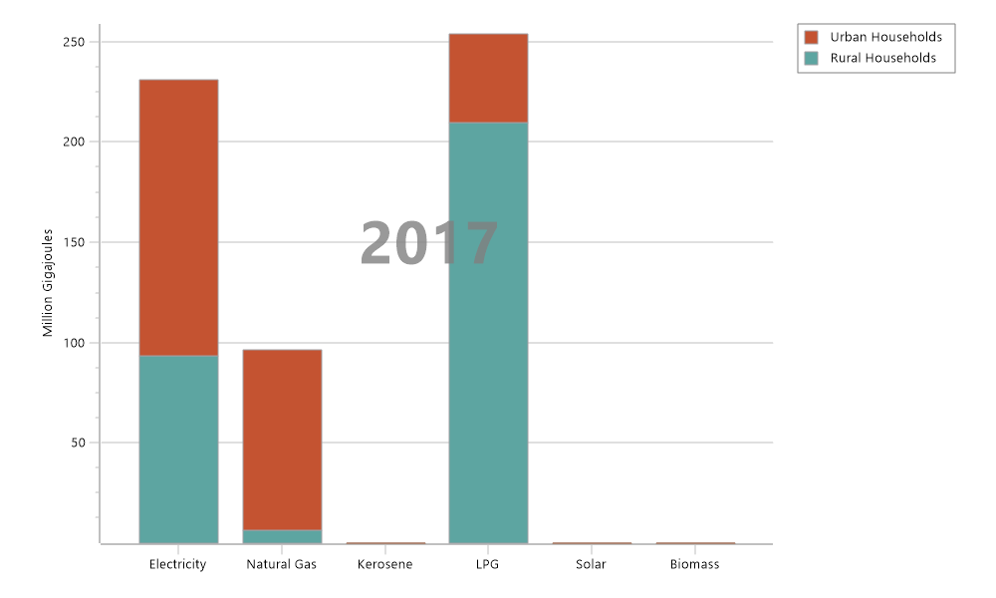
Current Accounts: Final Energy Demand,2017
| Residential Sector
Final Energy Demand ,2017
Branch: Demand: Residential Units: Million Gigajoules
Branch | Electricity | Natural Gas | Kerosene | LPG | Solar | Biomass | Total
Urban Households | 137.4 | 90.0 | 0.0 | 44.3 | 0.0 | 0.0 | 271.7
Rural Households | 93.4 | 6.4 | 0.1 | 209.5 | 0.0 | 0.0 | 309.4
Total | 230.9 | 96.4 | 0.1 | 253.8 | 0.0 | 0.0 | 581.1
Notes:
This slide presents Egypt's 2017 residential energy baseline from two complementary perspectives. On the left, the fuel-based chart shows how
electricity, natural gas, and LPG each break down by technology — showing that LPG is almost entirely consumed by cooking stoves, electricity
powers all modern appliances and air conditioning, and gas fills a growing but still small niche in water heating and urban kitchens.
On the right, the end-use table shows the same 381 PJ total but organized by service (cooking, heating, cooling, etc.) and fuel source.
This helps us see that cooking depends almost entirely on LPG, lighting and appliances are purely electric, and water heating is fuel-mixed.
Together, these two views are calibrated to the Egyptian Electricity Holding. The company’s 2017–2018 annual report serves as our Current Accounts reference point.
From here, we project forward into the Baseline and Carbon Neutral scenarios.

Slide 30
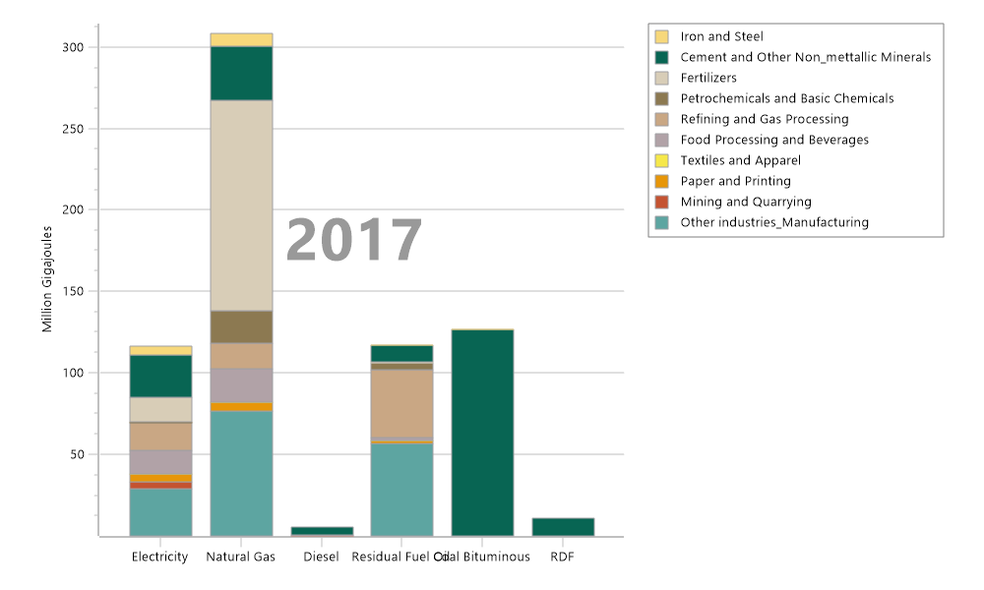
Current Accounts: Final Energy Demand,2017
| Industry Sector
Final Energy Demand ,2017 Branch: Demand, Industry Units: Million Gigajoules
Branch | Electricity | Natural Gas | Diesel | Residual Fuel Oil | Coal Bituminous | RDF | Total
Iron and Steel | 5.5 | 7.9 | - | 0.0 | 0.2 | - | 13.7
Cement and Other Non_mettallic Minerals | 26.1 | 33.1 | 4.5 | 10.0 | 126.7 | 10.8 | 211.1
Fertilizers | 14.9 | 128.7 | - | 0.8 | - | - | 144.5
Petrochemicals and Basic Chemicals | 0.5 | 20.4 | - | 3.9 | - | - | 24.8
Refining and Gas Processing | 17.2 | 15.6 | - | 41.8 | - | - | 74.6
Food Processing and Beverages | 14.1 | 20.3 | 0.9 | 2.0 | - | - | 37.3
Textiles and Apparel | 0.1 | 0.1 | - | 0.0 | - | - | 0.2
Paper and Printing | 4.8 | 5.6 | - | 1.5 | - | - | 11.9
Mining and Quarrying | 4.1 | - | 0.0 | - | - | - | 4.2
Other industries and Manufacturing | 29.3 | 76.4 | - | 56.9 | - | - | 162.5
Total | 116.6 | 308.1 | 5.3 | 116.9 | 126.9 | 10.8 | 684.7

Slide 31
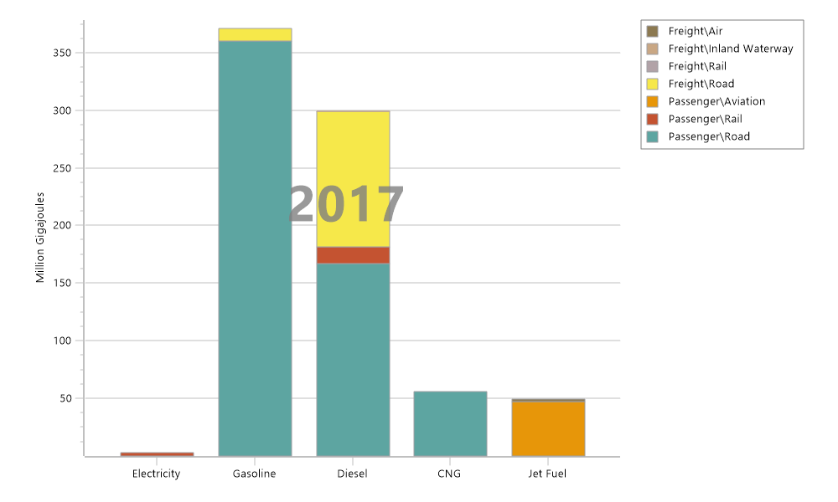
Current Accounts: Final Energy Demand,2017
| Transport Sector
Final Energy Demand , Transport Sector ,2017 Units: Million Gigajoules
Branch | Electricity | Gasoline | Diesel | CNG | Jet Fuel | Total
Passenger | 2.7 | 359.7 | 181.8 | 55.8 | 47.5 | 647.4
Road | - | 359.7 | 167.3 | 55.8 | - | 582.7
Cars | - | 321.2 | 11.4 | 22.1 | - | 354.7
Buses | - | - | 37.8 | 1.1 | - | 39.0
Taxi | - | 20.4 | - | 23.5 | - | 43.8
Motorcycles_Scooters | - | 13.2 | - | - | - | 13.2
Microbuses | - | - | 118.1 | 9.0 | - | 127.1
Tuk Tuks | - | 4.9 | - | - | - | 4.9
Rail | 2.7 | - | 14.5 | - | - | 17.2
Electricity _ Cairo Metro | 2.7 | - | - | - | - | 2.7
Diesel | - | - | 14.5 | - | - | 14.5
Aviation | - | - | - | - | 47.5 | 47.5
Jet Fuel | - | - | - | - | 47.5 | 47.5
Freight | - | 11.1 | 117.6 | - | 1.6 | 130.3
Road | - | 11.1 | 117.3 | - | - | 128.4
Light Trucks | - | 11.1 | 14.9 | - | - | 26.0
Medium Trucks | - | - | 22.4 | - | - | 22.4
Heavy Trucks | - | - | 80.0 | - | - | 80.0
Rail | - | - | 0.1 | - | - | 0.1
Diesel | - | - | 0.1 | - | - | 0.1
Inland Waterway | - | - | 0.1 | - | - | 0.1
Diesel | - | - | 0.1 | - | - | 0.1
Air | - | - | - | - | 1.6 | 1.6
Jet Fuel | - | - | - | - | 1.6 | 1.6
Total | 2.7 | 370.8 | 299.4 | 55.8 | 49.1 | 777.7

Slide 32
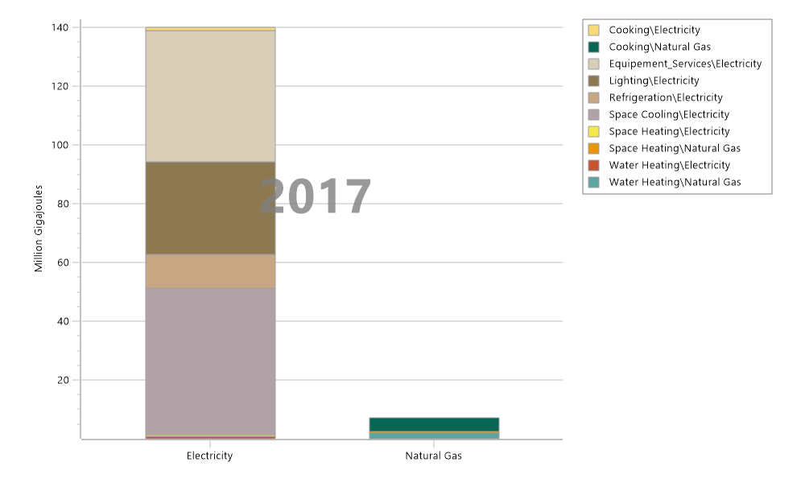
| Commercial & Public Sector
Current Accounts: Final Energy Demand,2017
Final Energy Demand, Commercial _ Public Services, 2017
Units: Million Gigajoules
Branch | Electricity | Natural Gas | Total | Total
Space Cooling | 49.9 | - | 49.9 | 49.9
Electricity | 49.9 | - | 49.9 | 49.9
Lighting | 31.5 | - | 31.5 | 31.5
Electricity | 31.5 | - | 31.5 | 31.5
Water Heating | 0.8 | 2.3 | 3.0 | 3.0
Electricity | 0.8 | - | 0.8 | 0.8
Natural Gas | - | 2.3 | 2.3 | 2.3
Refrigeration | 11.5 | - | 11.5 | 11.5
Electricity | 11.5 | - | 11.5 | 11.5
Cooking | 1.1 | 4.5 | 5.7 | 5.7
Electricity | 1.1 | - | 1.1 | 1.1
Natural Gas | - | 4.5 | 4.5 | 4.5
Space Heating | 0.6 | 0.2 | 0.8 | 0.8
Electricity | 0.6 | - | 0.6 | 0.6
Natural Gas | - | 0.2 | 0.2 | 0.2
Equipement_Services | 44.6 | - | 44.6 | 44.6
Electricity | 44.6 | - | 44.6 | 44.6
Total | 139.9 | 7.0 | 146.9 | 146.9

Slide 33
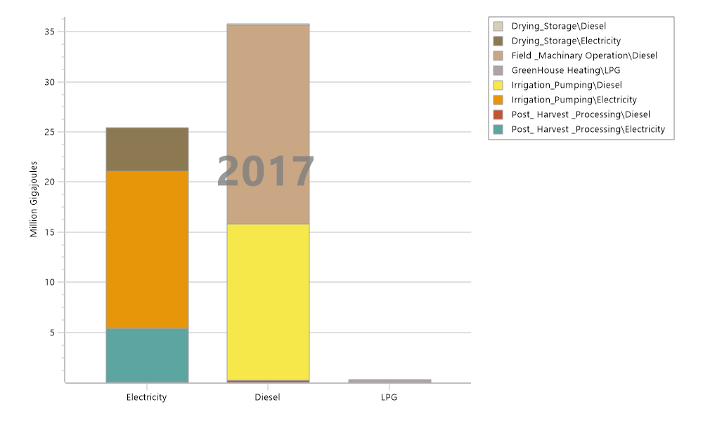
Current Accounts: Final Energy Demand,2017
| Agriculture Sector
Final Energy Demand, Agriculture Sector 2017, Units: Million Gigajoules
Branch | Electricity | Diesel | LPG | Total
Irrigation_Pumping | 15.7 | 15.7 | - | 31.3
Diesel | - | 15.7 | - | 15.7
Electricity | 15.7 | - | - | 15.7
Field _Machinary Operation | - | 19.8 | - | 19.8
Diesel | - | 19.8 | - | 19.8
Post_ Harvest _Processing | 5.4 | 0.2 | - | 5.6
Electricity | 5.4 | - | - | 5.4
Diesel | - | 0.2 | - | 0.2
Drying_Storage | 4.4 | 0.1 | - | 4.5
Electricity | 4.4 | - | - | 4.4
Diesel | - | 0.1 | - | 0.1
GreenHouse Heating | - | - | 0.3 | 0.3
LPG | - | - | 0.3 | 0.3
Total | 25.4 | 35.8 | 0.3 | 61.5

Slide 34
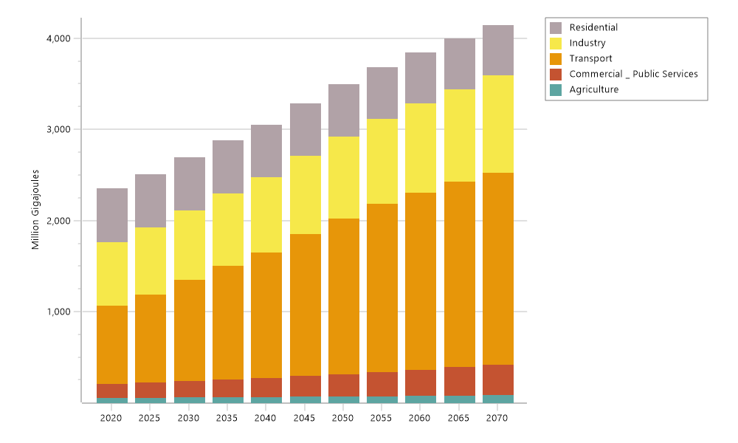
Final Energy Demand by Sector: (Million GJ)
Scenario: Baseline
Final Energy Demand , Scenario: Baseline, All Fuels, Units: Million Gigajoules
Branch | 2020 | 2025 | 2030 | 2035 | 2040 | 2045 | 2050 | 2055 | 2060 | 2065 | 2070 | Total
Residential | 581.5 | 579.5 | 577.3 | 574.6 | 571.7 | 568.6 | 565.4 | 560.3 | 554.9 | 549.4 | 543.6 | 6,226.7
Industry | 702.0 | 731.5 | 762.2 | 792.6 | 825.0 | 859.6 | 896.6 | 934.9 | 976.2 | 1,020.9 | 1,069.2 | 9,570.8
Transport | 859.7 | 971.9 | 1,118.7 | 1,253.7 | 1,377.6 | 1,563.2 | 1,713.3 | 1,846.7 | 1,947.1 | 2,035.9 | 2,108.6 | 16,796.3
Commercial _ Public Services | 154.0 | 166.6 | 180.1 | 194.9 | 210.8 | 228.1 | 246.8 | 266.7 | 288.2 | 311.5 | 336.7 | 2,584.4
Agriculture | 55.9 | 58.4 | 61.0 | 63.9 | 66.8 | 69.9 | 73.1 | 76.8 | 80.5 | 84.5 | 88.5 | 779.4
Total | 2,353.2 | 2,507.8 | 2,699.3 | 2,879.7 | 3,052.0 | 3,289.5 | 3,495.2 | 3,685.3 | 3,847.0 | 4,002.1 | 4,146.7 | 35,957.6

Slide 35
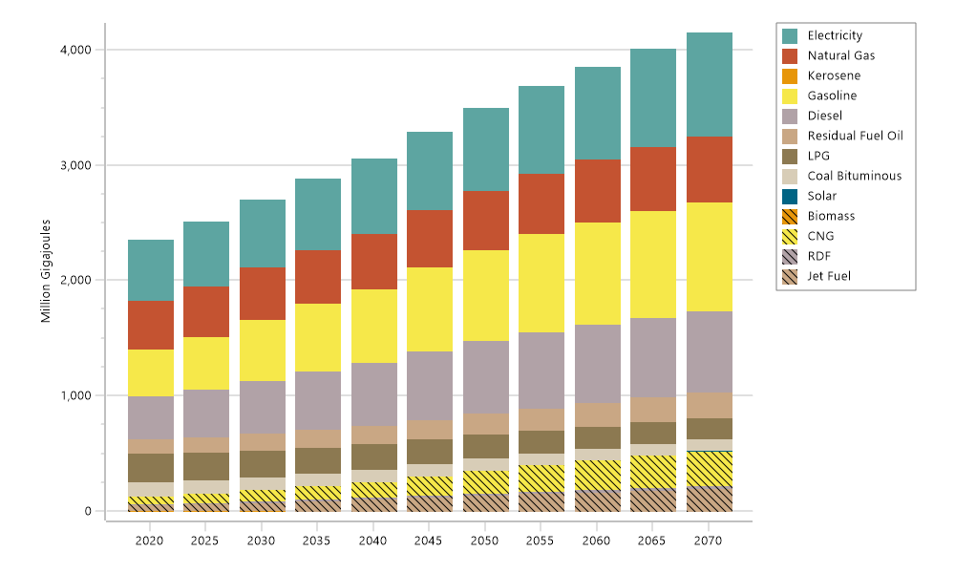
Final Energy Demand by Fuel: (Million GJ)
Scenario: Baseline
Final Energy Demand Scenario , Baseline Units: Million Gigajoules
Fuel | 2020 | 2025 | 2030 | 2035 | 2040 | 2045 | 2050 | 2055 | 2060 | 2065 | 2070 | Total
Electricity | 523.6 | 551.5 | 581.2 | 610.2 | 641.5 | 676.0 | 713.2 | 752.3 | 794.7 | 841.9 | 893.5 | 7,579.5
Natural Gas | 421.8 | 438.2 | 454.8 | 468.8 | 483.1 | 497.8 | 512.7 | 526.7 | 541.0 | 555.6 | 570.4 | 5,470.9
Kerosene | 0.0 | 0.0 | 0.0 | 0.0 | 0.0 | 0.0 | 0.0 | 0.0 | 0.0 | 0.0 | - | 0.1
Gasoline | 408.4 | 460.2 | 527.7 | 586.7 | 638.7 | 724.3 | 791.0 | 847.9 | 888.0 | 920.6 | 944.9 | 7,738.5
Diesel | 371.1 | 409.6 | 459.8 | 504.0 | 543.6 | 593.4 | 629.9 | 660.6 | 679.9 | 692.9 | 700.3 | 6,245.2
Residual Fuel Oil | 122.9 | 133.1 | 143.6 | 152.0 | 160.9 | 170.4 | 180.6 | 191.7 | 203.7 | 216.6 | 230.6 | 1,906.0
LPG | 250.4 | 240.5 | 230.9 | 224.5 | 218.2 | 212.0 | 205.8 | 198.7 | 191.7 | 184.8 | 178.1 | 2,335.7
Coal Bituminous | 124.1 | 119.3 | 114.6 | 112.5 | 110.3 | 108.2 | 106.0 | 105.4 | 104.8 | 104.1 | 103.4 | 1,212.6
Solar | 0.0 | 0.0 | 0.0 | 0.0 | 0.0 | 0.0 | 0.1 | 0.1 | 0.1 | 0.1 | 0.1 | 0.5
Biomass | -0.0 | -0.0 | -0.0 | 0.0 | 0.0 | 0.0 | 0.0 | 0.0 | 0.0 | 0.0 | 0.0 | 0.1
CNG | 63.7 | 77.2 | 94.2 | 113.7 | 133.6 | 165.8 | 196.6 | 225.3 | 251.2 | 277.6 | 302.5 | 1,901.2
RDF | 11.5 | 12.8 | 14.0 | 15.8 | 17.5 | 19.3 | 21.0 | 22.2 | 23.3 | 24.4 | 25.4 | 207.1
Jet Fuel | 55.6 | 65.3 | 78.4 | 91.5 | 104.5 | 122.4 | 138.3 | 154.5 | 168.7 | 183.5 | 197.5 | 1,360.3
Total | 2,353.2 | 2,507.8 | 2,699.3 | 2,879.7 | 3,052.0 | 3,289.5 | 3,495.2 | 3,685.3 | 3,847.0 | 4,002.1 | 4,146.7 | 35,957.6

Slide 36
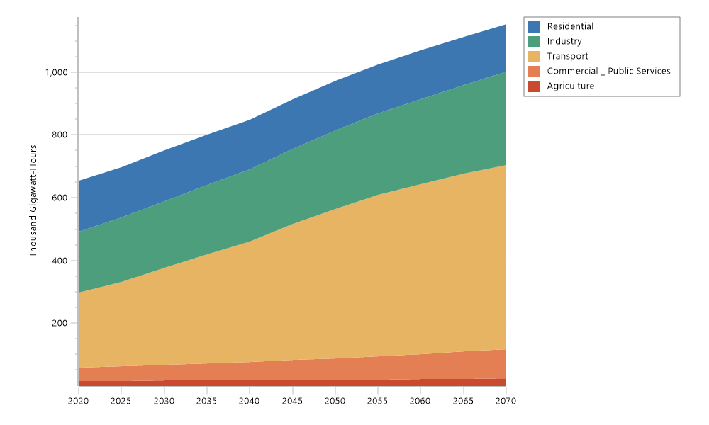
Final Energy Demand Scenario: Baseline, All Fuels
Final Energy Demand Scenario: Baseline, All Fuels , Units: Thousand Gigawatt-Hours
Branch | 2020 | 2025 | 2030 | 2035 | 2040 | 2045 | 2050 | 2055 | 2060 | 2065 | 2070 | Total
Residential | 161.6 | 161.0 | 160.4 | 159.7 | 158.9 | 158.0 | 157.1 | 155.7 | 154.2 | 152.7 | 151.1 | 1,730.3
Industry | 195.0 | 203.2 | 211.7 | 220.2 | 229.2 | 238.8 | 249.1 | 259.7 | 271.2 | 283.6 | 297.0 | 2,658.5
Transport | 238.8 | 270.0 | 310.7 | 348.3 | 382.7 | 434.2 | 475.9 | 513.0 | 540.9 | 565.5 | 585.7 | 4,665.6
Commercial _ Public Services | 42.8 | 46.3 | 50.0 | 54.1 | 58.6 | 63.4 | 68.6 | 74.1 | 80.1 | 86.5 | 93.5 | 717.9
Agriculture | 15.5 | 16.2 | 16.9 | 17.7 | 18.6 | 19.4 | 20.3 | 21.3 | 22.4 | 23.5 | 24.6 | 216.5
Total | 653.7 | 696.7 | 749.9 | 800.0 | 847.8 | 913.8 | 971.0 | 1,023.8 | 1,068.7 | 1,111.7 | 1,151.9 | 9,988.9

Slide 37
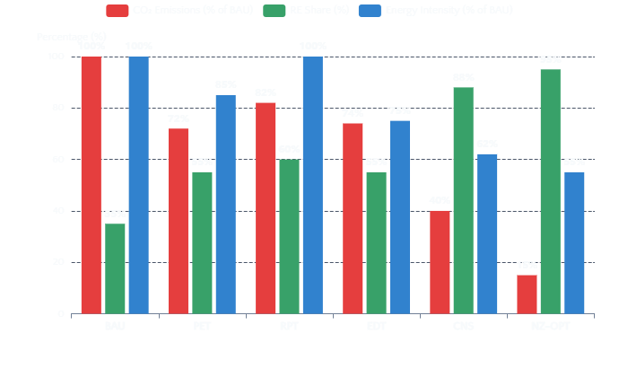
07 | EXPECTED RESULTS
Scenario Comparison: Key Expected Findings
Comparative Performance Indicators by Scenario (2070)
Key Insights
Neither renewables alone (RPT) nor efficiency alone (EDT) achieves
Carbon neutrality; both must be combined for deep decarbonization.
EDT/RPT: Renewable‑Led Power Transition Efficiency Slows
Demand growth and reduce emissions, yet residual emissions
remain from fossil fuel use.
CNS scenario shows ~60–75% reduction in CO₂ emissions vs BAU by
2070 through coordinated deployment.
Only the CNS / Carbon‑Neutrality Strategy + NZ-OPT/ NEMO Net‑Zero – Least‑Cost Pathway, combined pathway enables deep
decarbonization and a robust route to carbon neutrality.
Policy-aligned (PET) scenario underperforms on emissions without
stronger electrification mandates.
Demand-side efficiency has the greatest impact in residential & industrial sectors.
📊
⚡
💰
Critical Finding
GHG trajectory
by scenario
Energy mix
evolution
Investment
requirements
🌍
Policy
recommendations
The NZ-OPT benchmark reveals that the least-cost pathway requires
a 90%+ RE share and significant electrification of end-uses.

Slide 38

08 | KEY INSIGHTS & POLICY IMPLICATIONS
Critical Findings for Egypt's Energy Transition
Combined Approach Essential
Sector-Specific Efficiency Impact
Clean electricity and efficiency each reduce emissions, but neither is sufficient alone. Achieving carbon neutrality requires coordinated deployment of both supply-side and demand-side measures.
Demand-side efficiency has the greatest impact in residential & industrial sectors. Buildings' energy intensity reduction (30–40% by 2050) and industrial efficiency improvements are key levers.
Rapid Demand Growth Challenge
Policy Gaps in Current Plans
Rapid energy-demand growth requires integrating supply-side and
demand-side measures. With demand projected to triple by 2050, efficiency improvements are critical to moderate growth.
Policy-aligned (PET) scenario underperforms on emissions without stronger electrification mandates. Current official targets need enhancement to achieve deep decarbonization.
Core Policy Implication
Achieving carbon neutrality in Egypt depends on combining renewable expansion with strong efficiency policies. Carbon neutrality requires
coordinated action across both energy supply and demand - a single-strategy approach is insufficient for deep decarbonization.

Slide 39
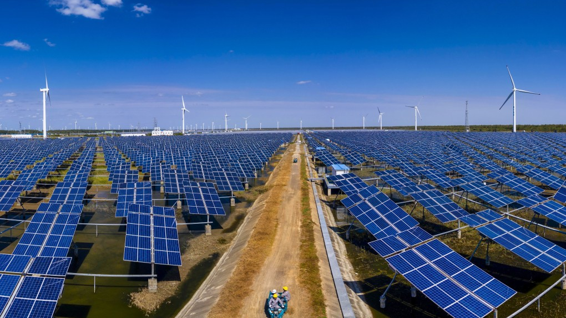
09 | CONCLUSION & RESEARCH CONTRIBUTIONS
Conclusion & Research Contributions
Key Conclusions
Key Research Contributions
Egypt's long-term energy transition cannot rely on a single strategy. Renewable electricity and energy efficiency each play essential but incomplete roles in achieving carbon neutrality.
1
First Integrated Model
First integrated LEAP+NEMO model calibrated to Egypt's 2017 energy system, providing a robust analytical foundation.
An integrated, LEAP-based scenario framework provides a realistic pathway toward carbon
neutrality by 2070, demonstrating that coordinated transformation is achievable.
2
Structured Framework
Carbon neutrality in Egypt is achievable only through a coordinated, long-term transformation of
Both energy supply and demand are supported by strategic investment sequencing.
Structured 6-scenario framework from BAU to the least-cost net-zero benchmark,
enabling systematic policy assessment.
This study delivers the most comprehensive long-range energy system model for
Egypt, demonstrating that carbon neutrality by 2070 is achievable but requires
coordinated deployment of renewables, demand-side efficiency, and electrification.
3
Long-Range Analysis
Long-range analysis extending to 2070 — beyond all existing Egyptian studies, providing unprecedented temporal scope.
4
Transferable Methodology
Transferable modeling methodology for other MENA & developing economies facing
similar energy-climate challenges.
Ashraf Elhaddad
Questions & Discussion
Ph.D. Candidate, University of Seoul
ashraf@uos.ac.kr

Slide 40
Thank You
University of Seoul, Urban Planning and Design Department, Doctoral Program 서울시립대학교, 도시공학과, 박사과정 아슈라프 엘하닫
Ashraf El Haddad
ashraf@uos.ac.kr
This research was supported by the BK21 4 (Four Outstanding Universities for Research) funded by the Ministry of Education (MOE, Korea) and the National Research Foundation of Korea (NRF) and also, It was supported by the Carbon Neutrality, a specialized program of the Graduate School through the Korea Environmental Industry & Technology Institute (KEITI) funded by the Ministry of Environment (MOE, Korea).

Slide 41
References
18. Park, S.Y., Yun, B.-Y., Yun, C.Y., Lee, D.H. and Choi, D.G. (2016), “An analysis of the optimum renewable energy portfolio using bottom–up models: focusing on electricity sector in South Korea”,
Renewable and Sustainable Energy Reviews, Vol. 53, pp. 319-329, doi: 10.1016/j.rser.2015.08.029.
19. Prina, M.G., Manzolini, G., Moser, D., Nastasi, B. and Sparber, W. (2020), “Classification and challenges of bottom-up energy system models”, Renewable and Sustainable Energy, Vol. 129,
109917, Doi: 10.1016/j.rser.2020.109917.
20. Prina, M.G., Groppi, D., Nastasi, B. and Garcia, D.A. (2021), “Bottom-up energy system models applied to sustainable islands”, Renewable and Sustainable Energy Reviews, Vol. 152, 111625,
Doi: 10.1016/j.rser.2021.111625.
21. Rady, Y. Y., Rocco, M. V., Serag-Eldin, M. A., & Colombo, E. (2018). Modelling for power generation sector in Developing Countries: Case of Egypt. Energy, 165, 198-209.
22. Salah, S. I.,, Eltaweel M., & Abeykoon, C. (2022). Towards a sustainable energy future for Egypt: A systematic review of renewable energy sources, technologies, challenges, and recommendations. Cleaner Engineering and
Technology, 8, 100497.
23. Sanchez, M.O., Noguez, J., Molina-Espinosa, J.M., Lozano-Espinosa, R. and Vargas-Solar, G. (2021), “The contribution of bottom-up energy models to support policy design of electricity end-use efficiency for residential
buildings”, Energies, Vol. 14 No. 20, 6466, Doi: 10.3390/en14206466.
24. Simões, H. M., & Stanicek, B. (2022). Egypt’s Climate Change Policies: State of Play Ahead of COP27. European Parliamentary Research Service.
25. Shabbir, R., & Ahmad, S. S. (2010). Monitoring urban transport air pollution and energy demand in Rawalpindi and Islamabad using leap model. Energy, 35(5), 2323-2332.
26. U.S. Energy Information Administration (2025); Energy Institute - Statistical Review of World Energy (2025); Bolt and van Zanden – Maddison Project Database 2023 – with major processing by Our World
in Data. “Primary energy consumption per GDP” [dataset]. U.S. Energy Information Administration, “International Energy Data”; Energy Institute, “Statistical Review of World Energy”; Bolt and van
Zanden, “Maddison Project Database 2023” [original data].
27. World Bank Group. Egypt, Arab Rep. (2021). Available online: https://data.worldbank.org/country/EG .
28. World Bank. Middle East and North Africa; World Bank Group: Washington, DC, USA, 2021; Available online: https://www.worldbank.org/en/region/mena/overview#1.

Slide 42
References
1. Abdulhakeem , A.H. Eideh, Therese El Gemayel, Wafa Aboul Hosn. (2015). Energy Consumption in Transport Sector in Selected Arab Countries
2. Abouaiana, A., & Battisti, A. (2025). Towards clean energy transition. An exploratory case study from rural Egypt. Sustainability, 17(4), 1-39.
3. Arab Development Portal Egypt’s Vision 2030. (2016). Available online: https://arabdevelopmentportal.com/sites/default/files/publication/sds_egypt_vision_2030.pdf.
4. Cai L, Luo J, Wang M, Guo J, Duan J, Li J, et al.(2023) Pathways for municipalities to achieve carbon emission peak and carbon neutrality: a study based on the LEAP model. Energy ;262:125435.
5. CAPMAS. Egypt Population, Housing, and Establishments Census (2017); Central Agency for Public Mobilization and Statistics: Cairo, Egypt, 2017. (In Arabic)
6. Egyptian Environmental Affairs Agency (EEAA). (2021). Summary for Policymakers: Egypt National Climate Change Strategy (NCCS) 2050.
Available : https://www.eeaa.gov.eg/Uploads/Topics/Files/20221206130720583.pdf .
7. El-Sayed, A. H. A., Khalil, A., & Yehia, M. (2023). Modeling alternative scenarios for Egypt 2050 energy mix based on LEAP analysis. Energy, 266, 126615.
8. Emodi, N. V., Emodi, C. C., Murthy, G. P., & Emodi, A. S. A. (2017). Energy policy for low carbon development in Nigeria: A LEAP model application. Renewable and Sustainable Energy Reviews, 68, 247-261.
9. Energy Consumption in Transport Sector in Selected Arab Countries. Available from:
https://www.researchgate.net/publication/281269326_Energy_Consumption_in_Transport_Sector_in_Selected_Arab_Countries [accessed Sep 19, 2025].
10.European Union (EU).(2015). ‘Integrated Sustainable Energy Strategy’ for Technical Assistance to Support the Reform of the Energy Sector (TARES); European Delegation of the European Union to Egypt:
Cairo, Egypt; Available online: https://eeas.europa.eu/archives/delegations/egypt/press_corner/all_news/news/2016/20160718_en.pdf .
11. Felver, T. B. (2020). How can Azerbaijan meet its Paris Agreement commitments: assessing the effectiveness of climate change-related energy policy options using LEAP modeling. Heliyon, 6(8).
12. Gibson, A., Makuch, Z., Yeganyan, R., Tan, N., Cannone, C., & Howells, M. (2024). Long-term energy system modelling for a clean energy transition in Egypt's energy sector. Energies, 17(10), 2397.
13. IRENA. Renewable Energy Outlook Egypt; International Renewable Energy Agency: Masdar City, United Arab Emirates, 2018: https://www.irena.org/ /media/Files/IRENA/Agency/Publication/2018/Oct/IRENA_Outlook_Egypt_2018_En.pdf
14. Global Carbon Budget (2024); U.S. Energy Information Administration (2025); Energy Institute - Statistical Review of World Energy (2025) – with major processing by Our World in Data. “Annual CO₂
emissions per unit energy (kg per kilowatt-hour)” [dataset]. Global Carbon Project, “Global Carbon Budget”; U.S. Energy Information Administration, “International Energy Data”; Energy Institute,
“Statistical Review of World Energy” [original data].
15. Mondal, M. A. H., & Ringler, C. (2020). Long-term optimization of regional power sector development: Potential for cooperation in the Eastern Nile region?. Energy, 201, 117703.
16. Mondal, M. A. H., Ringler, C., Al-Riffai, P., Eldidi, H., Breisinger, C., & Wiebelt, M. (2019). Long-term optimization of Egypt’s power sector: Policy implications. Energy, 166, 1063-1073.
17. New and Renewable Energy Authority (NREA).(2020). Annual Report; New and Renewable Energy Authority, 2020. Available: http://nrea.gov.eg/Content/reports/Annual%20Report%202020%20En.pdf .

