Slide 1


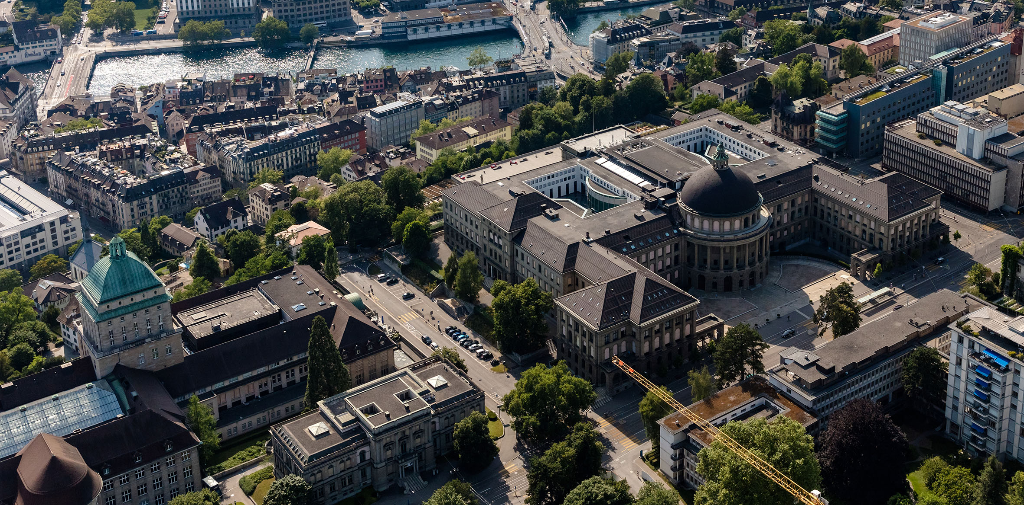

Efficient volatile exchange between atmosphere and magma ocean
Xuecheng Yang^{1*}, Cédric Gillmann¹, Paul Tackley¹
¹ Institute of Geophysics, ETH Zürich
* xuecheng.yang@eaps.ethz.ch
EGU 2026

Slide 2

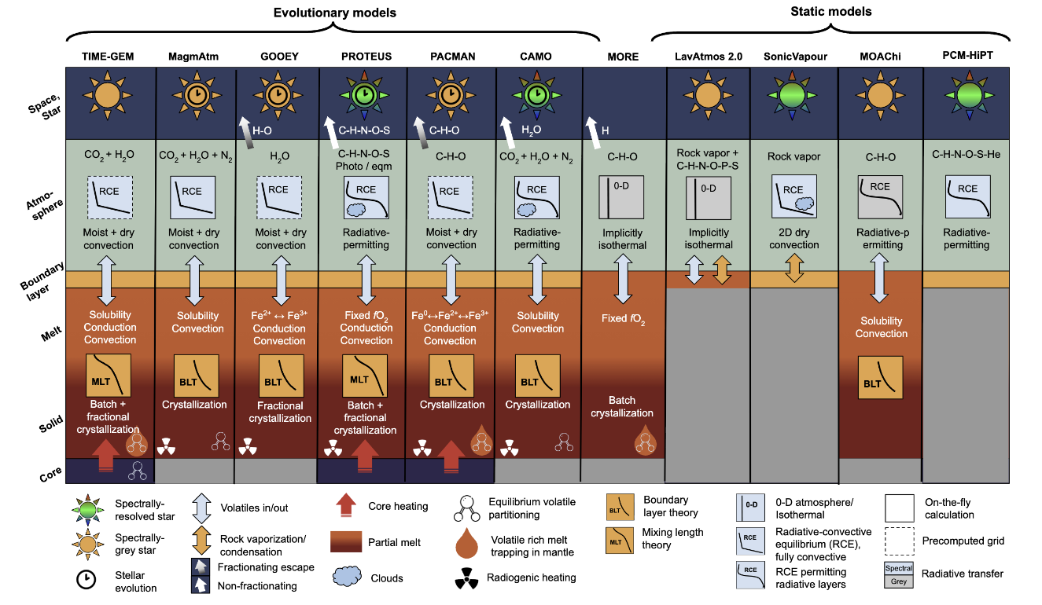
Coupled atmosphere-magma ocean models
From (Lichtenberg et.al, 2026, arXiv:2511.16142)
Notes:
Earth’s current ATM is thought to first originate from MO outgassing
Current understanding of this coupling is done by…

Slide 3
Coupled atmosphere-magma ocean models
Atmospheric model
Chemical Equilibrium
Magma ocean model
From (Lichtenberg et.al, 2026, arXiv:2511.16142)
Notes:
- Central idea ---- 2 models connected by chemical equilibrium

Slide 4
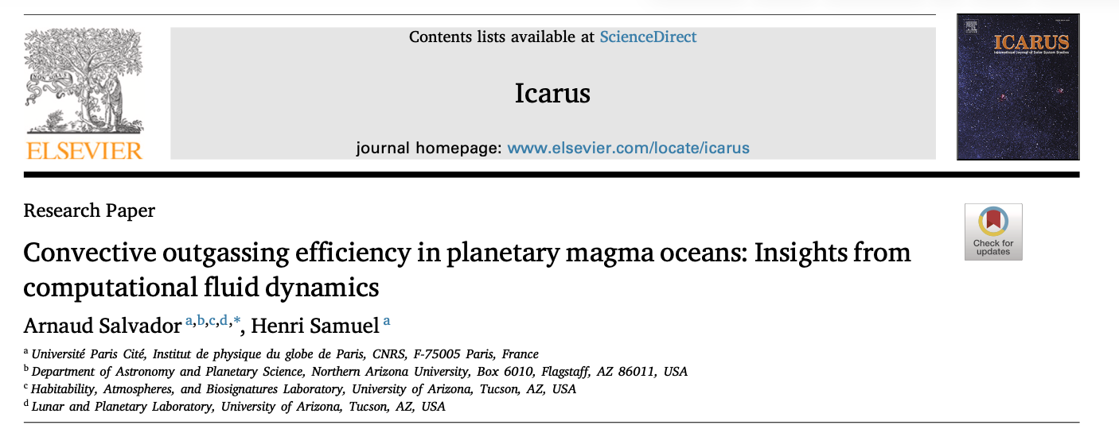
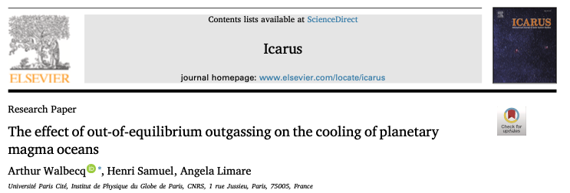
Recent challenges to the “chemical equilibrium” assumption
Notes:
- … by arguing volatile transport in MO is a slow process

Slide 5
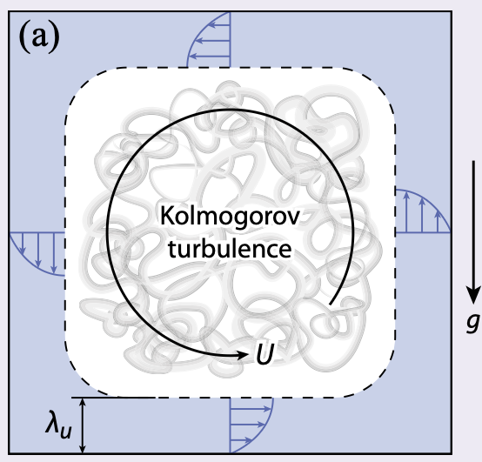
Main conclusions
Two distinct types of dynamics in the flow:
  Bulk transport: Fast
  Boundary layer transport: Slow
  BUT BL will break down in reality => overall Fast
=> Chemical equilibrium is a decent assumption!
From Lohse (2024, RMP)
Notes:
We study this topic further
Must view at 2 regions:
Bulk: turbulent => fast
BL (=thin layers close to the wall where the fluid “feels: the wall): No much vertical velocity to help with vertical transport & must rely on diffusion => slow
BUT this type of BLs are not relevant for MO => overall fast
=> Chemical equilibrium is a good approximation

Slide 6
Efficient volatile exchange between atmosphere and magma ocean
Welcome to PICO Spot 3.4!
Xuecheng Yang^{1*}, Cédric Gillmann¹, Paul Tackley¹
¹ Institute of Geophysics, ETH Zürich
* xuecheng.yang@eaps.ethz.ch
EGU 2026

Slide 7
Hint
We recommend starting with our abstracts to provide context for the following slides

Slide 8
Table of Contents
Two-minute summary: motivation & main conclusion
Volatile transport as a passive scalar diffusion process
Salvador (2023) & Walbecq (2025) models
Theory for turbulent transport in the bulk and its implications
Numerical simulation
  Setup
  Rapid turbulent mixing & formation of a chemical boundary layer
  Boundary layers as the bottleneck
  The lower bound for chemical fluacross the wall
Boundary layers are not real bottlenecks in early magma ocean stage

Slide 9

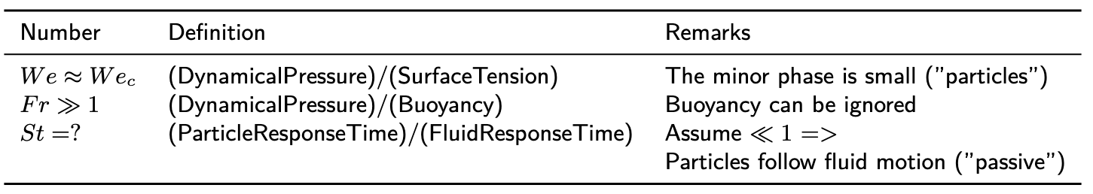

Dynamics of volatile transport in MO
Insights from dimensionless numbers for two-phase fluid motion
Notes:
- => To some extent, volatile transport in MO can be regarded as a passive scalar diffusion process, which may be described by a simple advection-diffusion process (or may be tracked by Lagrangian tracers as in S23 & W25 models, but there are problems, see below)

Slide 10
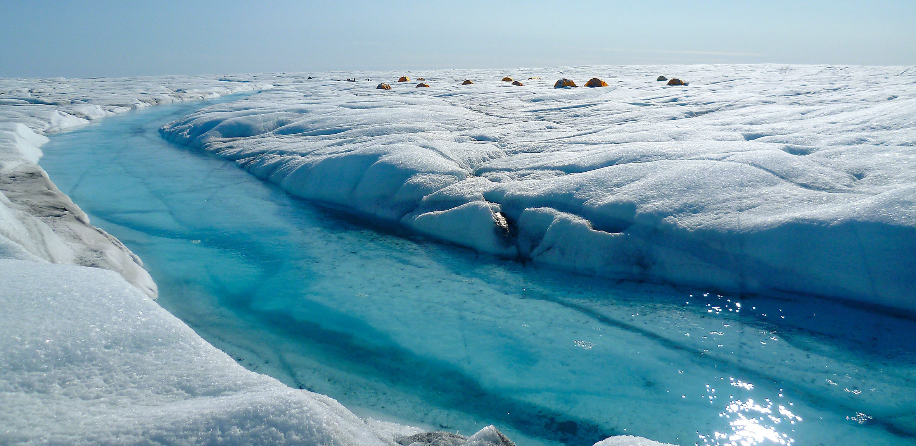
Salvador (2023) & Walbecq (2025) models

Slide 11
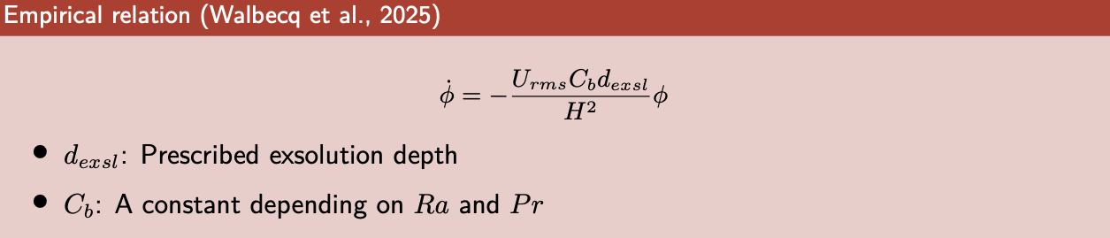
Salvador (2023, Icarus) & Walbecq (2025, Icarus) models
Simulation of turbulent thermal convection + passive Lagrangian tracers
=> “Outgassing” rate can be described as:
04.05.26
11
Notes:
- \Phi = Total remaining amount

Slide 12
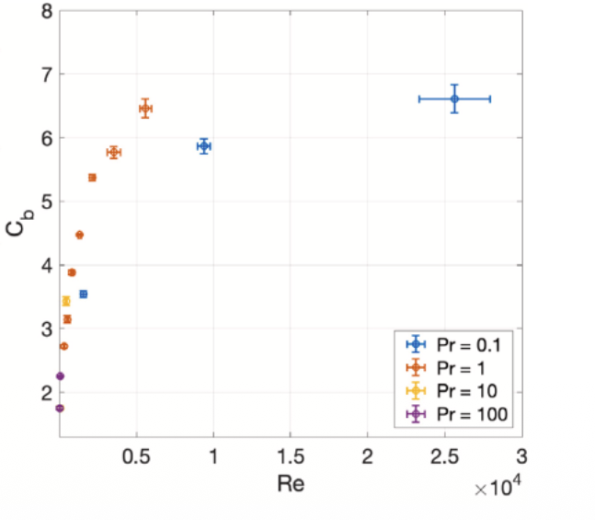
Problems with W25 empirical models:
(Non-)Constant pre-factor
From W25

Slide 13
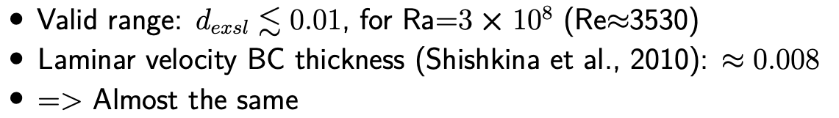
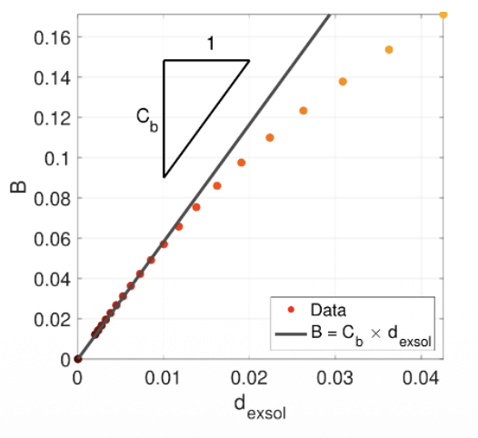
Problems with W25 empirical models:
Limited valid range for exsolution depth
From W25

Slide 14
Theory for turbulent transport in the bulk and its implications

Slide 15
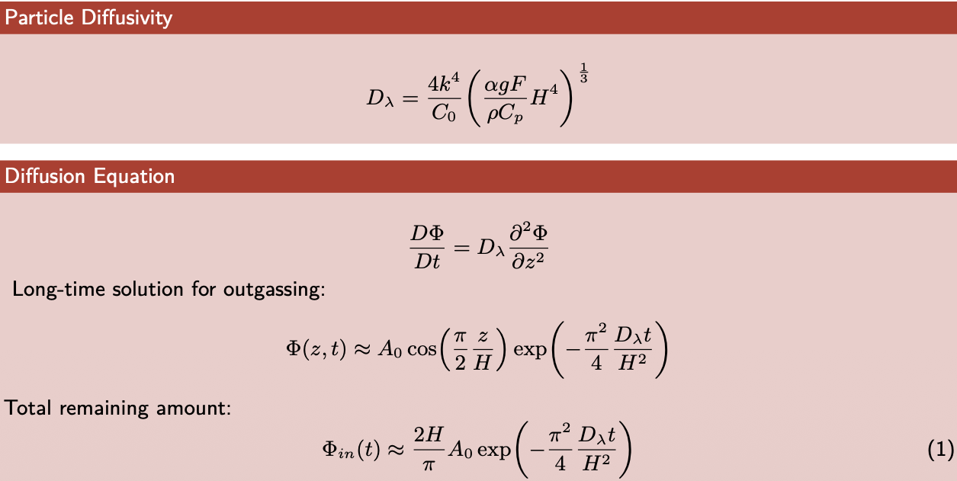
Theory for turbulent transport of a passive scalar

Slide 16
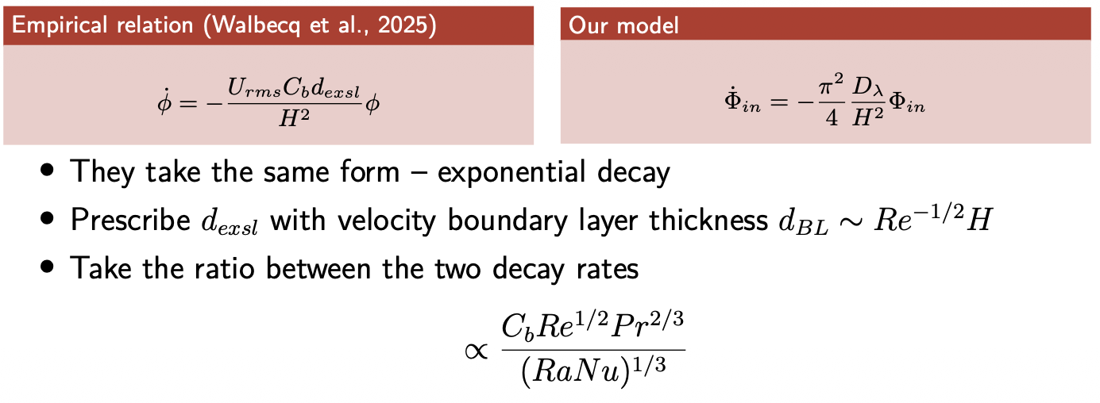
Comparison

Slide 17
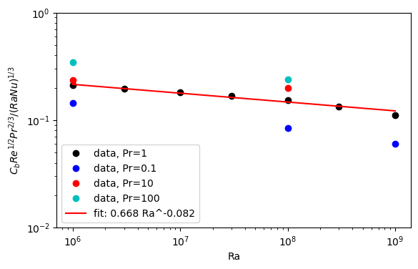

Comparison
=> Theory provides an expression for the non-constant $C_{b}$

Slide 18
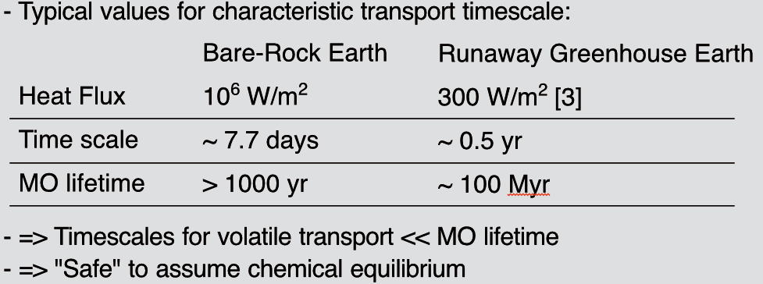
Theoretical implications
(Lebrun, 2013, JGR:P)
(Hamano, 2014, Nature)

Slide 19
Numerical simulation

Slide 20
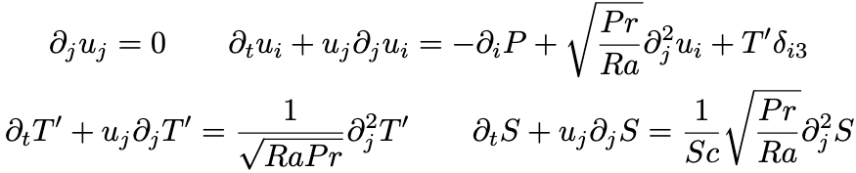
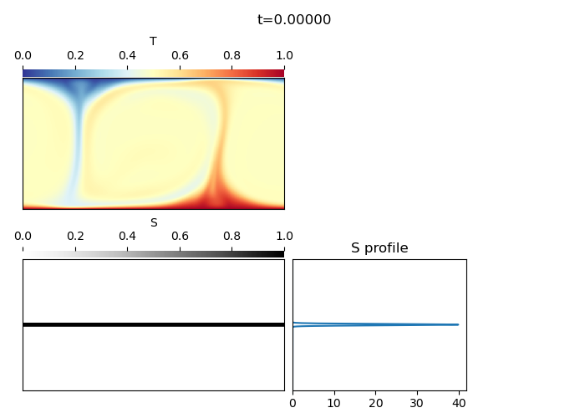




Model setup
Run a 2D thermal convection model till statistical steady state using dedalus (Burns,2020,PRR)
Initiate an additional passive scalar field at mid-height & continue
Governing equations:
- Boundary conditions:
- Example:
No-slip & T=0 & $S$=0
$$Φ$$
No-slip & T=1 & $dS/dz$=0
Periodic

Slide 21
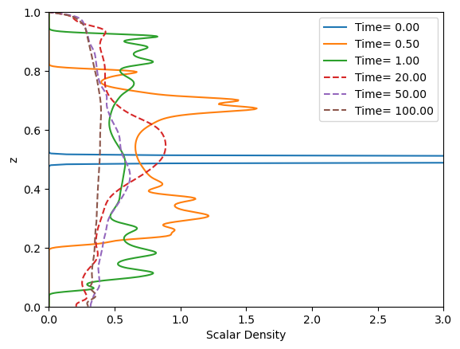

Evolution of vertical scalar profile
- Time scale unit = free-fall (short!)
- Solid curves: The initial central peak flattens almost instantly => Efficient mixing in the bulk
- Dashed curves: Rapid formation of a chemical boundary layer (CBL)
- See also videos

Slide 22


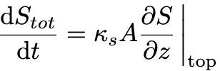
Bulk vs boundary layer transport
The advection-diffusion equation:
Advection
Diffusion
In the bulk: Velocity could be high => Advection is efficient & Diffusion can be sometimes neglected
In the BL: Velocity drops sharply => Advection is much less efficient:
Integrated over space =>Total loss rate:
Inside BLs!
Extreme case: Advection & diffusion balance => No Eulerian transport:
Controlled by diffusion
=> Bottleneck!

Slide 23
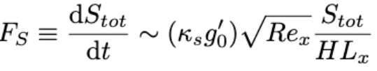
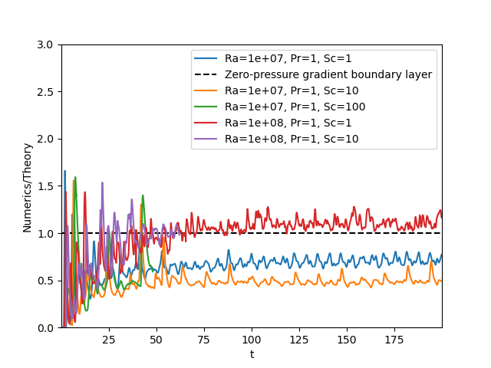
Chemical flux across a no-slip boundary (preliminary!)
Theoretically predicted wall flux for zero pressure gradient boundary layers:
The chemical flux is non-zero
This formula could only provide a qualitative estimate. Because large scale circulations (LSCs) of convection flows have non-zero pressure gradient

Slide 24
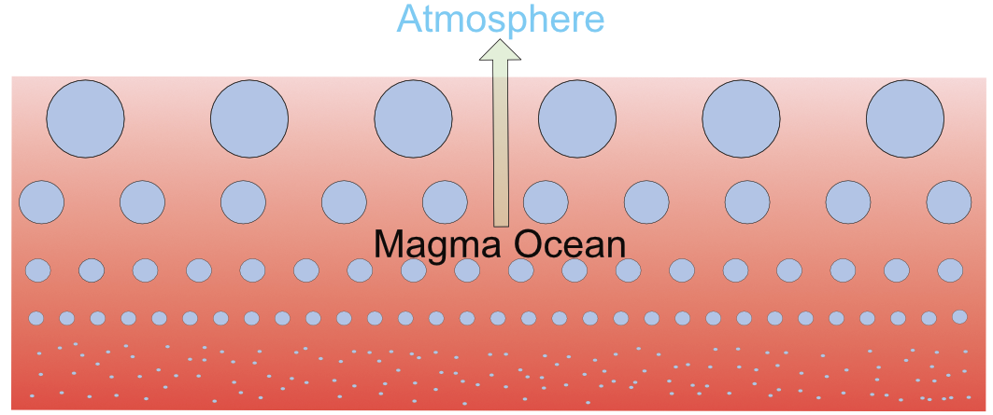
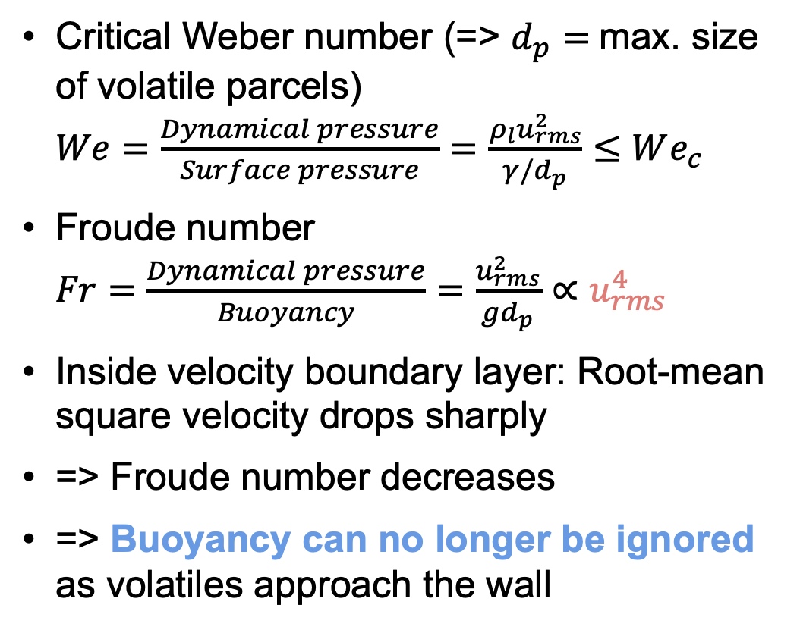
Boundary layers are not real bottlenecks I
Breakdown of “passive particles” approximation
Critical Weber number (=> $d_{p}=$max. size of volatile parcels)
$We=\frac{Dynamical pressure}{Surface pressure}=\frac{ρ_{l}u_{rms}^{2}}{γ/d_{p}}$ $≤We_{c}$
Froude number
$Fr=\frac{Dynamical pressure}{Buoyancy}=\frac{u_{rms}^{2}}{gd_{p}}∝$ $u_{rms}^{4}$
Inside velocity boundary layer: Root-mean square velocity drops sharply
=> Froude number decreases
=> Buoyancy can no longer be ignored as volatiles approach the wall

Slide 25
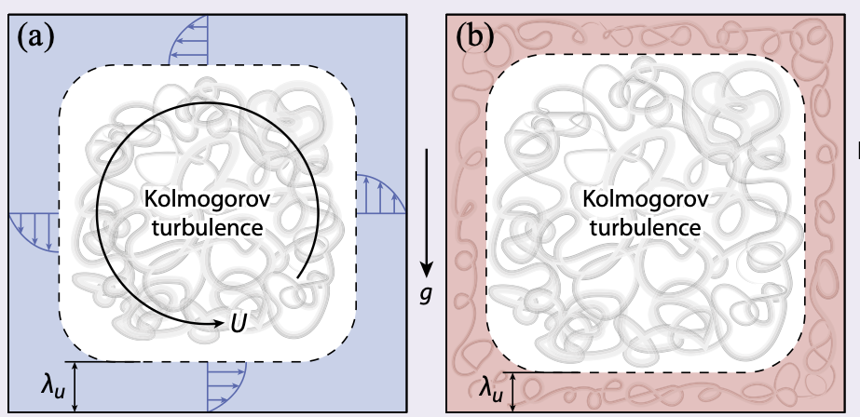
Boundary layers are not real bottlenecks II
Transition to turbulent BL
From Lohse (2024, RMP)
Low Rayleigh number => High Rayleigh number (relevant to early MO)

Slide 26
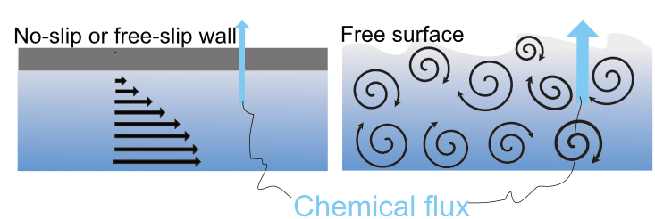
Boundary layers are not real bottlenecks III
Wall vs. free surface

Slide 27
Bonus slides

Slide 28
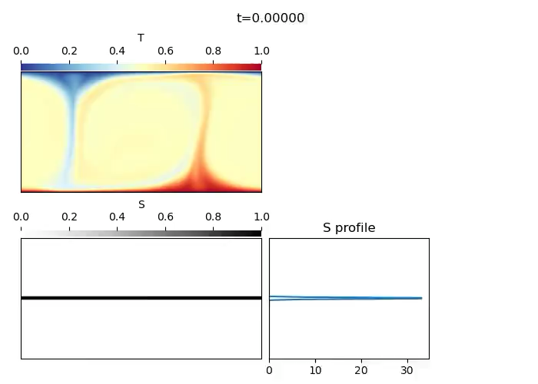
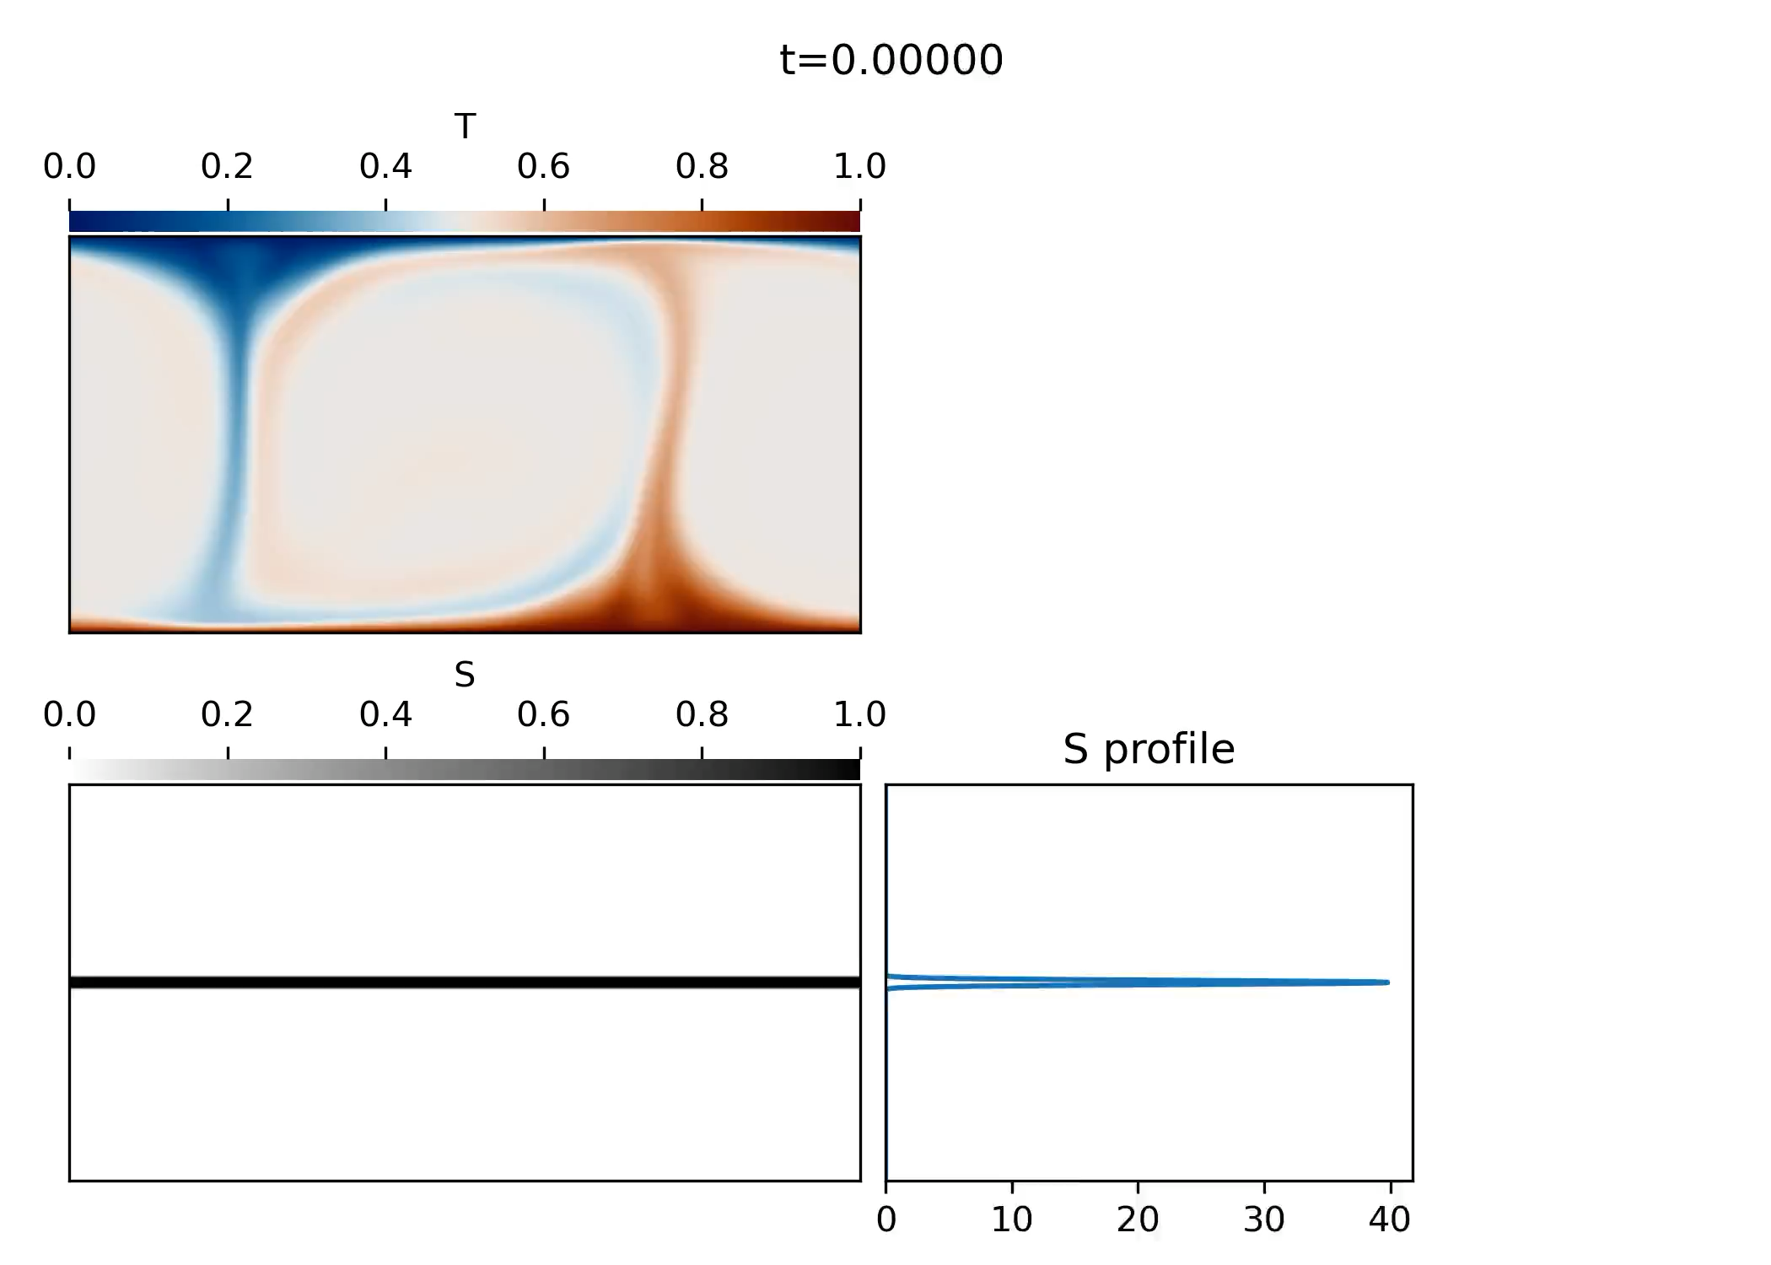

Videos
Ra=1e7, Pr=1:
Sc=1
Sc=10
Sc=100

Slide 29
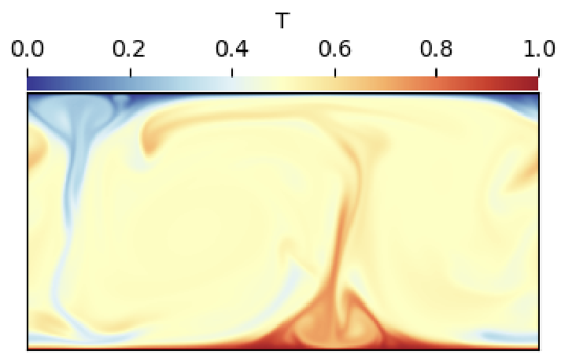
Non-zero pressure gradient
- Temperature snapshot
- Horizontal profiles of pressure gradient & velocity near the top boundary

