Slide 1


EGU supplementary
New Insights into Plume Buoyancy Fluxes and Dynamic Topography from Numerical Models of Plume-Lithosphere Interaction
Ziqi Ma, Maxim Ballmer, Antonio Manjón-Cabeza Córdoba
EGU26-720
Ziqi Ma 7th May 2026

Slide 2

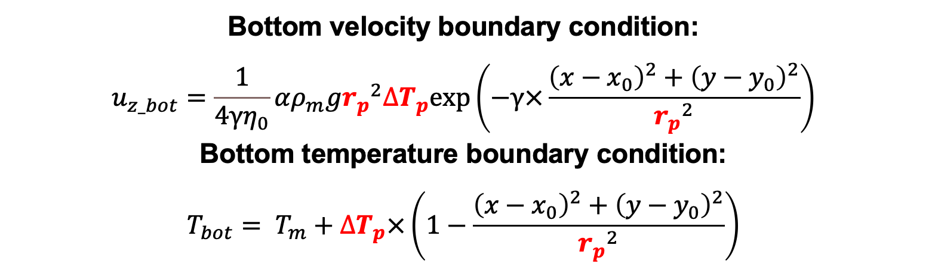
Introduction
Plume setup: velocity inflow and heat anomaly
Reference model:$r_{p}$= 250 km, $∆T_{p}$=250 K
Model Setup
Reference case results
1.1 Q_{surf} Scaling
1.2 r_{plume} and ∆T_{LM} Scaling
Bottom velocity boundary condition:
$$u_{z_bot}=\frac{1}{4γη_{0}}αρ_{m}g{r_{p}}^{2}∆T_{p}exp\left(−γ×\frac{{\left(x−x_{0}\right)}^{2}+{\left(y−y_{0}\right)}^{2}}{{r_{p}}^{2}}\right)$$
  Bottom temperature boundary condition:
  $$T_{bot}= T_{m}+∆T_{p}×\left(1−\frac{{\left(x−x_{0}\right)}^{2}+{\left(y−y_{0}\right)}^{2}}{{r_{p}}^{2}}\right)$$
2.1 Diffusion-only cases
2.2 Different composite rheology
Discussion
Navigation
Notes:
We setup the plume as aheat anomaly and also a velocity inflow defined by these equations.

Slide 3
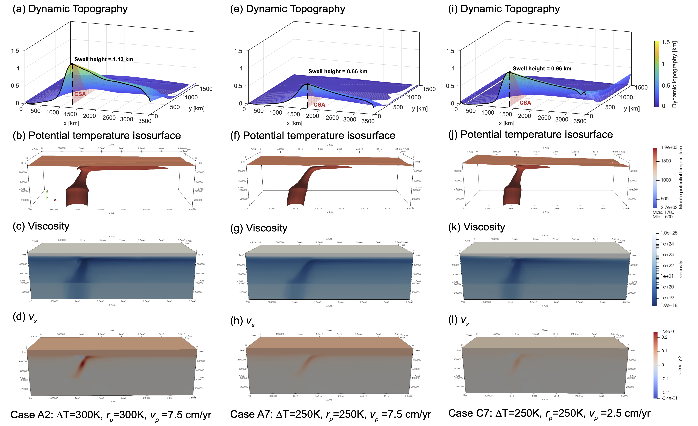
Introduction
Dynamic topography, T_{pot} isosurface, and Viscosity for example cases at 300 Myrs
Model Setup
Reference case results
1.1 Q_{surf} Scaling
1.2 r_{plume} and ∆T_{LM} Scaling
2.1 Diffusion-only cases
2.2 Different composite rheology
Discussion
Bigger and hotter plumes and slower plate velocity lead to higher swell.
Navigation

Slide 4
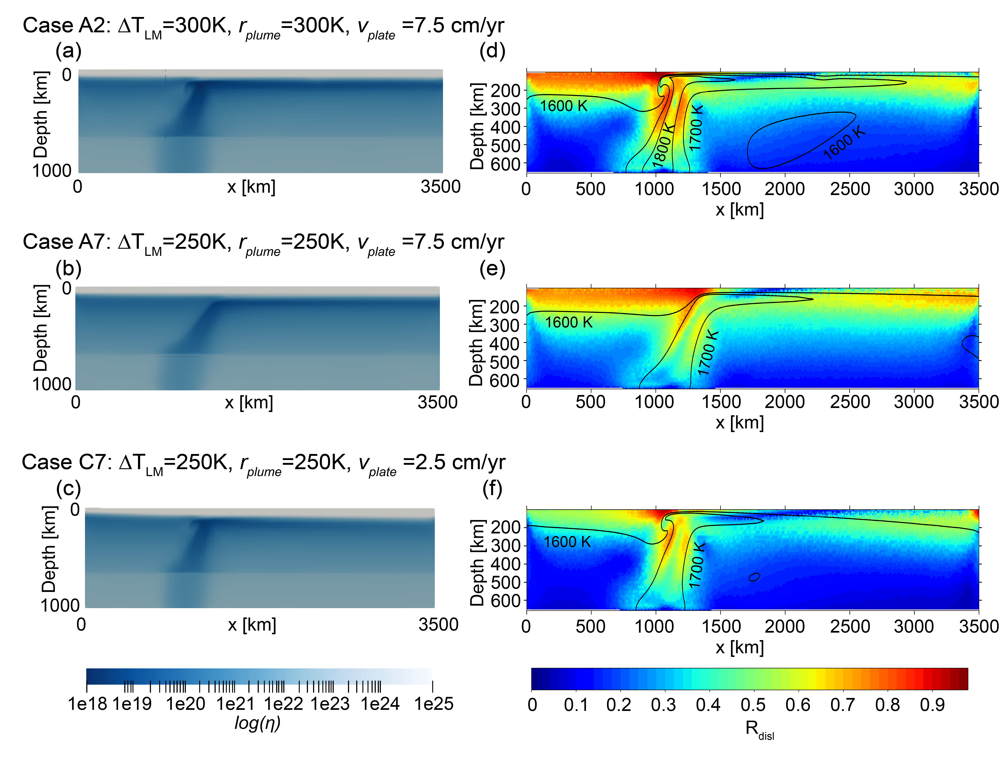
Viscosity at plume pancake center cross-section at 300 Myrs
Dislocation ratio
R_{disl} = η_{diff} /(η_{diff} + η_{disl})
Navigation
Introduction
Lowest viscosity, medium R_{disl}
Diffusion creep dominates the center of the plume stem.
Dislocation creep dominates the plume edge.
Model Setup
Reference case results
Medium viscosity, highest R_{disl}
1.1 Q_{surf} Scaling
1.2 r_{plume} and ∆T_{LM} Scaling
Highest viscosity, lowest R_{disl}
2.1 Diffusion-only cases
2.2 Different composite rheology
Diffusion
dominated
Dislocation
dominated
Discussion

Slide 5
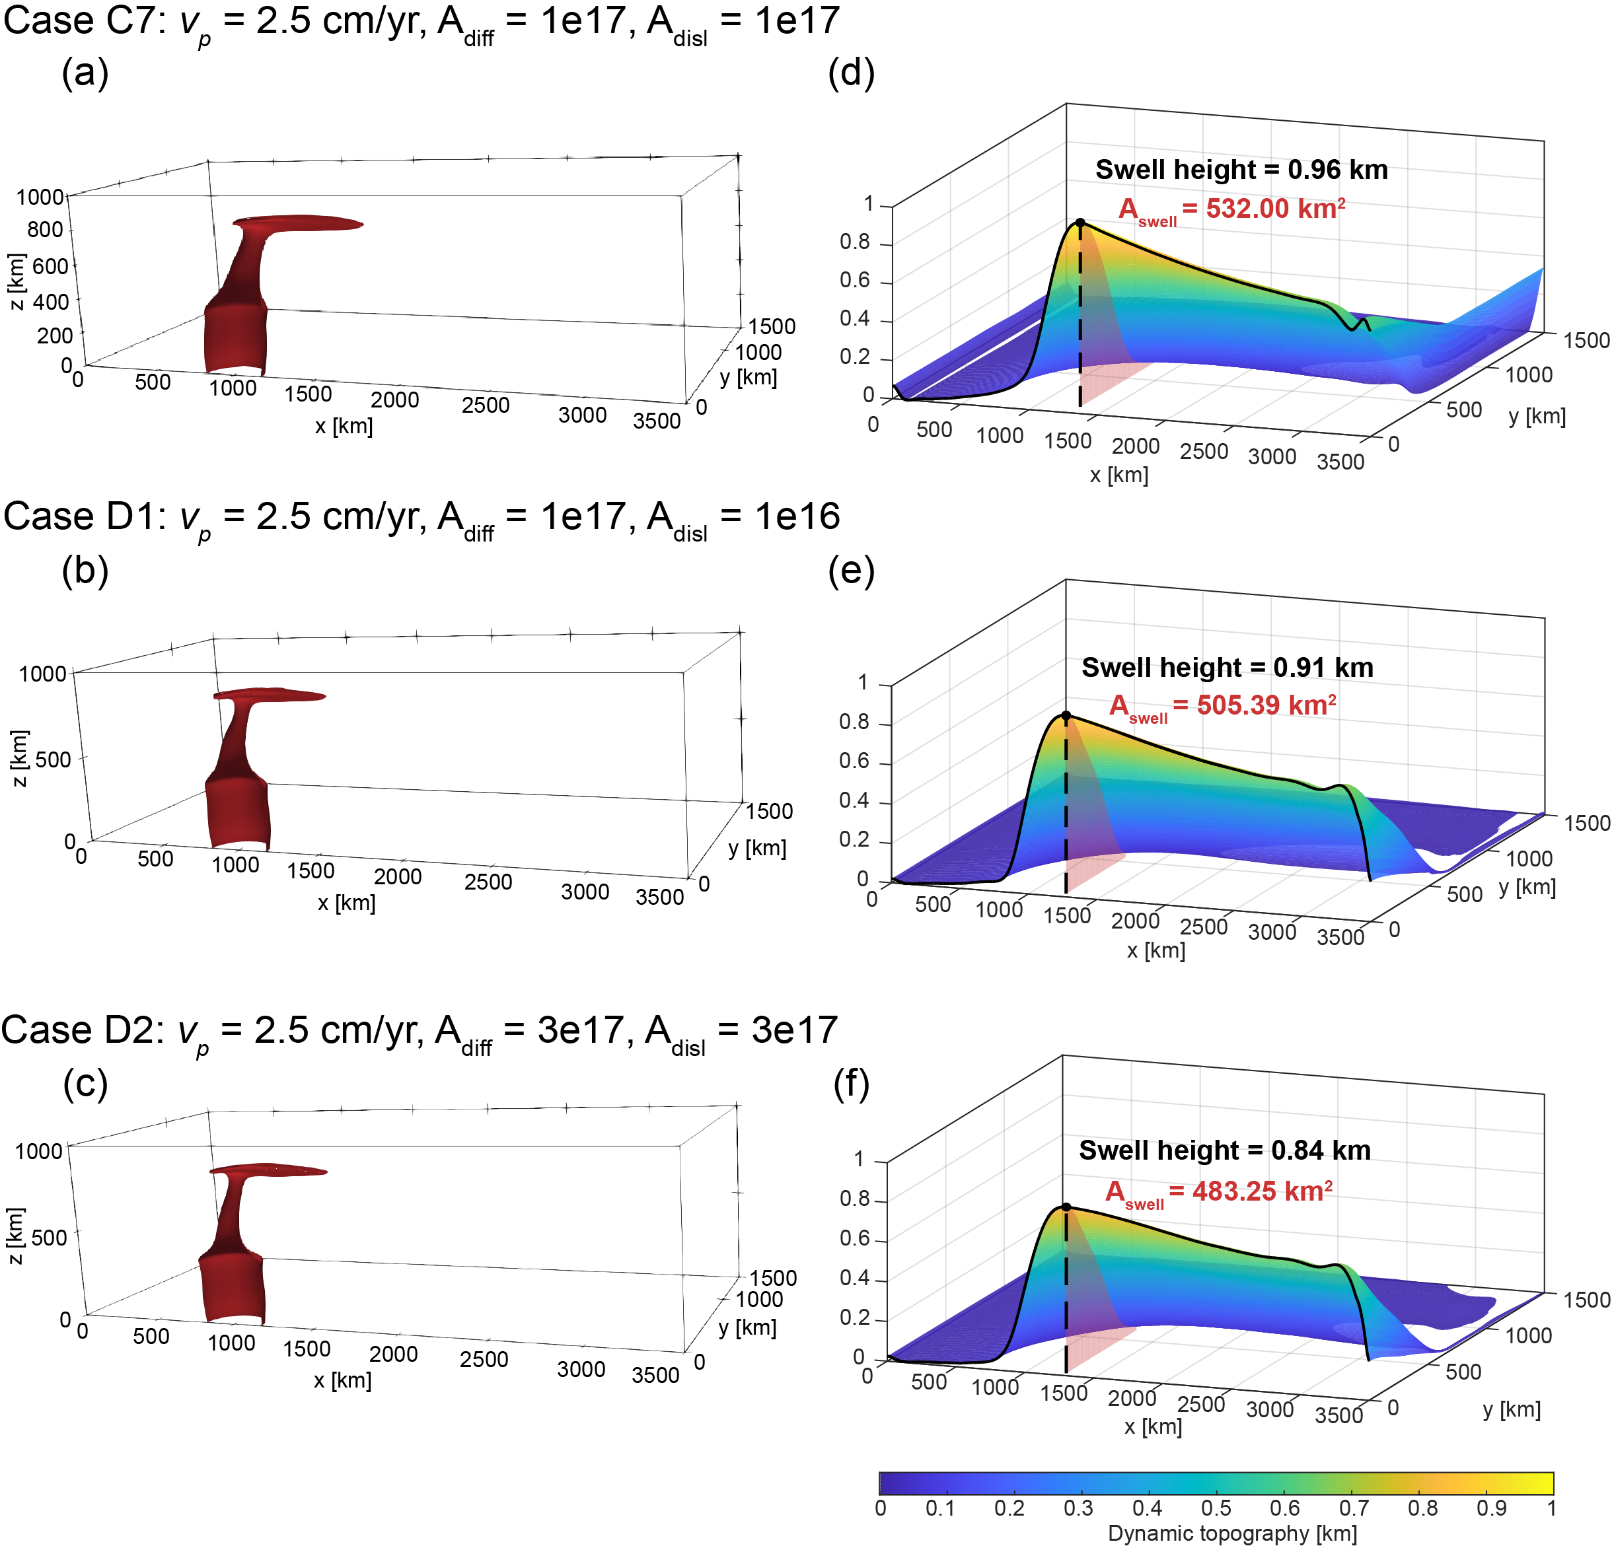
2.2 Different composite rheology
Notes:
And the second part of the rheology test is that we tested different composite theology by changing the diffusion and dislocation prefactors.
This is the reference case in part 1 (point to the first row)
We can see from the dynamic topography (point to the right most column) that different viscosity has a minor effect on the swell topography, which strengenthen our scaling in part 1.

Slide 6
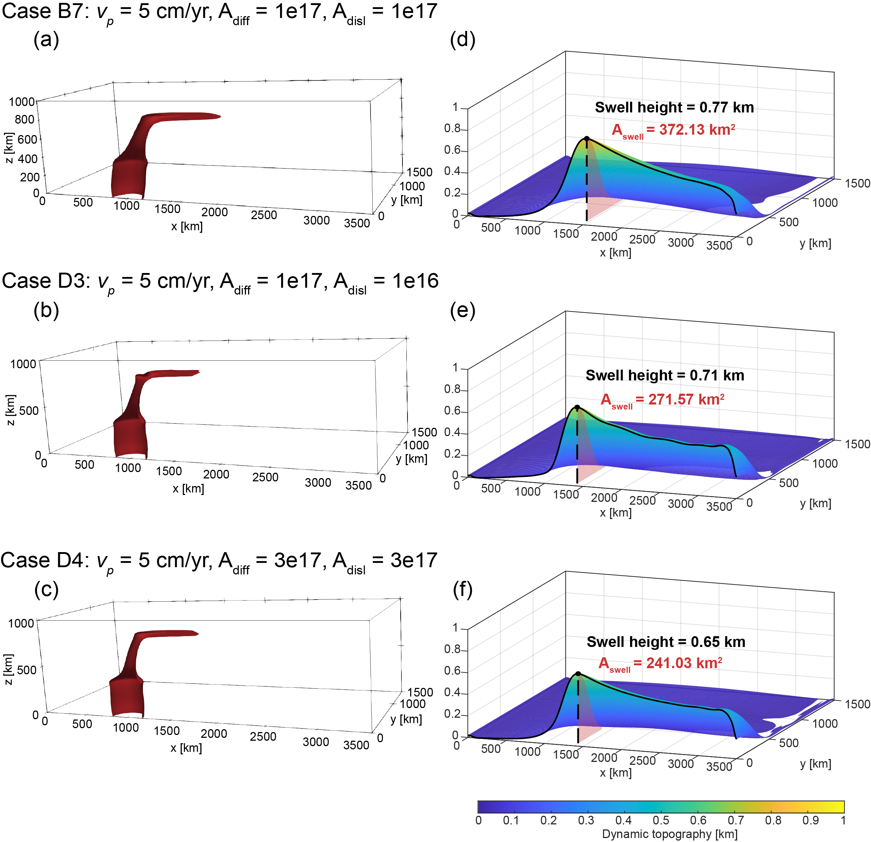
2.2 Different composite rheology
Reference case
Notes:
And the second part of the rheology test is that we tested different composite theology by changing the diffusion and dislocation prefactors.
This is the reference case in part 1 (point to the first row)
We can see from the dynamic topography (point to the right most column) that different viscosity has a minor effect on the swell topography, which strengenthen our scaling in part 1.

Slide 7
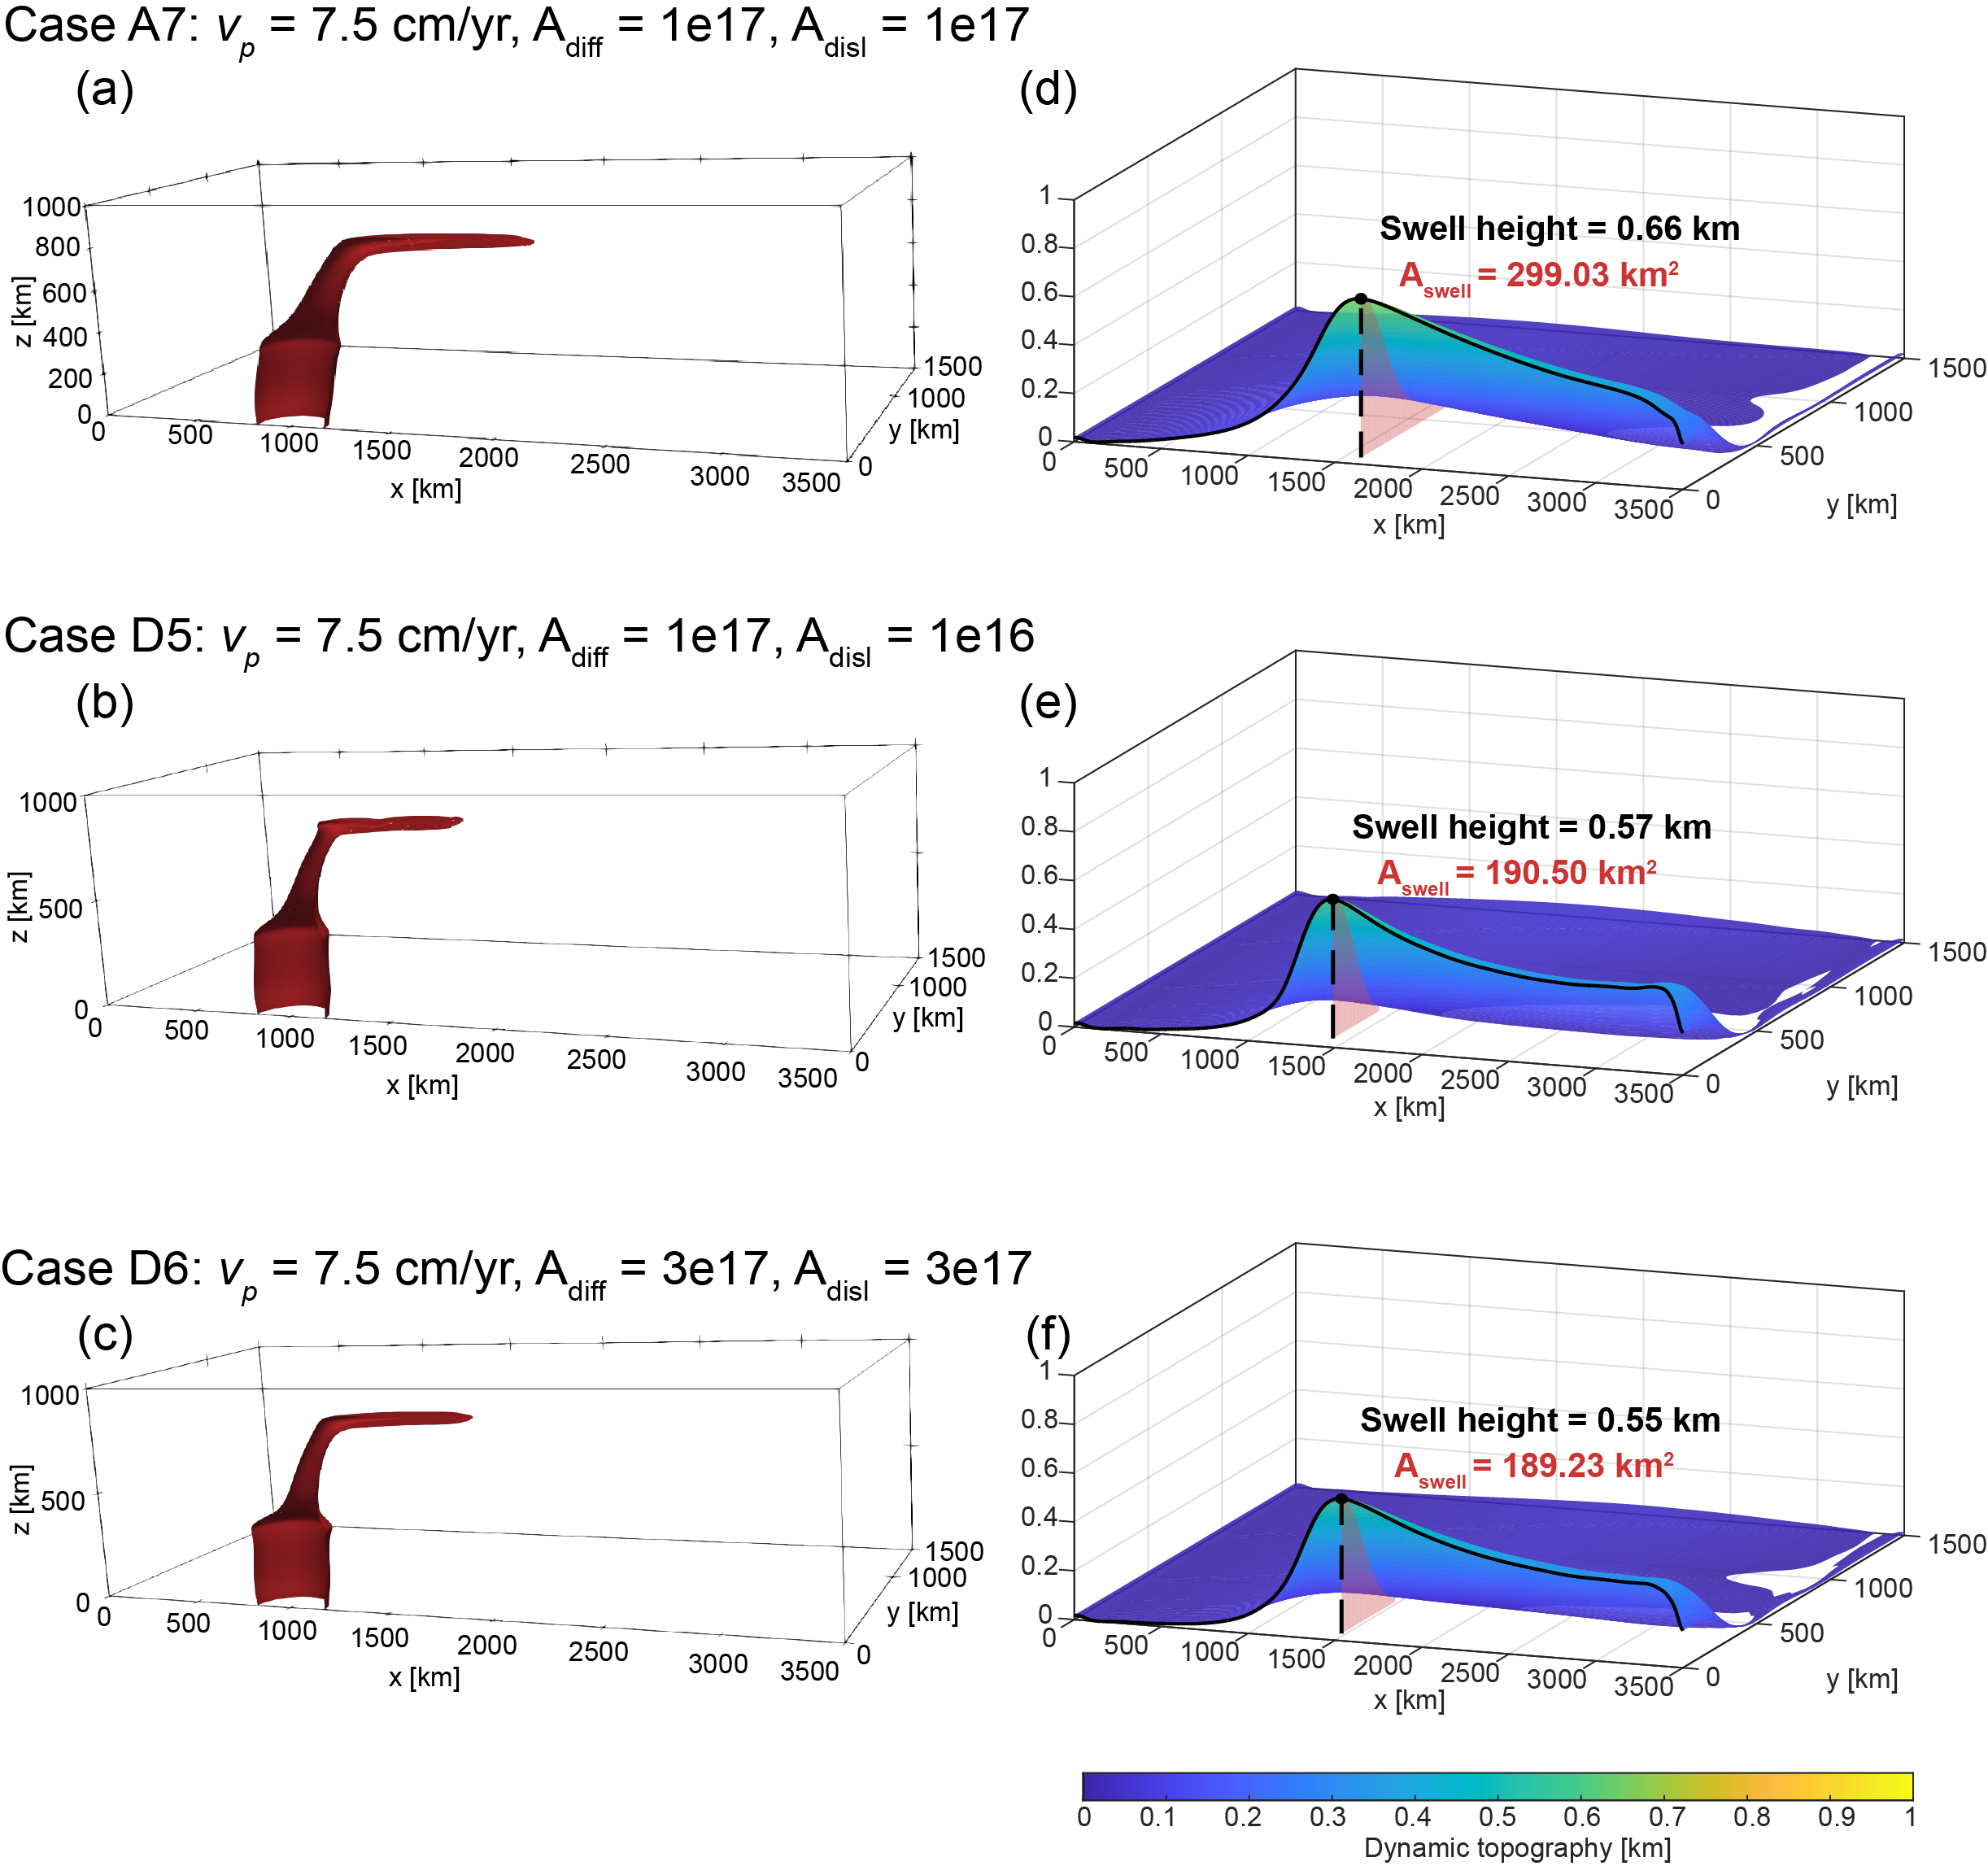
2.2 Different composite rheology
Reference case
Notes:
And the second part of the rheology test is that we tested different composite theology by changing the diffusion and dislocation prefactors.
This is the reference case in part 1 (point to the first row)
We can see from the dynamic topography (point to the right most column) that different viscosity has a minor effect on the swell topography, which strengenthen our scaling in part 1.

