Slide 1

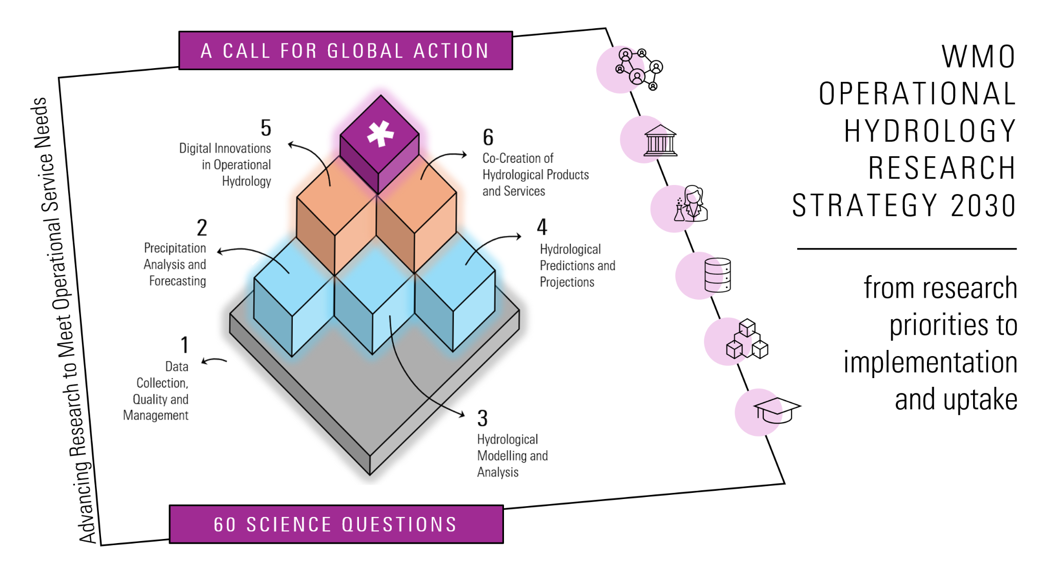
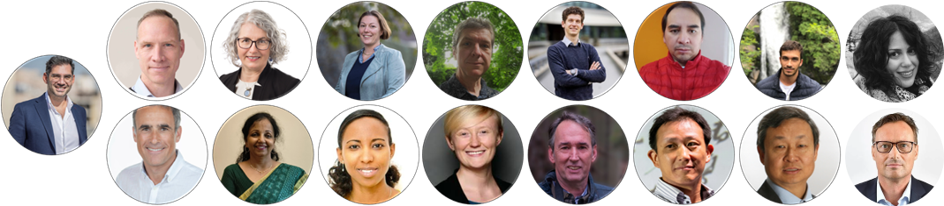
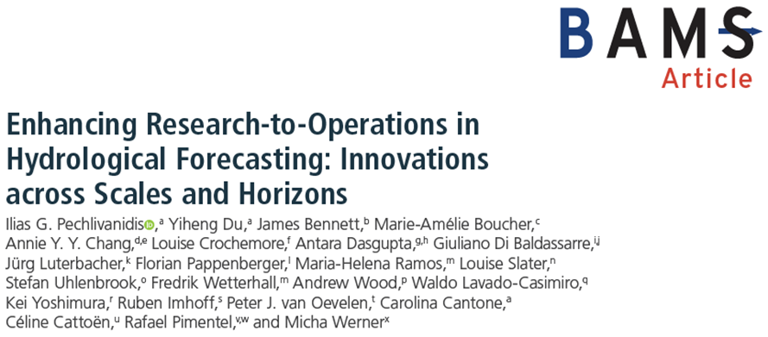
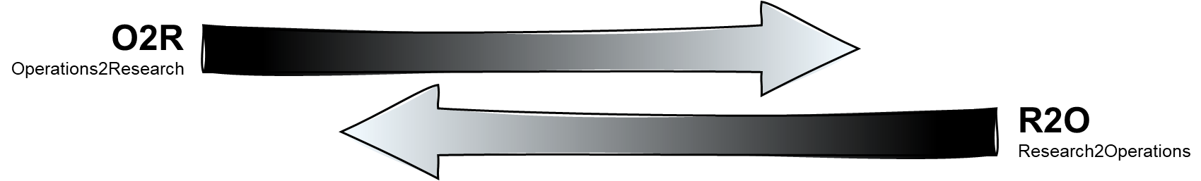
Bridging Hydrological Science and Services

Slide 2
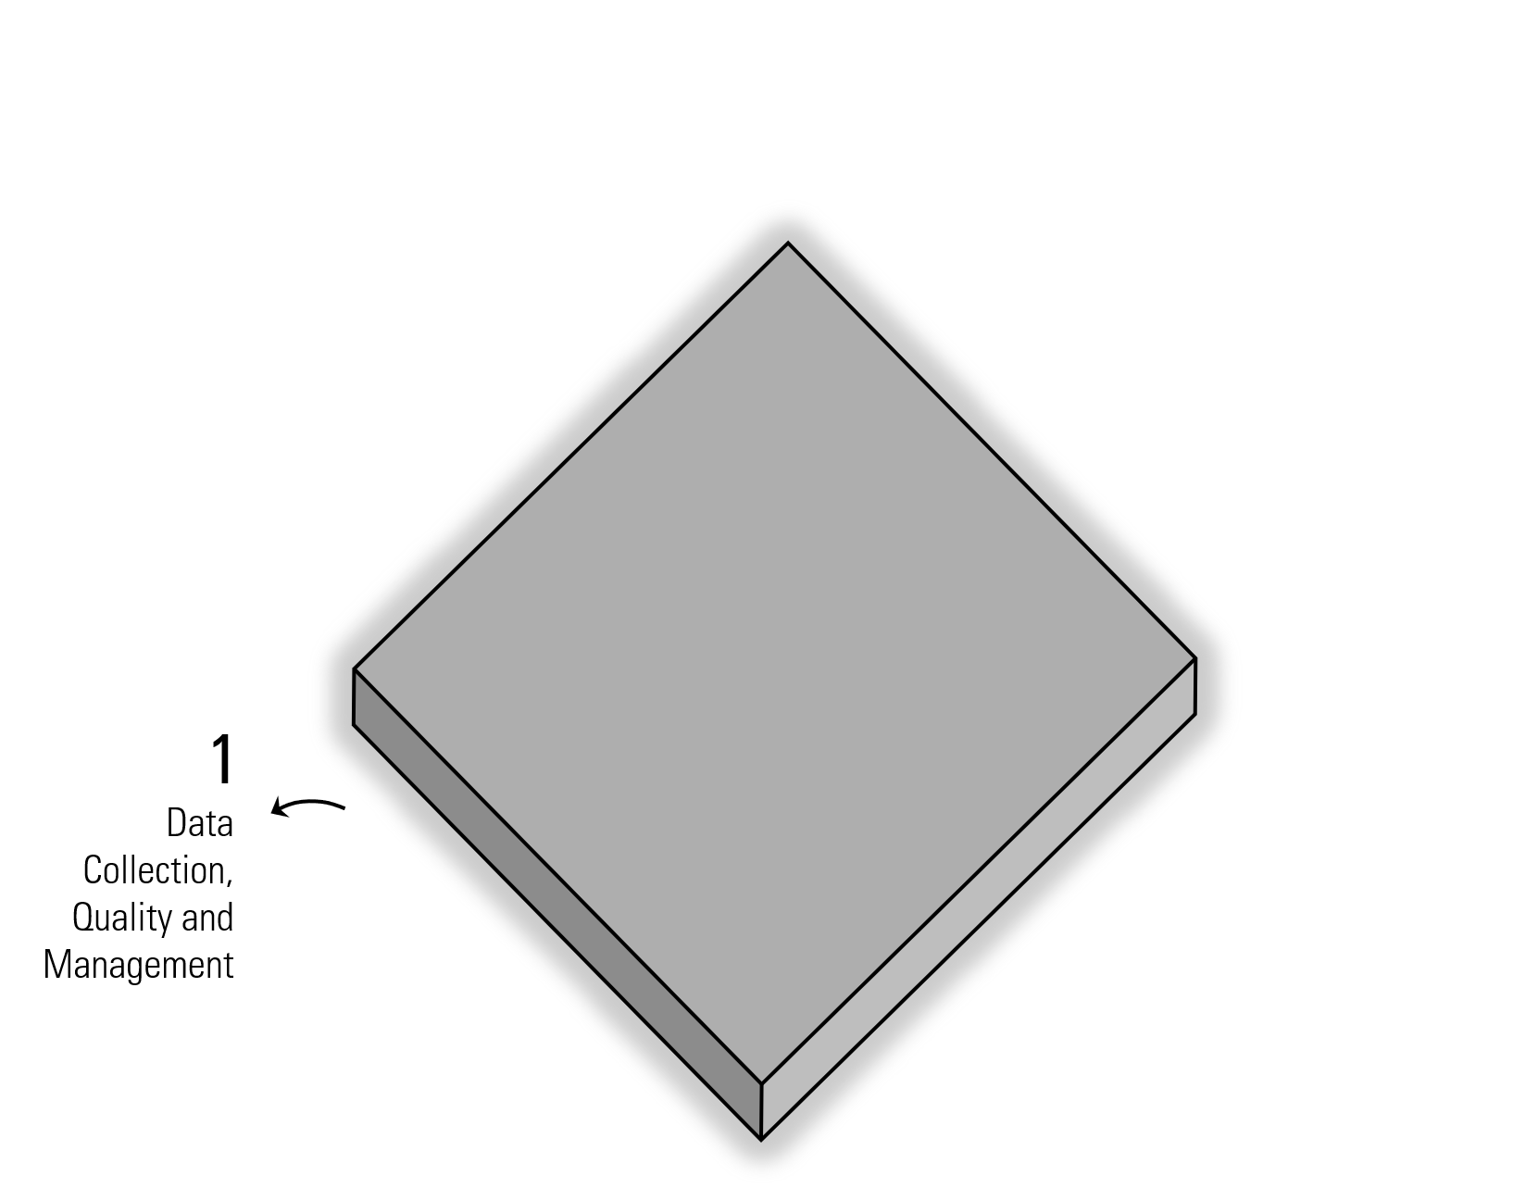
Data underpins everything !
Enhance monitoring using in-situ, remote sensing, and crowd-sourced data
Promote quality control, standardization, and interoperable systems
Optimize networks for evolving hydrological needs
Notes:
1 – Data Collection, Quality and Management
Enhance monitoring using in-situ, remote sensing, and crowd-sourced data
Promote quality control, standardization, and interoperable systems
Optimize networks for evolving hydrological needs

Slide 3
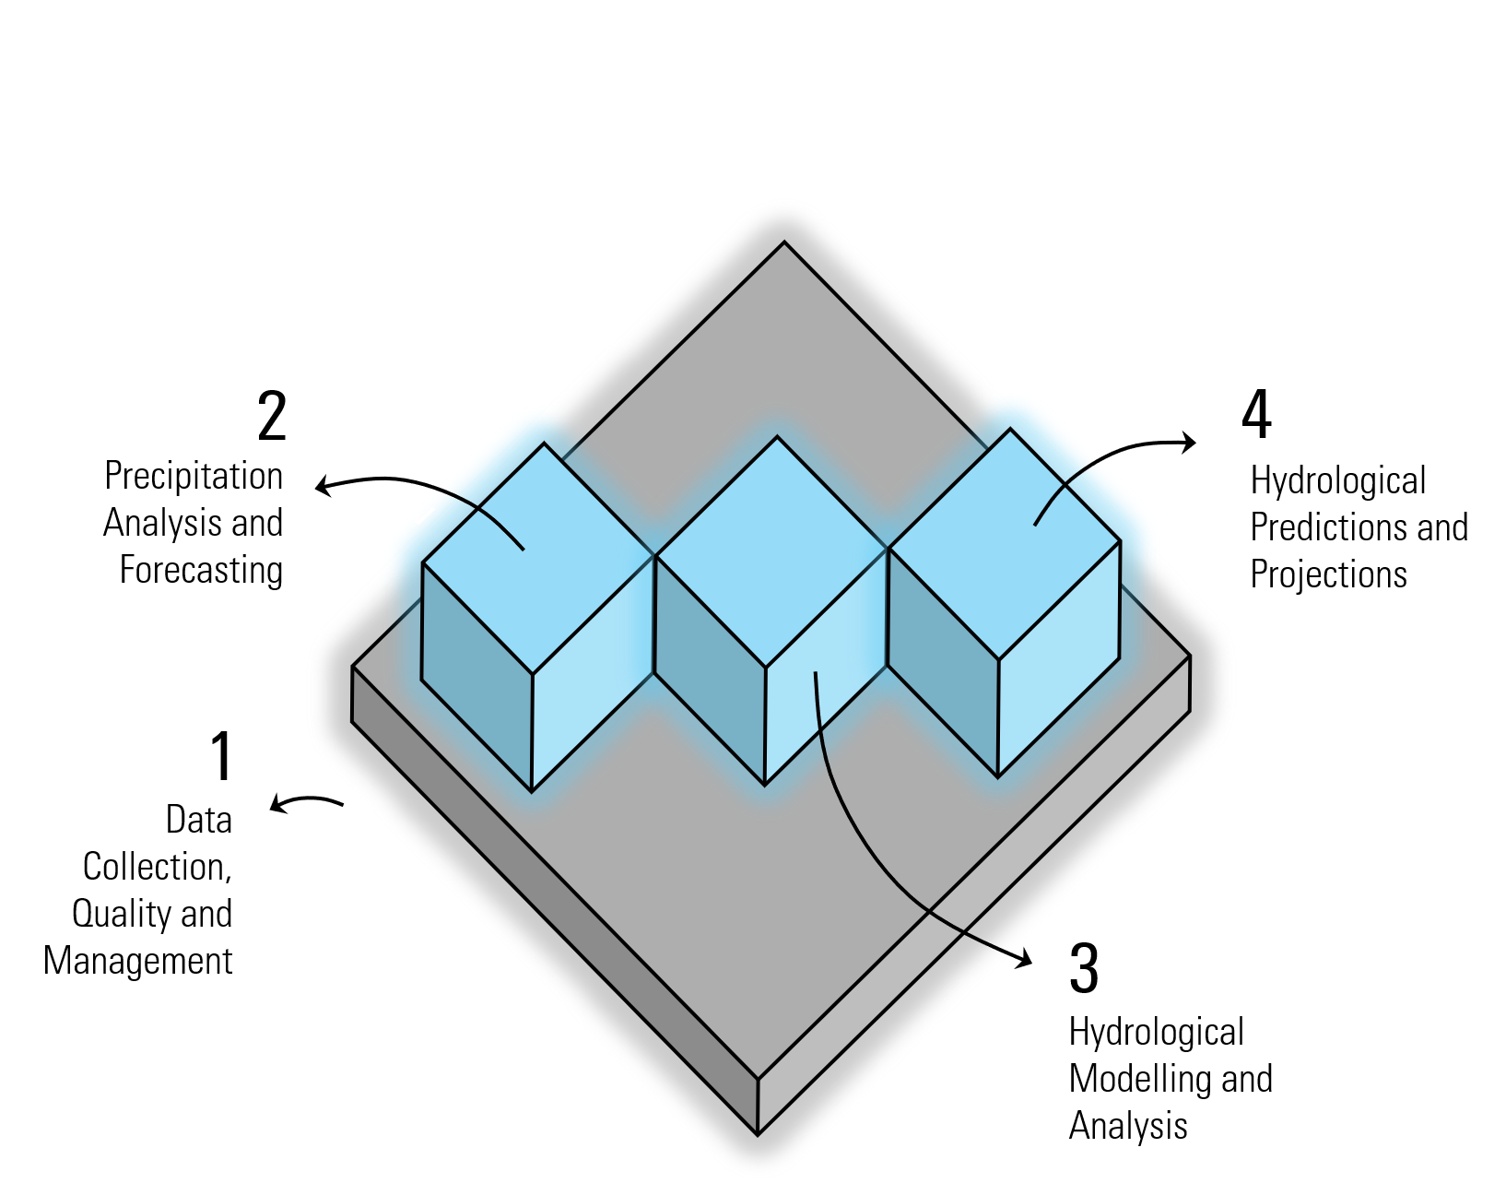
Then comes analysis, modelling, predictions ...
Address seamless predictions from minutes to decades
Enhance forecast skill and uncertainty communication
Support transition to impact-based forecasting for decision-making
Improve accuracy and resolution of precipitation measurements
Blend remote sensing with ground-based data
Apply AI and uncertainty quantification for fit-for-purpose inputs
Advance process-based, statistical, data-driven, and hybrid models
Integrate new data types through assimilation methods
Improve modelling of floods, droughts, and extremes under environmental change
Notes:
2 – Precipitation Analysis and Forecasting
Improve accuracy and resolution of precipitation measurements
Blend remote sensing with ground-based data
Apply AI and uncertainty quantification for fit-for-purpose inputs
3 – Hydrological Modelling and Analysis
Advance process-based, statistical, data-driven, and hybrid models
Integrate new data types through assimilation methods
Improve modelling of floods, droughts, and extremes under environmental change
4 – Hydrological Predictions and Projections
Address seamless predictions from minutes to decades
Enhance forecast skill and uncertainty communication
Support transition to impact-based forecasting for decision-making

Slide 4
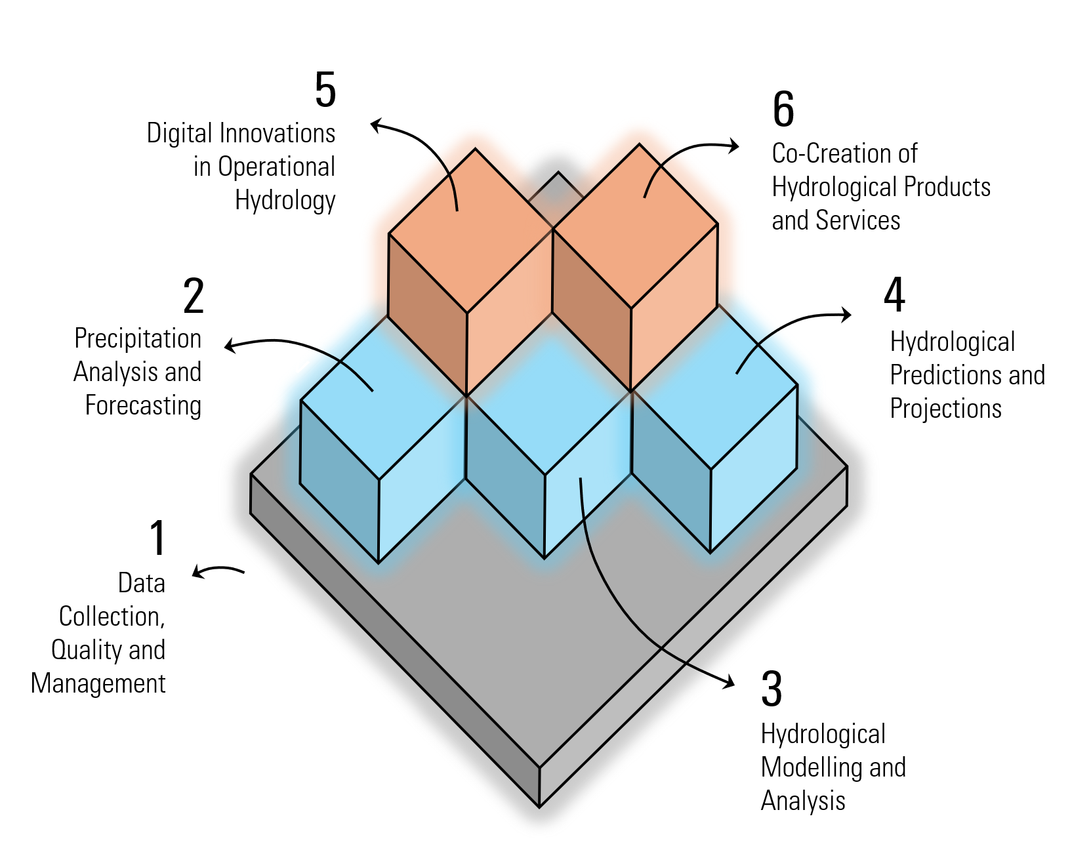

Digital innovation and co-creation
Explore digital twins and virtual simulations, and real-time decision tools
Integrate models, advanced tools, observations, and user feedback
Enable anticipatory action and proactive water management
Focus on user engagement, communication, and visualization
Assess human-water-ecosystem interactions
Develop services tailored to user contexts and improve clarity
Notes:
5 – Digital Innovations in Operational Hydrology
Explore digital twins and virtual simulations, and real-time decision tools
Integrate models, advanced tools, observations, and user feedback
Enable anticipatory action and proactive water management
6 – Co-Creation of Hydrological Products and Services
Focus on user engagement, communication, and visualization
Assess human-water-ecosystem interactions
Develop services tailored to user contexts and improve clarity

Slide 5
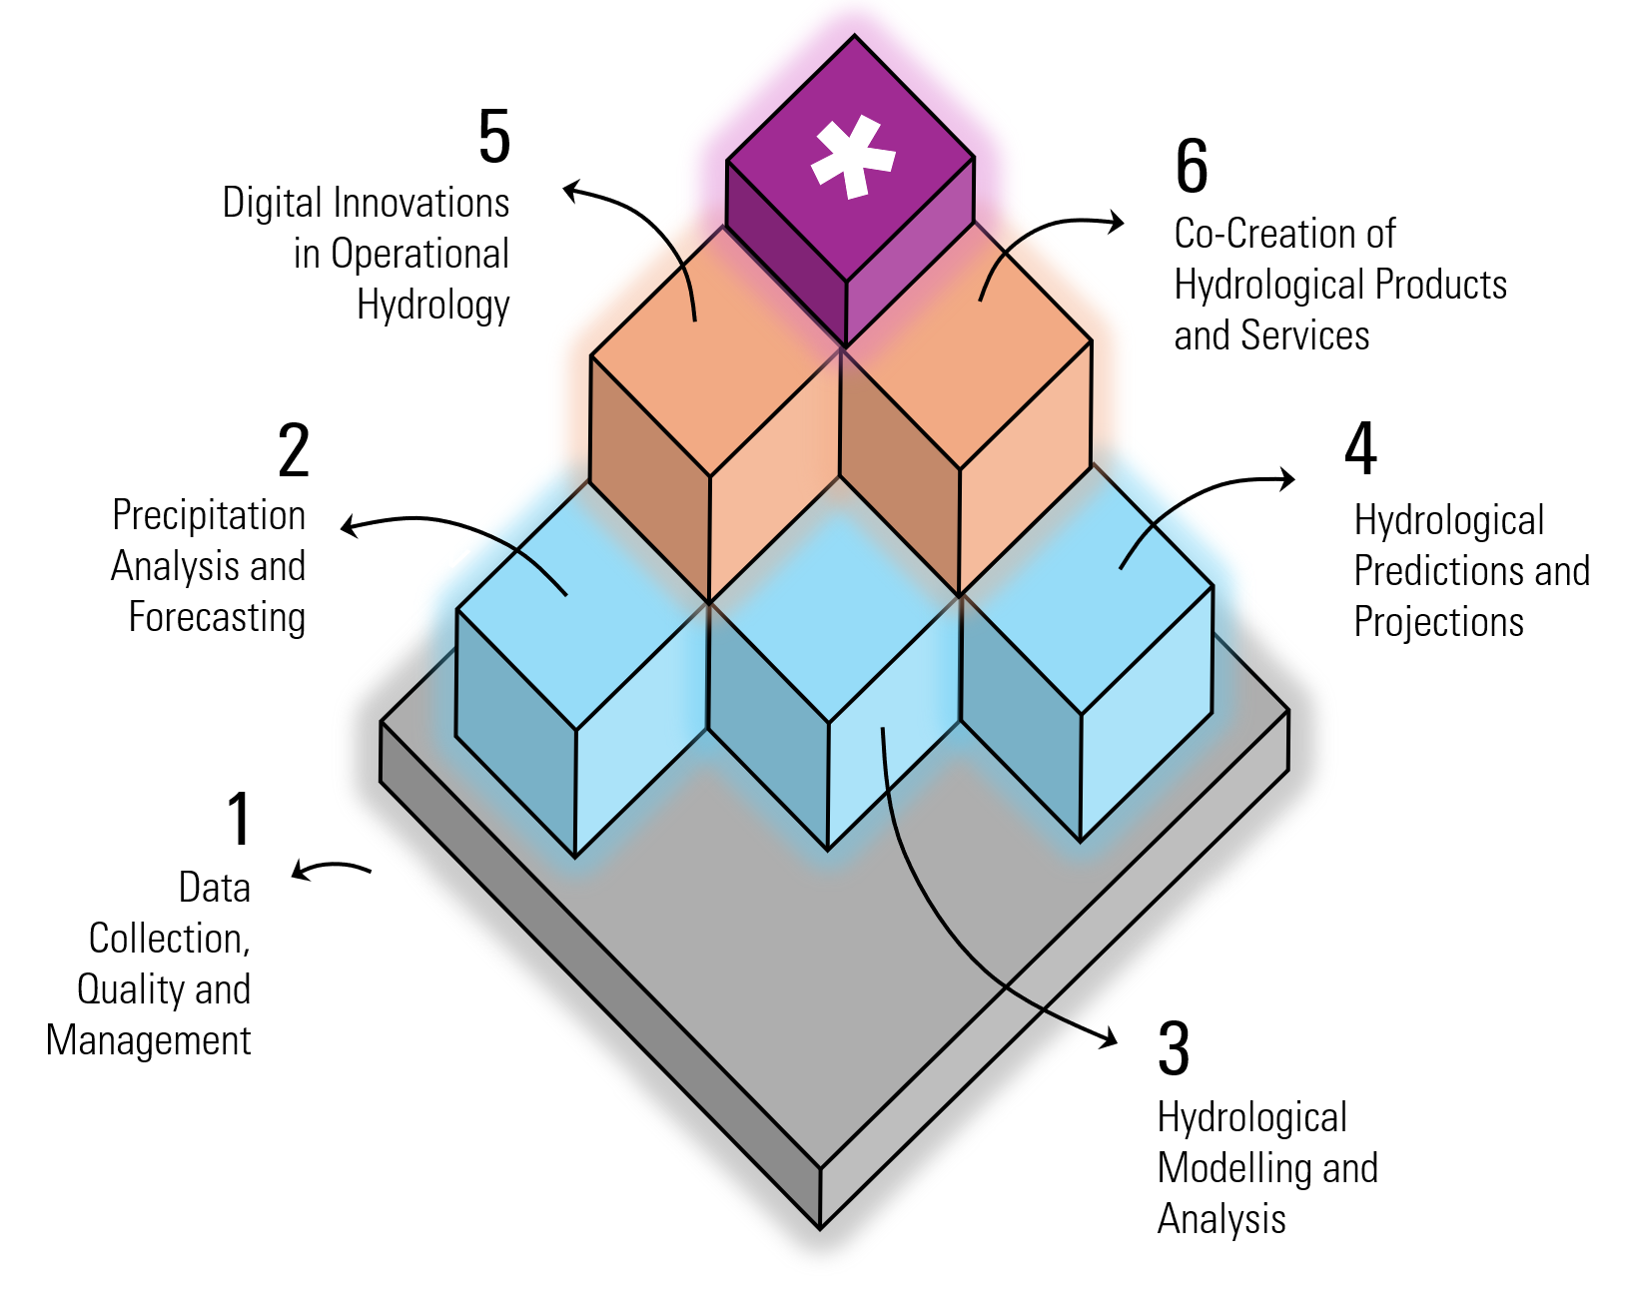
Call for Global Action
Call for global action:
Alignment of research investments with the strategy, stronger complementarity with global initiatives, and reinforcement of the R2O–O2R loop through active engagement of NMHSs.
Implementation
and uptake:
Embedding priorities into national and international programmes, leveraging existing structures
(e.g., Permanent Representatives, Hydrology Advisors), and integrating diverse knowledge systems.
Notes:
Call for global action: Alignment of research investments with the strategy, stronger complementarity with global initiatives, and reinforcement of the R2O–O2R loop through active engagement of NMHSs.
Implementation and uptake: Success requires embedding priorities into national and international programmes, leveraging existing structures (e.g., Permanent Representatives, Hydrology Advisors), integrating diverse knowledge systems, and monitoring progress through scientific and operational indicators.

Slide 6
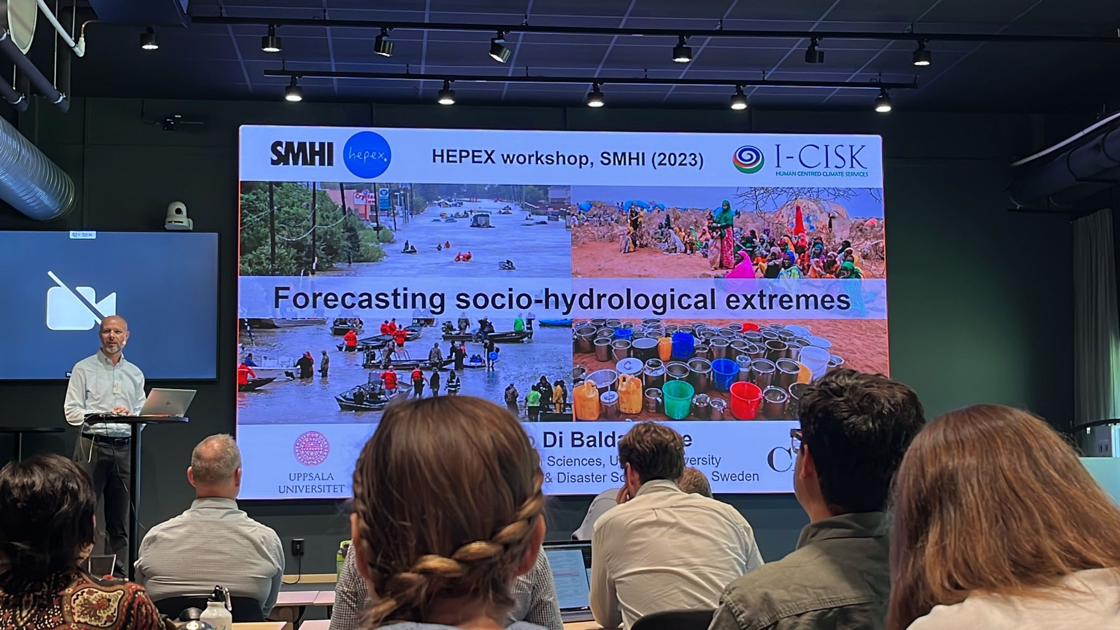

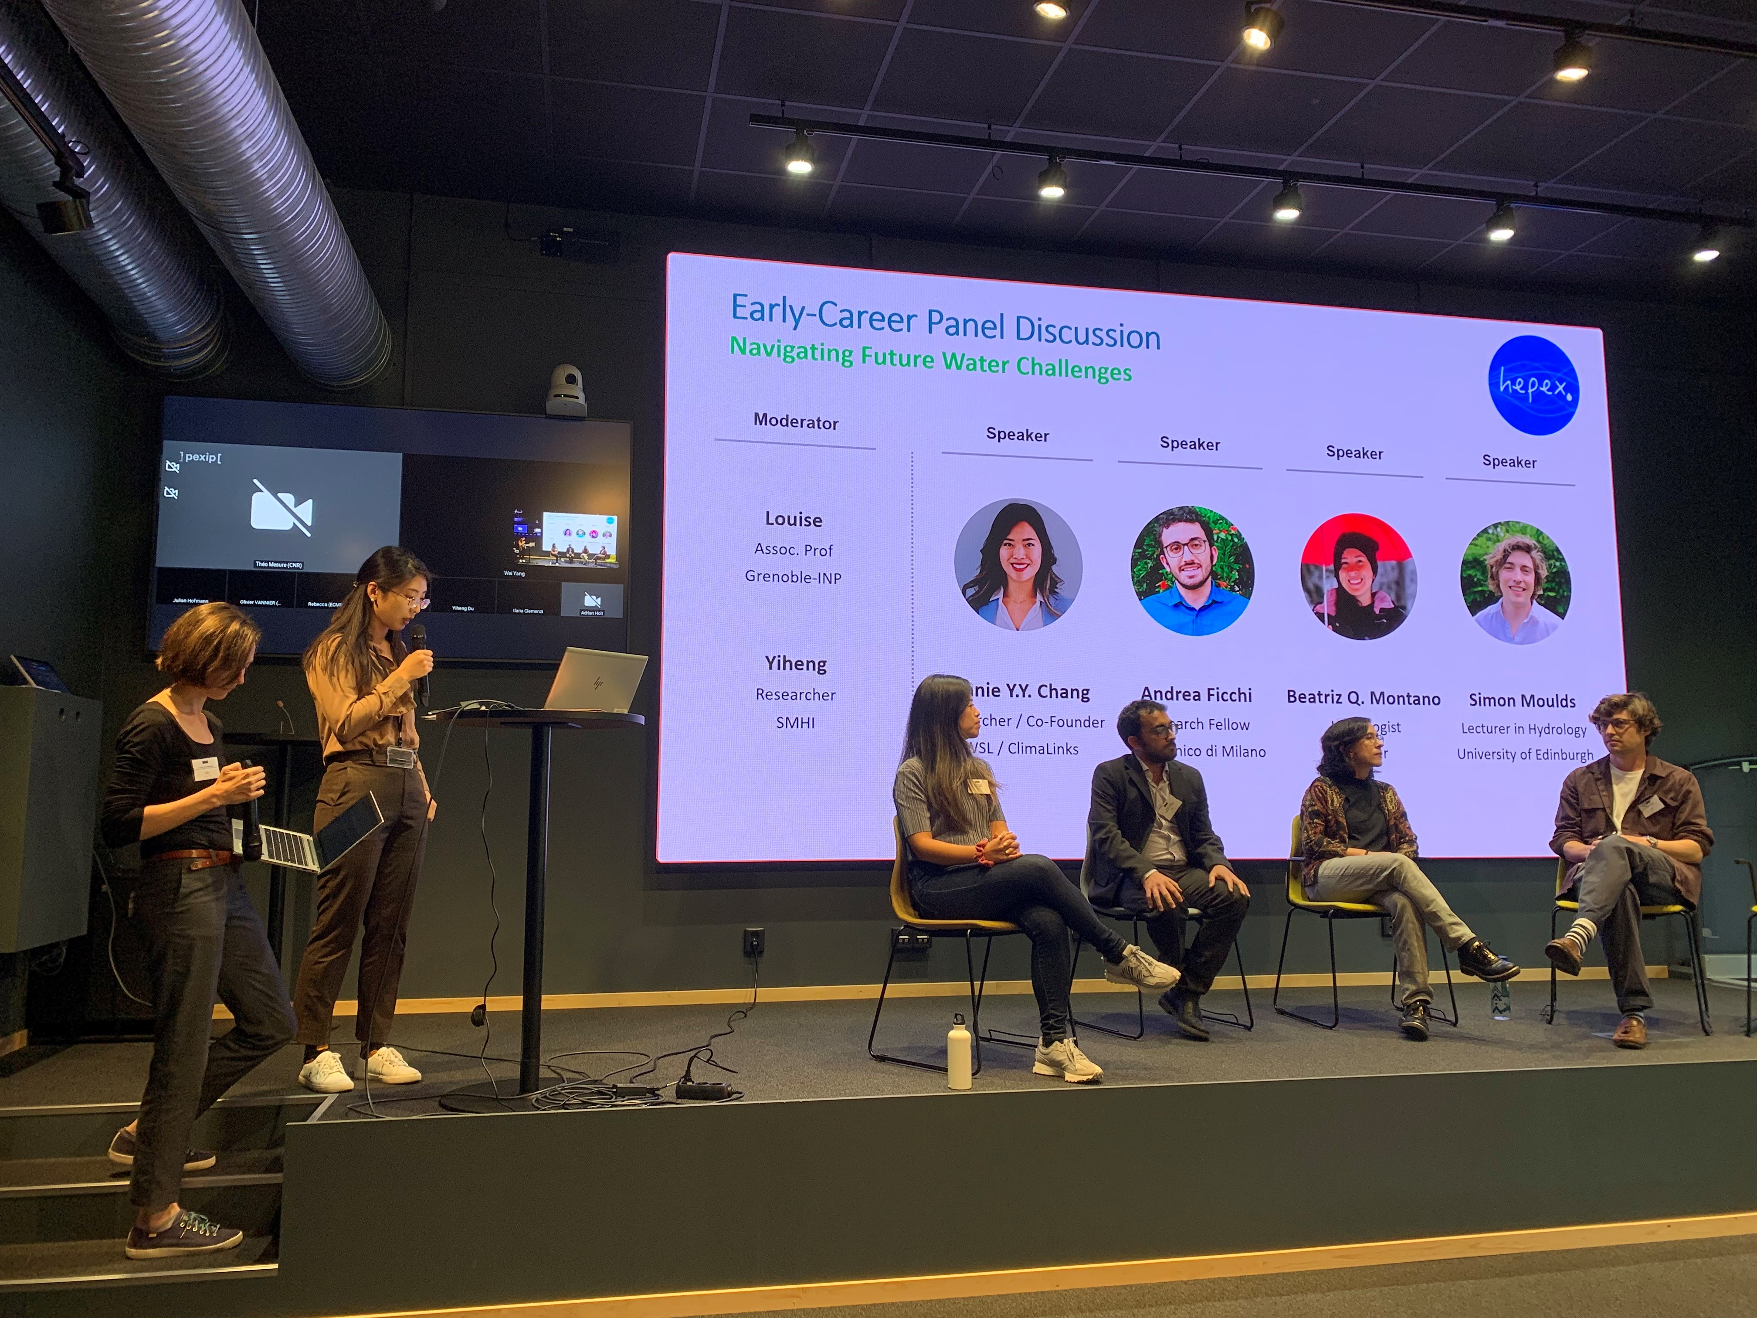
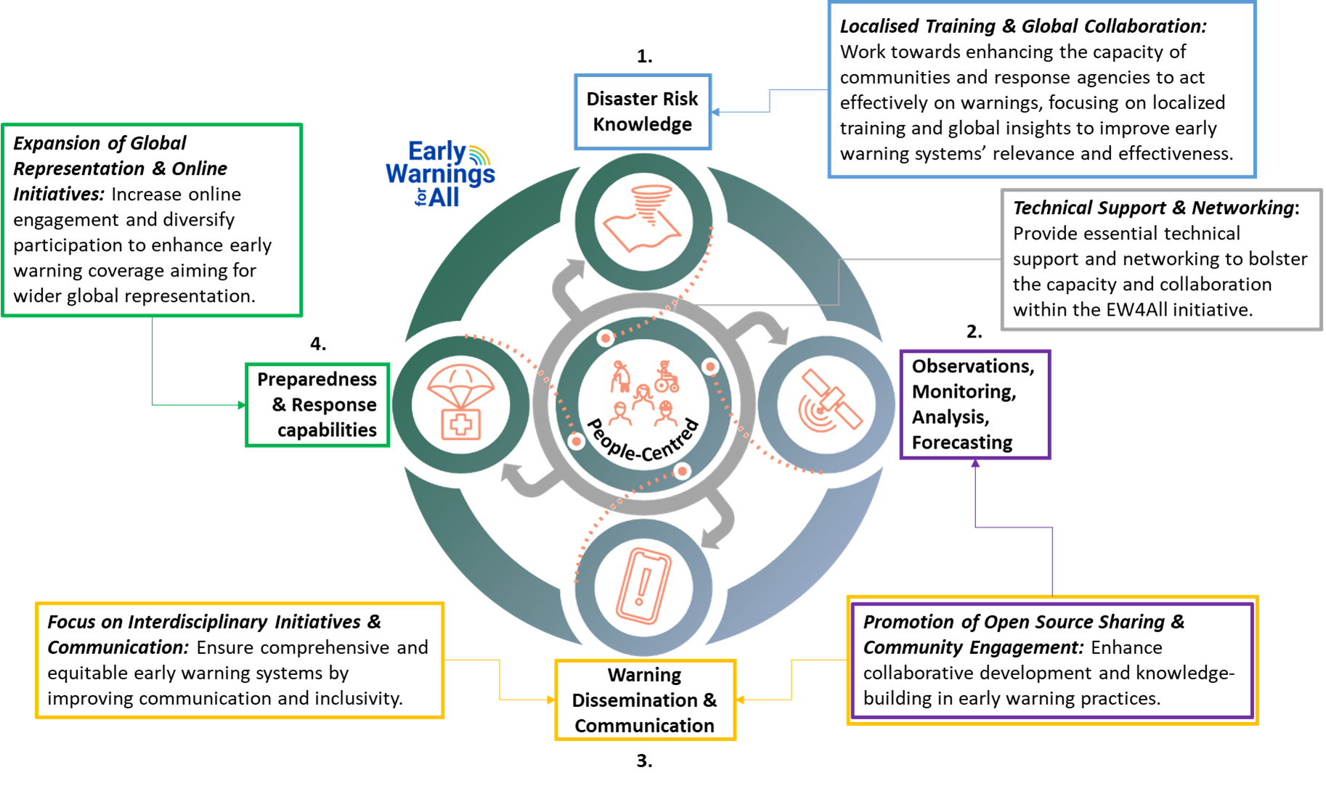
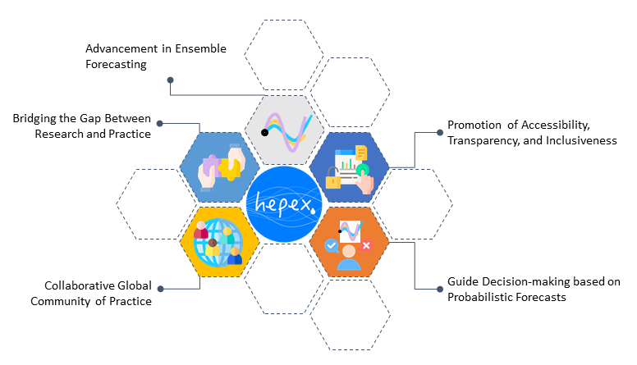
Innovations across scales and horizons
How can we contribute to EW4All?
Which are the main achievements in advancing R2O hydro forecasting?
https://doi.org/10.1175/BAMS-D-24-0322.1

