Slide 1
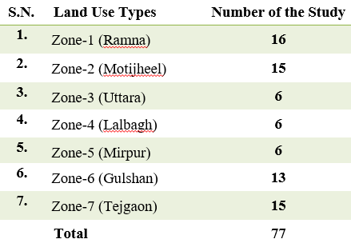
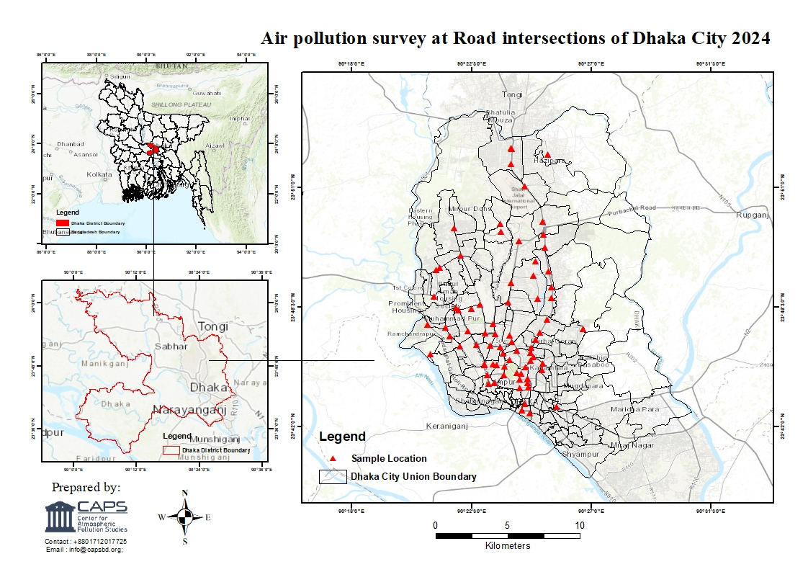
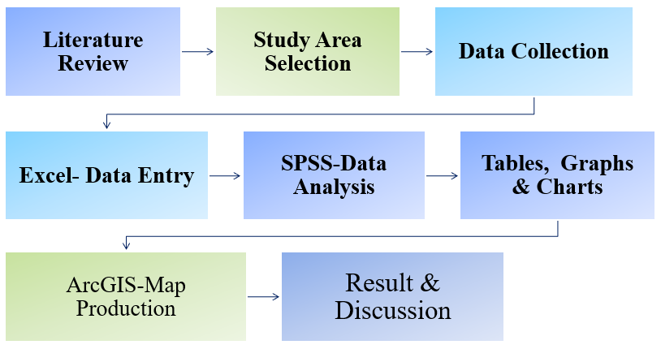
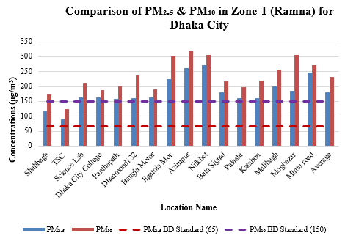
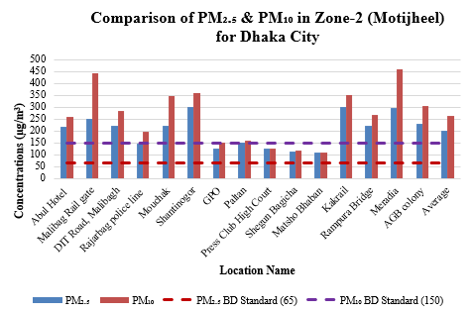
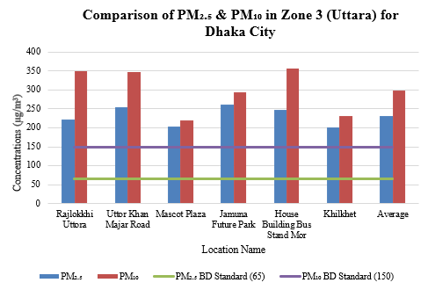
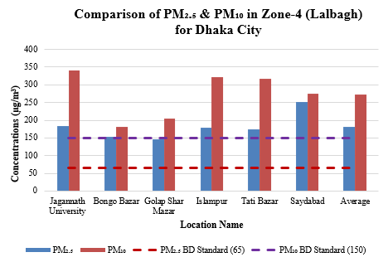
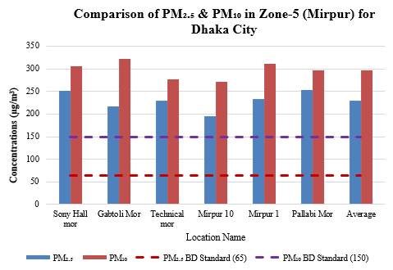
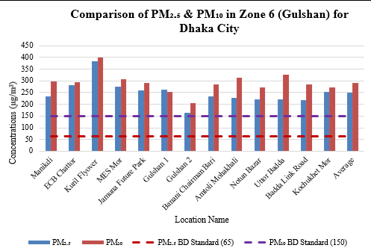
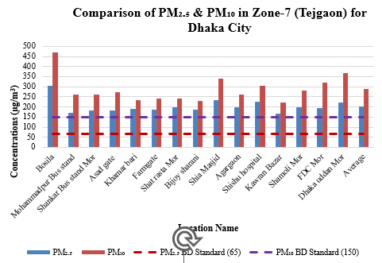
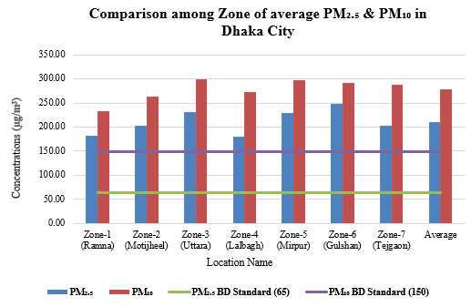
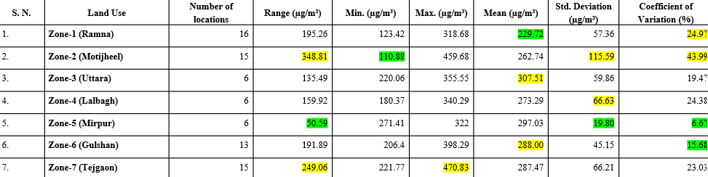
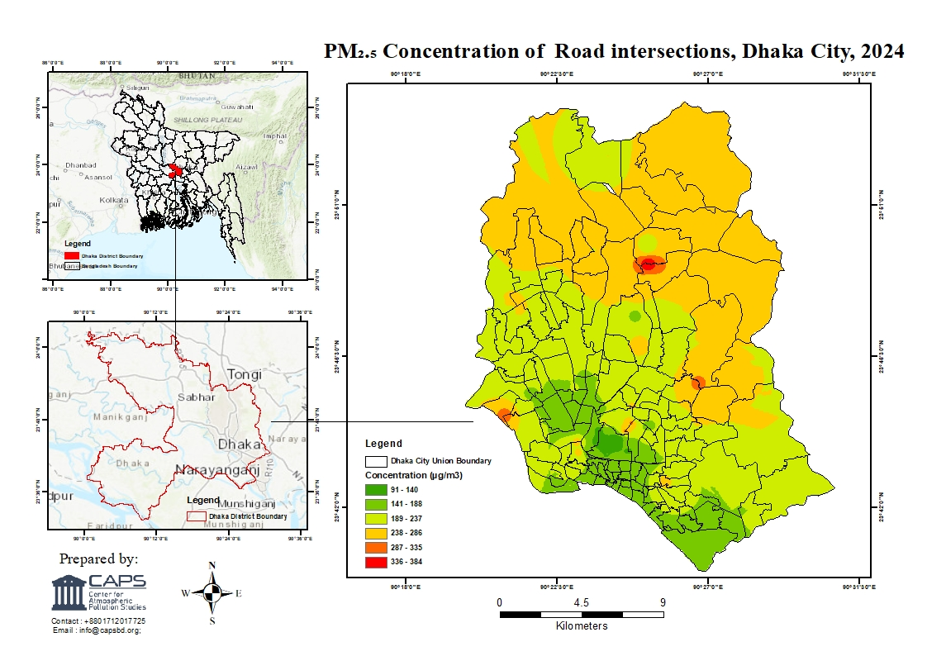
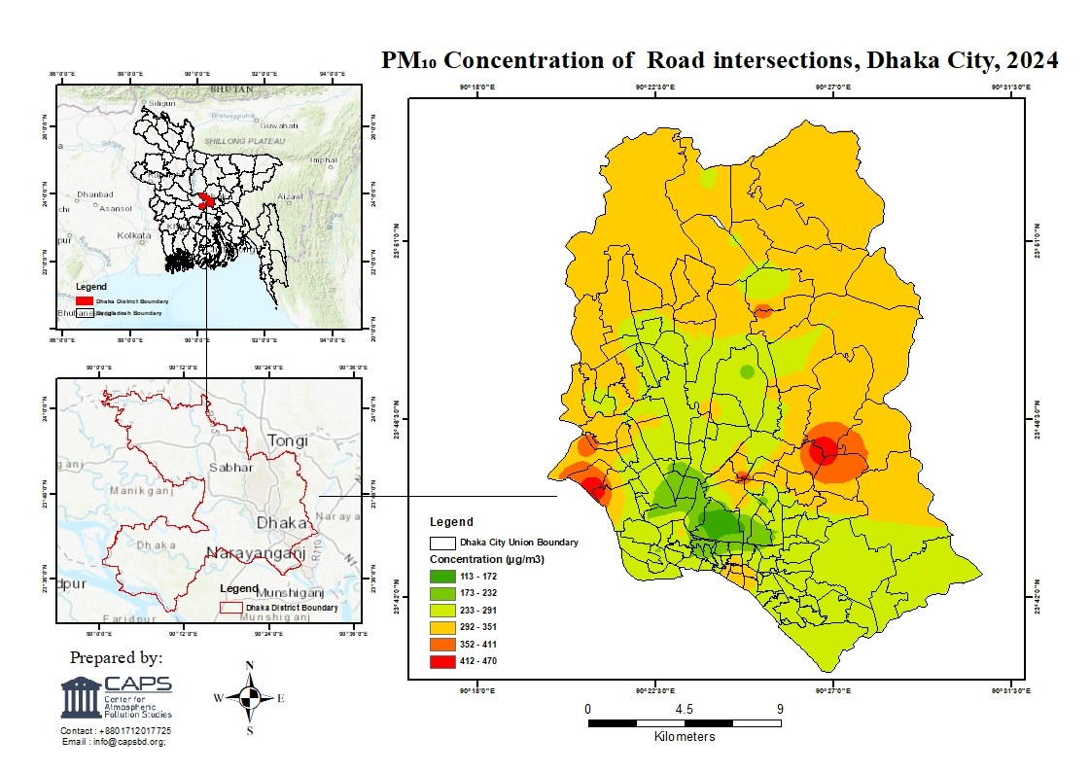
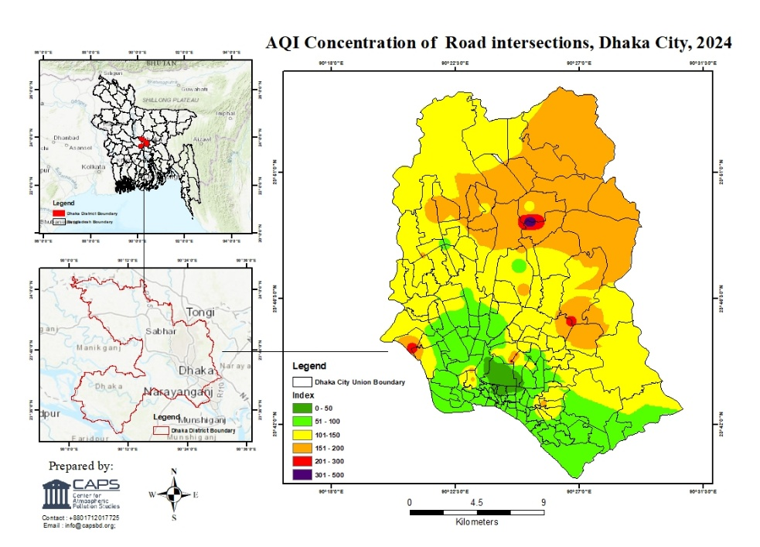
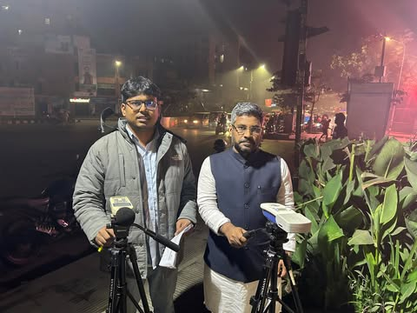
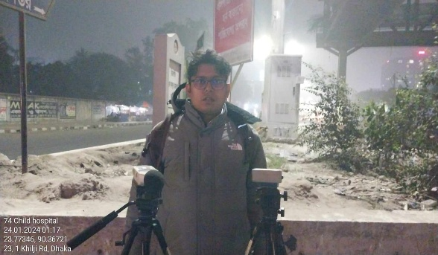
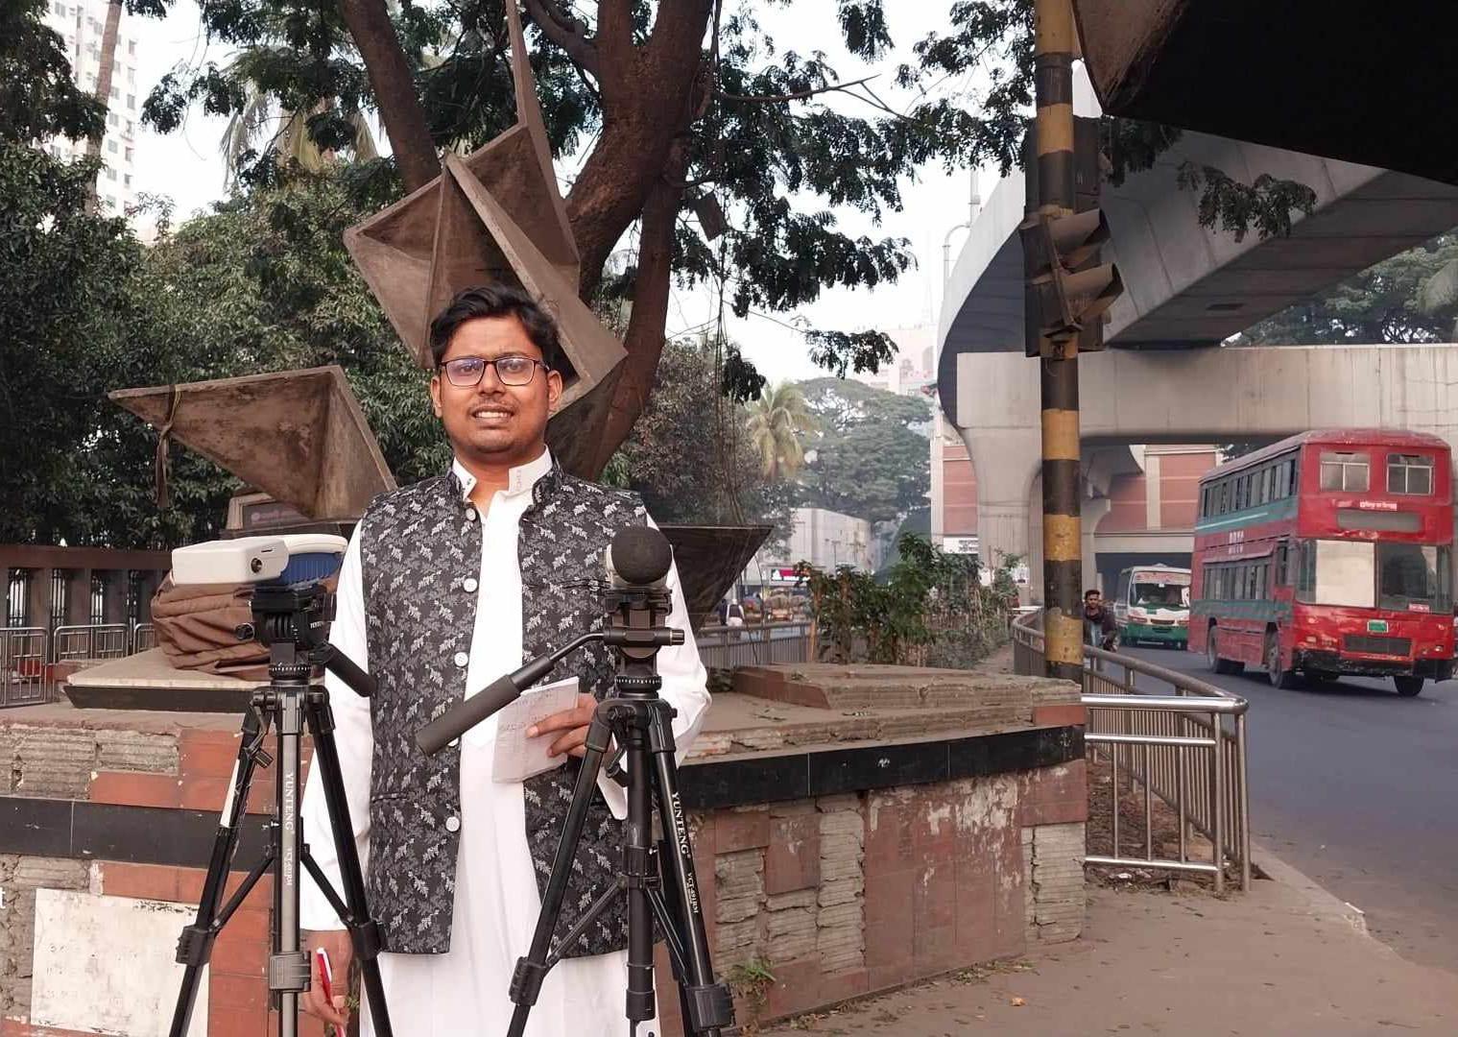
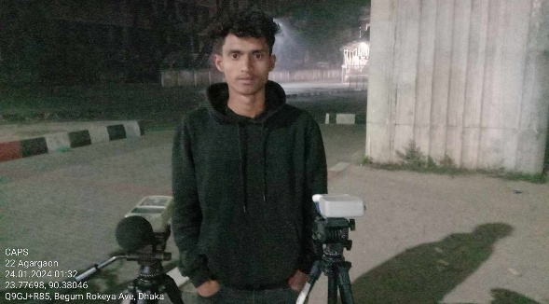
Status of Air Quality and Associated Health Risks in Dhaka Metropolitan City, Bangladesh: A Cold Wave Period Analysis
Ahmad Kamruzzaman Majumder*, Mahmuda Islam, Marziat Rahman, Mohsina Hossain, Mohsina Hossain, and Md Nasir Ahmmed Patoary
Figure-1: Study Area and Location map of data group point in Dhaka Metropolitan City
Figure-2: Material and Methods
Figure-3: Result & Discussion
Figure 4: PM₂.₅ and PM₁₀ Concentration Map of Dhaka Metropolitan City During Cold Wave Time
Figure 5: AQI on PM₂.₅ Concentration Map of Dhaka
Metropolitan City During Cold Wave Time
Figure 6: Survey Photograph

