Slide 1
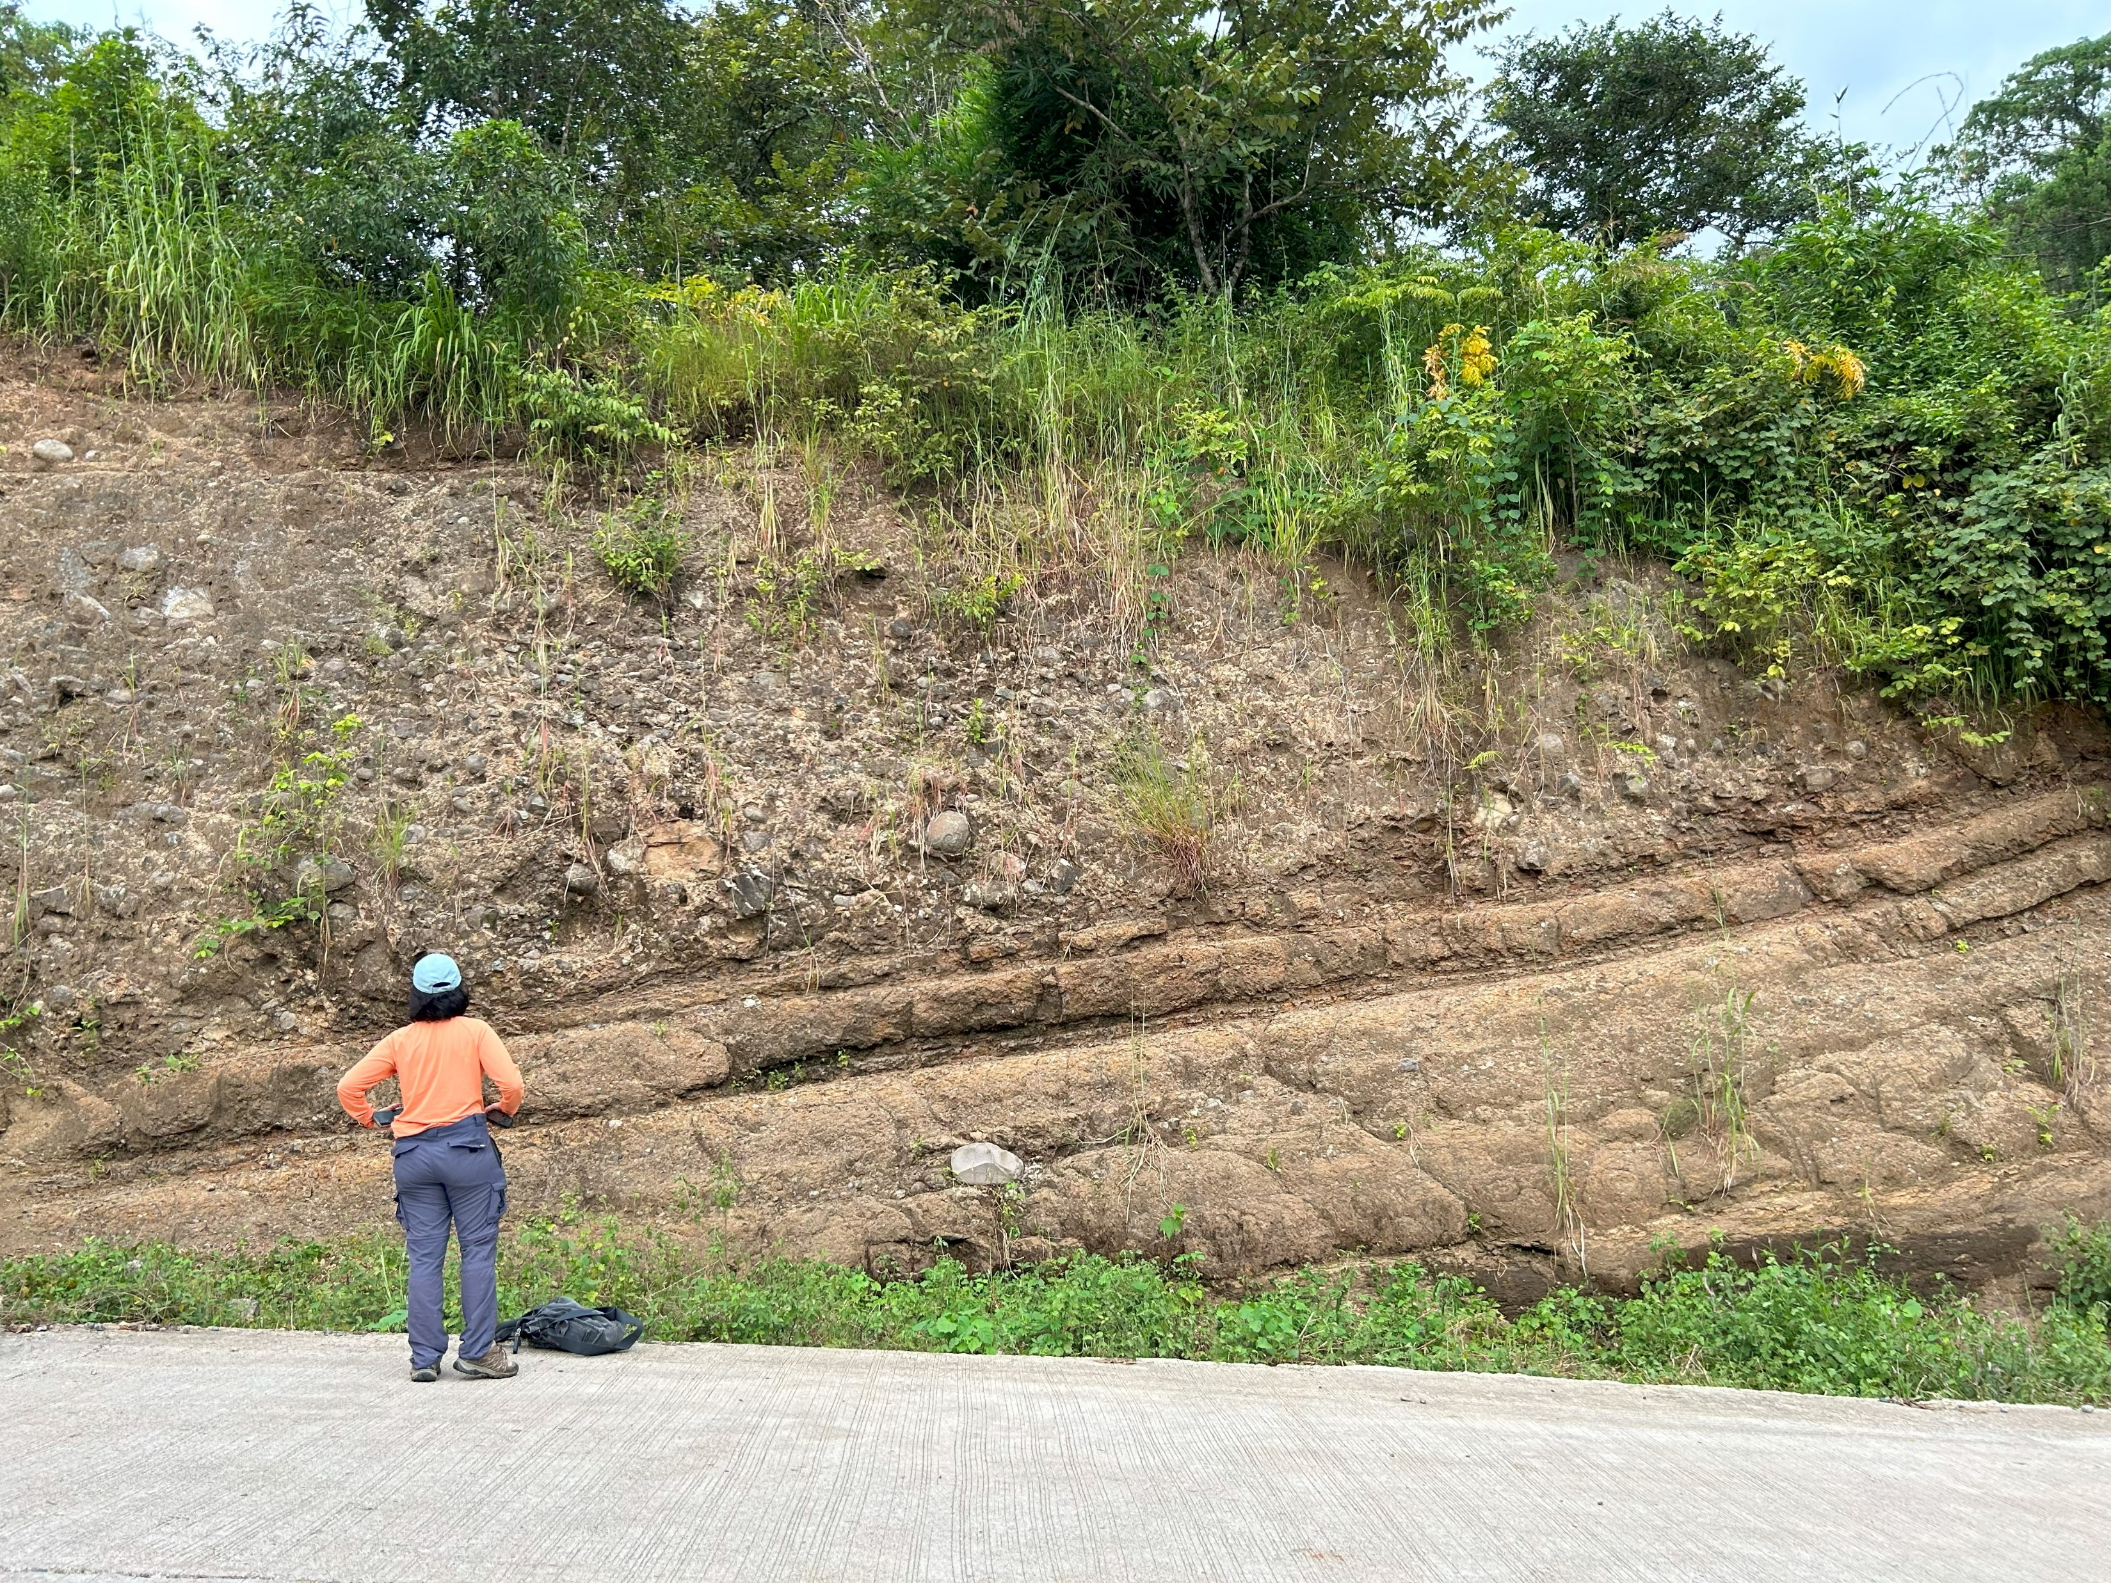
Identification of active fault traces of the Abra River fault system, northwestern Luzon, Philippines, from tectonic geomorphic features
Chun-Chi Chen, J. Bruce H. Shyu, and Noelynna T. Ramos

Slide 2
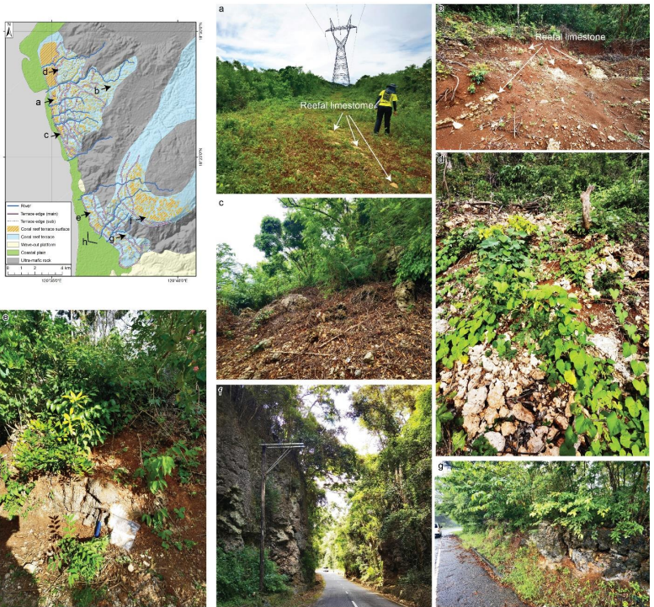
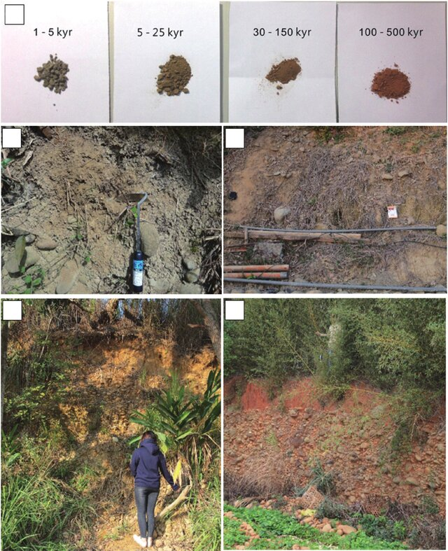
Age determination
Soil development in Taiwan for the Taiwan Earthquake Model
Soils in NW Luzon
MIS 5a
MIS 7a
1-5 kyr
5-25 kyr
MIS 5c
A: T1 (MIS 5a)
B: T4 (MIS 7a)
C: T1 (MIS 5a)
D: T2 (MIS 5c)
E: T1 (MIS 5a)
F: T8
G: T3 (MIS 5e)
MIS 5a
30-150 kyr
100-500 kyr
MIS 5a
MIS 5e
(Shyu et al., 2016)
Wang et al. (2026)
Notes:
climate change that cause
Discuss with Gennie

Slide 3
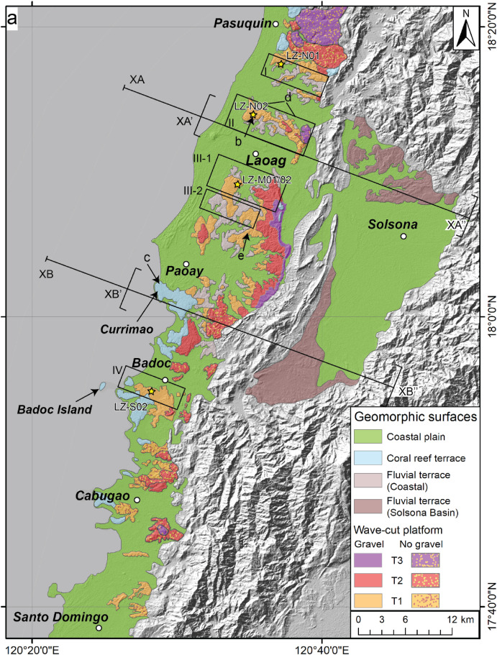
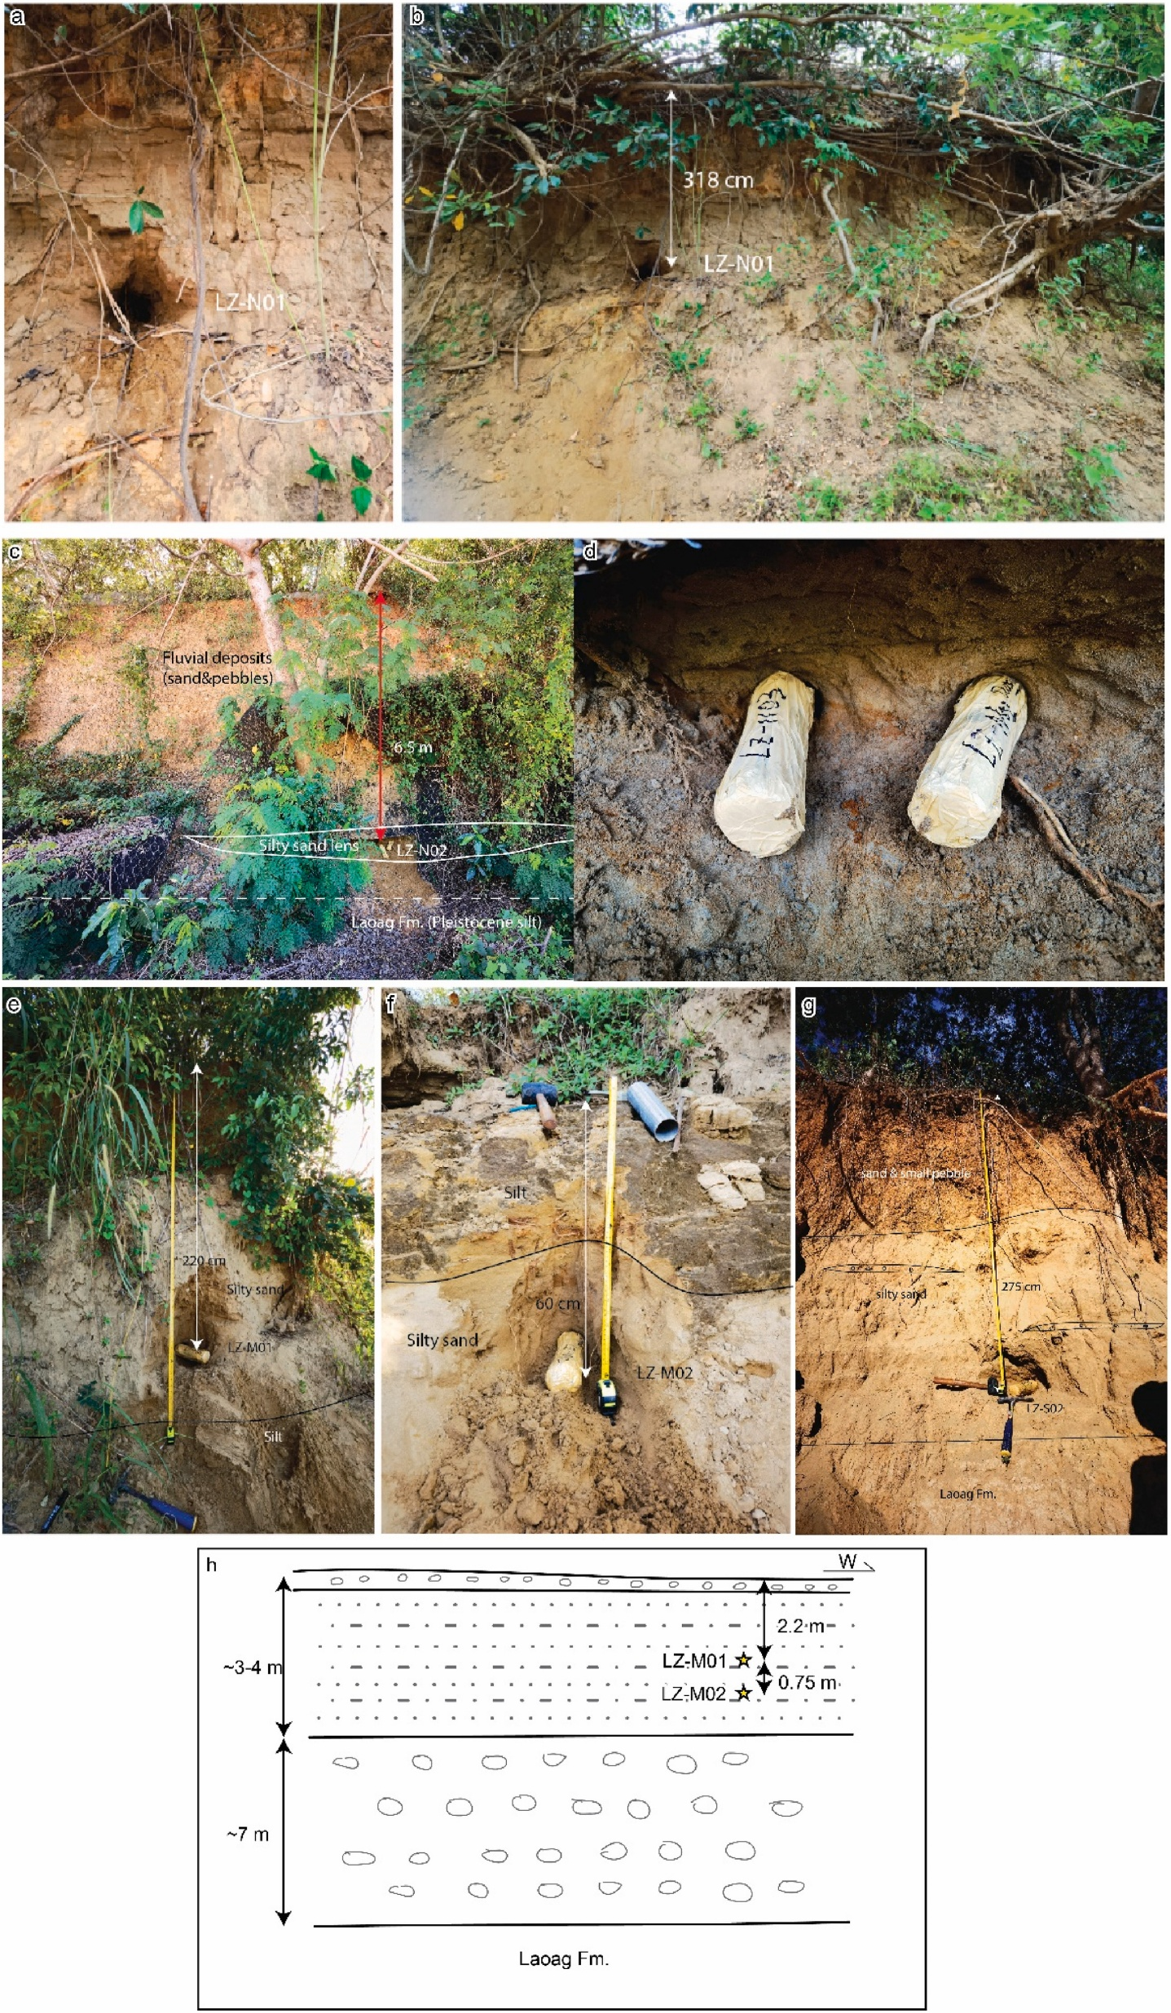


Age determination
Soil development in Taiwan for the Taiwan Earthquake Model
Soils in NW Luzon
1-5 kyr
5-25 kyr
LZ-N02: 87.1 $±$ 10.4 kyr
LZ-S02: 82.7 $±$ 14.2 kyr
30-150 kyr
100-500 kyr
(Shyu et al., 2016)
Wang et al. (2025)
Notes:
climate change that cause
Discuss with Gennie

Slide 4
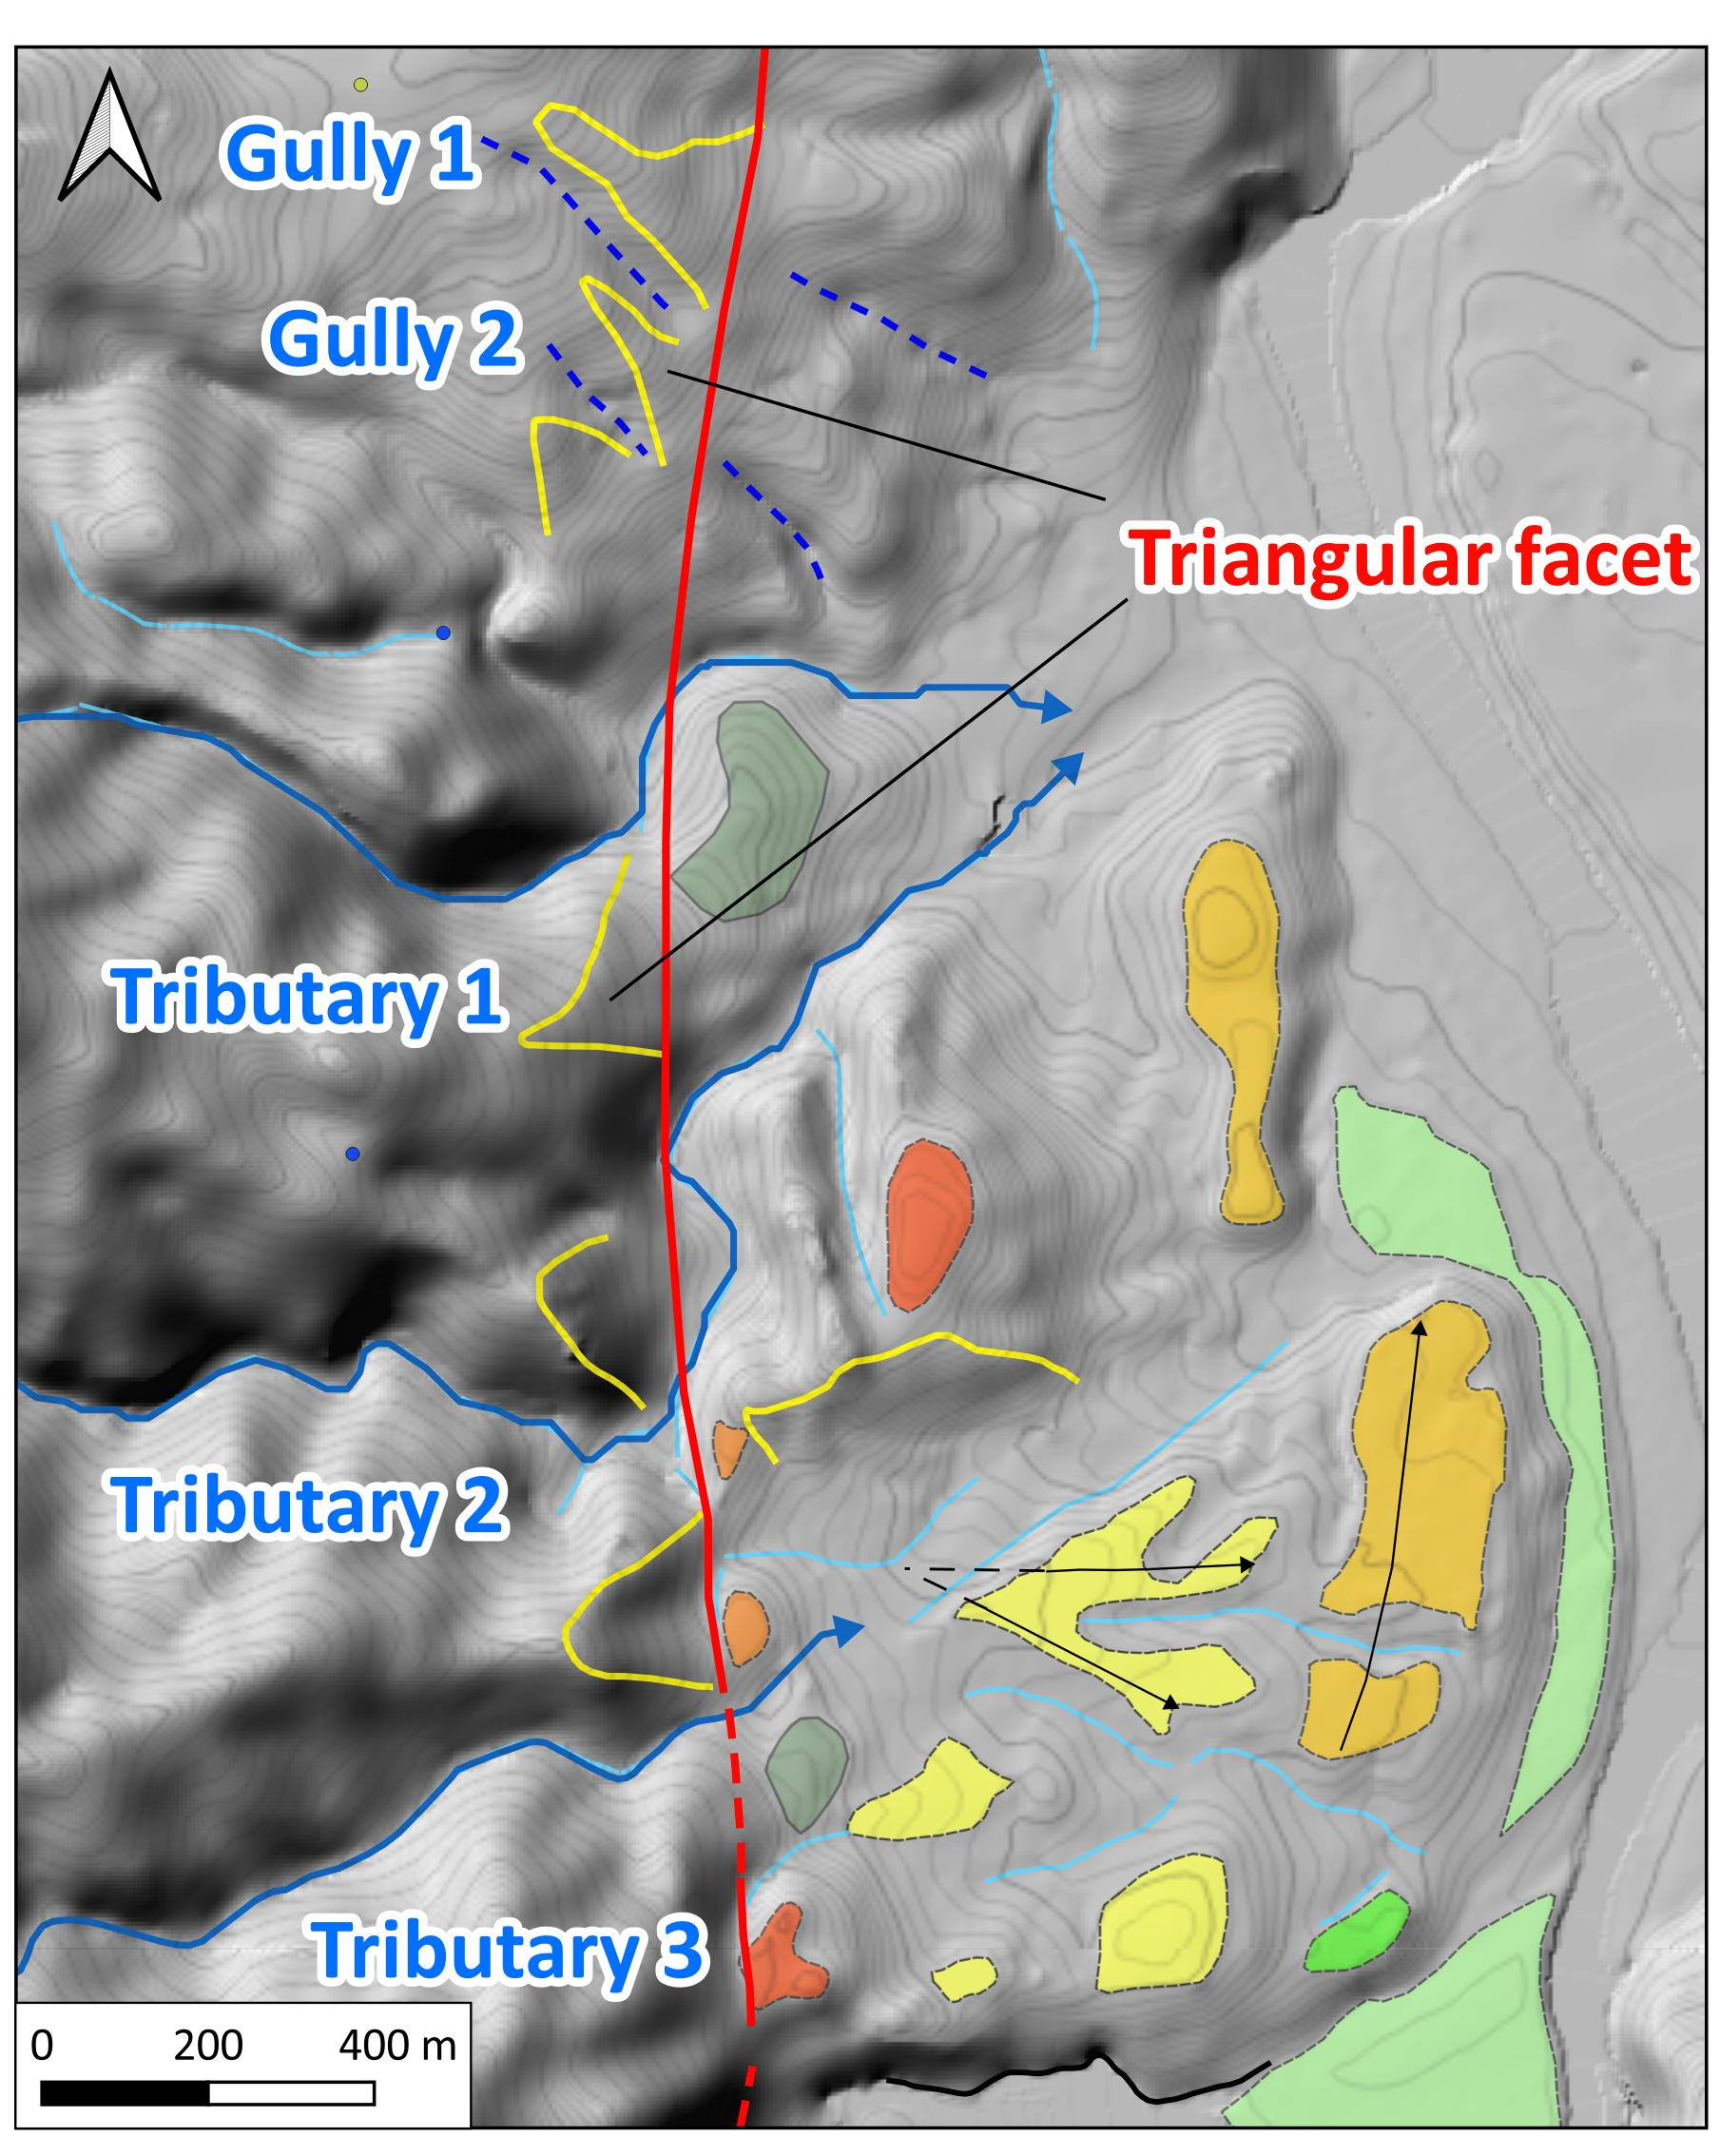
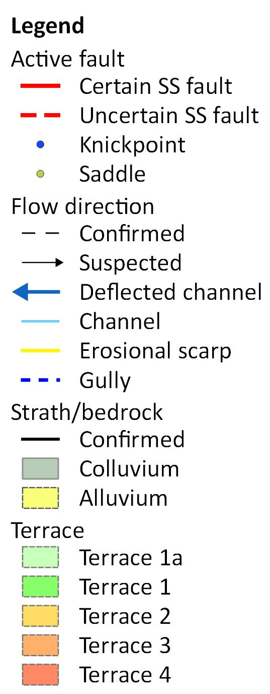
Luba
Displacement of the gullies
Gully 1: 127-140 m
Gully 2: 81-90 m
Displacement of the channels
Tributary1: 156-177 m
Tributary 2: 351-390 m
Tributary 3: 179-194 m/270-280 m
Contour interval: 2 m

Slide 5
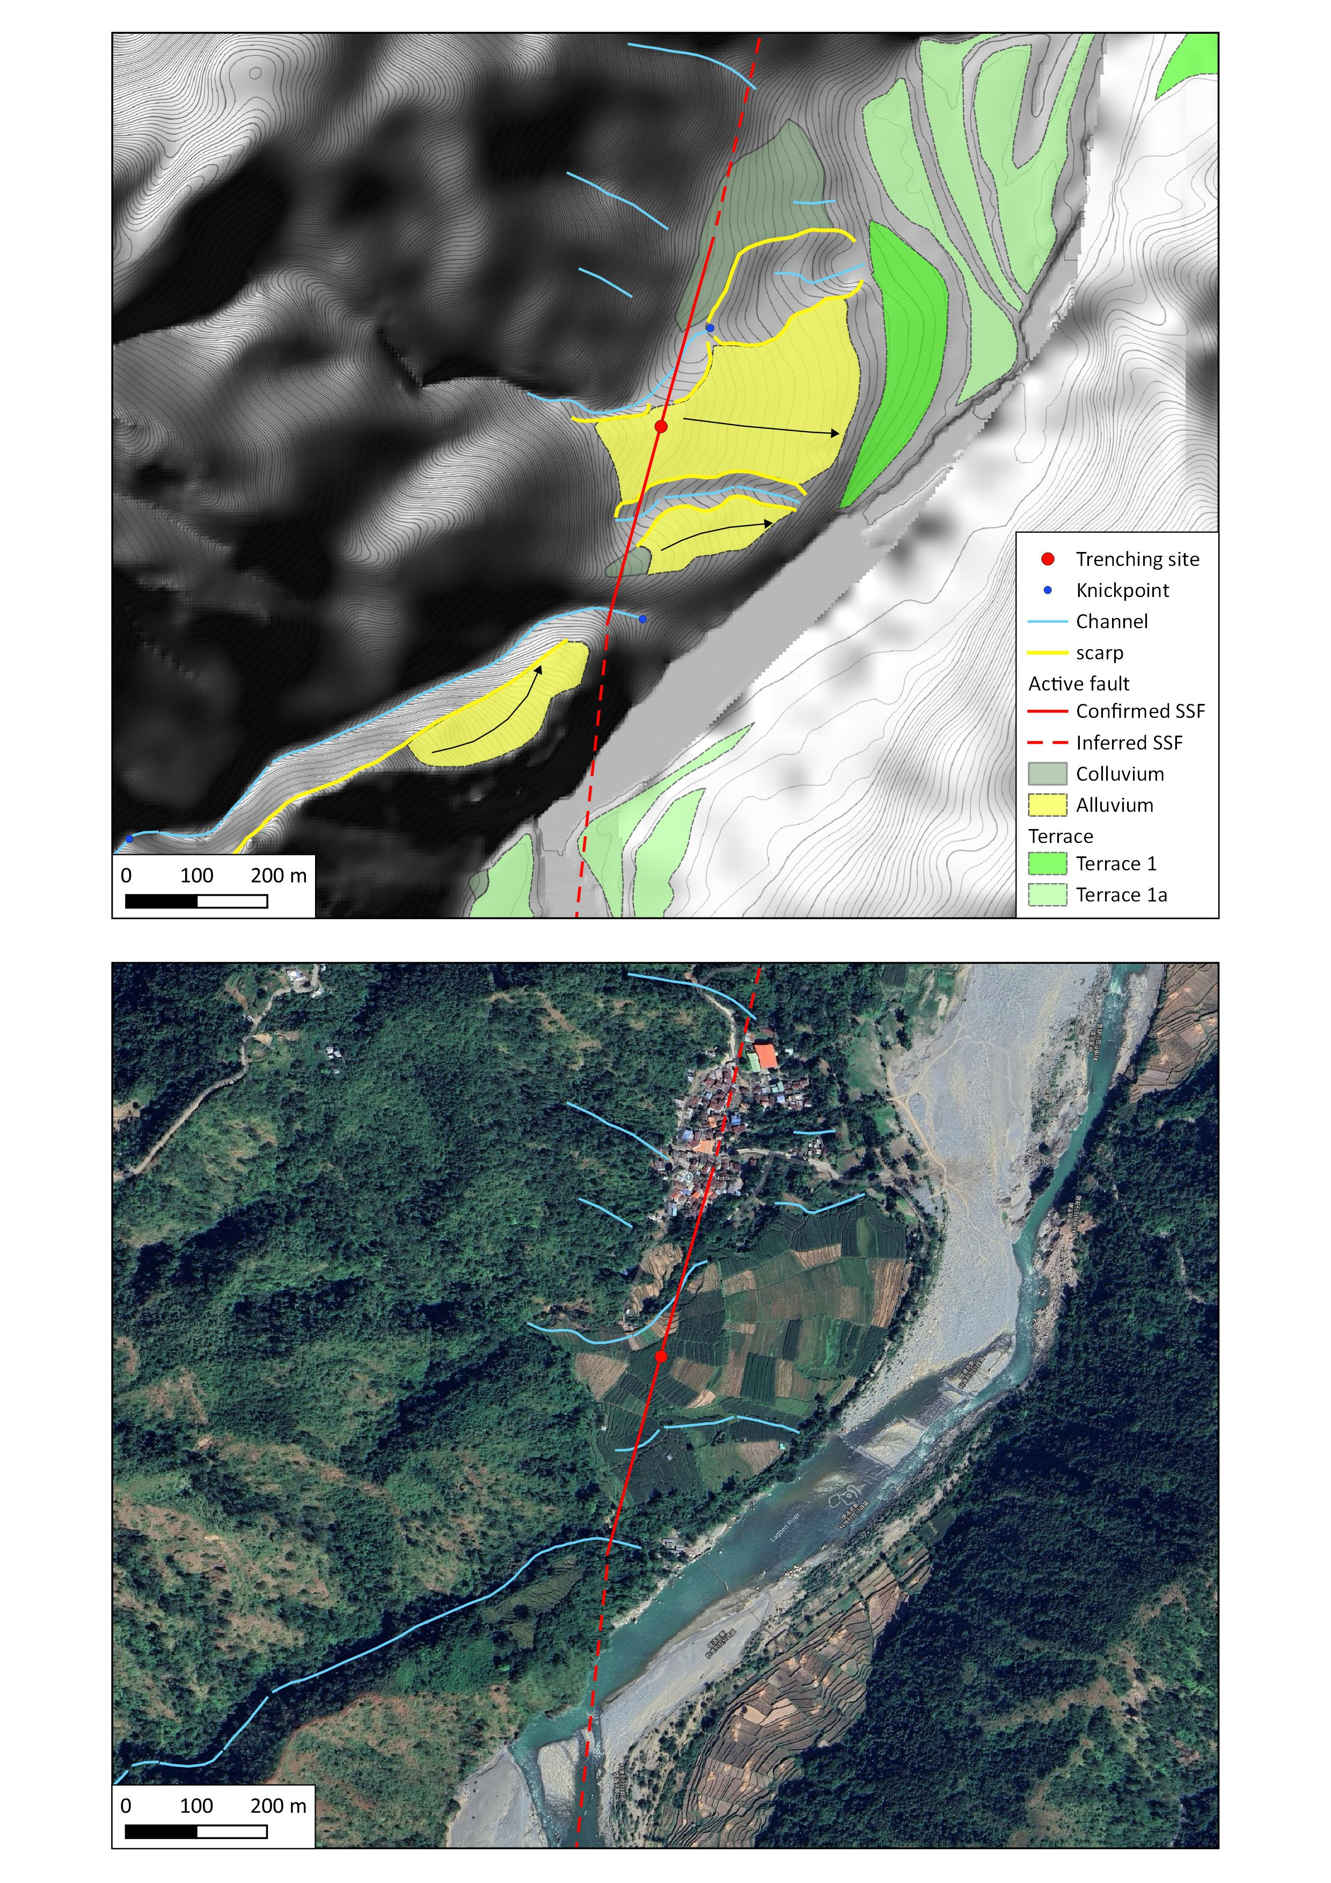
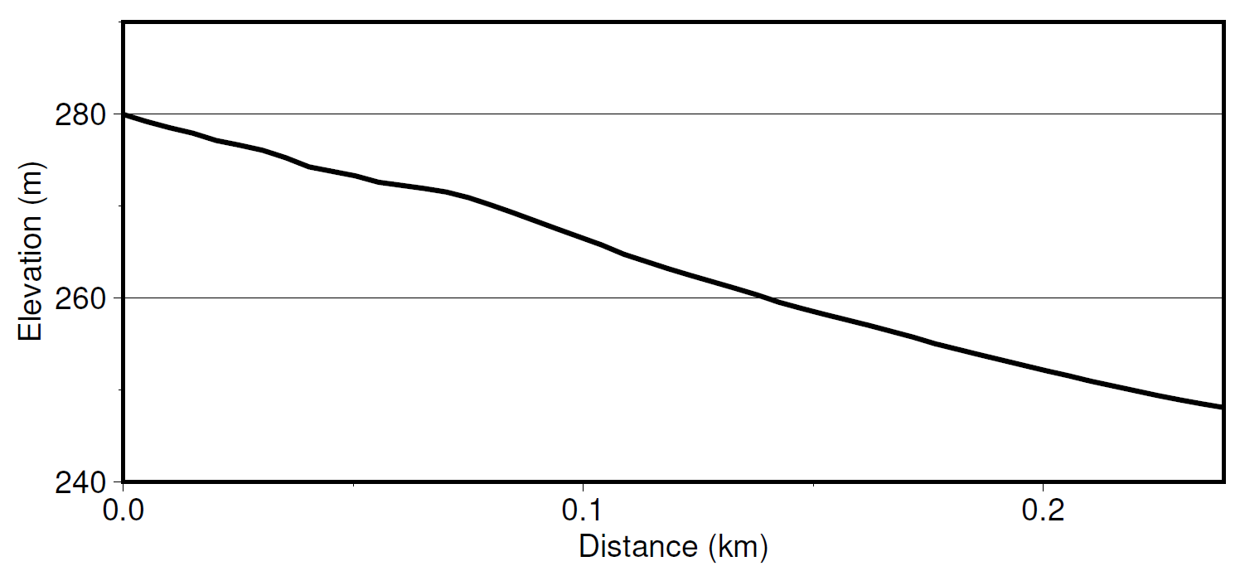
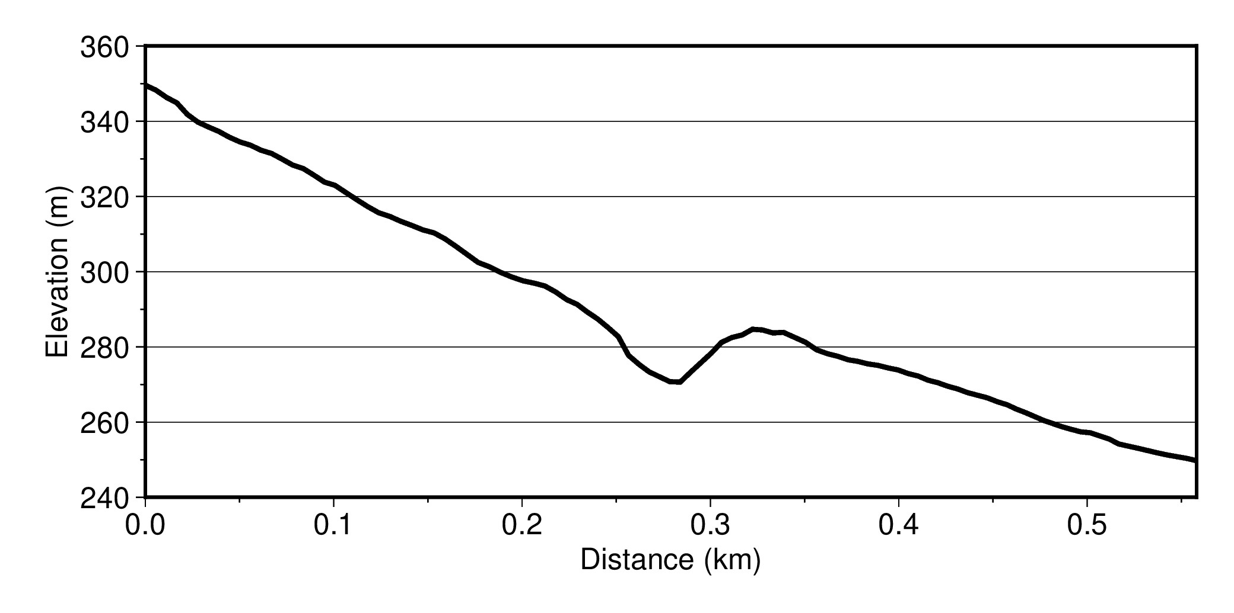
Matibuey
A
A’
Deformed surface
Offset channel: 85-165m
VE= 2
A
A’
B
B’
Beheaded channel: 136-162 m
B’
B
VE= 2
Contour interval: 2 m

Slide 6
Matibuey
Contour interval: 2 m
Possible restoration of the offset alluvial fan
B
B’
B’
B
Distance
VE= 2
140 m

Slide 7
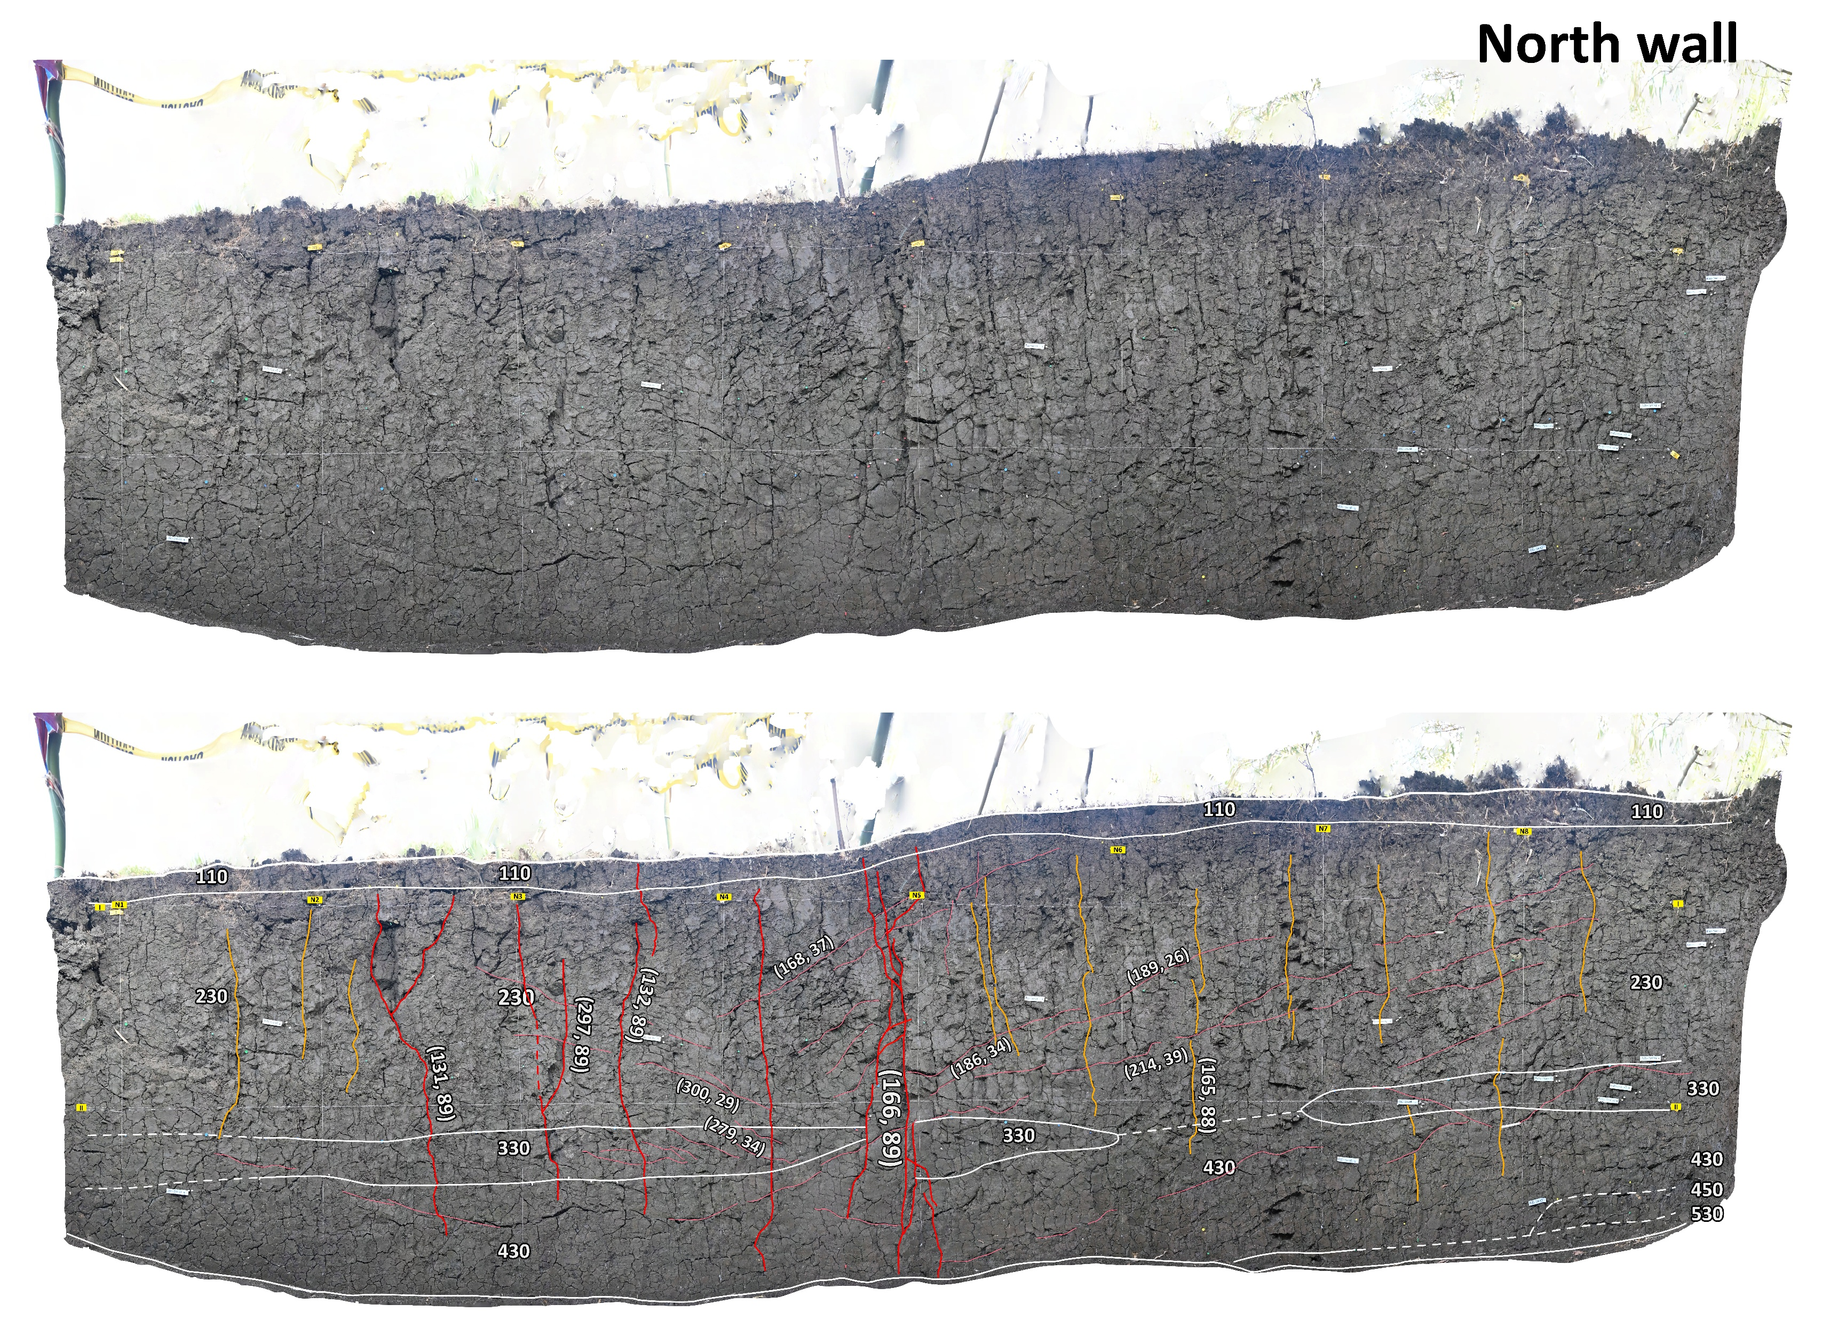

Slide 8
