Slide 1
Fog water as a non-conventional resource for strengthening water security in coastal settlements of the Atacama Desert
Catalina Contreras-López, Camilo del Río, Virginia Carter, Vicente Espinoza and Felipe Lobos-Roco
Geographer
Master student in Geography and Geomatic – PUC Chile
Tuesday 05 May 2026

Slide 2
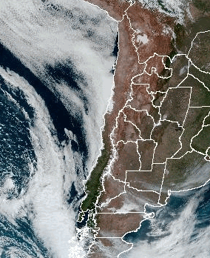
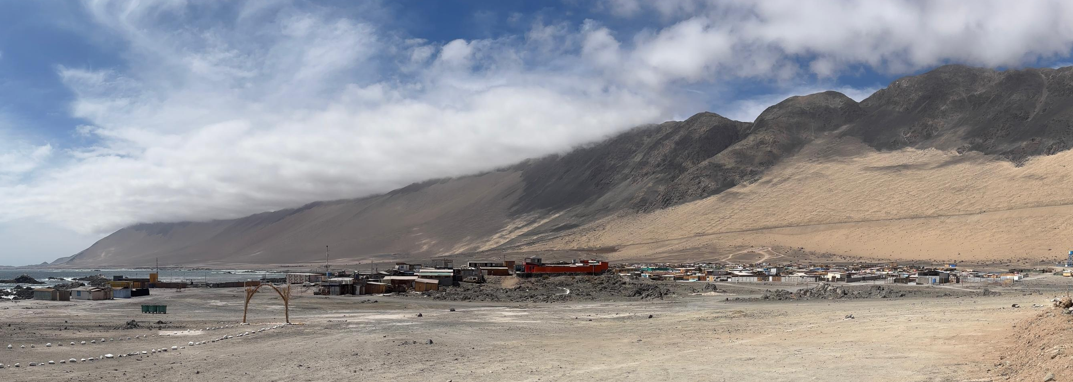
ACCESS TO WATER RESOURCES
Populations
310 households
117 residents
Supply Rural Sanitary Service (SSR)
Tanker trucks
Desalinitation plant
Is fog a viable option for increasing the water supply in coastal settlements?
How do local residents view the potential implementation of fog water harvesting as a supplementary water source?
25 Sep 2025 – GOES-19

Slide 3
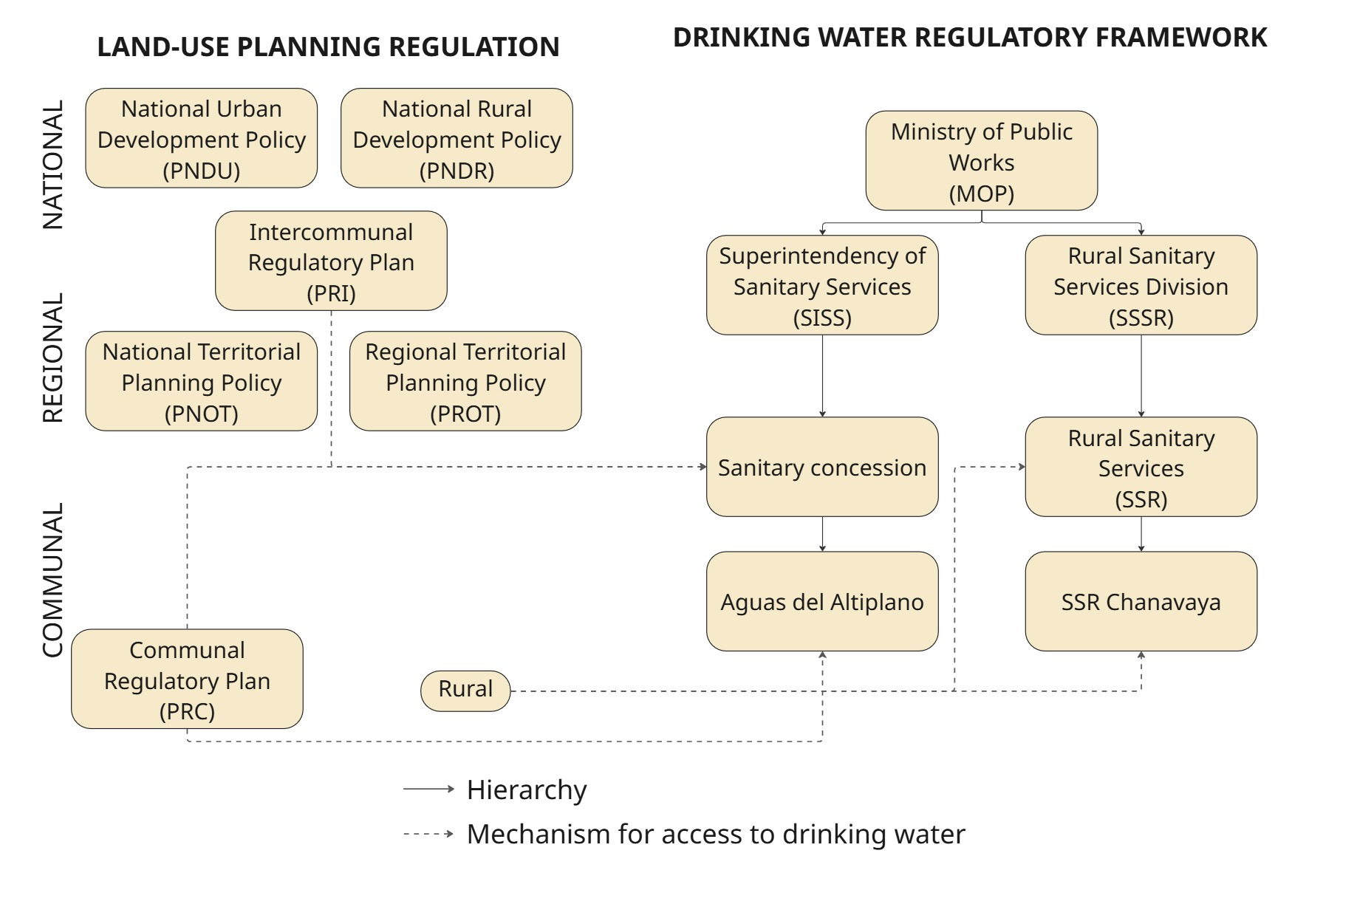
CURRENT ACCESS TO DRINKING WATER AND LOCAL PERCEPTION OF FOG WATER
Review was based on public institutional data
Interviews key stakeholders
Survey to 15 residents

Slide 4
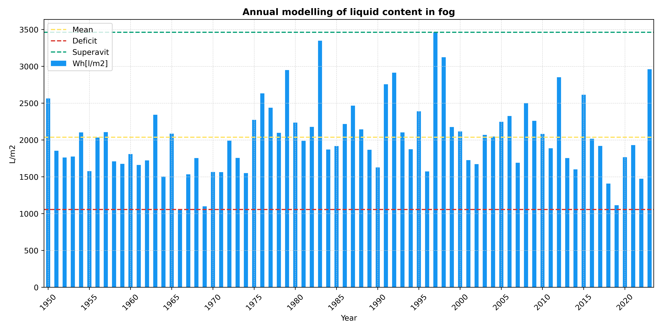
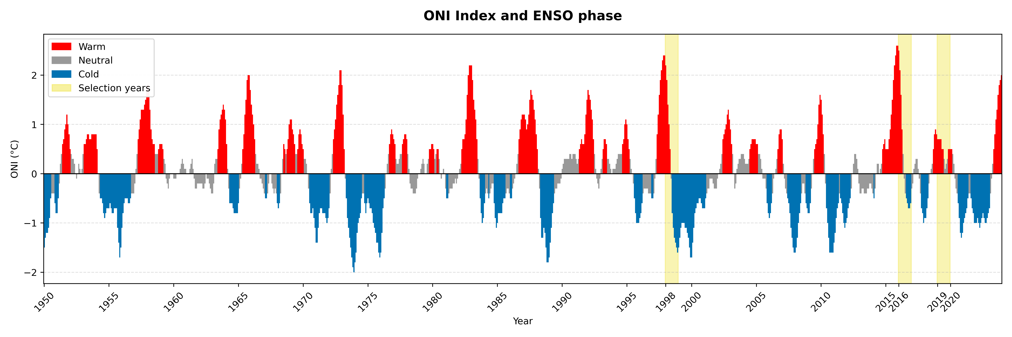
AVAILABILITY OF FOG WATER AND CLIMATE DINAMICS
1998
2016
Available liquid content in the fog according to ERA 5 model
2019
Influence of the El Niño Southern Oscilation (ENSO)

Slide 5
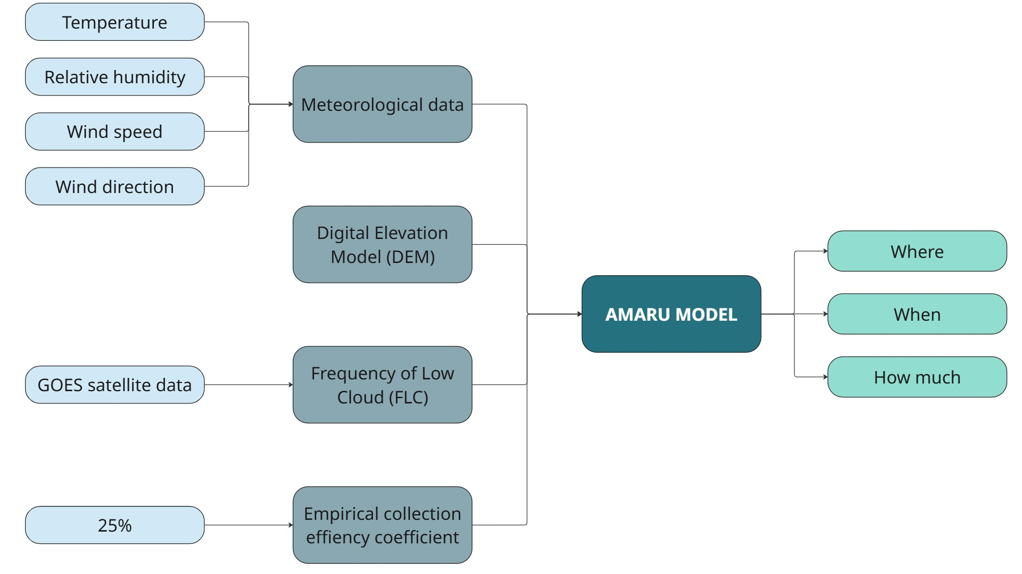
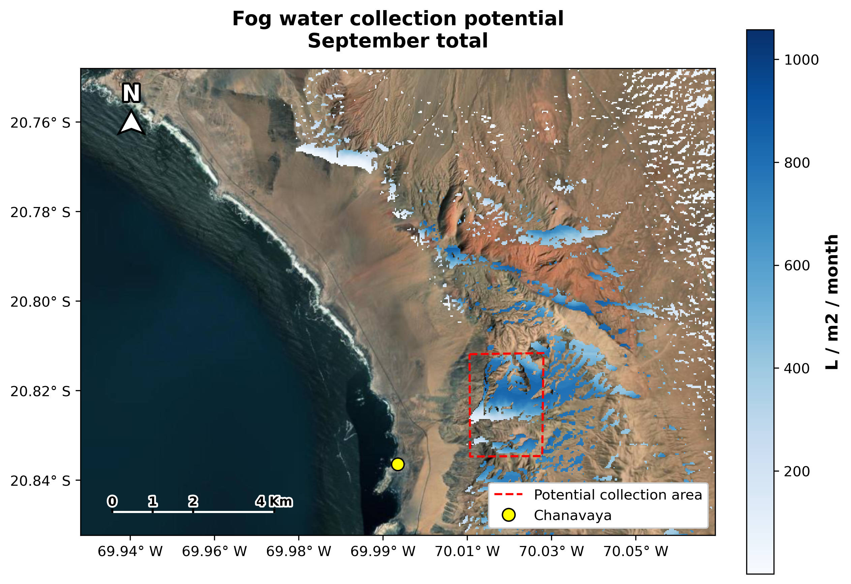
ANALISIS OF THE POTENTIAL FOR FOG WATER COLLECTION
FOG WATER COLLECTION POTENTIAL
SEPTEMBER - 1998

Slide 6
PRELIMINARY RESULTS

Slide 7
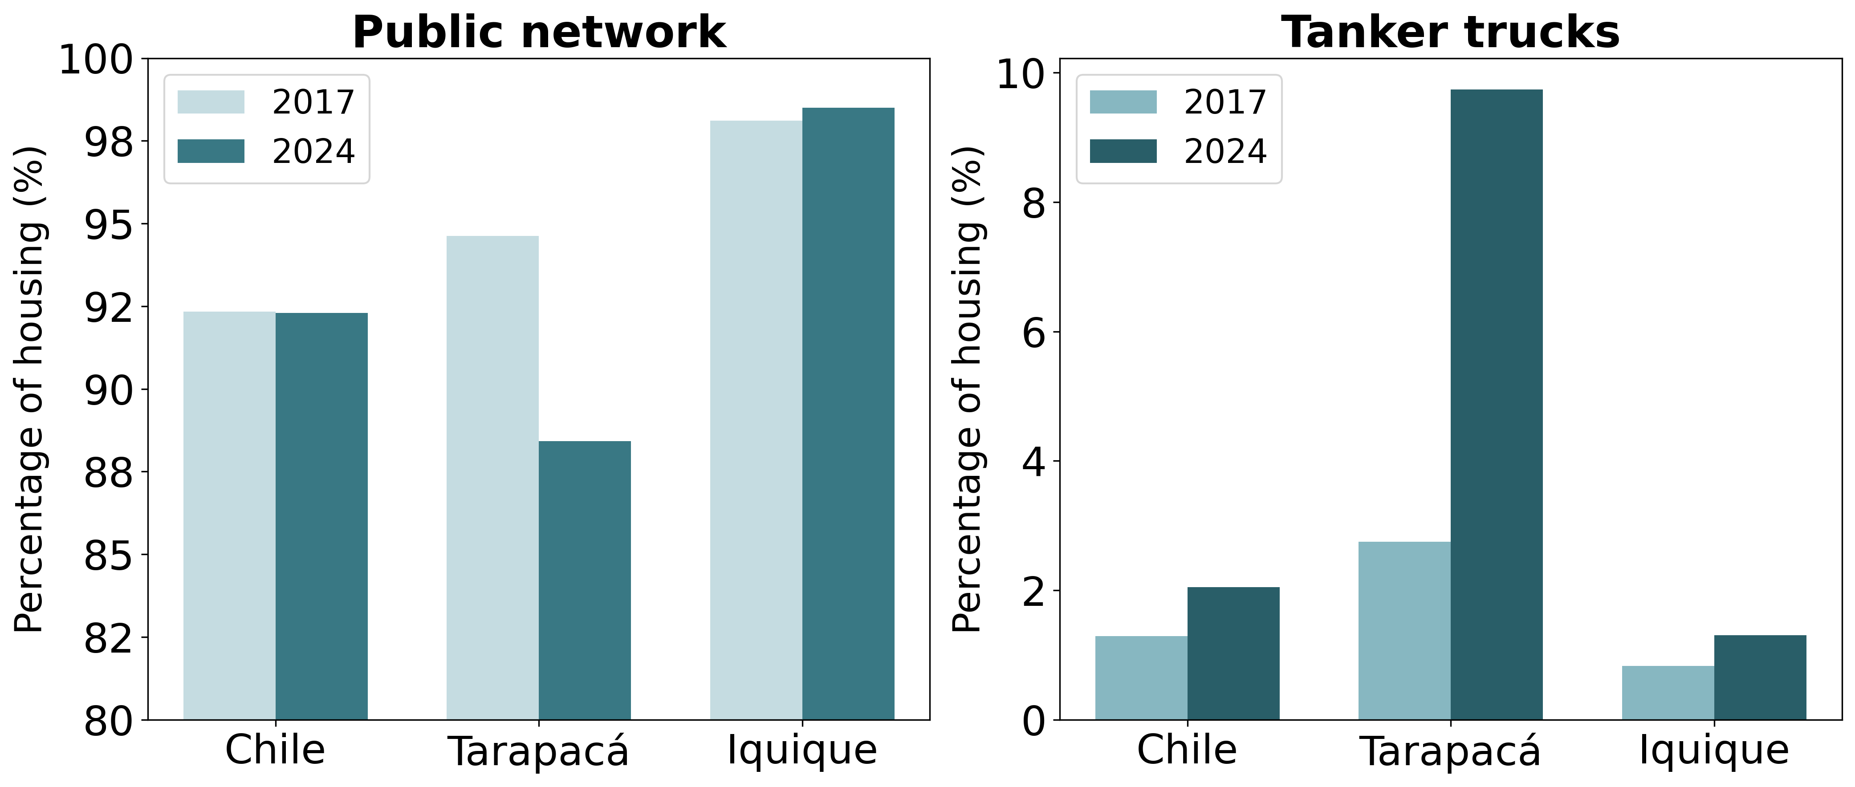
CURRENT ACCESS TO DRINKING WATER

Slide 8
CURRENT ACCESS TO DRINKING WATER IN CHANAVAYA
FORMAL
INFORMAL
Scenarios | 100 m3 / month | 150 m3 / month | 150 m3 / month
Liters | 100.000 | 150.000 | 150.000
N° of households | 58 | 58 | 55
N° of habitants | Not available information | Not available information | 203
Average liters per household per month | 1.724 | 2.586 | 2.727
Average liters per household per day | 57,4 | 86,2 | 90
Average liters per person per day | Not available information | Not available information | 24
Source: Dirección de Obras Hidráulicas (DOH) (2025).
What says the World Health Organization?
Access level | Liters / per person / day
Basic | 20
Intermediate | 50
Optimal | 100 or more

Slide 9
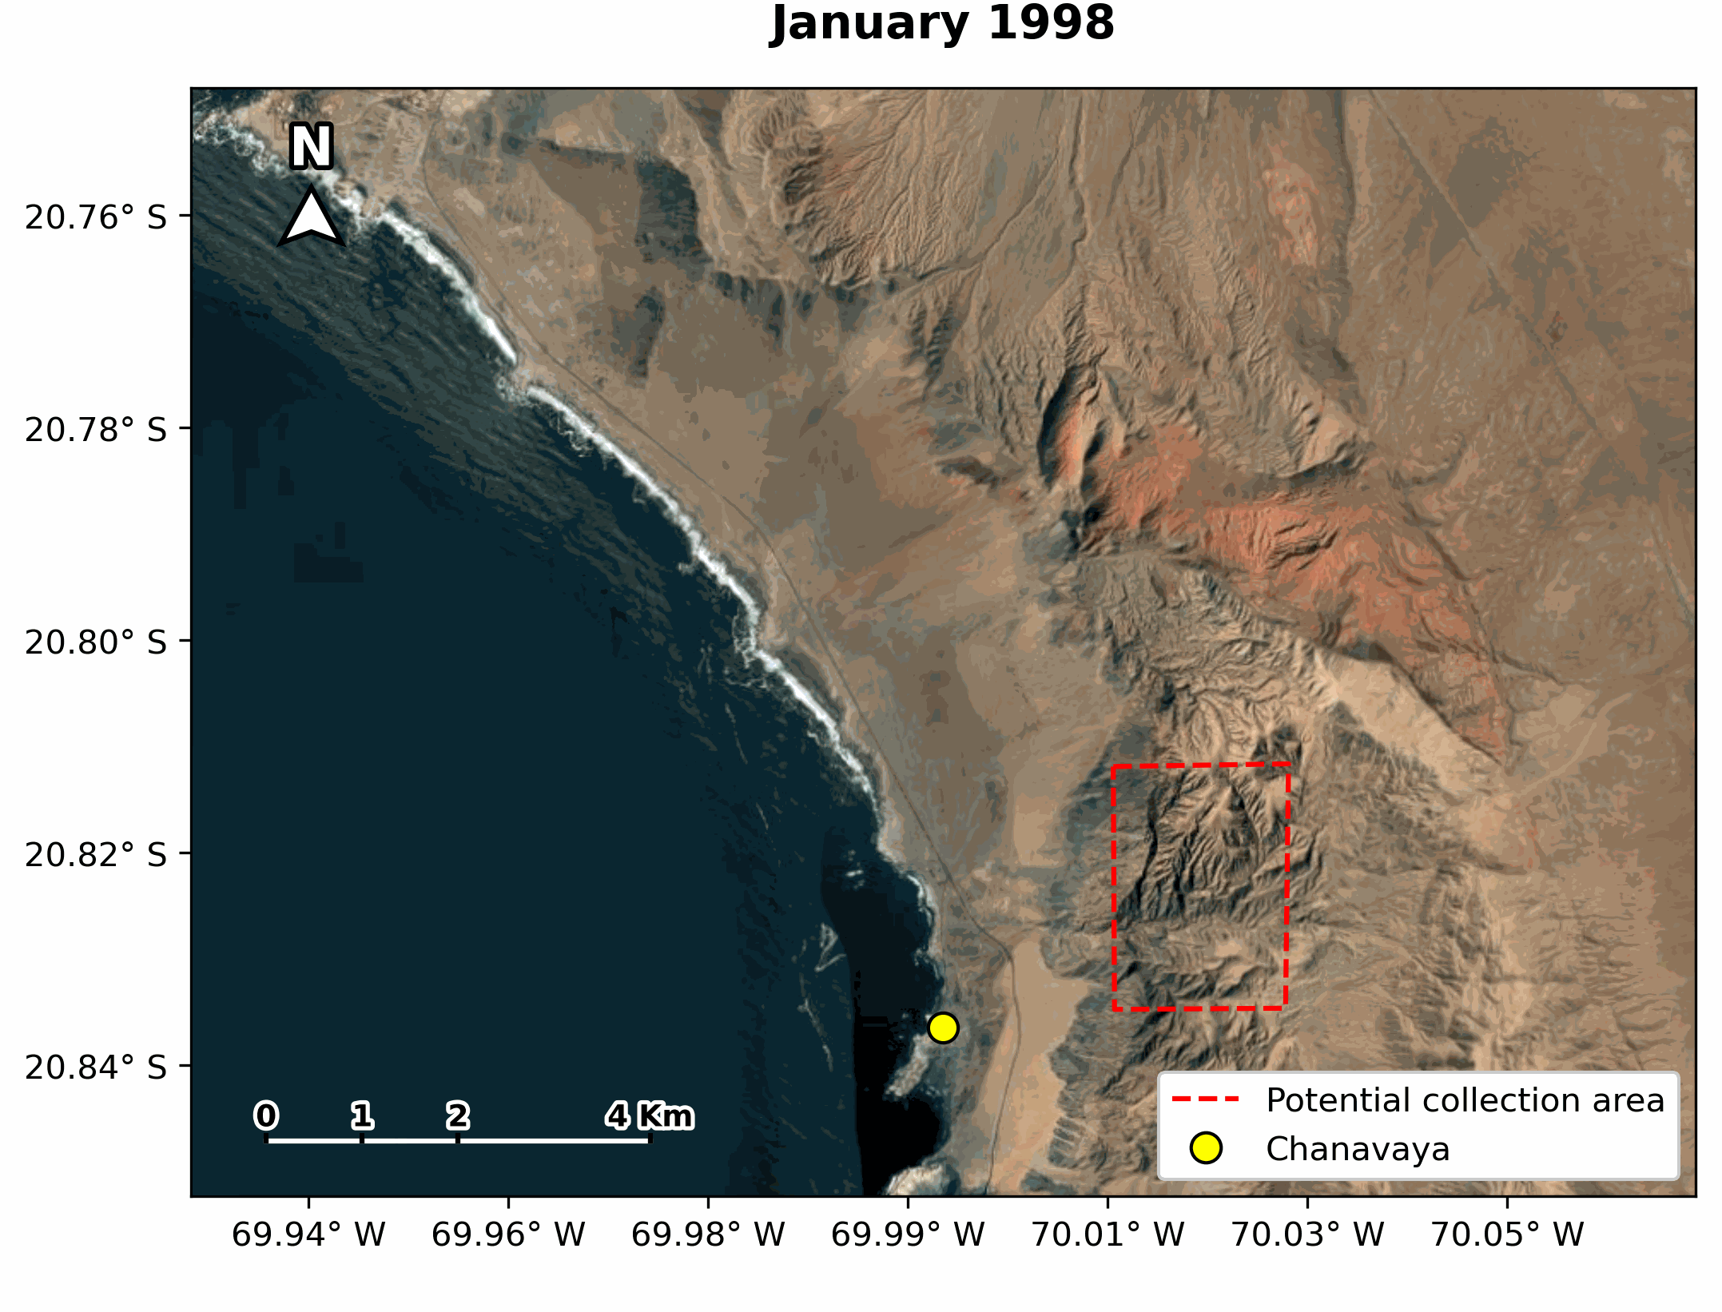


POTENCIAL OF FOG COLLECTION
SUPERAVIT
MEAN
DEFICIT

Slide 10
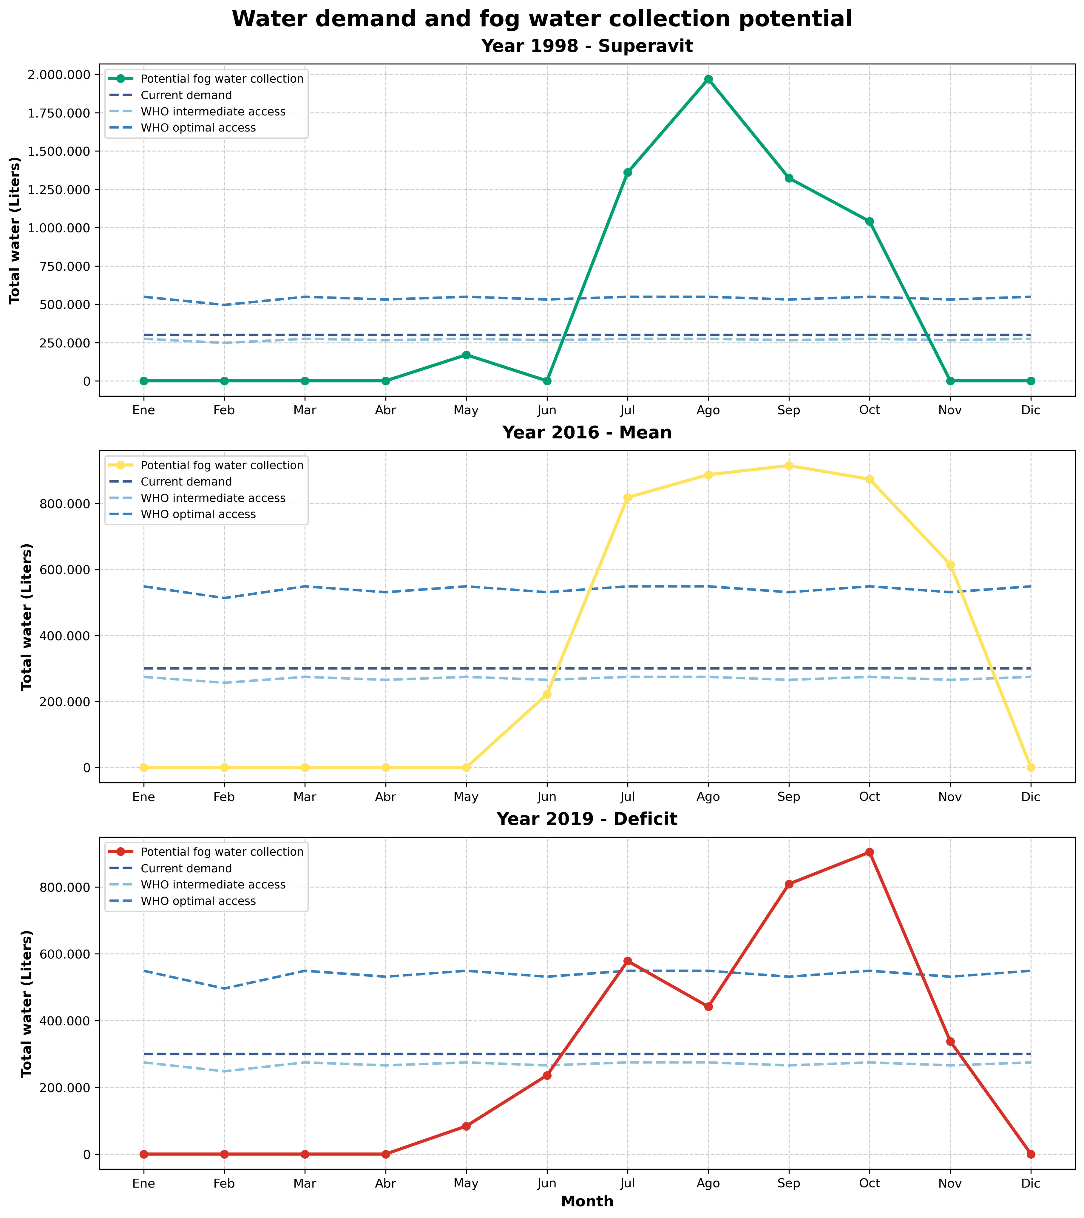
POTENCIAL OF FOG WATER COLLECTION AND WATER DEMAND

Slide 11
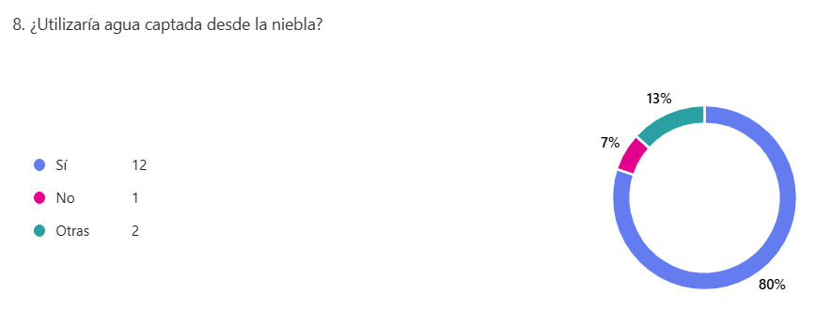
USES AND LOCAL PERCEPTION OF FOG WATER
Activities carried out using the actual water received
Activities that are not carried out or are carried out less frequently
Sanitation
Human consumption
Plant irrigation
Animal feed
Economic / productive activities
Laundry
Use of sanitary facilities (shower and toilet)
They have no plants or water them less
Yes
Would you use water collected from fog?
15 surveys
No
Depend

Slide 12







USES AND LOCAL PERCEPTION OF FOG WATER
Willingness to pay for fog water
What would people do if they had more water?
The same or less tan what you currently pay
~ 3 euros
~ 4 USD
around per $m^{3}$
It would be a problem due to a lack of storage
They don’t need more water

Slide 13
FUTURE CHALLENGES
Economic feasibility of fog water harvesting in the area
Fog water storage capacity
Governance in fog water management

