Slide 1
Investigating nuclear events and vector borne disease risk through atmospheric dispersion modelling with HYSPLIT
EGU2026 – Supplementary Material
Samuel McKeague, Klara Finkele, Saji Varghese

Slide 2
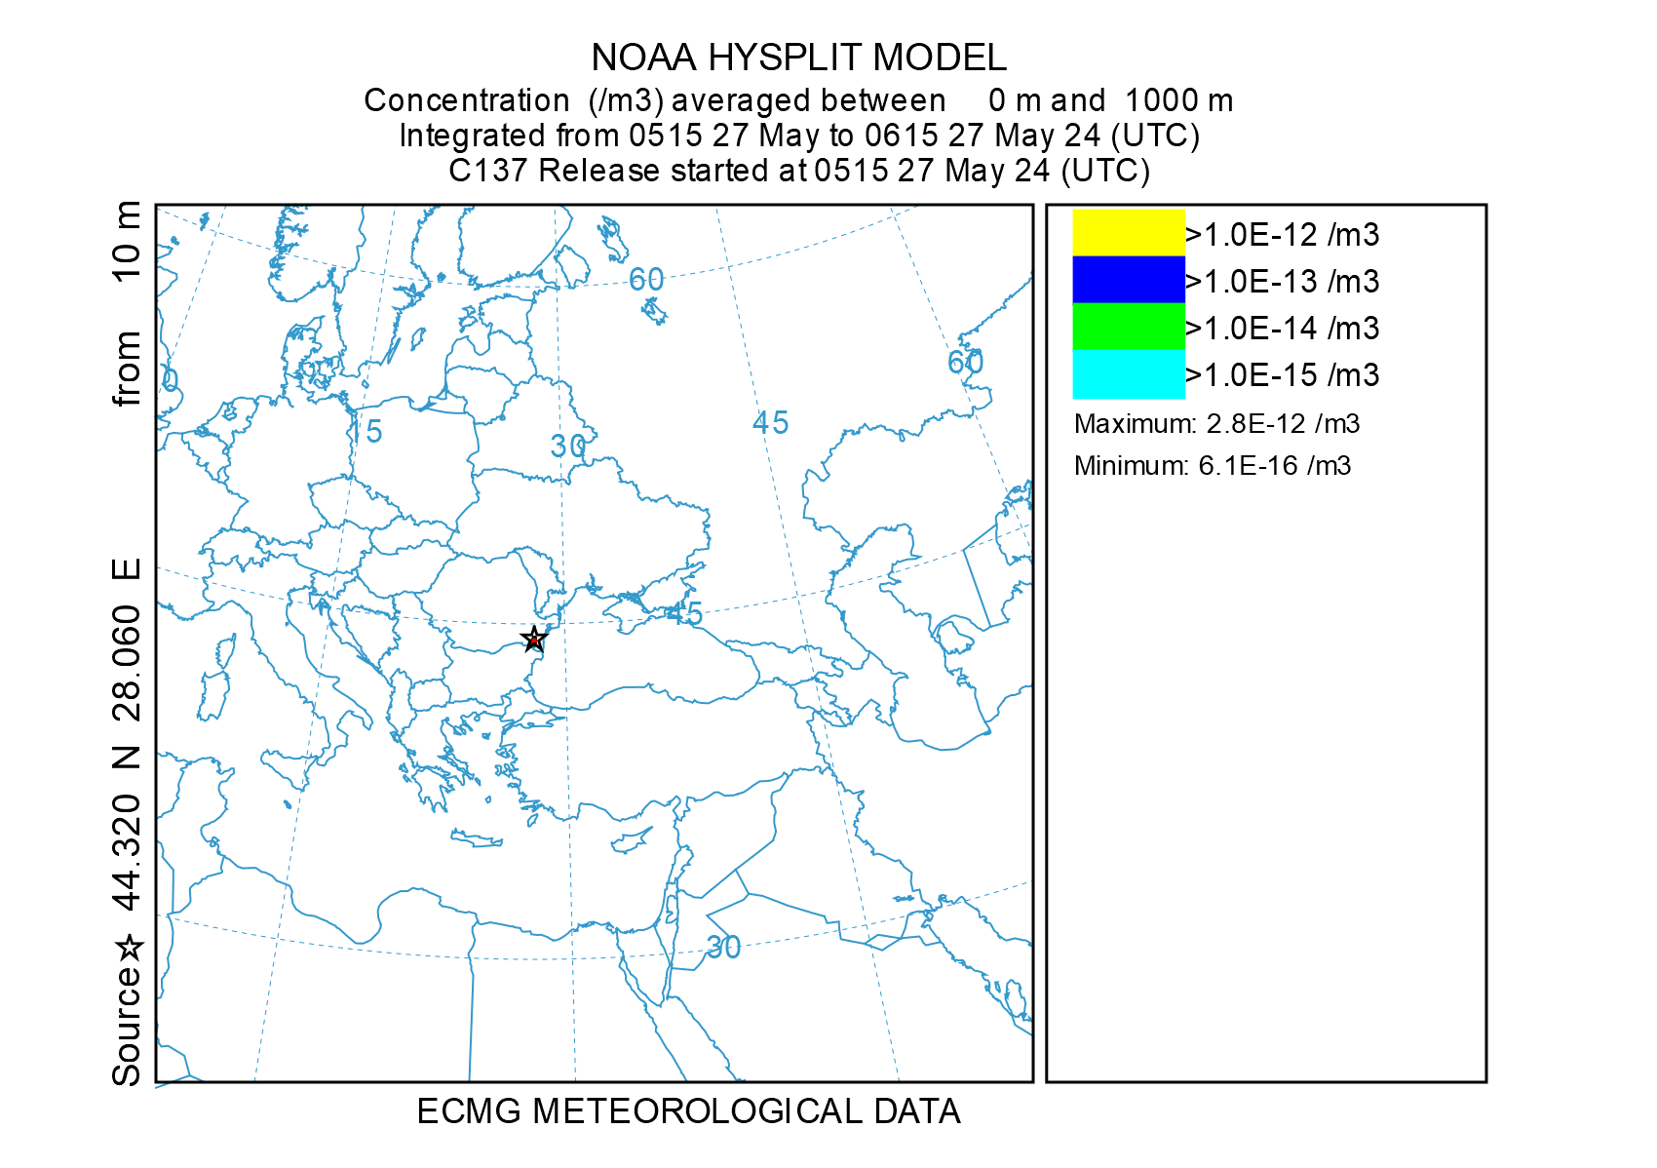
ConvEx-3 Preliminary Dispersion
The following HYSPLIT simulations model the potential emission from Cernavoda beginning at 05:15 UTC today.
The dispersion pollutant uses HYSPLIT’s pre-configuration for Caesium-137.
Release is currently believed to be ongoing, however rate of emission is unknown and will be given a unit value.
Hourly concentration over 48 hours from ConvEx-3 (Day 1).

Slide 3
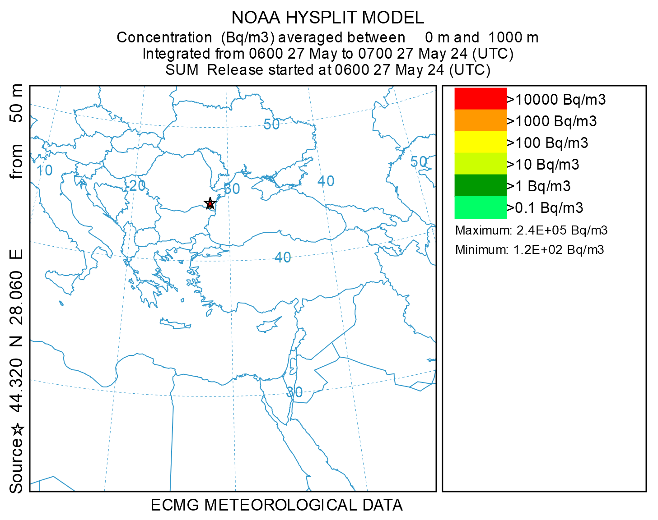
ConvEx-3 Day 1 Final Model
The following HYSPLIT simulations model the potential emission from Cernavoda beginning at 06:00 UTC yesterday (27/05/2024).
The dispersion pollutant is primarily Xe-135 for the Noble gas release with the I-131p and Cs-137 pre-config from HYSPLIT.
Release height set at 50 m.
Total release of 8.42E+17 Bq is done over a 9-hour duration.
Noble gas (Xe-135): 8.35E+17 Bq
Iodines (I-131p): 4.74E+15 Bq
Other (Cs-137): 2.22E+15 Bq
Hourly concentration over 72 hours from ConvEx-3 (Day 1).

Slide 4
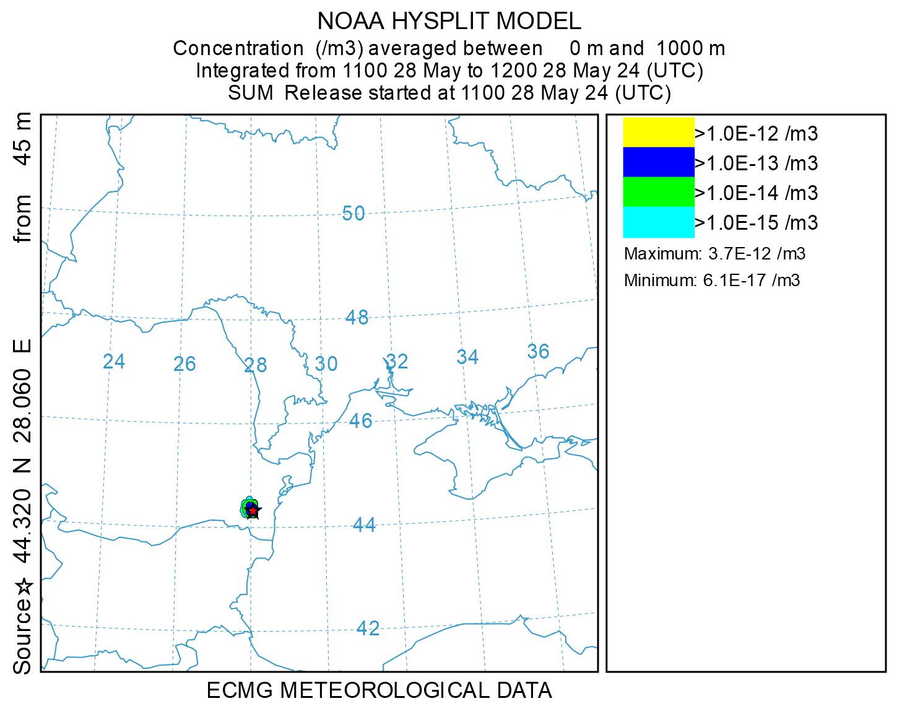
ConvEx-3 Day 2 Dispersion
The following HYSPLIT simulations model the additional emission from Cernavoda beginning at 11:00 UTC today (28/05/2024).
The release rate is unknown and so the HYSPLIT pre-config for Cs-137 is used as the pollutant.
Release height set at 45 m.
Emission rate is taken as unit value and duration is for 3 hours.
Hourly concentration over 48 hours from ConvEx-3 (Day 2).

Slide 5
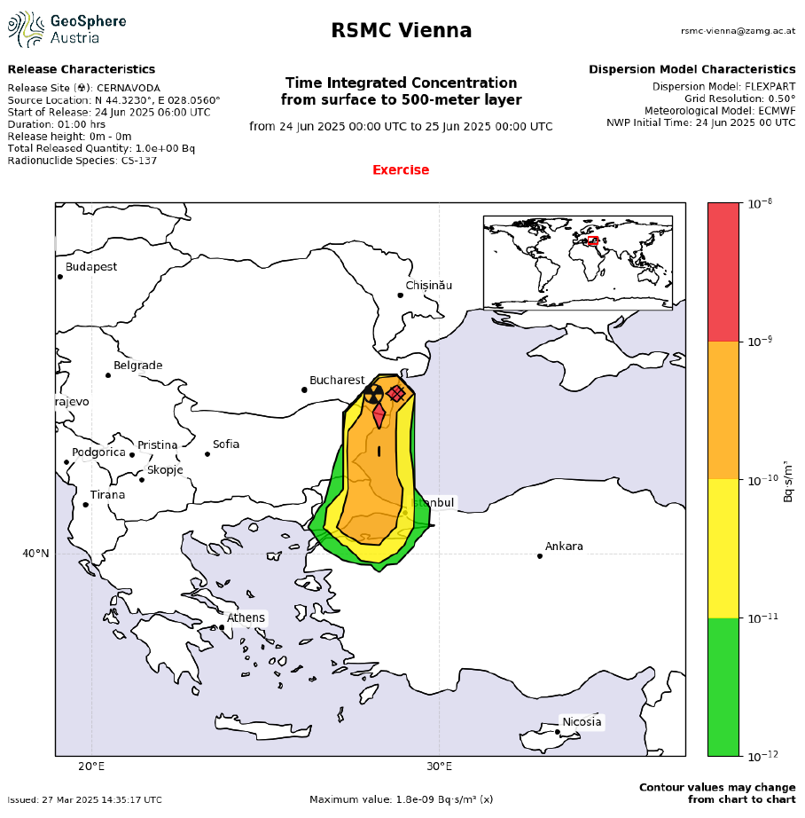
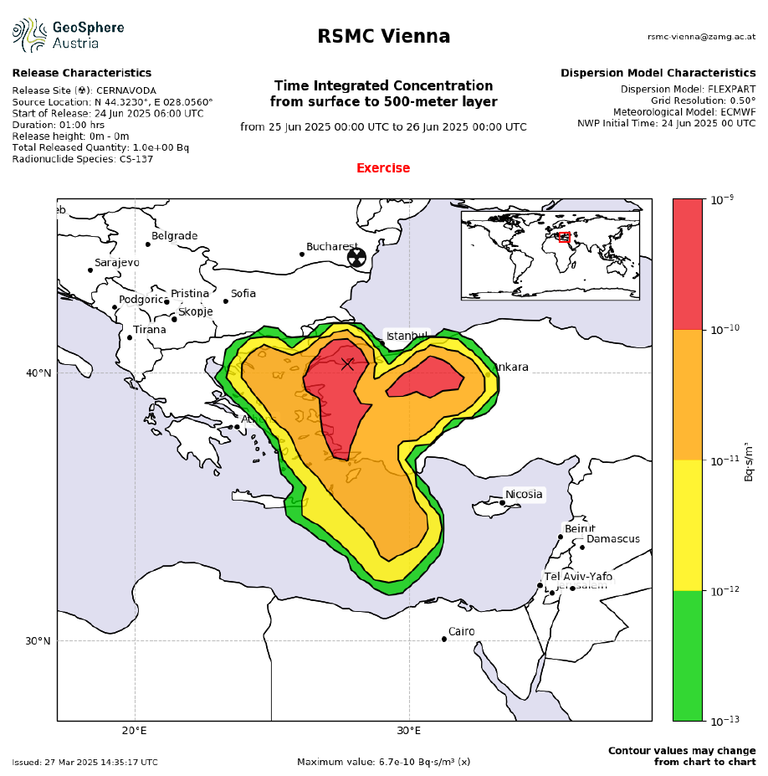
WMO ConvEx-3 Modelling
The World Meteorological Organization (WMO) Regional Specialized Meteorological Centres (RSMCs) prepared global radiation monitoring data (model calculations) based on historical (27 May 2024) meteorological conditions that were chosen to represent weather conditions at the time of the exercise.
The following model calculations were prepared for Radionuclides air concentrations (0-500m).
Global radiation monitoring data assumptions
# | Time of release |  |  | Radioisotopes | Total amount released | Effective height of release
 | Start | End | Duration
1 | 06:00 UTC | 07:00 UTC | 1 hour | Cs-137 | 1 Bq | 0 m (surface)
Examples of Cs-137 time integrated concentrations for Day 1 (top) and Day 2 (bottom).

Slide 6
BTV “Worst-case” Assumptions
The BTV forecast model simulation assumes:
A fixed particle emission rate per hour
3 hours of uniform emission centred at sunrise and sunset
Emission from arbitrary fixed coastal locations
No wet or dry deposition
Particles become extinct 20 hours after emission

Slide 7
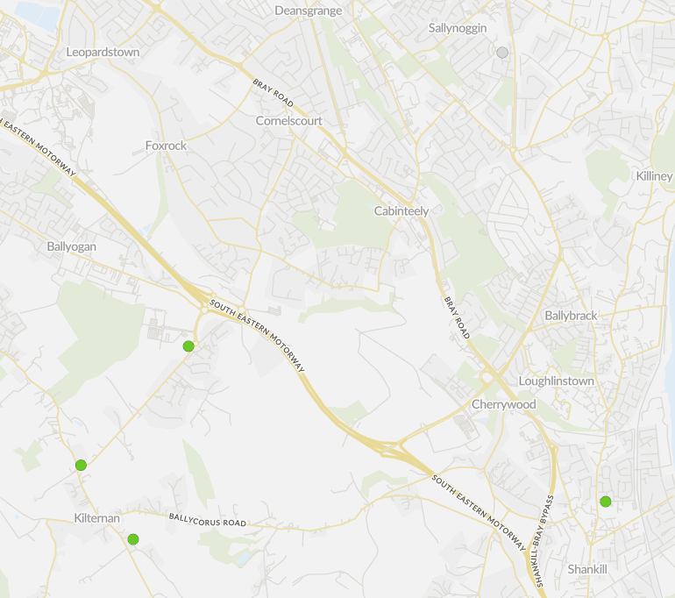
Air Quality Monitoring (AQM)
The Centre for Climate and Air Pollutions Studies (C-CAPS) have an AQM station in Trinity College Botanic Gardens that measured no significant plumes during August 2025.
The EPA’s AirQuality.ie has archival data for a station at Dún Laoighre that measured marginal increases on a couple of days during the fire events, but never beyond the “Good” band.
Dún Laoighre-Rathdown County Council have a local AQM network, data from these stations was provided by request made by Dáithí Kelleghan.
Hourly and unaveraged data for 5 stations in proximity from Ticknick Park was provided (all <5 km).
NE
NW
W
E
WSW

Slide 8
NE
NW
W
E
WSW

Slide 10
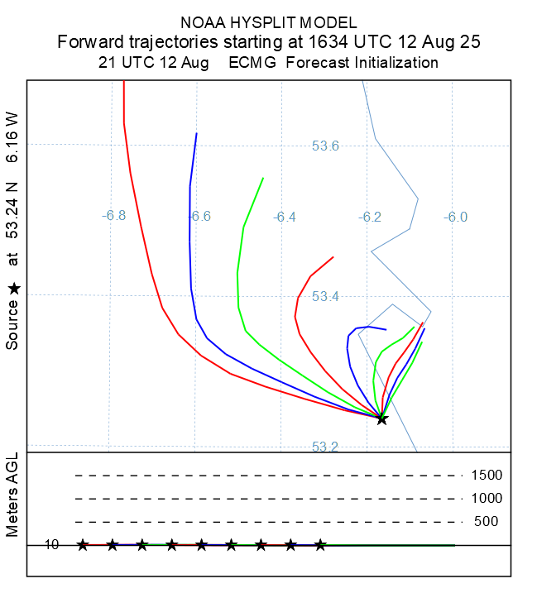
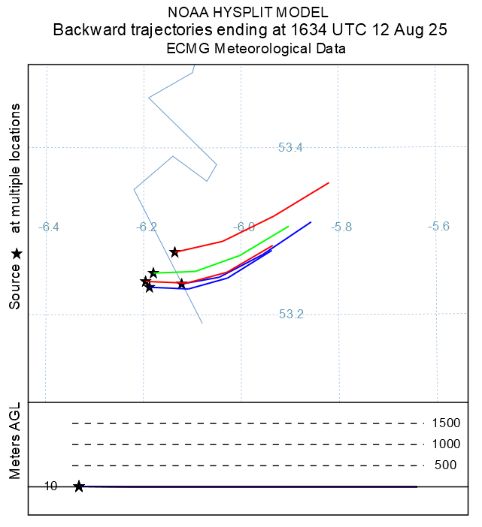
Forward & Backward Trajectories

Slide 11
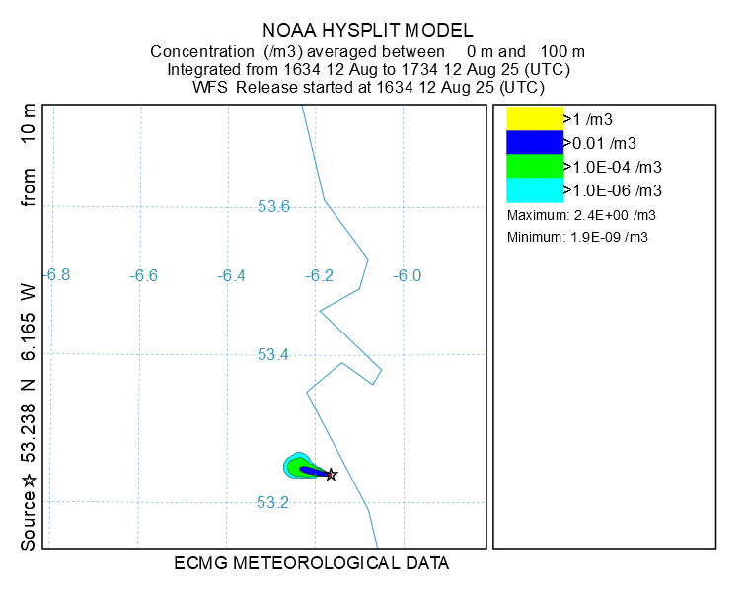
Concentrations
Concentration calculations were made with a horizontal Gaussian puff and vertical particle setup.
Due to the highly localised nature of the event, high resolution grid spacing was found to be needed to get meaningful simulation results (0.002° x 0.002°).
Generally seemed to be reasonable agreement with direction of plumes and increased PM_{2.5} monitoring, but difficult to accurately match concentration values.
Increased deposition values may account for lack of monitoring readings at ~10 km away.

Slide 12
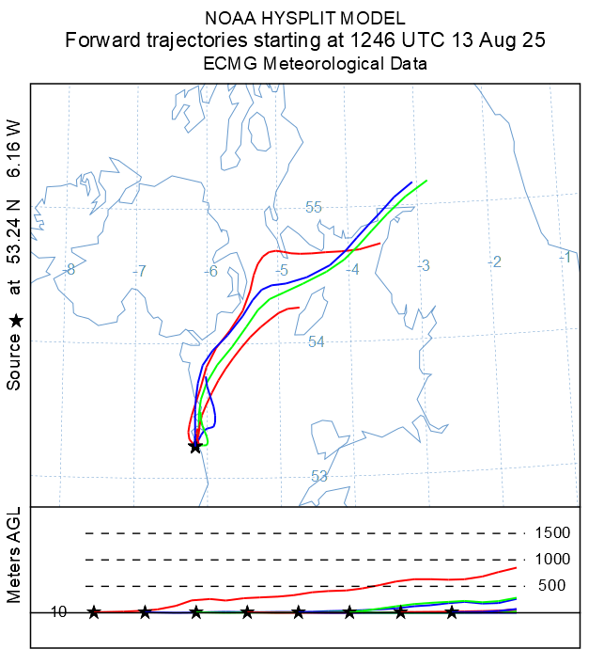
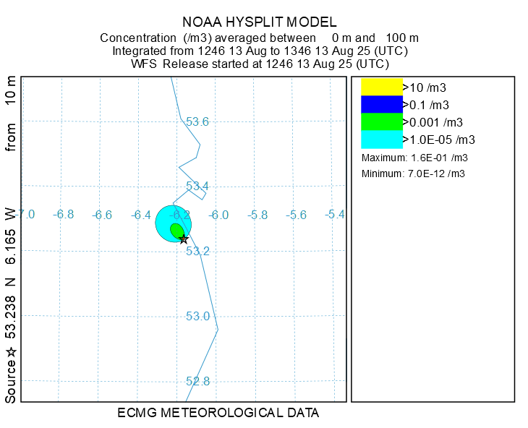
Plume 2025-08-13

Slide 13
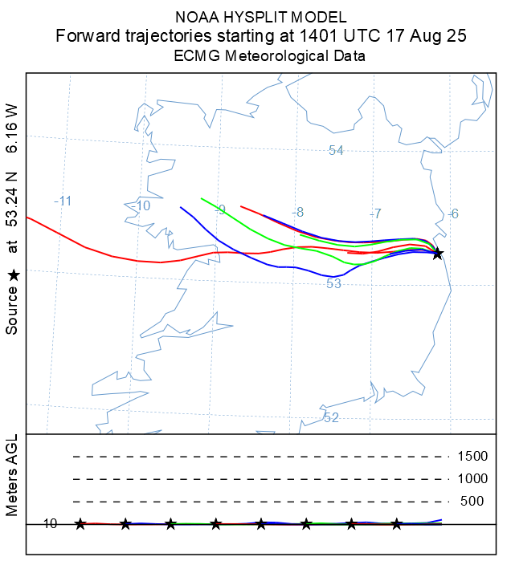
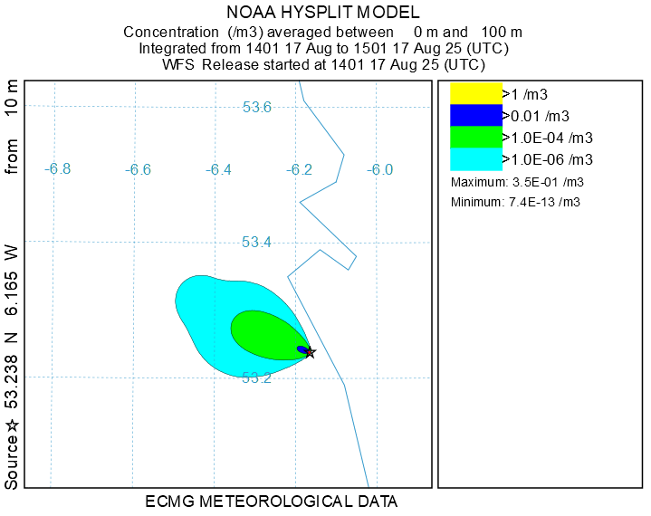
Plume 2025-08-17

Slide 14
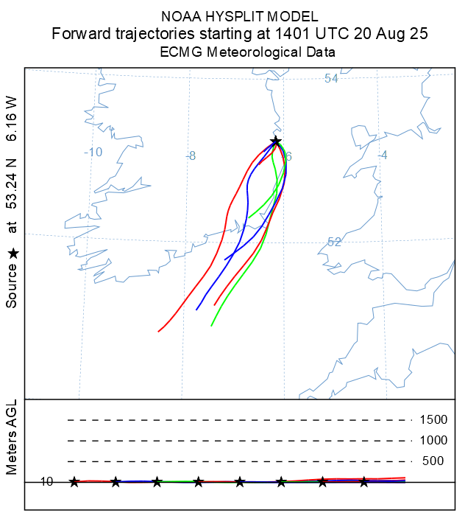
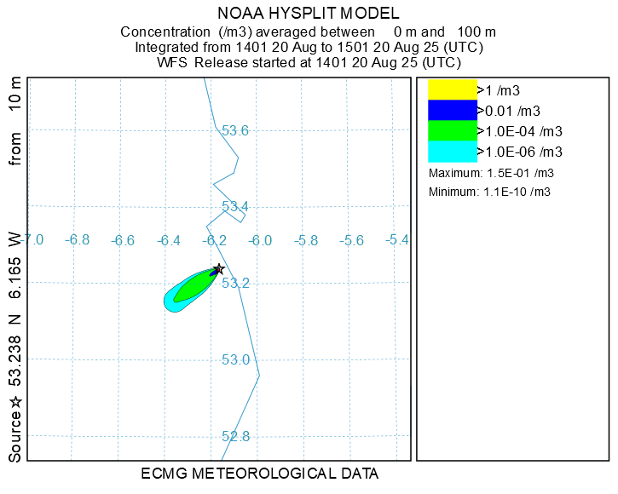
Plume 2025-08-20

Slide 15
Future Plans and Developments
Implementation of source term ensembles for an emergency scenario system where details of an incident may be unknown, like in the case of an initial nuclear disaster.
Testing ensemble data inputs with ECMWF IFS Ensemble to provide a more complete statistical dispersion forecast, similar to the weather forecast.
The shared expertise of the User Group will assist in expanding the products and systems to other pollutants by discussion of source term characteristics, as has already started after the User Group exercise and the discussion of how to paramterise PM2.5 for dispersion modelling.
Examples of other pollutants to develop operational models for include:
Pollen and Spores,
Volcanic Ash,
Saharan Dust.

