Slide 1
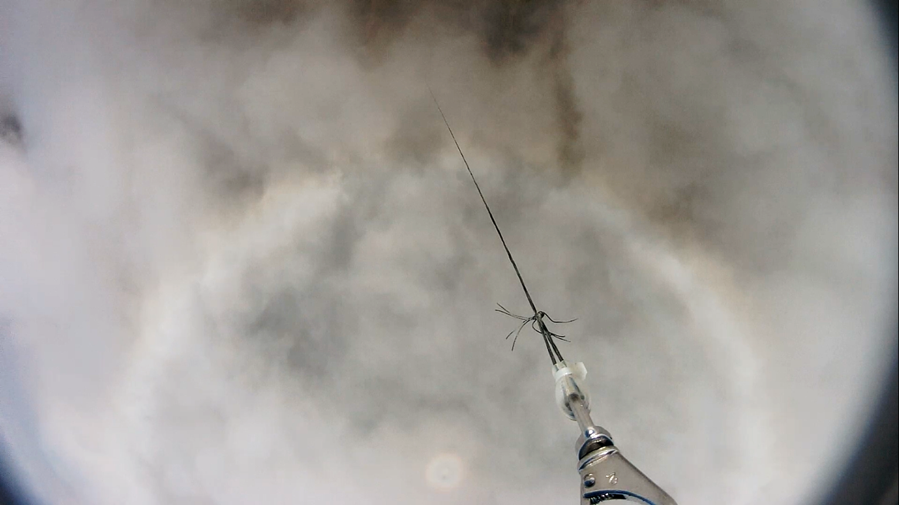





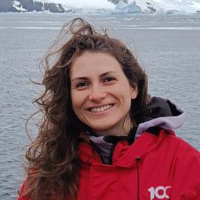









Vertical profiling of airborne microbial communities across the atmospheric boundary layer
VOTE FOR OSPP
Sofía Galbán¹, Ana Justel², Sergi González³, Tamara Pletzer⁴, Pablo Sanz⁵, Manuel Bañón⁶, Juan Antonio Higuera⁷, Javier Méndez⁸, Woo Young Kim⁹, Antonio Quesada¹
¹Department of Biology, Universidad Autónoma de Madrid, Spain.
²Department of Mathematics, Universidad Autónoma de Madrid, Spain.
³WSL Institute for Snow and Avalanche Research SLF, Davos, Swiss.
⁴School of Earth and Environment, University of Canterbury, New Zealand
⁵Centro de Computación Científica, Universidad Autónoma de Madrid, Spain.
⁶Spanish National Meteorological Agency (AEMET), Spain.
⁷General Services Supporting Experimental Research (SEGAINVEX), Spain.
⁸Instituto de Ciencia de Materiales de Madrid, Spain.
⁹Department of Mechanical Engineering, Hanyang University, Republic of Korea.
AKNOWLEDGEMENTS
Funded by the Spanish State Research Agency (AEI, PID2020-116520RB-I00). Sofía Galbán was supported by a PIPF fellowship (PIPF-2022/ECO-25833) from the Community of Madrid. Additional support came from a PEJ fellowship (PEJ-2024-AI/COM-32565) funded by the Community of Madrid and co-funded by the European Union.
CONTACT
sofia.galban@uam.es
Department of Biology
Universidad Autónoma de Madrid

Slide 2
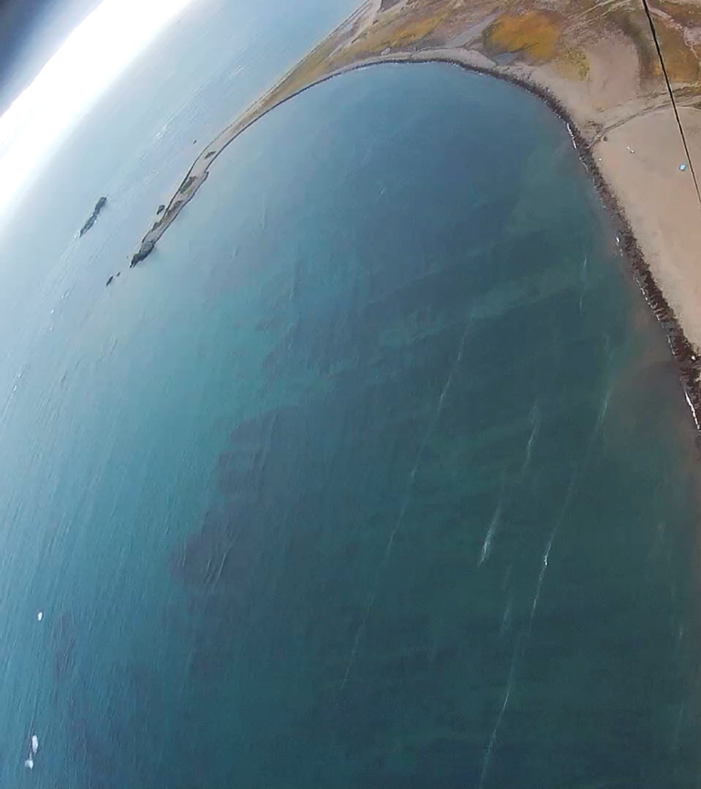
BYERS PENINSULA
Why does it matter? Characteristics that make it suitable for studying the microbial vertical profile:
Simple ABL structure due to minimal local orographic effects: low elevation, gentle topography, horizontal relief homogeneity and limited surface roughness
ASPA No. 126: mosaic of diverse terrestrial and freshwater ecosystems under minimal human impact
ABL similar to summer MABL Southern Ocean due to its costal location and small landmass (84.7 km²)
Preprint coming soon
Climate change framework: high connectivity with South America and high climate sensitivity

Slide 3
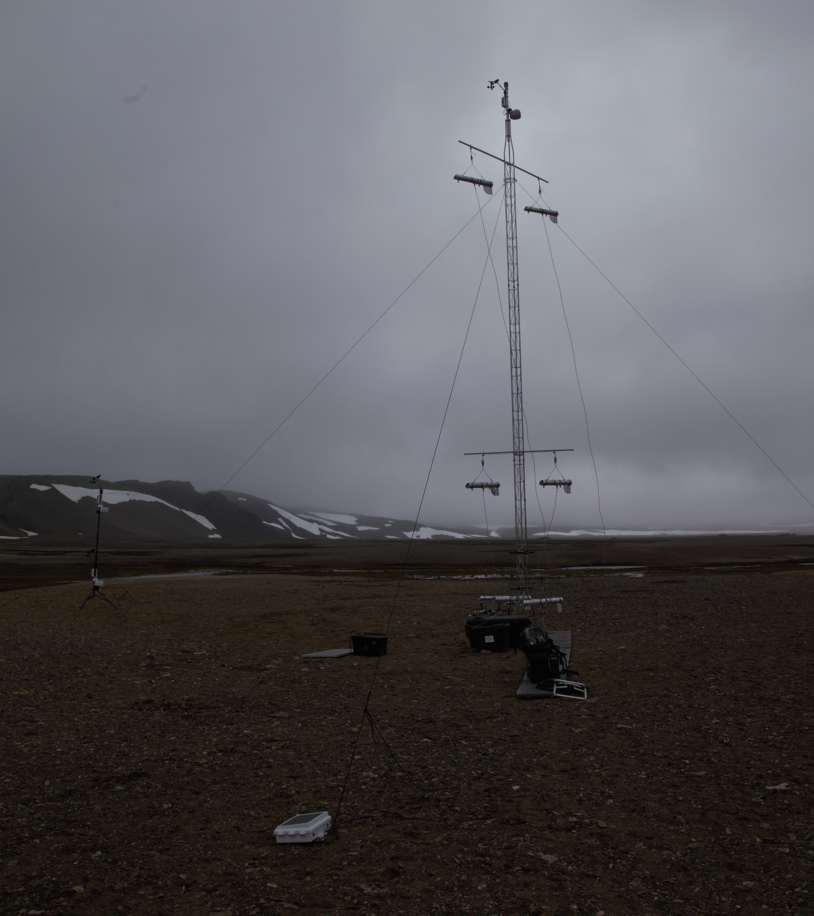
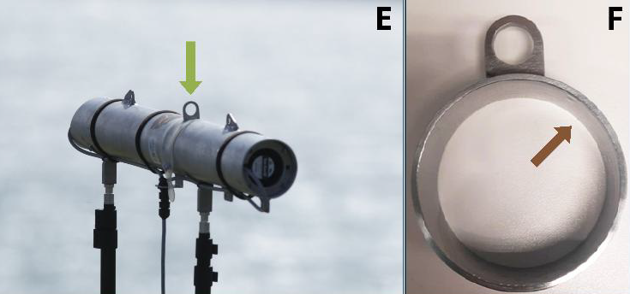
SAMPLING DETAILS
Tower and ballon samplings performed simultaneously for 6h at ~0.765 m³/min, only at target height (no ascent/descent), under aseptic field conditions.
Negative controls:
Unopened Vaseline-coated support to confirm preparation sterility
Vaseline-coated support placed in the collector at each height without active sampling to verify collector decontamination and handling procedures.
A
B
Preprint coming soon
Airborne aerosol collector (A) and sample holder with sterile Vaseline inside (B)
For more detail see Parro et al. (2025)

Slide 4
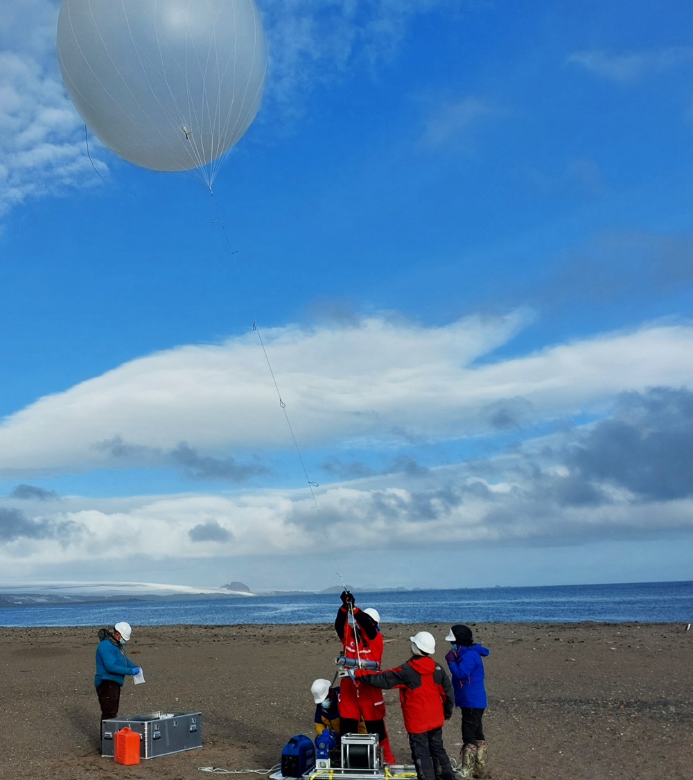
BIOLOGICAL PROCESSING
AMPLIFICATION & SEQUENCING
Illumina MiSeq paired-end sequencing (Microomics, Spain)
Primers:
Bacteria: 341F-805R (16S rRNA, V3-V4)
Eukaryota: 1391F-EukBr (18S rRNA, V9)
PCR negative controls included
Reads processed into ASVs, contamination filtered and taxonomically assigned against SILVA v138.2
EPIFLUORESCENCE MICROSCOPY
SYBR Green I (final concentration 1×)
Microbial abundance estimated from the mean count of 100 random fields at 1000× magnification, expressed as cells/m³ air.
Classified by size (<5 µm, 5–20 µm, >20 µm) and morphotype (coccoid, filamentous). For more detail see Galbán et al. (2021)
Preprint coming soon

