Slide 1

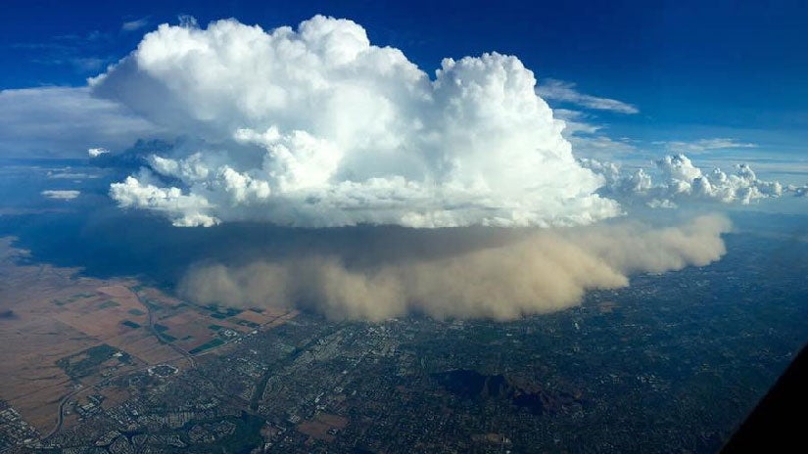

The impact of grid resolution on global dust emission potential
Pascal Kunze
Bernd Heinold, Ina Tegen
https://s.w-x.co/cqfu6h3xeaaztsr.jpg
Notes:
2 Min pico:
1. haboobs als kleiskaliges phänomän
2. hoch auflösned modelieren wichtig
3. DUP
4. Regionen
lets discuss

Slide 2
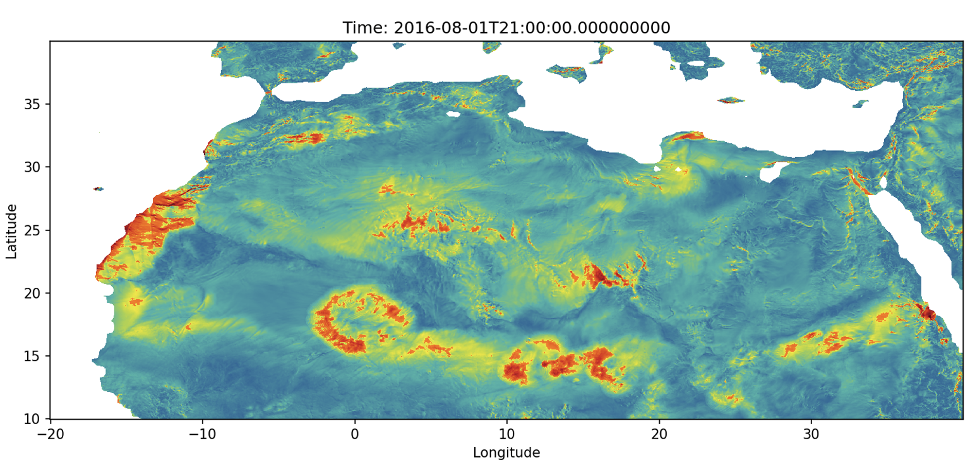
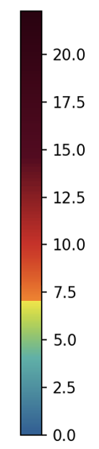
The impact of grid resolution
ICON
Wind speed [m s⁻¹]
Threshold for dust emission: 7 m s⁻¹
Haboobs?

Slide 3
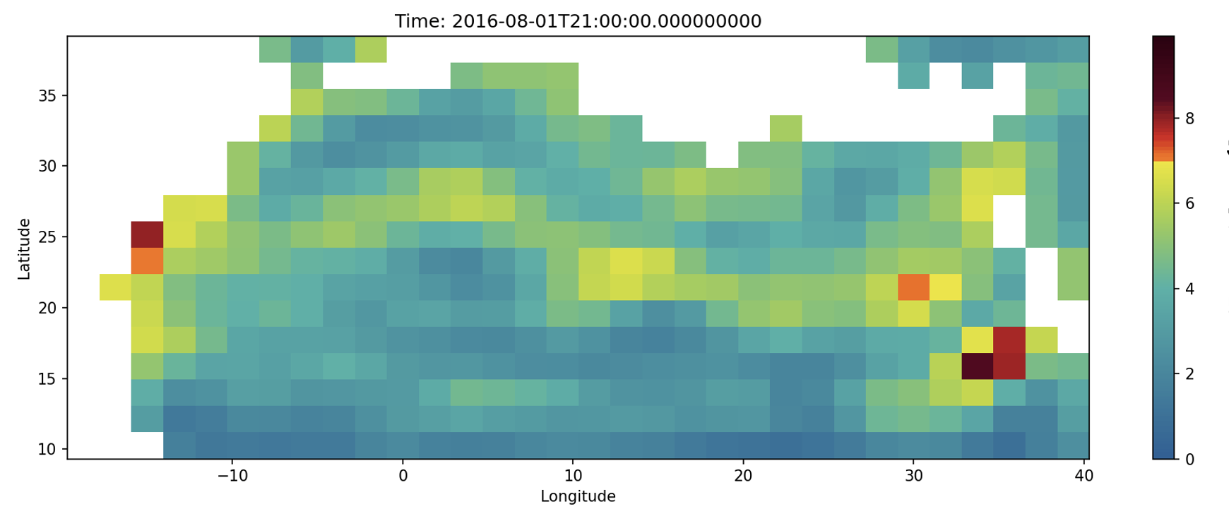
The impact of grid resolution
CMIP-6
Wind speed [m s⁻¹]
Haboobs?

Slide 4
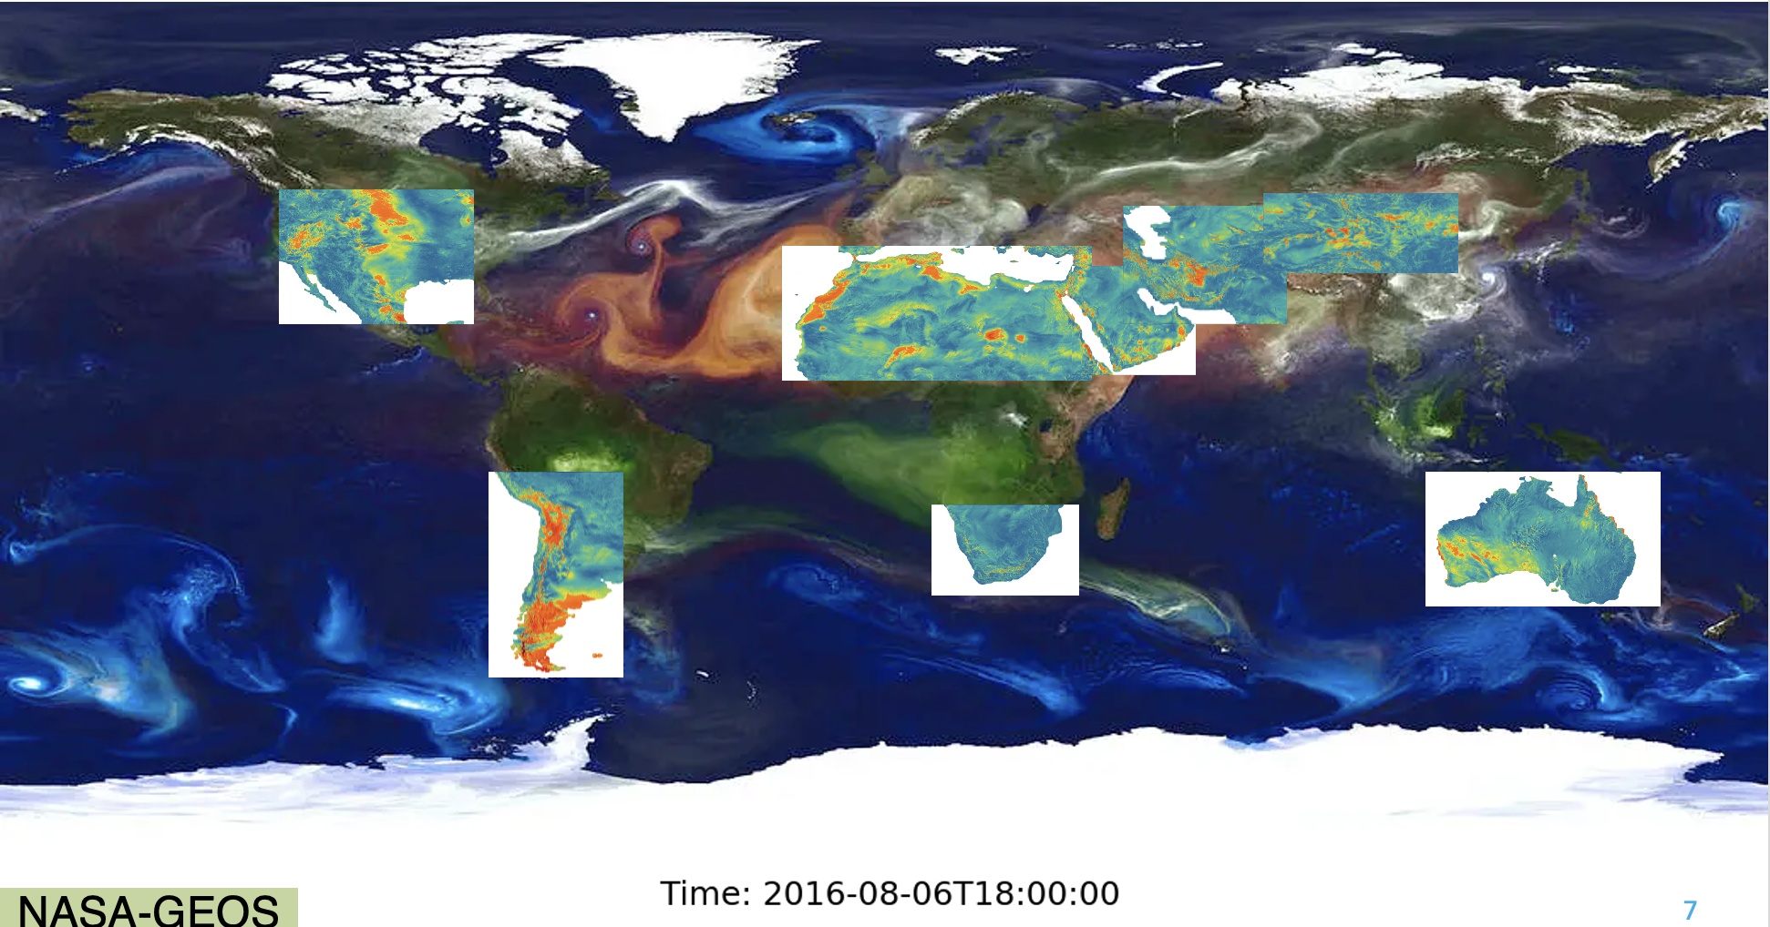
Global dust source regions

Slide 5
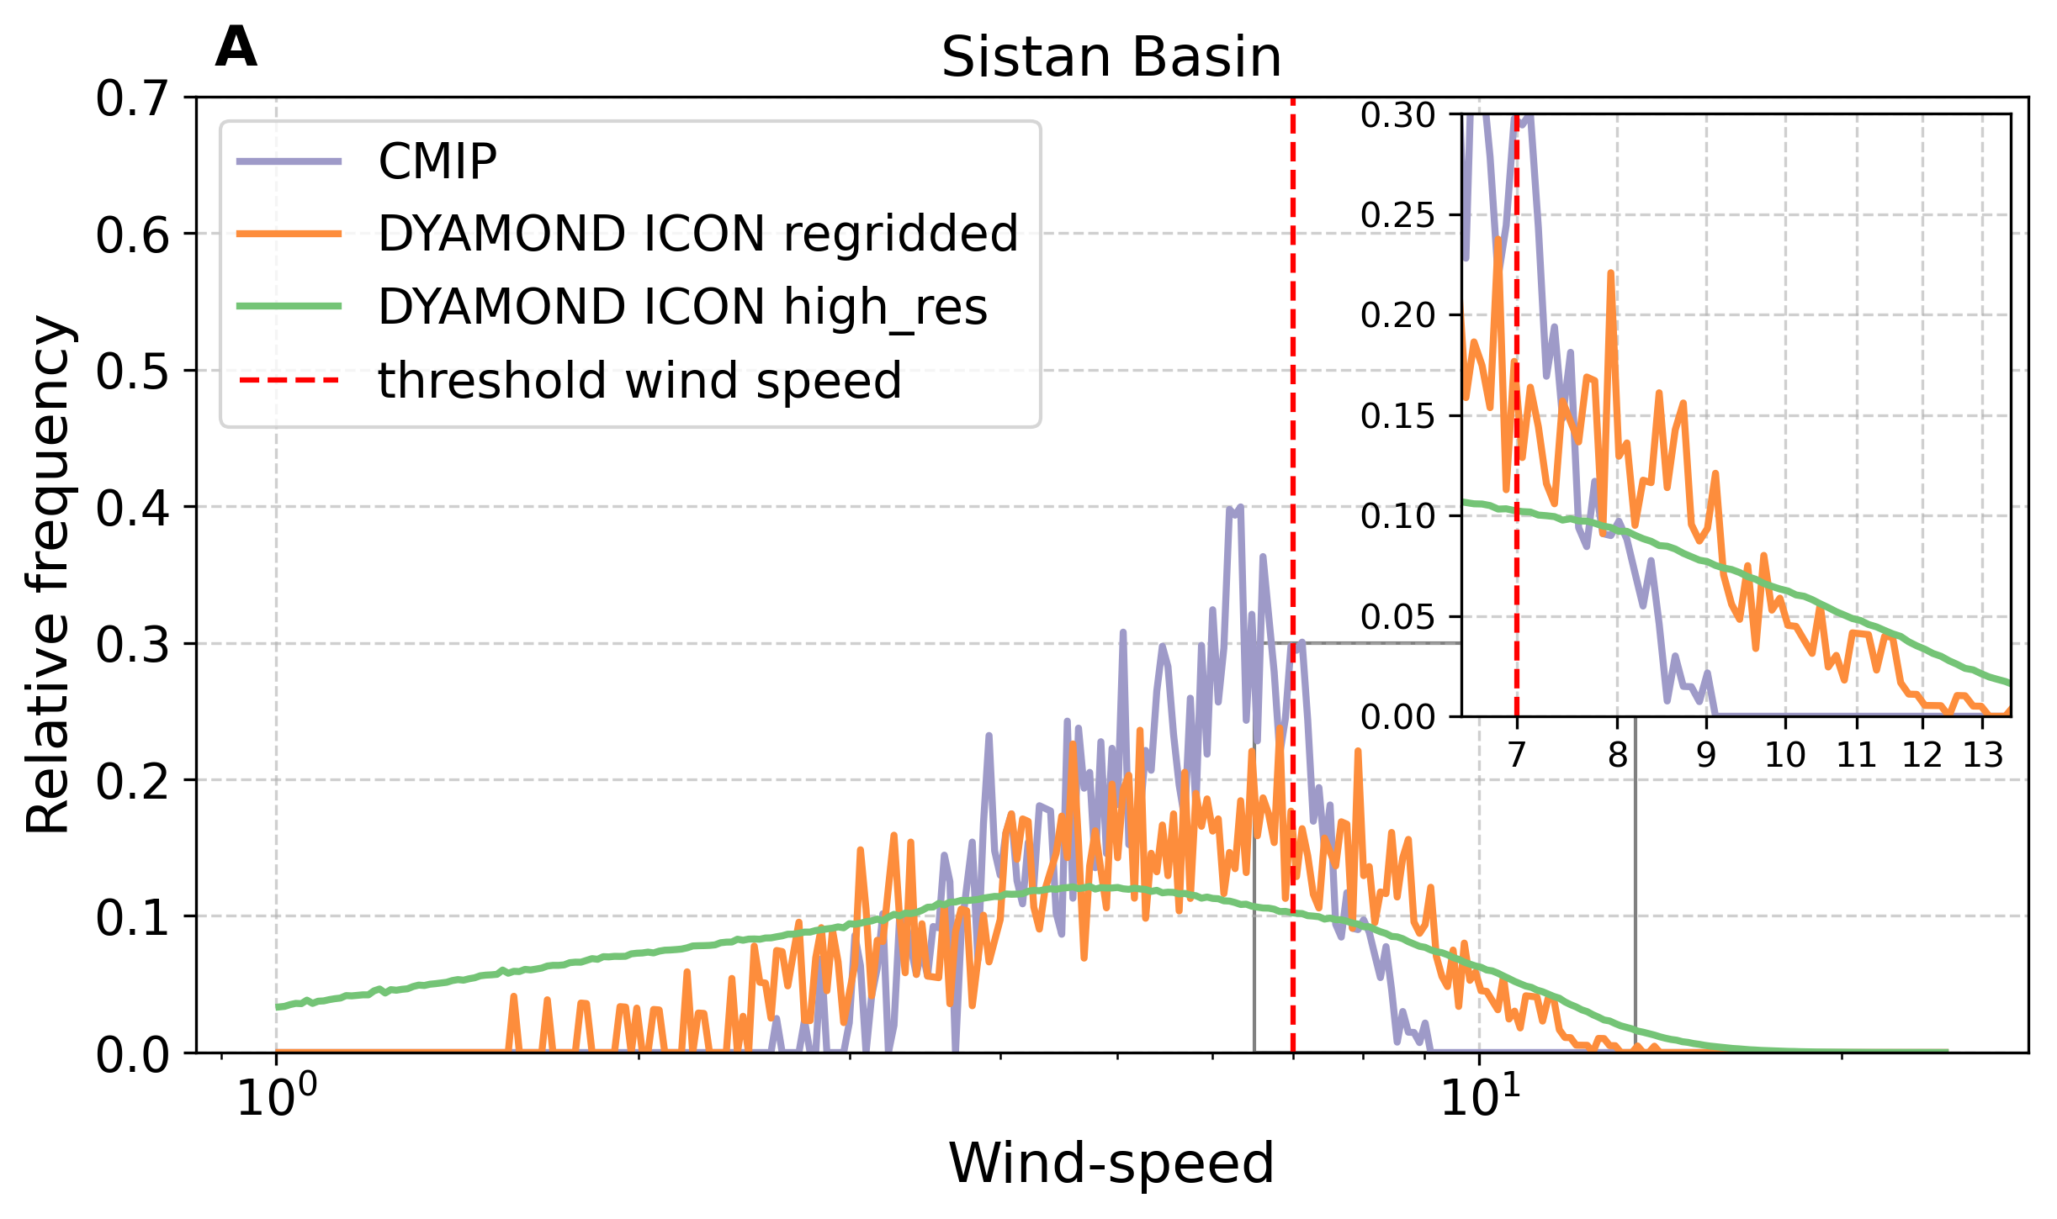
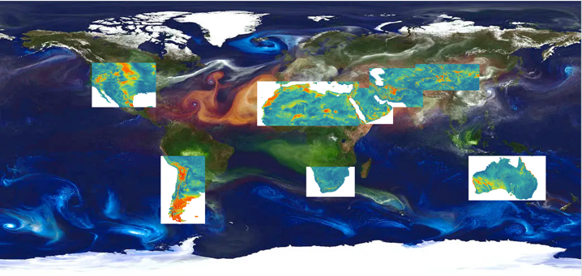
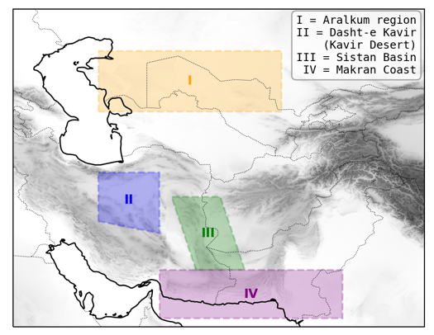
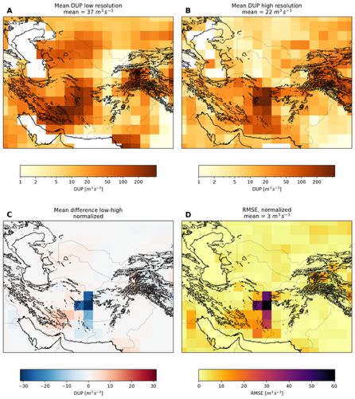
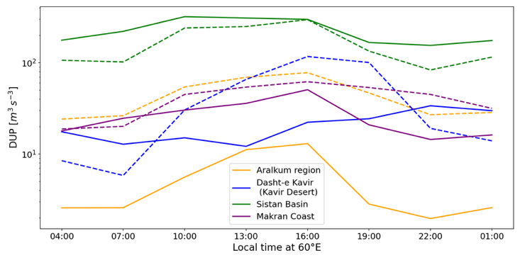
LET‘S DISCUSS AT PICO-SPOT 5.6!

Slide 6
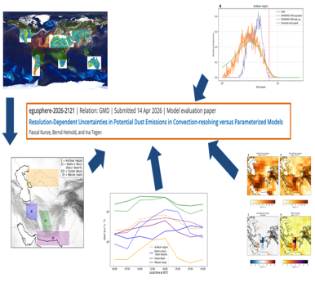

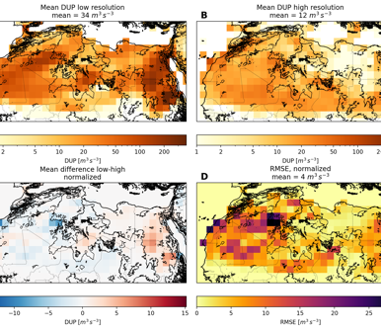
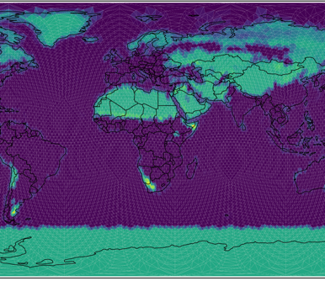
The impact of grid resolution on global dust emission potential
Pascal Kunze
Bernd Heinold, Ina Tegen
Conclusion
Motivation
Results
Models &
Methods
Notes:
2 Min pico:
1. haboobs als kleiskaliges phänomän
2. hoch auflösned modelieren wichtig
3. DUP
4. Regionen
lets discuss

Slide 7
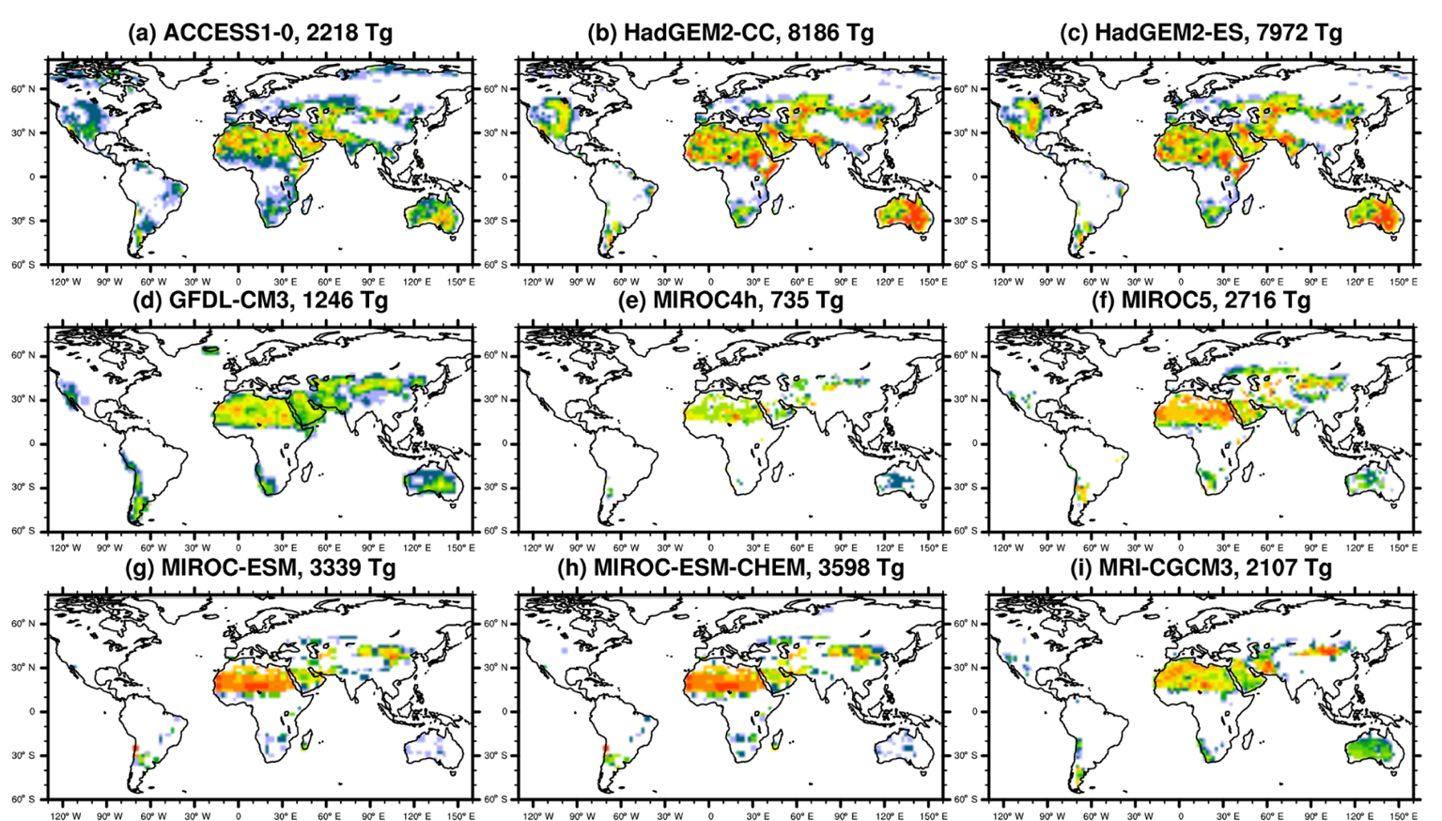

How do models perform?
CMIP-5 – coarse resolution ensemble data
Huge differences between models
Total emissions differ by an order of magnitude
Also differences in impact of source regions
Wu et al., 2020

Slide 8
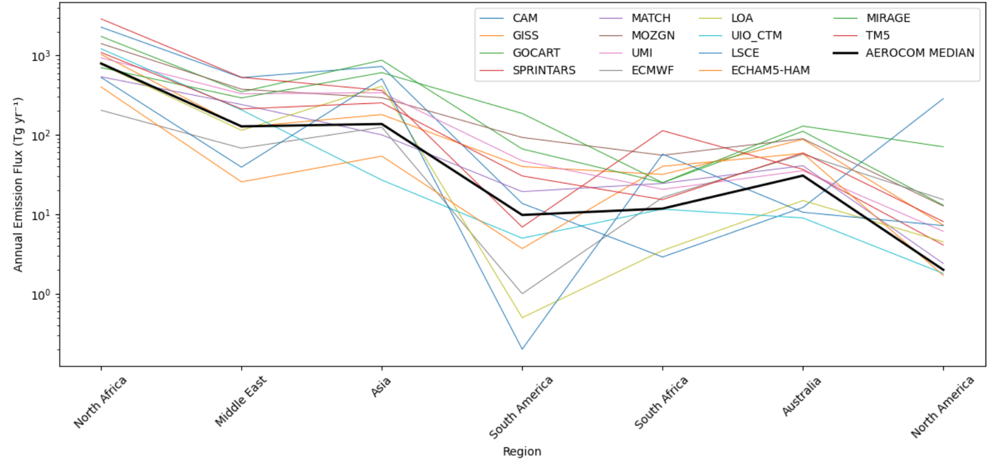
How do models perform?
3000
200
Annual Emission Flux
(Tg year⁻¹)
Global models vary largely in quantity of dust emission
North
Africa
Middle
East
Asia
South
America
South
Africa
North
America
Australia
with data from Hunneus et al., 2010

Slide 9
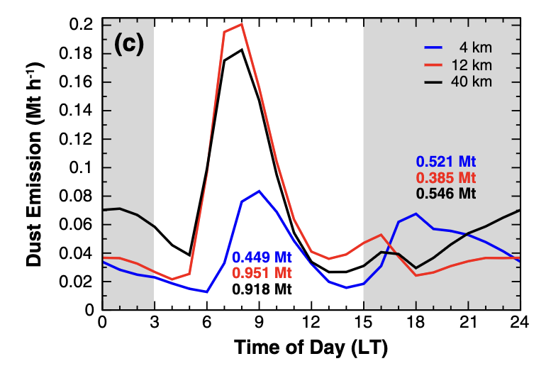
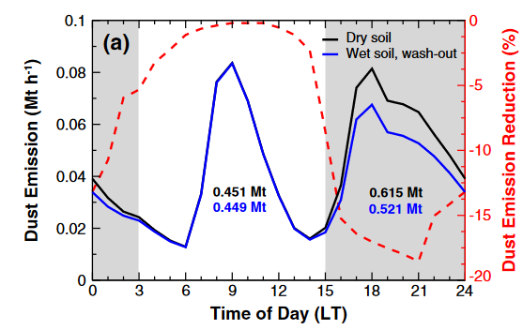
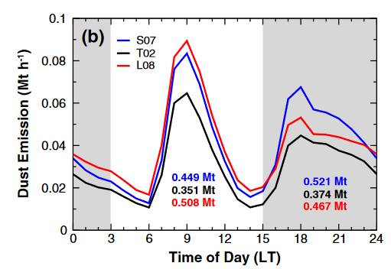
Heinold et al, 2013
What drives the model uncertainties?
Tegen et al. 2002
Grid-resolution
Soil moisture
Dry soil
Land-surface
parameterization
Convection resolving
Wet soil
Schepanski et al. 2007
Parameterized convection
Laurent et al. 2006
High sensitivity on model resolution
Model resolution: 50%
Soil moisture: 9-18%
Land parameterization: 25-35%
UK Met Ofﬁce Uniﬁed Model
Notes:
2013 huge effort
Benoit

Slide 10
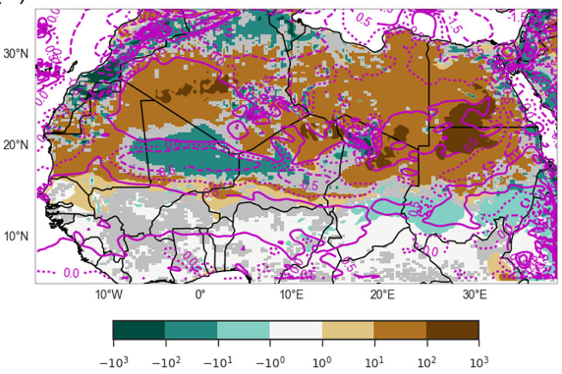
Dust emission in Northern Africa
Garcia-Carreras et al., 2021
Higher values Low resolution (Overestimation):
  Northern regions and Sudan
  Activity of LLJ
Smaller values Low resolution (Underestimation):
  Sahel region → Haboobs
Some regions with diurnal differences
  Overestimation in morning & Underestimation during night
low – high resolution

Slide 11
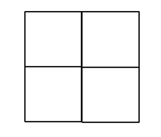
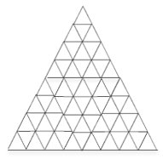
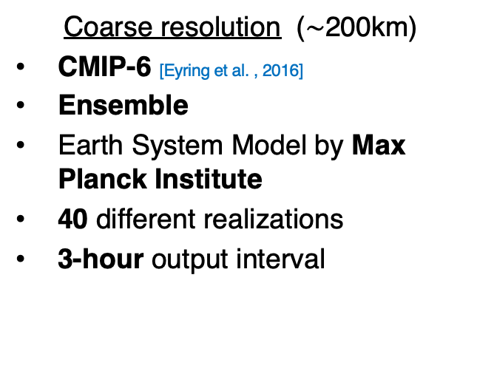
Modeling on different grid sizes
Coarse resolution ($\sim$200km)
CMIP-6 [Eyring et al. , 2016]
Ensemble
Earth System Model by Max Planck Institute
40 different realizations
3-hour output interval
High resolution (2.5km)
DYAMOND-project [Stevens et al. , 2019]
Ensemble of individual models
Summer and winter project (40 days)
ICON-model
Use GEOS as 2nd reference
15-minutes output interval
Data for 08/2016 and 02/2020
Notes:
The Dynamics of the atmospheric general circulation modeled on non-hydrostatic Domains
ran global model high resolution model

Slide 12
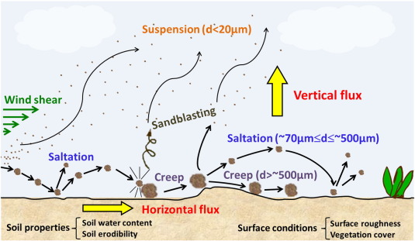
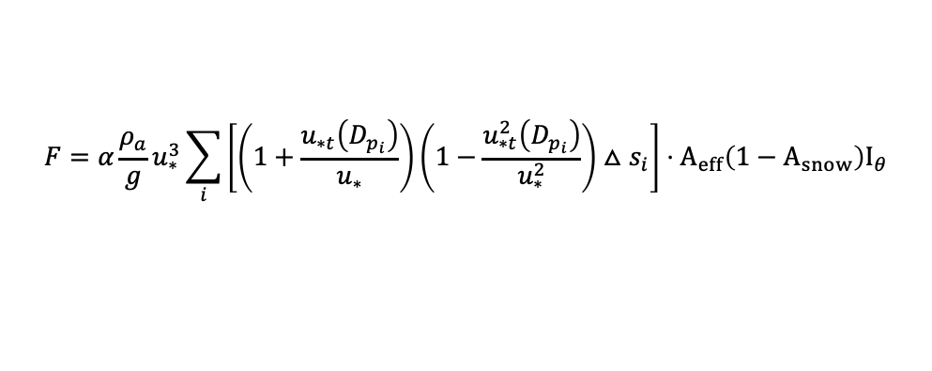

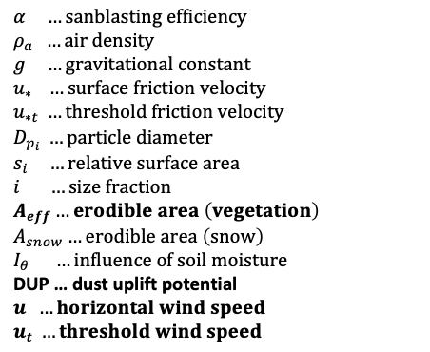
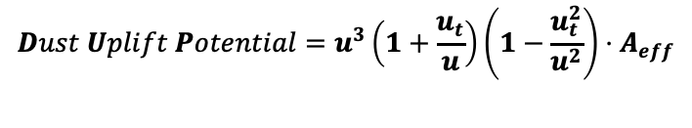
Quantifying dust emissions
$$α …sanblasting efficiency$$
$$ρ_{a} …air density$$
$$g …gravitational constant$$
$$u_{∗} …surface friction velocity$$
$$u_{∗t} …threshold friction velocity$$
$$D_{p_{i}} …particle diameter$$
$$s_{i} …relative surface area$$
$$i …size fraction$$
$$A_{eff}…erodible area \left(vegetation\right)$$
$$A_{snow}…erodible area \left(snow\right)$$
$$I_{θ} …influence of soil moisture$$
DUP … dust uplift potential
$$u …horizontal wind speed$$
$$u_{t} …threshold wind speed$$
$$F=α\frac{ρ_{a}}{g}u_{∗}^{3}\sum_{i}{\left[\left(1+\frac{u_{∗t}\left(D_{p_{i}}\right)}{u_{∗}}\right)\left(1−\frac{u_{∗t}^{2}\left(D_{p_{i}}\right)}{u_{∗}^{2}}\right)△s_{i}\right]}⋅A_{eff}\left(1−A_{snow}\right)I_{θ}$$
Tegen et al, 2002
$$u_{t}=7 m s^{−1}$$
$$Dust Uplift Potential=u^{3}\left(1+\frac{u_{t}}{u}\right)\left(1−\frac{u_{t}^{2}}{u^{2}}\right)⋅A_{eff}$$
adapted from Marsham et al, 2013
Exclude particle size dependency
Exclude soil data
Exclude vegetation & snow
Take wind speed instead of friction velocity
Use vegetation and snow mask
Notes:
DUP used alot in papers
why asumption? unlinearity --> peak wind speeds are important, neutral conditions, smooth surfaces

Slide 13



Quantifying dust emissions
$$α …sanblasting efficiency$$
$$ρ_{a} …air density$$
$$g …gravitational constant$$
$$u_{∗} …surface friction velocity$$
$$u_{∗t} …treshold friction velocity$$
$$D_{p_{i}} …particle diameter$$
$$s_{i} …relative surface area$$
$$i …size fraction$$
$$A_{eff}…erodible area \left(vegetation\right)$$
$$A_{snow}…erodible area \left(snow\right)$$
$$I_{θ} …influence of soil moisture$$
DUP … dust uplift potential
$$u …horizontal wind speed$$
$$u_{t} …treshold wind speed \\ FPAR … fraction of absorbed$$
$photosynthetically active radiation$
$$f_{shrub} …fraction of shrub vegetation \\ f_{grass} …fraction of grass vegetation \\ NDVI …normalized difference vegetation$$
$index$
$$F=α\frac{ρ_{a}}{g}u_{∗}^{3}\sum_{i}{\left[\left(1+\frac{u_{∗t}\left(D_{p_{i}}\right)}{u_{∗}}\right)\left(1−\frac{u_{∗t}^{2}\left(D_{p_{i}}\right)}{u_{∗}^{2}}\right)△s_{i}\right]}⋅A_{eff}\left(1−A_{snow}\right)I_{θ}$$
Tegen et al, 2002
$$Dust Uplift Potential=u^{3}\left(1+\frac{u_{t}}{u}\right)\left(1−\frac{u_{t}^{2}}{u^{2}}\right)⋅A_{eff}$$
adapted from Marsham et al, 2013
$A_{eff}=1−\left(FPAR\left(\max_{ann}\right)⋅f_{shrub}+FPAR\left(month\right)⋅f_{grass}\right)⋅\frac{1}{0.25}$
$$u_{t}=7 m s^{−1}$$
$$FPAR=1.222⋅\left(\frac{NDVI}{0.559}−0.1566\right)$$
Tegen et al, 2002
Notes:
DUP used alot in papers
why asumption? unlinearity --> peak wind speeds are important, neutral conditions, smooth surfaces

Slide 14
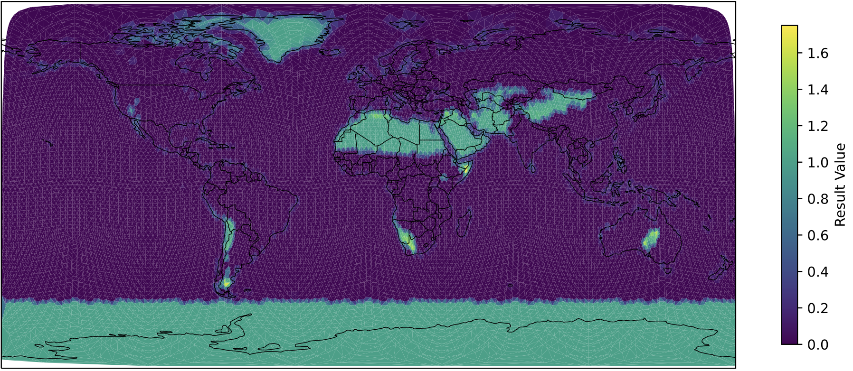

The effective area A_{eff}
$A_{eff}=1−\left(FPAR\left(\max_{ann}\right)⋅f_{shrub}+FPAR\left(month\right)⋅f_{grass}\right)⋅\frac{1}{0.25}$
August
$$FPAR=1.222⋅\left(\frac{NDVI}{0.559}−0.1566\right)$$
Tegen et al, 2002
A_{eff}

Slide 15
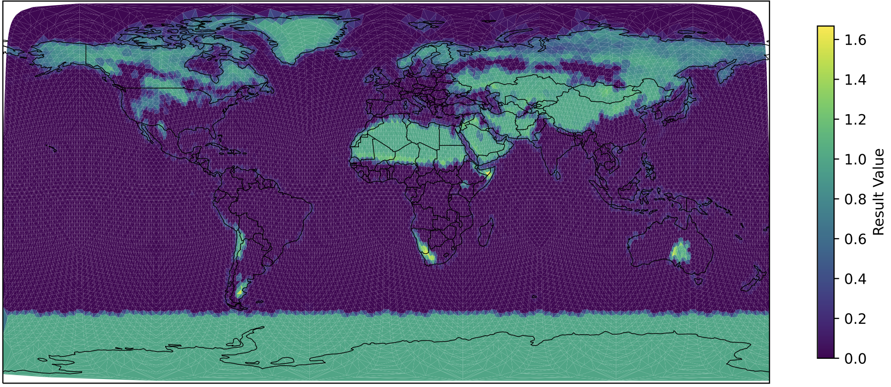
The effective area A_{eff}
$A_{eff}=1−\left(FPAR\left(\max_{ann}\right)⋅f_{shrub}+FPAR\left(month\right)⋅f_{grass}\right)⋅\frac{1}{0.25}$
February
$$FPAR=1.222⋅\left(\frac{NDVI}{0.559}−0.1566\right)$$
Tegen et al, 2002
A_{eff}

Slide 16

Global dust source regions

Slide 17
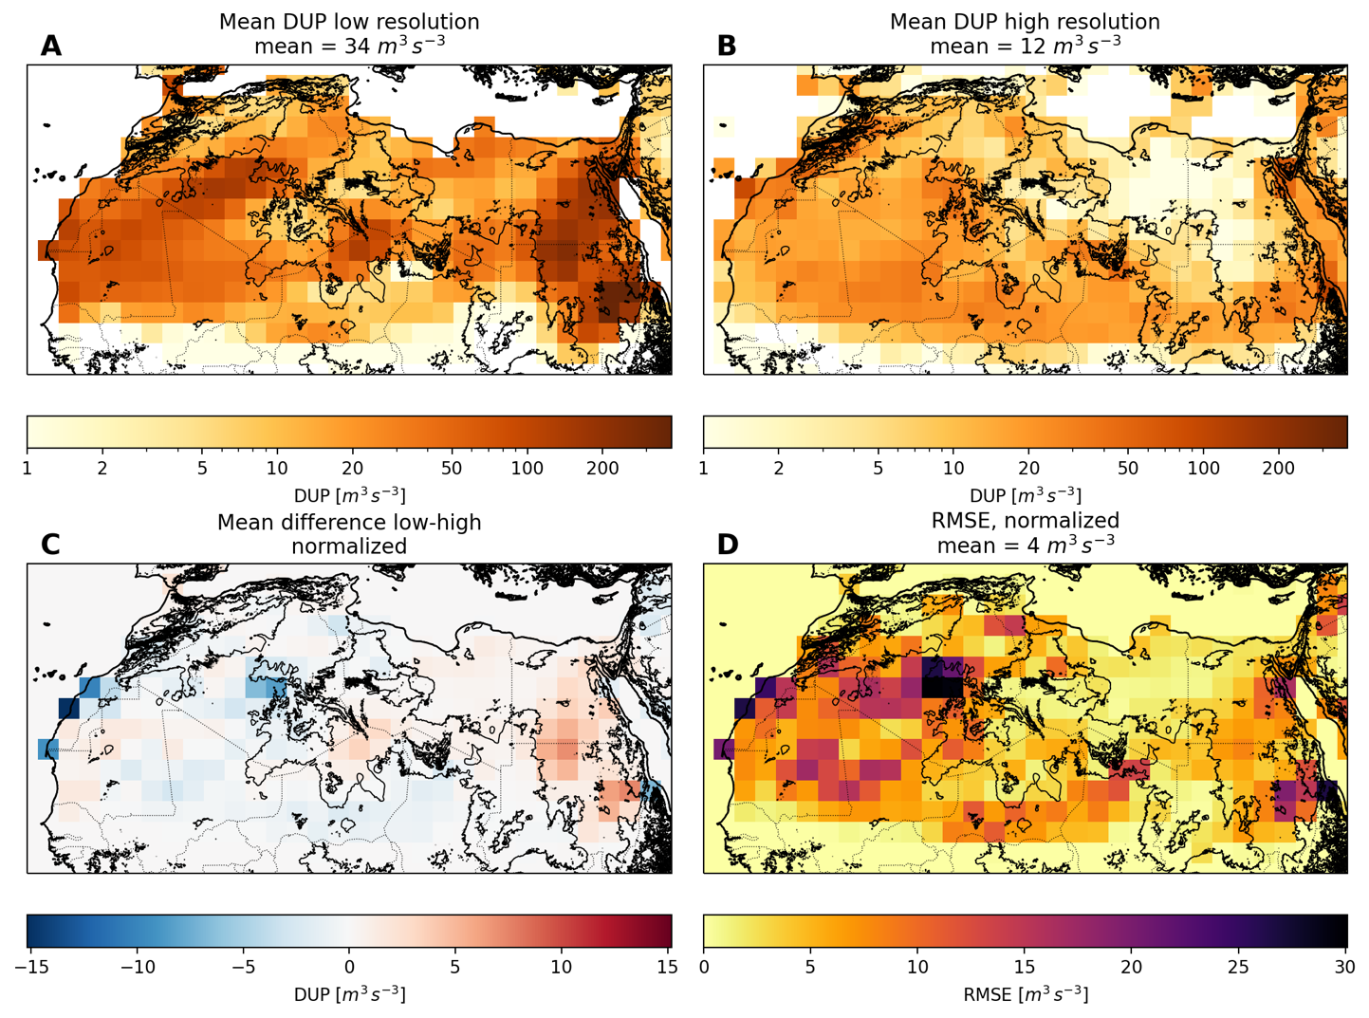
North Africa

Slide 18
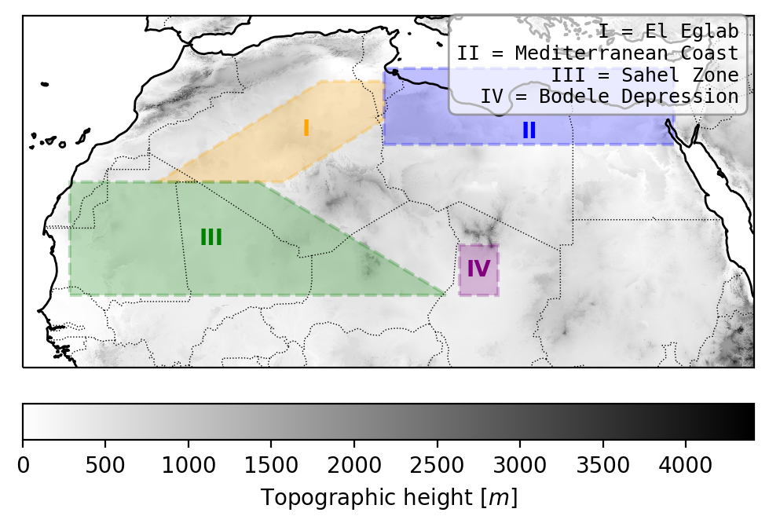
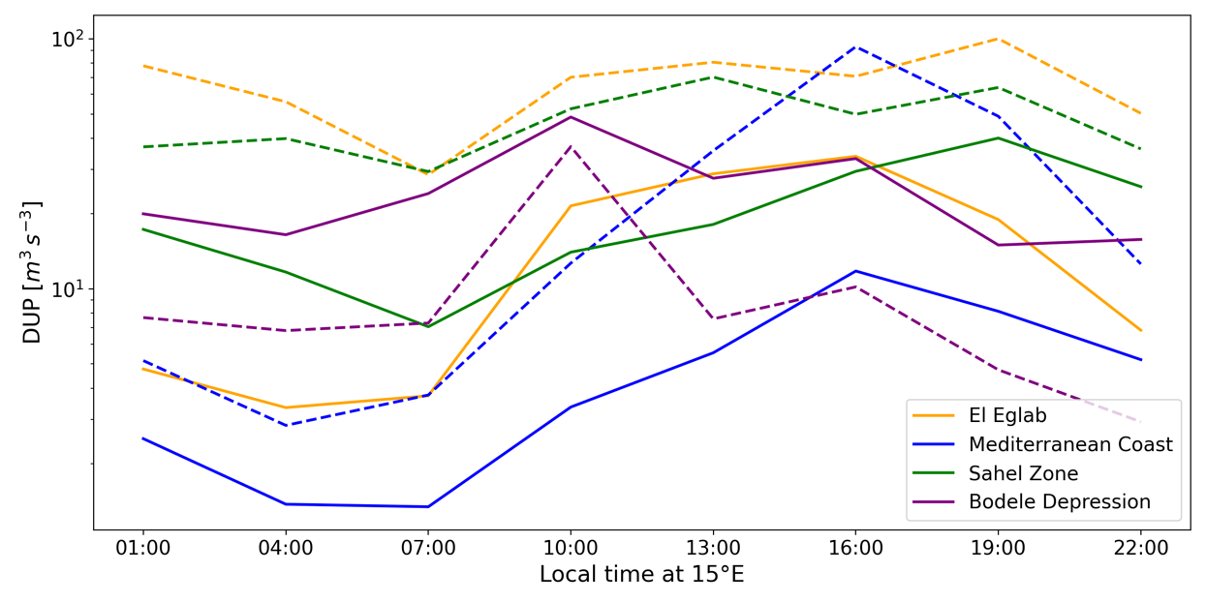
North Africa

Slide 19
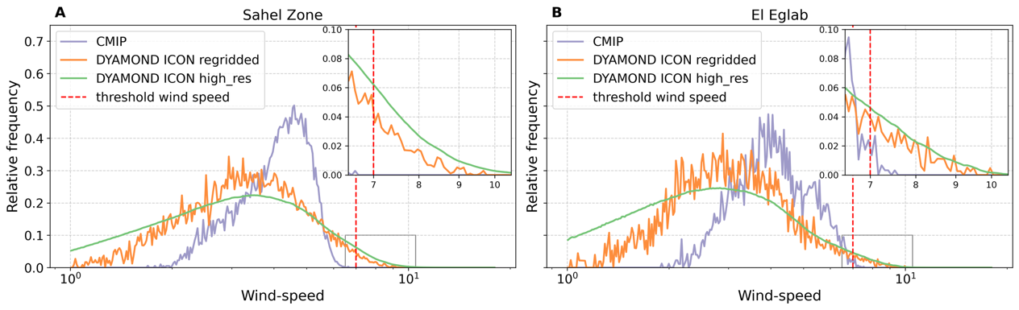
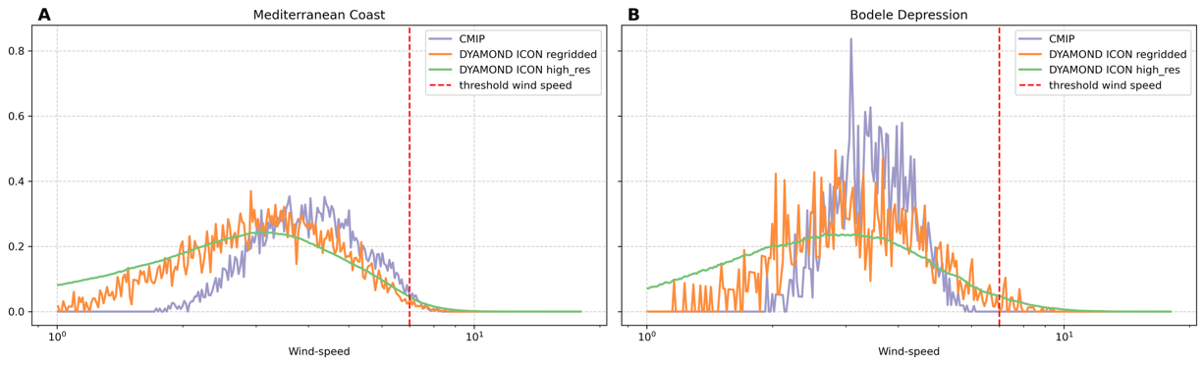
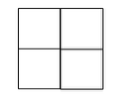
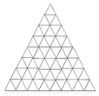
North Africa
 | 1 | 2 | 3
wind
DUP

Slide 20
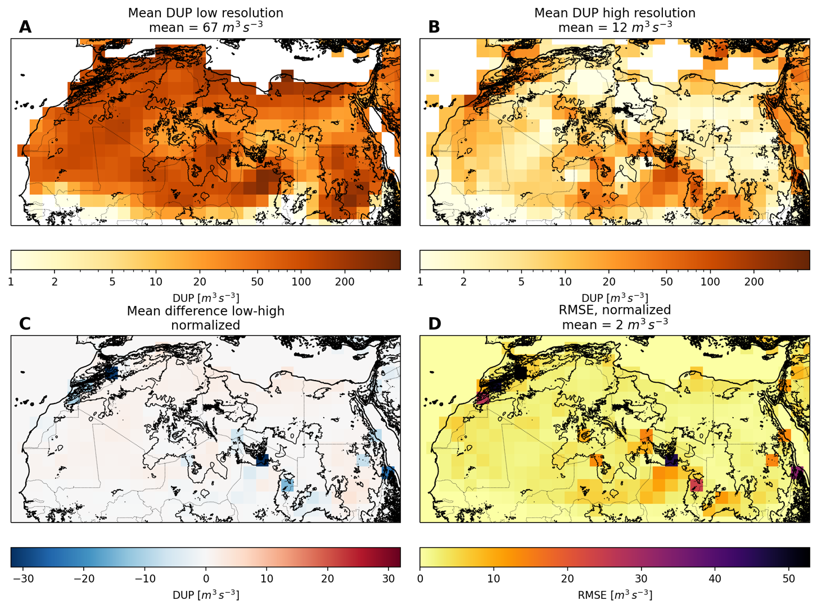
North Africa

Slide 21
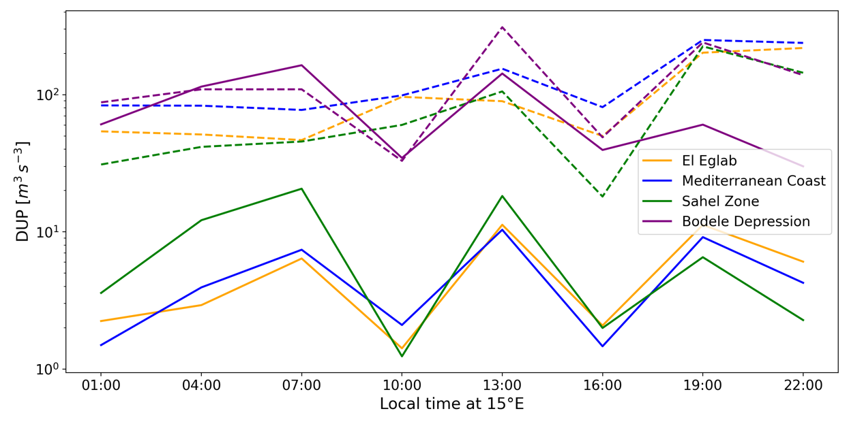
North Africa

Slide 22
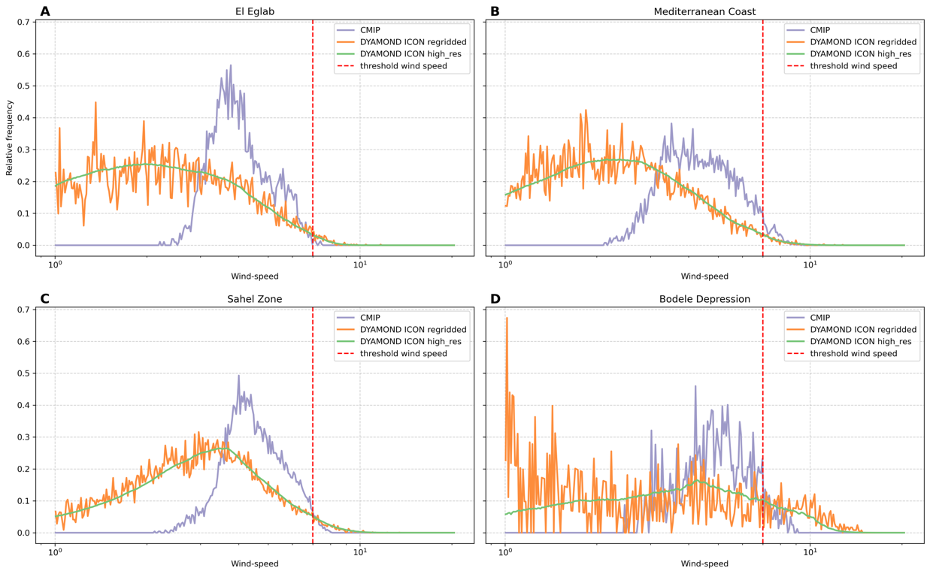
North Africa
 | 1 | 2 | 3
wind
DUP

Slide 23
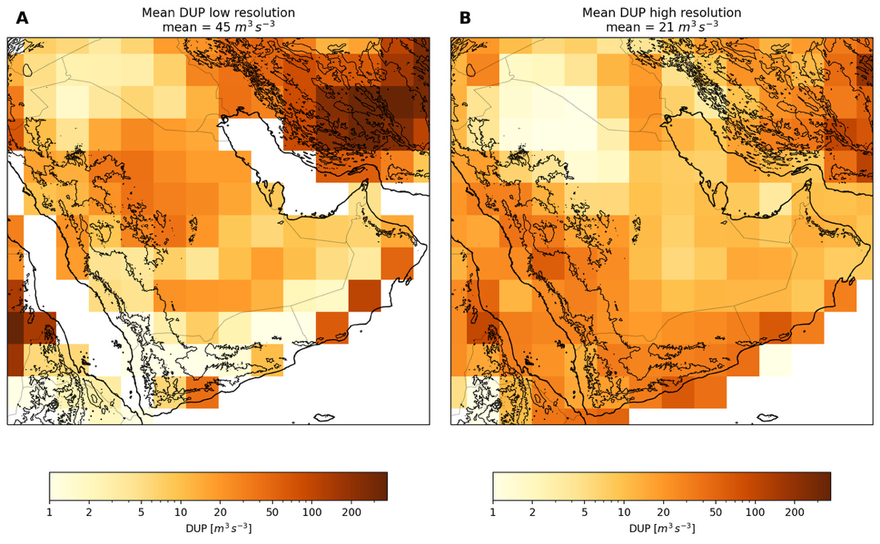
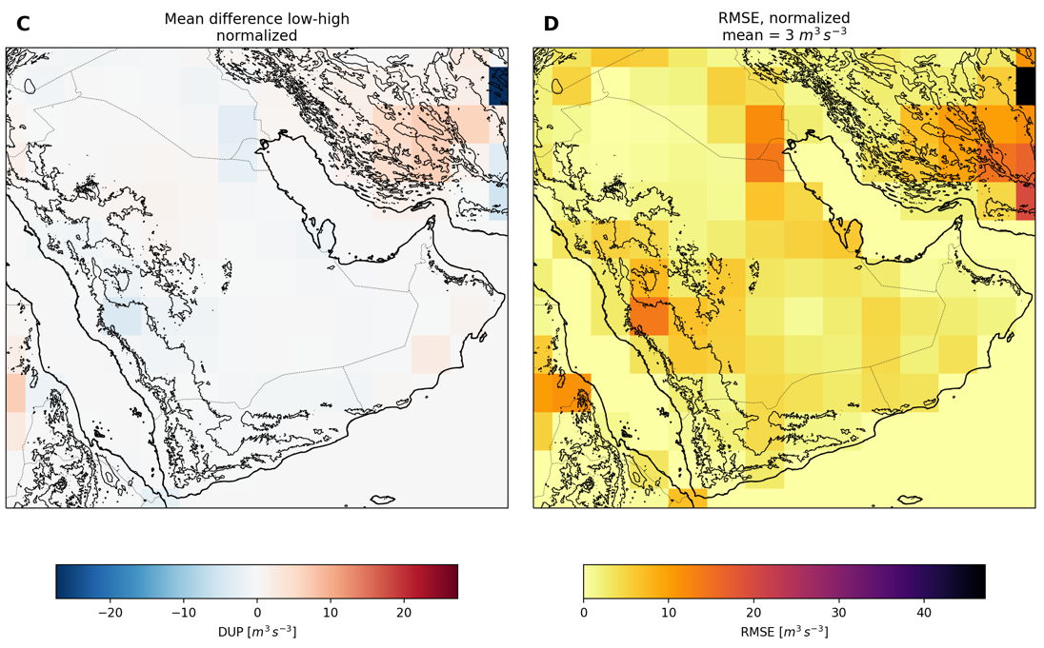
Arabia

Slide 24
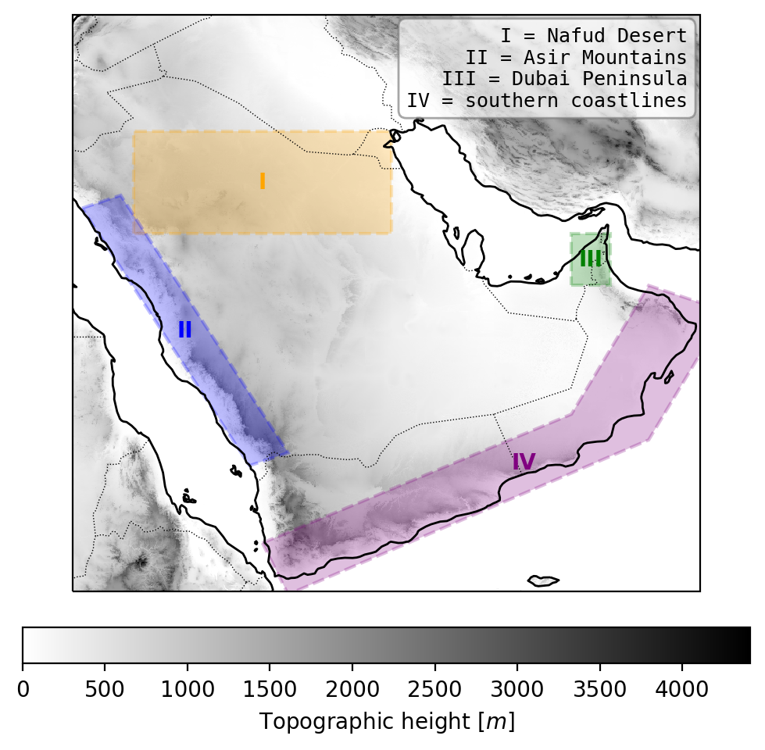
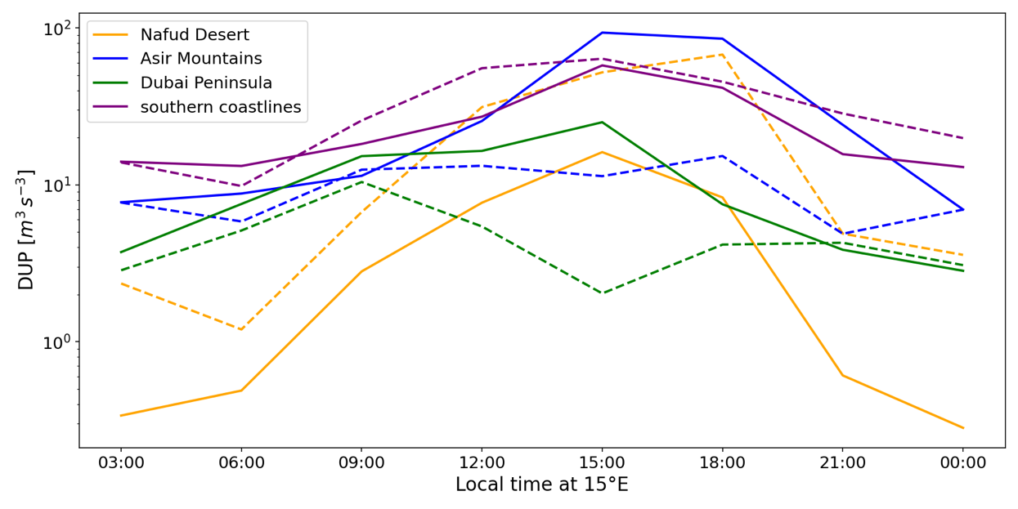
Arabia

Slide 25
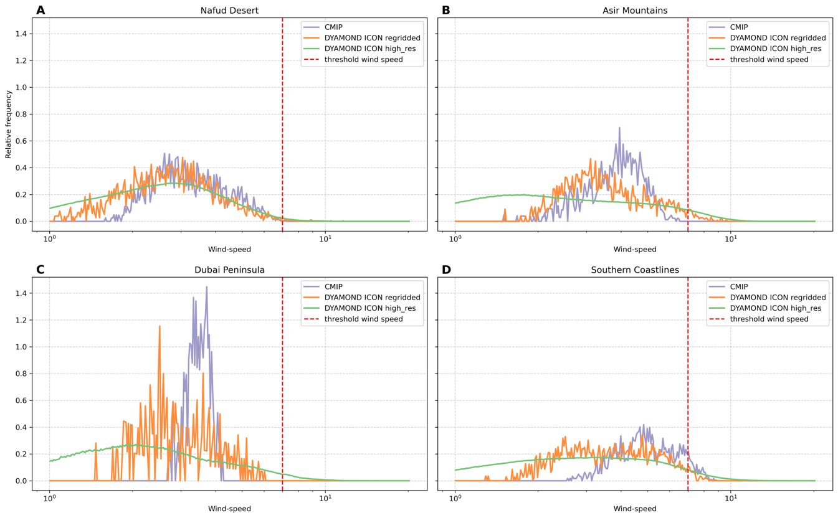

Arabia
 | 1 | 2 | 3
wind
DUP

Slide 26
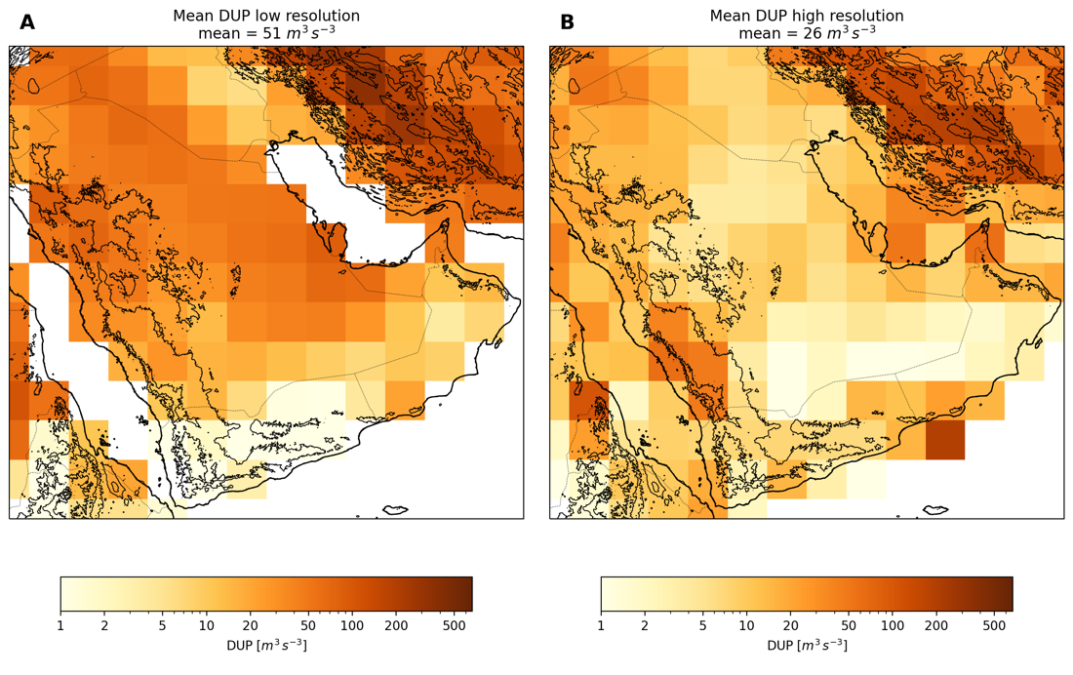
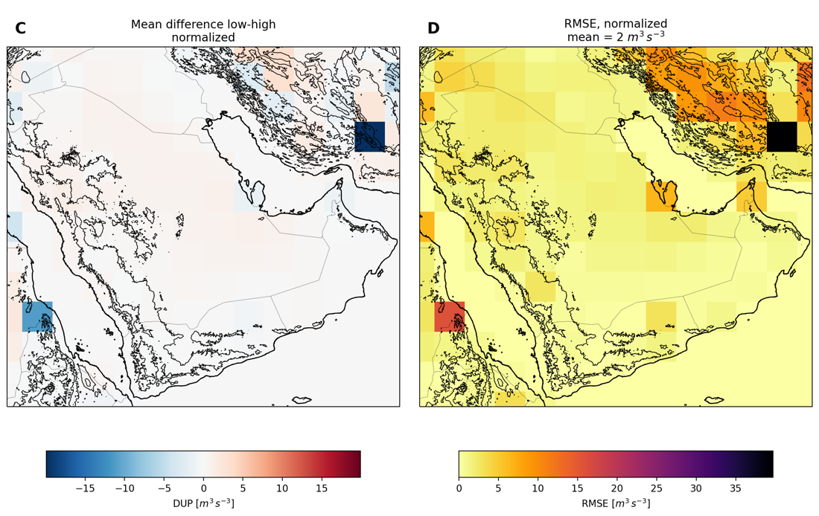
Arabia

Slide 27
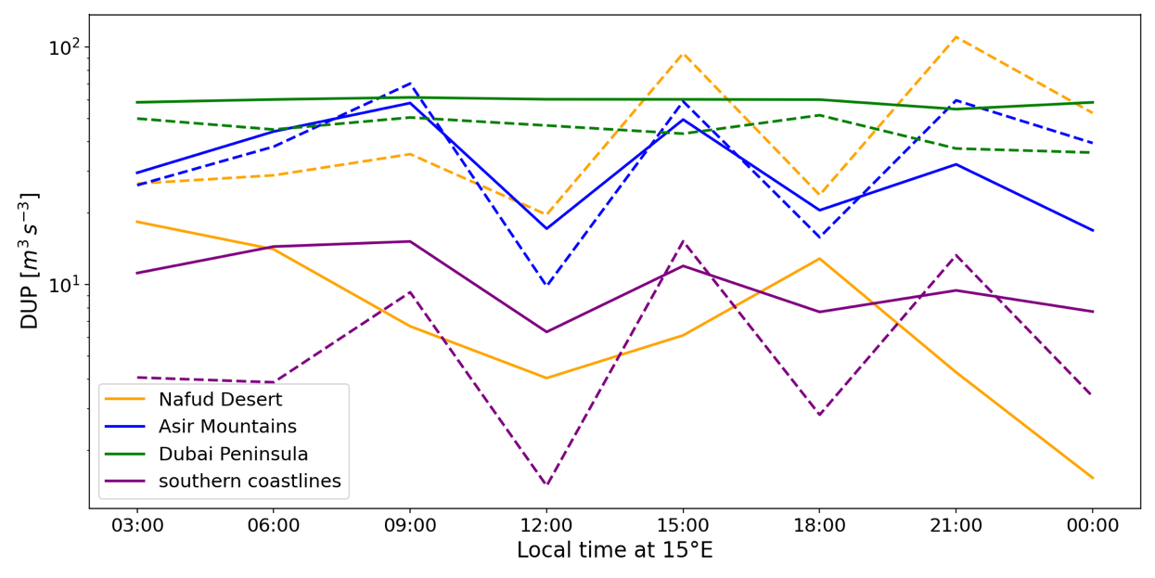
Arabia

Slide 28
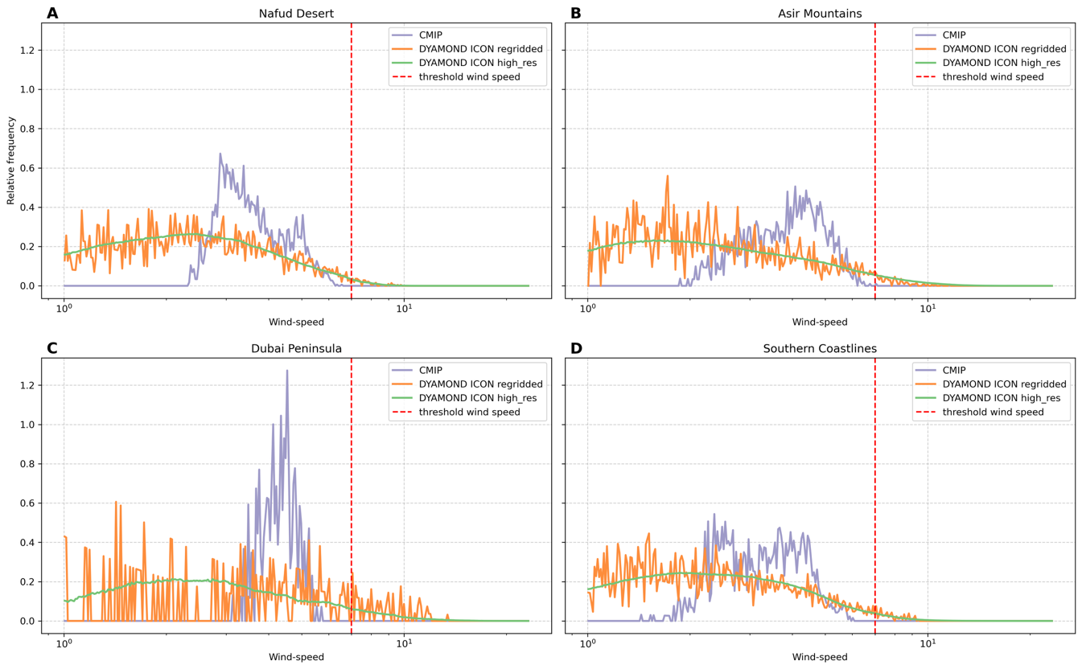
Arabia
 | 1 | 2 | 3
wind
DUP

Slide 29
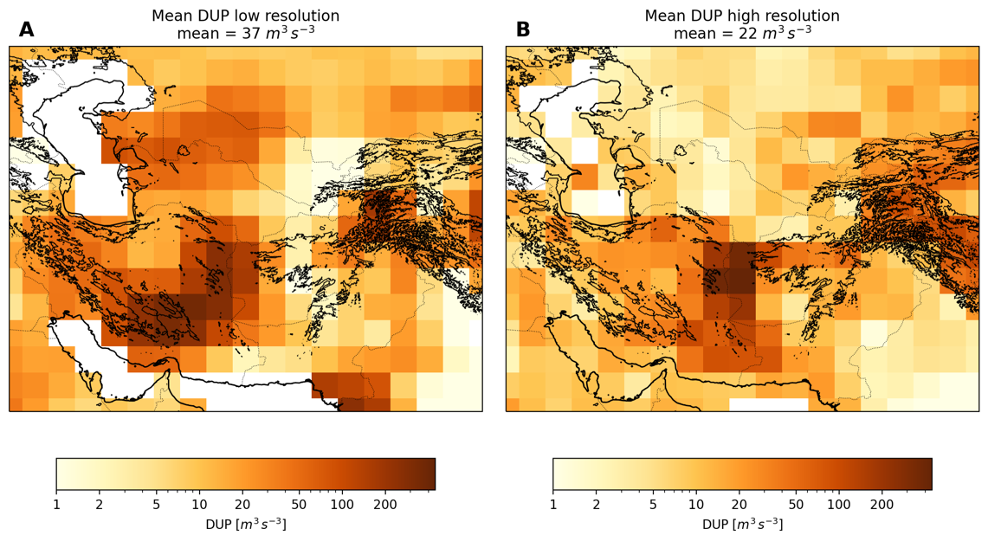
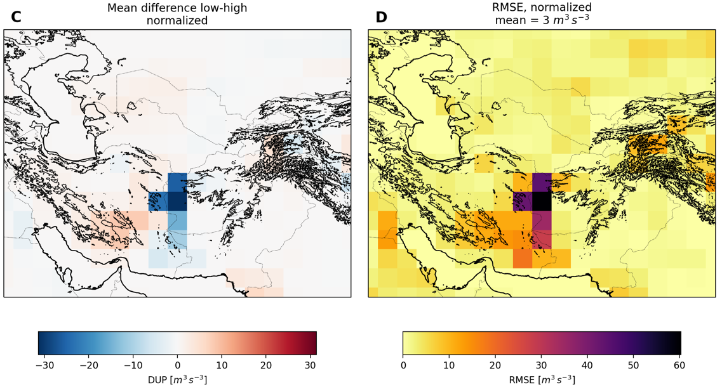
Central Asia

Slide 30


Central Asia

Slide 31



Central Asia
 | 1 | 2 | 3
wind
DUP

Slide 32


Central Asia

Slide 33

Central Asia

Slide 34

Central Asia
 | 1 | 2 | 3
wind
DUP

Slide 35

East Asia

Slide 36


East Asia

Slide 37



East Asia
 | 1 | 2 | 3
wind
DUP

Slide 38



East Asia

Slide 39

East Asia

Slide 40

East Asia

Slide 41

East Asia
 | 1 | 2 | 3
wind
DUP

Slide 42

Australia

Slide 43


Australia

Slide 44


Australia
 | 1 | 2 | 3
wind
DUP

Slide 45

Australia

Slide 46

Australia

Slide 47

Australia
 | 1 | 2 | 3
wind
DUP

Slide 48

South Africa

Slide 49


South Africa

Slide 50


South Africa
 | 1 | 2 | 3
wind
DUP

Slide 51

South Africa

Slide 52

South Africa

Slide 53

South Africa
 | 1 | 2 | 3
wind
DUP

Slide 54


South America

Slide 55


South America

Slide 56


South America
 | 1 | 2 | 3
wind
DUP

Slide 57


South America

Slide 58

South America

Slide 59

South America
 | 1 | 2 | 3
wind
DUP

Slide 60

North America

Slide 61


North America

Slide 62


North America
 | 1 | 2 | 3
wind
DUP

Slide 63

North America

Slide 64

North America

Slide 65

North America
 | 1 | 2 | 3
wind
DUP

Slide 66


Conclusion
pkunze@tropos.de
Compared DUP of convection parameterization and explicit convection for 8 global dust source regions
Investigated regional and seasonal differences
Found synoptical drivers by comparing the diurnal cycle
Investigated drivers of differences → Parameterization vs grid resolution
Found global patterns:
Convective systems (underestimated in current climate models)
Breakdown of the nocturnal LLJ (overestimated in current climate models)
Overlapping drivers
Events with constant windspeed (underestimated in current climate models)
Notes:
Steht bald bei egusphere???

Slide 67




(1) Convective events e.g. Sahel summer
Underestimation of high resolution models by climate models
Nighttime peak
Climate models fail to model high windspeed
Differences due to synoptic parameterization not due to grid

Slide 68



(2) Breakdown of the LLJ e.g. Bodélé winter
Overestimation of high resolution models by climate models
Peak in the morning hours
wind speeds near the threshold windspeed → higher frequency in climate models
Differences due to synoptic parameterization not due to grid

Slide 69



(3) Multiple drivers e.g. Taklamakan summer
Combination of both drivers
in the morning hours driven by breakdown of LLJ → overestimated by climate models
During Nighttime: driven by convective events → underestimated by climate models

Slide 70




(4) Special cases
e.g.Sistan Basin summer
Sistan Basin with constant wind
Comparable outcomes in both model
Shift of the peak but comparable outcomes in total daily emission
Not enough dust events during the experiment

Slide 71

Winter mostly driven by breakdown of the LLJ
Regions near the equator driven by connective events
Higher latitudes driven by breakdown of the LLJ
→ differences due to synoptic parameterization not due to grid
Notes:
Model-data

