Slide 1




Session HS 4.4 (PICO) “Operational forecasting and warning systems for flood, water scarcity and multi-hazards: challenges and innovations”
EGU26-7569: Mon, 4 May, 08:30–10:15 | PICO spot 2
Seasonal forecast of streamflow and suspended sediment
in the Blue Nile Basin, Ethiopia
Ethiopian ⬄ German scientific co-operation in water and climate
Axel Bronstert^{1,5} , Morteza Zargar¹, Till Francke¹ , Kindie B. Worku¹, Fasikaw A. Zimale², Harald Kunstmann^{3,4}
University of Potsdam, Institute for Environmental Sciences, Potsdam, Germany, axel.bronstert@uni-potsdam.de
Bahir Dar University, Bahir Dar Institute of Technology, Faculty of Civil and Water Resources Engineering, Bahir Dar, Ethiopia
Karlsruher Institut für Technologie (KIT), Campus Alpin, Institut für Meteorologie und Klimaforschung, Garmisch- Partenkirchen, Germany
University of Augsburg, Lehrstuhl Regionales Klima und Hydrologie, Augsburg, Germany
International Centre of Excellence for Dams (ICED), Indian Institute of Technology Roorkee, Roorkee (Uttarakhand), India

Slide 2
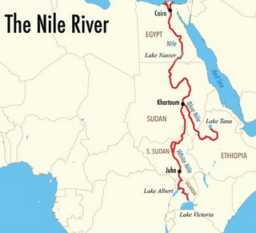
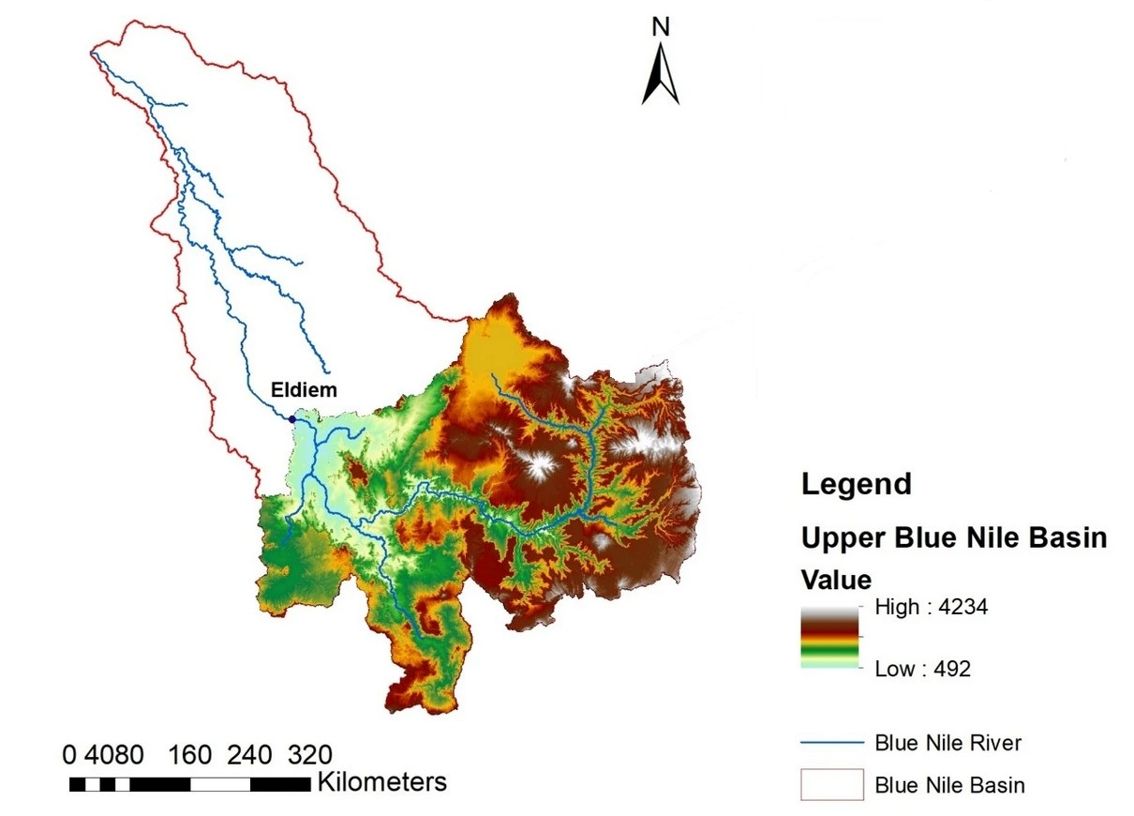
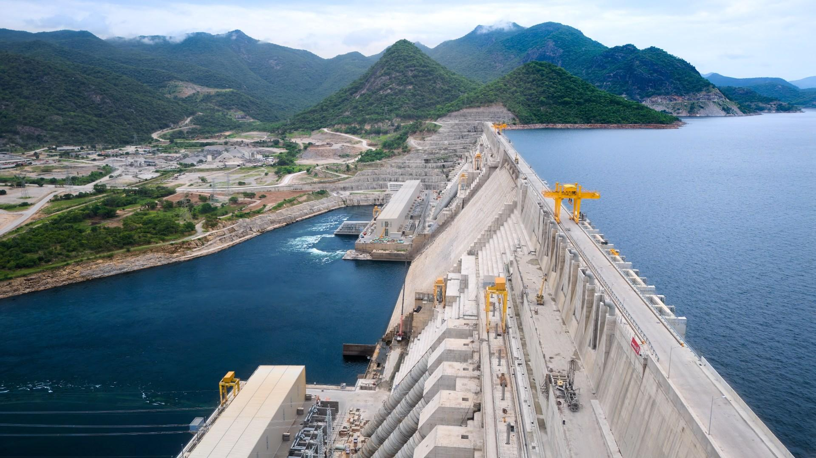
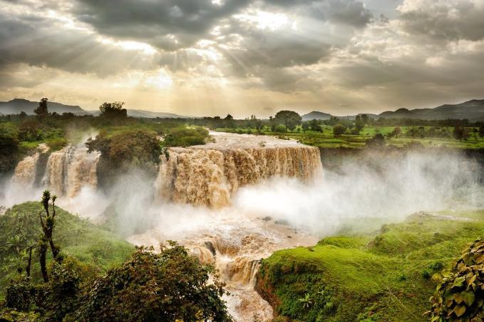
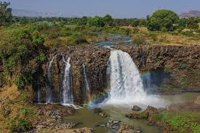
Motivation
Upper Blue Nile Basin
Blue Nile: main tributary of the Nile (60% of tot. runoff)
Water resources of Sudan and Egypt depend heavily on it
High seasonality in river runoff and contained sediment
Dam ‚GERD‘ now under operation at Ethiopian basin outlet: Vast electrical energy for Ethiopia but concern in Egypt about Nile’s future water resources
Blue Nile Falls during high-flow
Blue Nile Falls during low-flow

Slide 3
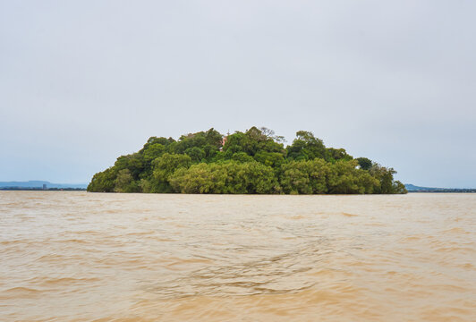
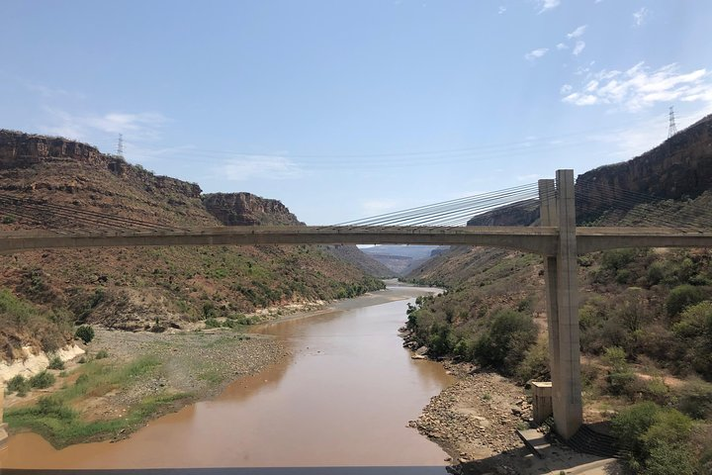

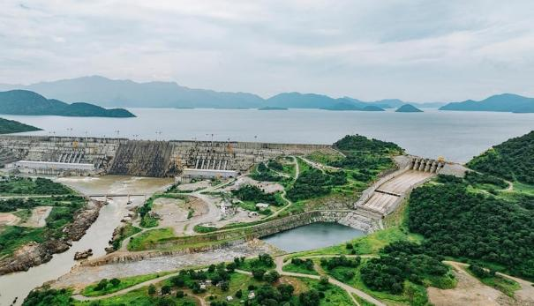
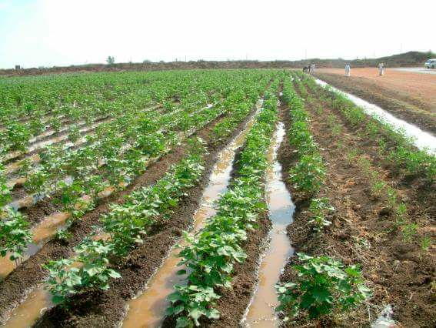
Aim: seasonal predictions of water and sediment
Decision planning
In water resources,
Hydro-Power,
agriculture
Lake Tana
Blue Nile
days ... months
GERD
… up to 7
months ahead!
Irrigation in SE-Sudan

Slide 4
Introduction/background
Seasonal forecast of streamflow and suspended sediment in the Blue Nile Basin, Ethiopia
Introduction
Hydrological conditions and data
The SPS-Blue Nile Project
Methodologies
Results
Conclusions

Slide 5
2. Hydrological conditions and data
Blue Nile Falls during high-flow
Blue Nile Falls during low-flow
Note the differences in sediment transport !

Slide 6
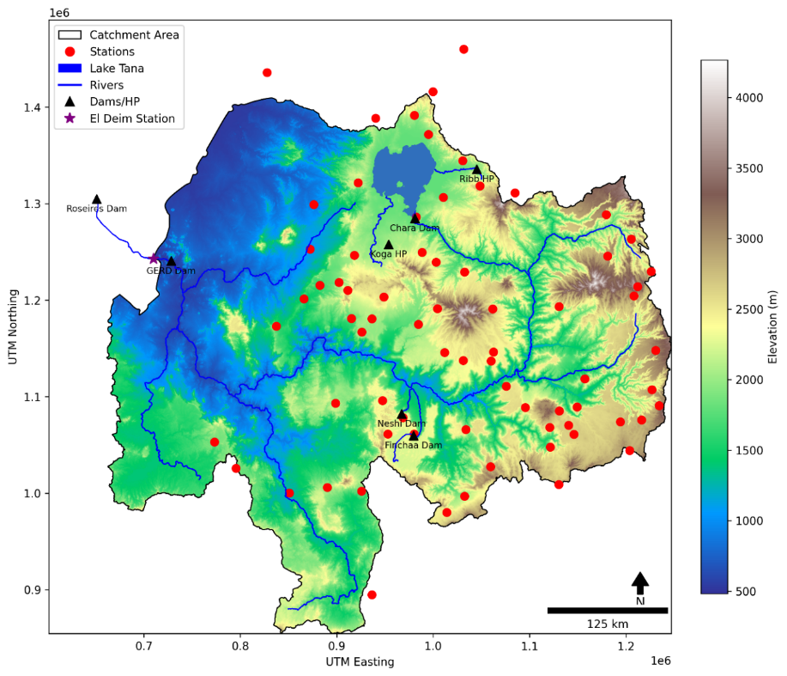
The Upper Blue Nile Basin (UBNB)
From upstream Lake Tana in Ethiopia to Sudan border (EL-Diem Station)
Area: 199,812 km²
Elevations: from 500 masl (Sudan border) to over 4,260 masl in the highlands
Annual mean Rainfall: between 1,200 and 1,800 mm
Average Temperature: 15°C to 25°C
Average annual discharge: 50 km³ / year ~ 1600 m³/s (before construction of GERD)

Slide 7
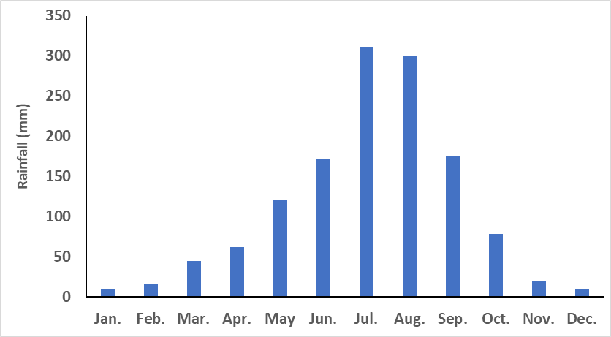
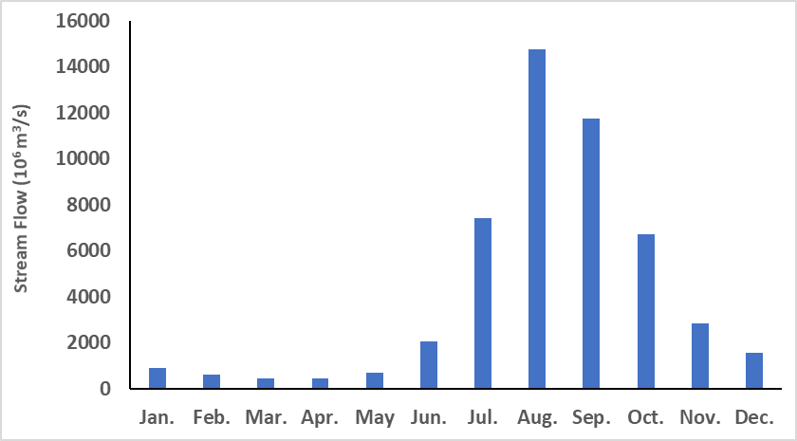
Upper Blue Nile : the hydrological regime
Average monthly rainfall and runoff in the Upper Blue Nile
Rainfall
Streamflow at the El Diem station
Approximately 70% of the annual rainfall in the UBNB occurs from June to September.
Approximately 70% of the annual runoff occurs from July to October.

Slide 8
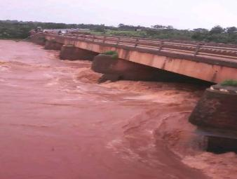
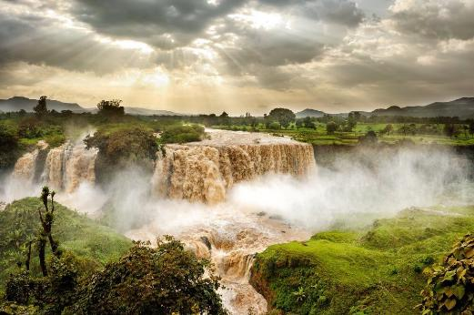
Upper Blue Nile : sediment dynamics
GERD
Gilgel Abay at Bicolo
Gumara (August 2017)
GERD
Lake Tana

Slide 9
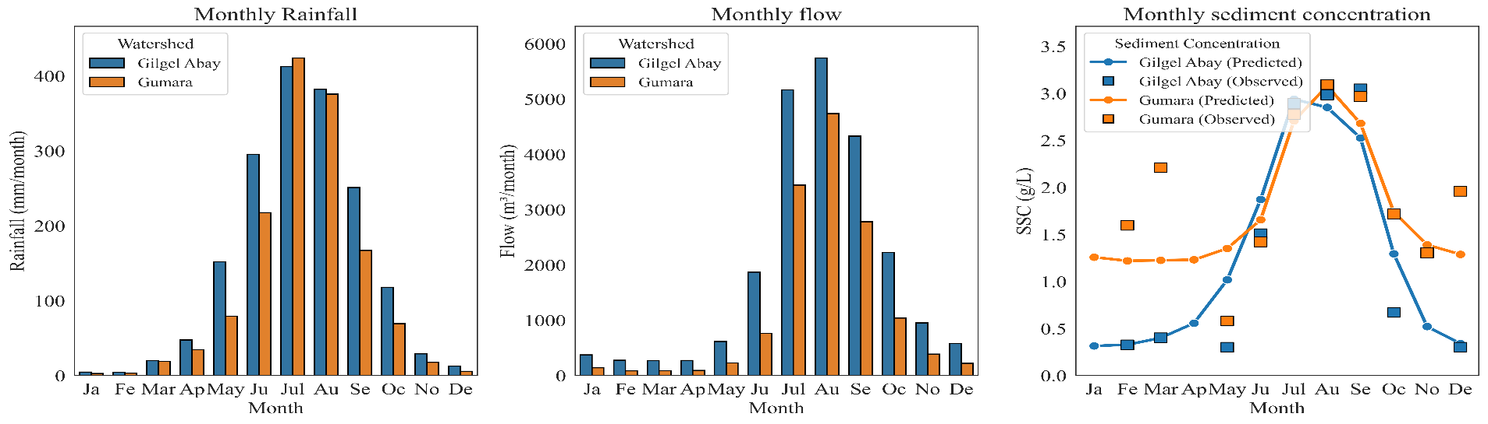
Upper Blue Nile : the hydrological regime
Monthly rainfall, runoff and sediment fluxes at Gilgel Abay and Gumara
Main rain months: June –September
Main discharge months: July – Oktober
Main sediments months: June – September / Oktober

Slide 10
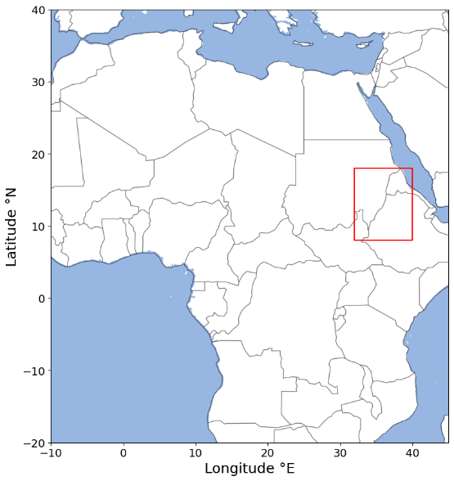
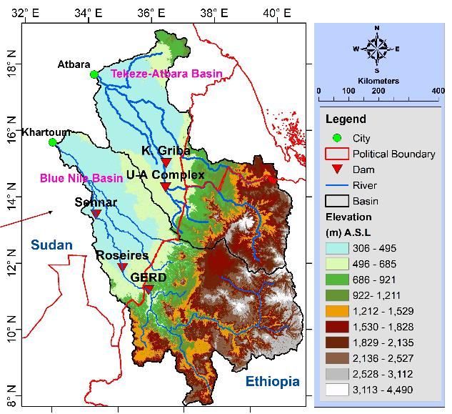
3. SPS Blue Nile Project
This research is part of the SPS-Blue Nile project funded by the BMBF under the GRoW program.
Blue Nile:
main tributary of the Nile (60% of total runoff)
Seasonal forecast (KIT)
Hydrological-, sedimentological-, and crop yield modeling (UP, KIT)
Seamless climate-hydrological prediction system (KIT, UP)

Slide 11
4. Methodologies
Seasonal atmospheric forecast
Seasonal hydrological and sedimentological forecast
Water resources use and crop yield expectations

Slide 12

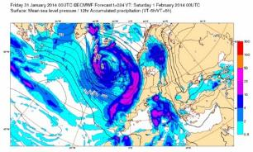
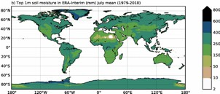
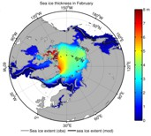

Methodologies: Seasonal forecast of atmospheric drivers
: SEAS5
Coupled atmosphere-ocean-land-sea ice model:
Initial condition uncertainty
Forecast uncertainty
forecast horizon up to 7 months
36 km horizontal resolution
Daily temporal resolution
51 members
Seasonal
Bias Correction and downscacling: Seasonal forecast of P and T: 10 km resolution; every month

Slide 13
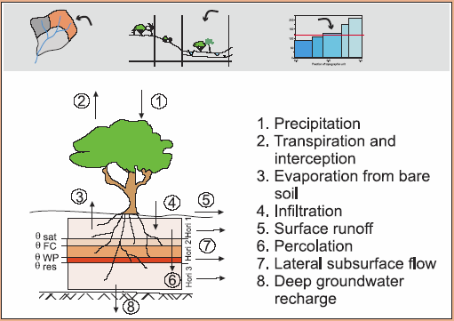
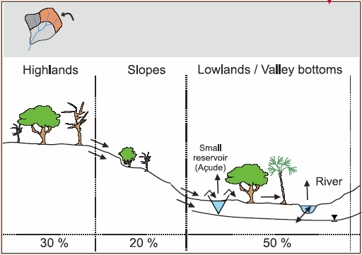
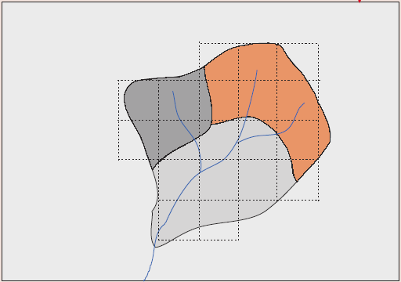
WASA-SED:
A meso-scale hydro-sediment-ological model:
* Catena-based
* multi-scale
* distributed,
* process-oriented,
Methodologies: Seasonal hydrological forecast (+ sediment)

Slide 14
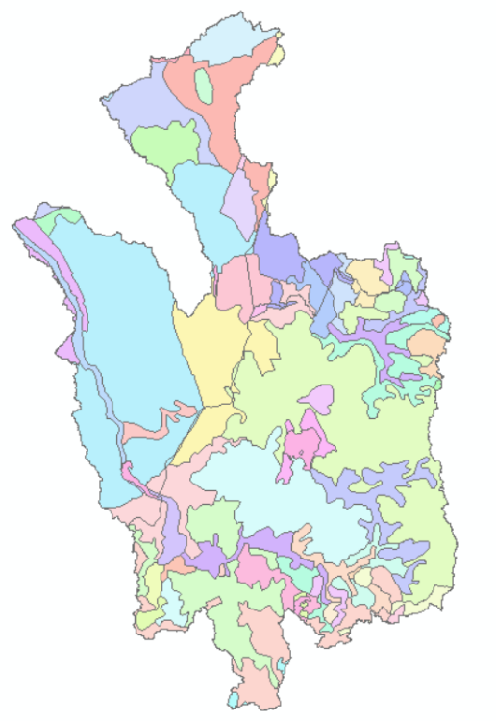
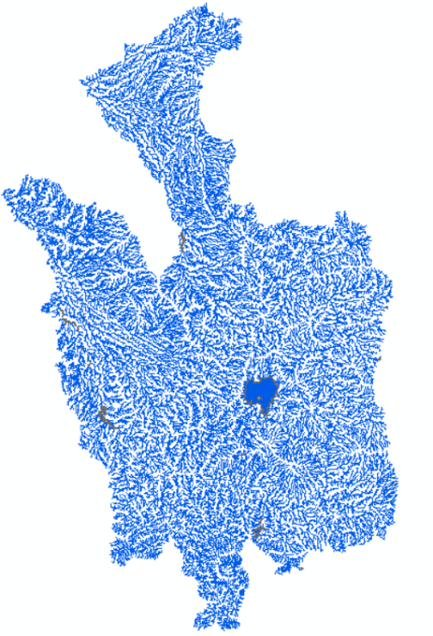
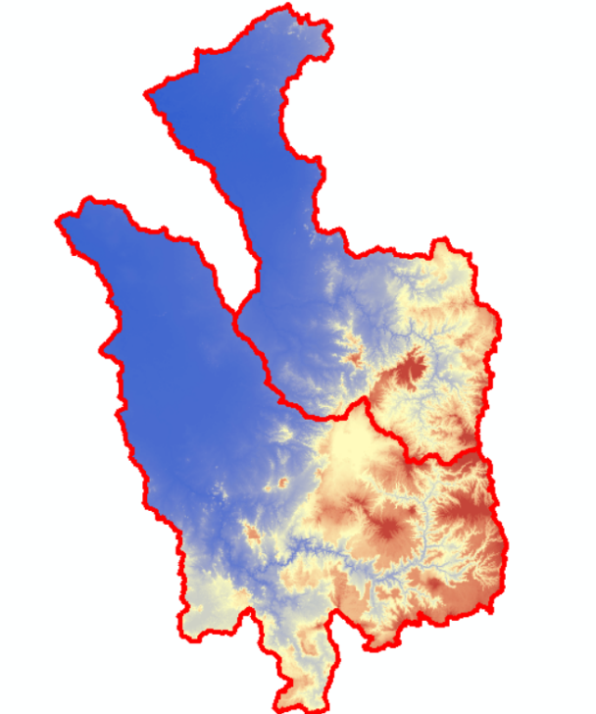
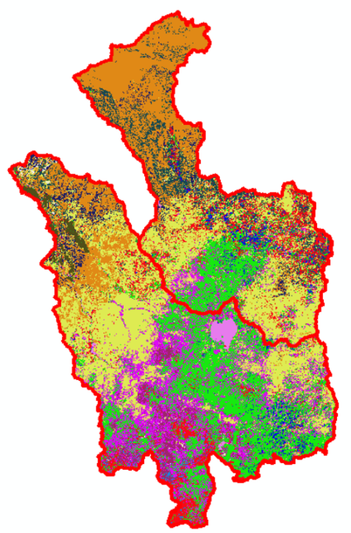
WASA-SED – Input data
Soil types
Land-use types
Stream Network
Time series data:
-Weather data
- Soil and Land-USE properties
Topography
Data type, source and resolution

Slide 15
Data collection: Hydro-sedimentological dynamics
Parameter | Temporal Resolution | Summary Stats (Min/Median/Max) | Source
Discharge | Daily(1990-2020 | Gilgel Abay: 0.51/30.92/618.91 m³/s Gumara: 0.2/9.30/374.04 m³/s | MoWE, ABAO
Rainfall | Daily (1990-2020) | Gilgel Abay: 0.0/1.9/48.5 mm Gumara: 0.0/0.46/55.02 mm | EMI
Temperature | Daily (1990-2020) | Gilgel Abay: 10.2/18.5/26.3°C Gumara: 9.8/19.1/27.0°C | EMI
Suspended sediment concentration (SSC) | Intermittent (1990-2020) | Gilgel Abay: 0.2/1.27/3.4 g/L Gumara: 0.52/1.62/2.07 g/L | MoWE, ABAO
Evapotranspiration | Daily (1990-2020) | Gilgel Abay: 2.0/4.5/7.1 mm Gumara: 1.8/4.3/6.8 mm | calculated

Slide 16
5. Results
Seasonal atmospheric forecast
Seasonal hydrological and sedimentological forecast
Water resources use and crop yield expectations

Slide 17
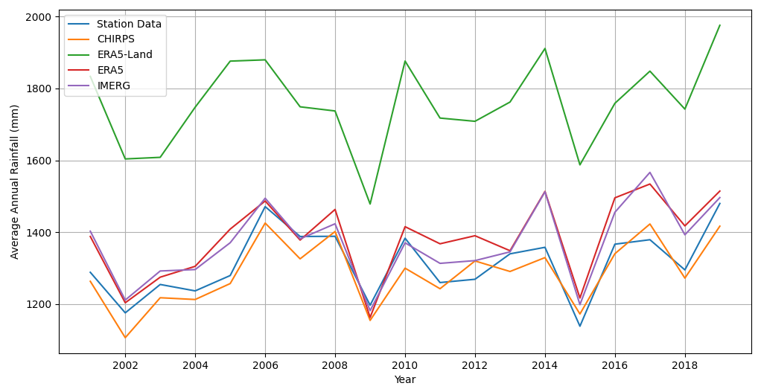

Compare Rainfall: Station data, CHIRPS, ERA5, ERA5-Land, IMERG
The average annual rainfall for the period 2001–2019
Zargar, M., Bronstert, A., Francke, T., F. A., Zimale, et al., (2025) Comparison and Hydrological Evaluation of different Precipitation Data for a Large Tropical Region: The Blue Nile Basin in Ethiopia, Submitted to Journal: Frontiers in Water, Specialty Section: Water and Hydrocomplexity, Volume 7 doi: 10.3389/frwa.2025.1536881

Slide 18
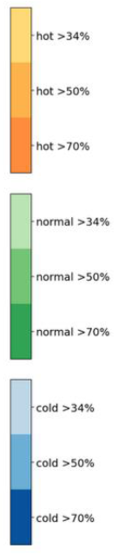
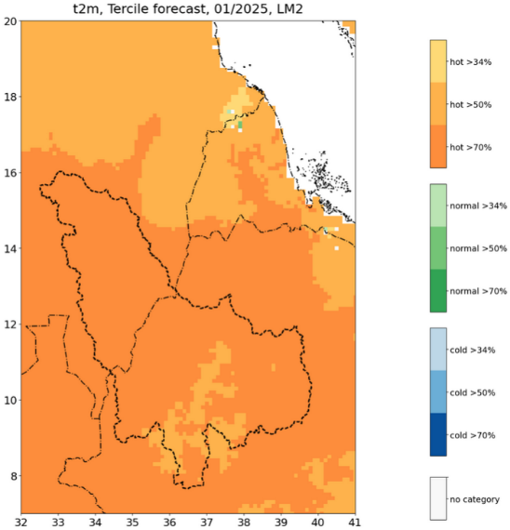
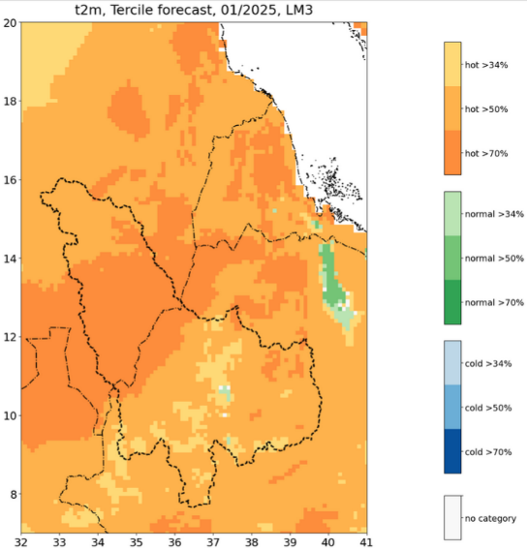
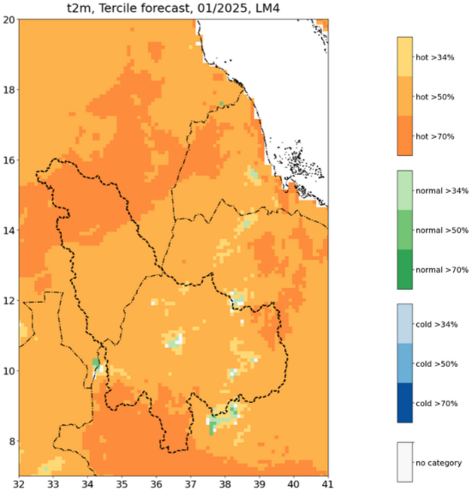
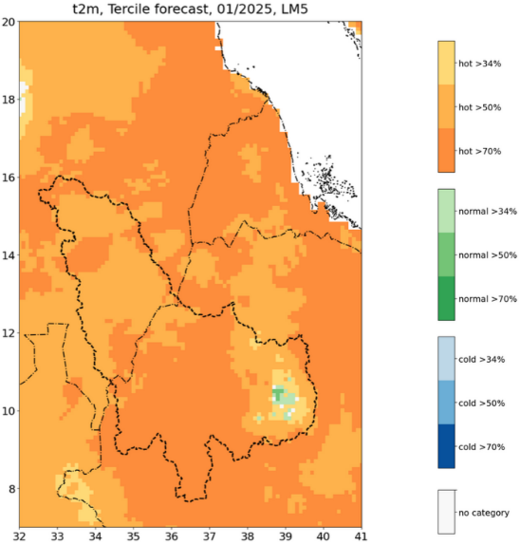
Results: Temperature (t2m) forecasts
January tercile forecast for
March April May June

Slide 19
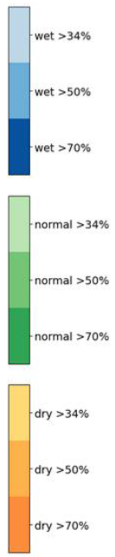
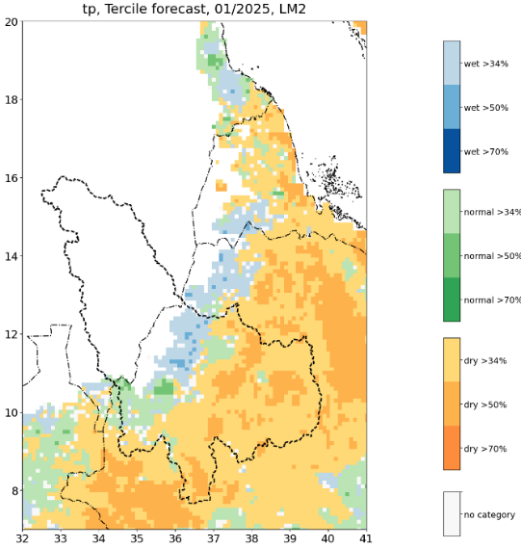
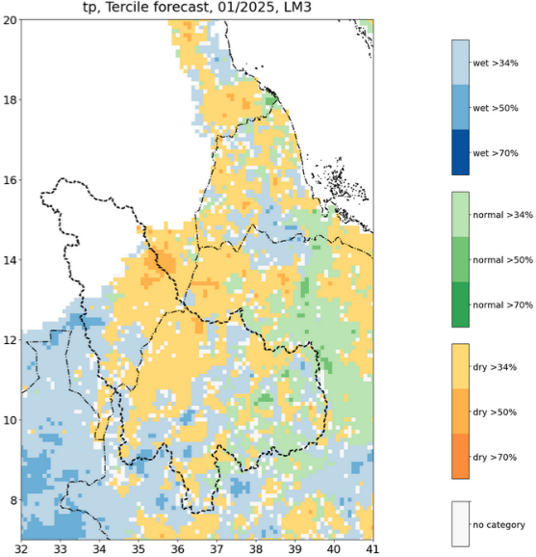
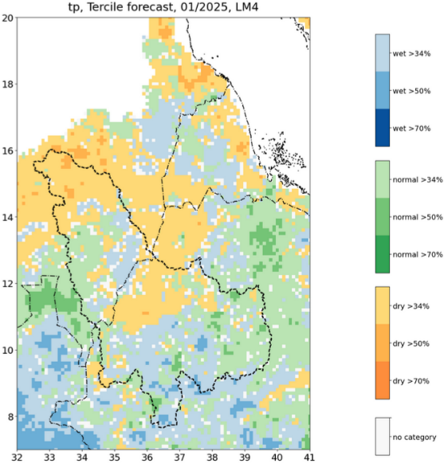
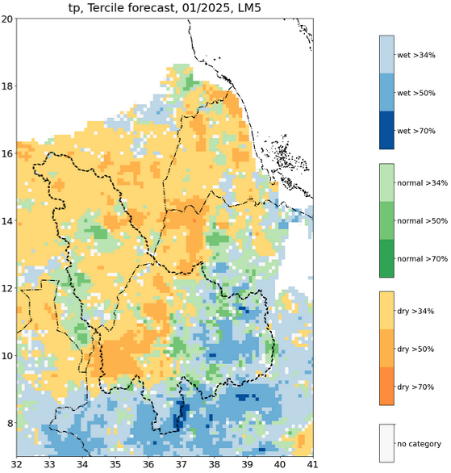
Precipitation (tp) forecasts
January tercile forecast for
March April May June

Slide 20
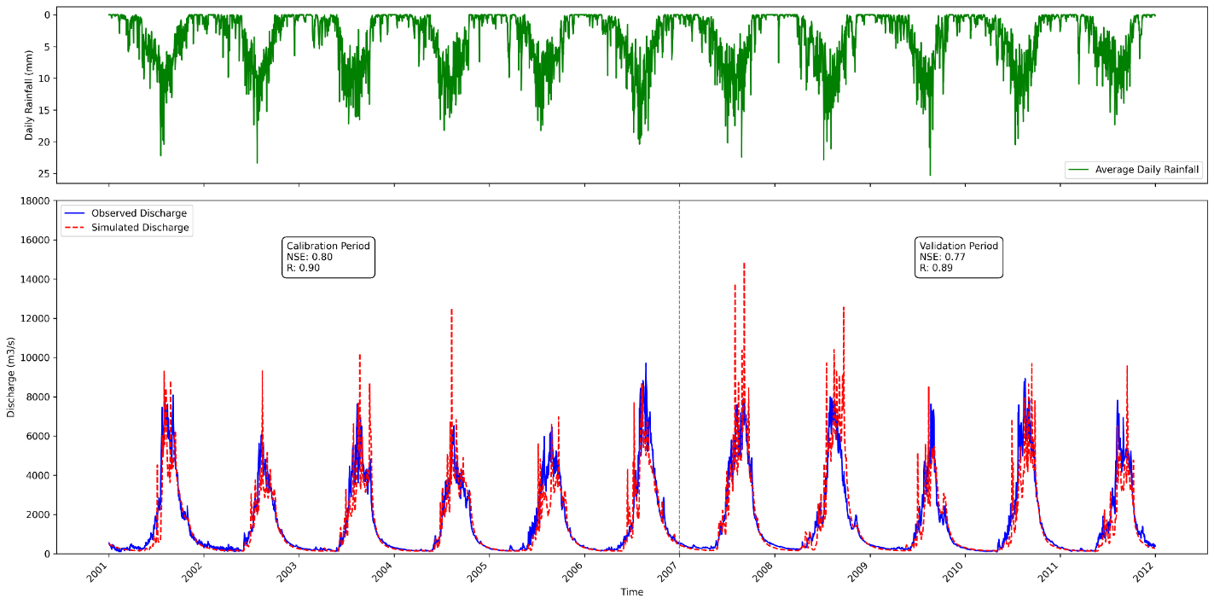
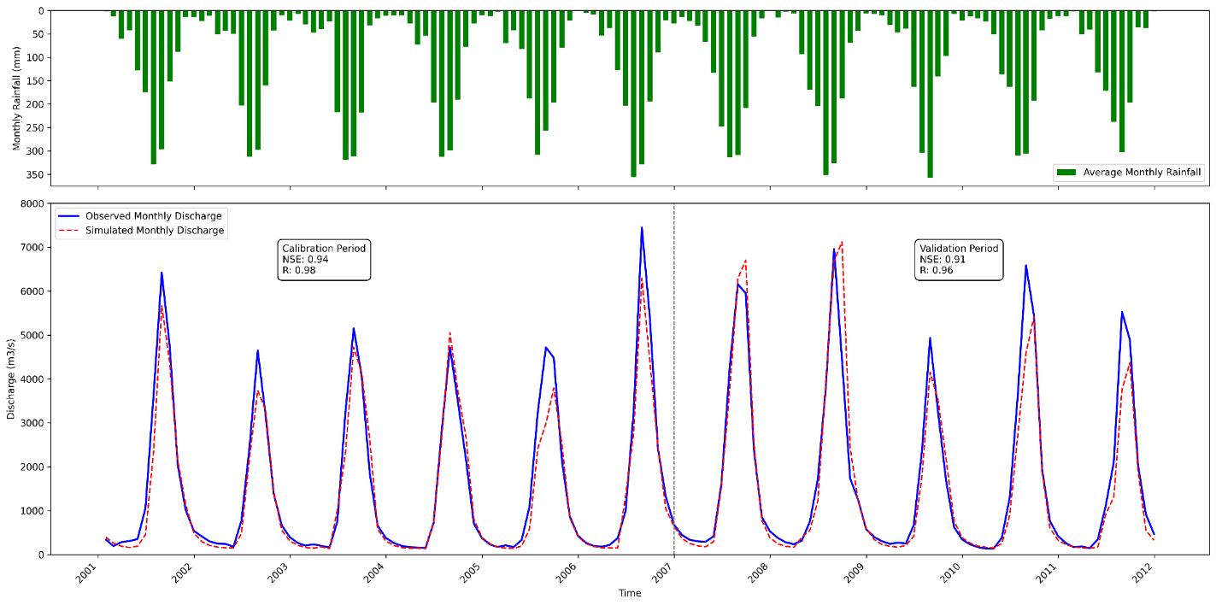
Calibration & Validation WASA-SED Model at the El-Diem
Daily Discharge
Monthly Discharge
Comparison: observation and simulated discharge (2001-2011 )

Slide 21
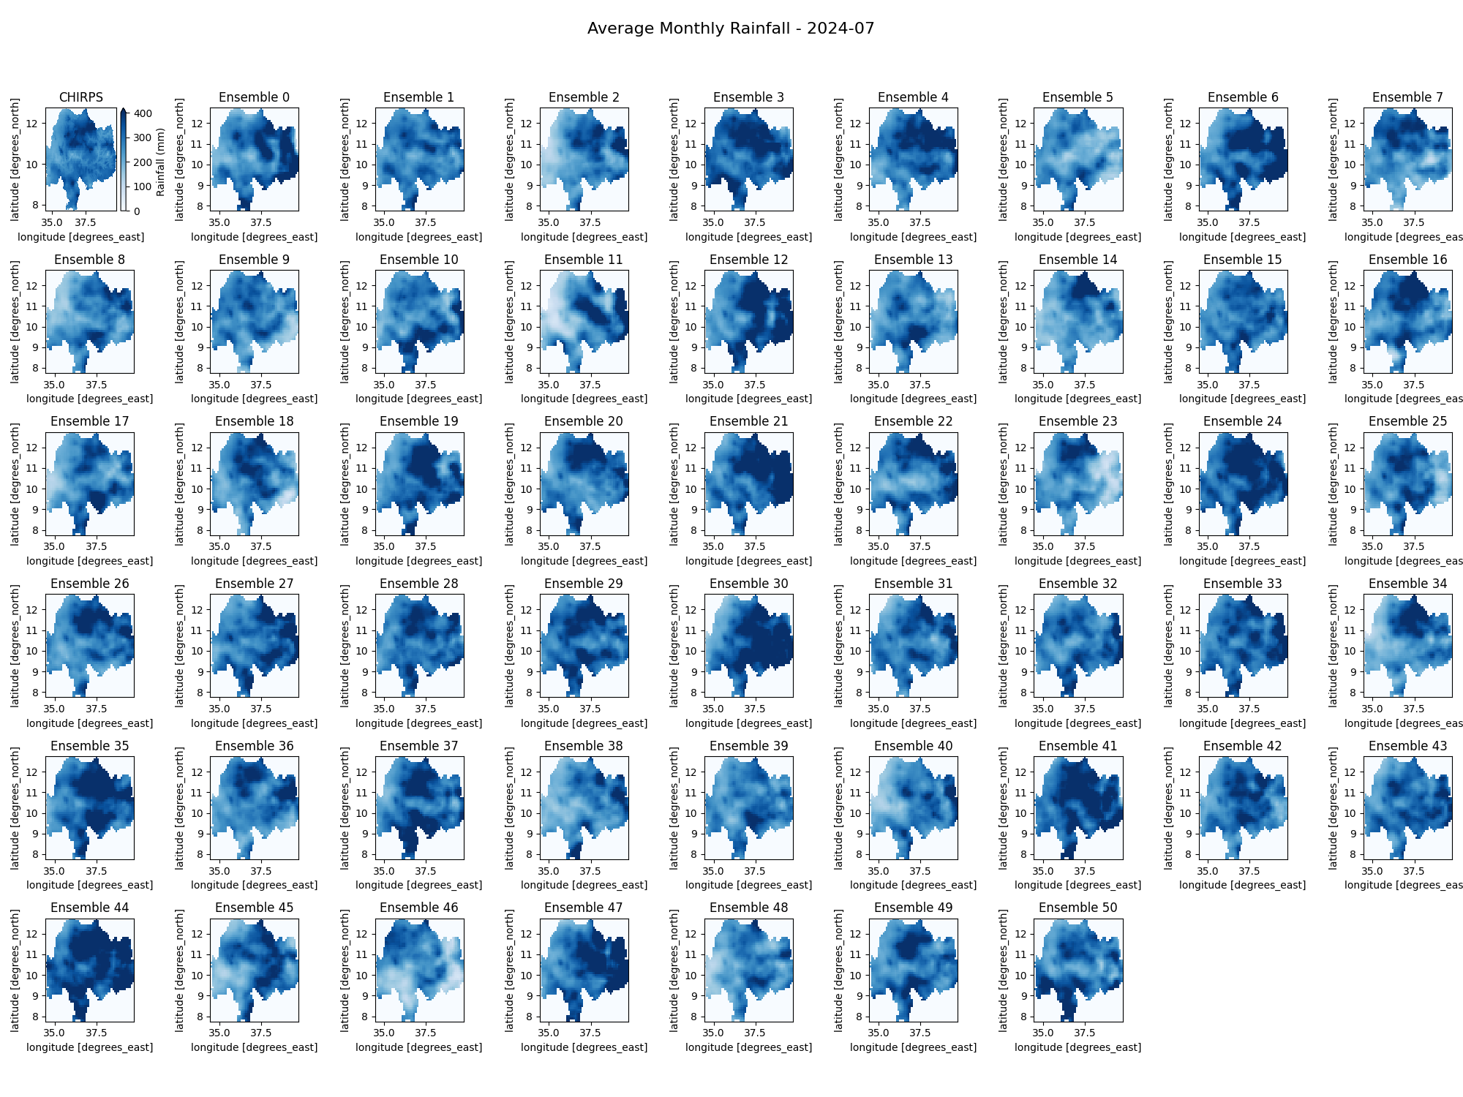
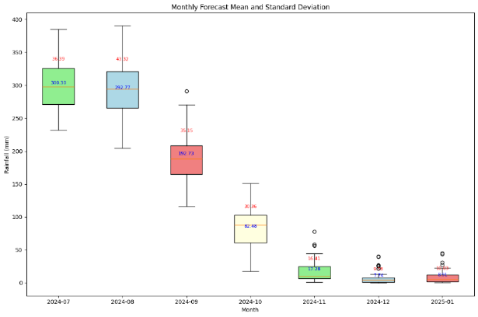
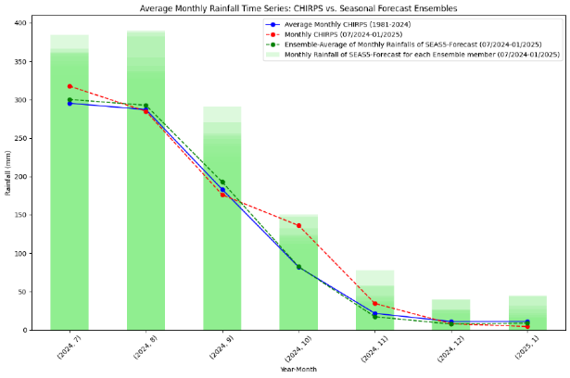
Seasonal Rainfall Forecast for Summer 2024 :
Initialized forecast 07/2024

Slide 22
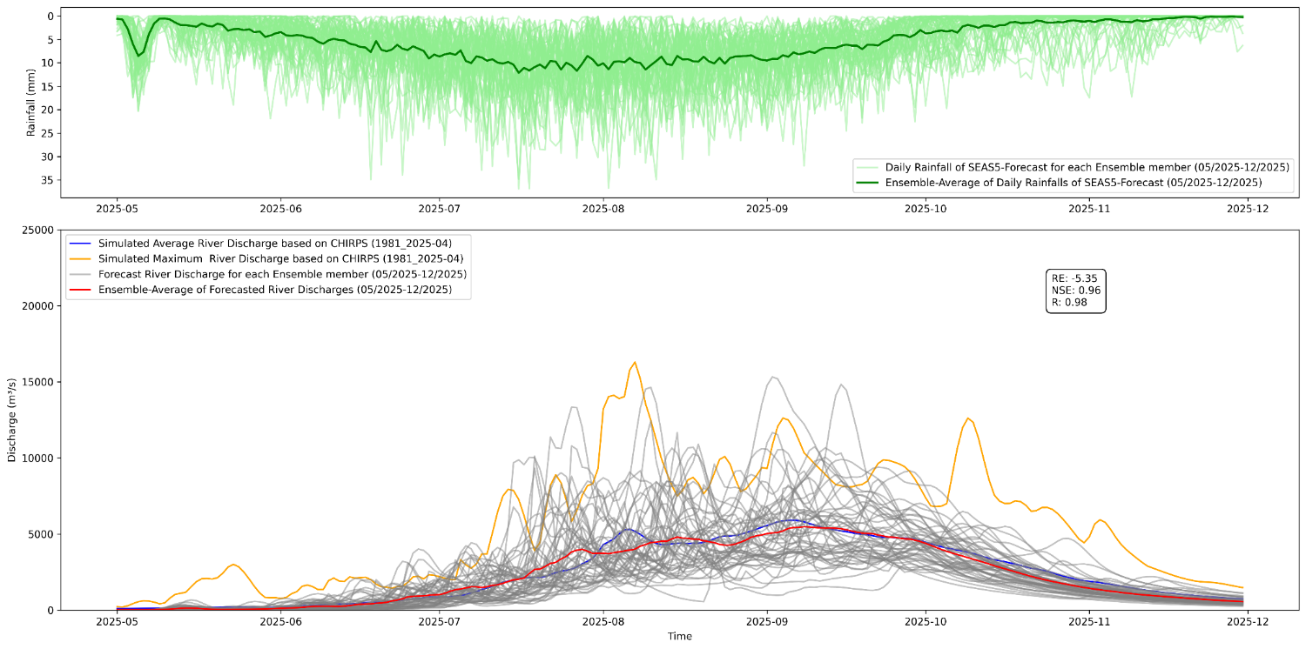
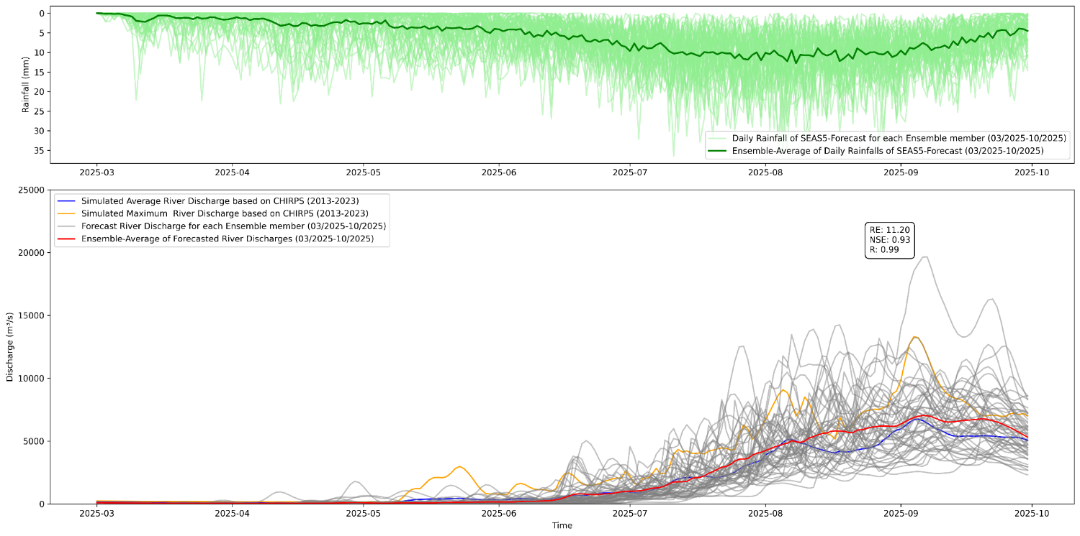
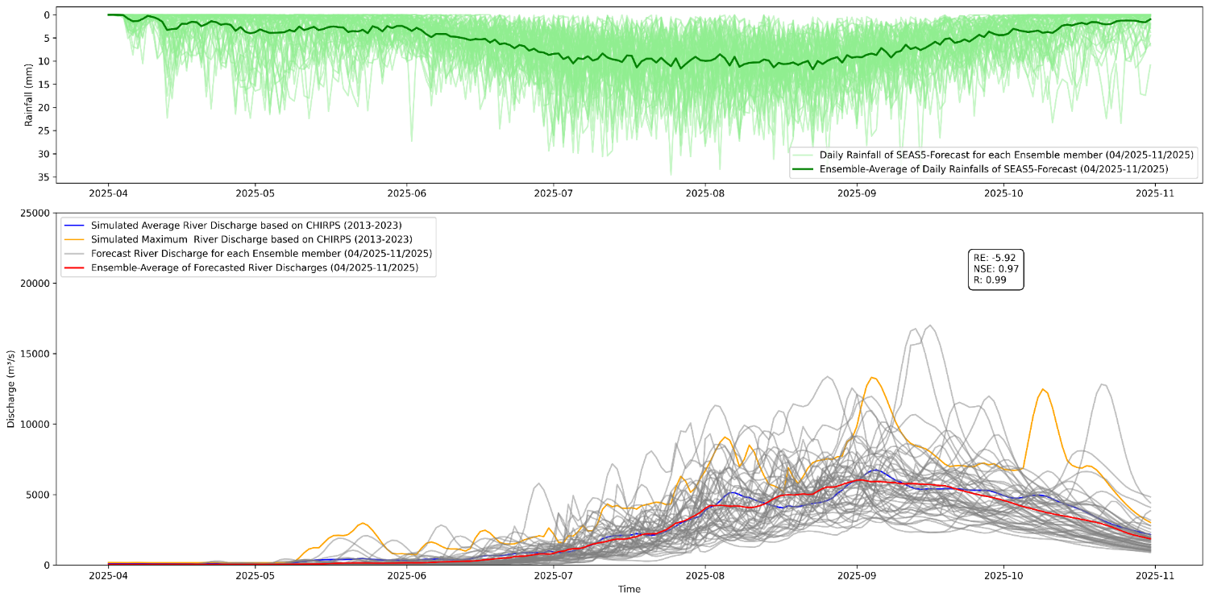
Seasonal Stream Flow Forecast for March and April 2025
(daily)
Initialized forecast 03/2025
Initialized forecast 04/2025
Initialized forecast 05/2025

Slide 23
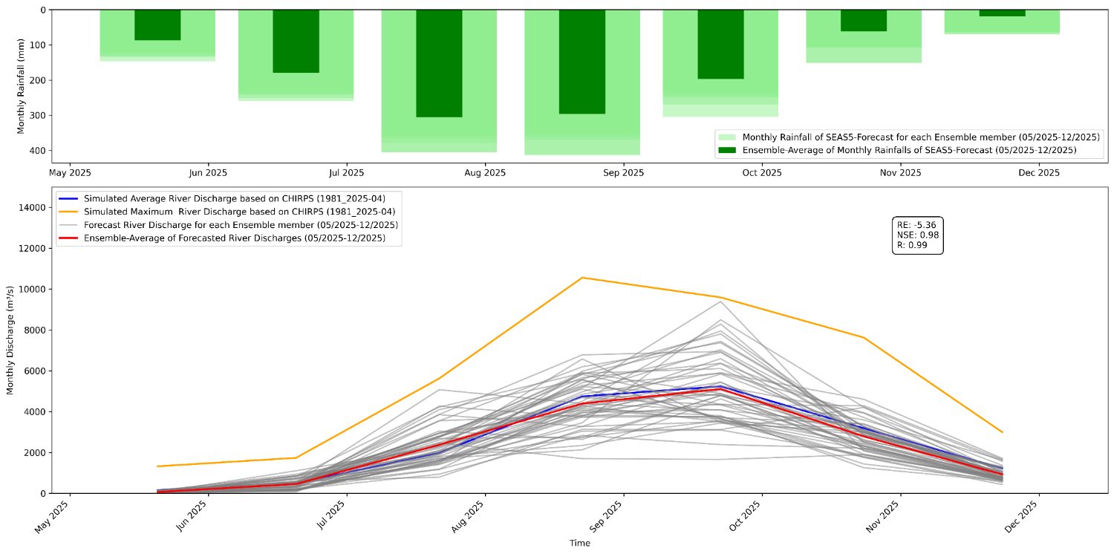
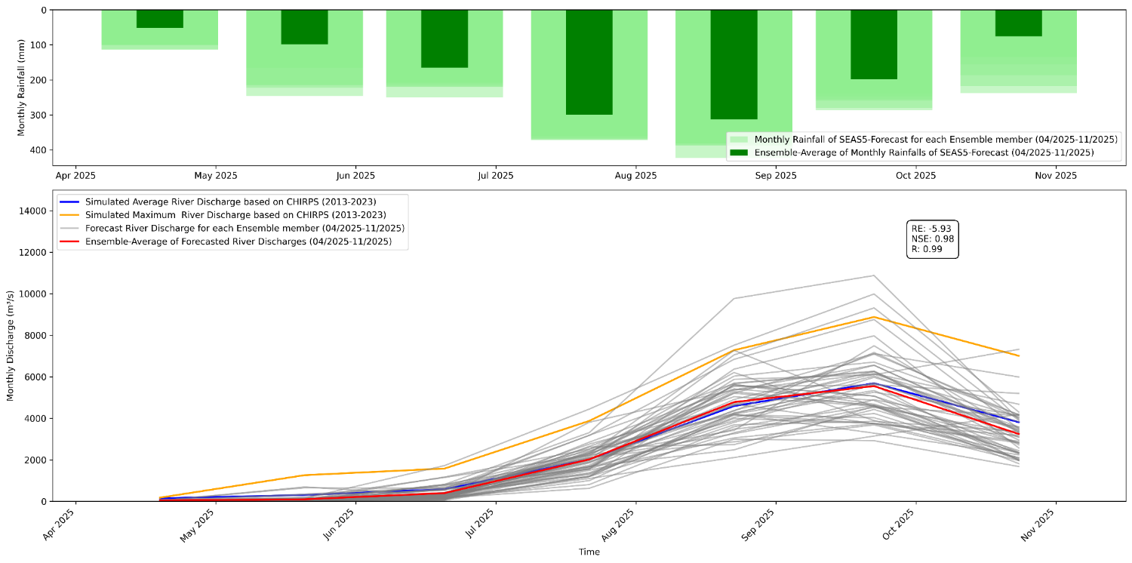
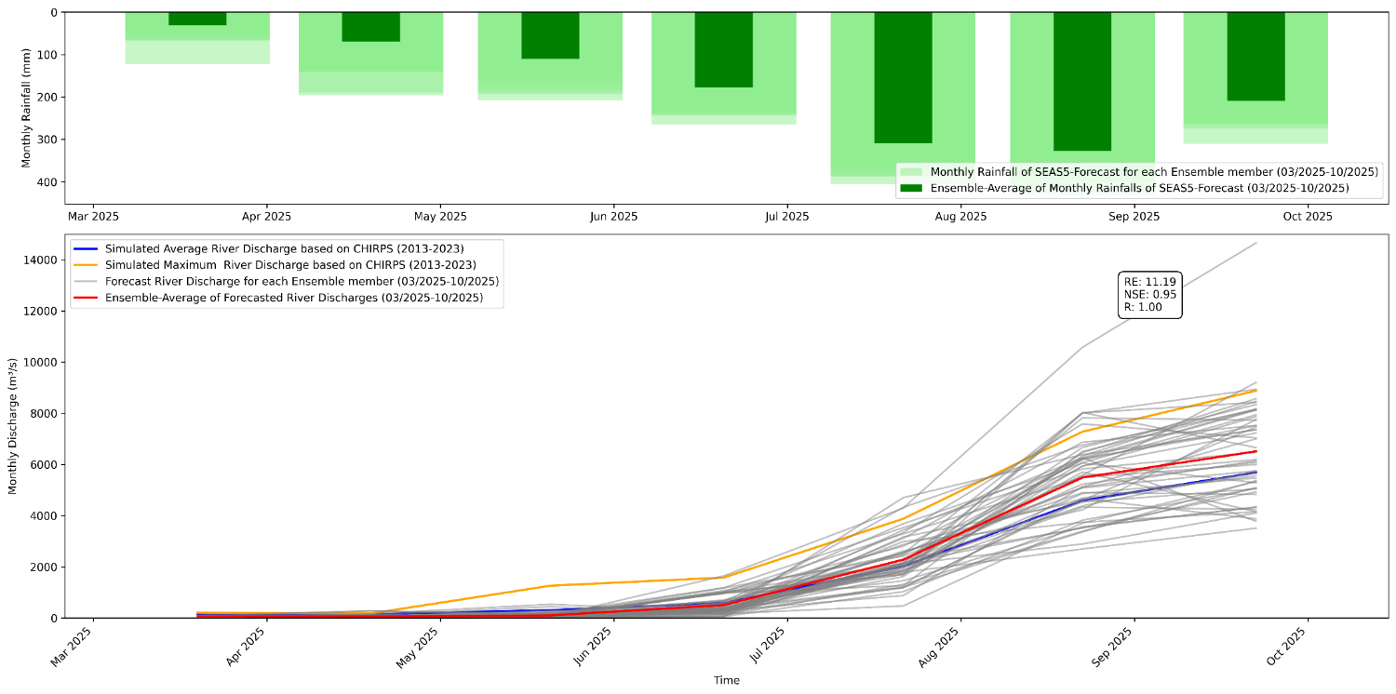
Seasonal Stream Flow Forecast for March and April 2025
(monthly)
Initialized forecast 04/2025
Initialized forecast 03/2025
Initialized forecast 05/2025

Slide 24
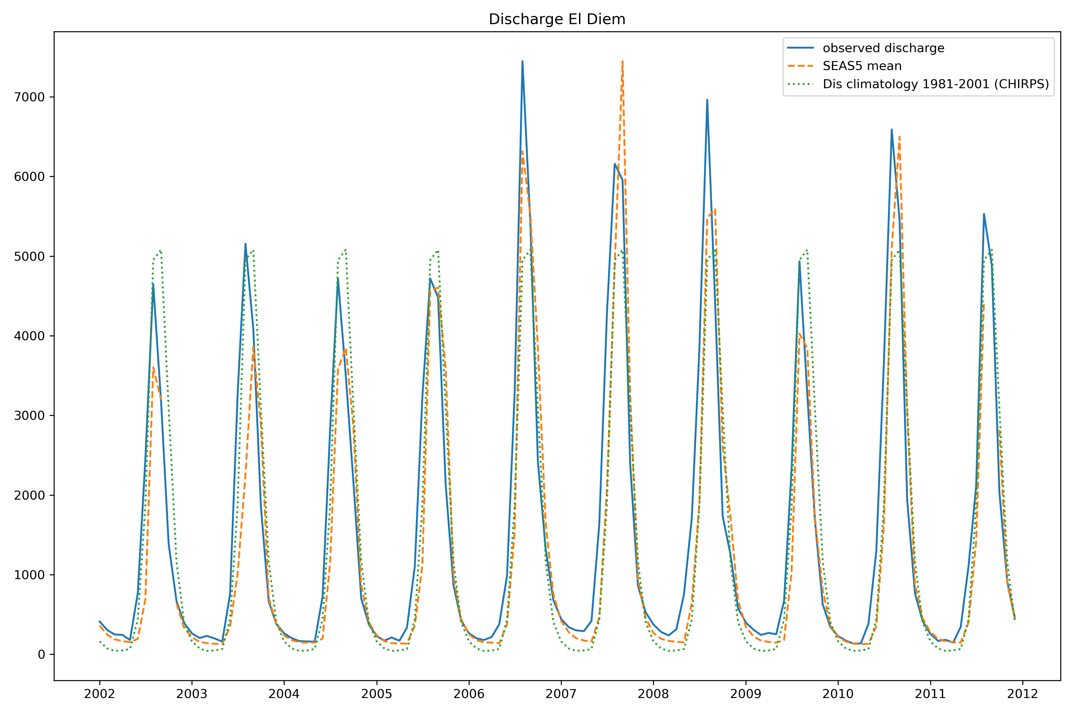
Stream Flow: observed; long term average; seasonal forecast

Slide 25

Relative error: long term average vs. seasonal forecast

Slide 26


Annual + Seasonal Hydro-Sediment Dynamics with IQR Uncertainty
Mean Ann Sediment Yield
Gilgel Abay: 30.4 ± 7.2 t/ha/yr
Gumara: 27.0 ± 10.7 t/ha/yr
Peak Yields
Gilgel Abay: 48.5 t/ha/yr (2013)
Gumara: 60.2 t/ha/yr (2020)
Inner Quantile range (IQR) shows the central 50% of predictions for a clear, robust uncertainty band.
-26-
-26-

Slide 27


Calibration & Validation of WASA-SED Model at El Diem
Daily Sediment
Monthly Sediment
Comparison: observation and simulated Sediment (2001-2011 )

Slide 28
6. Conclusions
This seasonal forecast system gives estimates of runoff yield up to ½ year ahead (e.g. for this large tropical catchment)
There is some forecast skill in such prediction, which may support a more efficient water resources use of the Blue Nile and even sediment flux management
It might improve hydropower production in Ethiopia and drought management / irrigation efficiency in Sudan
Still, the skill is not high enough for flood risk management months ahead
Further improvements of such forecasts systems are under development, Including data assimilation, in particular with snow data (in other regions)
Potentials for water management in Egypt?

Slide 29

Thank you for your attention
Session HS 4.4 (PICO) “Operational forecasting and warning systems for flood, water scarcity and multi-hazards: challenges and innovations”
EGU26-7569: Mon, 4 May, 08:30–10:15 | PICO spot 2
We gratefully acknowledge
Key contributions by partners from Ethiopia, Sudan and climate center of East Africa (ICPAC)
Provision of SEAS-5 forecasts by ECMWF
funding by BMFTR (Germany)
University supports from Bahir Dar (Ethiopia), Potsdam, Augsburg and Karlsruhe (Germany)
@ IGAD Climate Prediction and Application Centre

