Slide 1
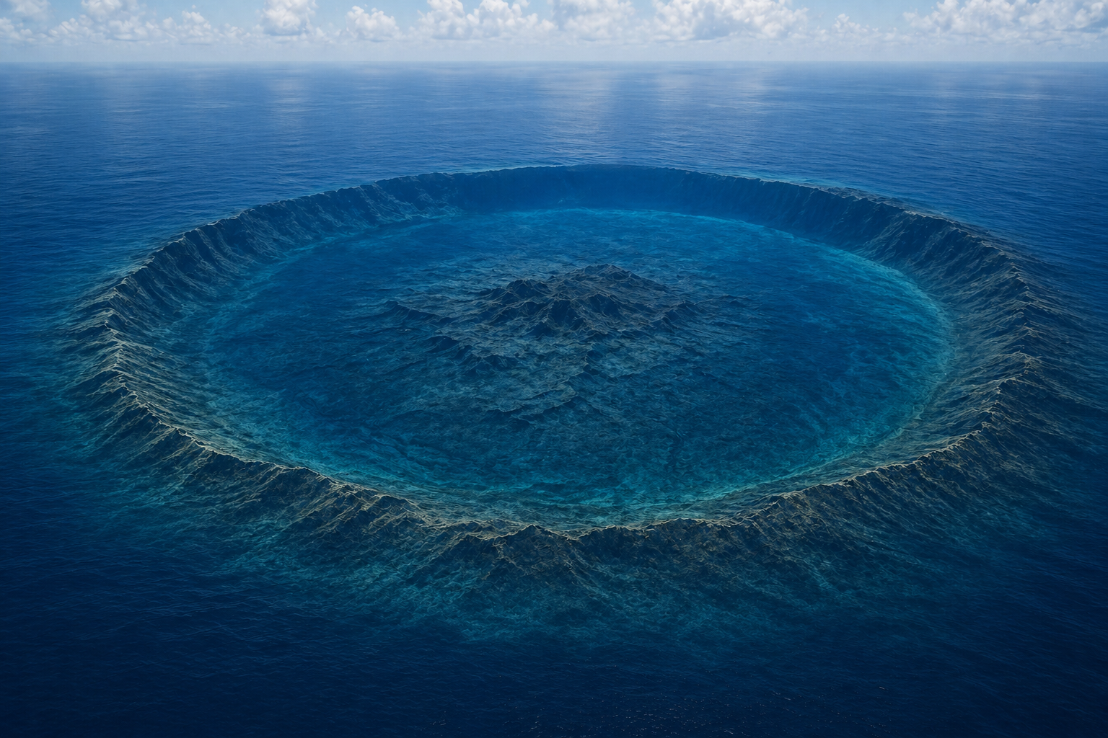


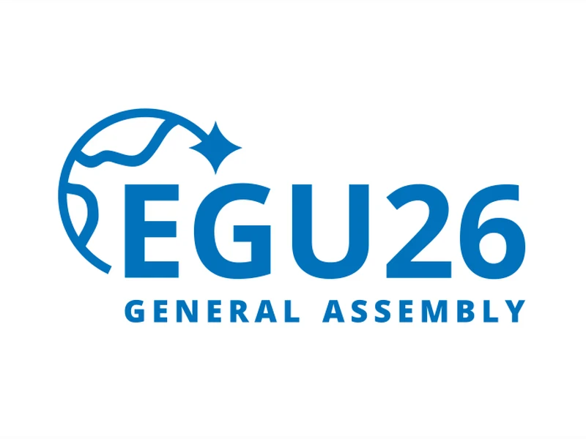
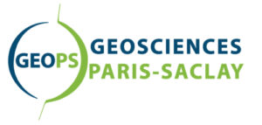
Calderas Beneath the Waves: AI-Powered Exploration of Subaqueous Volcanism
Andrea Verolino^{1,2*}, Christopher Lee³, Susanna F. Jenkins^{1,4}, Martin Jutzeler⁵, Adam D. Switzer^{1,4}
¹ Earth Observatory of Singapore, Nanyang Technological University, Singapore
² Géosciences Paris Saclay, Université Paris-Saclay, France
³ Department of Physics, University of Toronto, Canada
⁴ Asian School of the Environment, Nanyang Technological University, Singapore
⁵ School of Physical Sciences and Centre of Excellence in Ore Deposits (CODES), University of Tasmania, Australia

Slide 2
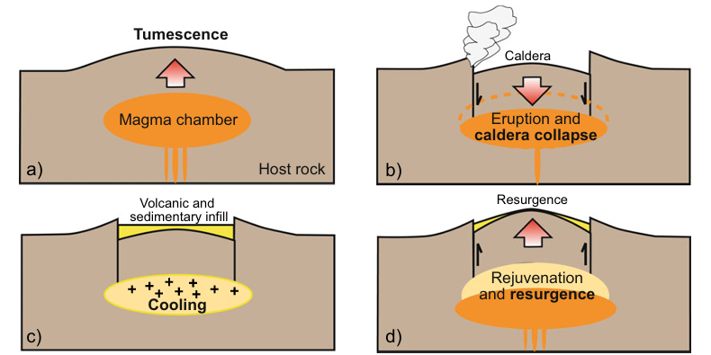
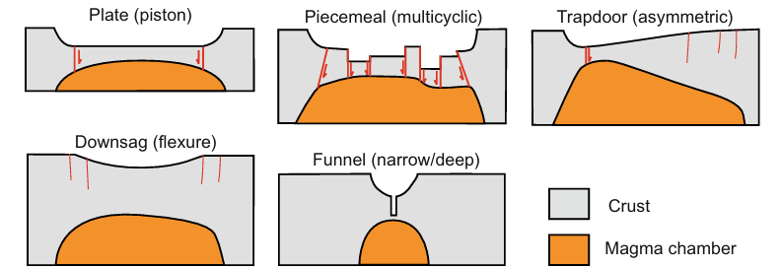

Introduction and background
What is a caldera?
Evolution of a Caldera
Calderas are large collapse depressions, formed by rapid magma withdrawal
Type of collapse (e.g. symmetric, asymmetric)
Composition (e.g. basaltic, rhyolitic)
Level of erosion (e.g. cauldron, ring structure)
Magma reservoir depth and geometry (e.g. funnel)
Caldera types (geometry)
Cole et al. (2005) – Earth-Science Review
In regional satellite-based studies, we rely on morphology to classify calderas
Acocella (2021) – Volcano-tectonic processes
Notes:
We all agree on this definition
Different types of caldera based on processes and morphologies
We use morphology in remote-based approaches in absence of field data (that’s what we did here)

Slide 3
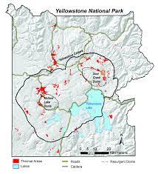
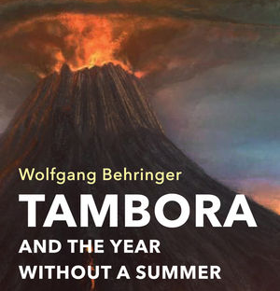
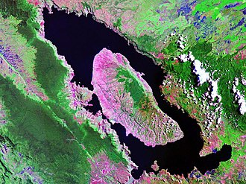
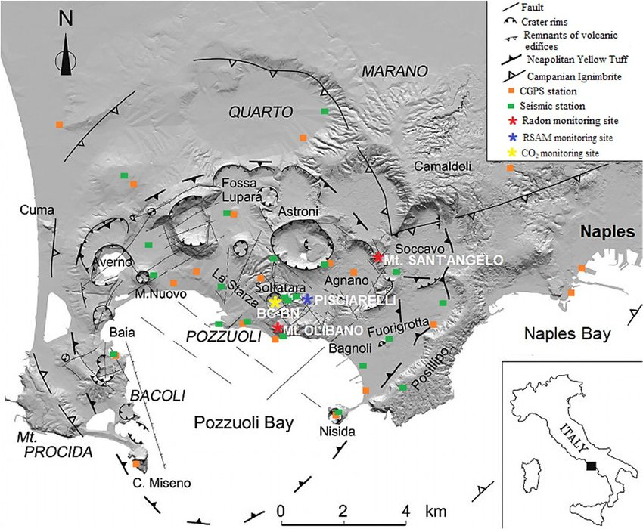
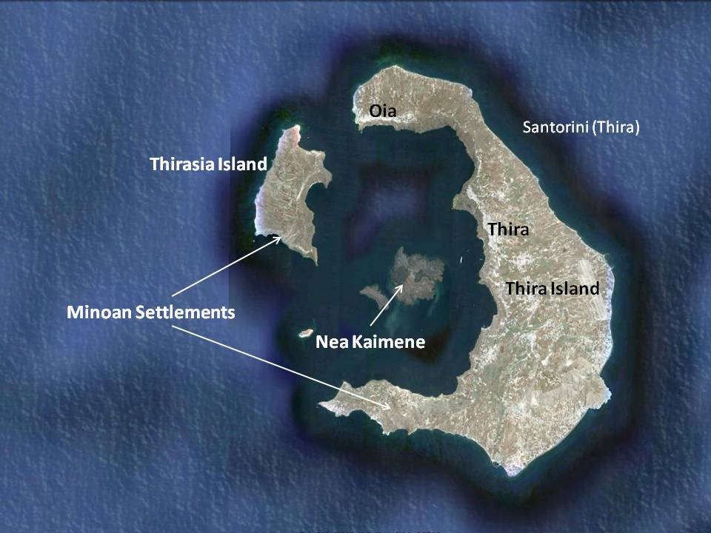
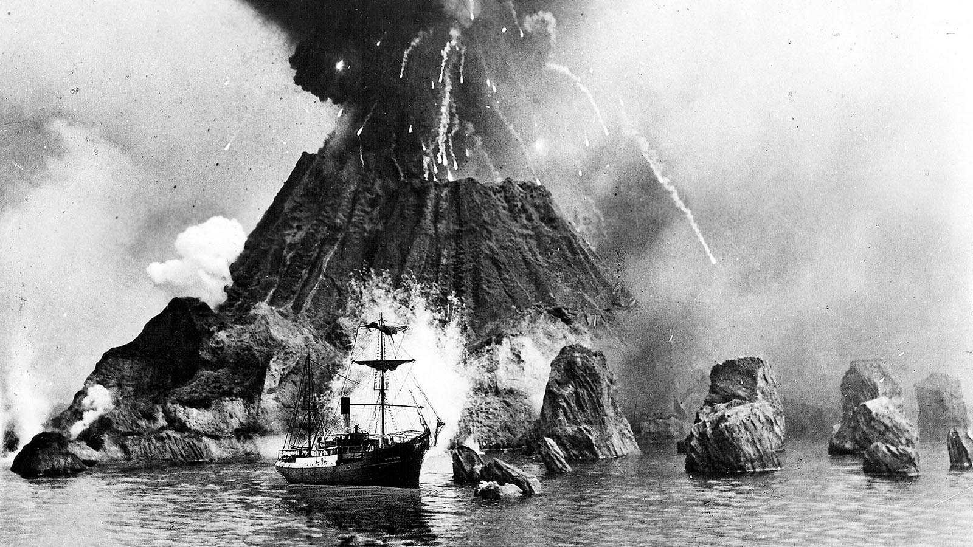
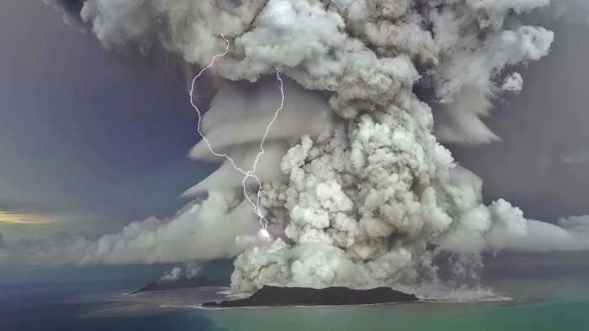
Introduction and background
Significance
Tambora
Yellowstone
Toba
Campi Flegrei
Santorini
Krakatau
Hunga Tonga-Hunga Ha’hapai
Notes:
Subaerial examples
Some submarine examples
They are important to study

Slide 4
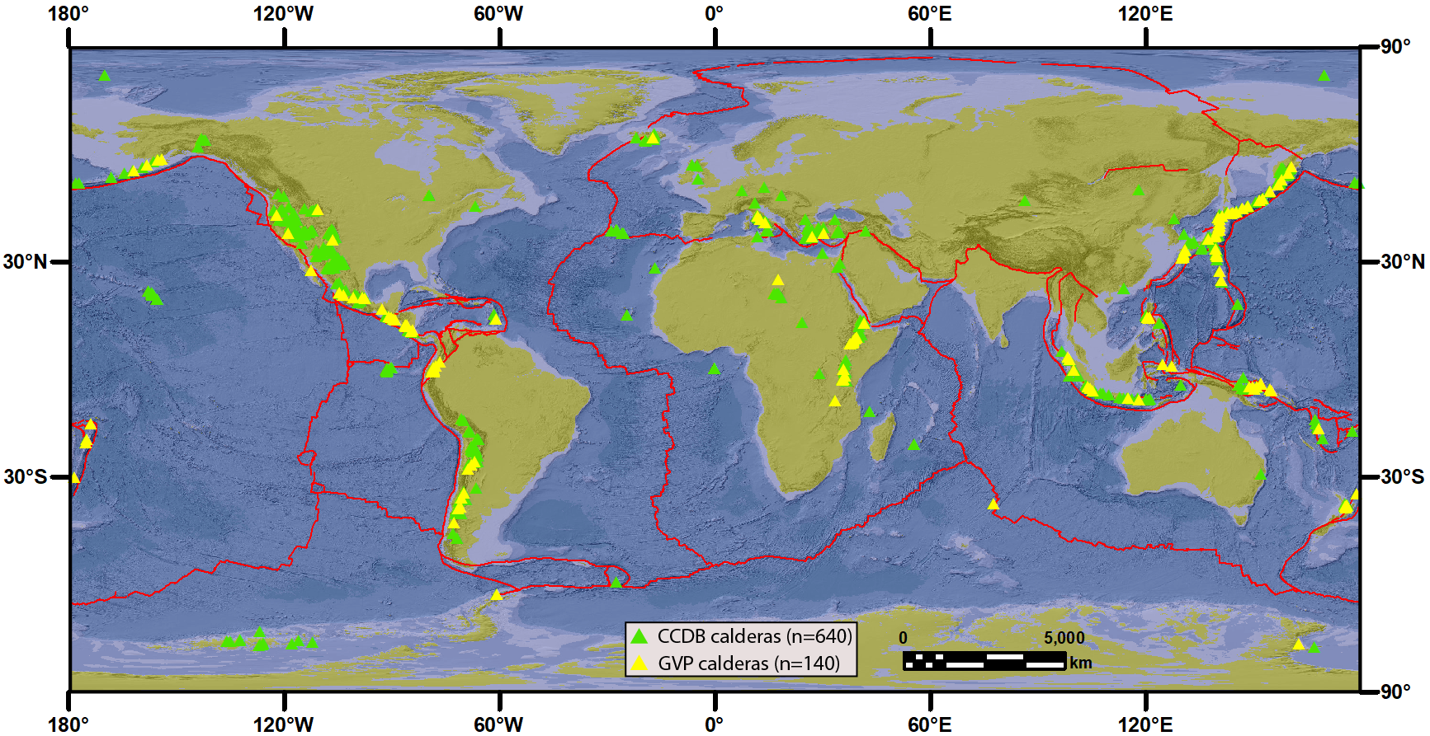
Introduction and background
What we do know and knowledge gap
GVP: 140 calderas
CCDB: 640 calderas
<5% is Submarine
Are we missing something?
Verolino et al. In Review – Comms. Earth & Environment
Notes:
Existing gap in current databases

Slide 5
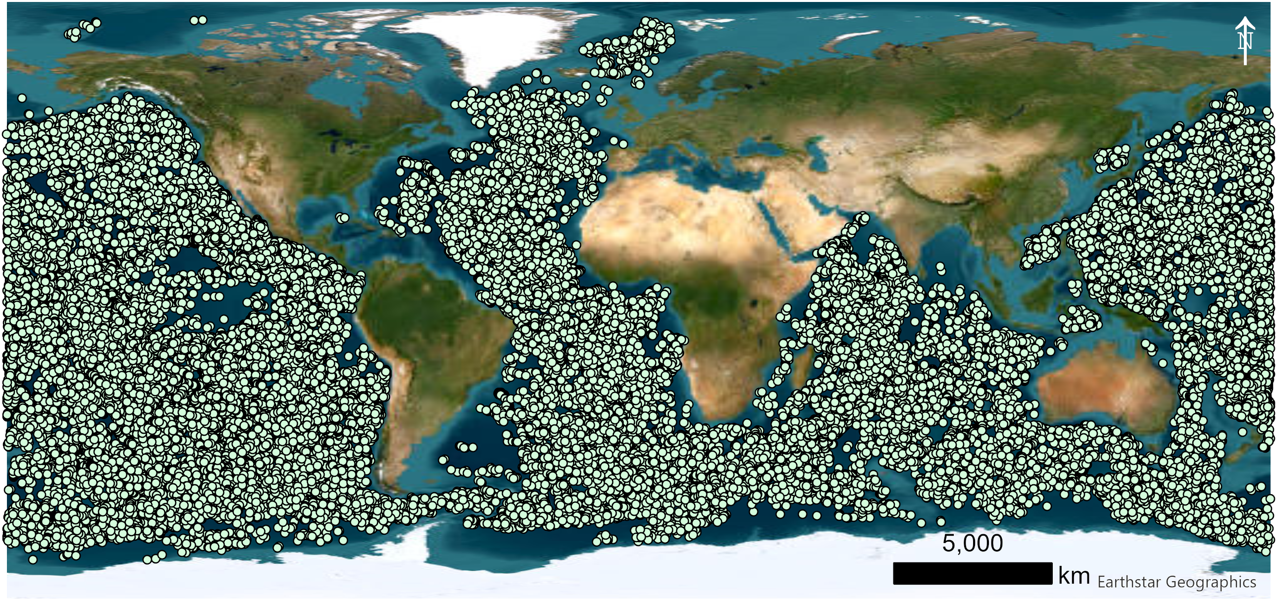
Introduction and background
What we do know and knowledge gap
>70% of earth’s volcanism is subaqueous
> 43,000 seamounts worldwide
Notes:
Majority of volcanism on earth is submarine
What about submarine calderas?

Slide 6
Study aim
Produce a global dataset of submarine calderas using a semi-automated framework
Identify high-priority calderas in terms of volcanic hazard potential
Identify key areas for future resource exploration
Identify key areas for the study early Earth conditions and marine ecosystems resilience
Promote targeted sea exploration at calderas of interest
Notes:
Aims

Slide 7
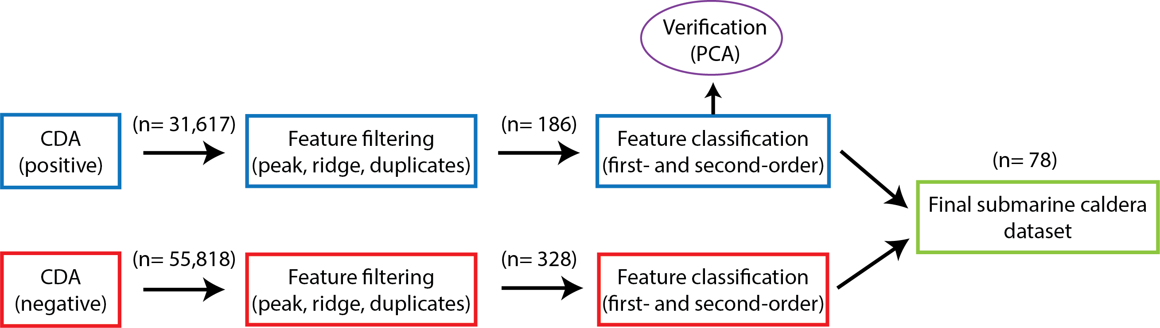
Methods
Workflow
Verolino et al. In Review – Comms. Earth & Environment
Notes:
This is the workflow (give also numbers)
We start with the CDA

Slide 8
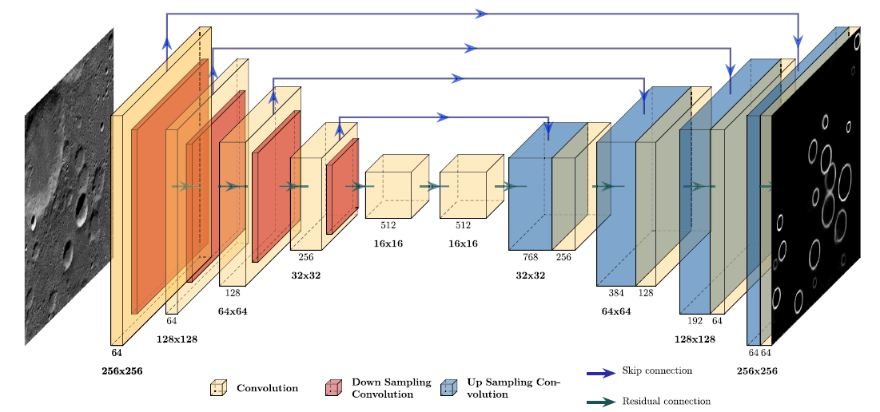
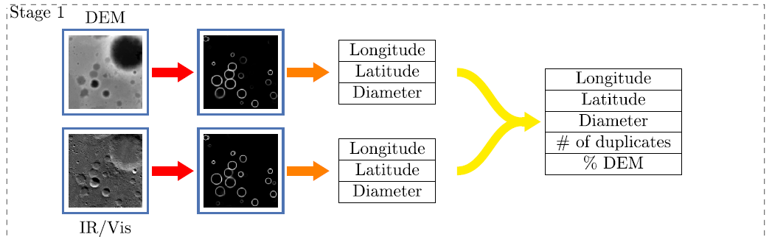
Methods
Crater Detection Algorithm (CDA)
Lee and Hogan (2021) - Computers and Geosciences
Positive CDA (depressions)
Sub-circular features
Negative CDA (mounds)
Notes:
Something from Lee and Hogan
Downsampling and upsampling (duplicates)
CDA positive (classic, to find depressions)
CDA negative (inverted to find mounds)

Slide 9
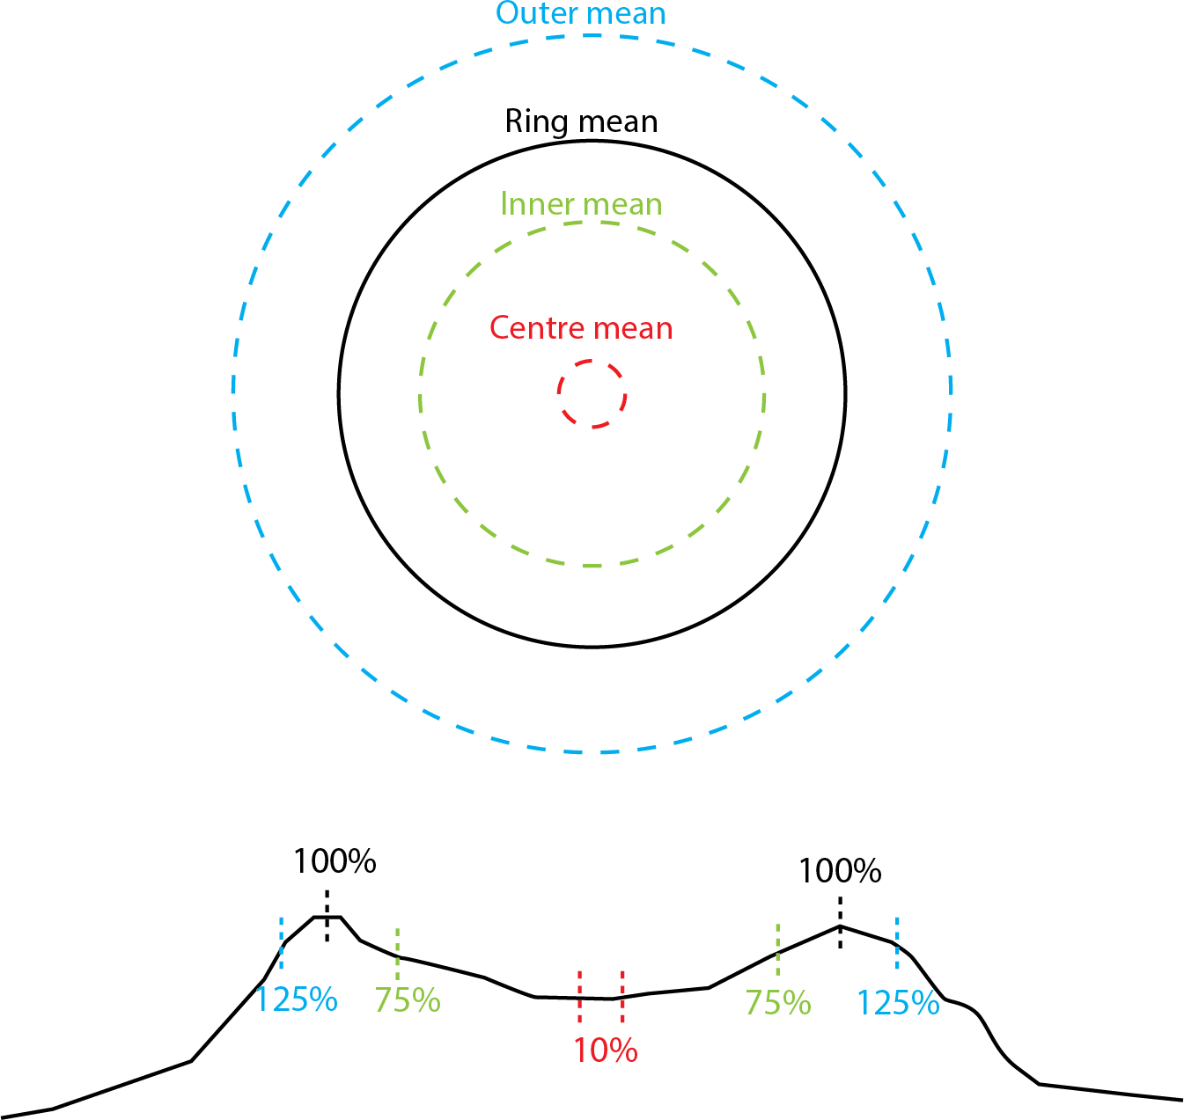
Methods
CDA outputs
PARAMETER | DESCRIPTION
Diameter | Mean diameter of the feature
Ring mean | Mean water depth of the feature ring
Centre mean | Mean water depth measured within a narrow ring concentric to the feature centre, positioned at 10% of the caldera radius, to represent near-central bathymetric conditions
Inner mean | Mean water depth measured within a concentric ring located at 75% of the feature radius, to represent intermediate bathymetric conditions within the structure.
Outer mean | Mean water depth measured within a concentric ring located at 125% of the caldera radius, characterizing the bathymetric conditions just beyond the caldera rim.
Duplicates | Number of times a feature is detected across multiple images
Peak | If Peak=T, centre mean > Inner mean; if Peak=F, centre mean < Inner mean
Ridge | If Ridge=T, Inner mean > Outer mean; if Peak=F, Inner mean < Outer mean
Verolino et al. In Review – Comms. Earth & Environment
Notes:
- Output by output

Slide 10
Methods
Crater Detection Algorithm (CDA) - Filtering
Verolino et al. In Review – Comms. Earth & Environment
Peak= F (centre lower than rings)
Ridge= T (depression within a mound, not on a flat floor)
Duplicates ≥ 2 (features identified in more than one image)
Notes:
Filters selection explained
Numbers down to 514 potential calderas

Slide 11
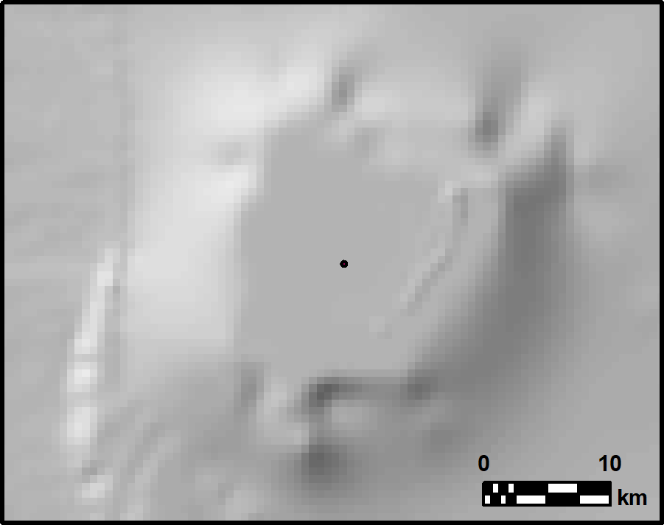
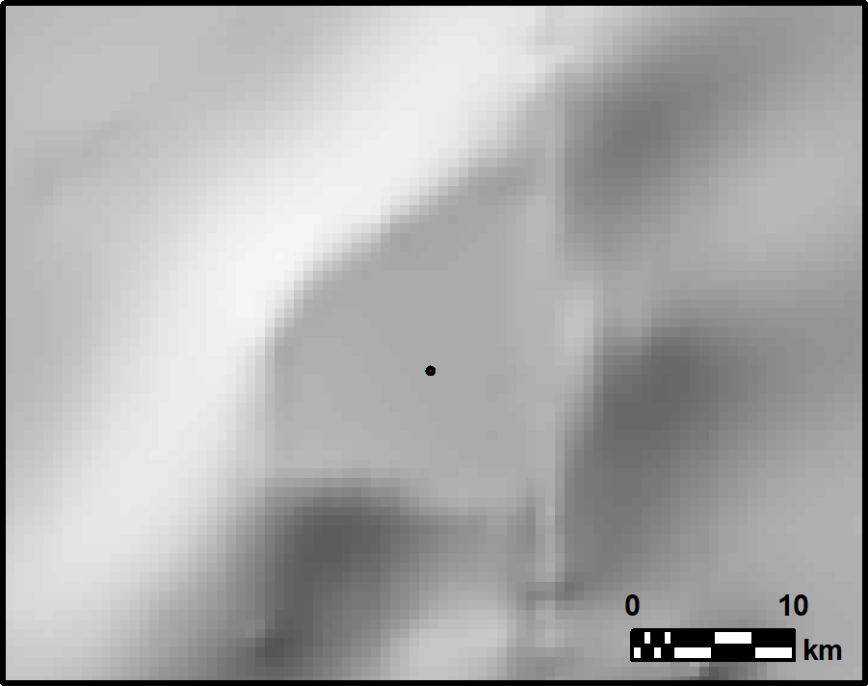
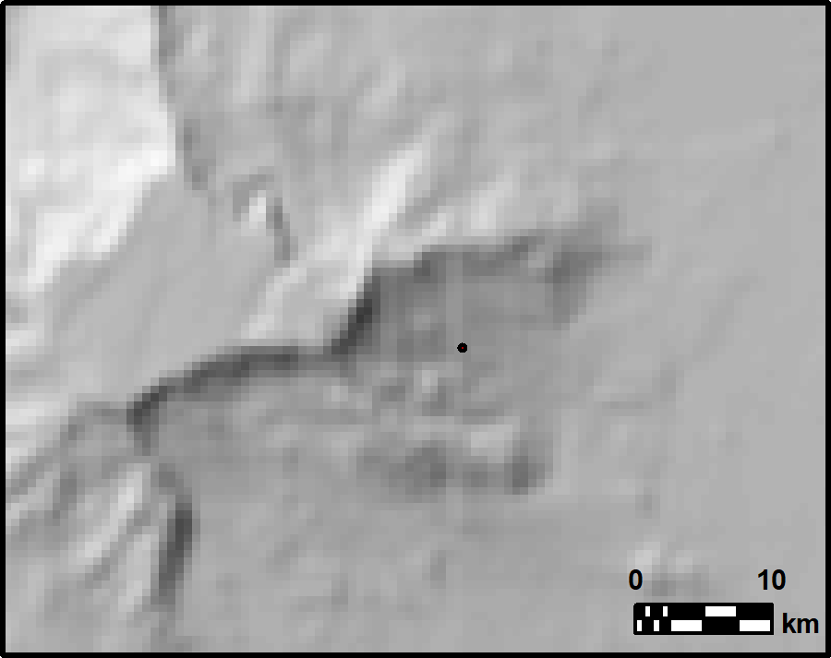
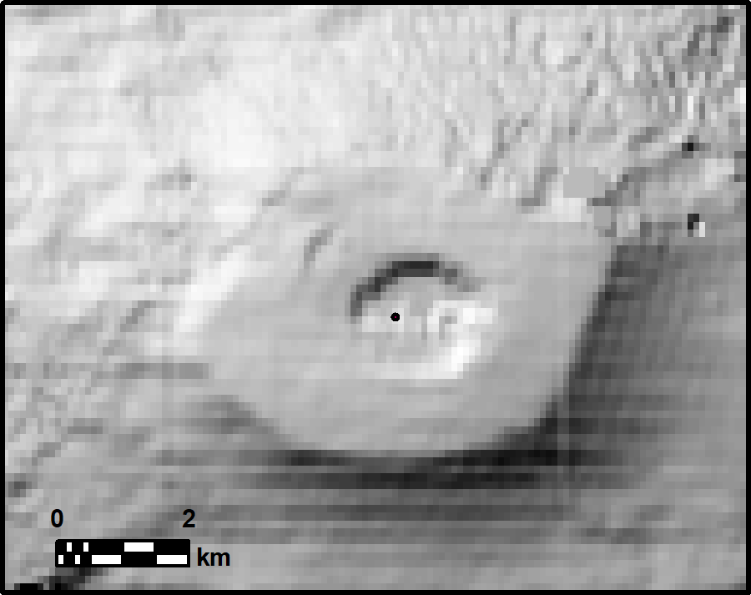
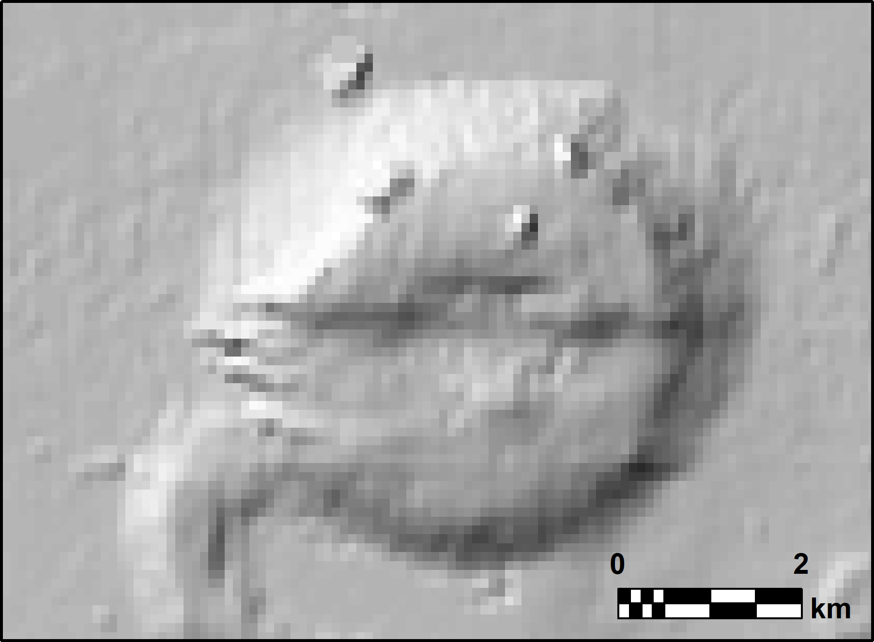
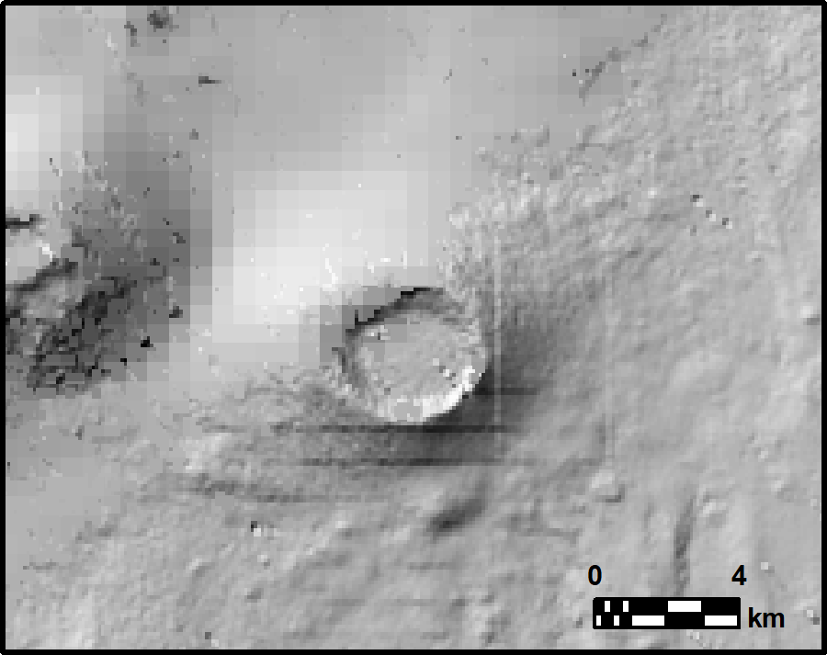
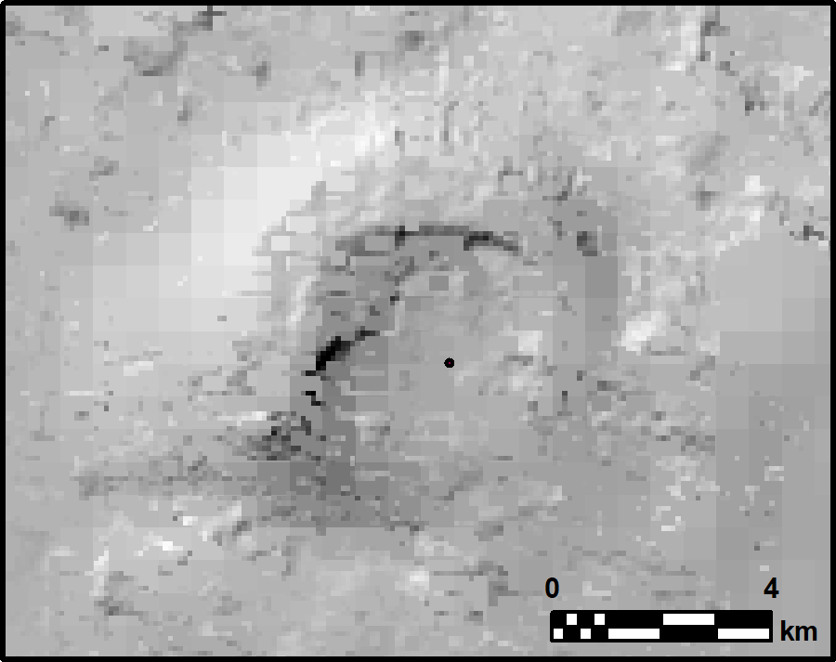
Methods
Crater Detection Algorithm (CDA) - Classification
Type | Sub-type | Description | Support
Atoll | Young atoll | Emerged or shallow (<50m) atoll | Satellite imagery and/or coral reef database³⁸
 | Sunken atoll | Deep sea (>100m) old atoll with gentle gradients between centre and edges | Hillshade visual analysis, bathymetric contour analysis, bathymetric profiling
Flank scar/eroded surface | Flank scar/eroded surface | Valley between volcanic ridges, or eroded volcanic surface or edifices | Hillshade visual analysis, bathymetric contour analysis, bathymetric profiling
Crater/small caldera | Full crater/small caldera | Enclosed volcanic depression <3km in diameter | Hillshade visual analysis, bathymetric contours, bathymetric profiling, presence of seamounts¹⁸
 | Horse-shoe/eroded crater / small caldera | Open/eroded volcanic depression <3km in diameter | Hillshade visual analysis, bathymetric contours, bathymetric profiling, presence of seamounts¹⁸
Caldera | Full caldera | Enclosed volcanic depression >3km in diameter | Hillshade visual analysis, bathymetric contours, bathymetric profiling, presence of seamounts¹⁸
 | Horse-shoe/eroded caldera | Open/eroded volcanic depression >3km in diameter | Hillshade visual analysis, bathymetric contours, bathymetric profiling, presence of seamounts¹⁸
Undefined | Undefined | Not classifiable (poor bathymetry or unclear structure) | N/A
Verolino et al. In Review – Comms. Earth & Environment
Notes:
Manual classification into these categories, first-order (type) and second-order (sub-type)

Slide 12
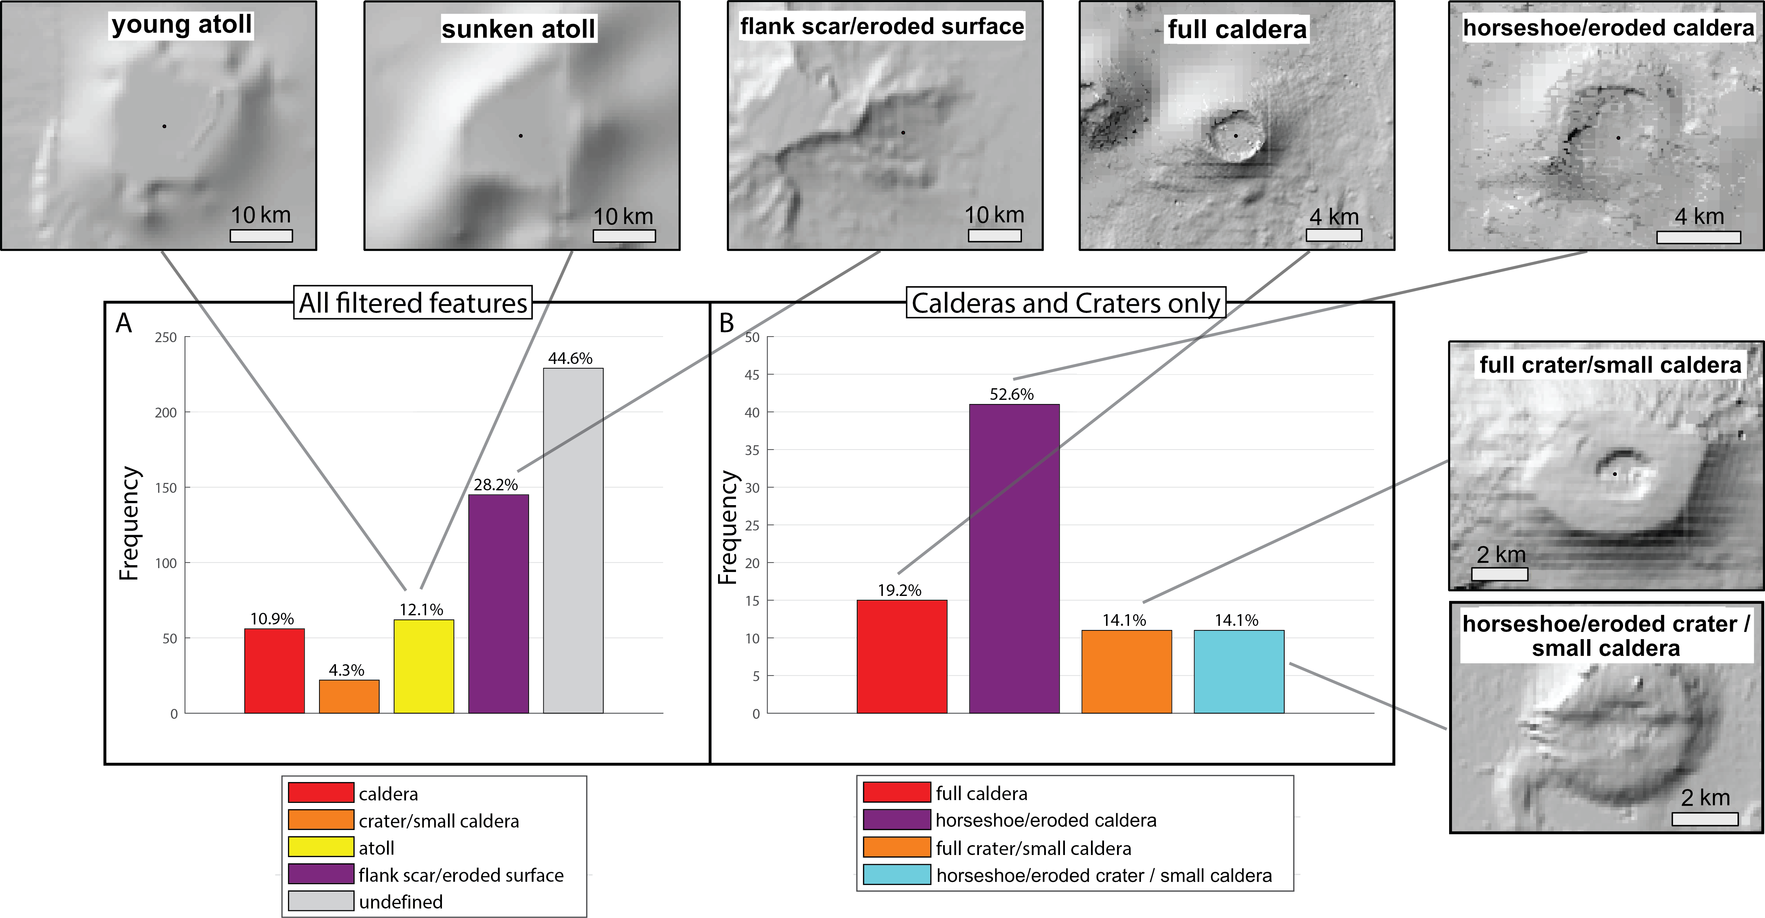
Results
Crater Detection Algorithm (CDA) - Classification
Verolino et al. In Review – Comms. Earth & Environment
Notes:
Manual classification into these categories, first-order (type) and second-order (sub-type)

Slide 13
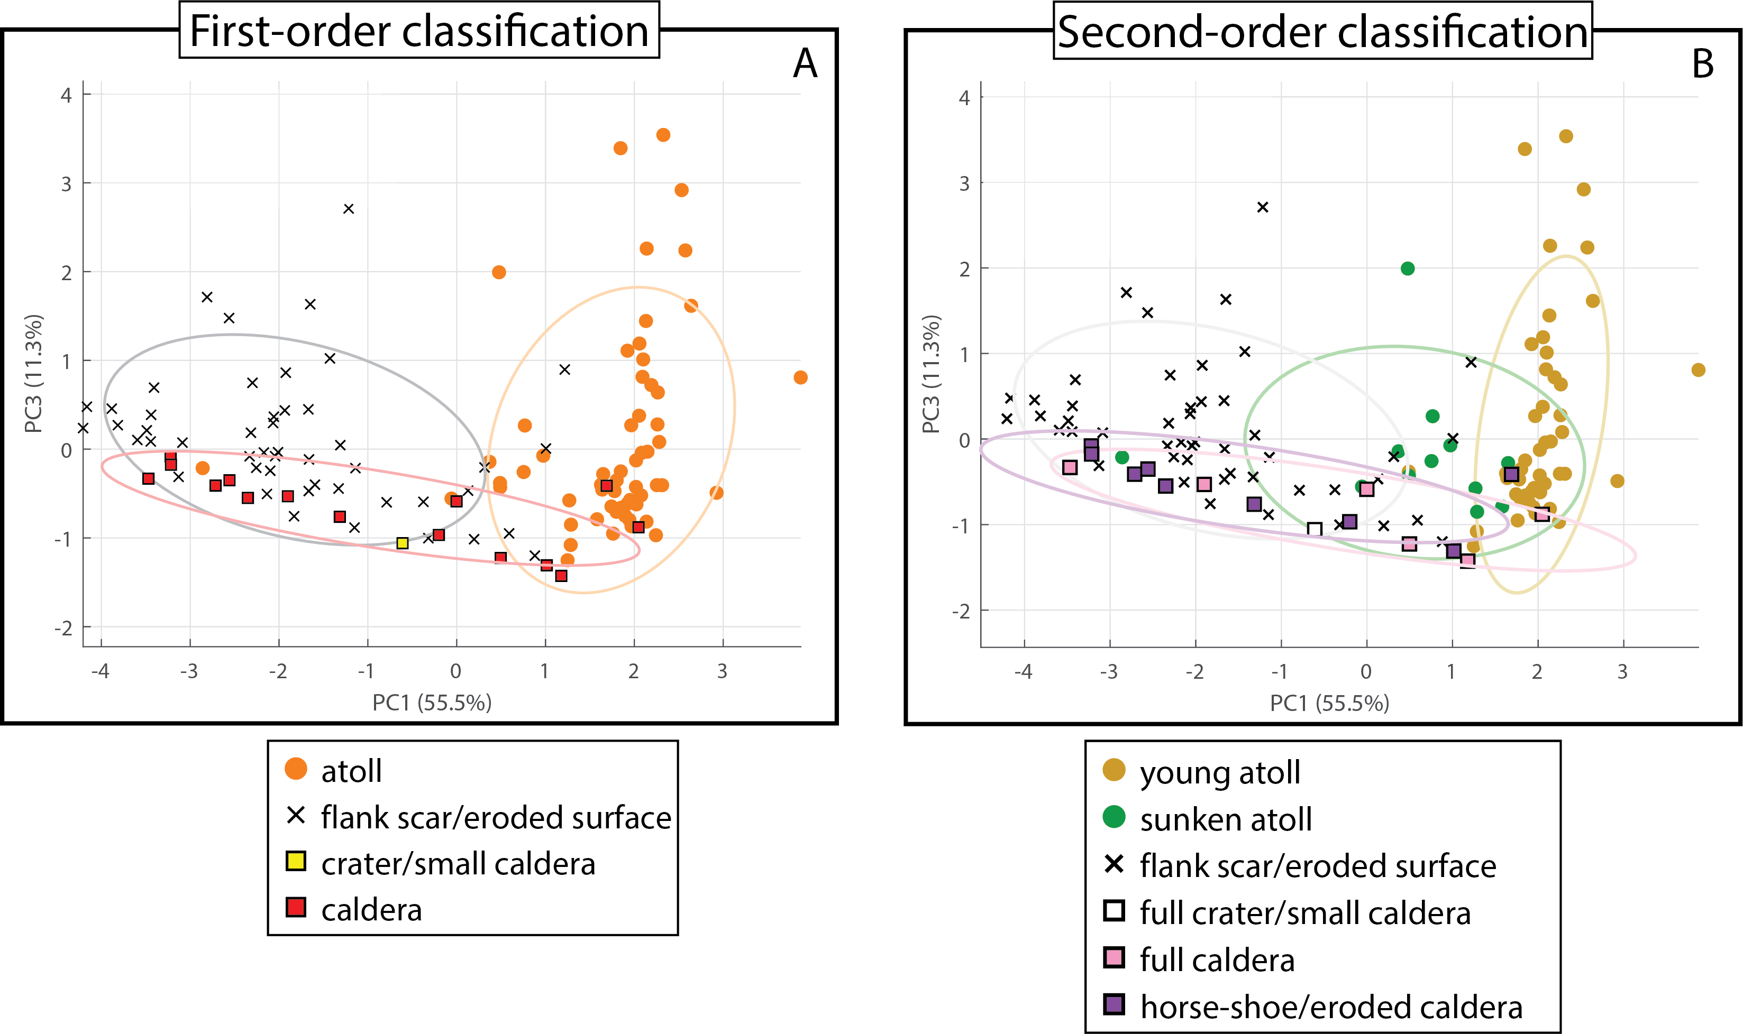
Results
Validation through PCA
Both first-order and second-order classification results were included in the PCA to evaluate morphological distinctions.
First-order PCA (A) shows well-separated clusters for atolls, calderas, and flank scars/eroded surfaces, though with some outliers.
Second-order PCA (B) effectively distinguishes young and sunk atoll sub-types as distinct clusters.
Full calderas and horse-shoe/eroded calderas overlap significantly, suggesting morphological similarity
Only one crater/small caldera data point was included (from the positive dataset), which fell within the caldera cluster.
Flank scars and eroded surfaces remain distinct in the PCA, with minimal cross-clustering.
Verolino et al. In Review – Comms. Earth & Environment
Notes:
PCA for a the negative subset
Overall good clustering > good agreement with our classification
Even better for sub-types (to tell us what is not a caldera)
Some overlapping, but we are happy with the overall result

Slide 14
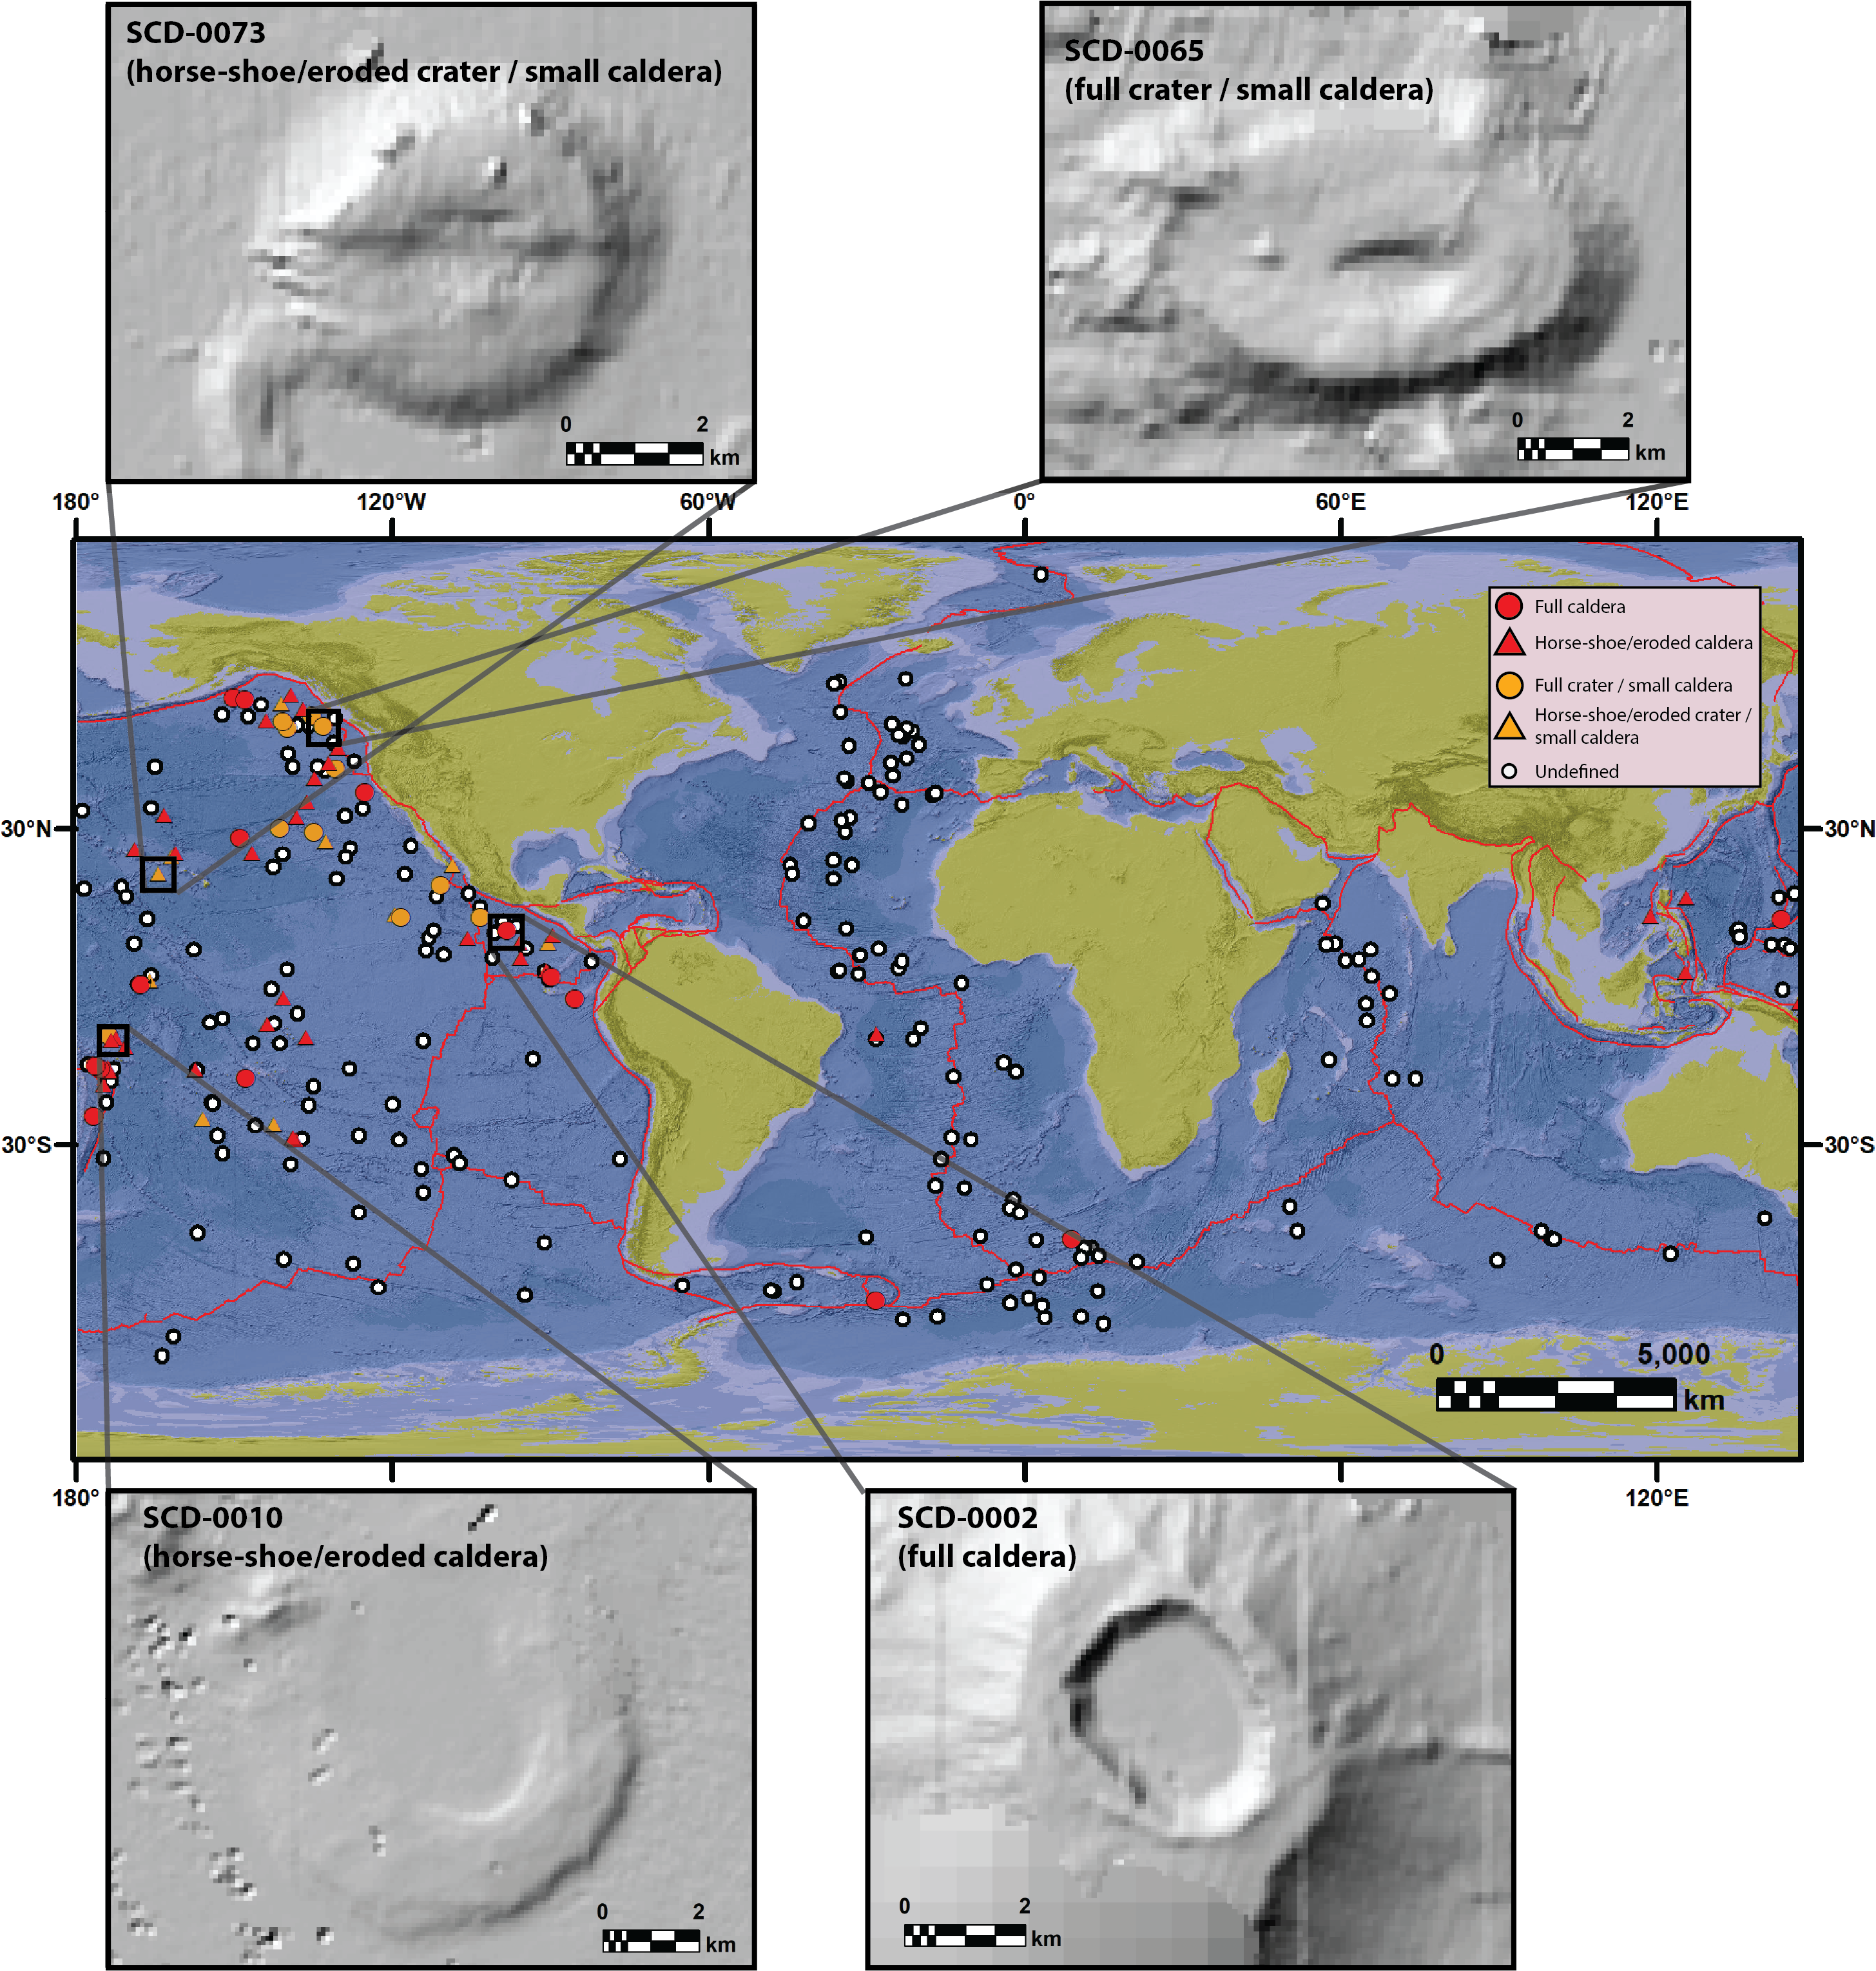
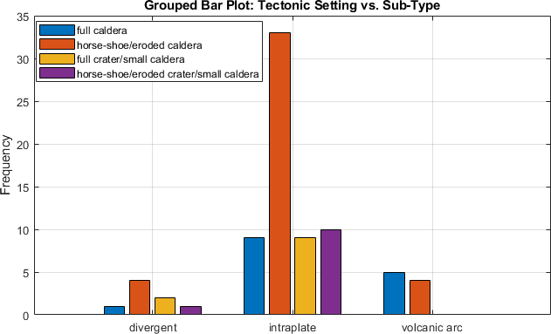
Results
Submarine Calderas Dataset (SCD)
78 potential calderas (75 new)
Verolino et al. In Review – Comms. Earth & Environment
Notes:
Results for calderas and craters
They have been combined cause we can’t differentiate them just based on diameter
78 potential calderas

Slide 15
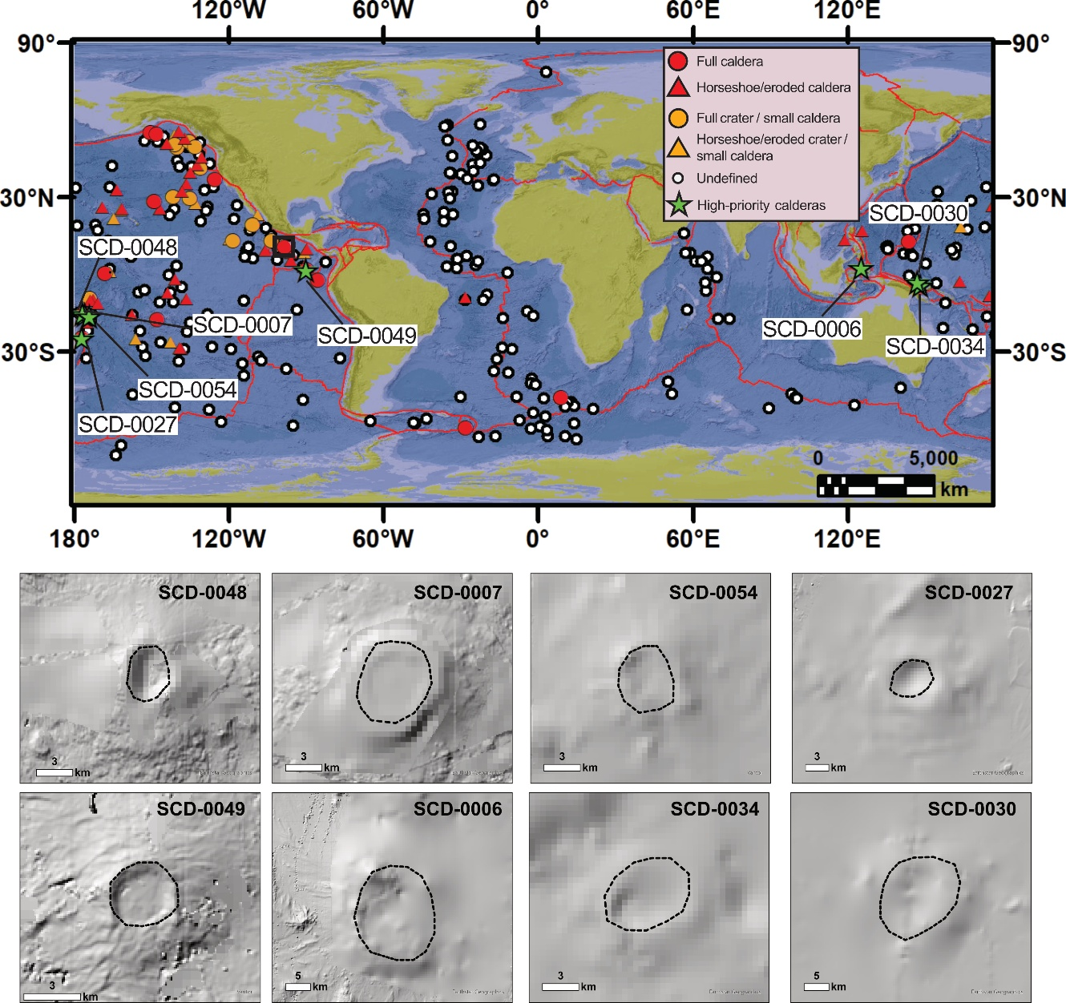
Discussion
High-priority submarine calderas (hazard)
Caldera name | Long | Lat | Caldera sub-type | Growth stage | Tectonic setting
SCD-0027 | -176.91 | -24.59 | full caldera | 3 | Volcanic arc (Kermadec arc)
SCD-0030 | 148.23 | -4.10 | horse-shoe/eroded caldera | 3 | Intraplate (South Bismarck plate)
SCD-0034 | 147.16 | -2.97 | horse-shoe/eroded caldera | 3 | Divergent (Manus spreading ridge)
SCD-0048 | -176.60 | -15.10 | full caldera | 3 | Volcanic arc (Kermadec arc)
SCD-0049 | -90.01 | 1.78 | full caldera | 3 | Divergent (Cocos-Nazca spreading centre)
SCD-0054 | -173.90 | -16.22 | horse-shoe/eroded caldera | 3 | Volcanic arc (Kermadec arc)
SCD-0006 | 125.44 | 2.70 | horse-shoe/eroded caldera | 4 | Volcanic arc (Sangihe arc)
SCD-0007 | -175.64 | -15.60 | full caldera | 4 | Volcanic arc (Kermadec arc)
Verolino et al. In Review – Comms. Earth & Environment
Notes:
High-priority list (hazard) based on tectonic setting and water depth
Not a comprehensive list just a priority list, based on hazard potential

Slide 16
Future directions
Improvement of the CDA with better global bathymetry
Implementation of a nested system of bathymetry datasets in the CDA, to include high-resolution bathymetry
More accessibility (on a global scale) to high-resolution bathymetric mapping technologies (wave gliders and Unmanned Surface Vehicles)
Implementation of on-site monitoring equipment at key calderas (e.g. Axial, Kolumbo)
Notes:
- What can be done

Slide 17
Summary
Submarine calderas are under-documented, despite their potential for explosive eruptions and geohazard risks.
A machine-learning-based Crater Detection Algorithm (CDA) was adapted to identify submarine calderas using global GEBCO bathymetric data.
514 filtered features were analysed, and classified, supported by Principal Component Analysis (PCA).
78 potential submarine calderas were identified.
We identified 8 high-priority calderas, based on their tectonic setting and growth stage, including shallow and partially emerged calderas.
Our new dataset lays a foundation for future sea exploration, hazard assessment, refinement of submarine volcanic monitoring, and much more (e.g. deep-sea mining, ecological studies to understand early life on Earth).

Slide 18
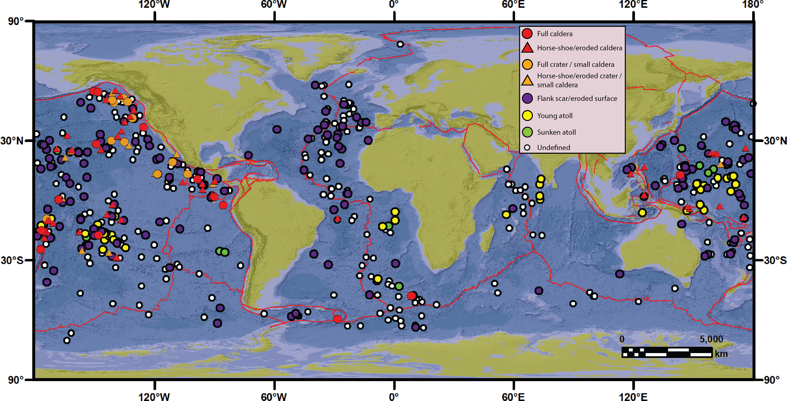
Supplementary Results
Feature classification results
Verolino et al. In Review – Comms. Earth & Environment
Notes:
- Overall results

Slide 19
Limitations
The CDA favours sub-circular features, making it less effective at detecting elongated (Toba or Axial Caldera) or more complex calderas, which were not captured.
Principal Component Analysis (PCA) was applied only to the positive dataset (186 of 514 features), making it less statistical robust.
Use of low-resolution GEBCO bathymetry limits the detection capability, leading to a high number of unclassified features (229 out of 514), some of which may be calderas.
Only two known submarine calderas were identified by the CDA (Niuatahi and Kemp), highlighting detection challenges under current bathymetric constraints.
The dataset likely represents a conservative minimum, not a comprehensive global inventory of submarine calderas.

