Slide 1






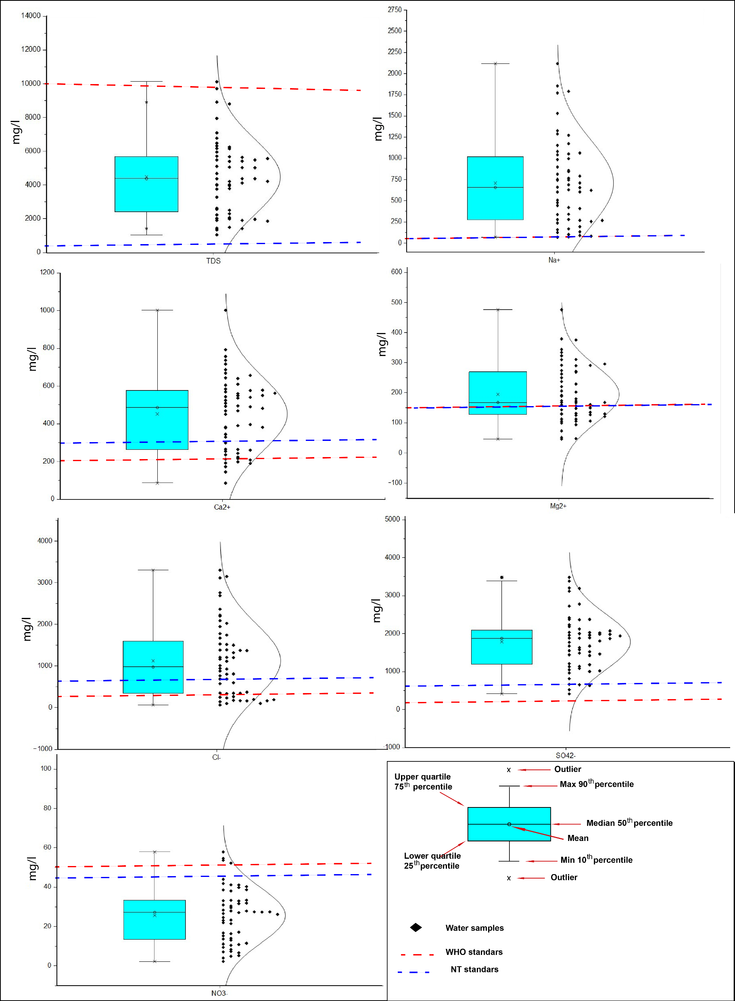
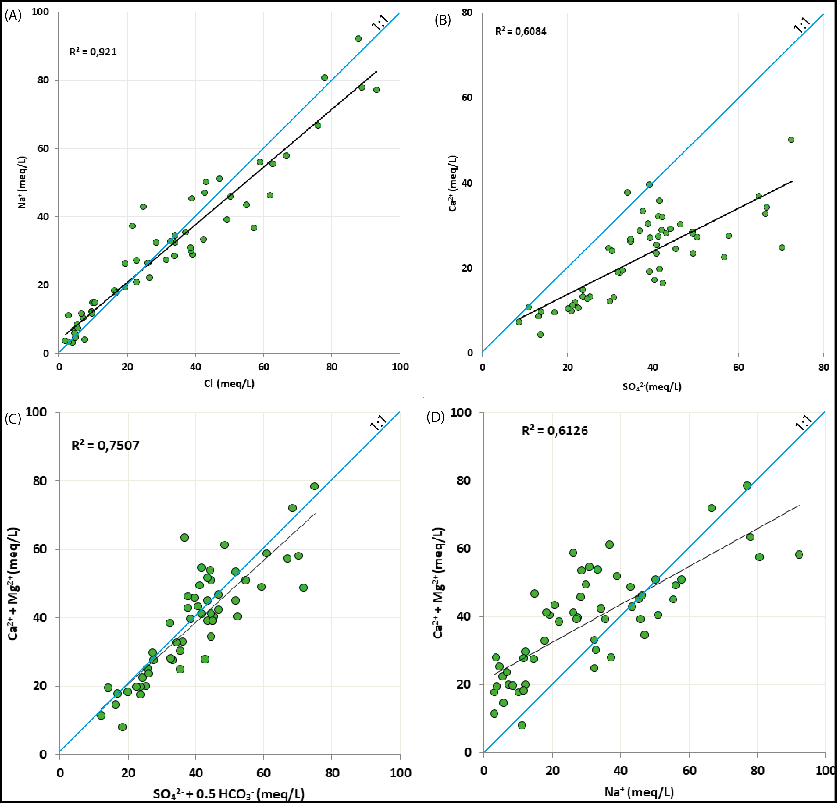
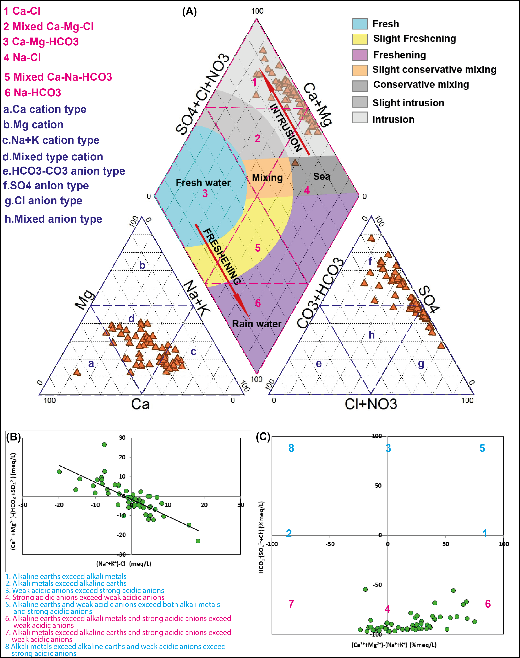
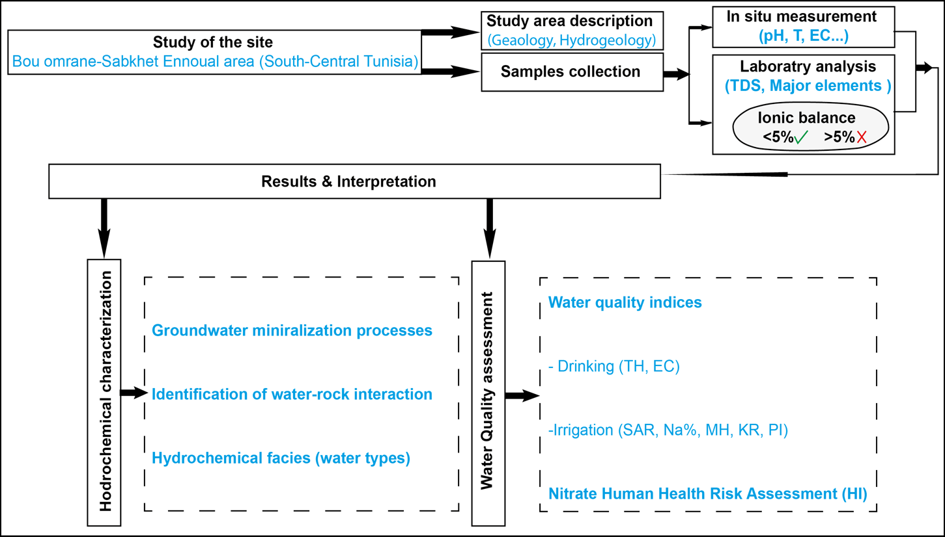
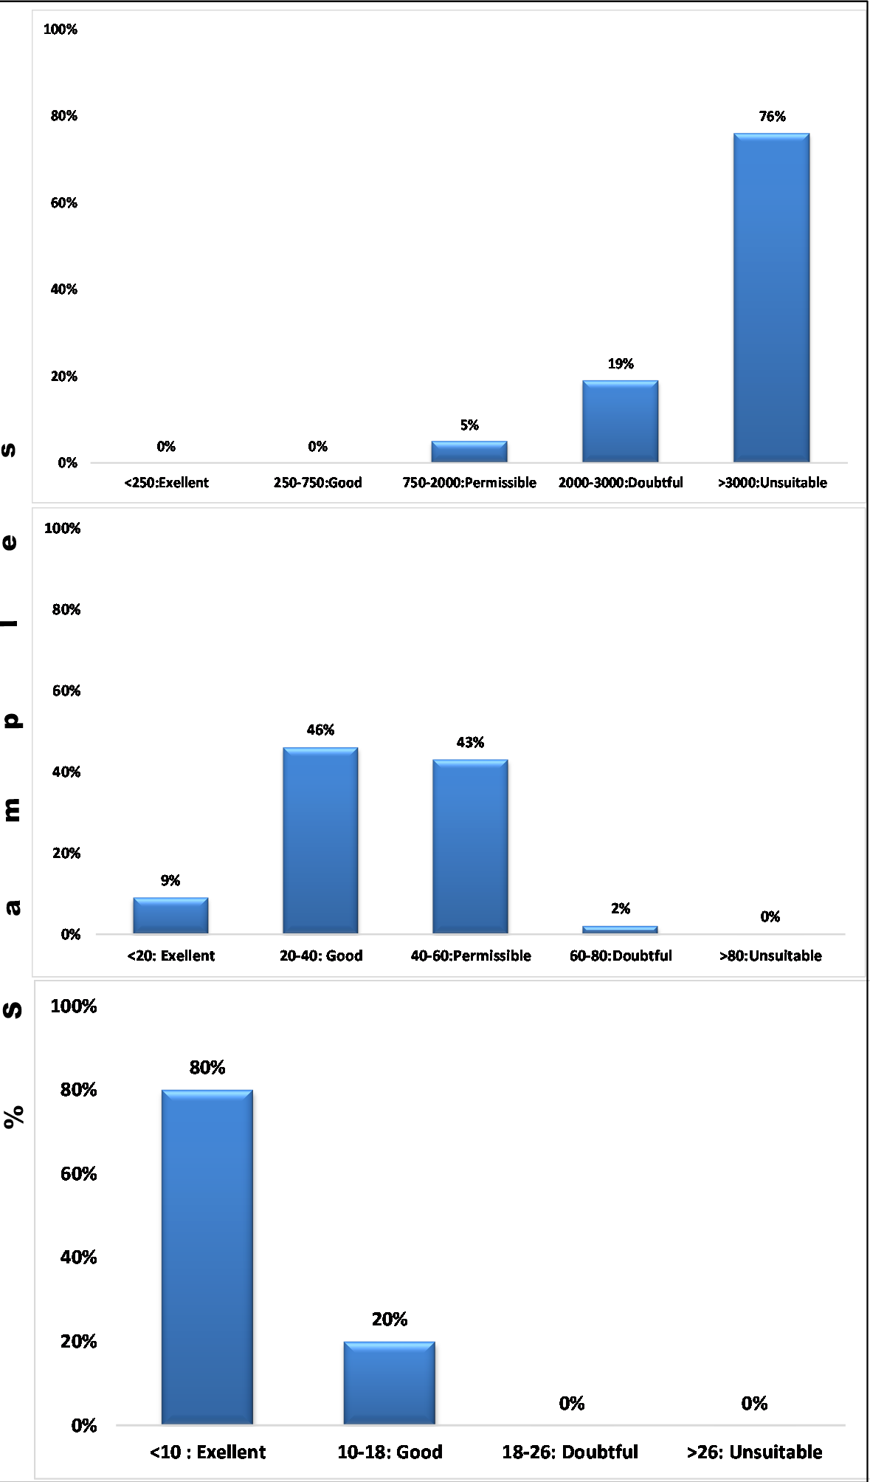
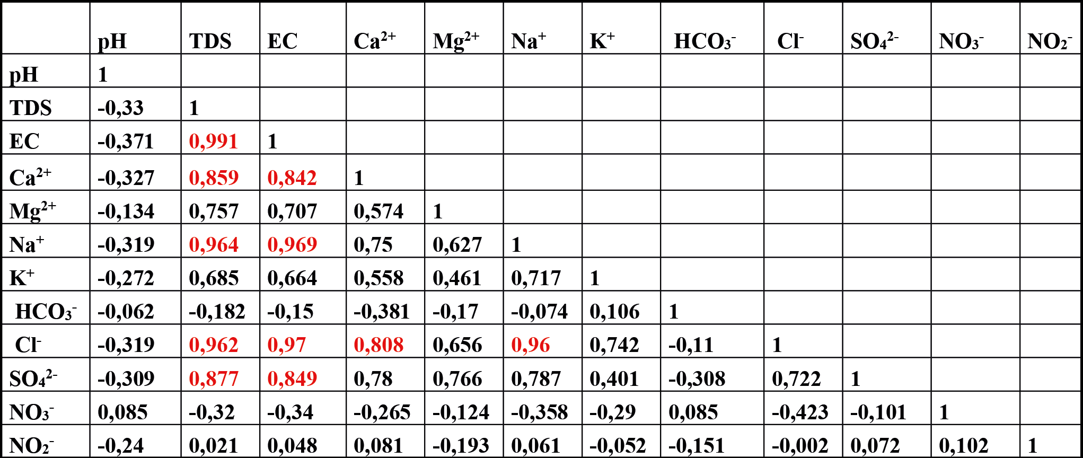
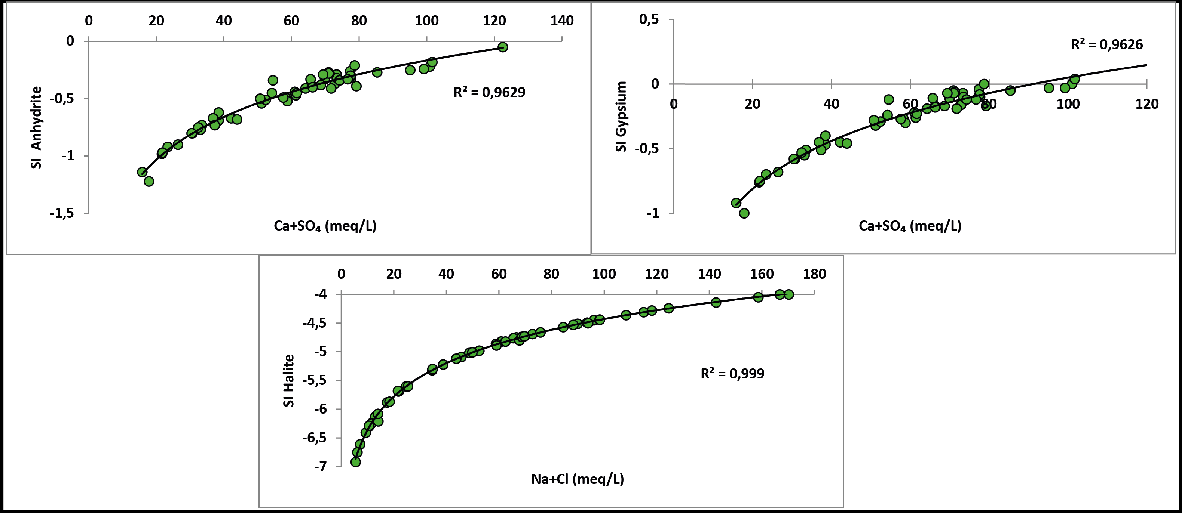
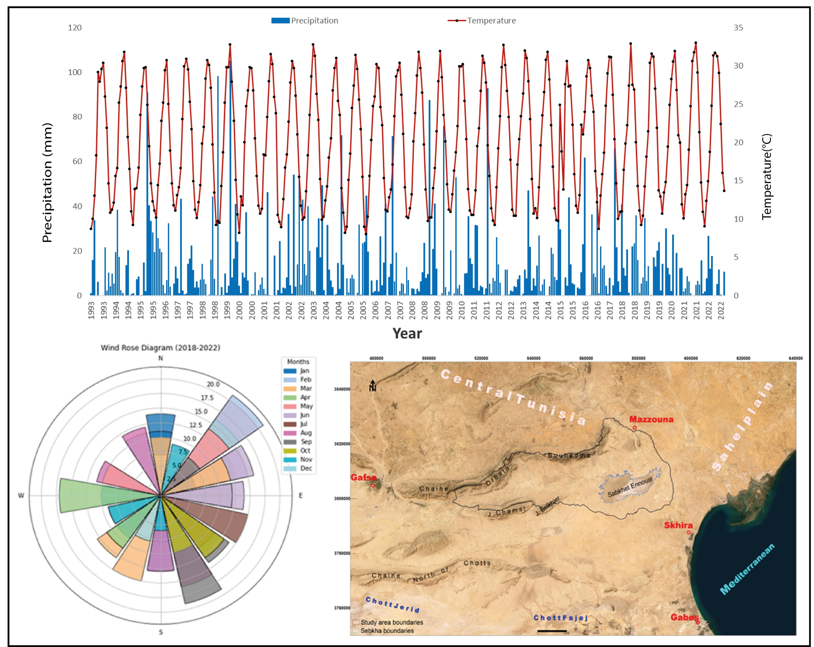
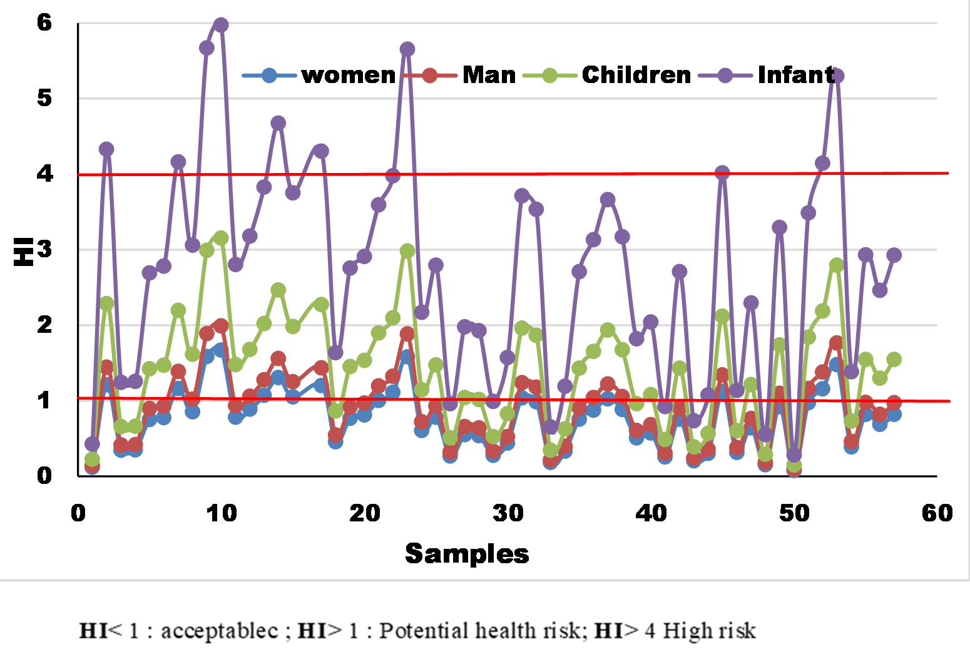
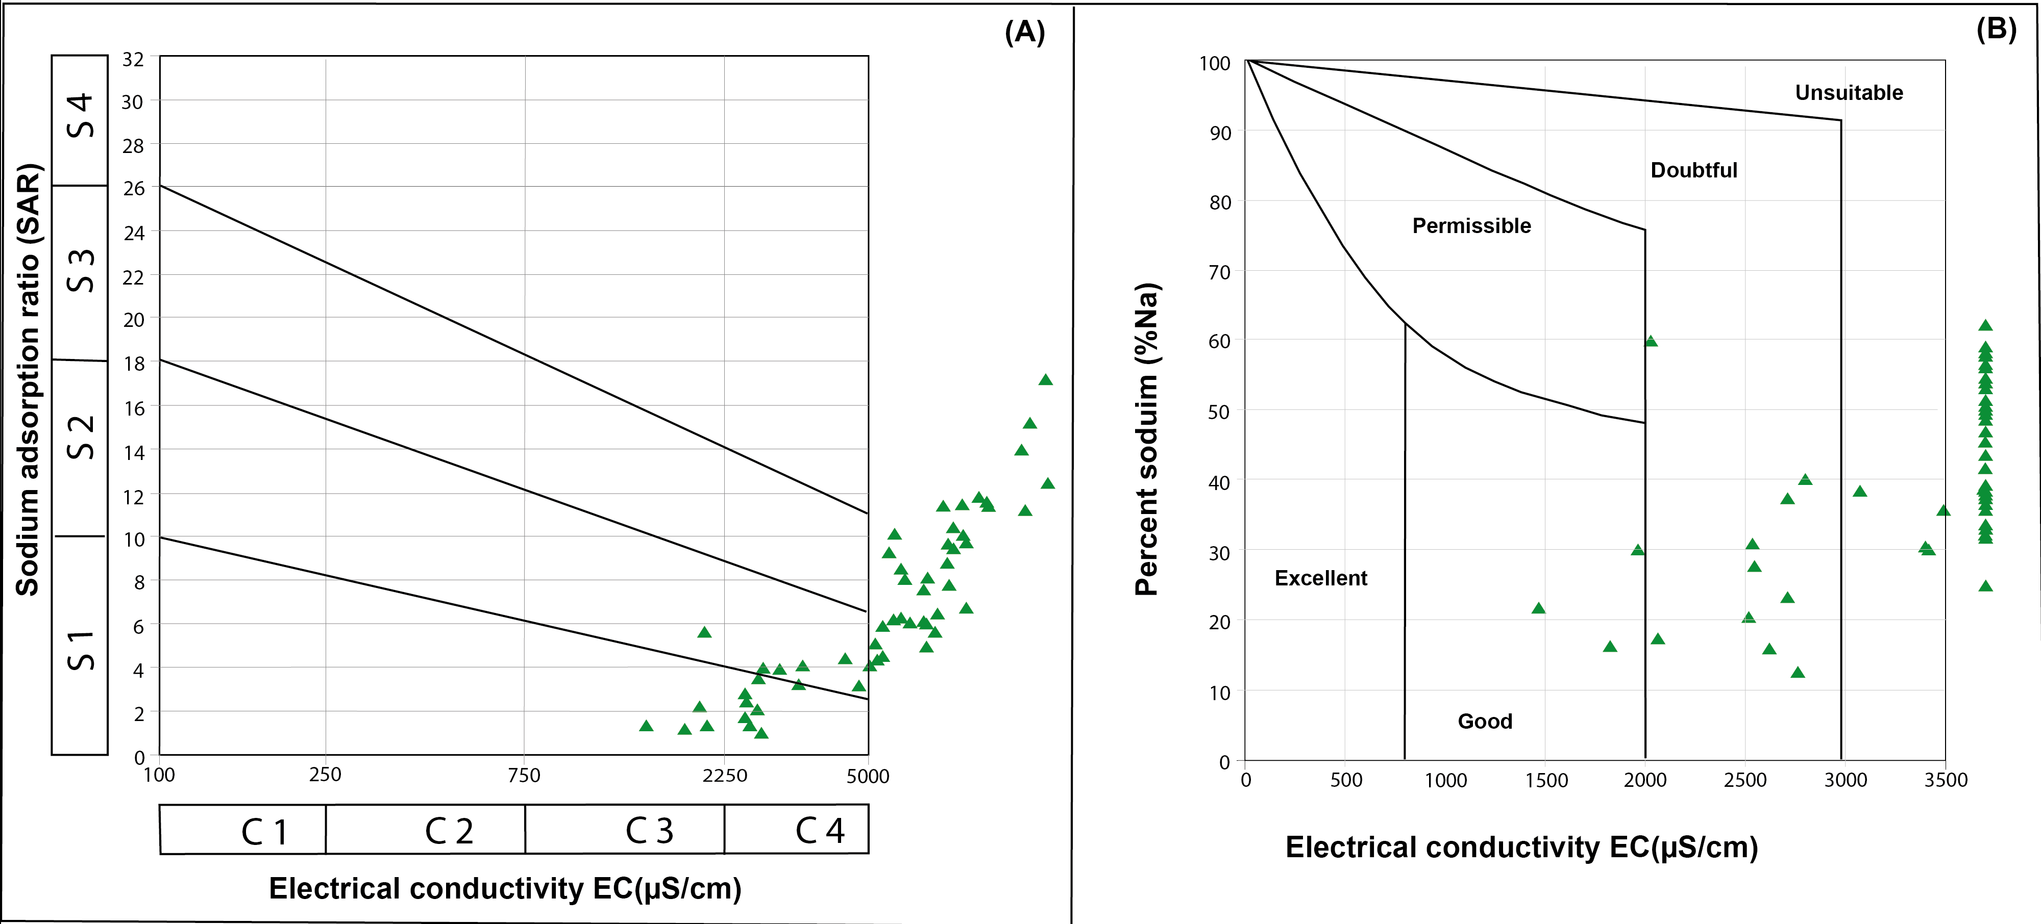
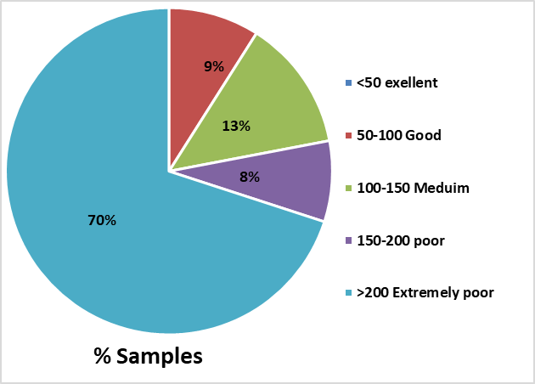
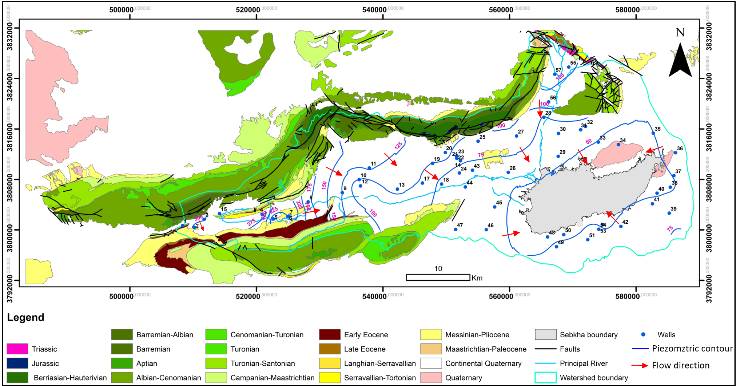
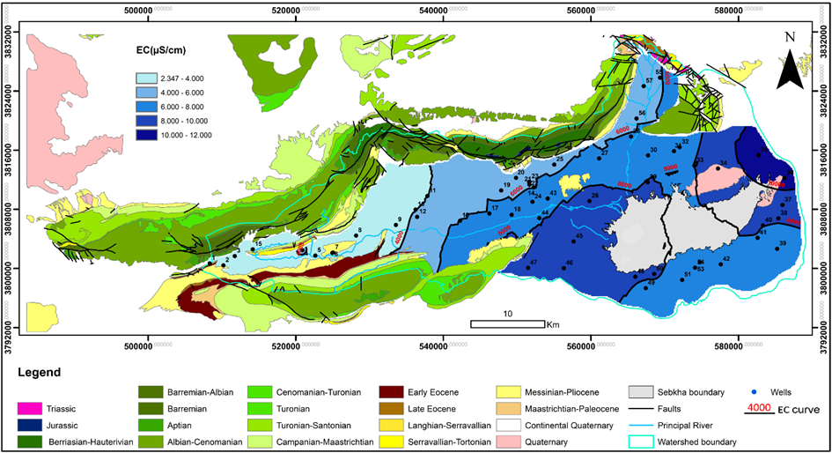

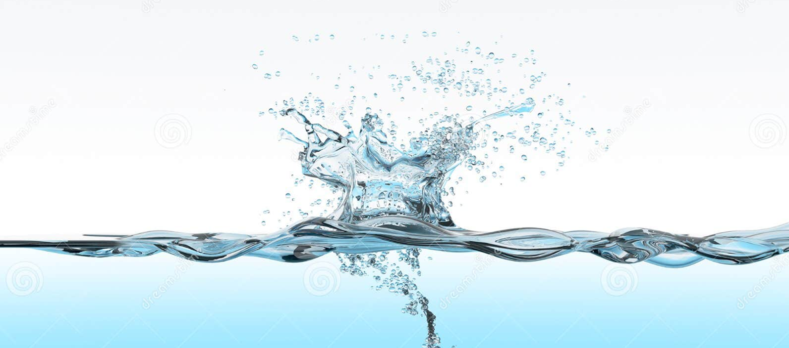
Integrated hydrochemical and multi-index assessment of groundwater quality
in the Mio-Plio-Quaternary aquifer of the Bou Omrane–Sabkhet Ennaouel area (South-Central Tunisia)
Marwa Ghaib^{1,3,5}, Dorra Tanfous ^{1, 3,} Nizar Troudi ³, Thomas Hermans⁵, Ferid Dhahri^{2, 4}, Kristine Walraevens⁵
1: Faculty of Sciences of Tunis, University of Tunis El Manar, Tunisia. 2: Faculty of Sciences of Gafsa, University of Gafsa, Gafsa, Tunisia. 3: Sedimentary Basins and Petroleum Geology Research Laboratory (BS&GP), University of Tunis El Manar F.S.T.
4: Geodynamics, Geo-Digital and Geomaterials Research Laboratory (LR18ES37), Faculty of Sciences of Tunis, University of Tunis-El Manar, Tunis, 5: Laboratory for Applied Geology and Hydrogeology, Department of Geology, Ghent University, Belgium.
MOTIVATION
RESULTS
Problem
Groundwater quality degradation: Salinization and nitrate contamination threaten the main water resource in this semi-arid region. Hydrogeochemical pressures: Evaporite dissolution, water–rock interaction, and intense evaporation increase groundwater mineralization. Water-use limitations: Deteriorating quality reduces groundwater suitability for drinking and irrigation, threatening agricultural sustainability.
Groundwater mineralization processes
Identification of water-rock interaction
Hydrochemical water type
•Na⁺ > Ca²⁺ > Mg²⁺ > K⁺.
Analysis
To understand groundwater quality in the Mio–Plio–Quaternary aquifer, hydrochemical and index-based approaches were applied. Hydrochemical characterization: analysis of physicochemical parameters and major ions to identify groundwater facies and geochemical evolution. Quality assessment: application of groundwater quality indices to evaluate suitability for drinking and irrigation.
•Cl⁻ > SO₄²⁻ > HCO₃⁻ > NO₃⁻
Goal
This study aims to assess groundwater quality and identify the key processes affecting it to support sustainable management. •Process identification: identify the dominant mechanisms controlling groundwater chemistry. •Management support: provide scientific insights for sustainable use and protection of groundwater resources
Dminance of Na-Cl (sebkha water intrusion) & Ca-Cl (ion exchange processes) facies → salinization
METHODS AND STUDY AREA
Groundwater shows severe salinization, with pH remaining within acceptable limits (6.51–7.46), while EC (1,475–14,600 µS/cm) and TDS (1,052–10,117 mg/L) indicate strong mineralization.
Major ions, particularly Na⁺, Mg²⁺, Cl⁻, SO₄²⁻, and locally NO₃⁻, also exceed guideline values.
Groundwater salinity is primarily controlled by natural processes, including sebkha intrusion, evaporation, and dissolution of carbonate and gypsum minerals, while human activities such as intensive pumping and irrigation further enhance salinization.
The Bou Omrane–Sabkhet Ennaouel basin, located south of the Tunisian Atlas Mountains, is characterized by a semi-arid climate and complex hydrogeological conditions.
Irrigation quality criteria
EC (Richard 1954) =EC (µs/cm)
All samples exceed the drinking water TDS limit (1000 mg/L), making groundwater largely unsuitable for consumption.
Pearson correlation matrix
Na% (Wilox 1955)
= [(Na⁺+K⁺)/(Ca²⁺+Mg²⁺+Na⁺+K⁺)] *100
The results indicate that the water quality is unsuitability according EC, 76%.
→ Salinity limits irrigation suitability
Nitrate Human Health Risk Index
Flow chart showing the methodology applied in this study
SAR (Richard 1954)
= Na⁺/√ [(Ca²⁺+Mg²⁺)/2]
Water quality
The basin is composed of Cretaceous to Mio–Plio–Quaternary deposits hosting multiple aquifer levels. Altitudes exceed 1100 m at Jebel Orbata, with strong temperature variability.
The region experiences high evaporation (~1100 mm/year) and low rainfall (<150 mm/year), promoting groundwater mineralization.
Groundwater flows from upstream piezometric levels (~300 m) toward Sabkhet Ennaouel (~50 m), which acts as a natural discharge zone.
Water quality index
Geographical setting and climatic characteristics
Elevated ion concentrations may pose risks related to salinity, hypertension, kidney disorders, and nitrate exposure.
CONCLUSION
Groundwater quality is strongly affected by salinization and nitrate contamination, mainly controlled by evaporite dissolution and hydrogeochemical processes. Most samples are classified as poor to unsuitable for drinking and irrigation, with salinity as the main limiting factor. These results emphasize the need for continuous monitoring, regulated groundwater abstraction, and adaptive management strategies to ensure the long-term sustainability of groundwater resources.
Contact: Marwa.Ghaib@UGent.be marwaghaib093@gmail.com
ResearchGate: Marwa Ghaib
Geological map of the study area with the Piezometric
Electrical conductivity distribution map

