Slide 1







Establishment of baseline values for fluvial sediments in the Paraopeba river basin (Brazil), prior to the Brumadinho dam failure
Lucas Leão, Fernando Pacheco, Luís Filipe Fernandes, Raphael Vicq, Fernando Laureano, Eduardo Marques, and Teresa Valente
Notes:
Good morning everyone, it is a pleasure to be here today to talk about such an important topic for environmental management in Brazil.Our study established baseline values for sediment samples collected prior to the Brumadinho dam failure, in the state of Minas Gerais, Brazil.This disaster occurred in January 2019 and, in addition to the tragic loss of hundreds of lives, approximately 9.8 million tons of iron mining tailings were released into the Ferro-Carvão stream basin and subsequently into the Paraopeba River. This resulted in both immediate and long-term impacts on water and sediment quality across the basin.Several studies have reported significant geochemical changes along tens of kilometers downstream, mainly associated with depositional processes and the remobilization of bed sediments.A key issue is that, prior to this event, no baseline values were available for the affected basin. As a result, the natural geochemical characteristics of fluvial sediments in the region were largely unknown.In this context, our study aimed to establish baseline values for 16 elements using a dataset of 717 stream sediment samples collected before the dam failure, from second- and third-order basins within the Paraopeba River system.Our results reveal anomalous concentrations of potentially toxic elements in specific areas of the basin. These patterns are partly controlled by the regional geological framework, although anthropogenic influences cannot be ruled out.Importantly, several elements show baseline values exceeding national regulatory limits, highlighting the critical need to define regional baseline values, particularly in areas affected by intensive mining activities.For those interested, I would be happy to share more details about our results after this session.Thank you very much for your attention.

Slide 2
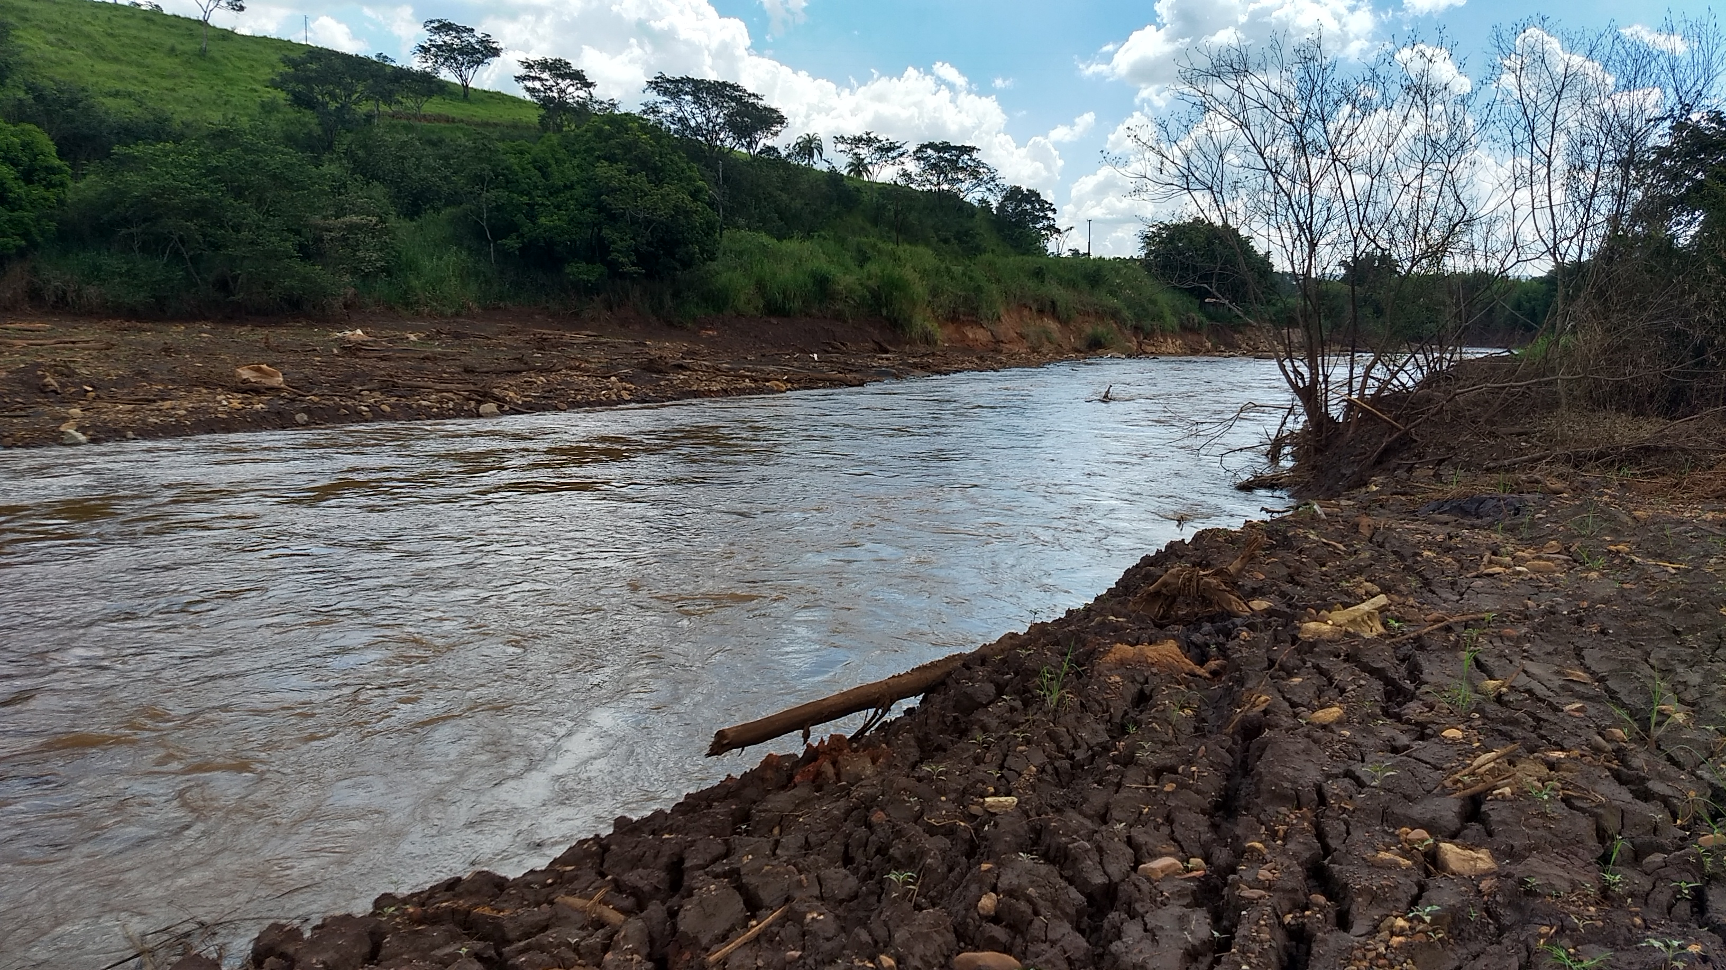
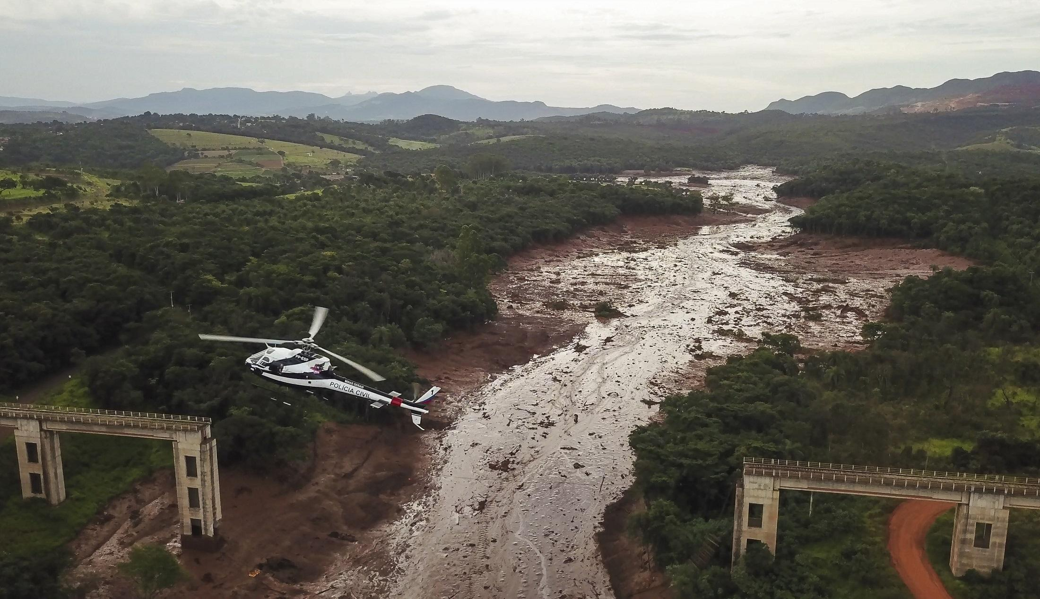
B1 Tailings Dam Failure – Brumadinho (MG, Brazil)
9.8 million m³ tailings released (Fe-rich);
Sediment and water contamination;
Strong geochemical alterations;
Downstream transport over tens of km;
Deposition and remobilization processes.
https://unearthed.greenpeace.org/2019/02/13/vale-brazil-mining-disaster-brumadinho-liam-fox

Slide 3
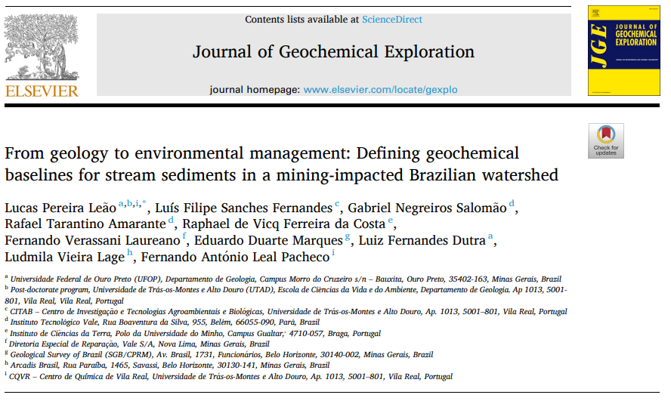

Slide 4
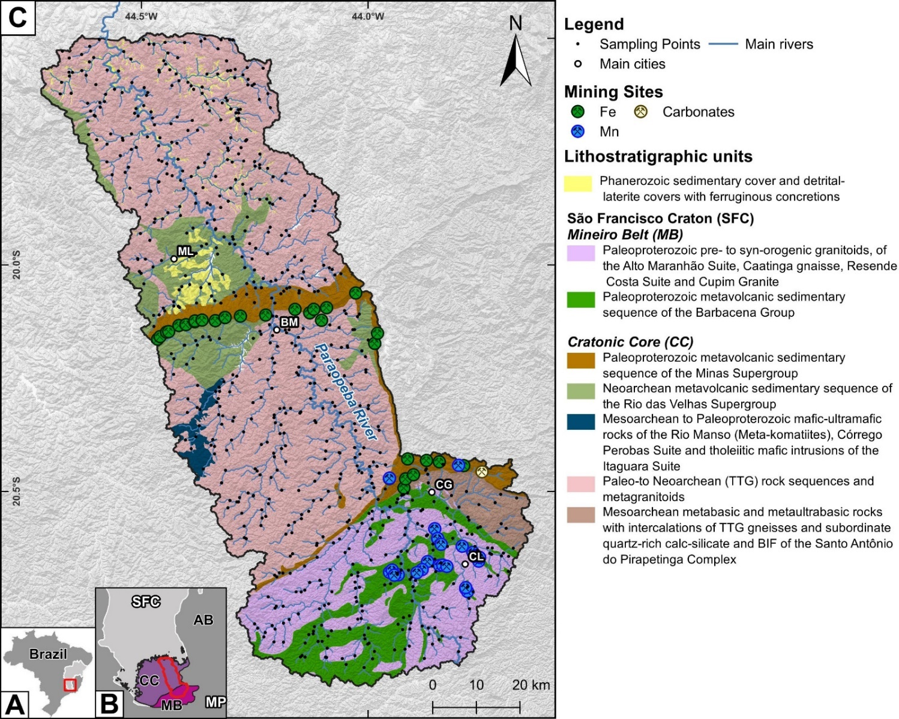
717 stream sediment samples (2008 and 2009);
Al, As, Ba, Ca, Cd, Co, Cr, Cu, Fe, Hg, K, Pb, Mn, Ni, P, Ti, V, and Zn;
Isoconcentration maps;
Baseline values determined using four distinct methodological approaches;
Geological/geochemical correlation;
Environmental implications.

Slide 5
Element | LLD | %< LLD | Mean | SD | Min | Q1 | Median | Q3 | Max
 |  |  |  |  |  |  |  |  |  | p.SW
Al | 100 | 0.2 | 2.58E+04 | 1.43E+04 | 1400 | 1.54E+04 | 2.43E+04 | 3.46E+04 | 8.16E+04 | <0.01
As | 0.1 | 2 | 7.6 | 19.8 | <0.10 | 0.9 | 1.9 | 5.8 | 234 | <0.01
Ba | 0.5 | 0 | 87.4 | 65.7 | 1 | 52.2 | 75.1 | 106 | 1.11E+03 | <0.01
Ca | 100 | 1 | 785 | 1.26E+03 | <100 | 300 | 500 | 800 | 1.86E+04 | <0.01
Cd | 0.01 | 17 | 0.04 | 0.07 | <0.01 | 0.02 | 0.03 | 0.05 | 1.34 | <0.01
Co | 0.1 | 1 | 14.3 | 19.2 | <0.10 | 4.6 | 8.7 | 17.8 | 309 | <0.01
Cr | 0.5 | 1 | 75.8 | 130 | <0.50 | 16.1 | 39.9 | 94.2 | 2.45E+03 | <0.01
Cu | 0.01 | 0 | 22.6 | 21.5 | 0.01 | 8.7 | 15.4 | 30.5 | 196 | <0.01
Fe | 100 | 0 | 6.14E+04 | 6.17E+04 | 100 | 2.60E+04 | 4.31E+04 | 7.25E+04 | >5.00E+05 | <0.01
Hg* | 0.01 | 1 | 27.7 | 24.2 | <1.00 | 15 | 23 | 35 | 415 | <0.01
K | 100 | 0 | 1.14E+03 | 807.9 | 8.0 | 500 | 1.00E+03 | 1.50E+03 | 6.80E+03 | <0.01
Mn | 1 | 0 | 898 | 1.55E+03 | 21 | 269 | 493 | 1.00E+03 | 2.00E+04 | <0.01
Ni | 0.1 | 0 | 23.8 | 38.3 | <0.10 | 6.4 | 12.7 | 28 | 684 | <0.01
P | 10 | 0 | 337 | 284 | 10 | 180 | 270 | 410 | 3.66E+03 | <0.01
Pb | 0.01 | 1 | 17.6 | 9.6 | <0.01 | 11.4 | 16.2 | 21.6 | 79.9 | <0.01
Ti | 10 | 0 | 474 | 379 | 10 | 210 | 380 | 640 | 2.75E+03 | <0.01
V | 2 | 0.1 | 58.2 | 48.8 | <2.00 | 23 | 45 | 77 | 301 | <0.01
Zn | 0.1 | 0 | 34.9 | 27.7 | <0.01 | 21.1 | 30 | 41.4 | 387 | <0.01

Slide 6
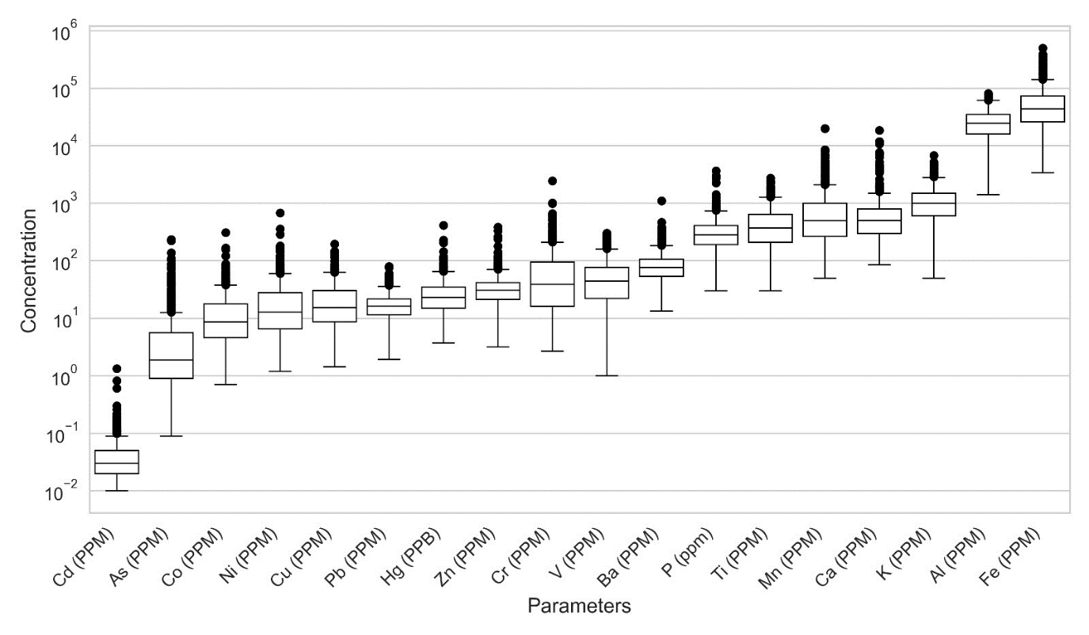

Slide 7
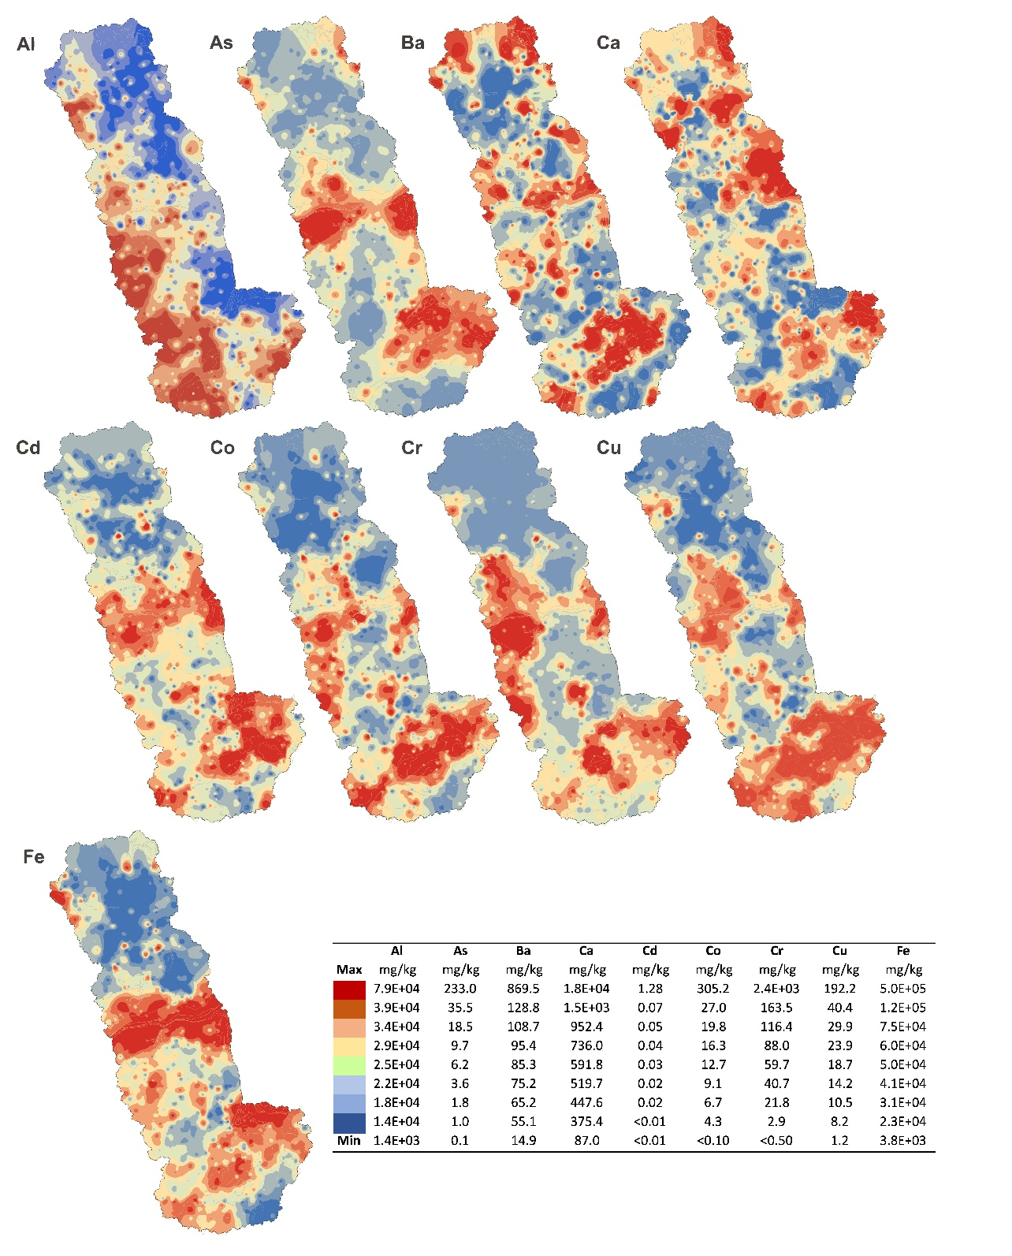
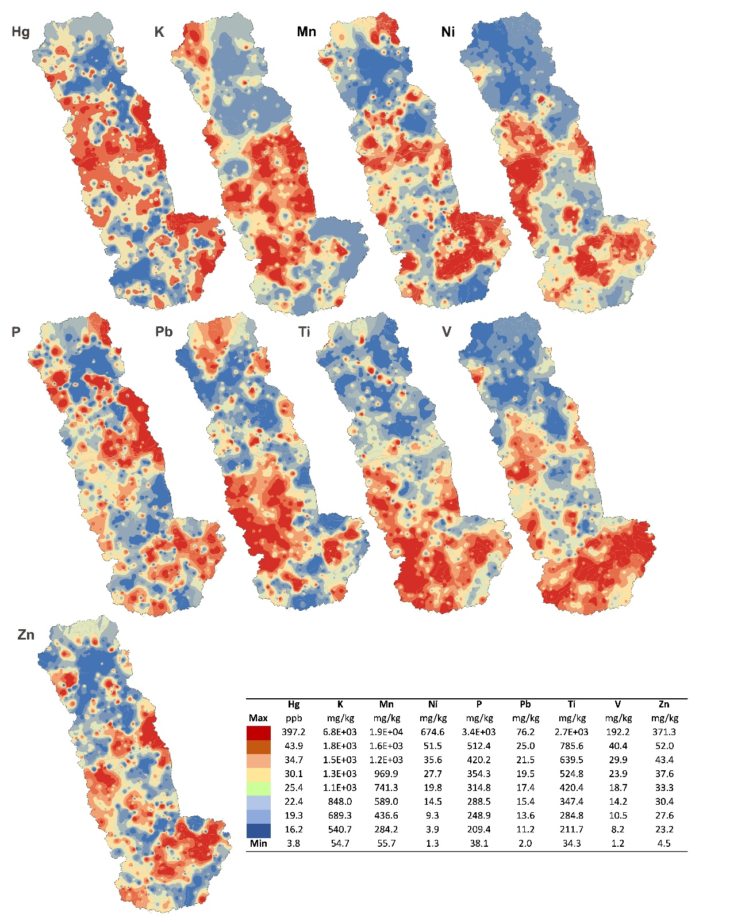

Slide 8
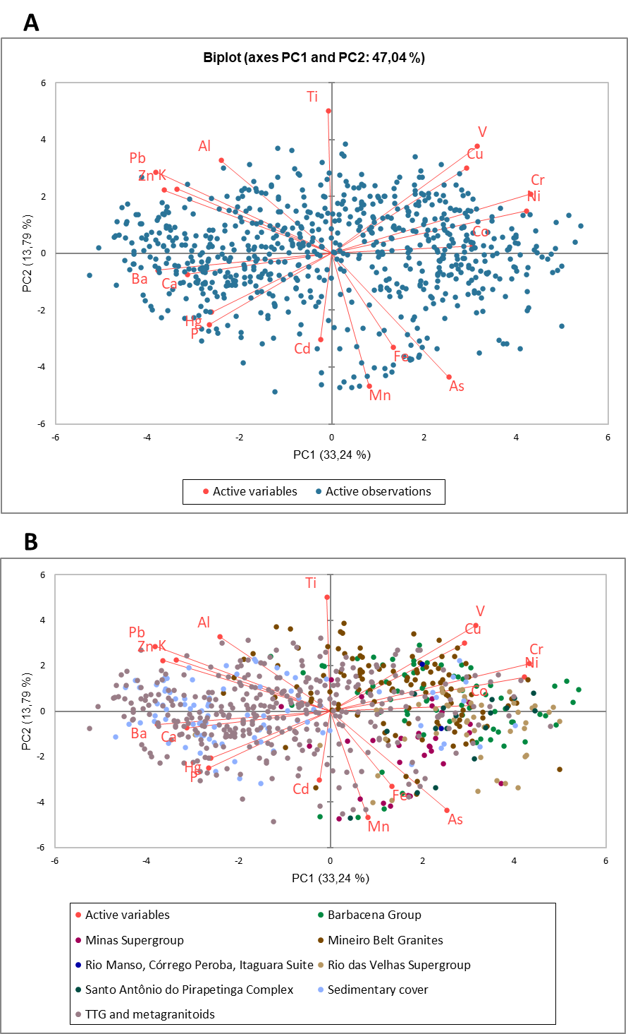
 | PC1 | PC2 | PC3 | PC4
Al | -0.471 | 0.412 | 0.411 | 0.373
As | 0.497 | -0.549 | 0.196 | 0.082
Ba | -0.739 | -0.074 | -0.317 | -0.164
Ca | -0.613 | -0.093 | -0.042 | -0.402
Cd | -0.047 | -0.383 | 0.068 | -0.309
Co | 0.598 | 0.033 | -0.454 | -0.312
Cr | 0.846 | 0.263 | 0.112 | 0.045
Cu | 0.572 | 0.378 | 0.312 | -0.380
Fe | 0.262 | -0.418 | 0.100 | 0.613
Hg | -0.510 | -0.261 | 0.564 | 0.075
K | -0.657 | 0.285 | -0.438 | 0.264
Pb | -0.747 | 0.360 | 0.013 | 0.164
Mn | 0.158 | -0.588 | -0.557 | 0.061
Ni | 0.828 | 0.189 | -0.106 | 0.019
P | -0.520 | -0.316 | 0.431 | -0.188
Ti | -0.015 | 0.632 | -0.390 | 0.184
V | 0.619 | 0.474 | 0.380 | -0.097
Zn | -0.713 | 0.280 | 0.029 | -0.323
Eigenvalue | 5.984 | 2.483 | 1.956 | 1.339
Variability (%) | 33.24 | 13.79 | 10.87 | 7.44
Cumulative % | 33.25 | 47.04 | 57.91 | 65.34

Slide 9
Data subset (n) | Methods | Al | As | Ba | Ca | Cd | Co | Cr | Cu | Fe | Hg* | K | Pb | Mn | Ni | P | Ti | V | Zn
Whole area (717) | mMAD | 7.48E+04 | 26.2 | 214.9 | 2.01E+03 | 0.10 | 62.7 | 533.2 | 98.5 | 1.97E+05 | 79.9 | 4.55E+03 | 42.9 | 3.43E+03 | 110.7 | 884.1 | 1.98E+03 | 278.7 | 79.9
 | TIF | 1.09E+05 | 86.9 | 297.9 | 3.48E+03 | 0.20 | 135.5 | 1.32E+03 | 198.2 | 3.40E+05 | 124.8 | 5.93E+03 | 55.5 | 7.41E+03 | 250.3 | 1.30E+03 | 3.41E+03 | 504.2 | 111.4
 | P98 | 5.99E+04 | 49.4 | 257.6 | 4.13E+03 | 0.14 | 60.6 | 341.1 | 79.4 | 2.81E+05 | 78.7 | 3.17E+03 | 43.8 | 4.58E+03 | 119.3 | 946.8 | 1.62E+03 | 202.7 | 83.5
 | P95 | 5.24E+04 | 27.6 | 186.4 | 1.90E+03 | 0.11 | 43.7 | 242.5 | 63.5 | 1.91E+05 | 59.2 | 2.62E+03 | 33.8 | 2.75E+03 | 70.4 | 735.9 | 1.26E+03 | 151.4 | 68.6
 | P90 | 4.53E+04 | 16.7 | 146.4 | 1.30E+03 | 0.08 | 31.8 | 162.0 | 48.7 | 1.25E+05 | 47.0 | 2.20E+03 | 27.2 | 1.99E+03 | 54.7 | 604.0 | 940.0 | 126.4 | 57.1
 | P75 | 3.46E+04 | 5.6 | 106.2 | 800.0 | 0.05 | 17.8 | 94.2 | 30.5 | 7.25E+04 | 35.0 | 1.50E+03 | 21.6 | 1.00E+03 | 28.0 | 410.0 | 640.0 | 77.0 | 41.4
TTGM (346) | mMAD | 7.52E+04 | 9.4 | 179.9 | 2.01E+03 | 0.10 | 33.2 | 165.1 | 40.5 | 1.30E+05 | 67.5 | 4.69E+03 | 44.7 | 2.49E+03 | 53.3 | 866.0 | 1.51E+03 | 141.1 | 72.4
 | TIF | 1.12E+05 | 23.7 | 228.1 | 3.48E+03 | 0.11 | 58.7 | 318.6 | 65.7 | 2.03E+05 | 105.3 | 7.42E+03 | 59.9 | 4.72E+03 | 91.7 | 1.33E+03 | 2.68E+03 | 239.8 | 96.9
 | P98 | 5.90E+04 | 26.9 | 236.0 | 4.57E+03 | 0.10 | 46.8 | 266.2 | 47.9 | 2.15E+05 | 66.2 | 3.20E+03 | 43.0 | 2.95E+03 | 85.6 | 1.10E+03 | 1.47E+03 | 138.3 | 77.0
 | P95 | 5.17E+04 | 15.5 | 156.6 | 1.90E+03 | 0.08 | 26.8 | 171.0 | 34.3 | 1.33E+05 | 53.5 | 2.87E+03 | 33.9 | 2.09E+03 | 56.0 | 797.2 | 1.20E+03 | 100.8 | 64.1
 | P90 | 4.46E+04 | 6.8 | 129.1 | 1.40E+03 | 0.06 | 21.0 | 95.3 | 28.9 | 8.98E+04 | 44.0 | 2.45E+03 | 29.4 | 1.49E+03 | 31.0 | 599.9 | 8.35E+02 | 72.5 | 53.8
 | P75 | 3.41E+04 | 3.1 | 95.9 | 800.0 | 0.04 | 11.4 | 45.4 | 17.9 | 5.69E+04 | 34.0 | 1.80E+03 | 23.5 | 792.7 | 16.6 | 400.0 | 530.0 | 49.0 | 39.4
SAPC (17) | mMAD | 1.09E+05 | 32.3 | 149.5 | 8.63E+03 | 0.09 | 43.1 | 469.5 | 137.0 | 2.94E+05 | 113.5 | 1.56E+03 | 30.2 | 3.29E+03 | 86.5 | 1.61E+03 | 1.32E+03 | 684.9 | 100.5
 | TIF | 1.86E+05 | 33.0 | 247.9 | 1.68E+04 | 0.11 | 57.9 | 770.0 | 226.6 | 2.94E+05 | 160.3 | 3.20E+03 | 33.6 | 5.86E+03 | 156.3 | 1.45E+03 | 1.45E+03 | 1.40E+03 | 141.3
 | P98 | 4.79E+04 | 44.5 | 162.0 | 1.12E+04 | 0.15 | 47.6 | 269.9 | 88.8 | 2.05E+05 | 77.0 | 931.1 | 47.6 | 3.75E+03 | 59.7 | 789.5 | 880.3 | 278.4 | 190.1
 | P95 | 4.78E+04 | 34.6 | 146.3 | 5.22E+03 | 0.12 | 37.8 | 258.1 | 75.1 | 1.85E+05 | 72.7 | 836.5 | 38.0 | 3.16E+03 | 48.4 | 732.5 | 865.9 | 273.2 | 137.4
 | P90 | 4.37E+04 | 28.0 | 136.9 | 3.03E+03 | 0.09 | 30.3 | 239.2 | 66.5 | 1.67E+05 | 63.5 | 800.0 | 28.6 | 2.57E+03 | 41.7 | 685.7 | 792.2 | 257.0 | 80.1
 | P75 | 3.28E+04 | 12.1 | 88.1 | 1.50E+03 | 0.05 | 23.3 | 188.7 | 55.5 | 1.20E+05 | 50.0 | 400.0 | 16.5 | 1.64E+03 | 38.3 | 480.0 | 660.0 | 228.0 | 44.5
MVSRV (49) | mMAD | 8.66E+04 | 270.0 | 164.1 | 1.36E+03 | 0.21 | 72.9 | 402.5 | 80.7 | 4.69E+05 | 97.2 | 1.90E+03 | 33.2 | 5.02E+03 | 128.6 | 659.6 | 1.22E+03 | 213.1 | 87.6
 | TIF | 1.31E+05 | 1392.0 | 247.3 | 2.49E+03 | 0.25 | 105.3 | 1.01E+03 | 117.6 | 7.68E+05 | 144.7 | 3.59E+03 | 48.3 | 4.65E+03 | 191.0 | 917.4 | 1.78E+03 | 268.9 | 129.5
 | P98 | 4.81E+04 | 79.1 | 255.6 | 1.30E+03 | 0.15 | 56.7 | 617.9 | 64.2 | 3.87E+05 | 106.1 | 2.24E+03 | 38.1 | 5.19E+03 | 177.3 | 713.4 | 1.08E+03 | 190.4 | 82.9
 | P95 | 4.62E+04 | 67.5 | 164.9 | 1.26E+03 | 0.13 | 43.4 | 573.8 | 61.3 | 3.29E+05 | 70.4 | 1.62E+03 | 24.7 | 2.32E+03 | 156.0 | 615.3 | 905.5 | 162.0 | 78.2
 | P90 | 4.30E+04 | 48.2 | 134.6 | 1.10E+03 | 0.11 | 37.3 | 511.1 | 47.7 | 2.52E+05 | 57.6 | 1.50E+03 | 23.9 | 2.18E+03 | 127.4 | 452.0 | 727.7 | 146.2 | 69.2
 | P75 | 3.72E+04 | 37.7 | 98.8 | 700.0 | 0.07 | 27.0 | 222.9 | 41.2 | 1.44E+05 | 48.0 | 1.10E+03 | 17.7 | 1.29E+03 | 57.6 | 400.0 | 480.0 | 98.0 | 45.8
MVSM (32) | mMAD | 6.63E+04 | 16.2 | 284.3 | 2.14E+03 | 0.14 | 65.9 | 256.8 | 95.9 | 6.78E+05 | 121.6 | 4.05E+03 | 31.5 | 6.35E+03 | 80.1 | 1.06E+03 | 1.15E+03 | 135.3 | 105.7
 | TIF | 8.44E+04 | 20.4 | 524.2 | 2.49E+03 | 0.21 | 110.3 | 359.4 | 131.1 | 1.11E+06 | 113.6 | 5.60E+03 | 39.3 | 8.84E+03 | 144.6 | 1.39E+03 | 1.99E+03 | 189.9 | 153.7
 | P98 | 4.95E+04 | 30.5 | 193.7 | 4.95E+03 | 0.18 | 34.6 | 184.4 | 57.2 | 3.12E+05 | 167.4 | 2.50E+03 | 28.7 | 4.77E+03 | 75.9 | 1.36E+03 | 1.01E+03 | 113.5 | 105.5
 | P95 | 3.71E+04 | 13.1 | 183.5 | 2.93E+03 | 0.14 | 27.2 | 136.8 | 52.4 | 3.01E+05 | 128.6 | 2.45E+03 | 22.8 | 3.03E+03 | 64.7 | 903.1 | 857.8 | 92.8 | 72.5
 | P90 | 3.29E+04 | 11.0 | 165.7 | 984.2 | 0.09 | 24.3 | 124.0 | 45.5 | 2.83E+05 | 79.0 | 2.31E+03 | 19.8 | 2.74E+03 | 52.5 | 723.7 | 720.3 | 85.4 | 55.6
 | P75 | 2.70E+04 | 7.7 | 137.2 | 700.0 | 0.08 | 20.6 | 110.1 | 36.3 | 2.19E+05 | 48.2 | 1.90E+03 | 16.4 | 2.10E+03 | 37.8 | 511.6 | 599.7 | 79.0 | 44.7
MVSB (71) | mMAD | 7.94E+04 | 124.7 | 271.3 | 2.00E+03 | 0.23 | 120.2 | 307.8 | 151.7 | 1.67E+05 | 87.2 | 2.86E+03 | 25.7 | 5.04E+03 | 113.5 | 939.8 | 1.36E+03 | 296.1 | 83.9
 | TIF | 1.35E+05 | 276.9 | 398.0 | 3.04E+03 | 0.30 | 196.0 | 528.8 | 231.8 | 2.21E+05 | 124.8 | 6.09E+03 | 34.6 | 1.68E+04 | 161.3 | 1.23E+03 | 1.80E+03 | 396.8 | 106.0
 | P98 | 6.62E+04 | 78.8 | 370.0 | 2.75E+03 | 0.43 | 124.2 | 606.0 | 144.4 | 2.70E+05 | 59.8 | 1.80E+03 | 51.9 | 2.00E+04 | 199.4 | 829.6 | 2.01E+03 | 247.7 | 95.2
 | P95 | 5.94E+04 | 33.9 | 261.4 | 1.80E+03 | 0.17 | 80.0 | 250.1 | 100.6 | 2.07E+05 | 51.4 | 1.70E+03 | 39.2 | 6.52E+03 | 73.4 | 674.1 | 1.43E+03 | 213.0 | 67.8
 | P90 | 5.34E+04 | 22.1 | 164.0 | 1.50E+03 | 0.12 | 50.1 | 219.8 | 80.5 | 1.25E+05 | 45.0 | 1.50E+03 | 24.0 | 3.66E+03 | 65.2 | 570.0 | 1.00E+03 | 196.0 | 62.0
 | P75 | 4.34E+04 | 11.1 | 120.1 | 900.0 | 0.08 | 35.1 | 127.2 | 62.3 | 8.58E+04 | 35.0 | 1.00E+03 | 16.7 | 1.83E+03 | 40.4 | 495.0 | 819.9 | 139.5 | 49.6
MBG (110) | mMAD | 6.19E+04 | 69.7 | 253.4 | 2.27E+03 | 0.12 | 68.0 | 285.0 | 92.8 | 1.39E+05 | 74.2 | 4.74E+03 | 34.5 | 2.48E+03 | 104.6 | 833.7 | 1.83E+03 | 216.0 | 93.5
 | TIF | 8.42E+04 | 149.4 | 398.1 | 3.48E+03 | 0.31 | 118.4 | 492.9 | 139.2 | 2.11E+05 | 138.5 | 8.11E+03 | 42.9 | 4.20E+03 | 235.8 | 1.75E+03 | 2.85E+03 | 330.3 | 128.7
 | P98 | 6.07E+04 | 101.5 | 307.3 | 1.90E+03 | 0.15 | 60.8 | 290.8 | 107.0 | 1.85E+05 | 84.9 | 3.44E+03 | 48.7 | 4.85E+03 | 98.4 | 925.2 | 1.97E+03 | 176.2 | 83.2
 | P95 | 5.59E+04 | 40.2 | 266.8 | 1.35E+03 | 0.11 | 52.8 | 215.2 | 69.3 | 1.40E+05 | 52.6 | 2.85E+03 | 33.4 | 3.20E+03 | 77.6 | 746.4 | 1.33E+03 | 145.1 | 71.8
 | P90 | 4.93E+04 | 24.5 | 212.7 | 1.11E+03 | 0.09 | 41.7 | 173.1 | 58.8 | 1.08E+05 | 41.2 | 2.30E+03 | 25.3 | 2.33E+03 | 61.7 | 652.9 | 1.21E+03 | 136.0 | 63.1
 | P75 | 3.98E+04 | 9.1 | 130.6 | 800.0 | 0.06 | 23.4 | 119.8 | 39.4 | 6.95E+04 | 33.5 | 1.70E+03 | 22.0 | 895.7 | 38.7 | 447.5 | 867.5 | 110.5 | 48.4
SCDL (90) | mMAD | 6.11E+04 | 7.2 | 175.8 | 1.36E+03 | 0.01 | 17.1 | 57.8 | 23.8 | 8.98E+04 | 63.3 | 1.90E+03 | 34.9 | 1.16E+03 | 15.3 | 717.4 | 715.3 | 73.4 | 56.5
 | TIF | 1.10E+05 | 12.7 | 248.5 | 2.26E+03 | 0.06 | 37.8 | 195.4 | 43.5 | 1.56E+05 | 82.9 | 2.17E+03 | 46.2 | 2.10E+03 | 29.7 | 1.38E+03 | 1.11E+03 | 139.9 | 77.4
 | P98 | 4.24E+04 | 10.4 | 177.4 | 4.96E+03 | 0.10 | 25.6 | 239.0 | 44.9 | 1.29E+05 | 54.0 | 1.86E+03 | 35.7 | 2.00E+03 | 57.7 | 727.9 | 1.20E+03 | 105.5 | 64.1
 | P95 | 3.68E+04 | 6.0 | 127.4 | 1.85E+03 | 0.05 | 17.7 | 177.9 | 34.0 | 1.07E+05 | 47.6 | 1.55E+03 | 29.0 | 1.36E+03 | 41.4 | 536.3 | 809.02 | 88.0 | 50.2
 | P90 | 2.89E+04 | 4.0 | 110.8 | 1.20E+03 | 0.03 | 12.1 | 112.6 | 24.2 | 5.98E+04 | 40.1 | 1.40E+03 | 24.6 | 1.07E+03 | 24.4 | 441.0 | 576.6 | 67.2 | 43.1
 | P75 | 2.44E+04 | 1.4 | 87.5 | 800.0 | 0.02 | 8.0 | 26.5 | 12.9 | 3.74E+04 | 26.0 | 900.0 | 18.2 | 480.5 | 7.5 | 334.9 | 320.0 | 34.0 | 29.9

Slide 10
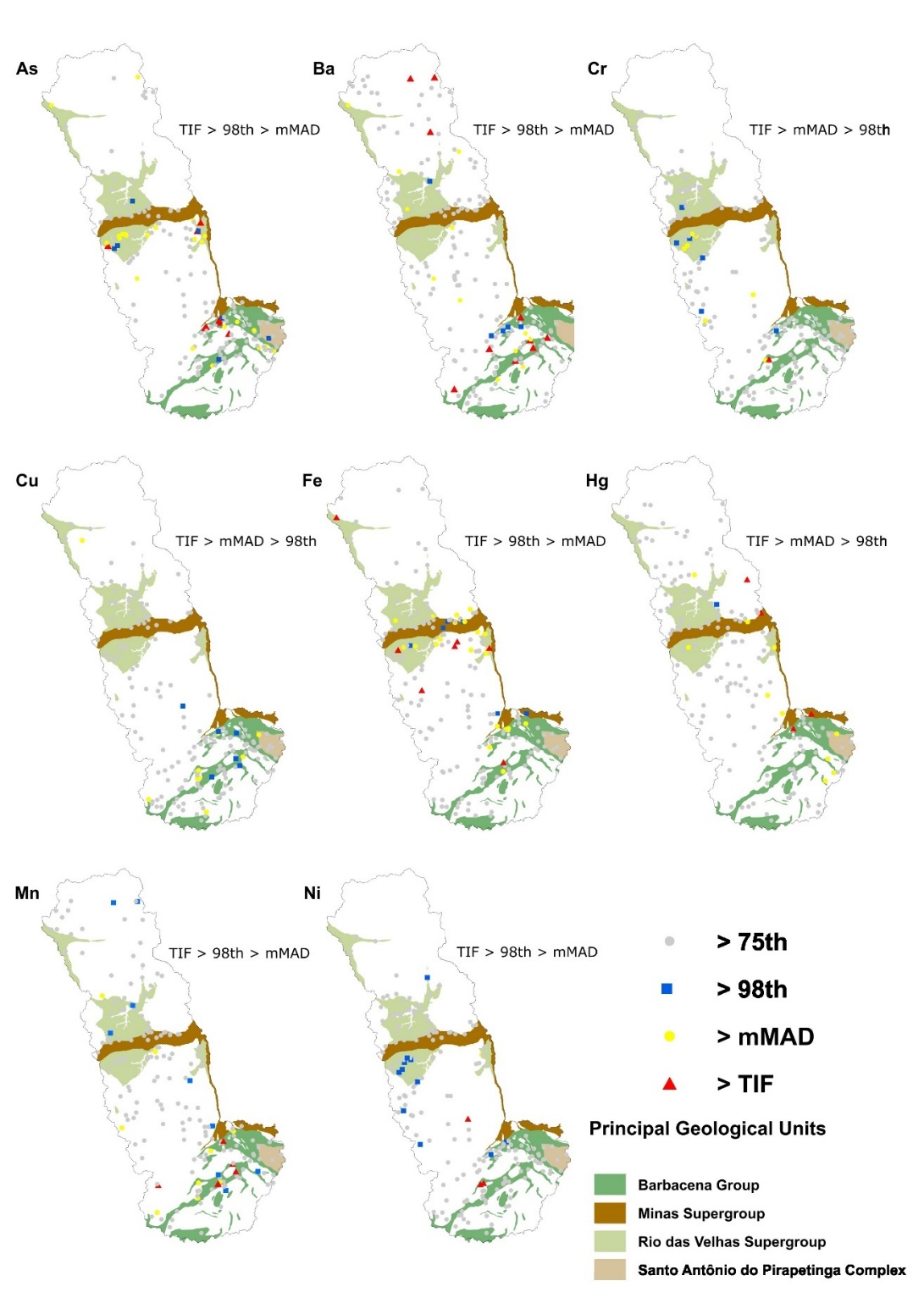

Slide 11
Source | Region (Country) | Sample size (n) | Particle Size (mm) | Approach | Al | As | Ba | Ca | Cd | Co | Cr | Cu | Fe | Hg* | K | Mn | Ni | P | Pb | Ti | V | Zn
This Study | Paraopeba River Basin (MG, Brazil) | 717 | 0.175 | AR/ICPMS/mMAD | 7.48E+04 | 26.2 | 214.9 | 2.01E+03 | 0.10 | 62.7 | 533.2 | 98.5 | 1.97E+05 | 79.89 | 4.55E+03 | 3.43E+03 | 110.7 | 884.1 | 42.9 | 2.0E+03 | 278.7 | 79.9
Medeiros Filho et al. (2025) | Quadrilátero Ferrífero (MG, Brazil) | 804 | 2 | AR/ICPMS/mMAD | - | 288.0 | 242.0 | - | 0.30 | 57.4 | 379.0 | 105.0 | 3.6E+05 | 230.0 | - | 3.9E+03 | 27.7 | - | 15.0 | - | 59.0 | 37.0
Larizzatti et al. (2018) | Quadrilátero Ferrífero (MG, Brazil) | 3662 | 0.175 | AR/ICPMS/75th | 3.0E+04 | 3.9 | 112.0 | 800 | 0.05 | 18.4 | 96.3 | 28.4 | 6.9E+04 | 63.0 | 1.4E+03 | 948.0 | 25.2 | 500.0 | 23.4 | 800.0 | 93.0 | 43.0
Vicq et al. (2018) | Quadrilátero Ferrífero (MG, Brazil) | 541 | 0.063 | AR/ICPOES/75th | - | 6.1 | - | - | 0.90 | - | 128.0 | 33.0 | 2.0E+05 | - | - | 1.8E+03 | 43.0 | - | 32.0 | - | - | 32.0
Vicq et al. (2023) | Upper Velhas River Basin (MG, Brazil) | 208 | 0.063 | AR/ICPOES/75th | - | 20.6 | - | - | 1.10 | - | 151.3 | 37.9 | 1.7E+05 | - | - | 1.8E+03 | 56.9 | - | 28.4 | - | - | 63.1
Salomão et a. (2020) | Itacaiúnas River Watershed (IRW) (PA-Brazil) | 761 | 0.177 | AR/ICPMS/mMAD | - | 7.6 | 199.6 | - | 0.08 | 46.0 | 154.8 | 138.2 | 1.1E+05 | 140.0 | - | 3.8E+03 | 33.9 | - | 35.6 | - | 203.0 | 59.9
CONAMA 454/12 | Brazillian environmental resolution Level 1 | - | - | - | - | 5.9 | - | - | 0.60 | - | 37.3 | 35.7 | - | 170.0 | - | - | 18.0 | - | 35.0 | - | - | 123.0
CONAMA 454/12 | Brazillian environmental resolution Level 2 | - | - | - | - | 17.0 | - | - | 3.50 | - | 90.0 | 197.0 | - | 486.0 | - | - | 36.0 | - | 91.3 | - | - | 315.0
Rudnick & Gao (2003) | Upper continental crust (UCC) | - | - | - | 1.5E+05 | 4.8 | 628.0 | 3.6E+04 | 0.09 | 17.3 | 92.0 | 28.0 | 5.0E+04 | 50.0 | 2.8E+04 | 1.0E+03 | 47.0 | 1500 | 17.0 | 6.4E+03 | 97.0 | 67.0
The importance of establishing regional geochemical baseline values to support water resource management in settings characterized by complex geological controls and intensive mining activities.

Slide 12
Thank you very much for your attention.
lucas.leao@ufop.edu.br

