Slide 1


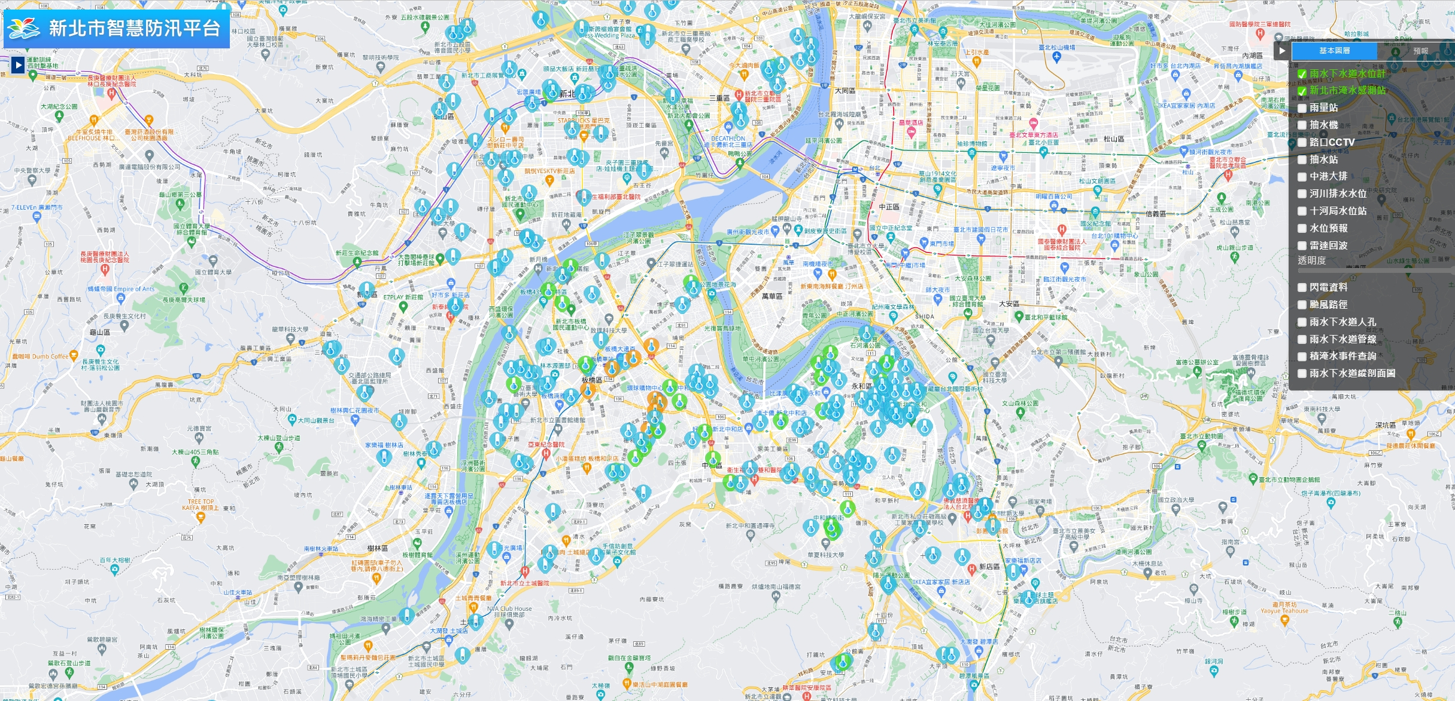
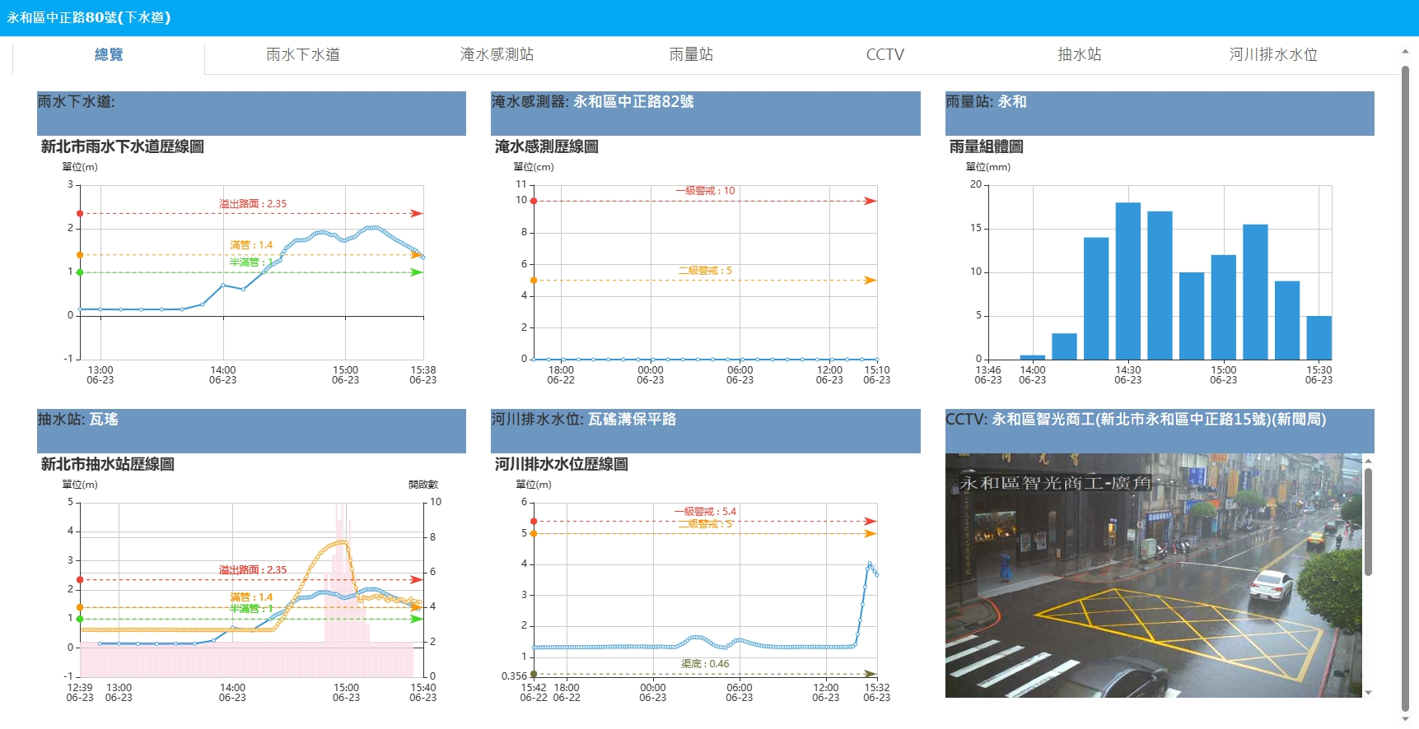
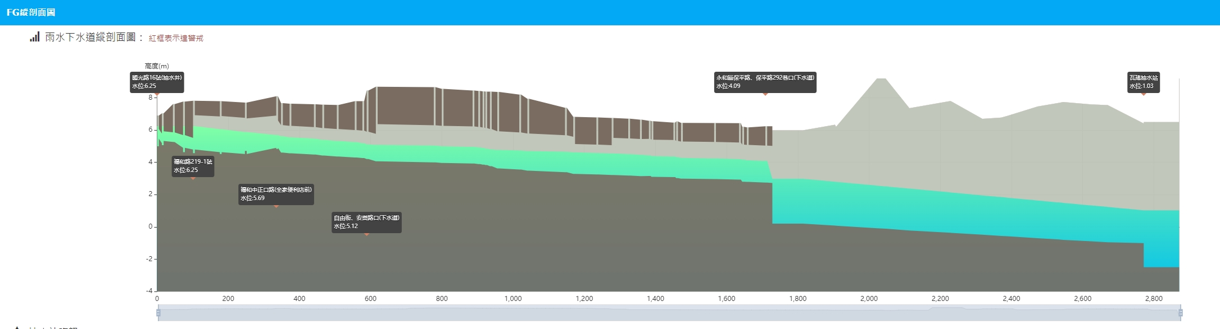
European Geosciences Union General Assembly
Research on the Adaptation Strategies of Urban Stormwater Drainage to Increased Rainfall Due to Climate Change
Sheng-Hsueh Yang¹, Der-Ren Song², Mao-Song Huang², Jyh-Hour Pan², Chen-Wei Chen², Xi-Jun Wang¹, Keh-Chia Yeh¹
1.Disaster Prevention & Water Environment Research Center,National Yang Ming Chiao Tung University. 1001, University Road, Hsinchu, 300093 Taiwan; Email: shyang1977@gmail.com, http://dpwe.nycu.edu.tw
2. Water Resources Department, New Taipei City Government, New Taipei City 22001, Taiwan;
ABSTRACT
4.This second rainfall event persisted for approximately 30 minutes. Full-pipe conditions in the stormwater drainage remained for about one hour before a noticeable drop in drainage pipe flow depth was observed. Although the pumping station forebay water level began to decline, it maintained high-capacity operation. As shown in the Bottom-center panel, preemptive pump operations created additional storage capacity within the drainage system, helping maintain lower surface water levels in the area.
5.Despite total accumulated rainfall exceeding the allowed threshold of the stormwater drainage system and the system remaining at full capacity for an extended period, the adaptive operational strategy prevented any surface flooding or overflow. It has successfully achieved the objectives of water level reduction and flood disaster prevention during this high-intensity rainfall event.
A 2024 climate change study in Taiwan indicated an increase in rainfall of approximately 10-35%, causing flooding in some urban areas where stormwater drainage systems exceeded their original design protection standards.
The first step requires IoT monitoring data to provide real-time information on the drainage system and to set warning management values​​ at key drainage bottlenecks and surrounding rain gauge stations.
The second step involves establishing long-term correlations between water levels and rainfall for drainage facilities below sea level, and improving the efficiency of urban drainage gates and pumping stations.
The third step involves developing multi-scenario adaptation strategies for the overall stormwater drainage system.
Finally, monitoring and implementing tasks to lower the water level in stormwater sewers
Monitoring and display platform
Monitoring 1
Stormwater sewer
Road flooding monitoring
Rain gauge station
CCTV
Pumping Station
Water level station
Overview
Road flooding monitoring
Rain gauge station
Stormwater sewer
Warning Line
Warning Line
Methodology
Sewer system water level monitoring
The process of urban rainwater adaptation research, analysis and practical application is shown in Figure 1 and Figure 2.
Pumping Station
Water level station
CCTV
Sewer system
Pumping station
Warning Line
Monitoring 1
Monitoring 5
Collection of information related to rainwater sewers
Monitoring 2
Open channel
The first step
Monitoring 3
Monitoring 4
Set warning management values​​
Figure 2 shows six panel water-information interface the data collection and integration through monitoring data in the second stage
The second step
Establishing long-term correlations between water levels and rainfall for drainage facilities below sea level
Figure 3 Real-time water level warning and monitoring data display
Case study
Improving the efficiency of urban drainage gates and pumping stations.
The detailed real rainfall scenario and response process, in Figure 2 and Figure 3 , are illlustrated clearly as follows:
1. At 14:00, rainfall began at the Yonghe Rain Gauge Station (Top-right panel), and within 20 minutes, the 10 mm/10 min warning threshold was exceeded. Composite Reflectivity (radar) data indicated continued rainfall. Meanwhile, the Wayao Pumping Station (bottom-left panel) had already executed pre-rainfall drawdown measures and continued monitoring water level trends.
2.By 14:20, the stormwater drainage channel under Zhongzheng Road in Yonghe exceeded 50% capacity. Real-time water level monitoring was switched to 1-minute intervals. By 14:30, the system reached full-pipe (pressurized) conditions. The Wayao Pumping Station received instructions to activate additional pumping units within 5 minutes. Full deployment was achieved within 10 minutes to expedite internal drainage.
3.By 15:00, rainfall intensity slightly decreased, though another rainband followed shortly. Pumping operations continued uninterrupted to handle this second wave.
CONCLUSIONS
The third step
Developing multi-scenario adaptation strategies for the overall stormwater drainage system.
The research uses data including actual data from the past 3 hours, rainfall forecasts for the next 6 hours, and tidal changes. Real-time water level information at each monitoring point is displayed and updated every 10 minutes. Once the management warning threshold is exceeded, the information is updated every minute. This data is used to develop adjustment strategies and simultaneously issue these early warning messages within the drainage system, as well as to systematically set up operations to lower water levels in stormwater sewers. This is analogous to monitoring and controlling the water level in stormwater sewers as if they were flood retention spaces. Based on operational experience over the past 3 years, this method will be used in the future to address the threat of increased rainfall due to climate change and to develop urban flood control strategies to reduce disaster losses.
Urban Stormwater Adaptation and Practical Response
Automated water level forecasting
Joint operation of gates and pumping stations to lower water levels
Fig. 1 Research analysis and practical application process diagram

