Slide 1
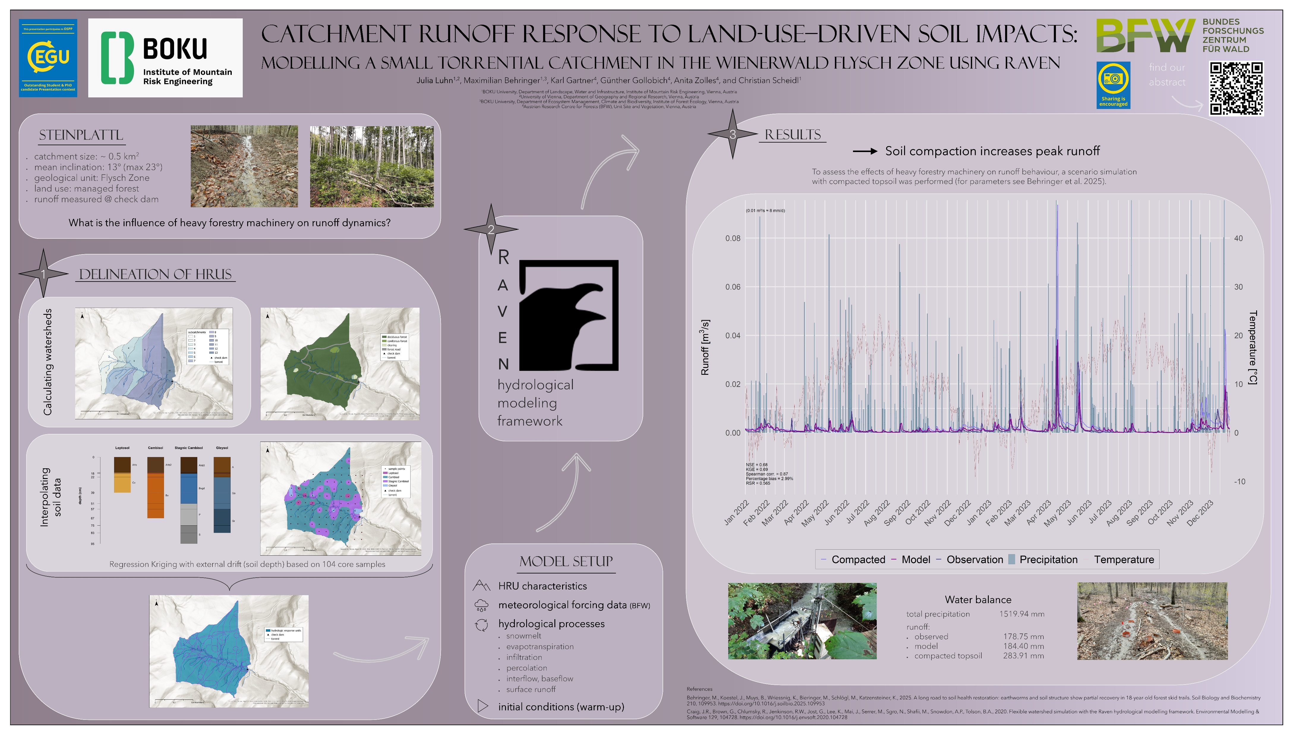

Slide 2
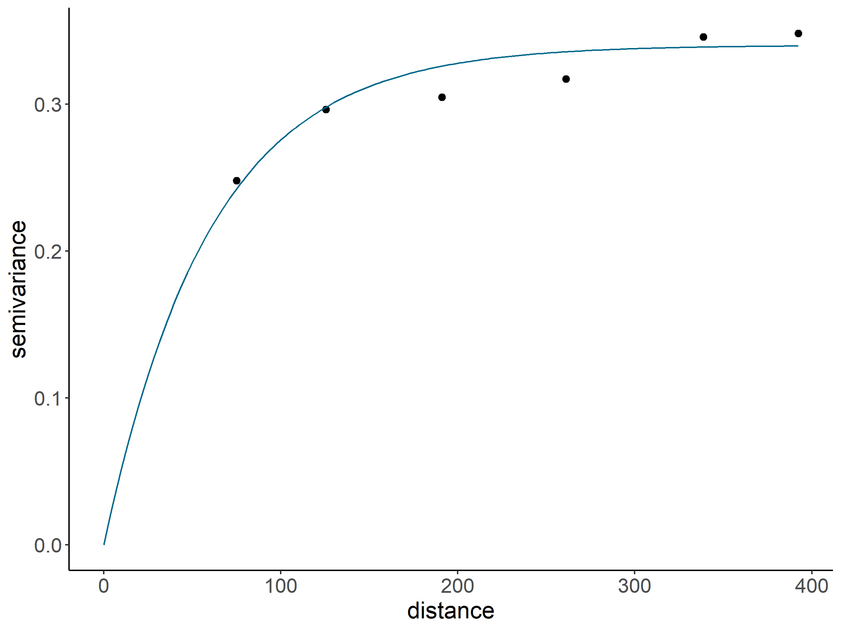
Regression kriging of soil samples (performed with Rstudio)
external drift: soil depth
GAM:
edf ≈ 1
→ linear relationship btw. soil depth and soil classes
Residuals show spatial autocorrelation
→ justifies regression kriging
Cross-validations show similar results
k-fold
LOOCV
Spatial CV
→ robust
fig. 1: variogram of residuals (Rstudio)

Slide 3
Raven setup
meteorological input data (measured in 2.5 km distance):
PRECIP,
TEMP_DAILY_MIN,
TEMP_DAILY_MAX,
SW_RADIA,
WIND_VEL,
REL_HUMIDITY,
TEMP_DAILY_AVE
(data provided by Bundesforschungszentrum für Wald)
adapted parameters for scenario with compacted topsoil:
bulk density
porosity
considered hydrological processes:
Snow Refreeze
Precipitation
Canopy Evaporation
Canopy Sublimation
Canopy Drip
Snow Balance
Abstraction
Open Water Evaporation
Seepage
Infiltration
Soil Evaporation
Capillary Rise
Percolation
Interflow
Baseflow

Slide 4
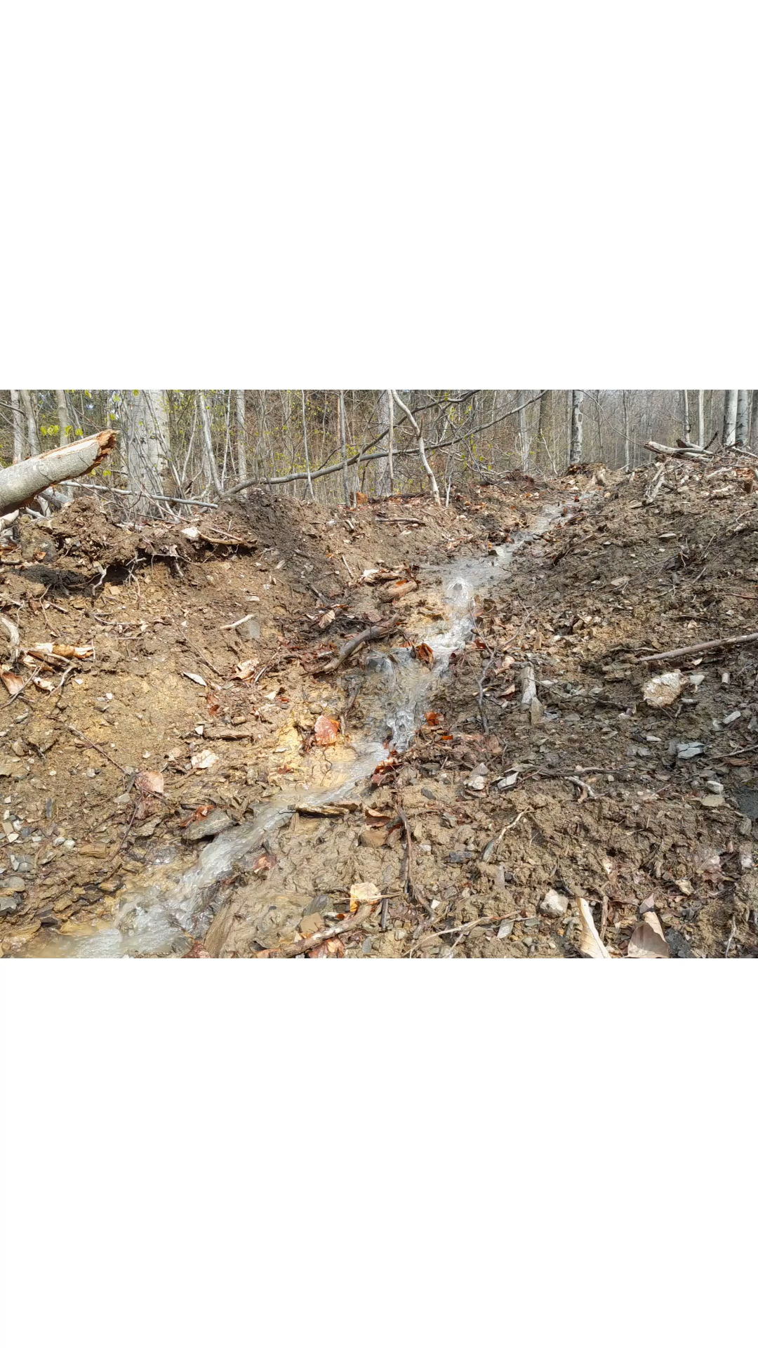
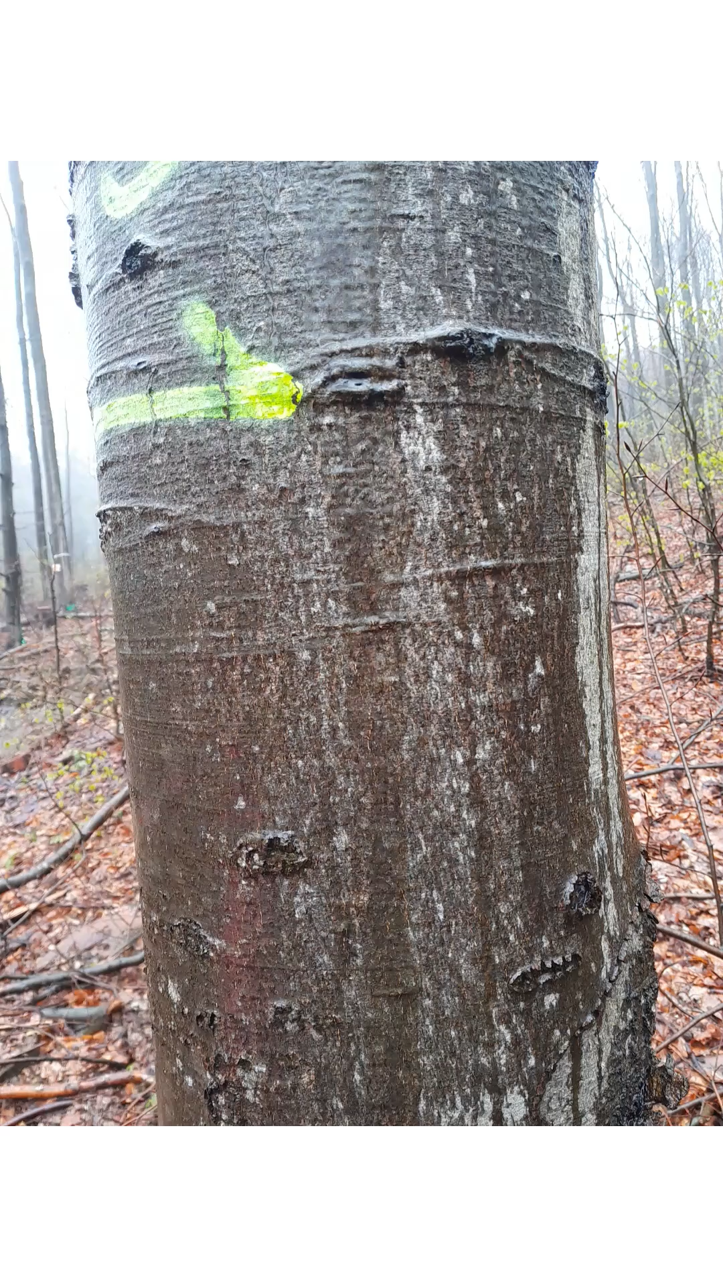
stemflow (video: Maximilian Behringer, 19.04.2023)
surface runoff (video: Maximilian Behringer, 17.04.2023)

