Slide 1




EGU26-7894

Slide 2

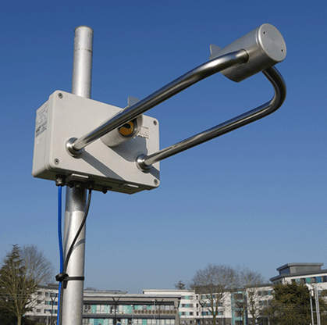
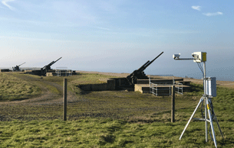
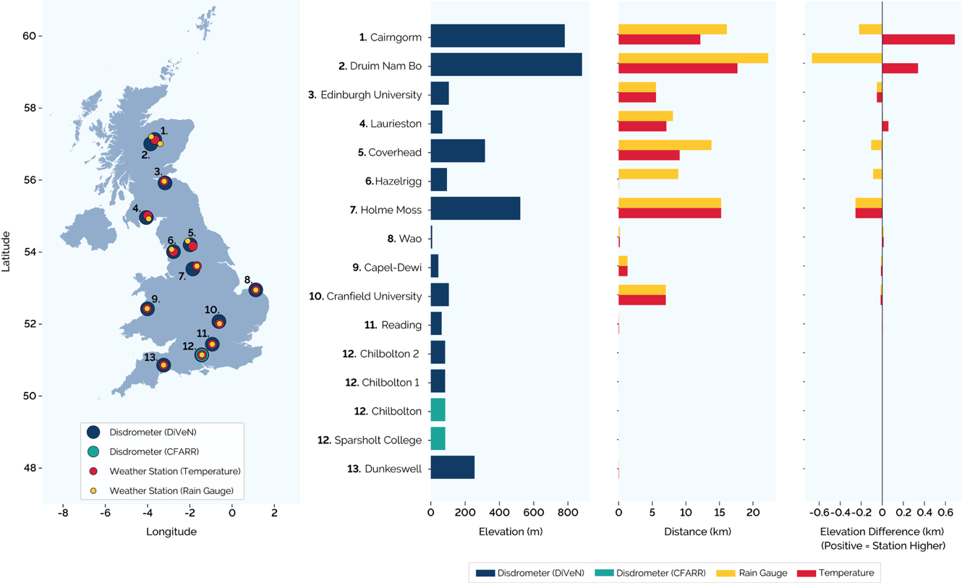
Drop Size Distribution-Based Rainfall Classification
EGU26-7894
Disdrometer Network
Theis Laser Precipitation Monitors (LPM)
20 Drop-Diameter Bins (≥ 0.125 to > 8.0 mm)
22 Fall-Speed Bins (≥ 0.0 to > 20.0 ms⁻¹)
1-Minute Temporal Resolution
March 2017 to November 2019
Pickering, B. S., Neely III, R. R., and Harrison, D.: The Disdrometer Verification Network (DiVeN): a UK network of laser precipitation instruments, Atmos. Meas. Tech., 12, 5845–5861, https://doi.org/10.5194/amt-12-5845-2019, 2019.

Slide 3
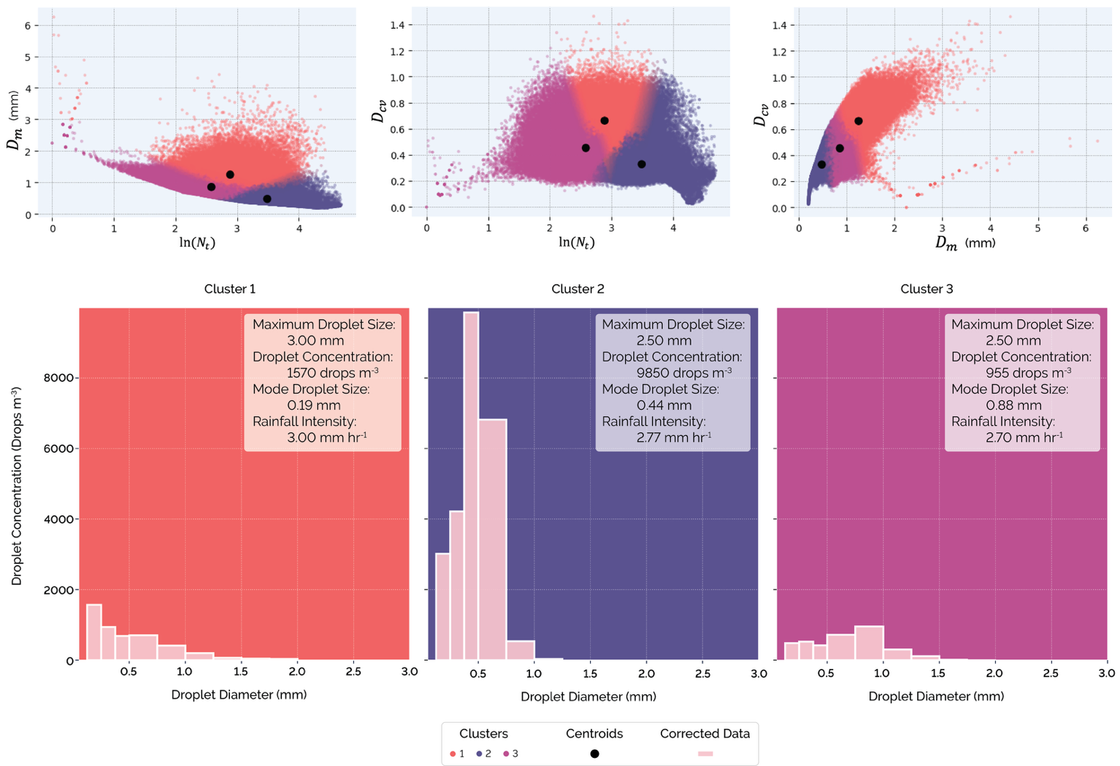
Drop Size Distribution-Based Rainfall Classification
EGU26-7894
Selection of Clustering Variables
Cluster Analysis Results: Cluster Descriptions
Cluster 1
Cluster 2
Cluster 3
Droplet Concentration (m⁻³) (Number of Drops)
Mean Volume Diameter (mm) (Dominant Size)
Coefficient of Variation of Drop Diameter (Spread)
Number of Drops (m⁻³)
Droplet Diameter (mm)
Droplet Diameter (mm)
Droplet Diameter (mm)
Many tiny droplets and a few large droplets.
Strong, sharp peak at small droplets.
Lower peak and broader distribution.
Paper in Preparation: Enhancing British Rainfall Typologies Using Drop Size Distributions and Spatiotemporal Analysis

Slide 4
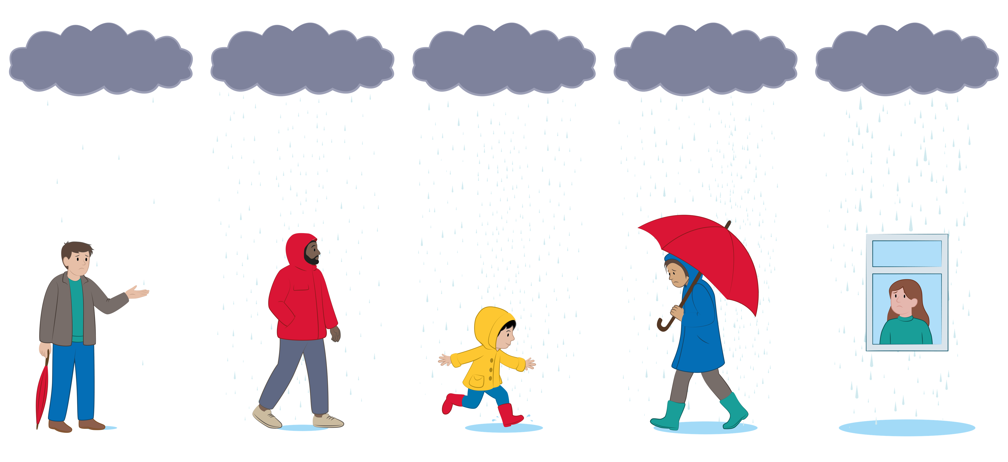


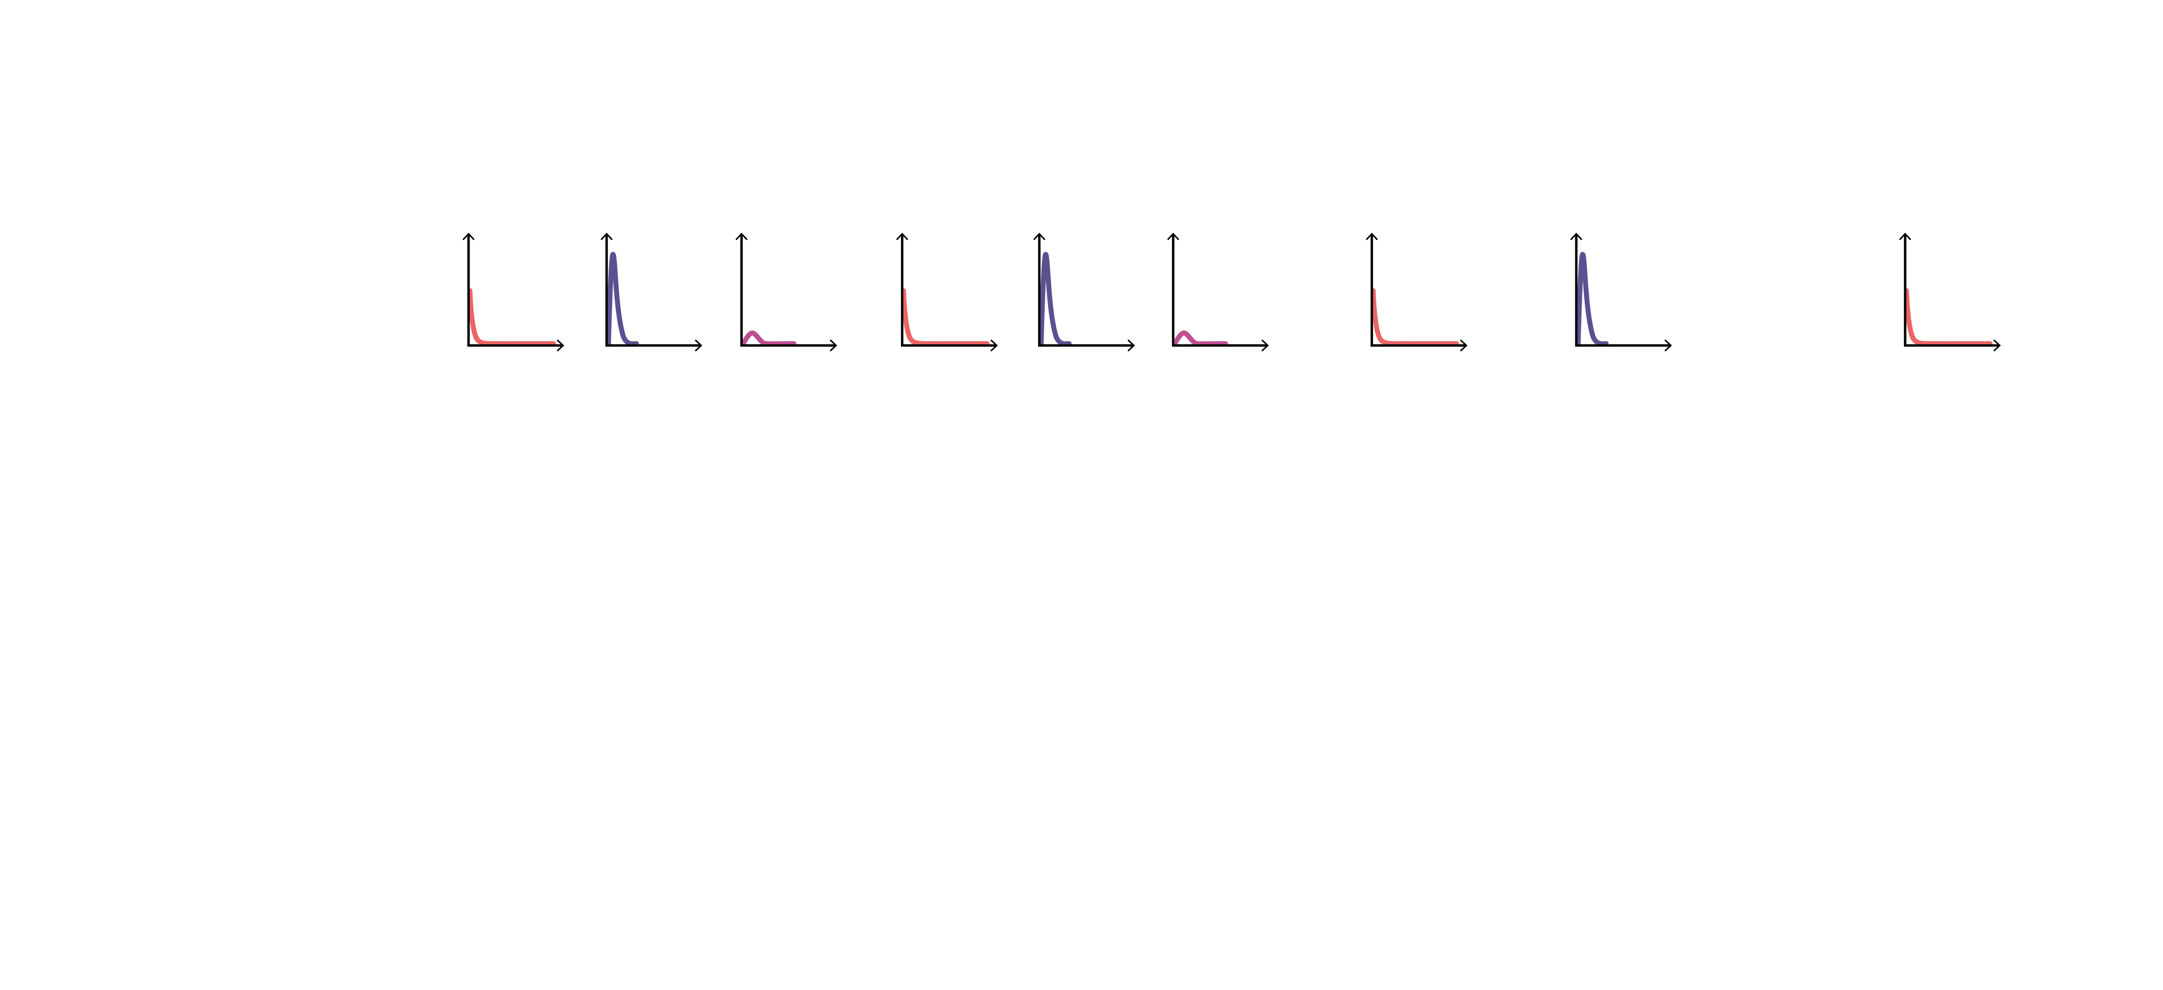
Drop Size Distribution-Based Rainfall Classification
EGU26-7894
Drizzle
(0.0 – 0.1 mm hour⁻¹)
Light
(0.1 – 2.5 mm hour⁻¹)
Moderate
(2.5 – 12.5 mm hour⁻¹)
Heavy
(12.5 – 17.5 mm hour⁻¹)
Torrential
(17.5+ mm hour⁻¹)
1
2
3
1
2
3
1
2
1
Paper in Preparation: Enhancing British Rainfall Typologies Using Drop Size Distributions and Spatiotemporal Analysis

Slide 5
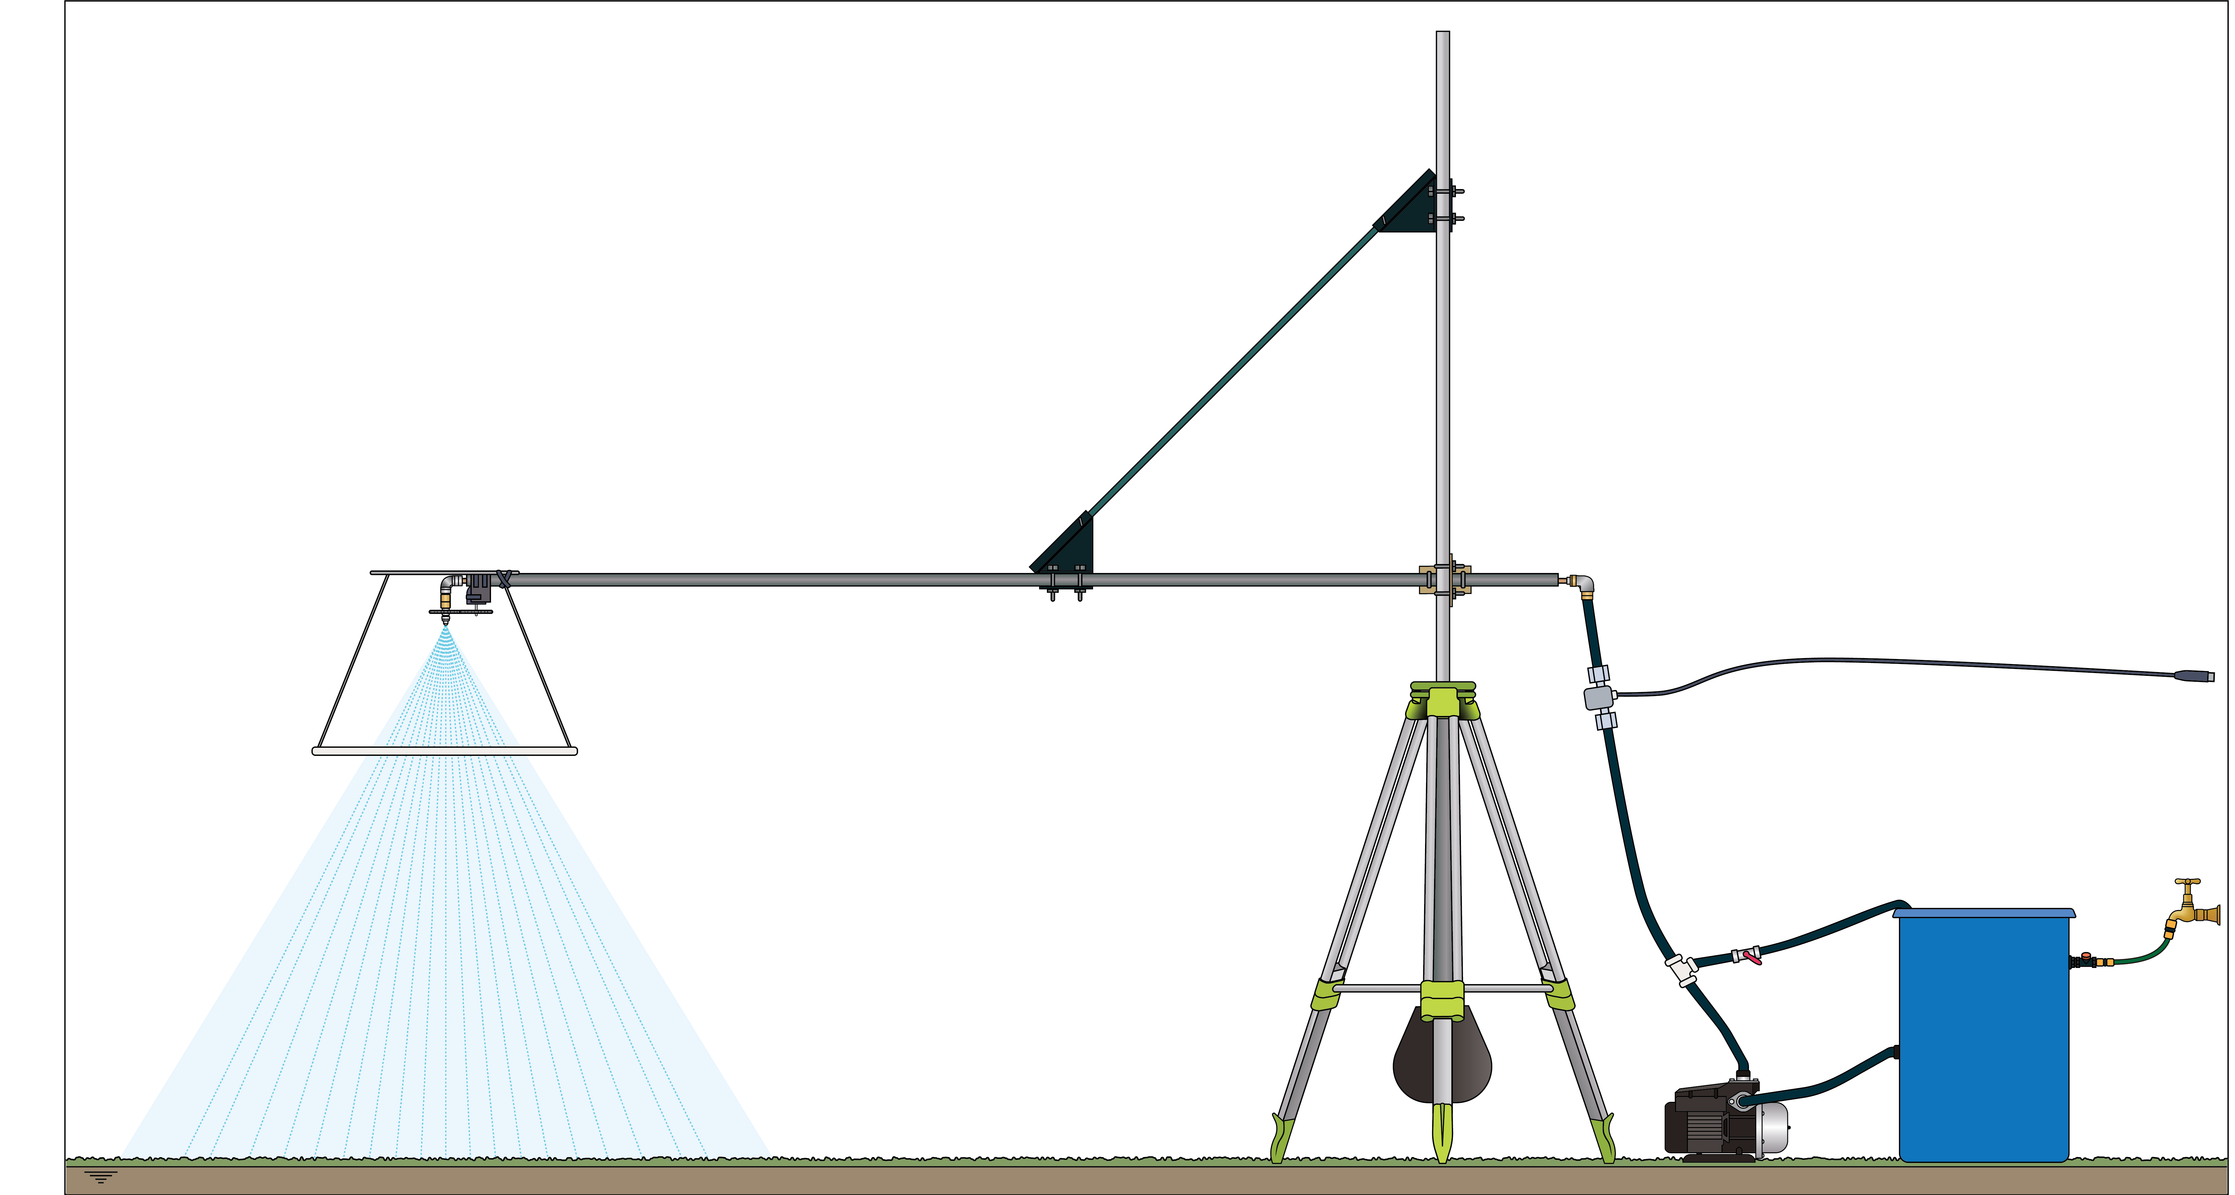
Artificial Rainfall Generation
EGU26-7894
Changeable Nozzle
Flow Sensor
Motorised Pump
Rotary Motor
Flow Control Valve
Randomising Grid
Water Supply
All Terrain Tripod
Paper in Preparation: The Design and Development of a Portable Rainfall Simulator for Evaluating Rain Gauge Measurement Accuracy

Slide 6

EGU26-7894
.5

Slide 7

EGU26-7894

Slide 8






Home Menu
Click on the links below for more information about any of the topics.
EGU26-7894
Linkedin.com
Research Motivations
Disdrometer
Data
Rainfall
Classifications
Rainfall
Simulator
Presentation
Slides
Navigation Buttons:
Information Buttons:

Slide 9
EGU26-7894

Slide 10
Drop Size Distribution-Based Rainfall Classification
EGU26-7894
Disdrometer Network
Theis Laser Precipitation Monitors (LPM)
20 Drop-Diameter Bins (≥ 0.125 to > 8.0 mm)
22 Fall-Speed Bins (≥ 0.0 to > 20.0 ms⁻¹)
1-Minute Temporal Resolution
March 2017 to November 2019
Pickering, B. S., Neely III, R. R., and Harrison, D.: The Disdrometer Verification Network (DiVeN): a UK network of laser precipitation instruments, Atmos. Meas. Tech., 12, 5845–5861, https://doi.org/10.5194/amt-12-5845-2019, 2019.

Slide 11
Drop Size Distribution-Based Rainfall Classification
EGU26-7894
Selection of Clustering Variables
Cluster Analysis Results: Cluster Descriptions
Cluster 1
Cluster 2
Cluster 3
Droplet Concentration (m⁻³) (Number of Drops)
Mean Volume Diameter (mm) (Dominant Size)
Coefficient of Variation of Drop Diameter (Spread)
Number of Drops (m⁻³)
Droplet Diameter (mm)
Droplet Diameter (mm)
Droplet Diameter (mm)
Many tiny droplets and a few large droplets.
Strong, sharp peak at small droplets.
Lower peak and broader distribution.
Paper in Preparation: Enhancing British Rainfall Typologies Using Drop Size Distributions and Spatiotemporal Analysis

Slide 12
Drop Size Distribution-Based Rainfall Classification
EGU26-7894
Drizzle
(0.0 – 0.1 mm hour⁻¹)
Light
(0.1 – 2.5 mm hour⁻¹)
Moderate
(2.5 – 12.5 mm hour⁻¹)
Heavy
(12.5 – 17.5 mm hour⁻¹)
Torrential
(17.5+ mm hour⁻¹)
1
2
3
1
2
3
1
2
1
Paper in Preparation: Enhancing British Rainfall Typologies Using Drop Size Distributions and Spatiotemporal Analysis

Slide 13
Artificial Rainfall Generation
EGU26-7894
Changeable Nozzle
Flow Sensor
Motorised Pump
Rotary Motor
Flow Control Valve
Randomising Grid
Water Supply
All Terrain Tripod
Paper in Preparation: The Design and Development of a Portable Rainfall Simulator for Evaluating Rain Gauge Measurement Accuracy

Slide 14
EGU26-7894
.5

Slide 15
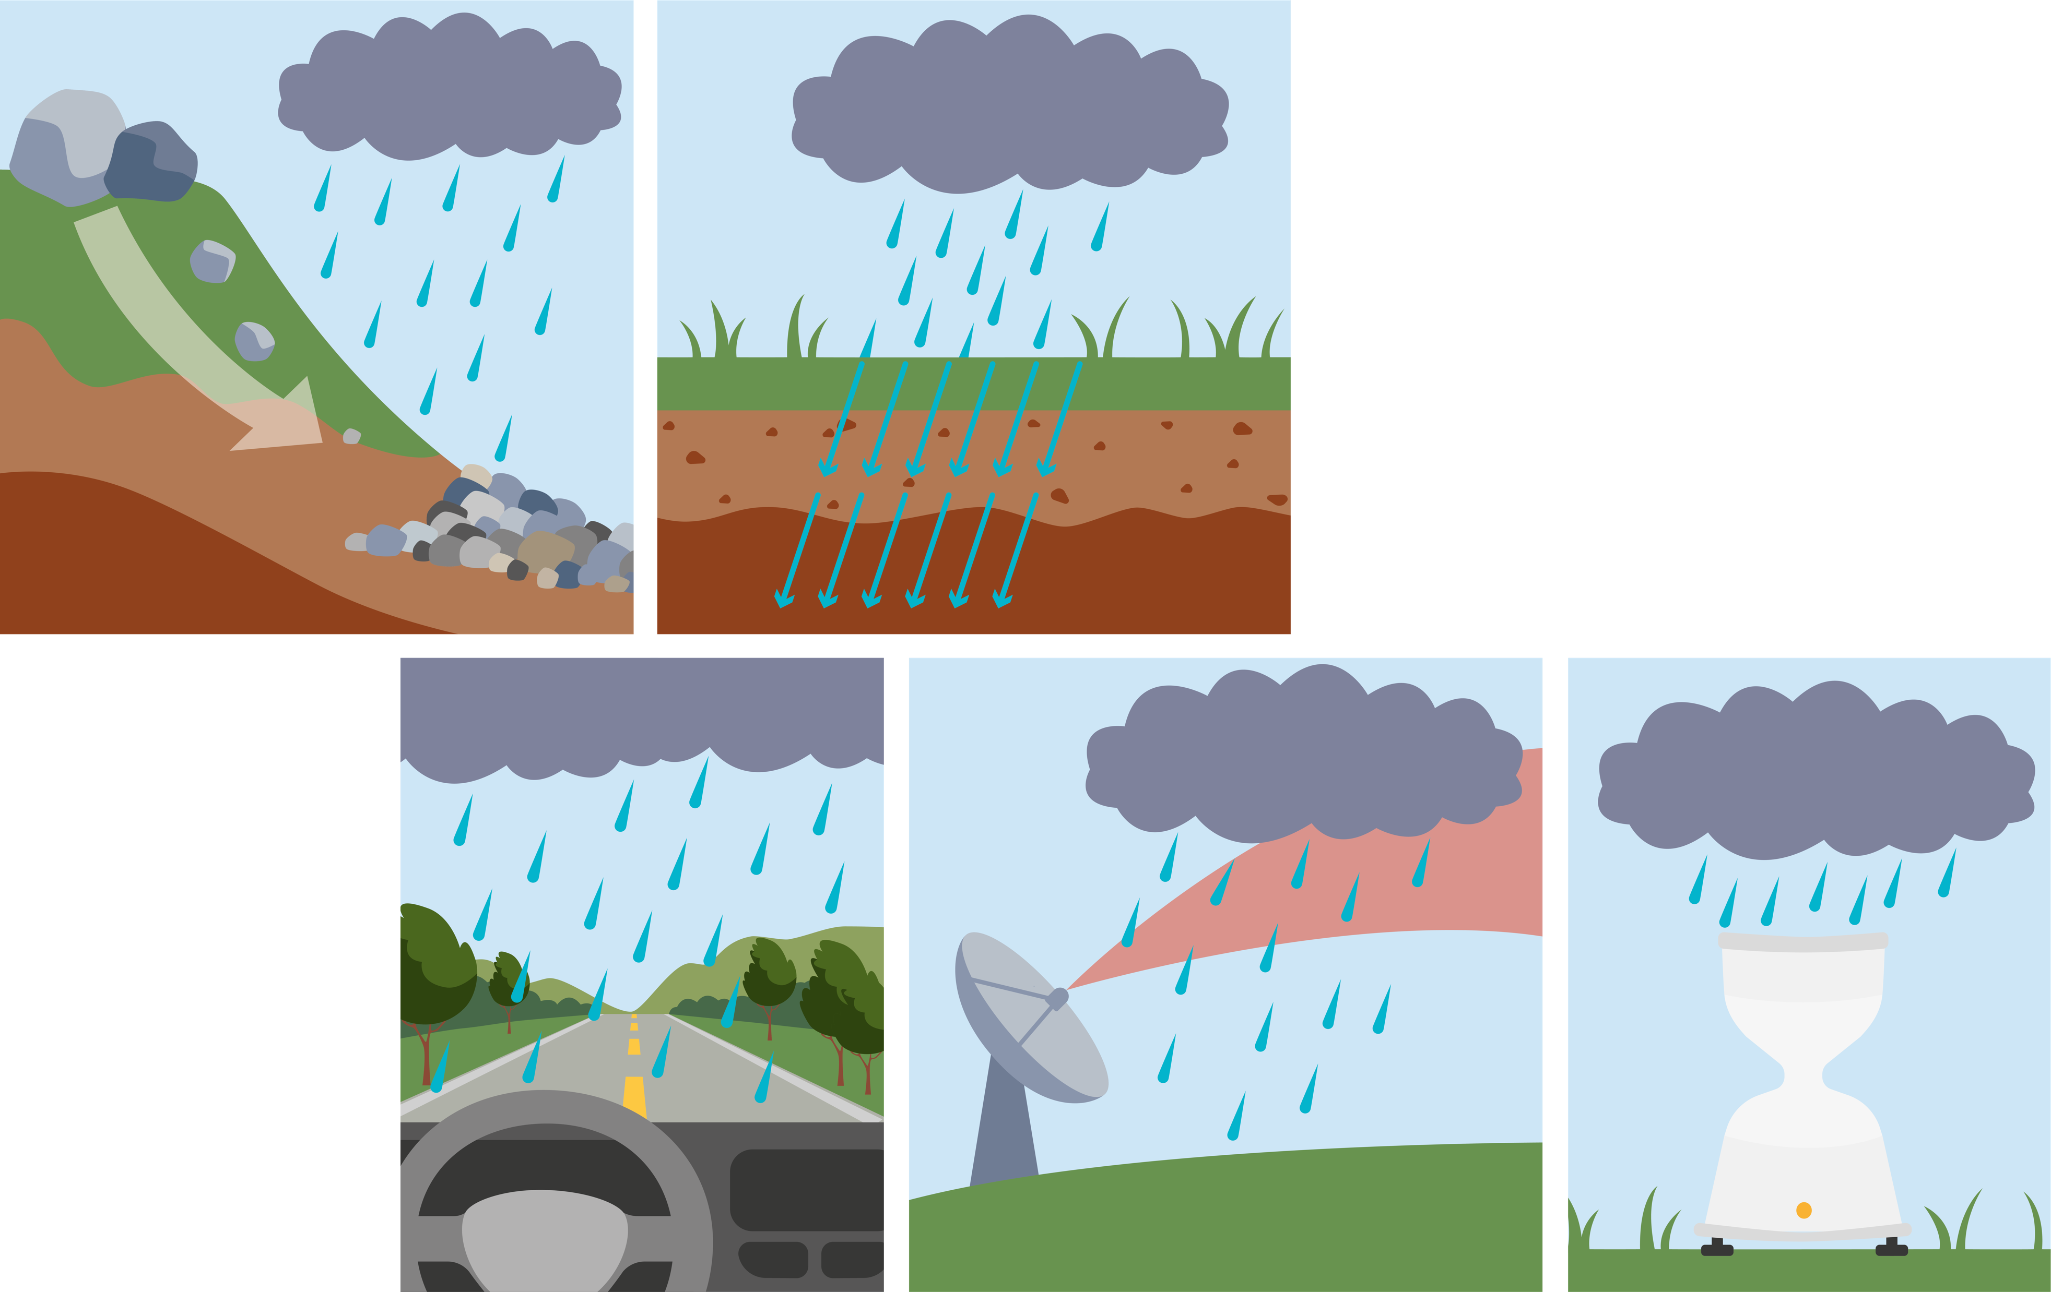

Research Motivations
EGU26-7894
Existing rainfall classification do not include droplet size distribution characteristics and typically don’t cover the full range of the spectrum.
A literature review paper that discusses rain gauge undercatch and how DSD influences it.
Droplet size distribution has been show to influence rates of erosion, soil transportation, rainfall infiltration, runoff, driver visibility, rain gauge accuracy, and radar range and accuracy.
Paper in Preparation: Enhancing British Rainfall Typologies Using Drop Size Distributions and Spatiotemporal Analysis

Slide 16
Disdrometer Data
EGU26-7894
Disdrometer Network
What is a disdrometer?
What does drop size distribution (DSD) mean?
Where can the disdrometer data be accessed?
What auxiliary data was used?
How was the disdrometer data cleaned, corrected, and validated?
Paper in Preparation: Enhancing British Rainfall Typologies Using Drop Size Distributions and Spatiotemporal Analysis

Slide 17
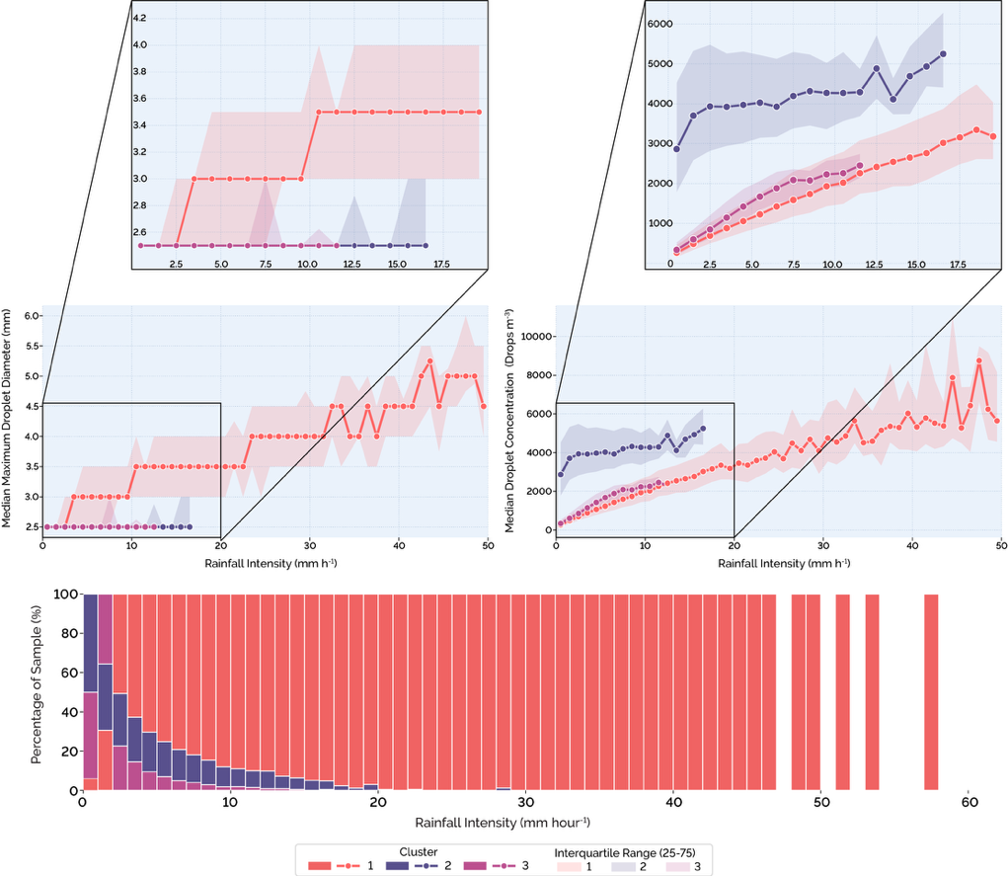
Drop Size Distribution-Based Rainfall Classification 1 of 2
EGU26-7894
Cluster Analysis Results: Structural Boundaries
Cluster Analysis Results: Cluster Descriptions
Only points with 10 or more samples are shown.
What is the methodology?
Paper in Preparation: Enhancing British Rainfall Typologies Using Drop Size Distributions and Spatiotemporal Analysis

Slide 18
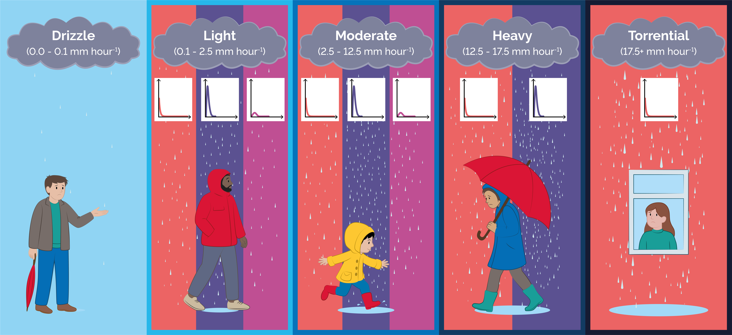
Drop Size Distribution-Based Rainfall Classification 2 of 2
EGU26-7894
Paper in Preparation: Enhancing British Rainfall Typologies Using Drop Size Distributions and Spatiotemporal Analysis

Slide 19
The Rainfall Simulator
EGU26-7894
The different nozzle configurations.
An annotated diagram of the simulator.
Simulator testing and validation.
Rain gauge experiment design.
Photograph of the setup.
Paper in Preparation: The Design and Development of a Portable Rainfall Simulator for Evaluating Rain Gauge Measurement Accuracy

Slide 20

EGU26-7894

Slide 21
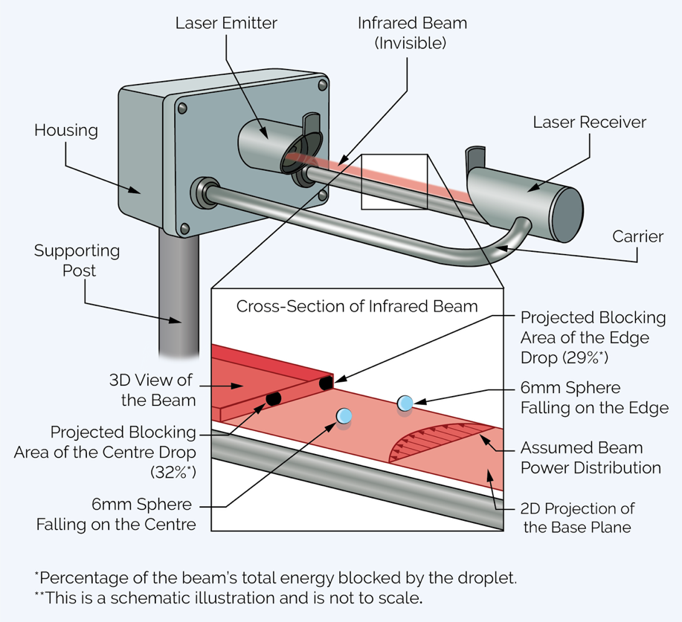
What is a Disdrometer?
EGU26-7894

Slide 22
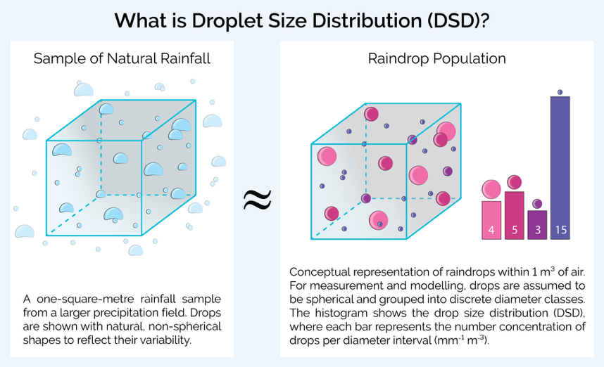
What is a Droplet Size Distribution (DSD)?
EGU26-7894

Slide 23

Where can the Disdrometer Data Be Accessed?
EGU26-7894
The disdrometer data comes from the Disdrometer Verification Network (DiVeN) more details are provided in the article blow/linked to the QR code.
Pickering, B. S., Neely III, R. R., and Harrison, D.: The Disdrometer Verification Network (DiVeN): a UK network of laser precipitation instruments, Atmos. Meas. Tech., 12, 5845–5861, https://doi.org/10.5194/amt-12-5845-2019, 2019.

Slide 24
What Auxiliary Data Was Used?
EGU26-7894
For data cleaning and verification, rain gauge and temperature data were used. Open data from the nearest Met Office weather weather stations provided this data. However, as shown by the adjacent graphs, the weather stations were not always located that close to the disdrometer.
Paper in Preparation: Enhancing British Rainfall Typologies Using Drop Size Distributions and Spatiotemporal Analysis

Slide 25
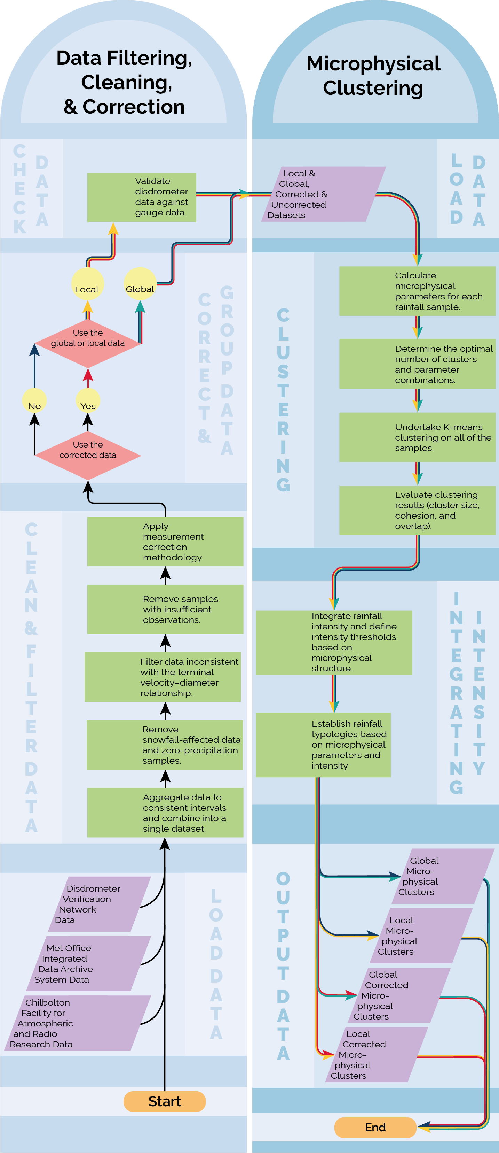
Data Filtering, Cleaning & Correction
CHECK DATA
EGU26-7894
CORRECT & GROUP DATA
How was the data cleaned?
How was terminal velocity exceedance checked for?
CLEAN & FILTER DATA
What correction factors were applied?
How did the correction factors change the data?
LOAD DATA
How was the disdrometer data validated?
Paper in Preparation: Enhancing British Rainfall Typologies Using Drop Size Distributions and Spatiotemporal Analysis

Slide 26
Data Filtering & Cleaning
CLEAN & FILTER DATA
EGU26-7894
How was the data cleaned?
How was terminal velocity exceedance checked for?
LOAD DATA
Paper in Preparation: Enhancing British Rainfall Typologies Using Drop Size Distributions and Spatiotemporal Analysis

Slide 27
Data Correction & Grouping
EGU26-7894
What correction factors were applied?
CHECK DATA
How did the correction factors change the data?
CORRECT & GROUP DATA
How was the disdrometer data validated?
Paper in Preparation: Enhancing British Rainfall Typologies Using Drop Size Distributions and Spatiotemporal Analysis

Slide 28
Data Clustering & Classification Defining
LOAD DATA
EGU26-7894
CLUSTERING
What parameters were considered?
How were the number of clusters and parameters selected?
INTEGRATING INTENSITY
What were the clustering results?
How well separated are the clusters?
OUTPUT DATA
How were clustering results used to define rainfall intensity thresholds in the classification?
Paper in Preparation: Enhancing British Rainfall Typologies Using Drop Size Distributions and Spatiotemporal Analysis

Slide 29
Data Clustering
EGU26-7894
LOAD DATA
What parameters were considered?
CLUSTERING
How were the number of clusters and parameters selected?
What were the clustering results?
How well separated are the clusters?
Paper in Preparation: Enhancing British Rainfall Typologies Using Drop Size Distributions and Spatiotemporal Analysis

Slide 30
INTEGRATING INTENSITY
Classification Defining
EGU26-7894
OUTPUT DATA
How were clustering results used to define rainfall intensity thresholds in the classification?
Paper in Preparation: Enhancing British Rainfall Typologies Using Drop Size Distributions and Spatiotemporal Analysis

Slide 31
Clustering Results
EGU26-7894
Scatter plots showing pairwise relationships between the clustering variables: (a) drop concentration against mean drop volume diameter (b) drop concentration against coefficient of variation of drop size; and (c) mean volume diameter against coefficient of variation of drop size. Points are coloured by cluster membership, with cluster centroids overlaid to indicate the central tendency of each group in feature space, and histograms of DSDs for the corrected observations closest to each cluster centroid at rainfall intensities of approximately 3.0 mm h⁻¹: (d) Cluster 1, (e) Cluster 2, (f) Cluster 3.
Paper in Preparation: Enhancing British Rainfall Typologies Using Drop Size Distributions and Spatiotemporal Analysis

Slide 32
What were the Clustering Results?
EGU26-7894
Scatter plots showing pairwise relationships between the clustering variables: (a) drop concentration against mean drop volume diameter (b) drop concentration against coefficient of variation of drop size; and (c) mean volume diameter against coefficient of variation of drop size. Points are coloured by cluster membership, with cluster centroids overlaid to indicate the central tendency of each group in feature space, and histograms of DSDs for the corrected observations closest to each cluster centroid at rainfall intensities of approximately 3.0 mm h⁻¹: (d) Cluster 1, (e) Cluster 2, (f) Cluster 3.
Paper in Preparation: Enhancing British Rainfall Typologies Using Drop Size Distributions and Spatiotemporal Analysis

Slide 33
What were the Clustering Results?
EGU26-7894
Scatter plots showing pairwise relationships between the clustering variables: (a) drop concentration against mean drop volume diameter (b) drop concentration against coefficient of variation of drop size; and (c) mean volume diameter against coefficient of variation of drop size. Points are coloured by cluster membership, with cluster centroids overlaid to indicate the central tendency of each group in feature space, and histograms of DSDs for the corrected observations closest to each cluster centroid at rainfall intensities of approximately 3.0 mm h⁻¹: (d) Cluster 1, (e) Cluster 2, (f) Cluster 3.
Paper in Preparation: Enhancing British Rainfall Typologies Using Drop Size Distributions and Spatiotemporal Analysis

Slide 34
Clustering Results
EGU26-7894
Relationships between rainfall intensity and (a) median maximum droplet diameter and (b) droplet concentration, stratified by cluster. Insets highlight the lower intensity range. Plots are truncated where fewer than 10 samples are available. Key features were used to define rainfall intensity thresholds: 0.1 mm h⁻¹ (analysis threshold); 2.5 mm h⁻¹ (divergence in maximum drop size for Cluster 1); 12.5 mm h⁻¹ (absence of Cluster 3); and 17.5 mm h⁻¹ (absence of Cluster 2). These thresholds are indicated by arrows. Arrows do not align exactly with the stated values due to the minimum sample size requirement (n ≥ 10).

Slide 35
How were Intensity Thresholds Defined?
EGU26-7894
Relationships between rainfall intensity and (a) median maximum droplet diameter and (b) droplet concentration, stratified by cluster. Insets highlight the lower intensity range. Plots are truncated where fewer than 10 samples are available. Key features were used to define rainfall intensity thresholds: 0.1 mm h⁻¹ (analysis threshold); 2.5 mm h⁻¹ (divergence in maximum drop size for Cluster 1); 12.5 mm h⁻¹ (absence of Cluster 3); and 17.5 mm h⁻¹ (absence of Cluster 2). These thresholds are indicated by arrows. Arrows do not align exactly with the stated values due to the minimum sample size requirement (n ≥ 10).

Slide 36
How were Intensity Thresholds Defined?
EGU26-7894
Relationships between rainfall intensity and (a) median maximum droplet diameter and (b) droplet concentration, stratified by cluster. Insets highlight the lower intensity range. Plots are truncated where fewer than 10 samples are available. Key features were used to define rainfall intensity thresholds: 0.1 mm h⁻¹ (analysis threshold); 2.5 mm h⁻¹ (divergence in maximum drop size for Cluster 1); 12.5 mm h⁻¹ (absence of Cluster 3); and 17.5 mm h⁻¹ (absence of Cluster 2). These thresholds are indicated by arrows. Arrows do not align exactly with the stated values due to the minimum sample size requirement (n ≥ 10).

Slide 37
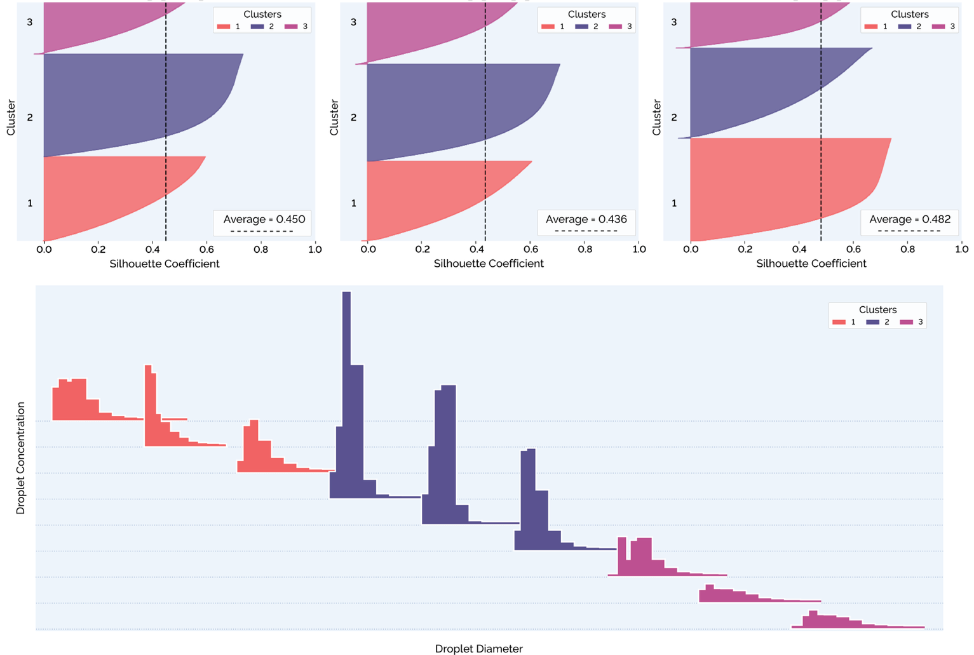
How well Separated are the Clusters?
EGU26-7894
Silhouette analysis for clustering using different variable pairs: (a) drop concentration against mean drop volume diameter (b) drop concentration against coefficient of variation of drop size; and (c) mean volume diameter against coefficient of variation of drop size. The plots show silhouette scores for each observation, providing a measure of cluster compactness and separation. The lower panel (d) presents a sequence of staggered histograms of drop size distributions (DSDs), with droplet concentration on the y-axis and droplet diameter on the x-axis. Exact values are not shown due to the staggered presentation; however, all histograms correspond to the same rainfall intensity.
Paper in Preparation: Enhancing British Rainfall Typologies Using Drop Size Distributions and Spatiotemporal Analysis

Slide 38
How well Separated are the Clusters?
EGU26-7894
Silhouette analysis for clustering using different variable pairs: (a) drop concentration against mean drop volume diameter (b) drop concentration against coefficient of variation of drop size; and (c) mean volume diameter against coefficient of variation of drop size. The plots show silhouette scores for each observation, providing a measure of cluster compactness and separation. The lower panel (d) presents a sequence of staggered histograms of drop size distributions (DSDs), with droplet concentration on the y-axis and droplet diameter on the x-axis. Exact values are not shown due to the staggered presentation; however, all histograms correspond to the same rainfall intensity.
Paper in Preparation: Enhancing British Rainfall Typologies Using Drop Size Distributions and Spatiotemporal Analysis

Slide 39
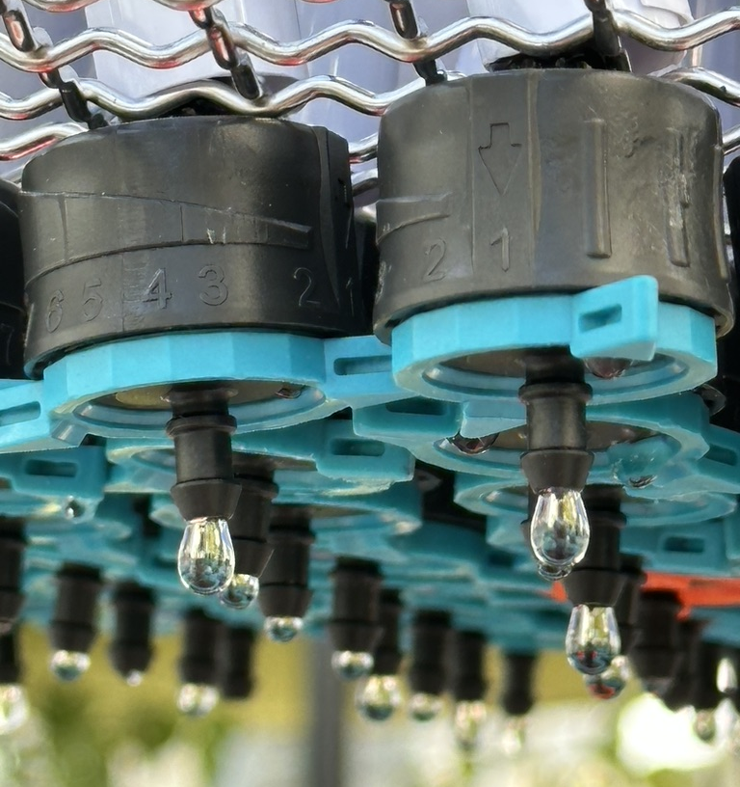
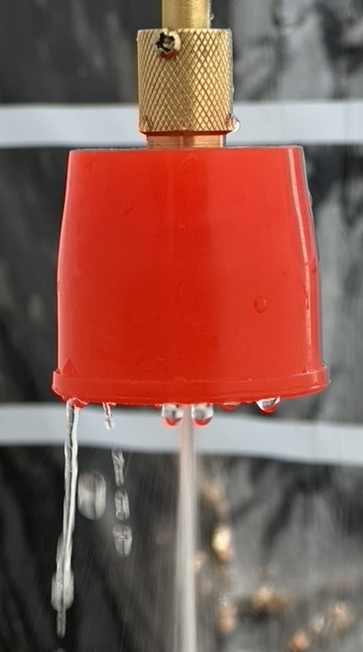
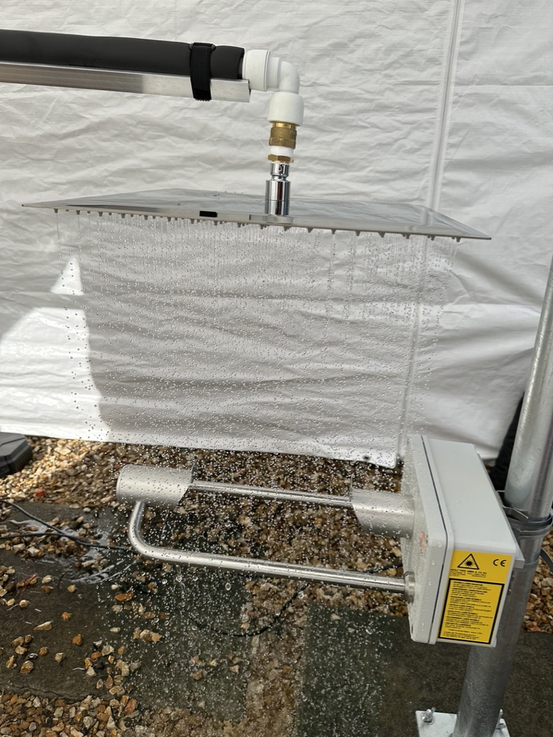
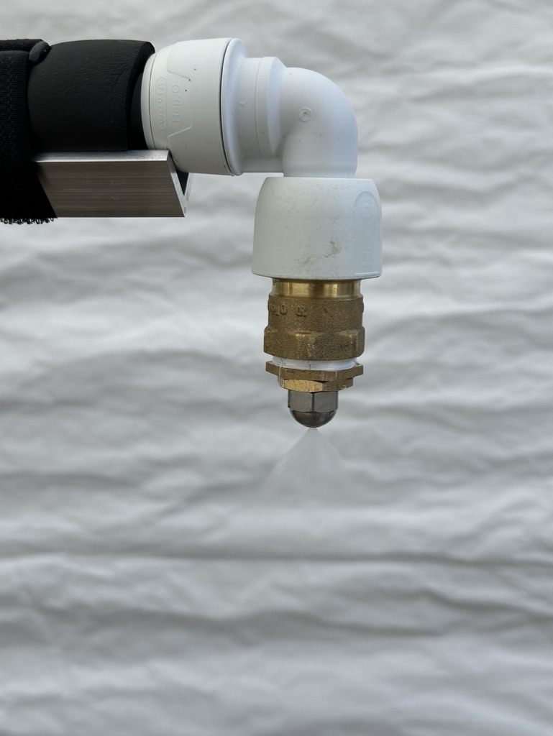
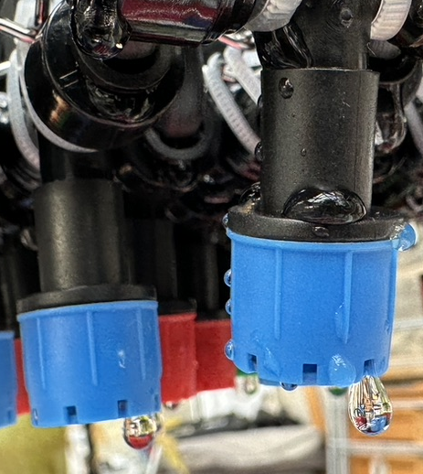
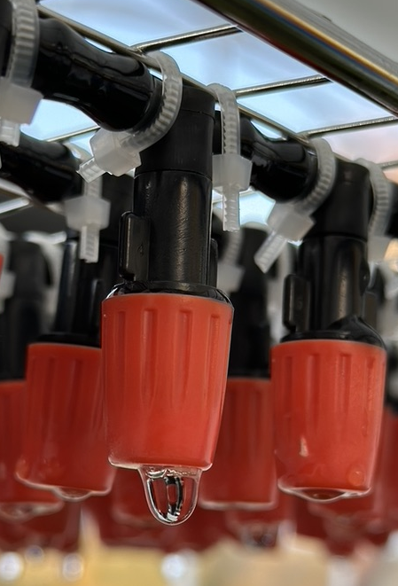
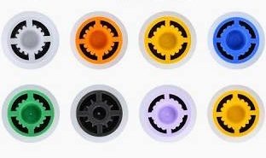
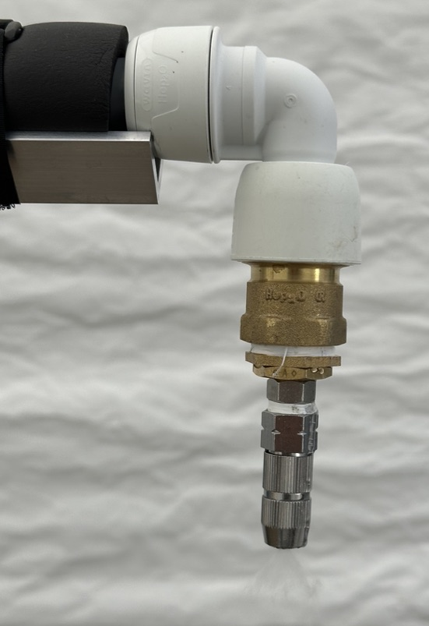
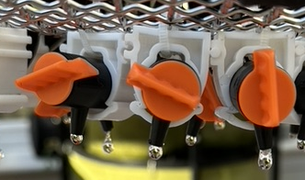
Tested Nozzle Configurations 1 of 3
EGU26-7894
Rainfall Shower Heads
& Flow Restrictors
Industrial Nozzles
Garden Nozzles
Irrigation Droppers
Paper in Preparation: The Design and Development of a Portable Rainfall Simulator for Evaluating Rain Gauge Measurement Accuracy

Slide 40
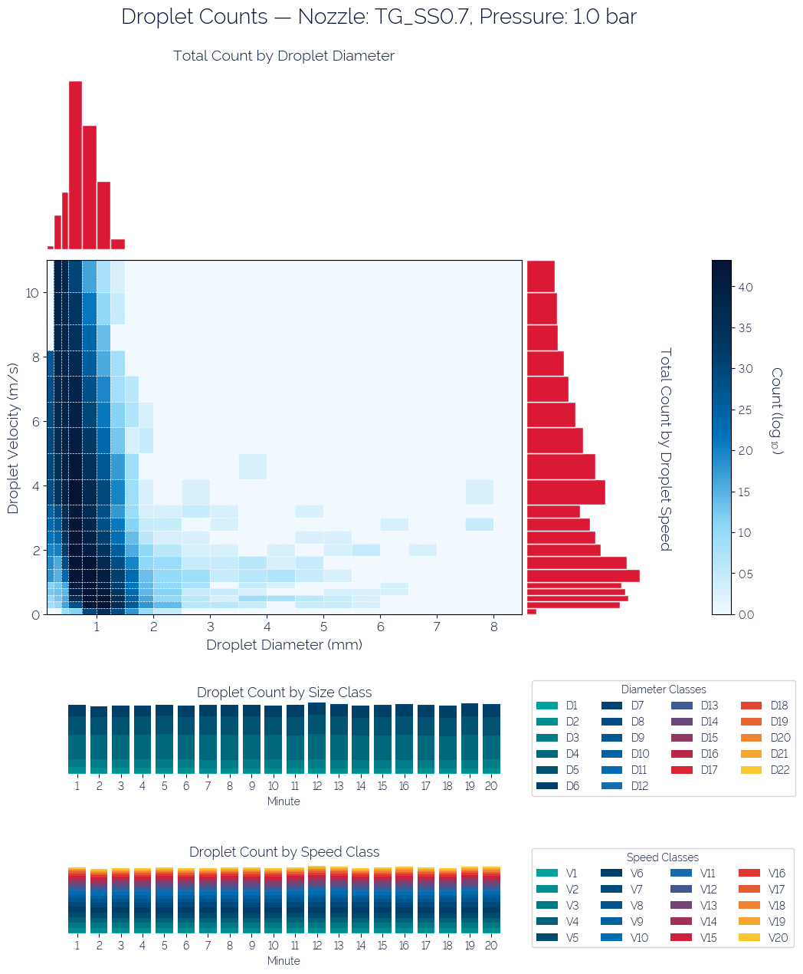
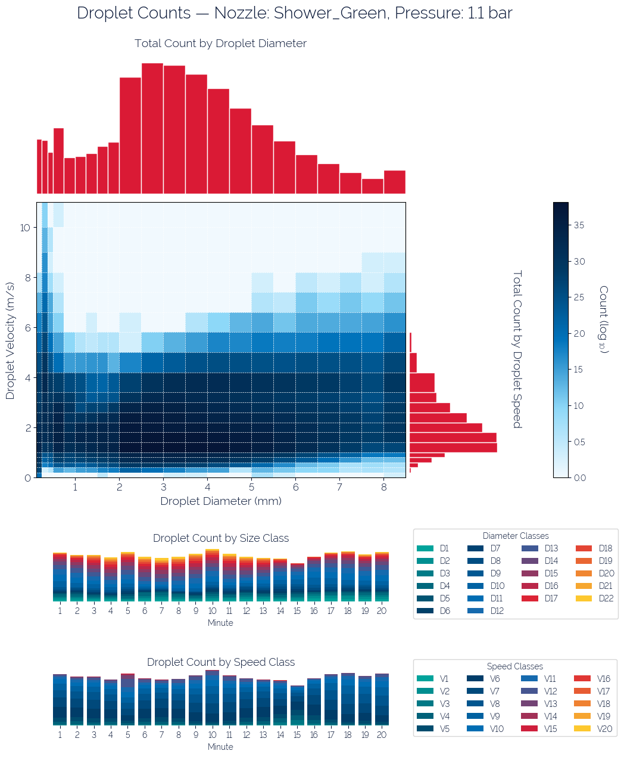
Tested Nozzle Configurations 2 of 3
EGU26-7894
Paper in Preparation: The Design and Development of a Portable Rainfall Simulator for Evaluating Rain Gauge Measurement Accuracy

Slide 41
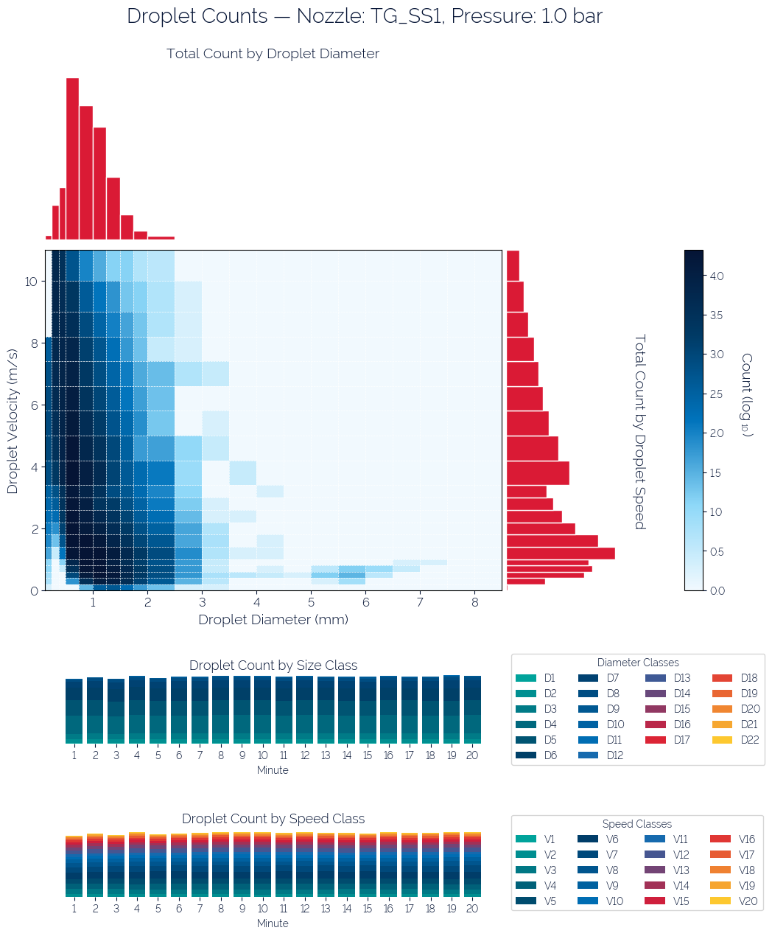
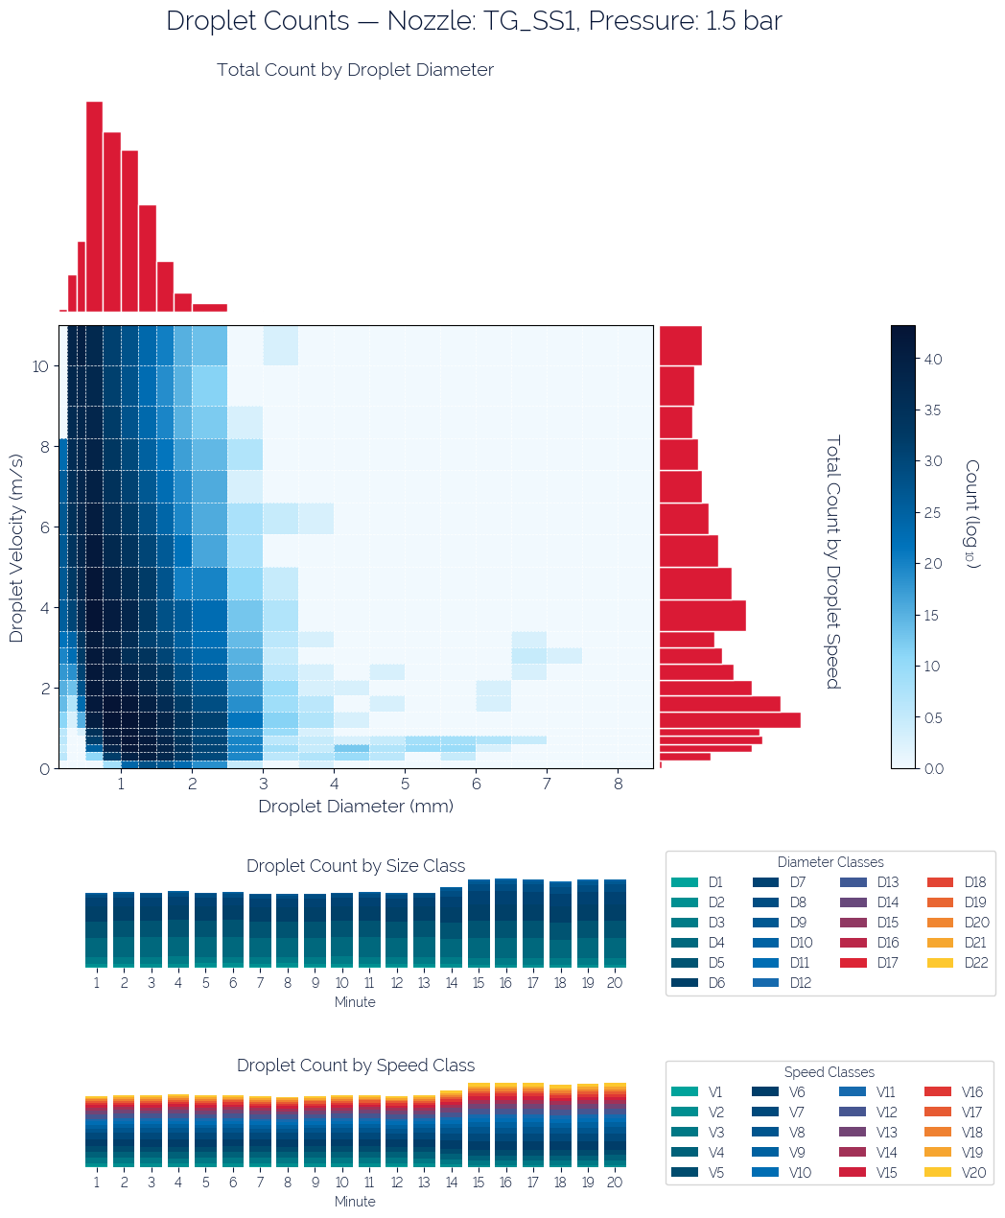
Tested Nozzle Configurations 3 of 3
EGU26-7894
Paper in Preparation: The Design and Development of a Portable Rainfall Simulator for Evaluating Rain Gauge Measurement Accuracy

Slide 42
Tested Nozzle Configurations
EGU26-7894
Rainfall Shower Heads
& Flow Restrictors
Industrial Nozzles
Garden Nozzles
Irrigation Droppers
Paper in Preparation: The Design and Development of a Portable Rainfall Simulator for Evaluating Rain Gauge Measurement Accuracy

Slide 43
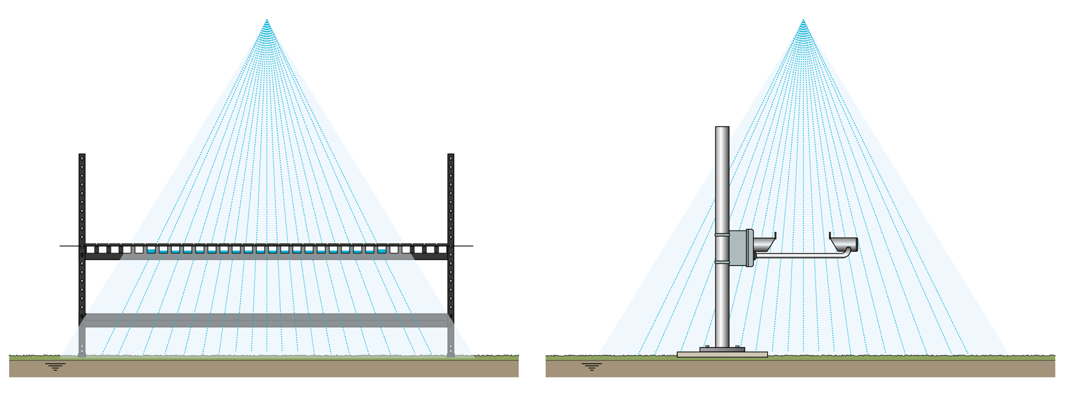
Simulator Validation Experiment Design
EGU26-7894
Distribution grid to assess the uniformity of the spray/drops.
A disdrometer to measure the size and velocity of the drops.
Paper in Preparation: The Design and Development of a Portable Rainfall Simulator for Evaluating Rain Gauge Measurement Accuracy

Slide 44
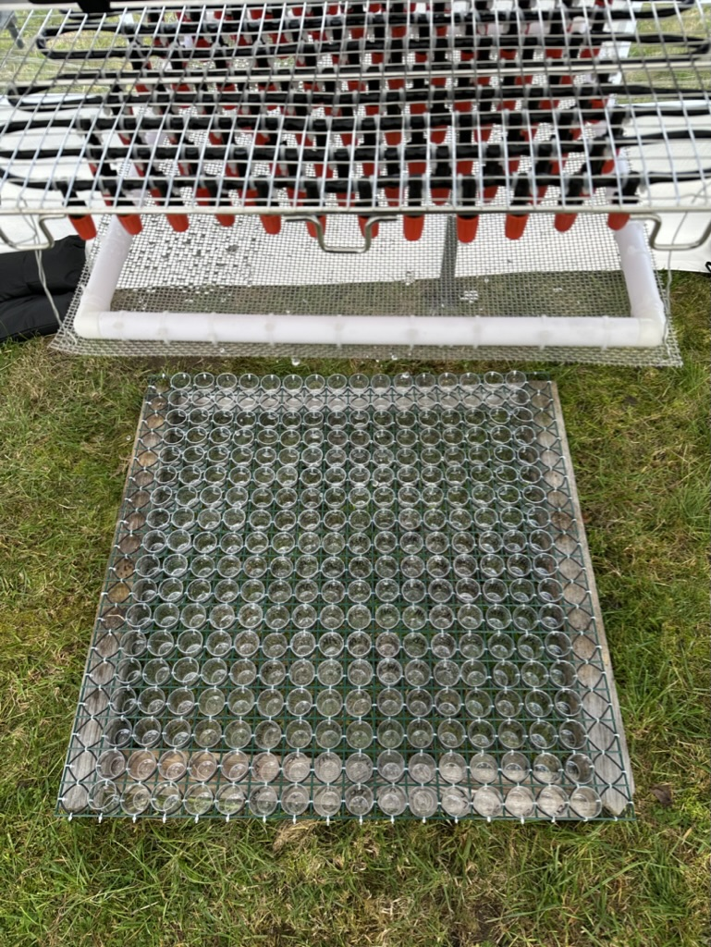
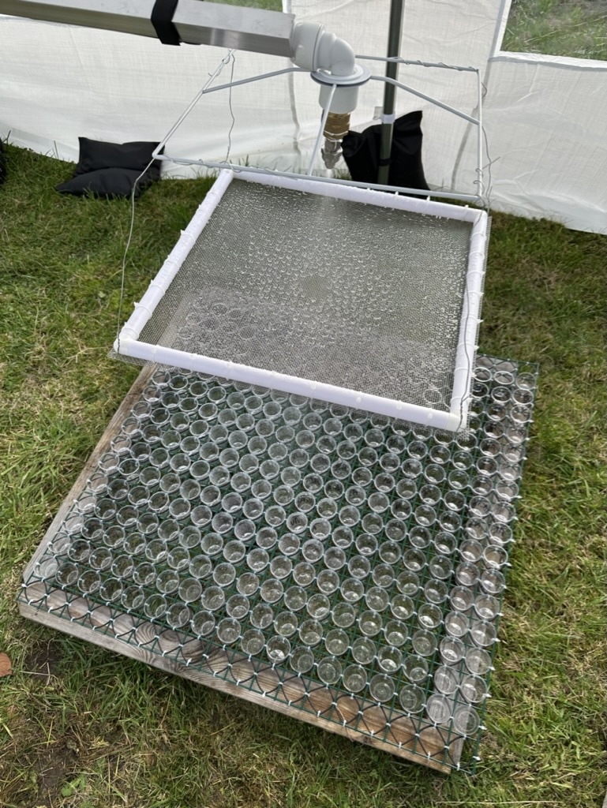
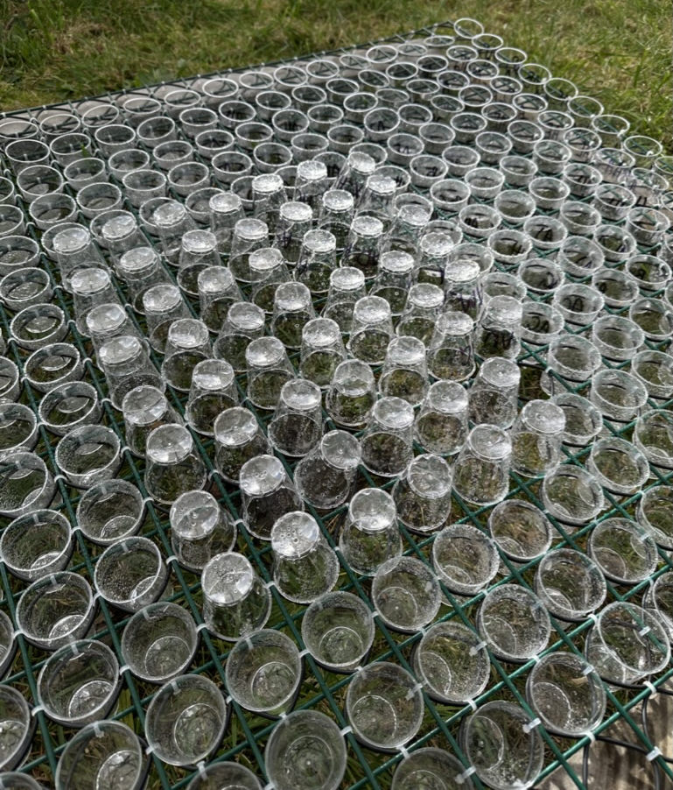
Distribution Grid Photos
EGU26-7894
Paper in Preparation: The Design and Development of a Portable Rainfall Simulator for Evaluating Rain Gauge Measurement Accuracy

Slide 45
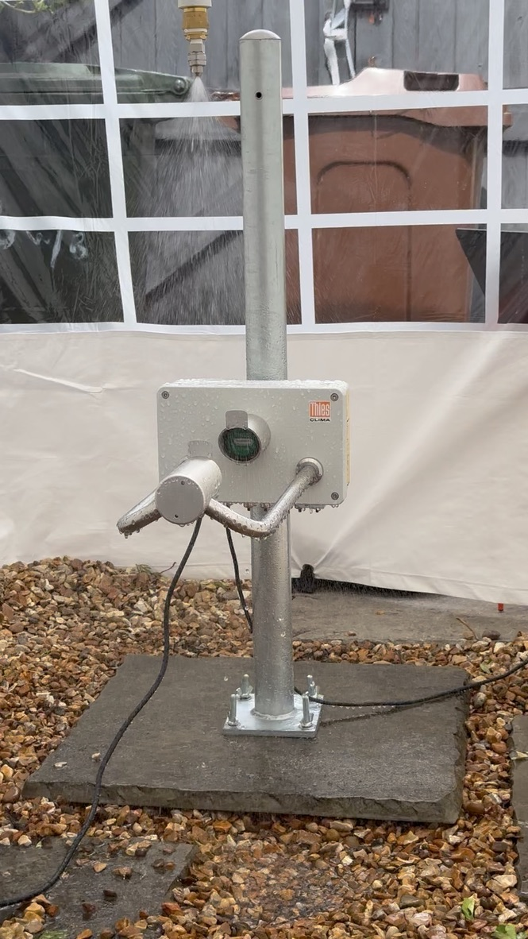
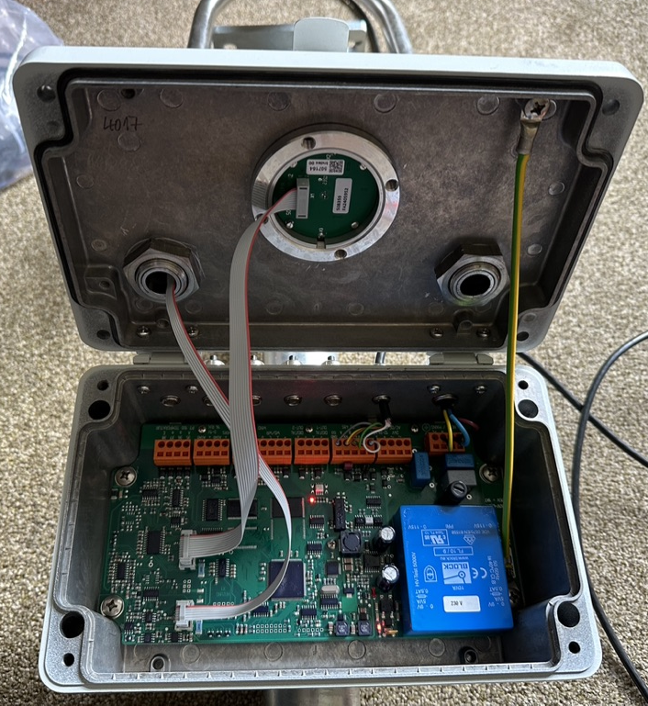
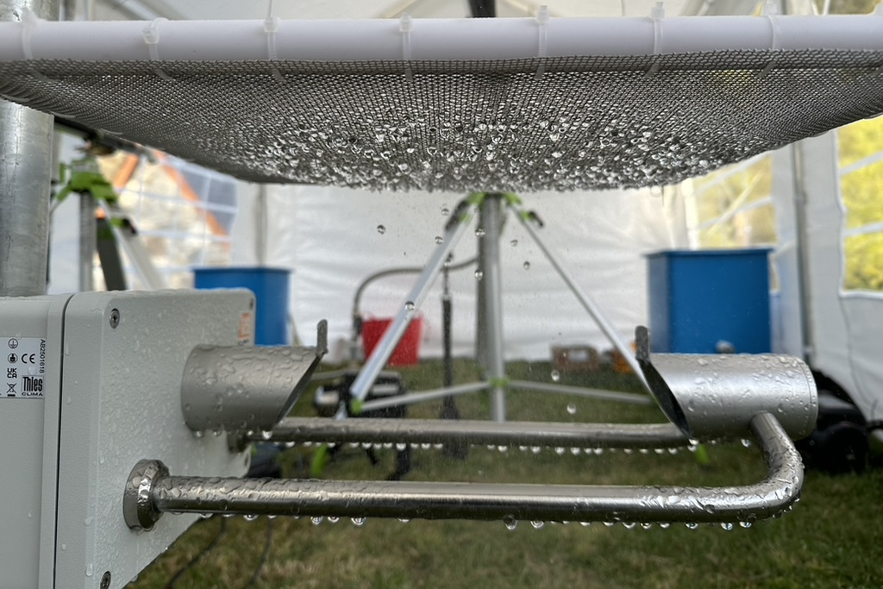
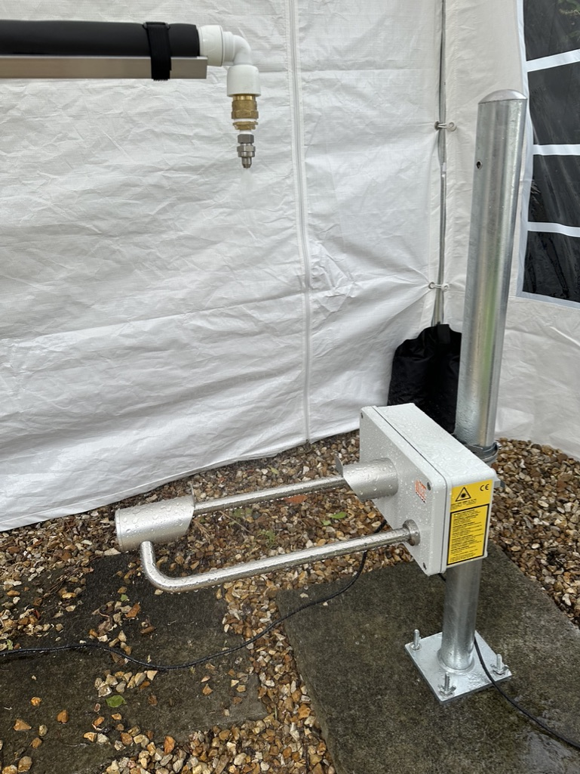
Disdrometer Photos
EGU26-7894
Paper in Preparation: The Design and Development of a Portable Rainfall Simulator for Evaluating Rain Gauge Measurement Accuracy

Slide 46
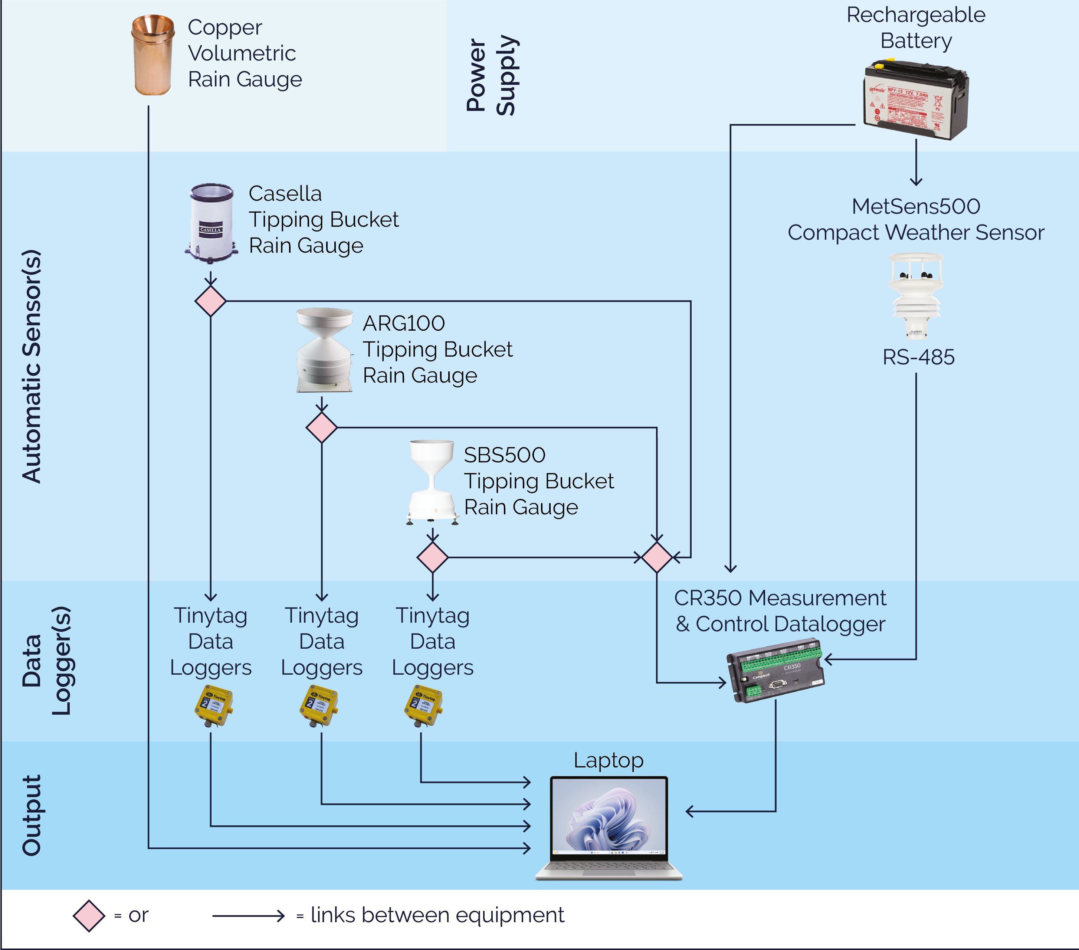
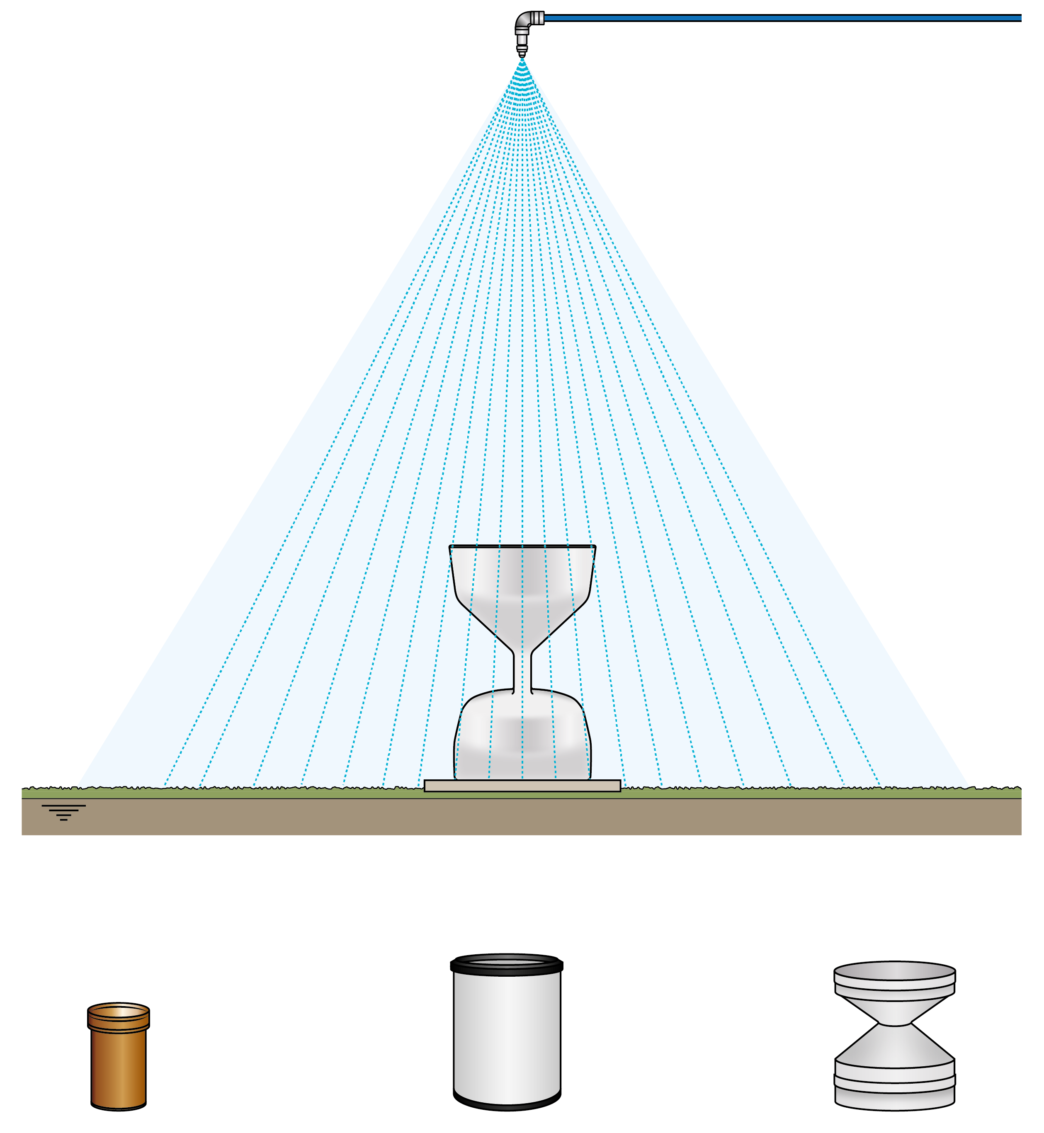
Rain Gauge Experiment Design
EGU26-7894
The simulator is designed to be portable, allowing deployment across a range of field locations. Three simulators have been constructed, enabling the simultaneous testing of three rain gauges. A weather station is used to record additional atmospheric variables at each site. The system setup is shown in the left-most figure, while the right-most figure illustrates the placement of the rain gauge beneath the simulator and the different types of gauges to be investigated.
Paper in Preparation: The Design and Development of a Portable Rainfall Simulator for Evaluating Rain Gauge Measurement Accuracy

Slide 47
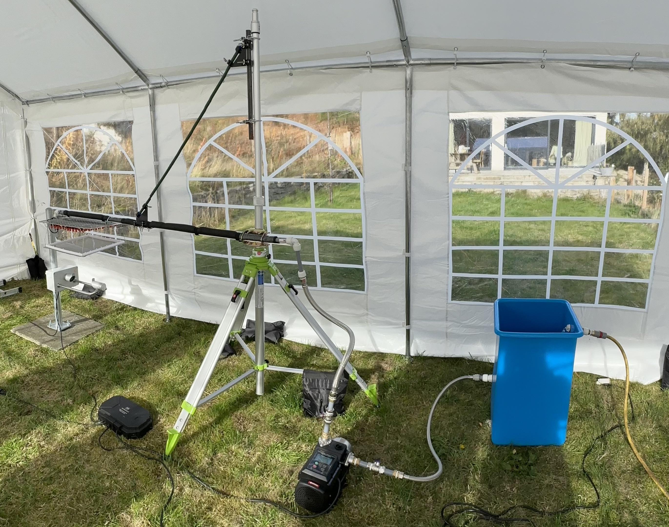
Simulator Photos
EGU26-7894
Custom-built rainfall simulator designed to control droplet size distribution and rainfall intensity for assessing rain gauge accuracy under varying environmental conditions and locations. The system is shown during testing, with a disdrometer used to measure droplet size distributions for calibration and validation.
This is an old version so it does not include the flow sensor or flow control valve.
Paper in Preparation: The Design and Development of a Portable Rainfall Simulator for Evaluating Rain Gauge Measurement Accuracy

Slide 48
The Rainfall Simulator Design
EGU26-7894
Changeable Nozzle
Flow Sensor
Motorised Pump
Rotary Motor
Flow Control Valve
Randomising Grid
Water Supply
All Terrain Tripod
Paper in Preparation: The Design and Development of a Portable Rainfall Simulator for Evaluating Rain Gauge Measurement Accuracy

Slide 49
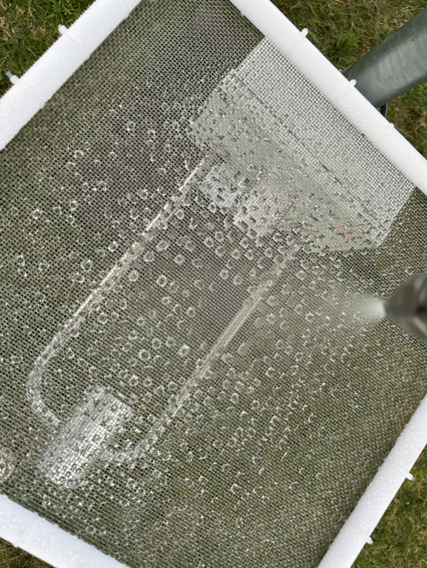
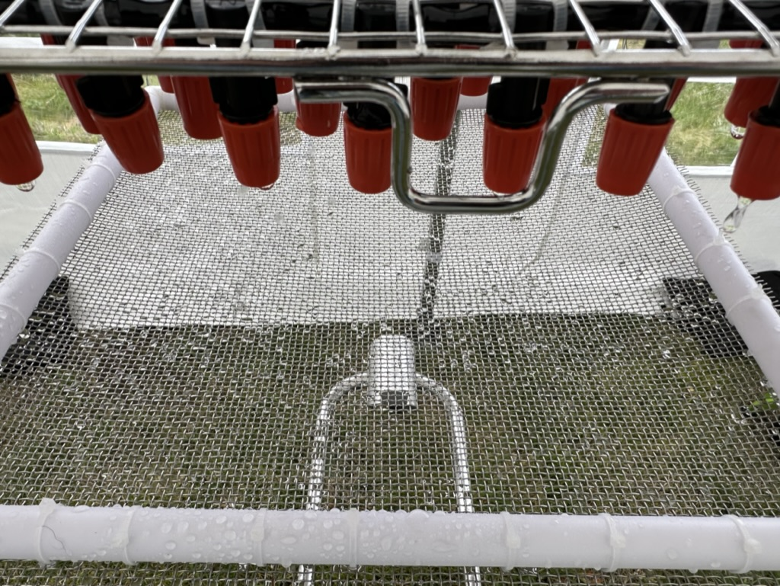
The Randomising Grid
EGU26-7894
Randomise the size and location of the droplets as they fall.
Paper in Preparation: The Design and Development of a Portable Rainfall Simulator for Evaluating Rain Gauge Measurement Accuracy

Slide 50
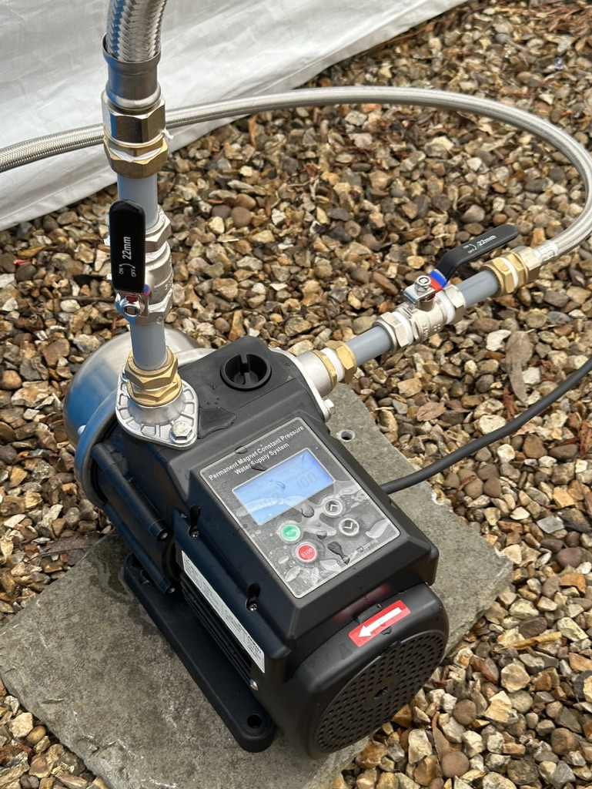
Motorised Pump
EGU26-7894
A motorised pump controls simulated rainfall intensity by adjusting the pressure setting
Paper in Preparation: The Design and Development of a Portable Rainfall Simulator for Evaluating Rain Gauge Measurement Accuracy

Slide 51
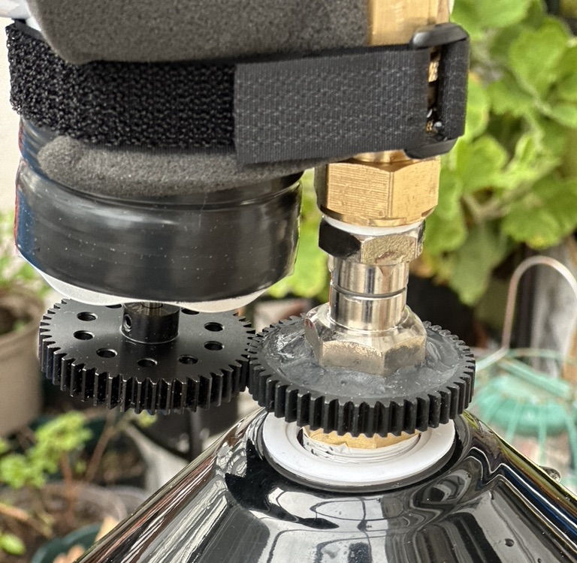
Rotary Motor
EGU26-7894
A small motor drives a gear assembly, transferring rotation to a gear encircling a freely rotating water pipe. This induces rotation of the nozzle head, enhancing variability in droplet trajectories. The motor operates at three selectable speeds.
Paper in Preparation: The Design and Development of a Portable Rainfall Simulator for Evaluating Rain Gauge Measurement Accuracy

Slide 52
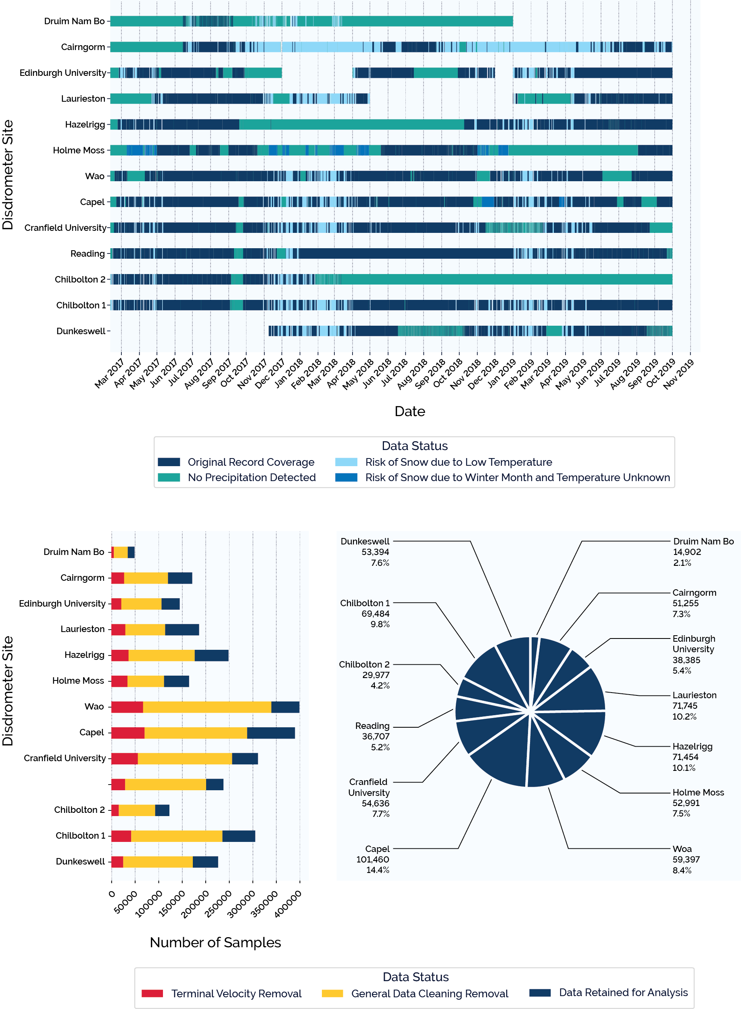
How was the Data Cleaned?
EGU26-7894
(a) Gantt chart showing disdrometer data availability across the DiVeN network over the study period. Periods excluded from analysis due to missing data, absence of detected rainfall, and potential snowfall risk are highlighted. (b) Stacked bar chart illustrating the relative volume of data contributed by each site, where data volume represents periods within operational time during which rainfall was detected, rather than total instrument uptime. (c) Pie chart showing the percentage contribution and number of one-minute samples from each site.
Paper in Preparation: Enhancing British Rainfall Typologies Using Drop Size Distributions and Spatiotemporal Analysis

Slide 53
How was the Data Cleaned?
EGU26-7894
(a) Gantt chart showing disdrometer data availability across the DiVeN network over the study period. Periods excluded from analysis due to missing data, absence of detected rainfall, and potential snowfall risk are highlighted. (b) Stacked bar chart illustrating the relative volume of data contributed by each site, where data volume represents periods within operational time during which rainfall was detected, rather than total instrument uptime. (c) Pie chart showing the percentage contribution and number of one-minute samples from each site.
Paper in Preparation: Enhancing British Rainfall Typologies Using Drop Size Distributions and Spatiotemporal Analysis

Slide 54
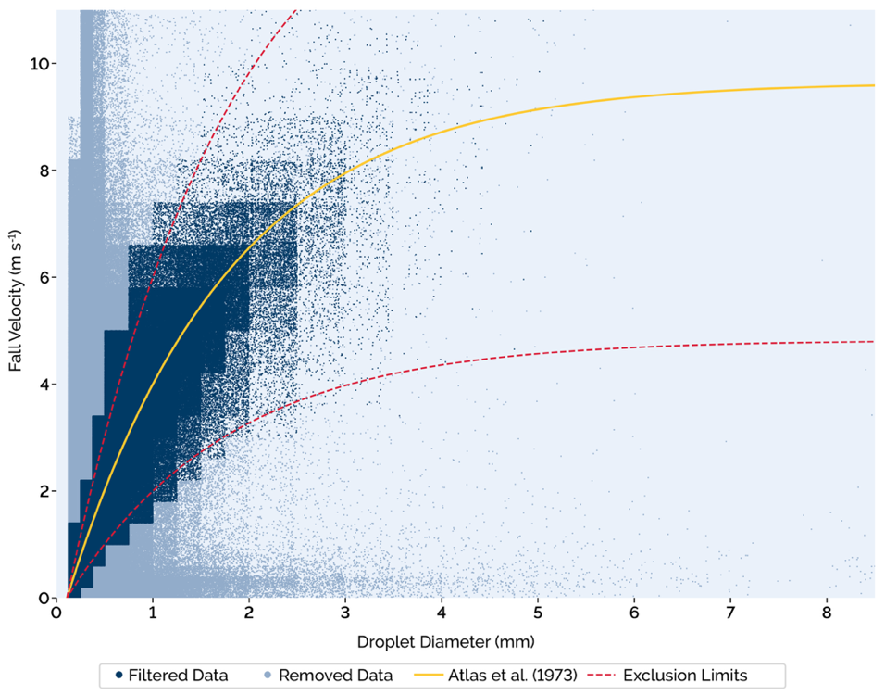
How Terminal Velocity Exceedance Check For?
EGU26-7894
Scatter plot of DiVeN data during quality control, where each point represents a one-minute sample. Dark blue points indicate retained data, while light blue points indicate excluded data based on unrealistic fall velocities. The yellow line shows the theoretical fall velocity, and the red dashed lines define the upper and lower acceptance envelope.
Paper in Preparation: Enhancing British Rainfall Typologies Using Drop Size Distributions and Spatiotemporal Analysis

Slide 55
How Terminal Velocity Exceedance Check For?
EGU26-7894
Scatter plot of DiVeN data during quality control, where each point represents a one-minute sample. Dark blue points indicate retained data, while light blue points indicate excluded data based on unrealistic fall velocities. The yellow line shows the theoretical fall velocity, and the red dashed lines define the upper and lower acceptance envelope.
Paper in Preparation: Enhancing British Rainfall Typologies Using Drop Size Distributions and Spatiotemporal Analysis

Slide 56
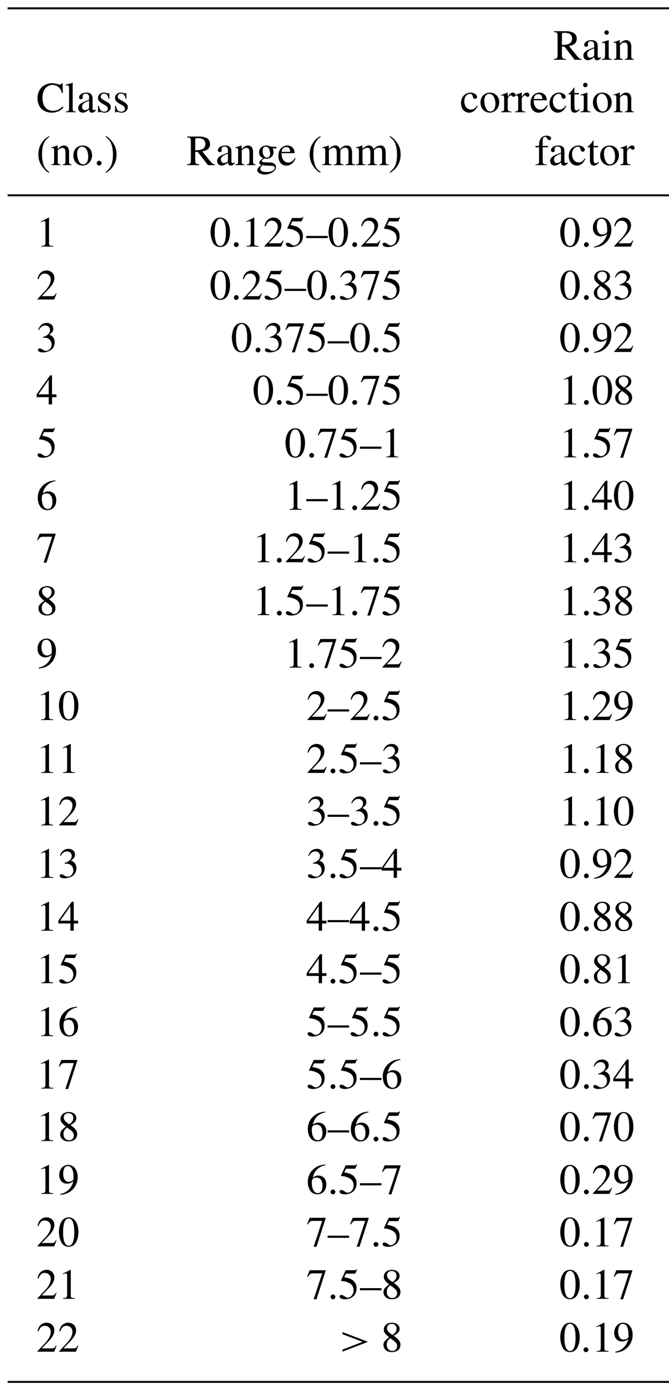

What Correction Factors were Applied ?
EGU26-7894
This table comes from the following article (or scan the above QR code), please refer to it for additional information :
Fehlmann, M., Rohrer, M., von Lerber, A. and Stoffel, M. (2020) ‘Automated precipitation monitoring with the Thies disdrometer: biases and ways for improvement’, Atmospheric Measurement Techniques, 13, pp. 4683–4698. doi: 10.5194/amt-13-4683-2020.
Paper in Preparation: Enhancing British Rainfall Typologies Using Drop Size Distributions and Spatiotemporal Analysis

Slide 57
What Correction Factors were Applied ?
EGU26-7894
This table comes from the following article (or scan the above QR code), please refer to it for additional information :
Fehlmann, M., Rohrer, M., von Lerber, A. and Stoffel, M. (2020) ‘Automated precipitation monitoring with the Thies disdrometer: biases and ways for improvement’, Atmospheric Measurement Techniques, 13, pp. 4683–4698. doi: 10.5194/amt-13-4683-2020.
Paper in Preparation: Enhancing British Rainfall Typologies Using Drop Size Distributions and Spatiotemporal Analysis

Slide 58
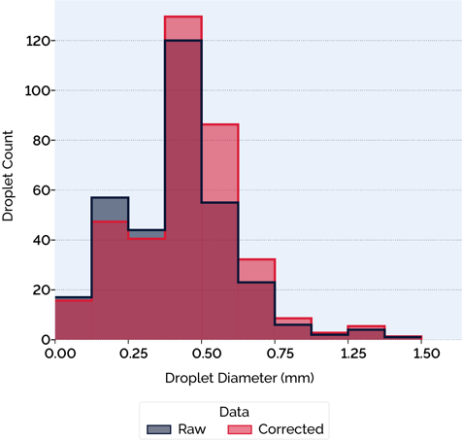
How did the Correction Factors Change the Data?
EGU26-7894
Histogram illustrating a sample of data before and after application of the Fehlmann correction factors. In general, applying the correction factors reduces the number of small drops, increases the number of medium-sized drops, and decreases the number of large drops.
Paper in Preparation: Enhancing British Rainfall Typologies Using Drop Size Distributions and Spatiotemporal Analysis

Slide 59
How did the Correction Factors Change the Data?
EGU26-7894
Histogram illustrating a sample of data before and after application of the Fehlmann correction factors. In general, applying the correction factors reduces the number of small drops, increases the number of medium-sized drops, and decreases the number of large drops.
Paper in Preparation: Enhancing British Rainfall Typologies Using Drop Size Distributions and Spatiotemporal Analysis

Slide 60
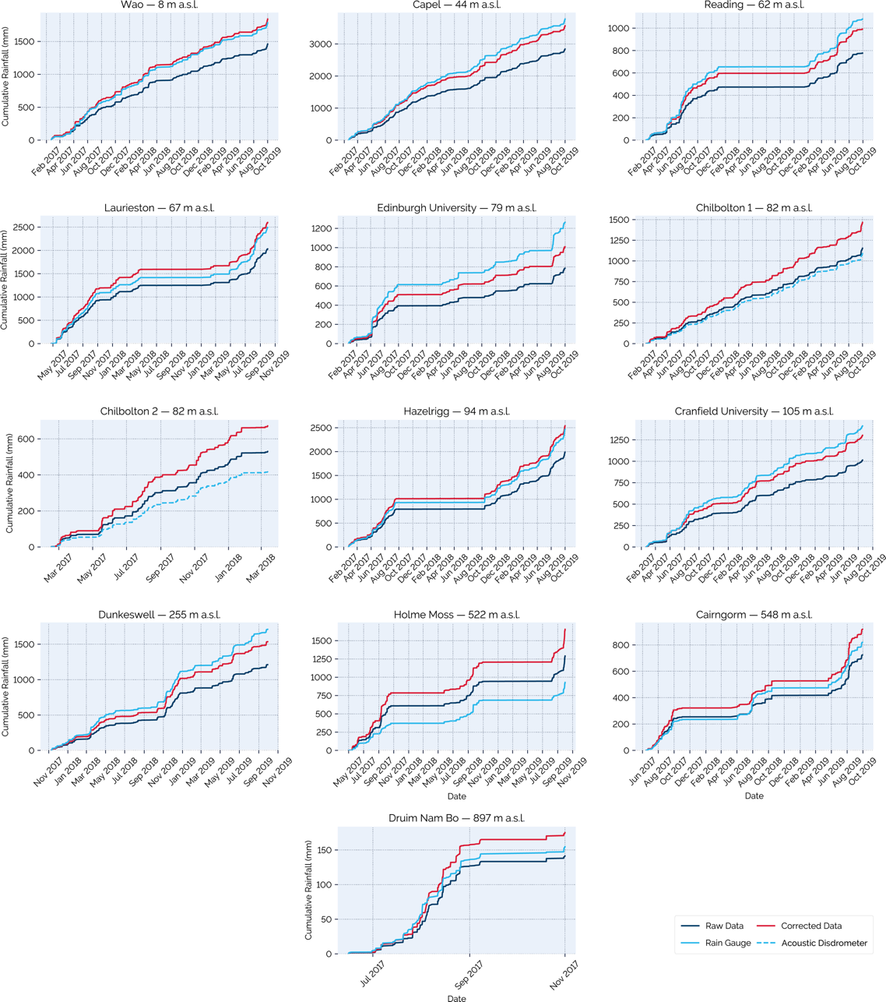
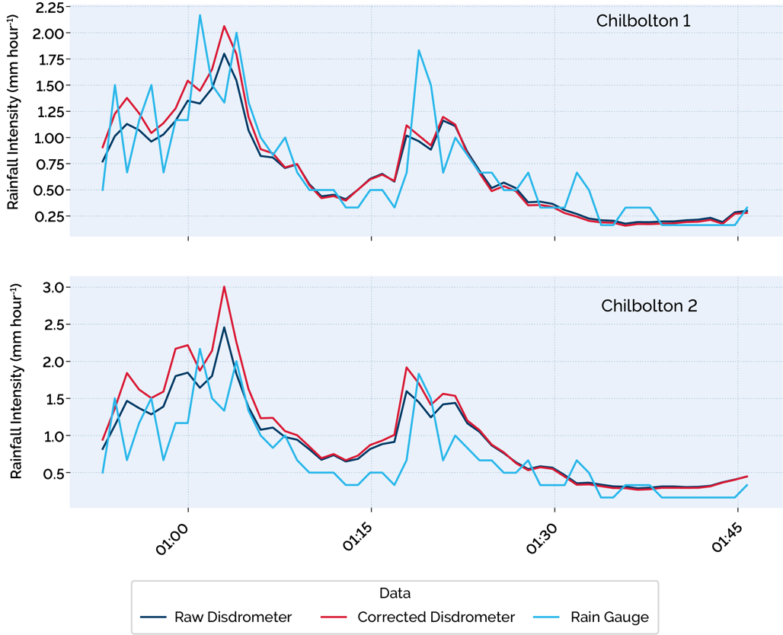
How was the Disdrometer Data Validated?
EGU26-7894
Cumulative rainfall totals over the full observation period for all disdrometer sites. Each panel shows accumulated rainfall from a co-located rain gauge (light blue), raw disdrometer data (dark blue), and corrected disdrometer data (red). Panels are ordered by site elevation, from lowest to highest.
Line plots comparing rainfall intensity derived from raw LPM data (dark blue), corrected LPM data (red), and drop-counting rain-gauge measurements (light blue). (a) Chilbolton Disdrometer 1. (b) Chilbolton Disdrometer 2.
Paper in Preparation: Enhancing British Rainfall Typologies Using Drop Size Distributions and Spatiotemporal Analysis

Slide 61
How was the Disdrometer Data Validated?
EGU26-7894
Cumulative rainfall totals over the full observation period for all disdrometer sites. Each panel shows accumulated rainfall from a co-located rain gauge (light blue), raw disdrometer data (dark blue), and corrected disdrometer data (red). Panels are ordered by site elevation, from lowest to highest.
Line plots comparing rainfall intensity derived from raw LPM data (dark blue), corrected LPM data (red), and drop-counting rain-gauge measurements (light blue). (a) Chilbolton Disdrometer 1. (b) Chilbolton Disdrometer 2.
Paper in Preparation: Enhancing British Rainfall Typologies Using Drop Size Distributions and Spatiotemporal Analysis

Slide 62
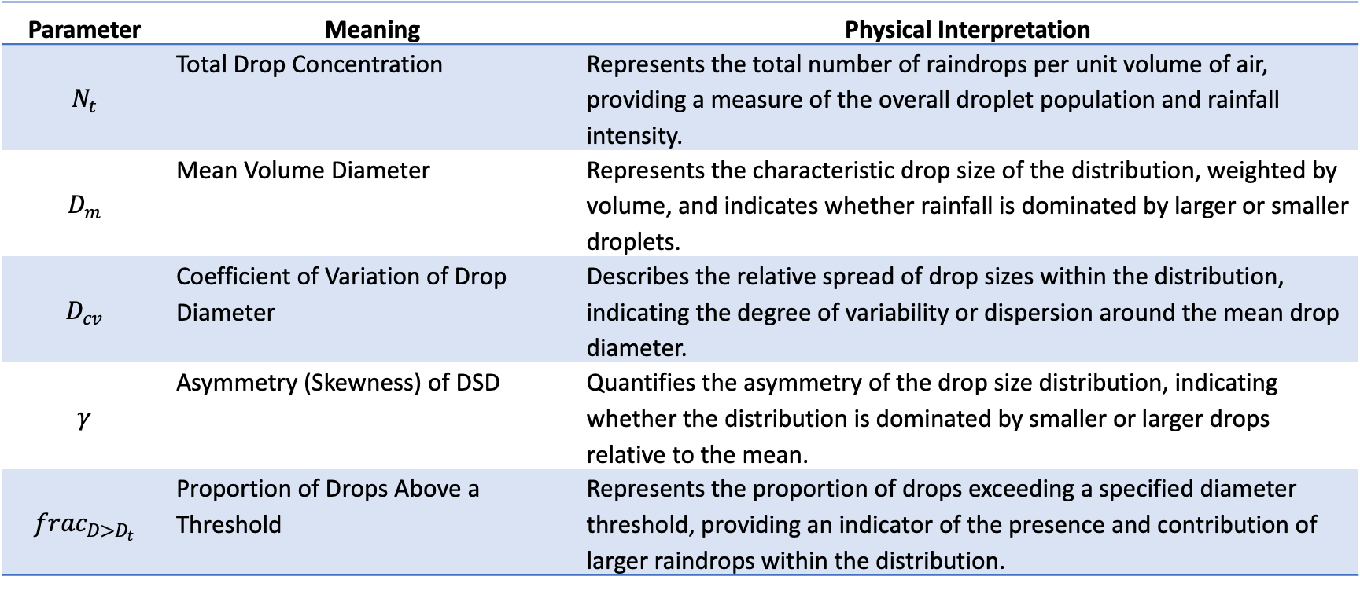
How were the Number of Clusters & Parameters Selected?
EGU26-7894
Parameter | Meaning | Physical Interpretation
$$N_{t}$$ | Total Drop Concentration | Represents the total number of raindrops per unit volume of air, providing a measure of the overall droplet population and rainfall intensity.
$$D_{m}$$ | Mean Volume Diameter | Represents the characteristic drop size of the distribution, weighted by volume, and indicates whether rainfall is dominated by larger or smaller droplets.
$$D_{cv}$$ | Coefficient of Variation of Drop Diameter | Describes the relative spread of drop sizes within the distribution, indicating the degree of variability or dispersion around the mean drop diameter.
$$γ$$ | Asymmetry (Skewness) of DSD | Quantifies the asymmetry of the drop size distribution, indicating whether the distribution is dominated by smaller or larger drops relative to the mean.
$${frac}_{D>D_{t}}$$ | Proportion of Drops Above a Threshold | Represents the proportion of drops exceeding a specified diameter threshold, providing an indicator of the presence and contribution of larger raindrops within the distribution.
Paper in Preparation: Enhancing British Rainfall Typologies Using Drop Size Distributions and Spatiotemporal Analysis

Slide 63
How were the Number of Clusters & Parameters Selected?
EGU26-7894
Parameter | Meaning | Physical Interpretation
$$N_{t}$$ | Total Drop Concentration | Represents the total number of raindrops per unit volume of air, providing a measure of the overall droplet population and rainfall intensity.
$$D_{m}$$ | Mean Volume Diameter | Represents the characteristic drop size of the distribution, weighted by volume, and indicates whether rainfall is dominated by larger or smaller droplets.
$$D_{cv}$$ | Coefficient of Variation of Drop Diameter | Describes the relative spread of drop sizes within the distribution, indicating the degree of variability or dispersion around the mean drop diameter.
$$γ$$ | Asymmetry (Skewness) of DSD | Quantifies the asymmetry of the drop size distribution, indicating whether the distribution is dominated by smaller or larger drops relative to the mean.
$${frac}_{D>D_{t}}$$ | Proportion of Drops Above a Threshold | Represents the proportion of drops exceeding a specified diameter threshold, providing an indicator of the presence and contribution of larger raindrops within the distribution.
Paper in Preparation: Enhancing British Rainfall Typologies Using Drop Size Distributions and Spatiotemporal Analysis

Slide 64
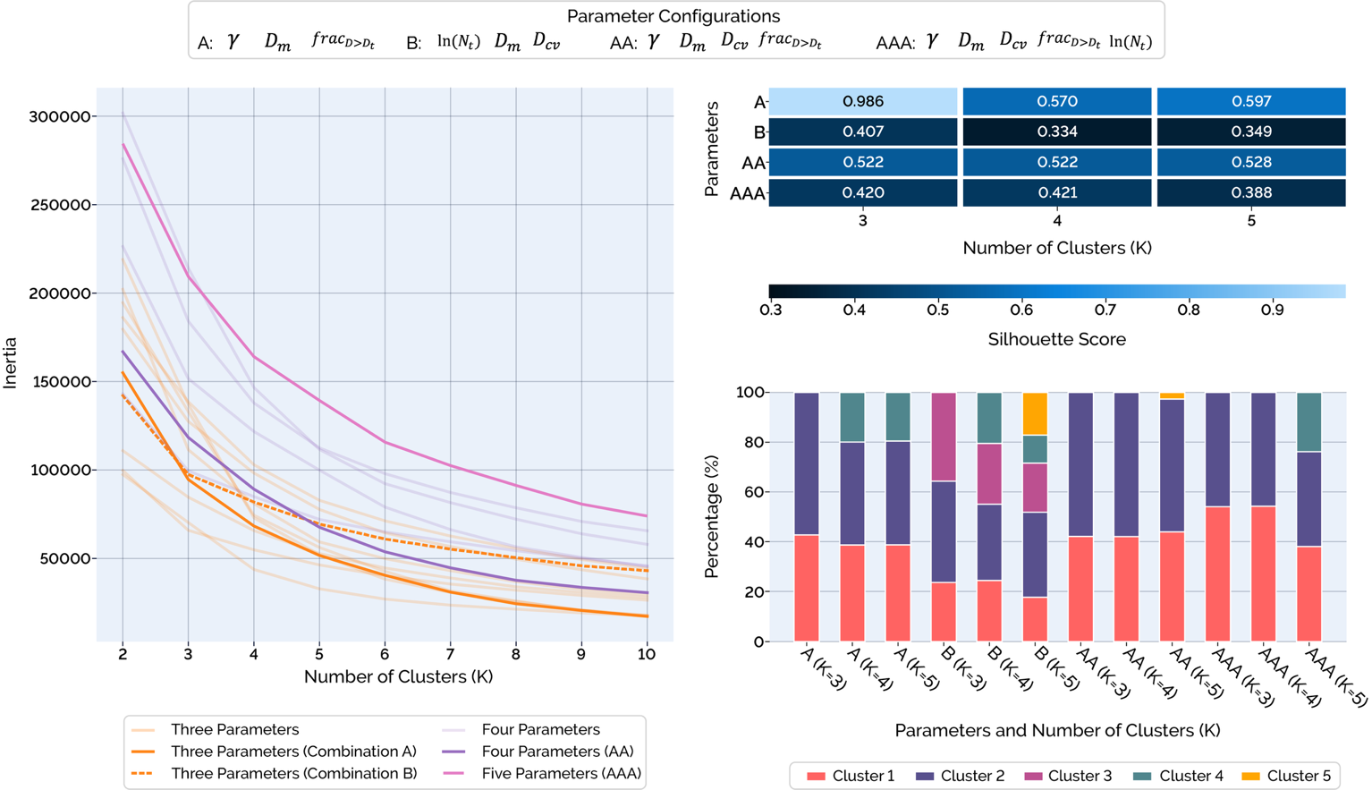

How were the Number of Clusters & Parameters Selected?
EGU26-7894
Parameter | Meaning
$$N_{t}$$ | Total Drop Concentration
$$D_{m}$$ | Mean Volume Diameter
$$D_{cv}$$ | Coefficient of Variation of Drop Diameter
$$γ$$ | Asymmetry (Skewness) of DSD
$${frac}_{D>D_{t}}$$ | Proportion of Drops Above a Threshold
Evaluation of clustering performance across parameter combinations. (a) Elbow plots showing the within-cluster sum of squares (inertia) as a function of the number of clusters (K), used to identify an appropriate number of clusters. (b) Silhouette scores across parameter combinations and K, indicating cluster cohesion and separation. (c) Proportion of observations assigned to each cluster, illustrating differences in cluster composition across parameterisations.
Paper in Preparation: Enhancing British Rainfall Typologies Using Drop Size Distributions and Spatiotemporal Analysis

Slide 65
How were the Number of Clusters & Parameters Selected?
EGU26-7894
Parameter | Meaning
$$N_{t}$$ | Total Drop Concentration
$$D_{m}$$ | Mean Volume Diameter
$$D_{cv}$$ | Coefficient of Variation of Drop Diameter
$$γ$$ | Asymmetry (Skewness) of DSD
$${frac}_{D>D_{t}}$$ | Proportion of Drops Above a Threshold
Evaluation of clustering performance across parameter combinations. (a) Elbow plots showing the within-cluster sum of squares (inertia) as a function of the number of clusters (K), used to identify an appropriate number of clusters. (b) Silhouette scores across parameter combinations and K, indicating cluster cohesion and separation. (c) Proportion of observations assigned to each cluster, illustrating differences in cluster composition across parameterisations.
Paper in Preparation: Enhancing British Rainfall Typologies Using Drop Size Distributions and Spatiotemporal Analysis

Slide 66
How was the Data Cleaned?
EGU26-7894
Gantt chart showing disdrometer data availability across the DiVeN network over the study period. Periods excluded from analysis due to missing data, absence of detected rainfall, and potential snowfall risk are highlighted.
Paper in Preparation: Enhancing British Rainfall Typologies Using Drop Size Distributions and Spatiotemporal Analysis

Slide 67
How was the Data Cleaned?
EGU26-7894
Gantt chart showing disdrometer data availability across the DiVeN network over the study period. Periods excluded from analysis due to missing data, absence of detected rainfall, and potential snowfall risk are highlighted.
Paper in Preparation: Enhancing British Rainfall Typologies Using Drop Size Distributions and Spatiotemporal Analysis

Slide 68
How was the Data Cleaned?
EGU26-7894
(a) Stacked bar chart illustrating the relative volume of data contributed by each site, where data volume represents periods within operational time during which rainfall was detected, rather than total instrument uptime. (b) Pie chart showing the percentage contribution and number of one-minute samples from each site.
Paper in Preparation: Enhancing British Rainfall Typologies Using Drop Size Distributions and Spatiotemporal Analysis

Slide 69
How was the Data Cleaned?
EGU26-7894
(a) Stacked bar chart illustrating the relative volume of data contributed by each site, where data volume represents periods within operational time during which rainfall was detected, rather than total instrument uptime. (b) Pie chart showing the percentage contribution and number of one-minute samples from each site.
Paper in Preparation: Enhancing British Rainfall Typologies Using Drop Size Distributions and Spatiotemporal Analysis

Slide 70
EGU26-7894

