Slide 1



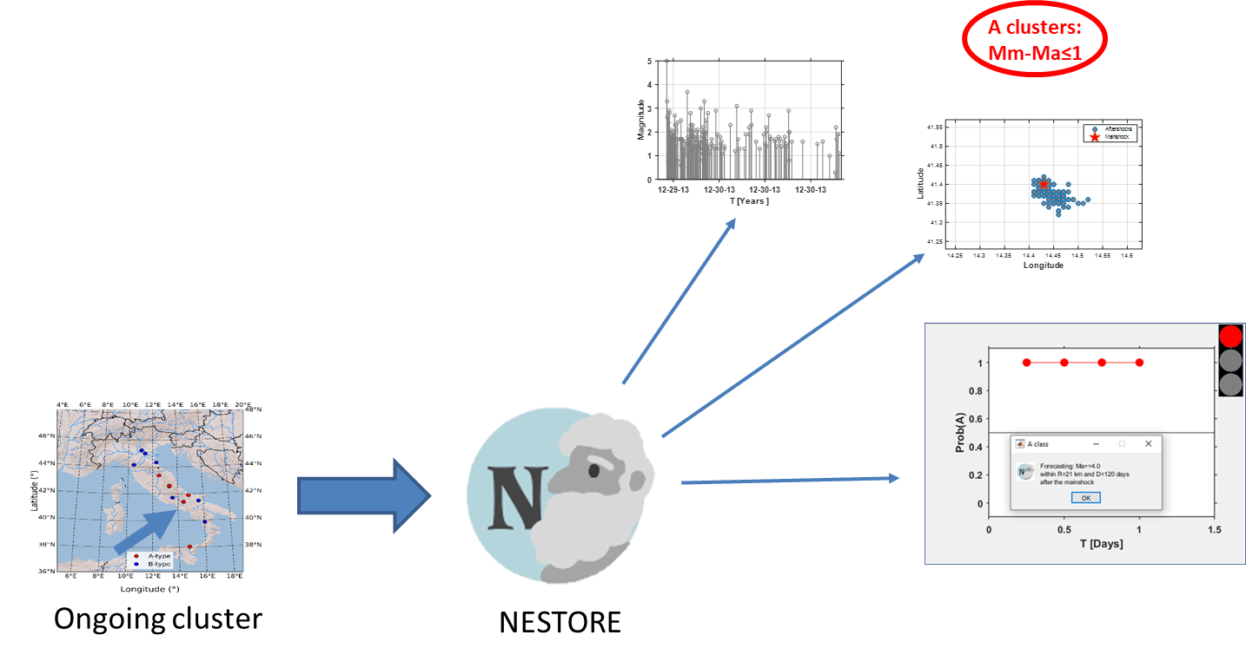

NESTORE
NExt STrOng Related Earthquake — Strong Aftershock Forecasting
What It Does
Why It Matters
Forecasts the probability of a strong earthquake following a mainshock — in near real time.
Uses seismic features from the evolving aftershock sequence and a machine-learning (decision-tree + Bayesian) pipeline.
Classifies ongoing clusters into two types: Type A (next strong quake ≤1 mag unit below mainshock) and Type B (>1 unit below).
Applied in Italy, W. Slovenia, Greece, California, Japan and New Zealand.
Strong aftershocks damage already-weakened buildings, raising collapse risk and potential fatalities.
When validated, NESTORE can support for risk management.
NESTOREv1.0 is freely available on GitHub; v2.0 (available soon) extends model robustness with improved methods.
Gentili, Caravella & Chiappetta: An enhanced version of the NESTORE software for strong aftershock forecasting

Slide 2
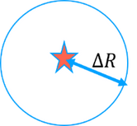
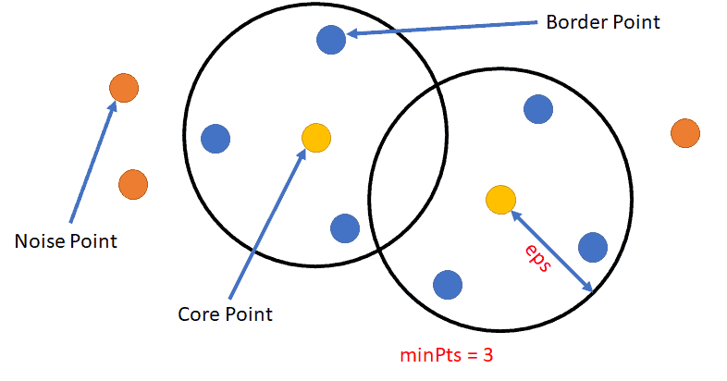
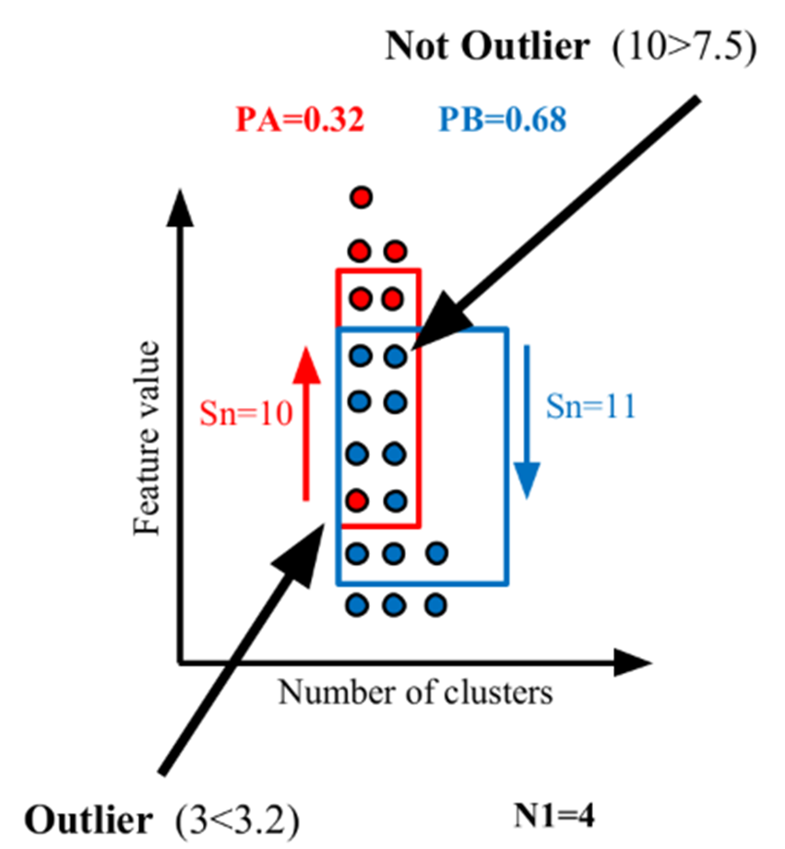
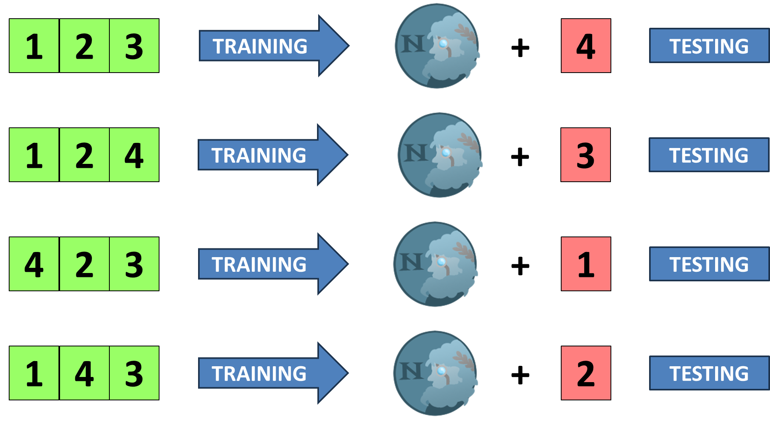
NESTOREv2.0 — Key Improvements
Modular
Cluster Input
REPENESE
Outlier Removal
K-Fold Cross
Validation
Accepts any external clustering method via text-file input for maximum flexibility.
Handles class imbalance — Type A clusters are rare.
Selects relevant features by TPR, FPR and Precision thresholds.
Detects oriented neighborhood outliers consistently across all relevant features and time intervals.
Splits clusters into K folds; each is tested once and trained on the rest.
Stratified split preserves class balance in every fold.
Provides more robust performance estimates than a chronological train/test split.
+

Slide 3
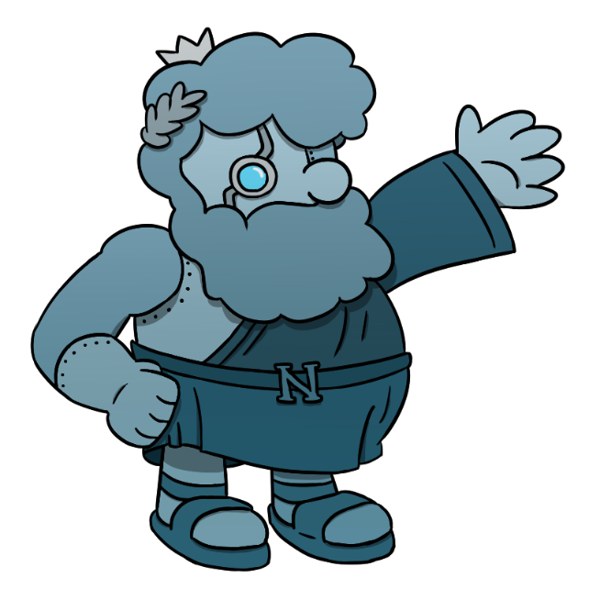
Interested in strong aftershock forecasting?
Come see our presentations!
📍 PICO · EGU26-7901
🎤 Oral · EGU26-524
An enhanced version of the NESTORE software for strong aftershock forecasting
Forecasting strong aftershocks in New Zealand with the machine-learning NESTORE algorithm: two different testing approaches
Monday, 04 May
Wednesday, 06 May
08:49 – 08:51 CEST
14:25 – 14:35 CEST
Session ESSI2.8 PICO1b.7
Session NH4.8 Room 1.15/16
We'd love to chat — find us there! · Gentili, Caravella & Chiappetta · OGS-CRS sgentili@ogs.it Logos by SiarpaMayBeReal

