Slide 1
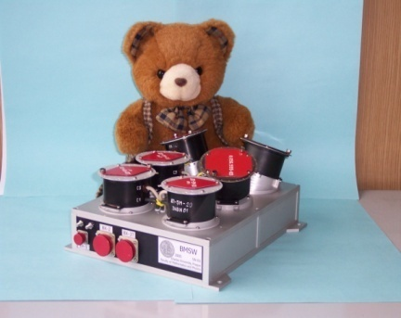

Solar wind on the path from the Sun to Earth
Zdenek Nemecek and Jana Safrankova
Charles University, Faculty of Mathematics and Physics, Prague, Czech Republic
with thanks to our collaborators
Tereza Durovcova, Alexander Pitna, Frantisek Nemec, Lubomir Prech, Jiri Pavlu, Gilbert Pi, O. Goncharov, K. Grygorov
and former and present students in our Space Physics Lab
EGU General Assembly, Vienna, 2026
Hannes Alfvén Medal lecture

Slide 2
Outline:
Introduction and motivation
What is the solar wind velocity - deHoffmann-Teller (HT) frame
Normal and tangential components of the velocity
Evolution of magnetic field and its fluctuations
Velocity–temperature relation
Possible scenario of processes near the Sun
Summary – where does the solar corona end?

Slide 3
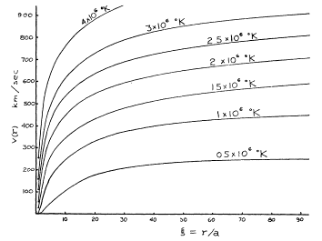
Solar wind in 1958 vs solar wind in 2026
alias Eugene Parker vs Parker Solar Probe
Parker (1958)
Hydrodynamic model
Isothermal expansion
No magnetic field
Predicts the temperature- velocity relationship
The temperature needed for hydrodynamic formation of the solar wind (Parker, 1958) is much larger than that observed
The magnetic field adds additional bonding force
The temperature-velocity relationship would be shallower at larger distances but the opposite trend is observed
Outstanding questions:
What helps the solar wind to leave the Sun?
What mechanism forms the temperature-velocity relationship through the heliosphere?
(Durovcova et al. 2025, 2026)

Slide 4
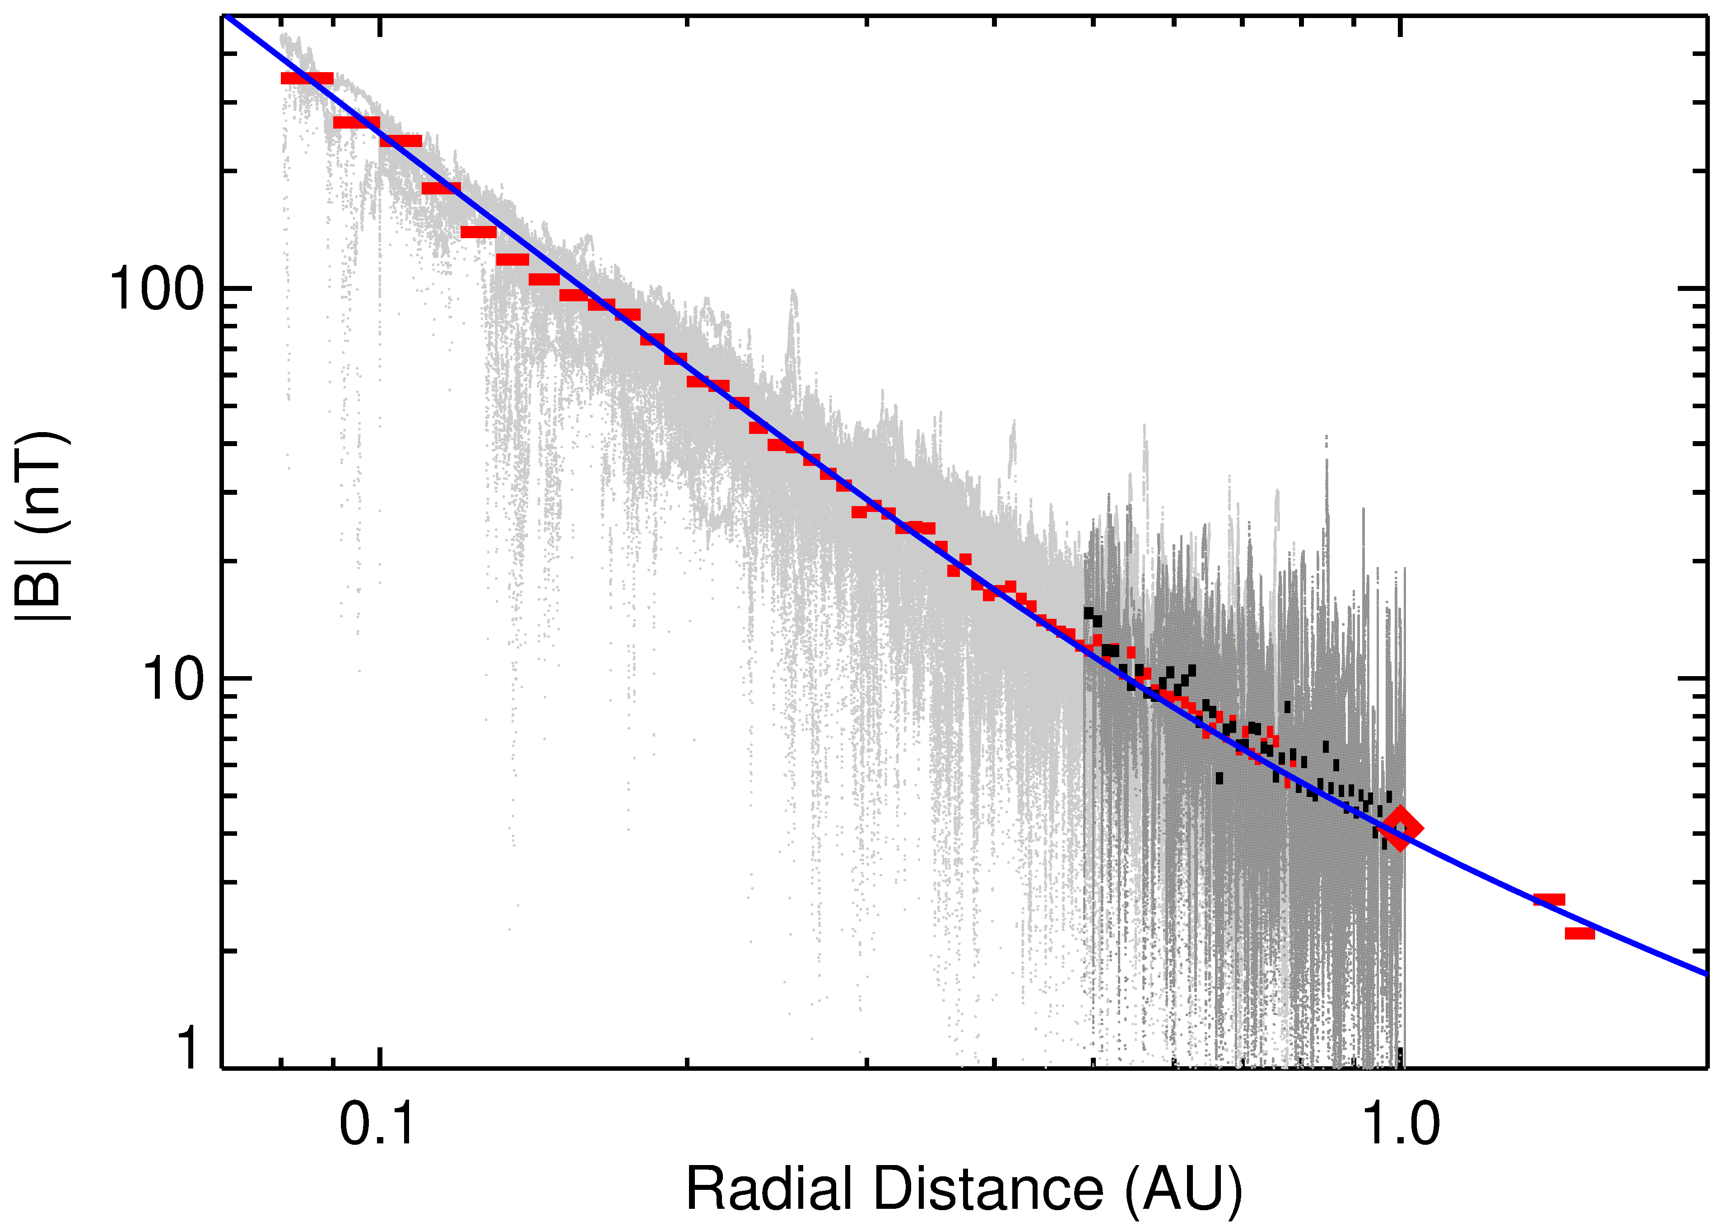
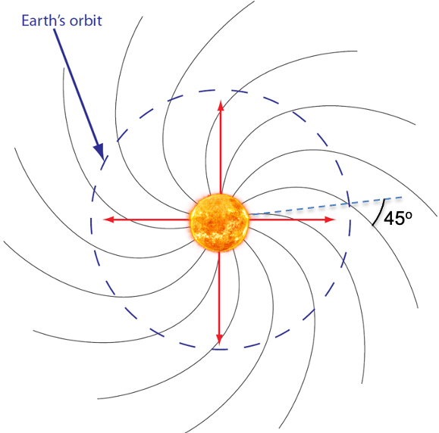
Interplanetary magnetic field
Frozen-in conditions
Parker (1958) – spiral field through the heliosphere
Magnetic field decreases as 1/R at larger distances
PSP, SolO, Wind, Maven
Fitted
Parker (1958) equation
Median |B| radial profile corresponds to the Parker’s prediction up to the Mars orbit, in spite of its simplicity
Mean IMF direction was checked by many authors; it also corresponds to the Parker’s prediction
Frozen-in conditions are held on large scales
adapted from Safrankova et al. (2023)

Slide 5
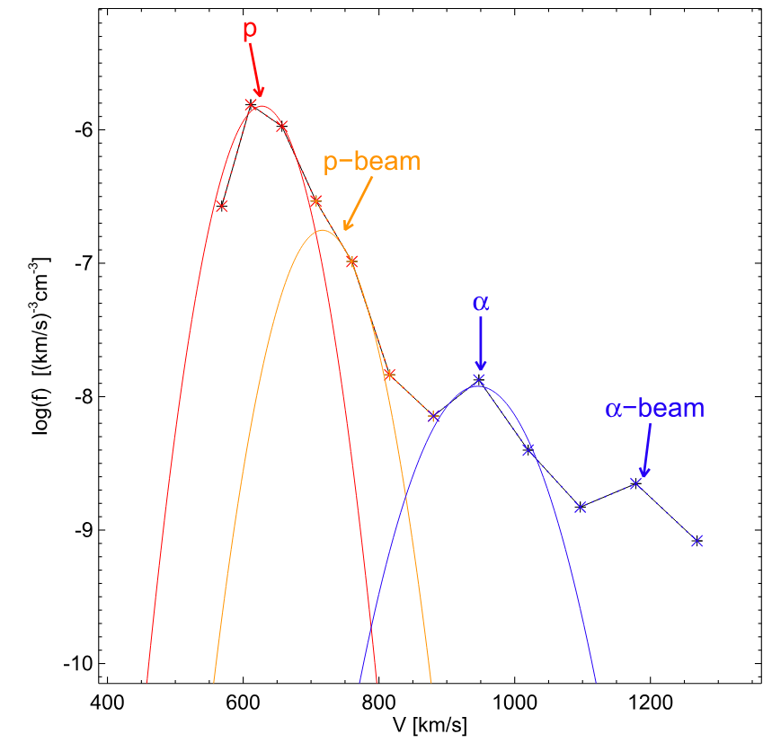
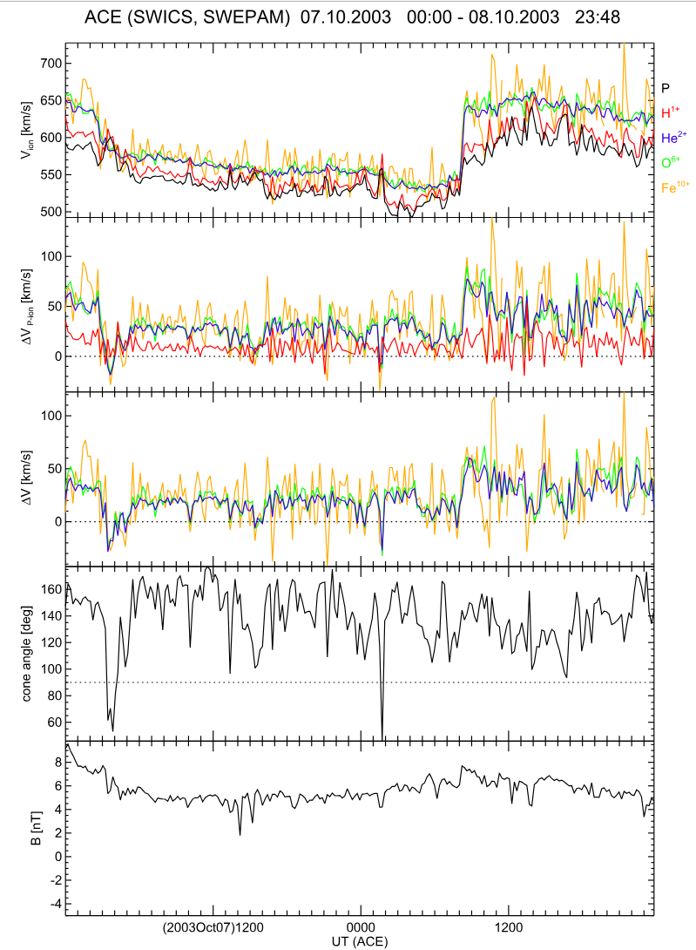
What is the solar wind velocity?
V_{pcore}, V_{pbeam}, V_{He}, V_{O6+}, V_{Fe10+}
Question to be answered
Q1 – What is a possible source of the proton VDF splitting?
V [km/s]
The solar wind is composed of many ion populations
Ion populations are regularly divided into core and beam(s)
Each of them moves with its own velocity
Which of them (if any) would be considered as the solar wind velocity?
adapted from Nemecek et al. (2020a)

Slide 6
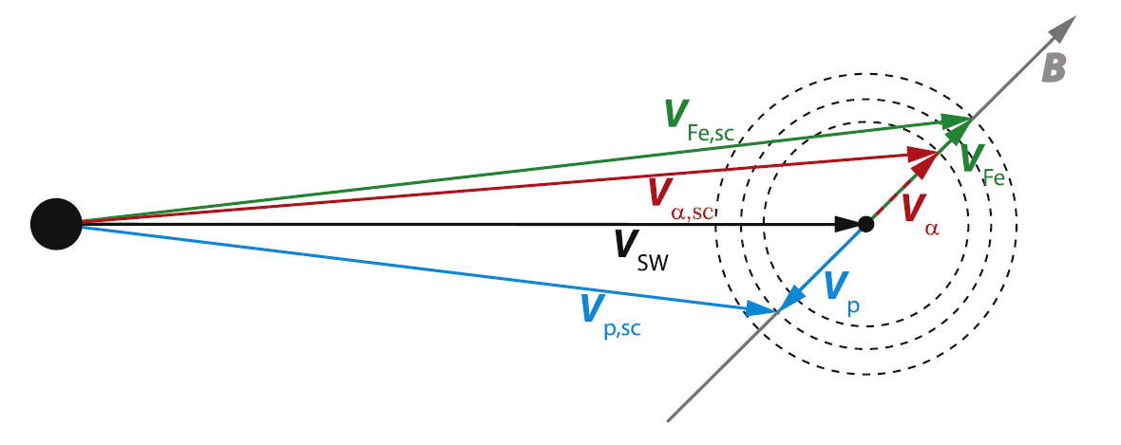
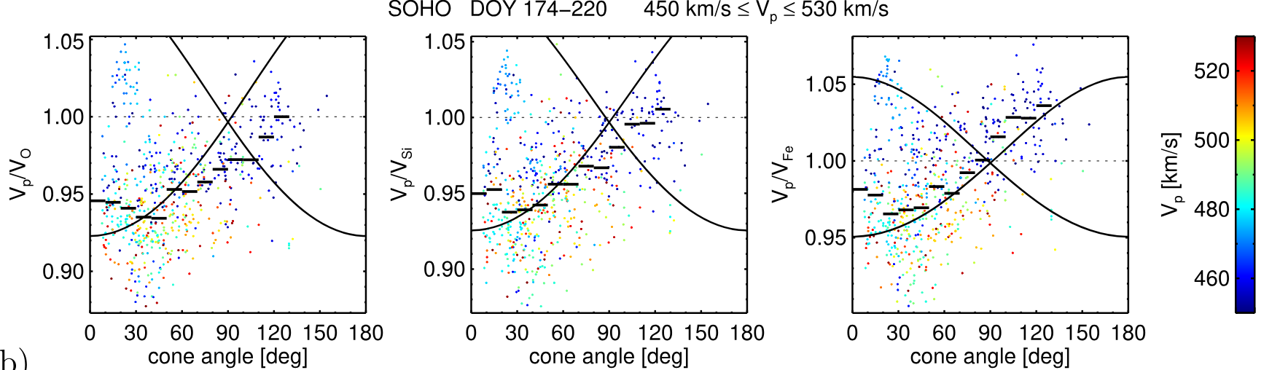
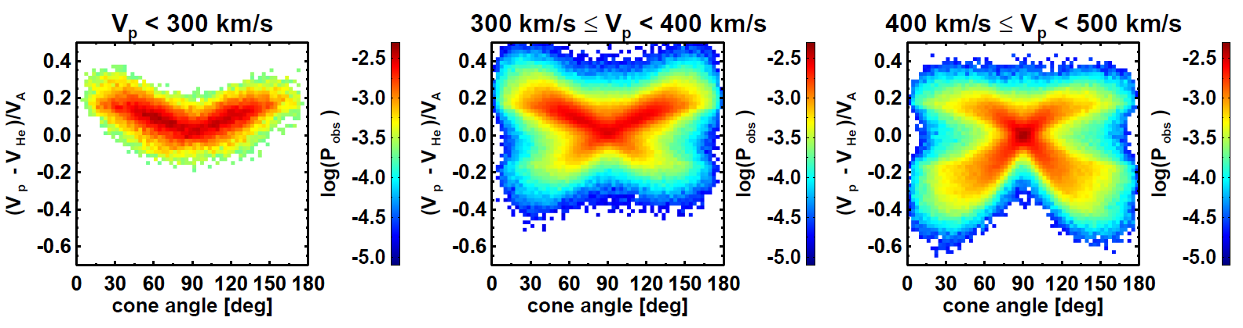
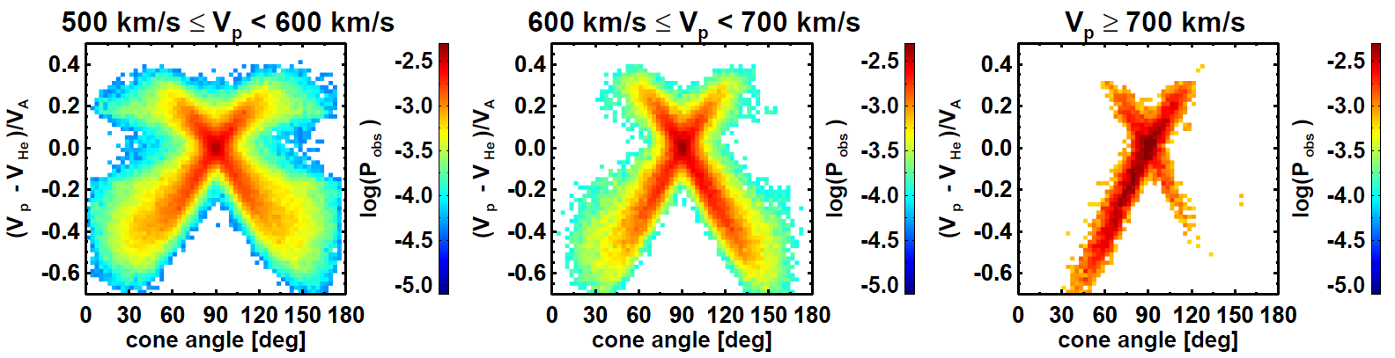

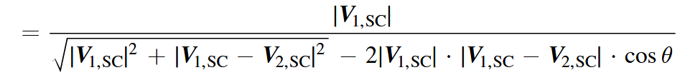
Basic considerations
V_{H}/V_{O}
V_{H}/V_{Si}
V_{H}/V_{Fe}
Velocities are measured in spacecraft frame, Vsw is the solar wind velocity
In the solar wind frame, velocities of all components should be aligned with the B direction to mitigate E = v x B
When B rotates, the velocities of all components follow this rotation
The ratios of velocities as a function of the cone angle should follow the equation
adapted from Nemecek et al. (2020a)

Slide 7
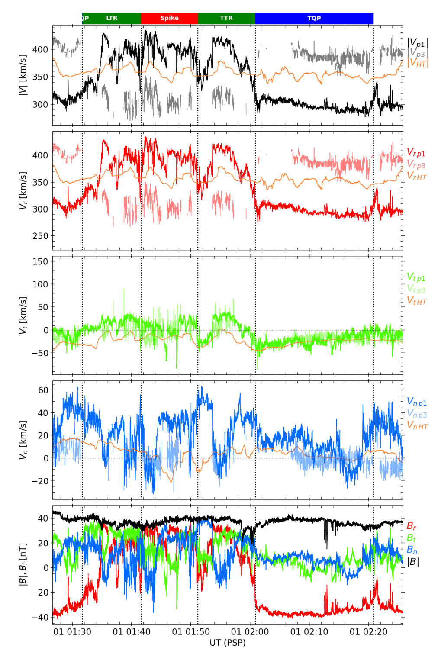
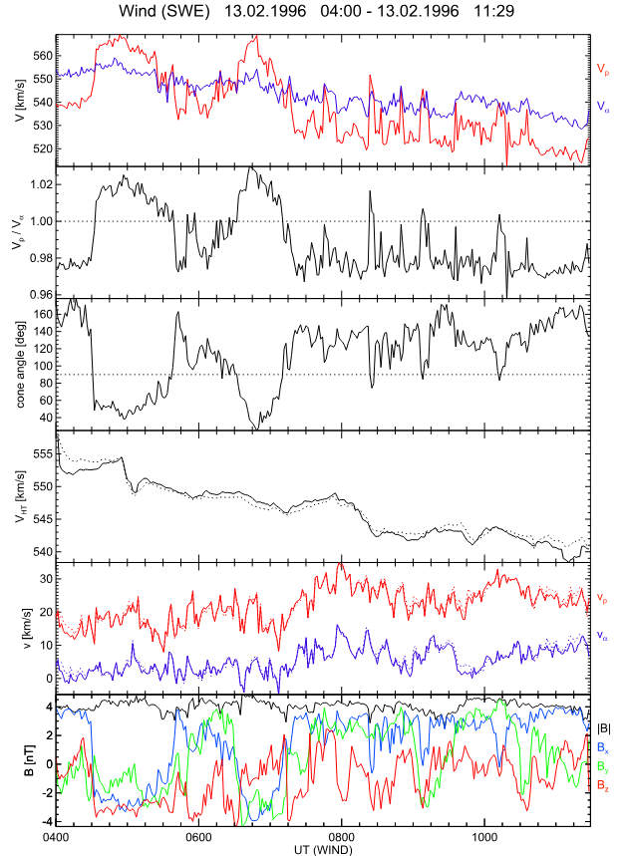
Velocity of deHoffman-Teller frame
Wind at L1
PSP at 0.22 AU
Nemecek et al. (2020a) proposed the frame of minimum motional E field (deHoffmann-Teller, HT frame) as the proper frame for solar wind studies
This velocity is unique, its value does not depend on the ion used for its determination
V_{HT} is constant or changes smoothly during magnetic field rotation at 1 AU as well as at 0.2 AU
Velocities of ion components follow the field rotation
Surprisingly, alpha particle velocity is a good approximation of V_{HT} in a great majority of cases
V_{pcore}, V_{alpha}
V_{pcore}, V_{pbeam,} V_{HT}
V_{pcore}/V_{He}
Radial components
Tangential components
Cone angle
V_{HTp}, V_{HTalpha}
Normal components
B
B_{r}
1996-02-13
V_{HT} is the solar wind velocity
2018-01-26

Slide 8
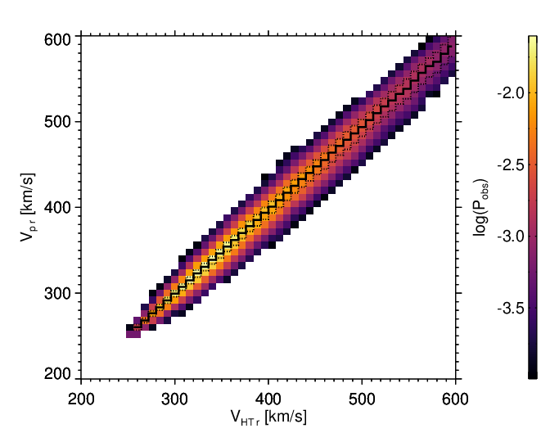
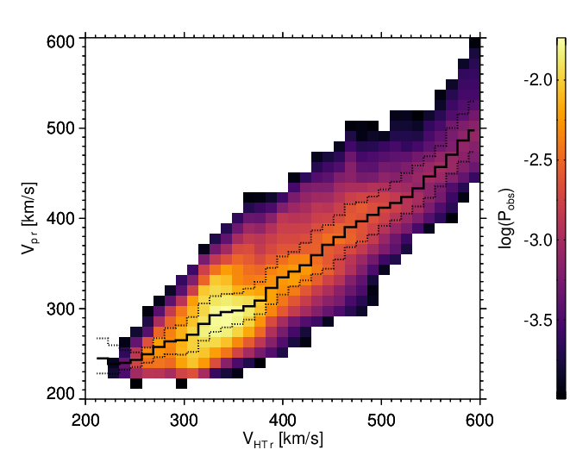
Relation of proton and solar wind velocity
Wind at L1
PSP at 0.22 AU
The proton velocity is highly affected by waves of a large amplitude, especially close to Sun
Whereas V_{HT} is about equal to the proton velocity at L1, it is typically larger by a factor of 1.2 at 0.2 AU
For example, 400 km/s of the proton velocity can correspond to any V_{HT} in the range from 350 to 570 km/s
Wind
PSP
V_{pr}
V_{pr}
V_{HTr}
V_{HTr}
Courtesy of T. Durovcova

Slide 9
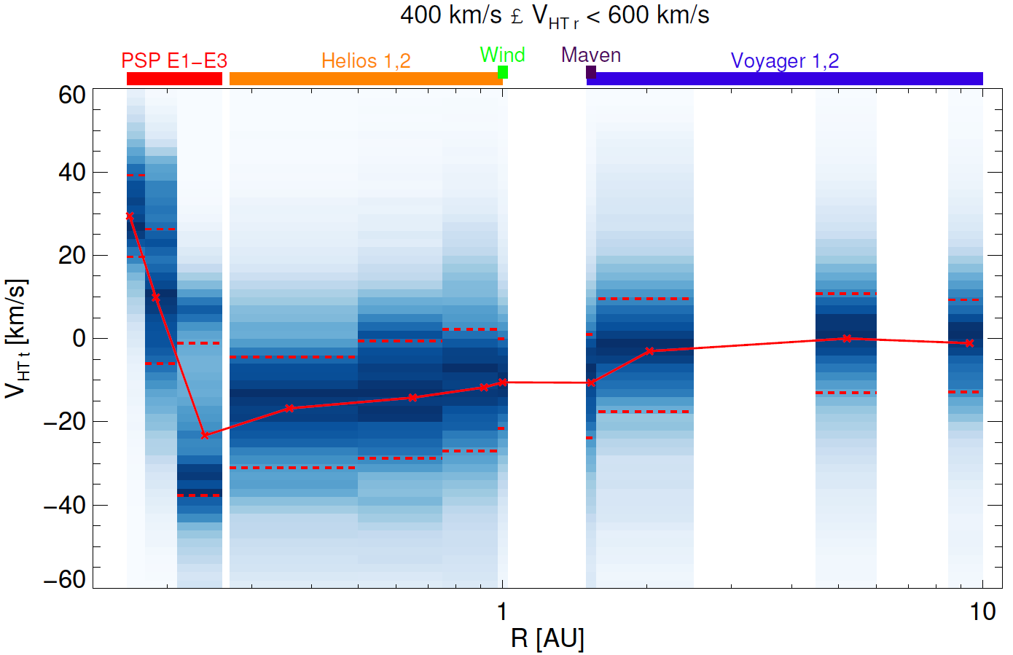
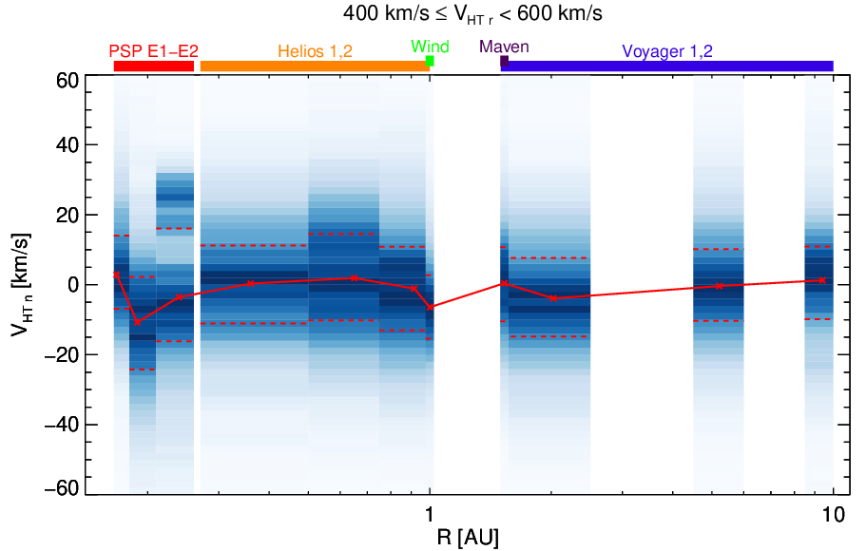
Radial evolution of solar wind velocity components
The tangential component of the SW velocity (velocity of HT frame) is positive (co-rotating) up to ~0.2 AU
It is negative farther from the Sun with a peak of -30 km/s at ~0.25 AU and gradually relaxes to zero through the heliosphere
The normal component is close to zero all the way
V_{HTt} from tail magnetopause tilt
V_{HTt}
Questions to be answered
0.3 AU
Q2 – What happens at ~0.3 AU?
Q3 – What is the difference between tangential and normal directions?
Q4 – What is a source of the observed SW deflection?
V_{HTn}
adapted from Nemecek et al. (2020b)

Slide 10
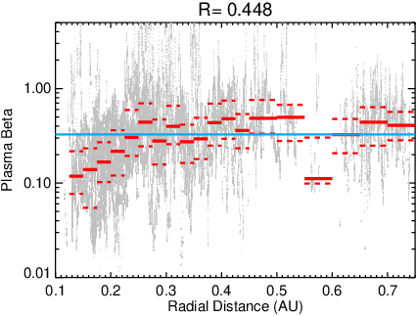

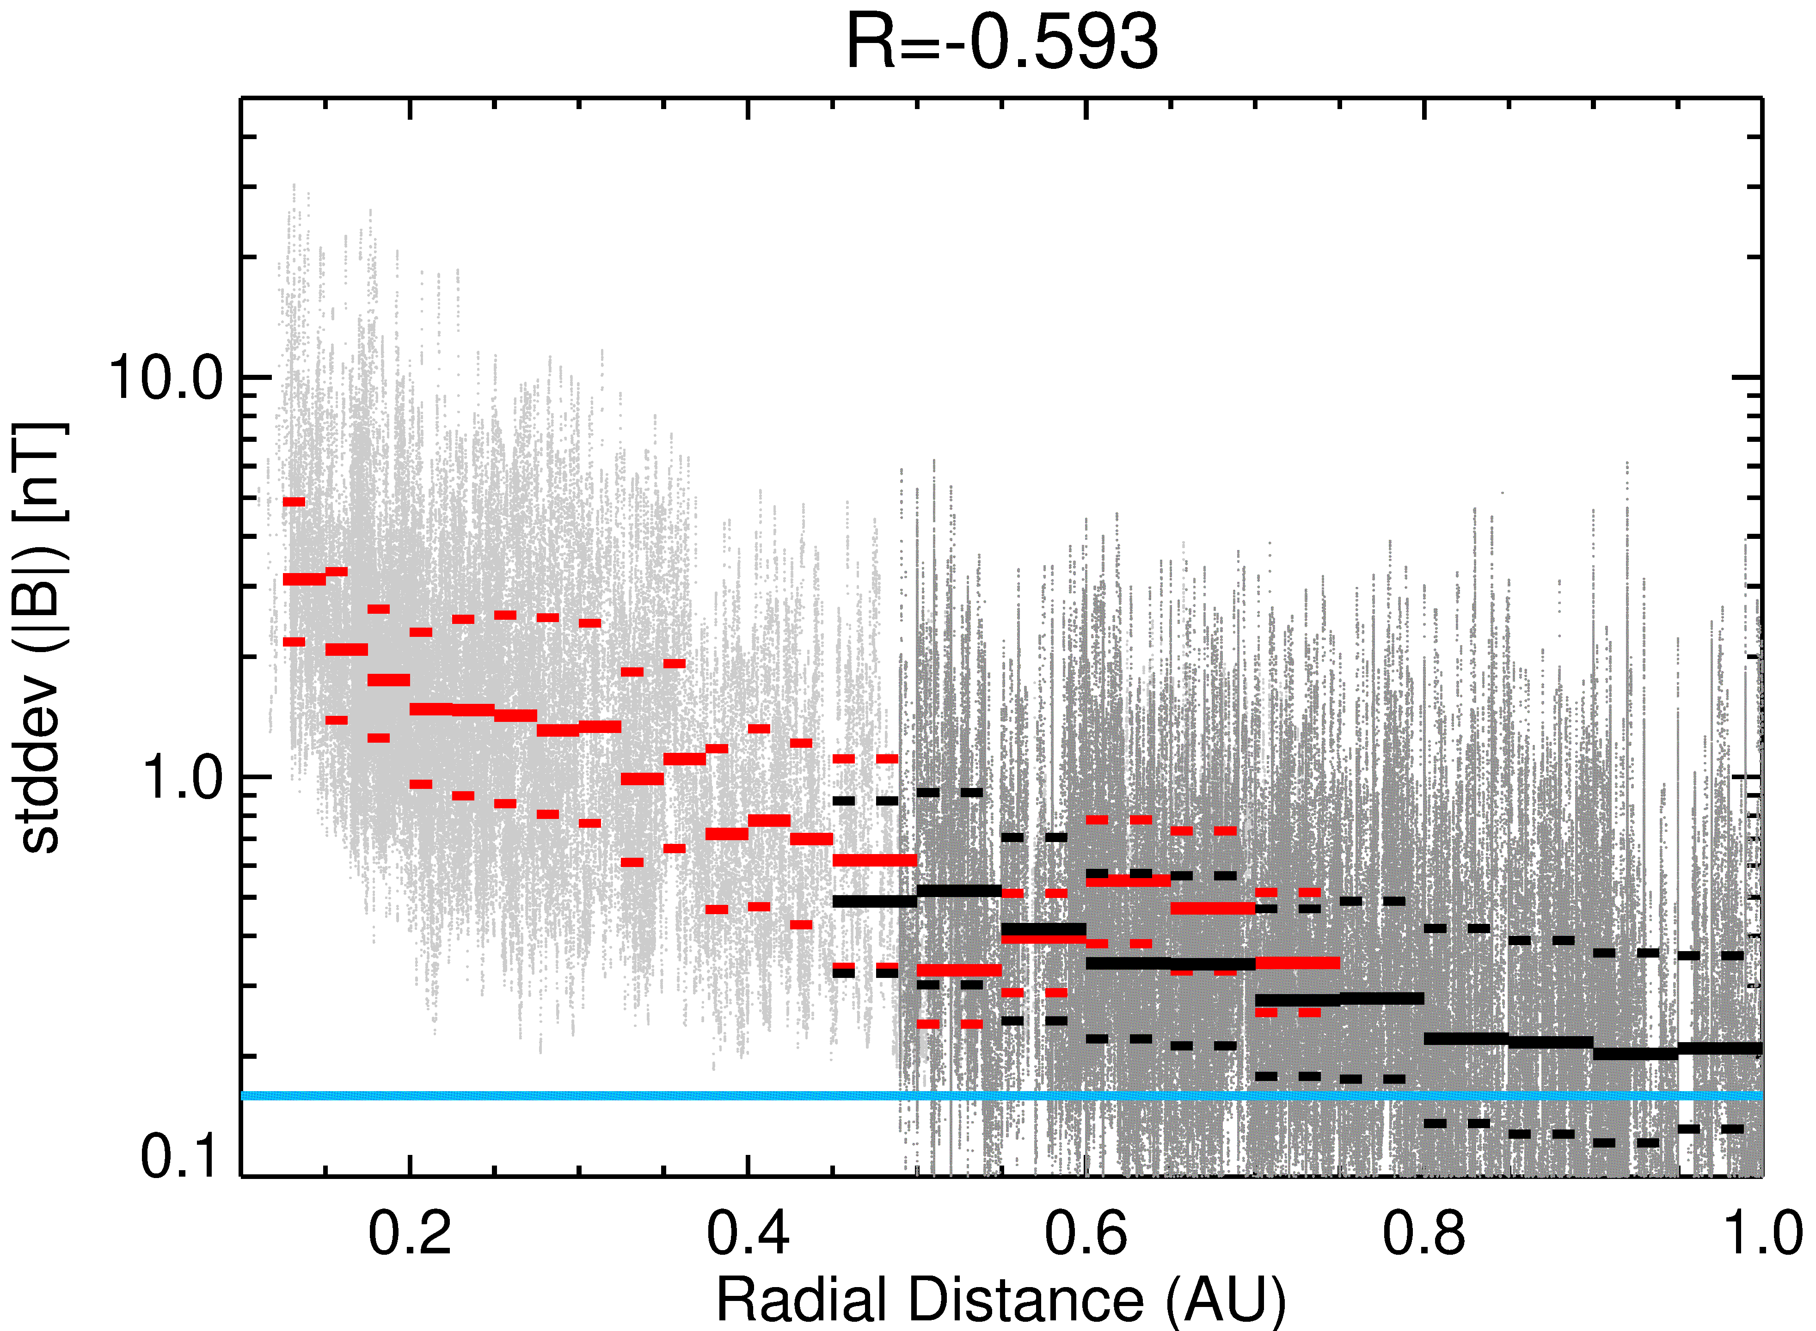
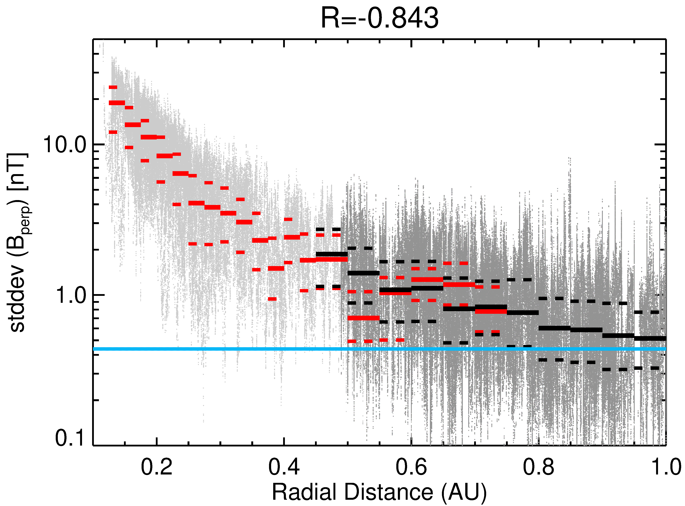
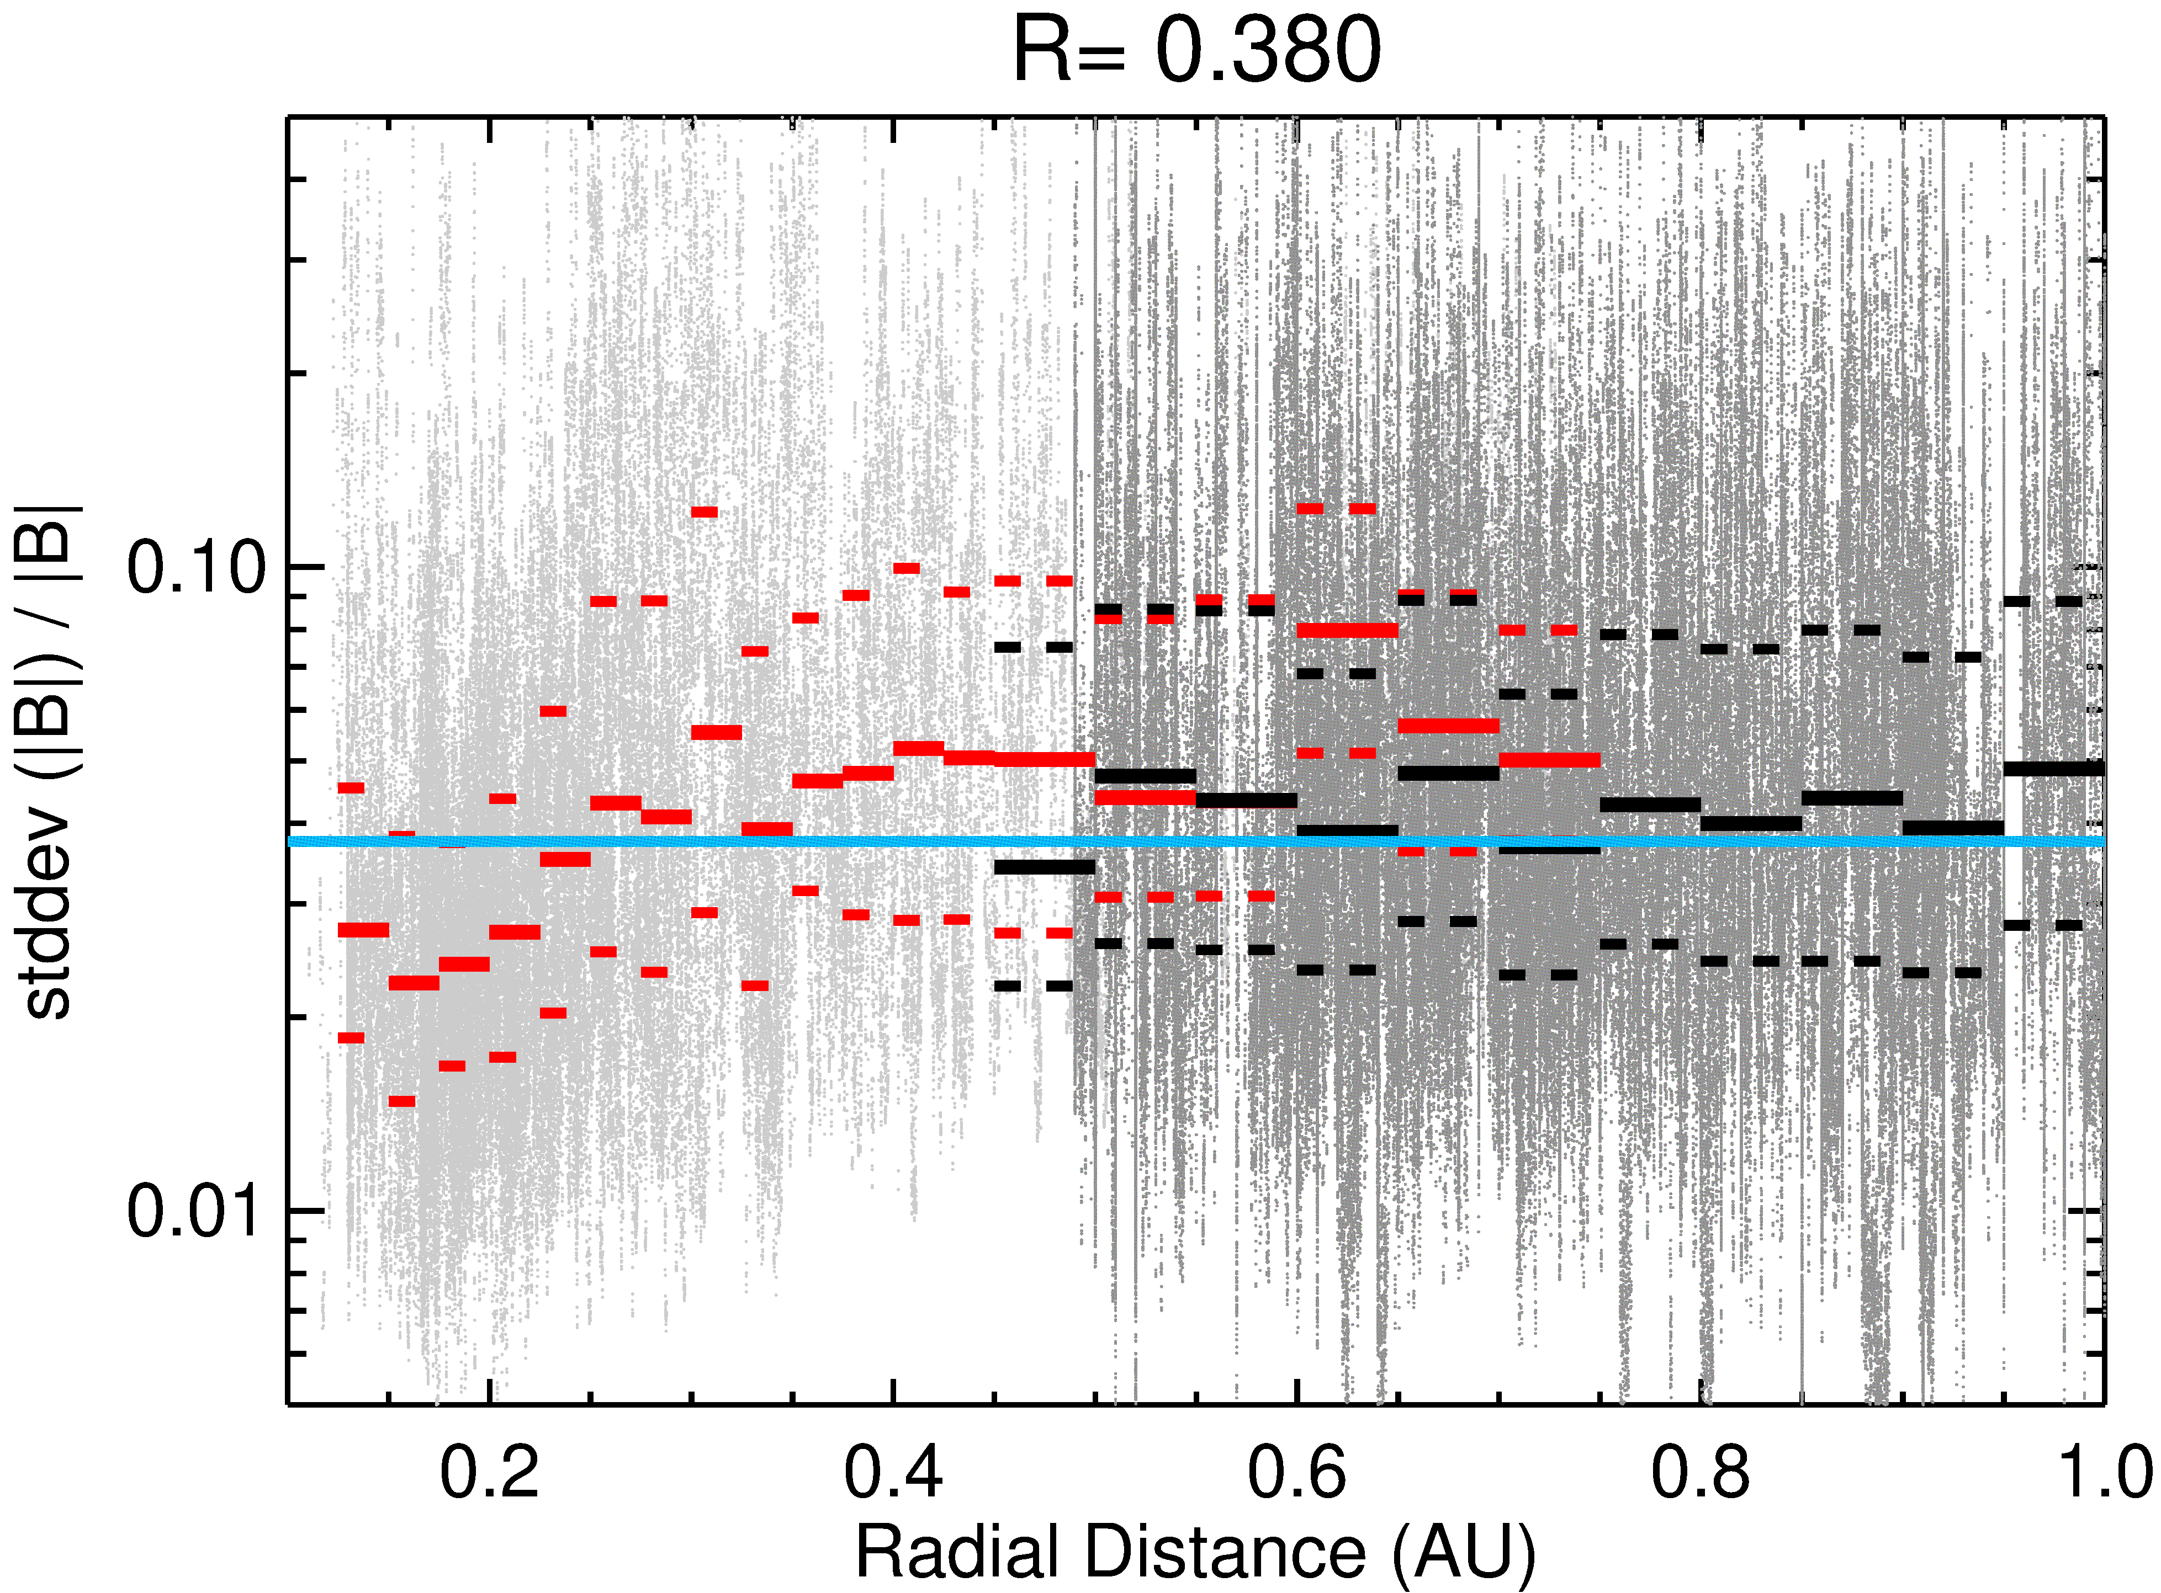
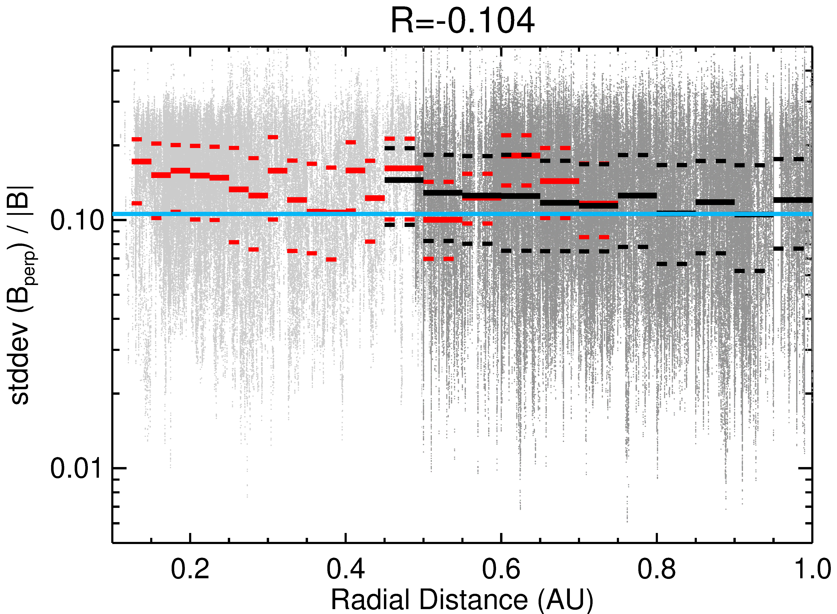
Radial evolution of the interplanetary magnetic field
|B|
Data from PSP and SolO compared with mean values at L1 (Wind, blue horizontal lines)
Plasma beta exhibits a clear change of the radial trend at ~0.3 AU, it is equal to 1 AU value farther from the Sun
Fluctuation level of both perpendicular and compressive components correlates with decreasing IMF magnitude
Normalized fluctuation level increases till 0.3 AU but it is about constant beyond
ẞ
0.3 AU
Ϭ|B|
Ϭ(B_{perp})
Questions to be answered
Ϭ|B|/|B|
Q2 – What happens at 0.3 AU?
Q5 – Could be dissipation of turbulent fluctuations a source of solar wind heating?
0.3 AU
Ϭ(B_{perp})/|B|
0.3 AU
adapted from Safrankova et al. (2023)

Slide 11
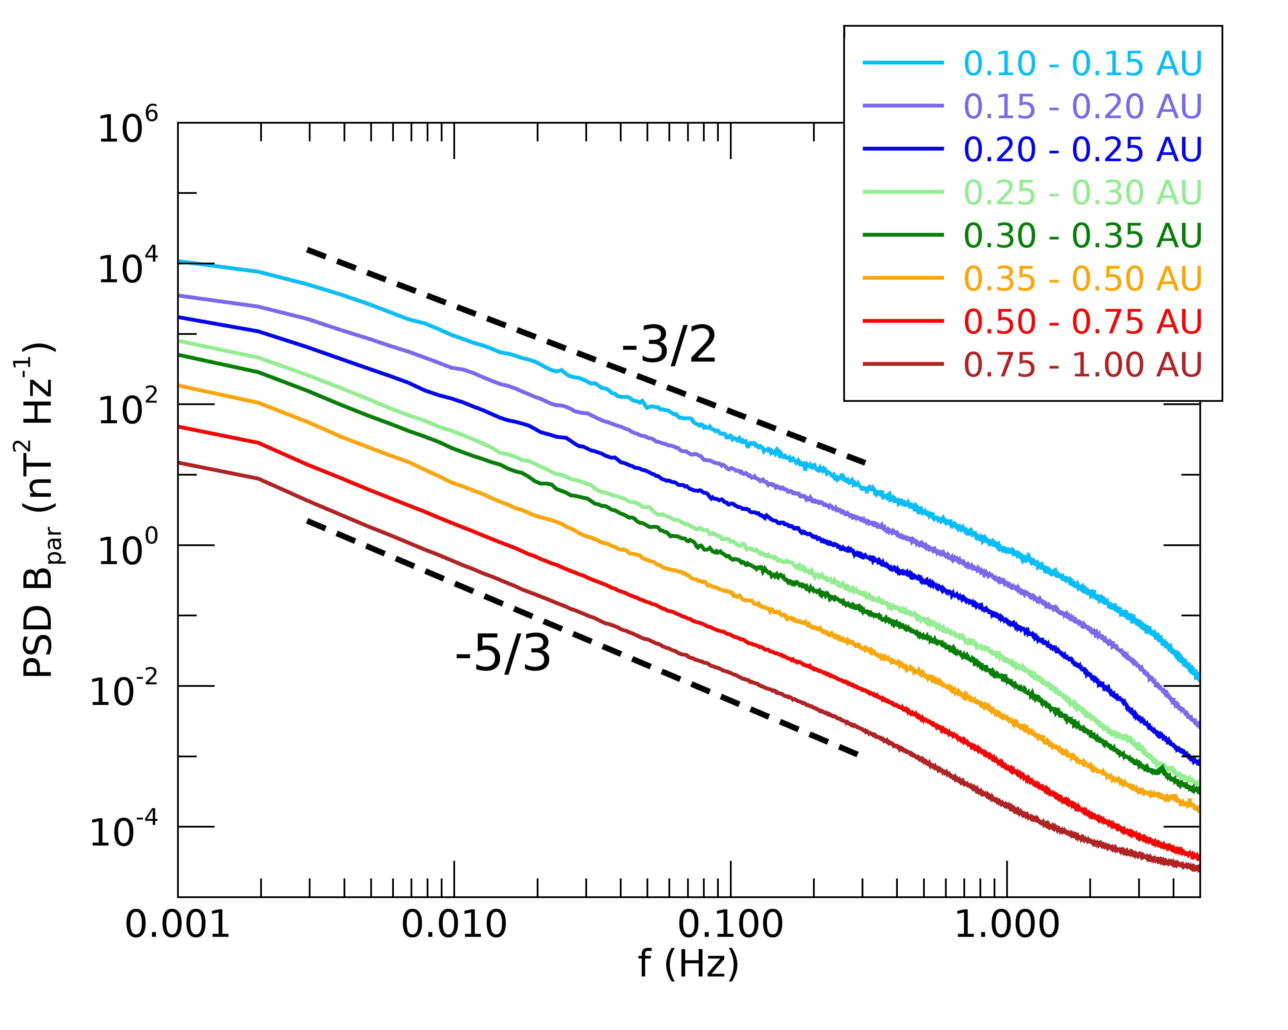
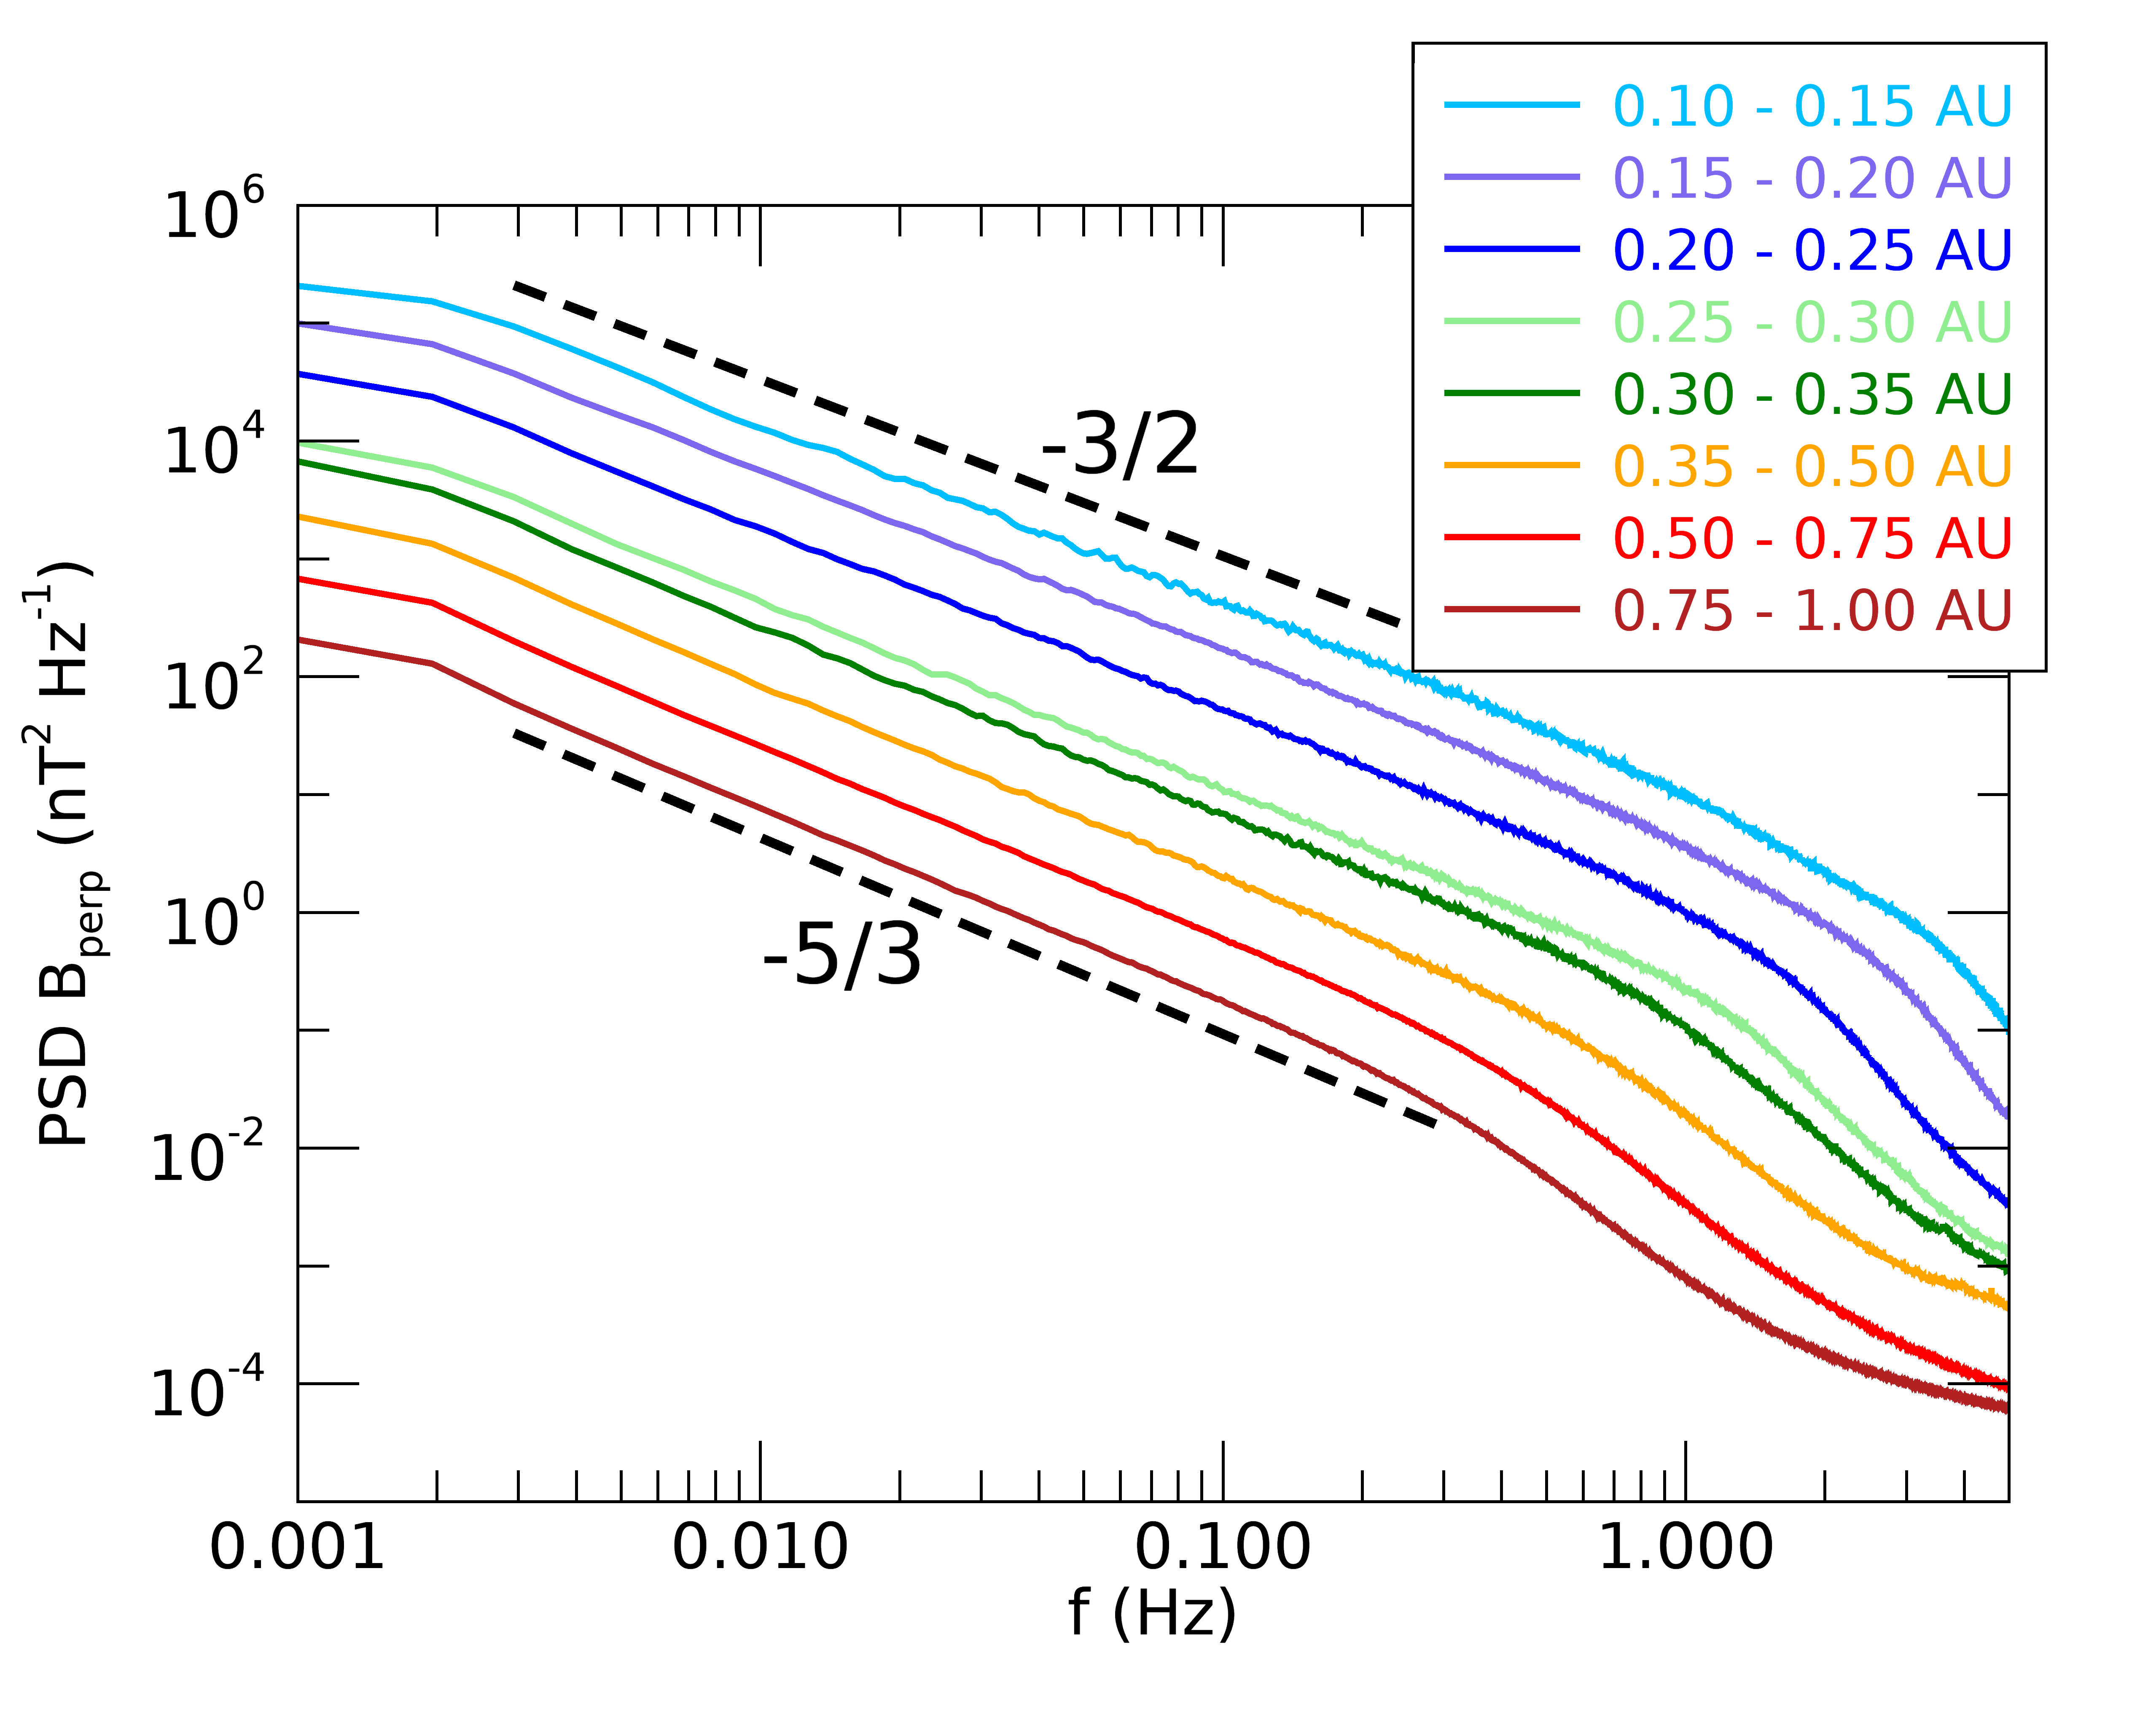
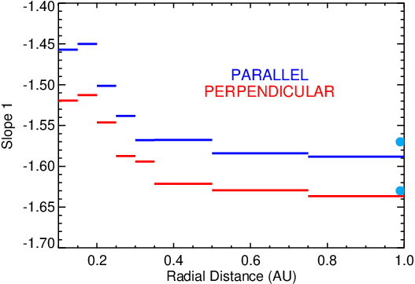
Radial evolution of IMF power spectral density
Inertial range
The PSD slope of both compressive and perpendicular IMF components is around -3/2 (Iroshnikov-Kreichnan) close to Sun
It quickly evolves toward -5/3 (Kolgomorov) value till ~0.3 AU
This trend is consistent with the increase of plasma beta
Plasma beta as well as slope 1 values observed at ~0.3 AU are close to that derived from 20 years of Wind observations at L1 (blue line)
It is surprising that the slope (cascade speed) is so sensitive to beta value
ẞ
0.3 AU
Question to be answered
0.3 AU
Wind
Q2 – What happens at 0.3 AU?
adapted from Safrankova et al. (2023)

Slide 12
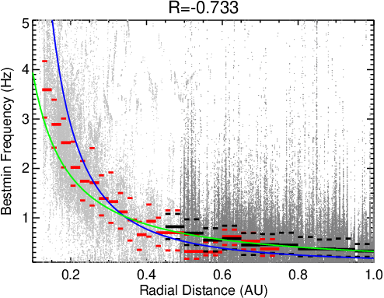
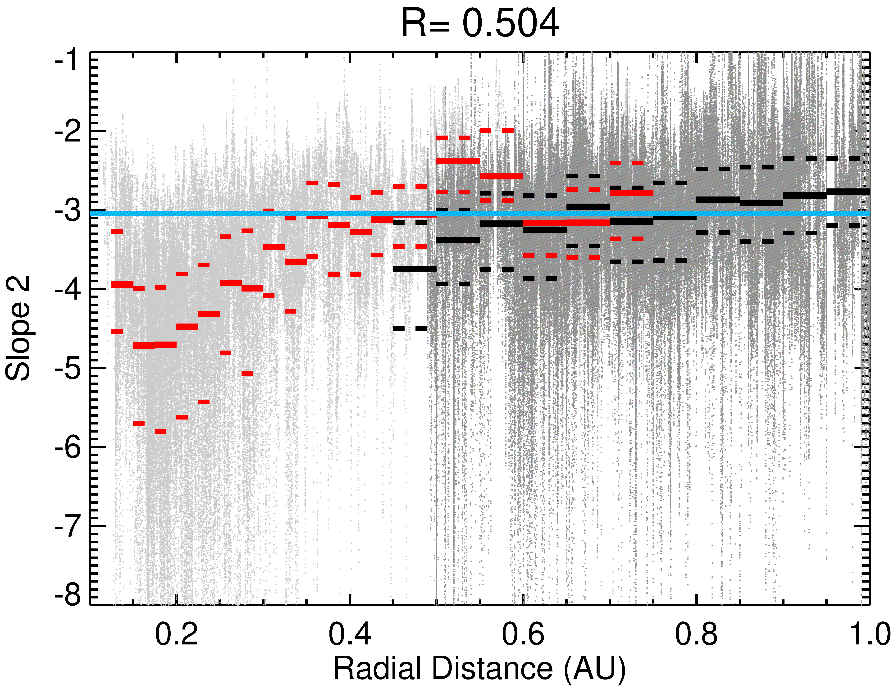
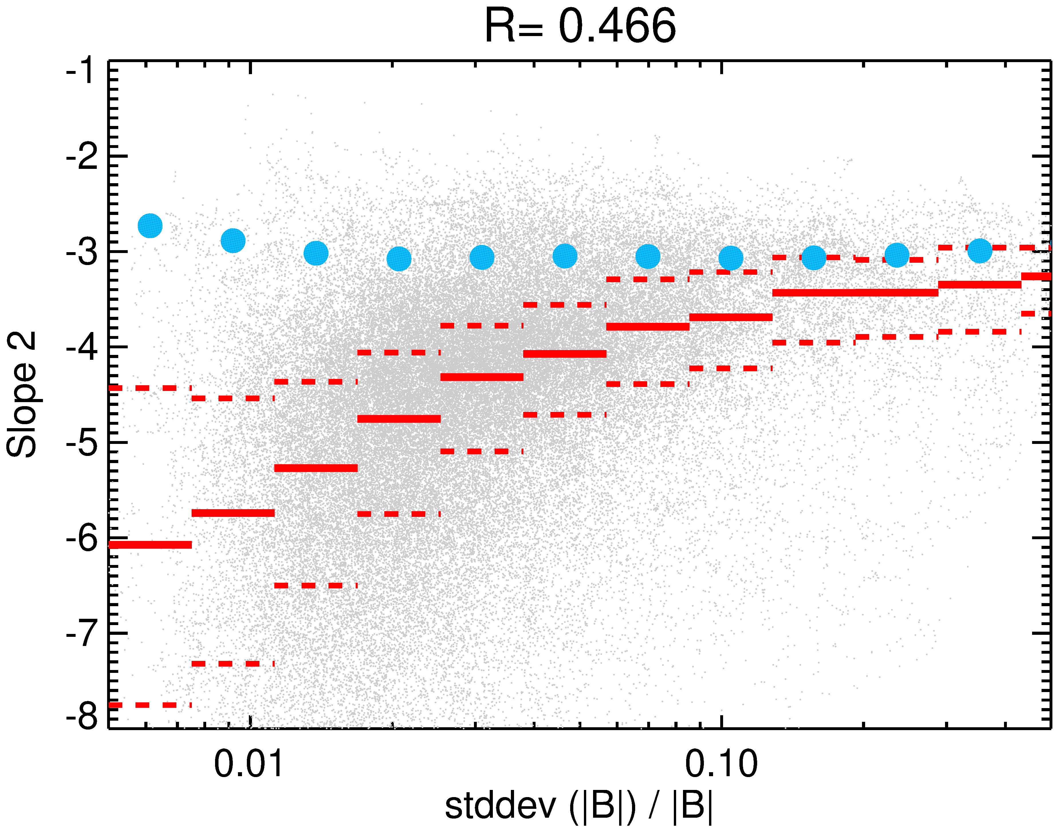
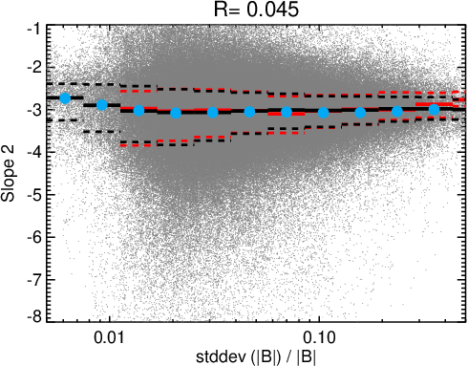
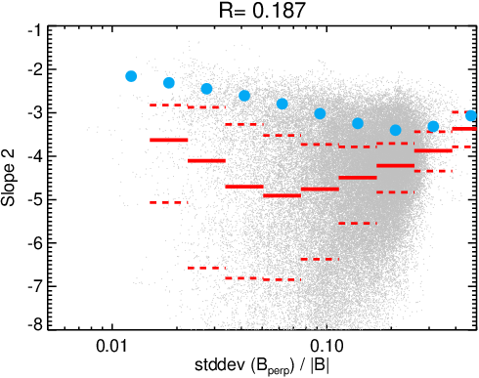
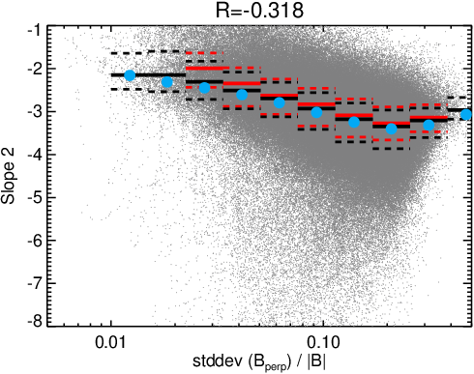
Radial evolution of IMF power spectral density
Kinetic range
f_{break}
The break frequency between inertial and kinetic ranges roughly follows the change of proton gyrofrequency (blue curve)
The kinetic-range spectral slope exhibits flattening until 0.3 AU; it is nearly constant and equal to 1 AU value beyond
The relation between slope 2 and normalized fluctuation amplitude is conserved beyond 0.3 AU (SolO and Wind) but it is significantly different closer to the Sun
slope 2
0.3 AU
0.1 – 0.3 AU
> 0.4 AU
slope 2
slope 2
Ϭ|B|/|B|
Ϭ|B|/|B|
Questions to be answered
Q2 – What happens at 0.3 AU?
Q6 – Why parallel and perpendicular fluctuation components behave differently?
slope 2
slope 2
Ϭ(B_{perp})/|B|
Ϭ(B_{perp})/|B|
adapted from Safrankova et al. (2023)

Slide 13
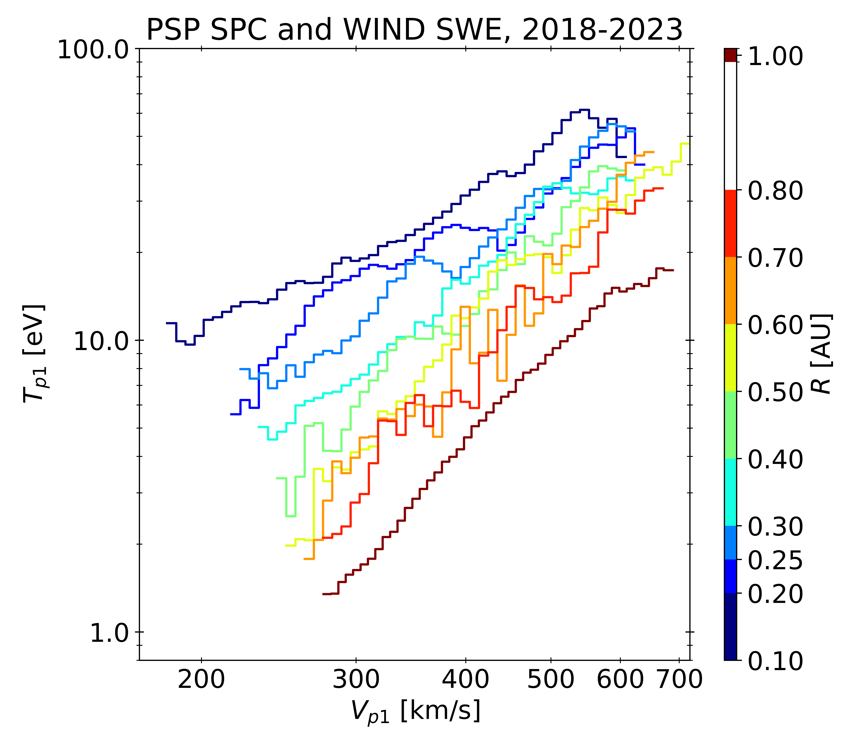
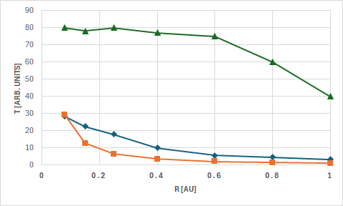
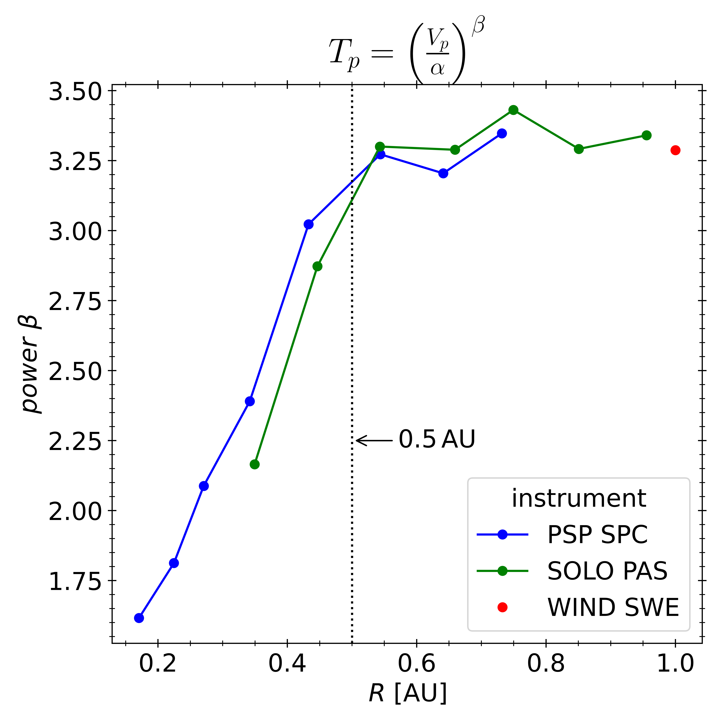
Temperature–velocity relation
The T-V profile becomes steeper with increasing radial distance because the temperature decreases faster with radial distance in the slow than in the fast wind
This trend is not seen in ICME, the temperature is low for all speeds
The slow wind cools down nearly adiabatically, the fast wind keeps its temperature up ~0.4 AU
The evolution of the power index stops at about 0.5 AU; it remains nearly constant farther from the Sun
800 km/s
Tp [eV]
Tp [eV]
200 km/s
adiabatic cooling
R [AU]
Vp [km/s]
(Durovcova et al., EGU26-5360)
Questions to be answered
power index
Q2 – What happens at 0.3 AU
Q7 – What is the mechanism responsible for the fast wind heating?
Q8 – Why are CMEs so cold?
R [AU]
Vp [km/s]
(Démoulin, 2009)
(Durovcova et al., EGU26-5360)

Slide 14
Open questions
Q1 – What is a possible source of proton VDF splitting?
Q2 – What happens at 0.3 AU?
Q3 – What is the difference between tangential and normal velocity directions?
Q4 – What is a source of the observed SW deflection?
Q5 – Could the dissipation of turbulent fluctuations serve as a source of the solar wind heating?
Q6 – Why parallel and perpendicular fluctuation components behave differently?
Q7 – What is the mechanism responsible for heating of the fast wind?
Q8 – Why are CMEs so cold?

Slide 15
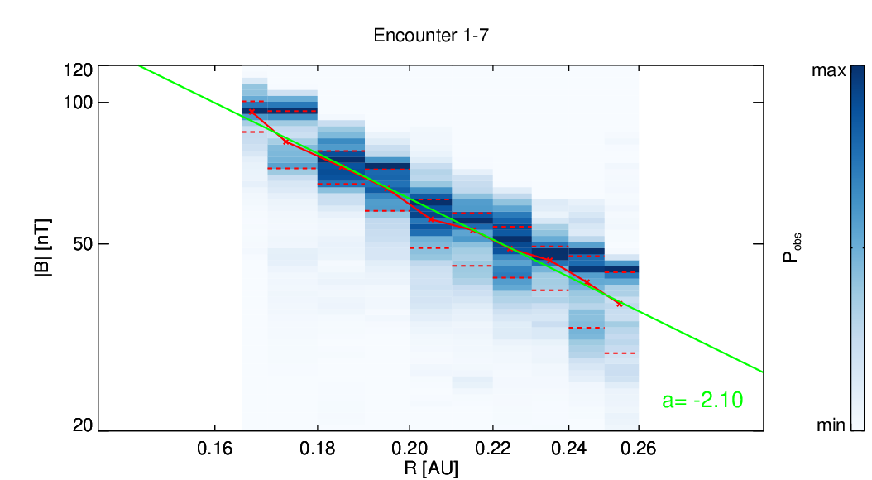
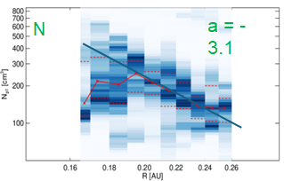
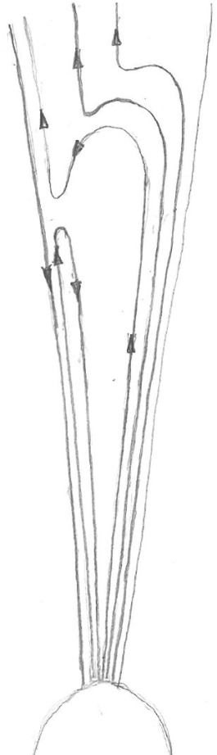
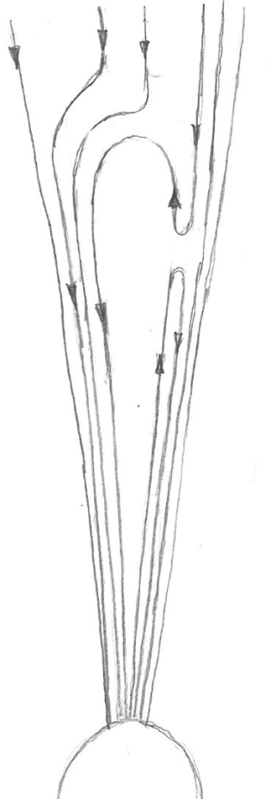
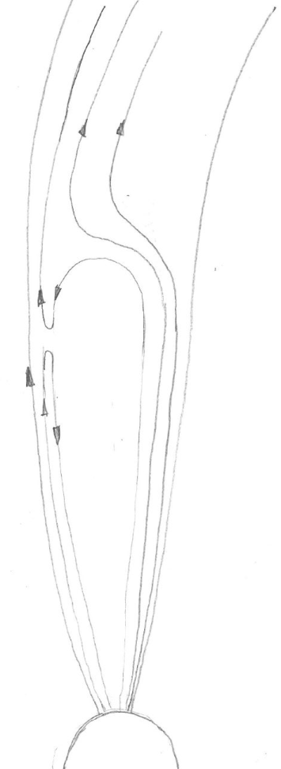
Possible answer to many questions – interchange reconnection
Q3 – What is the difference between tangential and normal velocity components?
Q4 – What is a source of the observed SW deflection?
Q1 – What is a possible source of proton VDF splitting
Reconnection produces the accelerated proton beam that propagates into the undisturbed solar wind as the second population
Reconnection is more probable on windward side
Reconnection produces the velocity component directed oppositely than the solar rotation in the r-t plane
Motion of field line footprints is random
Turbulent motion of field lines is also random
No preferred direction in the r-n plane
Q2 – What happens at ~0.3 AU
a = -2.1
|B|
X
windward side
reconnection sites
X
X
leeward side
B and N decrease much faster than Parker’s prediction to 0.3 AU
It can be considered as an evidence of presence of non-negligible portion of closed field lines till 0.3 AU
These lines reconnect with open lines from neighboring coronal holes
The closed lines are exceptional (CMEs) at larger distances
wind speed
expanding loops
r
r
n
t

Slide 16
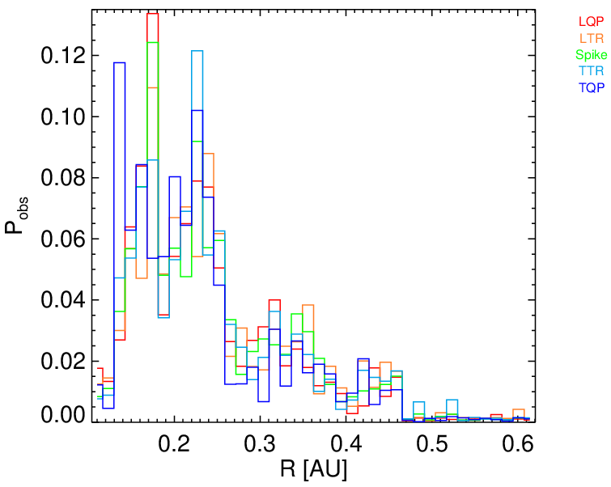
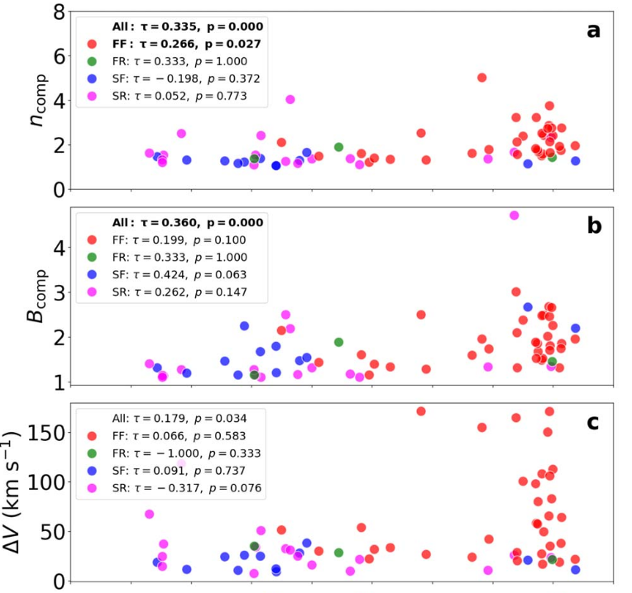
IP shock and switchback occurrence
Q2 – What happens at 0.3 AU?
Switchback occurrence
Magnetic reconnection is a typical source of slow shocks
Magnetic reconnection was also suggested as a source of switchbacks (Sterling and Moore, 2020)
Fast shocks are formed at stream interaction regions or in front of CMEs
IP shock occurrence
0.3 AU
0.3 AU
Analysis of PSP shock and switchback databases shows:
No fast shocks below 0.3 AU
Only exceptional observations of slow shocks above 0.3 AU
Switchbacks are predominantly observed below 0.3 AU
These observations suggest that reconnection activity is highly reduced above 0.3 AU
adapted from Kruparova et al. (2025)

Slide 17
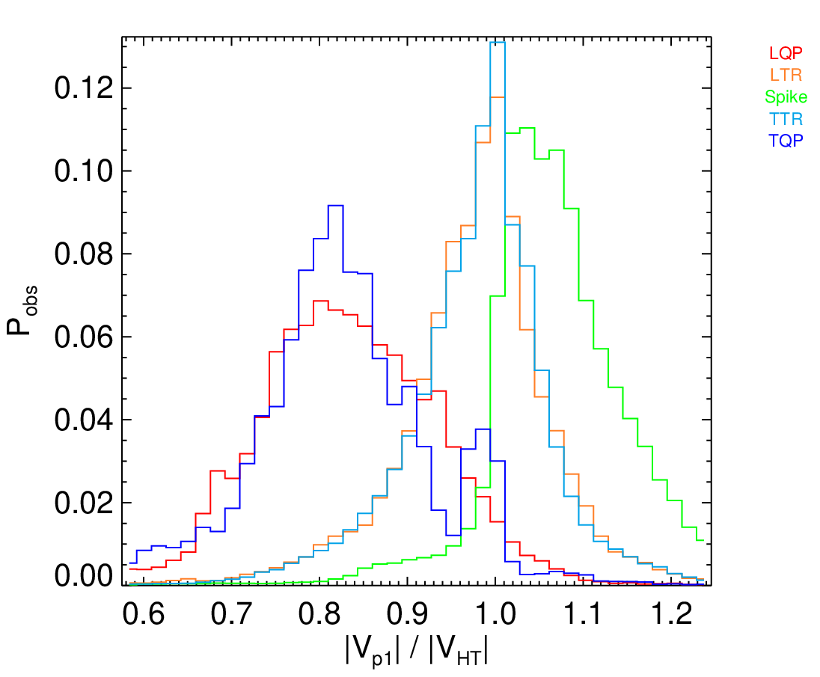
Discussion of switchbacks
Radial direction
Parker spiral direction
Q4 – What is the source of solar wind deflection?
SW direction
Interchange reconnection leads to switchback-like IMF structure (Sterling and Moore, 2020)
Reconnection outflow is accelerated in the magnetic field direction that changes with distance to follow Parker spiral
Ions move into the curved field lines, their momentum is partly transferred to the field lines motion, i.e., to the change of V_{HT}
This transfer is gradual and occurs far from the reconnection site where reconnection signatures are not apparent
Note that even deflected flow following from statistics is much more radial than the Parker spiral field
We believe that interchange reconnection is a primary cause of both – switchbacks and the flow deflection
Prior to and after switchback
Inside the switchback
0.2 AU
X

Slide 18
Dissipation of turbulent fluctuations
Q5 – Could be the dissipation of turbulent fluctuations a source of solar wind heating?
Ϭ|B|/|B|
Normalized fluctuations should be considered!!!
Their level increases toward 0.3 AU and it is constant till1 AU
No evidence about fluctuation level decay at larger distances
Since there is no doubt about solar wind heating by turbulence cascading, it implies that there should be a source of new fluctuation modes that keep the fluctuation level approximately constant
A new question arises: what is the source of these fluctuations?
0.3 AU
0.3 AU
Ϭ(B_{perp})/|B|
Q6 – Why parallel and perpendicular fluctuation components behave differently?
0.1 – 0.3 AU
Small fluctuation level – no source of fluctuations – dissipation leads to steep spectrum and vice versa
It is known that Alfvenic (perpendicular) fluctuations prevail at Sun vicinity
Reconnection feeds predominantly parallel fluctuation components
The switchback spectral structure is gradually mixing with turbulent wave field (Dudock de Wit et al., 2020)
Ϭ|B|/|B|
Ϭ(B_{perp})/|B|

Slide 19
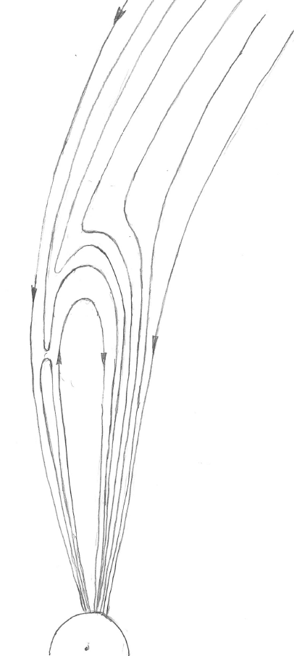
Still open questions
fast wind with two proton populations
Q7 – What is the mechanism responsible for heating of the fast wind?
Q8 – Why are CMEs so cold?
slow wind with two proton populations
Speculations
PSP path
800 km/s
PSP data come from the stream belt latitudes where the fast wind can be affected by interaction with the magnetic field
We are waiting for SolO measurements in “real” fast wind
The rise of the coronal temperature from 10⁴ to 10⁶ K occurs at a relatively thin layer
CMEs are probably originated below this layer where the plasma is still cold
We do not know how the temperature evolves in course of CME propagation, cooling is probable
Statistical processing of CME observations in different distances from the Sun can shed light on this problem
fast wind
Tp [eV]
PSP path
injection of second proton population
200 km/s
adiabatic cooling
X
R [AU]
decelerated slow wind
Vp [km/s]
(Démoulin, 2009)

Slide 20
Where the solar corona ends?
fast wind with two proton populations
Presented as well as many other published observations suggest that a proper boundary between the solar corona and freely expanding solar wind is somewhere around the Mercury orbit
We are eagerly awaiting the Bepi Colombo results
However, Ulysses observations show that the situation at higher latitudes far from the Sun could be completely different
We hope that Solar Orbiter will bring the answer on high latitude solar wind closer to the Sun
slow wind with two proton populations
PSP path
fast wind
PSP path
injection of second proton population
X
decelerated slow wind
We believe that we will understand solar wind origin 70 years after its prediction!

Slide 21
Many thanks to EGU for the medal and
to all of you for your attention

