Slide 1

Surface Deformation Assessment in the Bulqiza Chrome Mine
Using Empirical and Numerical Modelling
PIETRO BELBA
Polytechnic University of Tirana, Faculty of Geology and Mining, Department of Mineral Resources Engineering, Albania

Slide 2
INTRODUCTION
Underground mining has a significant impact on surface stability, particularly through subsidence, sinkholes, landslides, and damage to infrastructure.
Effective investigation of subsidence requires an integrated approach combining field observations, remote sensing, subsurface exploration, and analytical modelling.
Empirical models offer practical tools for predicting the extent and magnitude of subsidence based on mining geometry and depth.
They are often complemented by numerical simulations, such as finite element, boundary element, or discrete element methods, to capture the complex geomechanical responses of rock masses.

Slide 3
INTRODUCTION
The Bulqiza chrome mine in Albania is one of the most important chromium deposits in Europe and has been mined for over sixty years.
It initially used the cut-and-fill method, where ore is removed in horizontal slices, and the voids are filled with waste material to support the surrounding rock.
  Although this method offered good ground stability and reduced the risk of surface subsidence, it was found to be inefficient due to low ore recovery and safety concerns related to manual backfilling.
The mine shifted to sublevel stoping, a more productive and widely used mining method. In this approach, ore is extracted in horizontal layers (sublevels) without backfilling, leaving large underground voids (stopes).
  This significantly improved productivity but introduced new geotechnical challenges, such as increased rock mass instability and surface deformation risks.

Slide 4
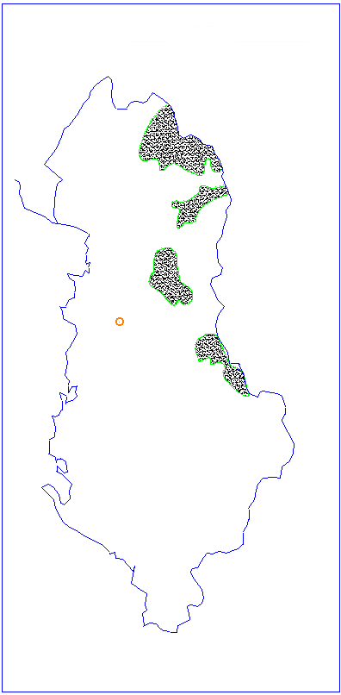
ULTRABASIC MASSIFS OF ALBANIA
Tropoja massif
Kukesi massif
Bulqiza massif
TIRANA
Bulqiza mine
Shebeniku massif

Slide 5
GEOLOGICAL AND MINING CONTEXT
The study area is located within the Bulqiza chrome mining district, a geologically complex region dominated by ultramafic rocks, primarily dunite.
The mineralisation occurs in structurally controlled ore veins, with the geological setting significantly influenced by a high frequency of tectonic discontinuities, which critically affect the mechanical behaviour of the rock mass during and after mining activities

Slide 6
LONGITUDINAL SECTION OF CHROMITE BULQIZA DEPOSIT
Thickness: 2.5 ÷ 3.5 m
Inclination angle: 50 - 60º
Mining method: sub-level caving

Slide 7
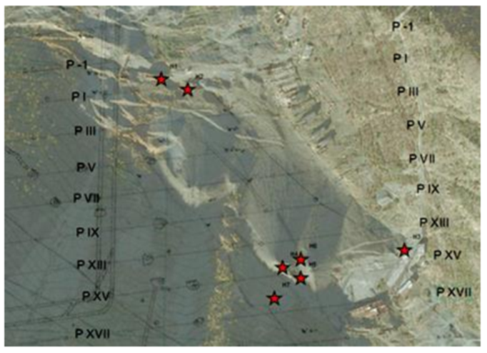
BACKGROUND
Until 1974, the phenomenon of rock movement at the Bulqiza deposit was studied only in its volume of influence within the rock mass.
After 1974, the ground surface collapsed with the presence of funnels, holes, large-scale fracturing, continuous subsidence, and landslides on the ground surface.
Attention was paid to the construction and use of empirical and reliable models for calculating the rock mass stability conditions and studies with numerical modelling.
Funnels appearing on the ground surface of the mine (Profiles -1 to XVII)
Funnel in the mining region of Bulqiza

Slide 8
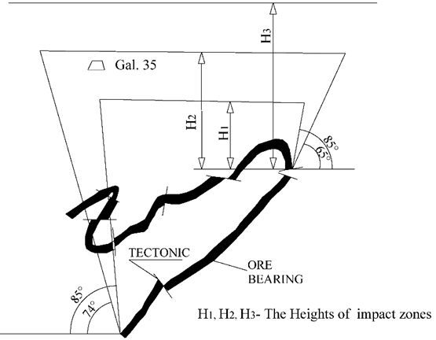
SURFACE EFFECTS OF UNDERGROUND MINING
Zones of influence of the mining exploitation:
I- caving zone
II- fissure-flexures zone
III- lightly bending zone

Slide 9
AIMS OF THE STUDY
To assess the effectiveness of empirical methods for predicting surface impacts
To apply numerical modelling techniques, specifically the Finite Element Method (FEM).
  To see whether the modelling reproduces the situations that occurred or not.
  To judge the integrity of the data related to the physical and mechanical properties of rocks.
  To recommend the use of this method, even as an alternative method for the impact of underground exploitation on the surface.

Slide 10
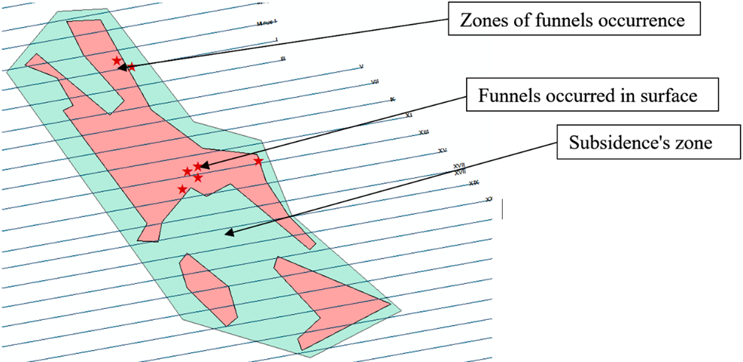
FIELD INVESTIGATIONS
  Field investigations and data sources were utilized to characterize the geological and geomechanical conditions of the study area
  Based on this conclusion, the impact zones were mapped
Mapped zones of funnels and subsidence occurrences.

Slide 11
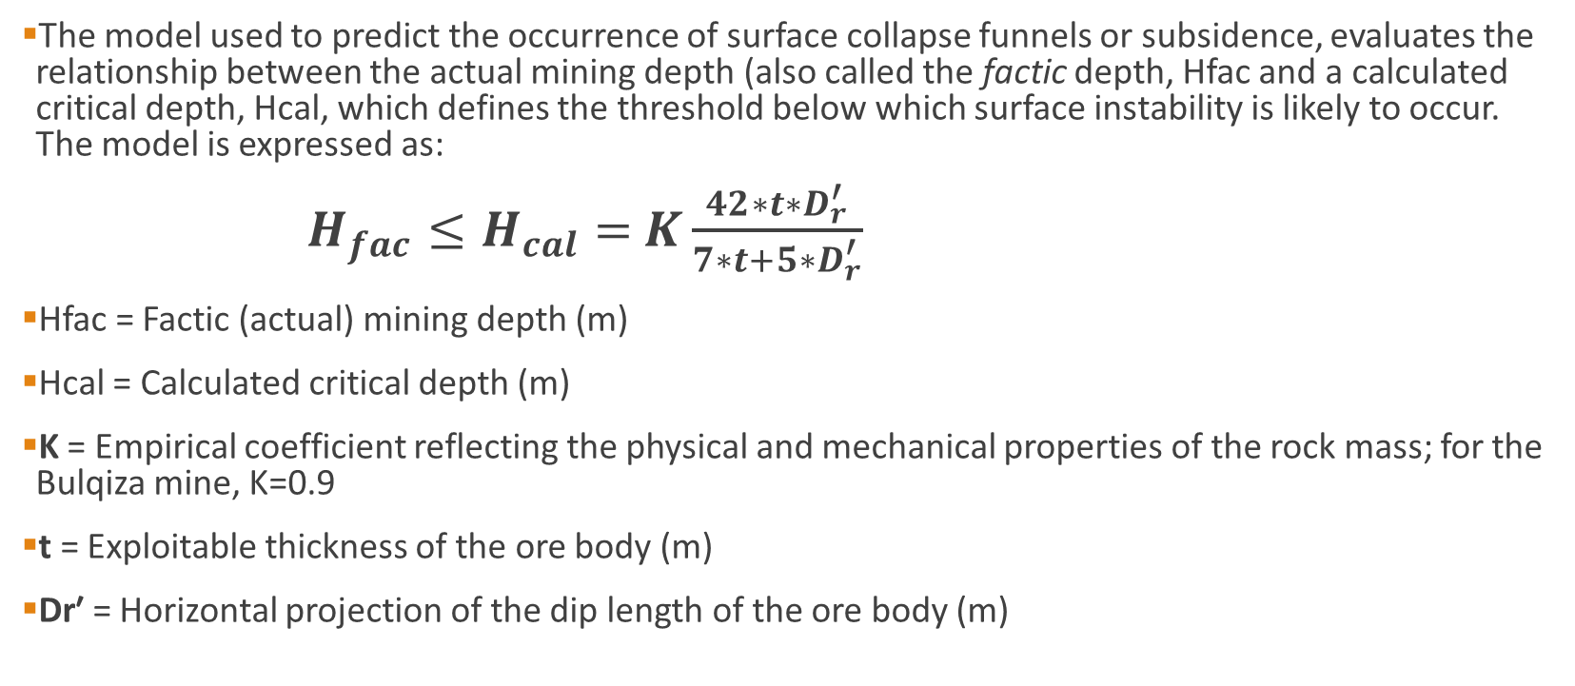
EMPIRICAL MODEL
The model used to predict the occurrence of surface collapse funnels or subsidence, evaluates the relationship between the actual mining depth (also called the factic depth, Hfac and a calculated critical depth, Hcal, which defines the threshold below which surface instability is likely to occur. The model is expressed as:
$H_{fac}≤H_{cal}=$ $K\frac{42∗t∗D_{r}^{′}}{7∗t+5∗D_{r}^{′}}$
Hfac​ = Factic (actual) mining depth (m)
Hcal = Calculated critical depth (m)
K = Empirical coefficient reflecting the physical and mechanical properties of the rock mass; for the Bulqiza mine, K=0.9
t = Exploitable thickness of the ore body (m)
Dr′​ = Horizontal projection of the dip length of the ore body (m)

Slide 12
NUMERICAL MODELLING
Rock mechanical parameters required for numerical modeling were derived from laboratory tests on intact rock samples and adjusted for rock mass conditions using empirical relations.
Rock | Density kN/m³ | σ_{c} (MPa) | σ_{shear} (Mpa) | E (GPa) | Cohesion (Mpa) | Friction angle (°)
Dunite | 26.5 - 32.6 | 53 - 115 | 10 - 16.5 | 1 - 100 | 12.8-23.5 | 39-46
Chrome | 25.0 - 41.5 | 48 - 80 | 9 - 20 | 0.1 - 100 | 11.5-23.1 | 30-39
The laboratory mechanical properties of principal rocks
Rock mass | σ_{cmass} (MPa) | E_{m} GPa | Cohesion (Mpa) | Friction angle (°)
Dunite | 18 | 15.4 | 4.2 | 40.0
Chrome | 13.5 | 12.3 | 3.6 | 35.0
Rock mass properties
Empirical formula are used for estimating the caving area and the elastic modulus of goaf material.

Slide 13
METHODS
The study was focused on two specific profiles.
These two profiles represent different types of surface impacts from underground mining.
Profile with continuous subsidence and landslides on the surface,
Profile with funnel (sinkhole) formation on the surface.
Figure 1. Two profiles in the study
Continuous subsidence and landslides
Funnel occurrence

Slide 14
METHODS
In the profile with continuous subsidence and landslides on the surface, two simulations were performed:
With only the mining void.
With the goaf (caved zone) included.
In the profile with funnel (sinkhole) formation on the surface, four simulations were performed:
Two (with only the mining void and with the goaf ) in the situation without tectonics.
The other two (with only the mining void and with the goaf ) are in a situation with tectonics.

Slide 15
RESULTS
EMPIRICAL SUBSIDENCE MODEL
For a profile involving continuous subsidence and landslides (Figure 2), the input parameters were :
Ore thickness, t=2.9 m; Horizontal projection of dip length, Dr′=60 m; Effective mining depth, Hfac=29.9 m.
The model results in Hcal=20.5 m<Hfac=29.9 m.
In this case, the model suggests a lower likelihood of funnel formation but indicates the potential for ongoing subsidence and landslide activity, consistent with surface observations documented.
Figure 2. Profile with continuous subsidence and landslides

Slide 16
RESULTS
EMPIRICAL SUBSIDENCE MODEL
For a profile with funnel (sinkhole) formation on the surface (Figure 3), the input parameters were:
Ore thickness, t=5.3 m; Horizontal projection of dip length, Dr′=38.2 m; Effective mining depth, Hfac=9 m.
Applying the model yielded: Hcal=33.55 m>Hfac=9 m.
In this case, the model suggests a high risk of funnel formation.
Figure 3. Profile with funnel occurrence

Slide 17
RESULTS-NUMERICAL MODELLING
Numerical simulation results were performed in two profiles:
THE PROFILE WITH CONTINUOUS SUBSIDENCE AND LANDSLIDES ON THE SURFACE
  a) only the excavation
  b) the excavation and the goaf
THE PROFILE WITH FUNNEL (SINKHOLE) FORMATION ON THE SURFACE
  a) two excavations,
  b) two excavations and the goaf,
  c) two excavations and the tectonics,
  d) two excavations, the goaf and the tectonics.

Slide 18
RESULTS-NUMERICAL MODELING
1. THE PROFILE WITH CONTINUOUS SUBSIDENCE AND LANDSLIDES ON THE SURFACE
The case without a goaf, presenting only the excavation (Figure 4)
The vertical displacements were limited to the collapse zone.
The maximum displacement was 13.9 mm.
Figure 4. Displacements for modelling a) only the excavation

Slide 19
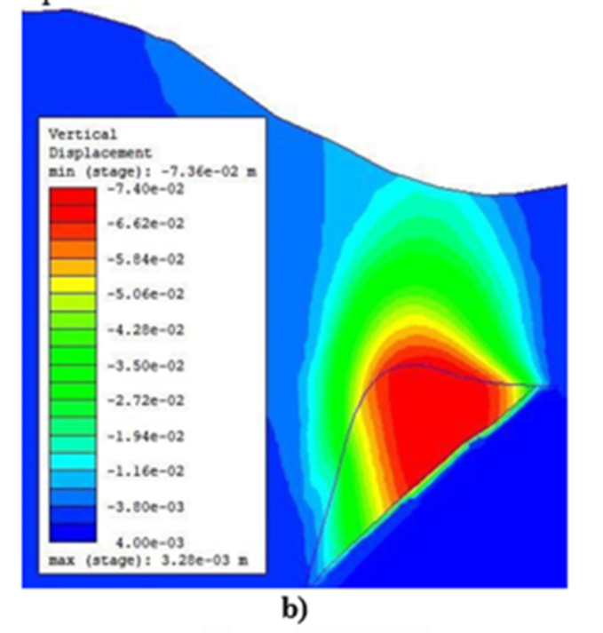
RESULTS-NUMERICAL MODELING
1. THE PROFILE WITH CONTINUOUS SUBSIDENCE AND LANDSLIDES ON THE SURFACE
The case with the excavation and the goaf (Figure 5)
There is a minor increase in surface displacement
Maximum displacements remain in the same order of magnitude (13–14 mm).
Figure 5.Displacements for modelling b) the excavation and the goaf

Slide 20
RESULTS-NUMERICAL MODELING
1. THE PROFILE WITH CONTINUOUS SUBSIDENCE AND LANDSLIDES ON THE SURFACE
ANALYSING BOTH SCENARIOS:
  No evidence of surface funnels
  Consistency with empirical prediction.
  Surface subsidence is minimal (max 13.9 mm).
  Adding goaf makes little difference:
  No funnels or significant surface impact are observed, and subsidence remains continuous.

Slide 21
RESULTS-NUMERICAL MODELING
2. THE PROFILE WITH FUNNEL (SINKHOLE) FORMATION
  SCENARIO WITHOUT TECTONICS
  a) two excavations,
  b) two excavations and the goaf
Surface displacement
  Increased to 24.3 mm when the goaf is included
  Approaching critical values
Figure 6. Vertical displacements for
a) two excavations, b) two excavations and the goaf

Slide 22
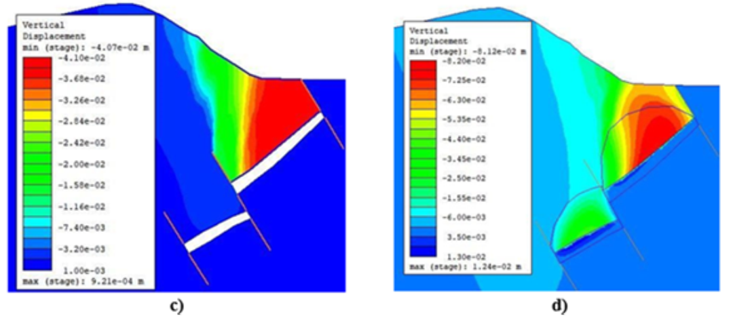
RESULTS-NUMERICAL MODELING
2. THE PROFILE WITH FUNNEL (SINKHOLE) FORMATION
  SCENARIO WITH TECTONICS
In the case of two excavations
  The surface displacement was up to 40.4 mm because there was only excavation.
In the case of two excavations and the goaf
  The maximum surface displacement reached 61 mm.
Figure 7. Vertical displacements for c) two excavations and the tectonics, d) two excavations, the goaf and the tectonics.

Slide 23
RESULTS-NUMERICAL MODELLING
2. THE PROFILE WITH FUNNEL (SINKHOLE) FORMATION
ANALYSING BOTH SCENARIOS:
In the case without tectonics, surface displacement increases to 24.3 mm when the goaf is included. No funnels are observed, although values approach critical thresholds.
Under tectonic conditions without a goaf, surface displacement reaches 40.4 mm due to excavation alone.
The inclusion of a goaf increases the maximum displacement to 61 mm, demonstrating that the interaction between tectonic stresses and the void substantially amplifies surface deformation.
The presence of tectonics considerably increases the influence of mining on the ground surface.
Sliding along tectonic planes facilitates the appearance of funnels on the surface

Slide 24
CONCLUSIONS
The impact of underground exploitation on the surface during mining is an important issue which must be treated with caution due to the impact it has on human activity in the area concerned.
The Bulqiza area, with a history of several decades of chrome mining exploitation, is quite sensitive to the phenomenon of the appearance of the impacts of exploitation on the surface emerging in the form of a bending subsidence zone, sinkholes, or funnels.
Empirical formulas are a useful tool for estimating mining subsidence, and they can provide a useful approximation for the construction of susceptibility maps. Nevertheless, since their accuracy is limited because we often lack a deep understanding of the geological and mining conditions of the region, their use must be done with caution to avoid unexpected events. Continuous surveying of ground movements in the area is a good practice to follow.

Slide 25
CONCLUSIONS
The use of numerical methods enables a better understanding of the phenomenon of mining subsidence and the hierarchy of influencing factors. For the Bulqiza mine, the finite element method is used for a specific profile to understand the mechanism of mining subsidence and to integrate the influence of multiple excavations.
The results of the calculations show that, in addition to factors such as the physical-mechanical properties of the rock mass, the shape and orientation of the mining voids, proximity to the surface, etc., tectonics also play a very important role
We were unable to demonstrate a very significant influence of the goaf, its extent, and its properties. In the future, a more detailed study should be carried out to study the propagation of the damaged zone above the goaf and its influence on the surface subsidence.

Slide 26

Thank you for your attention!

